Slide 1
Sensor linearity and response stability Pierre Antilogus, Pierre Astier , Claire Juramy , Laurent Leguillou , Eduardo Sepulveda October 2nd 2018

Slide 2
CCD response vs time
After a power on , the only factor that induces change in our CCD+electronic response is temperature change of the sensor or of the REB .
+4 deg change in the CCD T ➔ -.1 % change in gain (e2v)
+1 deg change in the REB T ➔ -.05 % change in gain
On the Paris setup , with temperature variation of >0.01 deg for the CCD and ~0.2 for the REB , we have a sensor response stable at 10⁻⁴ over 3 days , if we correct for the temperature change in the room , we can go down to a few 10⁻⁵ .
In real life it will be worse indeed …:
The camera signed for a stability at the 1% per night , .1% / hour …which like all LSST requirement looks easy to achieve …but are not that good on the photometric calibration side .
On short term ( between exposure and in exposure ) , we are sensitive to flux (in flat) and exposure frequency ( >~ .1 % effect )
On REB the temperature monitoring readout sensitivity on the ASPIC doesn’t allow a .1% correction … other temperature probe should be used ... We have to learn how to perform this correction in real life …(temperature gradient on board … )

Slide 3
Gain monitoring in real time
Beyond monitoring the temperature, and performing the associated correction , we are evaluating two other path for monitoring / correcting the gain in real time :
We can use a “fix” signal at the CCD amplifier level : we can digitize the reset of the CCD ( RG ~ 60 ke-)
In the BIAS level there is a ~ 2500 e- signal coming from clock injection in the first stage amplifier
Both “signals” are sensitive to gain change .
We are on our way to evaluate if we can use these signals to get a monitoring at ~ 0.05 % level …
for the moment : no success yet

Slide 4
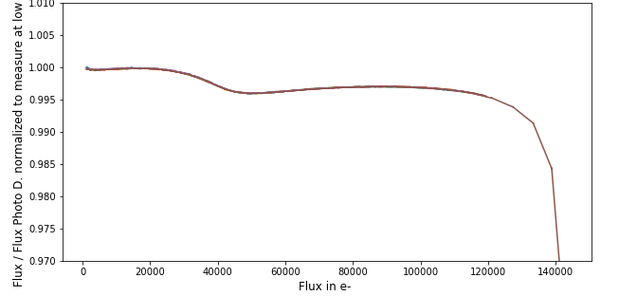
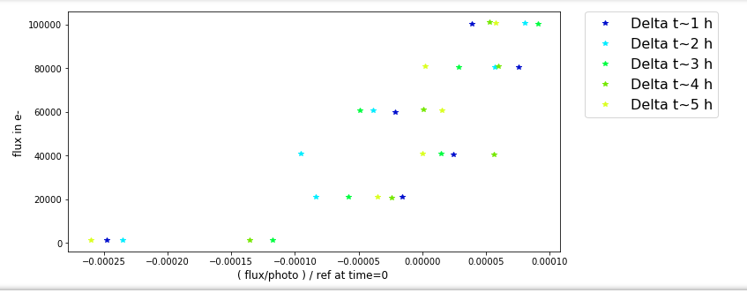
Sensor+REB linearity
With our lab setup we can measure the CCD linearity with a very good precision!
But for this we have :
Temperature stable over days :
A room/REB stable at δ=0.1 deg
A CCD stable at better than δ=0.01 deg
A lamp flux/power stabilized by a photodiode at better than 1% ( for ~ 72 h)
A clap on the CCD plane able to measure int(ilumination) stable over time at a few 10⁻⁵ and precise at <10⁻⁴ (it has no linearity issue as the lamp is stable at 1% , and it does it’s measurement at 31.25 kHz )
➔ hard to get in real life that way
Linearity ( e2v data for 6 PTC , ~ 1h/per ptc )
Aspic “glitch” ~ 0.4 %
CCD / OD slope ~ 0.5%
At low flux (<1500 e-) work to be done
Measured Flux/Photo diode
Flux in e- ➔
Flux in e- ➔
Flux at t / Flux at t0 ➔

