Slide 1
GANSU survey prospectives

Slide 2
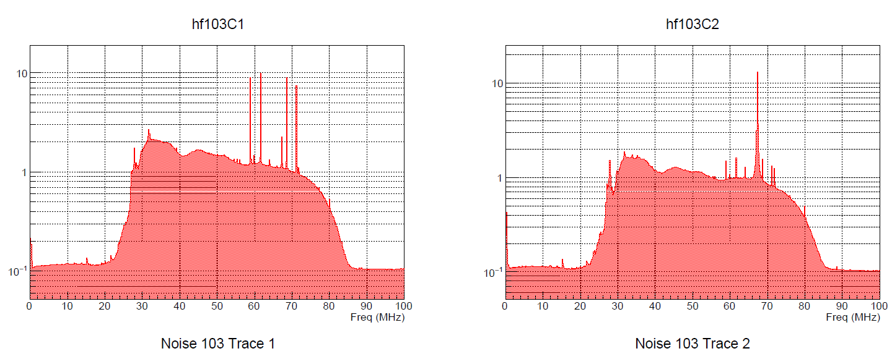
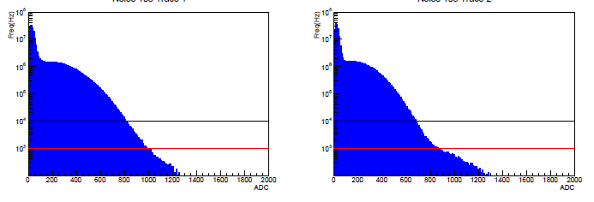
Background level estimation
So far very limited data & no standard procedure
  Radiodetection of transient pulses is a recent topic.
  Different antennas, DAQ, frequency ranges, etc…
  Mostly with external trigger from particle detectors (except TREND& Antarctica)
  One example: AERA @ AUGER site
NS channel
EW channel
FFT for stationnary noise:
Continuum (Galactic + human) + fixed frequencies (human)
For your eyes only…
NS channel
EW channel
Occurrence of transient signals (few seconds of radom data)

Slide 3
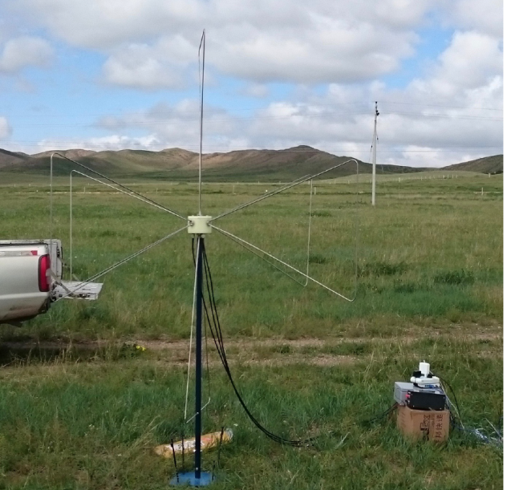
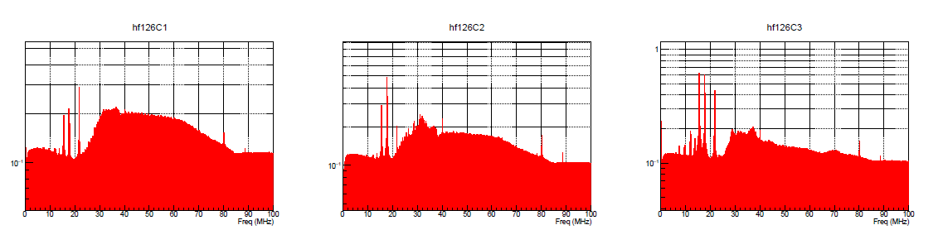
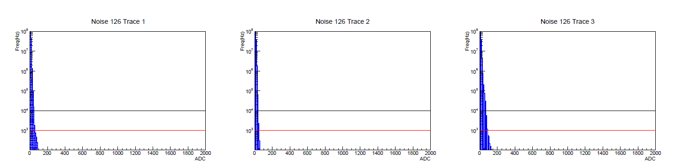
Background level estimation
Similar setup as AERA:
AERA elec
SUBATECH (3polar) antenna
Ulastai (TREND site, Aug 2016): trig rate >10 times better!!
NS channel
EW channel
Vert channel
NS channel
EW channel
Vert channel

Slide 4
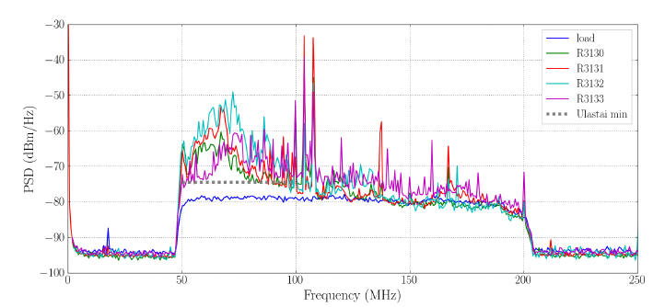
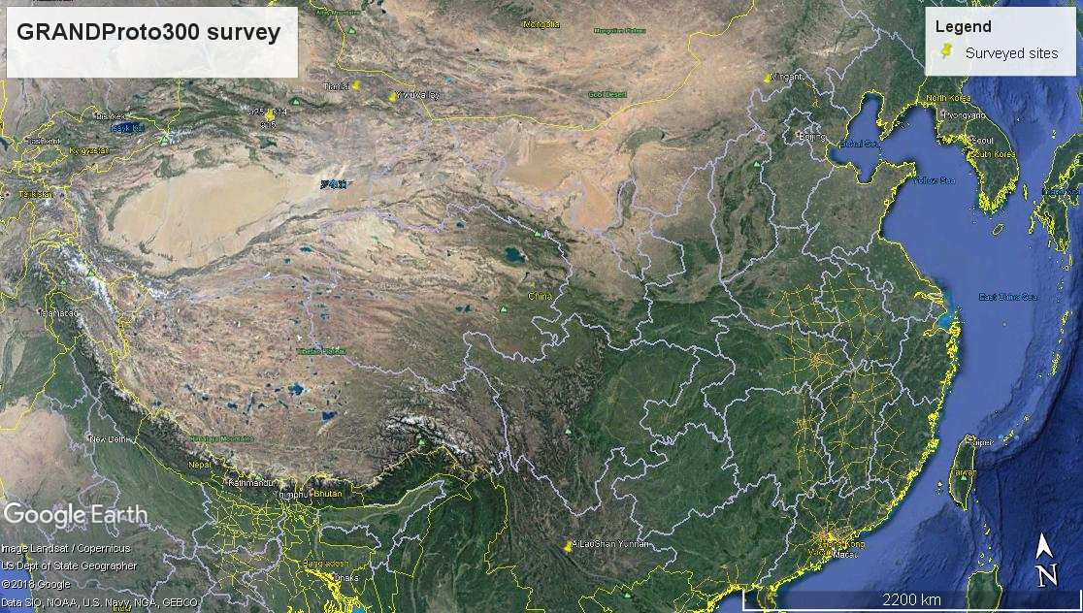
Site survey in China
YiWu valley
In InnerMongolia, Yunnan, XinJiang (Aug 2017-April 2018).
Same setup all along & standard procedure
Tianlai
Mingantu
Never as good as TREND
Inner Mongolia as bas as AUGER site
All the rest in between (~5 times worst trig rate)
➔ there WILL be noise in GRAND (but probably not as bad as in AUGER)…
How shall we deal with it?
TREND
YiWu valley
AiLao Shan

Slide 5
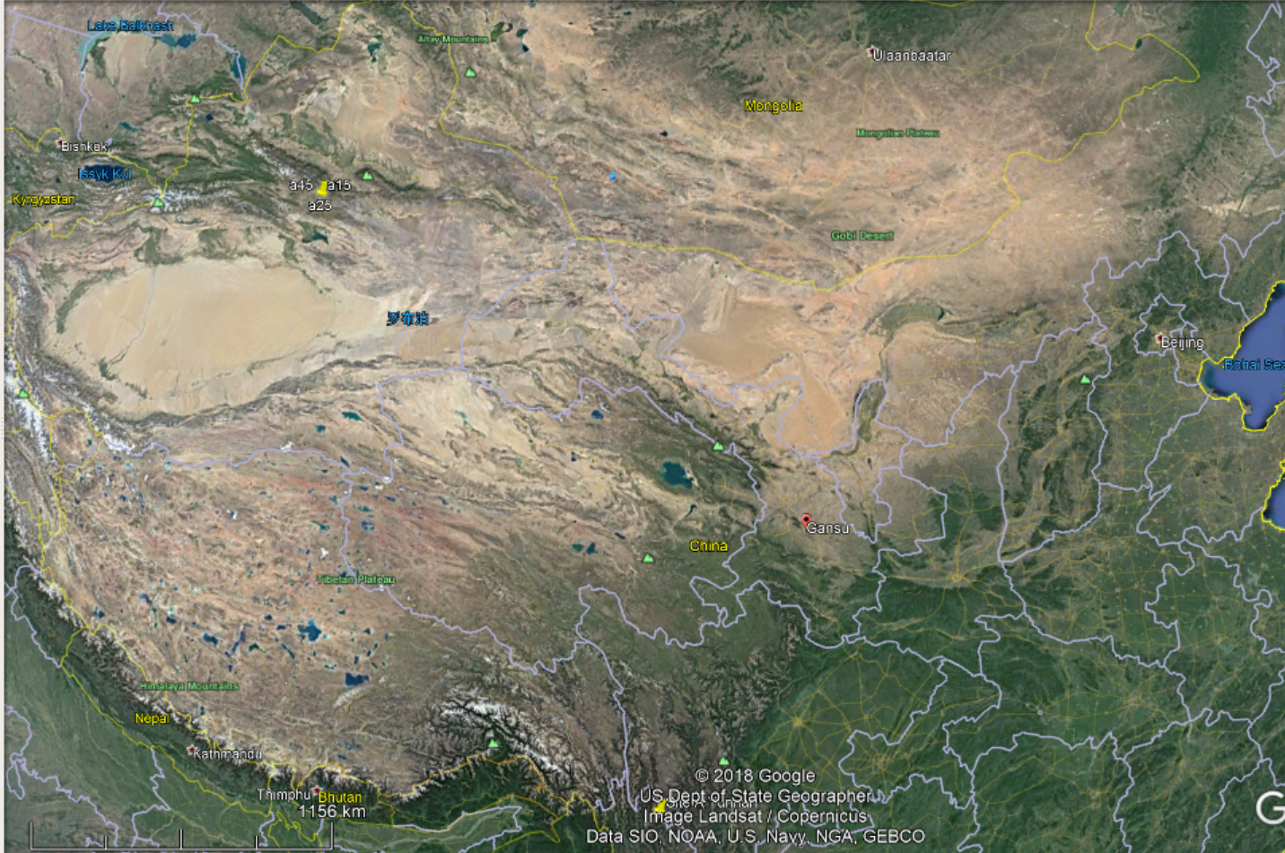
Mountains
Tianshan
Desert (Gobi)
Mongolia
XinJiang
Desert (Taklamkan)
Gansu
west tip
Inner Mongolia
Large population aera
Main communication axis (Hexi corridor / Silk road)
Mountains
(Tibetan plateau)
NingXia
QinHai
Gansu

Slide 6
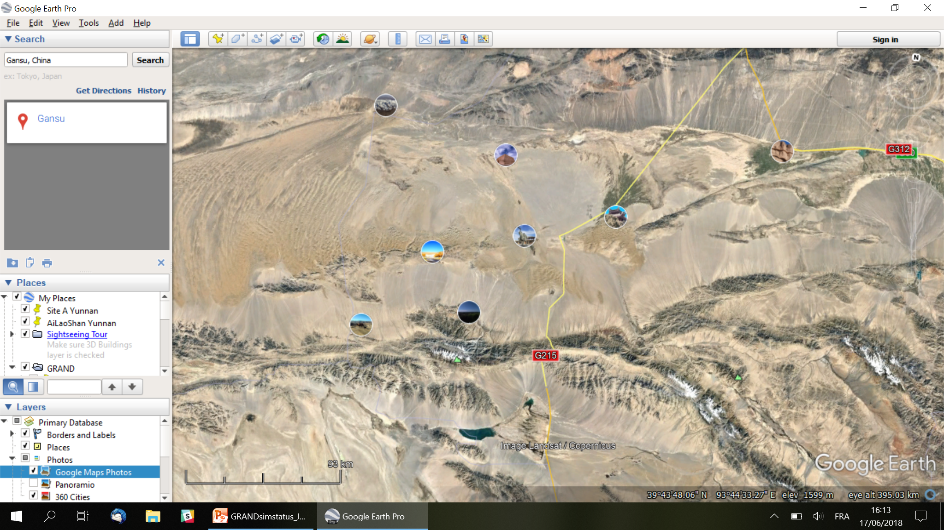
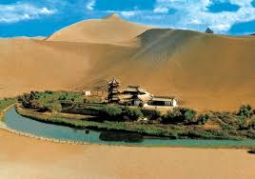
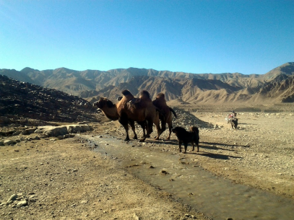
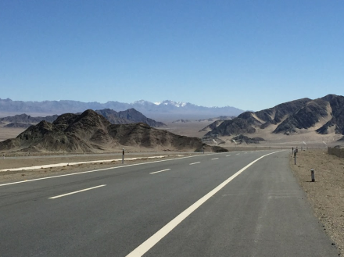
Gansu western tip
XINJIANG
DunHuang
Zone 1
GANSU
Altun Mountains
Zone 2
QINHAI

Slide 7
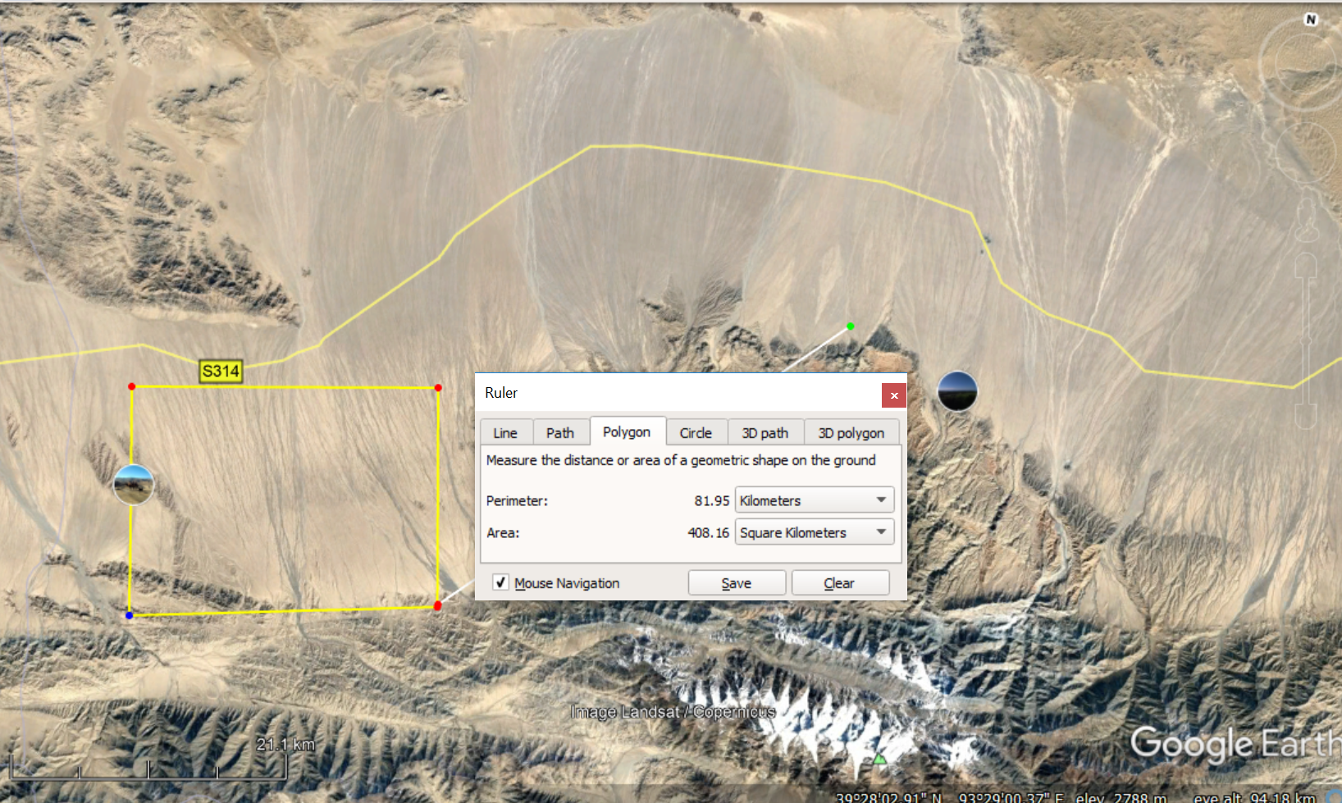
Zone 1
DunHuang 130km from zone
XinJiang border
Closest town?
DuoBaGou
Alt 2200m
Alt 2500m
GRANDProto300?
Alt 2800m
Alt 3300m

Slide 8
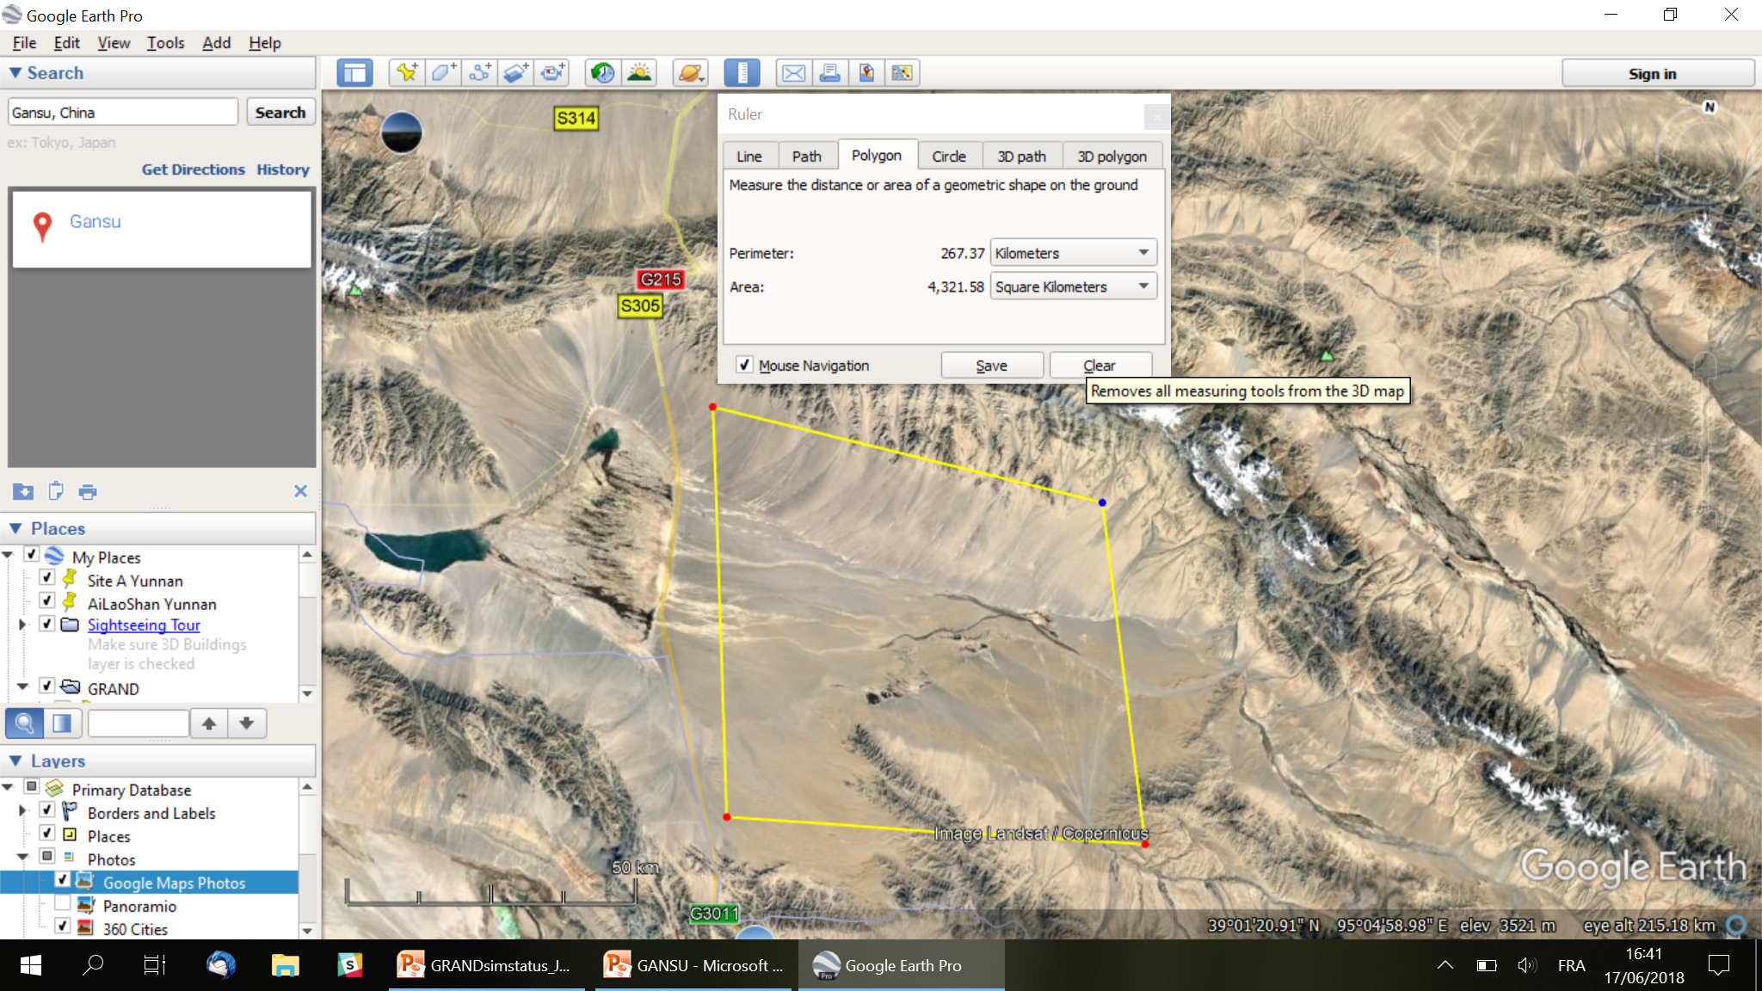
Zone 2: very remote, slope & large… Too high? Power plant?
Windmills plant
Alt 3000m
Alt 3800m
GRANDProto300
(➔ GRAND10k)?
Alt 3400m
QinHai border
Alt 4000m

Slide 9
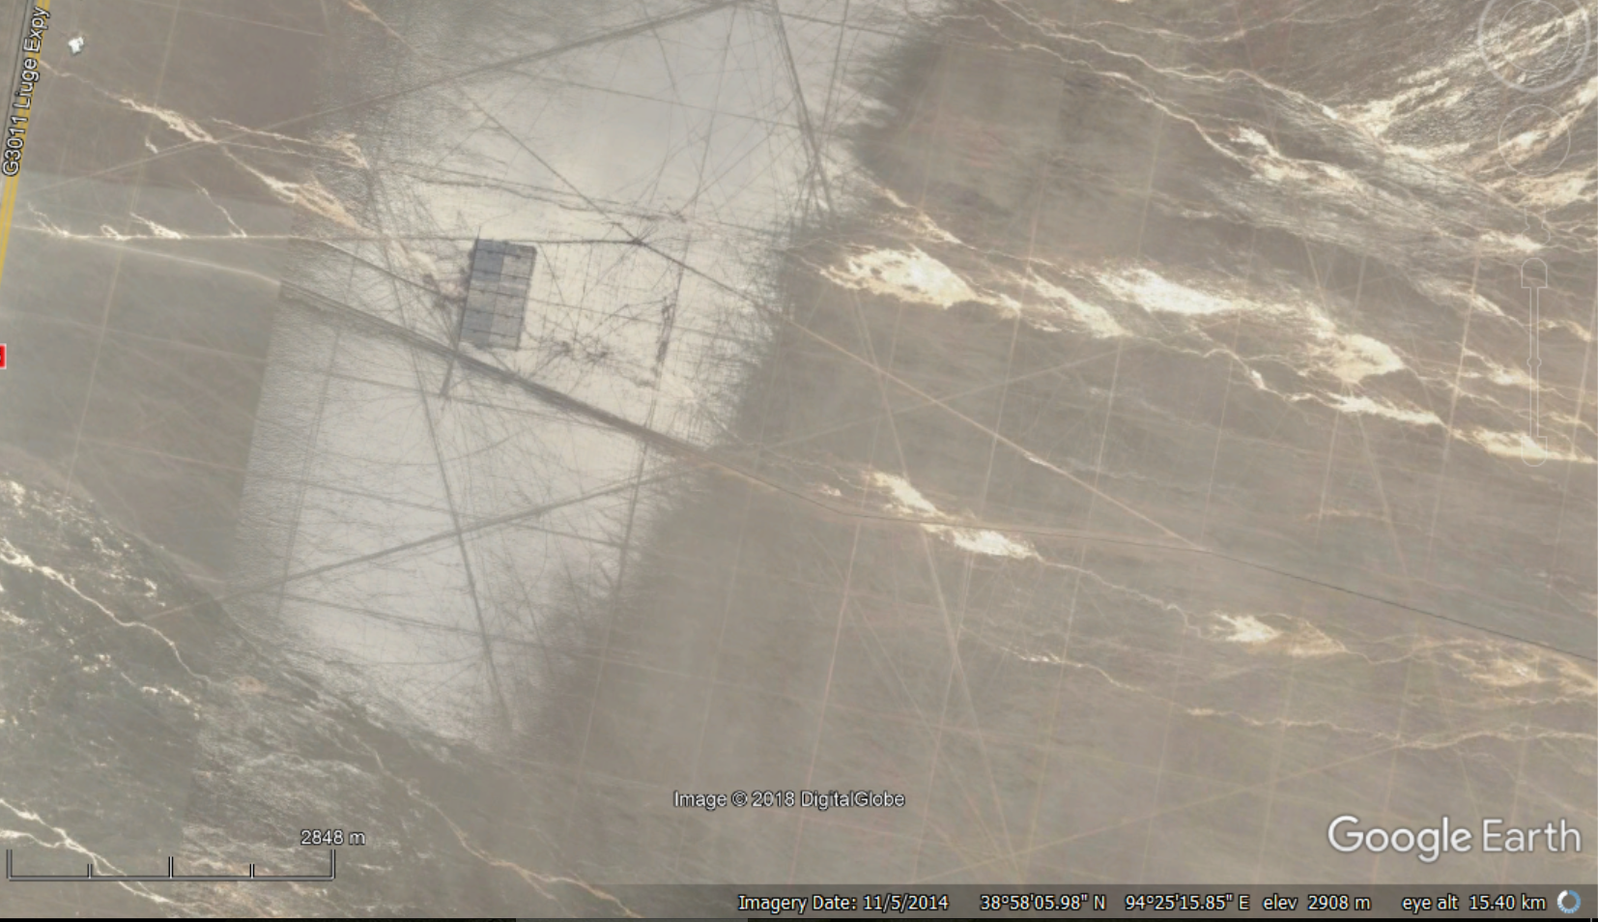
Not fully empty…

Slide 10
Conclusion
Significant effort for systematic site survey over the last 12 months
Clean sites exist
Yiwu good, but XinJiang probably risky politically.
Gansu promising on paper
Actions to be taken after Gansu survey:
  Define priority site
  Get administrative support
  Long term survey in Autumn

