Slide 1
What are we going to discuss?
Status of GP35 – Olivier
GP300 -- Charles
  General Overview
  Antenna/LNA (Didier)
  Status of electronics (Rene)
  station layout
  Possible site
  Making GP300 a reality
FRB/GRP
Upcoming site survey -- Olivier

Slide 2
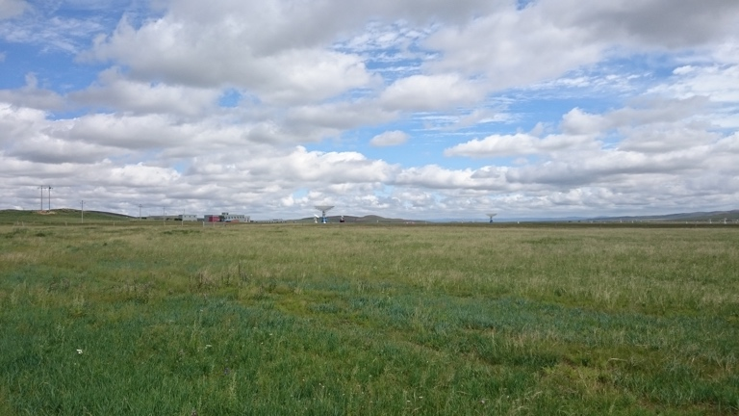
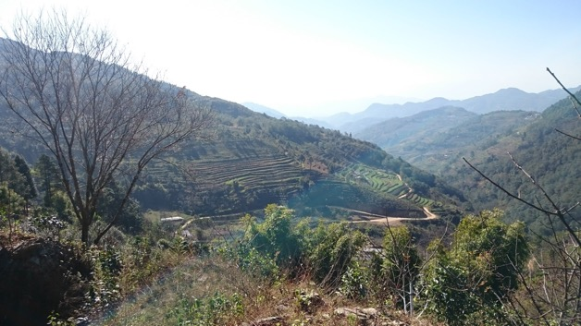
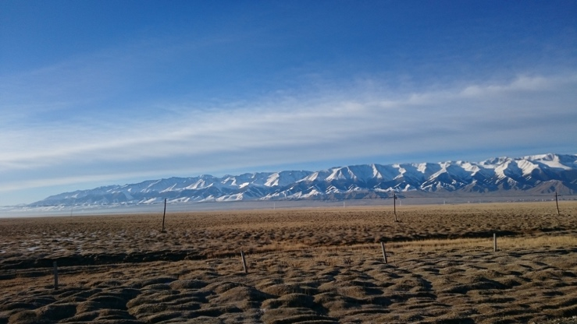
Site selection
The test procedure consists of several aspects:
Visual inspection of the site to evaluate ease of access and deployment.
Measurement of the transient noise of the site in the 30-80 MHz regime using a butterfly antenna with 3 polarizations. This measurement is not performed in the 50-200 MHz regime as no suitable electronics was available.
Measurement of the frequency spectrum of all polarizations through an FFT of the time domain in the 30-80 MHz regime using a butterfly antenna.
Measurement of the frequency spectrum between 50 and 200 MHz using either a TREND or butterfly antenna.

Slide 3
GP300 -general overview
Array of 300 radio antennas on a surface of 100-300 km²
  Horizonantenna
  30-200 MHz
  14 bit 500 MHz digitization
  Working 24/7 on solar power
  Wireless comms
Main Array will have 1 km spacing
Denser infill will be created
  More vertical showers
  Lower energy
  Connection to AERA
If there is money: surface particle detector will be added.

Slide 4
Electronic status
Rene Habraken

Slide 5
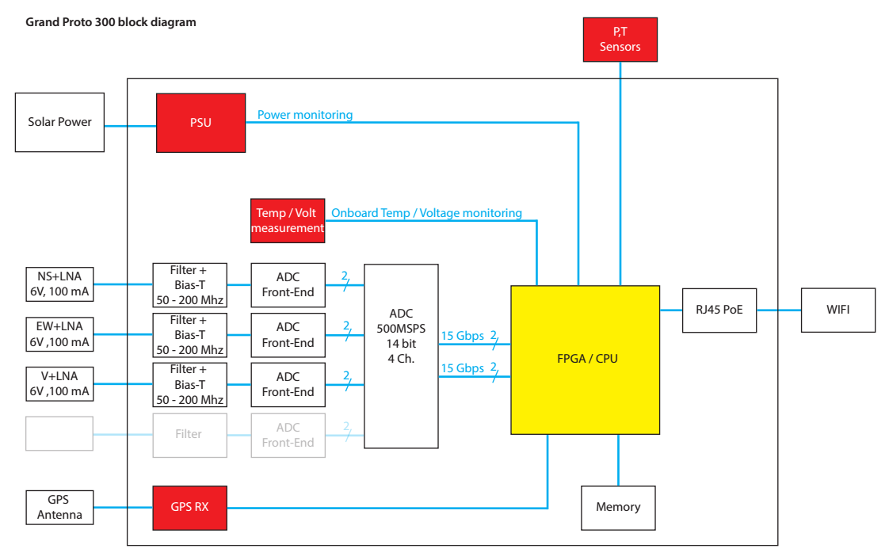
30-200MHz
30-200MHz
30-200MHz

Slide 6
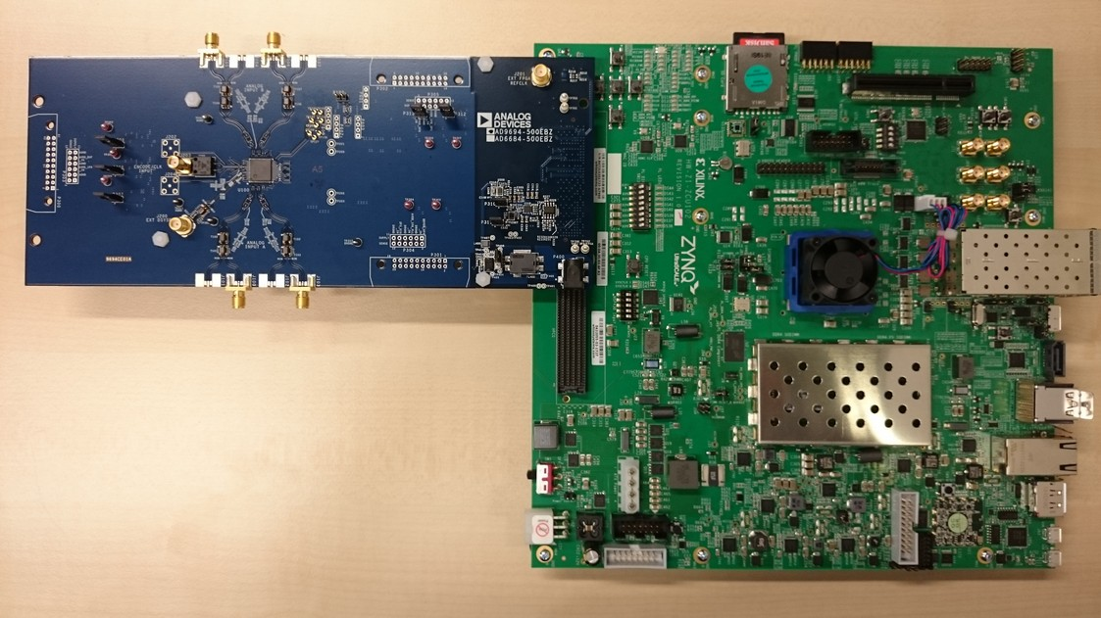
ADC 9694 + Zync ZCU102 reference setup
ZYNC ZU9EG FPGA
Application processor:
- Quad core Cortex A53, 1.5Ghz
Real-Time processor:
- Dual core Cortex R5, 600MHz
Graphics Processing unit
ARM Mali-400 MP2
- a lot of interfaces…
- 24x 16.3Gb/s GTH transceivers in FPGA
- Processor: 4GB DDR4 64-bit
- FPGA: 512MB DDR4
- ethernet out
500MSPS
Quad ADC
2x 15GS/s serial output

Slide 7
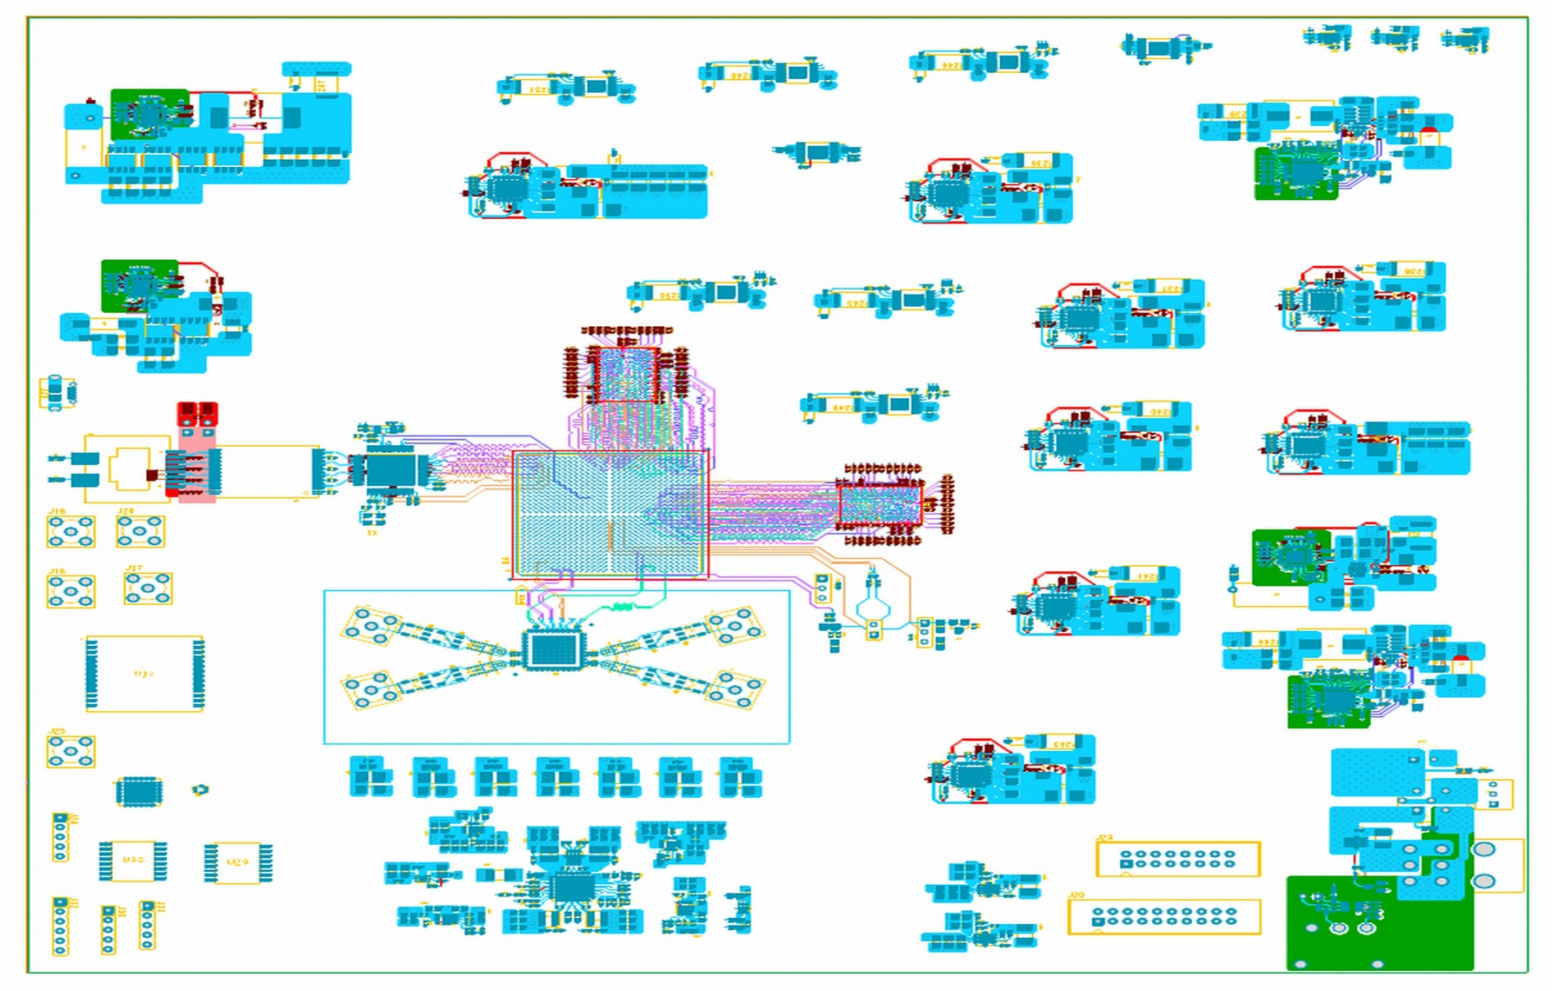
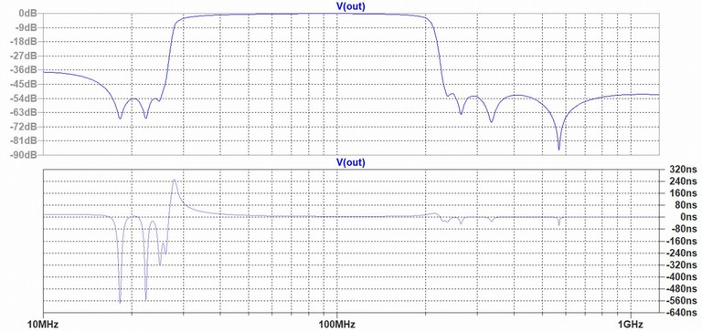
Status board design
Board (Floris Hahn, techocenter)
- Schematic is ready for review this week.
- Preliminary routing done for:
DDR4 memories
ADC
Ethernet interface
Power supply modules
- Component placement started.
Other (Daniel Szalas)
- Filter design started, first schematic is ready. Needs to be optimized.
- GPS module designed and build. Ready for test with reference setup.

Slide 8
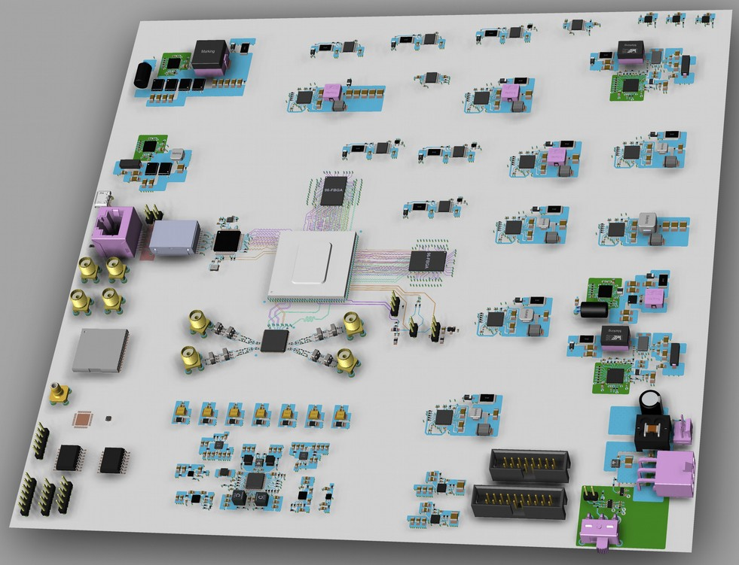
Component placement
Power supplies
DDR4 memories
(connected to the CPU and the programmable logic)
Power inlet
Ethernet
FPGA
(XCZU5CG)
ADC
ADC
power supply
Notes:
- FPGA with embedded dual A53 core
- 500 MSPS 14-bit ADC with its own low noise power supply
- Two DDR4 memories connected to the CPU and programmable logic. With this prototype the overall memory usage will be evaluated. The decision which memory to keep (and with what size) will be made after the power usage of the whole board is measured.
- The clock chip provides four low jitter (90fs) clocks for the ADC, FPGA GTH transceiver, DDR4 memory and the CPU reference clk.
- The (10/100/1000MHz) ethernet connection will provide PoE to the Bullit wifi antenna.
- The power takes up the most space on the board but will be reduced and optimized in the next version of the PCB.

Slide 9
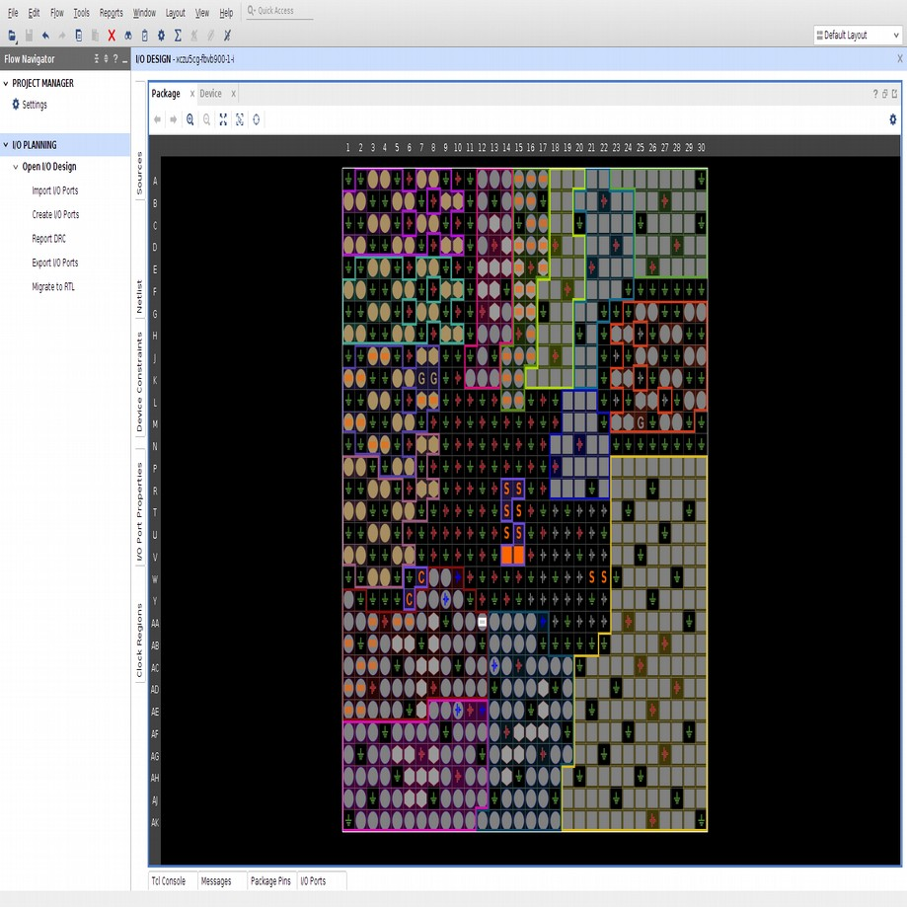
Status firmware and software
Firmware
Until the prototype arrives all firmware is developed for the reference setup (slide 3).
- High speed ADC readout (JESD204B interface) is finished but needs a Linux kernel to be up and running to be able to test functionality. Kernel image is build but hangs during boot. Needs debugging.
- Firmware for DDR4 memory test (PL-side) is build and will be tested coming weeks. Needs integration with ADC readout.
- Firmware for triggering and event building is available but must be copied and modified from the previous AERA digitizer. Needs to be started.
Software
Needs to be started.
- drivers
- interface to FPGA
- migration software AERA digitizer
- readout sensors (pressure, humidity and temperature)

Slide 10
Cost estimate GRAND electronics
August 22nd 2018
Item | Partnumber | Datasheet | unit price (300+) | # on pcb | total
PCB |  |  | 70 | 1 | 70
FPGA | XCZU5CG-1FBVB900E |  | 775 | 1 | 775
ADC | AD9694 |  | 500 | 1 | 500
GPS antenna |  |  | 100 | 1 | 100
GPS trimble |  |  | 40 | 1 | 40
Bullit |  |  | 90 | 1 | 90
power supllies |  |  | 3.6 | 24 | 86.4 | can be reduced in a later stage!
DDR4 mem |  |  | 12 | 2 | 24
Clock |  |  | 7.5 | 1 | 7.5
Ethernet controller |  |  | 4 | 1 | 4
SMA connectors |  |  | 3.32 | 4 | 13.28
T, P & RV sensor | BME280 | https://cdn-shop.adafruit.com/datasheets/BST-BME280_DS001-10.pdf | 3.4 | 1 | 3.4
QSPI flash mem | MT25QU256ABA8ESF-0SIT |  | 3.32 | 2 | 6.64
other |  |  |  |  | 200
TOTAL Price per board |  |  |  |  | 1920.22

Slide 11
Station Layout

Slide 12
Elements of a station
HorizonAntenna (5m high) -- Didier
LNA (3) -- Didier
Environmental sensors (P,T)
Bosch BME280 accuracy 0.5 degrees, 1 hPa
GPS (Trimble RES SMT360+ 5V antenna)
Simultaneous GPS / GLONASS or GPS / Beidou tracking
1 pps timing accuracy 15 ns → relative timing will be better
communications antenna
External wireless communications unit (Bullet, Ubiquity)
>100 Mbps (tested ~70 Mbps, 10km real conditions)
Electronics board
Solar Panel
Charge Controller
Battery
Sensors (battery voltage, current)
CABLES!
Mechanics

Slide 13
Possible Site
Yiwu Valley

Slide 14
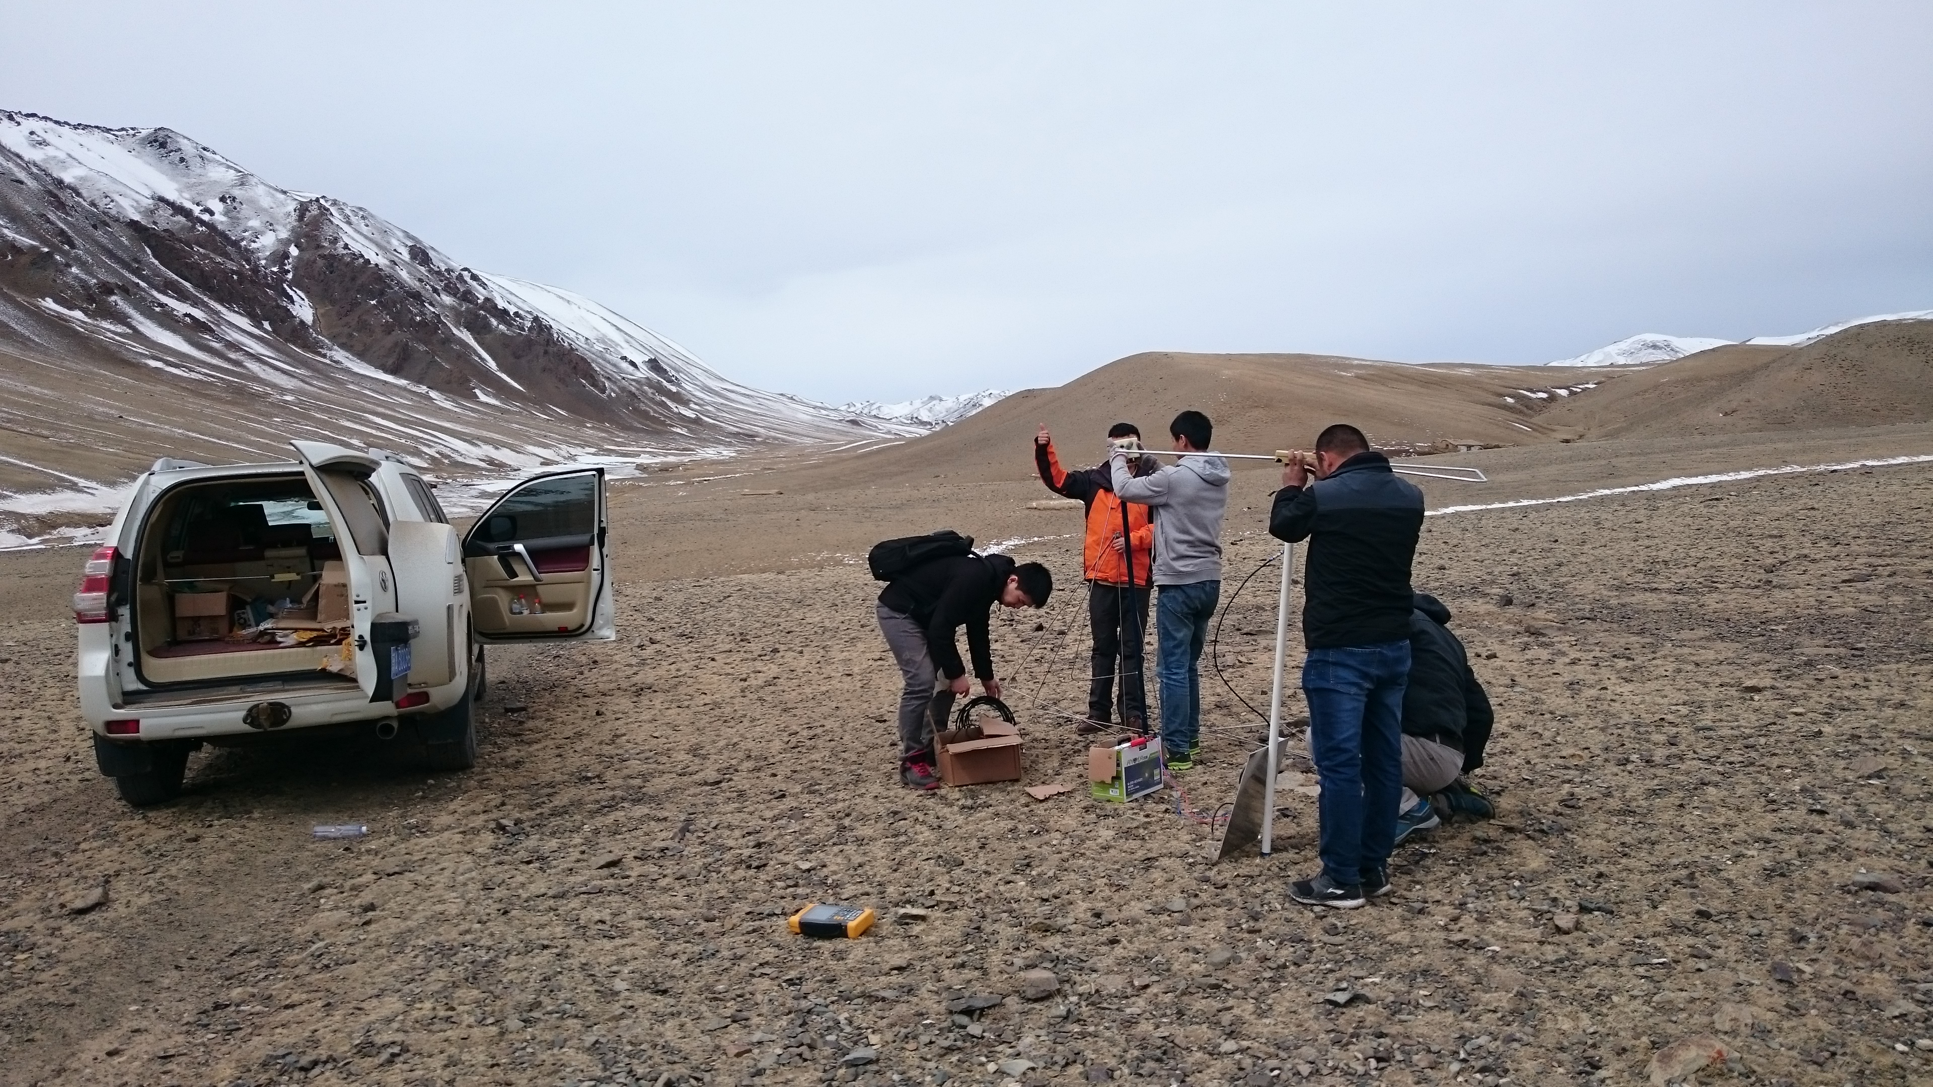
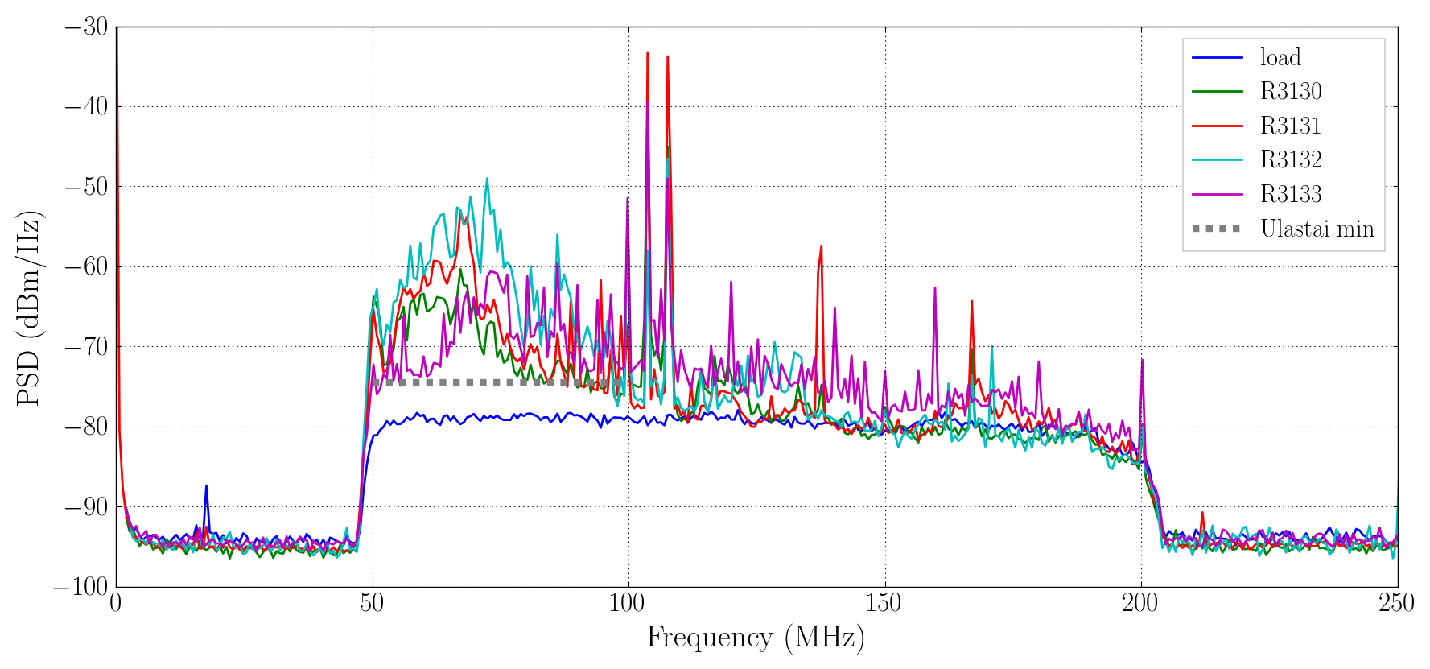
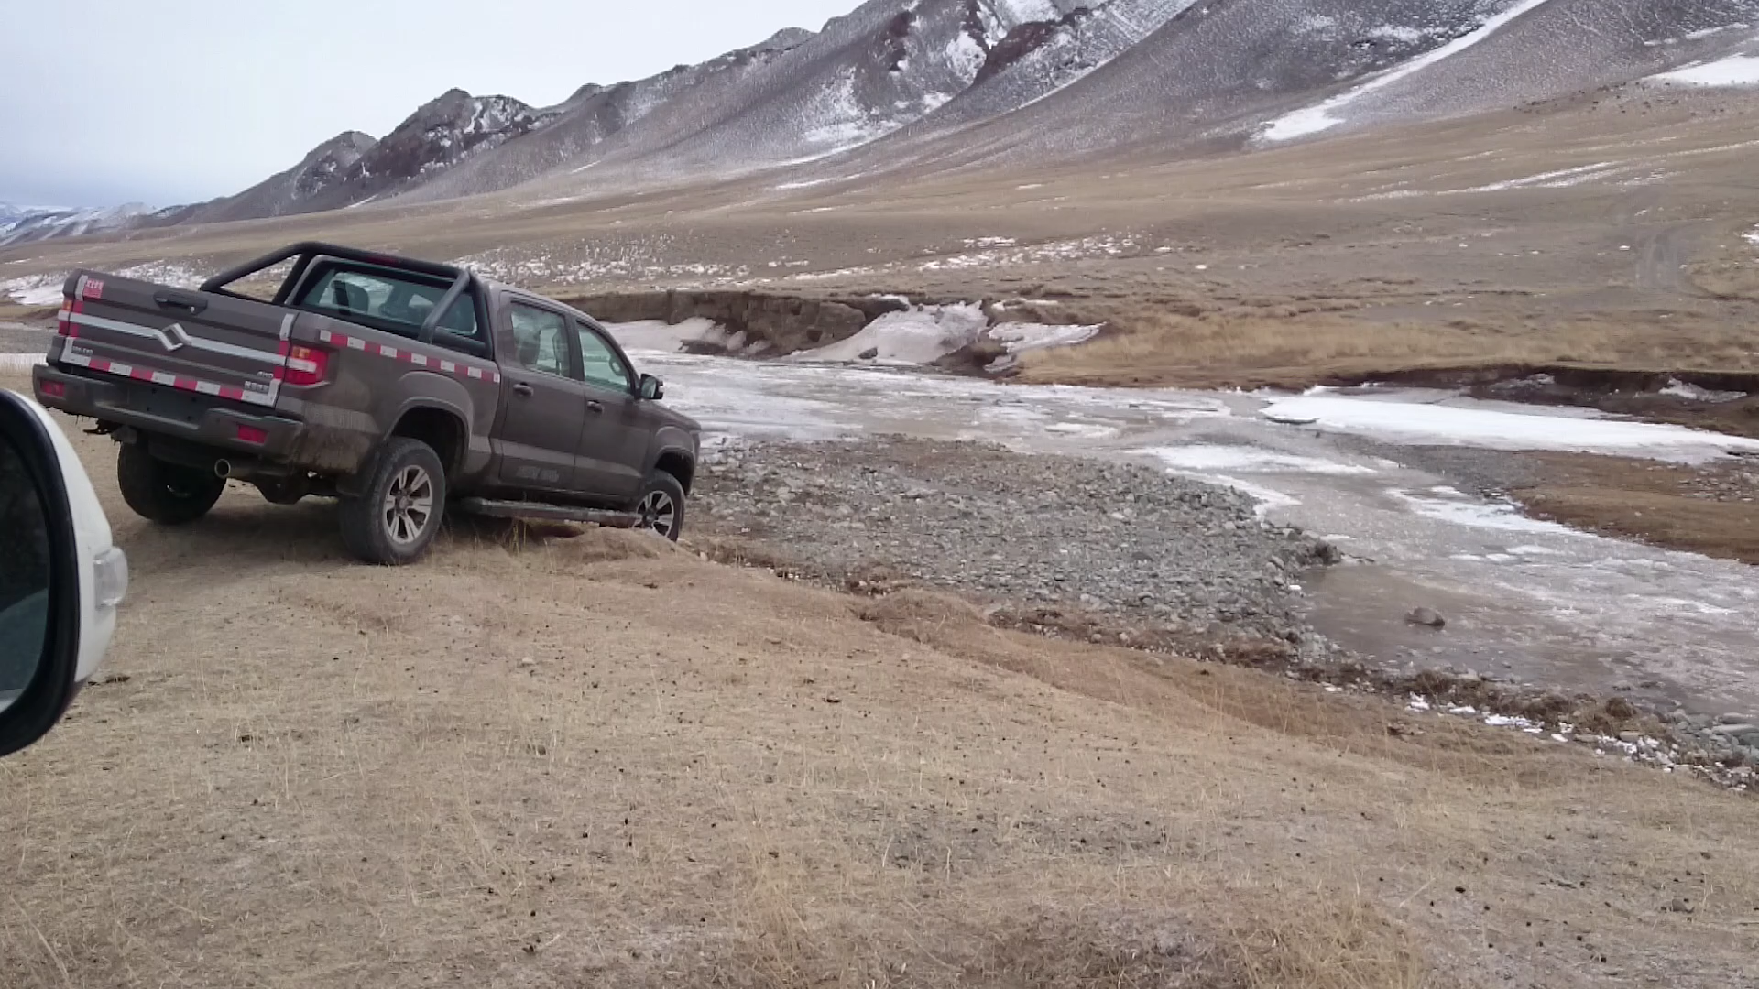
Latitude: 43.612421°
Longitude 93.820829°
Altitude 2783m
●
●
●
●
●
●
●
●
●
●
●
●
●
●
●
●
●
●
●
●
●
●
●
●
●
●
●
●
●
●
●
●
●
●
●
●
●
●
●
●
●
●
●
●
●
●
●
●
●
●
●
●
●
●
●
●
●
●
●
●
●
●
●
●
●
●
●
●
●
●
●
●
●
●
●
●
●
●
●
●
●
●
●
●
●
●
●
●
●
●
●
●
●
●
●
●
●
●
●
●
●
●
●
●
●
●
●
●
●
●
●
●
●
Small Valley in Bailikun | Threshold/Ulastai threshold
 | Rate: 1k | Rate:10k
B103A | 7.5 | 7.8
B3133 | 7.4 | 6.8
B3130 | 3.0 | 3.1
B3132 | 4.5 | 4.6
B3131 | 6.2 | 6.1
●
●
●●●●●●●
●
●
●
●
●
●
●
●
●
●
●
●
●
●
● ●
●●●●●●●
●
●
●
●
●
●
●
●
●
●
●
● ●
●
●●●●●●●
●
●
●
●
●
●
●
●
●
●
●
●
●
●
●
●
●
● ●
●●●●●●●
●
●
●
●
●
●
●
●
●
●
●
●
●
●
●
●
●
●
●
●
●
●
●
●
●
●
●
●
●
●
●
●
●
●
●
●
●
●
●
●
●
●
●
●
●
●
●
●
●
●
●
●
●
●
●
●
●
●
●
●
●
●
●
●
●
●
●
●
●
●
●
●
●
●
●
●
●
●
●
●
●
●
●
●
●
●
●
●
●
●
●
●
●
●
●
●
●
●
●
●
●
●
●
●
●
●
●
Status:
Deployment of a few antennas for long term monitoring is permitted
10 km

Slide 15
COMMUNICATIONS
GRANDProto 300
Number of antenna's | 299
Polarizations/antenna | 3
Sampling frequency (MHz) | 500
Tracelength (ns) | 2048 | --> Number of samples | 1024
Bytes/sample | 2 | --> Event Size (B) | 6144
Trigger Rate/station | 1000
Time stamp size (B) | 4 | --> TS throughput (B) | 4000
 |  | --> TS input at DAQ (kB) | 1167.97
Dense Array (250 m)
Energy threshold (EeV) | 0.1
Area (km2) | 2.25 | -->Event Rate (mHz) | 0.56
avg Antennas/event | 3.5 | -->Event Rate/antenna (mhz) | 1.96
Antenna's | 43 | --> Physics Throughput (kB/s) | 0.51
Noise Rate/Antenna (Hz) | 10 | --> Noise Throughput (kB/s) | 2580
Infill Array (500 m)
Energy threshold (EeV) | 0.3
Area (km2) | 25 | -->Event Rate (mHz) | 0.5
avg Antennas/event | 3.5 | -->Event Rate/antenna (mhz) | 1.75
Antenna's | 112 | --> Physics Throughput (kB/s) | 1.18
Noise Rate/Antenna (Hz) | 10 | --> Noise Throughput (kB/s) | 6720
Main Array (1 km)
Energy threshold (EeV) | 1
Area (km2) | 150 | -->Event Rate (mHz) | 0.2
avg Antennas/event | 3.5 | -->Event Rate/antenna (mhz) | 0.7
Antenna's | 144 | --> Physics Throughput (kB/s) | 0.60
Noise Rate/Antenna (Hz) | 10 | --> Noise Throughput (kB/s) | 8640
Total |  | Pysics Event Throughput (kB/s) | 2.29
 |  | Noise Event Throughput (kB/s) | 17940
 |  | Event Throughput (kB/s) | 17942.29
 |  | Total Throughput (MB/s) | 18.662
 |  | Physics storage (TB/ yr) | 0.07
 |  | Total storage (TB/yr) | 563.39
Cost estimate for Communication infrastructure: ~10k
Divide array into several sub-arrays
Put up 2 relay stations
Set up DAQ-shed at the valley entrance
Create a wireless backbone to Yiwu or Balikun

Slide 16
Other issues….
Online system
Monitoring
Data transfer to Beijing/Europe/US
Offline reconstruction
Data analysis

Slide 17
Things to do for making GP300 a reality
Find suitable site for GP300
Political negotiations on site usage/access permissions
Long term test in 30-200MHz band
Finalize station design and development
Determine site layout
Obtain funding
Procurement of elements
Construction of stations
Test stations (develop test procedure)
Deploy stations
commissioning

