Slide 1
GRANDProto35 status
GRAND workshop
IAP, August 23, 29018

Slide 2
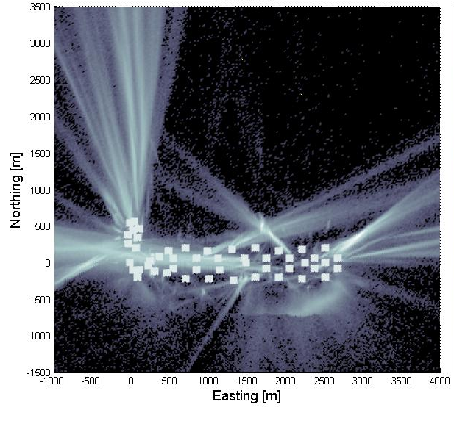
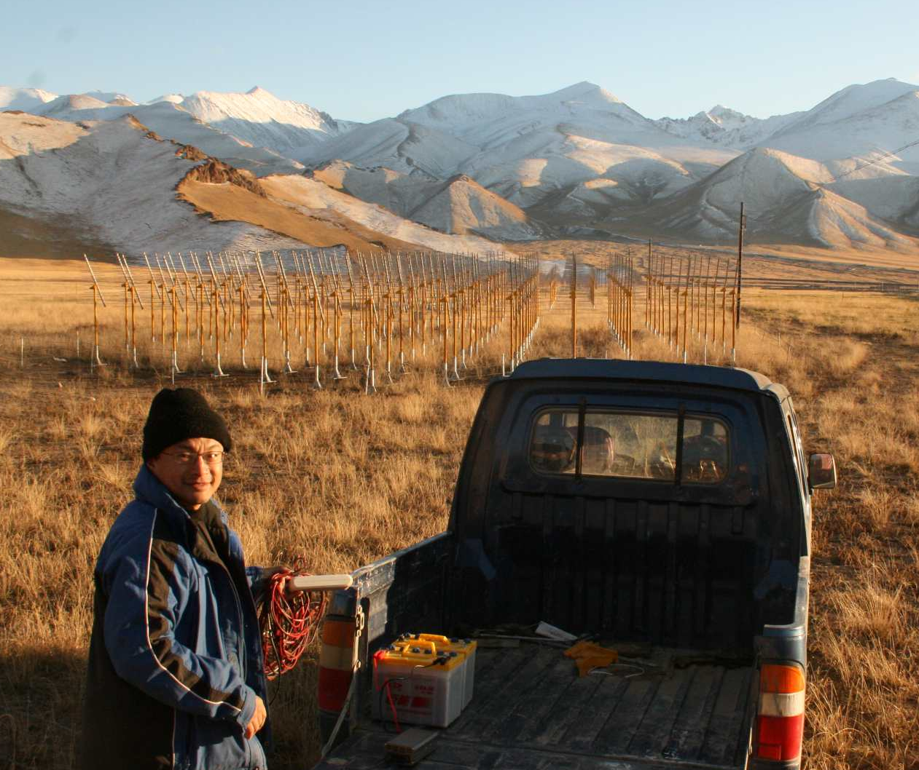
Radio selftriggering challenges
Feedback from TREND:
Even in remote areas, background sources (HV, planes, tranes, etc) generate many more events than air showers.
Major issue for GRAND: detect & identify neutrino signals out of ultra-dominant background
2011-2012 data
TREND antenna
Reconstructed source position
HV transformer

Slide 3
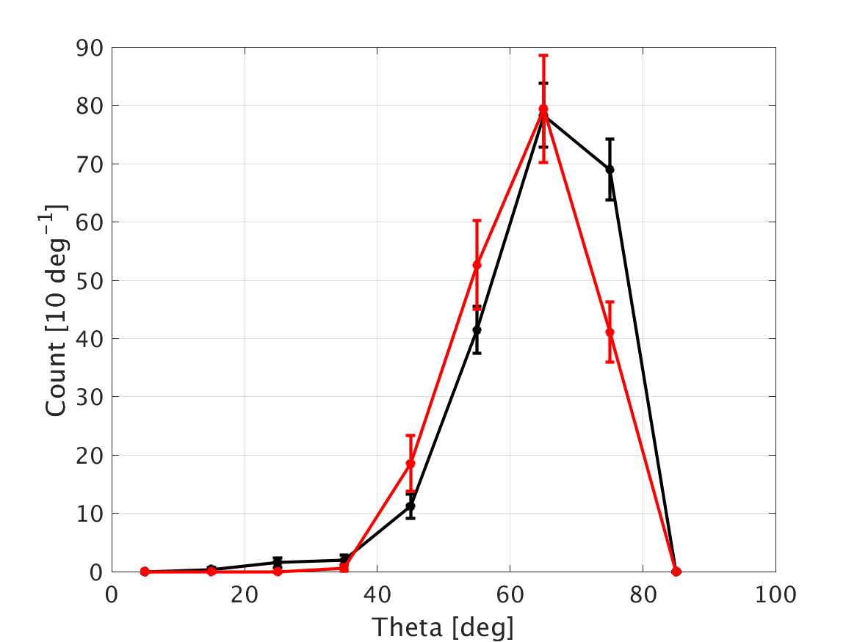
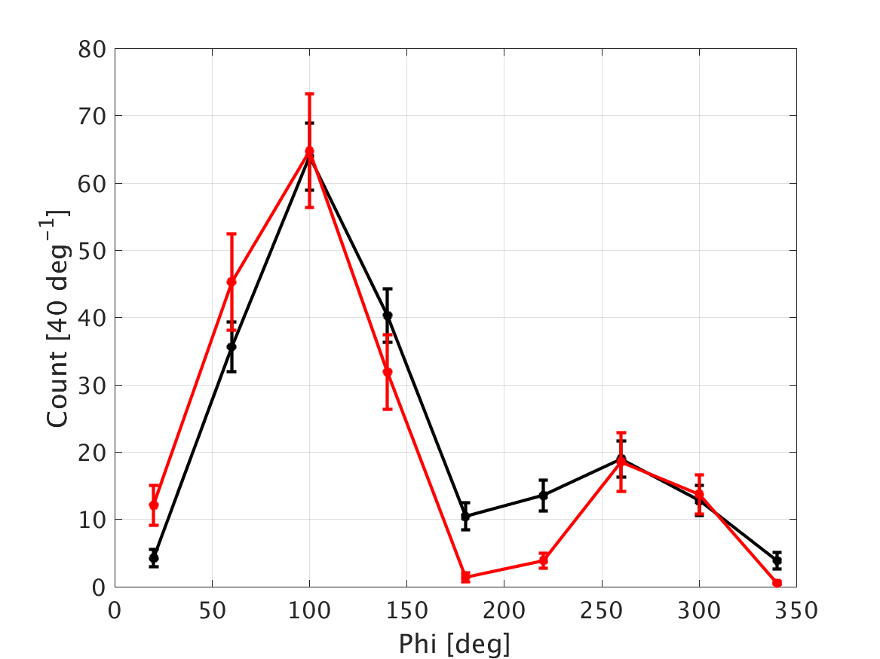
TREND results
Offline algorithm to select air-shower candidates from their specific features (wavefront shape, trigger pattern at ground etc)
Results in an excellent background rejection (huge fraction of background events killed: from 7.3 10⁸ to ~500 background events)
Data: selected candidates
Simulated air shower events

Slide 4
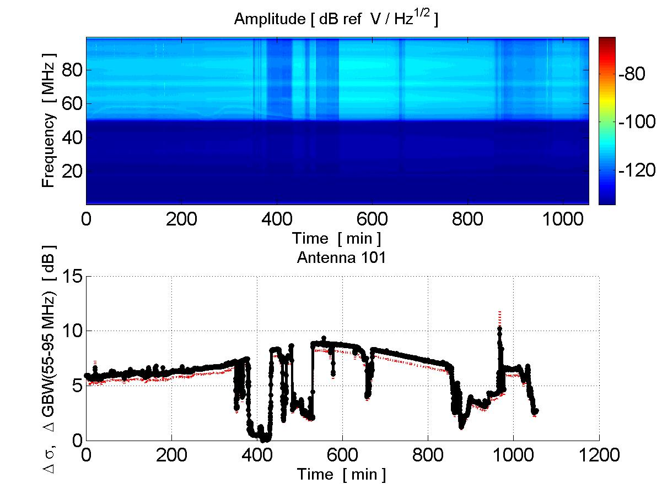
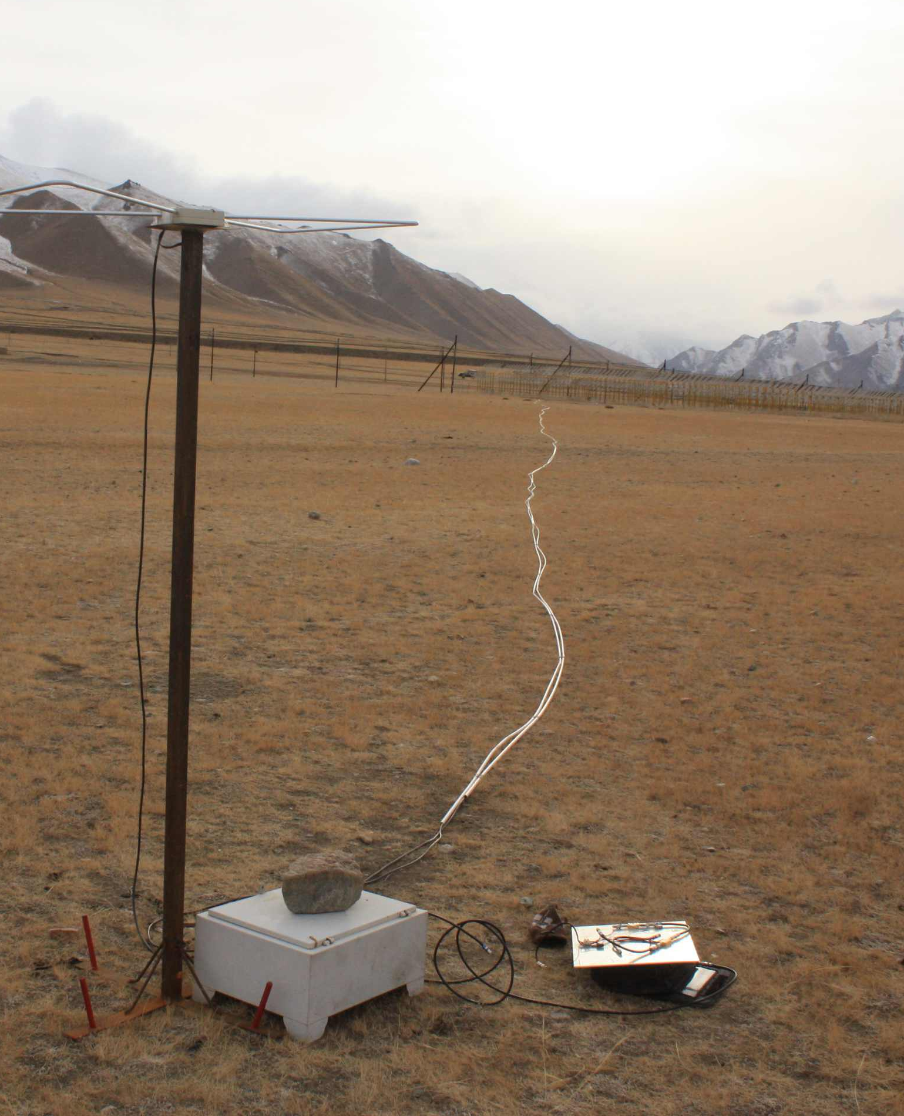
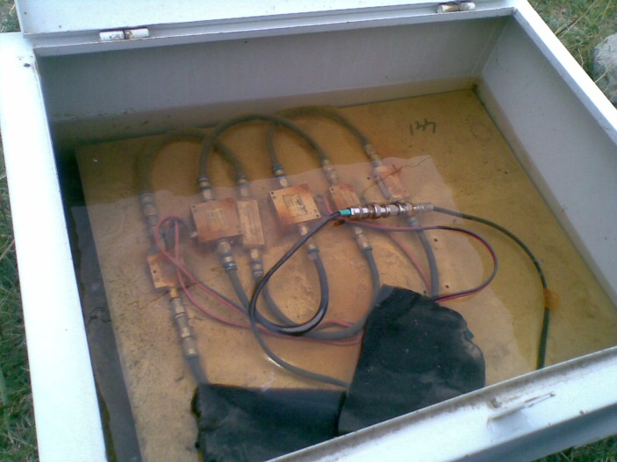
TREND issues
«You get what you pay for»: system reliability questionnable
  Sudden drops in gain
  Aging (antennas, amplifiers, optical system, computers…)
- Significant maintenance effort required
- Reduced detection efficiency
- Determination of efficiency &
absolute calibration (very) challenging
50-100MHz noise level (dB)

Slide 5
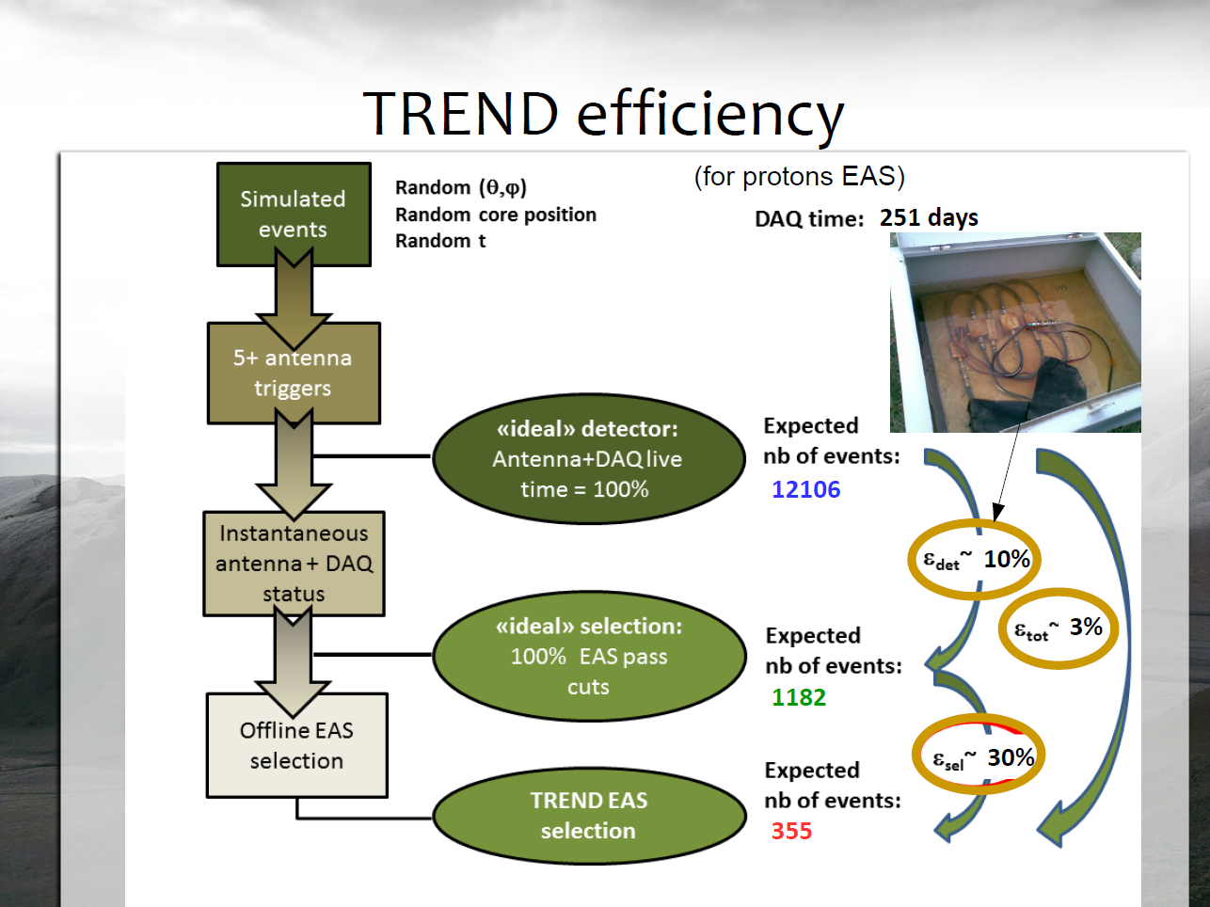
S. Le Coz, FCPPL2018

Slide 6
Motivations from GRANDproto35 (2013)
Confirm TREND results: autonomous radiodetection works.
Improve detection efficiency ε_{tot =} ε_{det} xε_{sel}
  Improve ε_{det} with upgraded detectors allowing for a larger fraction of detctor up-time.
  Goal: ε_{det} >90%
  Improve background rejection with new tools. Goal: ε_{sel} >80%

Slide 7
GRANDProto35 developments
(2014-2017)
Antennas
Electronics
Ground array

Slide 8
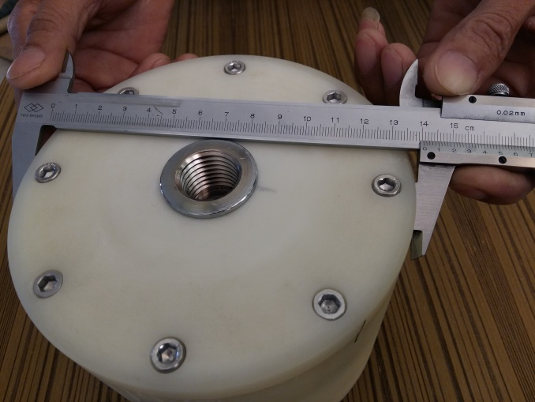
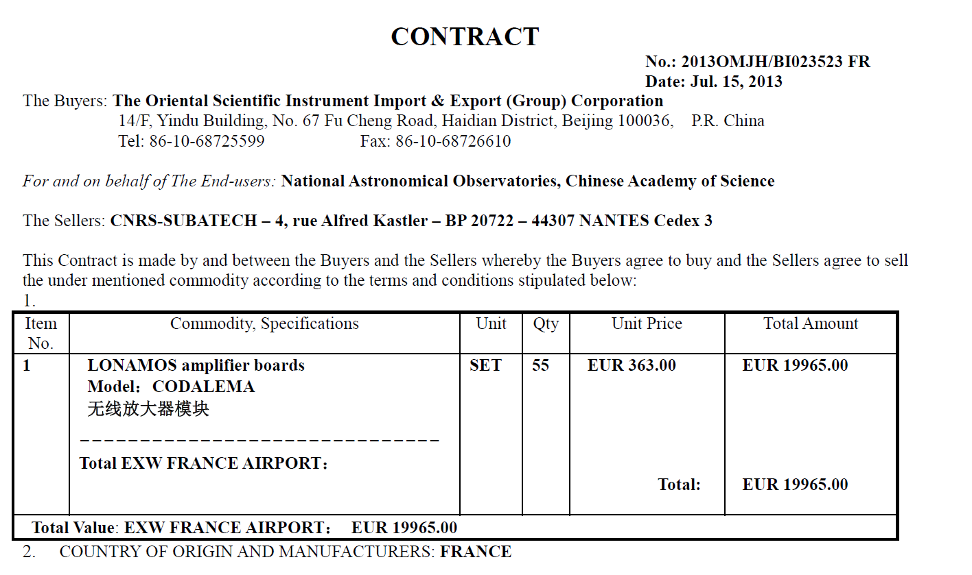
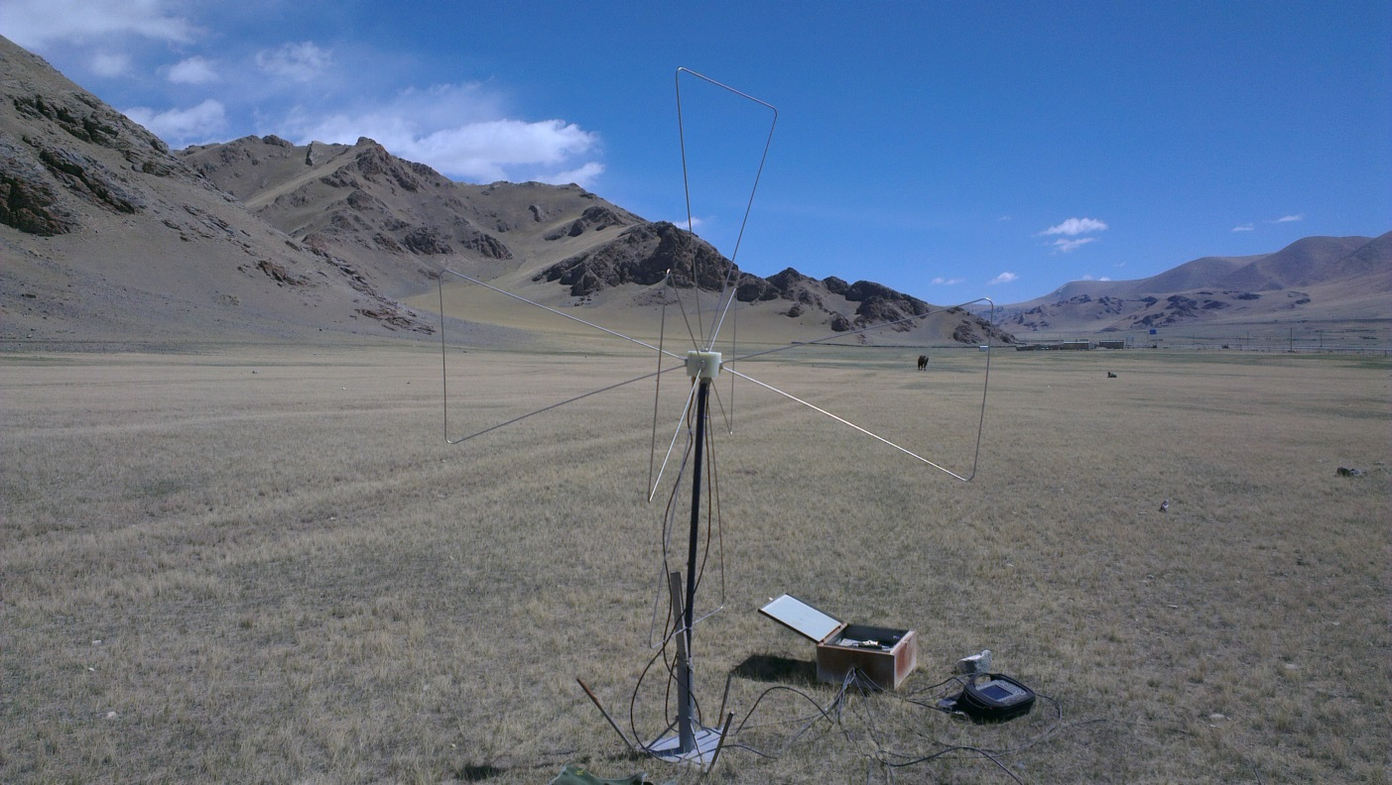
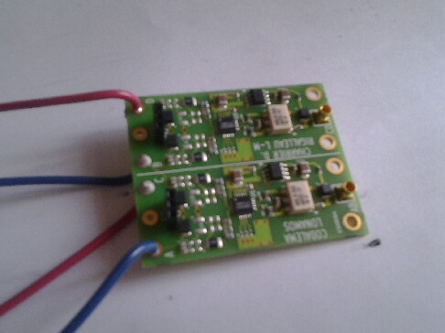
GP35 antennas
Production: SUBATECH (D. Charrier) + XiDian U (Zhang Fushun)with NAOC funding
Tested and validated as early as 2014
3xASIC LNA
(6V supply, 67mA consumption)

Slide 9
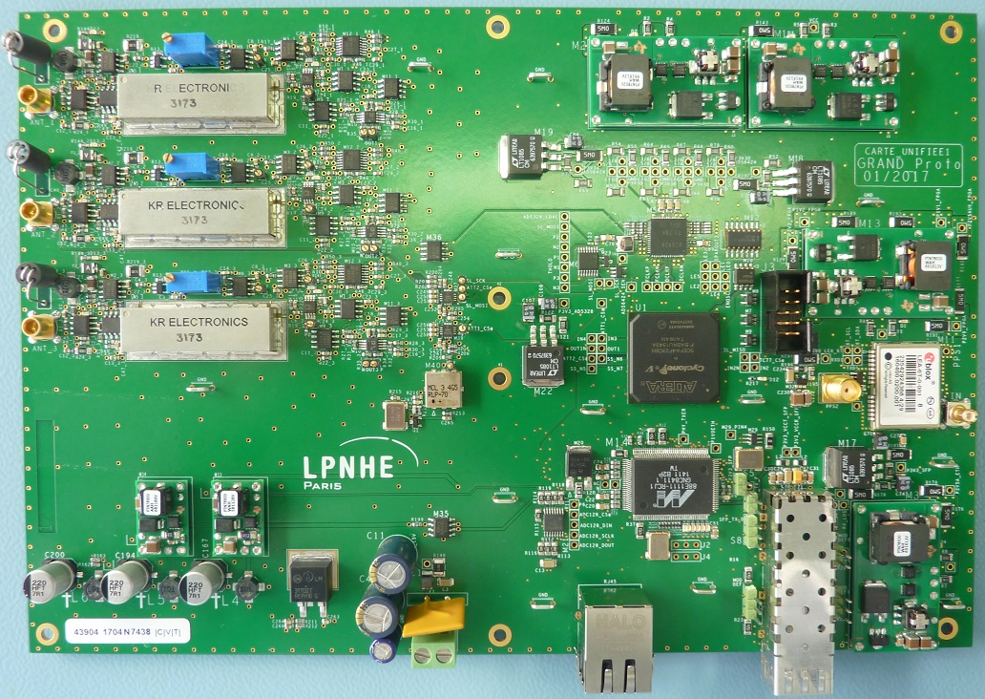
GP35 electronics

Slide 10
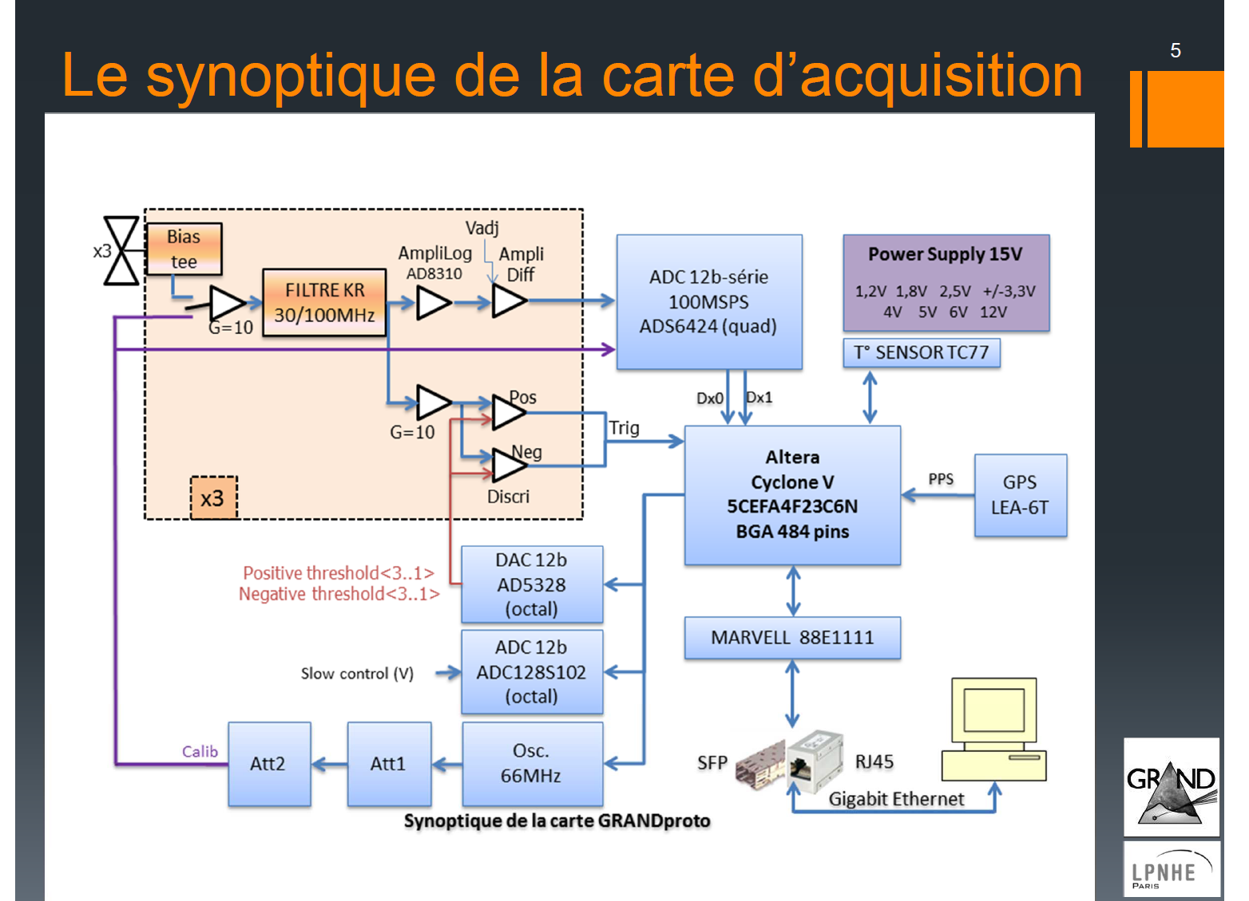
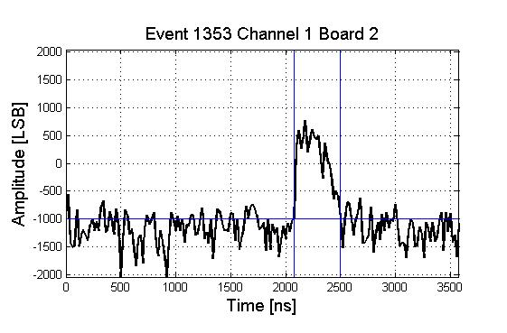
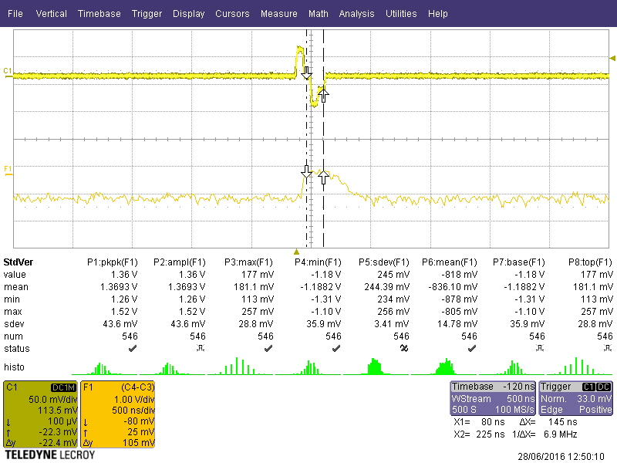
Input: bipolar pulse 200ns 30mVpp
Output = enveloppe

Slide 11
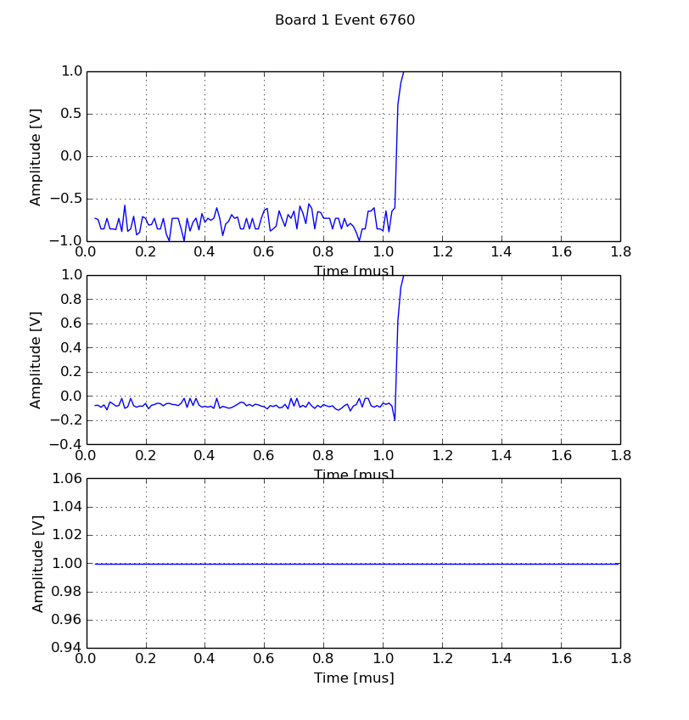
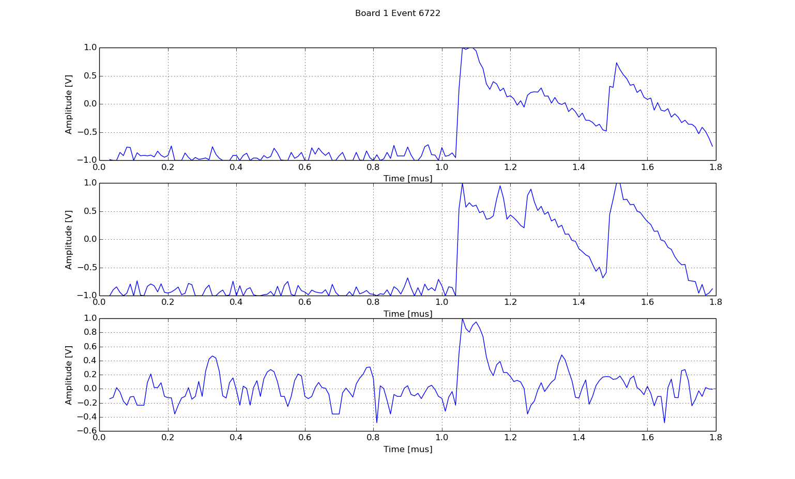
Enveloppe detection
A vulnerable system
(ex: measurement @ Mingantu)

Slide 12
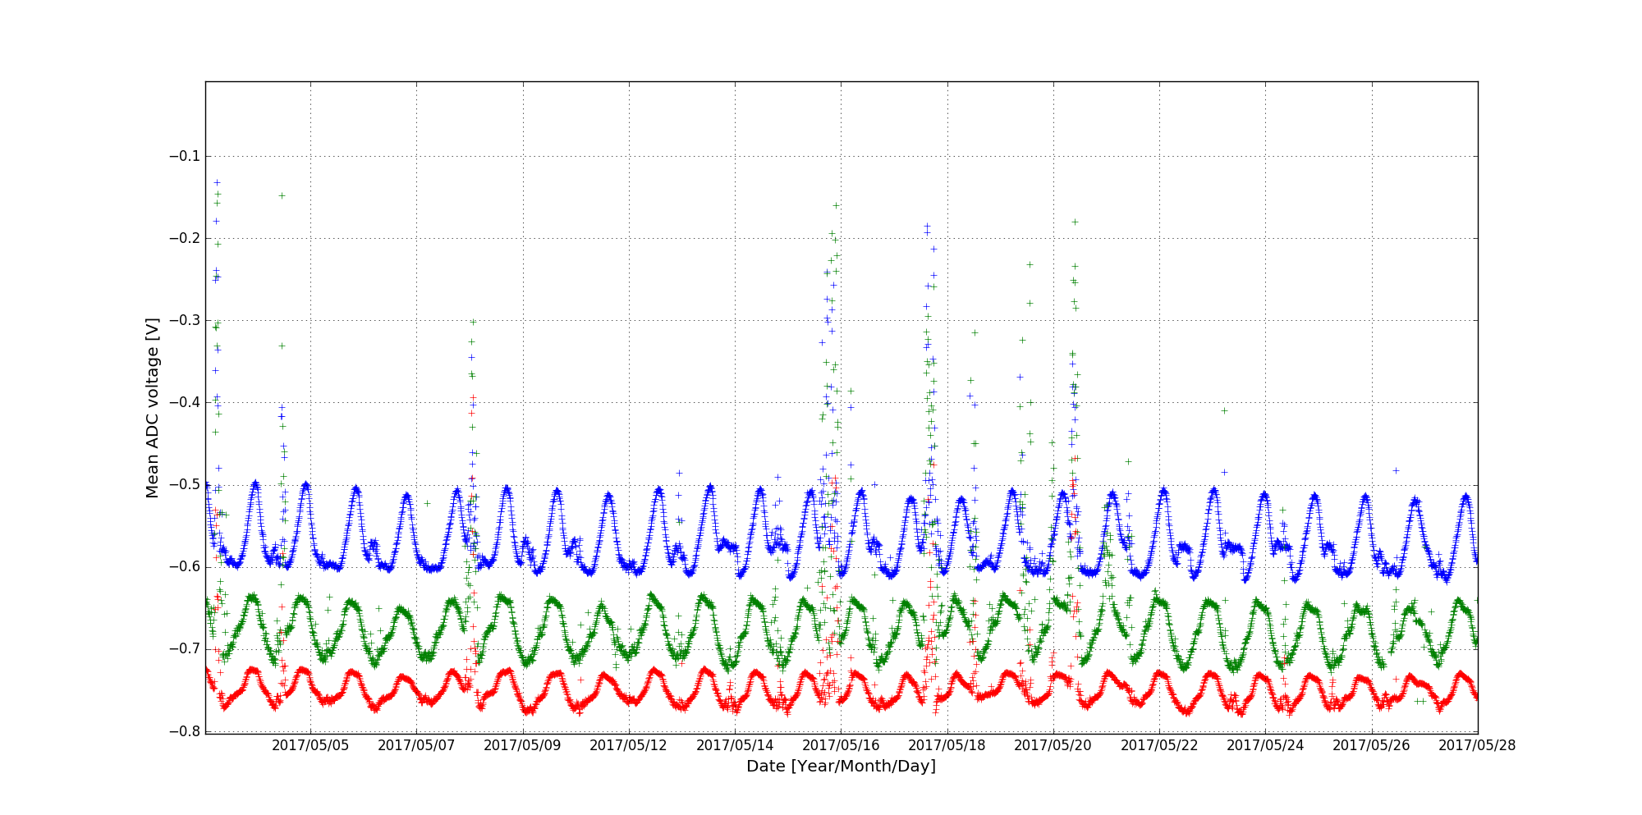
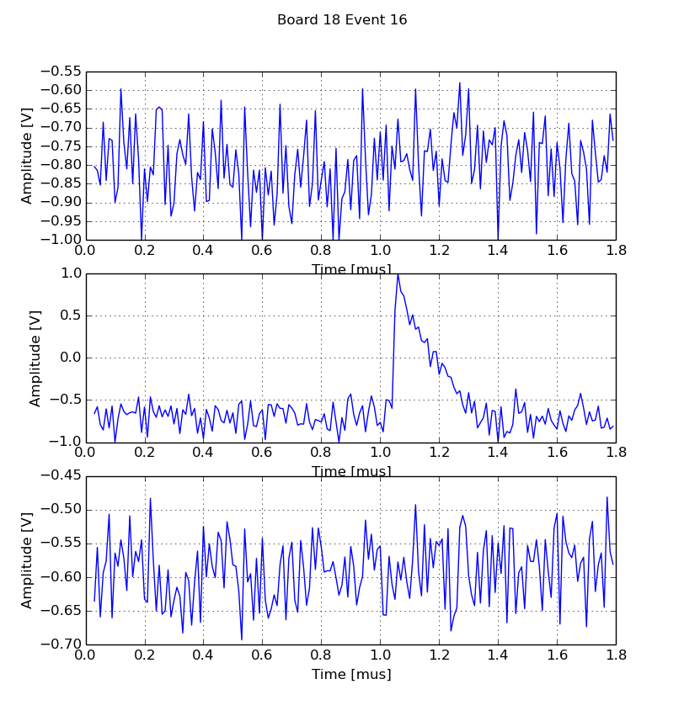
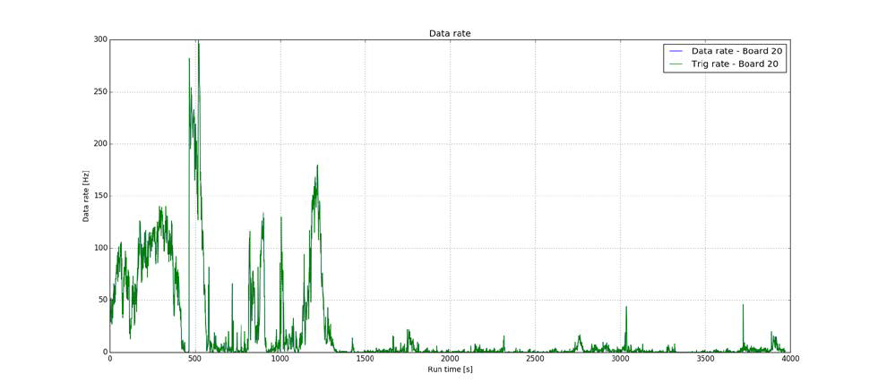
GRANDproto detector reliability
Preliminary tests in 2016 (proto boards)
➔ Clean pulses measured
➔ observation of the galactic fluctuation for 26 consecutive days
➔100% detection efficiency ( ~1h test run, tested in Dec 2016).
26 days

Slide 13
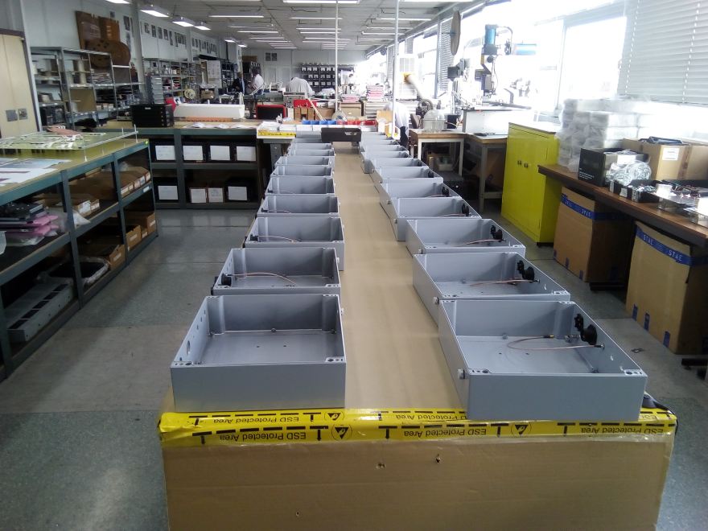
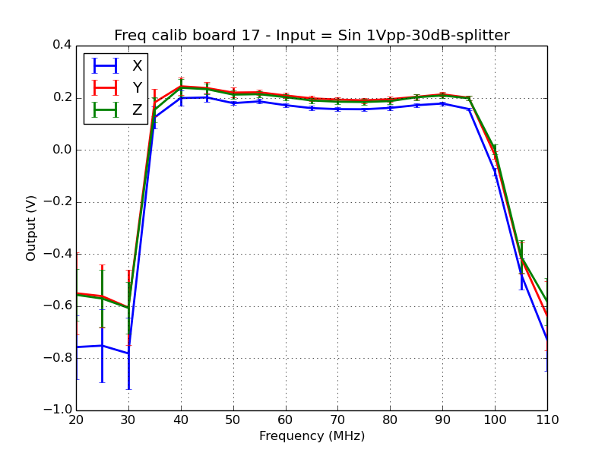
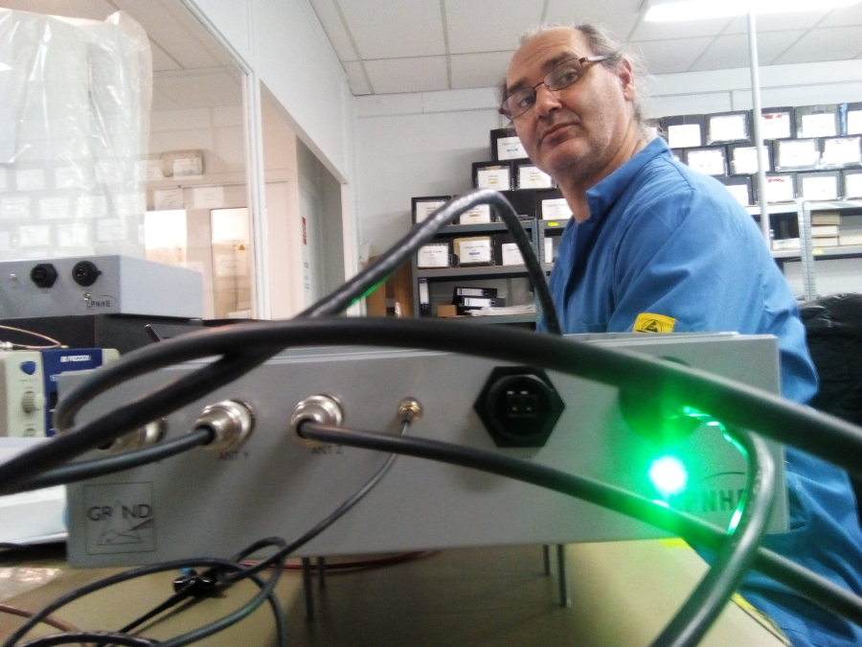
GRANDproto35 electronics production
Completed December 2017
34 boards fully tested & calibrated (1 dead).
31 units shipped to Ulastai early 2018 (+3@LPNHE).
Nov 2017, STAE company @ Antony
Dec 6, 2017

Slide 14
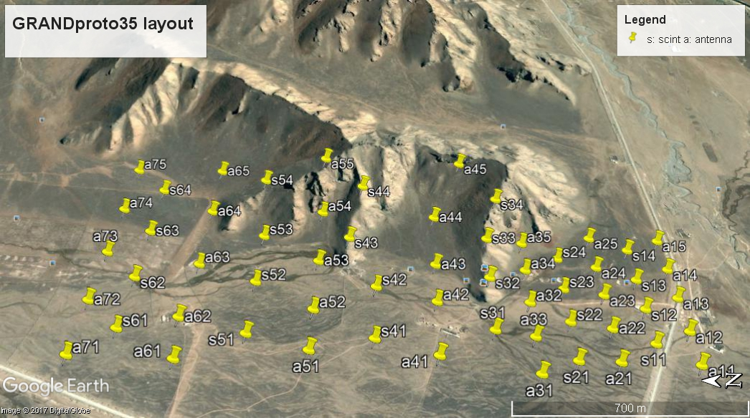
Deployment status
deployed
connected
All fibers + power cables installed. Full deployment can be done within days.

Slide 15
Commissioning
DISCLAMER: VERY early tests
  Spent few hours only so far
  Remote connection, communication to site going through Gu Junhua@Beijing
  DAQ not adapted to multiple detectors yet
  Firmware loaded on FPGA not up to date
    Freezes if burst of event. Requires run restart
    ➔ fixed in next firmware version
    Up/down link collision sometimes leads to antenna becoming deaf. Requires board reboot (ie power OFF/ON)
    ➔ Could not be reproduced @ lab in next firmware version

Slide 16
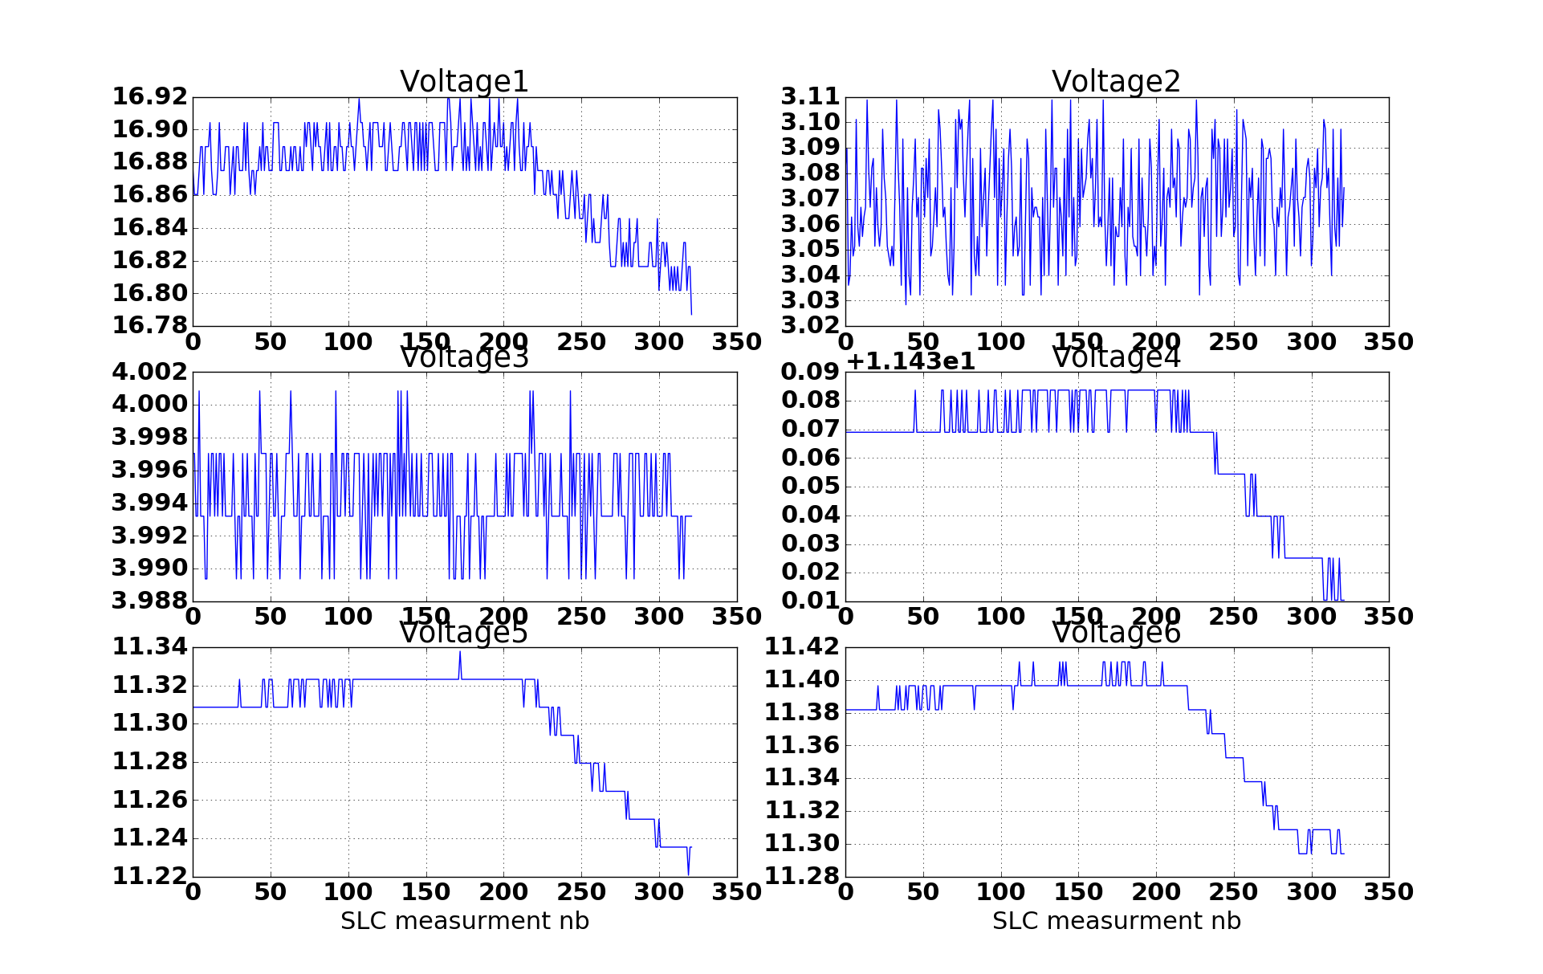
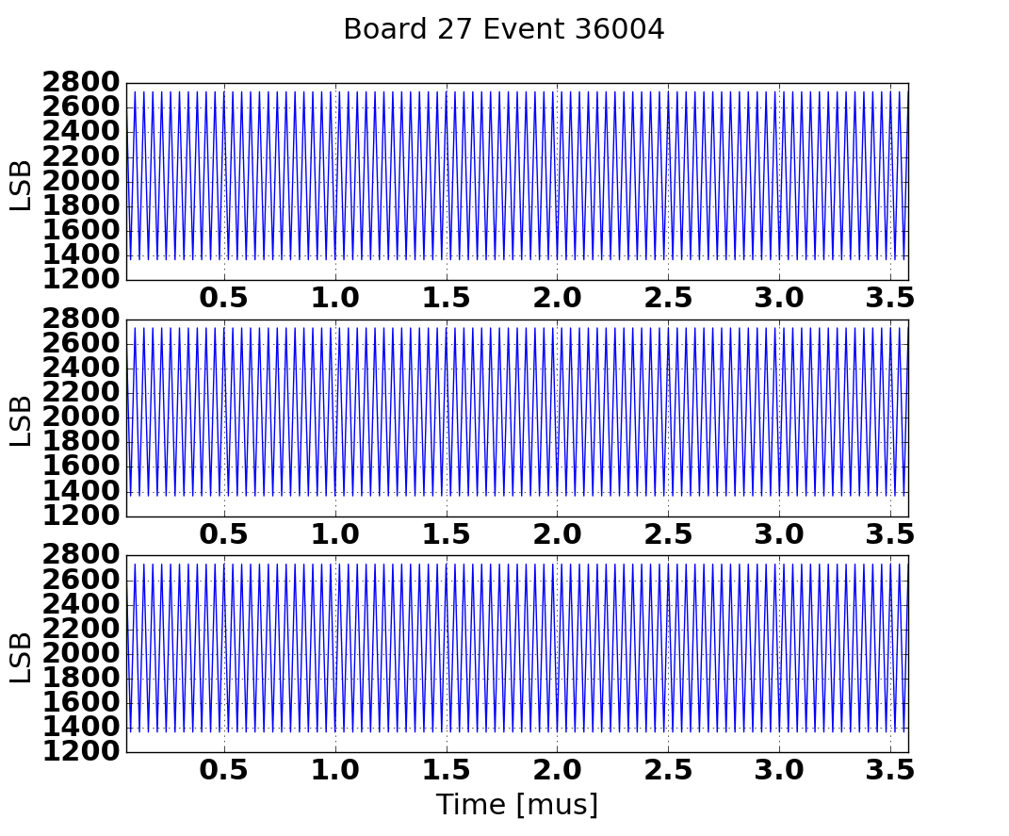
Commissioning
All boards have correct voltages & ADC behavior. GPS data coming in.
101010101010
010101010101
Main voltage
-3V
+4V
LNA1: 11.4V
LNA2: 11.2V
LNA3: 11.4V
1 SLC measurement every 10s

Slide 17
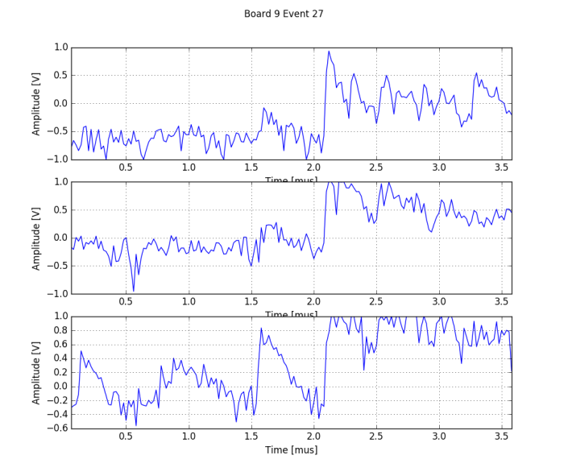
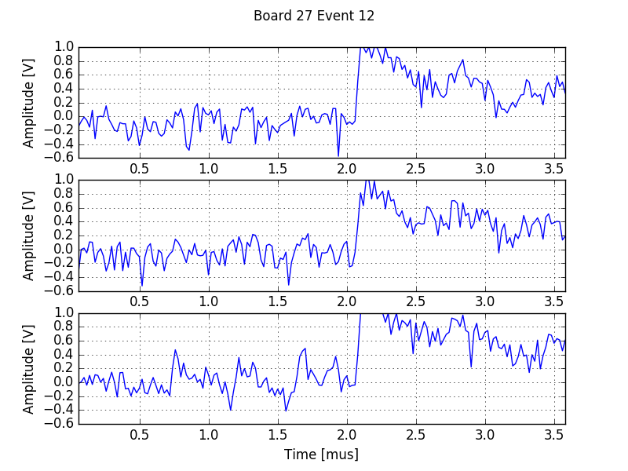
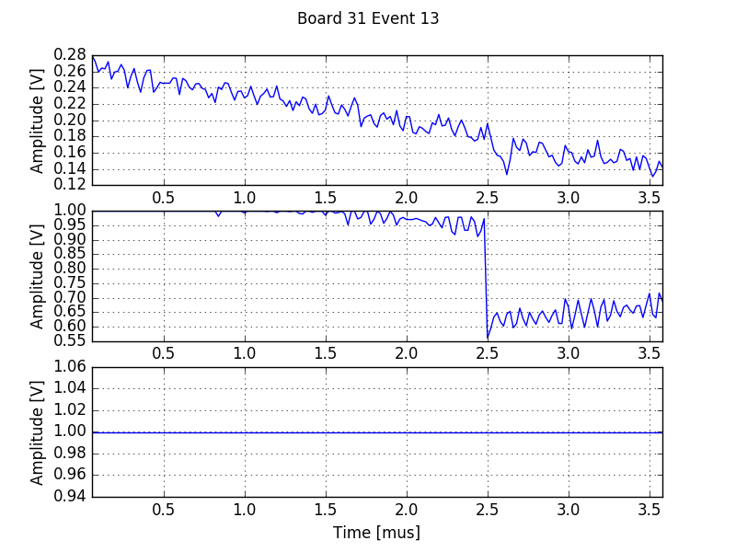
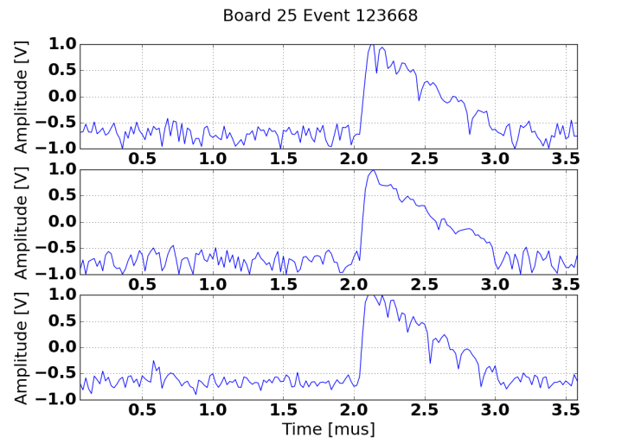
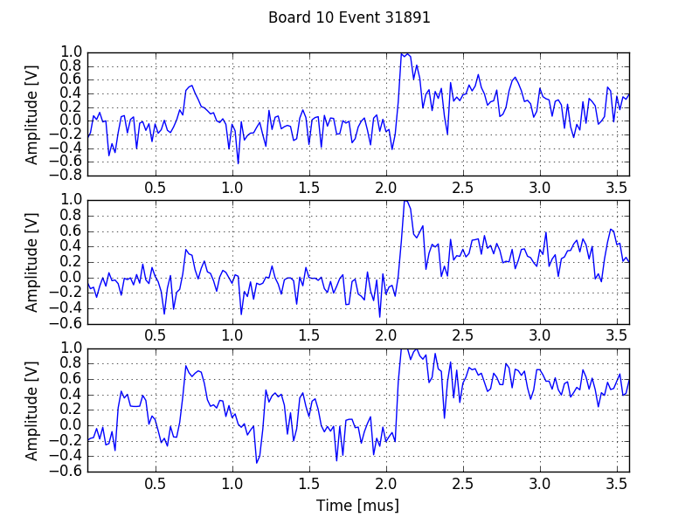
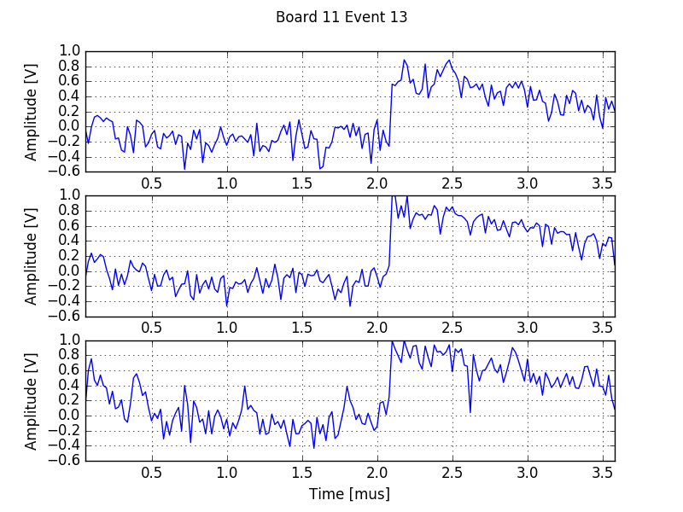
Normal pulses (bumpy?) observed on 5 antennas out of 6.

Slide 18
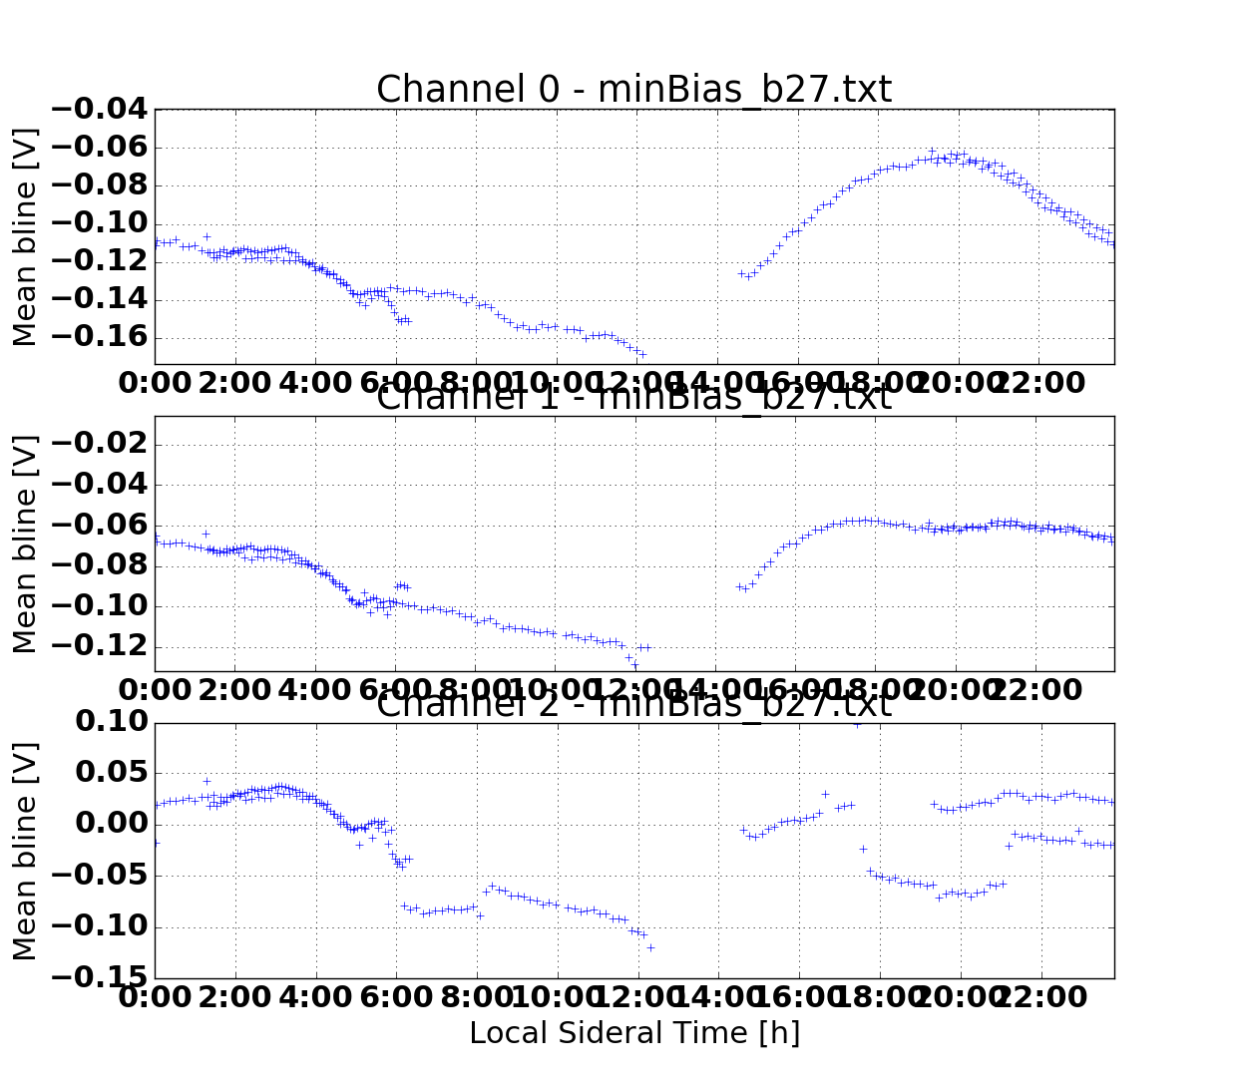
Issues
Response to commands seems heratic
Connection lost more often than before
Galactic signal not clear on several tested channels

Slide 19
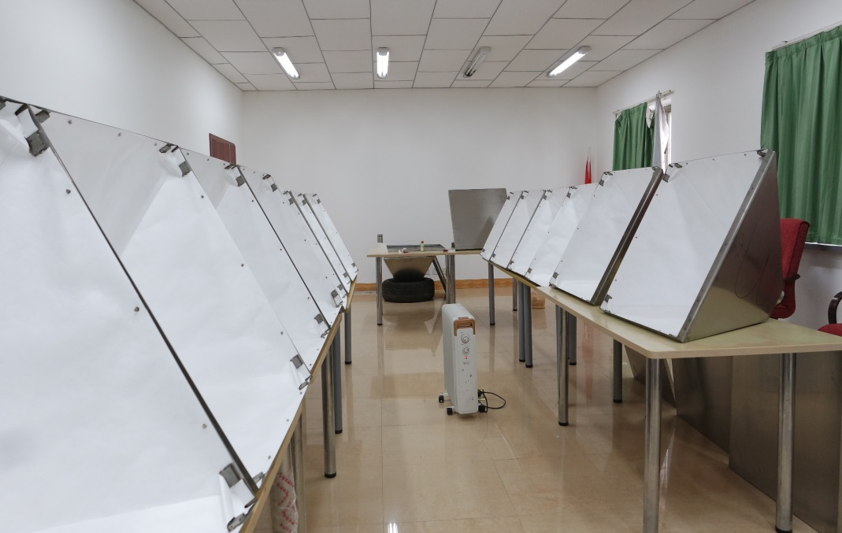
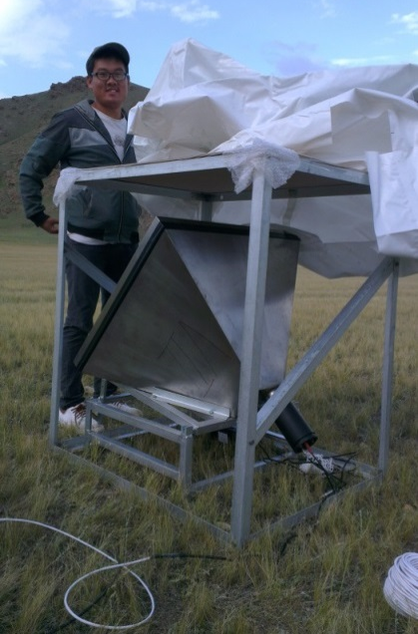
Scintillator array
21+3 air light-guide scintillator (tilted orientation)
6 already deployed for tests in 2015… Status = idle.

Slide 20
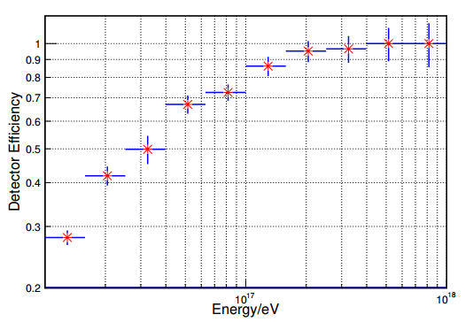
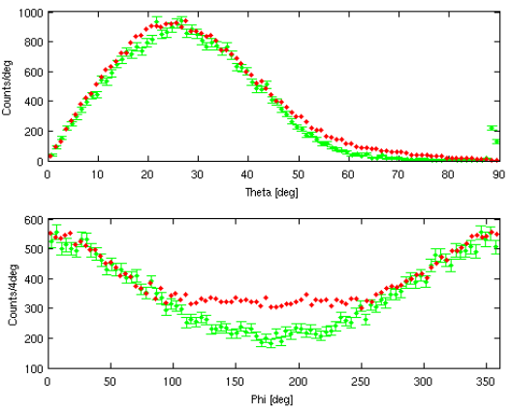
Scintillator array
Zenith (top) and azimuth (bottom) distributions of events reconstructed with the 6-scintillators prototype array (2015) .
3-fold coincidences are shown in
red, larger multiplicities in green
Expected efficiency of the scintillator array for cosmic ray showers with an incoming direction within ±20°from North, zenith angle 70> θ> 40◦.
95% efficiency for E>2 10¹⁷ eV
All recons has to be done!!
Notes:
201

Slide 21
ToDo
Upgrade DAQ and push on tests (Beijing, August 26-28).
Upgrade firmware (September?)
Complete GRANDproto35 manual (late September)
Train Chinese researchers (XiangLi, JianLi,… ) under Gu Junhua supervision for data taking&analysis.
Deploy more antennas (all?)
Develop reconstruction software
➔ First reconstructed radio-events by October
Ground array???

