Slide 1
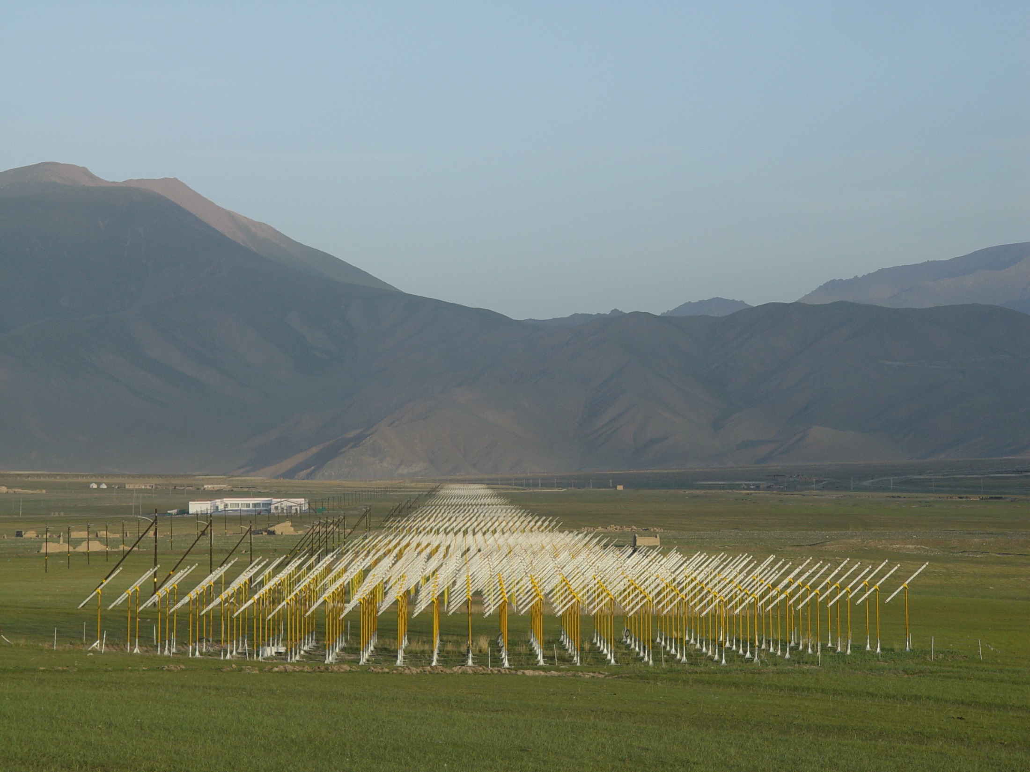
GRAND:
Site and Funding in China
(update since last meeting)
Xiang-Ping Wu

Slide 2
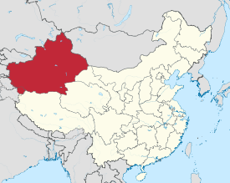
Xinjiang Uighur Autonomous Region شىنجاڭ ئۇيغۇر ئاپتونوم رايونى
 | 新疆维吾尔自治区 (Xīnjiāng Wéiwú'ěr Zìzhìqū)
Ideal Site

Slide 3
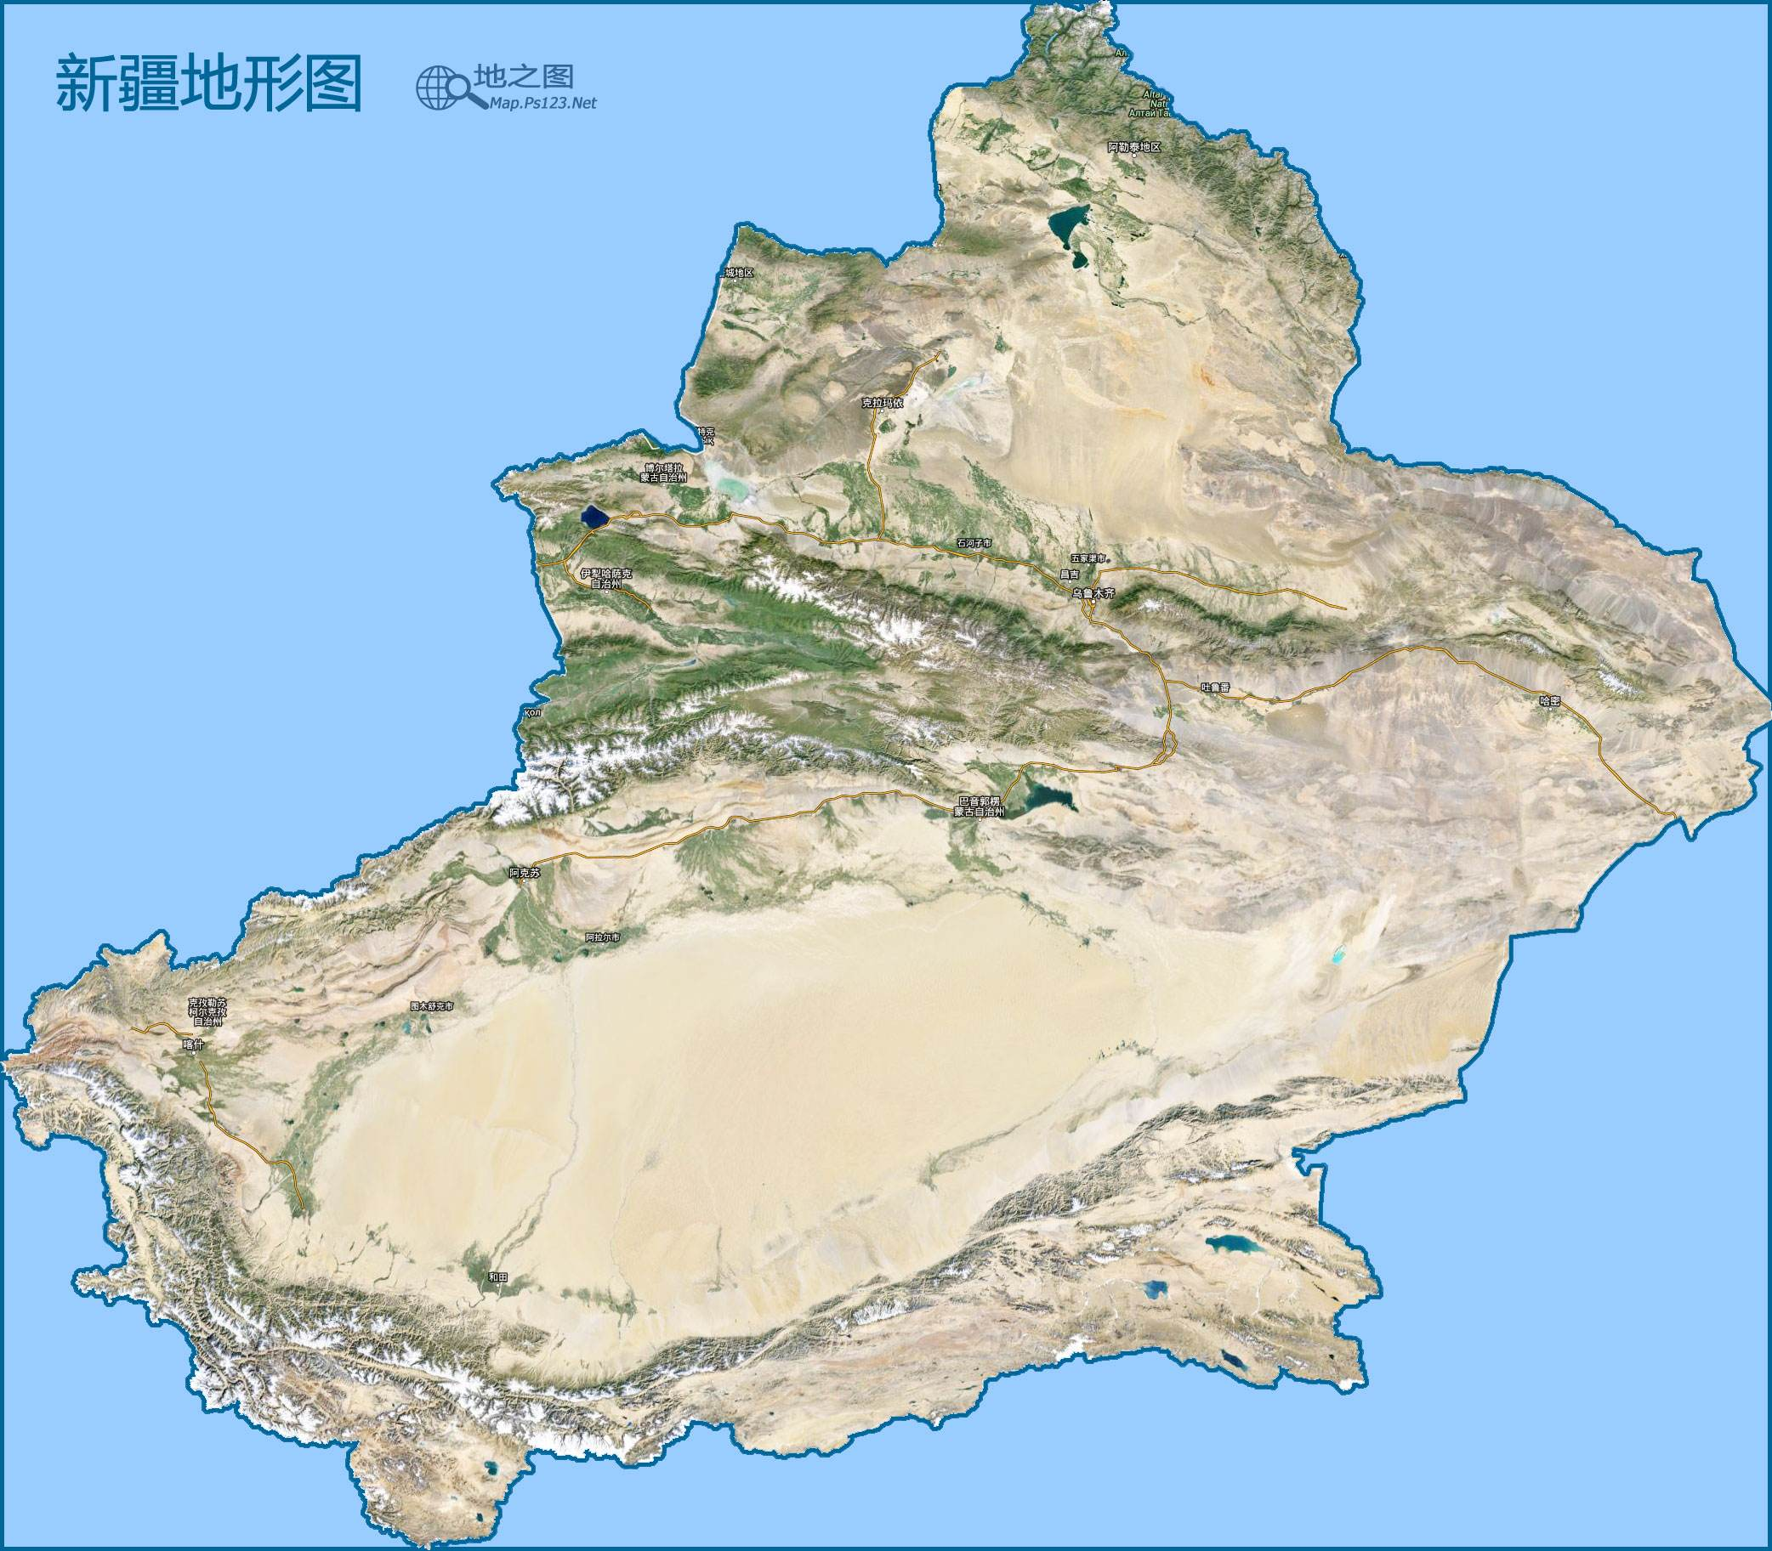

Slide 4
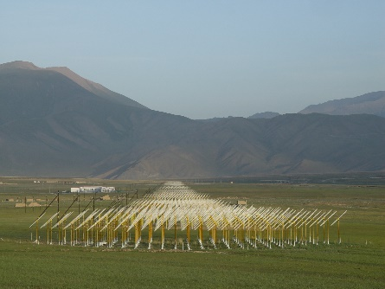

Slide 5
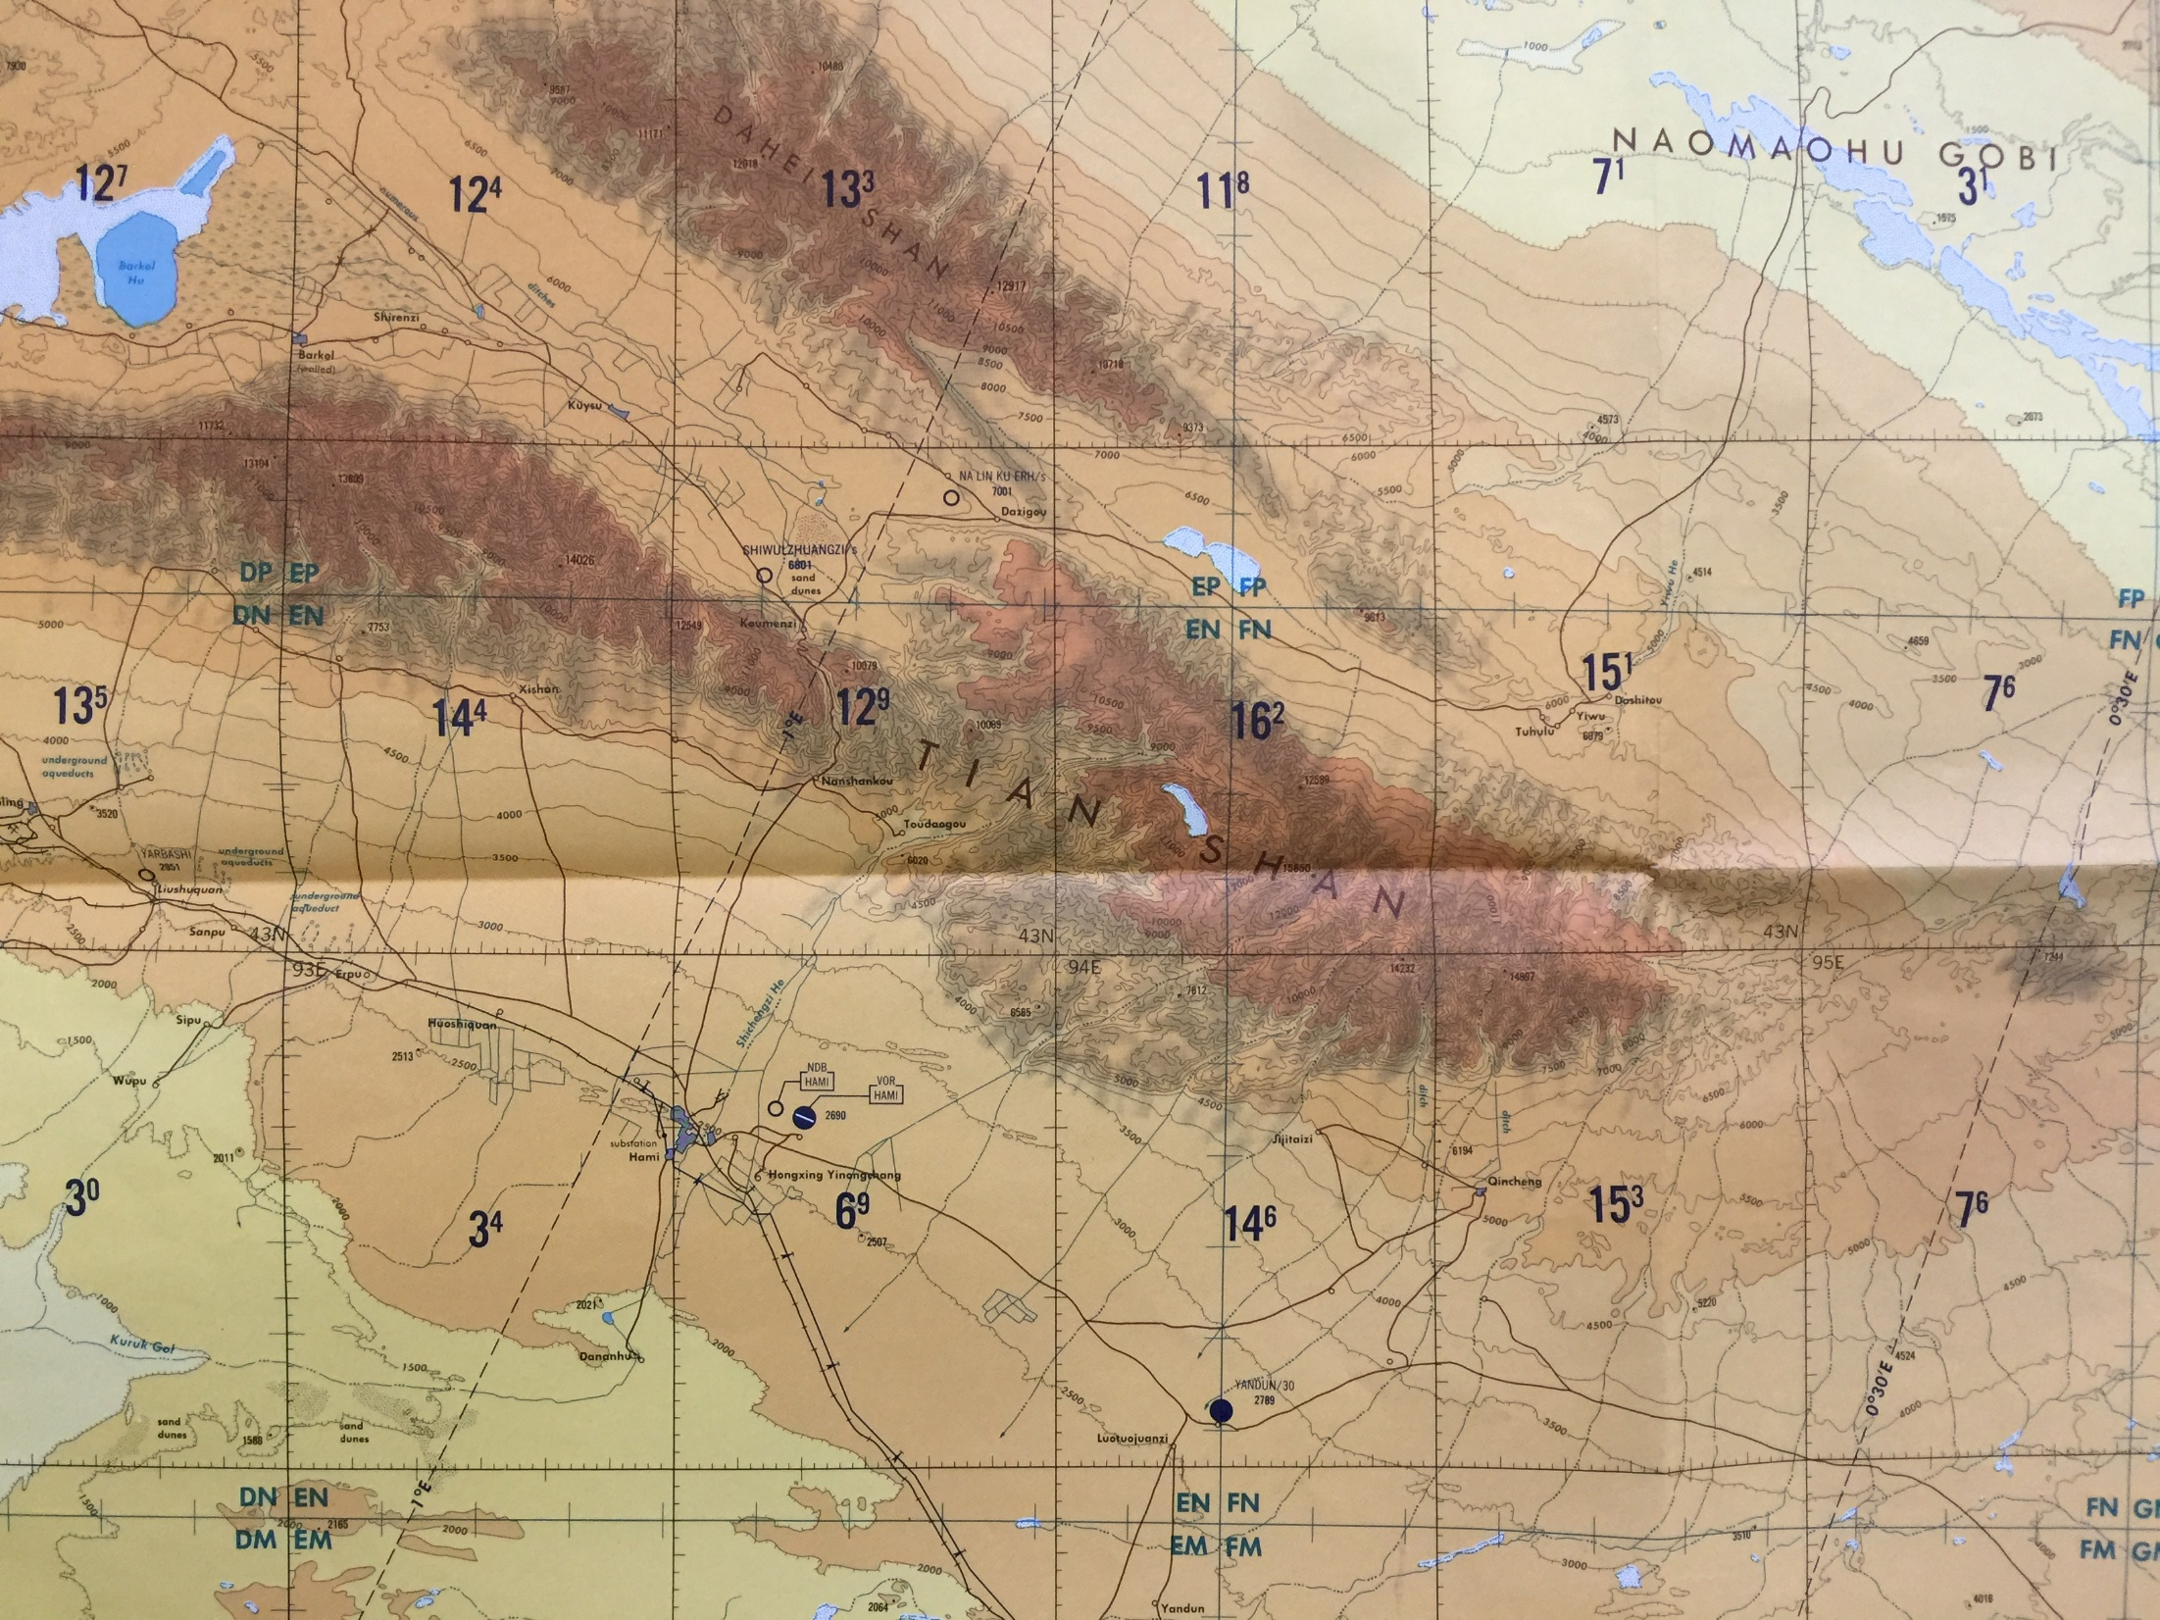
Balikun
Yiwu
Hami

Slide 6
June 5 2018
Balikun
Yiwu
Hami

Slide 7
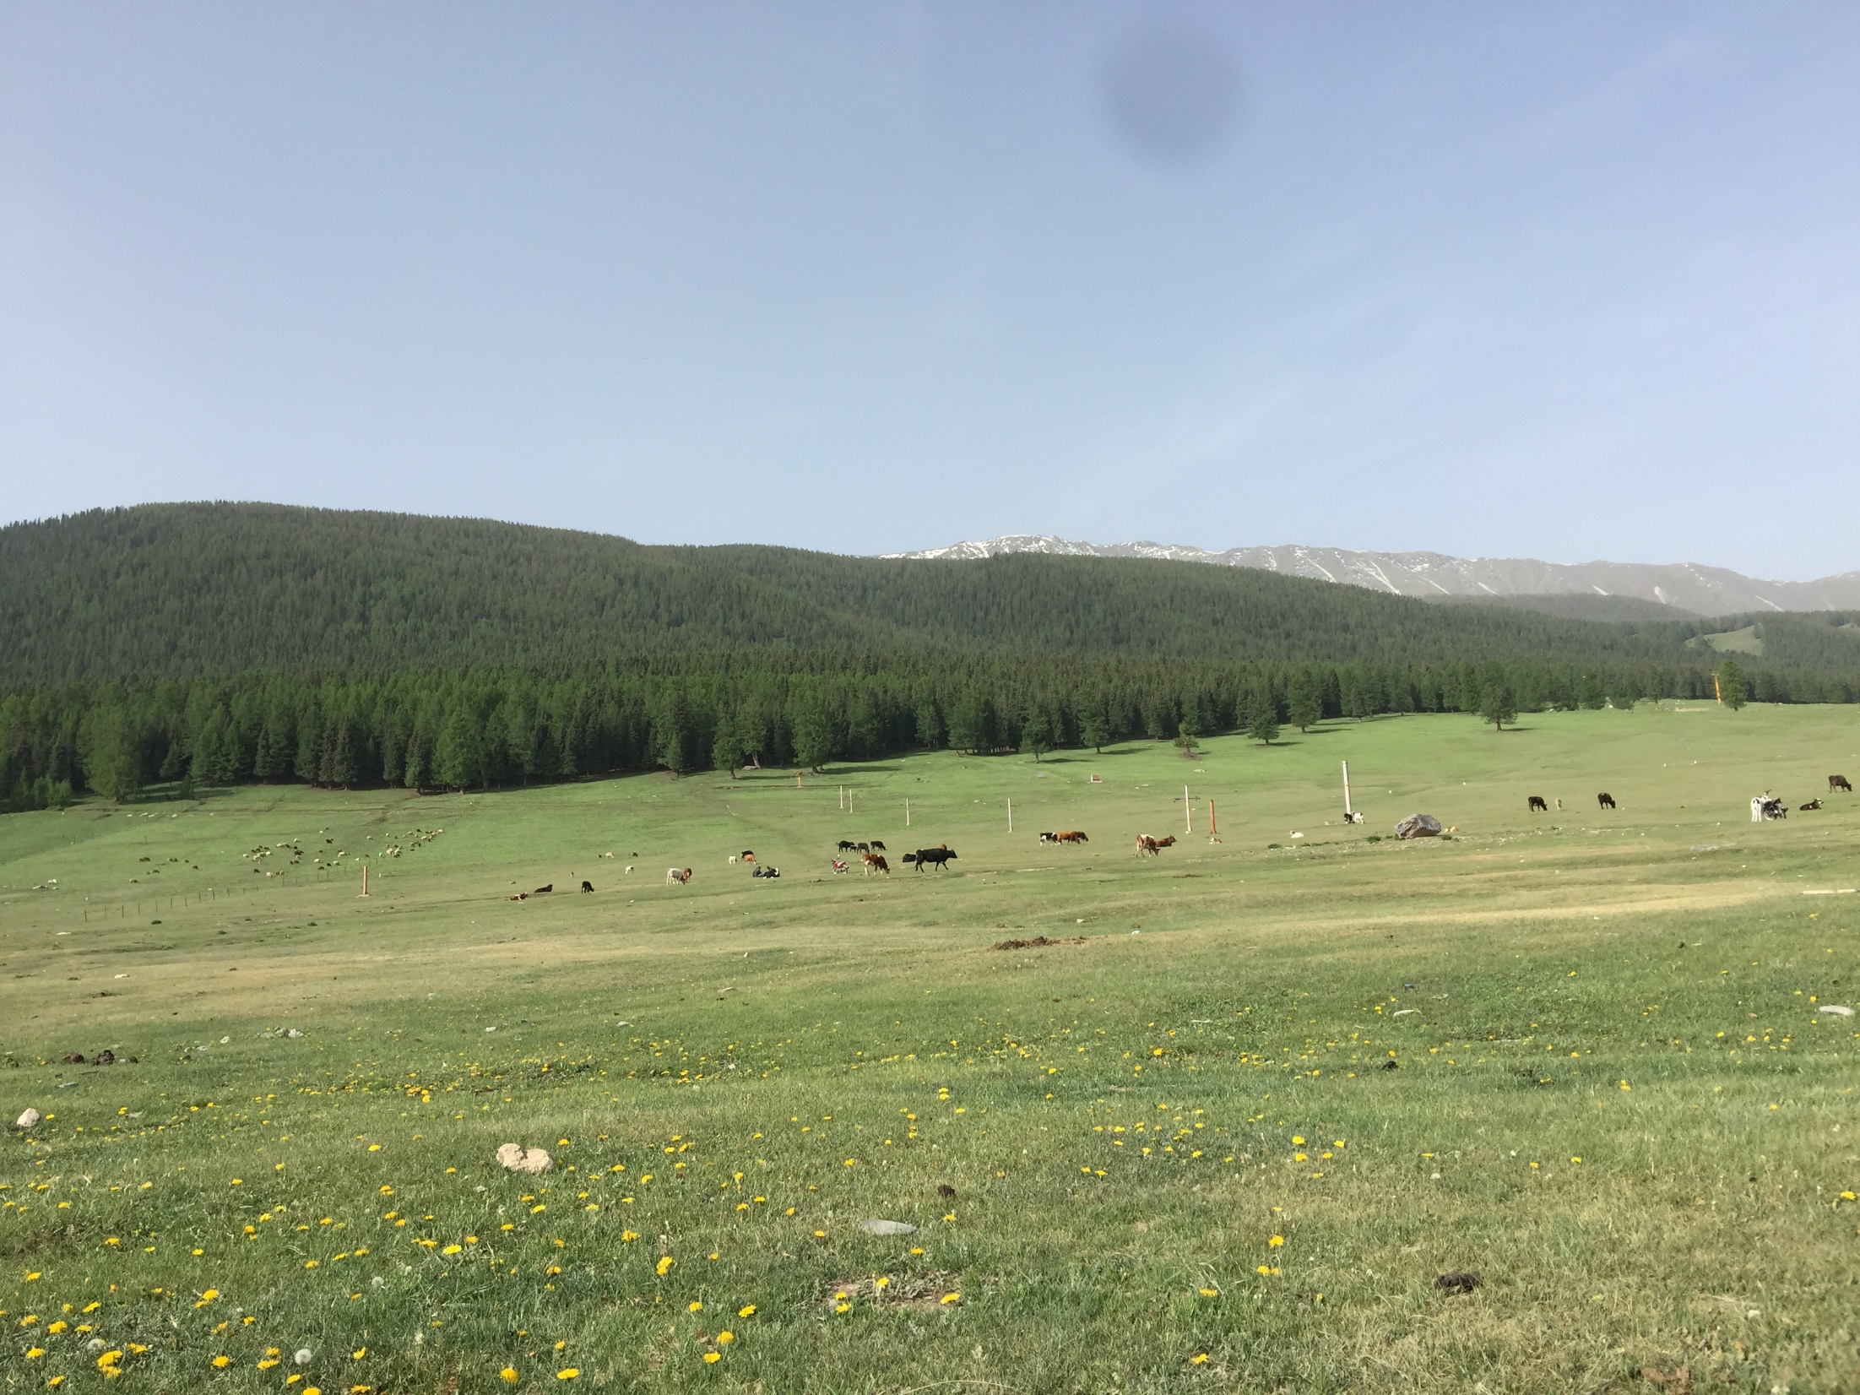
Balikun
June 5 2018

Slide 8
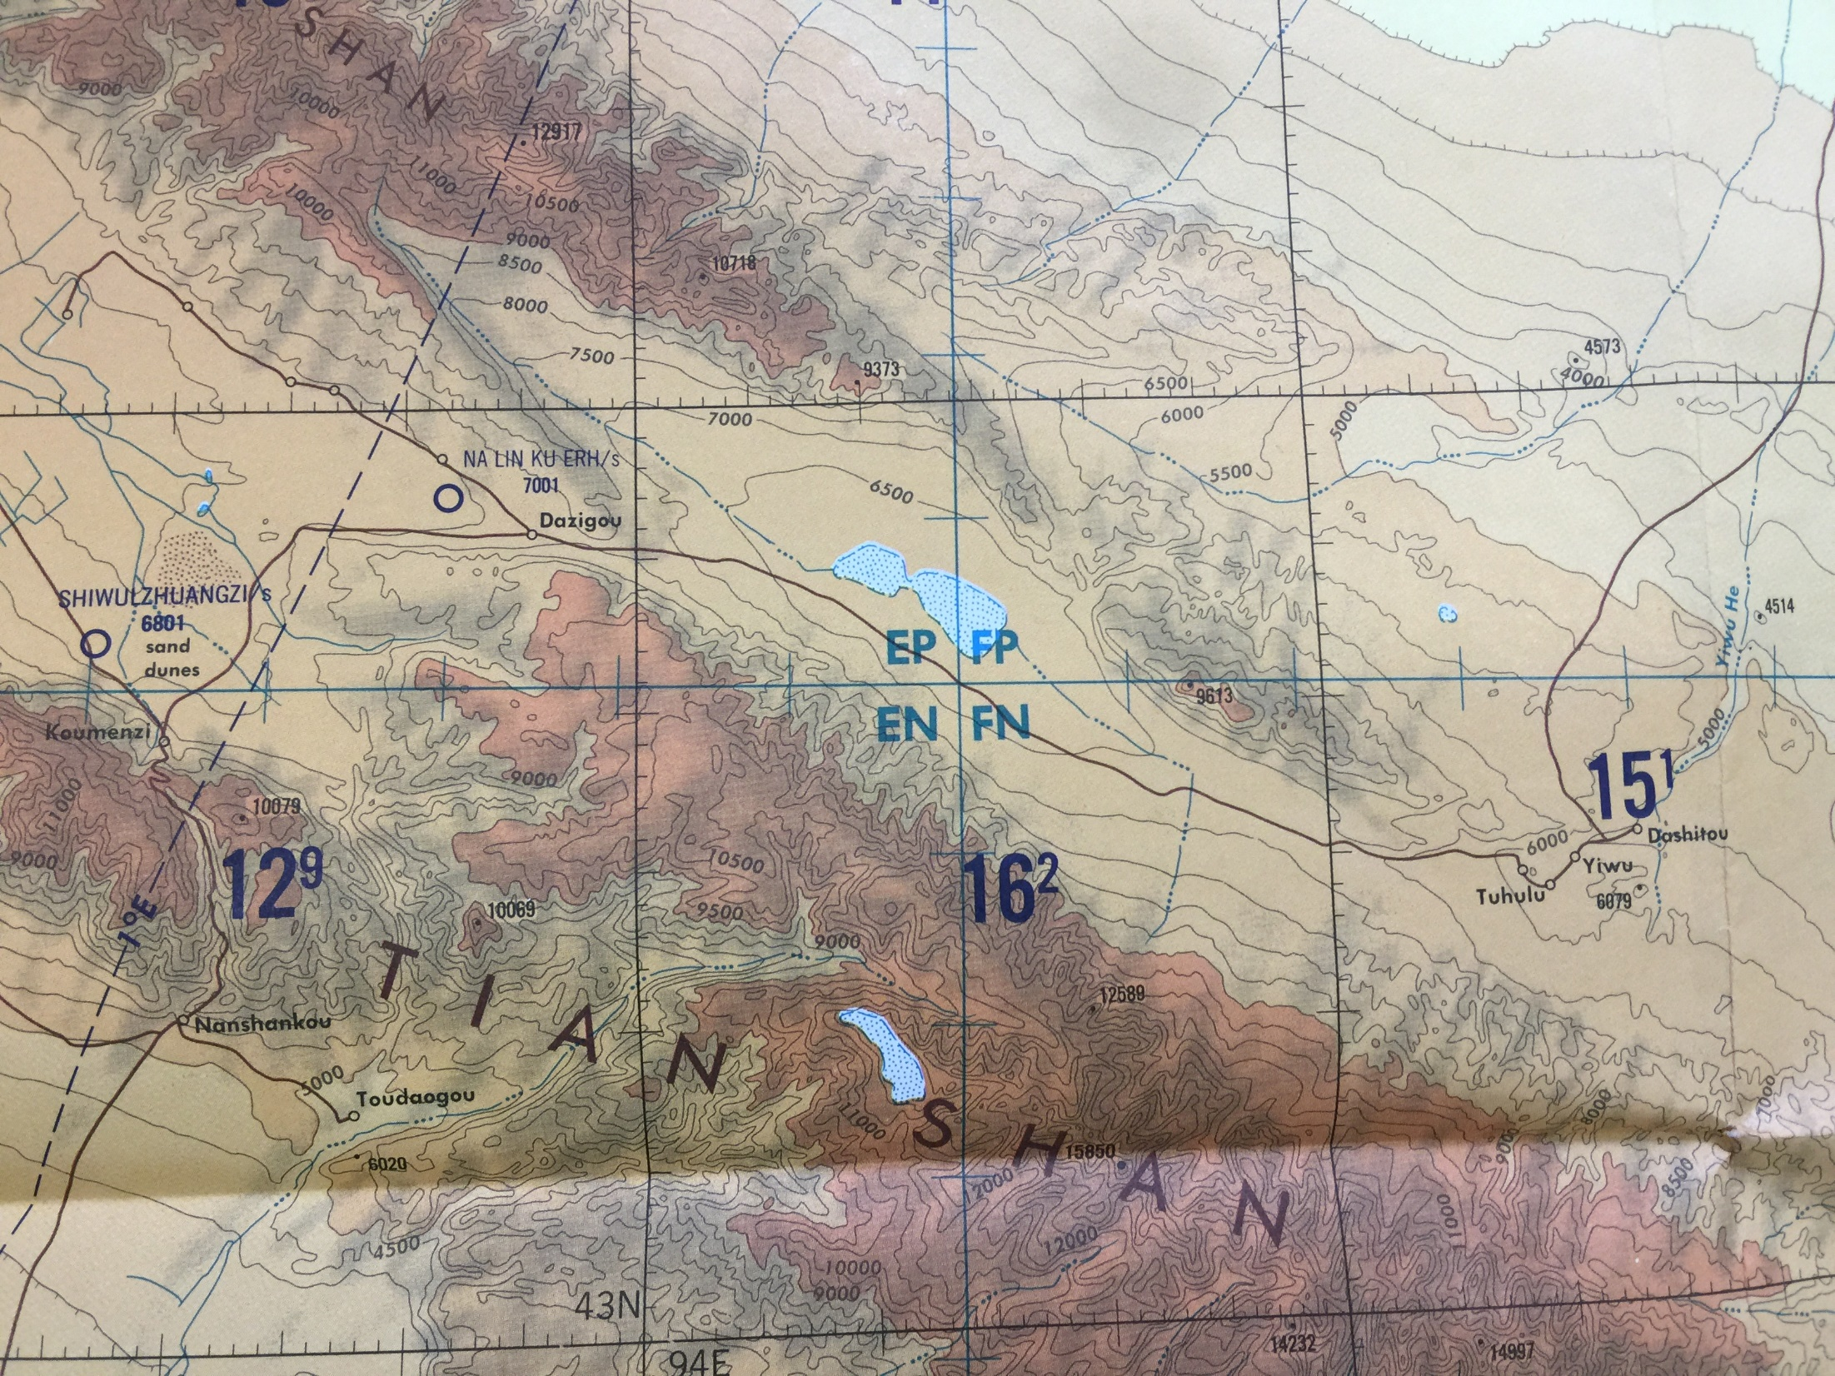

Slide 10
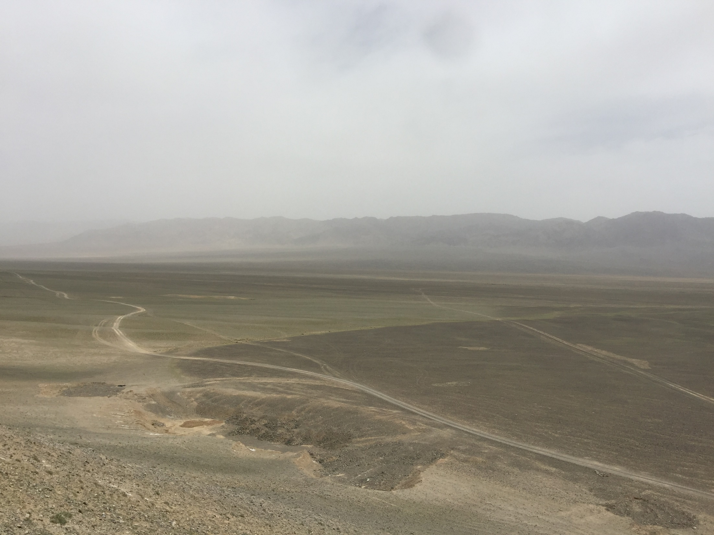
Yiwu Valley
June 5 2018

Slide 11
Hami
June 20 2018
Local Government Requests:
(1)State-approved document of “GRAND”
(2)An official radio environment assessment report.

Slide 12
NAOC to Xinjian
Xinjiang Central Government to Yiwu

Slide 13
Ready to deploy testing antennas on site

Slide 14
Funding Situation for GRAND_proto in China

Slide 15
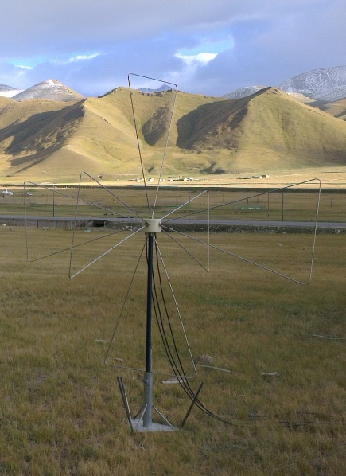
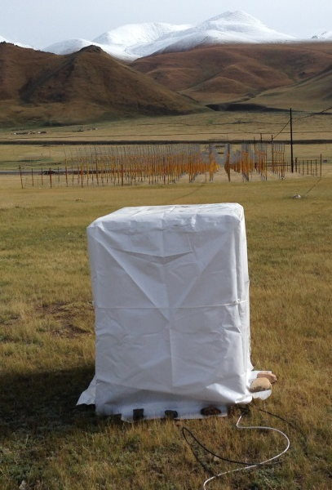
Budget for GRAND_proto35
2.6M RMB or 330k Euros
(antennas, receivers, DAQ, fibre, cables, etc.)
Solution 1: work with remote control
Solution 2: move to a new site

Slide 16
Funding Situation for GRAND_proto
1.CAS Key Project: Gravitational Wave Astronomy (2016-2021)
Total Budget: 25M Euros （200M RMB）
GRAND： about 64K Euros (500K RMB) for next 3 years
(GRAND budget is cut due to slow progress)
2.State Key Project: Preparation for SKA (MOST) (2018-2023)
Total Budget: 6.5M Euros （43M RMB）
GRAND： about 0.13M Euros (1M RMB) for next 4 years
(27 team numbers including Olivier + Charles)
3.CAS Frontier Science Project (2017-2022)
Total Budget: 0.64M Euros （5M RMB）
GRAND： about 19k Euros (150K RMB) for site rent
Total Funds: 0.5M+1M+0.15M = 1.65M RMB (200K Euros)

Slide 17
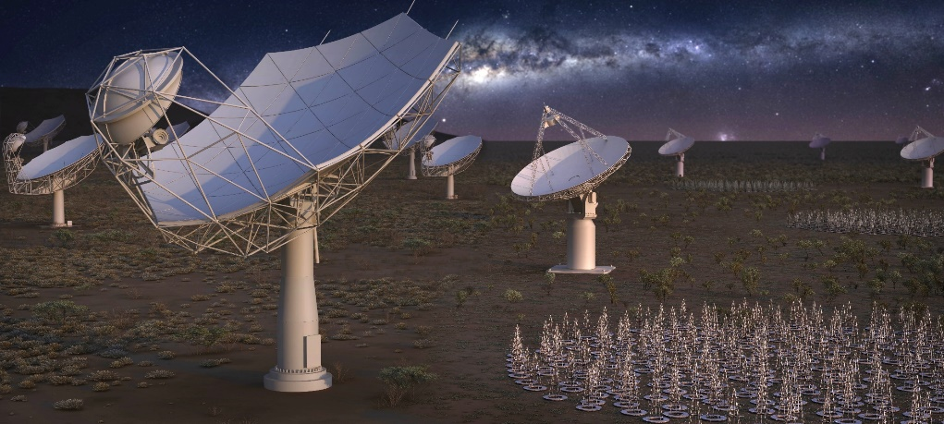

Request:
228M Euros (2B RMB) for 10 years (starting data: 2019-2020)
GRAND: 1.3M Euros / yr (hopefully)

Slide 18

CAS Strategic Planning 2020-2035
(Astronomical Facilities)
Sky Monitoring System (optical)
2. Sub-Millimeter Telescope (a single dish of 30-50m)
3. 8m Solar Telescope
+
Neutrino Telescope: GRAND
(included but not in the priority)

Slide 19
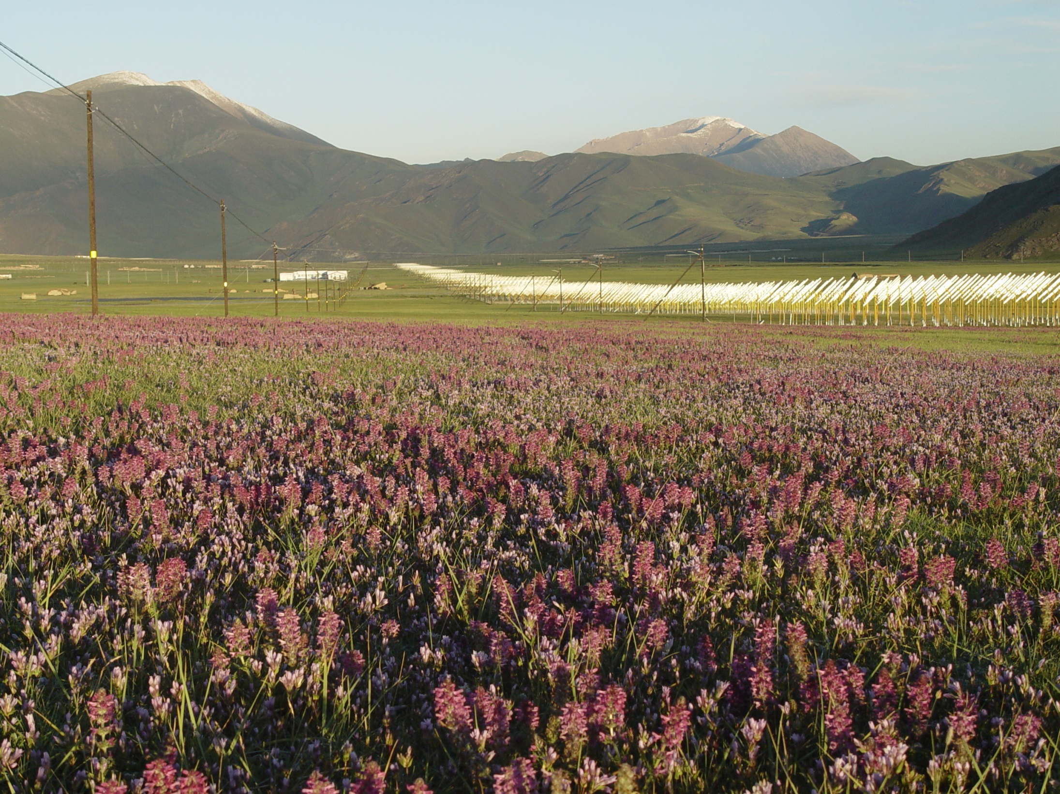
Then, the strategies ……

