Slide 1
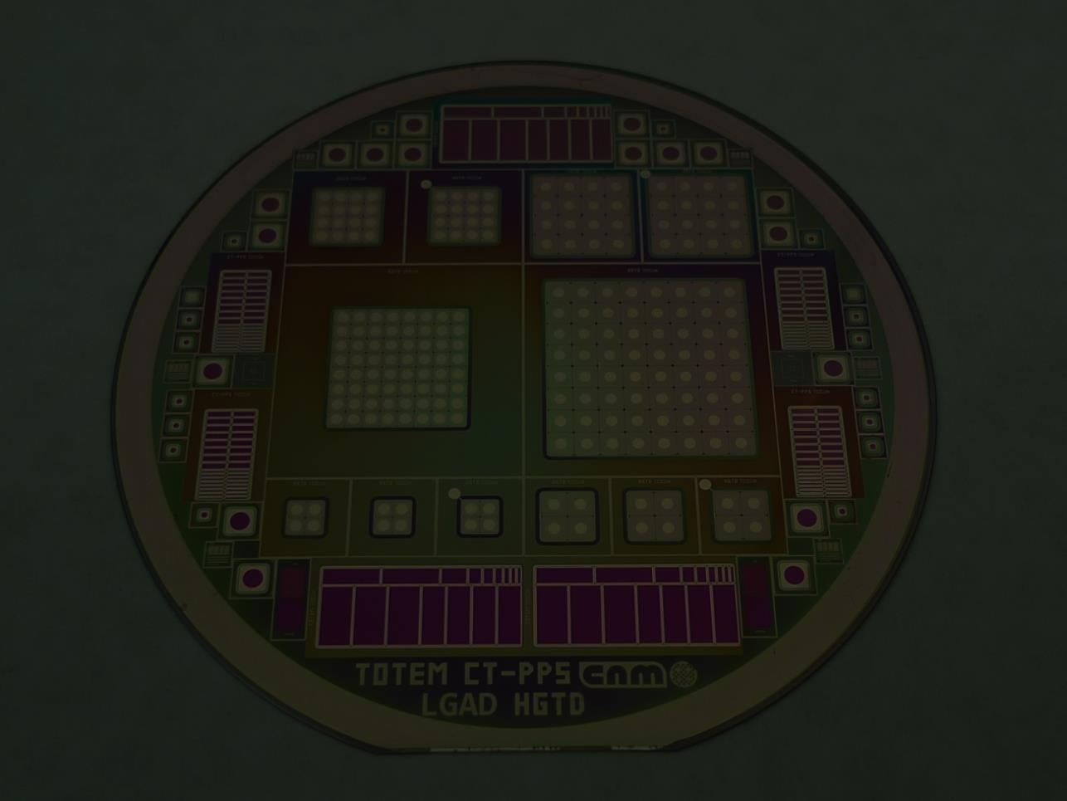
Fabrication of LGAD Detectors and RadHard
JFETs with the aid of TCAD Simulations
D. Flores, C. Couso, M. Carulla, S. Hidalgo, D. Quirion,
G. Pellegrini
IMB-CNM (CSIC), Spain

Slide 2
Outline
IMB-CNM Presentation
Introduction to Basic Simulation Procedures
LGAD Basic Detectors
Fitting Simulations and Process Technology
Radiation Hard Multi-Ring JFET
HGTD and CT-PPS Simulation and optimization
Conclusions

Slide 3
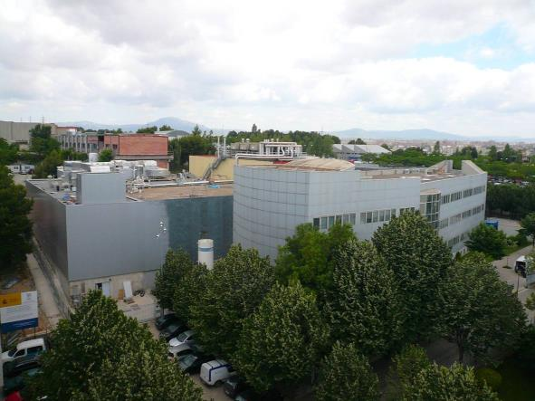
IMB-CNM Presentation
Public Research Organism that belongs to the Spanish Council for Scientific Research (CSIC)
Located in Bellaterra, close to Barcelona (Spain)
Devoted to Nano and Microelectronics
Micro Nano Fabrication Facility (Clean Room)
Departments:
  Micro and Nano Systems
  Systems Integration (Power Systems)
STAFF (2017)
Researchers | 67
Ph.D. Students | 25
Clean room | 39
Support services | 28
Management & admin | 16
TOTAL: | 175
2017 Budget: 10,5 M€
External funding: 43.4 %
Project funding splitting:
EU: 67 %
National: 15 %
Industrial contracts: 18 %

Slide 4
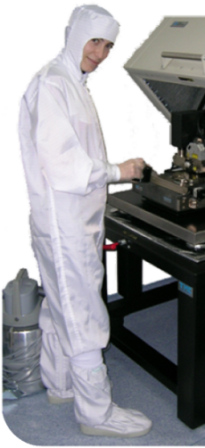
IMB-CNM Facilities
Clean Room
  1.500 m², class 100 to 10.000
  Micro and nano fabrication technologies
  Three areas:
    Pure (CMOS)
    Noble metals allowed
    Nanoelectronics
Processes
  4'' complete
  6'‘ (no poly)
Available technologies:
  CMOS, Power Devices (Si, SiC, GaN, Diamond)
  MCM-D, MEMS/NEMS
  Bump bonding packaging
Silicon micromachining
Packaging
  200 m², class 1000
Laboratories
  Characterization and test
    DC and RF (up to 8 GHz)
    Power devices
    Wafer testing
    IR Thermography
    Radiation testing
  Reverse Engineering
  Simulation
  CAD
  Mechanical Workshop
  Chemical sensors
  Bio-sensors
  Radiation sensors
  Optical sensors

Slide 5
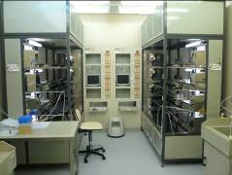
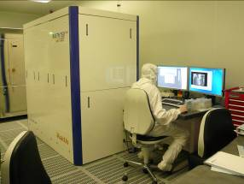
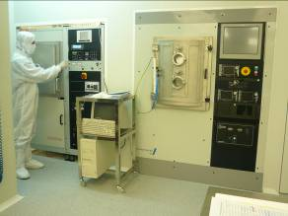
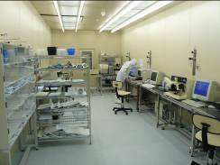
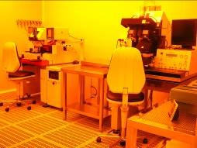
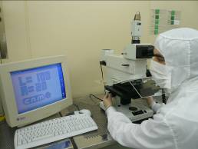
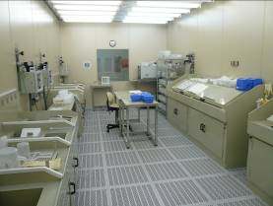
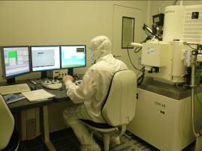
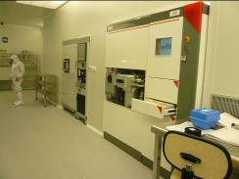
IMB-CNM Clean Room Images

Slide 6

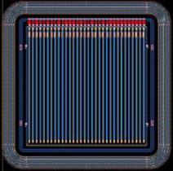
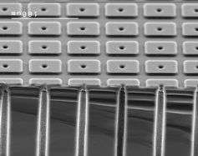
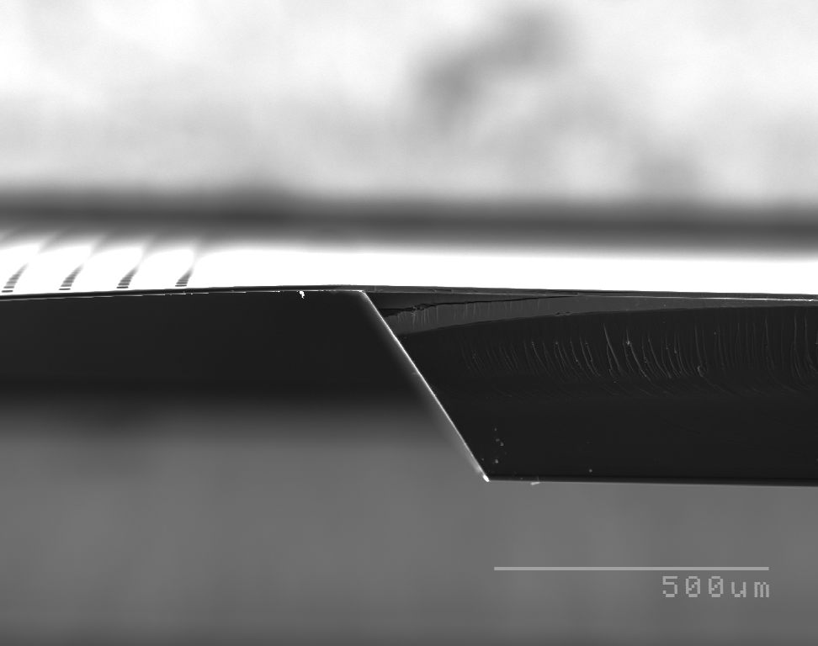
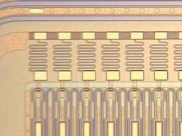
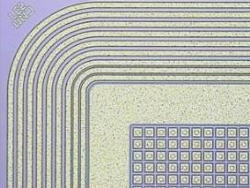
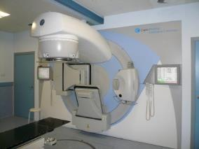
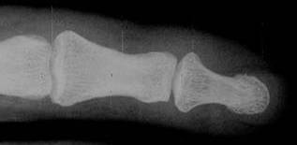
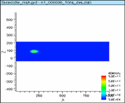
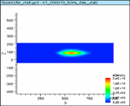
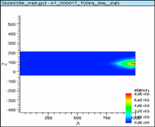
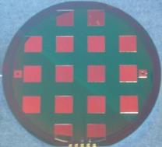
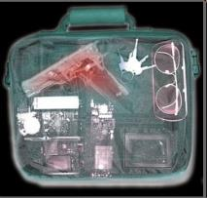
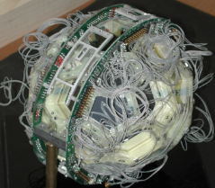
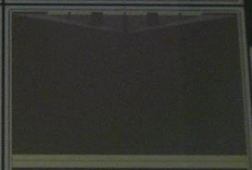
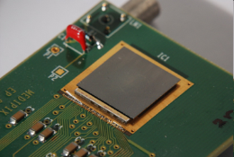
Design, simulation, fabrication and test of radiation detectors
for:
High Energy Physics
Sincrotron
Dosimetry
Medical Imaging
Security
Nuclear Physics

Slide 7
III. FEM Simulations: SDevice
Introduction to Basic Simulation Procedures:
Sentaurus Device

Slide 8

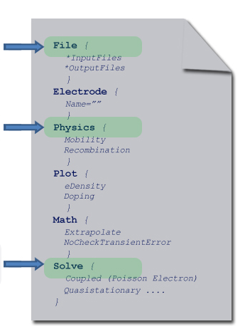
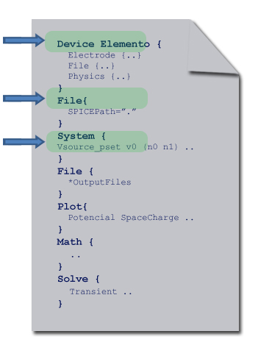
II. FEM Simulations: SDevice
Sentaurus Device:
Sdevice has not a graphical interface. Instructions are introduced from a command file (.cmd)
Tool used for FEM Simulations
Device Mode
Mixed Mode
Files to Solve the Model
Devices in the Circuit
File with Spice elements
Physics Models
Elements in the Circuit and their connections
Types of Analysis: Quasistationary, Transient, ACCoupled

Slide 9
III. FEM Simulations: SDevice
Device Mode Simple Simulation: I-V curve on a Diode
File {
Grid = “Diode_msh.tdr”
Current = “Diode_IV.plt”
Plot = “Diode_IV.tdr”
Output = “Diode_IV.log”
}
Electrode {
{Name=“ElectrodeN” Voltage = 0.0}
{Name=“ElectrodeN” Voltage = 0.0}
}
Diode_IV.cmd
Physics {
AreaFactor = 1
Temperature = 300
Mobility (
DopingDependence
eHighFieldSaturation
hHighFieldSaturation
Enormal
CarrierCarrierScattering
)
Recombination (
SRH (DopingDependence)
Auger (withGeneration)
Avalanche (UniBo Eparallel)
Band2Band (Hurkx)
)
EffectiveIntrinsicDensity (OldSlotboom)
}
Math {
#Cylindrical
Method=Pardiso
Number_of_threads = 4
Stacksize=200000000
Extrapolate
Derivatives
AvalDerivatives
RelErrControl
Iterations=15
Notdamped=60
BreakCriteria {
Current (Contact = "ElectrodeN" maxval = 1e-8)
}
}

Slide 10
III. FEM Simulations: SDevice
Device Mode Simple Simulation: I-V curve on a Diode (Quasistationary)
Plot {
eDensity hDensity
eCurrent/Vector hCurrent/Vector
Current/Vector
Potential
ElectricField/Vector
SpaceCharge
eMobility hMobility
eVelocity hVelocity
DopingConcentration
DonorConcentration AcceptorConcentration
srhRecombination AugerRecombination
AvalancheGeneration
eAvalanche hAvalanche
TotalRecombination
}
Diode_IV.cmd
Solve {
Coupled (Iterations=50) {Poisson}
Coupled (Iterations=15) {Hole Poisson}
Coupled (Iterations=15) {Electron Hole Poisson}
QuasiStationary (
InitialStep = 1e-6
MaxStep = 0.01
MinStep = 1e-9
Goal {Name="ElectrodeN" Voltage=1000}
Plot {Range = (0 1) Intervals=2}
)
{
Coupled {Hole Electron Poisson}
Plot (
FilePrefix="IV_"
Time=(0.01; 0.05; 0.1; 0.5)
NoOverwrite
)
}
}

Slide 11
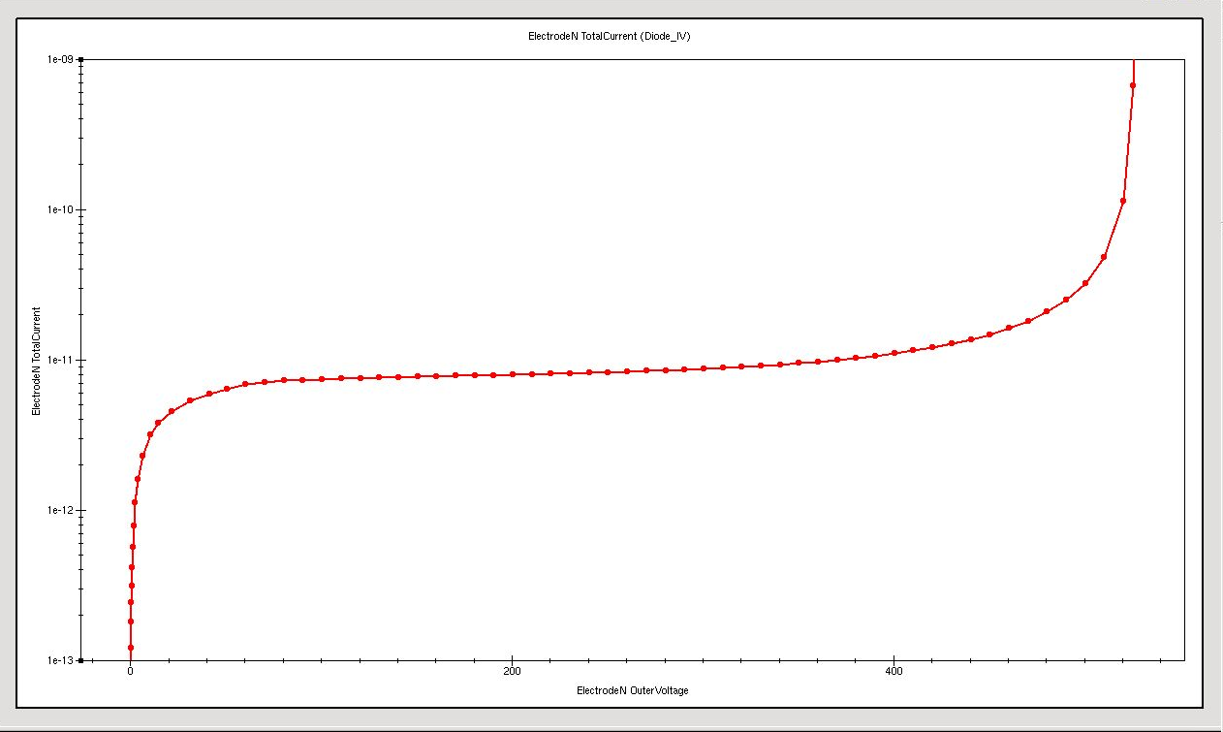
III. FEM Simulations: SDevice
Device Mode Simple Simulation: I-V curve on a Diode
Diode_IV.plt

Slide 12
III. FEM Simulations: SDevice
Mixed Mode Simple Simulation: C-V curve on a Diode (AC Coupled)
device Diode {
Electrode {
.….
}
File {
Grid = "Diode_msh.tdr"
Current = "Diode_CV_1kHz.plt"
Plot = "Diode_CV_1kHz.tdr"
}
Physics {
.....
}
Plot {
.....
}
} #End device Diode
Diode_CV.cmd
System {
Diode diodesystem ("ElectrodeN"=front "ElectrodeP"=0)
Vsource_pset vn (front 0) {dc=0}
}
File {
Output ="Diode_CV_1kHz.log"
ACExtract = "Diode_CV_AC_1kHz.plt"
}

Slide 13
III. FEM Simulations: SDevice
Mixed Mode Simple Simulation: C-V curve on a Diode (AC Coupled)
Solve {
Coupled (Iterations=50) {Poisson}
Coupled (Iterations=15) {Hole Poisson}
Coupled (Iterations=15) {Electron Hole Poisson}
Coupled (Iterations=15) {Electron Hole Poisson Contact}
QuasiStationary (
  InitialStep = 1e-6
    MaxStep = 1e-2
MinStep = 1e-7
Increment = 2
Decrement = 4
Goal {Parameter = vn.dc Voltage=100}
)
{
ACCoupled (
StartFrequency=1e3
EndFrequency=1e3
NumberOfPoints =1 Decade
Iterations=15
Node (front)
ACMethod=Blocked
ACSubMethod("diodesystem")=ParDiSo
){ Poisson Electron Hole Contact Circuit}
}
}
Diode_CV.cmd

Slide 14
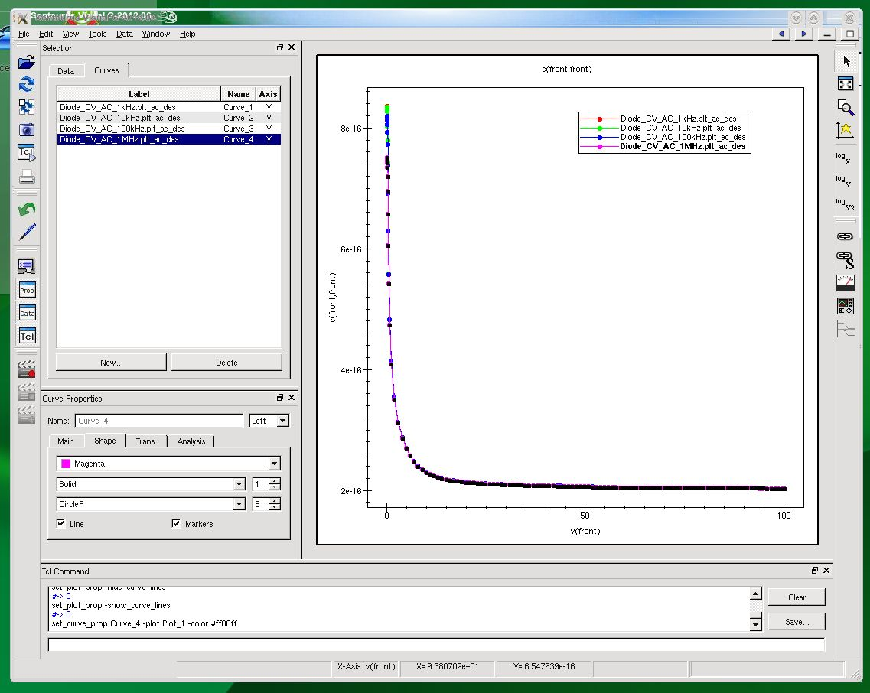
III. FEM Simulations: SDevice
Mixed Mode Simple Simulation: C-V curve on a Diode (AC Coupled)

Slide 15
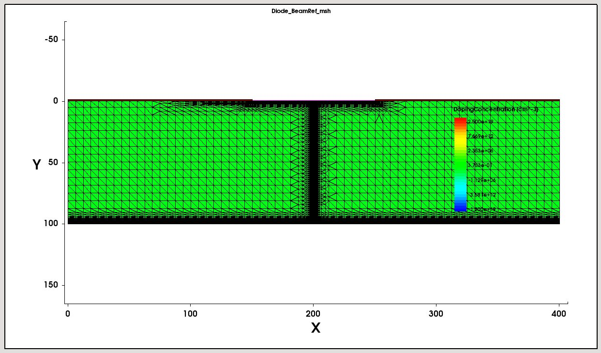
III. FEM Simulations: SDevice
Transient Simulation: Heavy Ion Impact
Diode_HI.cmd
Physics {
…...
HeavyIon (
Direction = (0,1)
Location = (200, 0)
Time = 1e-9
Length = [0 0.001 100 100.001]
Wt_hi = [1.0 1.0 1.0 1.0]
LET_f =[0 8.7e-6 8.7e-6 0]
Gaussian
PicoCoulomb
)
}
Solve {
…….
NewCurrentPrefix = "trans_"
Transient (
    InitialTime = 0
FinalTime = 35e-9
MinStep = 1e-17
MaxStep = 1e-10
){Coupled { Poisson Electron Hole Circuit }
Plot (FilePrefix="TransHI_" Time=(0.5e-9; 1e-9; 2e-9; 5e-9; 10e-9) NoOverwrite)
}
}

Slide 16
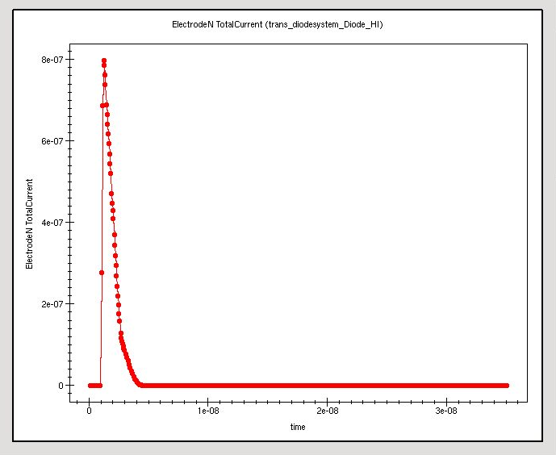
III. FEM Simulations: SDevice
Transient Simulation: Heavy Ion Impact

Slide 17
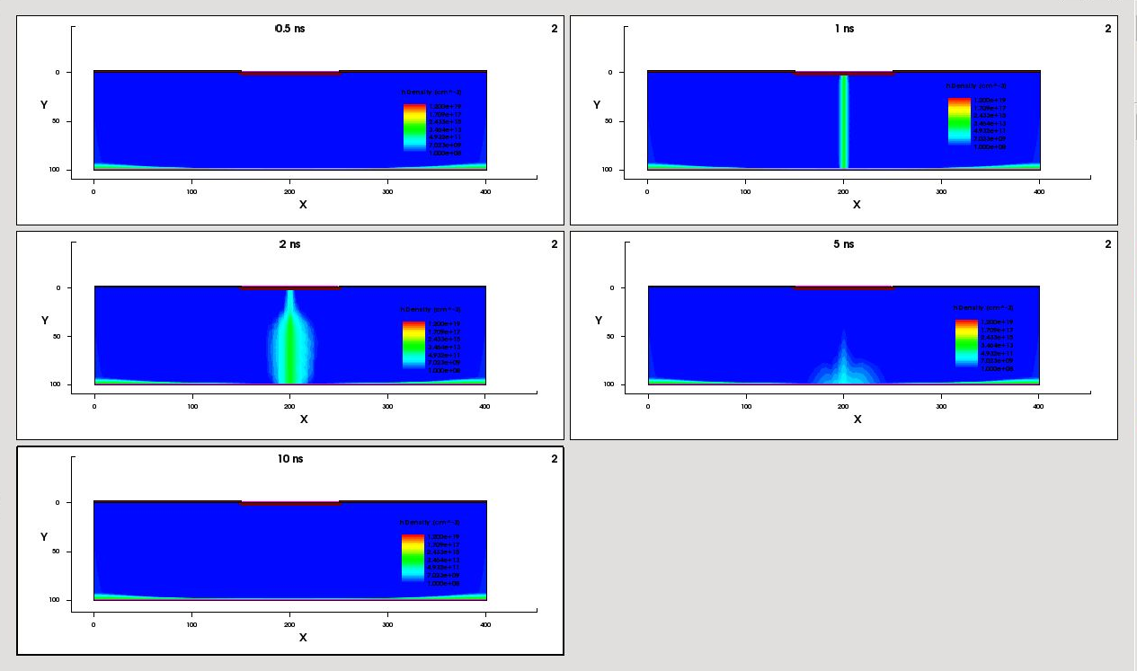
III. FEM Simulations: SDevice
Transient Simulation: Heavy Ion Impact
hDensity

Slide 18
III. FEM Simulations: SDevice
Transient Simulation: Laser Illumination
Optics (
OpticalGeneration (
ComputeFromMonochromaticSource ()
TimeDependence (
WaveTime = (1e-9 1e-9)
WaveTSigma = 50e-12
)
Scaling = 0
)
Excitation (
Wavelength = 0.8 *um
Intensity = 0.06 *W/cm2
Window("L1") (
Origin = (200,0)
XDirection = (1,0,0)
Line (Dx = 10)
)
Theta = 0 * Angle from positive y-axis
)
OpticalSolver (
OptBeam (
LayerStackExtraction (
WindowName ="L1"
WindowPosition = Center
Mode = ElementWise
)
)
)
ComplexRefractiveIndex (WavelengthDep (real imag))
)
Diode_Opt.cmd
Solve {
…….
NewCurrentPrefix = "trans_"
Transient (
    InitialTime = 0
FinalTime = 60e-9
MinStep = 1e-17
MaxStep = 1e-10
){Coupled { Poisson Electron Hole Circuit }
}
}

Slide 19
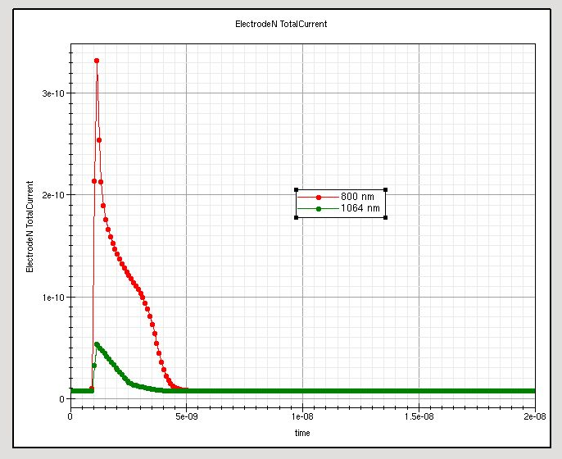
III. FEM Simulations: SDevice
Transient Simulation: Laser Illumination

Slide 20
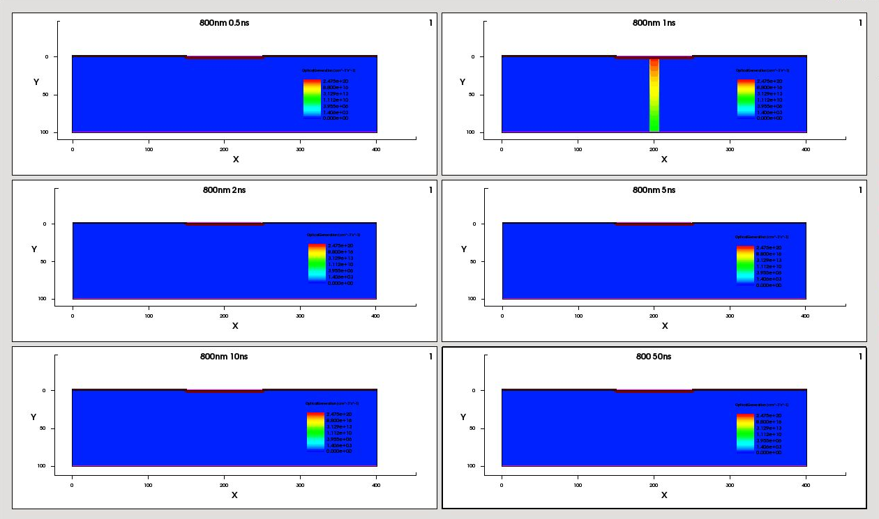
III. FEM Simulations: SDevice
Transient Simulation: Laser Illumination
Optical Generation 800 nm

Slide 21
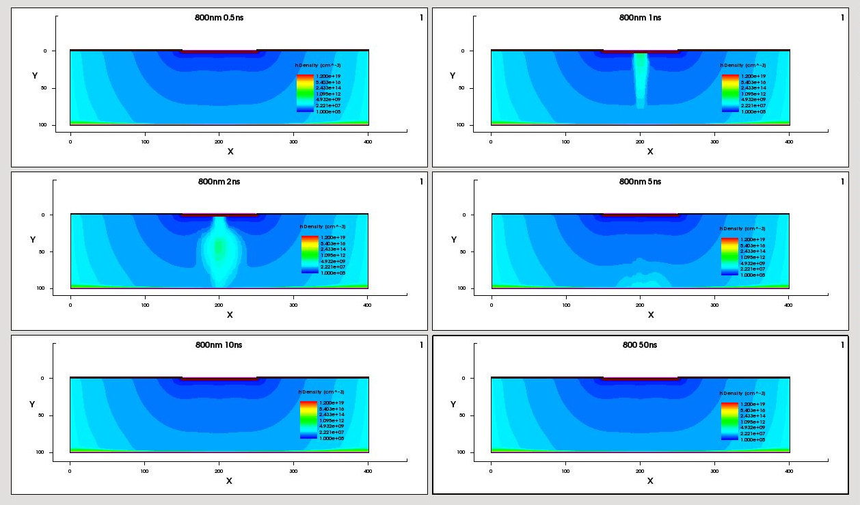
III. FEM Simulations: SDevice
Transient Simulation: Laser Illumination
hDensity 800 nm

Slide 22
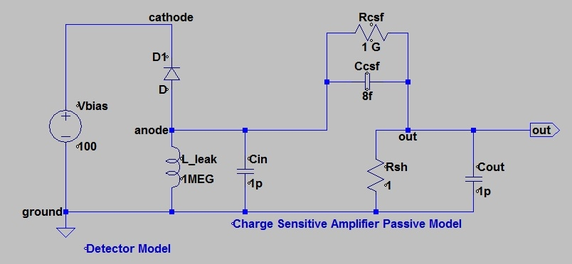
III. FEM Simulations: SDevice
Mixed Simulation with a more complicated circuit
System { Set(ground=0)
Vsource_pset V_bias (cathode ground) {dc=0}
Diode diodesystem ("ElectrodeN"=cathode "ElectrodeP"=anode)
Inductor_pset L_leak(anode ground){inductance=1e6}
#CSF input capacitance
Capacitor_pset C_in (anode ground){capacitance=1e-12}
#CSF passive feedback network:
Capacitor_pset C_csf (anode out) {capacitance=8e-15}
Resistor_pset R_csf (anode out) {resistance=100e6}
#CSA amp internal out resistence
Resistor_pset R_sh(out ground){resistance=1}
#CSA external capacitance
Capacitor_pset C_out (out ground){capacitance=1e-12}
Plot "CircuitCSF" (time() v(anode ground) v(out ground) v(anode out) i(L_leak anode) i(C_in anode)
i(R_sh out) i(C_out out))}
# Detector connected to a CSF (charge sensitive filter)
#Vbias between ground and cathode
#Detector between cathode and anode
#C_in between anode and ground
#CSF Passive network
#L_leak between anode and ground
#C_csf and R_csf between anode and outamp
#R_outamp between outamp and ground

Slide 23
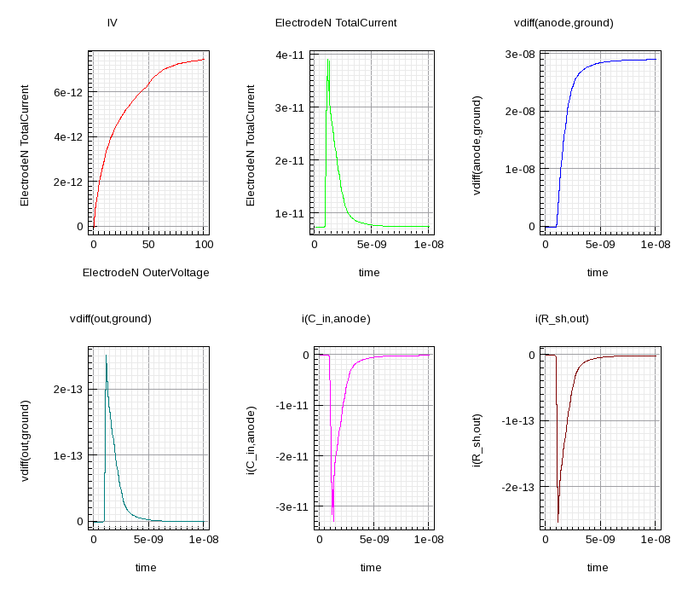
III. FEM Simulations: SDevice
Mixed Simulation with a more complicated circuit

Slide 24
III. FEM Simulations: SDevice
Simulation of the Radiation Effects
Diode_Rad_IV.cmd
Diode_Rad_CV.cmd
Physics (material="Silicon") {
Traps (
(Acceptor Level EnergyMid=0.42 fromCondBand Conc=2.3226E15 Randomize=0.29 eXsection=9.5E-15 hXsection=9.5E-14)
#Conc=Fluence*1.1613
(Acceptor Level EnergyMid=0.46 fromCondBand Conc=1.8E15 Randomize=0.23 eXsection=5E-15 hXsection=5E-14 )
#Conc=Fluence*0.9
(Donor Level EnergyMid=0.36 fromValBand Conc=1.8E15 Randomize=0.31 eXsection=3.23E-13 hXsection=3.23E-14 )
#Conc=Fluence*0.9
)
}
Physics (MaterialInterface="Oxide/Silicon") {
# Traps (FixedCharge Conc=5e10 )
Charge(Conc=1.5e11)
}

Slide 25
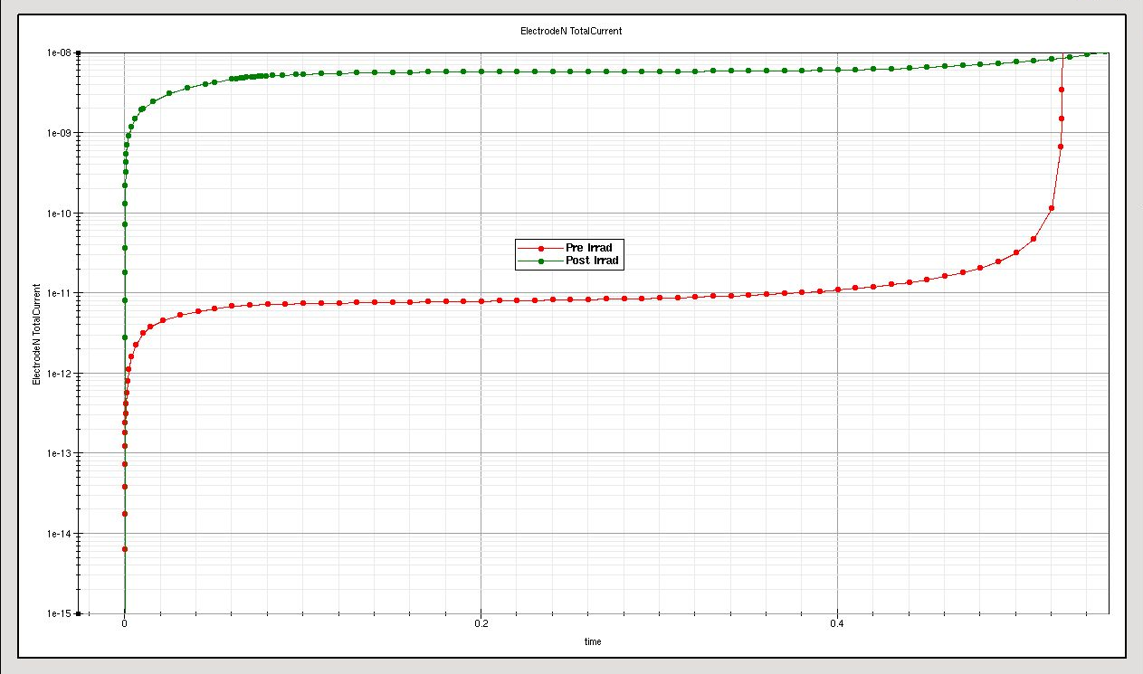
III. FEM Simulations: SDevice
Simulation of the Radiation Effects : I-V Simulation

Slide 26
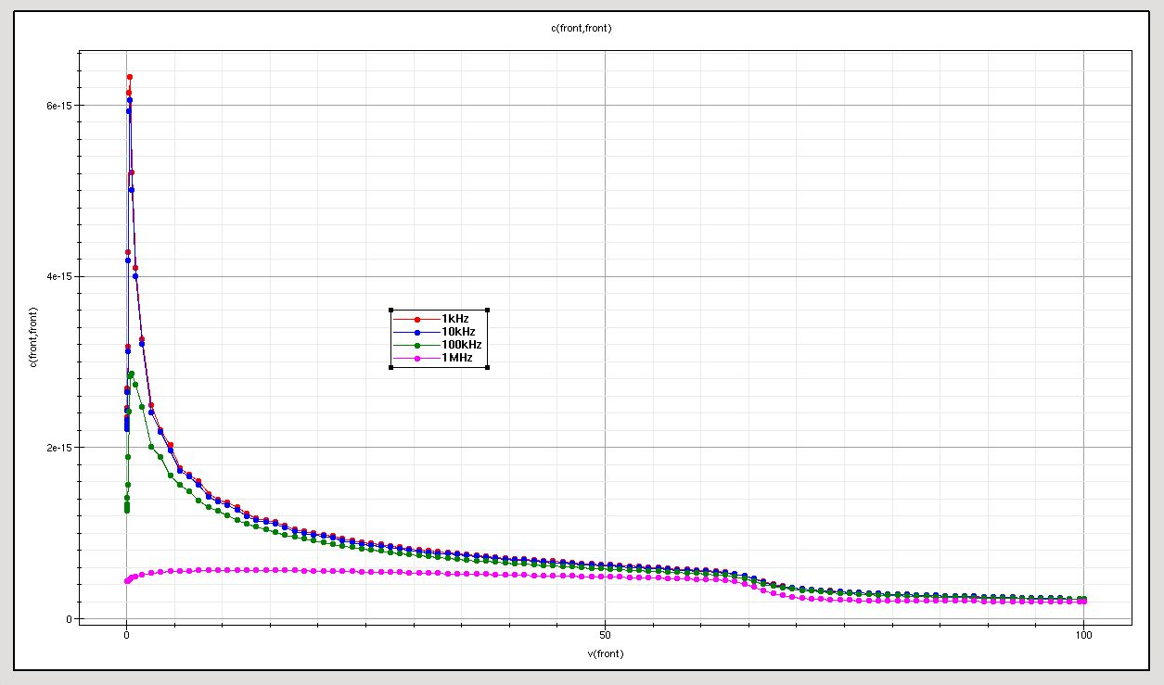
III. FEM Simulations: SDevice
Simulation of the Radiation Effects : C-V Simulation

Slide 27

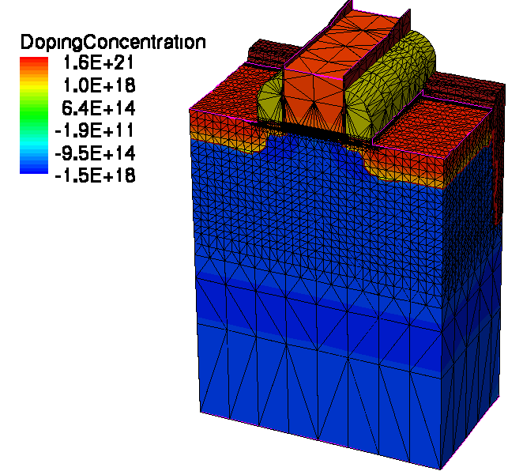
IV. Additional Tools: SProcess
Sentaurus Process
Tool for emulating the technological steps of a fabrication process
It allows emulating:
  Deposition of layers of different materials
  Localized etching of material with a mask
  Ion implantation
  Diffusion of the implanted species (thermal steps)
  Oxide and epitaxial growth
  Etc… (almost any process you can perform in a real clean room)
A specific mesh is created to solve the process emulation equations
It is a powerful tool, that can faithfully reproduce the fabrication processes of a given clean room.
Usually, this mesh is not suitable for device simulation

Slide 28

IV. Additional Tools: SProcess
Sentaurus Process: From a Foundry Point of View
General Simulation flow
Process Technology Simulation
Re-meshing and adjustment
FEM Simulation
Regular use of Sprocess in a foundry (at least at IMB-CNM)
1st Mode: From device performance to fabrication process
  Combined SDE and Sdevice Simulations are necessary to obtain the desired performance
  Sprocess simulation is carried out to determine the technological steps that provide the optimized performance
2nd Mode: From fabrication process to device performance
  A new or modified technological step is simulated with sprocess
  The performance of the whole device is then analyzed with the aid of a SDE+Sdevice simulation

Slide 29
III. FEM Simulations: SDevice
LGAD Basic Detectors

Slide 30
Silicon Detectors with Internal Gain and Proportional Response
Tracking Detectors
Low Gain Avalanche Detectors (LGAD)
  Proportional response (linear mode operation)
  Good efficiency
  Good spectral range
  Better sensibility (Gain)
  Thin detector integration with the same signal and higher collection efficiency
  Better signal/noise ratio
  After Irradiation
  Similar pre & post irradiation signal (higher quality signal + lower noise increase)
  Power consumption slightly increased
  Ionisation damage in oxides (relevant on n-on-p structures)
PiN Diodes
  Proportional response
  Good efficiency
  Good spectral range
  Pad, strip and pixel designs available
  After Irradiation
  Worse signal to noise ratio (lower quality signal + noise increment)
  Increment of the power consumption (leakage current increase)
  Ionisation damage (relevant on n-on-p structures)
  Internal Gain
Notes:
The aim of this work is to improve the performance and stability against radiation of PiN diode detectors for tracking applications.
In this sense, the controlled use of avalanche phenomenon, characteristic of a PN junction polarized in reverse mode, allow us to improve some characteristics of the PiN diodes used in such applications.
Thus, we will be able to get more stable detectors, reducing degradation due to radiation, and achieving a higher signal to noise ratio. This will allow more accurate detection of the particles and the fabrication of thinner detectors with the same signal and greater collection efficiency.

Slide 31
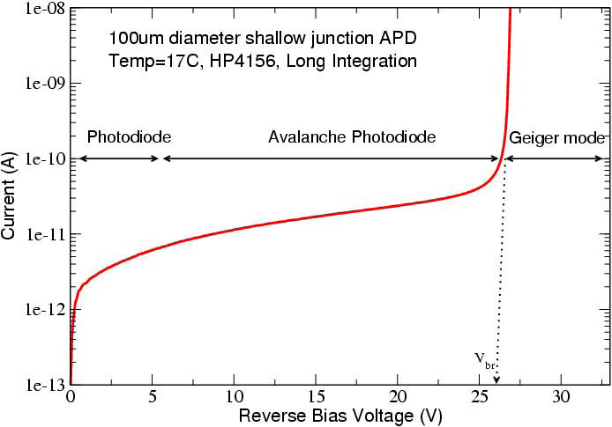

Linear Mode Operation. Gain Definition
Diodes with multiplication can operate in Linear or Geiger mode
  Linear mode: Moderate gain: Proportional response to the deposited energy
  Geiger mode: Very high gain: Digital response (detection or not detection)
Linear mode
No Gain
Gain > 10⁴
Digital response
Moderate Gain
Proportional response
Notes:
Since we are interested in a detector with a moderate gain and a proportional response, we fix its operating point in the linear region with a voltage below its breakdown voltage.
In this situation, we consider the Gain as the ratio between the signal at this point and the constant signal at low voltage, taking into account the procedure fixed by Tapan in 1997.

Slide 32
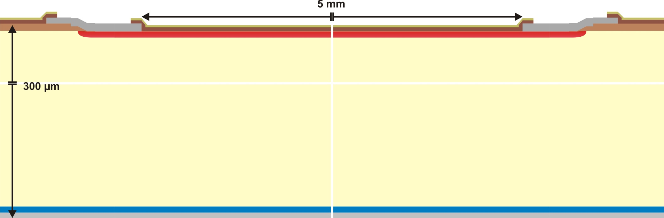
PiN Diode (No Gain)
N⁺ cathode
P-type (π)substrate
P⁺ anode
Abrupt N⁺P junction with trapezoidal electric field profile (linearly decreasing in the P substrate)
  Electrons are accelerated towards the N⁺ region until they reach the saturation velocity
  Since the electric field is much lower than E_{crit}, electrons can not generate new carriers
  (NO IMPACT IONIZATION AND NO GAIN)
Notes:
The structure on which we have worked is based on a PiN-PAD diode with an area of 25 square millimeters.

Slide 33
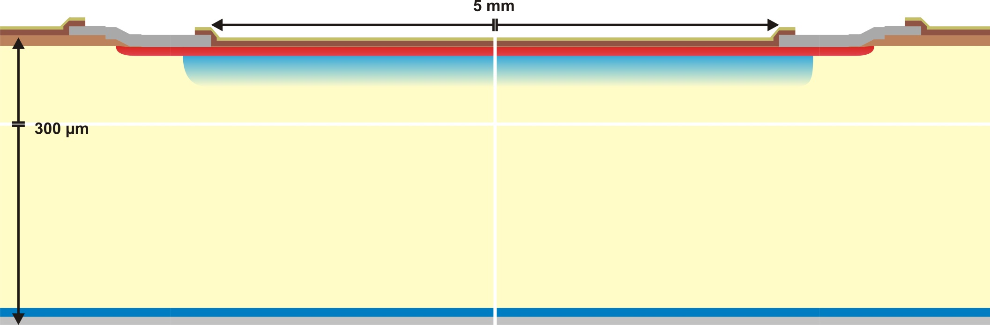
Pad Diode with internal Gain (LGAD)
N⁺ cathode
P-type multiplication layer
P-type (π)substrate
P⁺ anode
Gaussian N⁺P junction where the P-multiplication layer becomes completely depleted at a very low reverse voltage
  Electrons are accelerated towards the N⁺ region until they reach the saturation velocity
  The electric field in the P layer is close to the E_{crit}, value
  (IMPACT IONIZATION AND GAIN)
Notes:
On a highly resistive P-type substrate, prior to N-plus well to form the diffusion cathode, we have defined a P well to be the multiplication layer. The objective of this layer is to enhance the value of the electric field in that region, and its impurity profile will be the main technological parameter to define in order to adjust the gain value.

Slide 34
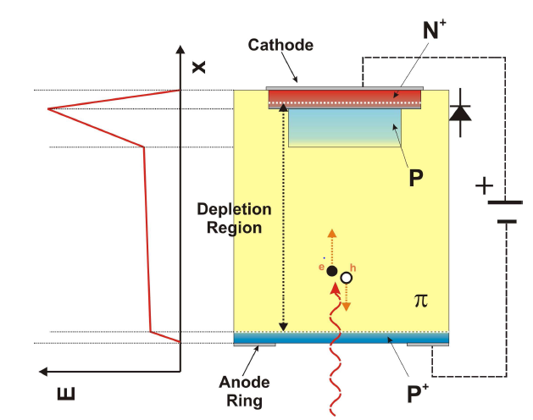
Conditions for Gain
Impact ionization requires a minimum electric field of 1e5 V/cm in the P layer
  Full depletion of the P-type substrate is needed to avoid recombination
  The E_{crit} value (~3e5 V/cm) can not be reached in the N⁺P junction (reverse breakdown)
Impact ionization region
Electrons traveling at their saturation velocity (good for signal uniformity)

Slide 35
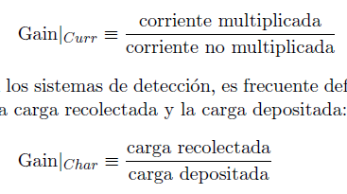
Gain Definition and Usage
The Gain can be defined in two equivalent ways and is identical whatever the incident particle is
  A known radiation source has to be used to calibrate the gain
    Collected charge is determined by integrating the current waveform
    The total number of generated electron-hole pairs in Silicon is determined by the type of radiation source
If no impact ionisation is contemplated (Equivalent PiN diode.)
Once the Gain is calibrated, the detector can be used to identify the incident radiation by simply measuring the collected charge

Slide 36

Gain Simulation
Gain simulation considering generated and collected charge
  An initial charge distribution has to be introduced in the Sentaurus Heavy Ion model
  The evolution of the generated charge is calculated by transient simulations
  We have not been able to observe any transient current increase
    Impact ionisation is an statistic concept while transient simulation considers the evolution of each single electron…
Gain simulation considering multiplied and non-multiplied current (alternative method)
  Ionisation coefficients are modified in a very small volume of the P-type substrate (3 orders of magnitude greater) to create a know number of electron-hole pairs (3000)
  Quasi static simulations are performed with and without the generated charge
    The PiN diode is simulated to determine current increase due to the generated charge (no impact ionisation is present)
    Then, the LGAD counterpart is simulated with and without charge (impact ionisation is present)
    Finally, the simulated Gain corresponds to the ratio between PiN and LGAD currents when charge is generated

Slide 37
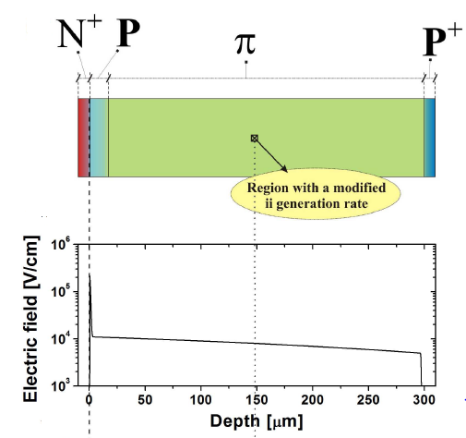
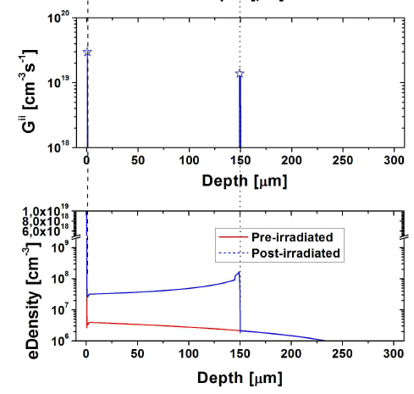
Gain Simulation

Slide 38
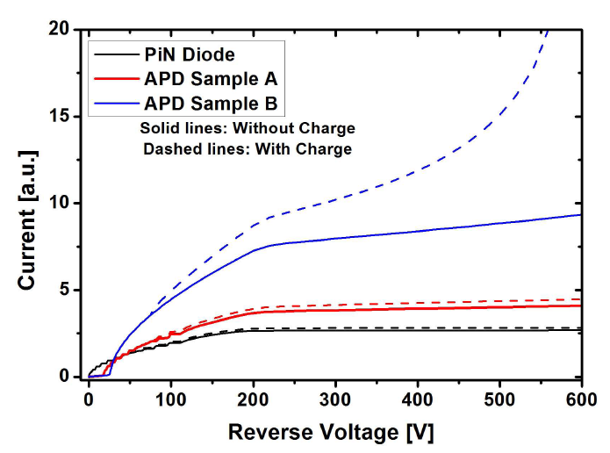

Gain Simulation
  Local charge generation equivalent to the absorption of a 30 KeV X-ray
  The doping of the sample B P-multiplication layer is higher than the A sample (high Gain)

Slide 39


Design of the P-Multiplication Region
Doping profile of the P-multiplication layer is critical
1D Simulation @ Pad Centre
Gain/V_{BD} trade-off
If implant dose increases:
  Gain increases
  V_{BD} decreases
Small modifications in the Boron implant dose
induce great changes in Gain and V_{BD}
Notes:
The simulations show that the adjustment of the impurity profile in this region is critical, due to its effect on the gain and on the voltage capability for the analyzed detector. The P well dose must be enough to obtain a determined gain without a high reduction on its breakdown voltage.
Thus, small modifications in the Boron implant dose, in the order of ten to twelve atoms per square centimeter, can induce great changes on the gain and breakdown voltage values.
Therefore, the accurate control of the doping profile in the multiplication area, is the most important technological condition for its fabrication.

Slide 40

Design of the Edge Termination
The optimization of the edge termination is ruled by the electric field at the multiplication layer (not by the maximum voltage capability, as in the case of power devices)
P-Multiplication layer
Correlated values
P-Substrate

Slide 41

Edge Termination: Why is needed?
The N⁺ shallow contact and the P-multiplication layers have to be locally created with a lithography mask
  The electric field at the curvature of the N⁺/P junction is much higher than that of the plane junction (where Gain is needed)
  Avalanche at the N⁺/P curvature at a very low reverse voltage (premature breakdown)
Shallow N⁺ and P-multiplication layers self aligned
High electric field peak
at the curvature

Slide 42

Compatible Edge Termination Techniques
Maximum efficiency of 80%
Maximum efficiency of 60%
Maximum efficiency of 90%

Slide 43


Edge Termination with Guard Ring
The N⁺ shallow diffusion is used to implement a floating guard ring
  The lateral electric field distribution is smoothed leading to two peaks (main junction and floating guard ring)
  The electric field peak and the risk of avalanche breakdown at the curvature of the main junction is reduced. Optimisation of the guard ring location is needed

Slide 44


Edge Termination with N⁺ Extension
The N⁺ shallow diffusion is used to extend the N⁺ beyond the edge of the multiplication layer
  Enhanced Phosphorous diffusion in the very low doped substrate (increased curvature radius and voltage capability)
  The electric field rapidly increases at the plain junction (multiplication)
  At high reverse voltage the electric peak at the extended N⁺ diffusion leads to breakdown
Avalanche
Multiplication

Slide 45

Edge Termination with Junction Termination Extension
Junction Termination Extension (JTE) with an additional deep N diffusion
  Additional photolithographic step with high energy Phosphorous implantation
  A field plate can also be implemented for additional electric field smoothing
Field Plate
N⁺ cathode
P-type multiplication layer
JTE diffusion
P-type substrate
P⁺ anode
Notes:
To achieve this condition, we define a low doping N-well in the periphery of the cathode diffusion, deeper than this, and with the aim to increase the voltage cability of the peripheral zone. This low doping N-well is known as Junction Termination Extension (JTE).

Slide 46


Edge Termination with Junction Termination Extension
  Deep N diffusion with high curvature radius (long anneal process)
  Reduced electric field peak at the JTE diffusion
  Highest electric field at the plane junction (gain control) V_{BD plane} < V_{BD JTE} (Gain control)
Multiplication and avalanche control

Slide 47

Edge Termination with Junction Termination Extension
Electric Field @ 400 V
Planar and uniform electric field distribution, high enough to activate charge multiplication
N⁺
N
P
π
Notes:
The reduction in the peripheral electric field, allows that the maximum Electric Field is reached in the multiplication area. We can also see how, if we add a field plate on the end of the JTE, we can increase the reduction of the electric field, increasing the breakdown voltage in that area.

Slide 48


Design of the Device Periphery
  Full depletion below 100 V reverse bias
  Fast lateral depletion of the low doped substrate. A deep P⁺ diffusion –P stop- is needed in the die periphery to avoid the depletion region reaching the unprotected edge

Slide 49


What about the Inherent Positive Oxide Charges?
  Field oxides grown in wet conditions (H₂+O₂) typically with a positive charge density of 5e10 cm⁻²
  Surface inversion and modification of the depletion region, reaching the deep P-Stop peripheral diffusion
Surface inversion + fast depletion + electric field peak at deep P-stop + SURFACE LEAKAGE CURRENTS

Slide 50

How to Protect the Surface, Limiting the Current Leakage?
Oxide positive charges create a surface inversion layer (electron path towards the cathode electrode, masking the charge collection when used as a detector)
  A shallow P-type diffusion (P-Spray) can be used to compensate the surface inversion
  A deep P⁺ diffusion can be placed close to the JTE to eliminate the electron surface current
Blanket Boron implantation
Same Boron implantation

Slide 51


How to Protect the Surface, Limiting the Current Leakage?
An additional N-type collecting ring is implemented by using the deep JTE diffusion
  The N ring has to be placed close to the JTE to avoid a premature breakdown at the JTE
  The P-spray diffusion has to be efficient (to avoid short circuit through the inversion layer)
  The voltage capability is not degraded since the junction to be protected is now the right edge of the added ring (identical than the JTE)
P
N⁺
N
N
P⁻
N⁺
Multiplier Junction
Overlap
Collector Ring
P⁺

Slide 52


Simulation of the Irradiated Devices
Curves @ 600 V
No Irradiated
Irradiated. Φ_{eq} = 1 x 10¹⁵
High Electric Field peak at the junction
PiN: electric field strength at the junction increases after irradiation
LGAD: electric field strength at the junction is almost equal after irradiation
Irradiation Trap Model (Perugia Model)
Acceptor; E= E_{c} + 0.46 eV; η=0.9 σ_{e} = 5 x 10⁻¹⁵ σ_{h} = 5 x 10⁻¹⁴
Acceptor; E= E_{c} + 0.42 eV; η=1.613 σ_{e} = 2 x 10⁻¹⁵ σ_{h} = 2 x 10⁻¹⁴
Acceptor; E= E_{c} + 0.10 eV; η=100 σ_{e} = 2 x 10⁻¹⁵ σ_{h} = 2.5 x 10⁻¹⁵
Donor; E= E_{v} - 0.36 eV; η=0.9 σ_{e} = 2.5 x 10⁻¹⁴ σ_{h} = 2.5 x 10⁻¹⁵
Impact Ionization Model (Univ. of Bolonia)
Notes:
Taking into account that the value of the electric field in the junction, causes the appearance of the charge multiplication, using numerical simulations we can compare the electric field profile of an irradiated detector with an un-irradiated one.
Thus, simulations show that the electric field at the junction of a PiN diode increases by the action of radiation, while maintaining substantially equal in the low gain avalanche diode (LGAD).

Slide 53

Experimental Results
Static Performance
  Current levels below 1 µA thorough the whole voltage range
  Junction breakdown above 1100 V
W5_F11
Junction breakdown above 1100 V
Current level
(~ few hundreds of nA)
Wafer 5 (1.4 × 10¹³ cm⁻²)
Notes:
In all cases identified as "good devices", the reverse leakage current is less than one micro ampere for voltages lower than the breakdown voltage. This voltage reaches a value of eleven hundred volts for all wafers (1100 V), except the eighth wafer that reaches eight hundred volts, as planned.

Slide 54


Experimental Results
Multiplication factor has been tested with tri-alpha (²³⁹Pu/²⁴¹Am/²⁴⁴Cm) source.
  Irradiation through the anode (back side, 1 µm Aluminum):
Back Side Irradiation
Notes:
The Detectors characterization using a tri-alpha source, shows how the gain increases with voltage, which is in the range of 10.
Irradiation measures through the back of the detector, provide better results than the measurements performed irradiating through the cathode.

Slide 55
III. FEM Simulations: SDevice
Fitting Simulations and Process Technology

Slide 56
Conventional LGAD Detector Process Set-up
Integrate a pad detector for tracking applications with internal gain (5-10)
The leakage current has to be as low as possible
Surface inversion is always a challenge in extremely low doped substrates (P-Spray, P-Stop and other structures have to be used
Although a double Boron and Phosphorous implantation is something quite simple (through a screen oxide), a precise control is mandatory and repeatability is the key point for production purposes
Silvaco platform is preferred for process simulation when dealing with Silicon technology
Sentaurus platform is preferred for performance and irradiation effects simulation
SEM inspection and SIMs profiles are useful tools for technology stabilization
-3-
Notes:
One of our motivation has been the achievement of a well defined LGAD doping profile that reproduces the experimental data of our devices.
The other one has been the idea of taking advantage of our well stablished LGAD technology process to fabricate position-sensitive detectors with a small gain in a 300um substrate thickness and a uniform electric field all along the device that guarantee the same signal amplification wherever a particle passes the device.
These kind of device with inner amplification allows us to reduce the substrate thickness in order to archive a fast charge collection without reducing the signal amplitude. LGAD structures could be interesting for tracking and timing applications like primary interaction vertex or medical applications.

Slide 57


Conventional LGAD Process Technology
Several fabrication runs to optimize the performance of the LGAD devices.
High resistivity P-type substrate, 200 & 300 μm thick
Wafers with different P-layer doping doses
Wafers with PiN diodes included for reference
Front view of the wafer
Metal grid
Back view of one LGAD detector
7 Photolithographic levels
More than 80 Technological Steps
Average fabrication time: 3 moths

Slide 58



Fabricated Prototypes
DR
SiO₂/Si₃N₄
Passivation
Metal
P-type multiplication layer
N-Type Diffusion (JTE)

Slide 59

Optimization of LGAD Electrical Simulations
1ST Step: The Doping profile from process technology simulation is compared with the experimental SIMs values. A new Doping profile for electrical simulation is then obtained.
V.Gkougkousis, LGAD Dopng Profiles, 27th RD50 Workshop, CERN, December 2015

Slide 60

Optimization of LGAD Electrical Simulations
Dop_PWell | Dop_Junction | Dop_Psub | tNPlus | tPWell
5E+16 | 3E+16 | 5.5E+11 | 1,03 | 4,9

Slide 61

Optimization of LGAD Electrical Simulations
2nd Step: The new doping profile is validated by C(V) simulations and experimental data
Foot Zoom
VFD =70V
$$∆V\sim 0.5V$$
V =30V
ZOOM
-5-
Notes:
The capacitance simulation (represented by black open symbols) has fitted quite well the experimental data (the red open symbols) measured at the CNM Radiation Lab. Both of them have the same multiplication layer depletion Voltage at 30V and the same full depletion Voltage at 75V.

Slide 62

Optimization of LGAD Electrical Simulations
3rd Step: The Gain Simulation is compared with the experimental Gain (measured with a tri-alfa source at IMB-CNM), as well as with the experimental MIP data (measured at CERN).
Gain @ 700V 4.4
Gain @ 700V 4.2
Otero.S; Characterization of LGAD Sensors CNM Run7859 RD50 –December 2015
-6-
Notes:
And last but not least, we have done the MIP Simulation in order to compare the simulated gain with the experimental Gain measurement we had done at the CNM Radiation Lab with a tri-alfa source, as well as with the MIP measurement done at CERN by Christian and Sofia.
We expected a Gain of 4.7 at 700V and we have obtained a gain of 4.4, not the same gain value but assuming the inner clean room process fluctuation, the experimental precision, and the simulation error that we can assume it’s near 10%, this new profile reproduces quite well the experimental data.
With this well defined doping profile the segmented LGAD have been simulated and compared.

Slide 63

Optimization of LGAD Electrical Simulations (Silvaco & Synopsys)
 | Dop_PWell | Dop_NPlus | Dop_Junction | Dop_Psub | tNPlus | tPWell
Synopsys (SIMS Fit) | 5E+16 | 3.8E+19 | 3E+16 | 5.5E+11 | 1.03 | 4.9
Silvaco full.cpl | 7E+16 | 3.5E+19 | 4.5E+16 | 5.5E+11 | 1.1 | 5.67
Silvaco Fermi | 9E+16 | 3.5E+19 | 3.8E+16 | 5.5E+11 | 1.08 | 4.17

Slide 64


Optimization of LGAD Electrical Simulations
Diffusion Models:
All diffusion models (Fermi, two dimensional or fully coupled model) follow the same generic mathematical form of a continuity equation. Second order Fick’s Equation
$\frac{∂C_{ch}}{∂t}=−∇J_{A}+S$ (1)
At any given temperature, a finite number of dopant-defect pairs is present. This fraction is responsible for the redistribution of dopant atoms.
Fermi Model:
The Fermi Model assumes that point defects are in thermodynamic equilibrium. There is no difference between Interstitials or Vacancies and Vacancies with different charge states interact with impurities independently. The diffusion coefficient in extrinsic silicon is described by
$D=D_{i}^{0}$+ $D_{i}^{+}\left(\frac{p}{n_{i}}\right)+D_{i}^{−}\left(\frac{n}{n_{i}}\right)+D_{i}^{=}{\left(\frac{n}{n_{i}}\right)}^{2}$ (2)
Full coupled Model:
Substitutional impurities are assumed to move both via vacancy-assisted diffusion with a fraction $f_{V}=1−f_{I}$ and via interstitial-assisted diffusion with a fraction $f_{I}$ . By default $f_{I}=0.94$.
The model is based in non-equilibrium of point defects concentration. The coupled equations for impurities and point defects must be solved, because impurities continue to have dynamic interactions with point defects during annealing.

Slide 65

Optimization of LGAD Electrical Simulations
Optimization of defects fraction:
  The continuity equation for dopants are
  $\frac{∂C_{ch}}{∂t}=−\sum_{X=I,V}{∇·J_{AX}}$ (3)
  $J_{AX}=−f_{X}D_{AX}\left[∇\left(C_{A}\frac{C_{X}}{C_{X}^{∗}}\right)−Z_{A}\left(C_{A}\frac{C_{X}}{C_{X}^{∗}}\right)\frac{qE}{kT}\right]$ (4)
  $f_{I}=FI.0e^{\left(−\frac{FI.E}{kT}\right)}$ (5)
  Boron → $FI.0=0.53$ y $FI.E=0.001$
  Phosphorus →$FI.0=0.81$ y $FI.E=0.001$
Optimization of impurities segregation:
  The segregation coefficients are extracted from SIMs
  $F=h\left(C_{A}−\frac{C_{B}}{k_{0}}\right)$ [Plummer p. 414 Eq. 7.61] (6)
  h is the interface transfer coefficient (cm sec⁻¹) across the interface and k₀ is the segregation coefficient at the interface.
  $F_{S}=h_{12}·\left(\frac{C_{1}}{M_{12}}−C_{2}\right)$ [Atena user’s manual p. 116 Eq. 3-12] (7)
  $M_{12}=SEG.0·e^{\left(−\frac{SEG.E}{kT}\right)}$ (8)
  Boron → SEG.0 = 0.18 y SEG.E= 0.001
  Phosphorus → SEG.0 = 800 y SEG.E= 0.001
  This parameters are optimized for that specific thermal process and for that specific wafers.

Slide 66




Optimization of LGAD Electrical Simulations
Dose (·10¹³ cm⁻²) | Dop_PWell | Dop_NPlus | Dop_Junction | Dop_Psub | tNPlus | tPWell
1.8 | 5E+16 | 3.5E+19 | 3E+16 | 5.5E+11 | 1.03 | 4.9
2.0 | 5.6E+16 | 3.5E+19 | 3.3E+16 | 5.5E+11 | 1.03 | 4.91
2.2 | 6.0E+16 | 3.5E+19 | 3.6E+16 | 5.5E+11 | 1.02 | 4.94

Slide 67
I(V) Performance for Different implantation Boron Doses and Temperatures
T = 295 K
Dose = 1.8e13 cm⁻²
Dose = 2e13 cm⁻²
T = 253 K

Slide 68


C(V) Performance for Different Boron Implantation Doses
Dose = 1.8e13 cm⁻²
Zoom foot
$$∆V\sim 0.5V$$
Zoom foot
$$∆V\sim 0.5V$$
Dose = 2e13 cm⁻²

Slide 69


Gain at Different Boron Implantation Doses and Temperatures
Dose = 2e13 cm⁻²
Dose = 1.8e13 cm⁻²
Doping Dependence lifetimes: (Scharfetter Relation)
$τ_{dop}=\left(N_{A,0}+N_{D,0}\right)=$
$τ_{min}+\frac{τ_{max}−τ_{min}}{1+{\left(\frac{N_{A,0}+N_{D,0}}{N_{ref}}\right)}^{γ}}$ (9)
 | e | h
$$τ_{max}$$ | 2·10³ µs | 7·10² µs
$$τ_{min}$$ | 0 µs | 0 µs

Slide 70
Static Performance of Conventional LGAD
Notes:
The capacitance versus voltage measurements show that the LGADs depletion voltage is around 40 volts for the 7509 run, and around 30 volts for the 7859. So, in this figure we can see how, for the small LGAD devices, the capacitance is slightly lower on the 7509 run.

Slide 71
Gain Performance of Conventional LGAD
Dose: 1.8e13
Gain: 3.7 – 8.4
Dose: 2.0e13
Gain: 8.3 – 44
Measurements done in the Silicon Lab at CERN
TCT measurement- IR back

Slide 72
LGAD. Run 7859. Homogeneity @ 100 V. Dose 1.8e13
  9 W1 F10-3 Red Back
  4 W2 E3-1 Red Back
  9 W1 F10-3 Red Front
  4 W2 E3-1 Red Front
Patterns are independent from bias voltage. Optical inspection shows residues

Slide 73
LGAD. Run 7859. Homogeneity @ 100 V. Dose 2.0e13
  7 W3 C2-3 Red Back
  4 W4 I3-1 Red Back
  7 W3 C2-3 Red Front
  4 W4 I3-1 Red Front
Patterns are independent from bias voltage. Optical inspection shows residues

Slide 74


Gain and Leakage Degradation on Conventional LGAD

Slide 75


Charge Collection after Neutron Irradiation
Diodes irradiated in Ljubljana (Slovenia) with neutrons in steps, with 80 min annealing at 60ºC between irradiation fractions:
    W8 (High Boron implant), fluence steps: 1, 2, 3, 5, 20, 100 x 10¹⁴ cm⁻²
    W7 (Medium Boron implant), fluence steps: 1, 2, 3, 5, 10, 20, 30 x 10¹⁴ cm⁻²
Run 6474
Charge multiplication decreases with increasing fluence

Slide 76
Gain after Proton Irradiation
Irradiation at Los Alamos Nat. Lab. (US) with 800 MeV protons.
Neutron equivalent doses:
7.10 × 10¹¹
8.52 × 10¹²
1.07 × 10¹⁴
1.28 × 10¹⁵
2.13 × 10¹⁶
Annealing: 8 min at 80ºC
Run 7062
The gain decreases with increasing fluence.

Slide 77

A new Vertical JFET Technology for Harsh Radiation Applications
A Rad-Hard switch for the ATLAS Inner Tracker
P. Fernández-Martínez, D. Flores, S. Hidalgo, D. Quirion,
M. Ullán
IMB-CNM (CSIC), Spain

Slide 78
Outline
Introduction: V-JFET
Motivation and basic Structure
Device Layout and Process Technology
Electrical Performance
First Radiation Hardness Results
Conclusions

Slide 79



Motivation: Powering Scheme in the ITk
ATLAS experiment @ CERN
Upgrade for High Luminosity
  Higher performance, Higher compactness, Higher radiation hardness…
Switch Goal: To switch-off a malfunctioning sensor when it demands too much current to the power supply
Powering scheme for the strips detectors of the Inner Tracker (the HV-MUX system) requires radiation-hard switches.
  500 – 700 V detector bias
  Forward current: > 5 mA
  Reverse current: < 1 mA (after irradiation)
  Maximum radiation levels:
    Fluence: 2×10¹⁵ 1-MeV equivalent neutrons/cm²
    Total Ionizing Dose: 50 Mrad(Si)
Source
Gate
Drain
Large
Current
Increase
Switch- off
Targeted production of 20k devices

Slide 80
Controlled Switch Candidates
Silicon
Insulated Gate Transistors (MOSFET, IGBT): Gate oxide degradation by ionization damage prevents their use.
Thyristors: Difficult turn-off and complex control circuitry. Not feasible for the application.
JFET: Optimal candidate, but:
  N-type substrates too sensitive to radiation displacement damage (undergo type inversion under high fluences).
  P-type JFET: lack of commercially available devices.
SiC
Commercial JFETs have been tested: Most of them fail. The only surviving device is no longer sold.
GaN
Commercial HEMTs have been tested: Good performance of one candidate, but:
  Normally-Off device: need for continuous control voltage.
  Technology not mature; long term radiation damage in GaN still to be fully understood.

Slide 81
Silicon Custom V-JFET Main Features
Bulk device:
  Very hard against radiation ionizing damage
  Reduced power density (long-term reliability)
High resistivity p-type substrate:
  Hard against radiation displacement damage (p-type)
  High blocking voltage; low switch-off voltage (High resistivity)
  Poor on-state conduction (p-type and High resistivity)
To reach the target current: parallel cell design
Deep Trench technology:
  Deep trench (80 µm range) needed to achieve the target V_{OFF} (1-3 V)
  Increased current density
  Final device area meet the reserved space in the HV-MUX board
Layout made with independent cylindrical cells:
  Deep trench filling prevents the use of honeycomb designs
  Guard ring edge termination

Slide 82


V-JFET: Features
Custom Silicon Vertical JFET based on the 3D-trench technology set-up at CNM-Barcelona for 3D detectors.
Features:
  Depletion mode device → (Normally-On)
  3D Device with Vertical Conduction
    High voltage capabilities
    Rad-hard against ionization
    Low switching-off voltage
  P-type
    Rad-hard against displacement (at least, damage mechanisms are known)
  Cellular design
    Adaptable Current capability
  Custom made
    Optimization for the requirements
Cellular design
Each cell includes a conduction channel, surrounded by a deep trench (circular layout), which constitutes de gate electrode.
The channel current is modulated by the depletion region extended from the gate-substrate reverse-biased junction
Figures of merit in terms of several geometric parameters evaluated for an optimum design (2D TCAD simulation)

Slide 83







V-JFET cell: How it works?
Source
Oxide
ON-State (V_{GS} = 0)
OFF-State (V_{GS} > V_{OFF})


Polysilicon Gate
80 µm
Channel Region (Inside)
Output
Transfer
Drift Region
Drain

Slide 84
First V-JFET Prototypes
Optimization: substrate doping?
  Trench depth = 80 µm
  Substrate Thickness = 300 µm
Substrate Resistivity:
150 – 500 Ω·cm
(Boron doping: 3e13 – 8e13 cm⁻³)
2r=35 µm
Values on Target
  Nominal substrate doping spans in a wide range!
2r=23 µm

Slide 85

Device Structure
Cell Core
Non-doped polysilicon
Inter-level Oxide (TEOS)
Metal Electrode (Source)
_
P+ Electrode (Source)
N-Type Diff.
Doped polysilicon (N-type)
2r
S/2
Diffusion (N-type) from the Doped polysilicon
Cell Core Region
Inter-cell
Region

Slide 86



Device Layout
7 photolithographic levels
Gate Electrode
Guard Rings
Ch. Stopper
Source Electrodes
Gate Runners

Slide 87


Design of Experiments
Device Design (parameter values)
7 Designs with different 2r and/or S (6x6 mm²) (green)
S\2r | 23 | 29 | 35
10 | X | X | XX
7 | X |  | X
Design
2 Additional designs with 8.9x6 mm² (blue)
P-Spray Strategy
 | Dose [cm⁻²]
w/o P-Spray | -
With P-Spray | 1e12
With P-Pray | 5e12
S
Technology
Substrate Doping
“High-Resistivity” (500-1000 Ω·cm) → Lower V_{OFF}
“Low-Resistivity” (150-500 Ω·cm) → Lower V_{Drop}
2r

Slide 88


Fabrication: Trench Etching
Trench photolithography: Metal mask
Exposed
Protected
Trench Etching: SEM images
Trench width = 4.7 µm

Slide 89
Fabrication: Trench Filling (Polysilicon 1)
Trench filling with Polysilicon 1: SEM images
Hole width = 3 µm

Slide 90
Fabrication: Trench Filling (Polysilicon 2)
Trenches are filled with Poly 2, which is then removed from the surface
Hole width after Poly 1 deposition
(< 3 µm)
Doped Poly 1
Non-Doped Poly 2
(inside the trench)
Hole width after Poly 2 deposition
(350-480 nm)
~1.1 µm

Slide 91
Fabrication: Trench Re-Filling (Polysilicon 2)
An additional layer of non-doped polysilicon (300 nm) is deposited.
SEM images before the polysilicon etching
Trench closed

Slide 92


Process Technology
D = 80 µm
2r = 35 µm
S = 10 µm

Slide 93




Process Technology
Trenches are sealed
Inter-level Oxide
P-type Diffusion (Source)
N-type diffusion from Poly 1
Poly 2
Poly 1

Slide 94


Process Technology
Inter-level Oxide
Doped (N⁺) Polysilicon
N-type Diff.
P-type Source
Non-Doped Polysilicon
80 µm
300 µm

Slide 95


Electrical Performance
Output Characteristic
2r = 23 µm; S = 10 µm
Transfer Characteristic
Narrow channel devices:
  High enough current
  Low enough V_{OFF}
  Close to target device
Good agreement with simulations
  Confirms simulation results
Good starting point for fine optimization
 | I_{DSS} (I_{DS}@V_{DS}=-50V) | V_{drop} (V_{DS} @I_{DS}=5mA) | V_{OFF} (V_{GS} @ I_{DS} =10 µA) | I_{OFF} (I_{DS}@V_{GS}=10V)
Measured | 12 – 18 mA | 0.46 – 0.64 V | 1.90 – 2.55 V | 0.4 – 1.7 µA
Sim (6e13) | 11 mA | 0.68 V | 1.85 V | 0.5 µA
Sim (7e13) | 17 mA | 0.50 V | 2.25 V | 0.5 µA

Slide 96


Electrical Performance
Gate current
Voltage capability
Most devices show Gate current < 1 µA
Some devices show high Gate current
Other devices show I_{G} increase when biased in the off-state
Interlevel oxide pin-holes may totally or partially short Source and Gate Metals
Breakdown voltage < 300 V
Edge termination (4 floating guard rings) is not optimized for the used substrate doping
Edge termination is tricky: Gate voltage at the device periphery and maximum electric field 80 µm deep into the substrate…

Slide 97



Performance at low Temperature
Output
Transfer
Operating temperature (External cooling): -30 ºC
Blocking

Slide 98


Radiation Hardness
Ionizing damage has been tested
  Gamma irradiations up to 50 Mrad(Si)
I_{ON} is reduced as a consequence of Ionizing damage (Dependence with Dose)
Devices are still fully operative (meeting the specifications) under 50 Mrad(Si)

Slide 99
III. FEM Simulations: SDevice
3D Junction Field Effect Transistors (JFET)

Slide 100


JFET working
2D JFET
3D JFET

Slide 101

3D – JFET troubles! (Early breakdown)
Increase the device radius

Slide 102


Current density
Off-state
On-state
V_{DS} = -50 V, V_{GS}= 10 V
V_{DS} = -50 V, V_{GS}= 0 V

Slide 103


Current density
Comparison of simulated output (a) and transfer (b) characteristics to MR-JFET (red and green line) and V-JFET (black line).

Slide 104


3D – JFET troubles! (Early breakdown)
Improve the edge protection.
Introduction of:
Biasing guard-trenches.
Floating guard-trenches

Slide 105




Simulated electric field contour map of the edge of Vertical-JEFT (a) and MR-JFET (b) and their corresponding cross-section (c) and (d). The critical electric field can be observed in the cross-sections.

Slide 106

3D – JFET troubles! (Early breakdown)

Slide 107
III. FEM Simulations: SDevice
Improving Radiation Hardness

Slide 108
LGAD Radiation Hardness. Gallium Implantation
LGAD Gain value Decreases when equivalent Fluence Increases
Possible Solution 1: Replace Boron with Gallium
  Dopants such as Ga or Al form complexes with radiation-induced defects, which may have less impact on device performance, when compared to the boron related defect (B_{i}-O_{i}) complex. This study demonstrates that using Gallium as dopant in Si instead of Boron can reduce carrier removal effect (Acceptor Removal)
  Gallium has lower penetration than Boron, but higher diffusion (with annealing)
G. Kramberger et al., “Radiation effects in Low Gain Avalanche Detectors after hadron irradiations”, 2015 JINST 10 P07006
A. Khan, et al., “Strategies for improving radiation tolerance of Si space solar cells'', Solar Energy Materials & Solar Cells 75 (2003) 271
Notes:
Moreover, as Gregor Kramberger has shown, after hadron irradiations, LGAD gain value decreases when equivalent fluence increases. In order to reduce this carrier removal effect, we consider the Khan proposal to use Gallium instead of Boron to define the P-multiplication layer, taking into account that Gallium has lower penetration than Boron, but higher diffusion during annealing.

Slide 109

Gallium Implantation. GEANT4 Simulation
60 keV z mean = 19,58 nm (mpv ≈ 22 nm)
100 keV z mean = 39,46 nm (mpv ≈ 48 nm)
120 keV z mean = 51,22 nm (mpv ≈ 61 nm)
180 keV z mean = 90,87 nm (mpv ≈ 107 nm)
SiO₂ Si
35 nm

Slide 110



60 keV
Active Boron
SILVACO
Active Gallium
Substrate Doping
GEANT4
35 nm SiO₂
Geant4 final position vs SRIM range
19,58 vs 46,6 nm
SRIM

Slide 111


100 keV
GEANT4
Geant4 final position vs SRIM range
39,46 vs 71,6 nm
35 nm SiO₂
SRIM

Slide 112


120 keV
GEANT4
Geant4 final position vs SRIM range
51,22 vs 86,2 nm
35 nm SiO₂
SRIM

Slide 113


180 keV
Geant4 final position vs SRIM range
90,87 vs 124,2 nm
GEANT4
SRIM
35 nm SiO₂

Slide 114

Gallium P on N Diodes Run (R9089)
12 wafers with Gallium implantation, 3 energies, 2 doses
3 wafers with Boron implantation, 1 energy, 1 dose
Wafer | Implantation
 | Ion | Energy (keV) | Dose(at/cm^2)
1 | Ga | 160 | 1,0e14
2
3 |  |  | 1,0e15
4
5 |  | 180 | 1,0e14
6
7 |  |  | 1,0e15
8
9 |  | 195 | 1,0e14
10
11 |  |  | 1,0e15
12
13 | B | 70 | 1,0e15
14
15
GEANT4
Included structures
Ga implanted on N-type substrates
PiN diodes. (No LGAD!)
SiMS and other Technological Characterization structures
Useful to study Acceptor Removal (RD50 project)
P on N Diodes without multiplication!
Notes:
To test this idea, we have fabricated P on N diodes using Gallium implantation to perform the P-well. We used GEANT4 numerical simulations to predict the Gallium profile after implantation.
In this run we used 12 medium resistivity N-type wafers, 3 energies and 2 doses for the Gallium implantation. We included 3 additional wafers to implant Boron for reference. All the integrated devices are P on N diodes without multiplication.

Slide 115




Gallium P on N Diodes Run (R9089)
Notes:
Nowadays, this fabrication process is finished, and we are ready to send samples to different RD50 groups for further characterization.

Slide 116
Gallium P on N Diodes. First Measurements. I(V) Characteristics
W1: Dose 1e14 at/cm² Energy 160 keV; Temp 1100ºC time 180 min

Slide 117
Gallium P on N Diodes. First Measurements. C(V) Characteristics
W1: Dose 1e14 at/cm² Energy 160 keV; Temp 1100ºC time 180 min

Slide 118


LGAD Radiation Hardness. Carbon Doped Silicon Wafers
LGAD Gain value Decreases when equivalent Fluence Increases
Possible Solution 2: Use of Carbon doped silicon wafers
Carbon co-doping can reduce the concentration of B-O defects, as a result of the formation of more energetically favorable carbon-oxygen (C-O) complexes
Two different approaches:
  Diffusion of Carbon in a silicon wafer (bare wafers and n-p diodes)
  Implantation of Carbon in the multiplication layer region
H(40K)
Di-Vacancy (V2-/0)
+ Tri-Vacancy (V3-/0)
+Vacancy-Phosphorus (VP)
+ ???
E(30K) Donor
(VOi)
(IO₂)
BiOi (p-type)
H(152K)
H(140K)
H(116K)
E. Donegani, Comparison between n-type and p-type sensors, RD50 meeting, 01.12.2015 CERN
RD48- 3rd status report 31-12-1999
Notes:
We can find a second way to avoid, or reduce, this carrier removal effect in the bibliography. So, we consider the RD48 and RD50 proposals to use Carbon co-doping to reduce the Boron-Oxygen defects concentration as a result of the Carbon-Oxygen complexes formation. In this situation, we can consider two different approaches: Carbon diffusion in a few microns from the top of a silicon wafer, and Carbon implantation in the multiplication layer region.

Slide 119

Carbon Doped Silicon Wafers. Fabrication Plan
We will use 28 wafers with different resistivity
14 wafers will be “doped” in Chlorine (DCE Dichloroethylene) gas to diffuse Carbon into the silicon bulk
The remaining 14 wafers will be processed to make standard N-P diodes
[O] and [C] Expected Concentration after diffusion
Wafers | Type | Thickness (um) | Diffusion Time | Resistivity (Ohm*cm) | Conc at/cm-3
1-2 | SEN HRP (07/12) | 285 | 36h | > 5000 | < 2e12
3-4 | SEN HRP300 (05/12) | 300 | 36h | > 1000 | < 1e13
5-6 | SEN MRP300(06/15) | 300 | 36h | > 500 | < 2e13
9-10 | PAA | 500 | 36h | > 10 | < 1e15
11-12 | PAC | 525 | 36h | > 0,1 | < 3e17
13-14 | SEN LRP500(05/15) | 500 | 36h | > 0,01 | < 8,5e18
[1] L. Fonseca et al., Silicon wafer oxygenation from SiO2 layers for radiation hard detectors, Microelectronics Reliability 40 (2000) 791-794
Notes:
We are planning a new run to test the first approach. In this run we will use 28 wafers, 14 of them will be doped, during 36 hours, in Chorine gas to diffuse Carbon into the silicon bulk. The expected profile after the diffusion process is plotted in this figure. The remaining wafers will be processed to make standard N on P diodes for reference.

Slide 120

Carbon Implantation LGAD. Fabrication Plan
LGAD Multiplication Layer formation using Carbon atoms
This could be achieved by Implanting Carbon only in the first 5-6 µm of the wafer surface in the Multiplication Layer Region
Standard mask used in the past for LGAD devices
An optimization with simulation software tools (like Silvaco and Sentaurus) is necessary before starting the fabrication process
Carbon high efficiency in trapping silicon self-interstitials can cause the reduction of boron diffusion in C-rich silicon samples and this can lead to a change in the LGAD multiplication layer during the fabrication process
Notes:
To test the second approach, we must add Carbon atoms to the LGAD multiplication layer region, implanting Carbon only in the first 5-6 micron from the wafer surface. In this sense, we are planning a fabrication process using a LGAD standard mask set.
Previous to the process definition, we must optimize the Carbon implantation reproducing it with the numerical simulation tools available at CNM (Sentaurus and Silvaco TCAD tools) and including it in our full process simulation procedure.

Slide 121
III. FEM Simulations: SDevice
High Granularity Timing Detectors (HGTD)

Slide 122
Why 50 µm Thick LGAD?
For further mitigation of pile-up effects, a high-granularity timing detector with a precision of a few tens of picoseconds may be added in front of the endcap Liquid Argon calorimeters (High Granularity Timing Detector).
UFSD can also be used as timing detectors at CMS-TOTEM for the high momentum - high rapidity Precision Proton Spectrometer (CT-PPS)
Thin substrates (<50 µm) reduces the Bulk Radiation Effects and decreases the charge collection time.
Thin LGAD = Ultra Fast Silicon Detector (UFSD) with 5-10 gain
Medical applications, are also interesting field for HGTD Detectors
Notes:
LGAD integrates a small gain between 5-10 while maintains a similar noise levels and avoids readout front-end saturation & pile-up effects.
A reduction of substrate thickness from 300um to 50um will reduce the Bulk Radiation Effects and will decrease the collection time.
ATLAS is proposing Ultra Fast Silicon Detector based on LGAD as one of the technical options for the High Granularity Timing Detector (HGTD)
CMS-TOTEM are considering UFSD to be the timing detectors for the high momentum- high rapidity Precision Proton Spectrometer (CT-PPS)

Slide 123



High Granularity Timing Detector (HGTD)
Core
Pixels of 3x3 mm² and 2x2 mm²
High Resistivity P-type 50 µm SOI Wafers
Also trying with 50 & 75 µm Epitaxial Wafers
Termination
Notes:
On February 22nd we start the fabrication of 50um thick LGAD. Before we did a study of the optimum structure of the core and termination region of the device in order to guarantee a good voltage capability.
In the case of High Granularity Timing Detector (HGTD) we fabricate a 3000x3000 um^2 pixels, without JTE in pixels and as LGADs a extraction Nplus Ring that surrounds all the detector active area, in order to extract the peripheral leakage current.

Slide 124



CMS-TOTEM Precision Proton Spectrometer (CT-PPS)
CT-PPS Sensor Geometry
Core
Termination
Asymmetric design. Segmented according to the hit density distribution
Area = 12 mm X 6 mm
Thickness = 50 μm
Slim edge of 200 um on the side facing the beam
Gain ~ 15
Radiation Hard
Notes:
In the case of CMS-TOTEM Precision Proton Spectrometer (CT-PPS), the design of pads is asymmetric because the pads are segmented according to the hit density distribution.
The total area of the detector is 12mm X 6mm. One of the restrictions we have at the termination region was the distance from the active area to the edge has to be equal or less than 200um. After a Termination region study we decided to ensure the maximum voltage capability of the detector and chose a distance to the edge of 200um.

Slide 125


Electrical Performance Simulation (Dose = 1.8×10¹³ cm⁻²)
@ 140V
V_{FD} < 40V
Core
@ 140V
Termination

Slide 126
MIP and Gain Simulation
T = 295ºK
Dose = 1.9×10¹³ cm⁻²
T = 295ºK
T = 253ºK
Dose = 1.9×10¹³ cm⁻²
T = 253ºK

Slide 127


First 50 µm SOI Detectors (HGTD)
LGAD HGTD Run Basic Information:
  Cnm827 Mask Set
  8 Mask Levels
  100 Technological Steps
  Double Side Process
  Electron Collection
  P-Stop Surface Isolation
  JTE Termination
  Peripheral Collector Ring
  Pixel Detectors (2x2, 4x4, 8x8)
  Pad Detectors
  Detectors for Timing Applications
  Test Structures (Process Quality Control)

Slide 128




First 50 µm SOI Detectors (HGTD)
Back Surface
Front Surface
Back-side wet etch opening
Guard ring pad
HGTD
Passivation opening
Aluminium reaches the
back side contact
CT-PPS
Slim Edge

Slide 129

Connection to Front-End Electronics
Pixel = 3 x 3 mm²
High Resistivity P-type 50 µm SOI Wafers
Guard Ring Pad
Passivation Opening
FE
Glue
Glue
PCB
Al
SiO2
N+
P+
3000 µm
30 µm
P-stop
P-
50 µm
P++
Al
Al
300 µm
Calice Si-W Calorimeter Concept
Back-Side Contact
Silicon Wet Etching
Notes:
Last week we sent some HGTD gluing test structures to (El-Pi-En-Eich-I) LPNHE in Paris. This group will perform the gluing process as is shown in this pictures.

Slide 130

First Measurements: I(V) Characteristics
T=21ºC
Simulation
Full Depletion Voltage
LGAD Pads
PiN Diodes
Notes:
In these figures we can see the last measurements done at our Lab for LGAD pad devices on wafers 3 and 5 (with an implantation dose of 1.8 and 1.9e13, respectively). In both wafers, we observe a leakage current values between 1-10 nA, a full depletion voltage around 40 V, and a breakdown voltage around 300 V, as we expected from simulations.

Slide 131
First Measurements: C(V) Characteristics on Pad HGTD
Dose 1.8·10¹³ cm⁻²
Dose 1.9·10¹³ cm⁻²
1/C² (F⁻²)
V_{FD}~40V
1/C² (F⁻²)
V_{FD}~40V
Dose 2.0·10¹³ cm⁻²
V_{FD}>40V
1/C² (F⁻²)
1/C² (F⁻²)
40 V
Geometry Factor
~30 V
Notes:
CV measurements agree with the simulation, and show us that the device is full depleted at 40 V. When we compare the simulation with the experimental data we can see a difference in the capacitance, because the geometry factor that we used in the simulations is too large.

Slide 132
First Measurements: I(t) Stability
Experimental data show a good current Stability in reverse mode (Between 1.5 and 2.0 nA)
Notes:
In addition, experimental data show a good current stability in reverse mode (between 1.5 and 2.0 nA during 75 minutes).

Slide 133

First Measurements: TCT Gain
Measurements Conditions:
  Devices:
    W5_LGA32P (PIN)
    W5_LGA45 (Dose 1.9·10¹³ cm⁻²)
    W5_LGA81 (Dose 1.9·10¹³ cm⁻²)
  Min Voltage = 50 V
  Max Voltage = 250 V
  Step = 10 V
  Laser: Infrared
  Illumination: Front side
  Attenuation: 69%
  Frequency: 1kHz
Gain Values:
  2 @ 50 V
  12 @ 200 V
  25-35 @ 225 V
Notes:
First infrared laser TCT measurements performed at (Ai-Ef-Ei-I) IFAE in Barcelona, using front-side illumination, show a gain value from 2 to 12 for applied voltages from 50 V to 200 V. When the voltage is 225 V, the gain value rises to 25-35. [P] Please, see the next presentation by Joern Lange for more details.

Slide 134
III. FEM Simulations: SDevice
Inverted LGAD (iLGAD) Detectors

Slide 135
Conventional LGAD with Strip Layout

Slide 136

P on P Strip iLGAD: The “Inverted” LGAD
Double-sided LGAD with pad-like multiplication structure in the back-side and ohmic read out strips, or pixels, in the front-side
N on P vs P on P LGAD microStrips Comparison
LGAD
iLGAD
Notes:
The second approach considers a pad-like LGAD, in which we change the whole wafer P+ implantation, by several P+ strips in order to segment the readout electrode, like a P-on-P microStrip detector. In this structure, we move the multiplication layer to the back-side of the chip, and define the ohmic readout elements, strips or pixels, in the front-side.

Slide 137

P on P Strip iLGAD: The “Inverted” LGAD
Double-sided LGAD with pad-like multiplication structure in the back-side and ohmic read out strips, or pixels, in the front side
First Design and Run. Include Pads, microStrips and pixelated iLGADs
iLGAD
1987 United States Patent. Paul P. Webb et al. RCA Inc. “Avalanche photodiode”
Notes:
In this figure a schematic view of the proposed inverted LGAD is shown. This is a double-sided LGAD, with pad-like multiplication structure in the back-side, and ohmic readout strips, or pixels, in the front-side. Between strips, we could define a P-stop implantation to avoid surface inversion due to oxide charges.
To fabricate it, we can use our LGAD technology with four additional photolithographic mask levels. The new run to fabricate the first prototypes will include pad-like, microStrips and pixelated iLGAD.

Slide 138

iLGAD. P on P MicroStrips. 2D Simulation
Three microStrips. Electric Field Distribution: Maximum value @ P-N Junctions
STRIP iLGAD
STRIP LGAD
285 µm Detector
Notes:
Using numerical simulations, our two approaches have been compared, and the results show more uniform electric field distribution for the iLGAD, due to its greater, and uniform, P-N junction area, as we can see in this figure.
For iLGAD, the simulations let us assume a uniform high electric field distribution along the whole multiplication area, with the same electric field distribution for every P-strip. Nevertheless, for the strip LGAD, the high electric field is located in the middle of each strip, reducing its efficiency.

Slide 139

iLGAD. P on P MicroStrips. 2D Simulation
MicroStrips Simulation. Electric Field 2D Distribution @ V_{BR}
20 µm thin detector
50 µm thin detector
Notes:
To reduce the collection time, the substrate thickness effect on the iLGAD performances has been analysed. The simulations show that reducing detector thickness, increases the electric field within the structure, reducing collection time.

Slide 140

iLGAD. P on P MicroStrips. 2D Simulation
MicroStrips I(V). Breakdown performances limited by Thickness
Notes:
Moreover, this thickness reduction decreases its voltage capability. So, for timing applications, we obtain lower voltage capability for lower collection time, with a less precise gain control, due to the fast change from low electric field to high electric field conditions.

Slide 141



iLGAD. P on P MicroStrips. 2D Simulation. MIP
Charge Collection (MIP) @ 100 V, 50 µm Thick

Slide 142

iLGAD. P on P MicroStrips. 2D Simulation. MIP
Hole Density (MIP Strip) @ 100 V, 50 µm Thick

Slide 143

iLGAD. P on P MicroStrips. 2D Simulation. MIP
Hole Density (MIP Strip Edge) @ 100 V, 50 µm Thick

Slide 144

iLGAD. P on P MicroStrips. 2D Simulation. MIP
Hole Density (MIP Inter Strip) @ 100 V, 50 µm Thick

Slide 145




iLGAD. P on P MicroStrips. 2D Simulation
MIP. microStrip Detector. 80 µm pitch, 50 µm thick. Through Strip, Edge, InterStrip
MIPs
Multiplication side
Microstrips side

Slide 146
Strip LGAD vs iLGAD. MIP Simulation. Gain Evolution
µStrip iLGAD charge collection is more efficient than µStrip LGAD

Slide 147
iLGAD. P on P MicroStrips. 2D Simulation. Timing
MIP through the middle of the sensors (central strip) @ 500 V and 300 V (50 µm)
Notes:
In this figure we can see how, for the inverse detector, the charge collection does not change with the strip width. In this case, for a 300 microns thick detector, the collection time is around 12 nanoseconds.

Slide 148

iLGAD. First Mask Set Description. Integrated Devices
176 Chips
  44 (10 x 10 mm, total area)
  56 (5 x 5 mm, total area)
  76 (3.3 x 3.3 mm, total area)
113 LGAD Pad Detectors
  12 (8 x 8 mm mult area)
  49 (3 x 3 mm mult area)
  52 (1 x 1 mm mult area)
17 PiN Detectors
  2 (8 x 8 mm active area)
  5 (3 x 3 mm active area)
  10 (1 x 1 mm active area)
8 iLGAD pStrips Detectors
  4 (45 Channels)
  4 (90 Channels)
2 PiN pStrips Detectors
  1 (45 Channels)
  1 (90 Channels)
6 Pixelated iLGAD Detector (6 x 6 pixels)
4 Pixelated iLGAD MediPix Detector (145 x 145 pixels)
6 iLGAD for Timing Applications
  3 (720 µm to cut line)
  3 (370 µm to cut line)
4 Specific Test Structure (SPR,SIMS,XPS)
16 CNM Test Structures (Microsection, CBR, Kelvin, Capacitors, Diodes)
iLGAD
Notes:
The first iLGAD Run integrates 176 structures, including pad-like LGAD, PiN detectors, iLGAD , PiN P-type microStrips detectors, pixel iLGAD in a 6 by 6 matrix distribution, and in a 145 by 145 matrix distribution, compatible with MediPix readout circuit. Also, it integrates devices for timing applications with two distances to the dicing path, specific SIMS test structures and test chips to control the fabrication process quality.

Slide 149


LGAD and iLGAD Fabrication Runs. At Glance
LGAD Run Basic Information:
  Cnm761 Mask Set
  8 Mask Levels
  70 Technological Steps
  Single Side Process
  Electron Collection
LGAD
iLGAD Run Basic Information:
  Cnm809 Mask Set
  12 Mask Levels
  100 Technological Steps
  Double Side Process
  Hole Collection
iLGAD
Common Information:
  P-Stop to Improve Surface Isolation
  Junction Termination Extension
Notes:
The LGAD process is well known, and includes 8 mask levels and 70 technological steps. It is a single side process and integrates detectors for electron collection. Moreover, inverse LGAD process includes 12 mask levels and 100 technological steps. It is a double side process and it integrates detectors for hole collection.
Both processes use p-stop wells to improve the surface isolation at the multiplication side (top side for LGAD, bottom side for inverse LGAD) and include different termination designs to improve the voltage capability of the integrated structures. In addition, test structures to characterize the multiplication layer has been included.

Slide 150
iLGAD. First Fabrication Process
Critical Step
  Multiplication Layer Formation
    Boron Implantation 100 keV @ 1.8, 1.9 and 2.0E13 atoms/cm²
    Drive-in
1 - Field Oxide
2 - P Channel + P Stop
3 - Junction Termination Extension
Si P
4 - Multiplication Well
5 - N⁺ & P⁺ Wells
6 - Contacts
7 - Metallization
8 - Passivation
: Si
: Si p⁺
: Aluminum
: Oxide
: Si n⁺
: Passivation
Notes:
During this Run the multiplication layer formation has been the most critical step..
In these figures we can see a summary of the process flow. Starting from a P-wafer with field oxide on both sides, we define P-channel-stopper and PStop on both sides; next, JTE and multiplication layer are defined on back-side, followed by the N+ implantation on back-side and P+ implantation on front-side. Finally, we have proceed with the contact opening, metallization and passivation on both sides.

Slide 151




iLGAD. First Fabrication Process
Microstrips
FRONT-SIDE
Pixel
BACK-SIDE
Notes:
The first inverse LGAD Run was finished on March 1st. On the front side we can distinguish the microstrips and pixel detectors, meanwhile on the back-side we can see the typical LGAD pad.

Slide 152
iLGAD. First IV & CV Measurements
Dose = 1.8·10¹³ cm⁻²
Dose = 1.9·10¹³ cm⁻²
PiN
VFD =70V
30V
34V
Notes:
We did some measurements of iLGAD diodes of wafer 1 and wafer 5 with a different implantation dose. Wafer1 has a leakeage current around 2-3 uA and don’t present breakdown within 1000V. Wafer5 has a leakeage current around 0.2-0.6 uA and exhibits a good voltatge capability, although it presents breakdown at 900V. The CV curves shows the multiplication layer depletion voltage is higher for wafer 5 wich has higher implantation dose for the multiplication layer. The full depletion voltage is the same for the two wafers and it’s around 70V.

Slide 153



iLGAD. TCT Measurements
Sensors: W1-K037 ( STR.45.160.8000.06.12)
Láser: 670nm, Tune 35%
Vbias: 0 to -300V, step:10V.
Front-side incidence
Notes:
The preliminary TCT Measurements done at IFCA, shows a clear signal due to the holes multiplication. In this figure the first peak is due to electron current and the second peak to multiplied hole current. The hole current peak increases with voltage and the time collection decreases. The maximum voltage applied was 300V and for this case we expect a gain around 2.5. Future measurement at high voltages will be performed in order to see the gain evolution with the voltage.

Slide 154
A new Vertical JFET Technology for Harsh Radiation Applications
A Rad-Hard switch for the ATLAS Inner Tracker
P. Fernández-Martínez, D. Flores, S. Hidalgo, D. Quirion,
M. Ullán
IMB-CNM (CSIC), Spain

Slide 155
Outline
Introduction: V-JFET
Motivation and basic Structure
Device Layout and Process Technology
Electrical Performance
First Radiation Hardness Results
Conclusions

Slide 156
Motivation: Powering Scheme in the ITk
ATLAS experiment @ CERN
Upgrade for High Luminosity
  Higher performance, Higher compactness, Higher radiation hardness…
Switch Goal: To switch-off a malfunctioning sensor when it demands too much current to the power supply
Powering scheme for the strips detectors of the Inner Tracker (the HV-MUX system) requires radiation-hard switches.
  500 – 700 V detector bias
  Forward current: > 5 mA
  Reverse current: < 1 mA (after irradiation)
  Maximum radiation levels:
    Fluence: 2×10¹⁵ 1-MeV equivalent neutrons/cm²
    Total Ionizing Dose: 50 Mrad(Si)
Source
Gate
Drain
Large
Current
Increase
Switch- off
Targeted production of 20k devices

Slide 157
Controlled Switch Candidates
Silicon
Insulated Gate Transistors (MOSFET, IGBT): Gate oxide degradation by ionization damage prevents their use.
Thyristors: Difficult turn-off and complex control circuitry. Not feasible for the application.
JFET: Optimal candidate, but:
  N-type substrates too sensitive to radiation displacement damage (undergo type inversion under high fluences).
  P-type JFET: lack of commercially available devices.
SiC
Commercial JFETs have been tested: Most of them fail. The only surviving device is no longer sold.
GaN
Commercial HEMTs have been tested: Good performance of one candidate, but:
  Normally-Off device: need for continuous control voltage.
  Technology not mature; long term radiation damage in GaN still to be fully understood.

Slide 158
Silicon Custom V-JFET Main Features
Bulk device:
  Very hard against radiation ionizing damage
  Reduced power density (long-term reliability)
High resistivity p-type substrate:
  Hard against radiation displacement damage (p-type)
  High blocking voltage; low switch-off voltage (High resistivity)
  Poor on-state conduction (p-type and High resistivity)
To reach the target current: parallel cell design
Deep Trench technology:
  Deep trench (80 µm range) needed to achieve the target V_{OFF} (1-3 V)
  Increased current density
  Final device area meet the reserved space in the HV-MUX board
Layout made with independent cylindrical cells:
  Deep trench filling prevents the use of honeycomb designs
  Guard ring edge termination

Slide 159
V-JFET: Features
Custom Silicon Vertical JFET based on the 3D-trench technology set-up at CNM-Barcelona for 3D detectors.
Features:
  Depletion mode device → (Normally-On)
  3D Device with Vertical Conduction
    High voltage capabilities
    Rad-hard against ionization
    Low switching-off voltage
  P-type
    Rad-hard against displacement (at least, damage mechanisms are known)
  Cellular design
    Adaptable Current capability
  Custom made
    Optimization for the requirements
Cellular design
Each cell includes a conduction channel, surrounded by a deep trench (circular layout), which constitutes de gate electrode.
The channel current is modulated by the depletion region extended from the gate-substrate reverse-biased junction
Figures of merit in terms of several geometric parameters evaluated for an optimum design (2D TCAD simulation)

Slide 160
V-JFET cell: How it works?
Source
Oxide
ON-State (V_{GS} = 0)
OFF-State (V_{GS} > V_{OFF})


Polysilicon Gate
80 µm
Channel Region (Inside)
Output
Transfer
Drift Region
Drain

Slide 161
First V-JFET Prototypes
Optimization: substrate doping?
  Trench depth = 80 µm
  Substrate Thickness = 300 µm
Substrate Resistivity:
150 – 500 Ω·cm
(Boron doping: 3e13 – 8e13 cm⁻³)
2r=35 µm
Values on Target
  Nominal substrate doping spans in a wide range!
2r=23 µm

Slide 162
Device Structure
Cell Core
Non-doped polysilicon
Inter-level Oxide (TEOS)
Metal Electrode (Source)
_
P+ Electrode (Source)
N-Type Diff.
Doped polysilicon (N-type)
2r
S/2
Diffusion (N-type) from the Doped polysilicon
Cell Core Region
Inter-cell
Region

Slide 163
Device Layout
7 photolithographic levels
Gate Electrode
Guard Rings
Ch. Stopper
Source Electrodes
Gate Runners

Slide 164
Design of Experiments
Device Design (parameter values)
7 Designs with different 2r and/or S (6x6 mm²) (green)
S\2r | 23 | 29 | 35
10 | X | X | XX
7 | X |  | X
Design
2 Additional designs with 8.9x6 mm² (blue)
P-Spray Strategy
 | Dose [cm⁻²]
w/o P-Spray | -
With P-Spray | 1e12
With P-Pray | 5e12
S
Technology
Substrate Doping
“High-Resistivity” (500-1000 Ω·cm) → Lower V_{OFF}
“Low-Resistivity” (150-500 Ω·cm) → Lower V_{Drop}
2r

Slide 165
Fabrication: Trench Etching
Trench photolithography: Metal mask
Exposed
Protected
Trench Etching: SEM images
Trench width = 4.7 µm

Slide 166
Fabrication: Trench Filling (Polysilicon 1)
Trench filling with Polysilicon 1: SEM images
Hole width = 3 µm

Slide 167
Fabrication: Trench Filling (Polysilicon 2)
Trenches are filled with Poly 2, which is then removed from the surface
Hole width after Poly 1 deposition
(< 3 µm)
Doped Poly 1
Non-Doped Poly 2
(inside the trench)
Hole width after Poly 2 deposition
(350-480 nm)
~1.1 µm

Slide 168
Fabrication: Trench Re-Filling (Polysilicon 2)
An additional layer of non-doped polysilicon (300 nm) is deposited.
SEM images before the polysilicon etching
Trench closed

Slide 169
Process Technology
D = 80 µm
2r = 35 µm
S = 10 µm

Slide 170
Process Technology
Trenches are sealed
Inter-level Oxide
P-type Diffusion (Source)
N-type diffusion from Poly 1
Poly 2
Poly 1

Slide 171
Process Technology
Inter-level Oxide
Doped (N⁺) Polysilicon
N-type Diff.
P-type Source
Non-Doped Polysilicon
80 µm
300 µm

Slide 172
Electrical Performance
Output Characteristic
2r = 23 µm; S = 10 µm
Transfer Characteristic
Narrow channel devices:
  High enough current
  Low enough V_{OFF}
  Close to target device
Good agreement with simulations
  Confirms simulation results
Good starting point for fine optimization
 | I_{DSS} (I_{DS}@V_{DS}=-50V) | V_{drop} (V_{DS} @I_{DS}=5mA) | V_{OFF} (V_{GS} @ I_{DS} =10 µA) | I_{OFF} (I_{DS}@V_{GS}=10V)
Measured | 12 – 18 mA | 0.46 – 0.64 V | 1.90 – 2.55 V | 0.4 – 1.7 µA
Sim (6e13) | 11 mA | 0.68 V | 1.85 V | 0.5 µA
Sim (7e13) | 17 mA | 0.50 V | 2.25 V | 0.5 µA

Slide 173
Electrical Performance
Gate current
Voltage capability
Most devices show Gate current < 1 µA
Some devices show high Gate current
Other devices show I_{G} increase when biased in the off-state
Interlevel oxide pin-holes may totally or partially short Source and Gate Metals
Breakdown voltage < 300 V
Edge termination (4 floating guard rings) is not optimized for the used substrate doping
Edge termination is tricky: Gate voltage at the device periphery and maximum electric field 80 µm deep into the substrate…

Slide 174
Performance at low Temperature
Output
Transfer
Operating temperature (External cooling): -30 ºC
Blocking

Slide 175
Radiation Hardness
Ionizing damage has been tested
  Gamma irradiations up to 50 Mrad(Si)
I_{ON} is reduced as a consequence of Ionizing damage (Dependence with Dose)
Devices are still fully operative (meeting the specifications) under 50 Mrad(Si)

Slide 176
III. FEM Simulations: SDevice
3D Junction Field Effect Transistors (JFET)

Slide 177
JFET working
2D JFET
3D JFET

Slide 178
3D – JFET troubles! (Early breakdown)
Increase the device radius

Slide 179
Current density
Off-state
On-state
V_{DS} = -50 V, V_{GS}= 10 V
V_{DS} = -50 V, V_{GS}= 0 V

Slide 180
Current density
Comparison of simulated output (a) and transfer (b) characteristics to MR-JFET (red and green line) and V-JFET (black line).

Slide 181
3D – JFET troubles! (Early breakdown)
Improve the edge protection.
Introduction of:
Biasing guard-trenches.
Floating guard-trenches

Slide 182
Simulated electric field contour map of the edge of Vertical-JEFT (a) and MR-JFET (b) and their corresponding cross-section (c) and (d). The critical electric field can be observed in the cross-sections.

Slide 183
3D – JFET troubles! (Early breakdown)

