Slide 1

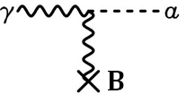
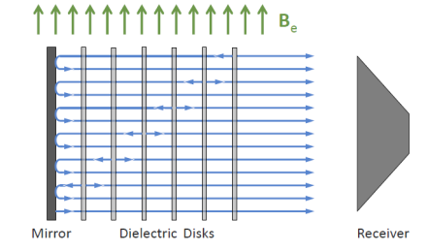
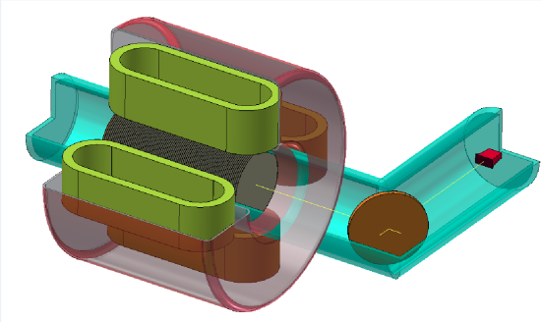
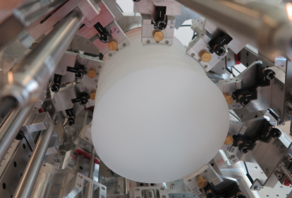
A new road to Axion Dark Matter detection with a dielectric haloscsope
Béla Majorovits – MPI für Physik, München
DM Axions as pool table oscillations
Axions and ALPs as DM candidates
The Axion detection method
Dielectric haloscope
MADMAX status and plans

Slide 2

The horizontal pool table problem
According to P. Sikivie, Physics Today 49, 12, 22 (1996)
$$Θ$$
2

Slide 3
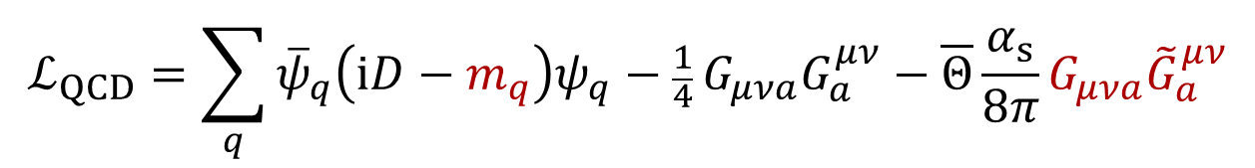
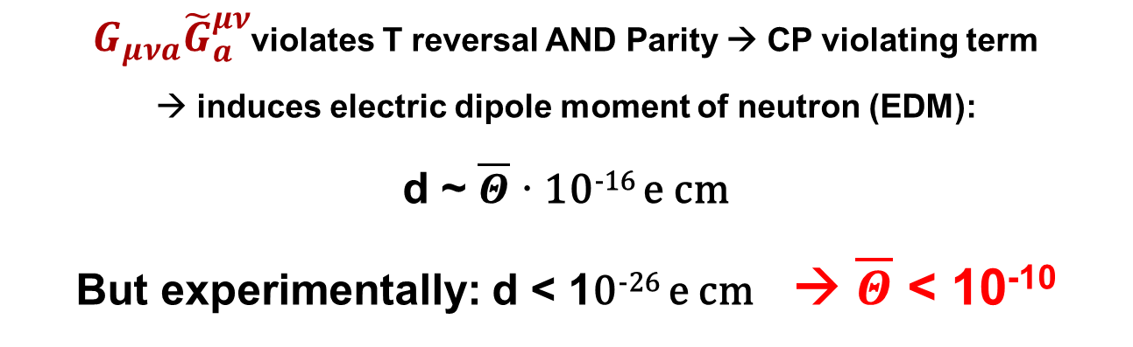
The strong CP problem
Strong force invariant under CP
$$ℒ_{QCD}=\sum_{q}{{\overline{ψ}}_{q}\left(iD−m_{q}\right)ψ_{q}−\frac{1}{4}}G_{μνa}G_{a}^{μν}−\overline{Θ}\frac{α_{s}}{8π}G_{μνa}{\tilde{G}}_{a}^{μν}$$
$G_{μνa}{\tilde{G}}_{a}^{μν}$violates T reversal AND Parity → CP violating term
induces electric dipole moment of neutron (EDM):
d ~ $\overline{Θ}$ · 10⁻¹⁶ e cm
But experimentally: d < 10⁻²⁶ e cm → $\overline{Θ}$ < 10⁻¹⁰

Slide 4
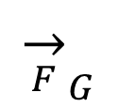
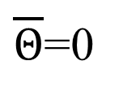
Solution to the horizontal pool table problem
According to P. Sikivie, Physics Today 49, 12, 22 (1996)
$${\overset{→}{F}}_{G}$$
$\overline{Θ}$=0
4

Slide 5
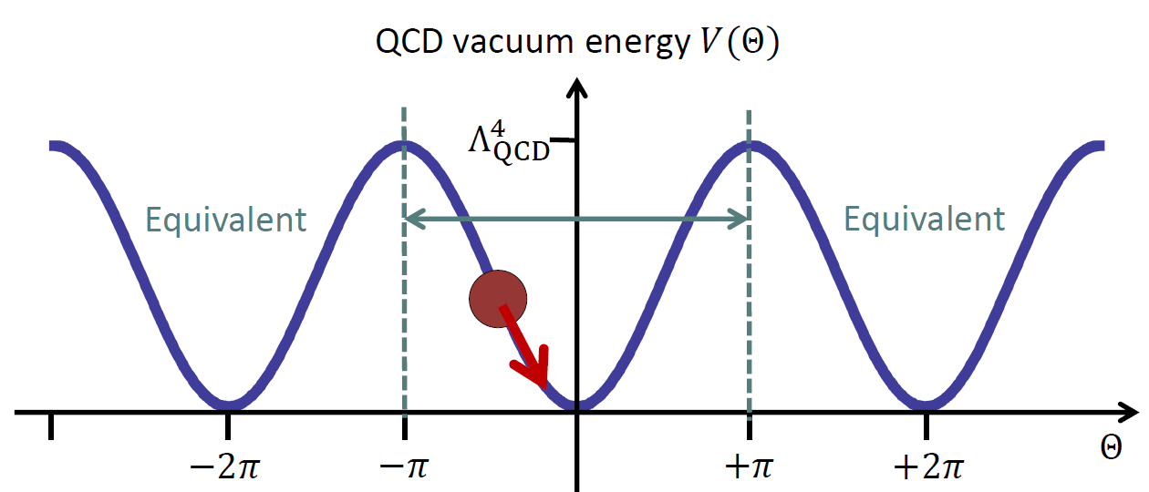
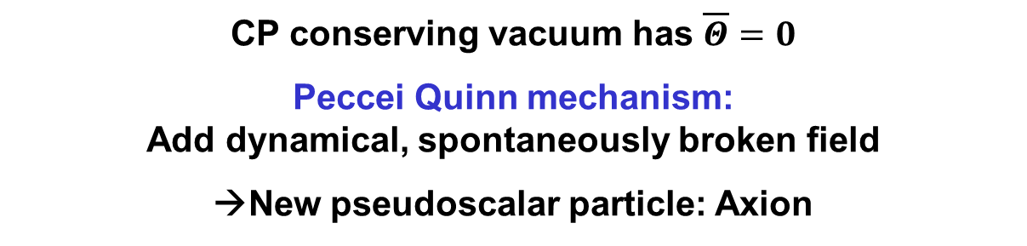
The strong CP problem
CP conserving vacuum has $\overline{Θ}=0$
Peccei Quinn mechanism:
Add dynamical, spontaneously broken field
→New pseudoscalar particle: Axion

Slide 6
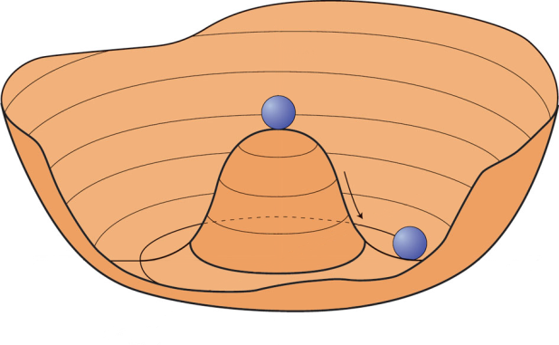
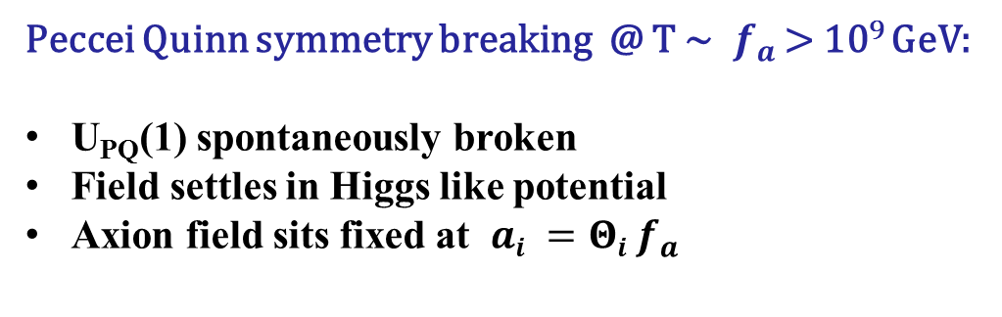


Solving the strong CP problem: the Axion
Peccei Quinn symmetry breaking @ T ~ $f_{a}$ > 10⁹ GeV:
U_{PQ}(1) spontaneously broken
Field settles in Higgs like potential
Axion field sits fixed at $ai =Θi f_{a}$
$$V(a)$$
$$a$$
Taken from G. Raffelt
6

Slide 7
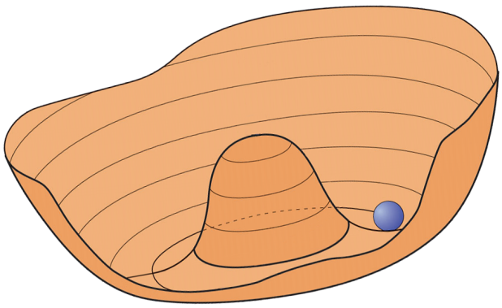

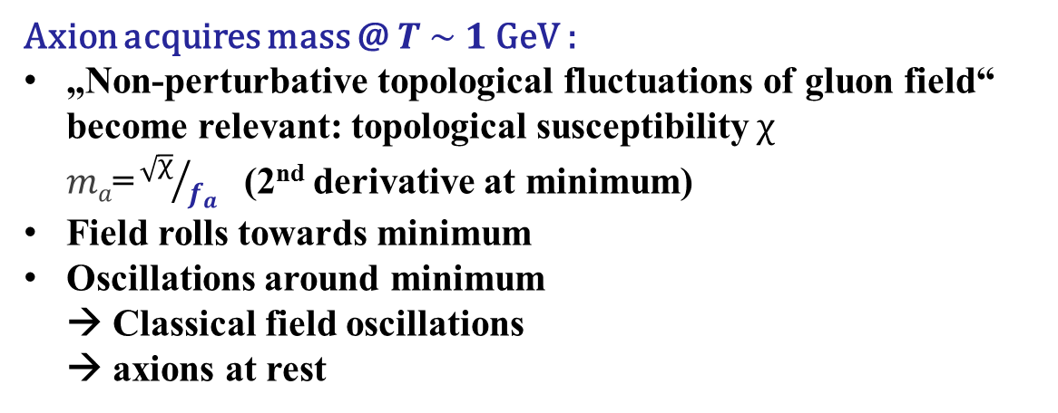


Solving the strong CP problem: the Axion
Axion acquires mass @ $T \sim 1 \text{GeV}$:
„Non-perturbative topological fluctuations of gluon field“ become relevant: topological susceptibility $χ$
$ma\text{=}{\sqrt{χ}}/{f_{a}}$ (2nd derivative at minimum)
Field rolls towards minimum
Oscillations around minimum
→ Classical field oscillations
→ axions at rest
$$V(a)$$
$$a$$
$$\overline{Θ}=0$$
Taken from G. Raffelt
7

Slide 8
Alignment of the pool table in gravity?
According to P. Sikivie, Physics Today 49, 12, 22 (1996)
8

Slide 9
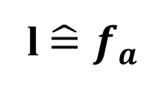

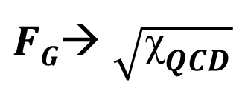
Solution to the horizontal pool table problem
According to P. Sikivie, Physics Today 49, 12, 22 (1996)
l${\hat{=}f}_{a}$
$$Θ$$
$FG$→ $\sqrt{{\text{χ}}_{QCD}}$
9

Slide 10
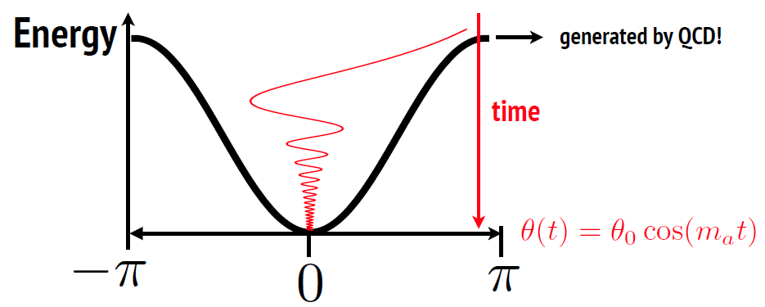

Solving the strong CP problem: the Axion
Axions are non-relativistic, classical field oscillations:
Very small mass, cold Dark Matter
10

Slide 11
The DM pie:
Neutrinos: Ω_{ν} < 0.2%
Baryons:
Ω_{b} ~ 4.4%
Dark Energy
Ω_{Λ} ~ 74%
Non-baryonic Dark Matter
Ω_{DM} ~ 21%
11

Slide 12
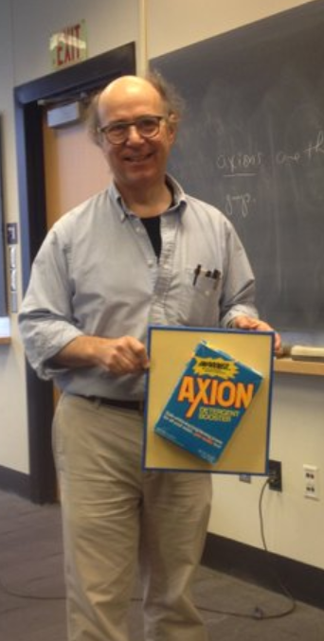

Solving the strong CP problem: the Axion
12

Slide 13
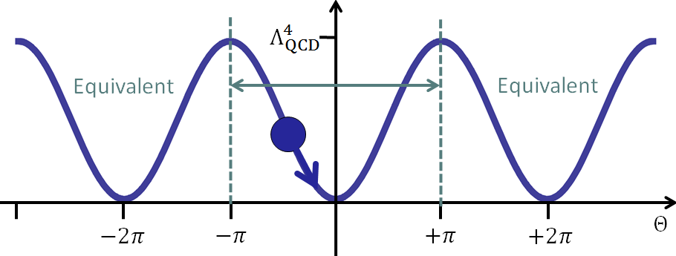

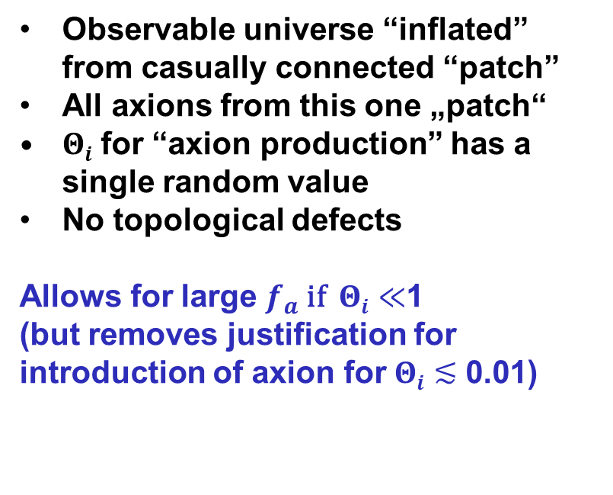
Axion DM: Pre-inflationary PQ breaking
Observable universe “inflated” from casually connected “patch”
All axions from this one „patch“
$Θi$ for “axion production” has a single random value
No topological defects
Allows for large $f_{a}$ if $Θi≪$1
(but removes justification for introduction of axion for $Θi$ $≲$ 0.01)
Observable Universe: Random $Θi$

Slide 14
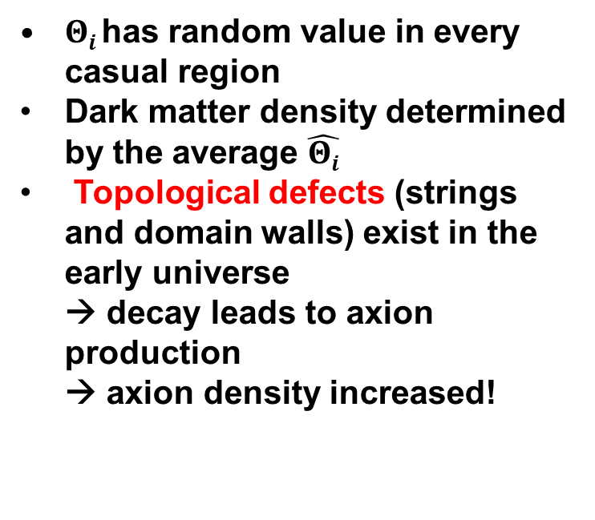
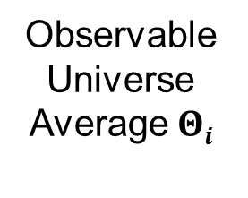
Axion DM: Post-inflationary PQ breaking
$Θi$has random value in every casual region
Dark matter density determined by the average $\hat{Θi}$
Topological defects (strings and domain walls) exist in the early universe
→ decay leads to axion production
→ axion density increased!
Observable Universe Average $Θi$

Slide 15
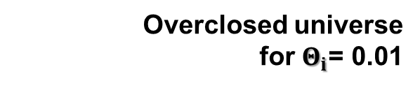
Θ_{i} could be anything 0–2π
(“anthropic range”)
Putting Axion DM into scale:
Astrophysical bounds
→ Axions no good DM candidates
Pre-
inflationary
Post-inflationary
Overclosed universe
for $Θ_{i}$= 0.01
m_{Planck}
f_{a}
10¹⁸
10¹⁵
10¹²
10⁹
10⁶
GeV
peV
neV
μeV
meV
eV
m_{a}
kHz
MHz
GHz
THz
ν_{γ}
λ_{de Broglie}
1000km
1km
1m
1mm
Pre-inflationary scenario
Post-inflationary scenario
15

Slide 16
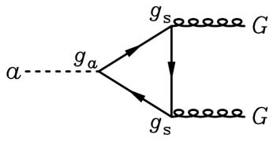
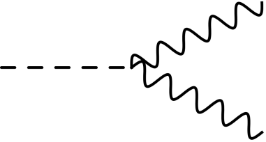
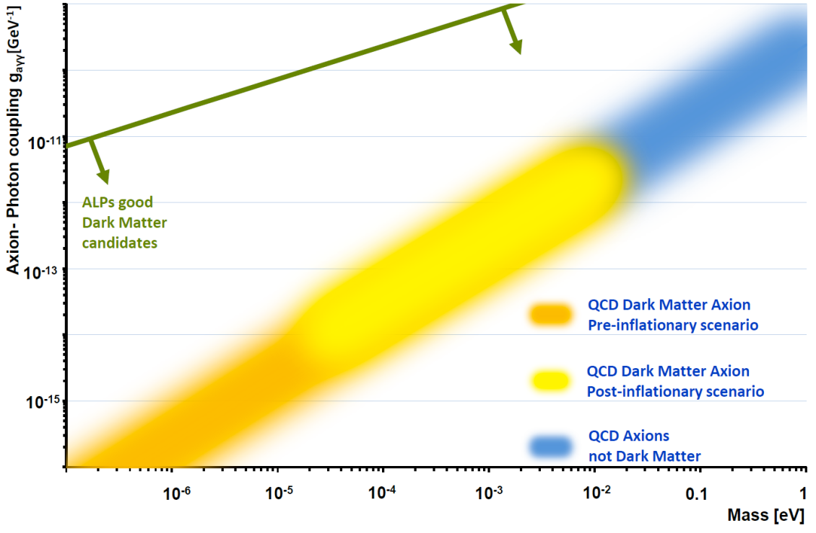



Generic Axion Like Particles (ALPs):
$$γ$$
f
$$a$$
$$γ$$
f
ALPs from generically possible U(1) Symmetries:
same couplings with different coupling constants possible,
no mass-coupling relation with PQ scale (not given by QCD)

Slide 17
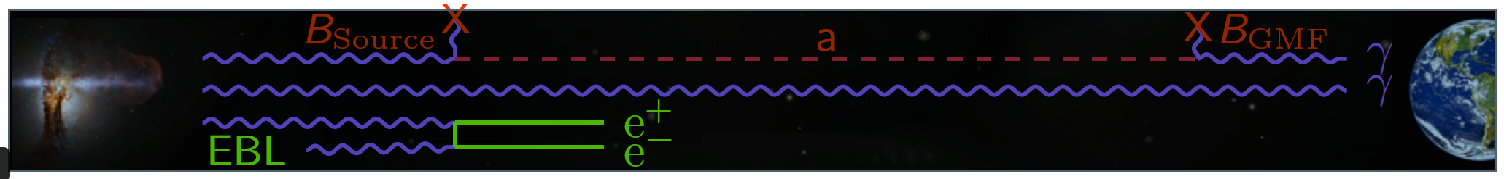
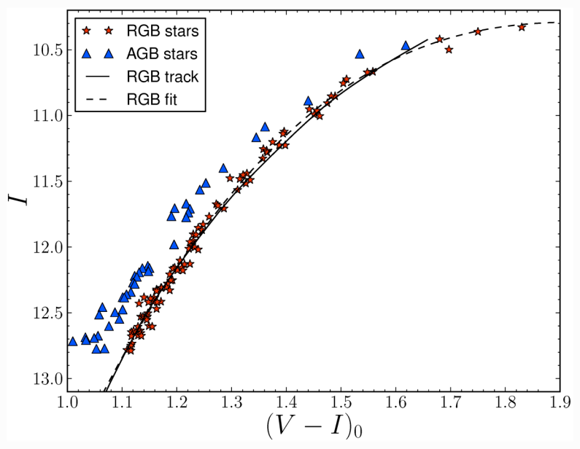
ALPs as solution to astrophysical hints?
TeV transparecncy hint: ALPs
arXiv:1302.1208
Prone to systematics of source?
Stellar cooling: Could be due to QCD axions
Brightest red giants
measured nonstandard energy loss
Statistically evidence for deviation from expectation
Could be due to ALP cooling
arXiv:1512.08108
How well do we understand standard stellar cooling?

Slide 18
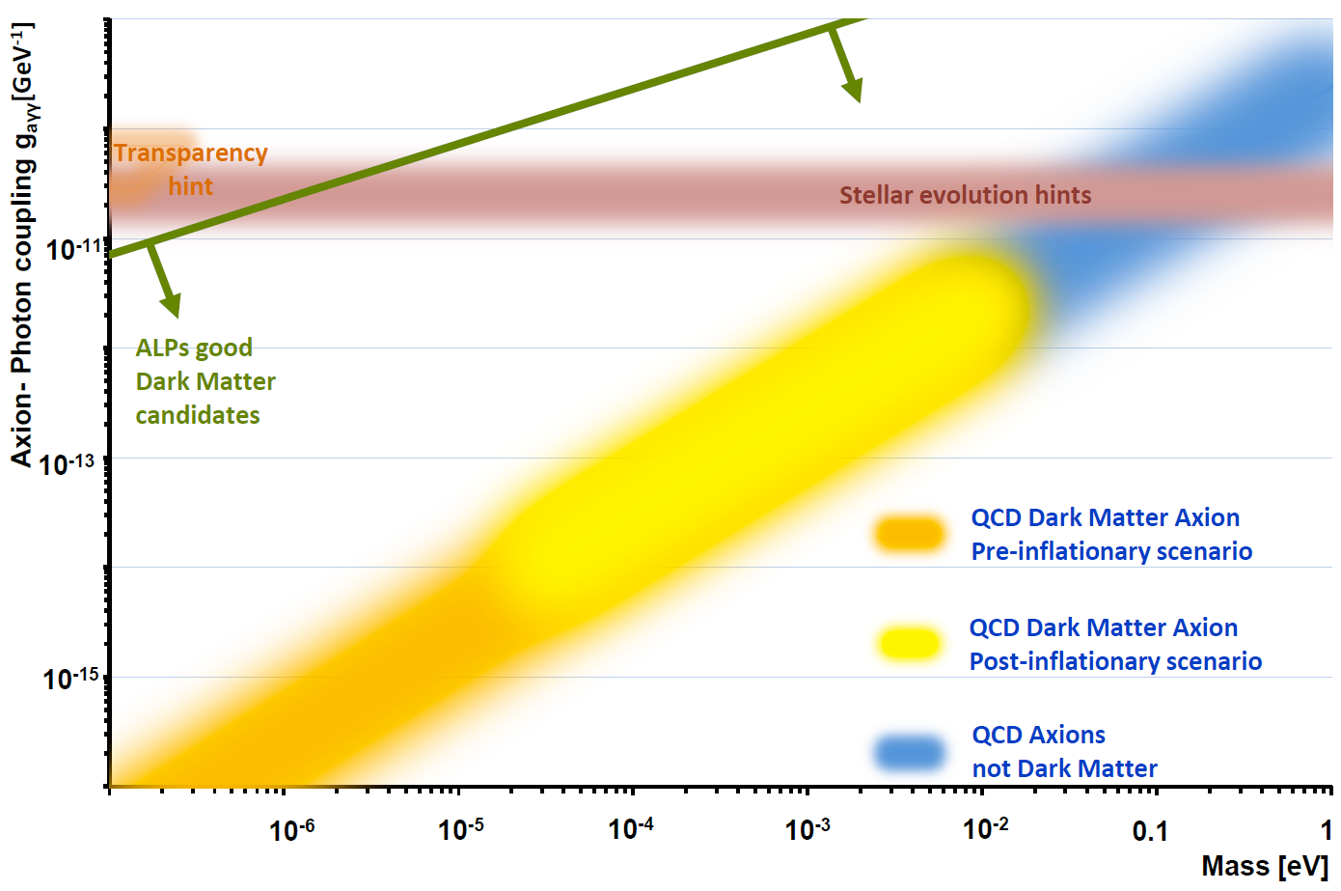
18

Slide 19
Motivation for axions and ALPs
strong CP problem
Solar (QCD) axions
QCD DM axion
(neV-1meV)
Axions and ALPs
TeV transparency / stellar cooling
Dark Matter
Stringy axions
[Hidden/Dark
photons]
New Fields (string theory)

Slide 20
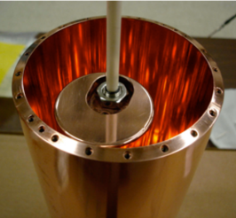
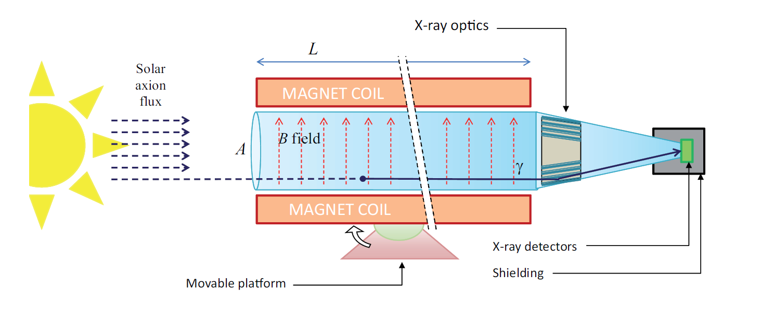
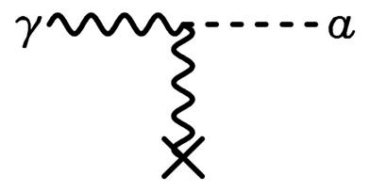
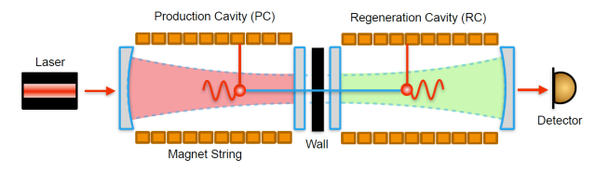
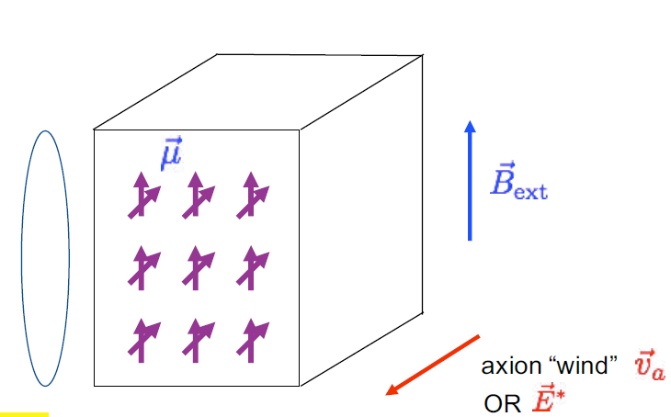

Experimental approaches:
Haloscopes - DM
Cavity Dish antenna
Dielectric haloscope
Helioscope – solar axions
Lab experiments - ALPs
Light shining through walls
LC circuit
NMR methods
Beam dump
5th force
Long range forces,
atomic transitions,…
Primakoff effect
$$B$$
Other couplings

Slide 21

Experimental efforts worldwide
CAST, OSQAR
CERN
Haystack
ABRACADABRA
Yale
IAXO,
MADMAX
ADMX
Seattle
ARIADNE
Reno
For sure not complete!
Tokyo
PVLAS Legnaro,
QUAX Frascati
CAPP
ORGAN

Slide 22
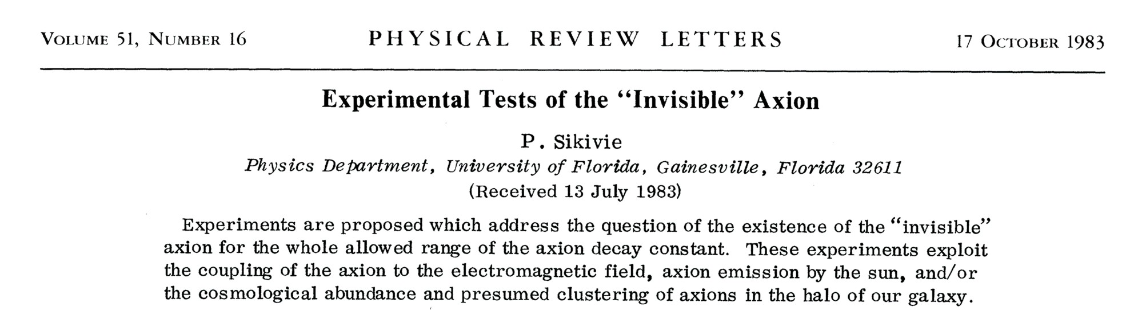

Primakoff effect:
Axion-photon transition in external
static E or B field
22

Slide 23


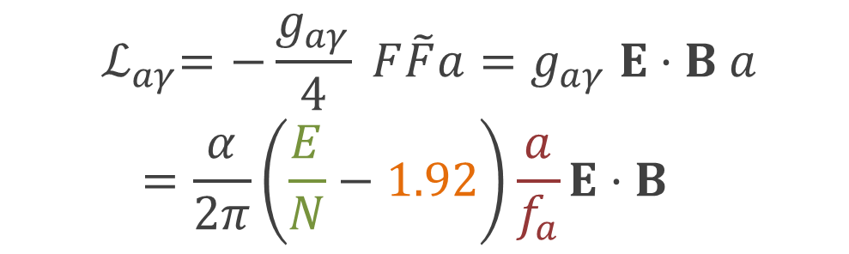


Axion to photon coupling
$${ ℒ}_{aγ}=−\frac{g_{aγ}}{4} F\tilde{F}a=g_{aγ} E⋅B a=\frac{α}{2π}\left(\frac{E}{N}−1.92\right)\frac{a}{f_{a}}E⋅B$$
$$γ$$
$$a$$
$$γ$$
Modifies Maxwell equations → Additional source term
$∇×B−\dot{E}=J+g_{aγ}$ $B\dot{a}$
→ in an external B-field the axion sources an E-field

Slide 24

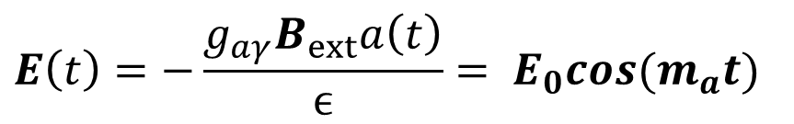
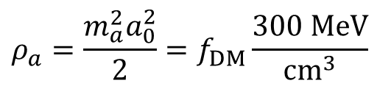

Axiont to photon coupling
$$γ$$
$$E\left(t\right)=−\frac{g_{aγ}B_{ext}a\left(t\right)}{ϵ}= E_{0}cos(m_{a}t)$$
$$a$$
$$γ$$
$ε$ is dielectric constant
With local dark matter density:
$$ρ_{a}=\frac{m_{a}^{2}a_{0}^{2}}{2}=f_{DM}\frac{300 MeV}{cm^{3}}$$
$$E_{0}=1.3×{10}^{−12}\frac{Volts}{meter} \frac{B_{ext}}{10 Tesla}C_{aγ}f_{DM}^{1/2}$$

Slide 25
Finding relic pool table oscillations
According to P. Sikivie, Physics Today 49, 12, 22 (1996)
25

Slide 26
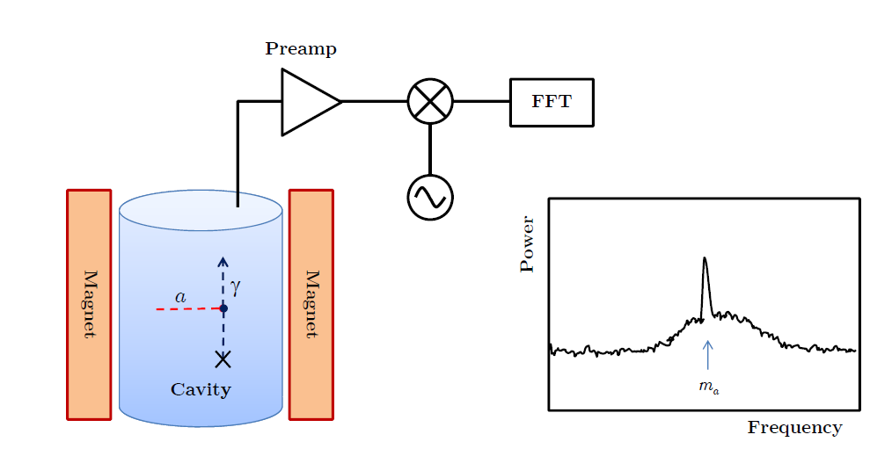



Experimental approach:
Cavity haloscope:
Primakoff effect
Additional source term to Maxwell equations
In resonant cavity:
enhancement of photon signal
by quality factor Q of cavity
$$B$$
$$B$$
$$P_{sig}=\left(B^{2}V Q_{cav}\right)\left(g_{aγγ}m_{a}{ ρ}_{a}\right)$$
ADMX: V~200 l:
Q-factor $2∙{10}^{5} B=8.5 T$
$$P_{sig,ADMX}≈{10}^{−23} Watts$$
Tuning of resonance frequency by movement of “tuning rod”

Slide 27
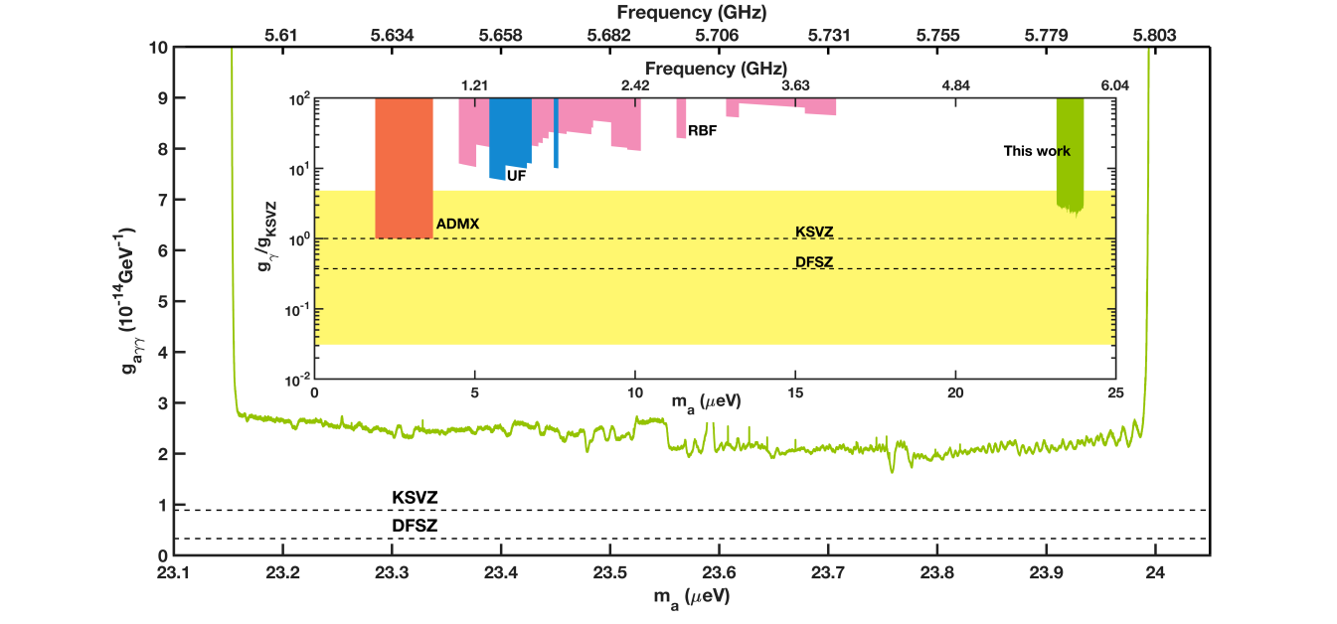
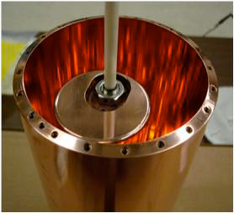
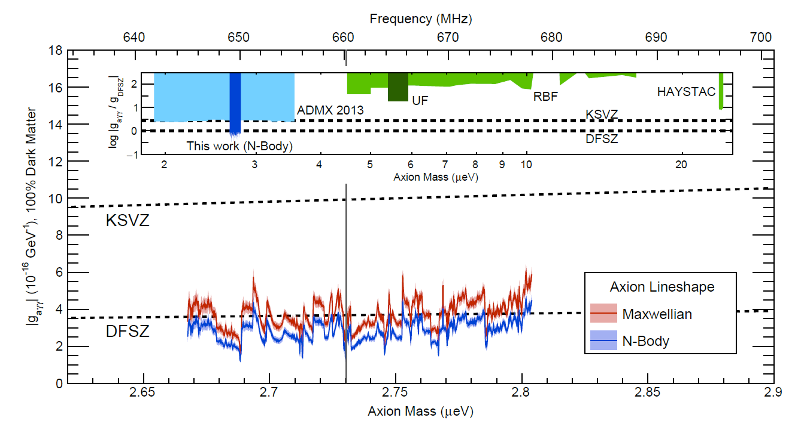
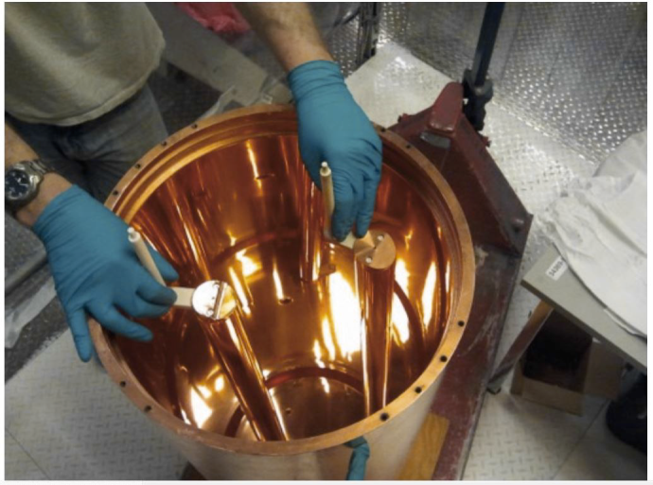
Experimental approach:
Cavity haloscope:
HAYSTAC
Phys. Rev. D 97, 092001 (2018) arXiv:1803.03690
ADMX
PhysRevLett.120.151301, arXiv:1804.05750
27

Slide 28
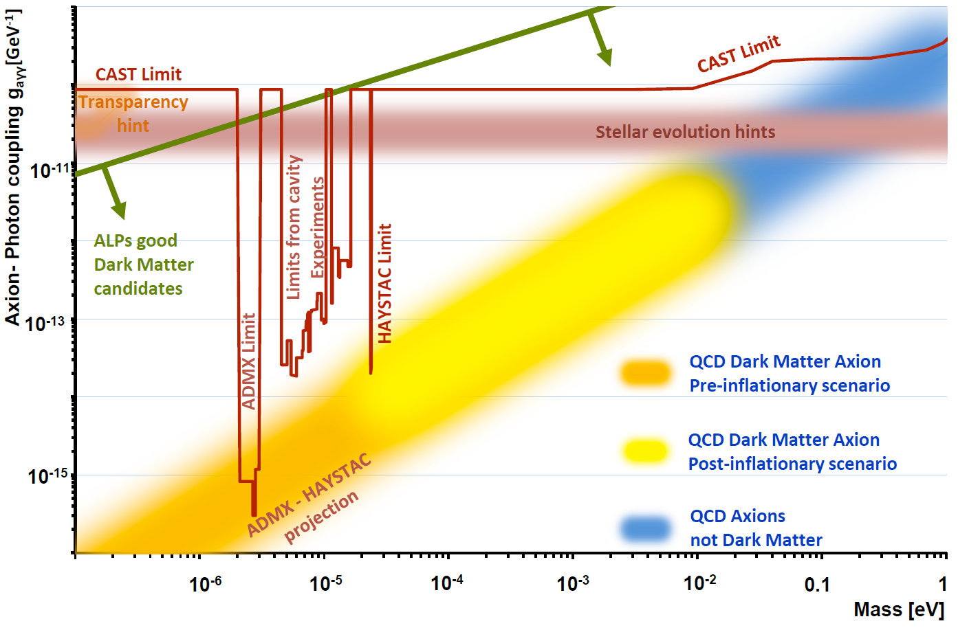
28

Slide 29
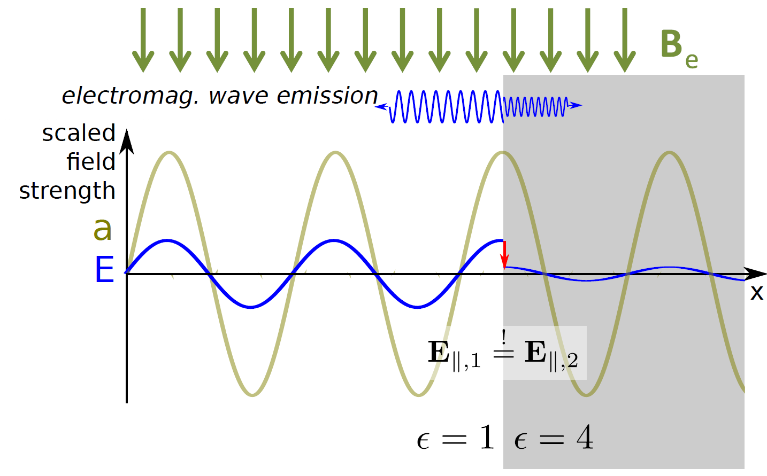

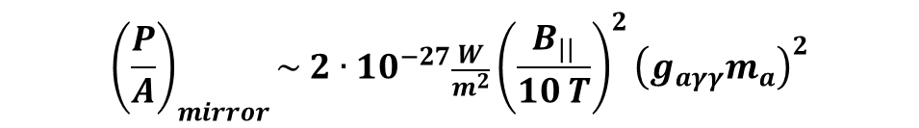
Experimental approaches: Effect of Dielectric
Mixing of axion with photon in extrenal B-field
→ Sources oscillating E-field
At surfaces with transition of ε: Discontinuity of E-field
→ Emission of photons
$$B$$
D. Horns, J. Jaeckel, A. Lindner, A. Lobanov, J. Redondo and A. Ringwald JCAP 1304 (2013) 016 [arXiv:1212.2970].
$${\left(\frac{P}{A}\right)}_{mirror}\sim 2∙{10}^{−27}\frac{W}{m^{2}}{\left(\frac{B_{||}}{10 T}\right)}^{2}{\left(g_{aγγ}m_{a}\right)}^{2}$$
29

Slide 30
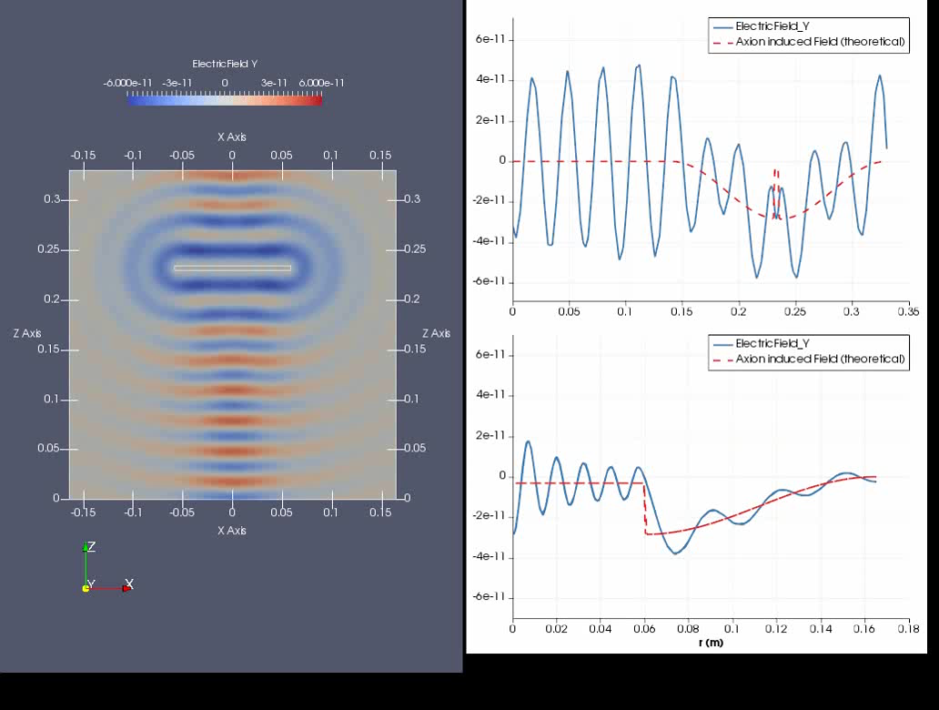
Simulation performed with ELMER
https://www.csc.fi/web/elmer
Emitted wave
Axion induced electric field oscillation
30

Slide 31
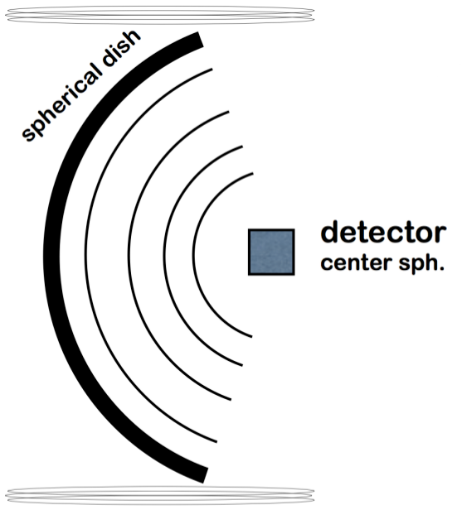

Experimental approaches
Dish antenna haloscope:
$$B$$
Broadband approach
Works independent of frequency (axion mass)!
For axion search:
Need large area or
Extremely sensitive detector
[BRASS @ Uni Hamburg/DESY]

Slide 32

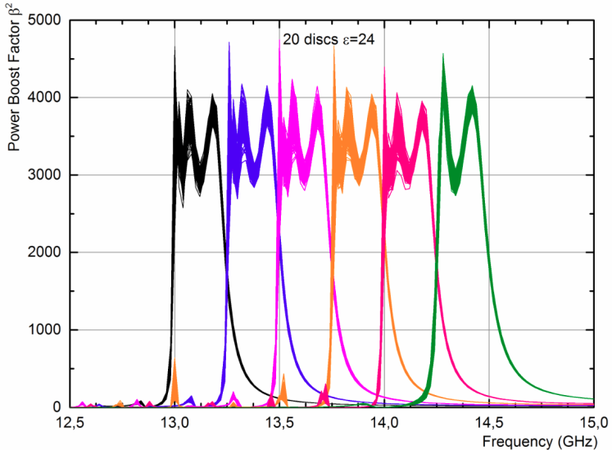


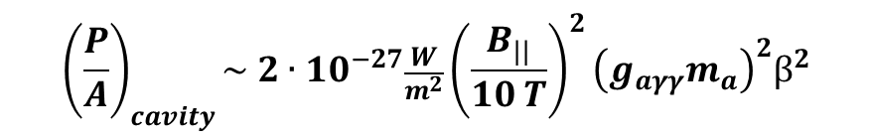
Experimental approaches
Dielectric haloscopes:
Mixing of axion with photon in extrenal B-field
→ Sources oscillating E-field
Many surfaces with transition of ε:
→ Coherent emission of photons from each surface
Interference effects can be exploited
$$B$$
A. Caldwell et al, Phys. Rev. Lett. 118, 091801 (2017)
$$β^{2}=\frac{P_{cavity}}{P_{mirror}}$$
“Quasi broadband” approach
$${\left(\frac{P}{A}\right)}_{cavity}\sim 2∙{10}^{−27}\frac{W}{m^{2}}{\left(\frac{B_{||}}{10 T}\right)}^{2}{\left(g_{aγγ}m_{a}\right)}^{2}β^{2}$$

Slide 33

Experimental approaches
Dielectric haloscopes:
Mixing of axion with photon in extrenal B-field
→ Sources oscillating E-field
Many surfaces with transition of ε:
→ Coherent emission of photons from each surface
Interference effects can be exploited
$$B$$
A. Caldwell et al, Phys. Rev. Lett. 118, 091801 (2017)
$$β^{2}=\frac{P_{cavity}}{P_{mirror}}$$
“Quasi broadband” approach
$${\left(\frac{P}{A}\right)}_{cavity}\sim 2∙{10}^{−27}\frac{W}{m^{2}}{\left(\frac{B_{||}}{10 T}\right)}^{2}{\left(g_{aγγ}m_{a}\right)}^{2}β^{2}$$
Also works for kinetic mixing
Sensitive to hidden photon,
no B-field needed

Slide 34

MAgnetized Disc and Mirror Axion eXperiment
Collaboration forming on 18th Oct. 2017
34

Slide 35



Collaboration forming at DESY, Hamburg
8 Institutes from France, Germany, Spain
Site: DESY Hamburg,
hall north
35

Slide 36

MAgnetized Disc and Mirror Axion eXperiment
~2m
Mirror
10 T dipole magnet
Horn antenna
(+ receiver)
80 adjustable dielectric discs
⊘: ~1m
Separate cryogenic volume
Parabolic Mirror
36

Slide 37







Dielectric disc, chose material:
  High dielectric constant $ε$ (for large boost & conversion)
  Low loss → low tan δ (reduce photon losses)
  Stable
  Cheap
  → Sapphire (Al₂O₃) @ 300K, 10 GHz:
$ε\sim 10; tan δ \sim { few∙10}^{−5}$
  → Lanthanide Aluminate (LaAlO₃) @ 77K
$ε\sim 24; tan δ\sim {3∙10}^{−5}$
  → Titanium dioxide – Rutil (TiO₂) @10 K, 8 GHz
$ε\sim 100; tan δ\sim$10⁻⁶
37

Slide 38




Chose dielectric material:
  High dielectric constant (for large axion/photon conversion factor)
  Low loss → low tan δ (in order to reduce photon loss)
  Stable
  Cheap
$ε_{}=9.35;tan δ$= 3·10⁻⁵
$ε_{=}=11.53;tan δ=\text{= }\text{8.6}\text{·10}\text{−5}$
  → Sapphire (Al₂O₃) @23 C, 10 GHz:
  → Lanthanide Aluminate (LaAlO₃)
IEEE Trans. Ultrasonics, Ferroelectrics, and Freq. Control, vol. 57, no. 10, October 2010
  → Titanium dioxide – Rutil (TiO₂)
$ε_{}\sim 100;tan δ$ = ?
38

Slide 39



Chose dielectric material:
  High dielectric constant (for large axion/photon conversion factor)
  Low loss → low tan δ (in order to reduce photon loss)
  Stable
  Cheap
$ε_{}=9.35;tan δ$= 3·10⁻⁵
$ε_{=}=11.53;tan δ=\text{= }\text{8.6}\text{·10}\text{−5}$
  → Sapphire (Al₂O₃) @23 C, 10 GHz:
  → Lanthanide Aluminate (LaAlO₃)
  → Titanium dioxide – Rutil (TiO₂)
${@10K: ε}_{}>100;tan δ$ ~ 10⁻⁶

Slide 40


The receiver, Heterodyne detection:
Signal analyzer
(4 samplers, 1.4% dead time)
Front end mixers and amps
Fake axion
LHe bath
→ 4K T_{He} + 5.5K T_{Amp}
= 9.5K T_{Sys}
40

Slide 41



Low Noise preamp, HEMT
  s: Signal
  T: Testfunction
  (Lorentz, Gauss, …)
Inject fake 18GHz axion signal with 10⁻²² W power
Measurement for 28 hours (integrate signal):
Receiver at LHe temp.
Cross correlation analysis (8kHz Lorentz shaped)
found ~5σ signal succesfully
For 1 week measurement:
Sensitivity at the level of ~ few 10⁻²³ W

Slide 42


Removable copper mirror
Booster response, Reflectivity
Dielectric discs
(Saphire)
„Ab-sorber“
Horn antenna
Mirror
42

Slide 43

Booster response, Reflectivity
43

Slide 44



20 disc setup:
Now available:
Reflectivity measurements with up to 20 discs
First results:
Reproducibility of positioning without algorithm: ~ µm
44

Slide 45


Disc positioning, reproducibility
45

Slide 46





Slide 47
Simulations and understanding of 3D effects
1D simulations:
Boost factor ok
10µm precision of discs fine
Diffraction effects under control
3D effects?
47

Slide 48

Simulations and understanding of 3D effects
COMSOL and ELMER: modify Maxwell equations
1st step: reproduce emission from Mirror → good agreement
Ongoing work: Mutiple discs, tiled discs,…
48

Slide 49

The Magnet
B²·A ≳100 T²m² over 2m
100 T²m² dipole magnet:
first ever
→ Design Study
→ Prototype
→ Full scale magnet
Innovation partnership: First in MPG
Tedious 16 months EU tendering process: Aug. 2016 – Dec 2017
Two innovation partners:
CEA-IRFU Saclay, France
Bilfinger Noell, Würzburg
One tender for whole magnet project!
49

Slide 50

The Magnet
Design studies: investigate options
50

Slide 51

The Magnet
Design studies: investigate options
51

Slide 52





The Magnet
Block design
Block design
Cos Theta design
FoM > 100 T²m² can be reached using NbTi:
9T 1.25 m² aperture:
Homogeneity acceptable
Forces under control
Quenching behavior ok
52

Slide 53

The Magnet
Weight: < 200.000 Kg
Length: 6900 mm
Diameter: 4400 mm
Warm bore: 1350* mm
Superconducting cable: 35.000 m
Superconducting wire: > 700.000 m NbTi
Operating temperature: ~2 K
So far no show stoppers, the show goes on!
53

Slide 54

The (prototype) Booster
The challenge:
disks positioning ~10µm precision
T ~ 4K B~ 10K
Use Piezo motors
→ R&D

Slide 55

The (prototype) Booster
Build prototype with 20 discs, 30cm diameter
Use inside prototype ( few T) magnet:
Test feasibility of 1m² booster
First physics results
Antenna
VERY PRELIMINARY DESIGN!
Parabolic mirror
:
Mirror + Discs + Mechanics
55

Slide 56



The (prototype) Booster
Discs with 1m² surface →Tiling needed
→Glueing
→Properties of glue?
Bigger tiles are better!

Slide 57


@ DESY HERA hall north
offered to host MADMAX
Cut
ALPS IIc (valve box)
HERA distribution box
H1 cold box
HERA
HERA yoke
and control room available
concrete
ALPS IIc
concrete
Iron yoke
Electronic Trailer
57

Slide 58


@ DESY HERA hall north
Cryogenic infrastructure under preparation
Cut
ALPS IIc (valve box)
HERA distribution box
H1 cold box
HERA
concrete
ALPS IIc
concrete
Iron yoke
Electronic Trailer
58

Slide 59

sensitivity projection
59

Slide 60



The sequel continues
2018-2020
Finish Proof of principle phase,
full understanding of 3D effects
2018-2022
Prototype magnet & booster
Integration, first physics runs,
search for ALPs and hidden photons
Afterwards:
Build final magnet
Build final booster
→ Start scanning 10-30GHz
(40-120 µeV) range
60

Slide 61



CONCLUSION
Axions could solve strong CP and DM problems
ALPs are DM candidates,
could solve Astrophysical inconsistencies
Axion mass range 30-400 µeV very well motivated, previously no experimental concepts available!
Dielectric haloscope could cover ~30-400 µeV axion/ALP mass rang
MADMAX collaboration formed in Oct. 2017
Magnet seems feasible
So far no show stoppers found
MADMAX, to be continued!
61

Slide 62


The Magnet
Homogeneity
+ 2.4 % / -3.0 %
+ 4.6 % / -1.7 %
62

Slide 63




The Magnet
The Forces
<200 Mpa Ppeak stress in conductor
<300 Mpa peak stress in yoke
→ Accepatble!
63

Slide 64

Axion spectra from different sources
Plot taken from Review, arXiv:1801.08127
“New experimental approaches in the search for axion-like particles”
tbp in Prog. Part. and Nucl. Phys. by I. Irastorza and J. Redondo
64

Slide 65


Slide 66

66

Slide 67

In the very early early Universe: U(1)_{PQ} good quantum number
@ $f_{a}$>~ 10⁹ GeV: Peccei Quinn symmetry broken
→ in every causually connected region field „rolls“to arbitrary value of $Θ$
@ T~ 1GeV: Realignment of CP due to QCD phse transition: topological suceptibility/ instanton gas kicks in

