Slide 1
La Physique des ions lourds Quelle stratégie pour demain ?
Sarah Porteboeuf-Houssais
Journée division Champs et Particules
Société Française de physique
22/11/2018 - LPNHE

Slide 2
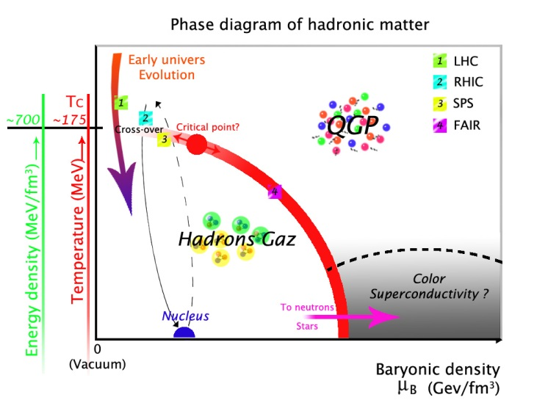
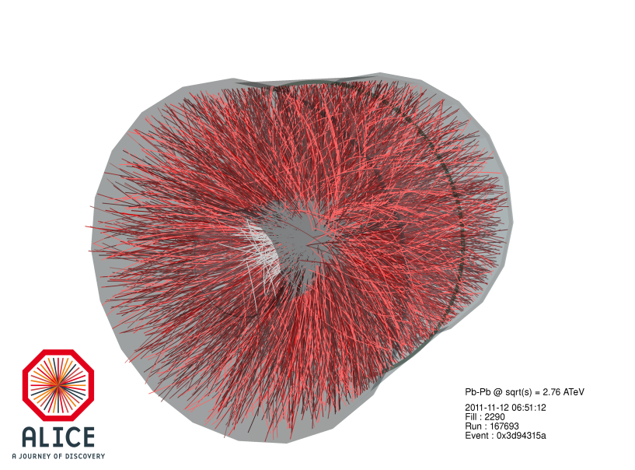
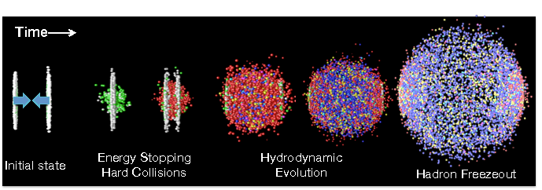
Le Plasma de Quarks et de Gluons
QGP: état déconfiné de quarks et de gluons produit dans les collisions d’ions lourds à hautes énergies (RHIC/LHC)
Son étude nécessite une déconvolution des autres composantes (état initial, effet nucléaire froid, état final)
Étude systématique de plusieurs observables dans plusieurs conditions (systèmes pp, p-A, A-A) inputs théoriques nécessaires

Slide 3
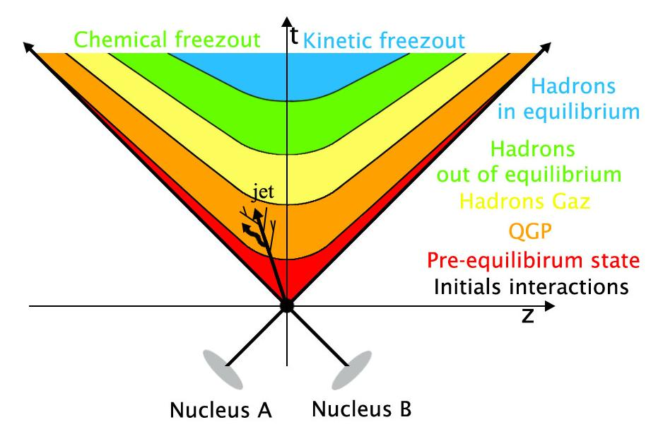
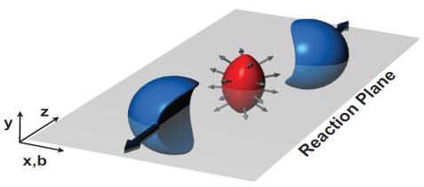
Les observables
Sondes molles, à bas p_{T}
Relatives à l’expansion et hadronisation du QGP.
Par exemple :
Augmentation étrangeté
Corrélations longues portées
Augmentation des photons directs
Écoulement anisotropique (flow v₂)
Sondes dures, produits à plus haut p_{T} lors de l’interaction initial. Suivant leurs natures ces sondes interagissent avec le QGP éventuellement formé. Par exemple :
Jet quenching
Facteur de modification nucléaire (R_{AA})
Quarkonia (supression/régénération)
Propagation dans le milieu des saveurs lourdes ouvertes
Sondes électromagnétiques

Slide 4
Contexte et communauté française
Le QGP est étudié depuis ~20 ans, ce domaine a beaucoup progressé. Restera-t-il des questions fondamentales à adresser après les Runs 3 et 4 au LHC ?
La communauté francaise s’est posé cette question à l’occasion des Rencontres QGP-France en Juillet 2018 (https://indico.cern.ch/event/706294/)
Saclay
ALICE
Théorie
Orsay
ALICE
LHCb
Théorie
Strasbourg
ALICE
Nantes
ALICE
Théorie
Palaiseau
CMS
LHCb
Théorie
5 groupes de travail et une table ronde, inputs pour la contribution IN2P3 à ESPP
(Cynthia Hadjidakis et Fréderic Fleuret coordinateurs)
Sondes molles (M. Guilbaud)
Clermont-Ferrand
ALICE
Grenoble
ALICE
Théorie
Sondes durs : Jets et Gamma (G. Conestra Balbastre)
Lyon
ALICE
Théorie
Sondes durs : saveurs lourdes (J. Castillo)
Petits systèmes (S. Porteboeuf-Houssais)
QCD froide (M. Winn)
+ Connexions avec le GDR QCD
Disclaimer : retour avec 30min de présentation + 1h discussion => quelques focus

Slide 5
Sondes durs : saveurs lourdes
$$R_{AA}=\frac{dN_{AA}/dp_{T}}{{<N}_{coll}>dN_{pp}/dp_{T}}$$

Slide 6
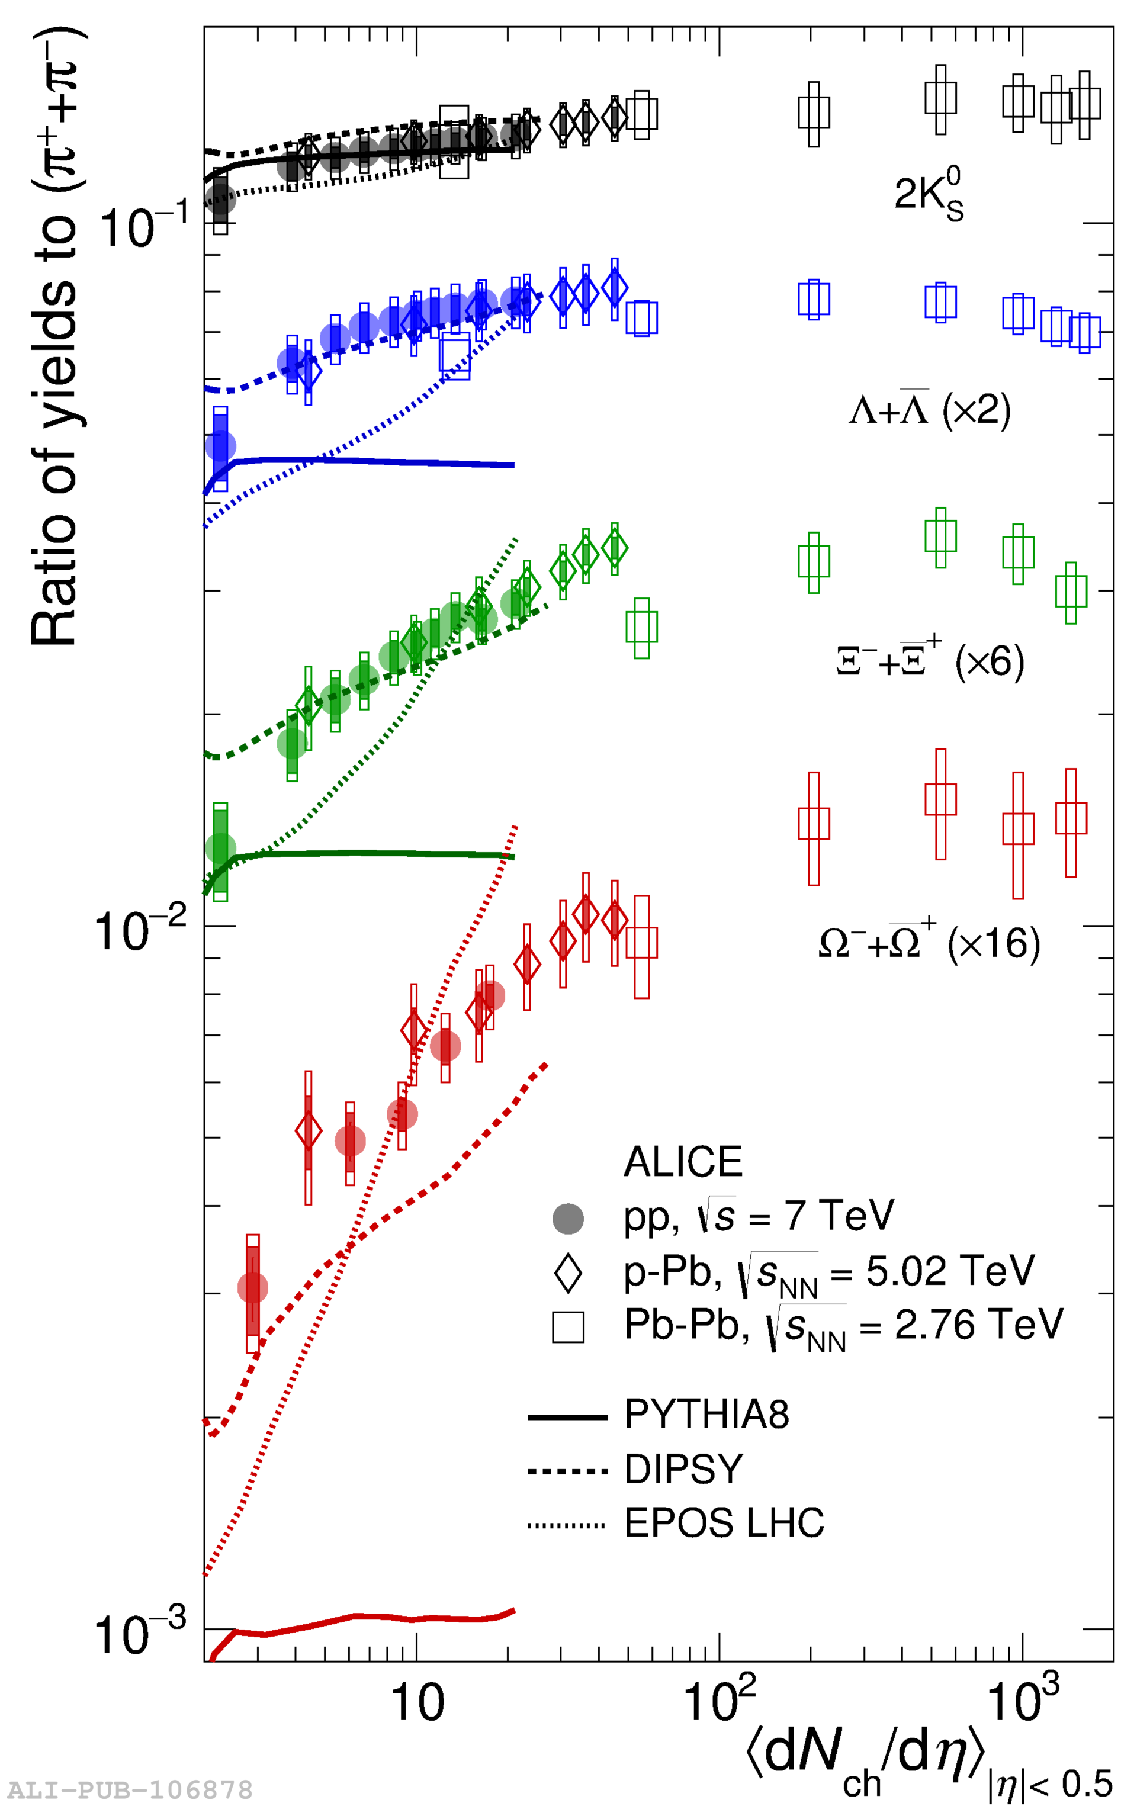
What is a small system for QGP physics?
Nature Physics 13 (2017) 535-539
”small” refers to system size: protons in initial stage
But with sometimes a final state looking like a large system, at least for charged particle multiplicity
For LHC RUN 1+2 energies, idea of reference system still valid for pp minimum bias. High multiplicity events represent a small contribution to the total cross section
O(10⁻⁴) in statistics

Slide 7
Sign of QGP in small systems at LHC ?
Table prepared by the WG small systems from the HL/E-LHC working group
See the yellow report, in preparation, for references (140)
Observable of effect | Pb-Pb | pPb (high mult) | pp (high mult)
SOFT Probes
low p_{T} spectra ("radial flow") | yes | yes | yes
Intermediate p_{T} ("recombination") | yes | yes | yes
HBT radii | R_{out}/R_{side}~1 | R_{out}/R_{side} ≤ 1 | R_{out}/R_{side} ≤ 1
Azimuthal anisotropy (v_{n}) (2 prt. correlations) | v₁-v₇ | v₁-v₅ | v₂-v₄
Characteristic mass dependence | v₂-v₅ | v₂-v₃ | v₂
Higher order cumulants | "4~6~8 " + higher harmonics | "4~6~8 " + higher harmonics | "4~6 "+ higher harmonics
Event by event v_{n} distributions | n=2-4 | Not measured | Not measured
Event plane and v_{n} correlations | yes | yes | yes
HARD Probes
Direct photons at low-p_{T} | yes | Not measured | yes
Jet Quenching | yes | Not observed | Not observed
Quarkonia | J/Ψ regeneration / Υ supression | suppressed | Not measured
Heavy-flavor anisotropy | yes | yes | Not measured

Slide 8
QGP et collisions hadroniques
Observe-t-on des gouttelettes de QGP dans les petits systèmes ?
Collectivité vs. QGP
Quid de l’interaction des sondes dures avec une gouttelette de QGP ?
Quel mécanisme de l’état initial permettrait d’atteindre la densité d’énergie associée à la transition de phase dans les petits systèmes ? Est-ce le même
Dans quelle mesure les collisions hadroniques à hautes énergies peuvent être décrites avec un seul formalisme ?
Les petits systèmes : non pas une énième sonde du QGP mais une redéfinition du sujet
Question centrale de l’émergence de la collectivité dans les collisions hadroniques

Slide 9
sarah.porteboeuf@clermont.in2p3.fr

Slide 10
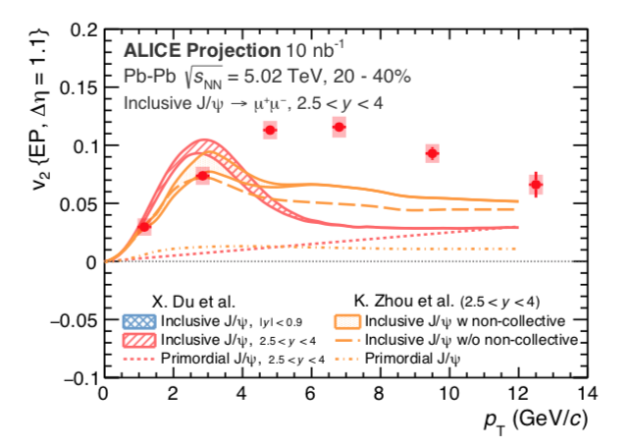
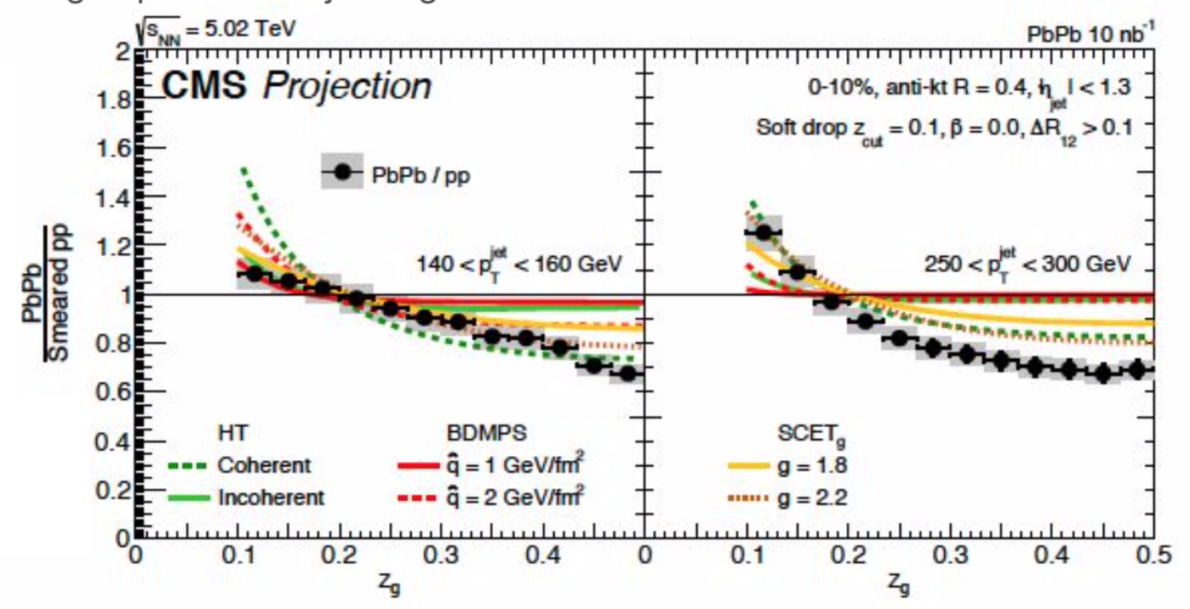
RUNS 3/4
Augmentation en énergie, augmentation en luminosité, augmentation en statistique
Bénéfice des upgrades (particulièrement pour ALICE et LHCb)
Des questions identifiées (effort expérimental et théorique)
Is there a common origin of soft particles production from pp to AA collisions? Is the prevailing description via fluid dynamics the correct approach? What is the dynamical origin of collectivity?
Can signatures of chiral symmetry restoration be found and thermal radiations of a QGP be identified?
How can jet and jet-substructure measurements characterize medium properties?
Do heavy flavours contribute to the medium dynamics and how do they probe the medium properties?
How far can we improve the knowledge of initial state?
How can we progress in the precise determination of parameters calculable from first QCD principles with refined measurements of very exclusive observables?
Physics case détaillé dans les Yellow reports du CERN

Slide 11
Et après? Quelques idées
Courtesy of G. Conestra Balbastre

Slide 12
Et après? Quelques idées
System scan
Cover a wide range of systems (pp, pA and AA) with various nucleus
O-O as a ”light heavy-ion” a good candidate
Energy scan
Cover a wide range of energy with pp and pA at the same energy as AA
Perform all measurements in multiplicity classes, multiplicity differential
The highest multiplicity classes are the more interesting for small systems, analysis are statistic consuming => Dedicated triggers and high lumi
Go toward more exclusive observables : full tomography of the final state
B_{c} and 𝝌_{c}
Systematic data/data and data/theory comparisons from all systems and all energies

Slide 13
What’s next ? LHC Run 5/6
ALICE upgrades ?
Not yet an official proposal
for a 4𝜋 compact silicium detector with very low momentum resolution (p_{T} > 20 MeV) with PID and TOF
Ideal for charged tracks, photons and electrons
LHCb upgrades ?
Physics case (https://arxiv.org/abs/1808.08865)
plan to run with the actual CMS/ATLAS lumi (10³⁴ pile-up 30/40) with the HLT developed for Run 3/4 (very fine event topology selection)
Providing reconstruction software development LHCb could be able to measure central heavy ion collisions at Run 5/6.

Slide 14
What’s next ? LHC Run 5/6
CMS upgrades ?
Hermeticity with low material budget.
Potential for dedicated run at ”low” lumi and low B field (low p_{T}).
Tagger = TOF PID at low pile-up ?
Already planned for Run 4 p/K/𝜋 with 0.7 <p_{T}< 3-4 GeV/c
https://indico.cern.ch/event/726024/
ATLAS upgrades ?
Not evaluated

Slide 15
What’s next ? Fixed target at LHC
AFTER program
arXiv.org:1807.00603
√s = 115 GeV for pp, pd,pA and √s = 72 GeV for Pbp, Pbd, PbA
High luminosity => high stat
2 programs: LHCb (already existing with SMOG) and ALICE
Multiplicity class reached with the available luminosity to be estimated
LHCb in RUN 3+4: increase by a factor 100 with SMOG2
Rich program in the quarkonia and open-heavy flavor sector
Rich program for the low-x physics
If high multiplicity reached at lower energy (below RHIC), interesting system scan to study the onset of collectivity

Slide 16
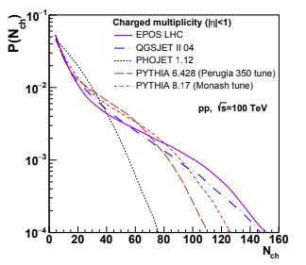
What’s next ? CERN HE-LHC/FCC/SPPS
Increase in multiplicity, increase in energy density
=> Increase in collision energy
Future colliders at energies greater than LHC: natural continuation for emergence of collectivity study
Physics at a 100 TeV pp collider: Standard Model processes arXiv:1607.01831v1
HE-LHC; upgrade LHC with FCC technology, 27 TeV, earliest possible physics starting date : 2040*
FCC-hh, 100 TeV, earliest possible physics starting date : 2043*
SPPS, chinese project at 100 TeV, FCC like
* ECFA meeting, FCC report, Michael Benedikt
https://indico.cern.ch/event/667672/contributions/2730846/attachments/1560446/2456317/171117_FCC-Status_Berlin_ap.pdf

Slide 17
What’s next ? EIC
Electron Ion Collider, first physics beam in 2027 (~10 years)
Interest for QGP/heavy-ion physics
Initial state (CGC, nPDF)
Hadronization
Centrality definition

Slide 18
Conclusions
Les Runs 1 et 2 du LHC très riches pour la physique des « ions lourds »
Perte d’énergie dans le milieu, recombinaisons du quark c, jet engineering, …
Signe de collectivité dans les petits systèmes
Runs 3 et 4 seront également très riches
Il restera beaucoup à faire pour étudier l’émergence de la collectivité
Au niveau expérimental : scan en énergie, scan en système
Au niveau théorique
De nombreux programmes d’intérêt pour la communauté « ions lourds »
La physique hadronique à FAIR-GSI
Les programmes sur cibles fixes au LHC (115 GeV)
Les expériences au SPS (NA60+)
Les expériences du LHC pour les runs 5 and 6
Le programme de collisionneur électron-ion à RHIC ou Jlab (EIC)
High-Energy LHC (HE LHC pp @ 27 TeV)
Future Circular Collider au CERN (FCC pp @ 100 TeV)

Slide 19
Sondes durs : saveurs lourdes

Slide 20
Sondes durs : saveurs lourdes

Slide 21
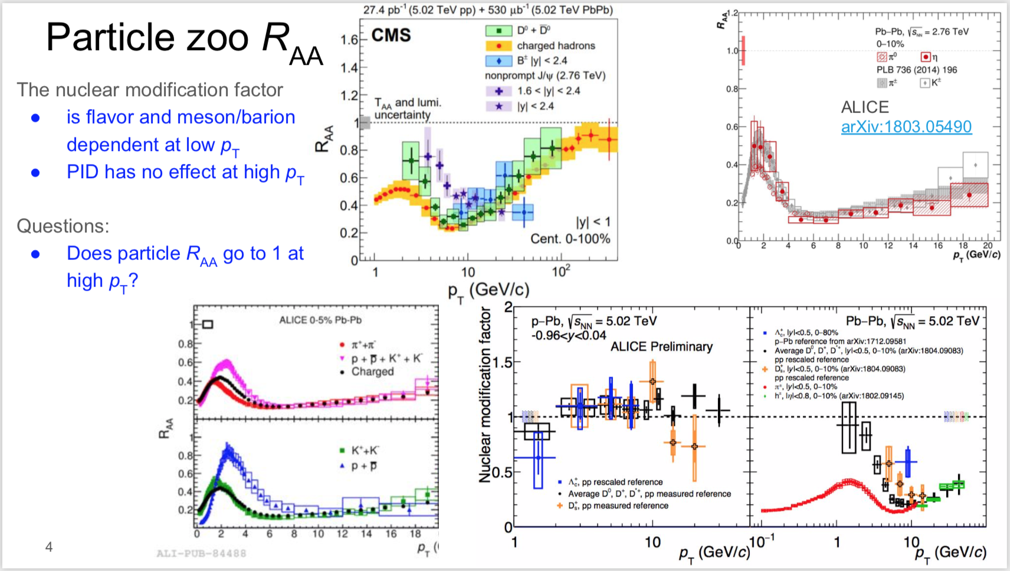
Sondes durs : Jets et Gamma
Courtesy of G. Conestra Balbastre

Slide 22
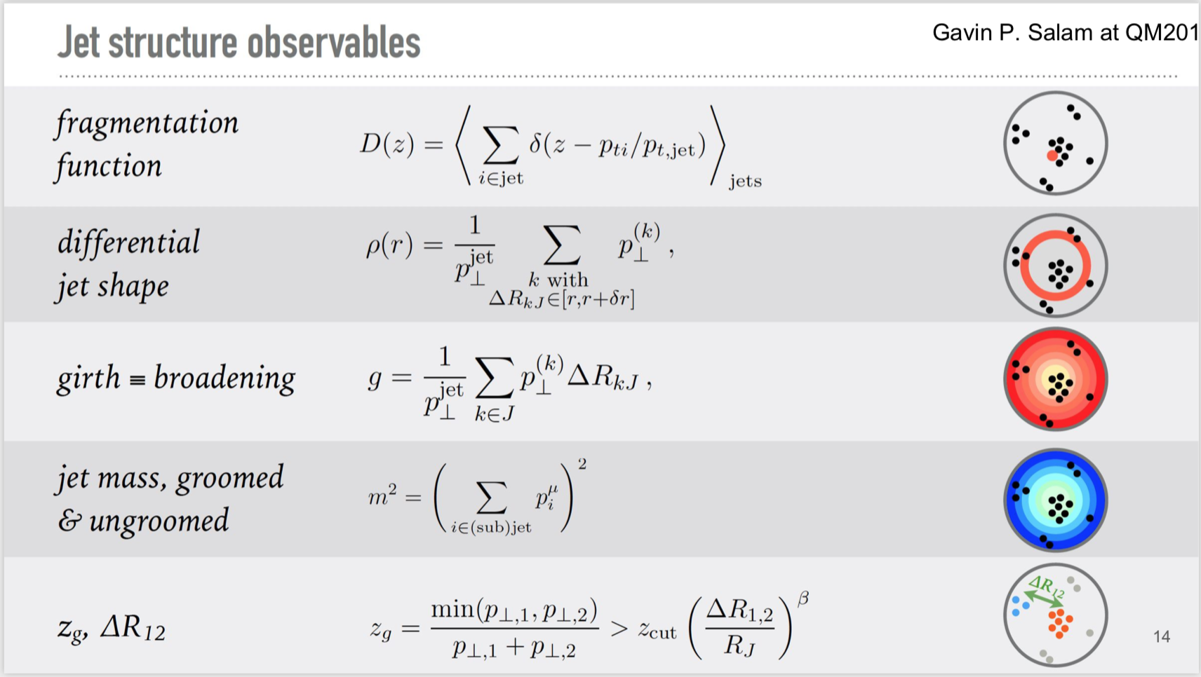
Sondes durs : Jets et Gamma
Courtesy of G. Conestra Balbastre

Slide 23
Quark-Gluon Plasma
Is the measurement the consequence of the evolution of a hydrodynamic fluid?
Warning: hydro application do not necessarily imply QGP
Hydro requires R_{e} >> 1 => small $\frac{η}{s},$ with $R_{e}$ the Reynolds number:
R: characteristic spatial dimension
$v$: characteristic velocity
$ν=\frac{η}{ρ}$: kinematic velocity
$η$: shear viscosity
$s$: entropy density
$$R_{e}=\frac{Rv}{ν}=\frac{Rv}{η/ρ}=\frac{RvT}{η/s}$$
Small $η/s$ (<0.2) is a feature of observed QGP
sarah.porteboeuf@clermont.in2p3.fr

Slide 24
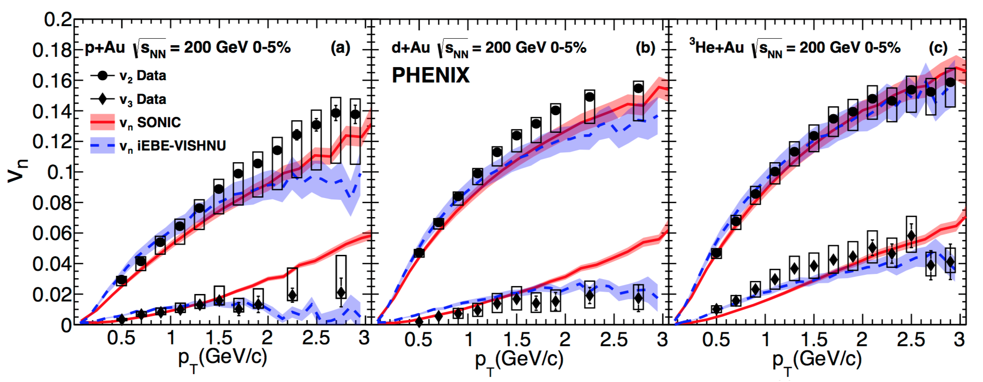
Sign of QGP in small systems at RHIC?
arXiv:1805.02973
PHENIX claim for QGP in small systems …
arXiv:1805.09342
… also explained by CGC.
sarah.porteboeuf@clermont.in2p3.fr

Slide 25
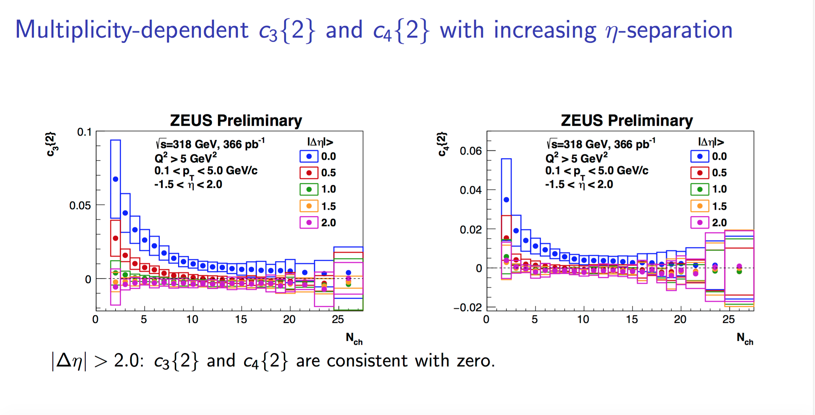
Sign of QGP in very small systems ?
QM2018, Yen-Jie Lee
LEP e⁺e⁻ √s=91 GeV
High mult = 55 particles in |η|<5
No ridge observed, compatible with PYTHIA
QM2018, Jacobus Onderwaater
HERA ep √s=318 GeV
High mult = 35 particles in -1.5<η<2
No observation of 2-particle correlations, compatible with Ariadne (dipole cascade model) and Lepto (Lund string)
sarah.porteboeuf@clermont.in2p3.fr

Slide 26
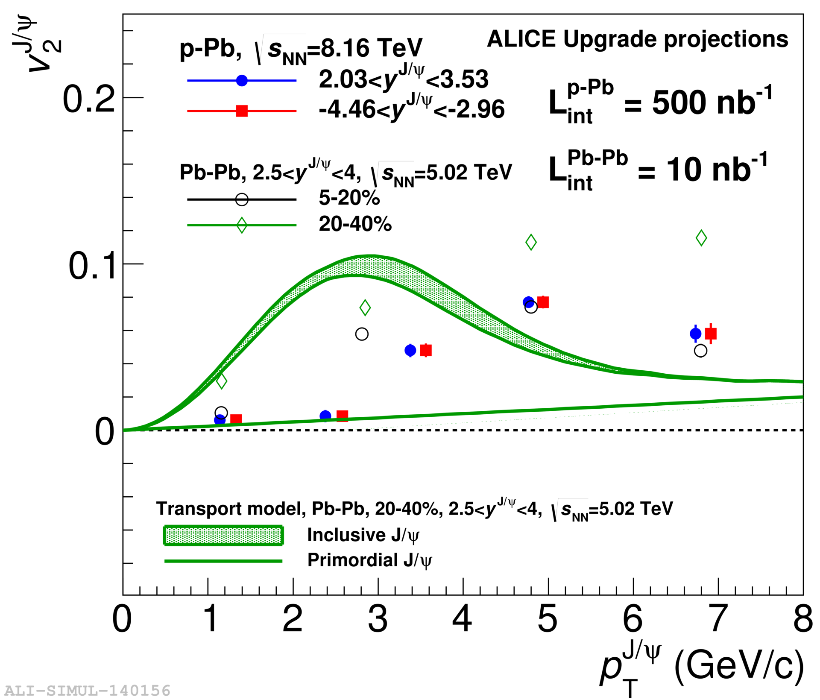
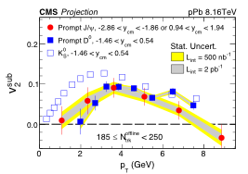
Run 3+4: Flow/Correlations https://indico.cern.ch/event/686494/contributions/3034636/attachments/1670133/2678939/HEHLLHCWorkshop_v3.pdf
Precise control over IS (geometry/fluctuations) and FS effects
Onset of collectivity
Test various description (hydro, CGC)
Non-flow v_{n} measurements
Symetric cumulants w and wo subevents
ID v_{n} (light, strange, charm, beauty)
sarah.porteboeuf@clermont.in2p3.fr

Slide 27
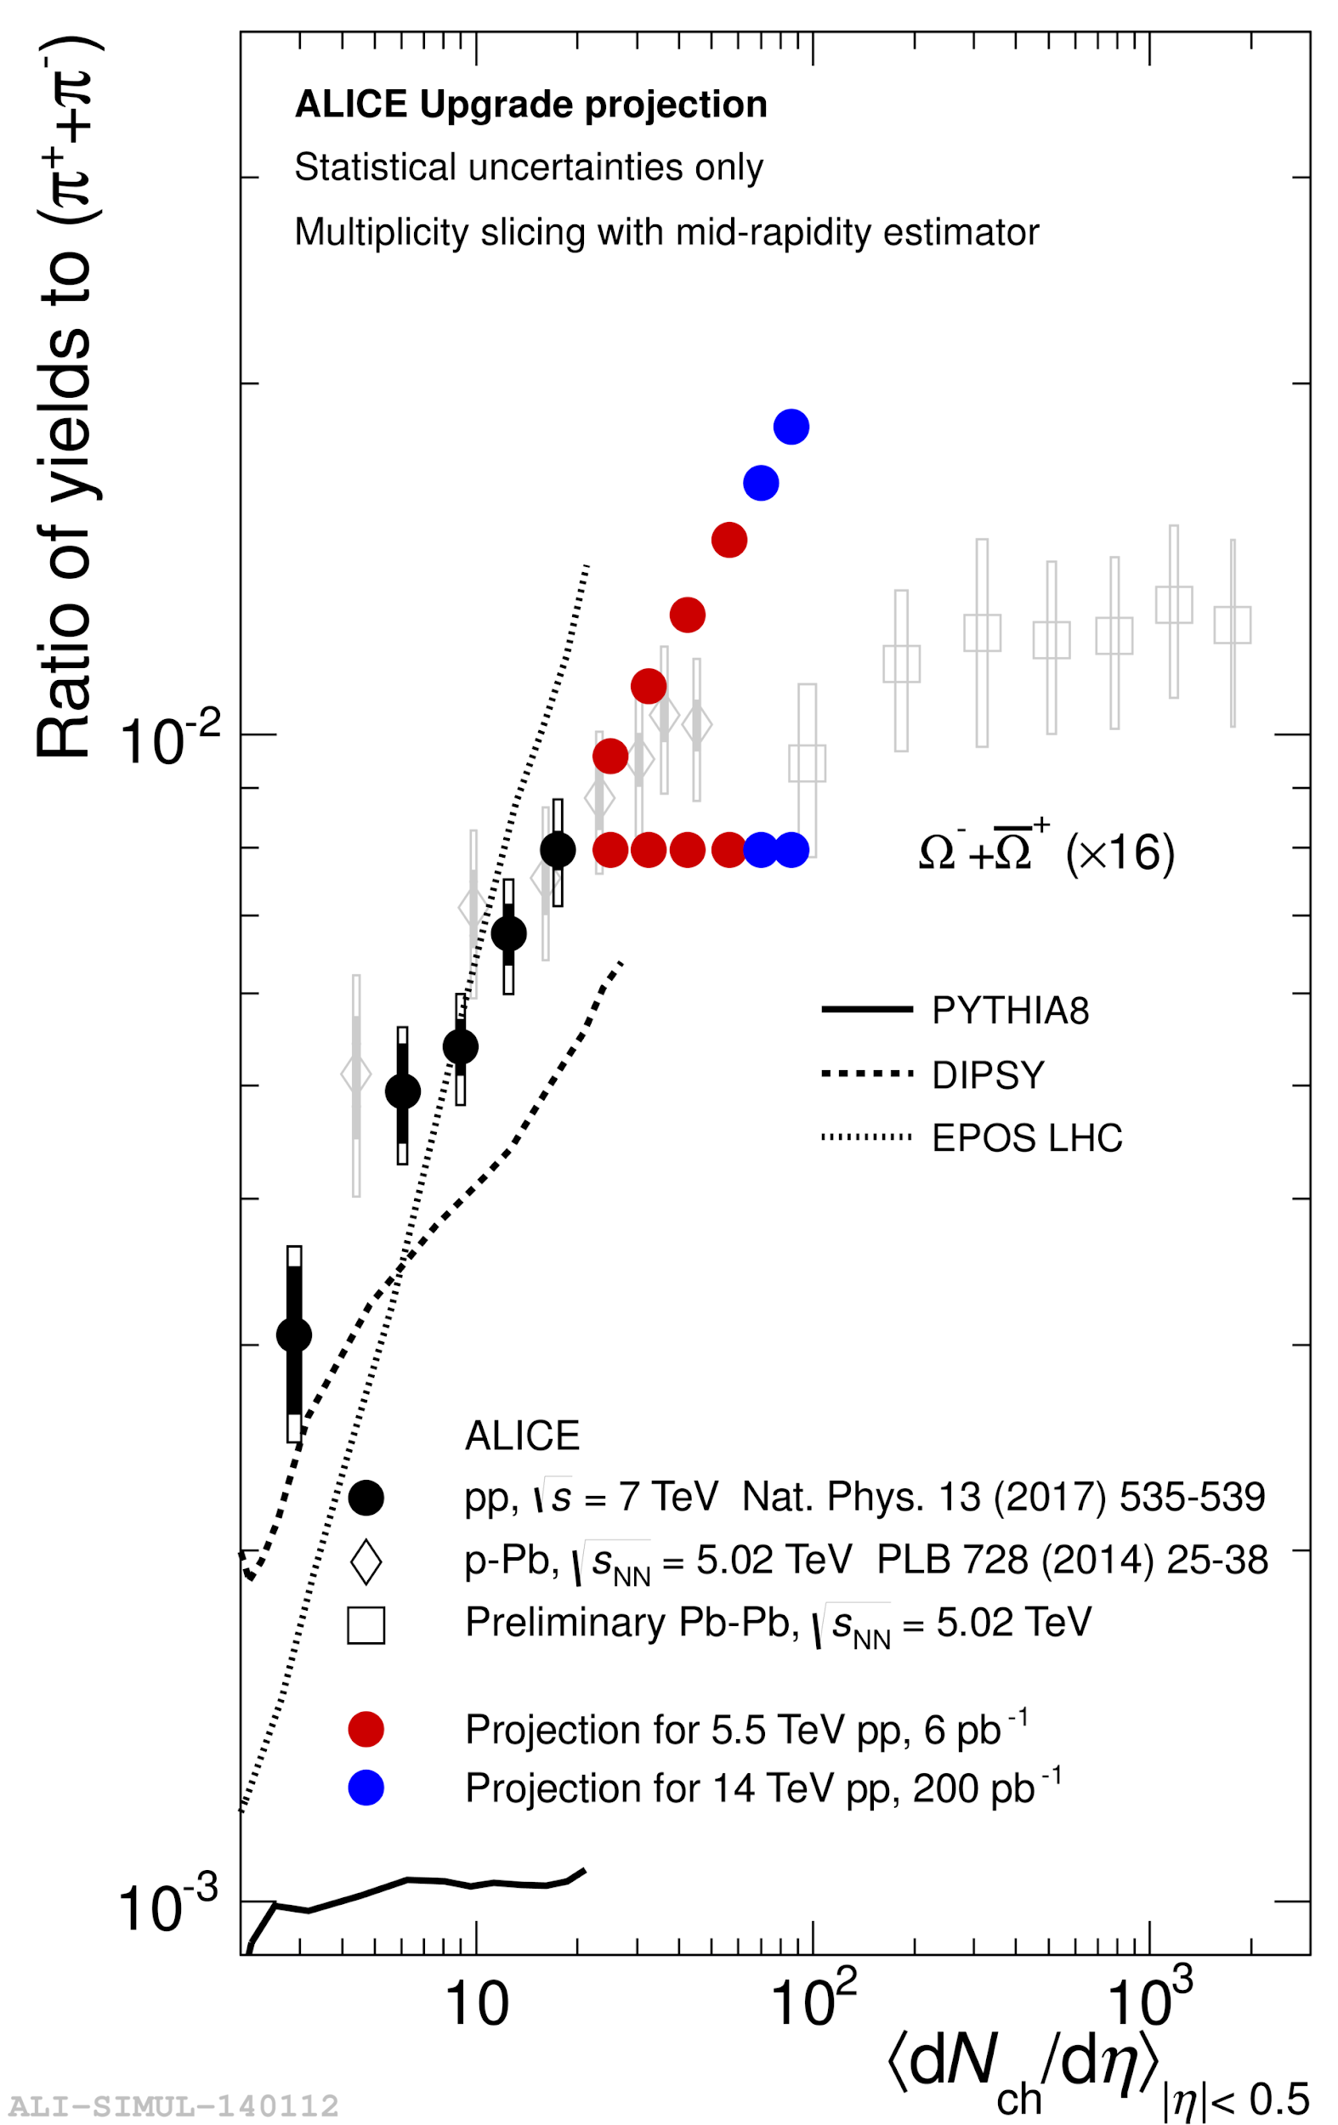
Run 3+4: Strangeness enhancement
https://indico.cern.ch/event/686494/contributions/3034636/attachments/1670133/2678939/HEHLLHCWorkshop_v3.pdf
Smooth transition between pp, pPb and PbPb
Is the grand canonical limit reached?
sarah.porteboeuf@clermont.in2p3.fr

Slide 28
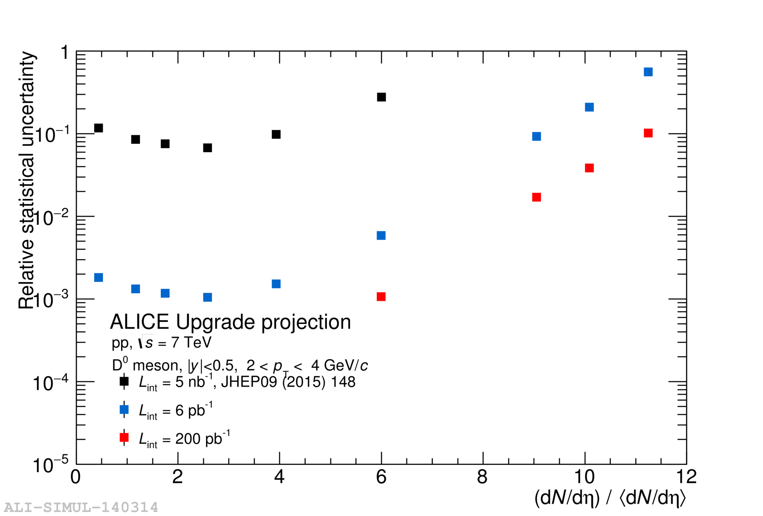
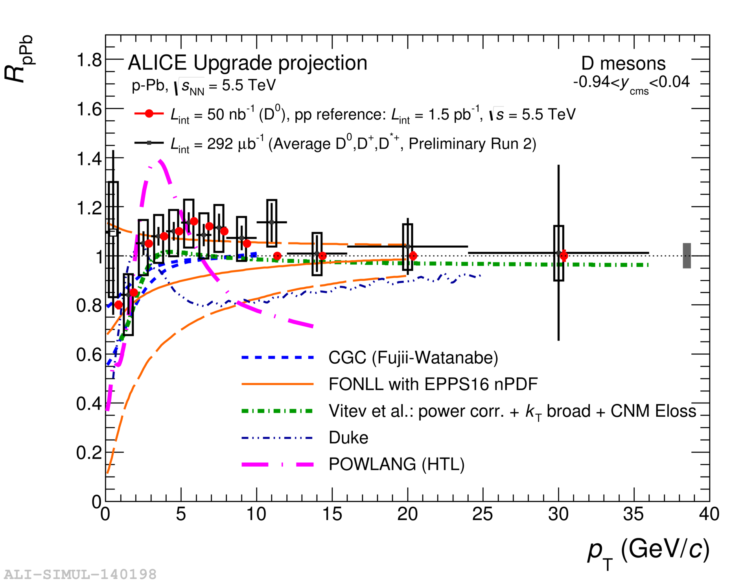
Run 3+4: D measurements
Large increase of precision help to reach high multiplicities and data/theory comparison
sarah.porteboeuf@clermont.in2p3.fr

Slide 29
Run 3+4: Open questions
What is the best system size estimator?
Multiplicity is the measured quantity (caveats: experimental estimator has to be well defined)
Multiplicity is protected from theoretical biases (N_{part}, N_{coll} from Glauber models ...)
But hard to compare to formal calculation and first principle
What about initial energy density or multiplicity per volume unit ?
Bjorken estimates
Multiplicity per volume unit
$$ε\sim \frac{nπ}{τ_{0}A}\frac{3}{2}{\left.\frac{dN_{ch}}{dη}\right|}_{η=0}$$
$$\frac{N_{ch}}{πR^{3}}$$
Problem of the definition of the normalization size in pp and p-Pb (A or R or ?)
sarah.porteboeuf@clermont.in2p3.fr

Slide 30
Run 3+4: Open questions
2) Role of geometry / system size on hydro evolution in small system
pp high mult has a small size
Hydro can be applied out of equilibrium even if R_{e} do not satisfied the condition R_{e} >>1
3) Energy loss definition
How to define jet-medium interaction in small systems
Energy loss proportional to system size => in small system, effect is small
How to define the reference ?
Ideas: jet asymmetry, jet substructure, Z-jet, photon-jet
4) Global interpretation and systematic data/theory comparison
Rivet, see for example the workshop Rivet for Heavy Ion (21-24 Aout)
https://indico.cern.ch/event/735911/
Run 3+4 physics program with planned detector upgrades is very promising for small systems
sarah.porteboeuf@clermont.in2p3.fr

