Slide 1


Future High Energy Accelerators
Barbara Dalena
CEA/DRF/Irfu/DACM, Université Paris-Saclay

Slide 2
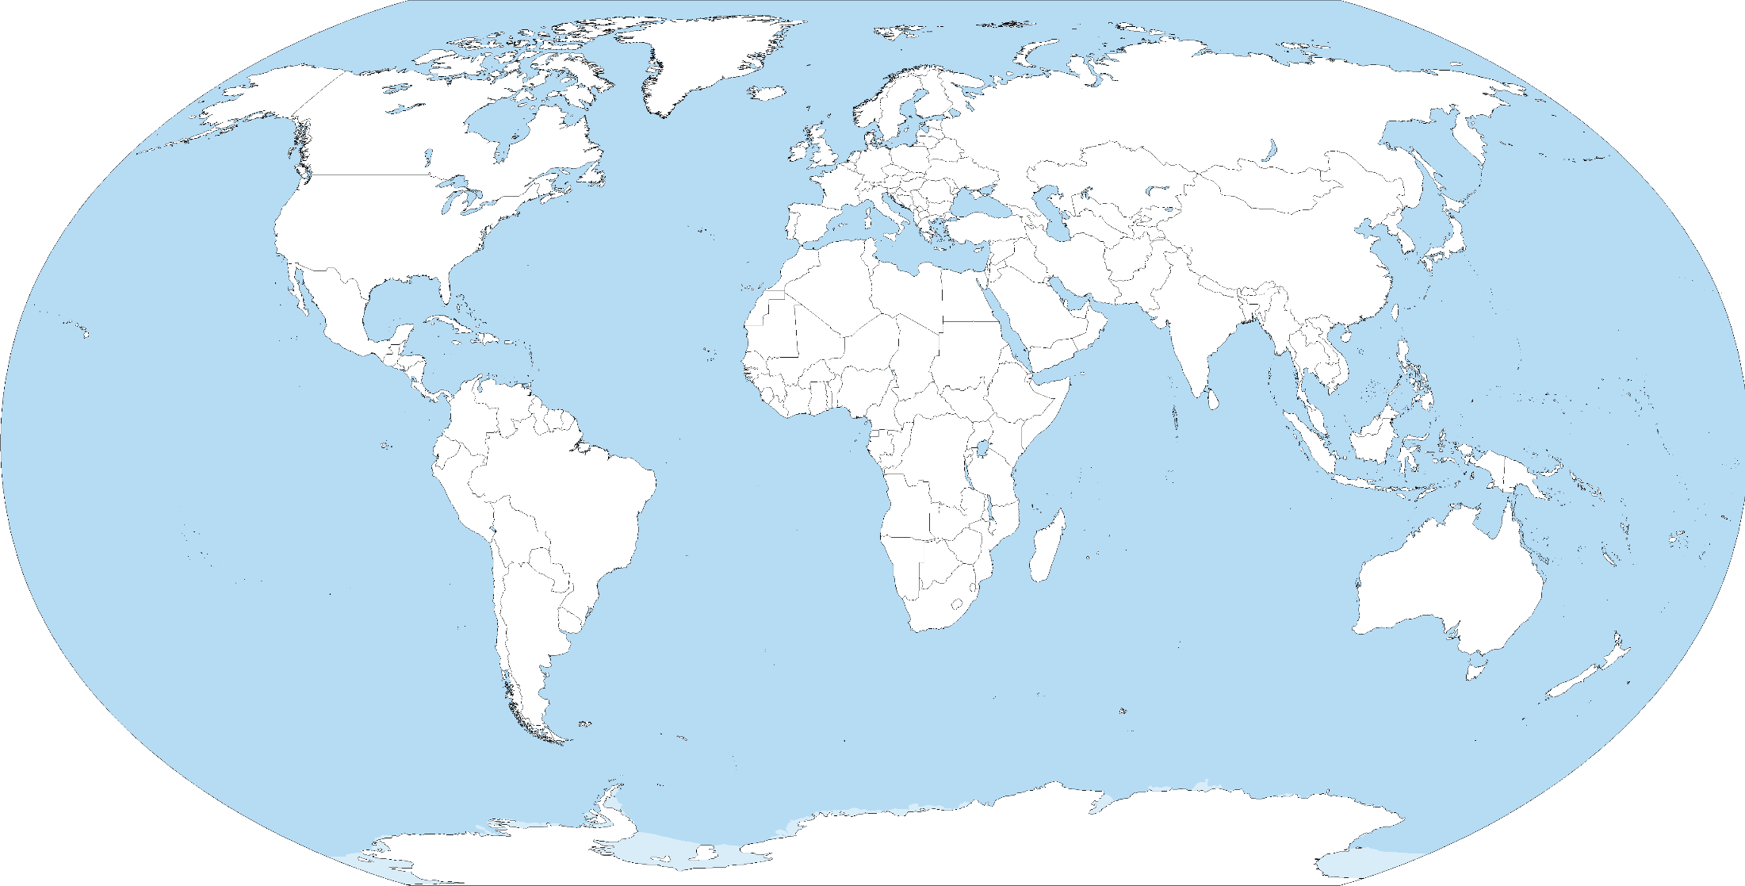
Future HEP accelerators
LHeC
HE-LHC
PIP I
PIP II
HE-eLHC
HL-LHC
FCC-hh
RHIC eRHIC
FCC-he
CLIC
FCC-ee
ILC
CEBAF EIC
SppC
JPARC MR
BEPCII
superKEKB
CepC
charm-τ factory
plasma acceleration
γγ and µ⁺µ⁻ colliders
…..
⇒ not included

Slide 3
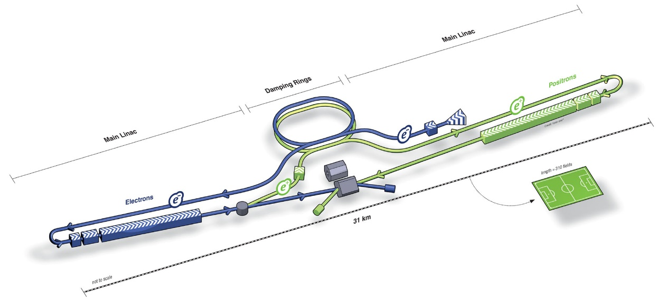
Linear Colliders: ILC/CLIC
TDR (2012) exits
Aim at cost reduction
ILC
CLIC
CDR 2012 Update ‘16
Key technology
Nano-beam
SRF accelerating technology
….
Key technology
Nano-beam
X-band accelerating cavity
High efficiency modulators and Klystron
Permanent magnets
…..
Decision by end 2018?
Decision by 2020?

Slide 4
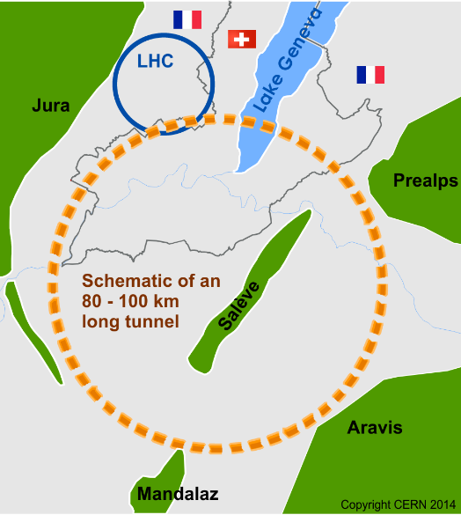
Circular Colliders: FCC and CEPC/SppC
International FCC collaboration (CERN as host lab) to study:
pp-collider (FCC-hh) → main emphasis, defining infrastructure requirements
~100 km tunnel infrastructure in Geneva area, site specific
e⁺e⁻ collider (FCC-ee), as potential first step
HE-LHC with FCC-hh technology
p-e (FCC-he) option, IP integration, e⁻ from ERL
Proposal for project in China
from pre-CDR to CDR 2017-2018
CEPC
Main emphasis on e+e- collider 90-240 GeV
focus on Higgs
Hadron collider (SppC)
to later be installed in the same tunnel 75 to O(150) TeV
HE-LHC
~16 T ⇒ 100 TeV pp in 100 km
FCC
CDR for EU strategy end 2018
earliest possible physics
FCC-hh: 2043
FCC-ee: 2039
HE-LHC: 2040
earliest possible physics
CepC: 2028
SppC: 2045

Slide 5
Circular colliders: parameters and challenges
Leptons
Parameter [unit] | Z FCC-ee / CepC | WW FCC-ee/ CepC | H (ZH) FCC-ee/ CepC | ttbar FCC-ee
Beam energy [GeV] | 45.6 / 45 | 80 / 80 | 120 / 120 | 182.5
Peak luminosity per IP [10³⁴ cm⁻² s⁻¹] | 230 /16.6-32.1 | 28 /10.1 | 8.5 / 2.93 | 1.55
Beam current [mA] | 1390 / 461 | 147 / 87.9 | 29 / 17.4 | 5.4
SR energy loss / turn [GeV] | 0.036 / 0.036 | 0.34 /0.34 | 1.72 /1.73 | 9.21
Total RF voltage [GV] | 0.1 / 0.1 | 0.44 /0.47 | 2.0 / 2.17 | 10.9
H,V geometric emittance [nm/pm] | 0.27,1.0 / 0.18,1.6-4 | 0.28,1.7 / 0.54, 1.6 | 0.63,1.3 / 1.21,3.1 | 1.46, 2.9
Hadrons
⇒ High efficient RF system, small emittance and small lifetime beam
Parameter [unit] | HL-LHC | HE – LHC (tentative) | FCC-hh baseline/ultimate | SppC 75 /150 TeV
Beam energy [GeV] | 7 | 27 | 50 / 50 | 37.5/ 75
Peak luminosity per IP [10³⁴ cm⁻² s⁻¹] | 5 | 25 | 5 < 30 | 10 /
Beam current [A] | 1.1 | 1.1 | 0.5 | 0.7 /
SR power / length [W/m/ap.] | 0.33 | 4.6 | 28.4 | 13 /
Events/bunch crossing | 132 | 800 | 170/1000 | 490 /
Stored energy/ beam [GJ] | 0.7 | 1.3 | 8.4 | 9.1 /
Arc dipole [T] | 8 | 16 | 16 | 12 / 24
⇒ SR comparable to light sources, beam losses, high field magnets

Slide 6
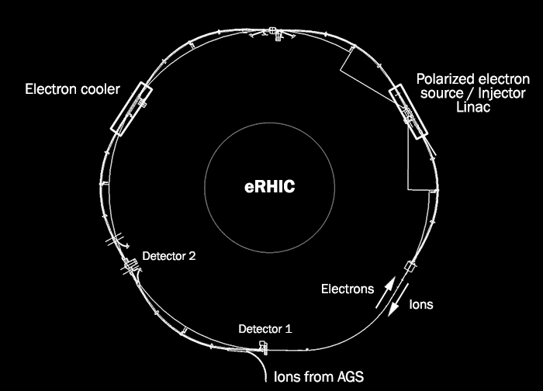
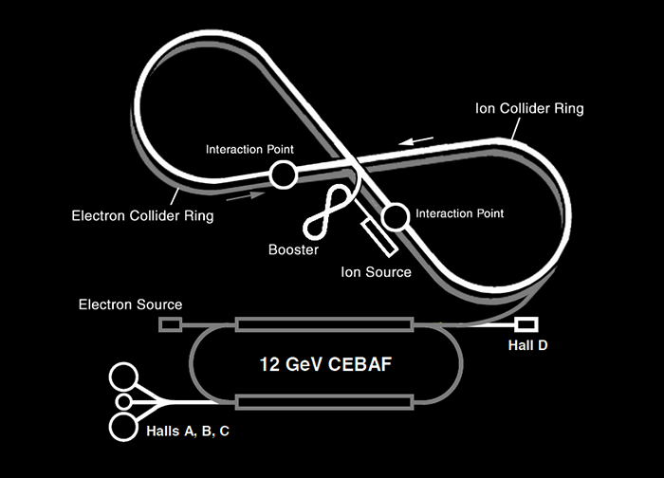
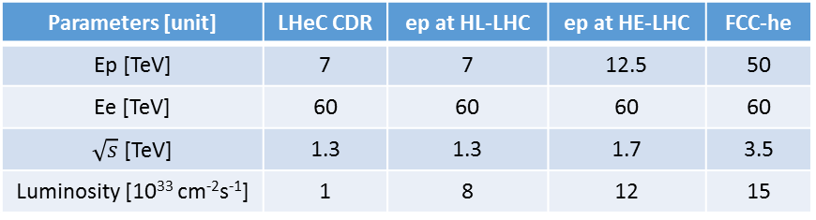
Electron hadrons colliders
New Document (early 2019):
higher luminosity goal for Higgs
new ep/eA physics prospects
updates on IR
eh in FCC study
eh in HE-LHC
Low energy test facility PERLE
Implementation of ERL at CERN
Submissions of eh Papers to EU Strategy:
FCC eh as part of FCC hh
LHeC with HL
PERLE technology development at Orsay
Parameters [unit] | LHeC CDR | ep at HL-LHC | ep at HE-LHC | FCC-he
Ep [TeV] | 7 | 7 | 12.5 | 50
Ee [TeV] | 60 | 60 | 60 | 60
$\sqrt{s}$[TeV] | 1.3 | 1.3 | 1.7 | 3.5
Luminosity [10³³ cm⁻²s⁻¹] | 1 | 8 | 12 | 15
US options
eRHIC (BNL)
EIC (JLAB)
The U.S. Nuclear Science Advisory Committee recommends building an Electron-Ion Collider as the highest priority new facility for the field

Slide 7
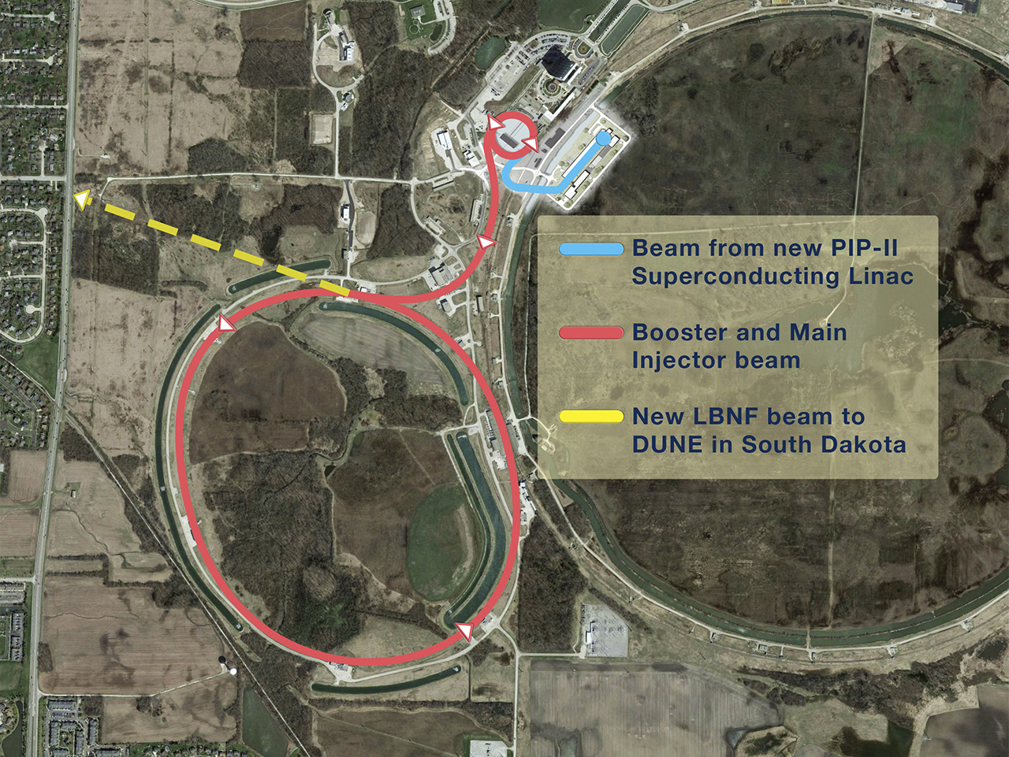
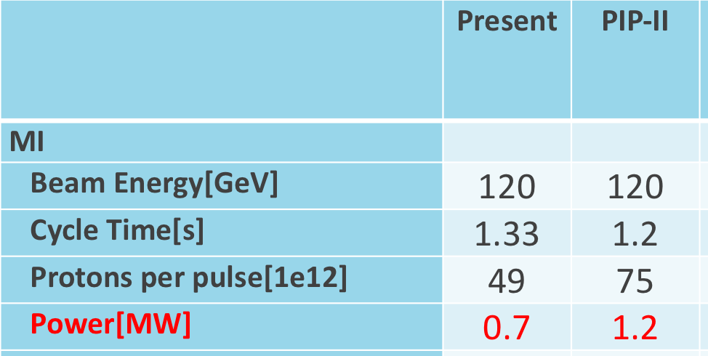
High power protons drivers for neutrino beams
PIP II @
MR
International Collaboration
Stage: CD0; CD1 anticipated 2018
Project Completion: ~2026
> 2022
Study groups explore the possibility to use ESS and CERN-SPS as proton drivers for neutrino beams

Slide 8
Key R&D and challenges
Many common and some project-specific developments required
High gradient and high efficient RF systems
High intensity beams (collective effects, beam losses, etc..)
Beam Quality (Generation and preservation of low emittance beams)
High field magnets
…
FCC-ee, CepC, ILC, CLIC…
FCC-hh, HE-LHC, SppC, PIP II, JPARC MR…
ILC, CLIC, LHeC, eRHIC, EIC, FCC-ee,
FCC-he, HE-eLHC…
FCC-hh, HE-LHC, HL-LHC, SppC…
Not exhaustive list. In the following some selected examples, only.
The R&D are addressed in world wide collaborations, country (EU, US…) or national level

Slide 9
Nano beams: ATF Collaboration
beam parameters at IPs
7.7 nm ILC 250 GeV
2.9 nm CLIC 380 GeV
ILC, CLIC

Slide 10
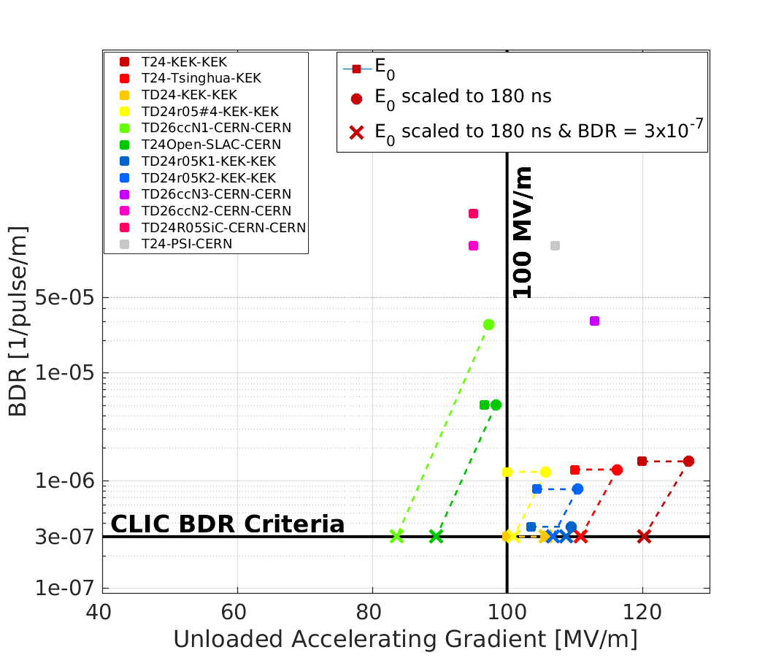
High gradient RF: NC
X-boxes (klystron based test stand) to test cavities
CLIC
Target BreakDown Rate (BDR) 3 × 10⁻⁷ pulse⁻¹ m⁻¹
Further optimization ongoing of structure production for industrialization

Slide 11
High gradient RF: SRF
ILC
⇒ US-Japan Collaboration on SRF technology
Coupler design
Cavity material
High gradient and high efficient cavities
N2-doping: few minutes 800°C N2 injected
N-infusion: longer time at 120°C N2 injected
PRAB 20, 042004 (2017)
Performance in vertical test of ~800 cavities for the European XFEL:
Average maximum 31.4 MV/m
Average usable 27.7 MV/m
XFEL Goal 24 MV/m
ILC goal 31.5 MV/m

Slide 12
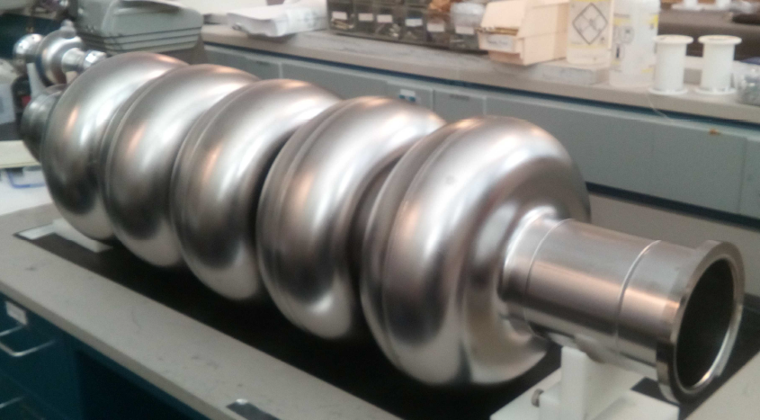
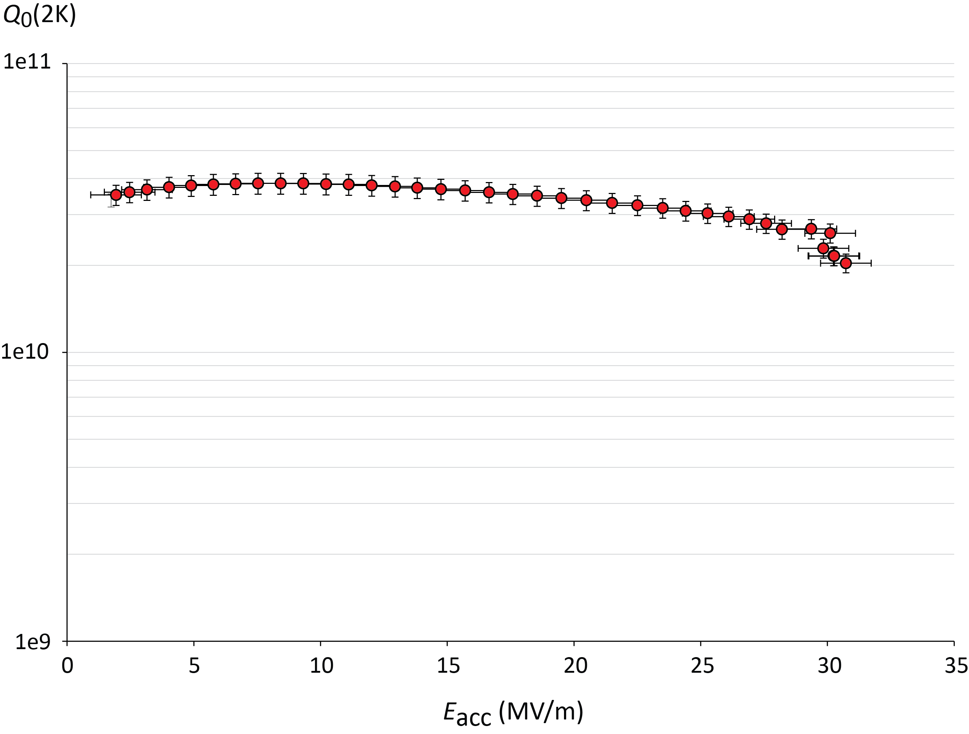
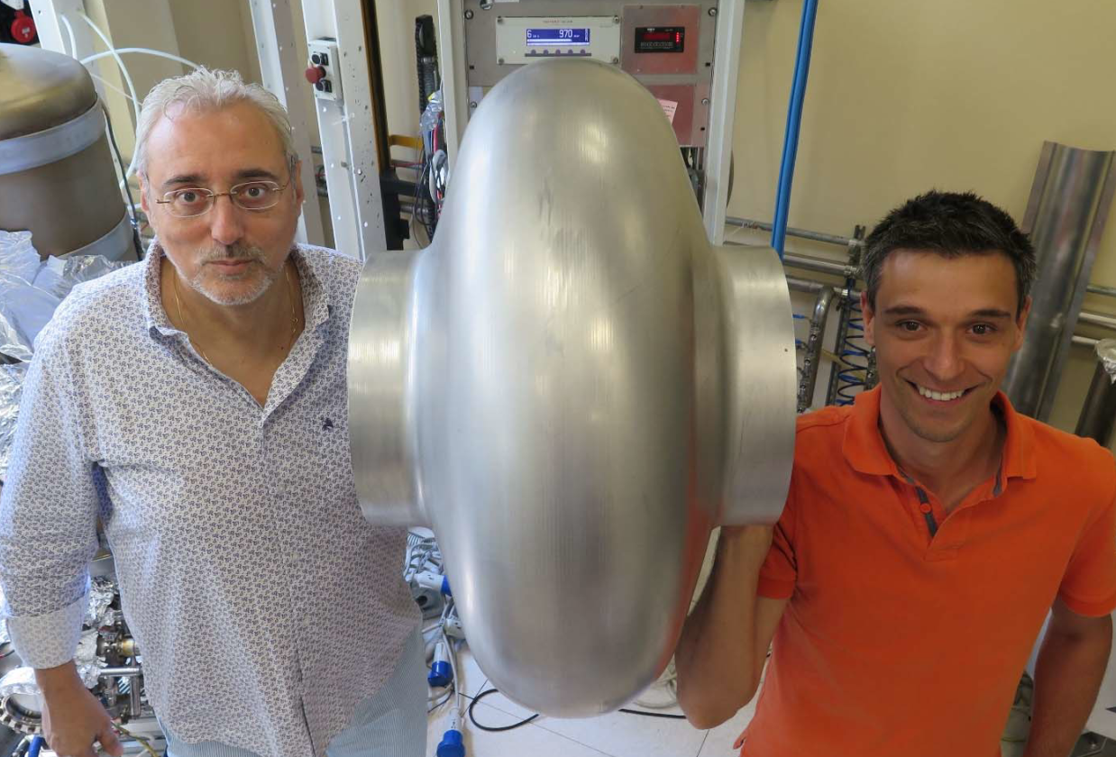
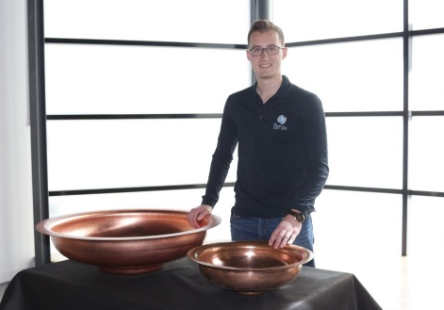


High efficient RF system
Recovery energy loss by SR in high current beam
develop techniques to improve Q₀ of SRF cavity (max gradient modest )
FCC-ee(eh), CepC, ERL based machines, CLIC
5-cell 800 MHz, JLAB prototype for both FCC-ee (t-tbar) and FCC-eh ERL
$Q0 4∙{10}^{10}$ @ 22 MV/m CepC
JLAB, Oct 25, 2017
F. Marhauser et al
$Q0 3∙{10}^{10}$ @ 20 MV:m FCC-ee
Seamless 400 MHz single-cell cavity formed by spinning at INFN-LNL
Legnaro, Feb 2018
Regime of E_{acc}
requirements
in LHeC, PERLE,
FCC-ee
V. Palmieri † C. Pira
CERN half-cells formed using Electro-Hydro-Forming (EHF) at Bmax.
2-cells 650MHz CepC
Vertical test Q₀=4⋅10¹⁰ @19.2 MV/m
J.-F. Croteau, EASITrain PhD Student
High efficiency RF generation (Klystrons)
Inside CepC study
In EuCARD² now ARIES

Slide 13

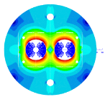
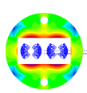

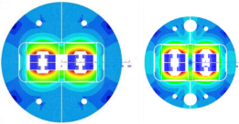

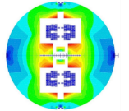
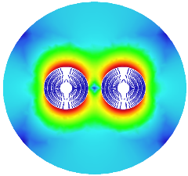



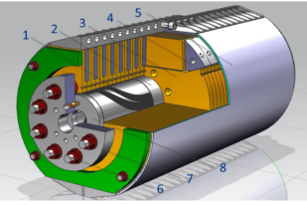
High Field Magnets: dipoles
FCC-hh, HE-LHC
Need 16 T to reach 50(14) TeV /beam
Move from NbTi (LHC technology) to Nb₃Sn
14.3 m long dipoles
Magnet is key cost driver
Improve cable performance
Reduce cable cost
Improve fabrication of magnet
Minimize amount of cables
Push lattice filling factor
Field Quality
Short models in 2018 – 2023
Prototypes 2026 – 2032
HL-LHC
11T First Nb₃Sn magnet, FRESCA2 dipole
15 T dipole demonstrator
60-mm aperture
4-layer graded coil
Russian 16 T magnet program launched by BINP recently

Slide 14
Beam losses: beam screen
FCC-hh
∼30 W/m synchrotron radiation (LHC: 1 W/m)
Small to make magnet cheap (aperture 50 mm)
Extract photons for good vacuum
Strong to withstand quench
FCC
LHC
Hide pumping holes from beam for low impedance
Laser treatment / carbon coating against e-cloud
Test station at KARA/KIT
Measurements (pressure evolution) confirm MC vacuum simulations
Confident to use simulations for all vacuum design

Slide 15
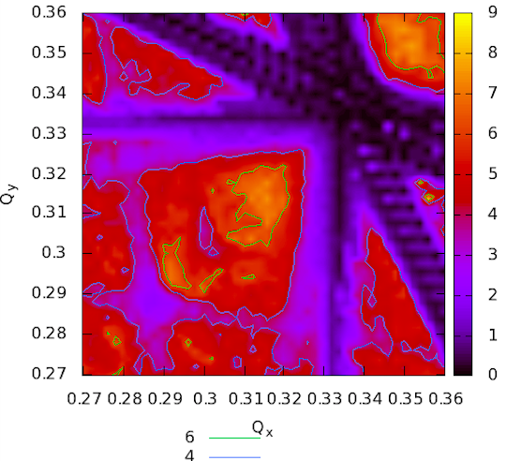
Beam Losses
FCC-hh
Mitigation of losses and heat load must be taken into account in the optics design and integration
~8 GJ kinetic energy per beam in FCC-hh
O(20) times LHC
Boing 747 at cruising speed
400 kg of chocolate
  Run 25,000 km to spent calories
Designed shielding to cope with the 500 kW collision debris per experiment
Dynamic Aperture
Triplet design allows for thick shielding
DA[σ]
Collimation system design
Designed system that can cope with the losses
Detailed studies and optimization of performance
Also reduction of impedance
Beam dump design
Machine protection
LHC experience to benchmark simulation tools

Slide 16
Advanced accelerators concepts
ALEGRO (Advanced LinEar collider study GROup, for a multi-TeV Advanced Linear Collider)
The aim of the first ALEGRO workshop was to prepare and deliver, by the end of 2018, a document detailing the international roadmap and strategy of Advanced Novel Accelerators (ANAs) with clear input for the European Particle Physics Strategy Update.
Specific topics to be addressed
Positron acceleration
Technological issue (efficiency, cooling, polarization,…)
The R&D focus on beam quality, beam stability, staging and continuous operation
Support from Particle Physics community is required, to make sure that specific research topics for collider are addressed

Slide 17
Acknowledgements – many many thanks
D. Schulte
R. Aleskan
S. Michizono
E. Levichev
J. Gao
Y. Chi
S. Cosineau
R. Assmann
E. Cenni
A. Chancé
https://indico.cern.ch/event/686555/contributions/2962553/attachments/1682220/2703710/
https://indico.cern.ch/event/686555/contributions/2962555/attachments/1681197/2702849/
https://indico.cern.ch/event/686555/contributions/2962542/attachments/1681194/2702876/
https://indico.cern.ch/event/466934/contributions/2474221/attachments/1489758/2320028/
http://irfu.cea.fr/Phocea/Vie_des_labos/Seminaires/index.php?id=4270
https://indico.cern.ch/event/686555/contributions/2962510/attachments/1682330/2703201/
https://indico.cern.ch/event/686555/contributions/2962546/attachments/1682189/2702955/
https://indico.cern.ch/event/686555/contributions/2962503/attachments/1680976/2700616/
https://indico.cern.ch/event/686555/contributions/2962538/attachments/1682997/2704639/
https://indico.phys.vt.edu/event/34/contributions/609/
https://indico.cern.ch/event/677640/contributions/2866274/attachments/1622621/2582653/

Slide 18
Documents
https://arxiv.org/abs/1711.00568 ILC
https://arxiv.org/abs/1608.07537 CLIC
https://arxiv.org/ftp/arxiv/papers/1810/1810.13022.pdf future colliders at CERN
https://arxiv.org/abs/1809.00285 CepC CDR
FCC CDR:
  concise summary volumes 1(PH), 2 (hh), 4(ee), 6(HE) ➔ December 2018
  Long technical volumes 3, 5, 7 ➔ Spring 2019
Friend J. Phys. A Conf. Ser. 888_012042, 2017 JPARC MR
http://pxie.fnal.gov/PIP-II_CDR/PIP-II_CDR_v.0.0.pdf PIP II
https://www.worldscientific.com/toc/rast/09 Application of Advanced Accelerator Concepts for Colliders

Slide 19
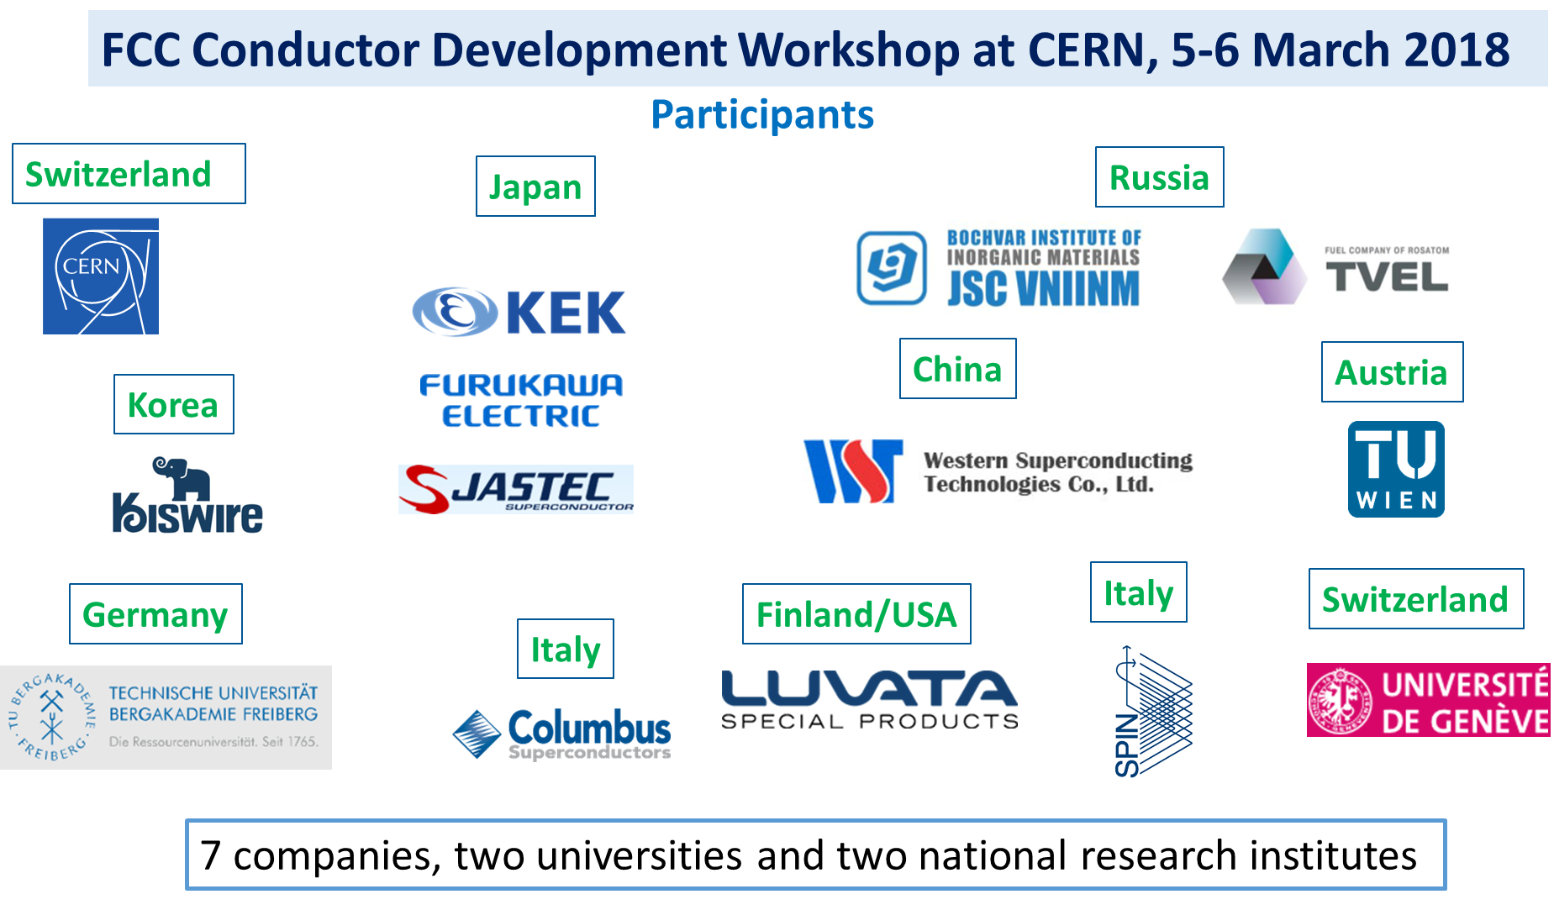
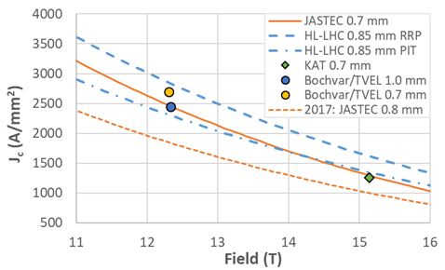
High Field Magnets: Conductors
HL-LHC,HE-LHC,FCC-hh,SppC
New activity with many collaborators started in 2017 with ambitious targets
Wire diameter | mm | ∼ 1
Non-Cu Jc (16 T, 4.2 K)* | A/mm² | ≥ 1500
Unit length | km | ≥ 5
Cost | €/kA m** | ≤ 5
Yellow: FCC_1
Green: FCC_2
Blue: FCC_3
Dashed red: FCC_4
Dashed blue: HL-LHC
Workshop series
Measurements @ CERN (4.2 K)
goal
First wires almost reached HL-LHC requirements

