Slide 1
MicroMegas
Efficiency study
Results from Testbeam data analysis

Slide 2
Outline
Principle of the measurement
Alignment process
Efficiency results

Slide 3
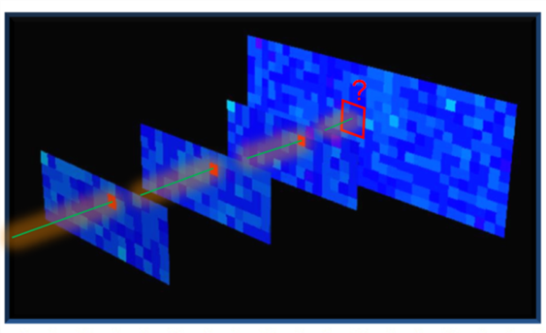
Principle of the measurement
Using preselected Gold Events
3 chambers with one single hit each
No condition on the 4th one
Straight line fitted through the hits
Event rejected if misaligned hits
Expected hit position in the 4th chamber is extrapolated
Look for a hit in the 3x3Pad area
Ratio expected hit / counted hit gives the efficiency
gold event

Slide 4
Why shall we compute chamber alignment
Strong evidence for chamber misalignment:
Efficiency = 98,54 ± 0,05%
Biased by the misalignment !
Knowing the real position of the chambers shoud improve the calculation

Slide 5
Offline allignment ?
Reconstructed trajectory
(hits are by default concidered at pad centers)
No hit should be expected !!
but an ineficiency is still counted
Real particle trajectory

Slide 6
Offline allignment ?
Reconstructed trajectory
(hits are by default concidered at pad centers)
Hit still expected in the wrong chamber
-> in a 1x1 pad target area an innefficiency would be counted
Real particle trajectory
The only possiblility to overcome misalignment problem is to keep a target area of 3x3 pads and neglect border pads.

Slide 7
Outcome
To get proper microMegas efficiency :
> Restrict study to a fiducial borderless area

Slide 8
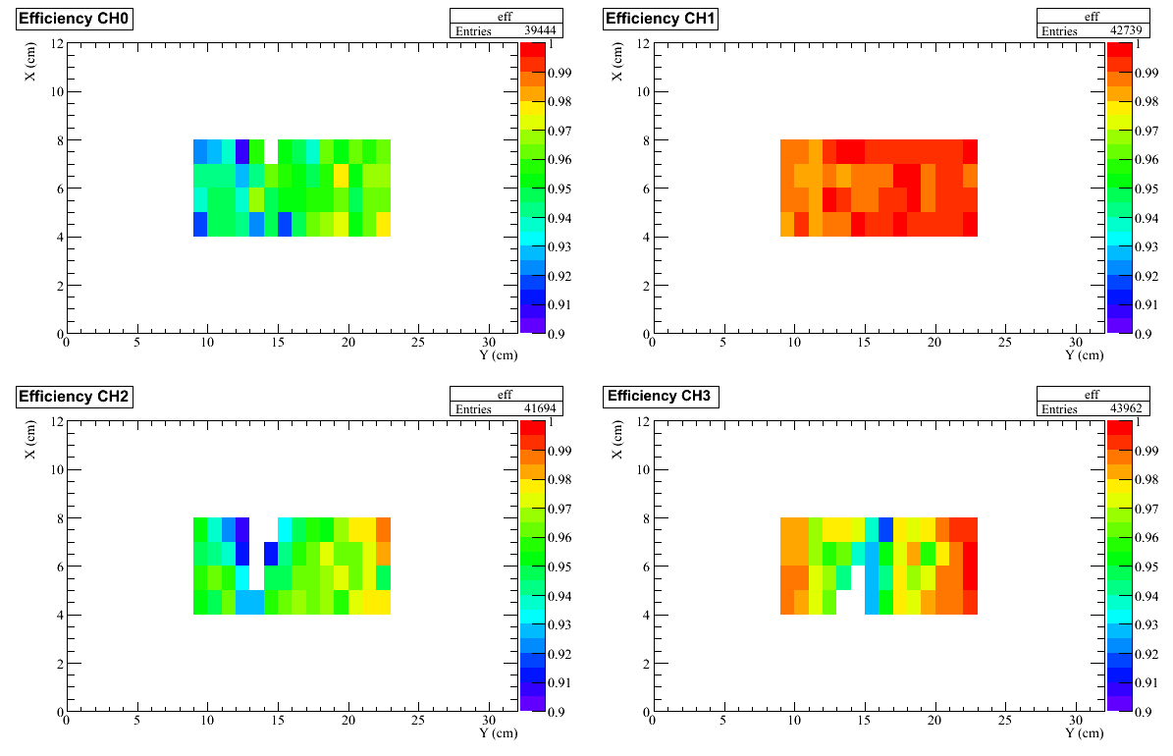
November data

