Slide 1
European Low-Frequency Survey (ELFS)
Angela Taylor
Mike Jones
Jaz Hill-Valler, Luke Jew
University of Oxford
Marco Bersanelli
University of Milan
Carlo Baccigalupi
SISSA, Trieste
Jose Alberto Rubino-Martin
IAC, Tenerife

Slide 2
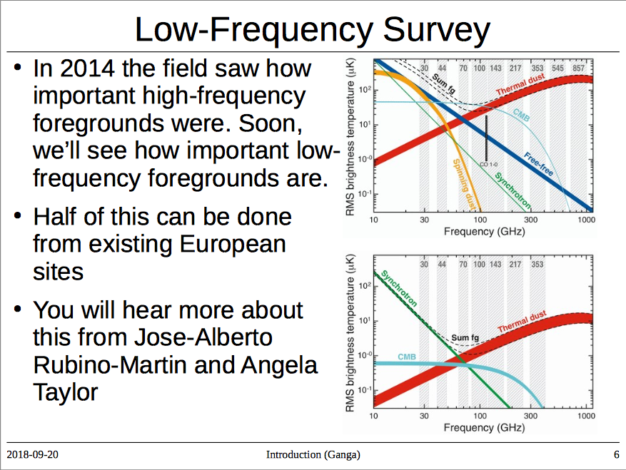

Slide 3
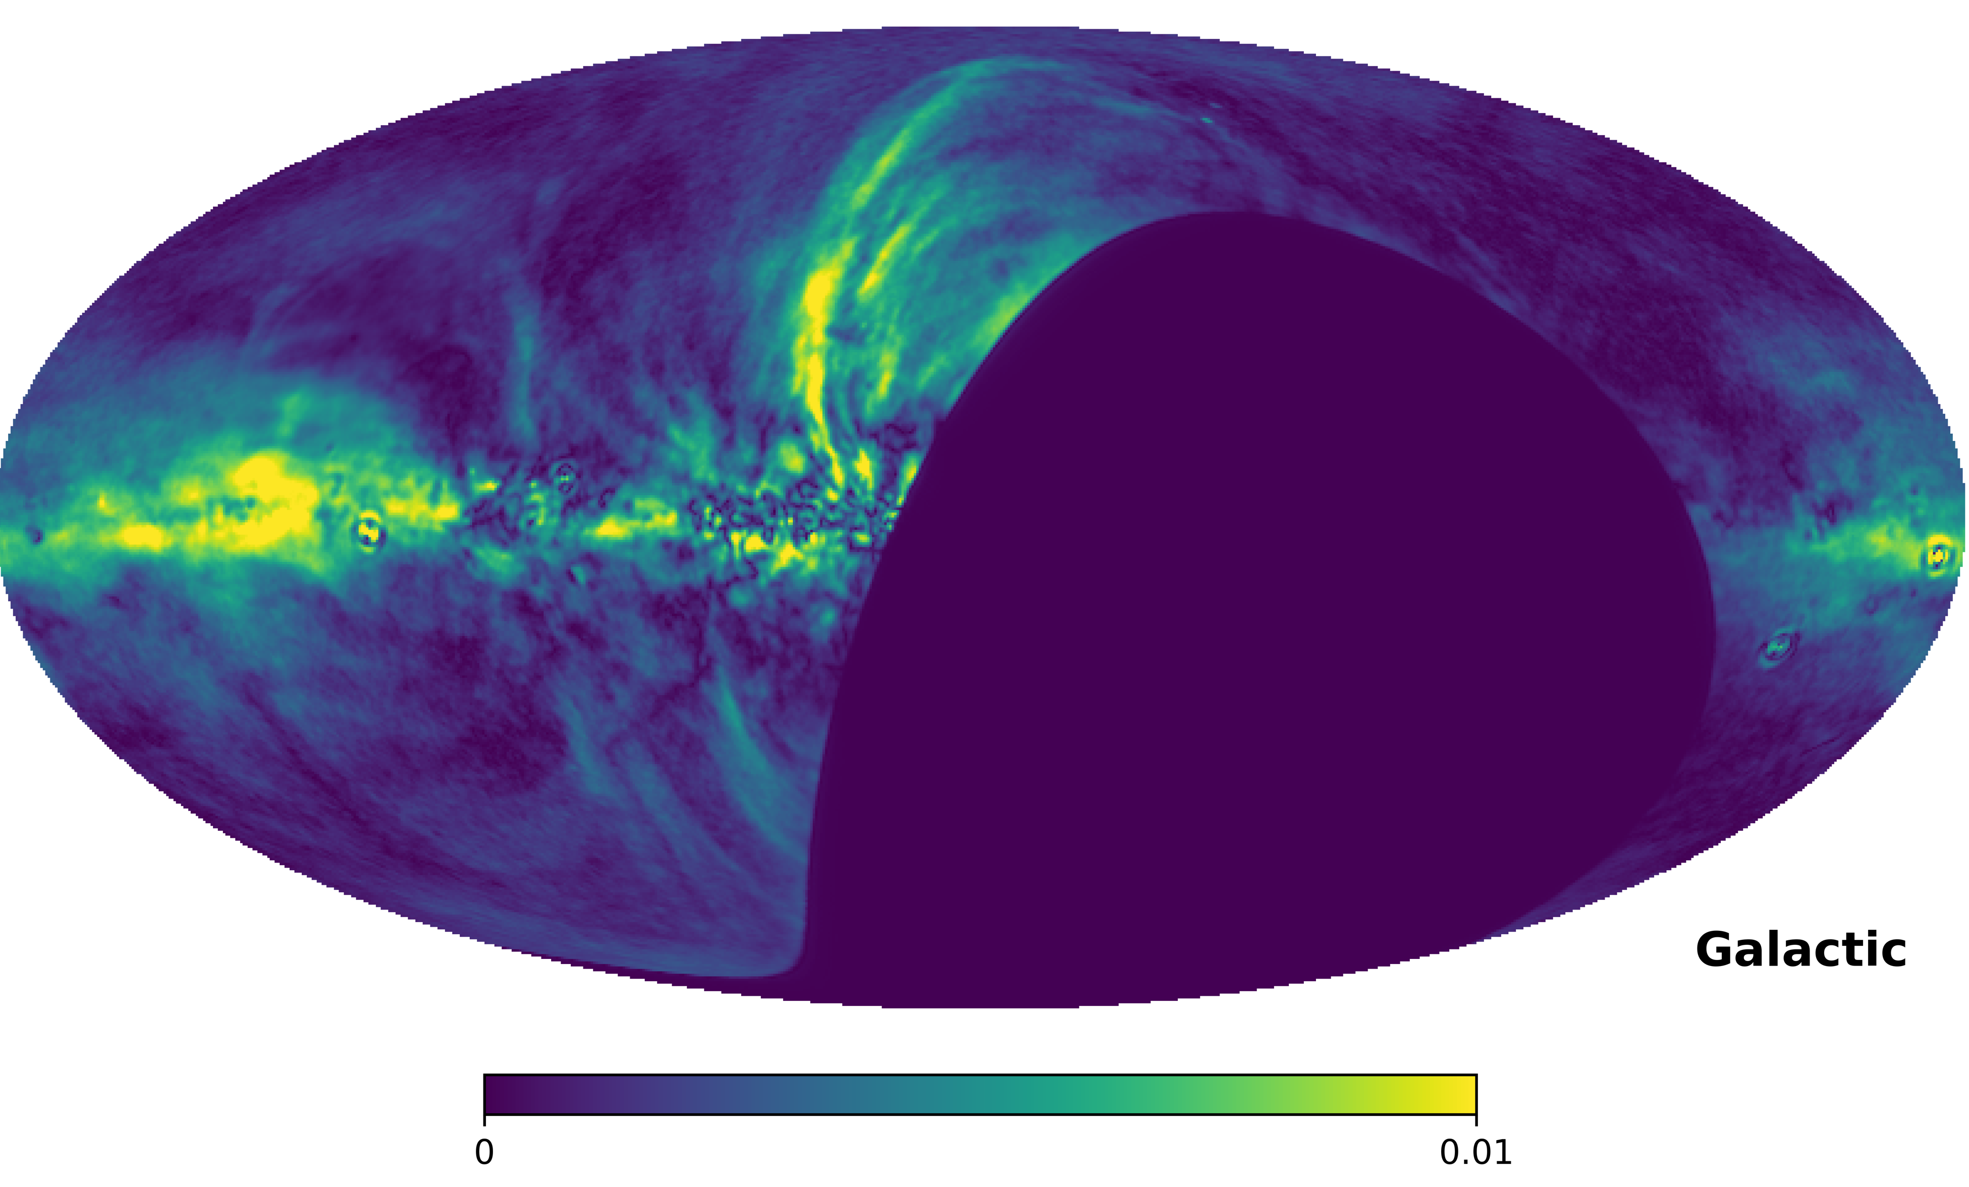
C-BASS P map

Slide 4
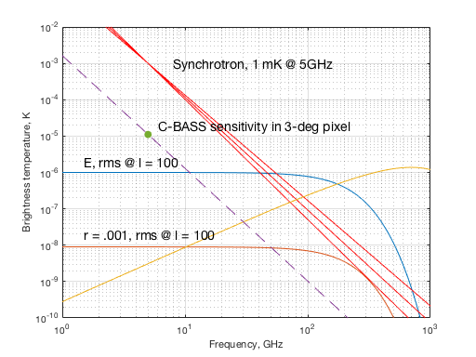
C-BASS P map

Slide 5
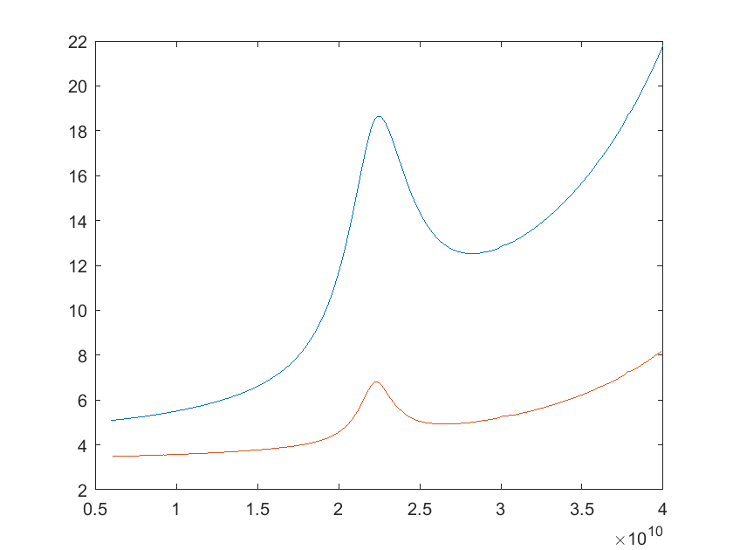
Sensitivity
Sensitivity goal: 1 μKarcmin at 100 GHz, scaled by synchrotron spectrum. How many pixels do you need?
Notes:
#Feeds as fn of freq.
C-BASS Site Klerefontein
Atacama site
7-~20GHz, only need one pixel… (come back to later)

Slide 6
Sensitivity – 1/100 element array with realistic T_{sys}
frequency | beam sens (uK) | uK arcmin array | synch factor | uK arcmin scaled | multipole
7.1 | 35.6 | 850 | 4786 | 0.18 | 904
7.9 | 39.8 | 847 | 3311 | 0.26 | 1015
8.9 | 44.1 | 837 | 2291 | 0.37 | 1138
10.0 | 49.5 | 837 | 1585 | 0.53 | 1277
11.2 | 55.3 | 833 | 1096 | 0.76 | 1433
12.6 | 62.4 | 838 | 759 | 1.10 | 1608
14.1 | 71.1 | 851 | 525 | 1.62 | 1804
15.8 | 8.0 | 87 | 363 | 0.24 | 1991
17.8 | 9.3 | 90 | 251 | 0.36 | 2234
20.0 | 11.9 | 103 | 174 | 0.59 | 2507
22.4 | 19.9 | 153 | 120 | 1.27 | 2813
25.1 | 15.7 | 107 | 83 | 1.29 | 3156
28.2 | 16.6 | 101 | 58 | 1.76 | 3541
31.6 | 20.1 | 110 | 40 | 2.75 | 3973
35.5 | 23.7 | 115 | 28 | 4.17 | 4458
39.8 | 27.8 | 120 | 19 | 6.30 | 5002

Slide 7
Specifications for ELFS
Frequency: synchrotron-dominated range (from ground)
  10-40 (radiometer) – essential complement to CMB-S4, satellites.
  90-120 GHz (KIDS) – no other high-freq, high-res in north
All-sky
  Two sites
Sensitivity: 1μK-arcmin scaled to 100 GHz
Resolution: l~1000 at lowest frequency
Systematics: highly-shielded optics to eliminate groundspill

Slide 8
ELFS Proposal
Two 6-m telescopes, shielded crossed Dragone
  CCAT-p/SO LAT-like, but relaxed surface/pointing specs
Sites in northern and southern hemispheres
  Tenerife, Atacama (or La Silla?)
10 – 40 GHz HEMT radiometer array with ~100 elements
  Two scaled octave-band corrugated feeds, 10 – 20 GHz (a few) and 20 – 40 GHz (most).
Digital polarimeter
  Continuous frequency coverage with high freq resolution (for RFI and science)
  Simultaneous I, Q, U from every pixel
KIDS array for 90 – 120 GHz
  Sequential operation on each telescope

Slide 9
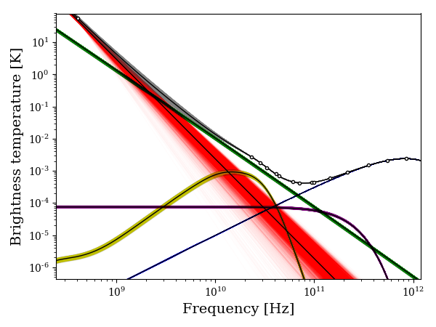
Single-pixel component separation - I
Haslam
WMAP
Planck
High-foregrounds
pixel (1-deg)
Notes:
Simulations – single low-latitude pixel with bright synch, free-free and dust. Brighter than CMB at all frequencies! Synch poorly constrained with just Haslam

Slide 10
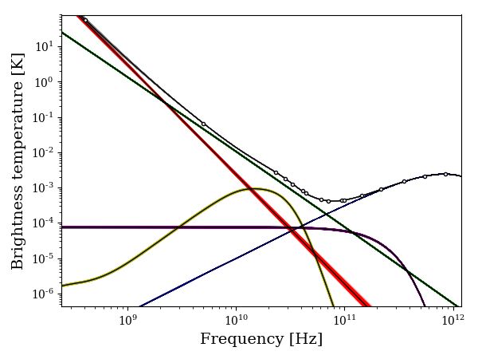
Single-pixel component separation - I
Haslam
WMAP
Planck
+ CBASS
High-foregrounds
pixel (1-deg)
Notes:
Adding CBASS improves constraints hugely (flick between two)

Slide 11
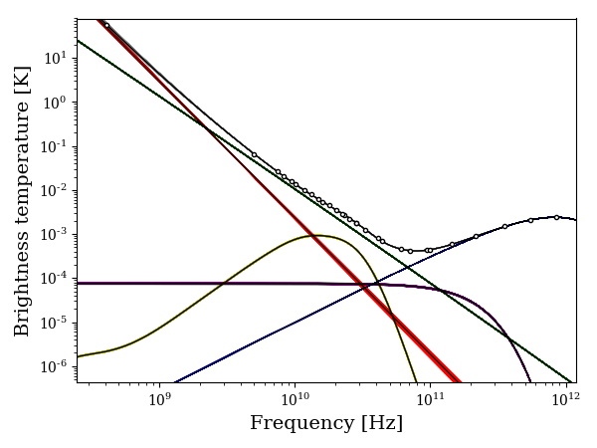
Single-pixel component separation - I
Haslam
WMAP
Planck
+ CBASS
+ ELFS
High-foregrounds
pixel (1-deg)

Slide 12
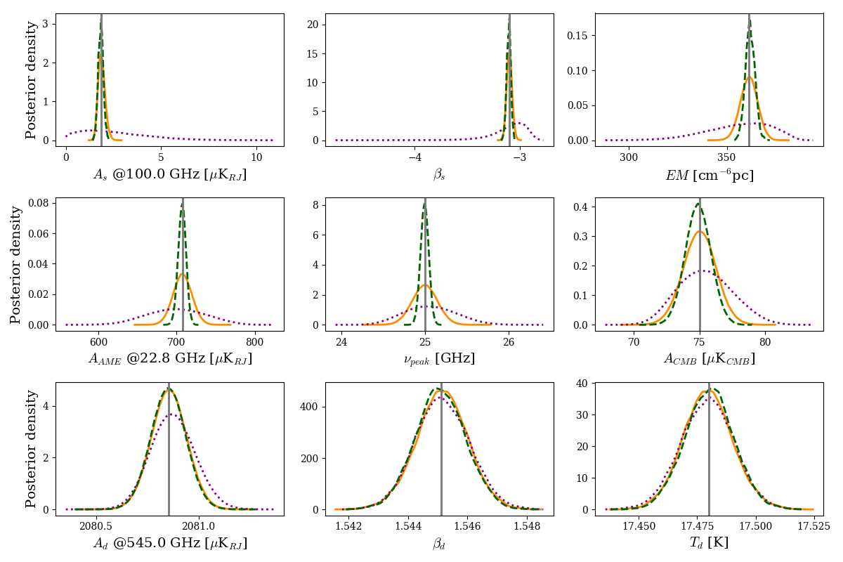
Single-pixel component separation - I

Slide 13
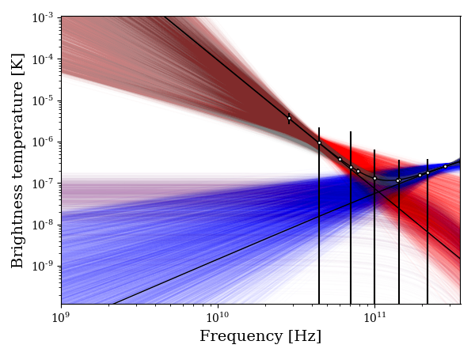
Single-pixel component separation - P
Planck
‘LiteBIRD’
Low-foregrounds
Pixel (3-deg)
r = 0
Notes:
Same but now with polarization. Only synch and dust. ‘LiteBIRD’ is representative, not exact current specs. CMB in model is zero amplitude (pretend all the EE has been cleaned out and looking for BB)

Slide 14
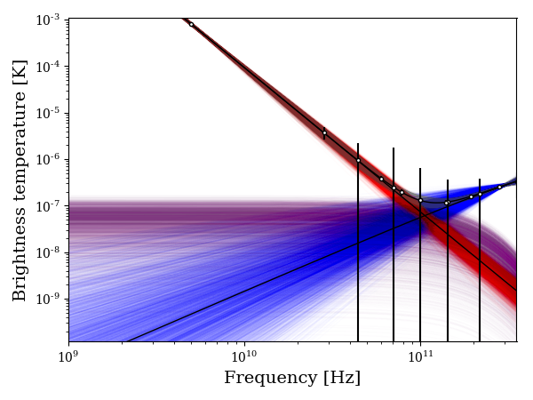
Single-pixel component separation - P
Planck
‘LiteBIRD’
+CBASS
Low-foregrounds
Pixel (3-deg)
r = 0
Notes:
Adding CBASS makes a big difference (flick)

Slide 15
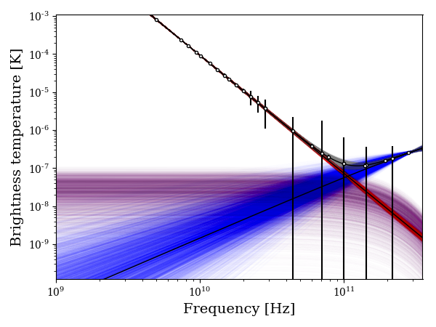
Single-pixel component separation - P
Planck
‘LiteBIRD’
+CBASS
+ELFS
Low-foregrounds
Pixel (3-deg)
r = 0

Slide 16
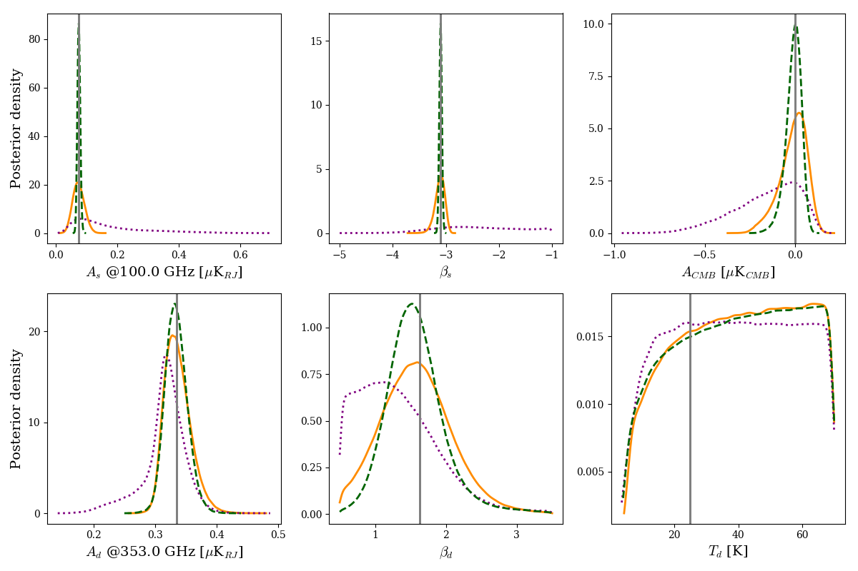
Single-pixel component separation - P

Slide 17
More complicated models?
Synchrotron is not a single power law
  Curvature/breaks due to volume averaging and intrinsic energy spectrum
  Simplest next model is a curvature term C
AME may not be unpolarized
  Until you prove it isn’t, need to include in models
More parameters will need more measurements/sensitivity
  Model with PICO freqs/sensitivity
  21 bands, 21 – 800 GHz, plus C-BASS, plus ELFS

Slide 18
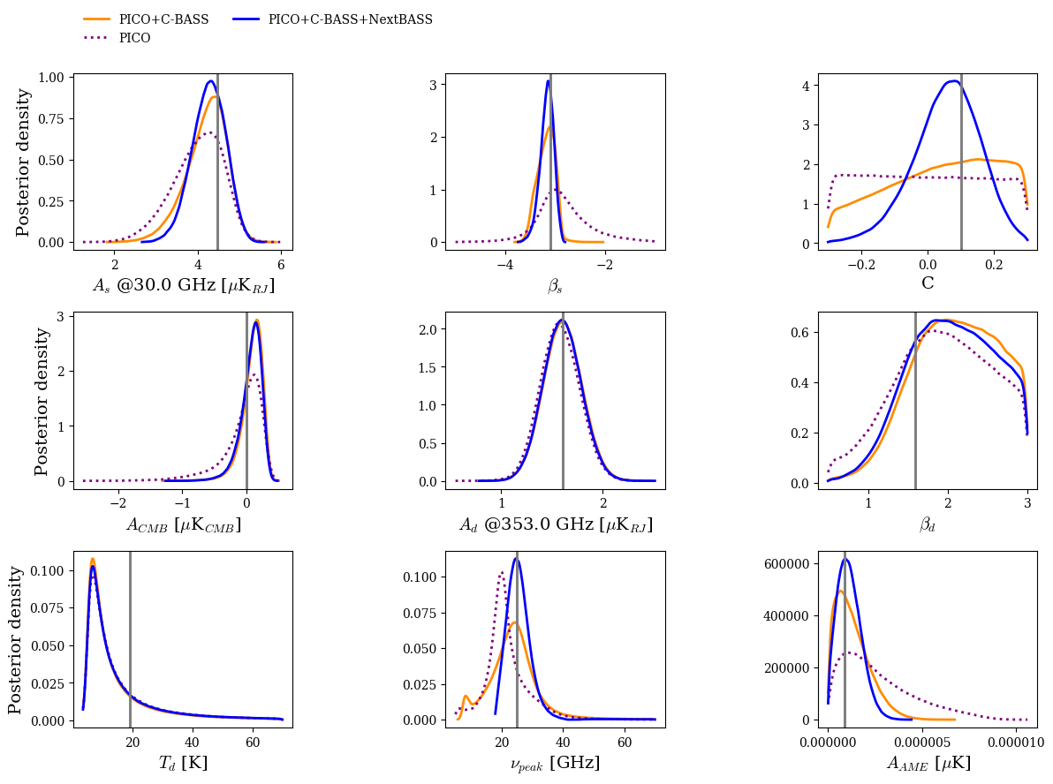
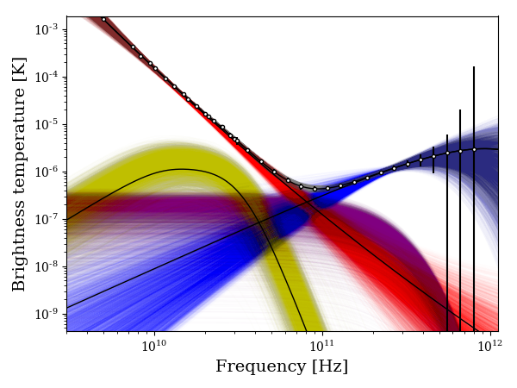
PICO + C-BASS + ELFS
c1a
offPlane

Slide 19
More complicated models?
But if you have low freqs done from the ground, do you need them from space as well?
Delete the 21 – 36 GHz channels from PICO…

Slide 20
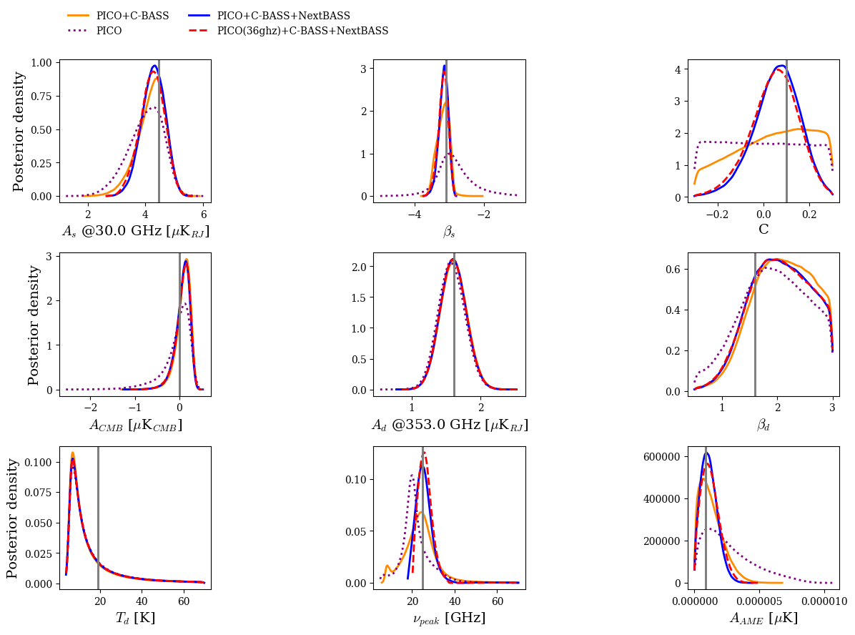

PICO (36GHz+) + C-BASS + ELFS
c1a
nearOrion2

Slide 21
Technology status
Telescope: CCAT-p/SO-LAT underway.
  Investigate lower spec/cost reduced version.
  ‘Clover’ ~2-m telescopes available now (STRIP, QUIJOTE, NextBASS)
Receiver array: Feeds/OMTs designed. LNAs available
  LNF LNAs with 0.25 K/GHz commercially available
Polarimeter backend: FPGA/digitizers developed for SKA (incl firmware, software, commercially available hardware).
Experience in systems, testing, integration, operations etc in Europe (UK, Italy, Spain…)
KIDS array: recently flown on OLIMPO / KISS /NIKA

Slide 22


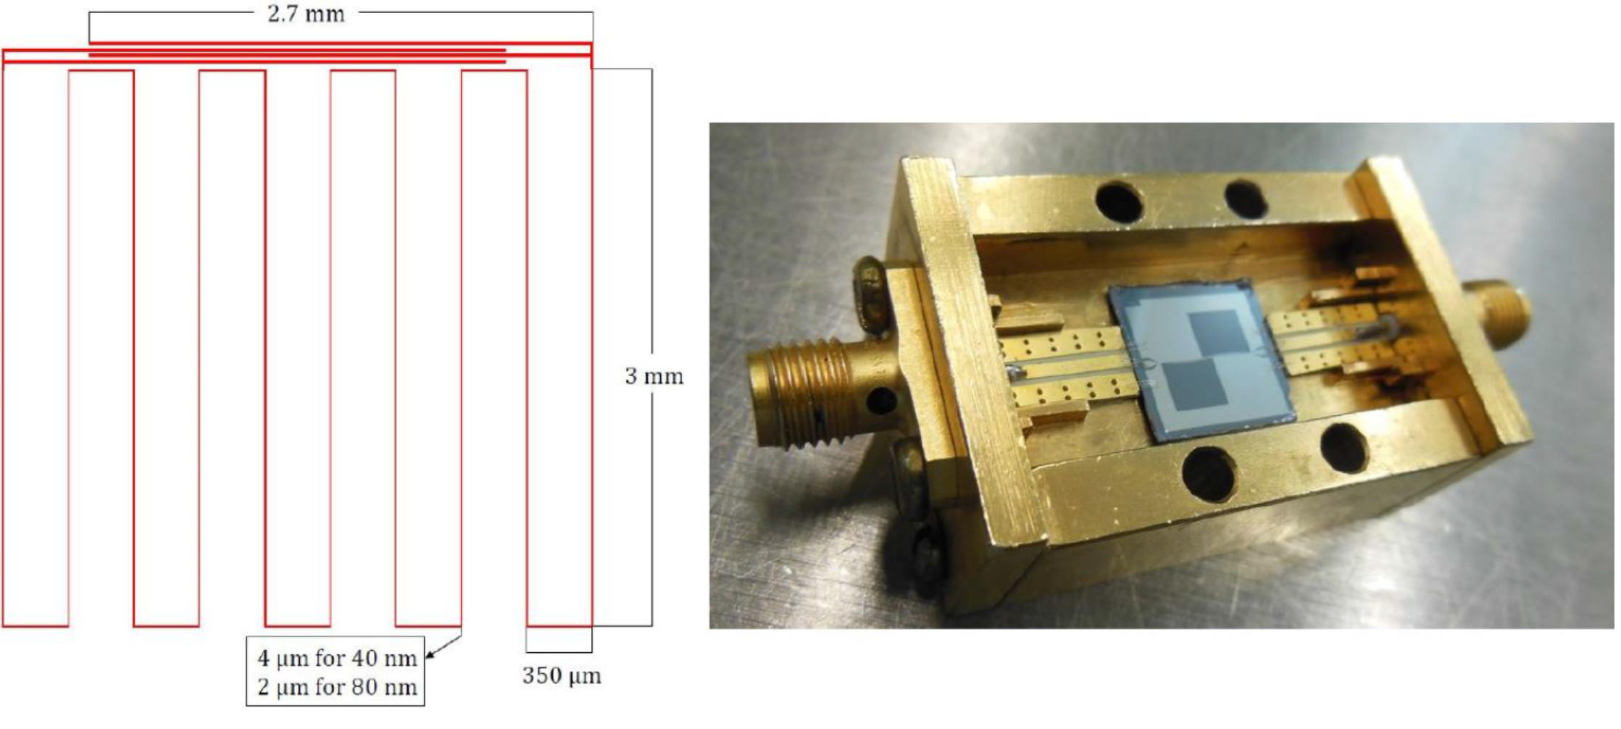
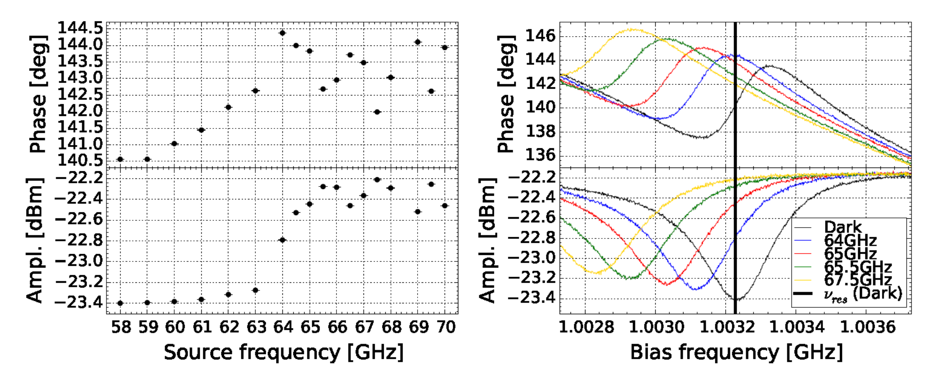
Development of Kinetic Inductance Detectors for the W-band
Paiella A., et al., Journal of Low Temperature Physics, 184, 97-102, 2016
Sapienza + IFN-CNR (Rome, Italy)
Initially developed for a FTS spectra-imager for the 64m Sardinia Radio Telescope.
Now considered for ground-based B-modes polarimetry
Bi-layer LEKIDs: 25 nm Al + 10 nm Ti
Good performance for f > 65 GHz
Slide from S. Masi

Slide 23
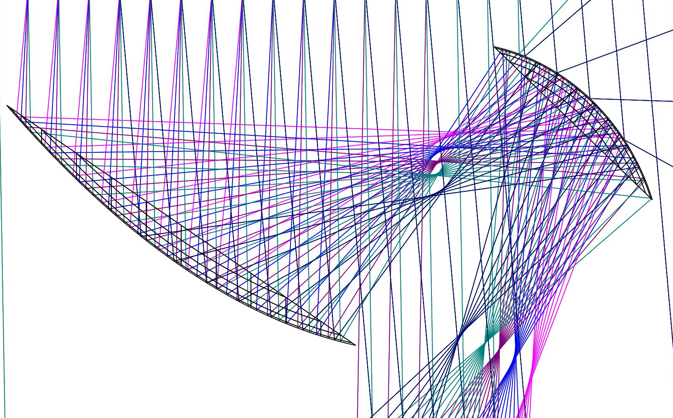
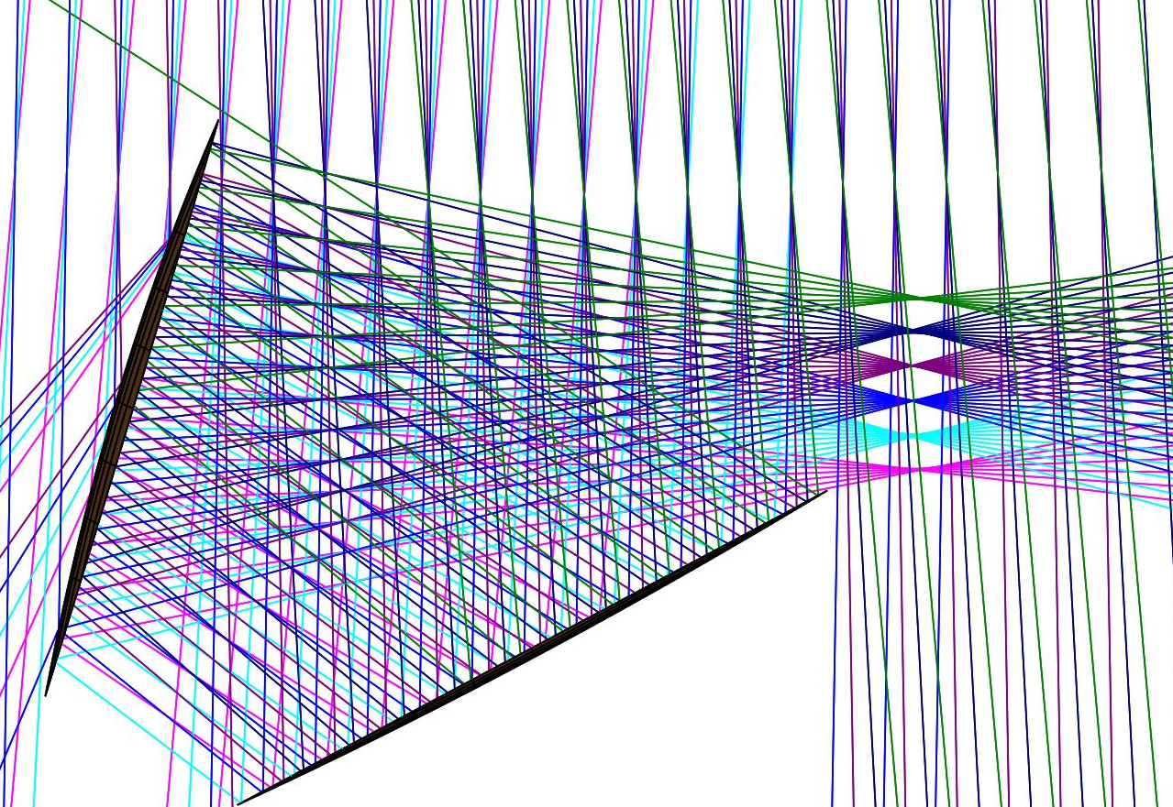
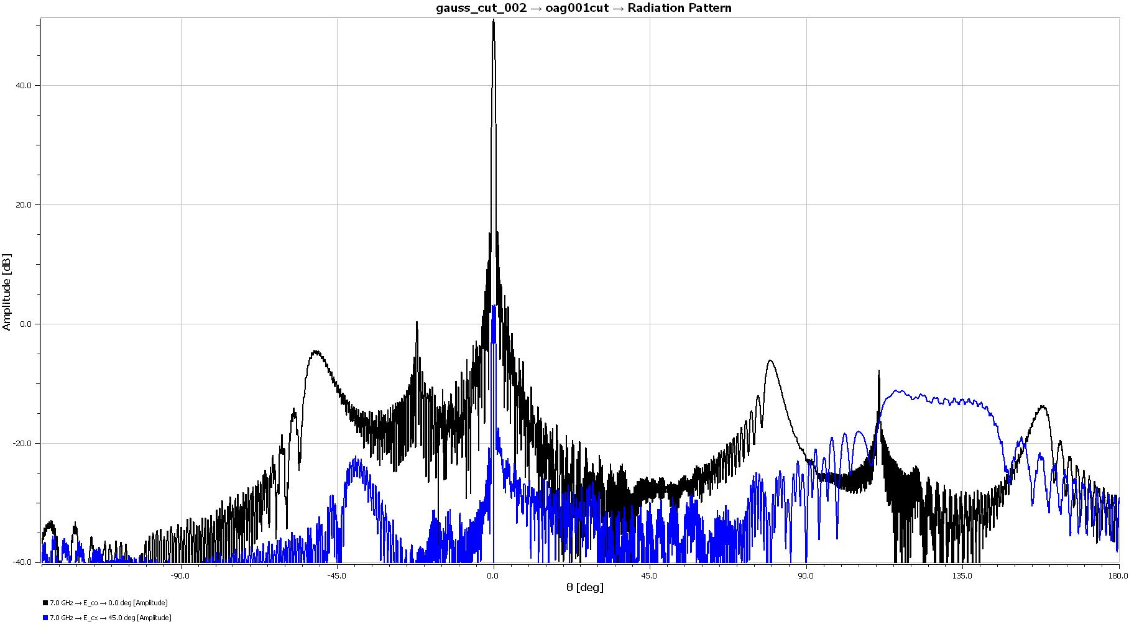
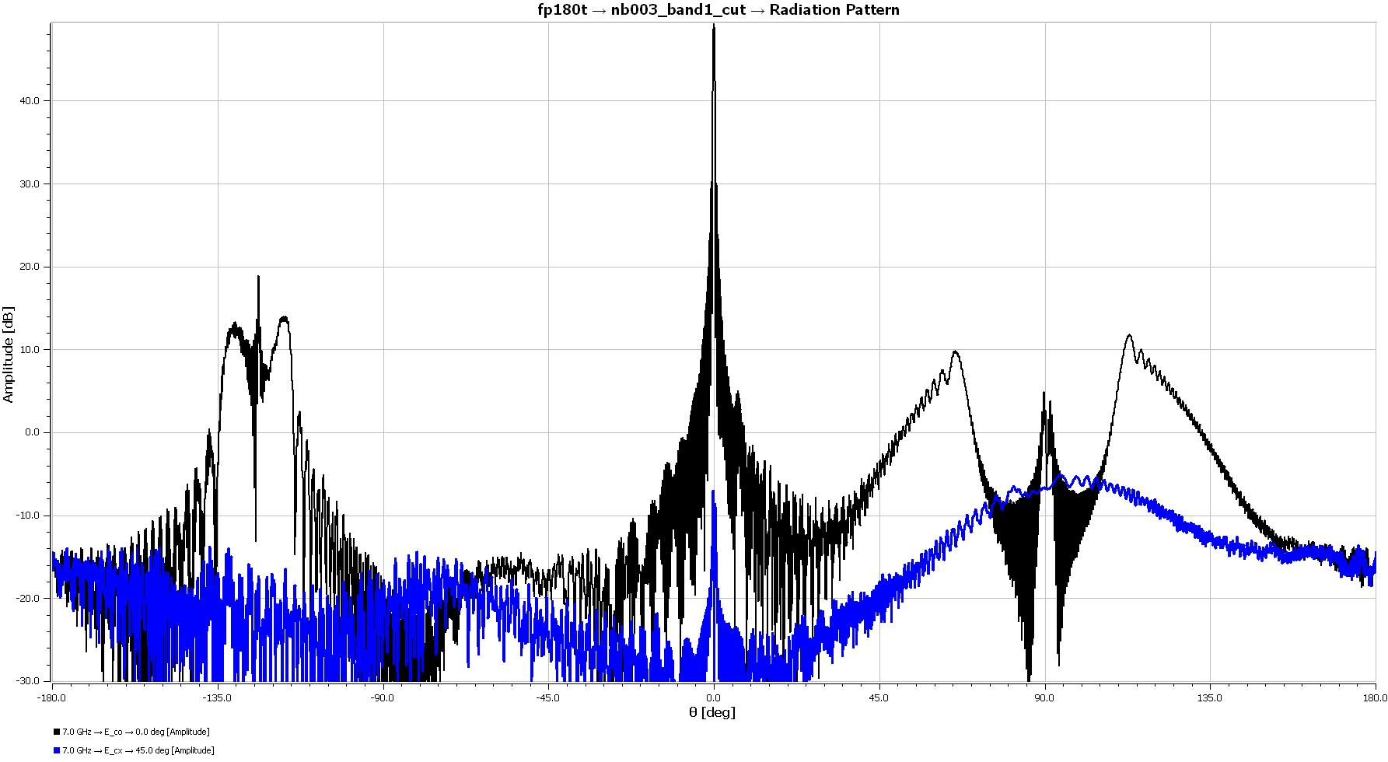
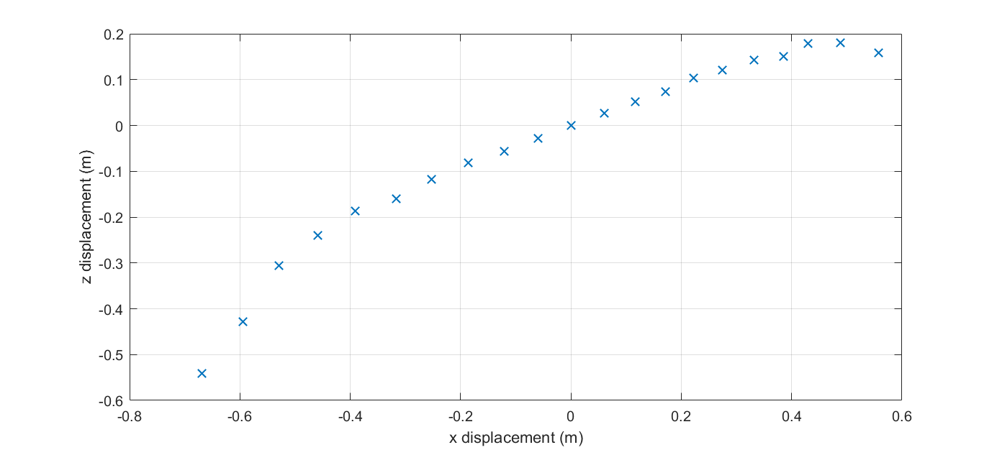
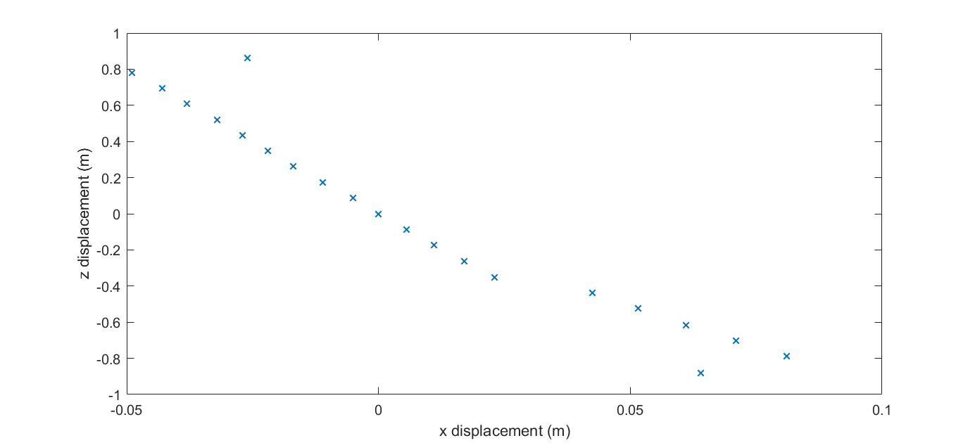
Telescope – Gregorian vs CD
Off-axis Gregorian vs. Cross-Dragone…
40dB
smaller secondary vs …
40dB
-135°
0dB
-45°
135°
90°
90°
0dB
-90°
-90°
... larger, flatter focal plane

Slide 24
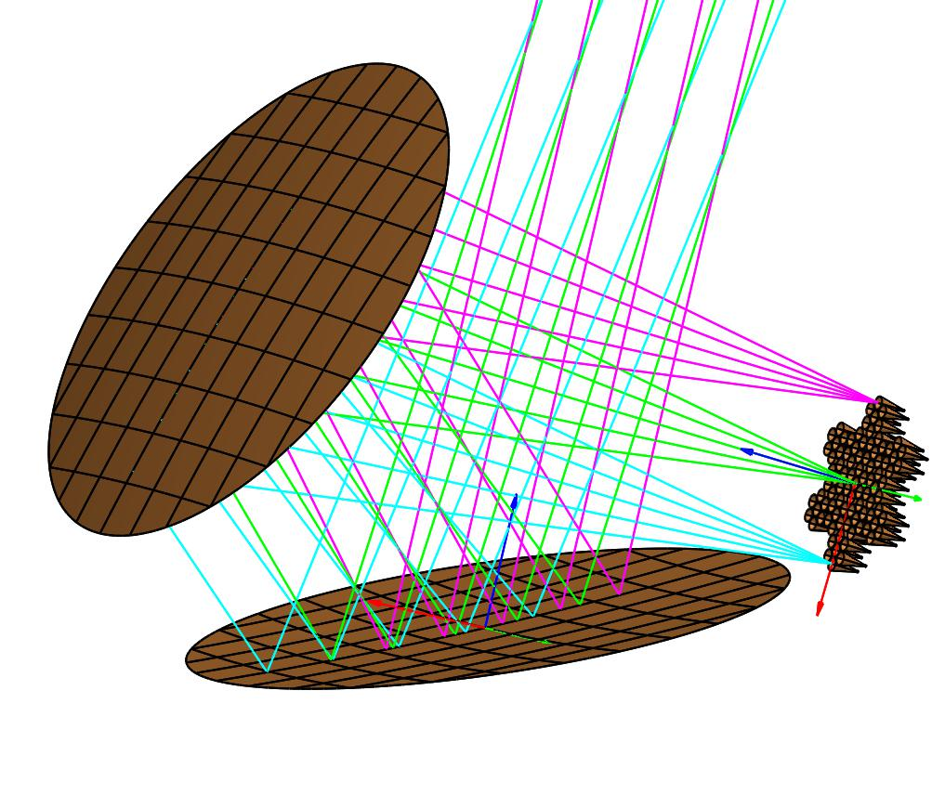
Telescope
Gregorian is not good enough (size of focal plane)
Shielding – ‘antenna in a box’ eg CCAT-p (but over-spec for max frequency 40/120 GHz)
Matched optics and interfaces with SO and CMB-S4?

Slide 25
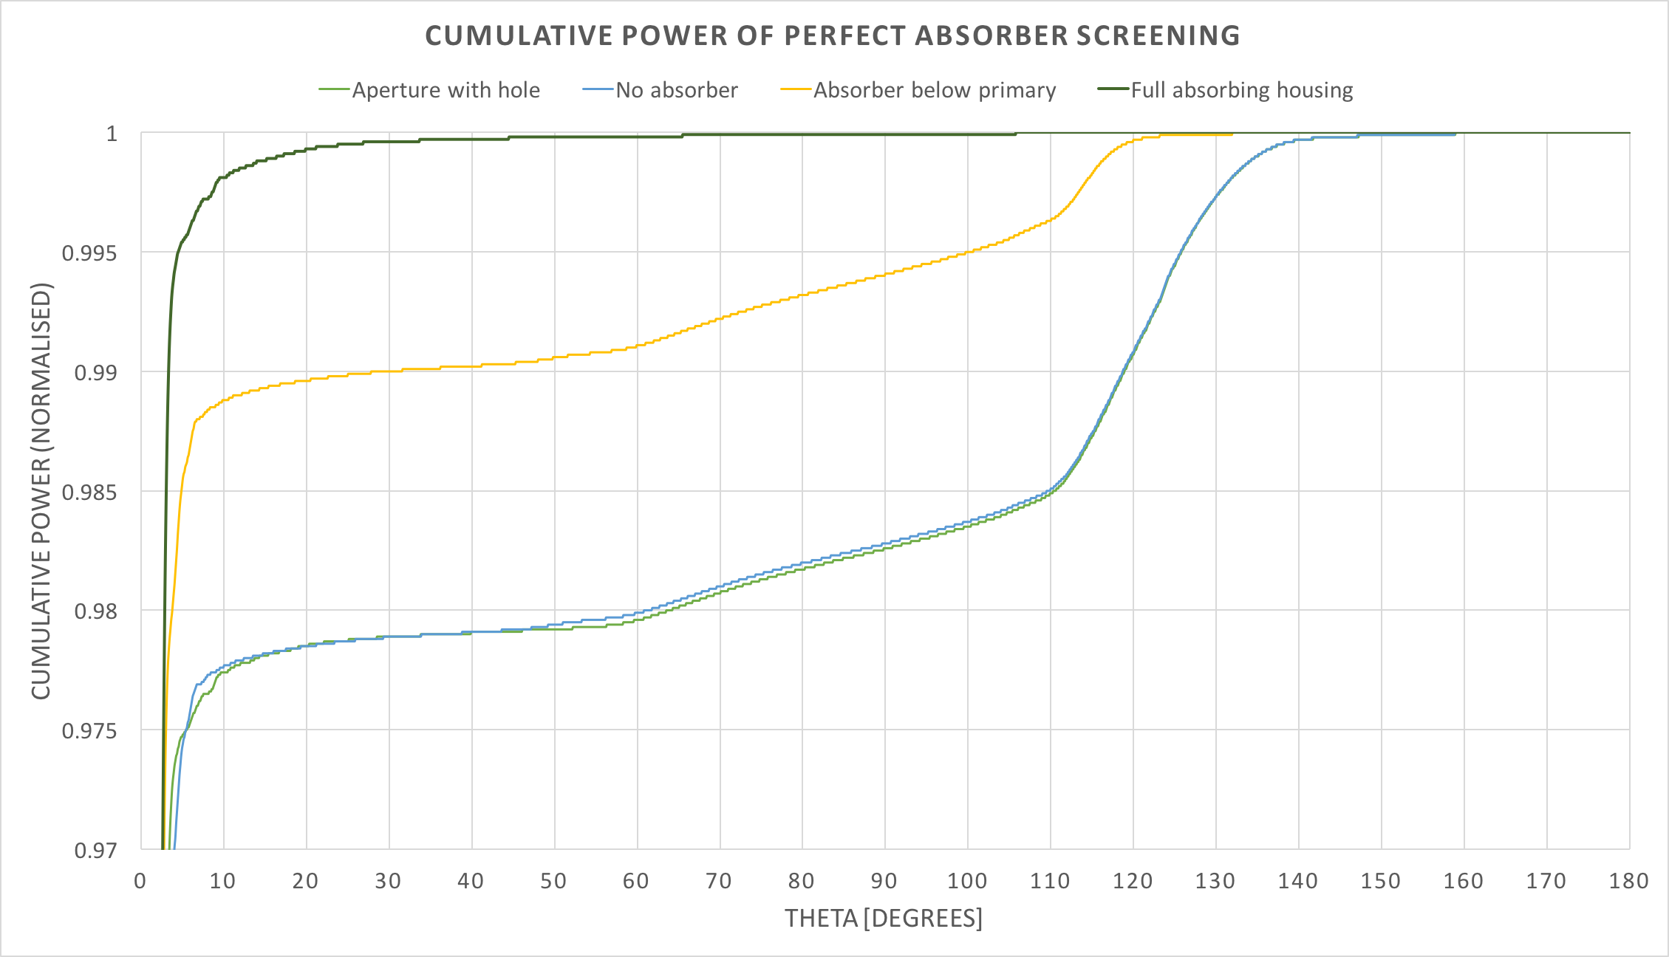
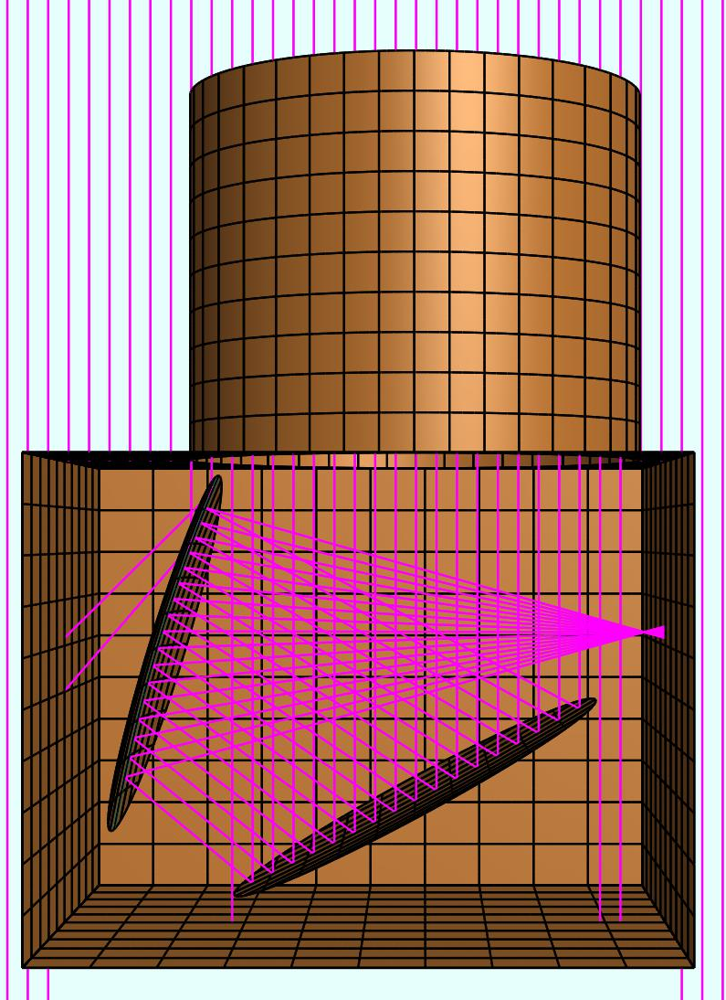
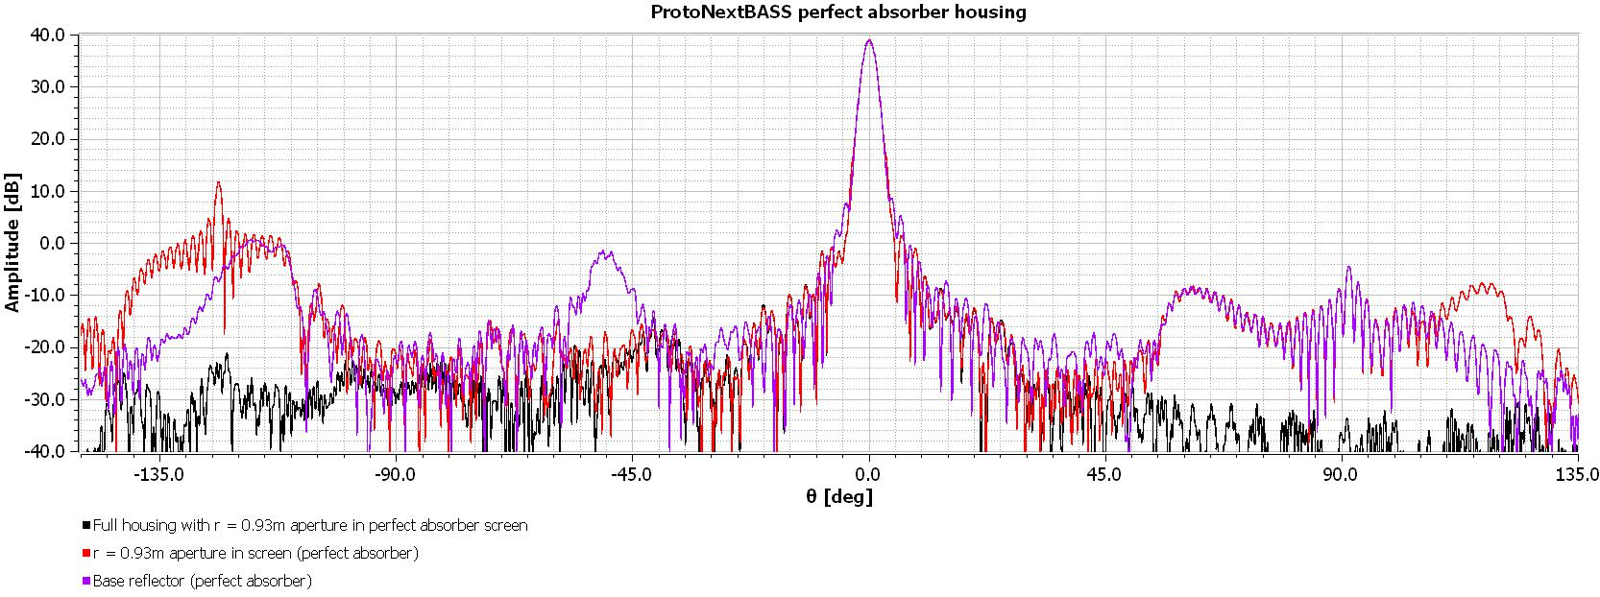
Baffling…

Slide 26
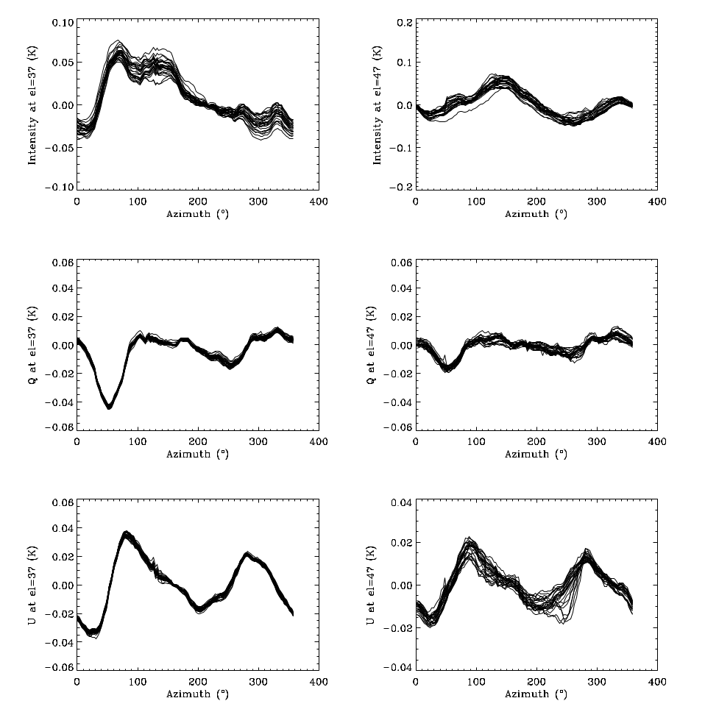
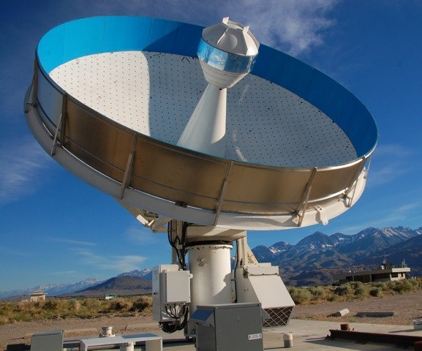
C-BASS ground pickup…
Biggest systematic for C-BASS despite very good far-out sidelobes: ~10 mK in raw data
Notes:
Ground templates

Slide 27
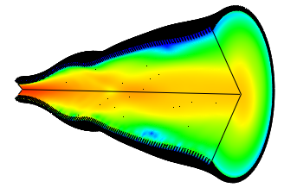
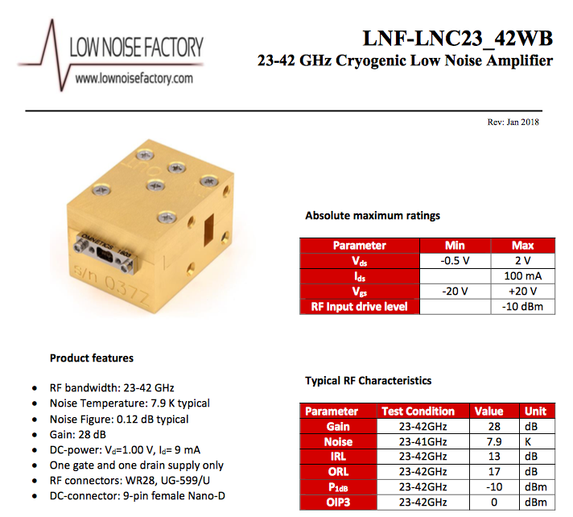
Feeds/OMTs/LNAs/Filters…

Slide 28
Digital radiometer/polarimeter
Downconvert and sample IF signals
4 GS/s-12b integrated with FPGA now off-the-shelf -> 8 GHz dual-pol pixel per board
Channelise
Q/U from x-correlation of R/L
I from autocorrelation of R,L, stabilized with calibration signal
Firmware/software control being done now for SKA/other projects

Slide 29
ELFS Proposal - costs
Very approximate at present!
Two telescopes: 2 x €5M = €10M
Site infrastructure: 2 x €1M = €2M
Operations: 2 x (€0.5M/yr) = €5M
Polarimeter array: €5M
Polarimeter backend: €5M
KIDS array receiver: €10M
Staff for construction, operations, analysis: €10M
Computing: €3M
Total: €50M (times π)
Timescale: Could start immediately funding is available

Slide 30
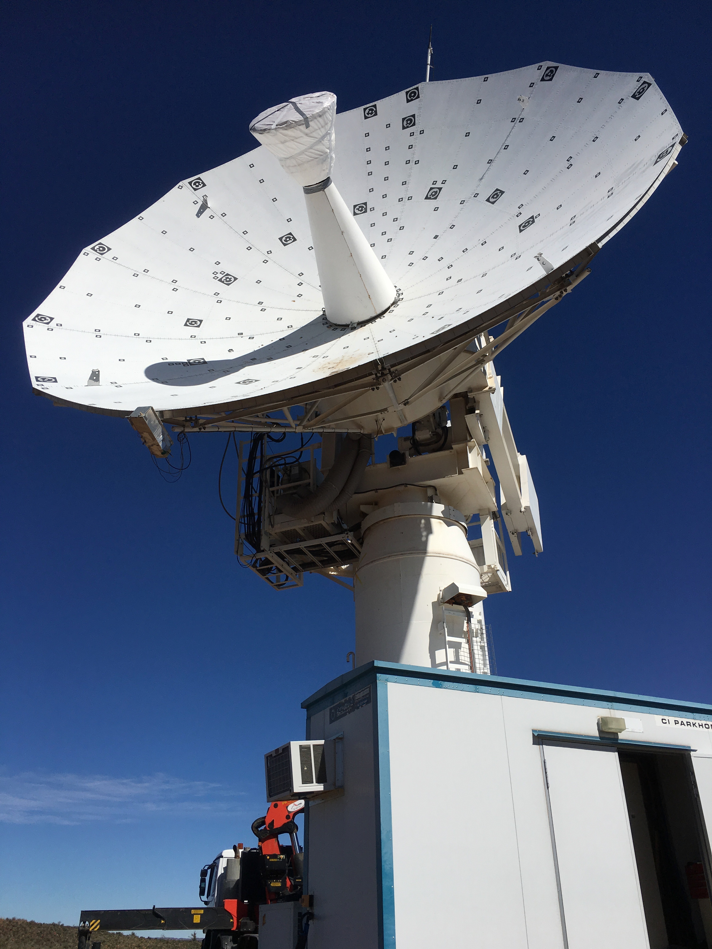
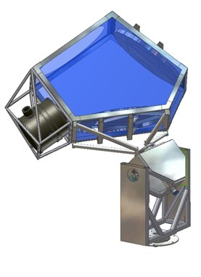
Steps on the way
X-BASS (STFC grant application, 2018)
  Single 7-15 GHz pixel on C-BASS South
  S4 equivalent sensitivity (if thermal noise limited)
STRIP
  40/90 GHz, Tenerife
QUIJOTE South
  10-20 GHz (South Africa/Chile?)
NEXTBASS (ERC grant application, 2018)
  31-element 15-30 GHz array on ex-Clover 2-m telescope
  C-BASS South site
  S3+ equivalent sensitivity
  Proves all technology
ELFS-p (ERC Synergy application? 2018/19?)
  6-m telescope, Tenerife
  ~100-element array 10 – 40 GHz

Slide 31
Summary
Low-frequency full-sky coverage is essential to complement CMB-S4 and satellites.
Two 6-m telescopes, north and south
Radiometer arrays 10 – 40 GHz with ~100 elements plus KIDS arrays at 90 – 120 GHz.
Europe has lead in these areas
A European Low-Frequency Survey should be a key part of the European CMB strategy.
Discuss!

Slide 32
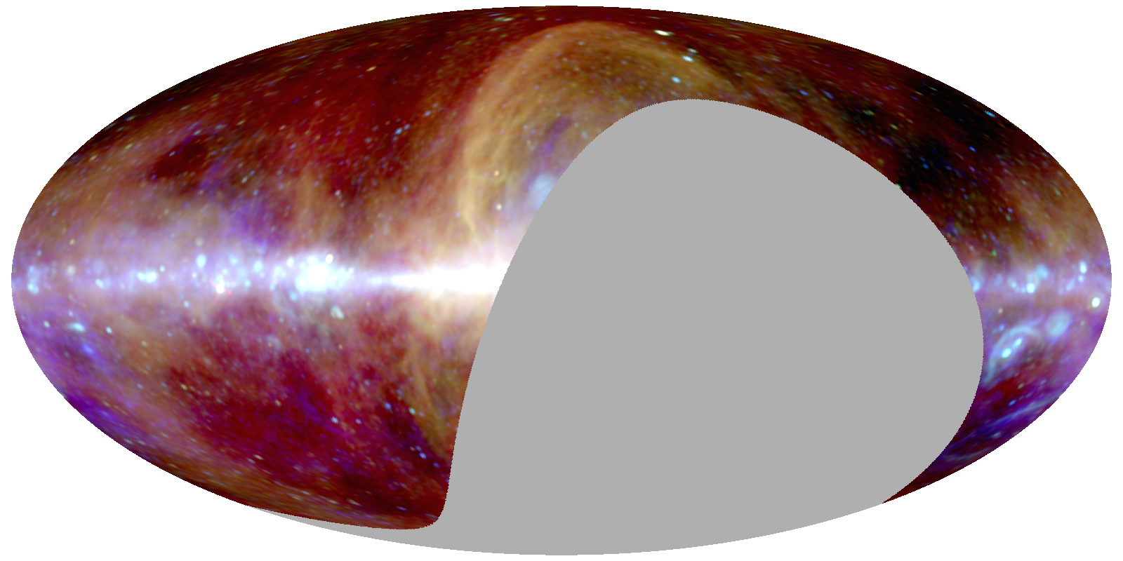
Notes:
The 3-colour map Haslam – CBASS – WMAP K minus CMB. Yellow-red synchrotron of various ages/spectra, cyan free-free, blue AME, multi-coloured extragalactic sources.

