Slide 1





Rigorous solution of few particle scattering problem and its applications
In collaboration with:
J. Carbonell (IPN Orsay, France)
R. Lazauskas

Slide 2

Theory of the particle collisions
It is even in the popular culture
Brothers Coen, N. Hawley , Fargo 3
13/06/2018
2
2
R. Lazauskas
Notes:
2

Slide 3

Ab-initio theory of the particle collisions
Very accurate predictions for the problems, where dynamical input is well known: atomic systems..
Understanding of the interactions for the systems, where it is not well known: nuclear, molecular, particle physics..
Reference to test and improve more efficient but approximate techniques.
n
¹S₀
p
n
n
n
³H
13/06/2018
3
3
R. Lazauskas
Notes:
3

Slide 4
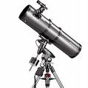
Status
Relativistic
2-body case is already problematic (LIA France-Brazil)
…
13/06/2018
4
4
R. Lazauskas
R. Lazauskas
Notes:
4

Slide 5
Status
Non-relativistic
2-body theory is on the solid grounds
(solution of the Schrodinger’s or Lippmann-Schwinger eq.)
3-body... the first complications
Infinity of the channels
Rearangement
Rescattering
Schrodinger’s/LS eq. is not enough
3-body Faddeev equations
>3-body problem:
Faddeev-Yakubovsky equations
…
13/06/2018
5
5
R. Lazauskas
R. Lazauskas
Notes:
5

Slide 6
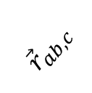

Rigorous theory of collisions should
Should separate all possible scattering channels to incorporate proper asymptotes! Number of binary channels increases ~2^{N}
Should be systematically reducible to smaller subsystems, in order to built proper asymptotic solutions and to be consistent to its subsystems (tree-like structure)
a
c
$${\vec{r}}_{ab,c}$$
$${\vec{r}}_{ab}$$
b
Notes:
6

Slide 7
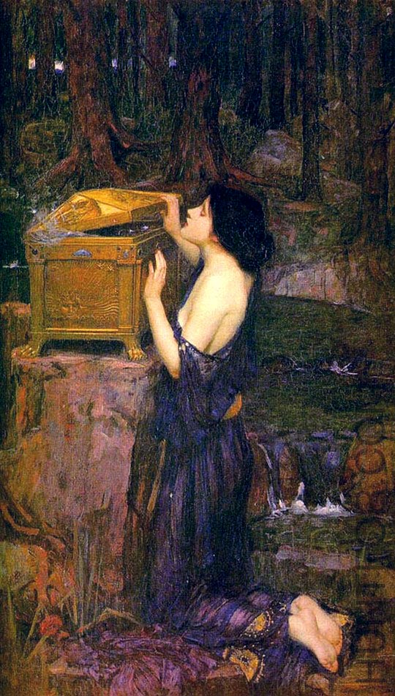
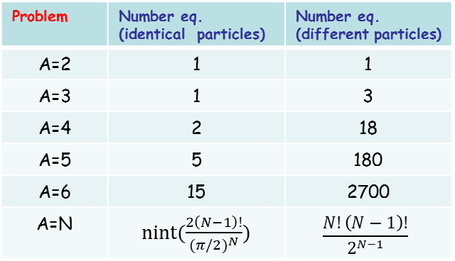
Faddeev-Yakubovsky equations
Merits:
Handling of symmetries
Boundary conditions for binary channels
Built-in reduction to subsystems
Price
Overcomplexity
Problem | Number eq. (identical particles) | Number eq. (different particles)
A=2 | 1 | 1
A=3 | 1 | 3
A=4 | 2 | 18
A=5 | 5 | 180
A=6 | 15 | 2700
A=N | nint($\frac{2\left(N−1\right)!}{{(π/2)}^{N}})$ | $$\frac{N!\left(N−1\right)!}{2^{N−1}}$$
J.W. Waterhouse : « Pandora »
Notes:
7

Slide 8
Applications: predictions
Production of the antimatter at CERN (GBAR, AEGIS, ATRAP,…)
Antihydrogen is anihilates, production rates small
Production rates are low
Reaction rates are required to optimize experimental setup
8
R. Lazauskas
R. Lazauskas
Notes:
8

Slide 9
Applications: predictions
Exotic nuclear systems:
A lot of turmoil about the possible existence of ⁴n resonant or even bound states (experiments in RIKEN & GANIL)
Presence of the resonant states in ⁵H, ⁶H & ⁷H
¹⁴Be→¹⁰Be+⁴n: 6 events consistent with bound or resonant
F.M. Marqués et al: Phys. Rev. C 65 (2002) 044006;
arxiv:nucl-ex/0504009
⁴He(⁸He, ⁸Be)⁴ n:
K. Kisamori et al., Phys. Rev. Lett. 116 (2016) 052501
R.L., J.Carbonell, Phys. Rev. C 72 (2005) 034003 (observable ⁴n resonances in conflict with theory)
E(⁵H)-E(³H)=1.8(1)-i1.15(15)
ECSM: 1.85(10)- i1.20(5)
Input of the Brazilian EFT community
I-N₃LO Potential
R. Lazauskas
R. Lazauskas
9
9
Notes:
9

Slide 10
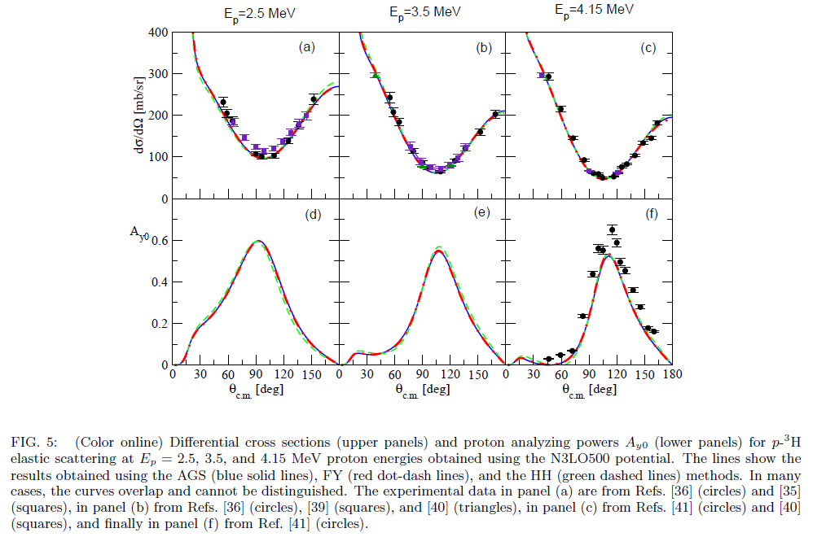
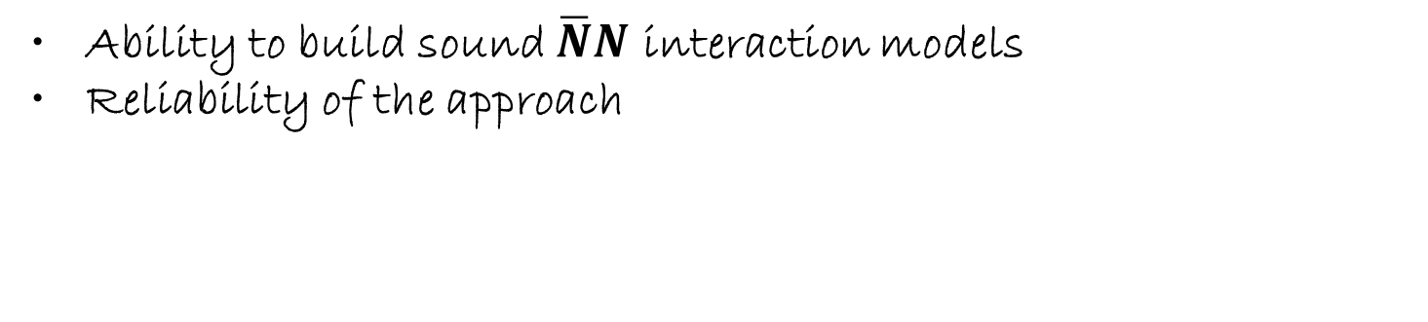

Test of the interaction models/approximate methods
Tests of the NN iteraction models in N-nucleus collisions
$$p+^{3}H↔n+^{3}He$$
And description of $\overline{N}$-nucleus collsions (PUMA project )?
Ability to build sound $\overline{N}N$ interaction models
Reliability of the approach
Relativity aspects (Brazil)??
R. Lazauskas
R. Lazauskas
10
10
Notes:
10

