Slide 1

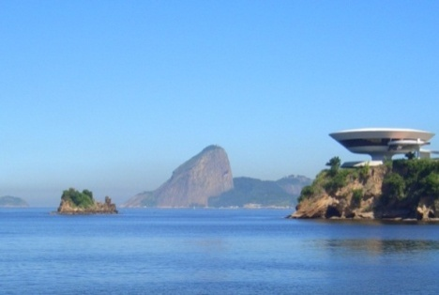
Competition between long- range collective and short range pairing correlations in two-neutron transfer reactions
Jesús Lubián Ríos
Institute of Physics
Federal Fluminense University
lubian@if.uff.br
J. Lubian I LIA meeting 2018, São José dos Campos

Slide 2
Outline
Nuclear spectroscopy via transfer reactions between heavy ions
The (¹⁸O,¹⁶O) reaction
Experimental results about ^{12,13}C(¹⁸O,¹⁶O)^{14,15}C, ¹⁶O(¹⁸O,¹⁶O)¹⁸O, ⁶⁴Ni(¹⁸O,¹⁶O)⁶⁶Ni and ²⁸Si(¹⁸O,¹⁶O)³⁰Si reactions @ 84 MeV incident energy
CRC and two-step DWBA (CCBA) calculations
Microscopic cluster calculations
J. Lubian I LIA meeting 2018, São José dos Campos

Slide 3
Nuclear spectroscopy via (¹⁸O,¹⁶O) reaction
The (¹⁸O,¹⁶O) reactions are good candidates to show the role of pairing interaction thanks to
The presence of a correlated pair of neutrons in the ¹⁸O_{g.s.} wave function
The very low polarizability of the ¹⁶O core
¹⁴C is a good benchmark for considerations
on the reaction mechanism, ⁶⁴Ni and ²⁸Si are good benchmark for studying long-range vs short-range correlations
Studies on both
¹³C(¹⁸O,¹⁷O)¹⁴C 1n transfer and ¹²C(¹⁸O,¹⁶O)¹⁴C 2n transfer
Presence of 2n correlations in the ¹⁴C_{g.s.} wave function
Strong selectivity in the populated states
Absolute cross sections reproduced without any scaling factor
M. Cavallaro et al., PRC 88 (2013) 054601
J. Lubian I LIA meeting 2018, São José dos Campos

Slide 4
Theoretical models and main ingredients
Exact finite range CRC
and
two-step CCBA calculations
Sao Paulo Potential (SPP) used as the optical potentials
Wood-Saxon form factors were used to generate single particle and cluster wave functions. Depth were adjusted to fit the exp. separation energies
Deformation parameters for collective excitations
Spectroscopic Amplitudes by shell-model in the 1p_{1/2}, 1d_{5/2}, 2s_{1/2} model space
(zbm interaction)
L.C. Chamon, et al., PRL 79 (1997) 5218
A.P. Zuker, et al., PRL 17 (1969) 983
J. Lubian I LIA meeting 2018, São José dos Campos

Slide 5
Theoretical models and main ingredients
J. Lubian I LIA meeting 2018, São José dos Campos

Slide 6
Theoretical models and main ingredients
J. Lubian I LIA meeting 2018, São José dos Campos

Slide 7
Theoretical results for other channels
Extreme Cluster Model
(CRC)
Relative motion of the 2n system frozen and separated by the c.m.
Only the term with the 2n coupled to S = 0 participates to the transfer
Sequential transfer
(DWBA)
Introducing the ¹⁷O +¹³C intermediate partition
Independent coord.
(CRC)
Presence of two-neutron pairing correlations in other ¹⁴C states
CRC -1n transfer
No arbitrary scaling
M. Cavallaro et al., PRC 88 (2013) 054601
J. Lubian I LIA meeting 2018, São José dos Campos

Slide 8
New works published in 2016-2017
What happens if we add a neutron to the ¹⁴C system?
Study of the ¹³C(¹⁸O,¹⁶O)¹⁵C reaction at
84 MeV incident energy
D. Carbone et al., PRC 95, 034603 (2017)
J. Lubian I LIA meeting 2018, São José dos Campos

Slide 9
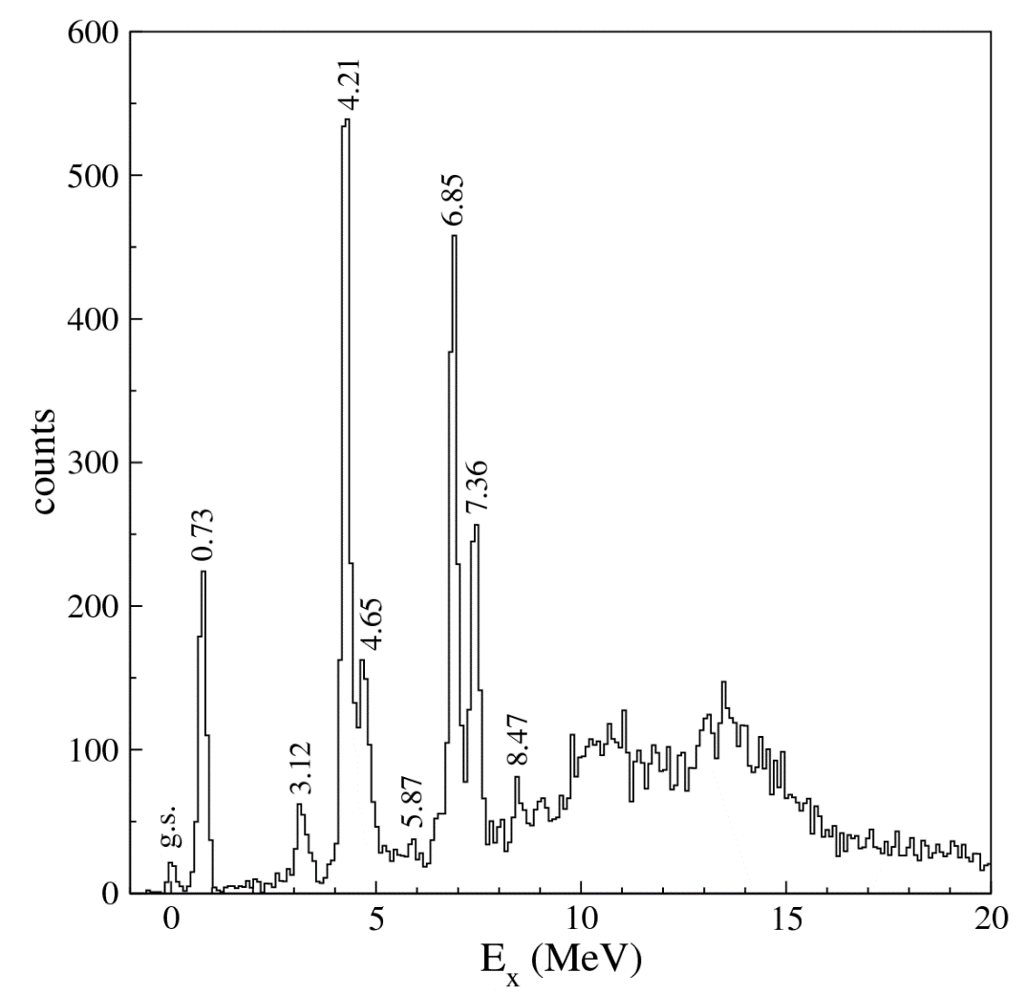
¹⁵C energy spectrum
¹³C(¹⁸O,¹⁶O)¹⁵C
Same states populated in the (t,p) reactions
Strong population of states with
¹³C + 2n configurations
Population of the Giant Pairing Vibration above S_{2n}
S_{n} = 1.218 MeV
S_{2n} = 9.35 MeV
13.7 (GPV)
F. Cappuzzello et al., Nat. Commun. 6, 6743 (2015)
D. Carbone, EPJ Plus (2015) 130:143
Energy resolution ~ 200 keV
9° < θ_{lab} < 10°
J. Lubian I LIA meeting 2018, São José dos Campos

Slide 10
J. Lubian I LIA meeting 2018, São José dos Campos

Slide 11
J. Lubian I LIA meeting 2018, São José dos Campos

Slide 12
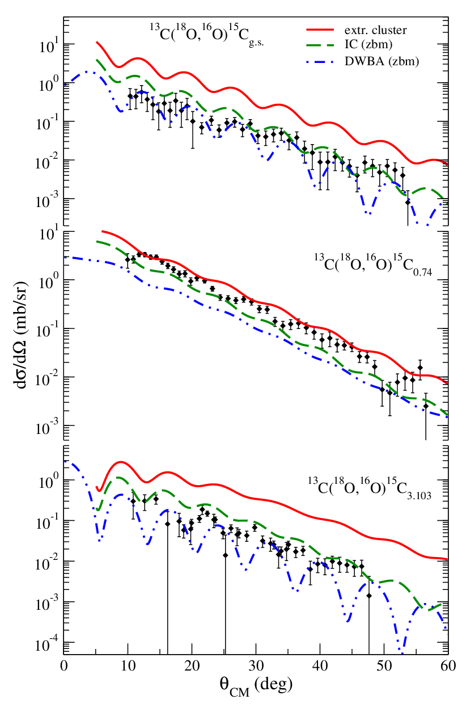
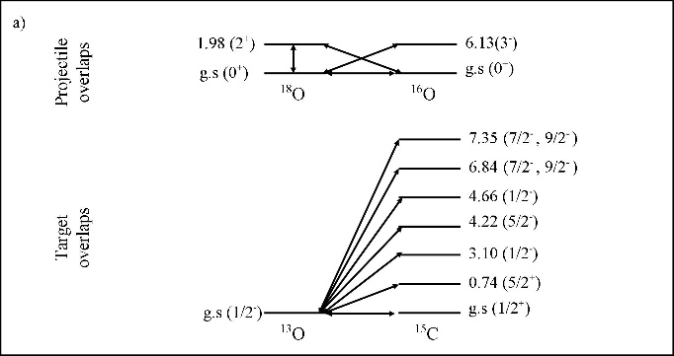
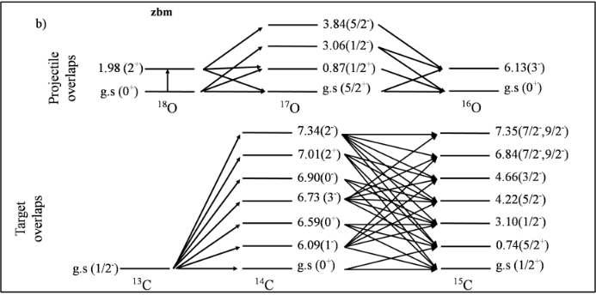
CRC and DWBA calculations
Extreme cluster model
Relative motion of the 2n frozen and separated by the c.m.
Only the term with the 2n coupled to S = 0 participates to the transfer
S.A. = 1 for all configurations
Independent coordinate model
The transfer is described taking into account spectroscopic information obtained by shell model calculations
¹³C(¹⁸O,¹⁶O)¹⁵C_{g.s.} (1/2⁺)
L = 1
¹³C(¹⁸O,¹⁶O)¹⁵C_{0.74} (5/2⁺)
L = 3
Coupling scheme
No scaling factors
¹³C(¹⁸O,¹⁶O)¹⁵C_{3.103} (1/2⁻)
Sequential transfer (DWBA)
Introducing the ¹⁷O + ¹⁴C intermediate partition
L = 0
Coupling scheme
J. Lubian I LIA meeting 2018, São José dos Campos

Slide 13
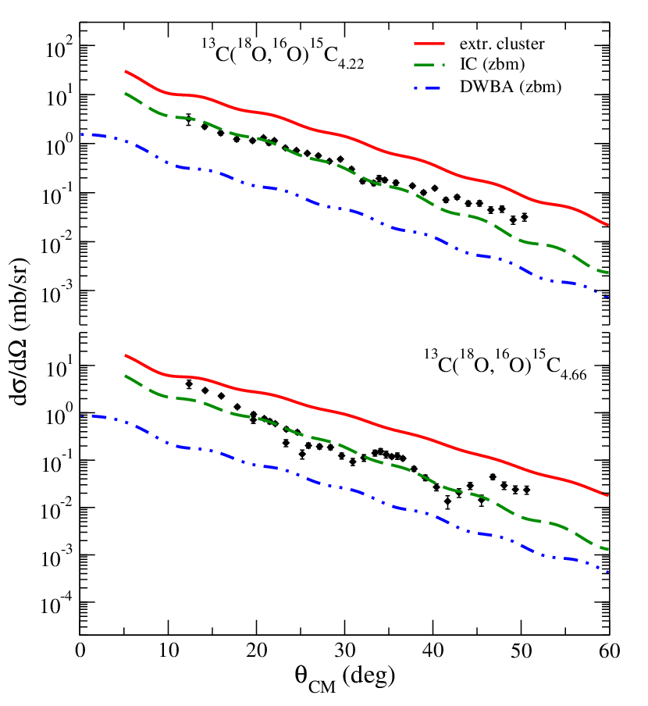
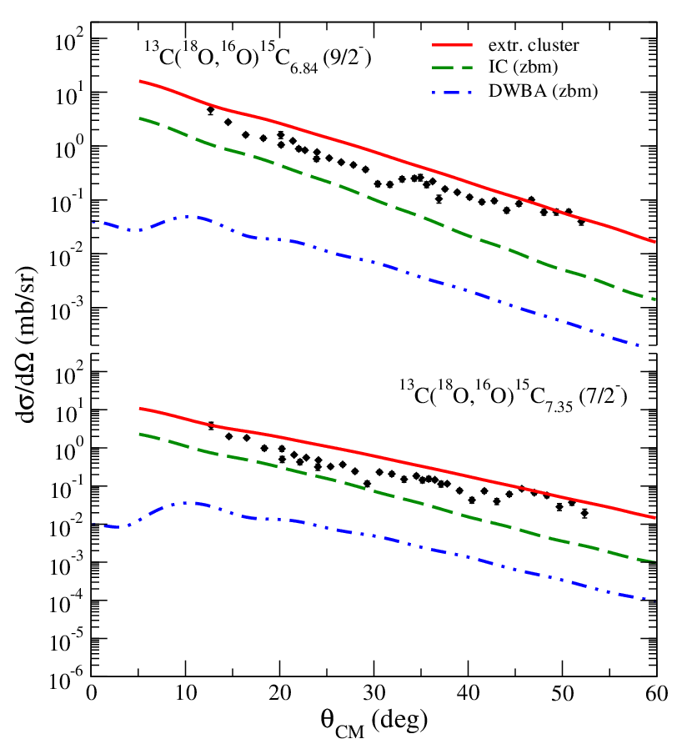
CRC and DWBA calculations
L = 2
L = 4
¹³C(¹⁸O,¹⁶O)¹⁵C_{4.22} (5/2⁻)
¹³C(¹⁸O,¹⁶O)¹⁵C_{6.84} (9/2⁻)
No scaling factors
¹³C(¹⁸O,¹⁶O)¹⁵C_{4.66} (3/2⁻)
¹³C(¹⁸O,¹⁶O)¹⁵C_{7.35} (7/2⁻)
Extreme cluster model overestimate the cross section (S.A. = 1)
Independent coordinate model describes quite well the cross sections
Sequential transfer (DWBA) underestimate the cross sections
J. Lubian I LIA meeting 2018, São José dos Campos

Slide 14
Microscopic cluster calculations
Wave functions for two particles in an harmonic oscillator common potential (j-j coupling)
wave functions in terms of the relative and centre of mass coordinates of the two particles (LS coupling)
(n,l) internal cluster state
(N,L) cluster motion relative to the core
Moshinsky coefficients
S.A. in j-j coupling
Two neutron amplitudes – zbm interaction
Initial state | j₁j₂ | J₁₂ | Final state | Spectr. Amp. | n | l | N | L | Λ | S | Spec. Amp. (c.m.)
¹³C_{g.s.}(1/2⁻) | (p_{1/2}s_{1/2}) | 0 | ¹⁵C_{g.s.}(1/2⁺) | -0.641 | 1 | 0 | 2 | 1 | 1 | 1 | -0.292
 |  |  |  |  | 1 | 1 | 1 | 2 | 1 | 1 | 0.338
 |  |  |  |  | 1 | 1 | 2 | 0 | 1 | 1 | -0.075
 | (p_{1/2}s_{1/2}) | 1 |  | -1.110 | 1 | 0 | 2 | 1 | 1 | 0 | 0.292
 |  |  |  |  | 1 | 1 | 1 | 2 | 1 | 0 | -0.338
 |  |  |  |  | 1 | 1 | 2 | 0 | 1 | 0 | 0.075
 |  |  |  |  | 1 | 0 | 2 | 1 | 1 | 1 | -0.413
 |  |  |  |  | 1 | 1 | 1 | 2 | 1 | 1 | 0.477
 |  |  |  |  | 1 | 1 | 2 | 0 | 1 | 1 | -0.107
J. Lubian I LIA meeting 2018, São José dos Campos

Slide 15
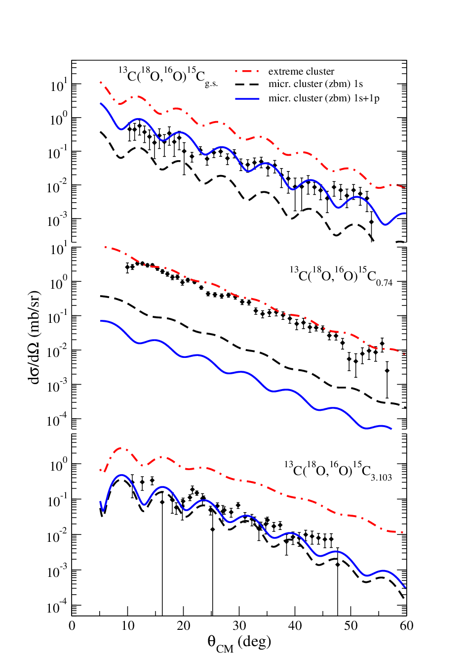
Microscopic cluster calculations
Extreme cluster model
Microscopic cluster 1s
Taking into account configurations with n = 1 l = 0
Microscopic cluster 1s + 1p
Taking into account configuration with n = 1 l = 0, 1
¹³C(¹⁸O,¹⁶O)¹⁵C_{g.s.} (1/2⁺)
L = 1
¹³C(¹⁸O,¹⁶O)¹⁵C_{0.74} (5/2⁺)
L = 3
Coupling scheme
No scaling factors
¹³C(¹⁸O,¹⁶O)¹⁵C_{3.103} (1/2⁻)
L = 0
Transitions to ground and 3.103 MeV states reproduced rather well with 1s + 1p waves
Transition to 0.74 MeV state probably needs more configurations
J. Lubian I LIA meeting 2018, São José dos Campos

Slide 16
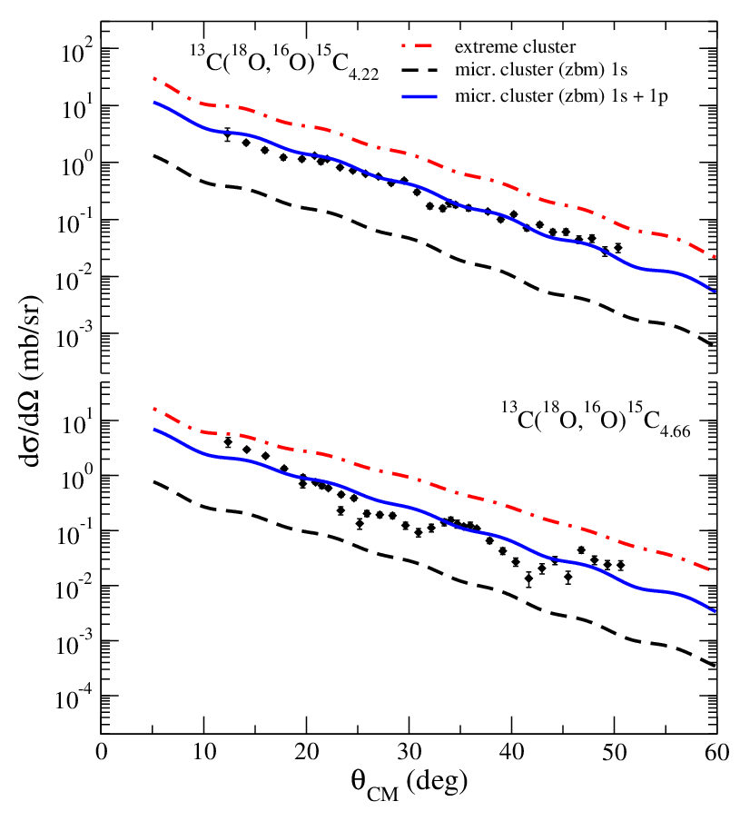
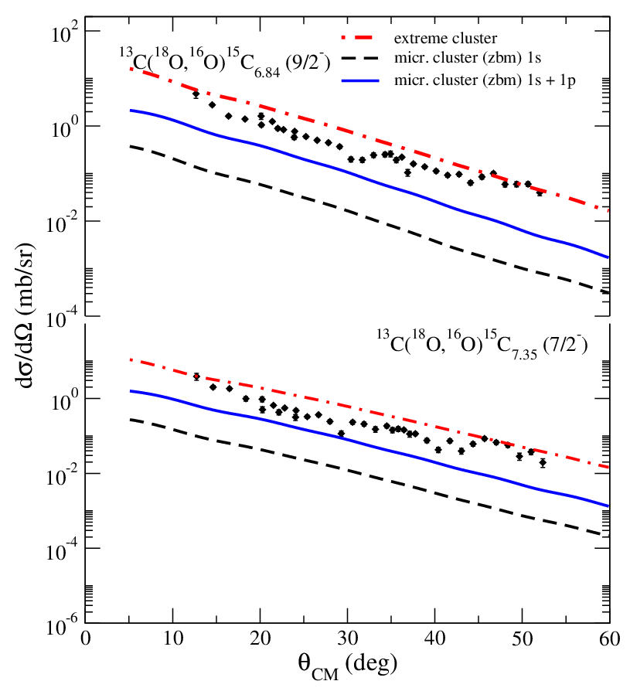
Microscopic cluster calculations
L = 2
L = 4
No scaling factors
¹³C(¹⁸O,¹⁶O)¹⁵C_{4.22} (5/2⁻)
¹³C(¹⁸O,¹⁶O)¹⁵C_{6.84} (9/2⁻)
¹³C(¹⁸O,¹⁶O)¹⁵C_{4.66} (3/2⁻)
¹³C(¹⁸O,¹⁶O)¹⁵C_{7.35} (7/2⁻)
Cross section reproduced quite well with 1s + 1p waves
Cross section underestimated with 1s + 1p waves
Relevant d_{3/2} contributions expected, excluded in our model space
J. Lubian I LIA meeting 2018, São José dos Campos

Slide 17
New works published in 2016-2017
Test of model space for the <¹⁸O|¹⁶O> projectile overlaps
Study of the ¹⁸O(¹⁶O,¹⁸O)¹⁶O reaction at
84 MeV incident energy
zbm vs psdmod interactions
Model space | valence orbitals
zbm (¹²C-core) | 1p_{1/2}, 1d_{5/2}, 2s_{1/2}
psdmod (⁴He core) | 1p_{3/2}, 1p_{1/2}, 1d_{5/2}, 2s_{1/2}, 1d_{3/2}
J. Lubian I LIA meeting 2018, São José dos Campos

Slide 18
Experimental results
S_{n}= 8.045 MeV; S_{2n}= 12.189 MeV
M. J. Ermamatov et al., PRC 94 (2016) 024610
J. Lubian I LIA meeting 2018, São José dos Campos

Slide 19
Results of theoretical calculations
g.s. only S=0 (A)
2+ S=0 (A) or (P)
Extreme cluster model works
For the lower states of projectile overlaps
the zbm model- space is enough.
The study of the higher excited states is in
progress
M. J. Ermamatov et al., PRC 94 (2016) 024610
J. Lubian I LIA meeting 2018, São José dos Campos

Slide 20
New works in medium mass system
Study of the ¹⁸O(⁶⁴Ni,⁶⁶Ni)¹⁶O reaction at
84 MeV incident energy
Model space | valence orbitals
protons | 1p_{1/2}, 1d_{5/2}, 2s_{1/2}
neutrons | 1p_{3/2}, 1p_{1/2}, 1d_{5/2}, 2s_{1/2}, 1d_{3/2, 1}, 1g_{7/2}
J. Lubian I LIA meeting 2018, São José dos Campos

Slide 21
Results of theoretical calculations
Microscopic results:
g.s.: IC results are better, specially in the bell-shaped region. Same order: one and two step.
2⁺ : Long-range correl. (coll.) dominates over the short-range (pairing)
Cluster model is not good for ^{64,66}Ni
J. Lubian I LIA meeting 2018, São José dos Campos

Slide 22
Results of theoretical calculations
Microscopic results:
g.s.: IC results are better, specially in the bell-shaped region.
2⁺ : Long-range correl. (coll.) dominates over the short-range (pairing)
B. Paes et al PRC 96.044612 (2017)
IBM2 for ^{64,66}Ni and IBFM for ⁶⁵Ni
J. Lubian I LIA meeting 2018, São José dos Campos

Slide 23
Results of theoretical calculations
Small for ¹⁴C ¹⁸C
Big for ²⁸Mg ⁶⁶Ni ⁷⁶Ge
J. Lubian I LIA meeting 2018, São José dos Campos

Slide 24
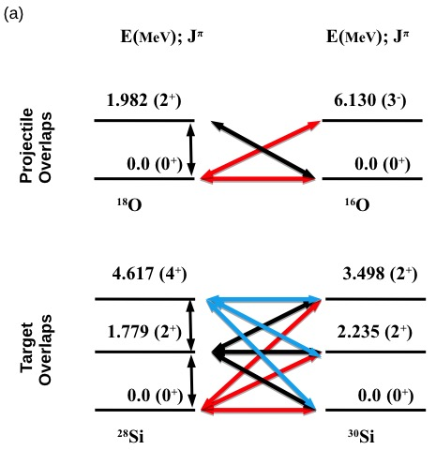
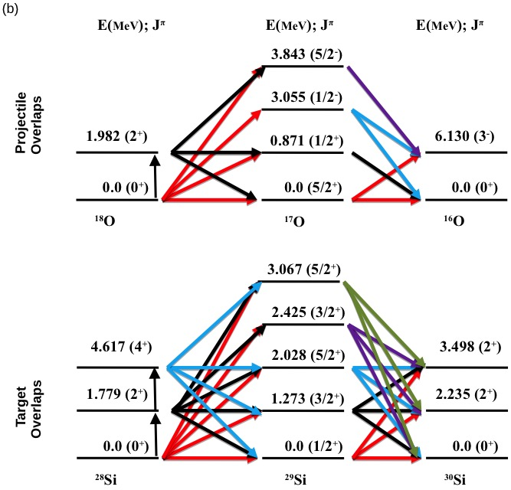
New works: deformed target
Study of the ¹⁸O(²⁸Si,³⁰Si)¹⁶O reaction at
84 MeV incident energy
Model space (⁴He core) | valence orbitals (similar to Ni)
Protons | 1p_{3/2}, 1p_{1/2}, 1d_{5/2}, 2s_{1/2}, 1d_{3/2}
neutrons | 1p_{3/2}, 1p_{1/2}, 1d_{5/2}, 2s_{1/2}, 1d_{3/2}
J. Lubian I LIA meeting 2018, São José dos Campos

Slide 25
Results of theoretical calculations
Microscopic results:
g.s.: Two-step DWBA results are better. Same order: one- and two- steps.
2⁺ : Long-range correl. (coll.) dominates over the short-range (pairing)
Si* the same results as the 2⁺ state
Cluster model is not good for ^{28,30}Si, Accepted in PRC on Monday (06/11/2018)
J. Lubian I LIA meeting 2018, São José dos Campos

Slide 26
Results of theoretical calculations
Does our theoretical calculations
describe other observables?
Elastic scattering
Inelastic scattering
J. Lubian I LIA meeting 2018, São José dos Campos

Slide 27
Conclusions and outlooks
^{12,13}C(¹⁸O,¹⁶O)¹⁵C, ¹⁶O(¹⁸O,¹⁶O)¹⁸O, ⁶⁴Ni(¹⁸O,¹⁶O)⁶⁶Ni, ²⁸Si(¹⁸O,¹⁶O)³⁰Si, at 84 MeV incident energy
Four models were used to calculate the cross section:
Extreme cluster
Independent coordinate
DWBA
Microscopic cluster (only for ¹³C)
no need for any “unhappiness” factor to reproduce the absolute cross sections
In ¹³C importance of a two-neutron correlation in the nuclear wave function, the extra neutron does not destroy the correlations observed in the ¹⁴C case
Dominance of the 1s and 1p waves in the two-neutron cluster internal wave function
Adequacy of zbm interaction for low-lying overlaps of the projectile were established for the projectile.
Dominance of long-range correlations for the excited 2⁺ state of ⁶⁶Ni over the short-range pairing correlations. The opposite for the g.s.
Dominance of long-range correlations in all states of ³⁰Si.
J. Lubian I LIA meeting 2018, São José dos Campos

Slide 28
Conclusions and outlooks
Outlooks:
Include other waves in the microscopic cluster calculations
Enlarge the model space for higher energy transitions (d_{3/2})
Describe high excited states of the projectile.
Include the deformed target (²⁸Si) to study the mixing of collective and single particle configurations.
Study the 2p and np transfers to study the pairing correlations in collaboration with the structure group of Genova of Prof. Santopinto.
J. Lubian I LIA meeting 2018, São José dos Campos

Slide 29
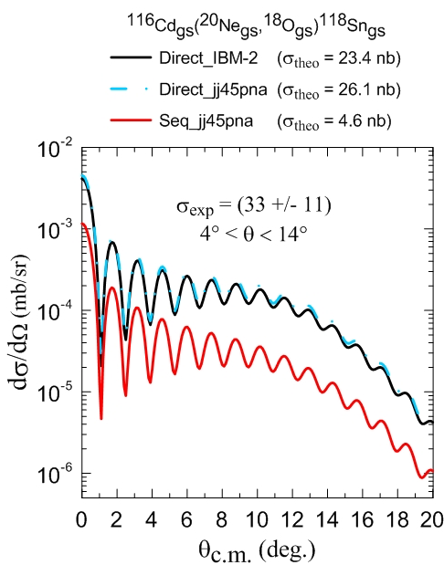
J. Lubian I LIA meeting 2018, São José dos Campos

Slide 30
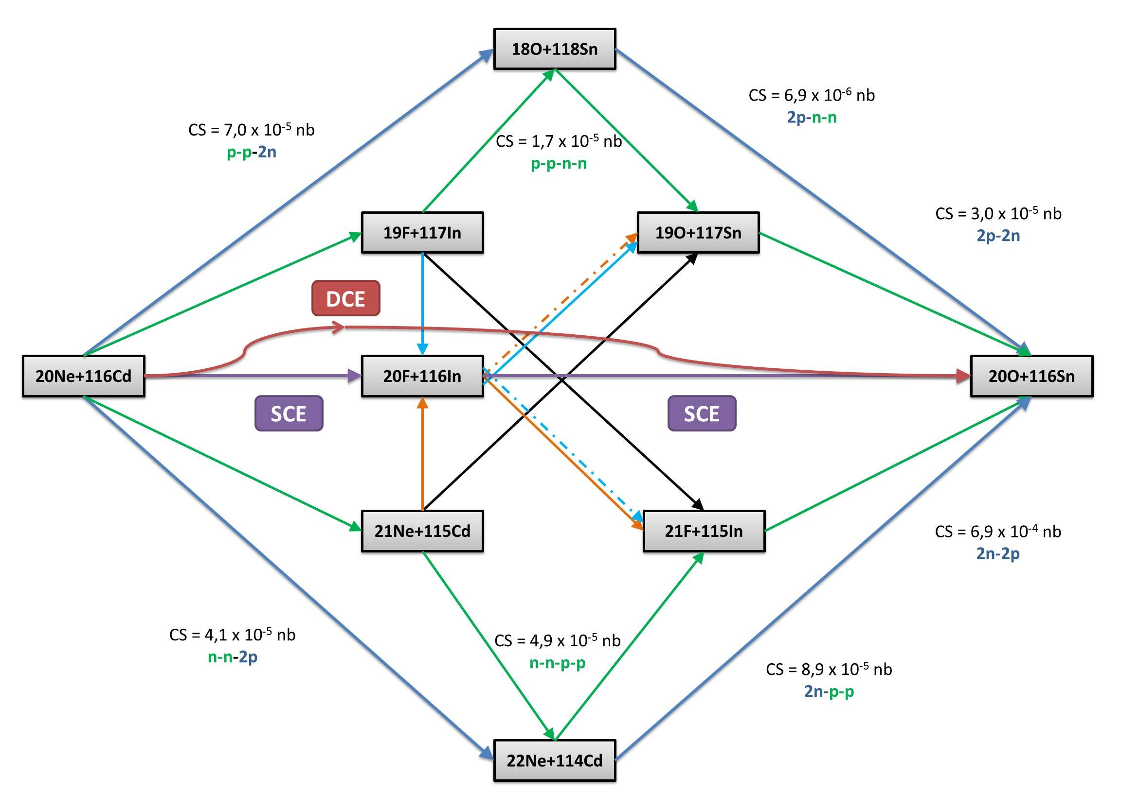
REACTIONS SCHEME CONCERNING THE ¹¹⁶Cd(²⁰Ne, ²⁰O) ¹¹⁶Sn
J. Lubian I LIA meeting 2018, São José dos Campos

Slide 31
Very recent results (last week)
¹⁸O + ⁶³Cu @ 161⁰
B(E2) ⁶⁵Cu: 185 e²fm4
B(E2) ⁶⁶Ni: 600 e²fm4
E. Crema et al. Submitted to PRC (2018)
J. Lubian I LIA meeting 2018, São José dos Campos

Slide 33
Working group
E. N. Cardozo, M. Ermamatov, P. de Faria, J. L. Ferreira, D. Mendes Jr., R. Linares, J. Lubian, B. Paes, V. Sagatto.
Instituto de Fisica, Universidade Federal Fluminense, Niteroi, RJ, Brazil
A. Gargano
Istituto Nazionale di Fisica Nucleare – Sezione di Napoli, Italy
S. Lenzi, A. Vitturi
Istituto Nazionale di Fisica Nucleare – Sezione di Padova, Italy
C. Agodi, S. Calabrese, D. Carbone, M. Cavallaro, F. Cappuzzello, A. Foti, G. Santagati
Dipartimento di Fisica e Astronomia, Università degli Studi di Catania, Italy
Istituto Nazionale di Fisica Nucleare – Laboratori Nazionali del Sud, Italy
Istituto Nazionale di Fisica Nucleare – Sezione di Catania, Italy
E. Santopinto, R. Magana, H. García-Tecocoatzi
Istituto Nazionale di Fisica Nucleare – Sezione di Genova, Italy
E. Crema
Istituto de Física, Universidade de São Paulo, São Paulo, SP, Brazil
Thank you
J. Lubian I LIA meeting 2018, São José dos Campos

