Slide 1

Research and Nuclear Physics Applications at IPEN
Frederico A. Genezini
LIA SUBATOMIC PHYSICS: KICK-OFF WORKSHOP São José dos Campos, 12 june 2018

Slide 2
Contents
The National Nuclear Energy Commission (CNEN)
The Nuclear Physics Applications at the IPEN
The CNEN;
Center for Development of Nuclear Technology - CDTN;
Institute of Radiological Protection and Dosimetry - IRD
Institute of Nuclear Engineering -IEN;
Nuclear and Energy Research Institute - IPEN;
Radiopharmacy Center;
Radiation Technology Center;
Laser and Applications Center;
Research Reactor Center.

Slide 3
National Nuclear Energy Commission - CNEN
Federal Government Autarchy under the Ministry of Science and Technology – MCT
CNEN acts in Research and Development in the Nuclear Technology field, as well as rendering technological services and education;
Regulatory Board;
MCT
Ministry of Science and Technology
CNEN
Brazilian Nuclear Energy Commission
~1800 workers
CDTN - (MG)
Nuclear Technology
and Development Center
270 workers
IEN - (RJ)
Nuclear Engineering
Institute
169 workers
IPEN - (SP)
Nuclear and Energy
Research Institute
688 workers
IRD - (RJ)
Radiological Protection
and Dosimetry Institute
189 workers
CRCN - (PE)
Regional Center of
Nuclear Sciences
61 workers
  There are other (6) smaller units: Angra dos Reis District, Rio de Janeiro, RJ; Caetité District, Caetité, BA; Fortaleza District, Fortaleza, CE; Goiânia District, Goiânia, GO; Planalto Central District, Brasília, DF; Laboratory Division of Poços Caldas, Poços de Caldas, MG.

Slide 4
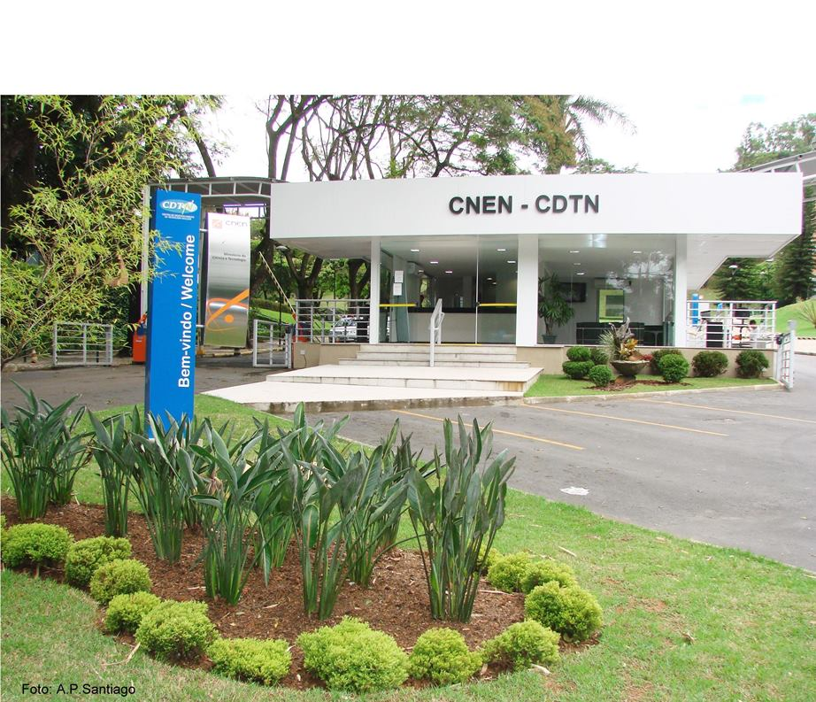
Center for Development of Nuclear Technology - CDTN
Located in Belo Horizonte - MG
Total about 50 researchers;
Research reactor;
18 MeV Cyclotron;
Radiation metrology Labs;
Radiopharmaceutical unit for Research and Production;
Gamma irradiation Lab (60 kCi panoramic Co);
Facilities for research on mining and processing of uranium.

Slide 5
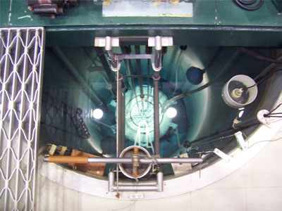
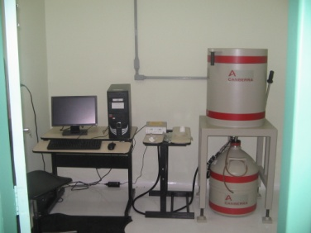
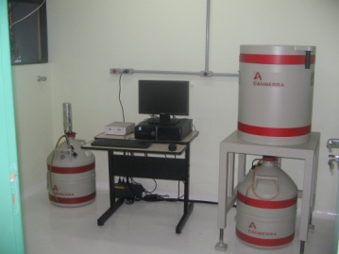
Center for Development of Nuclear Technology - CDTN
IPR-R1 | Research and Training | 100 kW | CDTN - CNEN/MG | Triga MARK-I
Neutron Activation Analysis

Slide 6
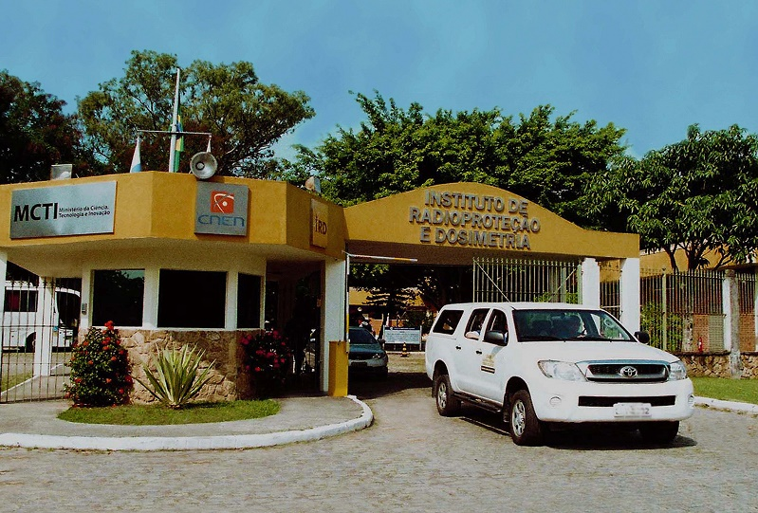
Institute of Radiological Protection and Dosimetry- IRD
Located in Rio de Janeiro - RJ
Total about 40 researchers;
Carrying out R&D in radiation protection, dosimetry and metrology of ionizing radiation;
IRD was designated by INMETRO (Brazilian Metrological Institute) as the national reference in the radiation field;
It has the only primary standardization laboratory in the southern hemisphere for neutron fluence;
Medical physics research (instrumentation development).

Slide 7
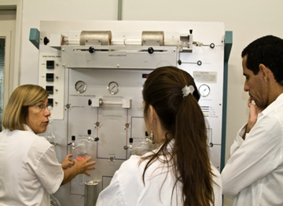
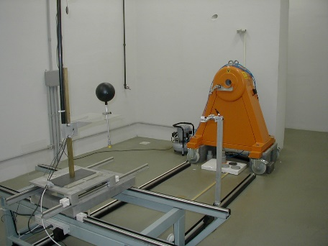
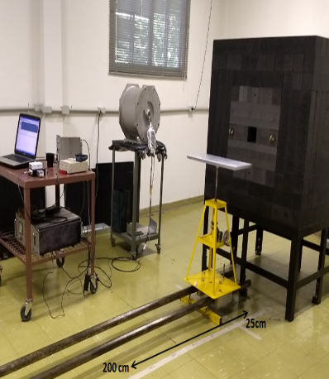
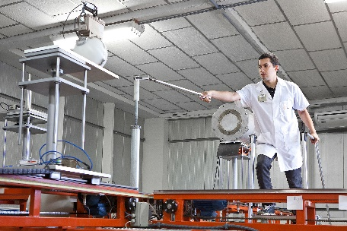
Institute of Radiological Protection and Dosimetry- IRD
Radiocarbon dating facility
Brazilian reference laboratory in ionizing radiation

Slide 8
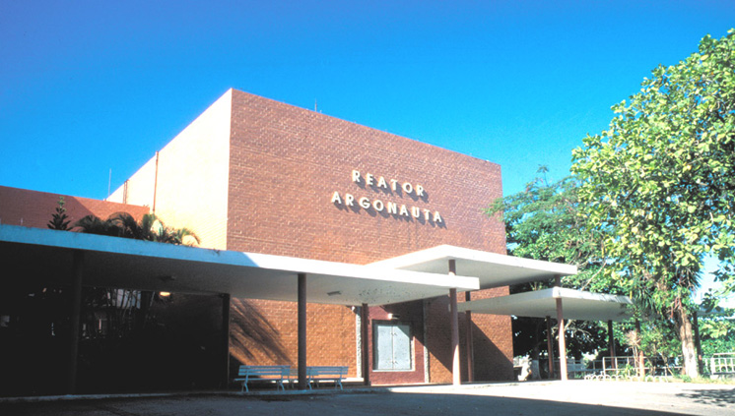
Institute of Nuclear Engineering- IEN
Located in Rio de Janeiro - RJ
Total about 55 researchers;
Research Reactor;
2 cyclotrons (28 MeV and 18 MeV);
Nuclear engineering research ;
Artificial Intelligence group ;
Research in neutron applications.

Slide 9
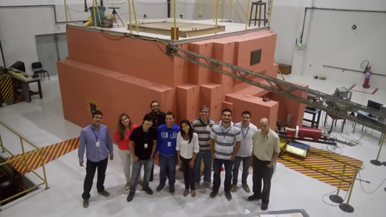
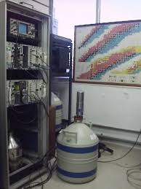
Institute of Nuclear Engineering- IEN
Neutron radiography;
Neutron Activation Analysis
ARGONAUTA | Research and Training | 500 W | IEN-CNEN/RJ | Argonaut

Slide 10
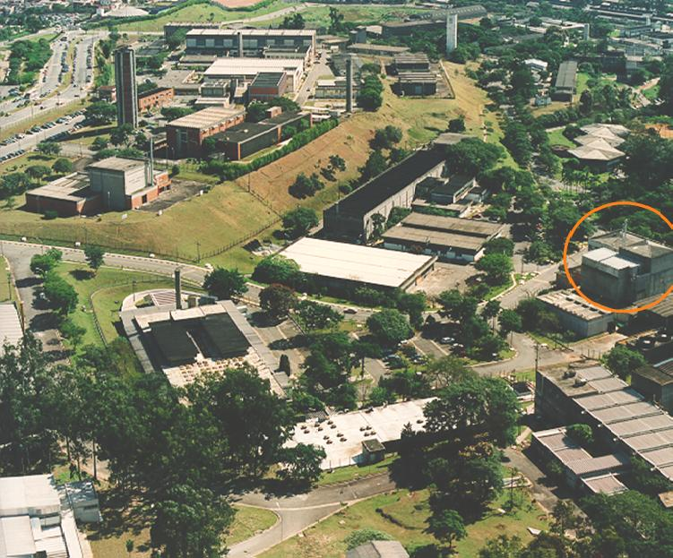
Nuclear and Energy Research Institute - IPEN
Located at the campus of University of São Paulo – USP
Total area of about 500.000 m²
Total of 102.000 m² of building area;
11 departments;
USP graduation ~150 M.Sc. and 60 Ph.D. /year om Nuclear Technology;
About: 680 permanent staff;
300 Undergraduate students;
500 Graduate students;
100 Post doc students;
120 Volunteers;
Total of 1500 workers

Slide 11
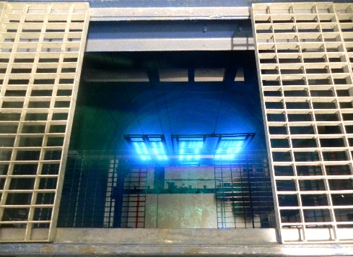
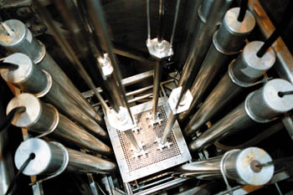
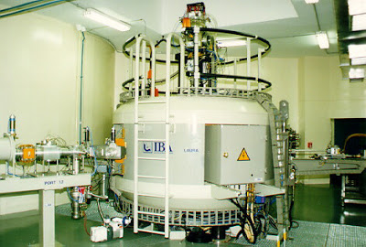
Nuclear and Energy Research Institute - IPEN
Main Facilities of IPEN
Nuclear | Radioactive
IEA-R1 Research Reactor (1957 – 5MW) IPEN/MB-01 Reactor (1987 – 100W) Fuel Factory | Cyclotron Accelerator (IBA Cyclone 30 - 1998) Cyclotron Accelerator (IBA 18/18 – under modification) Radiopharmacy unit (1959) Co source Irradiator (2002); Table Top TeraWatt Laser (2005).

Slide 12
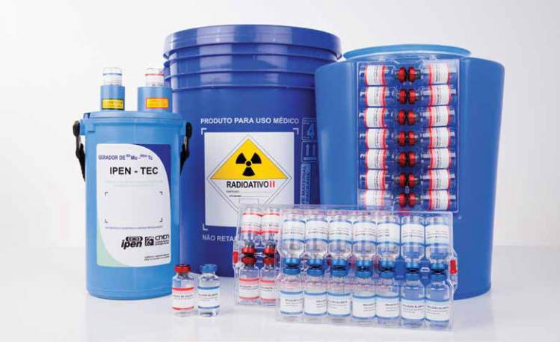
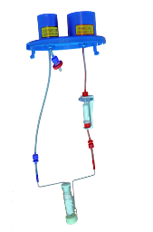
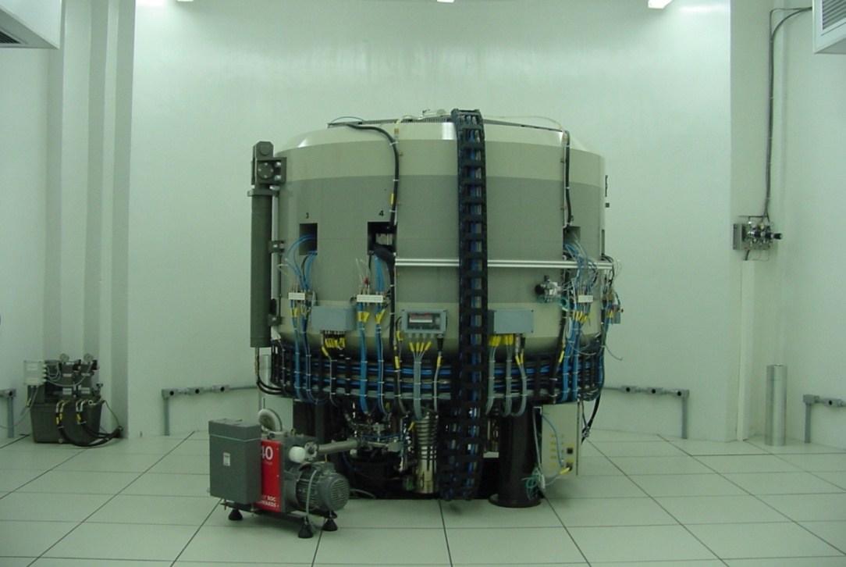
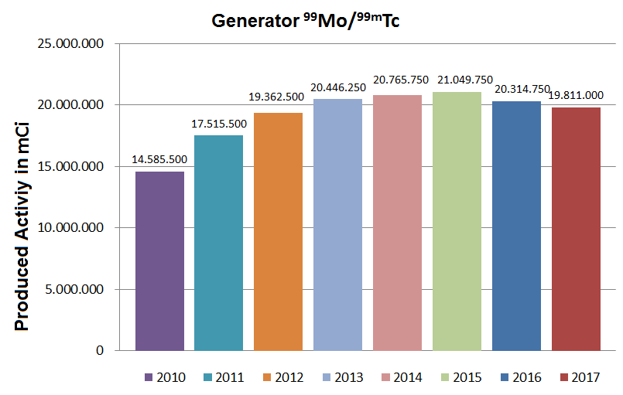
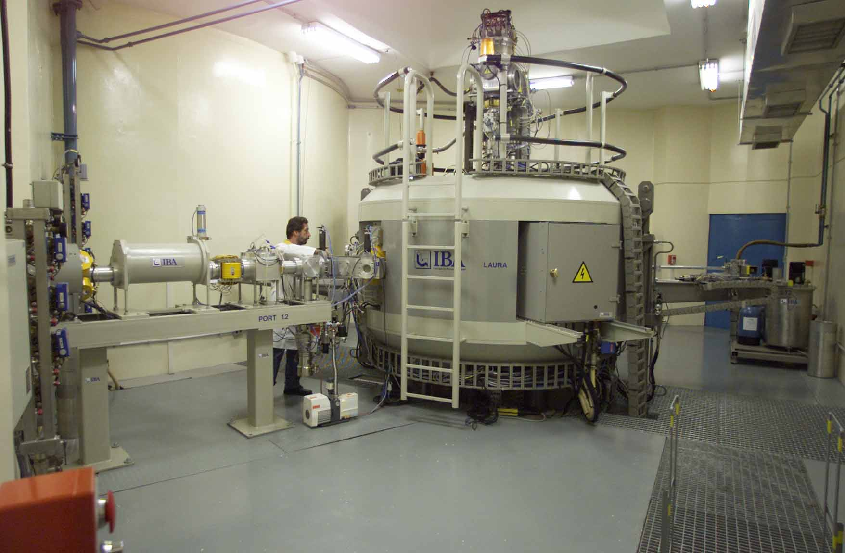
Radiopharmacy department at IPEN - CR
NaCl charge
^{99m}Tc eluate
Filter
Merck Millipore
(25 mm)
CYCLONE 18 - 2008
Air vent
Merck Millipore
(13 mm)
Saline solution
^{99m}TcO₄⁻ in saline
Alumina (Al₂O₃) bed with MoO₄²⁻
CYCLONE 30 - 1998
~1.5 M
procedures/year

Slide 13
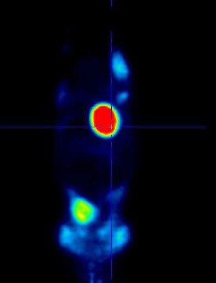
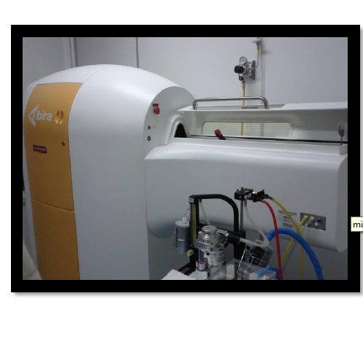
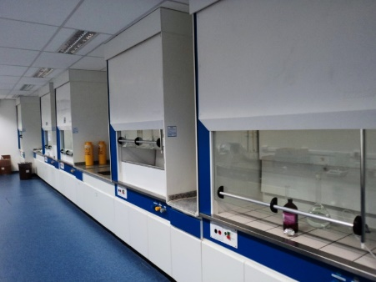
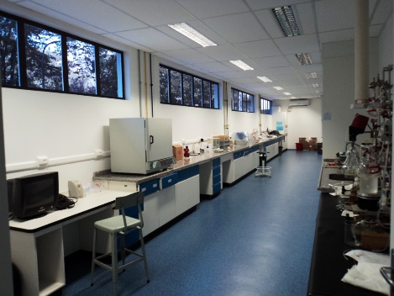
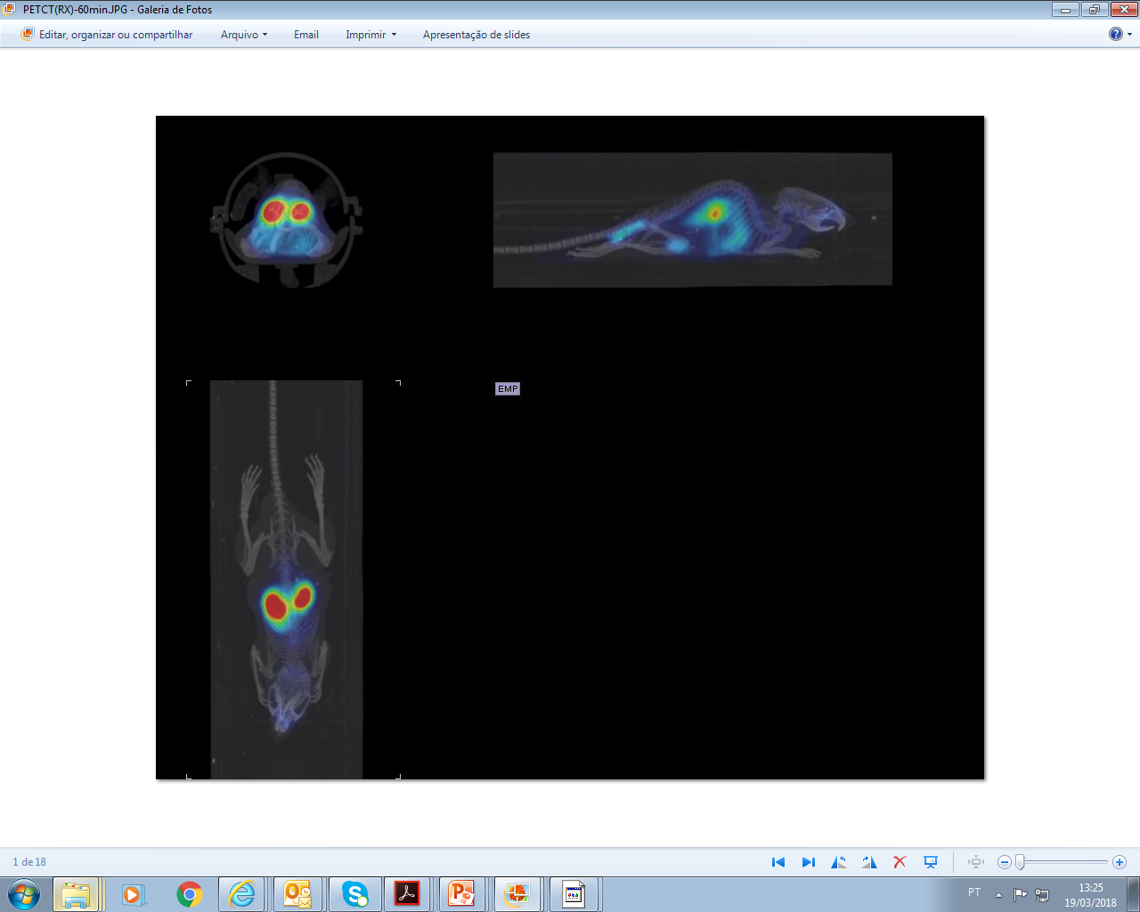
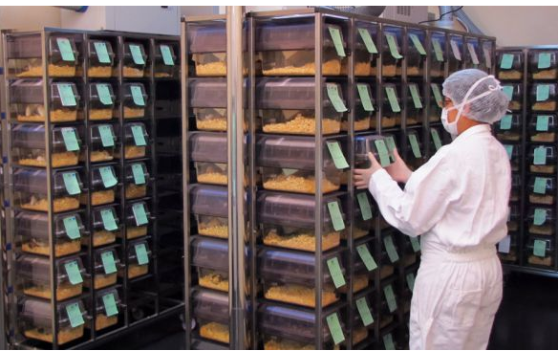
Radiopharmacy department at IPEN - CR
R&D structure;
Research in new radioisotopes;
Bioterium;
PET/SPECT/CT for small animals.

Slide 14
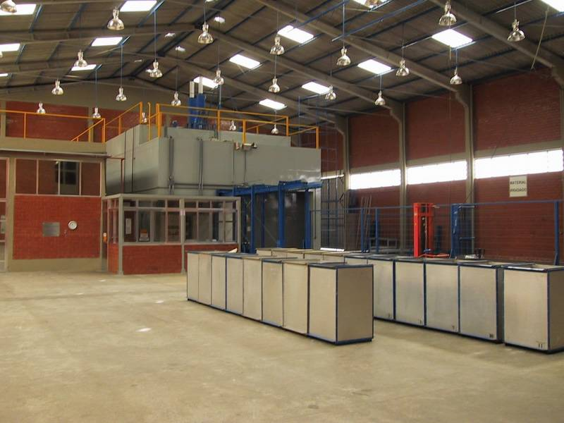
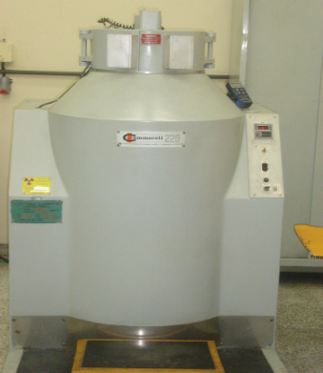
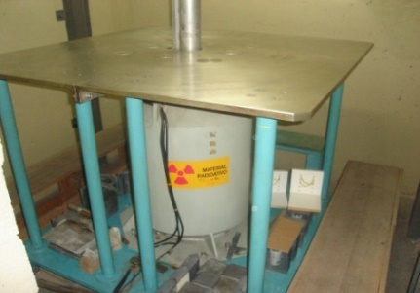
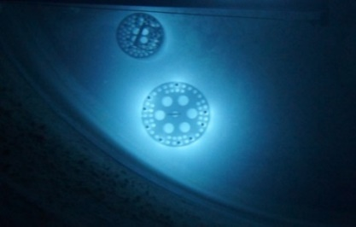
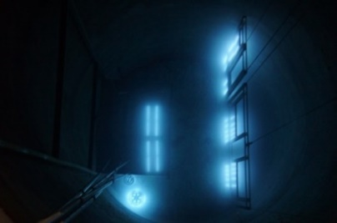
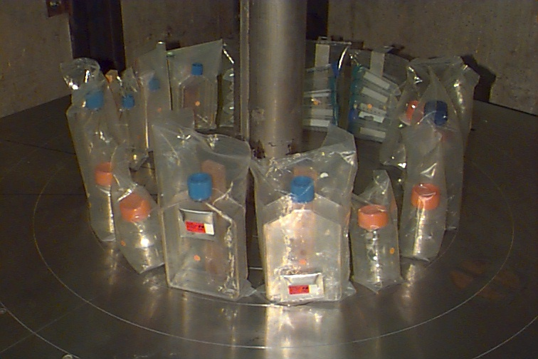
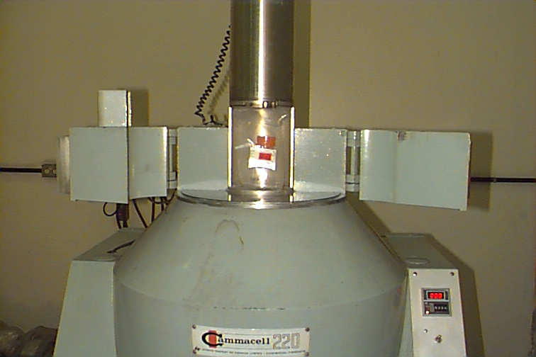
Radiation Technology department at IPEN - CTR
Industrial Irradiator (400 kCi)
Gammacell (2kCi)
3- Panoramica (12kCi)

Slide 15
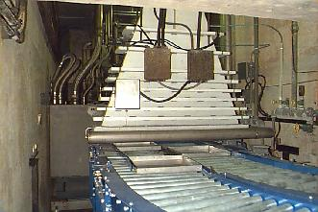
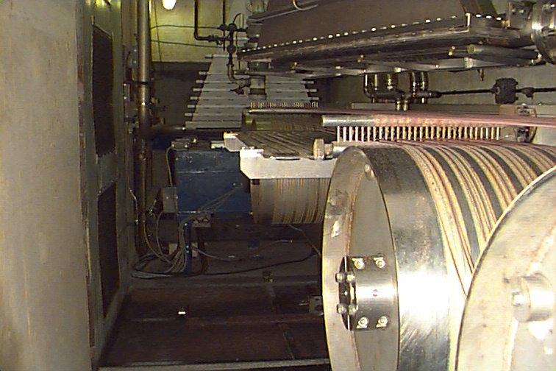
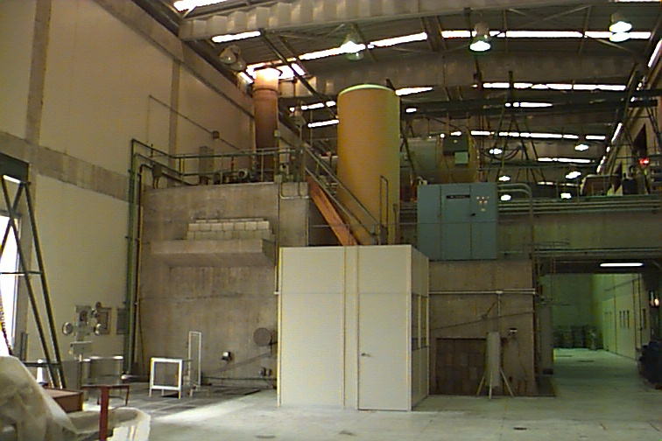
Radiation Technology department at IPEN - CTR
97.5kW (1.5MeV and 65mA)
37.5kW (1.5MeV and 25mA)
Research lines in:
Cultural heritage;
Food irradiation;
Radiosterelization;
Material beneficiation;
Radiotracers.

Slide 16
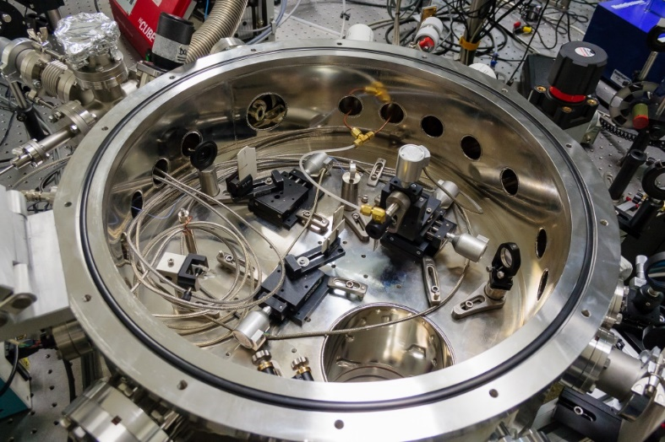
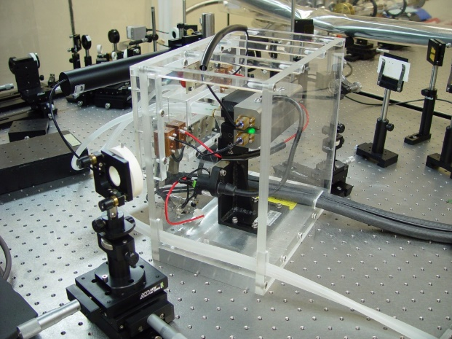
Lasers and Applications department at IPEN – CLA
Table Top TW =T3
Most powerful laser of south hemisphere
Research lines in:
Particle acceleration;
Thin film deposition;
Radioactive decontamination.

Slide 17
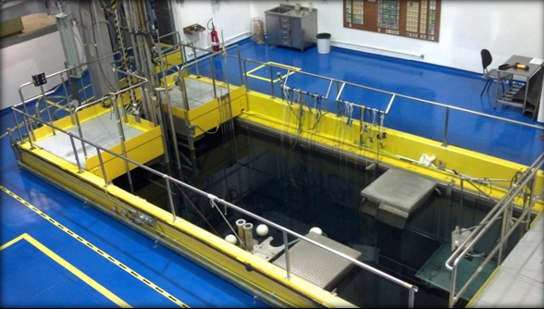
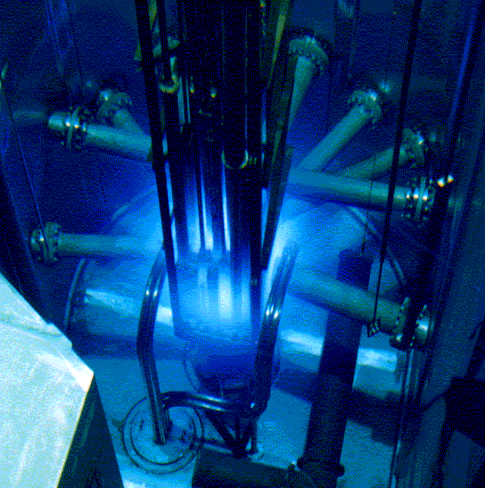
The IEA-R1 Research Reactor
Research Reactor department - CRPq
First criticality: September 16th, 1957
open pool type reactor
5 MW thermal power
Thermal flux: 1 x 10¹⁴ n cm⁻² s⁻¹
Fast flux: 1.3 x 10¹³ n cm⁻² s⁻¹
Operating cycle: 9h per day, 3-4 days per week
24 rods of U₃Si₂-Al, 3 g.cm⁻³ produced at IPEN

Slide 18
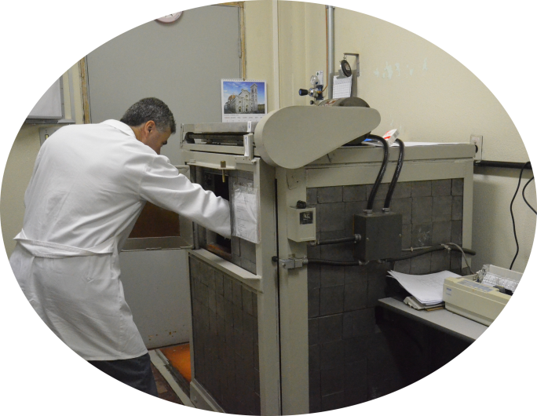
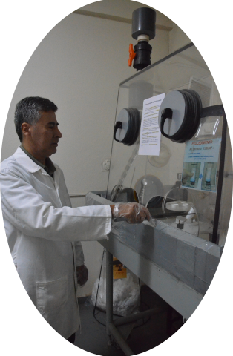

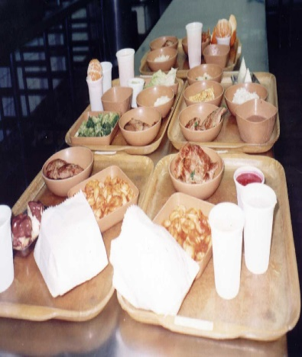
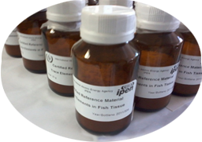
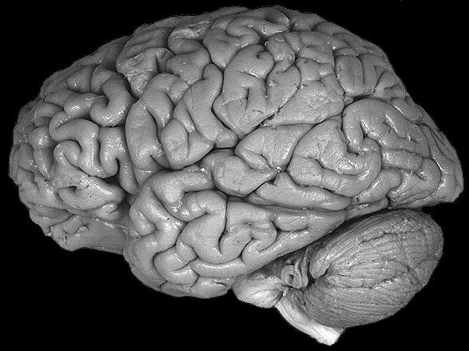
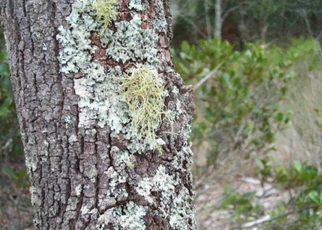
Induced radioactivity –NAA at CRPq
Archaeological Studies
Nutrition Assessment
Reference Material production
Health
Environmental Studies
High performance sports

Slide 19
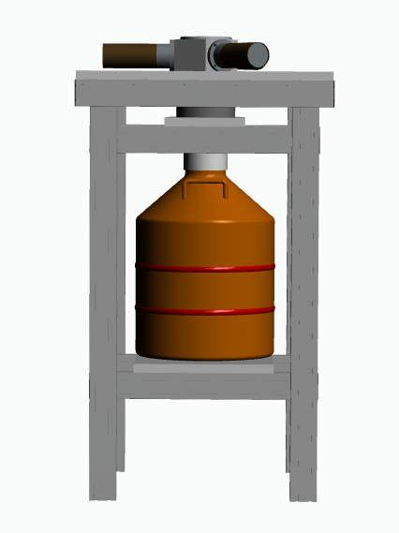
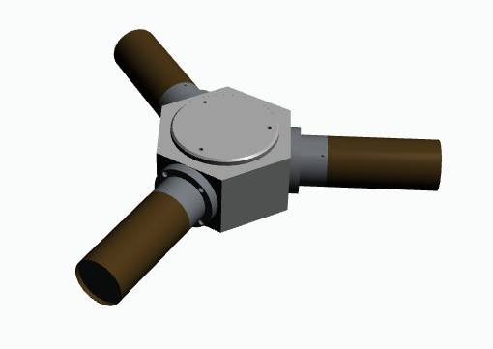
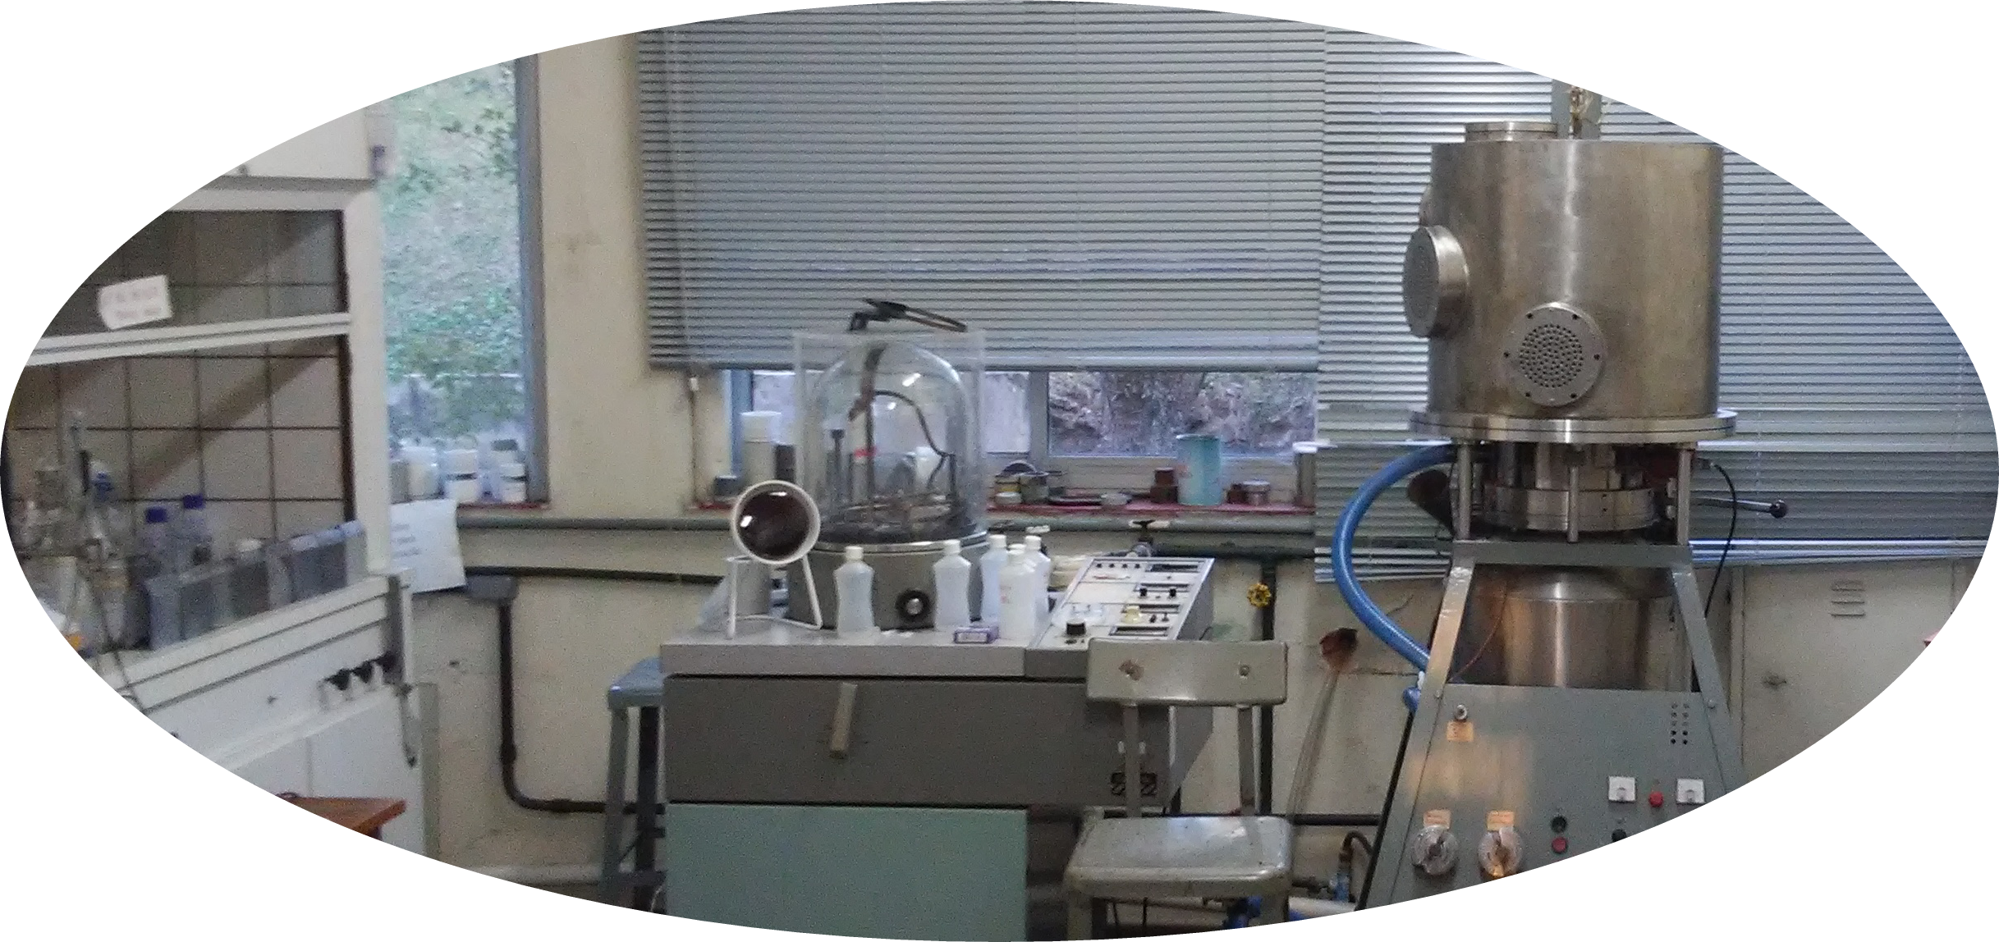

Induced Radioactivity –Nuclear Metrology at CRPq
Activity measurements with absolute methods.

Slide 20


Induced Radioactivity –Nuclear Data at CRPq
Measurement of half-lives shorter than 10 min. for neutron capture products (⁵²V, ⁶⁶Cu, ²⁸Al, ¹⁰⁸Ag, ¹¹⁰Ag, ²⁷Mg)
Determination of neutron cross sections (⁴¹K, ¹⁶⁵Ho, ⁴⁸Ca, ³⁵S, ⁴²K, ⁵⁷Co, ¹³⁷Cs, ²⁴¹Am,...)

Slide 21




Induced Radioactivity –Hyperfine Interactions at CRPq
PAC ⇒ perturbation caused by hyperfine interactions.
I_{i} , M_{i}
γ₁
I , M
γ₂
I_{f} , M_{f}

Slide 22




8 radial and 2 tangential BHs;
Thermal flux up to 1 x 10⁸ n cm⁻² s⁻¹
Neutron science at CRPq

Slide 23


Neutron science – Multipurpose Station
Used for large samples irradiation;
Neutron detector tests;
Failure rate of Integrated Circuits.

Slide 24

Neutron science – High Resolution Neutron Diffraction
The texture of materials in metals;
Microstructure and porous media of Portland cement;
The measurement of residual stress in components.

Slide 25




Neutron Science – Imaging
Valve for water flow control
valve
3D image
Mining
Fossil studies
Aluminum body
rubber diaphragm
Hydrogen Fuel cell - Proton Exchange Membrane
3D images
M.E.A.
Water into the MEA
Water distribution map

Slide 26
Multipurpose Research Reactor -RMB
New 30 MW research reactor
Completion scheduled for 2022-2023

Slide 27
Multipurpose Research Reactor -RMB
30 MW Reactor;
Radioisotopes production Lab;
Post-irradiation labs;
Neutron beams National Lab;
Neutron Activation National Lab;
Nuclear Fusion National Lab.

Slide 28

THANK YOU FOR YOUR ATTENTION!

Slide 29

National Nuclear Energy Commission - CNEN
Total = 1805
Goiás ( CRCN-CO)
Centro Regional de Ciências Nucleares do Centro-Oeste -20
Ceará (DIFOR)
Distrito de Fortaleza - 13
Minas Gerais (CDTN)
Centro de Desenvolvimento da Tecnologia Nuclear - 270
Pernambuco (CRCN – NE)
Centro Regional de Ciências Nucleares do Nordeste - 61
Rio de Janeiro
Diretoria/Sede – 333
Instituto de Radioproteção e
Dosimetria (IRD) – 1899
Instituto de Engenharia
Nuclear (IEN) - 169
São Paulo (IPEN)
Instituto de Pesquisas Energéticas e Nucleares – 688

Slide 30
Lasers and Applications department at IPEN – CLA
WORLD
RECORD
IPEN

Slide 31
Plasma and particle acceleration
The electrons attract the protons
Lasers and Applications department at IPEN – CLA

Slide 32

Lasers and Applications department at IPEN – CLA
LaserWake Field acceleration
(electron acceleration)
Laser Gaussian Intensity Profile
Electrons are pushed out of the beam
The ionization front moves with the speed of light and the ions remain in place, electrons are forced out and then pushed back, after the passage of the pulse, attraced back by the ions:
PLASMA FREQUENCY OCCILLATIONS
Electrons with 4.3 GeV
In 10 cm

