Slide 1


DPhN
(Nuclear Science Department)
Spallation reactions:
from modeling to applications,
what could be done?
Jean-Christophe David
1st Meeting of
LIA – Subatomic Physics: from theory to applications
12-13 June 2018 – ITA (São José dos Campos)

Slide 2
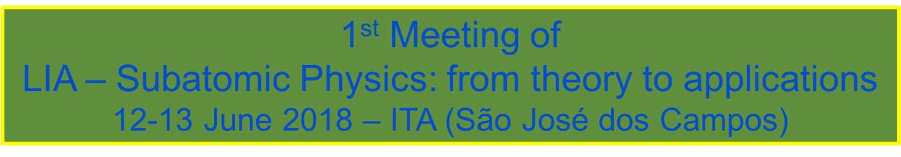
Introduction
15-20 years of experience in spallation summarized in 15-20 mn
General ideas
(what I am supposed to know)
Spallation reactions: from modeling to applications, what could be done?

Slide 3
Introduction
15-20 years of experience in spallation summarized in 15-20 mn
General ideas
(what I am supposed to know)
Details → if questions or during coffee break
Spallation reactions: from modeling to applications, what could be done?

Slide 4
A spallation reaction: what is it?
Light projectile + Nucleus
E_{p}: a few hundred MeV → a few dozen GeV
1st
phase fast
2nd
phase slow
Spallation reactions: from modeling to applications, what could be done?

Slide 5
Where? or Why they are interesting?
Spallation reactions: from modeling to applications, what could be done?

Slide 6
Modeling
1st phase
transport of energetic particles in the nucleus with collisions
2nd phase
de-excitation of a hot remnant nucleus
Spallation reactions: from modeling to applications, what could be done?
Notes:
collision binaire (pas affectée des autres) → pas basse énergie
état asymptotique avant prochaine collision → pas haute énergie (temps d’hadronisation; échelle partonique)

Slide 7
Modeling
1st phase : Main ideas
Transport equation solved by a Monte-Carlo method
Field
Collision
Pauli
Two types of models
With mean fields: Fast, but not suited to describe Nucleus-Nucleus reactions
Convenient in a particle transport code
With auto-generated fields: Much slower, but much dedicated to Nucleus-Nucleus reactions
Used in a particle transport code only when needed…
Spallation reactions: from modeling to applications, what could be done?
Notes:
collision binaire (pas affectée des autres) → pas basse énergie
état asymptotique avant prochaine collision → pas haute énergie (temps d’hadronisation; échelle partonique)

Slide 8
Modeling
Steps/Ingredients/Details:
  Initialization → mostly nucleus target (but also projectile if composite)
space and momentum
  Transport → most of the time, straight line
  Collisions → cross sections and final products (type, momentum),
pauli blocking…
  Resonances? → mass, width, decay
  At the border → reflection or transmission (potential, coulomb deviation, …)
  End of the 1st phase → criterion (time, energy); intermediate phase (preequilibrium)?
The two families – list of codes
  cst potentials INC (Bertini, Isabel, CEM, INCL, BIC, …, MCMC)
  generated potentials BUU (GiBUU, …), QMD (UrQMD, JQMD, ...)
Spallation reactions: from modeling to applications, what could be done?

Slide 9
Modeling
2nd phase : Main ideas
Low excitation ( < ~3-5 Mev/A)
Evaporation
principle of detailed balance
Fission
excited heavy nuclei
width: from individual to collective dof (Fokker-Planck equations)
fission fragment distribution
High excitation ( > ~3-5 Mev/A)
Multifragmentation
phenomenological approach (power low σ=A^{-τ})
statistical approach (partition function)
emission probability → P_{a}(ε) = ρ_{f}(E_{f}*)/ρ_{i}(E_{i}*) (2s+1) (4πp²/h³) σ_{c}(ε)
Spallation reactions: from modeling to applications, what could be done?

Slide 10
Modeling
Steps/Ingredients/Details:
  Density levels → numerous effects (pair, shell,…) + J (ot not)
  (and density level parameters)
  Capture cross sections → not always (well) known, especially for excited nuclei…
  Fokker-Planck equation → approximation needed to get results in reasonable time
  Fission fragment distributions → phenomenology
  Multifragmentation → Intermediate Mass Fragments
  (also by extented evaporation ? binary breakup?)
List of codes
Dresner(RAL,ORNL) – GEM – ABLA – SMM - … - “CRISP”
Spallation reactions: from modeling to applications, what could be done?

Slide 11
Modeling
How good is a model → Benchmarking
Spallation reactions: from modeling to applications, what could be done?

Slide 12
Benchmarking
International benchmark campaigns
Mid-90 NEA
    thin targets
n, p (1994) https://www.oecd-nea.org/science/docs/1994/nsc-doc94-02.pdf
nuclides (1997) https://www.oecd-nea.org/science/docs/1997/nsc-doc97-1/
    thick targets (1995) https://www.oecd-nea.org/science/docs/1995/nsc-doc95-02.pdf
2010 IAEA https://www-nds.iaea.org/spallations/
    thin targets
n, p, d, t, ³He, α, π production
nuclides (A, Z, isotopic distributions + excitation functions)
Spallation reactions: from modeling to applications, what could be done?

Slide 13
Benchmarking
International benchmark campaigns
2010 IAEA https://www-nds.iaea.org/spallations/
    thin targets
n, p, d, t, ³He, α, π production
nuclides (A, Z, isotopic distributions + excitation functions)
What did we learn, must be improved?
  1st phase
    preequilibrium: its use depends on the cascade model
    cluster emission: ad-hoc coalescence model seems the best solution
    (QMD models not able to to the job… and so slow)
  2nd phase
    IMF emission large differences
    Fission between the models
  and beyond this benchmark → extension towards low (<~150 MeV) and high energy limits;
Spallation reactions: from modeling to applications, what could be done?

Slide 14
Benchmarking
Done by transport code developers
PHITS http://phits.jaea.go.jp/Reference.html#cat2
~40 papers/studies (→ 200 GeV; elementary/thick; various projectiles)
MCNPX/ https://laws.lanl.gov/vhosts/mcnp.lanl.gov/references.shtml#mcnp6_refs_h
MCNP6 especially two on CEM (18 tests) and LAQGSM (18 tests) with many details
GEANT4 http://geant4.cern.ch/results/validation_plots.htm
DoSSiER: Database of Scientific Simulation and Experimental Results
actively being developed
Spallation reactions: from modeling to applications, what could be done?

Slide 15
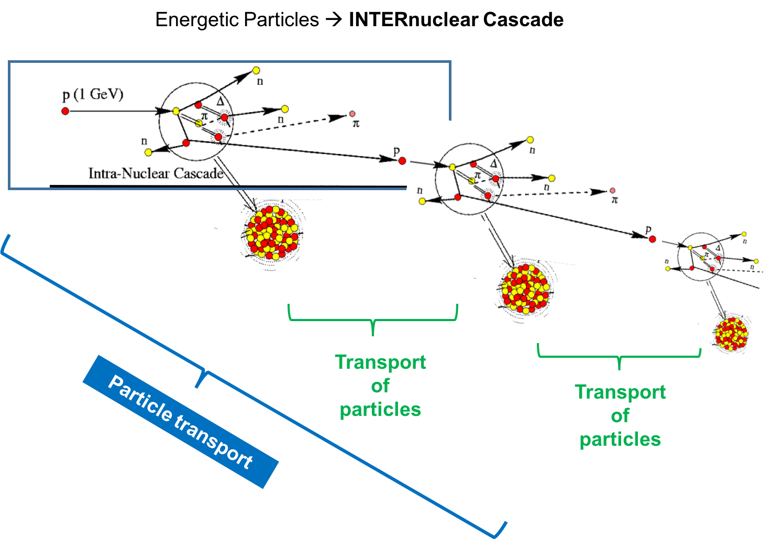
Transport codes
Spallation reactions: from modeling to applications, what could be done?

Slide 16
Transport codes
Which models?
Where? How?
3.02
ABLA++
from J.-C. David, EPJ A51:58 (2015)
Spallation reactions: from modeling to applications, what could be done?

Slide 17
Transport codes
Which models?
Where? How?
. one name
several versions
3.02
ABLA++
from J.-C. David, EPJ A51:58 (2015)
Spallation reactions: from modeling to applications, what could be done?

Slide 18
Transport codes
Which models?
Where? How?
. one name
several versions
. various combinations
(INC – Deex)
3.02
ABLA++
from J.-C. David, EPJ A51:58 (2015)
Spallation reactions: from modeling to applications, what could be done?

Slide 19
Transport codes
Which models?
Where? How?
. one name
several versions
. various combinations
(INC – Deex)
. ⚠️
→ projectiles acc. for
→ energy limits
3.02
ABLA++
from J.-C. David, EPJ A51:58 (2015)
Spallation reactions: from modeling to applications, what could be done?

Slide 20
Applications
or when the model becomes a tool…
My experiences
Within a transport code
  Radioactive Ion Beam: Eurisol Design Study (nuclide production and safety)
  Accelerator Driven System: Myrrha (benchmarking - uncertainties)
  Neutron sources
    Megapie (SINQ): neutron and nuclide production (volatiles)
    …ISOLDE (benchmarking for Megapie): pushed us to improve/extend INCL and more...
    ESS (Lund): nuclide production (reliability → uncertainty estimates…)
As a stand-alone code
  proton therapy building
  astrophysics (GCR) databases (particle and/or nuclide production)
Benchmarking – uncertainties/errors – code: as complete as possible
Spallation reactions: from modeling to applications, what could be done?

Slide 21
Conclusions
Last ~20 years, great improvements in spallation reactions (modeling, data, application)
However nothing is perfect and extensions are possible → still work to do
Some topics
    composite projectile (light nuclei) --- not exactly nucleus-nucleus
    lower and higher energies (incident energy)
    cluster emission
    fission fragment production
    … maybe more new (or with a renew of interest)
    isomeric states
    strangeness
    neutrino
    uncertainties…
Being implemented in a transport code is useful
          → macroscopic calculations (use and constraints)
          → better known
Spallation reactions: from modeling to applications, what could be done?

Slide 22
Thank you!
Spallation reactions: from modeling to applications, what could be done?

Slide 23
Thank you!
Obrigado!
Spallation reactions: from modeling to applications, what could be done?

Slide 25
BACKUP

Slide 26
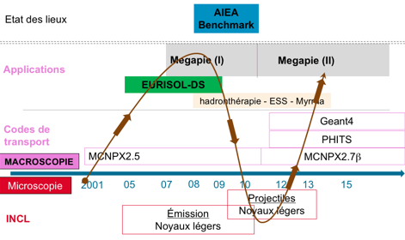
…
Spallation reactions: from modeling to applications, what could be done?

Slide 27
…
Spallation reactions: from modeling to applications, what could be done?

Slide 28
…
Spallation reactions: from modeling to applications, what could be done?

