Slide 1
Brazilian involvement at IPN-Orsay and GANIL
Field of Nuclear Physics – experiments
Valdir Guimarães
Instituto de Física da Universidade de São Paulo – Brazil

Slide 2
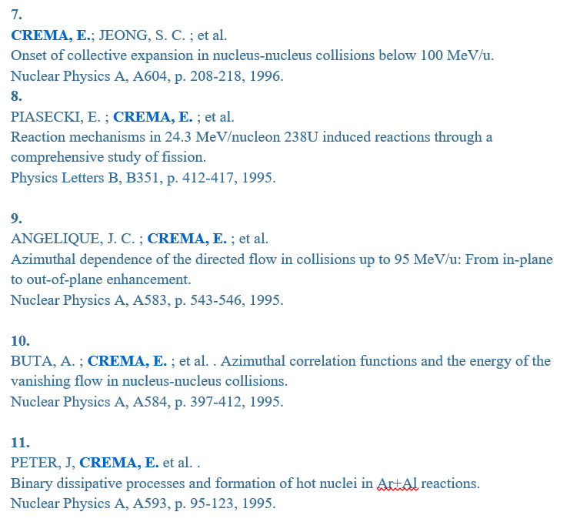
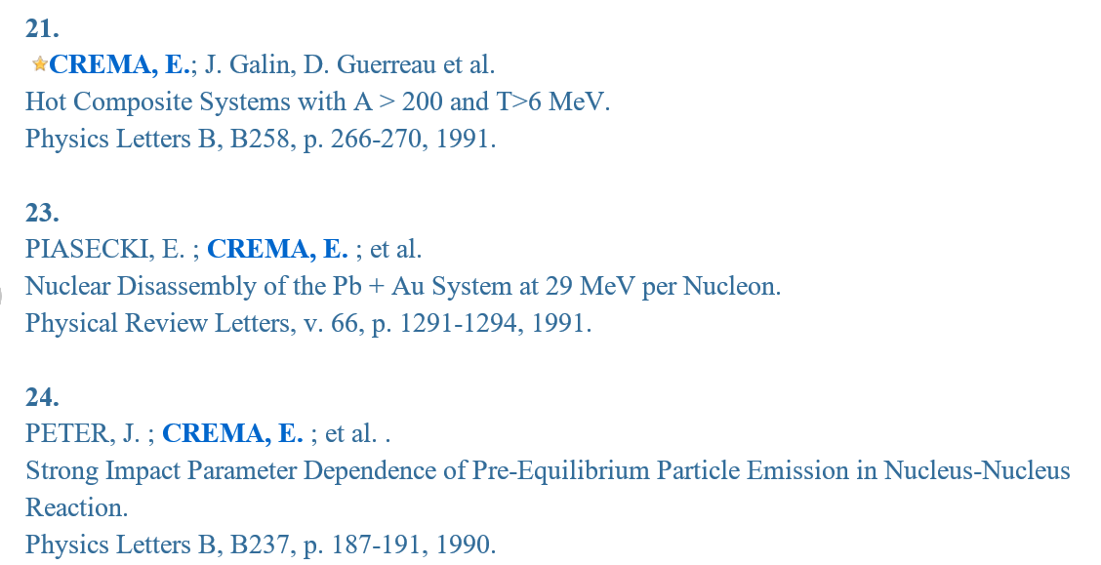
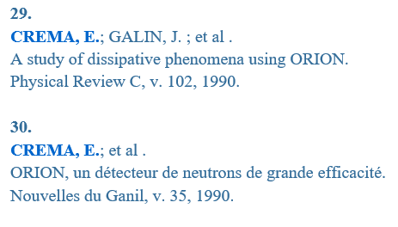
In the past
Edilson Crema – IFUSP
(1988-1990) Post-doc (1990-1991) – Associate Researcher - Commissariat L’ Energie Atomique CEAT
Collaboration with Daniel Guerreau and Joel Galin (4-pi neutron detector ORION)
Collaboration with Jean Peter (4-pi neutron detector Nautilus)
2012 Experiment at IPN-Orsay
total of 30 papers

Slide 3
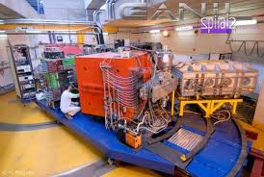
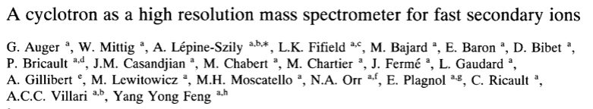
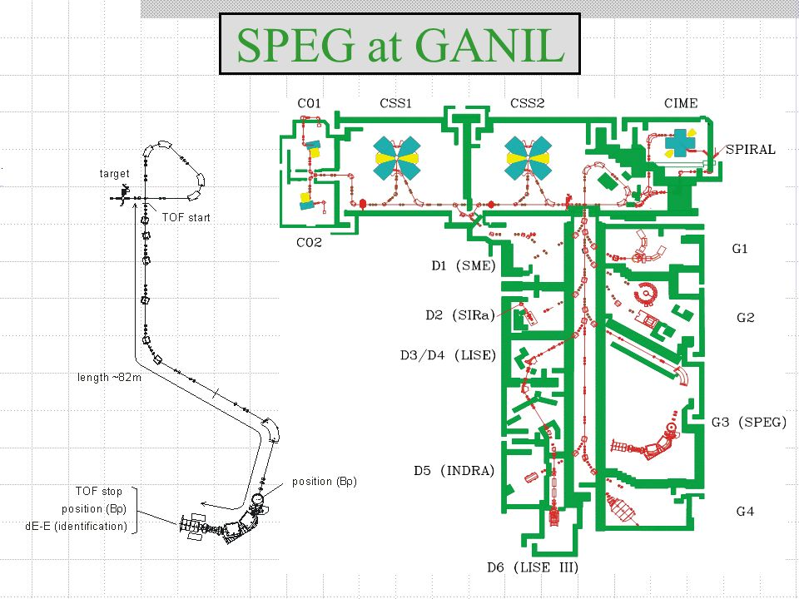
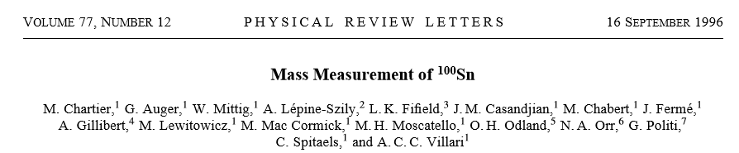
In the past
Alinka Lepine – IFUSP (1992-1994) Senior post-doc at GANIL
Other experiments in collaboration with W. Miting.
+ 30 papers

Slide 4
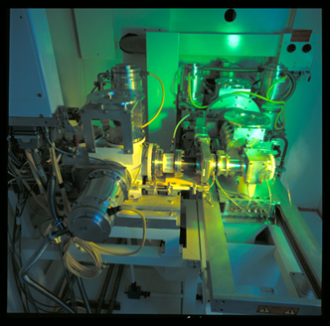
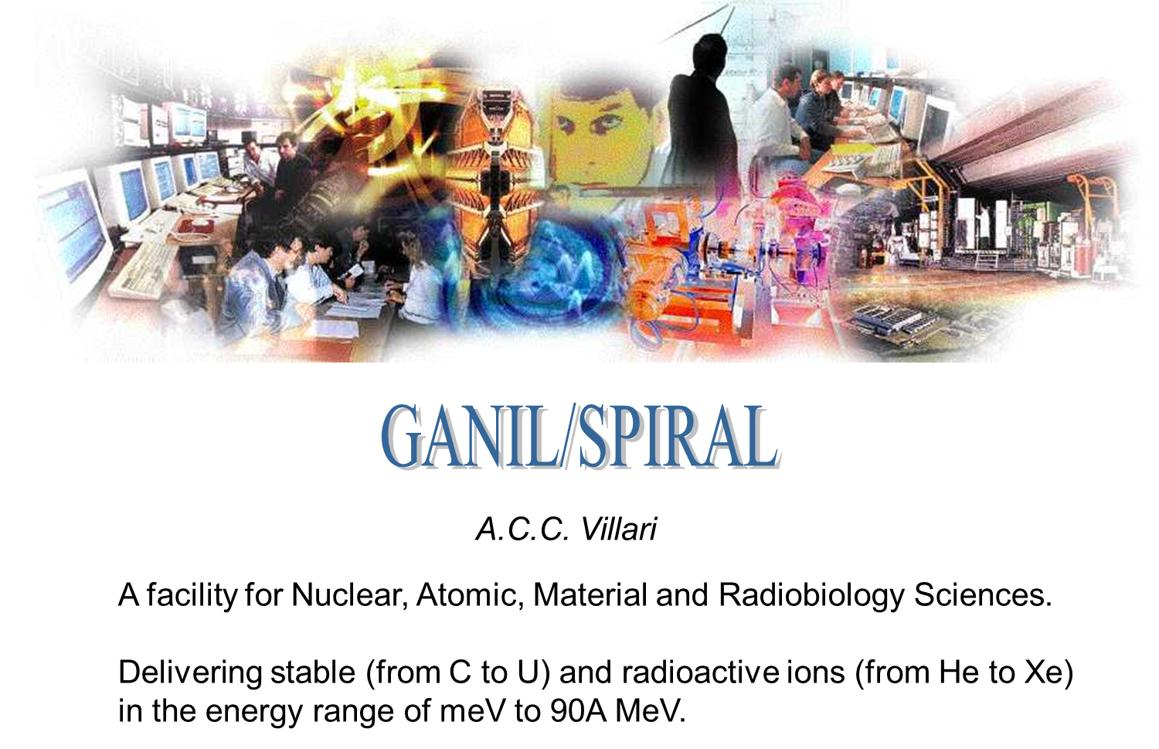
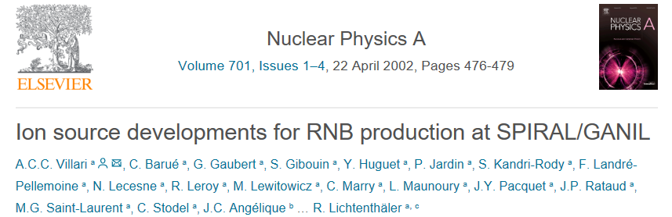
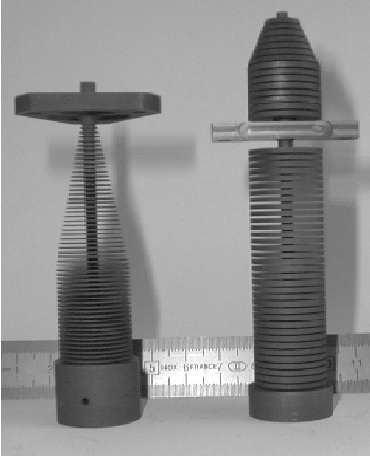
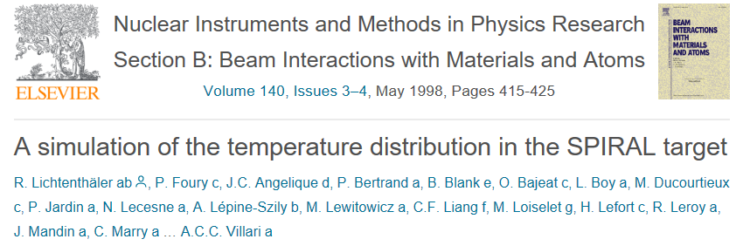
In the past
Antonio Carlos C. Villari (1993-2008) Directeur de Recherche responsible for SPIRAL ion-source
Rubens Lichtenthaler (1996-1997) Post-Doc
worked with the Ion source SIRa and carbon target

Slide 5
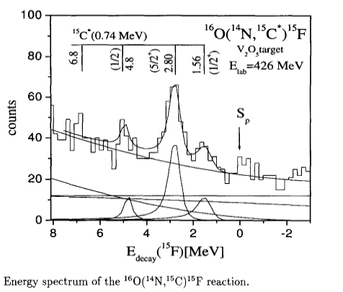
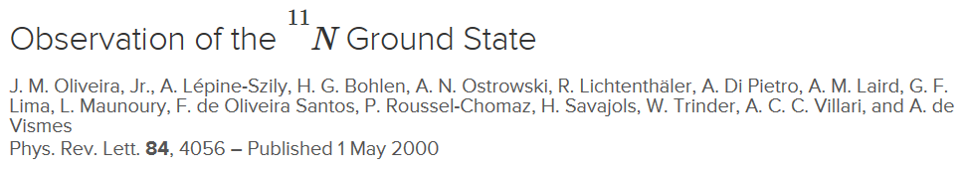
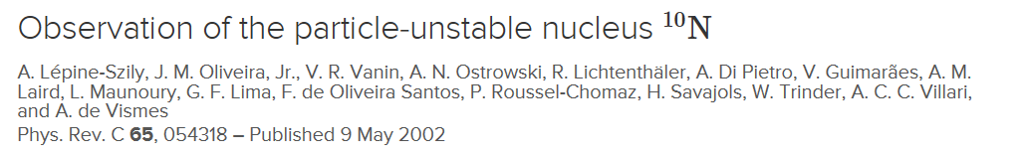
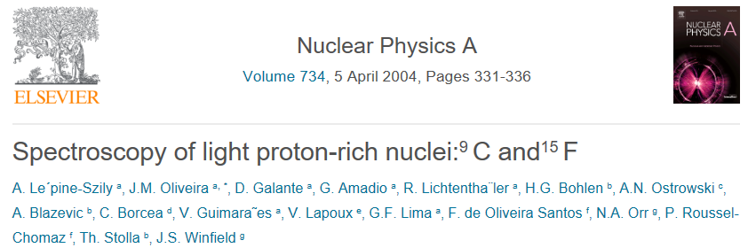
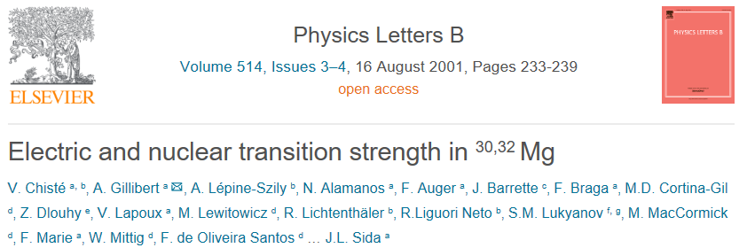
In the past
Alinka Lepine proposed an experiment in 1996 - spectroscopy of light proton rich nuclei
Antonio C. C. Villari, Rubens Lichtenthaler, Valdir Guimarães (post-doc), Vanessa Chiste (post-doc) Collaborator W. Miting participation of F. de Oliveira Santos
Spectroscopy
⁹C,^{10,11}N, ¹⁵F
Spectroscopy
^{30,32}Mg

Slide 6

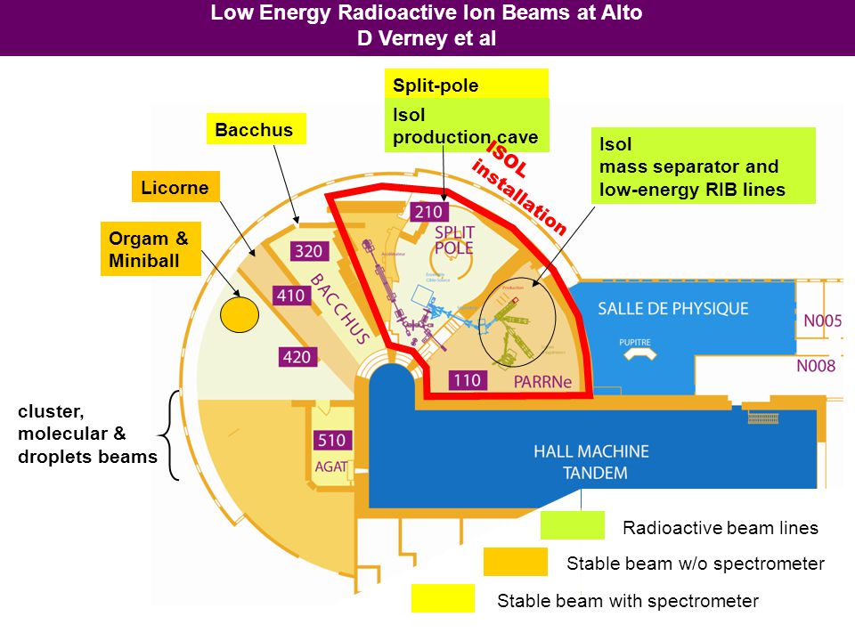
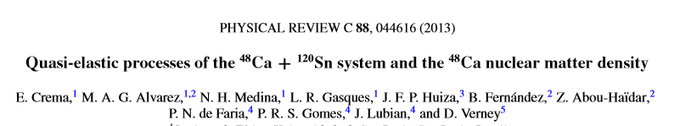
Present
Edilson Crema – IFUSP
Experiment at IPN-Orsay
Valdir Guimaraes (Dec 2014 – Dec 2015)
Senior Post-doc IPN-Orsay
Participated in several experiments in IPN-O with splitpole
In collaboration with Faïrouz Hammache
Nicolas de Sereville and Iulian Stefan

Slide 7
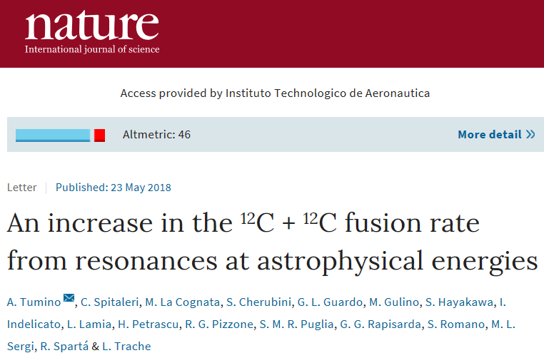
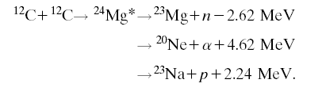
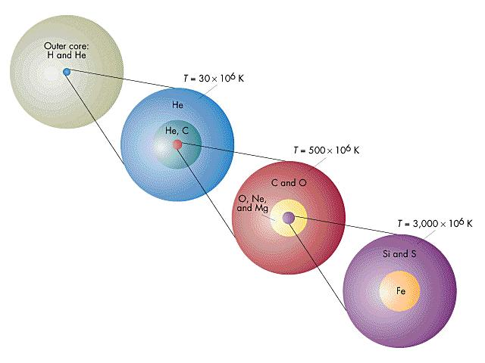
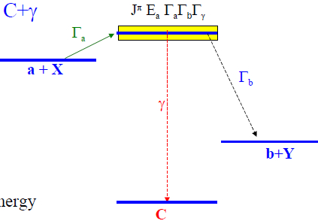
Carbon Burning phase in massive stars
²⁴Mg
For stars with mass M > 8M₀
T~ 600-700 MK
ρ ~ 10⁵-10⁶ g/cm³
¹²C+¹²C fusion
Dominant
reaction
Spectroscopy of ²⁴Mg above ¹²C+¹²C threshold not well known
H-shell burning
99% of ²³Na is consumed via efficient ²³Na(p,α)²⁰Ne and ²³Na(p,γ)²⁴Mg reactions

Slide 8
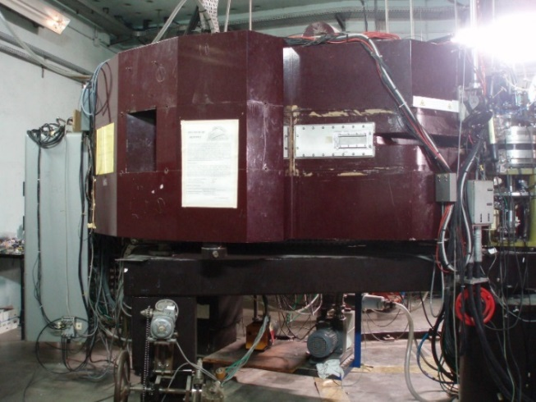

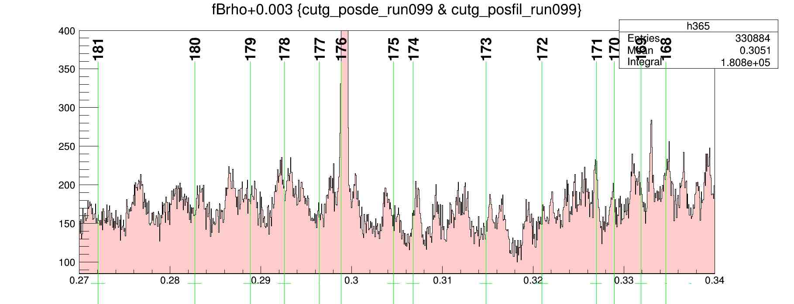
Study of unbound states (above ¹²C+¹²C threshold) in ²⁴Mg experiment in 2015
spectroscopy of the ²⁴Mg nucleus in the excitation energy range E*= 14.0 to 16.0 MeV
Inelastic scattering: ²⁴Mg(p,p´)²⁴Mg 25 MeV proton beam from IPNO.
Proton energy spectra – energy of the ²⁴Mg levels
Splitpole
Position (Bρ)
gas chamber
unbound states (above ¹²C+¹²C threshold Ex=13.934 MeV)
Ex = 14.0 to 16.0 MeV
²⁴Mg target
α, p´
³He or p
Faraday Cup
ΔE-E monitor
ΔE -proportional counter
Bρ

Slide 9
The Ne-Mg cycle in novae
T₉ = 0.1 to 0.4 K O-Ne novae.
22
Mg
23
Mg
24
Mg
Main reactions
3.8s
11.3s
²⁰Ne(p,γ)²¹Na
²¹Ne(p,γ)²²Na
²³Na(p,α)²⁰Ne
²¹Na(p,γ)²²Mg
21
Na
22
23
Na
Na
22.5s
2.6yr
²²Na(p,γ)²³Mg
²²Ne(p,γ)²³Na
20
Ne
21
22
Ne
dominated by
narrow resonances
Ne
²²Na(β+)²²Ne
1.275 MeV
²²Na (t_{1/2}=2.6y) in O-Ne Novae (γ=1.275 MeV)
Can be a signature of the explosive nucleosynthesis in novae

Slide 10
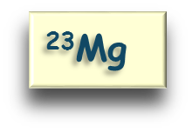
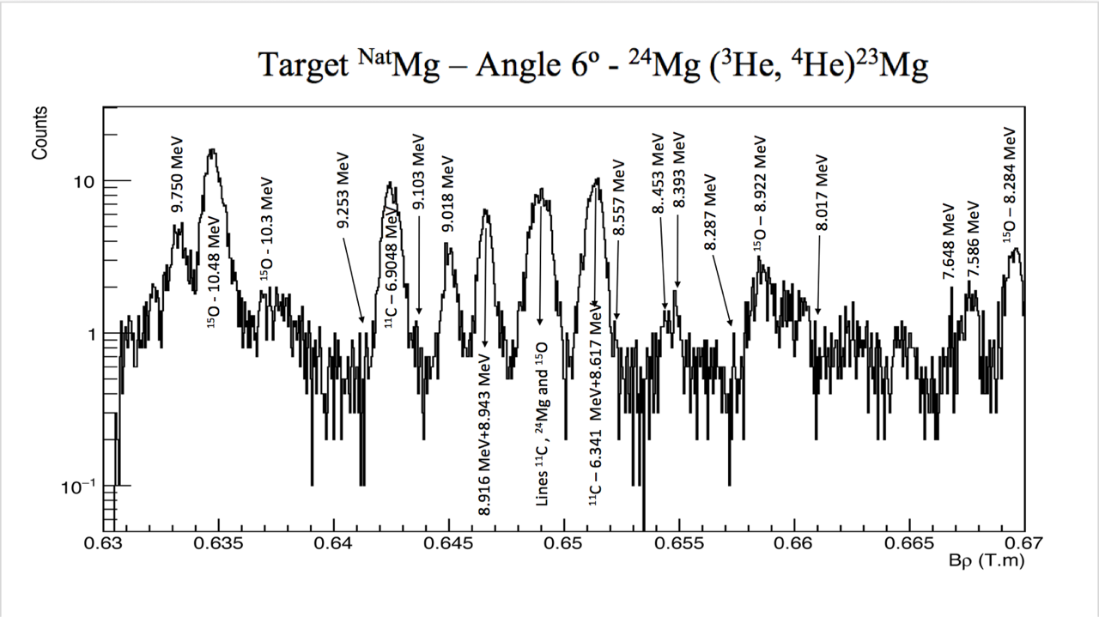
unbound states (above proton threshold) in ²³Mg
experiment proposed by V. Guimarães in 2016
Thesis of master of Alessandro Lara
²³Mg nucleus in the excitation energy 7.5 to 9.5 MeV.
Neutron transfer reaction: ²⁴Mg(³He,α)²³Mg
20 MeV ³He beam from IPNO.
Alpha energy spectra - energy of the ²³Mg levels
Angular distribution (4 to 50 degree in 12 angles)
- DWBA – L-transferred – (J^{π})
Ex = 8.3 to 9.7 MeV
²⁴Mg(³He,α)²³Mg
α
Position (Bρ)
gas chamber
²⁴Mg target
³He
(20 MeV)
Faraday Cup
ΔE-E monitor
ΔE -proportional counter
6⁰, 8⁰, 10⁰, 12⁰, 15⁰, 18⁰, 20⁰, 25⁰, 30⁰, 35⁰, 40⁰

Slide 11
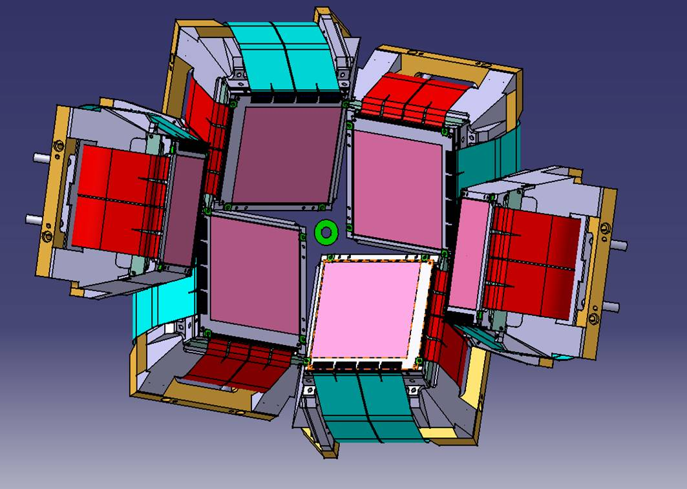
Experiment in GANIL May 2018
Above-barrier narrow resonances in ¹⁵F
Experiment proposed by I. Stefan and F. de Oliveira
MUST2

Slide 12


Future plans
France - IPN-Orsay, Orsay
F. Hammache
N. de Séréville
I. G. Stefan
GANIL – Caen
F. de Oliveira
Brazil - Universidade de São Paulo
Valdir Guimarães
Alessandro de Lara (student)
Brazil – Universidade Federal de São Paulo
Marlete Assunção
Plans for the future
spectroscopy of the ²³Na using transfer reaction: ²²Ne(³He,d)²³Na ?
spectroscopy of the ²⁶Mg using transfer reaction: ²²Ne(⁶Li,t)²⁶Mg
PhD for Alessandro Lara in co-supervision with Faïrouz Hammache
Collaboration with Active Target in GANIL with F. de Oliveira and Beyhan Bastin
10Be+p experiment in São Paulo with RIBRAS (French group participation)

