Slide 1
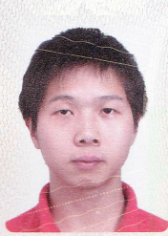
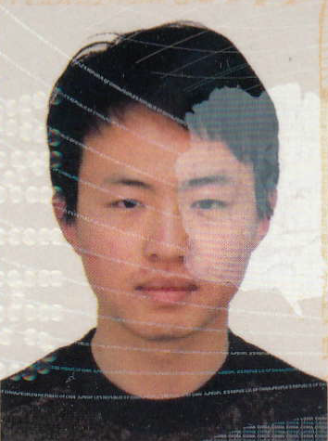
Voids for cosmology
  Void abundance (constraints on Ω_{M} and σ₈) eg, Betancort-Rijo et al. 2009
  Nature of dark energy and alternative gravity theories eg, Lee & Park 2009; Li Baojiu et al., 2012, Cai et al. 2015,…
  Primordial non-Gaussianities Song & Lee 2009
  Cosmic structure formation Peebles 2001: The Void Phenomenon
  Alcock-Paczynski test Sutter et al., Pisani et al, with VIDE,
  Baryonic Acoustic Oscillations (BAO) with DT Voids
  …
Liang Yu
  Tsinghua U. PhD Students : Zhao Cheng
+ Albert Chuang, F.S.Kitaura + other SDSS collaborators

Slide 2
ΛCDM : Dominant theory of
Structure formation and evolution
Tiny perturbations in the primordial universe seed the later formation of structures
Nearly scale-invariant Gaussian random field Bardeen, Bond, Kaiser, Szalay 1986
Structures form by gravitational instability
Biased galaxy formation from DM haloes
Matter dense regions contract under gravity while voids expand
Voids:
suffer less non-linear gravitational effects,
distribution closer to the initial DM density field
van de Weygaert & van Kampen 1993; Sheth & van de Weygaert 2004
Study of voids = test of ΛCDM

Slide 3
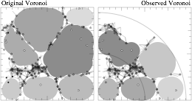
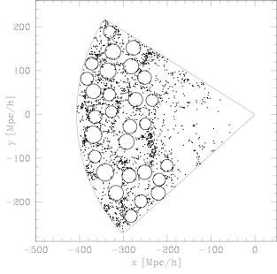
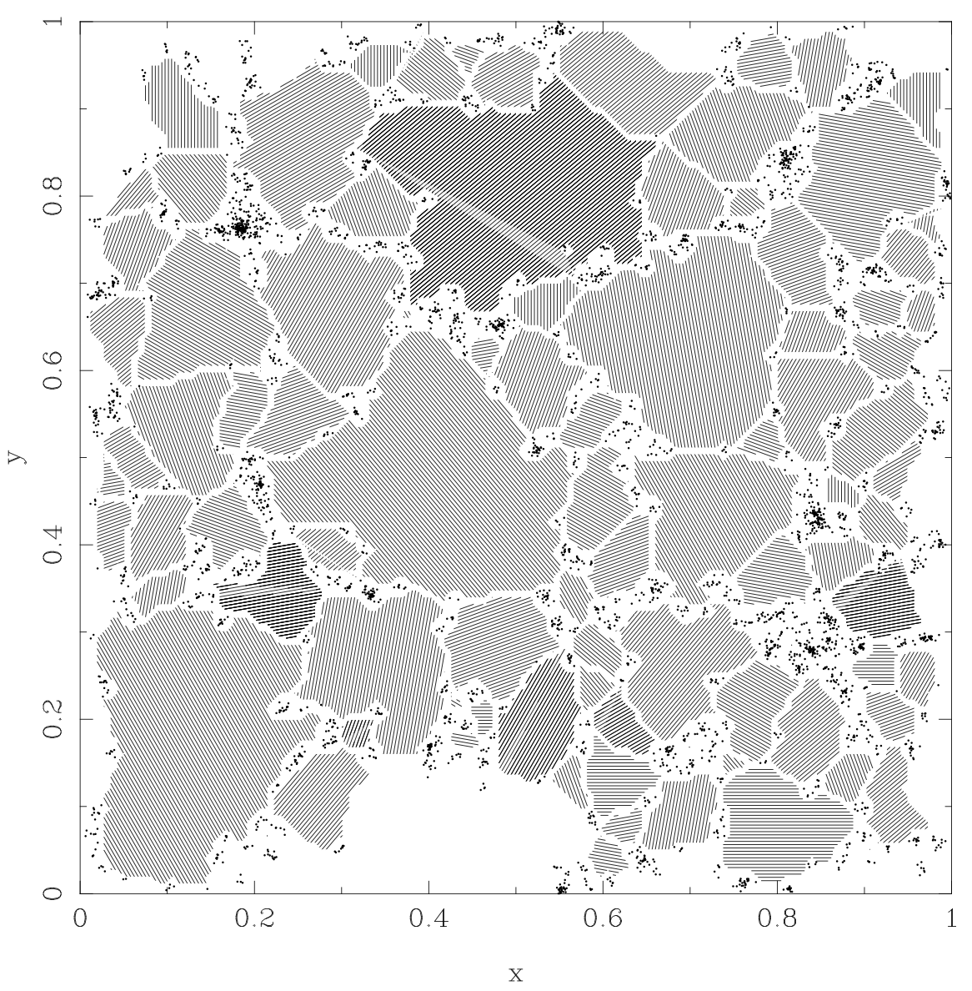
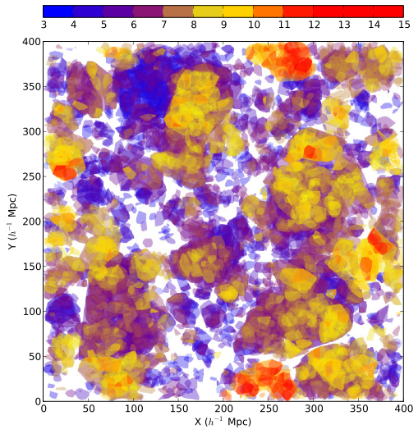
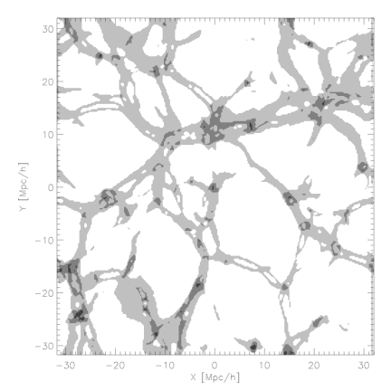
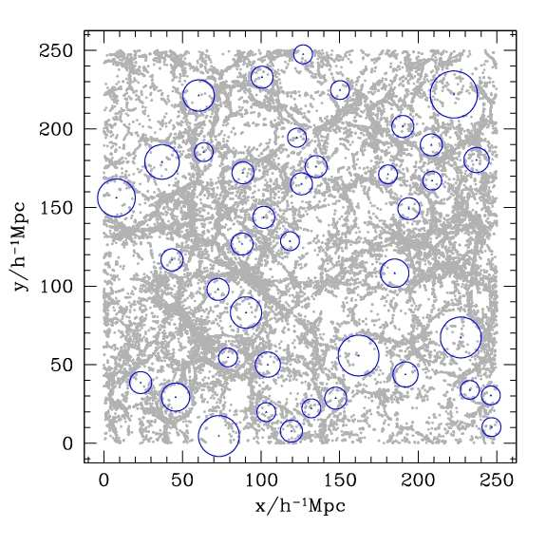
Many, many, Void Finders!
El-Ad et al. 1997
Patiri et al. 2006
Aikio et al. 1998
Lavaux et al. 2012
Hoffman et al. 2012
Padilla et al. 2005

Slide 4
Different Void definitions for different purposes
(i) under-dense regions based on the smoothed DM (or halo/galaxy) density field Colberg et al. 2005; Shandarinet al. 2006; Platen et al. 2007; Neyrinck 2008;
(ii) gravitationally expanding regions based on the dynamics of the DM density field Hahn et al. 2007, Forero-Romero et al. 2009, Homan et al. 2012, Cautun et al.2013,…
(iii) regions free of shell crossings based on phase-space tessellations of the particle distribution Abel et al. 2012;Falck et al. 2012; Shandarin et al. 2012,…
(iv) empty spatial regions among discrete tracers , e.g. El-Ad & Piran 1997; Aikio & Mahonen 1998; Hoyle & Vogeley 2002; Padilla et al. 2005; Patiri et al. 2006; Foster & Nelson 2009…

Slide 5
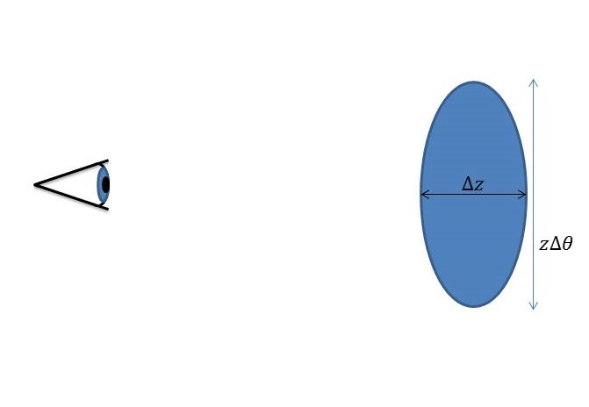
Example : Watershed algorithm: Platten 2007 (WVF) , Neyrinck 2008 (Zobov), Sutter 2012 (VIDE),…
Voronoi Tessellation technique
Categorize regions based on high density contrasting borders
Sutter et al. 2012
Find voids with “VIDE” void finder
Stack the voids
Use Alcock-Paczynski test on the stacked sphere (circle) to constrain cosmological parameters
Alcock and Paczynski Nature Vol. 281, 1979
Ratio of angular to radial size depends on cosmological model
Can be applied to all spherically symmetric distributions

Slide 6
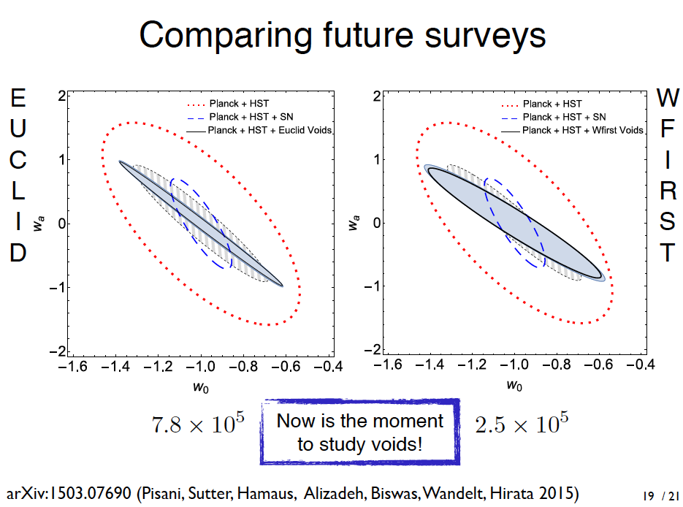

Alice Pisani postdoc CPPM
Stacked voids and their sphericity studies (AP test) could give constraints on DE parameters
better/complementary than/to SNIa !

Slide 7
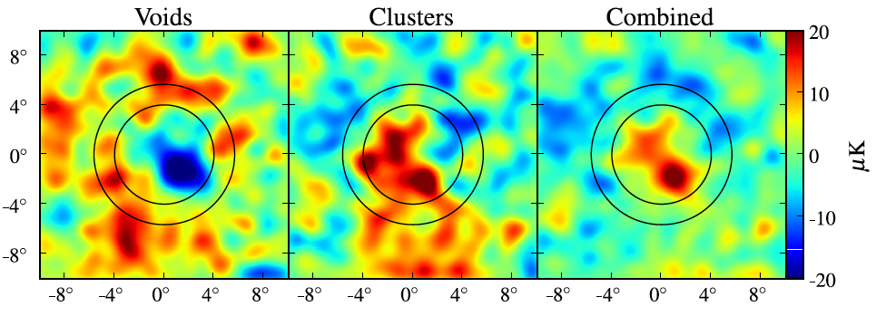
“Discovery” of the ISW effect
Granett, Neyrinck and Szapudi, 2008
SDSS DR5 LRG catalog
Identify Voids and Superclusters with ZOBOV (Zone Bordering on Voidness) method - Neyrinck (2008)
Stack Voids and Clusters
Measure cold (-11.3μK) and hot (7.9 μK) spots on the WMAP5 microwave background
- mean temperature deviation of 9.6 +/-2 μK, i.e. above 4 sigma ISW detection
Late-time Integrated Sachs-Wolfe (ISW) effect :
cosmic acceleration from dark energy ➔ gravitational potentials to decay, heat or cool photons passing through density crests or troughs.

Slide 8
Patiri et al. 2006
Spherical Voids
Padilla et al. 2005

Slide 9
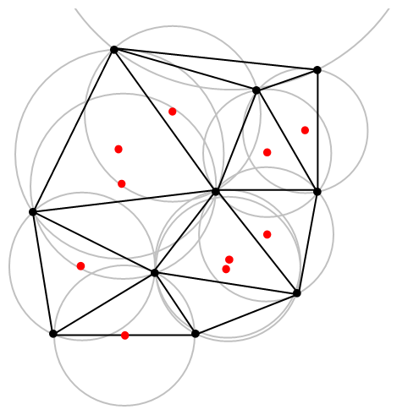
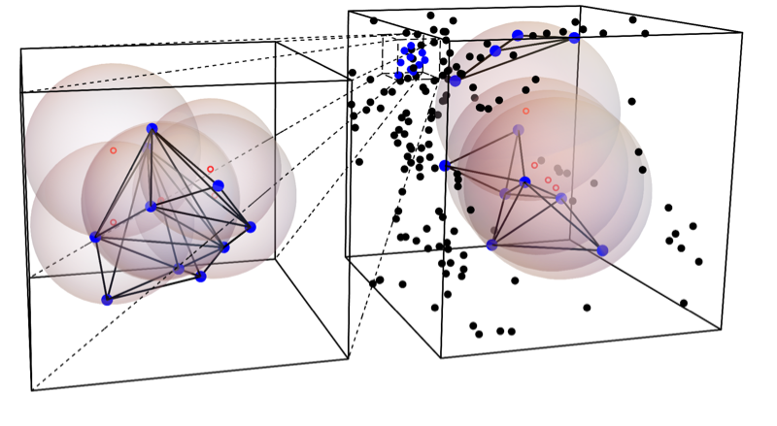
Delaunay TrIangulation Void FindEr
Zhao et al. 2016, MNRAS, 459, 2670
Delaunay Triangulation (DT)
Wikipedia
Dots: haloes
Open circles: centres of voids
cosmology independent
~10 minutes for 5.5 million haloes with a single CPU core

Slide 10
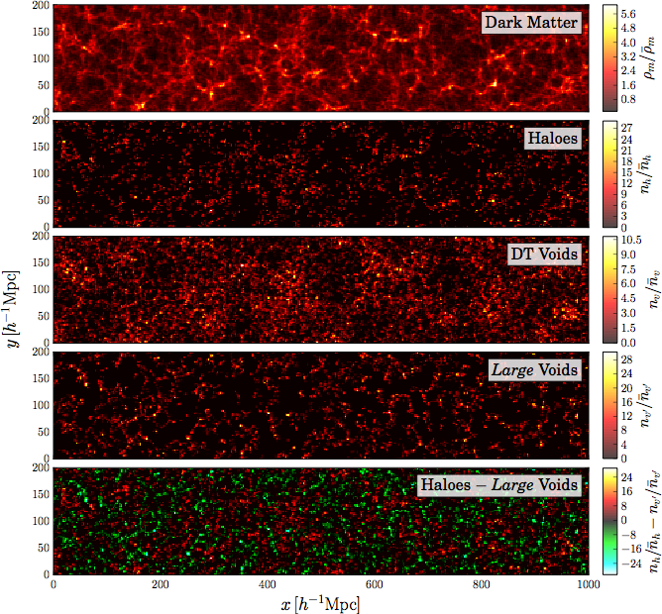
DT Voids complement Haloes/Galaxies
PATCHY mocks

Slide 11
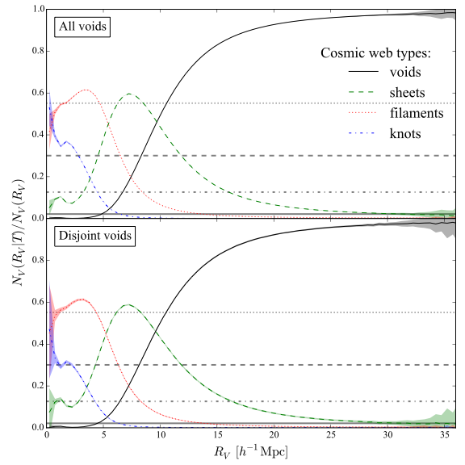

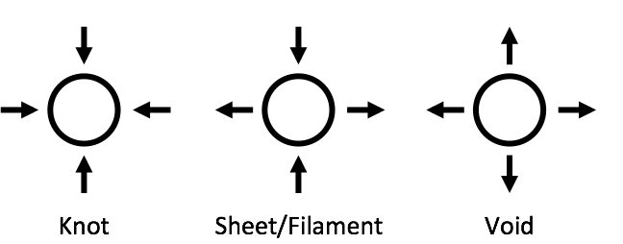
DT voids vs dynamical classification
Hahn et al. (2007), Forero-Romero et al. (2010)
16 Mpc/h <---- > 90%
Most of the large DT Voids are identified as « voids » by the dynamical classification

Slide 12
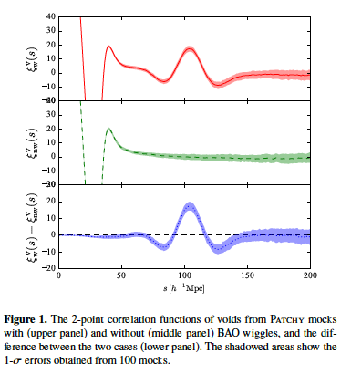
BAO SIGNAL with Patchy mock voids
arXiv:1511.04391, MNRAS,
Liang et al…
best seen subtracting
no-wiggle
N-body simulation

Slide 13
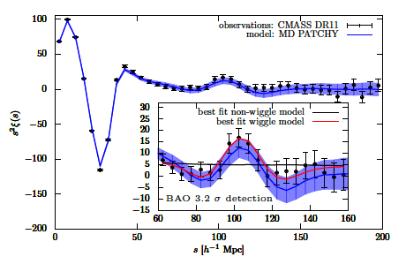
BAO detection with our New DT void definition
SDSSIII BOSS DR11 CMASS-North
BAO peak with our voids
3.2 σ detection!
arXiv:1511.04405 Signatures of the primordial Universe from its emptiness
Kitaura et al., PRL.

Slide 14
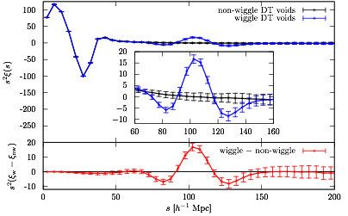
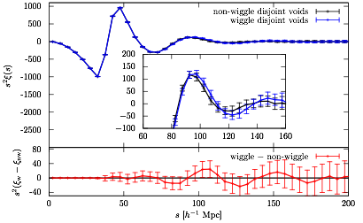
Comparison with disjoint voids
Kitaura et al. 2016, PRL, 116, 1301
Disjoint (traditional) voids
All DT voids
Overlapping voids (sub-structures) give more weights to large under-dense region

Slide 15
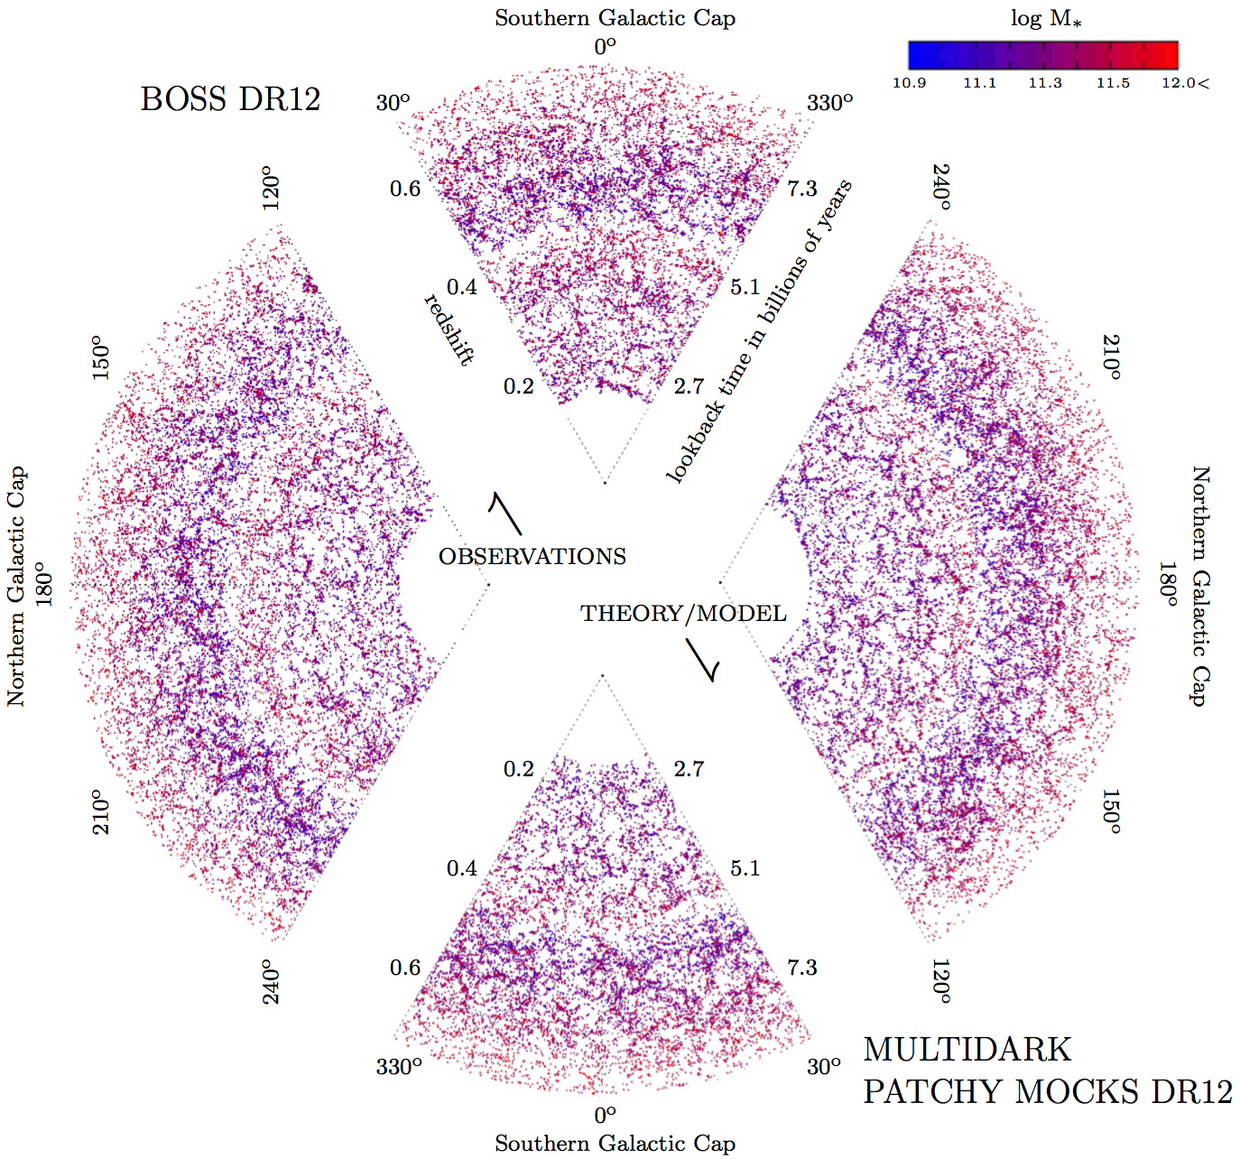
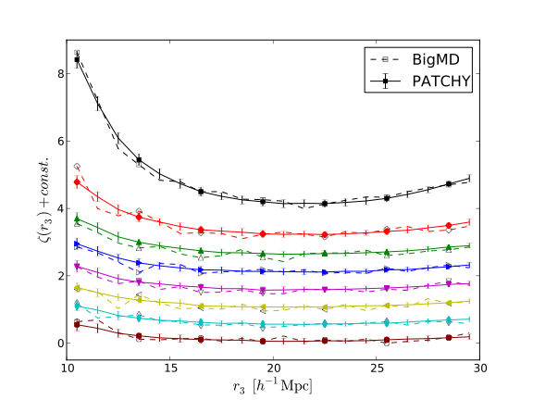
MultiDark Patchy DR12 mocks
Zhao et al. 2015, MNRAS, 451, 4266
3-pt correlation function of different mass bins
(mass assigned by the HADRON code)
Kitaura et al. 2016, MNRAS, 456, 4156
PATCHY: One of the official mock generator for SDSS-III BOSS DR12

Slide 16
What improvement to expect for cosmology with voids?
Voids and galaxies are correlated.
Any new information ?
  - Voids are correlated with galaxy 4pt statistics
  - Void BAO peak is narrower than LRG BAO peak
Zhao Cheng, PhD student Tsinghua U., paper soon

Slide 17
Voids indeed closer to the initial DM density field
Voids suffer less non-linear gravitational effects, and are closer to the initial DM density field than high-density tracers
van de Weygaert & van Kampen 1993; Sheth & van de Weygaert 2004
With MD Patchy mocks
Without need for
reconstruction

Slide 18
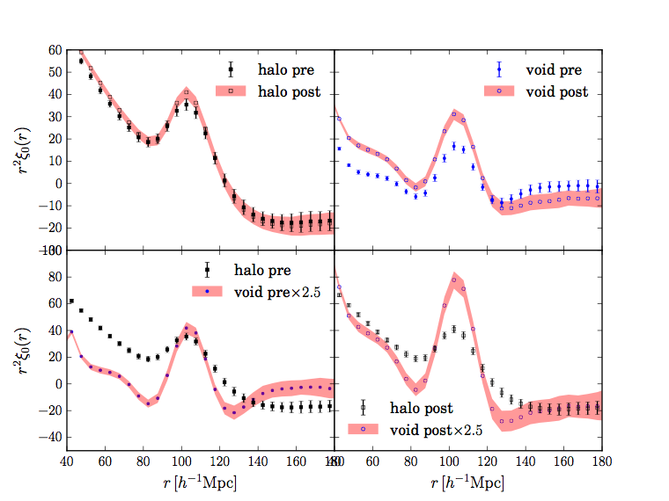
“Reconstruction” of primordial density fluctuation with galaxies can recover partly from the non-linear effects of gravity…
David Weinberg 1992, Eisenstein et al. for SDSS 2007

Slide 19
Combining galaxies and voids
Standard SDSS galaxy BAO model. not directly applicable
to voids !
Develop a new model that applies to both haloes/galaxies and voids

Slide 20




BAO fitting
Following Xu et al. 2012
Model Power spectrum
a=1Mpc/h for
high k damping
Damping parameter
Spherical Bessel function
CAMB
Eisenstein-Hu, 1998

Slide 21
Modified dewiggled model

Slide 22
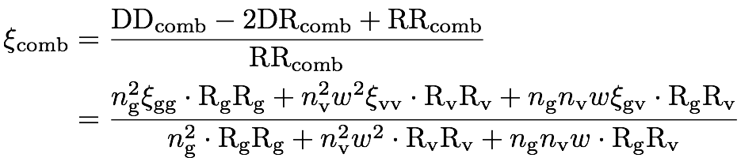
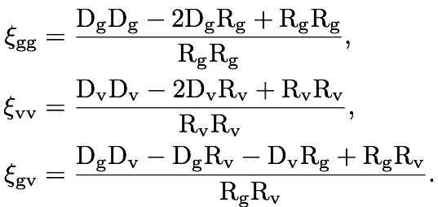
Combining galaxies and voids
Most simple model: a single contributing factor w for all voids

Slide 23
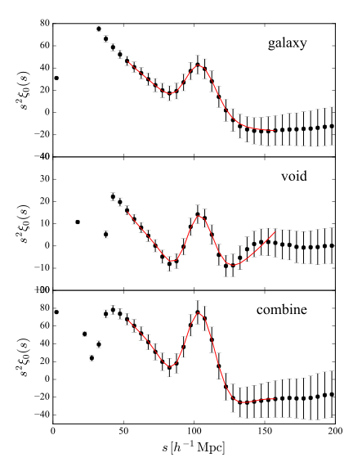
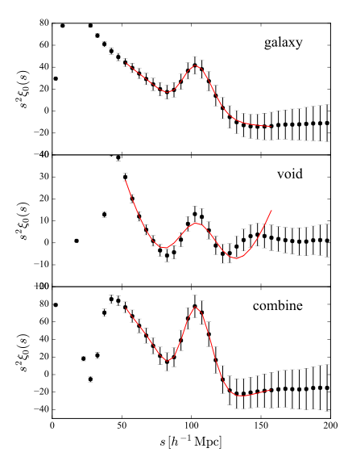
Optimal factor for voids
1000 post-recon MultiDark Patchy BOSS DR12 mocks
0.2 < z < 0.5
0.5 < z < 0.75
w = –0.07
w = –0.07

Slide 24
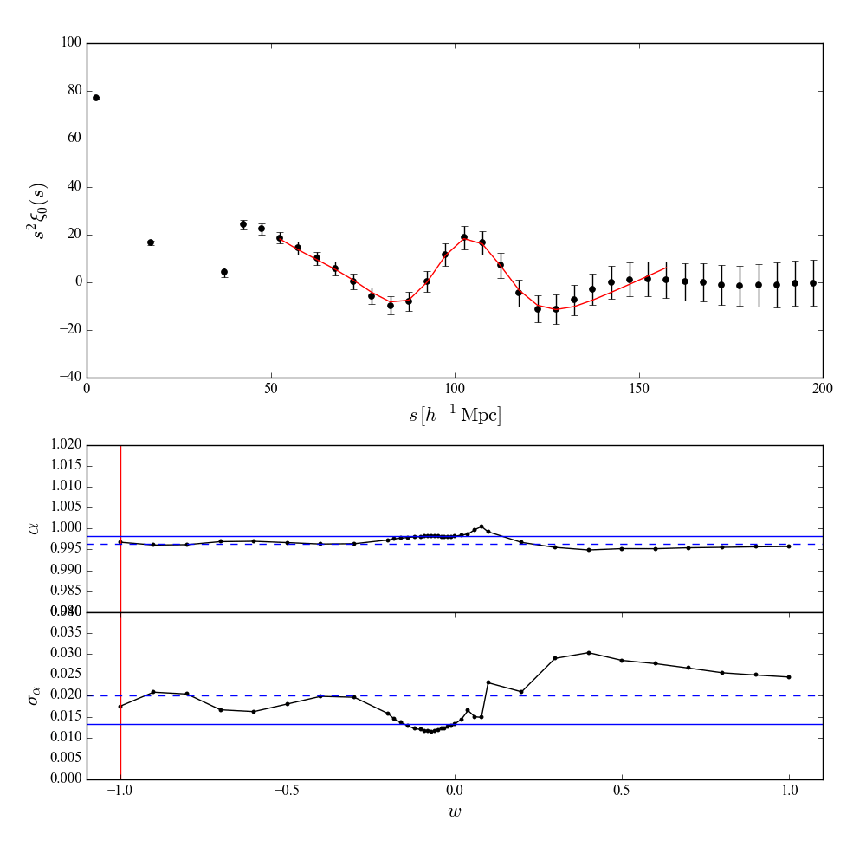
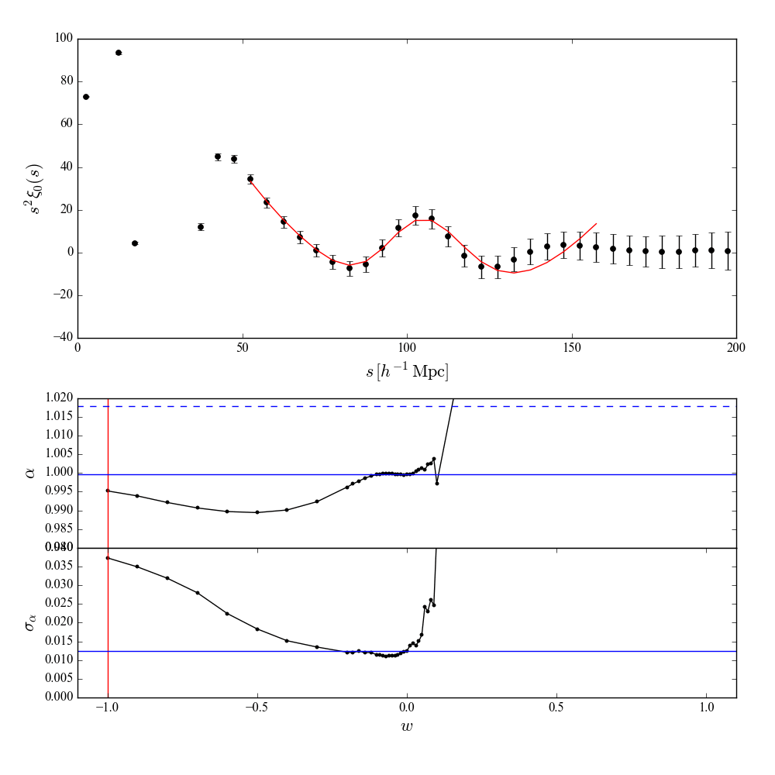
Optimal factor for voids
Fitting to the mean of 1000 post-recon MultiDark Patchy BOSS DR12 mocks
0.2 < z < 0.5
0.5 < z < 0.75

Slide 25
Optimal factor for voids
1000 post-recon MultiDark Patchy BOSS DR12 mocks
0.2 < z < 0.5
0.5 < z < 0.75
13.7%
improvement
11.1%
improvement
w = –0.07
w = –0.07

Slide 26
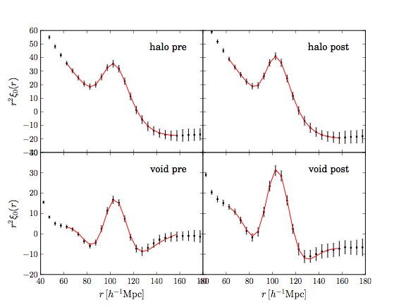

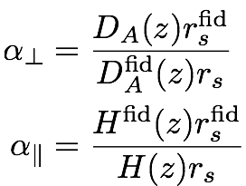
BAO fitting: 100 cubic mocks
1-α | pre-recon | post-recon
halo | 0.00395 ± 0.00391897 | 0.0006 ± 0.00275735
void | -0.00423 ± 0.00429069 | -0.001053± 0.00469319

Slide 27
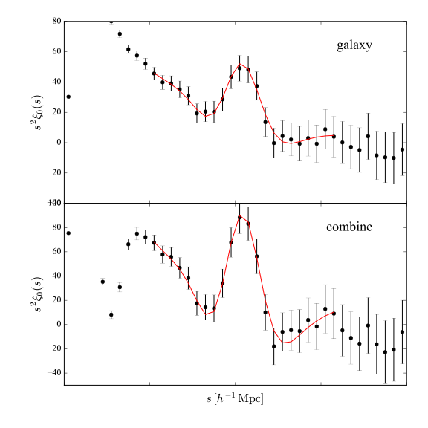
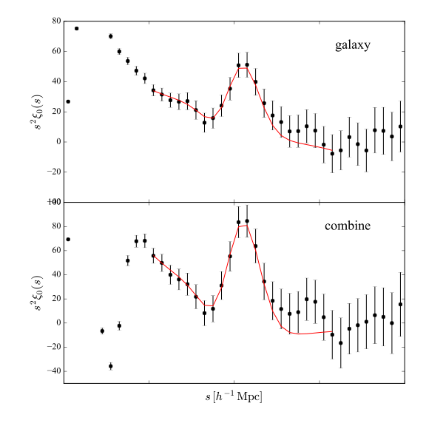
BAO fitting: BOSS DR12 data
w = –0.07
w = –0.07
0.2 < z < 0.5
0.5 < z < 0.75
11.6% improvement
–8.7% improvement: ie, worse

Slide 28
Summary on Void BAO
We use a cosmological independent definition of void, with the radius cut being the only parameter.
We evidenced a BAO peak with our new void definition.
Voids contribute to >10% improvements on the BAO position constraint after BAO reconstruction of galaxies (effectively >20% larger survey volume).
We have studied carefully to make sure the results are robust/unbiased.
Individual realisations (e.g. DR12 observations) do not necessarily show improvement, but is consistent with statistical fluctuations.
The method should be more promising for future surveys with larger volume.
Comes for ”free” > 10% improvement on σ_{α}
corresponds to 20% additional volume

Slide 29
Post-reconstruction halo/void 2CF

Slide 30
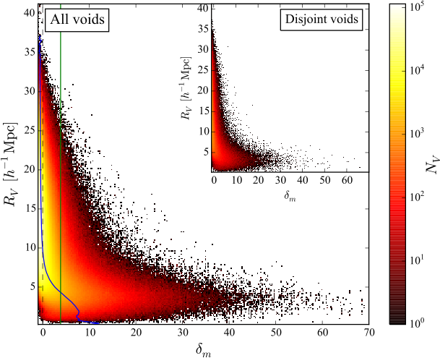
Voids are not empty regions!
Underdense regions= VOIDS
Blue curve:
Mean density of voids
Green line:
Mean density of haloes
Overdense regions= clusters

