Slide 1
LHCb Software and Computing for Run 3
Stefan Roiser
LCG/France Meeting
20 June 2018

Slide 2
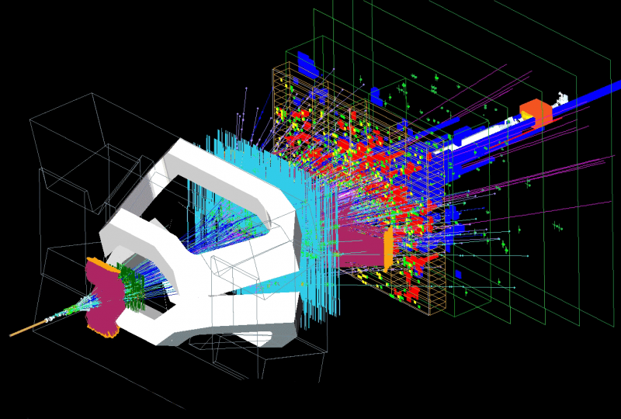
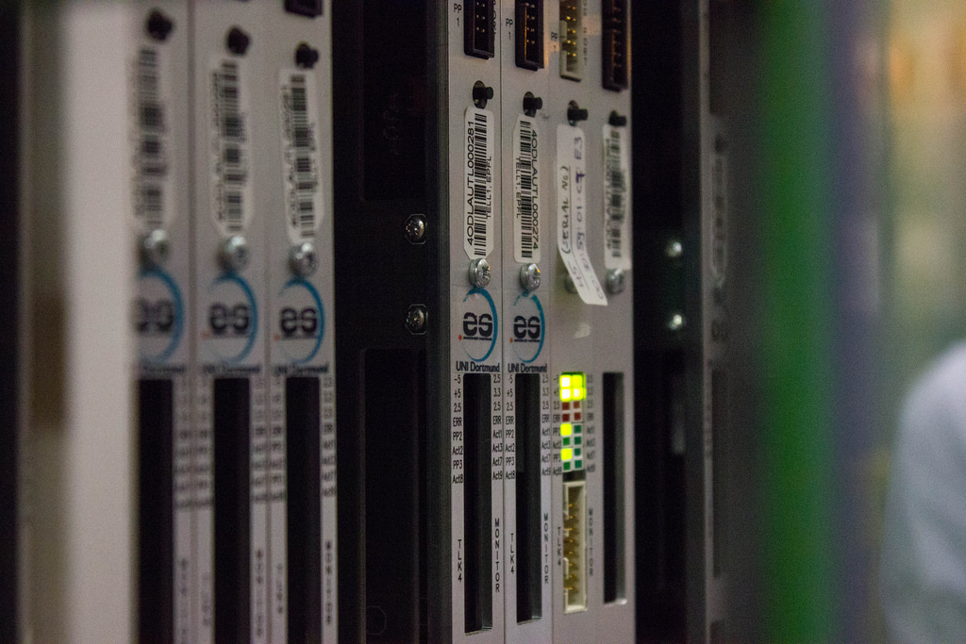
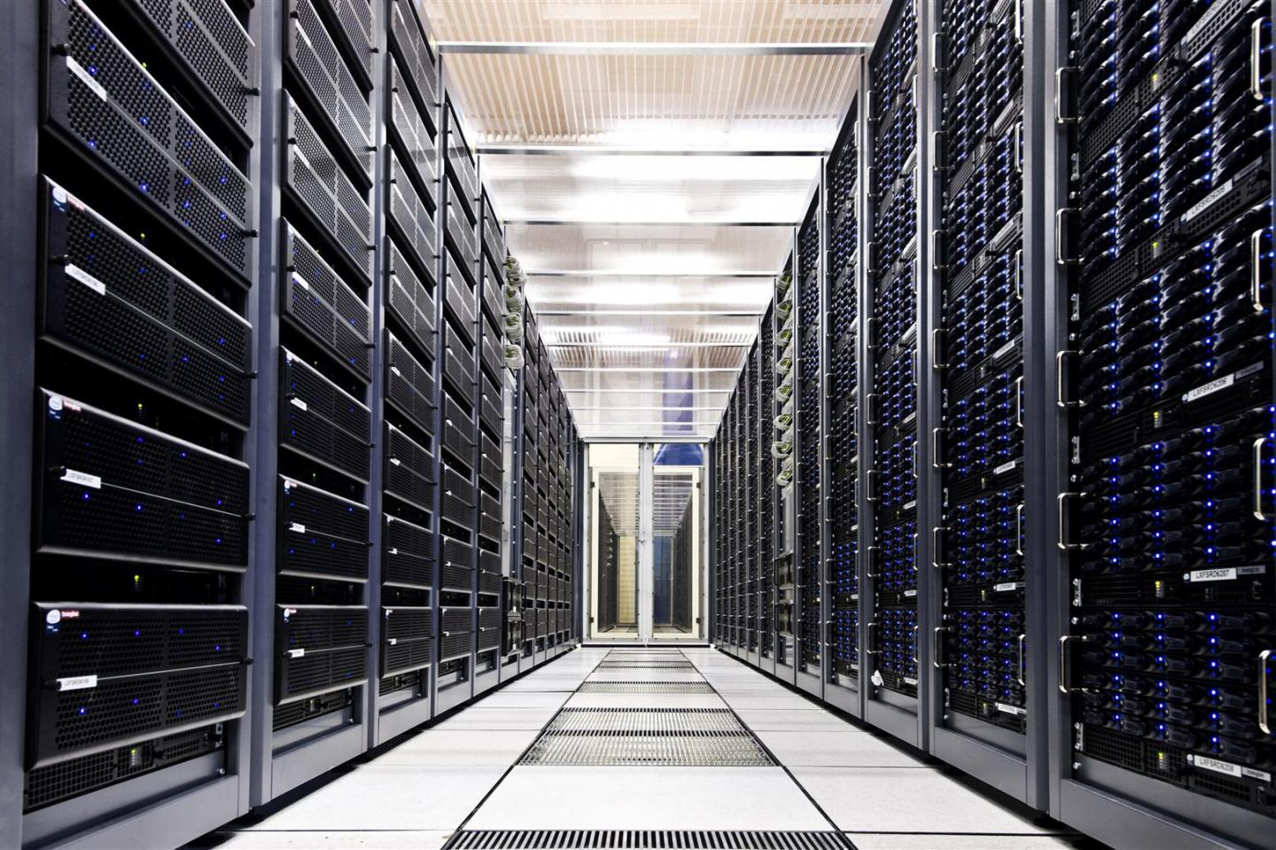
Data Processing Model Sketch (Classic Full Stream Workflow)
40 MHz
1 MHz
10 kHz
LHC bunch crossing
L0 Hardware Trigger
High Level Trigger (HLT)
“Online”
“Offline”
40 %
100 %
Stripping
Reconstruction
Physicist starts selecting
and analyzing the data
Slimming, streaming
and selecting of events
Generate physics objects
Online kHz: event rate
Offline %: data volume retention

Slide 3
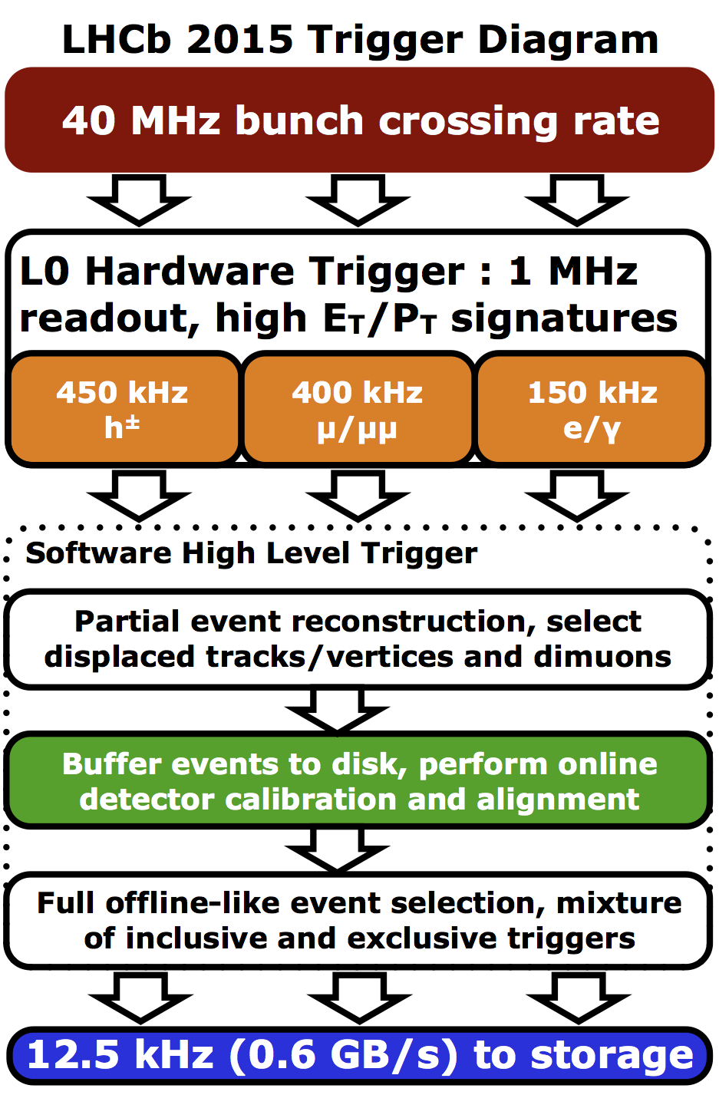
Run 2 (2015-2018)
RAW
RAW
Reco
Tesla
RDST
MDST
Online
Offline
Strpg
(M)DST
Merg
(M)DST
~ 10 kHz
~ 2.5 kHz
“Classic Workflow”
“Turbo Workflow”

Slide 4
Run 2
Split Online High Level Trigger (HLT) into two parts
  Disk buffer between HLT1 and HLT2
  Final detector calibration & alignment done from HLT1 output
  → no second pass processing needed offline
  → higher stripping retention with better detector conditions applied
  HLT 2 reconstruction becomes identical to offline reconstruction
New concept of “Turbo” stream (in addition to “Full”)
  Contains final reconstructed physics objects in m(icro)DST format ready for physics analysis without any further processing
    Little reformatting needed offline from “LHCb” format to ROOT format
    → 100 % retention, everything selected is signal, available in O(Hours)
  RAW information not to be kept on offline storage
  → One off chance to process data correctly in HLT

Slide 5
Run 3 (2021-2023)
RAW
100 %
Retention
Tesla
Online
Offline
MDST
“Turbo Workflow”

Slide 6
Run 3
Removal L0 hardware trigger, 30 MHz events to be triggered in software
  → Strain on CPU efficiency of the trigger software (Gaudi Online)
Trigger only signal events, event selection becomes classification
  → 100 % retention -> offline storage costs driven by HLT output rate
  Stripping becomes streaming of events
HLT output rate increase to O(GB/s), aim for vast majority to be “Turbo”
  → Smaller event sizes → more events recorded
  → Event formats will be in a range between MDST and DST
    If needed, decide which parts of the reconstruction information will be persistent
  → More events per file → sparse reading
    Efficient model for user analysis needed
  → Very little data processing to be done offline ☺
  → Signal proportional to MC needed → Work for simulation explodes ☹

Slide 7
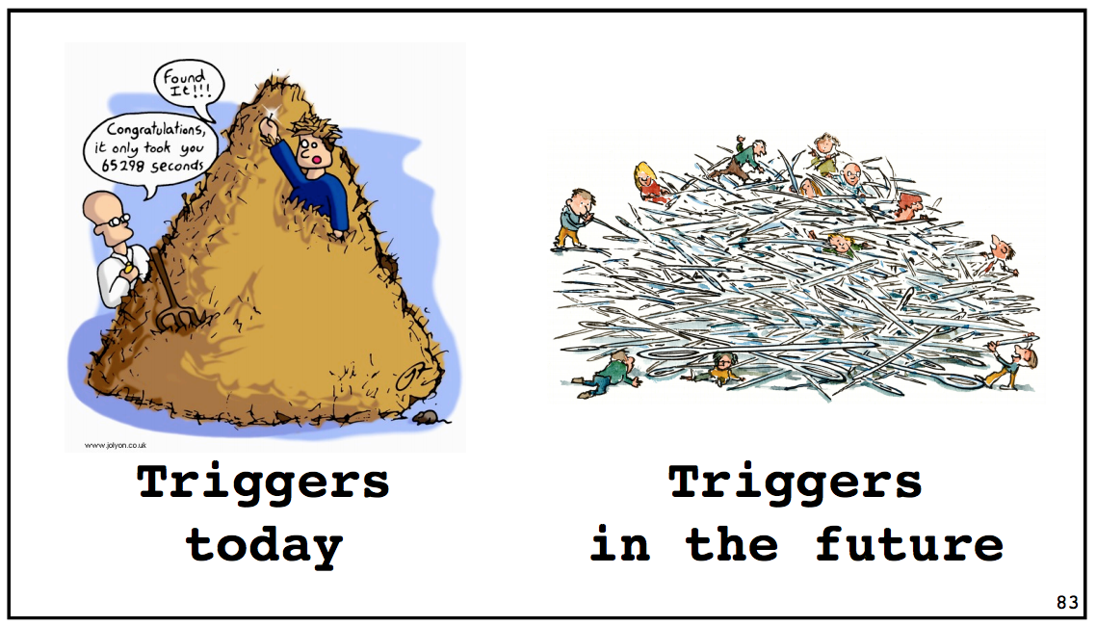
The Game Has Changed
(© Vava Gligorov)

Slide 8

Overall Roadmap towards Run 3
2015 |  | 2016 | 2017 | 2018 | 2019 | 2020 | 2021
… LS 1 | Run 2 |  |  |  | LS 2 |  |  | Run 3 ...
.........
 | 2027
Run 4 …
(HL-LHC)
Q4/15: Upgrade Kickoff Meeting
Q4/17: Software & Computing TDR
Q1/16: Upgrade Roadmap Document
Q3/18: Definition of Computing Model
Q1/17: Demonstrate Technology Changes
Very tight schedule to prepare software and computing for Run 3
Big difference in respect to preparing software for Run 1
  → Operating a detector while developing new software
Also in LS2 likely not to change, physics program continues …

Slide 9
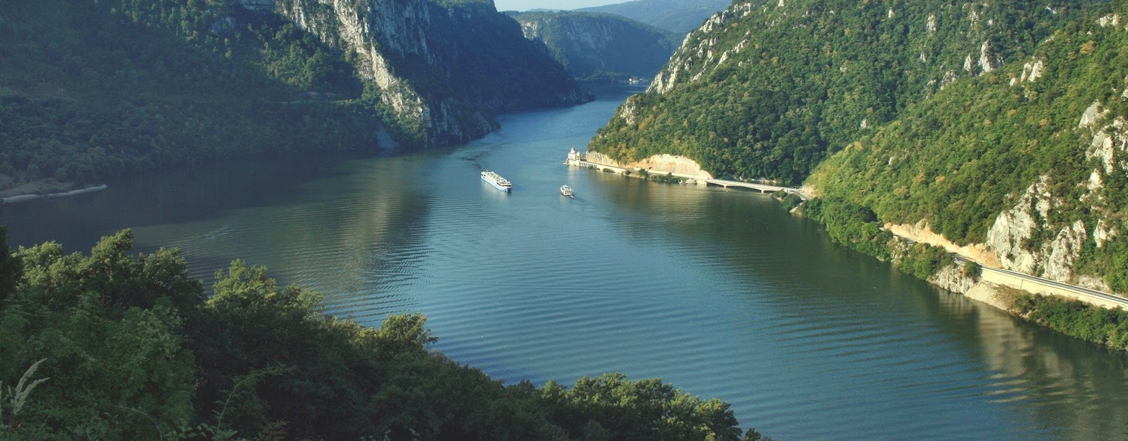
Software and Computing Areas for the Upgrade
“Revolutionary” non-backwards compatible developments
  Framework software, data/event model, detector description, conditions data, …
“Evolutionary” changes which can be integrated already during Run 2
  Fast simulations models, scalability of distributed offline computing, physics analysis workflows, …
“Revolution”
Taskforce established
Adiabatic integration into
current environment

Slide 10
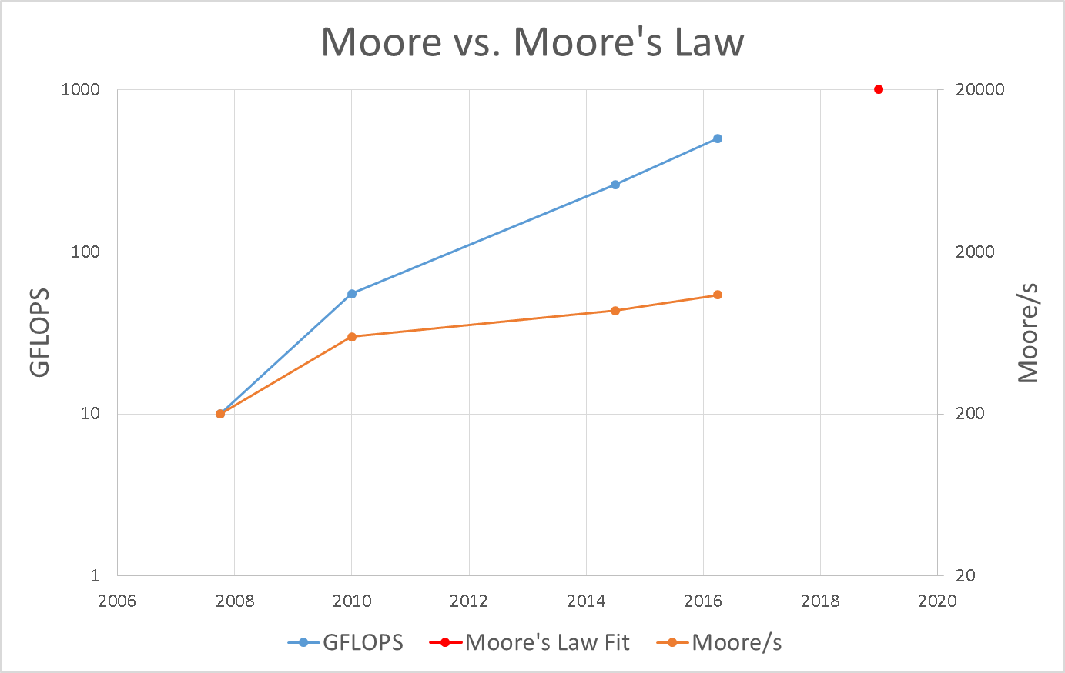
Software for the Trigger
LHCb software is not leveraging current hardware capabilities such as multi-core architectures
Resulting in:
  Cache misses
  Under-usage of SIMD instructions
Divergence in Run 3 of the estimated resources to computing needs is currently a factor 6
True not only for the trigger but all data processing
FLOPS of actual
Online farm hardware
Fit of average CPU
FLOPS since ~1970
Trigger Decisions/s actual
Online farm hardware

Slide 11
Status of Software
Major improvements already achieved in software performance
  Partial reconstruction tracking
  sequence in HLT1 improved
  by a factor 2 comparted to
  1 year ago
Improvement gains by switch
to multi-threaded application,
code vectorization and
algorithmic improvements
Work ongoing for further
improvements

Slide 12
Work spent for different LHCb processing types in one year
Simulation
Data Processing
User Analysis

Slide 13
Simulation
Offline (grid) processing
will be largely dominated
by simulation in Run 3
  With the increase of signal
  events the number of
  requested simulated events
  will grow
WLCG computing pledges
will not fit to cover this
increased needs
  Tackle CPU needs by moving to fast simulation workflows
    Already in production (ReDecay, RICHless, TrackerOnly), more to come

Slide 14
Distributed Computing
LHCb currently uses disk at T0/T1s and 13 T2 sites
  Currently no plan to increase the number of storage sites
Evolution of the LHCbDIRAC framework to sustain Run 3 load
  Modular architecture allows upgrade of individual components one by one
    Move to nosql stores for database backends
    Integrate new storage technologies
    Scale up workload management system
Move to “working group productions” for user analysis jobs
  Plan to continue submitting jobs to storage site
  Centralized execution of payloads to optimize CPU and I/O
  Possible aggregation of individual payloads into “trains”

Slide 15
Run 3 Software & Computing
TDR
Submitted to LHCC in May
Final version of document uploaded to CDS
  https://cds.cern.ch/record/2310827
Describes engineering choices taken for application software engineering and distributed computing
Asking for approval by LHCC in Q3/2018 together with the computing model document

Slide 16
Run 3 Computing Model
First numbers for distributed computing resource requests available
10 GB/s output trigger bandwidth allows full exploitation of the upgrade physics program
Resource optimizations taken into account
  Reduction of Run 1 & Run 2 data and monte carlo to 1 disk replica at most
  All Turbo data reduces needs to almost no offline data processing
  Monte carlo microDST used for vast majority of data
  Exploiting full potential of fast monte carlo with several production types

Slide 17
Run 3 Computing Model – First Numbers
 | CPU |  |  | Disk |  |  | Tape
 | kHS06 | FCB | AYG | PB | FCB | AYG | PB | FCB | AYG
Baseline scenario by end of Run3 (2023) | 2.931 | 2.7 | 2.0 | 356 | 3.5 | 1.6 | 398 | 2.2 | 1.4
Baseline scenario by end of LS3 (2025) | 3.823 | 2.4 | 1.7 | 375 | 2.6 | 1.2 | 408 | 1.6 | 1.2
Baseline scenario numbers with 10GB/s HLT output rate, ~ 5 Mio s LHC collisions / year, ~ 2 disk replicas
  2nd and 3rd columns are factor of “constant budget” (FCB) and average yearly growth (AYG)
In addition working on different additional resource optimizations
  Further optimizations possible especially for CPU and Disk
Aim to approach stakeholders during summer for further discussions
Use September LHCC week for final discussion

Slide 18
Summary
Ambitious software engineering program towards Run 3
  Major software improvements needed for trigger and simulation
  Technical Design report describing engineering work has been released
Computing model including Run 3 resource needs is being worked on
  Distributed computing storage will be driven by the HLT output rate
  Vast majority of computing power will be needed for monte carlo simulation
  First numbers available, working on further optimization scenarios

Slide 19
Backup

Slide 20
LHCb Fraction of WLCG Resources
Fraction of LHCb resources on WLCG move from 10 % in 2018 → peak of 28 % for Disk in 2021 → ~ 16 to 22 % by end of LS 3

Slide 21
Particle Collision @ LHCb

Slide 22
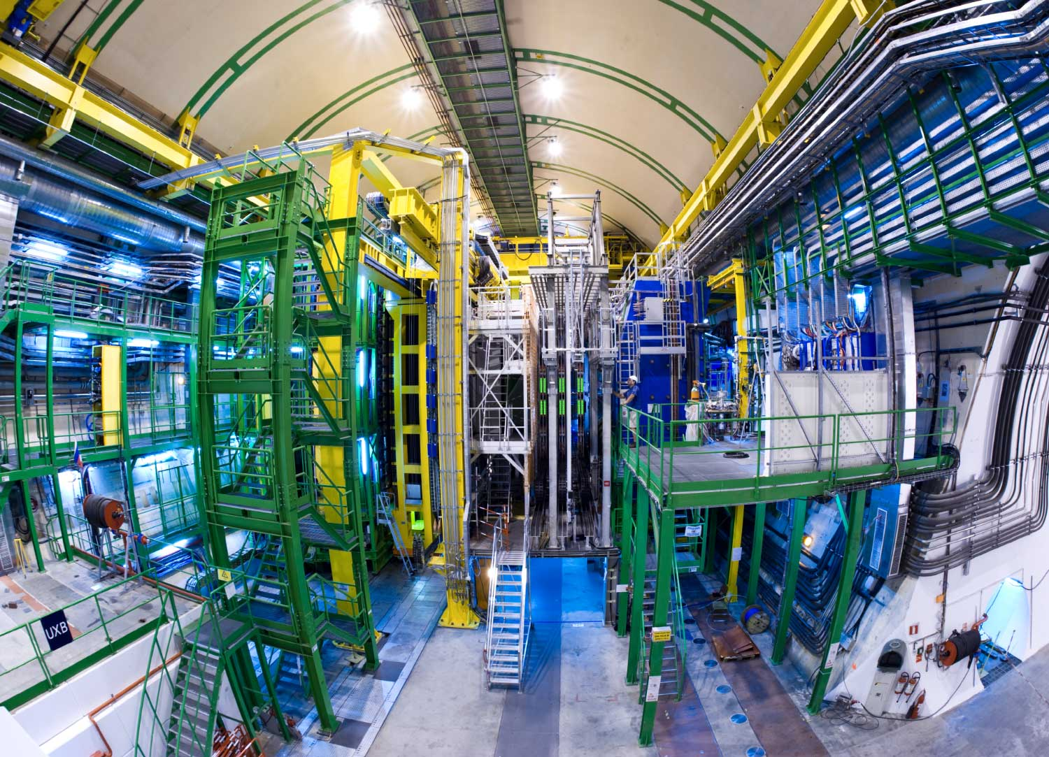
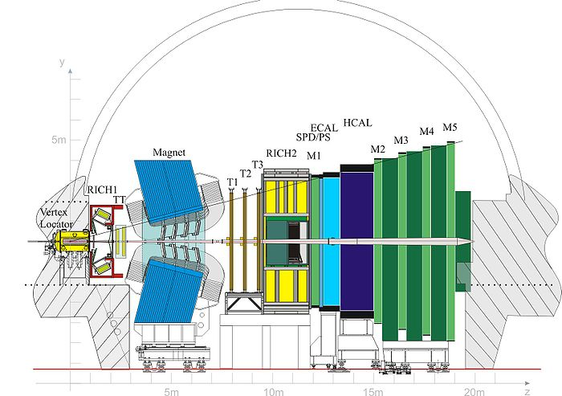
LHCb Detector

Slide 23

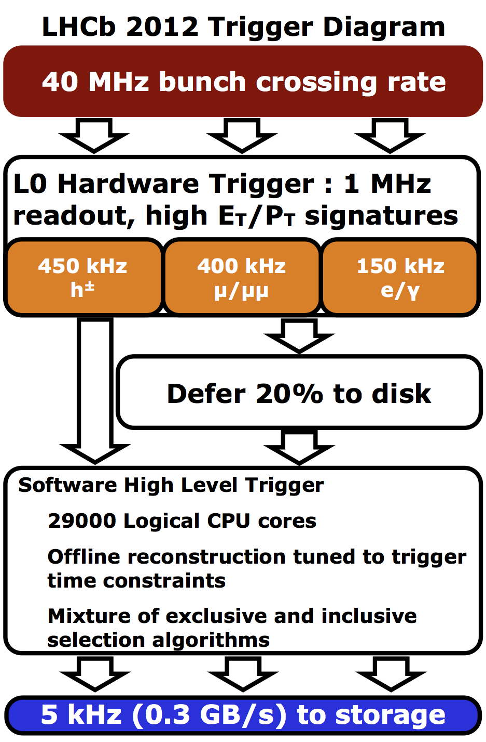
Run 1 (2010-2012)
RAW
RAW
RAW
Reconstruction
Online
Offline
RDST
RDST
RDST
Stripping
~ 60 % data
retention
(M)DST
(M)DST
(M)DST
(M)DST
(M)DST
(M)DST
(M)DST
(M)DST
(M)DST
…
Merging
(M)DST
(M)DST
(M)DST
…
“Classic Workflow”

Slide 24
Run 1
As of 2012 used disk buffer in front of HLT
  Buffer “overflow” during LHC fill to process during inter-fill gaps
“Classical” offline processing workflow for “Full” Stream
  Reconstruction -> Stripping -> Merging
  → ready for physics analysis
Stripping used for
  Reduction of file format to DST or M(icro)DST
  Event selection, usually ~ 60 % data retention
  Split into different streams used by physics working groups
At minimum 2 processing passes needed
  1st pass processing right after data collection
  2nd pass processing with improved detector calibration & alignment
    Usually started in September until Dec/Jan -> additional load on resources

