Slide 1
The CHEAP-Hunter project
(Compact High-Energy Ambitious Pion-bump Hunter )
All together: a very interesting and productive Scientific Discussion!
Francesco, Francesco [Hardware]
Gaia [Target Search]
Luca[Performances],
Marco[Logistic Engineering],
Martina[Software, Science Topic]

Slide 2
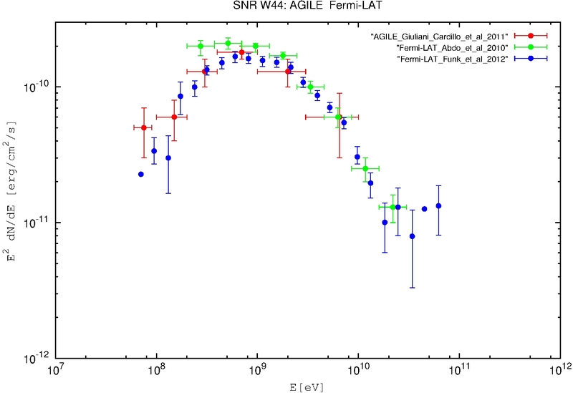
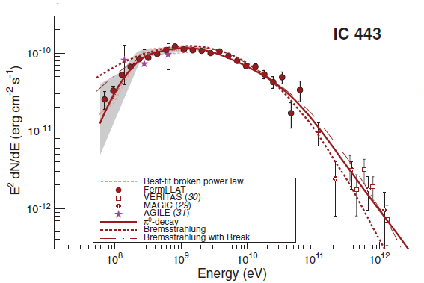
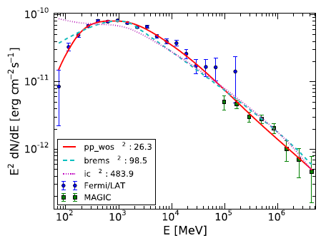
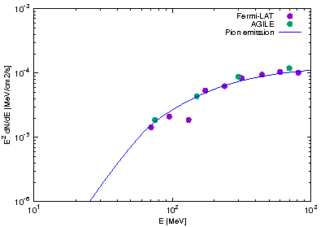
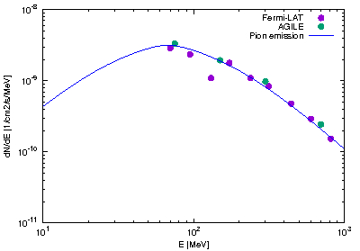
Science Topic
PION BUMP DETECTION (Kelner06, Giuliani11, Ackermann13, Cardillo14 )
Ackermann et al. (2013)
W44
W51c
Giuliani,Cardillo et al. 2011
Cardillo et al. 2014
Jogler et al. 2016
W44
67,5 MeV
Importance of no detection:
Confirmation of the theoretical model predicting low-energy CR exclusion from clouds (Gabici16)

Slide 3
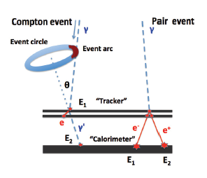
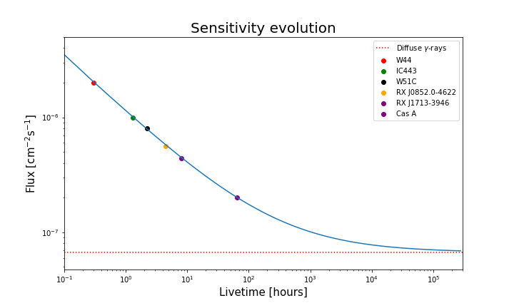
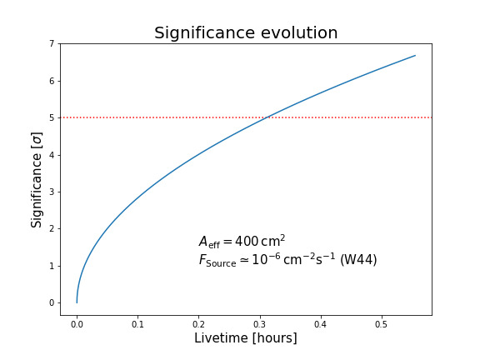
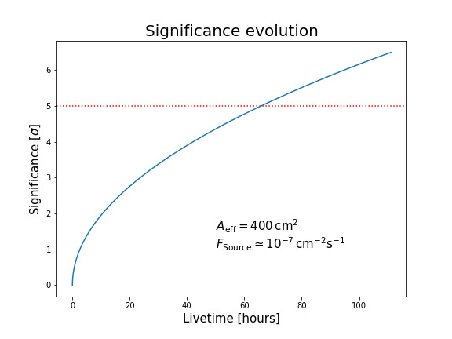
Instrument – Requirements
Energy range: 1 MeV – 1 GeV
we want focus our mission on the "pion-bump" feature research
Only-Silicon microstrip double-layer tracker for direction end energy reconstruction:
Compton effect (E~<10 MeV) and pair production
Imaging
low-energy photons and avoid the background due to Compton Scattering
Radiation Length: 0,5 X₀
Calorimeter
Caesium Iodide (CsI) pixels
Radiation Length: 1,3 X₀
Anti-Coincidence System and time of flight:
Particle rejection efficiency >95 %
Sensitivity: 7,85 x 10⁻⁸ ph/cm²/s [30-100 MeV, 1yr]
Effective Area: 400 cm² [constant] (Geometric Area*Efficiency(trigger, reconstruction, interaction) )
Angular Resolution and FoV to be estimated

Slide 4
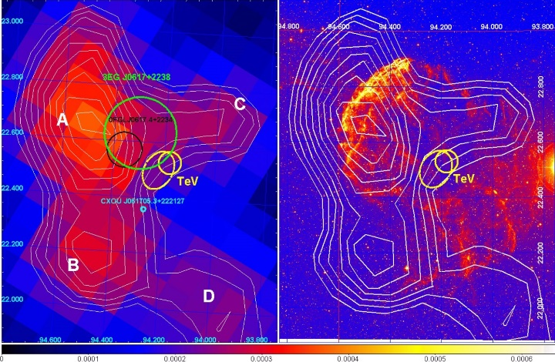
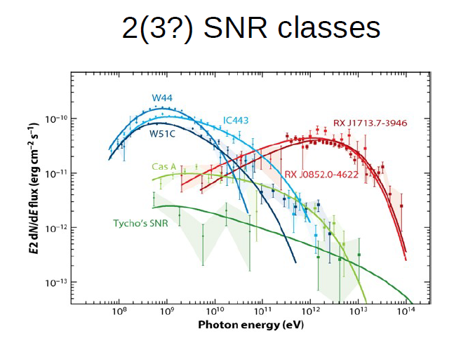
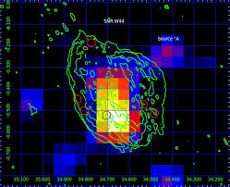
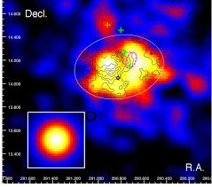
Target Sources
IC443
W44
Tavani et al. 2010
W51c
Cardillo et al. 2014
Sources | Fluxes (30-100 MeV)[ph/cm2/s]
W44 | ≈ 1e-6
IC443 | ≈ 5e-7
W51c | ≈ 4e-7
RX J0852.0-4622 | ≈ 2,8e-7
RX J1713,7-3946 | ≈ 2.2e-7
Cas A | ≈ 5e-8
Abdo et al 2009

Slide 5
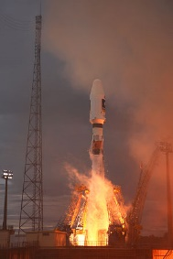
Instrument - Requirements
Physical parameter:
35 kg detector
24,5 cm x 24,5 cm x 28,2 cm
1mm between two Si slices of a single layer and 3mm between two layers
Launcher: Kourou – Vega [shared]
cheap, small mission, at the Equator
250 kg: total weight [J. Wijker 2008], including margins
Orbit: LEO (i < 10°)
between radiation belt and the densest atmosphere layer
one revolution every 95 minutes
Ground segment: Kourou
telemetry (up/down link, S band) → 10 minutes every 95 minutes (LEO)
data (down link, X band)
Power:
triple junction in solar panel (1,6m² total, (400 +/- 10%) Watt)
battery capacity (Li Ion) = 500 W/h
Issues | Budget [beginning + 1yr]
Industrial Cost | 5 millions
Launch | < 10 millions
Support, ground Segment, Team | < 2 millions/yr
Payload | < 3 millions
Contingency | < 3 millions/yr
 | 23 millions
ESA call for small Missions (< 50 million €)

Slide 6
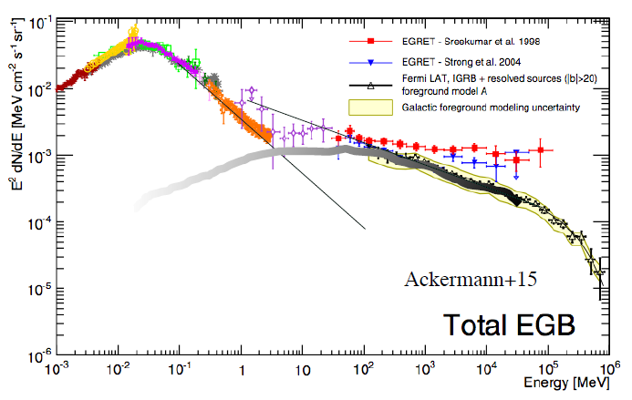
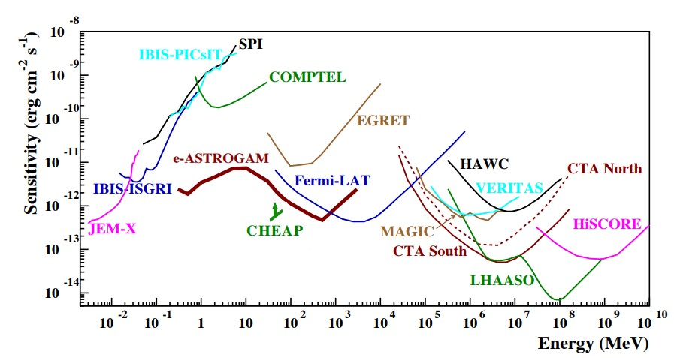
Instrument - Software
Instrument Response Function in fits format:
PSF (r68% or Gaussian)
Effective Area
Dispersion Energy
Background → MeV diffuse emission model (Ajello 2016)
Kalman-Filter recoursive algorithm (Giuliani 2006)
fundamental for the albedo photon rejection
Maximum Likelihood analysis (Mattox 1996)
optimized for extended sources
Flux, coordinates and spectral index (several spectral assumptions: power law w HE cut-off, log-parabola…)

Slide 7
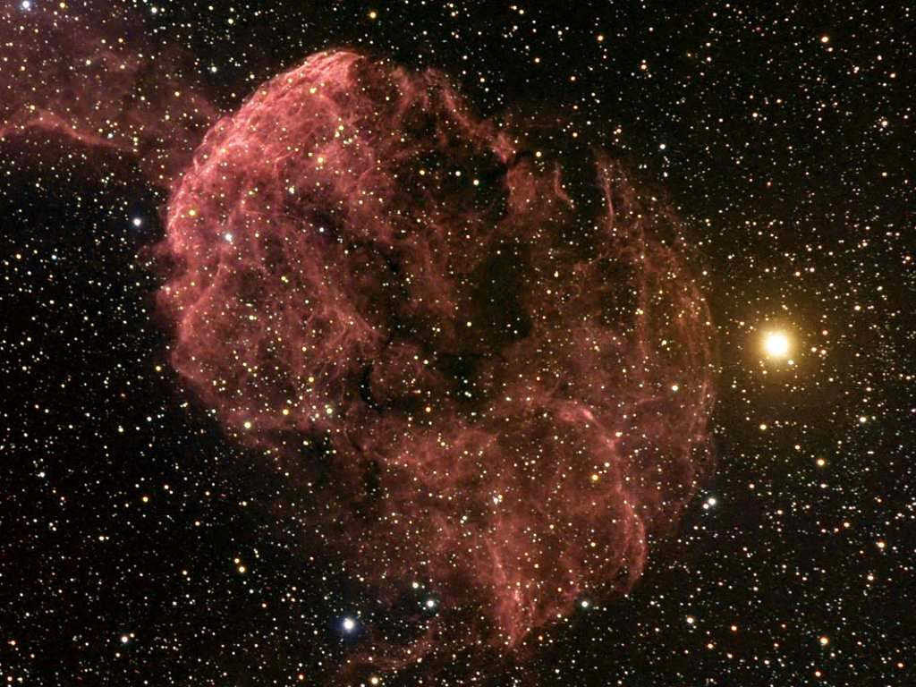
Comments and Summary
Every estimation is very raw due to the limited time
→ possible performance and target selection improvement
A "hot" scientific topic
→ a detection of "pion bump" can finally confirm the CR origin from SNRs
A very cheap payload for a brief "life time" (with possible time extension)
Possibility of analysis of other kind of gamma-ray sources
Thank you
very much!

