Slide 1
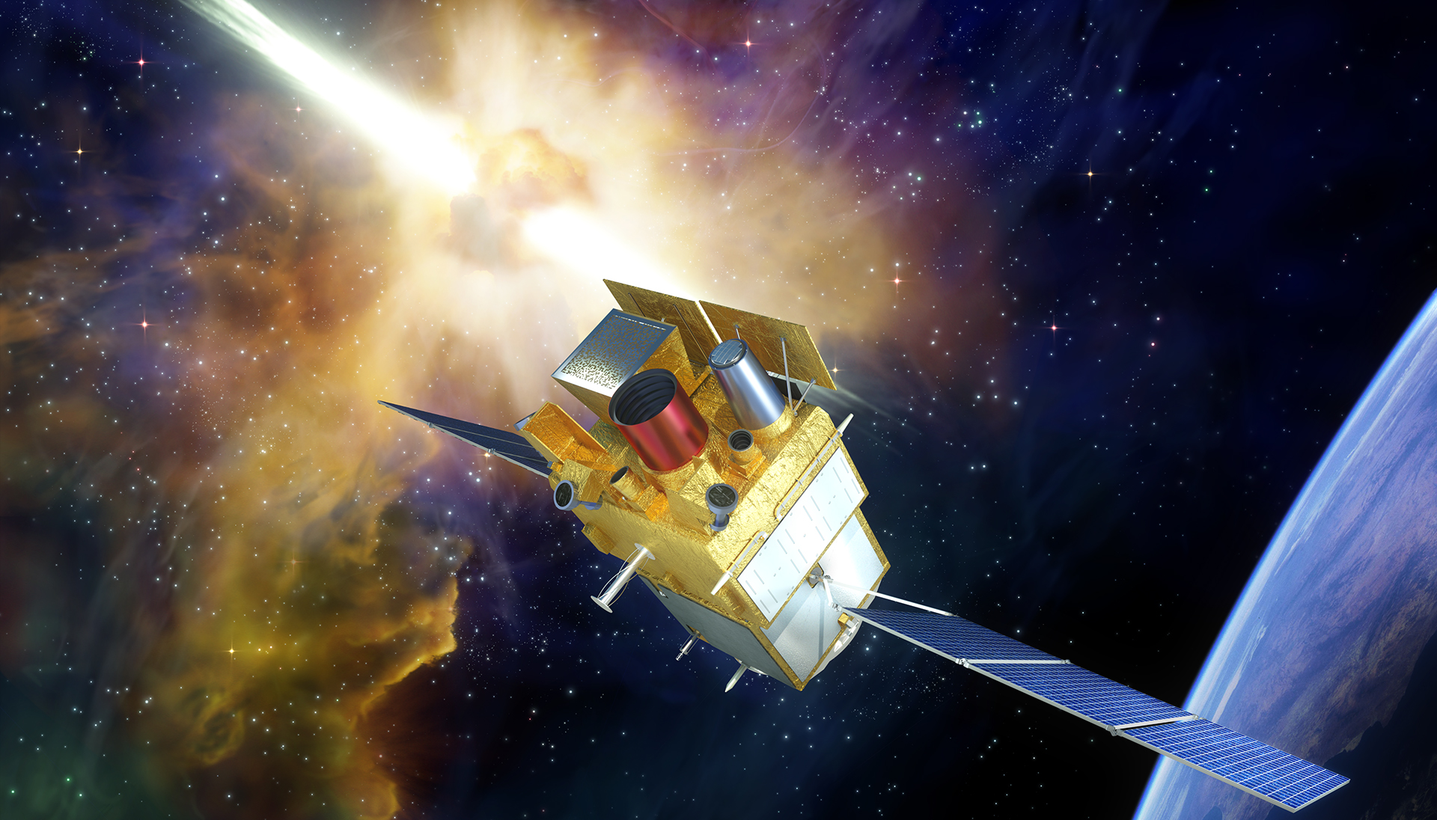








Imaging the hard X-ray sky with the ECLAIRs telescope onboard the SVOM mission
@SVOM_mission
Nicolas Dagoneau (CEA/AIM) 2nd year PhD student

Slide 2
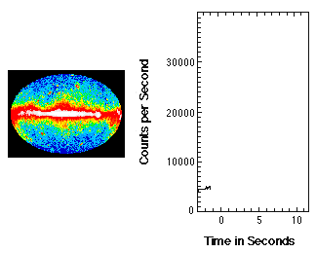
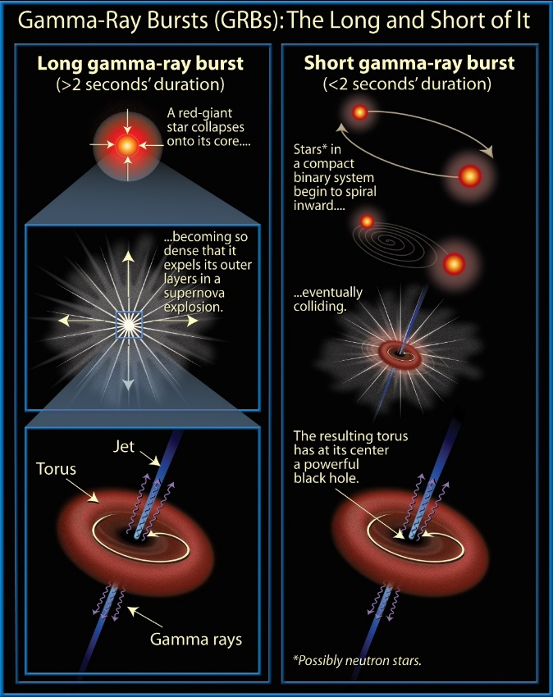
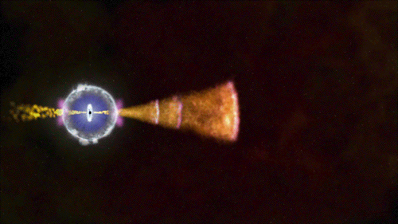

Gamma ray bursts
Gamma ray burst: fast and variable flash of gamma photod, random in the sky. Most energetic EM phenomena.
$E_{γ}∼10^{50}− {10}^{55}erg$ (iso)
CGRO/BATSE GRB
Emission of matter jets: the Fireball model
Internal shocks: prompt emission (gamma)
External shocks with interstellar medium: afterglow (X → radio)
Frédéric Daigne talk
NASA

Slide 3
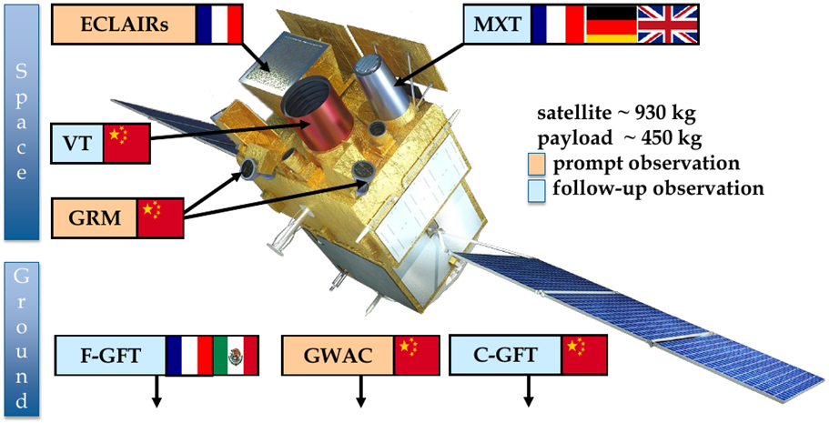
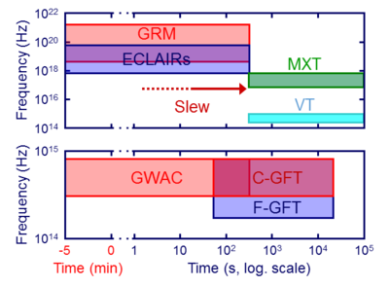
The SVOM mission
Henri Triou talk
Spaced based multi-band astronomical Variable Object Monitor (Phase C)
French (CNES) – Chinese (CNSA/CAS) collaboration
Launch in December 2021 in China (Xichang, Long March rocket)
A multi wave-length mission with space based and ground based instruments
Goal: build a homogeneous sample of GRBs with a good time and spectral coverage and redshift measurement.
White paper: Wei,Cordier+2016 arXiv:1610:06892

Slide 4
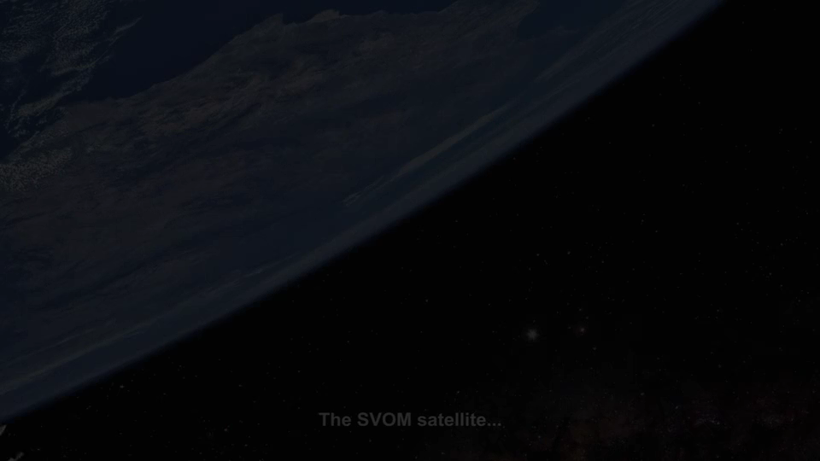
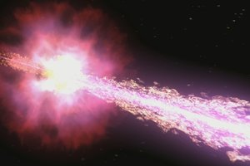



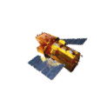

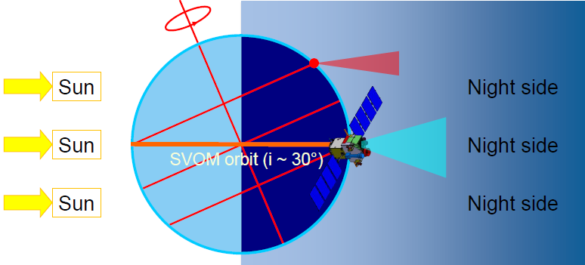



The SVOM mission
Henri Triou talk
T₀=trigger GRB
Auto slew
From space
VHF
From ground
T₀+30s
Other space missions
FSC
Outside SVOM
Inside SVOM
CSC
T₀+5min
T₀+hours/days
Alert Broadcast
Constrains:
Earth in the field of view 66% of the time
South Atlantic Anomaly crossing

Slide 5
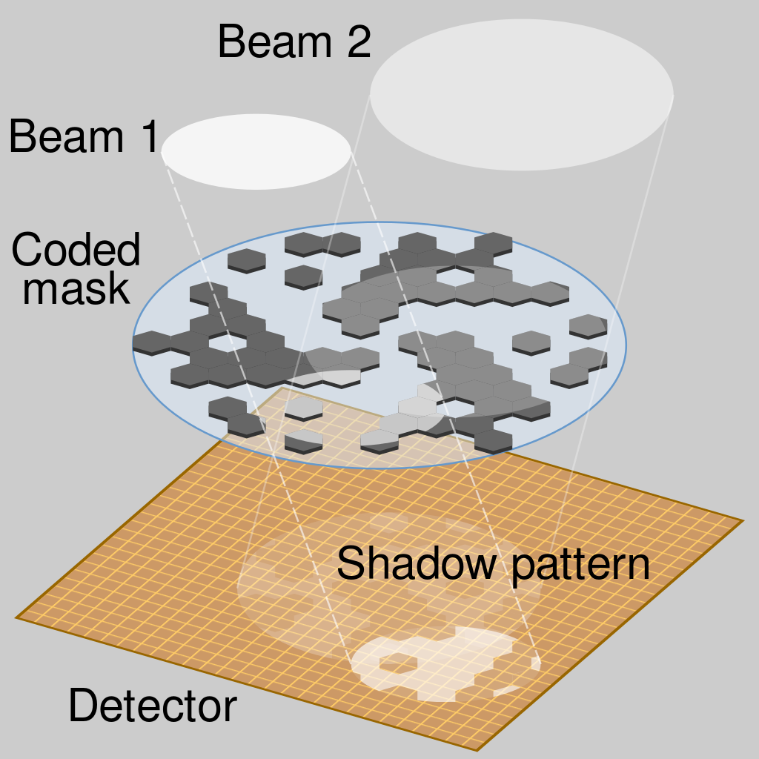
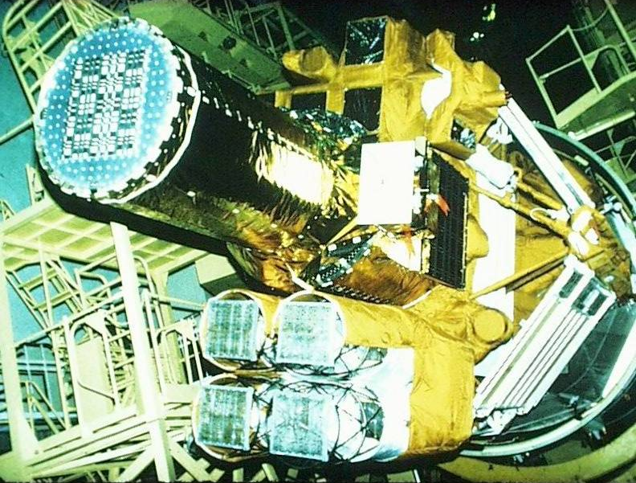
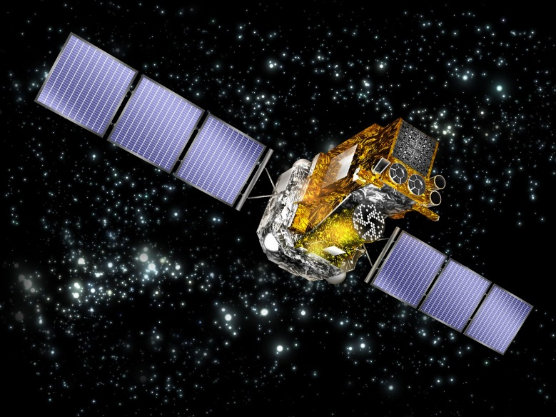
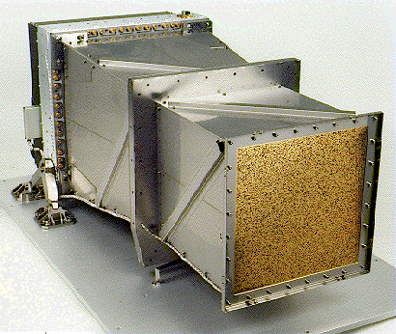


How to detect and localize?
Diego Götz talk
X-ray imaging: use coded-mask telescope (Granat/SIGMA, Beppo-SAX/WFC, INTEGRAL, Swift/BAT, Astrosat/CZTI)

Slide 6
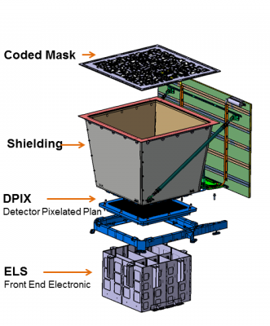
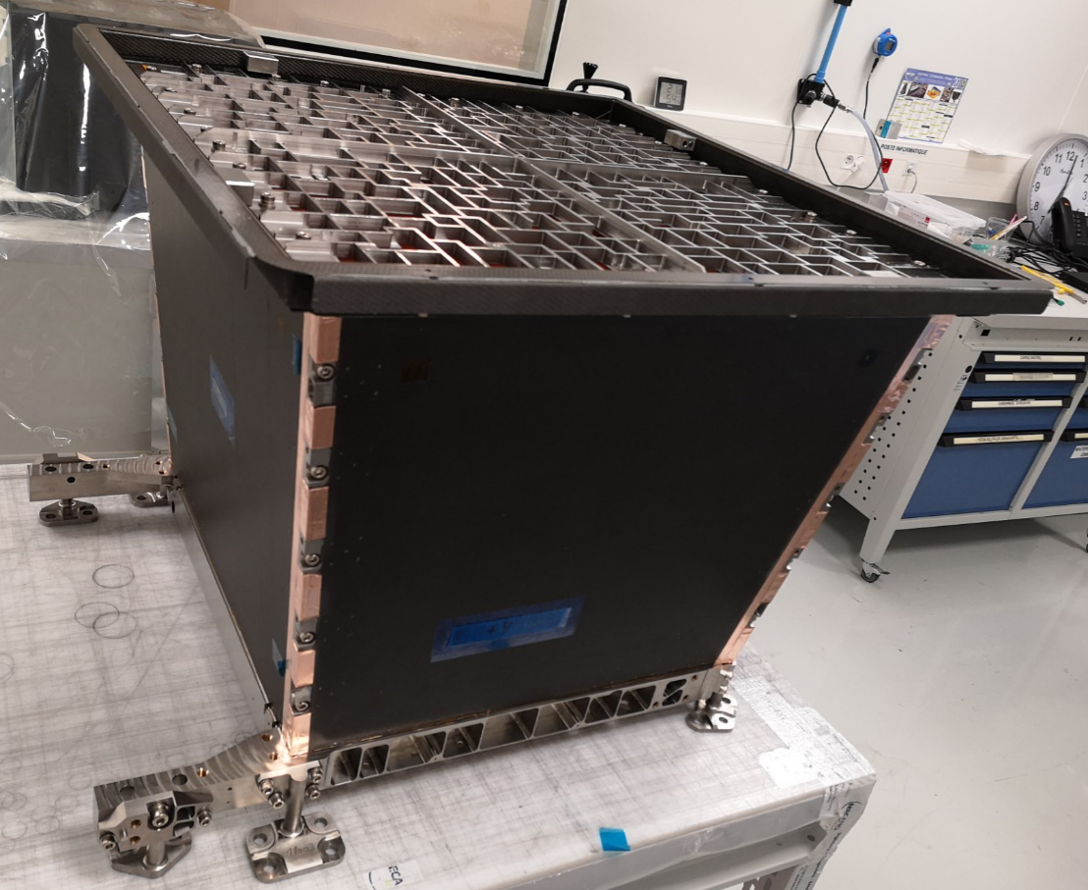
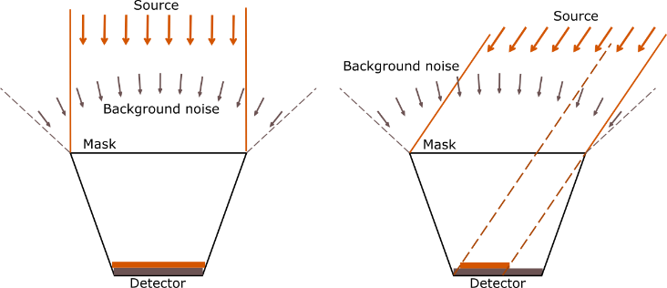
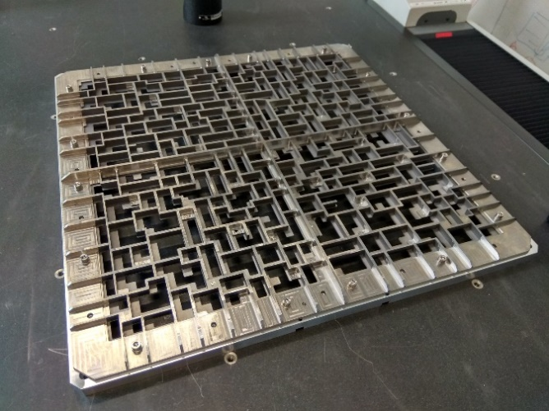
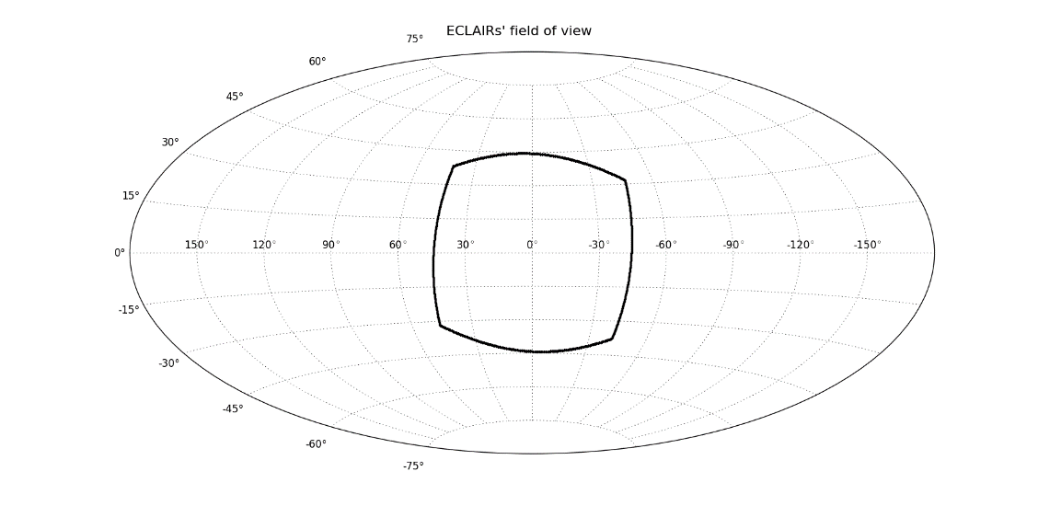
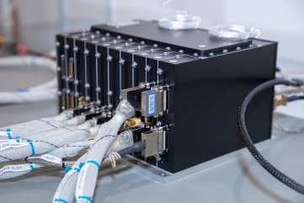
How to detect and localize?
X-ray imaging: use coded-mask telescope (Granat/SIGMA, Beppo-SAX/WFC, INTEGRAL, Swift/BAT, Astrosat/CZTI)
Titanium-Tantalum-Titanium mask
ECLAIRs telescope (4-150 keV)
Localization error < 10arcmin
Field of view: 2sr (~90*90 deg2)
80 x 80 pixels, 1024 cm²
UGTS: Unit for detector manaGement, Triggering and Scientific processing with 2 triggers (Count rate and image triggers)
From detector image to sky image: deconvolution knowing mask pattern (inverse problem)

Slide 7
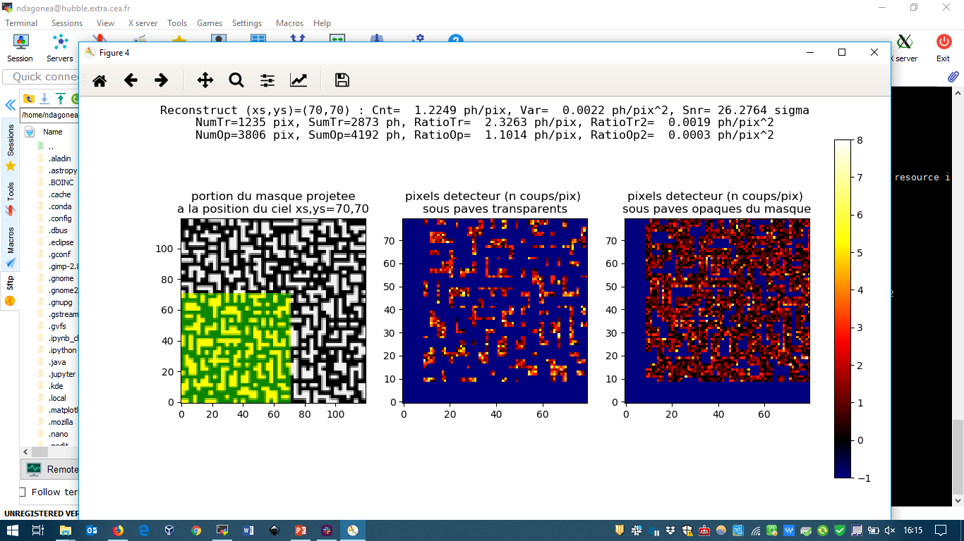
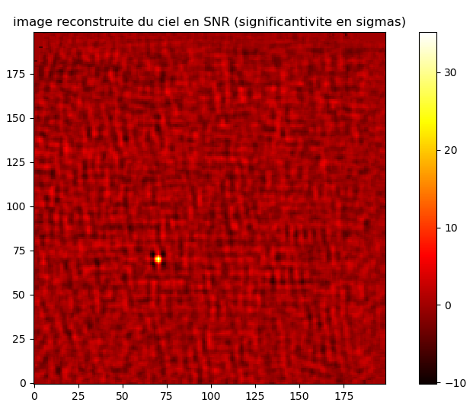
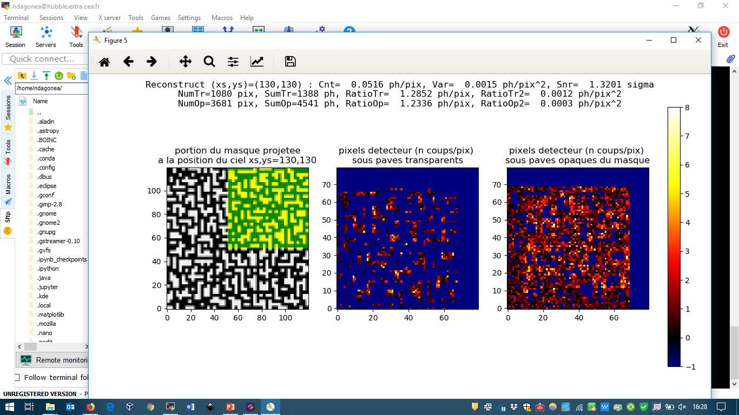
Deconvolution
Under mask holes
(photons seen from position)
Under mask opaque pixels
(photons from other positions)
At the source position
= (Mean( ) – Mean( ) )) / sqrt(Var)
SNR sky image
= (Mean( ) – Mean( )) / sqrt(Var)
At other positions

Slide 8
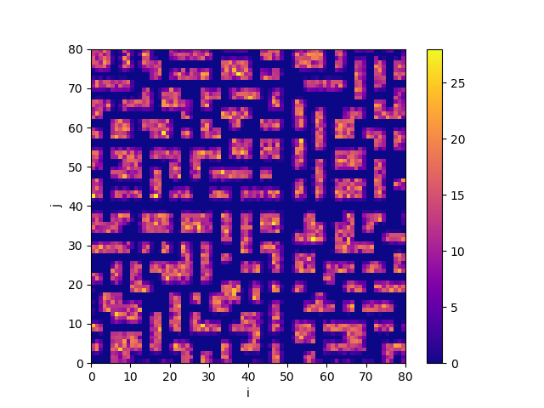
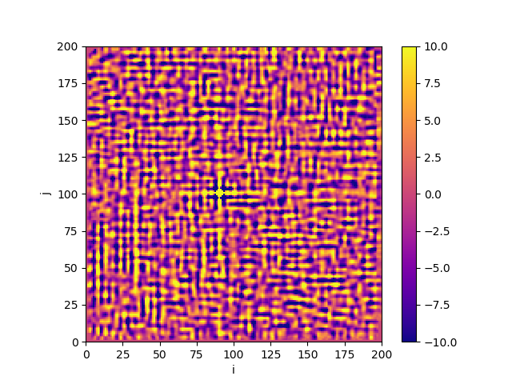
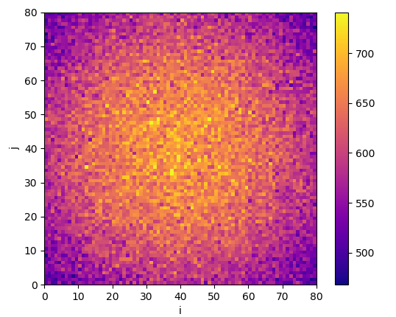
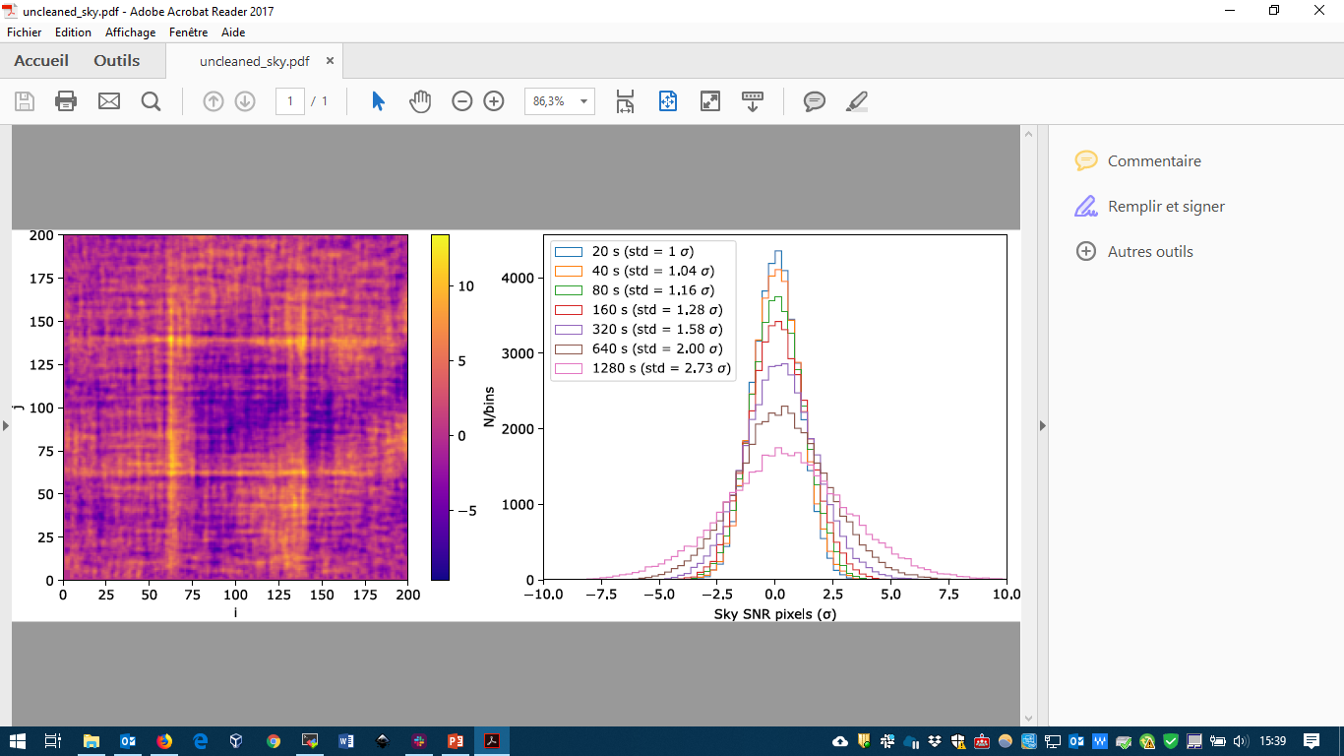
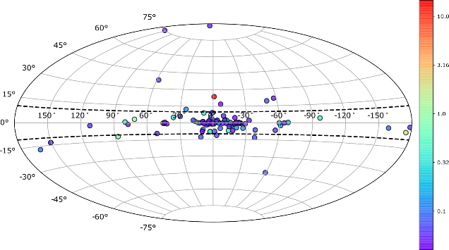
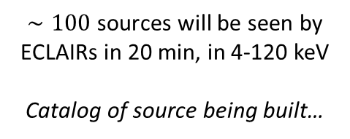
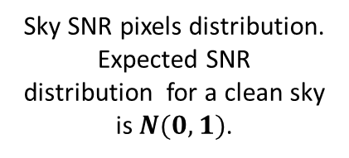
Background: 2 components and 2 effects
Cosmic X-ray Background (Moretti et al. 2009)
X-ray sources
Detector image (1000s) Sky SNR image (64 x 20s stacked)
Detector image (100 ph/cm²) Sky SNR image
CXB: 8.74 ph/cm²/s/sr + internal noise: 0.003 cnt/cm²/s/keV
Bright sources lead to coding noise (ghosts) in sky images → cannot just mask source peaks in the sky
Sky SNR pixels distribution. Expected SNR distribution for a clean sky is $N(0,1)$.
$∼100$ sources will be seen by ECLAIRs in 20 min, in 4-120 keV
Catalog of source being built…
Sujay Mate talk

Slide 9
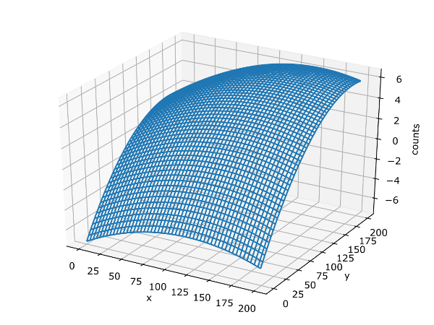
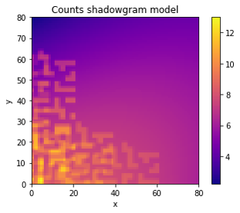
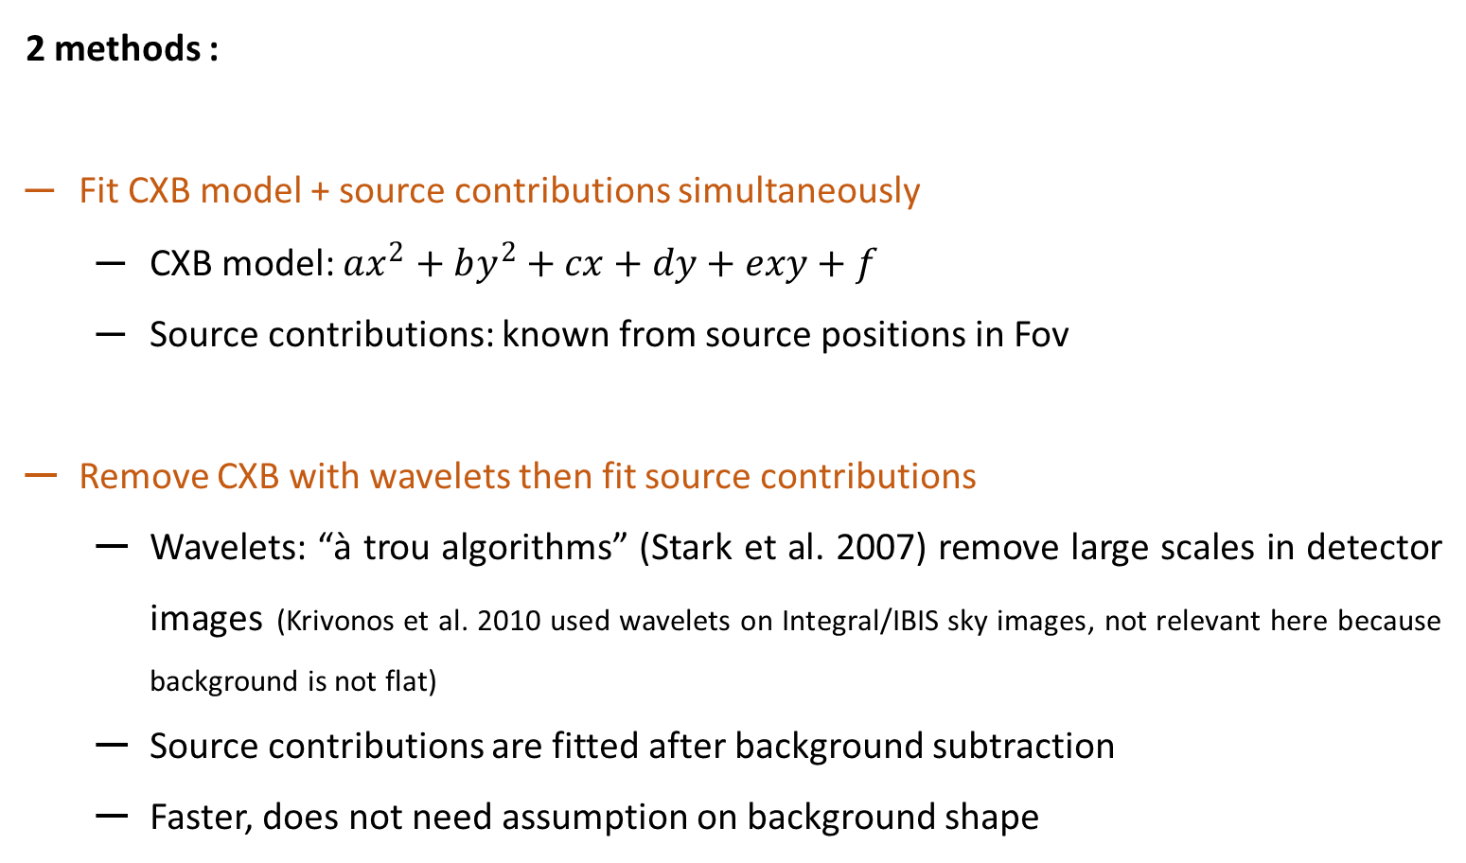
Cleaning background
2 methods :
Fit CXB model + source contributions simultaneously
  CXB model: $ax^{2}+by^{2}+cx+dy+exy+f$
  Source contributions: known from source positions in Fov
Remove CXB with wavelets then fit source contributions
  Wavelets: “à trou algorithms” (Stark et al. 2007) remove large scales in detector images (Krivonos et al. 2010 used wavelets on Integral/IBIS sky images, not relevant here because background is not flat)
  Source contributions are fitted after background subtraction
  Faster, does not need assumption on background shape
Earth in Fov (66% of time) changes the CXB counts shape in the detector.
Example of a fitted model (in counts) with an Earth-modulated CXB + 5 source illumination functions.

Slide 10
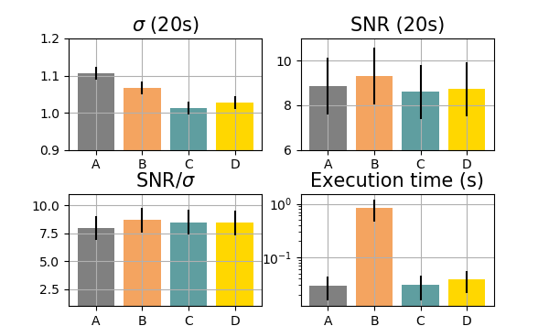
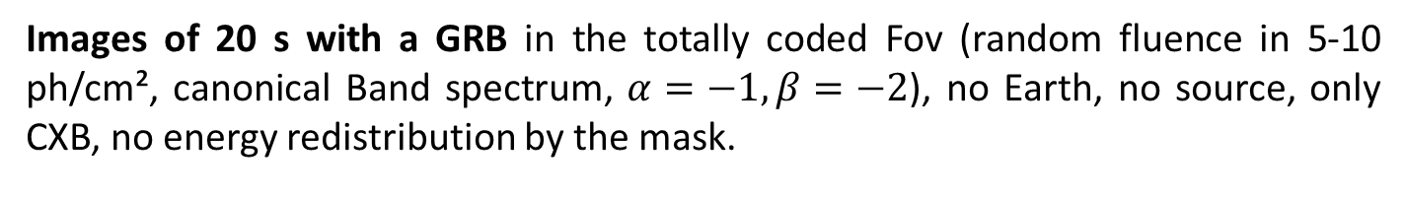
Cleaning background
Preliminary result
Images of 20 s with a GRB in the totally coded Fov (random fluence in 5-10 ph/cm², canonical Band spectrum, $α=−1, β=−2$), no Earth, no source, only CXB, no energy redistribution by the mask.
Methods : performance
Stdev of sky SNR pixel (=1 for a clean sky)
SNR of the GRB
GRB SNR normalized by the stdev of the sky SNR distribution
Execution time increases if additional sources fitted
A: no cleaning B: fit C: wavelets on the detector D: wavelets in the sky

Slide 11
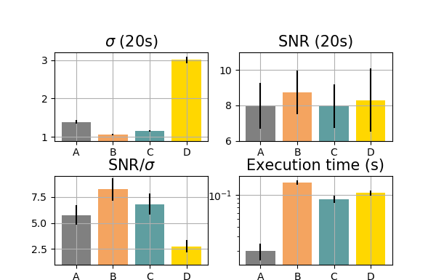
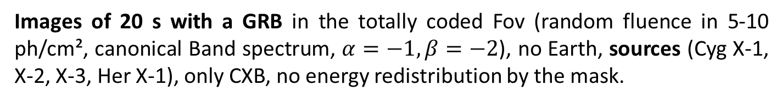
Cleaning background
Preliminary result
Images of 20 s with a GRB in the totally coded Fov (random fluence in 5-10 ph/cm², canonical Band spectrum, $α=−1, β=−2$), no Earth, sources (Cyg X-1, X-2, X-3, Her X-1), only CXB, no energy redistribution by the mask.
Methods : performance
Stdev of sky SNR pixel (=1 for a clean sky)
SNR of the GRB
GRB SNR normalized by the stdev of the sky SNR distribution
Execution time increases if additional sources fitted
Currently tuning wavelets parameters (number of scales to remove, size of the filter)
A: no cleaning B: fit C: wavelets on the detector D: wavelets in the sky

Slide 12
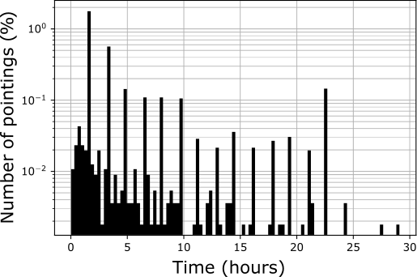
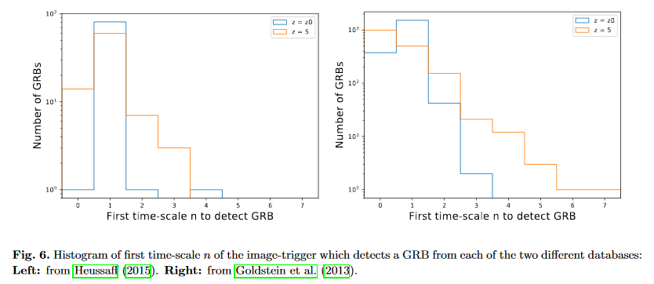
ECLAIRs: opening a discovery space for Ultra-long GRBs
ECLAIRs allows long pointing durations (up to 1 day) which may help to monitor transient events on long timescales.
Classical long GRB are detected on smallest scales of the image trigger, no detection from 160 s up to 20 min for Goldstein sample at z = z0 (arXiv:1810.12052).
Difficult to really define duration of such GRBs and simulate their detectability (only few events, all different … )
Simulation of Swift GRBs through ECLAIRs image trigger prototype. Most GRB are detected in 20s image.

Slide 13
Conclusion
SVOM/ECLAIRs can image the X-ray sky thanks to coded mask and deconvolution
Image processing (fit of the background model or wavelets + fit of known sources)
  Methods are being implemented on the UGTS
  Performances will be tested with a more detailed background model (albedo, reflection… )
ECLAIRs may be useful to detect long transient (such as ultra long GRBs)

Slide 14
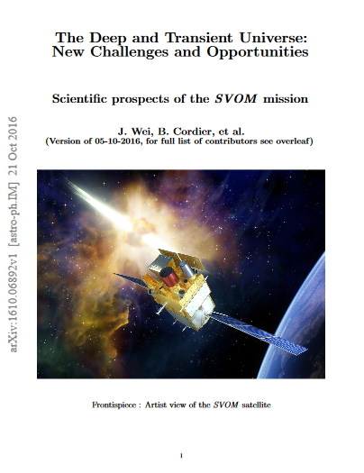

Thank you for your attention!
On Twitter @SVOM_mision
Mission white paper
svom.fr/en

