Slide 1
Univers 2.0 Funded by the Carasso Foundation
The aim of this project is to initiate an exploration, through a cross-reflection between artists and scientists, of the field that began with the recent discovery of gravitational waves, urgently questioning again:
the nature of space and time,
their texture and their relationship with the objects “within”
the notions of origin and horizon,
the role of information circulating in the Universe and its conservation or loss,
the role of the human as observer and/or perturbator, more generally the nature of our embedding in the cosmos.
In short, the overall image of a Gravitational Universe or Universe 2.0.

Slide 2
ARGO actions
Open Schooling, Teacher Trainiing
Citizen’s science
Gender
Embodied intelligence Craftmanship vs Robotics
Art and Science Univers 2.0
The global dimension of art and science
Critical
Thinking

Slide 3
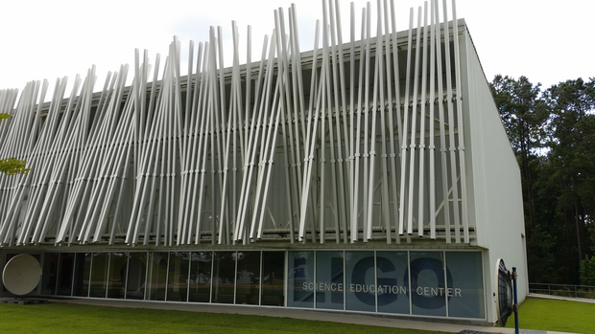
Univers 2.0 Final products*
An exhibition for 2019 in France and/or Italy ? (100th anniversary of the announcement of bending of light after Arthur Eddington’s eclipse measurement)
An open space exhibition here in EGO/Virgo or in association with a visitors centre as in LIGO’s Science Education Centre ?
Residences
Conference
Book
Film
Site
* In association with ArtSciLab and Leonardo, Museo de la Grafica, Musée des Arts et Metiers, Academia delle Arti del Disegnio, Caixa Foundation, Evgenides, Tuscany Region, City of Paris…, INFN, CNRS, NIKHEF, Hungary, Poland,, …

Slide 4
Possible themes (working groups)
Thought experiments as precursors for both art and science. (Democritus, Archimedes, Galileo, Newton, Einstein). Thales and geometry, Anaximander and the apeiron, Anaximenes and condensing or rarefying air, Pythagoras and the Harmonious Universe breathing in the void to separate the objects , Plato and Aristotle, the 4 elements and quintessence, the sublunar, the « horror vacuum », Democritus the different vacua , the atomos idea…Relativity and the continuum of symbolic forms (Weyl, Cassirer, Bergson, Reichenbach).
The medium is the message and/or the object. The genealogy of current notions of space-time: Galileo/Newton inventing the vacuum, space and time. The Moon and the telescope. The invention of the point of view by perspective , its role in the Galilean revolution and its negation in the formulation in the developments of modern physics (an art). The metaphysics of light till Goethe and Newton. Mawxell and Hertz, filling the vacuum with the electromagnetic field. Einstein and the new geometries deforming of space-time, dark matter and energy. What happens inside air. Annunciations and Ascensions in Renaissance art. Fields and particles, the quantum field theory: the field and the particle complementary descriptions depending on conditions (Higgs). Is space and time an an « aspect » of things, it is emergent in the relationship? Textures and plasticity of a medium or an object.

Slide 5
Possible themes (working groups)
Feeling the environment. The notion of Atmosphere (Stimmung). The paradoxes of the horizon, black holes. The Sublime and the Beautiful, the locus of sense and conscience, synaesthesia. Bioluminescence in the deep ocean. The New sublime. Multimessenger environment. What are the current possibilities of cognitive and emotional insertion of the human in the cosmos ?
Representations and measures. Rods/stics and asrtistc lines . The deformability of the medium imposes stardard rulers in science (étalons, Virgo) and representation media in art: stones, papers, painting, music, performance... When does the inflexibility and plasticity transforms an object to a measuring device (Rigid rods and flawless clocks) ? When does it transform it to a representation medium (stone, plaster, engraving (the line of Galileo), photography, digital media).
Embodied intelligence. Robots Artists and Scientists. The issue of robotics vs. craftsmanship. « The day that machines will know how to weave we will not need slaves anymore » Aristotle (inventor of the word automaton) The medium is the message. Can we treat people and the information in society as a unified field ? (agora, radio, television, internet). Creation of value. Mechanics and the creation of value. How value is created in the data age?
The dialogue between the two large systems à la Galileo: art and science and the image of the thinker, stereotypes, methaphores, allegories..The solitary versus the group, man vs women….,

Slide 6
What did we learn ?
The GW revolution and Virgo as a standard ruler
The artists of the group quite advanced in their Univers 2.0 contribution, need to decide site to make it more concrete (Lilian, Attila, Gorka, Raymond, Raphael, Letizia) also Thomas..
Links with
theory/philosophy (Heinz, Celine)
Textures (Eleni)
craftmanship/machine/graphics issues (Yves, Arnaud, Stephen)
cognitive aspects (Alain)
embedding in a larger societal context (Roger, Yves, Stavros)
Lessons from past exhibition experience (Roger, Yves, Alessandro, Vincenzo)
What next ? First steps:
Produce a strawman plan based on the presentations and discussions
Working meetings between subgroups ?
Next important date :
ARGO news ca 10-15 July
When do we meet ? July or September ?
Increase interface with ArtSciLab
We can support some residences, but also need to keep funds for the other possible actions. Volunteers for APC or EGO ?
Start talking to museums ? Pisa, Paris, Rome, elsewhere ?
Open space installations in EGO/Virgo ?
The Gravity platform

Slide 7
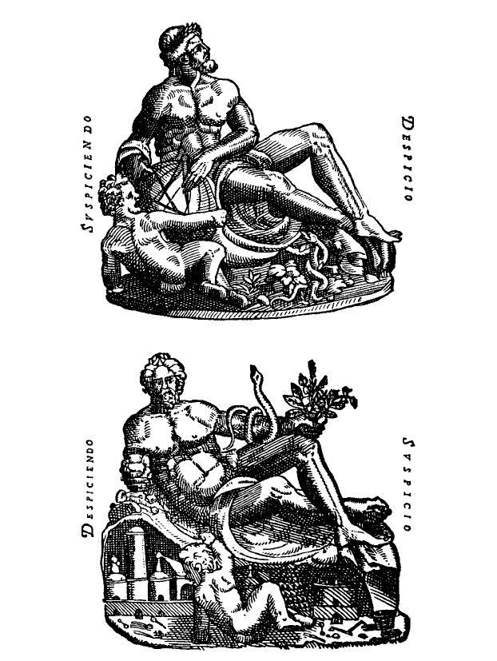
The 3 notions of the word Cosmos, Mundus, Monde, Mondo.
Universe
Society
Earth
Experiencing a « multimessenger » revolution in all three
Ainsi cosmos signifie-t-il en même temps parure et toute splendeur en général; univers ou totalité des êtres et constitution politique fondée sur la loi; principe d’ordre et d ’harmonie qui règle aussi bien les rapports entre les êtres qu’entre les éléments de chaque être; vertu ou bien immanents à chaque être et lui permettant de devenir ce qu’il est et de se maintenir tel qu’il est K. Papaioannou
From the frontispiece of
Tycho Brahe’s Uranienborg
Each time one of the other components are forgotten ideological « monsters » are produced : technocratic science, religious ecology, polluting economics

