Slide 1
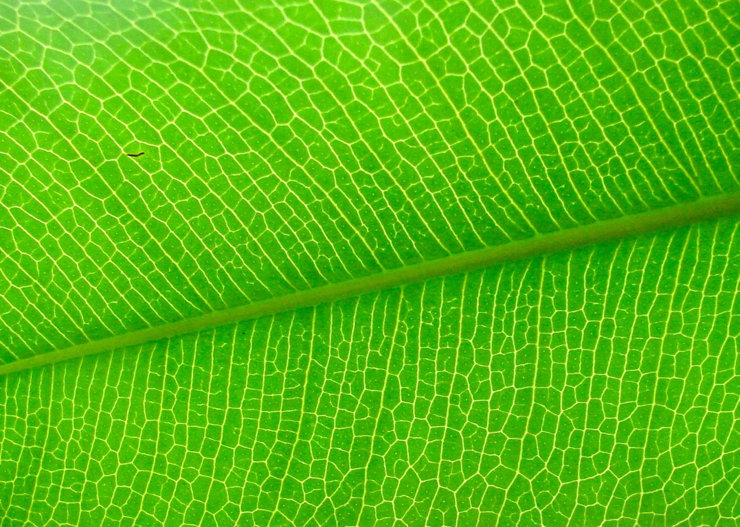
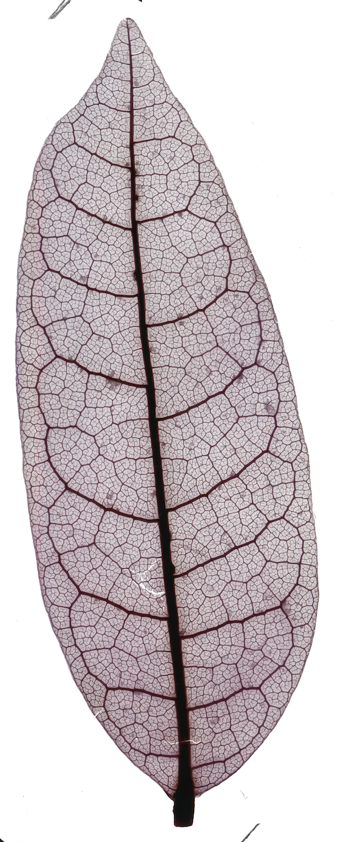
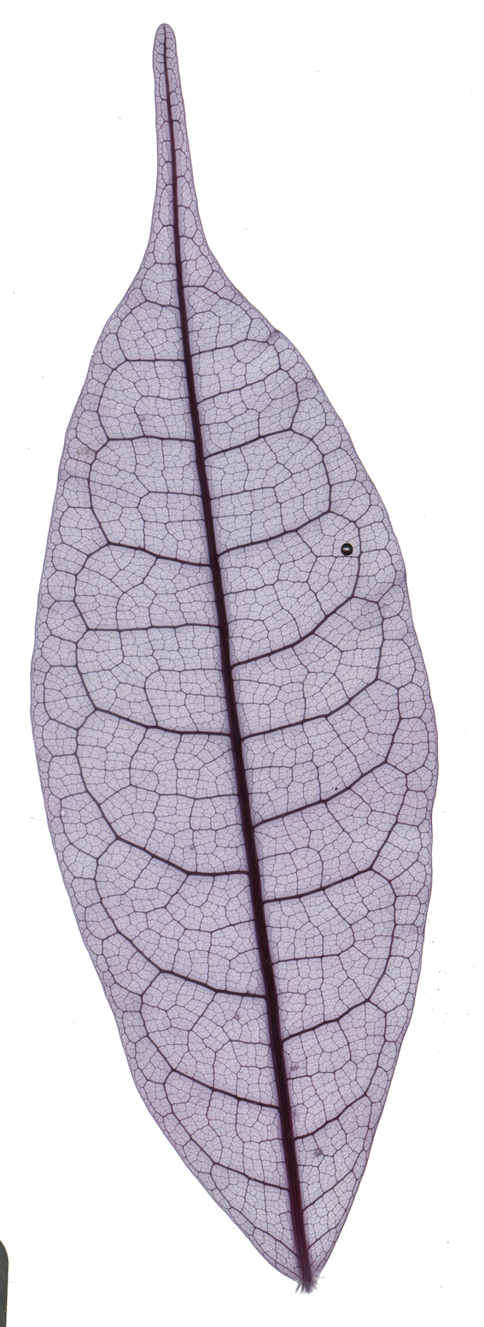
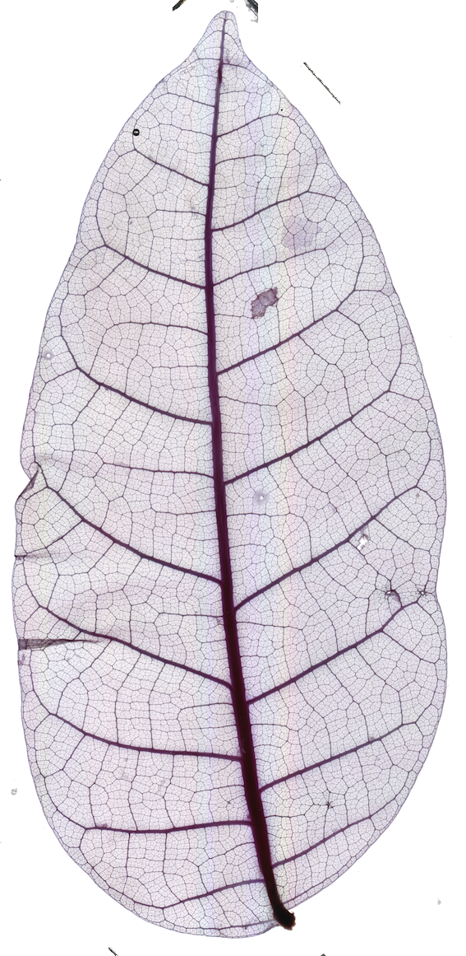
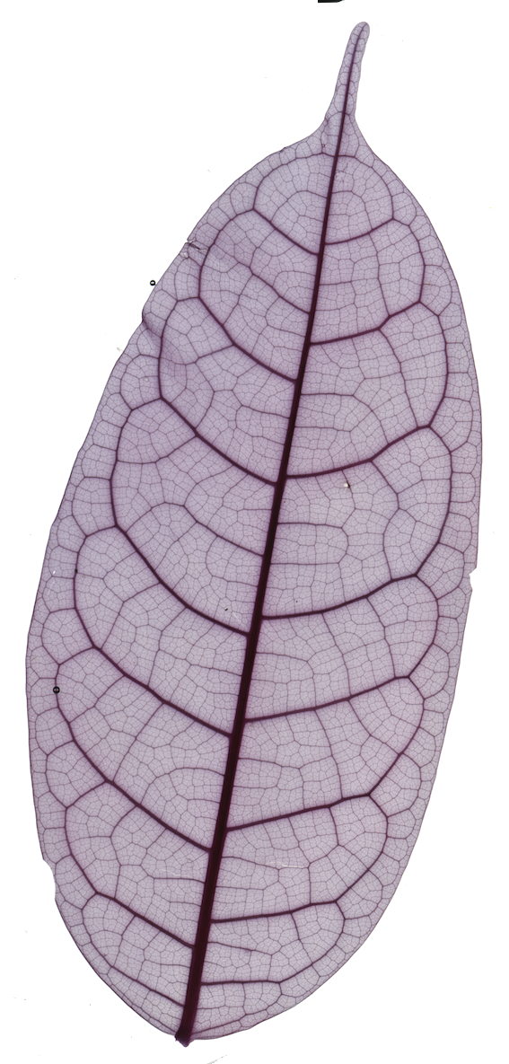
Textures
in nature
Eleni Katifori
Department of Physics and Astronomy, University of Pennsylvania
Notes:
Hi… thank the organizers

Slide 2
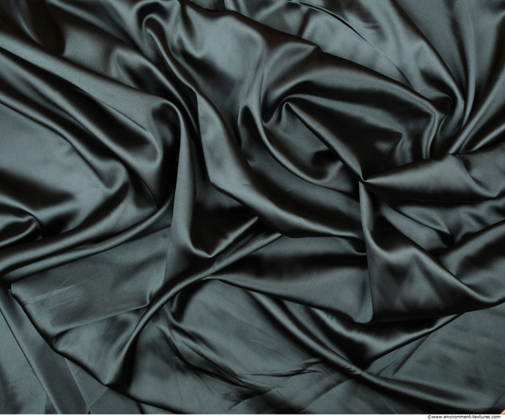
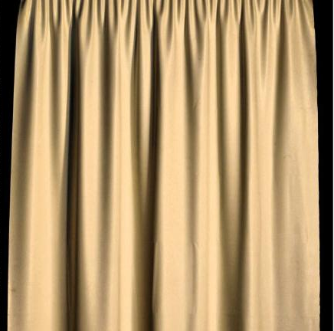
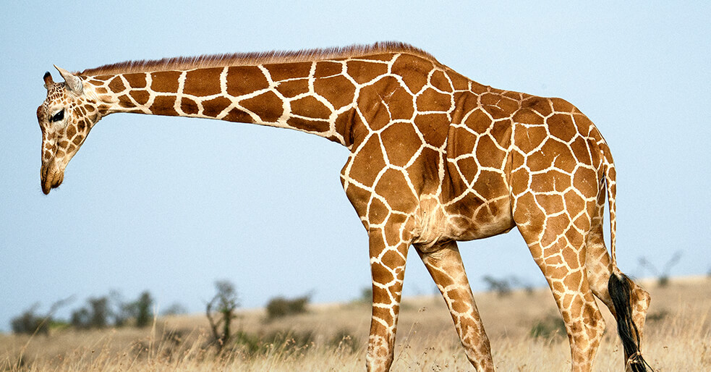
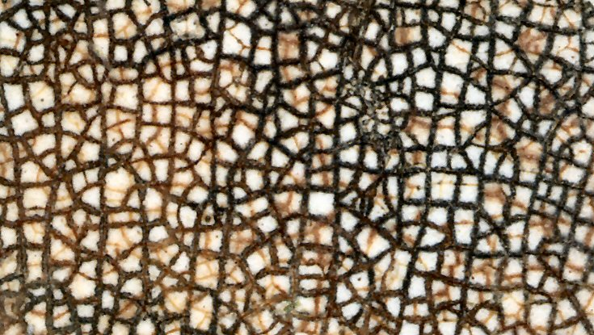
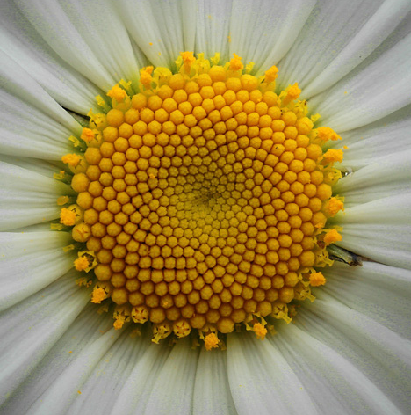
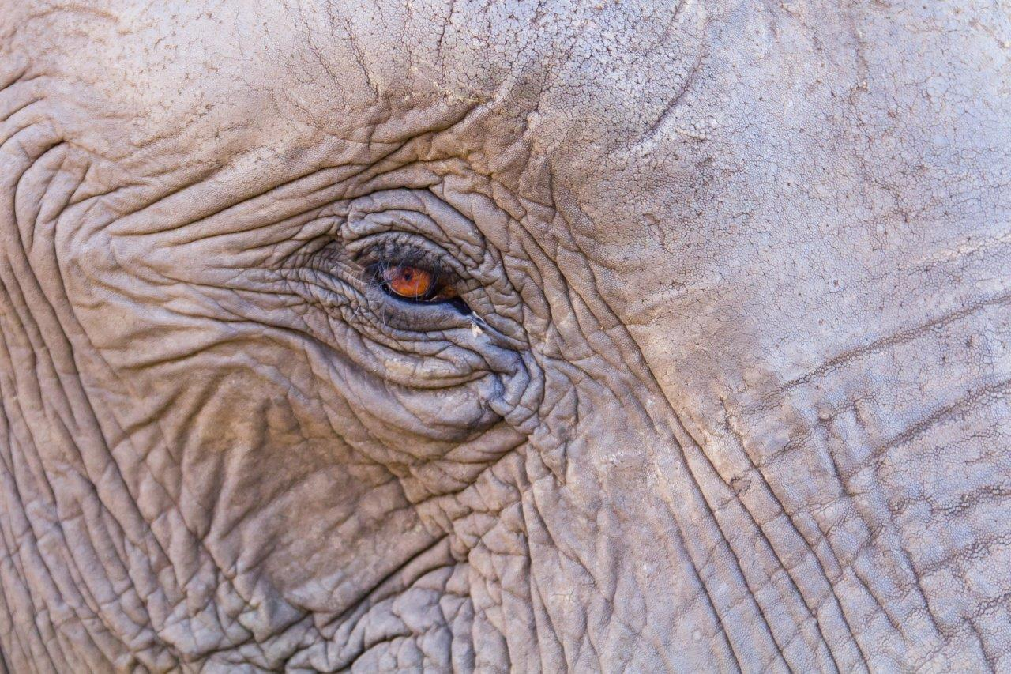
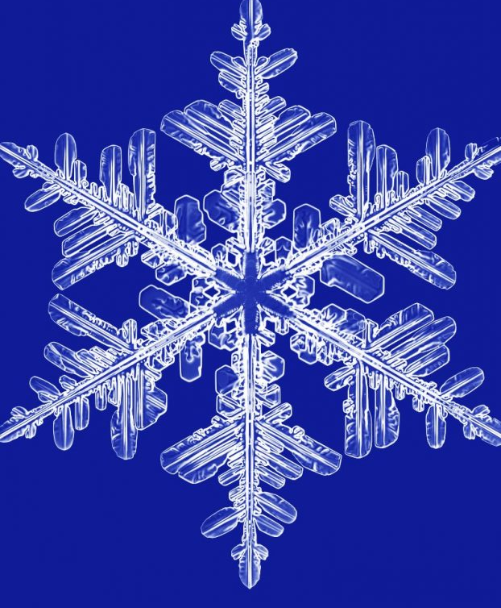

Slide 3
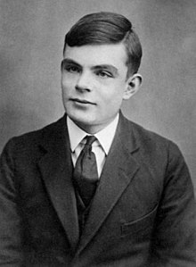
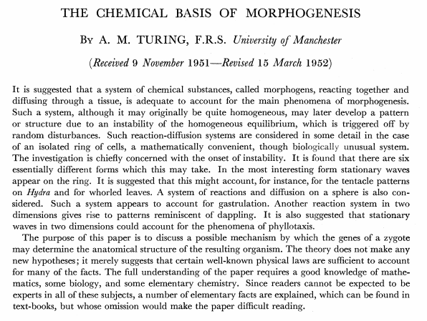

Slide 5
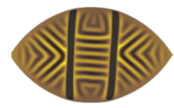
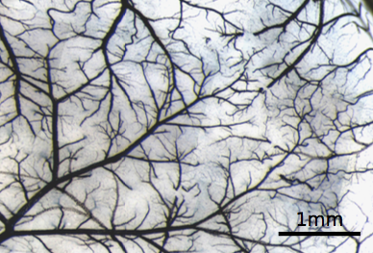
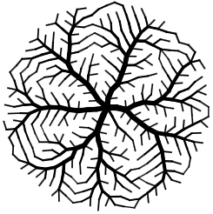
Textures in nature
Wrinkles
Pattern formation on curved shells
Veins
Self organization in vascular systems

Slide 6
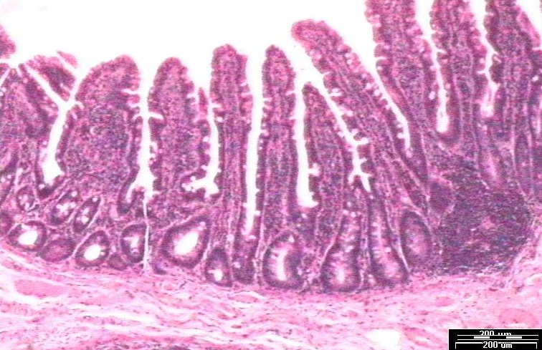
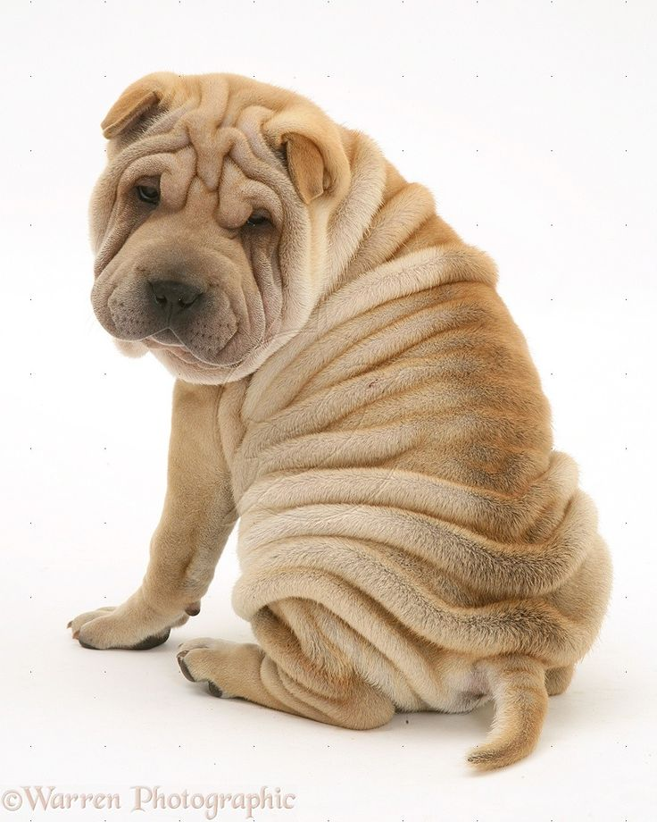
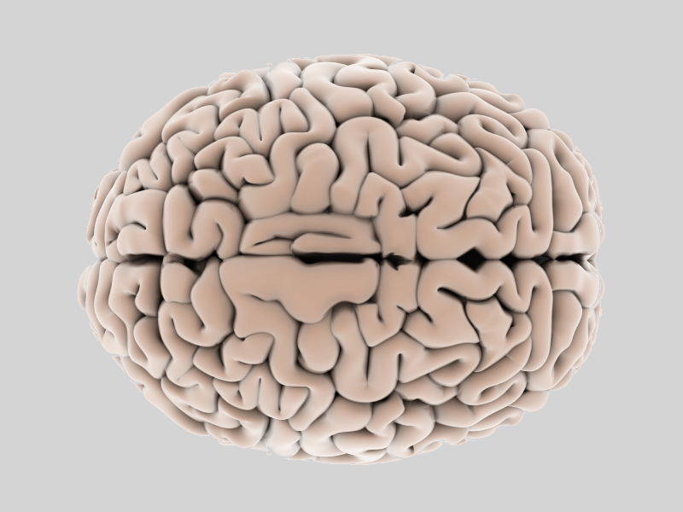
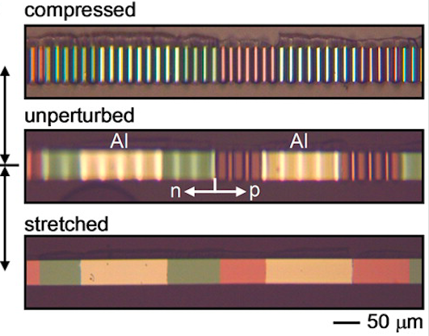
But why do we care about wrinkling?
Pattern formation in nature and in the lab
Flexible electronics, microlens arrays, micropatterning, etc
Notes:
Flat sheets under confinement/load have a very rich phenomenology, very well studied, in many contexts, both as freestanding (in quotes, meaning without a substrate) and supported by a liquid or solid substrate. Ridges, d-cones, drapes, origami, wrinkling, wrinkling to folding transition and many many more have been extensively studied - but in basically all of these cases, the methodology has relied on the fact that the thin sheet was of zero gaussian curvature, geometrically flat.
2:18

Slide 7
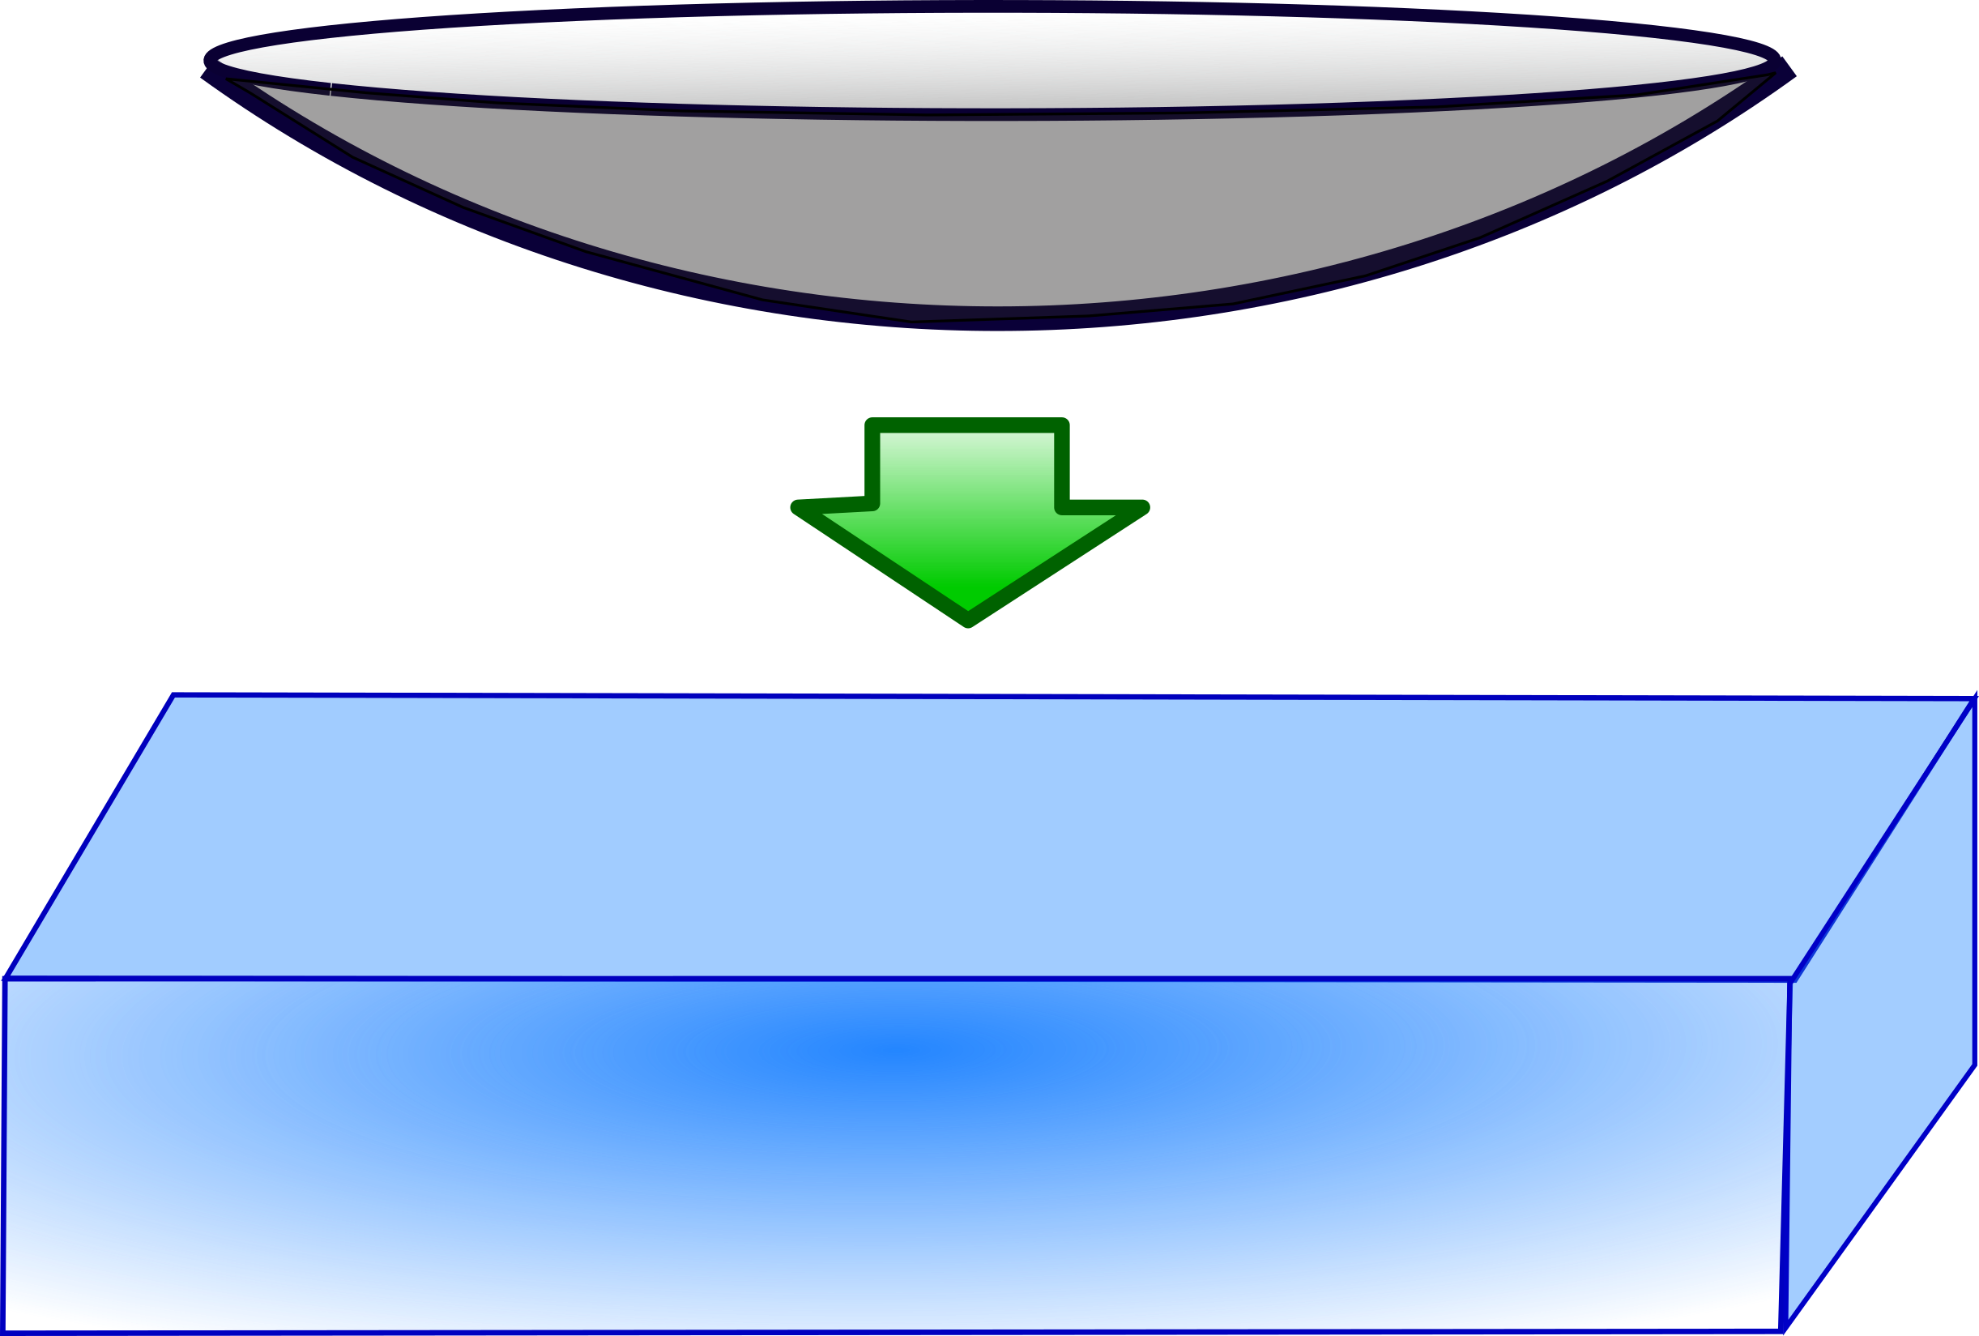
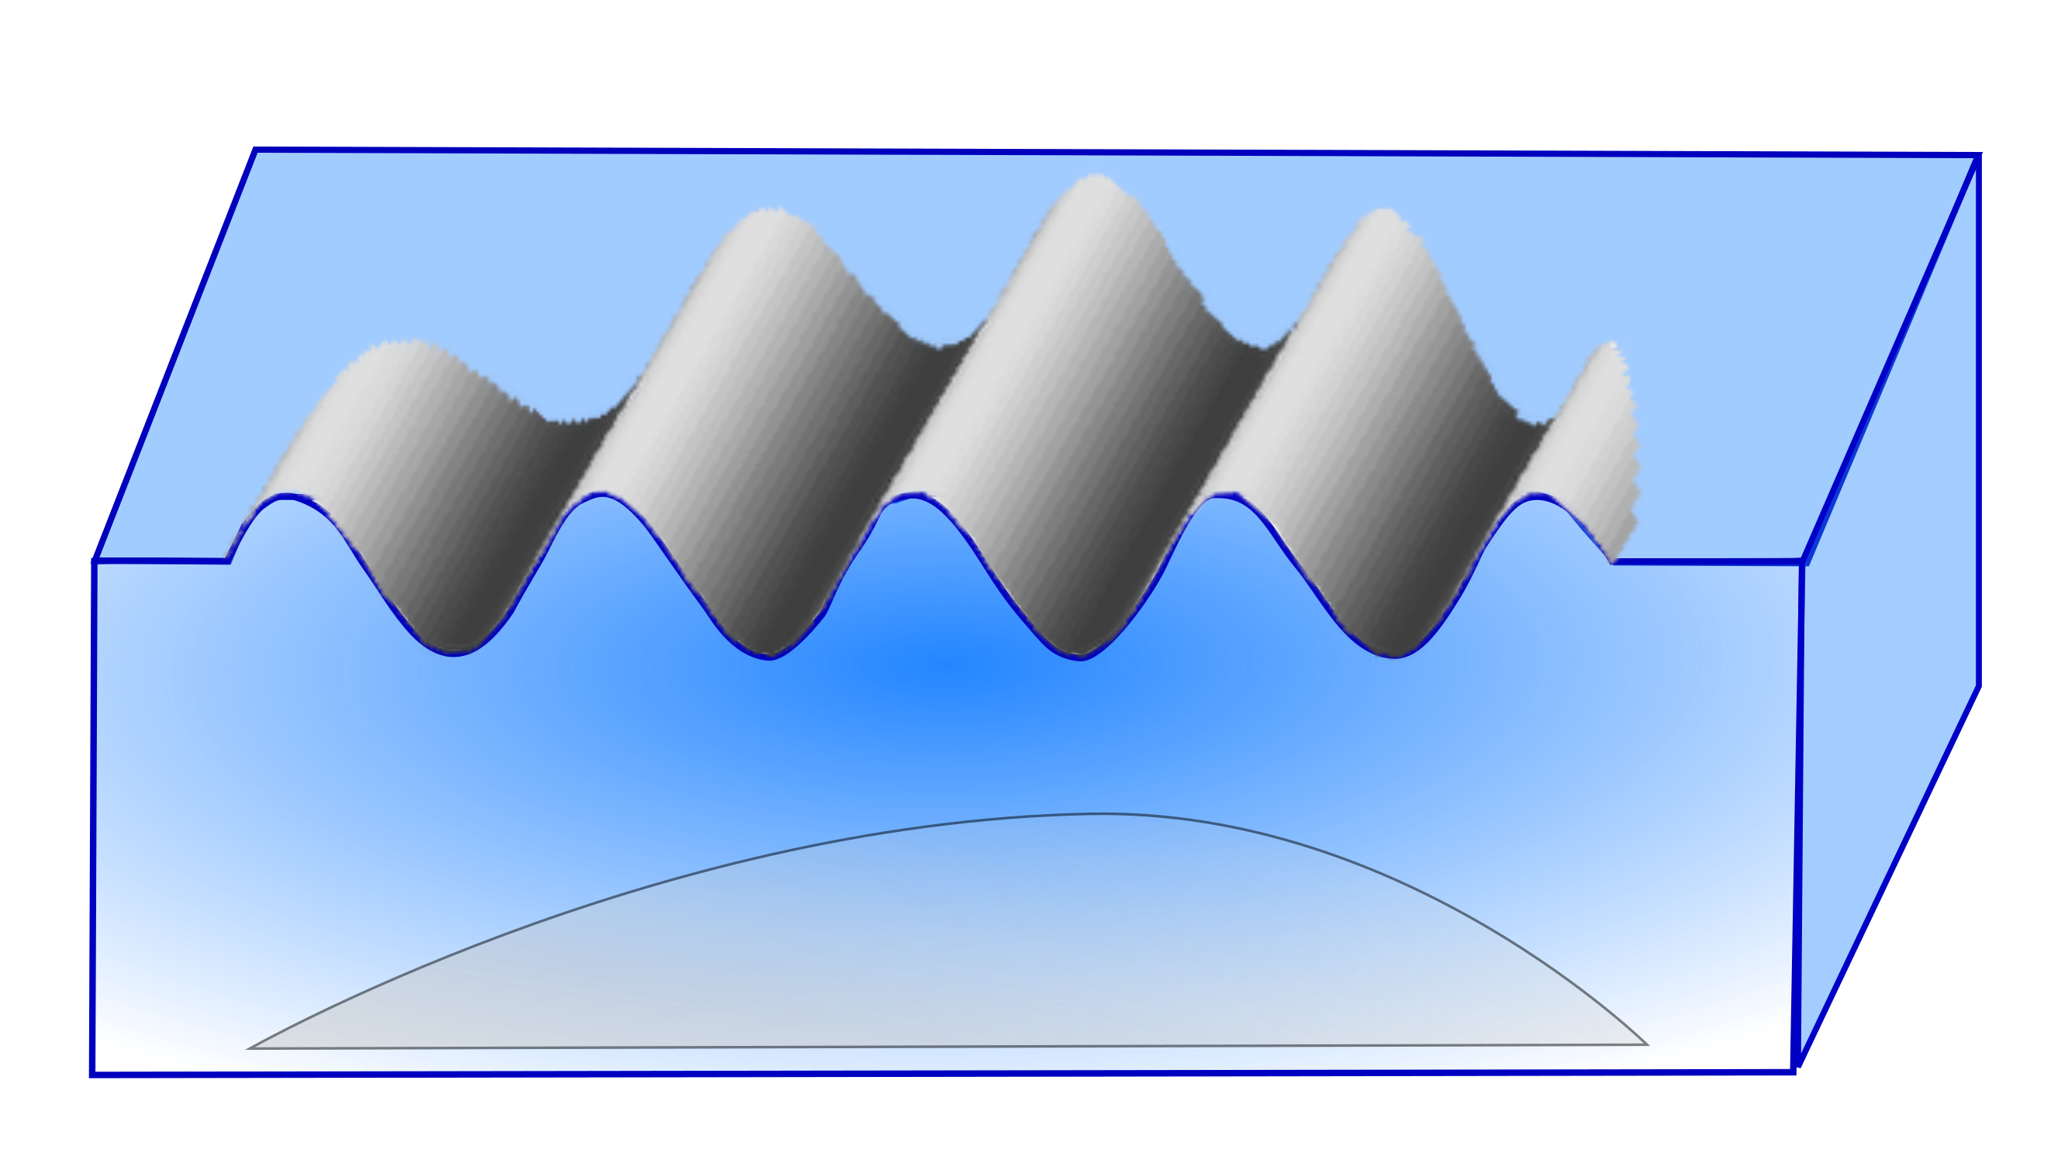
Excess area as effective confinement
Flat
Curved
Effective lateral confinement to accommodate excess area
Lateral compression of sheet
Notes:
In fact, this is not surprising, at the geometric incompatibility ….

Slide 8
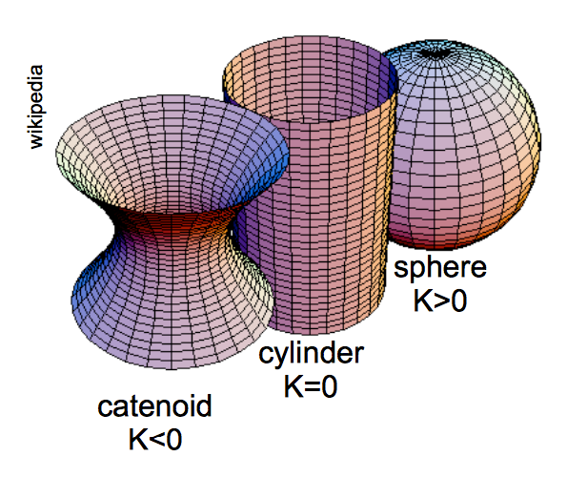
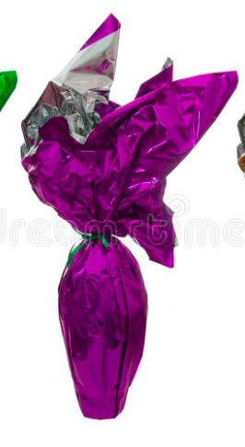
The physics in a (nut)shell
Bending energy
Stretching energy
Conservation of gaussian curvature (Gauss theorem)
Thin shells
stretching becomes energetically unfavorable
deformation by pure bending modes
Geometry!

Slide 9
A simple problem turned not so simple
Flat sheet on curved substrate
Curved sheet on flat substrate
?
King at al, PNAS 109 (2012): 9716
Notes:
Ever since this work, where … we have been wondering what would happen if we did the opposite, deposited a curved sheet on a fluid substrate. So, Octavio Albarran in Goettingen started performing these experiments by … We were expecting something like this, but instead we saw something that like this was the more stable configuration, especially for thinner shells..

Slide 10
A zoo of shapes
Octavio Albarran
(MPIDS)
Notes:
In fact, as we varied dimensions, thickness, width, radius of shell we quickly discovered that we could produce a zoo of wrinkling configurations, the majority of which is dominated by straight wrinkles, like the ones that we would see if there was lateral confinement of a flat sheet.
15:52

Slide 11
A zoo of shapes

Slide 12
Wrinkles
R: radius of curvature of spherical shell
t: thickness of shell
λ: measured wavelength
τ: specific thinckness (bendability)
Λ: elastica length scale
Is it like the geometrically flat case? Is stretching insignificant?

Slide 13
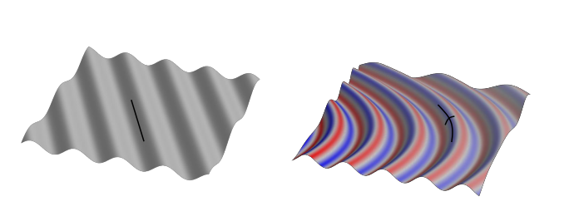
Bending of wrinkles
Wrinkle bending is unfavourable
Oscillating contribution to gaussian curvature
introduces stretching and penalises bending of wrinkles
Notes:
Wrinkles want to be straight … analogy with smectics
Patterns are arranged in domain walls
ADD MORE FROM HILLEL’S THEORY

Slide 14
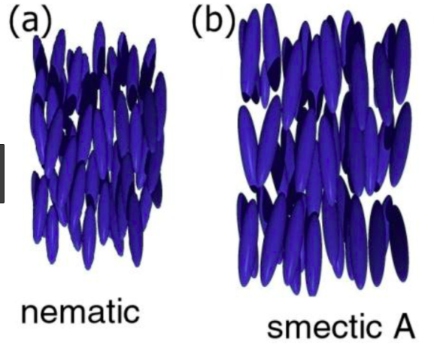
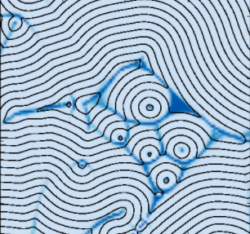
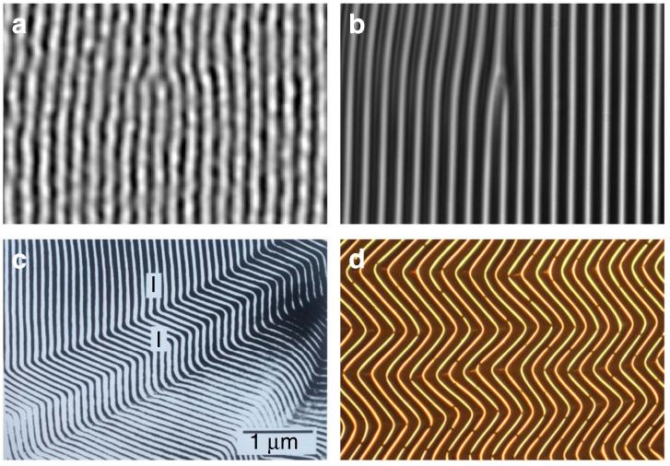
Interlude: Smectics
Level sets of a phase field φ
Diblock copolymer melts
thin sheets on soft substrates
Smectic energy
dislocations
Ground state
spacing
Herringbone patterns
Compression modulus
Bending
modulus
Notes:
In fact, this is not surprising, at the geometric incompatibility ….

Slide 15
Wrinkles
Minimizing elastic+substrate energy
shallow shell and small deformations
radial
hoop
elastica wavelength
intrinsically curved shell ~ flat sheet that is prestressed
curvature acts as effective confinement

Slide 16
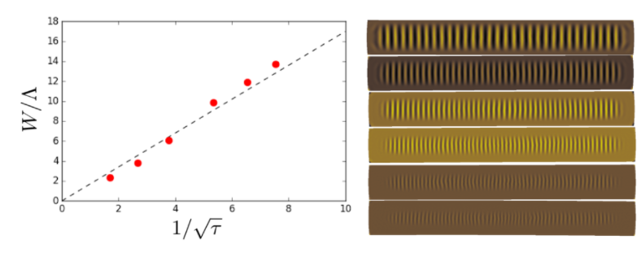
Wrinkles
W: width of flat region
τ: specific thinckness (bendability)
Λ: elastica length scale
W
Not a surface tension effect

Slide 17
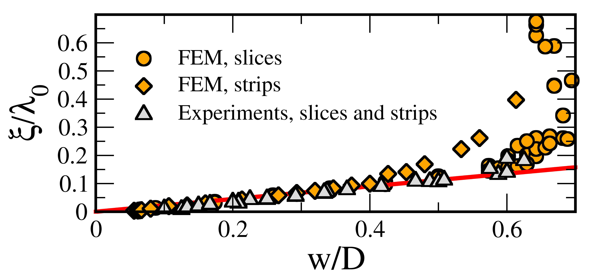
Folds
Maximum amplitude
W
ξ
ξ

Slide 18
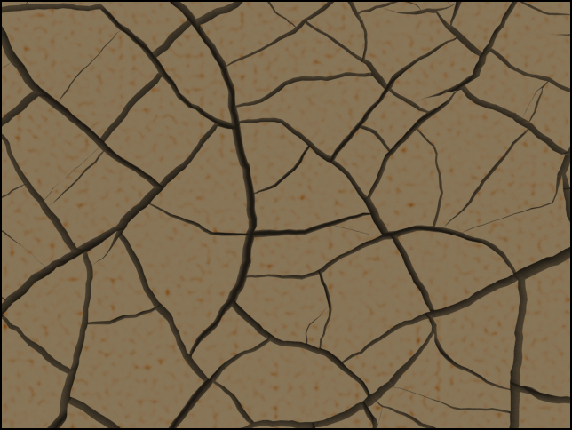
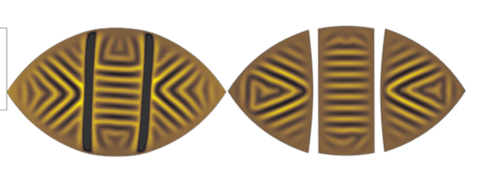
Folds
Folds act like anti-cracks

Slide 19
Dimples
Longitudinal cross sections
wrinkles
W
dimples
no longer sinusoidal
cylinders

Slide 20
Classifying the shapes
Order parameter: deviation from sinusoidal
folds
wrinkles
dimples
cylinders

Slide 21
A zoo of shapes: the exotic species
variable curvature
holes
stiff regions
shape of cuts

Slide 22
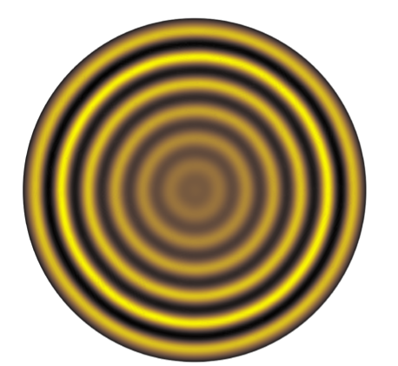
Summary
Wrinkling of curved shells supported by a fluid substrate
First step towards understanding the building blocks of the complex landscape of surface patterns: wrinkles and their lengthscale, folds, dimples etc
Geometry driven transitions

Slide 23
Textures in nature
Wrinkles
Pattern formation on curved shells
Veins
Self organization in vascular systems

Slide 24
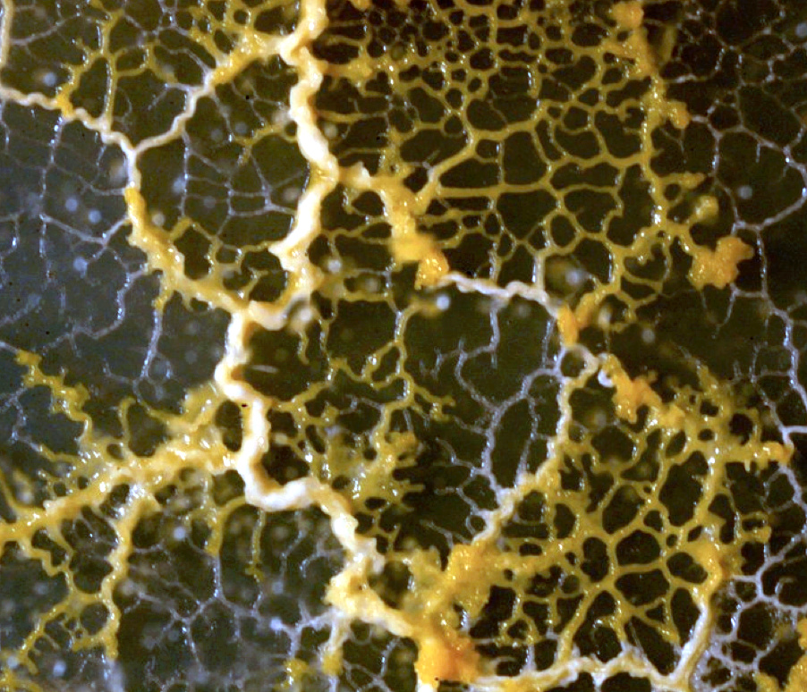
Transport and distribution networks
How does nature build and maintain well functioning transport networks?
The brain
Leaf
Physarum

Slide 25
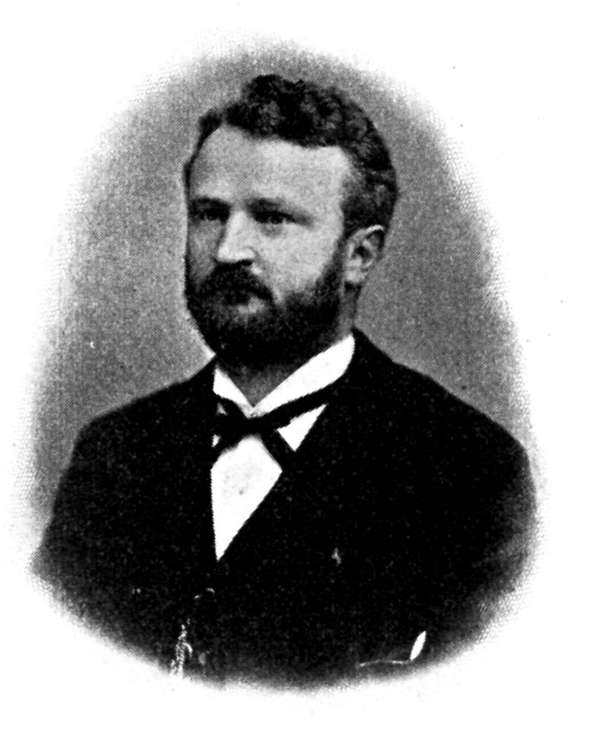
Blood vessels widen with flow
Richard Thoma (1847-1923)
Untersuchungen über die Histogenese und Histomechanik des Gefässsytems (1893)

Slide 26
How does nature build a (very) efficient transport network?
conductivity of vessel e
“A rich get richer” adaptation rule
flow through vessel e

Slide 27
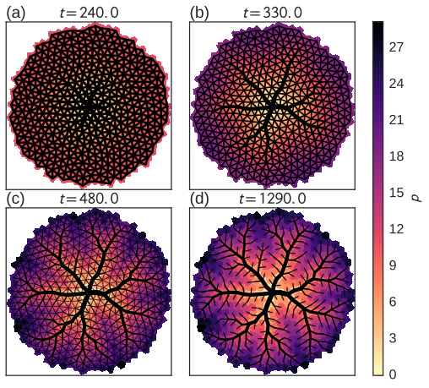
Dynamics of growth

Slide 28
Growth : It makes you more efficient!
Local adaptation rules lead to global optimum when growth is present
Dissipation
Grow slowly
and
grow a lot
Growth period is long
growth is initially strong
compared to adaptation
dissipation of “global” optimum
as found by annealing
Growth period is too short
growth is weak compared to adaptation

Slide 29
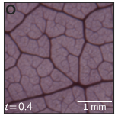
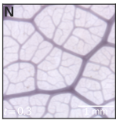
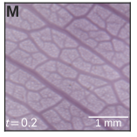
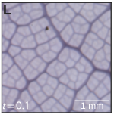
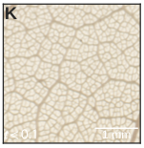
Functional archetypes
Tree archetype
“chickenwire” archetype
Decreasing σ
high cost
low percolation penalty
uniform
Low cost
high percolation penalty
hierarchical
EK, H. Ronellenfitsch, (in preparation)

Slide 30
Tatyana Gavrilchenko
Acknowledgements
Desislava Todorova
Octavio Albarran
Lucas Goehring
HIllel Aharoni
Henrik Ronellenfitsch
Tatyana Gavrilchenko
Johannes Grawer
Jason Rocks
Andrea Liu
Marcelo Magnasco
Carl Modes
Randy Kamien
Thank you!!!
Notes:
and the collaborators

Slide 31
Appendix

