Slide 1
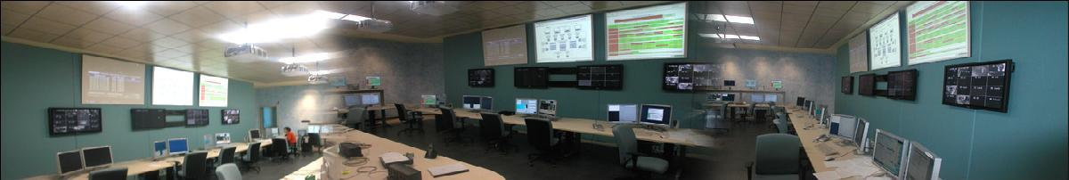

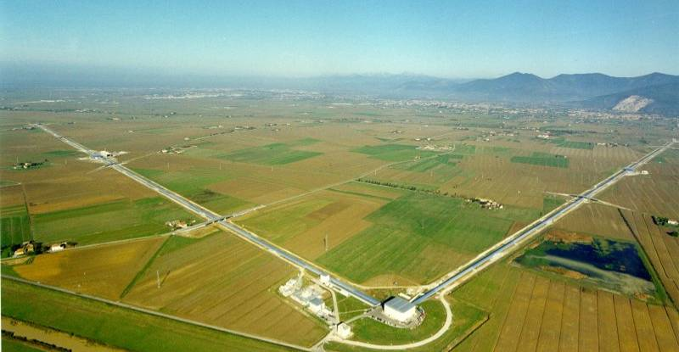
A la recherche de l’espace-temps « tordu »

Slide 2
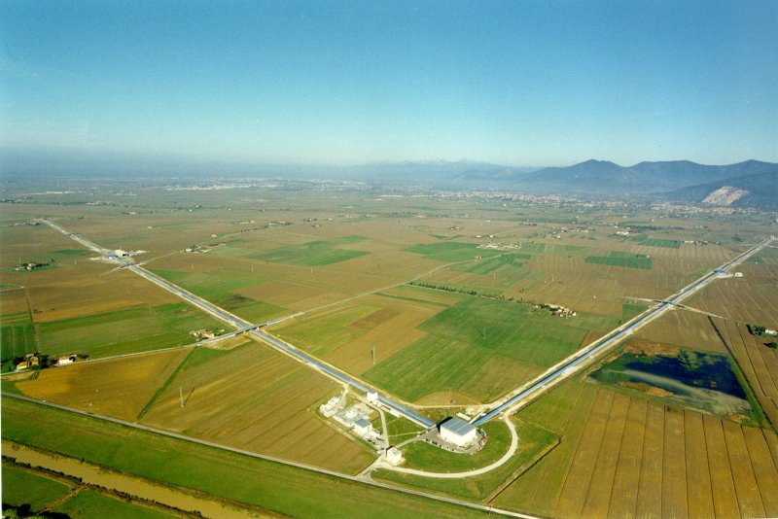





EGO/VIRGO
A large infrastructure :
3km long arms: ΔL / L = 10⁻²¹
60 ha of land; ~150000 m³ of buildings
The largest high vacuum system in Europe : 7000 m³ - 10⁻⁹ mbar
High tech optics
High tech environmental noise monitoring
Several class 10 clean rooms
600kW electrical power
24h/24h data taking; 1 TB/day collected

Slide 3
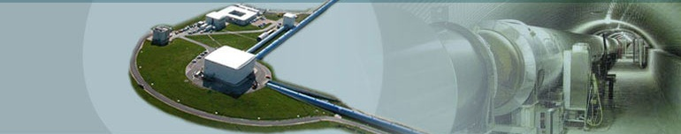

Aims
according to Statute
The Consortium shall have as its purpose the promotion of research in the field of gravitation in Europe.
EGO pursues the following objectives:
  ensures the construction of the antenna VIRGO, its operation, maintenance and the upgrade of the antenna as well as its exploitation.
  ensures the maintenance of the site infrastructures, including a computer centre and promotes an open co-operation in R&D;
  carries out any other research in the field of gravitation of common interest of the Members
  promotes contacts among scientists and engineers, the dissemination of information and the provision of advanced training for young researchers.
  promotes the co-operation in the field of the experimental and theoretical gravitational waves research in Europe

Slide 4
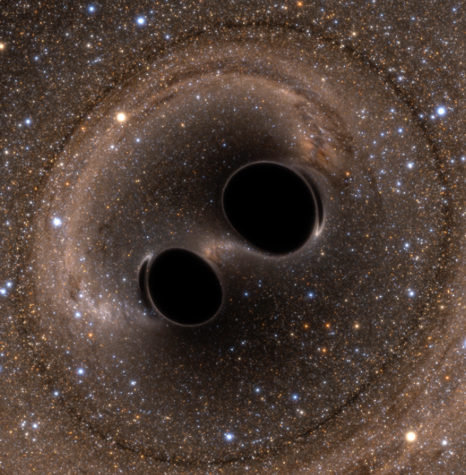
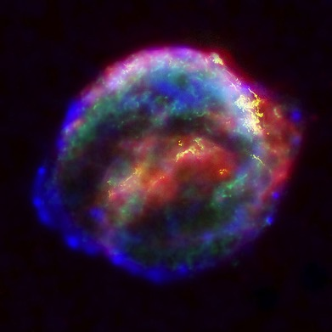
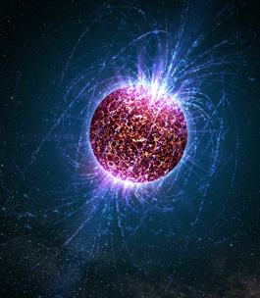
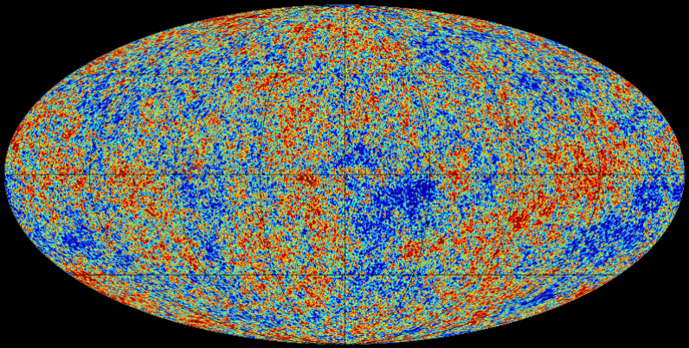
The Science:
Gravitational-Wave Sources
Coalescing Binary Systems
Black hole – black hole
Neutron star – neutron star
BH-NS
➔ analytical waveform
Transient‘Burst’Sources
core collapse supernovae
cosmic strings
➔ unmodeled waveform
Credit: Bohn, Hébert, Throwe, SXS
Cosmic GW Background
residue of the Big Bang
➔ stochastic, incoherent background
Continuous Sources
Spinning neutron stars
➔ monotone waveform
See talks by G. Losurdo and M. Razzano
Notes:
LIGO is designed to be an observatory, not a one-off proof that GWs exist. What do we look for?
There are number of predicted astrophysical sources of gravitational radiation, and most of them involve cataclysmic events.
Binary systems – NSs and BHs, most likely source, theoretically well understood with known waveforms
Bursts – GW emissions that are not well modeled or understood. These include asymmetrically core collapse supernova, cosmic strings, and perhaps unknown sources
The residual GW background
Continuously emitting sources such as spinning neutron stars, which have a pure monotone emission.

Slide 5
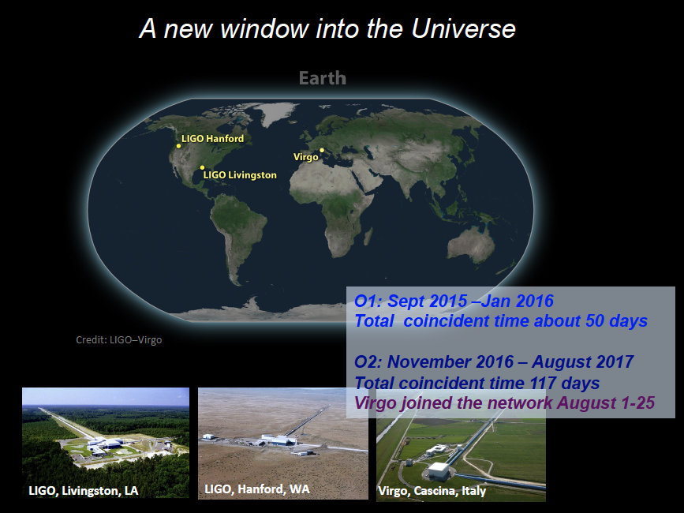
A new window to the Universe
See talks of G. Losurdo and M. Barsuglia
Notes:
LIGO is designed to be an observatory, not a one-off proof that GWs exist. What do we look for?
There are number of predicted astrophysical sources of gravitational radiation, and most of them involve cataclysmic events.
Binary systems – NSs and BHs, most likely source, theoretically well understood with known waveforms
Bursts – GW emissions that are not well modeled or understood. These include asymmetrically core collapse supernova, cosmic strings, and perhaps unknown sources
The residual GW background
Continuously emitting sources such as spinning neutron stars, which have a pure monotone emission.

Slide 6
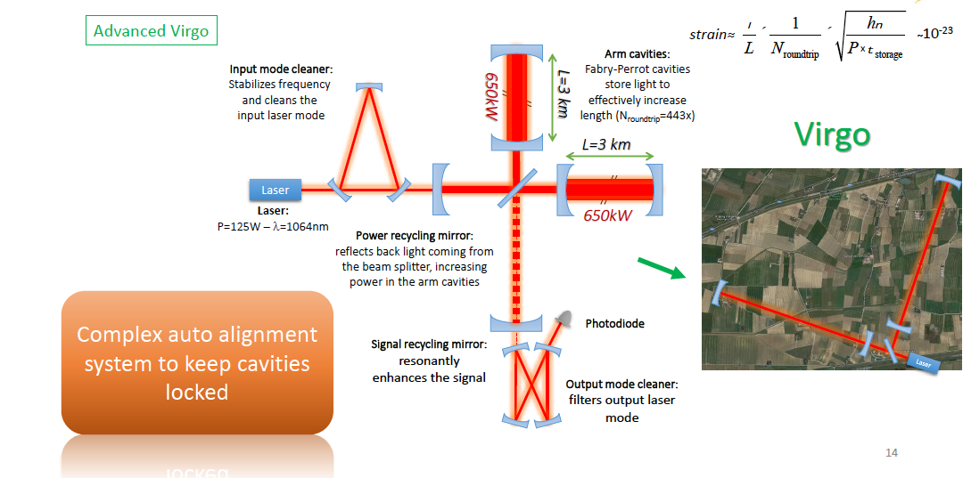
The Instrument: a light trap to catch
Gravitational Waves
See talk of G. Losurdo and M. Barsuglia
Notes:
LIGO is designed to be an observatory, not a one-off proof that GWs exist. What do we look for?
There are number of predicted astrophysical sources of gravitational radiation, and most of them involve cataclysmic events.
Binary systems – NSs and BHs, most likely source, theoretically well understood with known waveforms
Bursts – GW emissions that are not well modeled or understood. These include asymmetrically core collapse supernova, cosmic strings, and perhaps unknown sources
The residual GW background
Continuously emitting sources such as spinning neutron stars, which have a pure monotone emission.

Slide 7
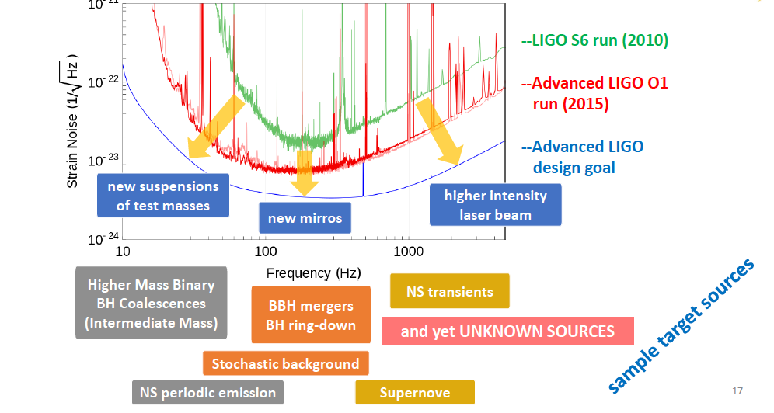
Sources at different frequencies a complex task at different technology fronts
See talk of M. Barsuglia
Notes:
LIGO is designed to be an observatory, not a one-off proof that GWs exist. What do we look for?
There are number of predicted astrophysical sources of gravitational radiation, and most of them involve cataclysmic events.
Binary systems – NSs and BHs, most likely source, theoretically well understood with known waveforms
Bursts – GW emissions that are not well modeled or understood. These include asymmetrically core collapse supernova, cosmic strings, and perhaps unknown sources
The residual GW background
Continuously emitting sources such as spinning neutron stars, which have a pure monotone emission.

Slide 8
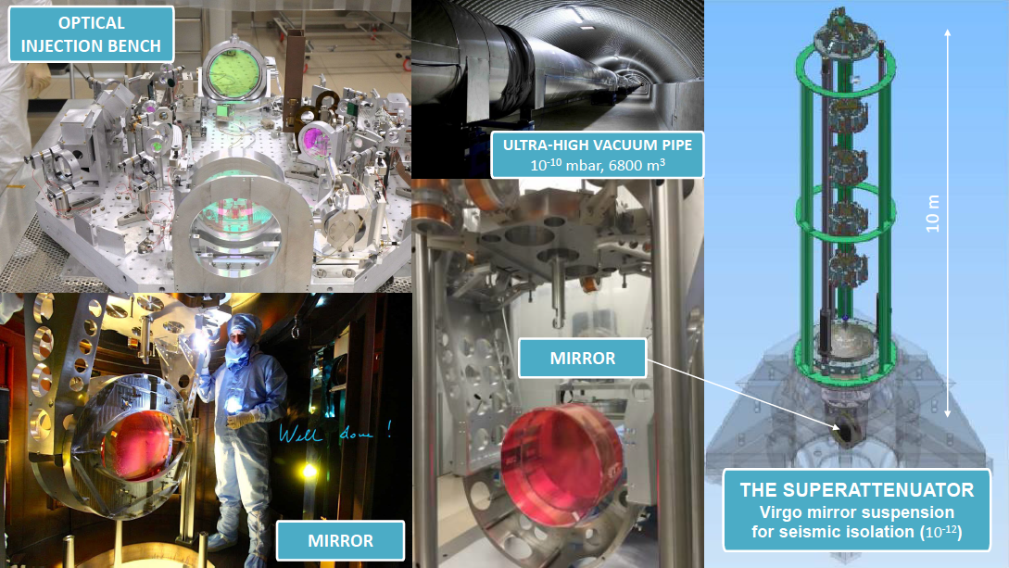
“Land art , elaborate sculptures and installations receptive to the environmental sounds and seismicity”
See talk of M. Barsuglia
Notes:
LIGO is designed to be an observatory, not a one-off proof that GWs exist. What do we look for?
There are number of predicted astrophysical sources of gravitational radiation, and most of them involve cataclysmic events.
Binary systems – NSs and BHs, most likely source, theoretically well understood with known waveforms
Bursts – GW emissions that are not well modeled or understood. These include asymmetrically core collapse supernova, cosmic strings, and perhaps unknown sources
The residual GW background
Continuously emitting sources such as spinning neutron stars, which have a pure monotone emission.

Slide 9
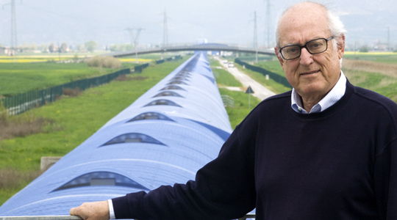
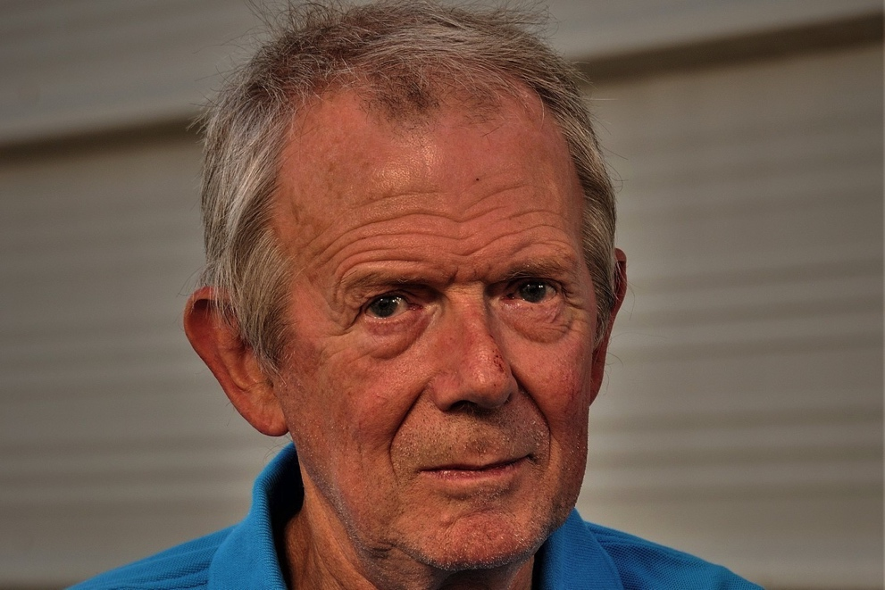
The history
of the project
Adalberto Giazotto
Alain Brillet
First studies:
    Brillet (Nice): optics
    Giazotto (Pisa): seismic isolation
  1992 CNRS and INFN approve VIRGO
  1997 Construction starts near Pisa
  2000 Foundation of EGO
  2004/2005 Commissioning
  2006 Physics
  2006 Netherlands joins EGO
  2009 EGO Council approves Advanced VIRGO
  2010 Poland (POLGRAW) & Hungary (RMKI) join EGO in 2010 later followed by Spain

Slide 10
The Structure ca 2018
EGO Council
(INFN/CNRS/NIKHEF)
STAC
Scientific and Technical Advisory Committee
EGO Director
Stavros Katsanevas
Virgo Collaboration
Jo Van der Brand
Directorate services
Interferometer
Technology
General
Infrastructure
Information
Technology
Administration
Vaccum and
Mechanics
50-55 EGO staff
EGO budget: 11 M€

Slide 11
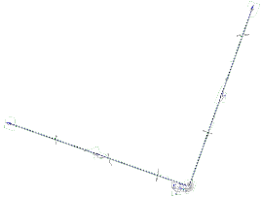
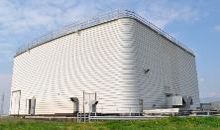
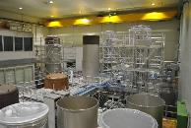
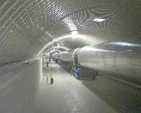
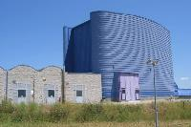
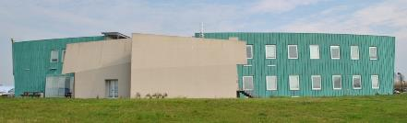
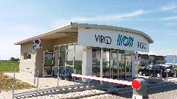
EGO-Virgo infrastructure main figures
Overall extension > 600.000 m²
Overall building volume > 170.000 m³
4 Experimental Buildings and 2 orthogonal Tunnels 3+3 km long
2 Intermediate Buildings hosting labs and technical facilities
3 Office Buildings including the Main Building – 1 Access Control Building

Slide 12
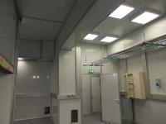
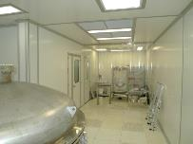
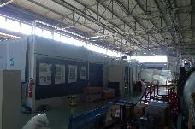
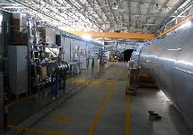
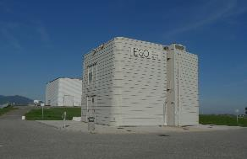
Central and Tower access Clean Rooms
Dedicated labs (INJ Lab, DET Lab, Payload assembly CRs, Fiber Lab, Minitowers Labs, Squeezing Lab)
6 Technical Buildings dedicated to the technical systems (HVAC systems, air compressors systems, electrical systems)
15 kV power supply and 6 MV/LV transformation cabins
1 Warehouse

Slide 13
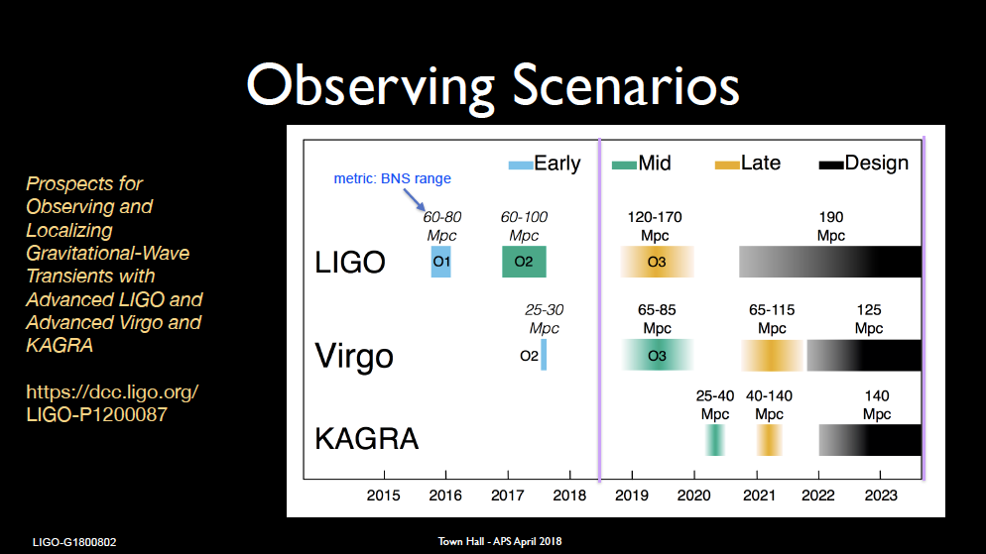
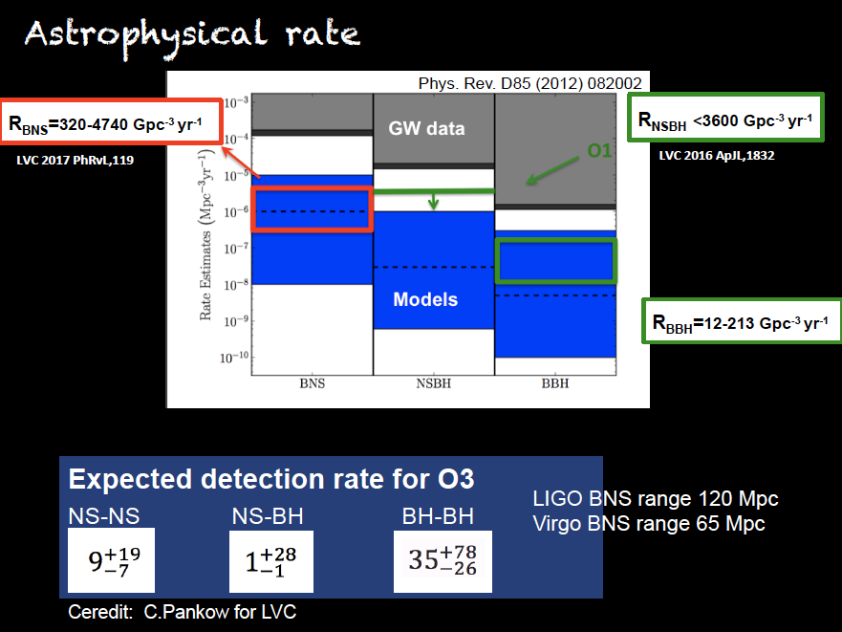

Slide 14
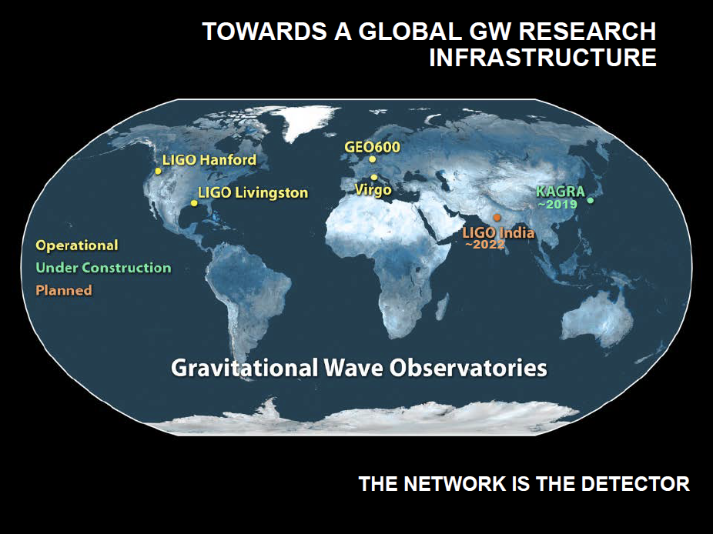

Slide 15
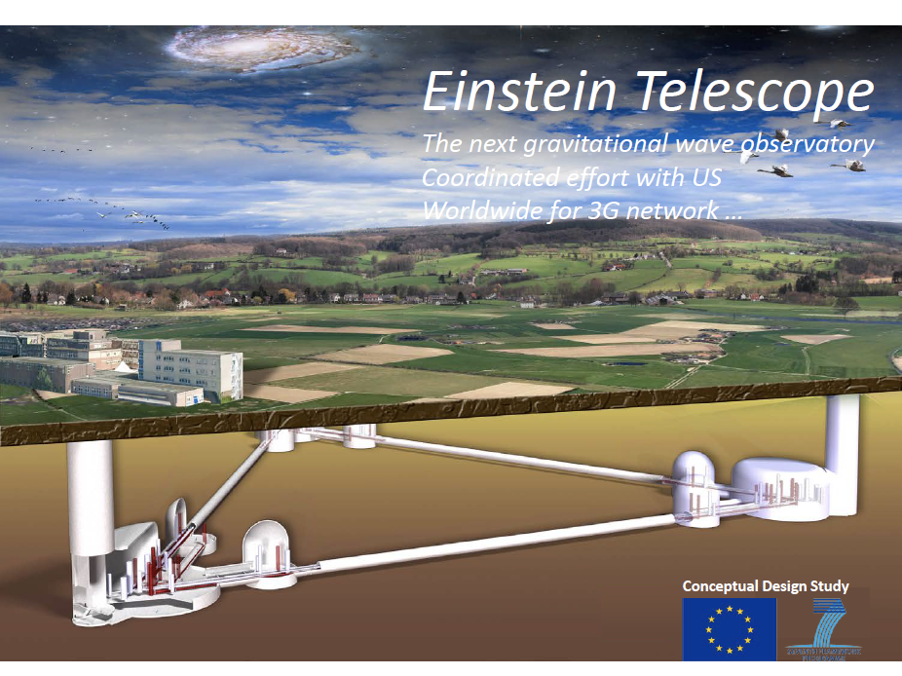

Slide 16
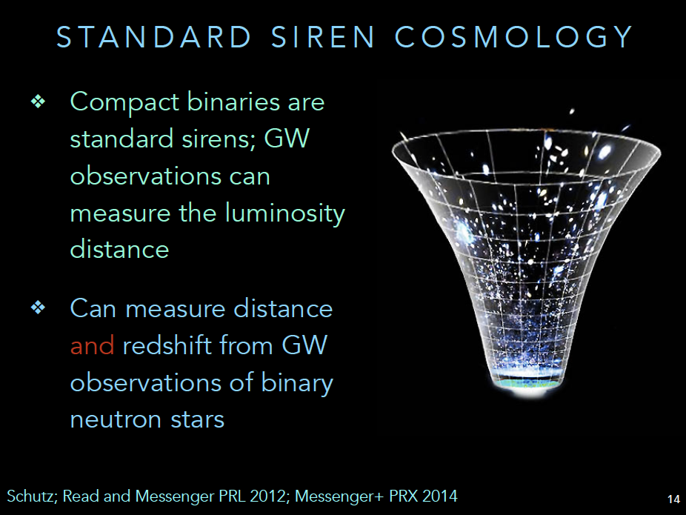
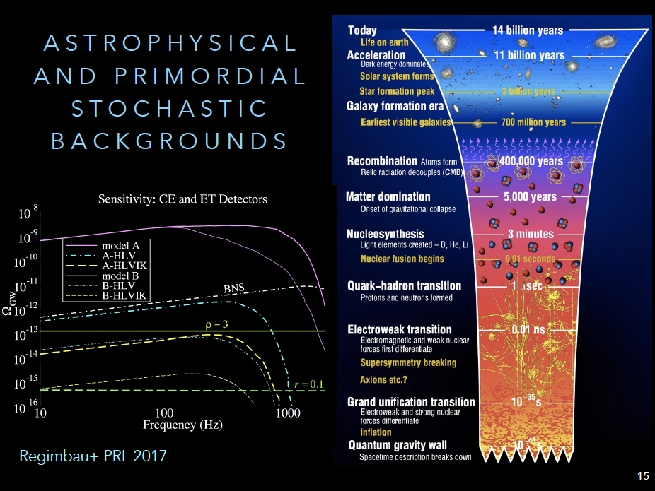
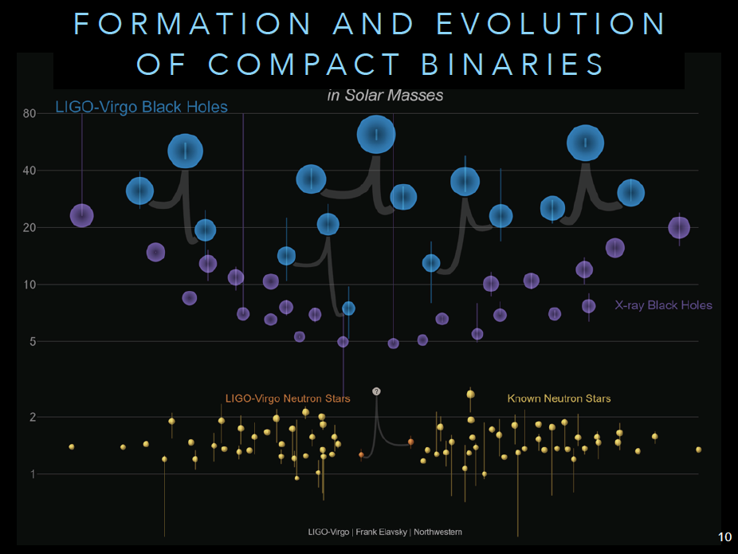
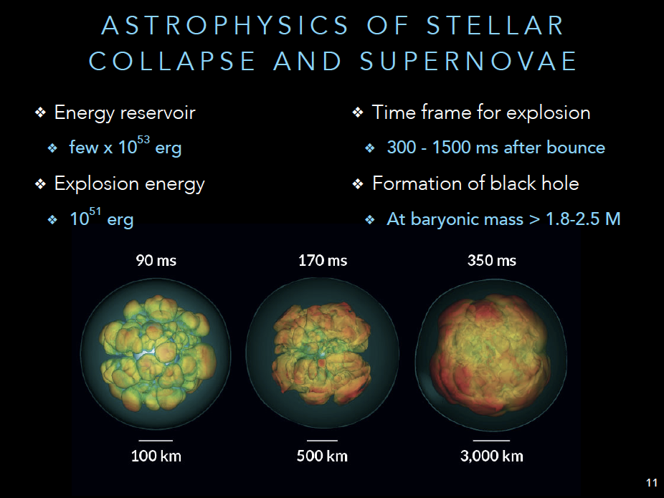
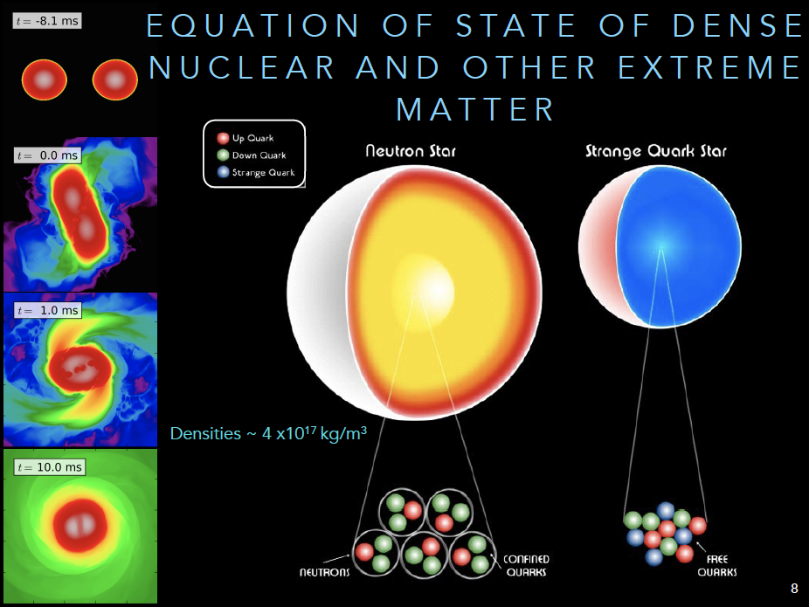
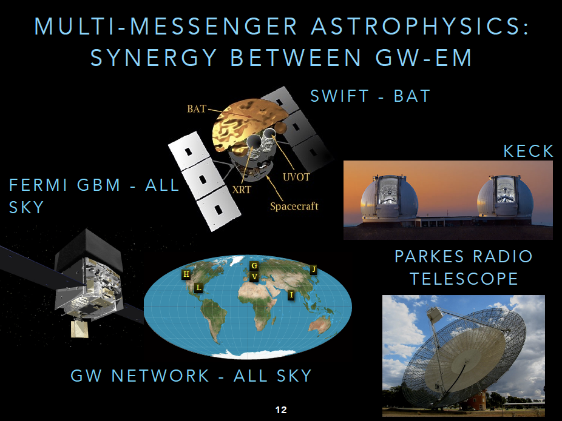

Slide 17
Accompany the Scientific Revolution:
Sense and Sensibility in Art, Science and Society
Pierre Binetruy and Universe 2.0
Art and Research of Gravitational Observation (ARGO)
A strawman unifying narrative
  The 3 notions of “Cosmos” (Mundus, Mondo, Monde) and our insertion
  The medium is the message and the the medium is the object
  The program of these days

Slide 18
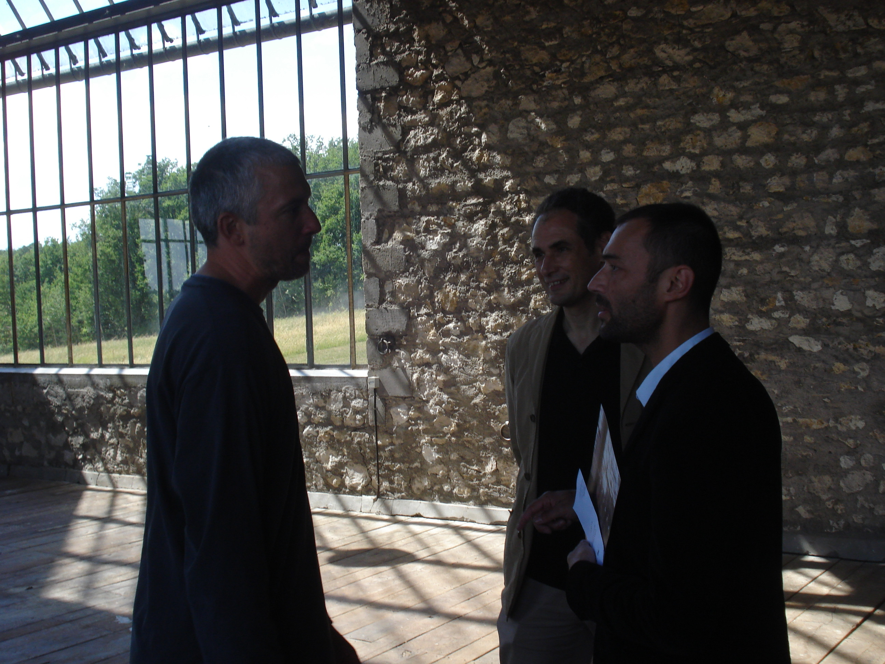
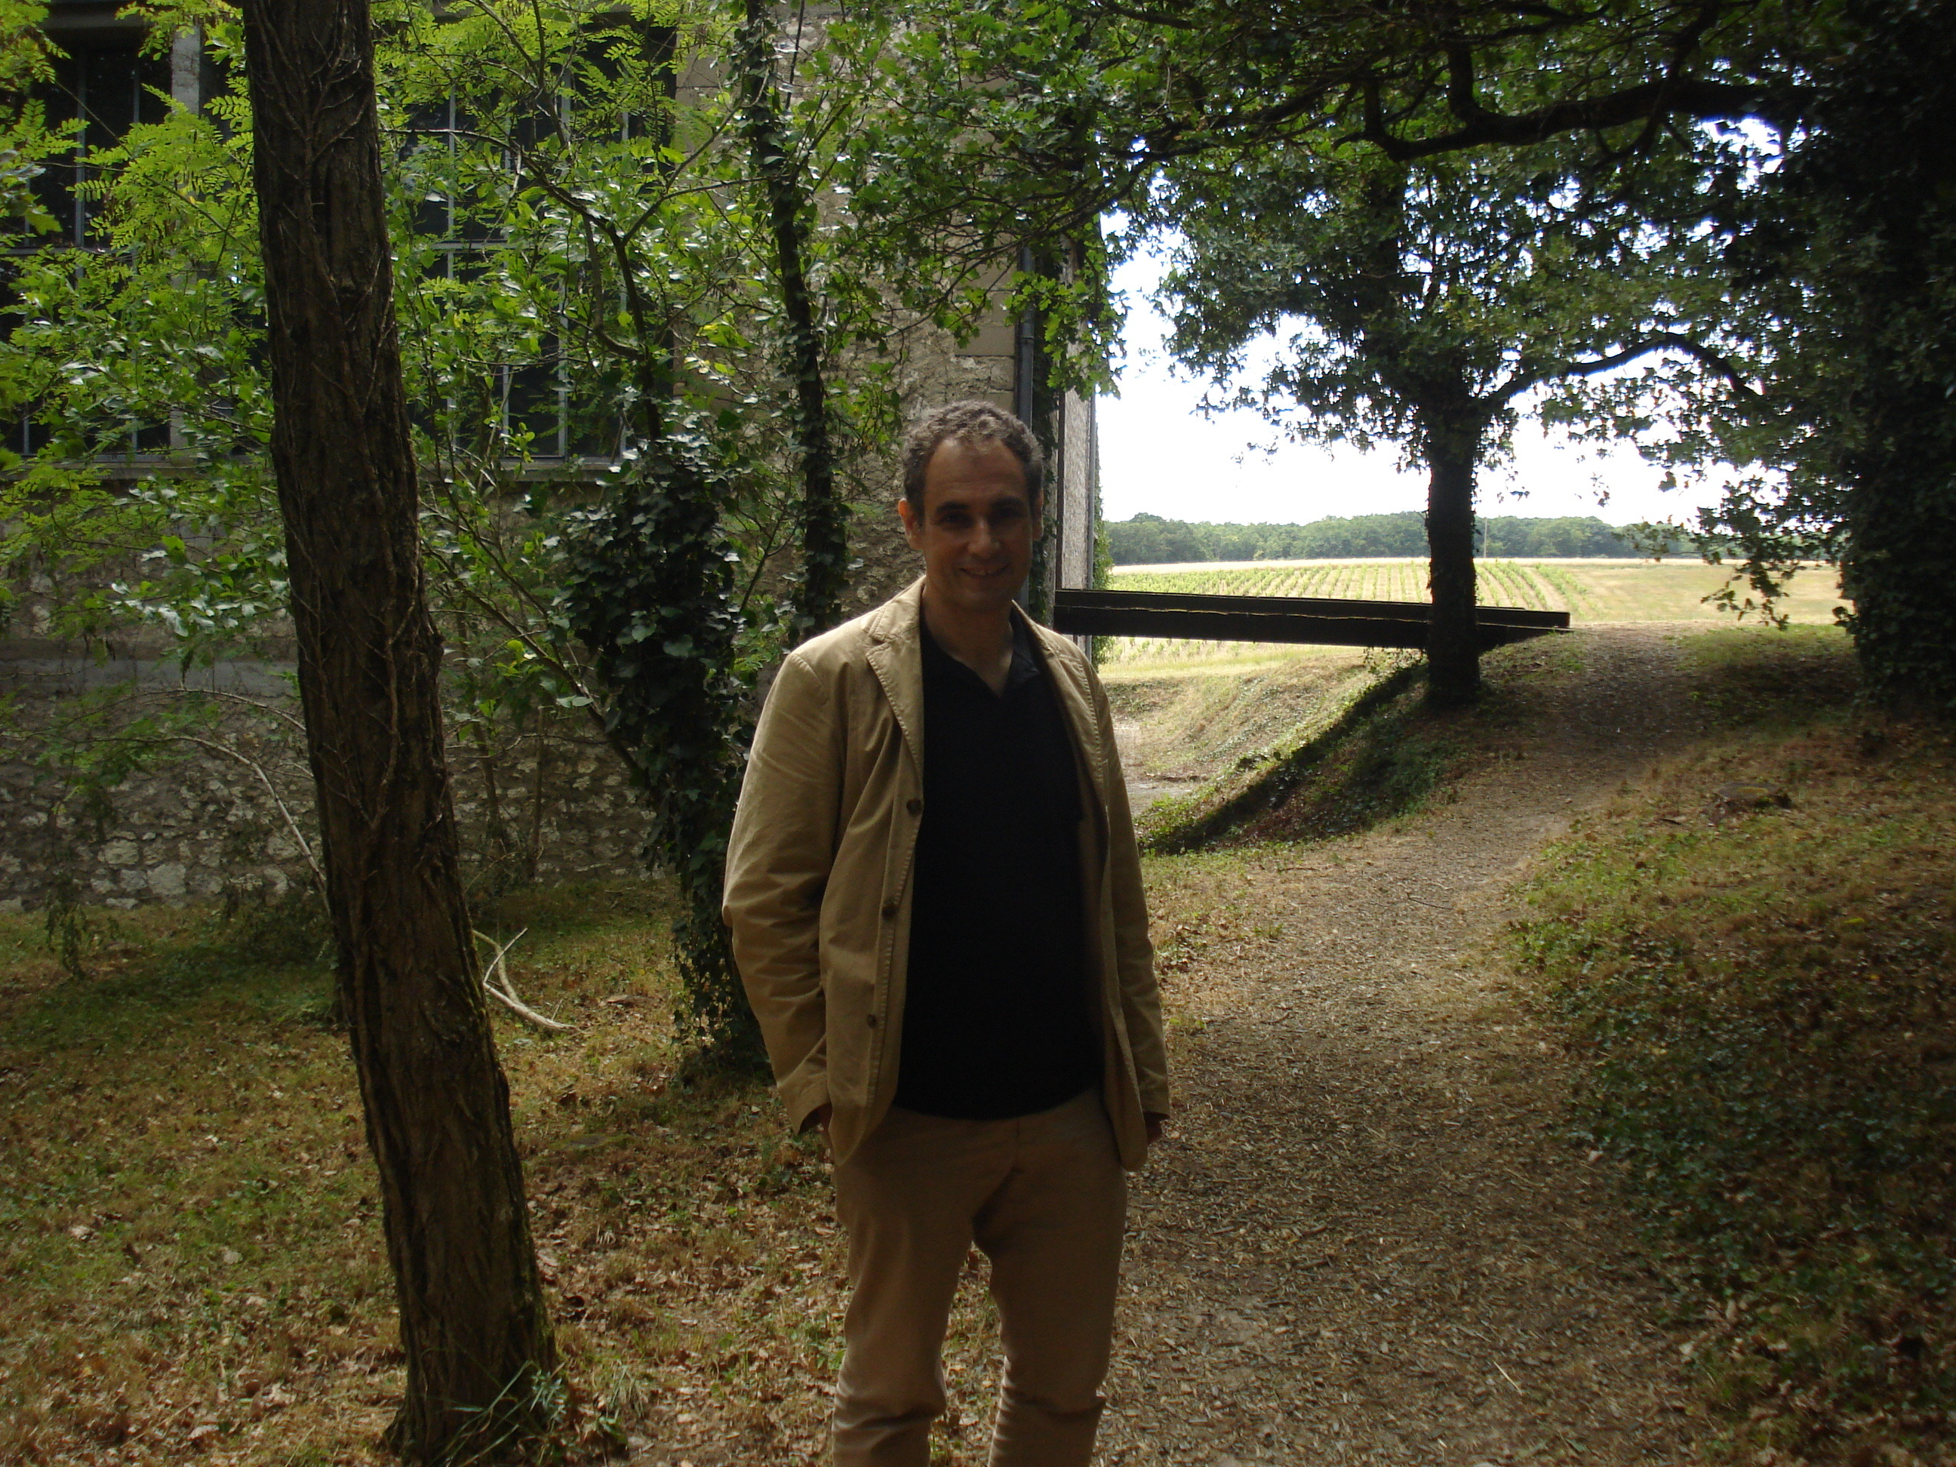
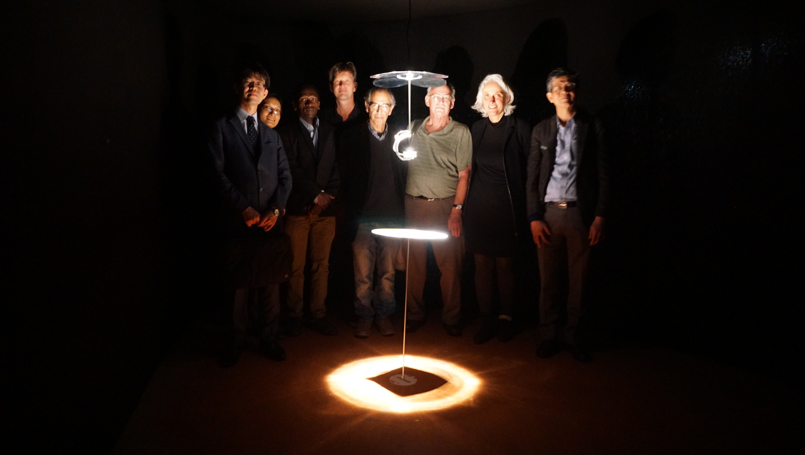
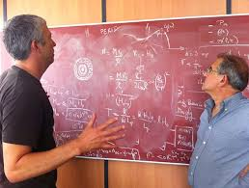
Pierre Binetruy (1955-2017)
From squaring the circle (2014) by Attila Csorgo to the Univers 2.0 proposal
Other residences for Universe 2.0?

Slide 19
Univers 2.0
Funded by the Carasso Foundation
The aim of this project is to initiate an exploration, through a cross-reflection between artists and scientists, of the field that began with the recent discovery of gravitational waves, urgently questioning again:
  the nature of space and time,
  their texture and their relationship with the objects “within”
  the notions of origin and horizon,
  the role of information circulating in the Universe and its conservation or loss,
  the role of the human as observer and/or perturbator, more generally the nature of our embedding in the cosmos.
In short, the overall image of a Gravitational Universe or Universe 2.0.

Slide 20
A Swafs proposal to EU (results by Nov 2018, 1,5 M€)
Art and Research of Gravitational Observation (ARGO)
Centred on the over-arching theme of teaching and learning from gravity in the context of the universe, Earth and society, the Art and Research of Gravitational Observation project, ARGO, aims to integrate diverse communities into the gravitational and gravitational-wave revolution. ARGO is a consortium of 27 partner organisations, across 11 countries, including: universities and research centres of excellence; large schooling and gender networks; private media-related enterprises; internationally-recognised cultural foundations; museums; and Nobel-prize networks.
The ARGO objectives are:
I - open schooling and science education collaboration;
II - interdisciplinary educational synergies;
III – Art and Science
IV triggering of social and institutional change, with emphasis on gender;
V - dissemination of critical-thinking
Fostering local and international partnerships, the ARGO community, the ARGOnauts, will grow through a holistic approach to citizen science, incorporating participants ranging from traditional educational theatres, such as schools and universities, all the way through to senior-citizen and elderly groups. It will include components from civil society, artists, scientists, from robotics to craftsmanship organisations. It will connect these communities at the global level, using new educational media. It will diffuse critical thinking practices.
ARGO will overcome gender gaps, disparities between manual practices and higher-educational activities, disciplinary fragmentations. The role of the teacher will be shared between its high-quality participants. It will reinvent institutions: from schools to universities; from the artisanal bottega to future industries; to artistic and cultural centres. ARGO is a unique open-learning community, reunifying art and science education.

Slide 21
ARGO actions
Open Schooling, Teacher Trainiing
Citizen’s science
Gender
Embodied intelligence Craftmanship vs Robotics
Art and Science Univers 2.0
The global dimension of art and science
Critical
Thinking

Slide 22
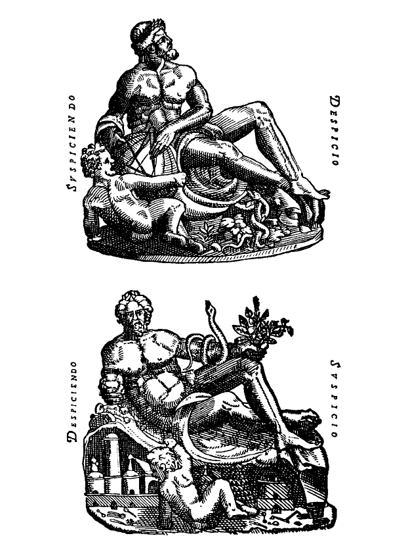
The 3 notions of the word Cosmos, Mundus, Monde, Mondo.
Universe
Society
Earth
Experiencing a « multimessenger » revolution in all three
Ainsi cosmos signifie-t-il en même temps parure et toute splendeur en général; univers ou totalité des êtres et constitution politique fondée sur la loi; principe d’ordre et d ’harmonie qui règle aussi bien les rapports entre les êtres qu’entre les éléments de chaque être; vertu ou bien immanents à chaque être et lui permettant de devenir ce qu’il est et de se maintenir tel qu’il est K. Papaioannou
From the frontispiece of
Tycho Brahe’s Uranienborg
Each time one of the other components are forgotten ideological « monsters » are produced : technocratic science, religious ecology, polluting economics

Slide 23
Univers 2.0
Work organisation up to now
1st meeting: 13th of June 2017 APC.
2nd meeting: 3th of October at APC, on the occasion of the Nobel Physics Announcement. First discussions of the physics.
3rd meeting: 17-18th November 2017 APC. First presentation of artist’s work and ideas.
4th Meeting 8 December 2017 Teleconference
5th meeting 14-15 May 2018 Pisa. Towards the final results

Slide 24
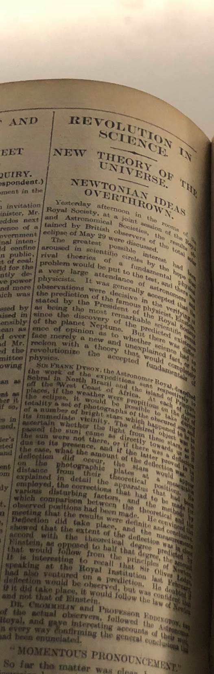
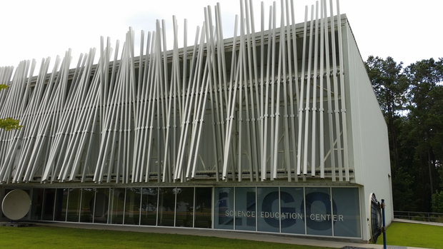
Univers 2.0
Final products*
An exhibition for 2019 in France and/or Italy ? (100th anniversary of the announcement of bending of light after Arthur Eddington’s eclipse measurement)
An open space exhibition here in EGO/Virgo or in association with a visitors centre as in LIGO’s Science Education Centre ?
Residences ?
Conference
Book
Film
Site
* In association with ArtSciLab and Leonardo, Museo de la Grafica, Musée des Arts et Metiers, Academia delle Arti del Disegnio, Caixa Foundation, Evgenides, Tuscany Region, City of Paris…, INFN, CNRS, NIKHEF, Hungary, Poland,, …

Slide 25
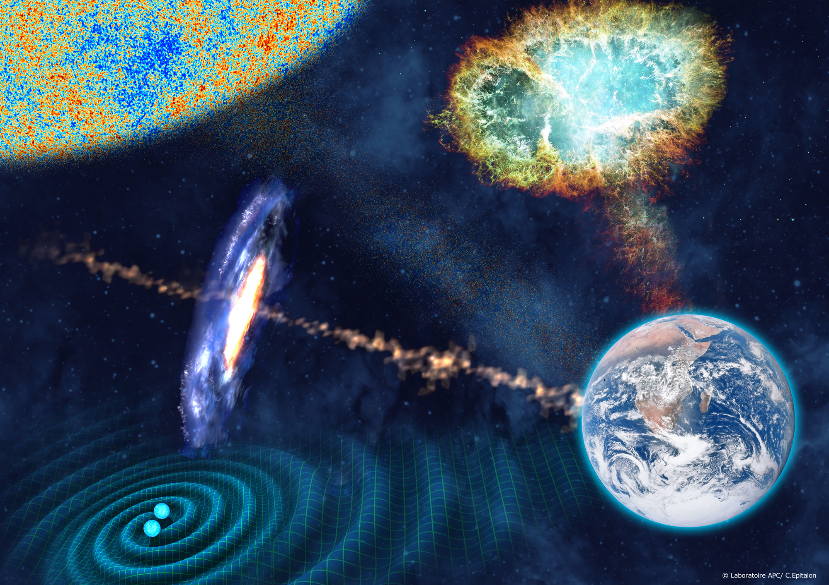
Possible unifying themes
Multimessenger studies
Or the
Medium is the message (and the object)

Slide 26
The medium is the message
There are two things that people [are surrounded by and] avoid trying to understand. One is music, and the other is electricity.
                Frank Oppenheimmer.
Qui affirmerait que quand la pointe du clocher miroitant au soleil nous envoie ses rayons dans les yeux, c’est le soleil lui-même que l’on voit?
                A. Meinong
C’est à travers l’ether par exemple que nous percevons les étoiles distantes, c’est par l’air que nous entendons le son d’une cloche, c’est grâce au baromètre que nous somme informés de la pression atmosphérique, par le biais d’un mouvement expressif, nous appréhendons une psychologie, à travers les yeux de quelqu’un , on jette un regard « dans les tréfonds de son âme », à la vue de la graphie de quelqu’un nous saisissons sa pensée et ainsi de suite. Certes ces cas de figure sont loin d’être identiques; ce qui les rassemble , toutefois, c’est qu’à chaque fois, l’objet de la connaissance n’agit pas de façon immédiate sur l’organe sensoriel mais par une forme ou une autre de truchement.
              Fritz Heider « Ding und Medium »

Slide 27
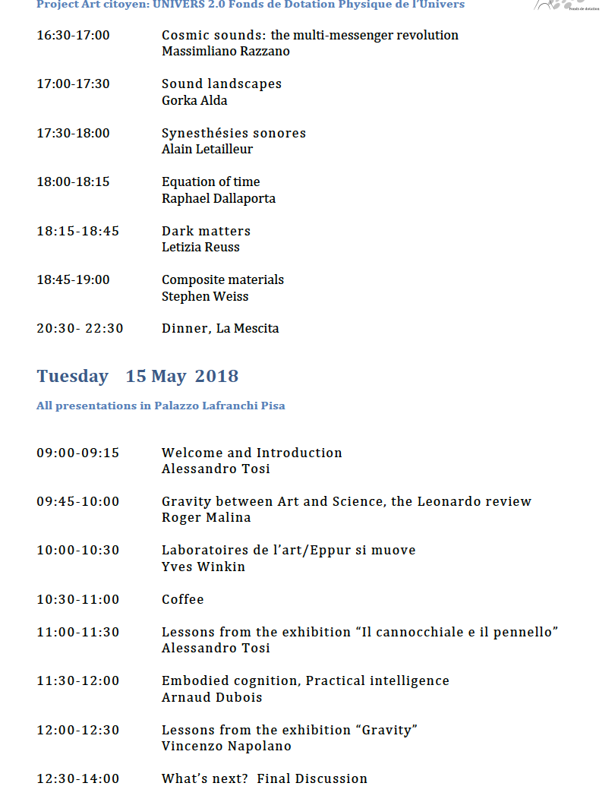
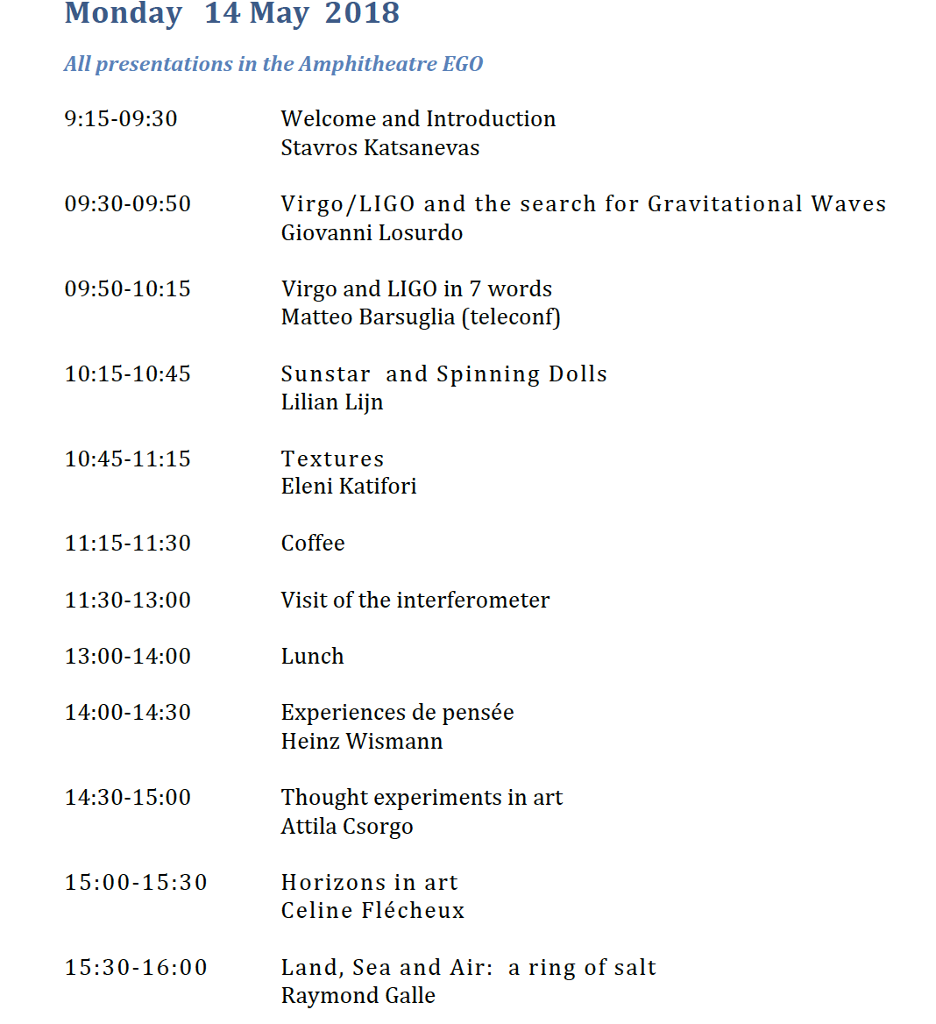
Program of the 2 days

Slide 28
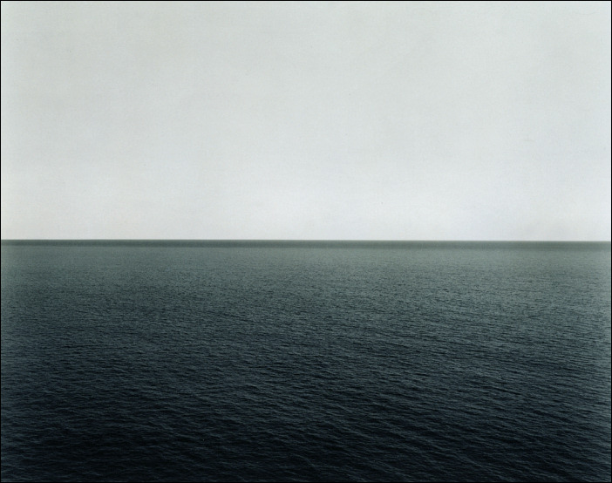
« I do not know what I may appear at the world but to myself I seem to have been only like a boy playing on the seashore, and diverting myself in now and then finding a smoother pebble or a prettier shell than ordinary, whilst the great ocean of truth lay all undiscovered before me » Newton
Hiroshi Sugimoto
Seascape

Slide 29
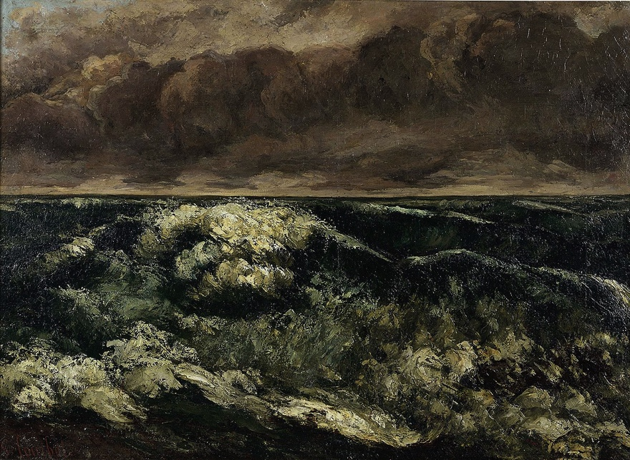
La vague Courbet
Les grandes Vagues, celles de Berlin . prodigieuse, une des trouvailles du siècle, bien plus palpitante, plus gonflée, d’un vert plus baveux, d’un orange plus sale, que celle-ci, avec son échevèlement écumeux, sa marée qui vient des fonds des âges, ton son ciel loqueteux et son âpreté livide. On la reçoit en pleine poitrine. On recule. Toute la salle sent l’embrun.
Cézanne cité en l4horizon de Céline Flécheux.

Slide 30
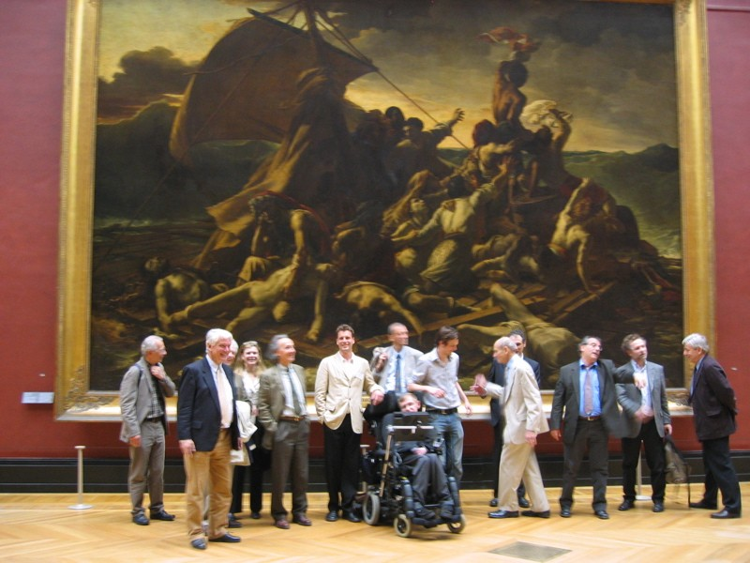
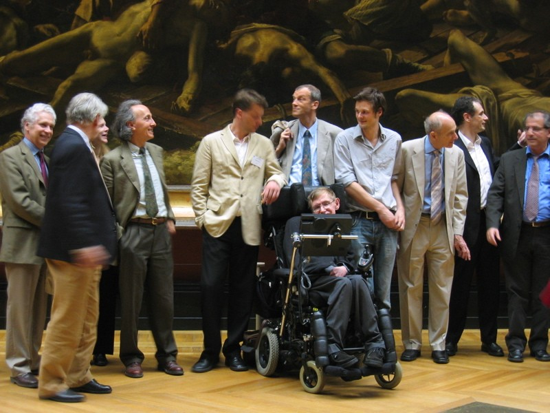

A night in the Museum
(APC inauguration 2006)
Can we unify the enigmatic smile of art with the enigmatic smile of science ?

