Slide 1
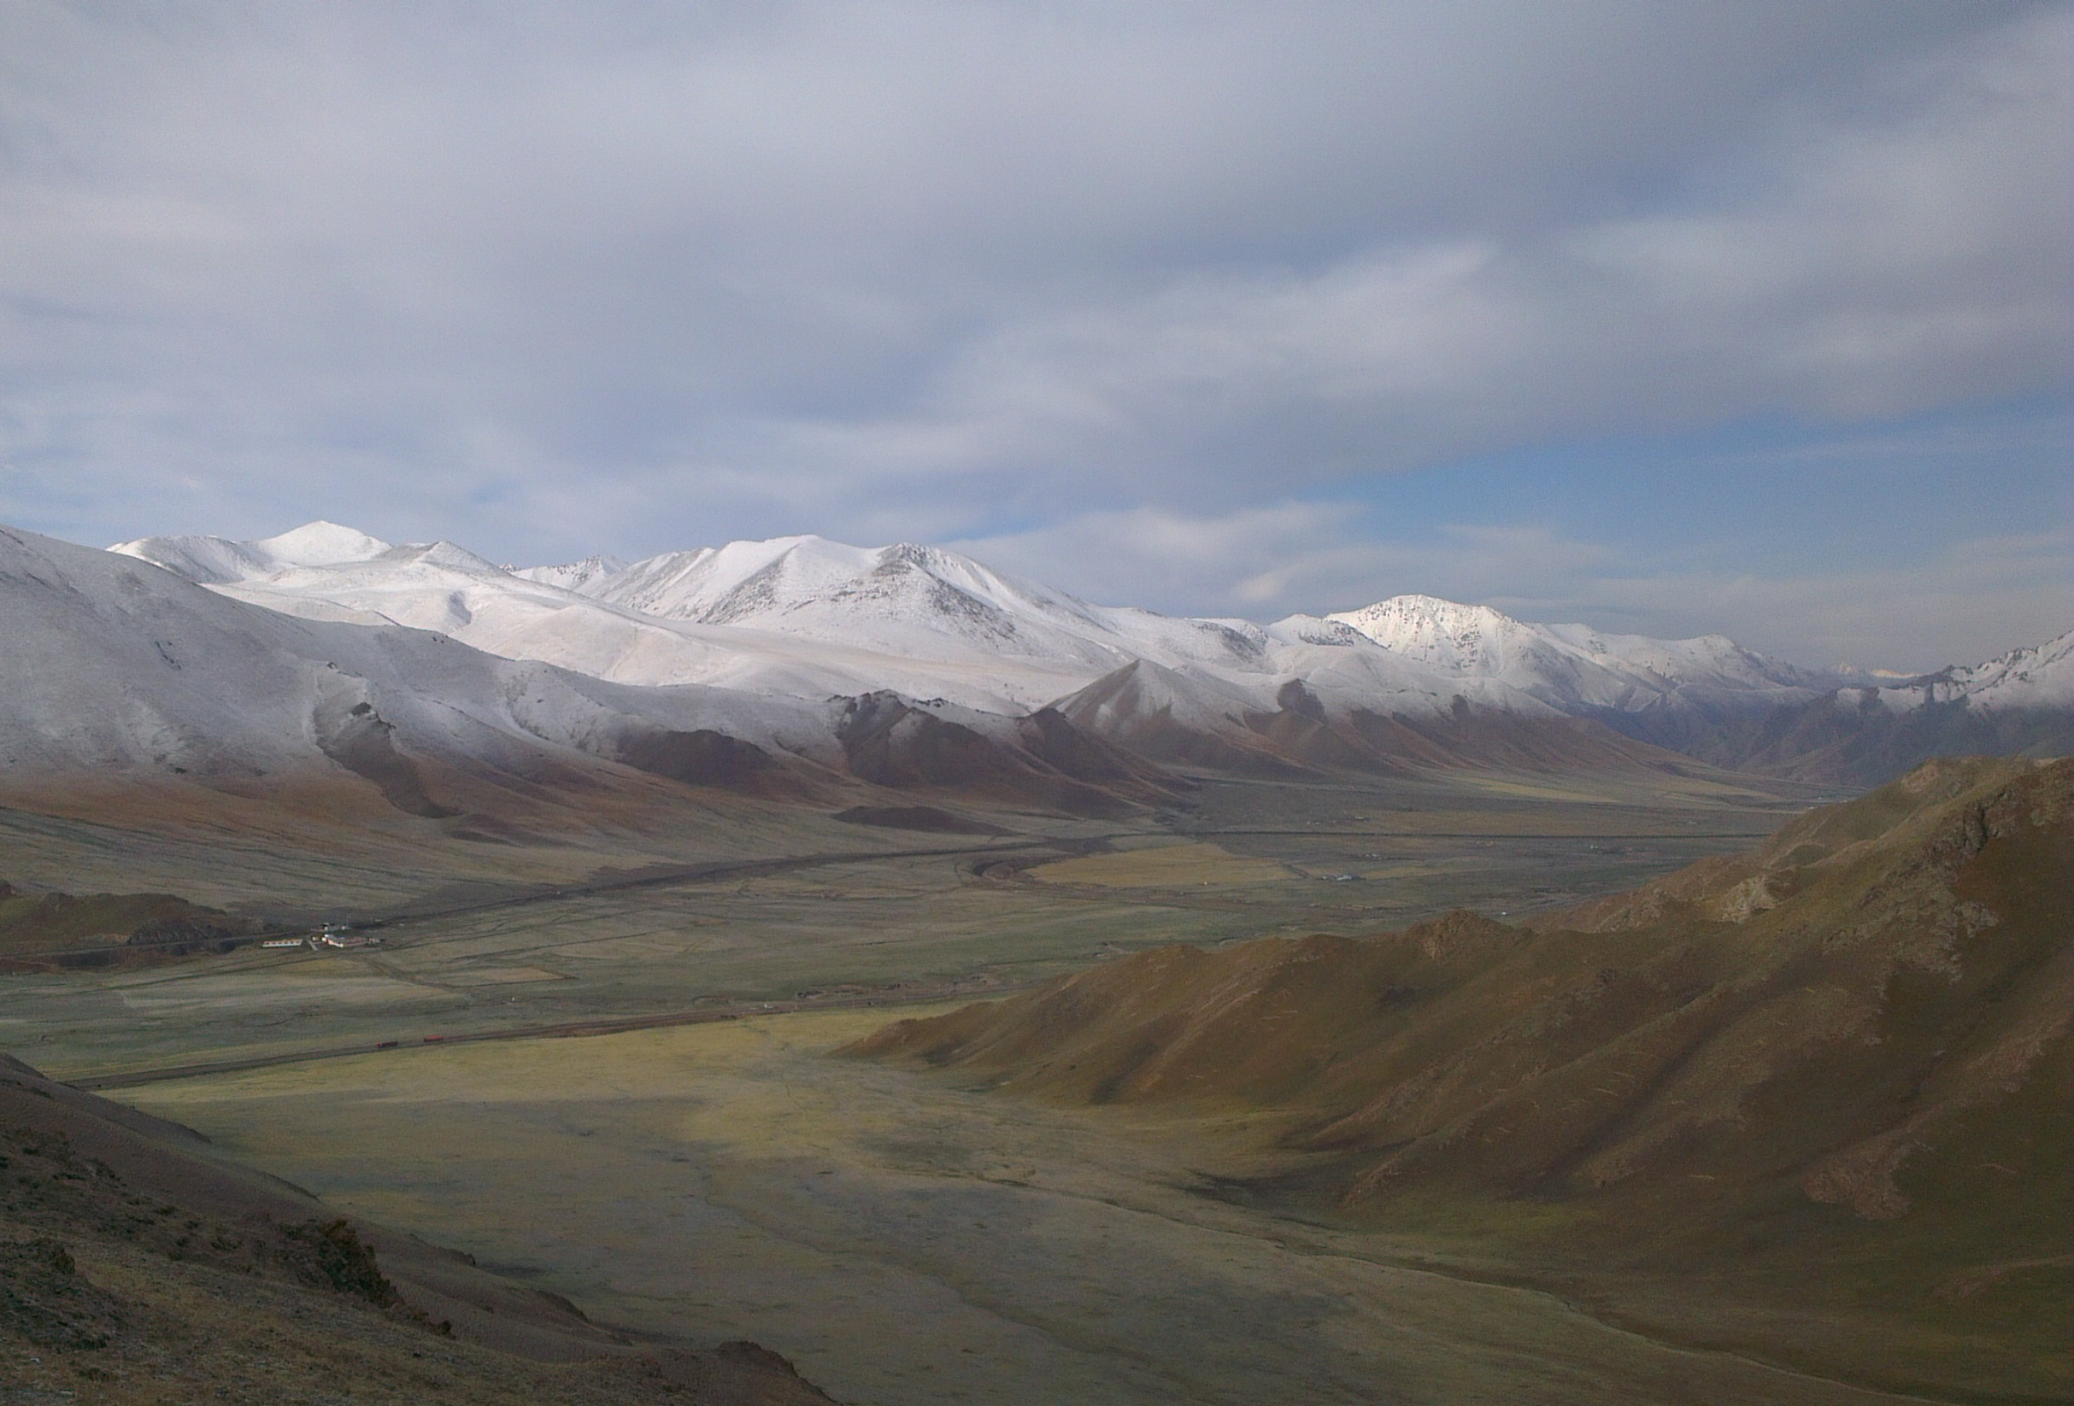
Radio-detection of UHE neutrinos
Olivier Martineau, LPNHE-IN2P3 & NAOC-CAS
June 12, 2018 -- GDR neutrino

Slide 2
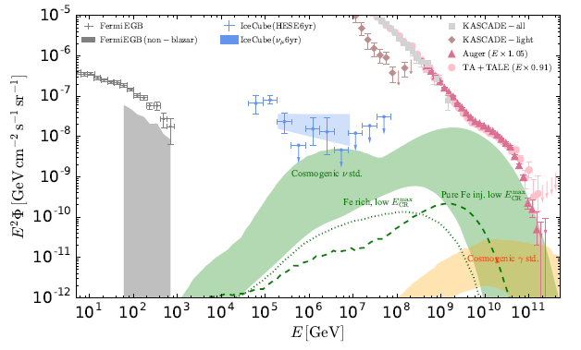
Why UHE neutrinos?
«Cleanest probe» of the Universe (no deflection, no attenuation, hadronic…).
Direct link to UHECRs (5% of primary energy)
5%/A

Slide 3
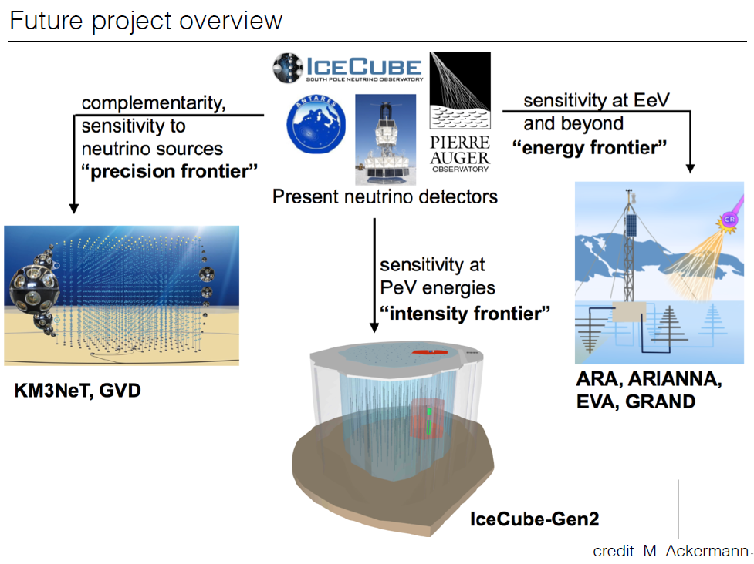
Kowalski@TeVPA2017

Slide 4
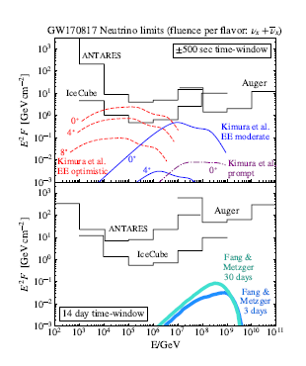
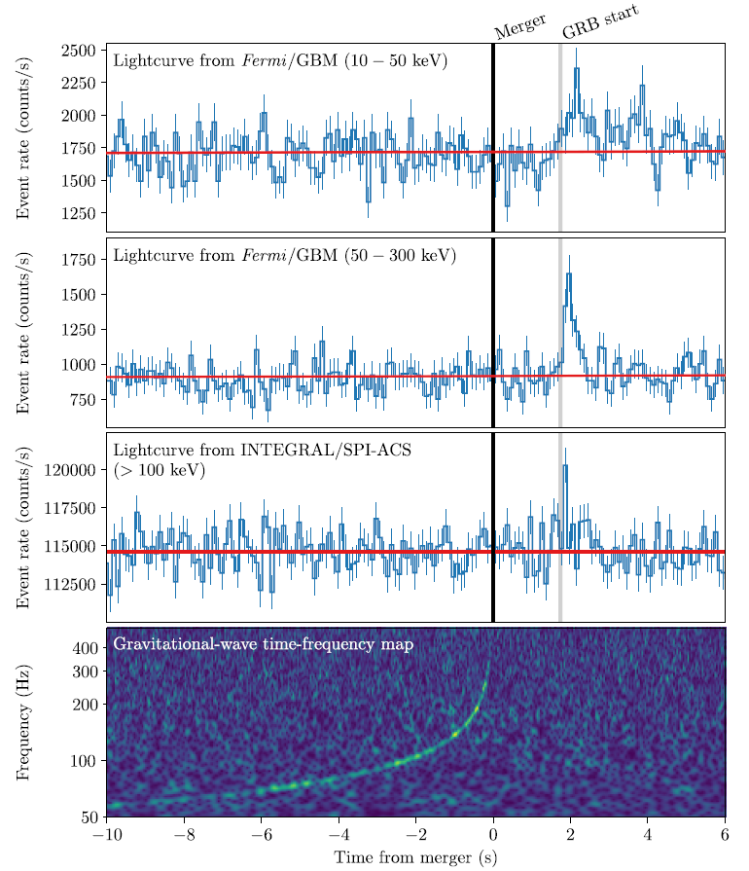
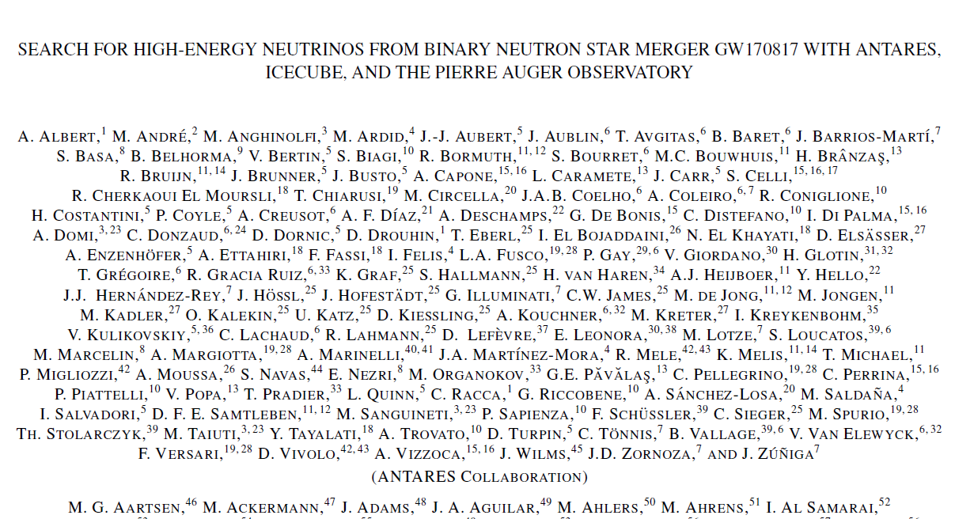
MultiMessenger Astronomy Era

Slide 5
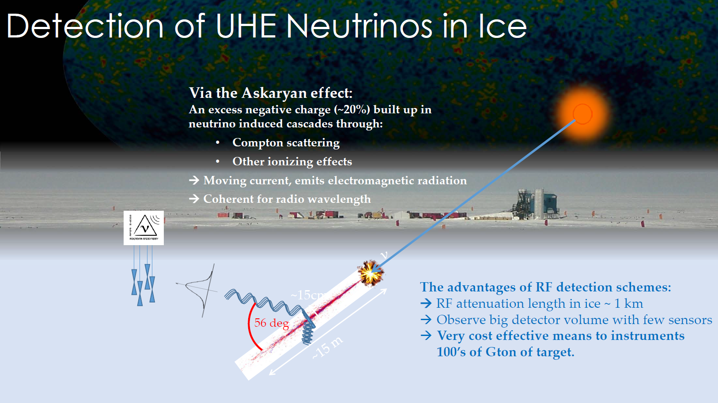
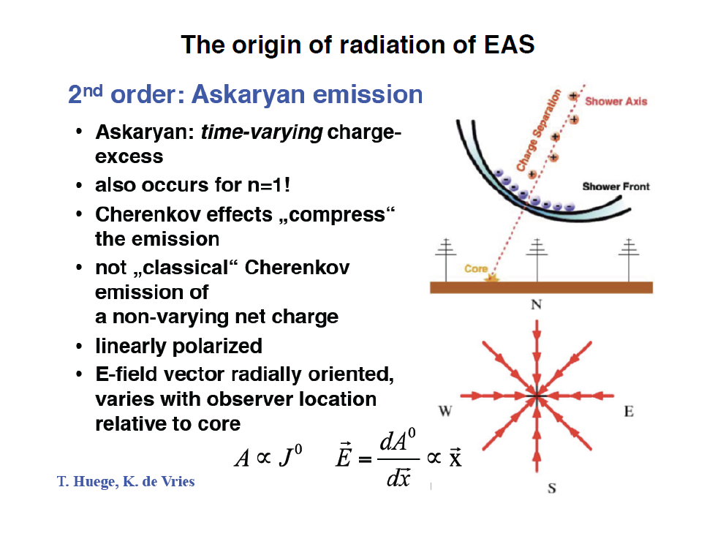
Radiodetection in Ice
All flavors, all interactions
Cerenkov emission:
- 100s MHz-GHz
- Strong directionnality
- Radial polarization
K. Hanson, ARENA2016

Slide 6
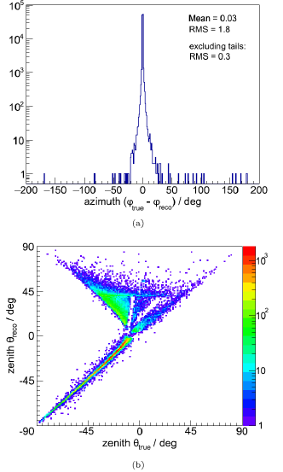
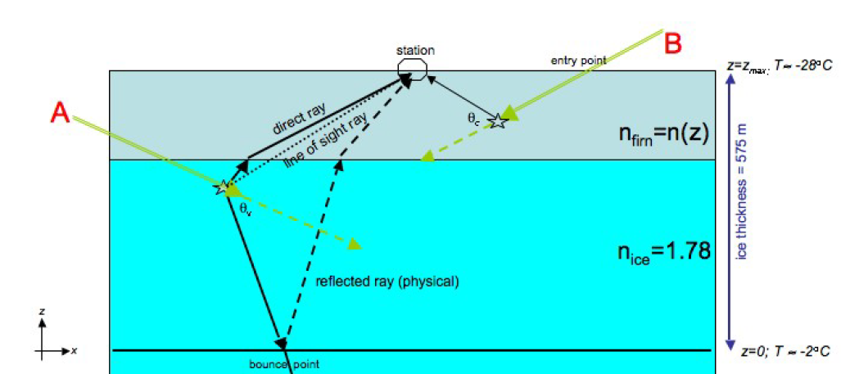
Issues with in-ice detection
In-ice ray-tracing extremely complex
Detection of a small fraction of the emission cone
➔ limited angular resolution ~degree scale
K. Hanson, ARA, ARENA2016
K. Dookaya, ARIANNA, PhD Thesis

Slide 7
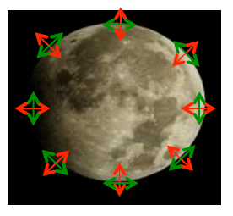
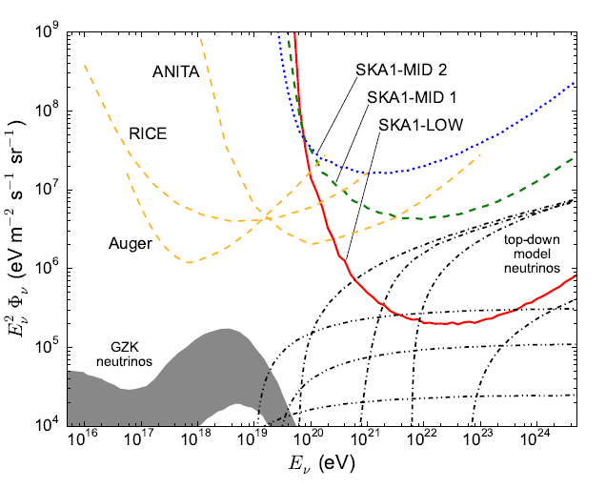
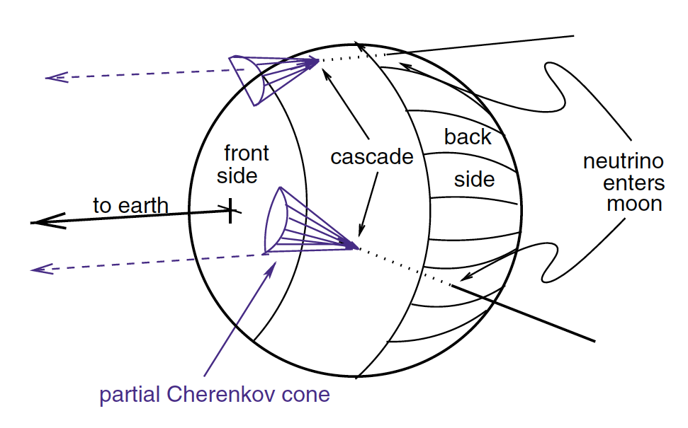
Moon as a target
Similar principle as in ice.
Huge target area… but very distant source (obviously…)➔ high energy threshold. Significant effect of surface roughness + ionosphere dispersion.
Competitive for exotic scenarios only.
J Bray, COSMIC2015 workshop

Slide 8

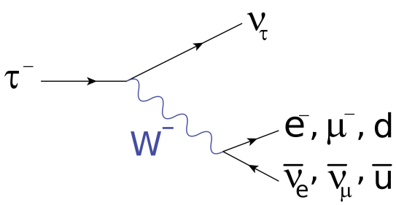
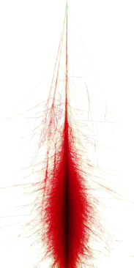
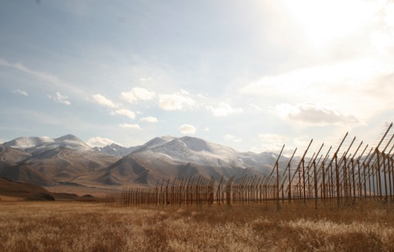
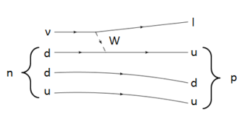
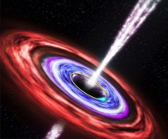
Earth-skimming neutrino detection
τ
ν_{τ}
Goal: search for cosmic neutrinos
Detection principle:
  ν-induced tau decays in atmosphere generate ~horizontal extensive air showers.
  [Fargion astro-ph/99066450, Bertou astro-ph/0104452]
  Issues:
    VERY seldom events
    Earth-skimming trajectories (mfp_{ν} <1000km)

Slide 9
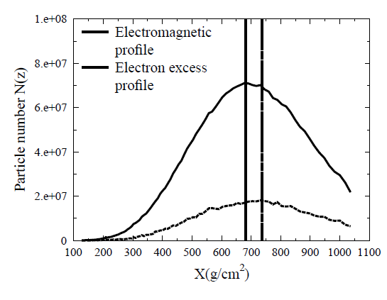
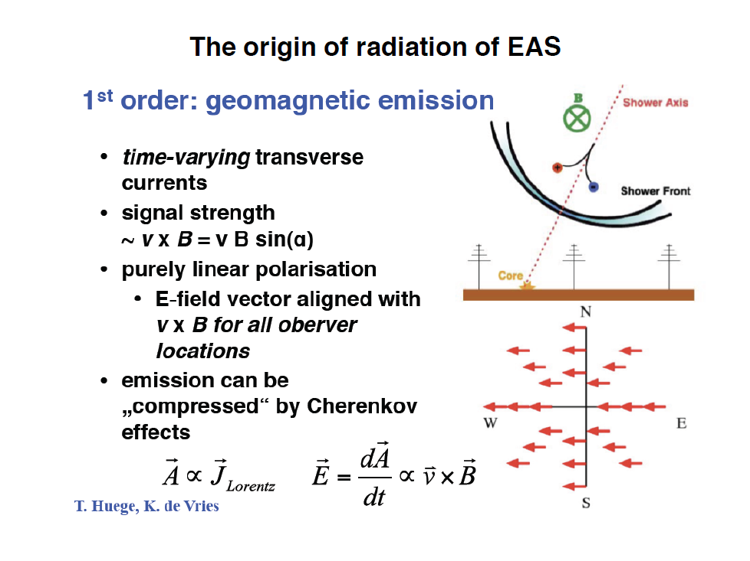
Radio emission by Air showers
Charge excess ⬄ Askaryan effect
De Vries et al.,
astro-ph/1304.1321
Geomagnetic effect

Slide 10
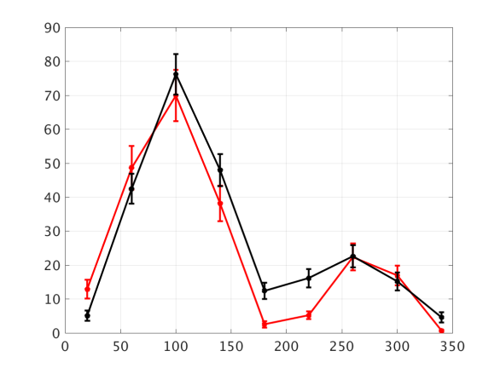
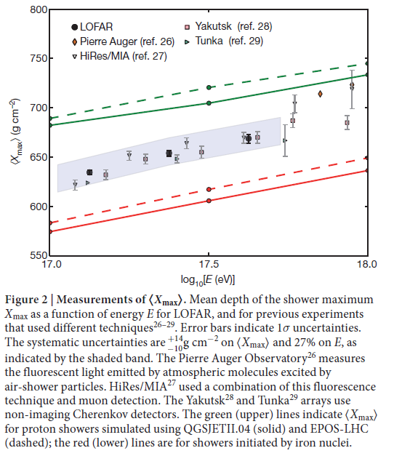
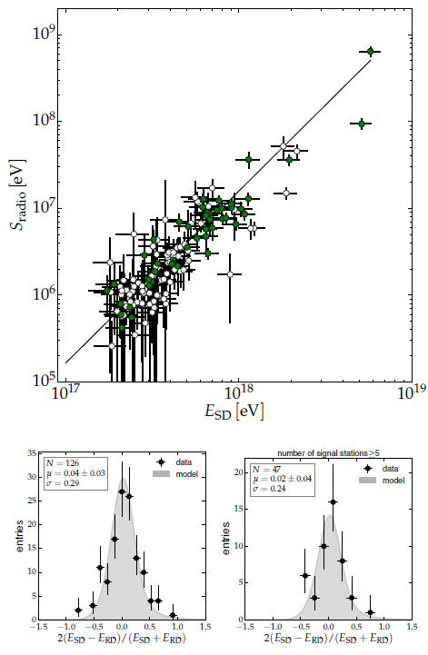
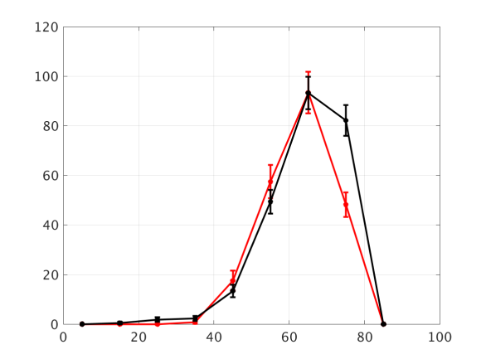
Why radio? Because it works!
MHz radio-detection of air showers becoming a mature technique
σ(Xmax) ~ 20g/cm²
ΔE/E<20%
Autonomous radio-detection & identification of air showers
-- Data
-- EAS simu
Aab et al., AUGER
astro-ph/1508.04267
Le Coz et al., TREND
ICRC2017
+A&A in prep
Azimuth (deg)
-- Data
-- EAS simu
Buitink et al., LOFAR, Nature
Zenith (deg)

Slide 11
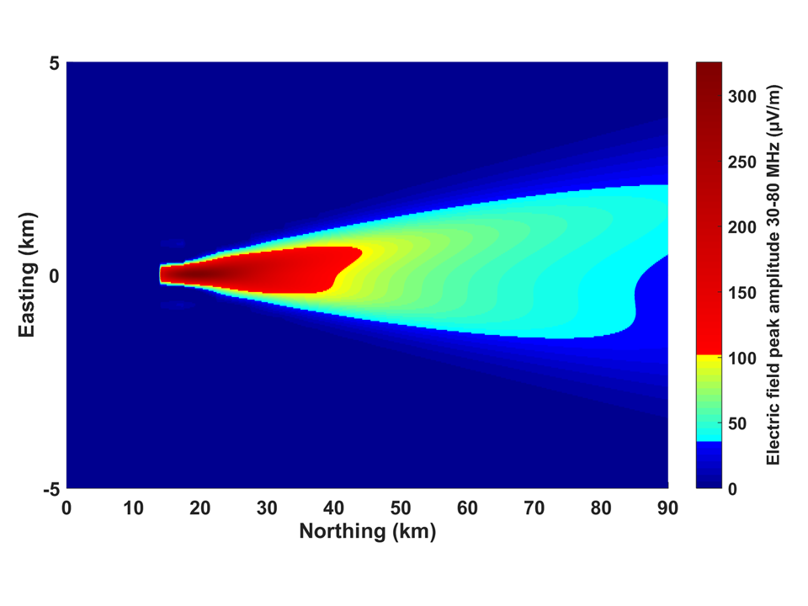
Why radio?
Because it is perfect for horizontal air showers!
50-200MHz radio emission of a 10^{17.5}eV shower viewed from the side:
~10s of km² detectable footprint @ ~100 km!!
Use
Elevation (km)
Use mountains as projection screen for radio emission
Background level: 15µV/m

Slide 12
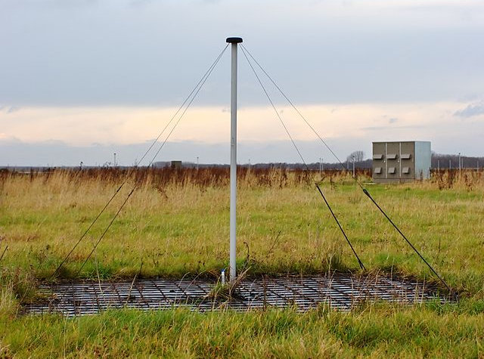
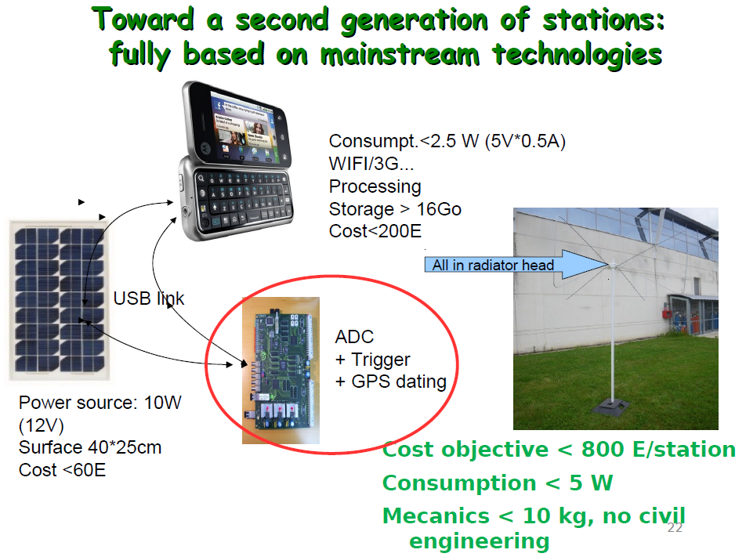
Why radio? Because it is cheap!
Basic ⬄ cheap
P. Lautridou (2011)

Slide 13
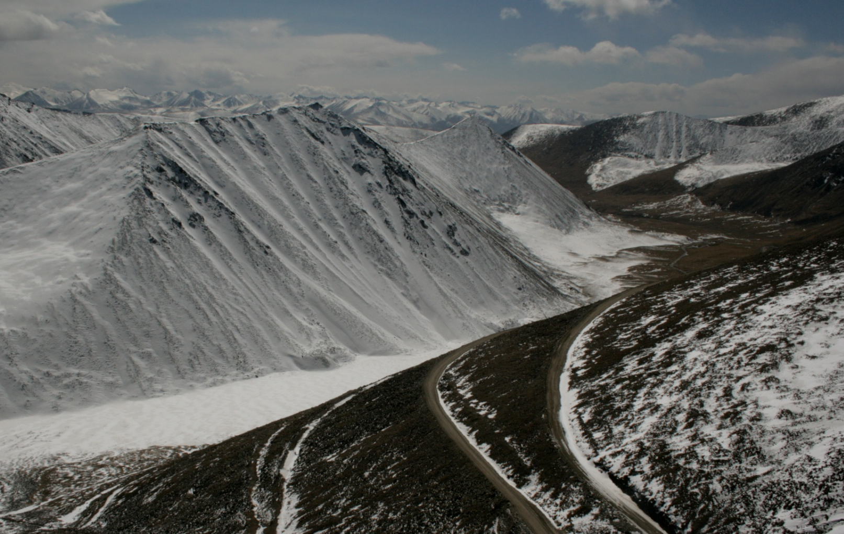
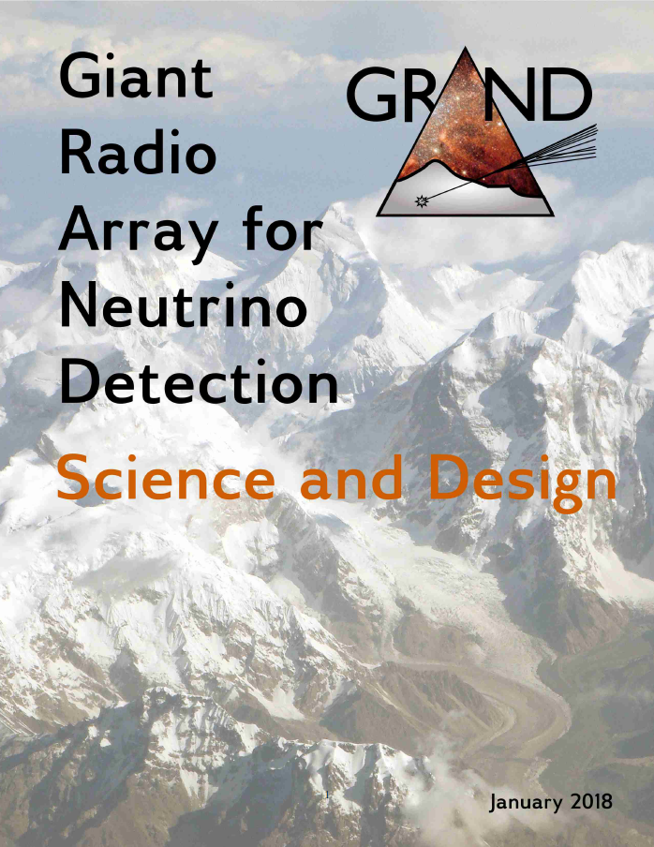
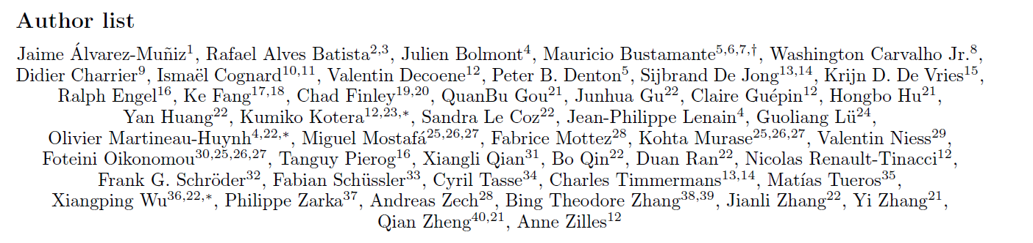
The GRAND project
Size of the neutrino detector is a key parameter.
>10000 km²?
- technical capacity?
- topology?
Ulastai

Slide 14
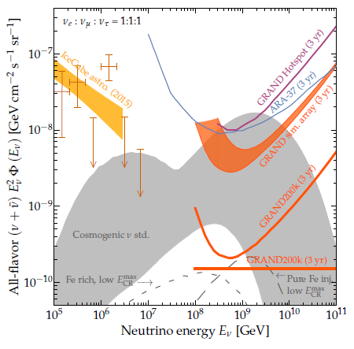
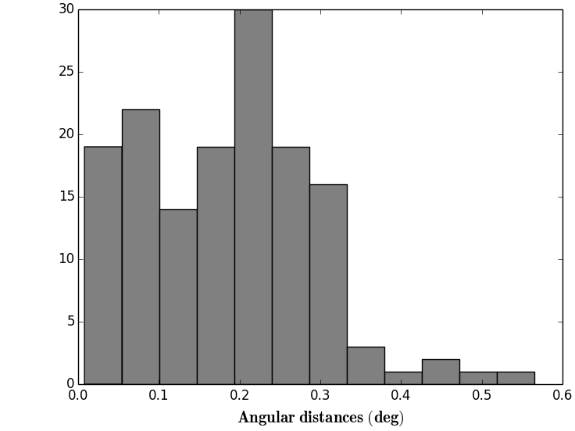
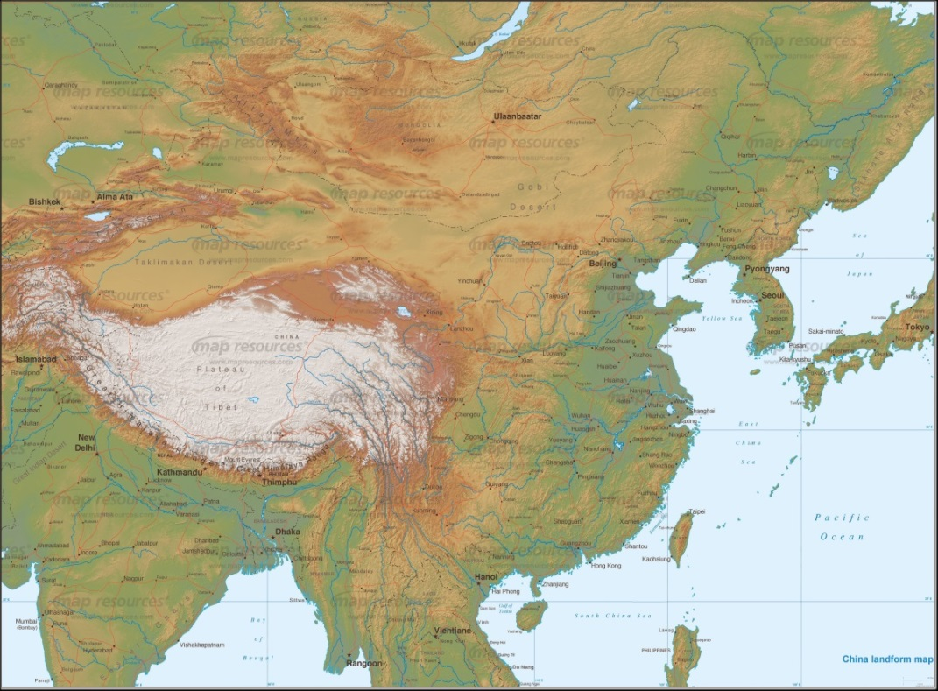
GRAND goal
Large enough to guarantee detection of UHE neutrinos
<ψ>= 0.2°
(Plane wave approx)
(V. Decoene)
PRELIMINARY
➔ Astronomy!!!
PRELIMINARY
o(10-20) hotpsots of o(20-10) kAntennas
deployed over o(20-10’000) km² hotspots with favorable topographies around the world.
➔ total area: 200’000km²

Slide 15
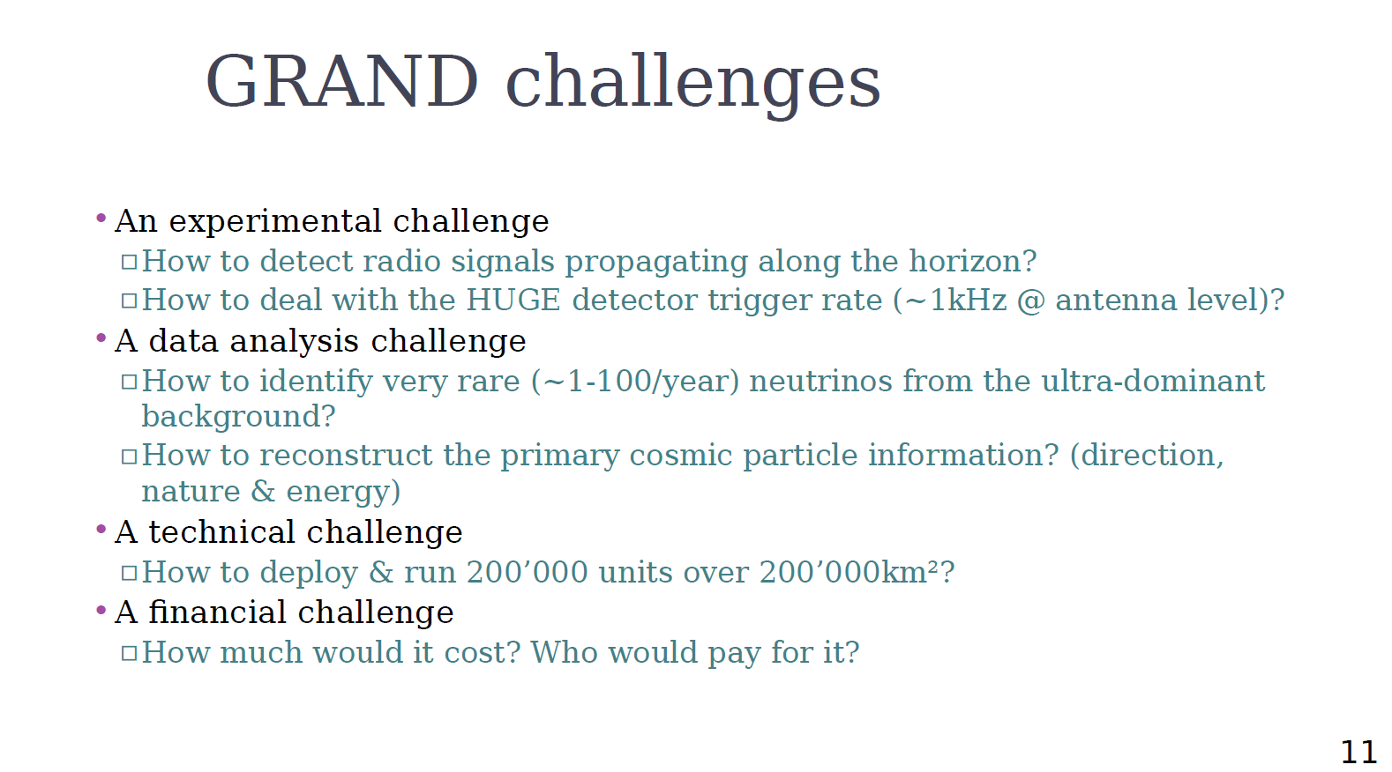

Slide 16
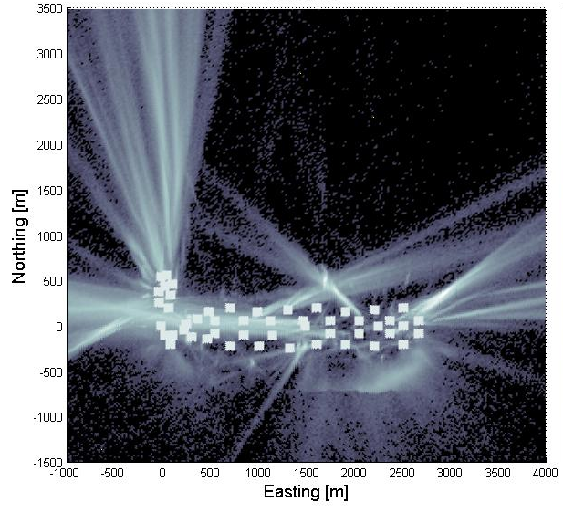
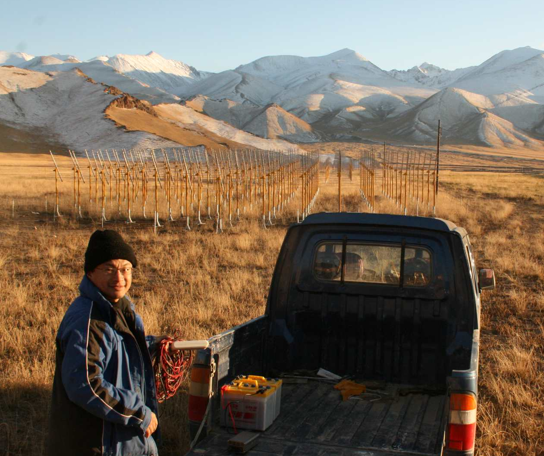
Radio background
Short waves
Simulated
galactic bckgd
Measured bckgd noise
ex: TREND autonomous array
  50 antennas over 1.2km²
  ~30Hz average coinc rate over whole array
  vs ~20 air showers/day expected
2011-2012 data
TREND antenna
Reconstructed source position
TREND site, October 2008

Slide 17
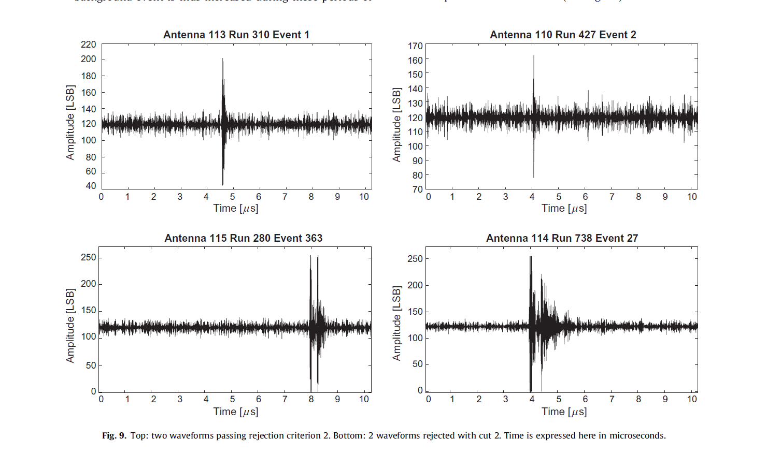
Signal identification & data transfer
Identification tools:
  Pulse shape
  Polarization
  Antenna coincidences
  Machine learning
Possible air shower signal
Certain background signal

Slide 18
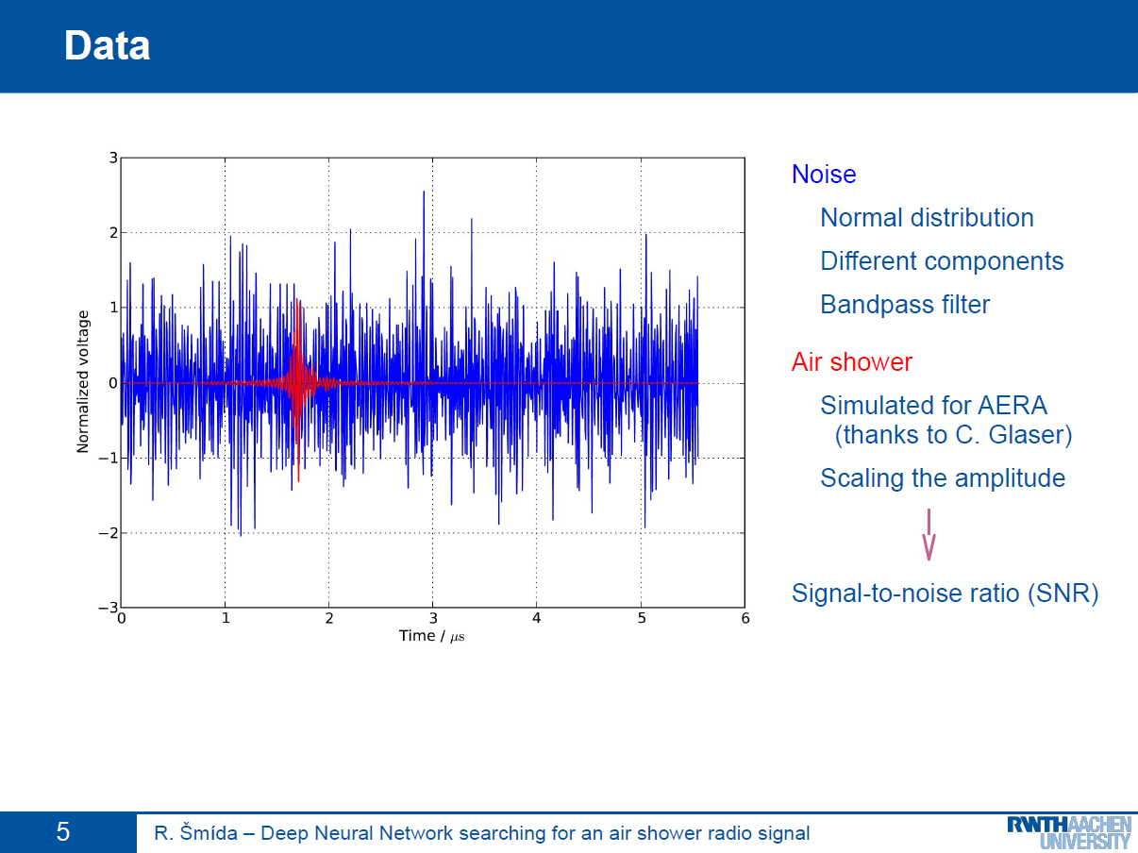

Slide 19
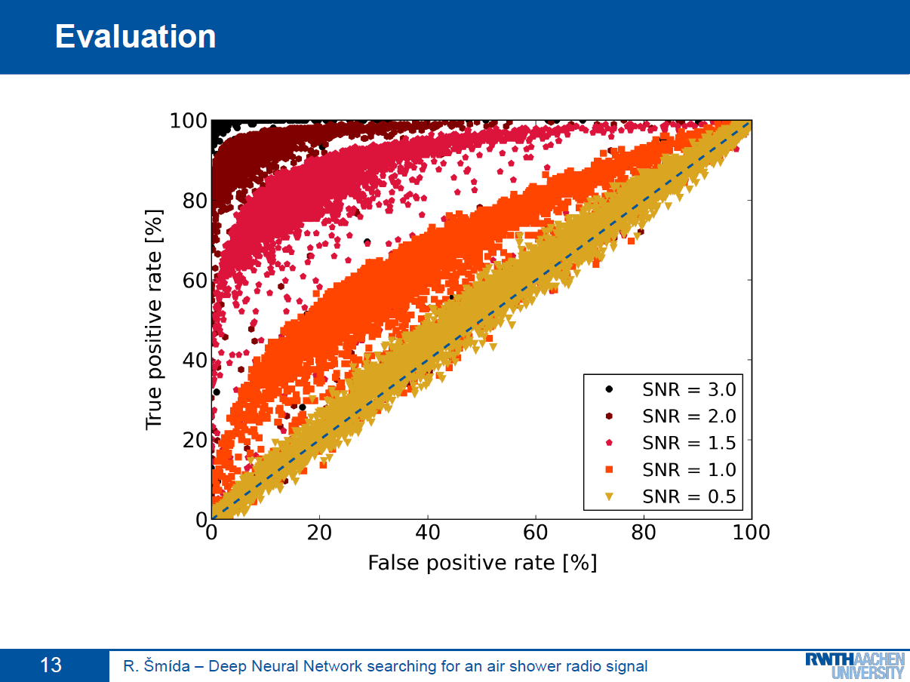

Slide 20
Signal identification & data transfer
Identification tools:
  Pulse shape
  Polarization
  Antenna coincidences
  Machine learning
Data transfer:
  Full trace: 2µs*500MHz*12bits~1.5kBy
  Really necessary??... Can surely cut down deep in data volume
Possible air shower signal
Certain background signal

Slide 21
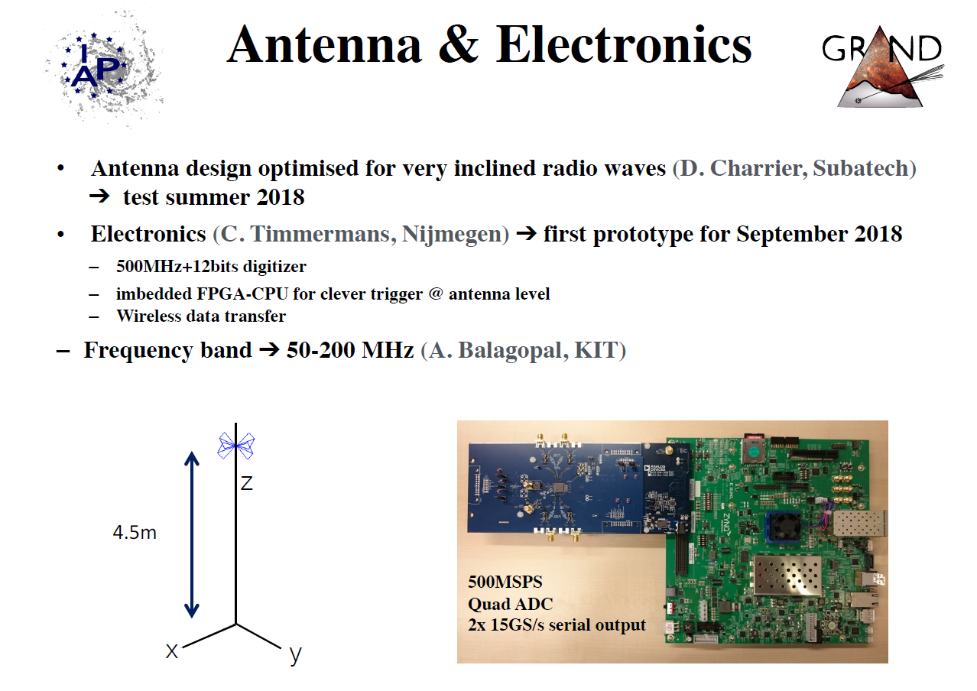
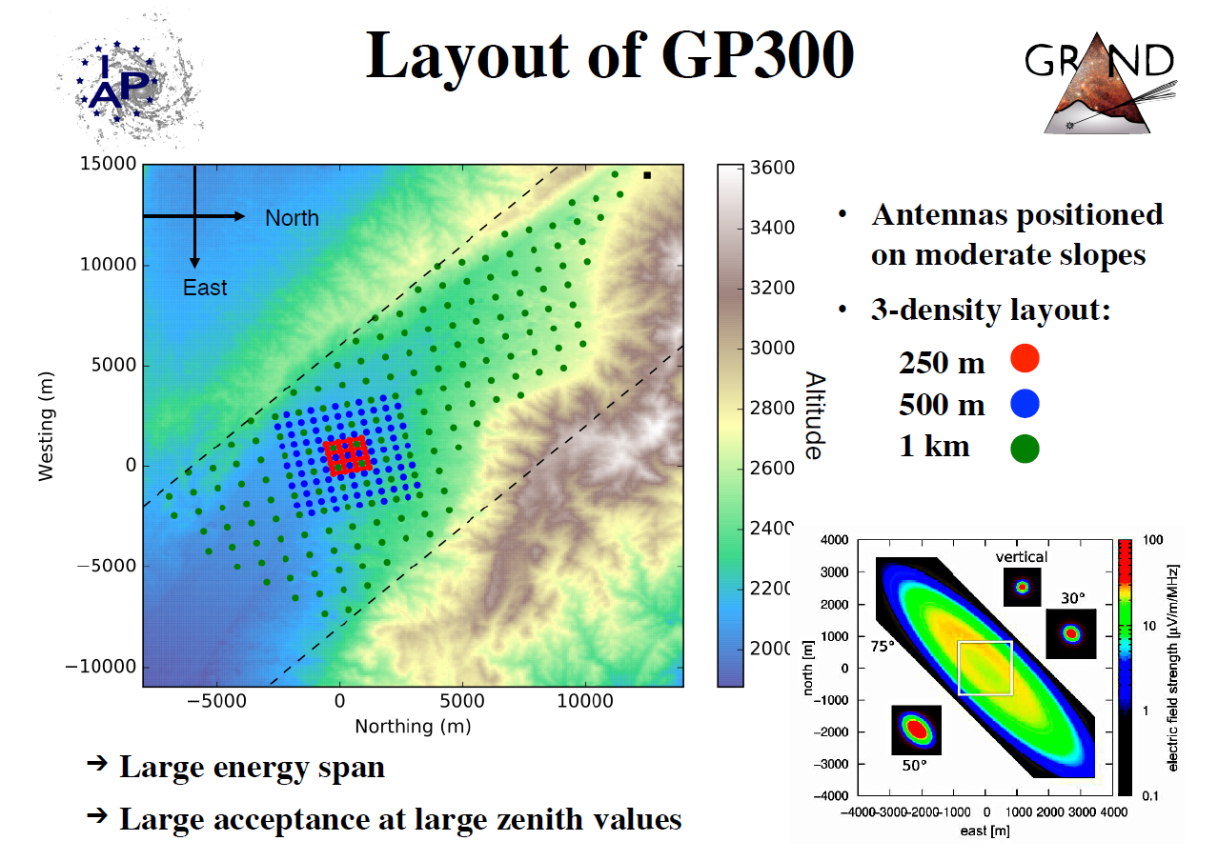
GRANDProto300
Engeneering array for GRAND
… and much more!
2020-2025
N. Renault-Tinacci, FCPPL wokshop

Slide 22
Back-up

Slide 23
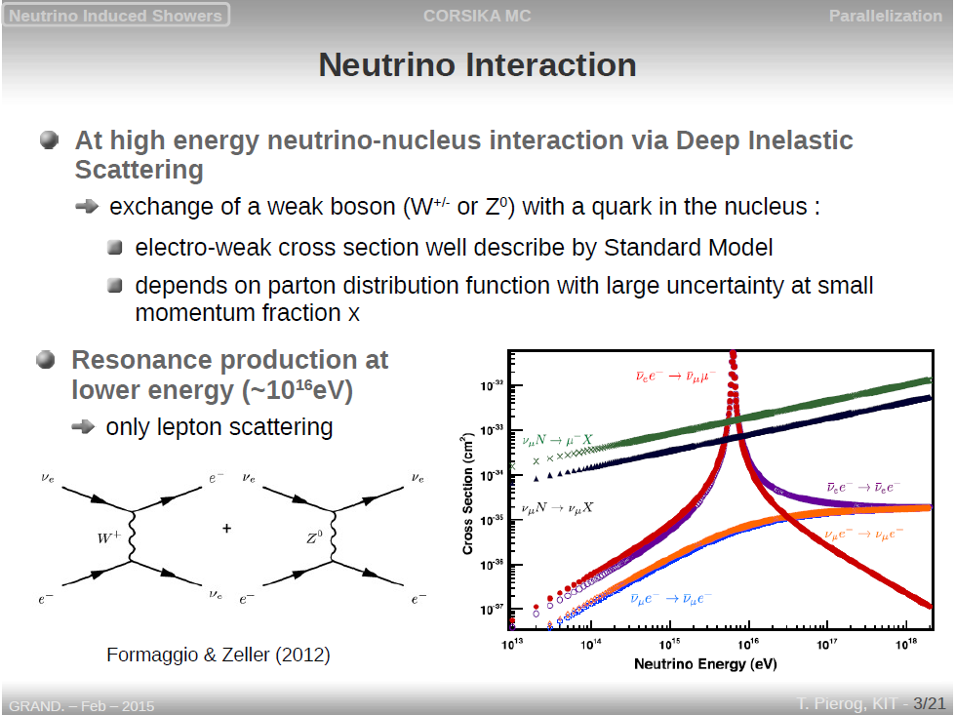
Tanguy Pierog,
GRAND workshop,
Feb 2015

Slide 24
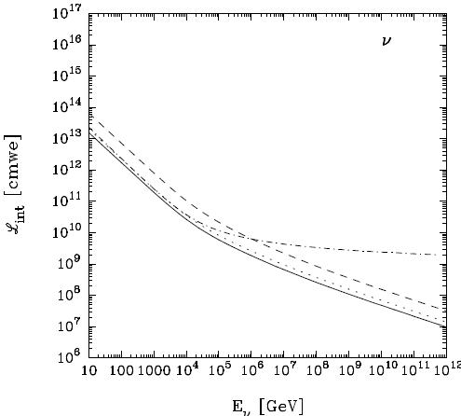
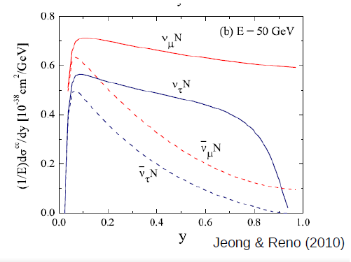
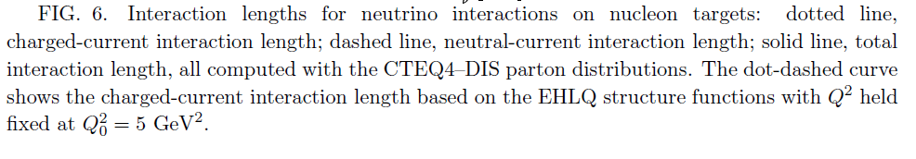
Neutrino → Tau
Mean free path: 100 to 1000kms in rock for E in 10¹⁷-10²⁰eV
Large dispersion on momentum transfer to lepton
Inelasticity y=E_{X}/E_{ν} , 1-<y>=0.8 (for all E in range)
Dutta et al.
hep-ph/0504208v2

Slide 25
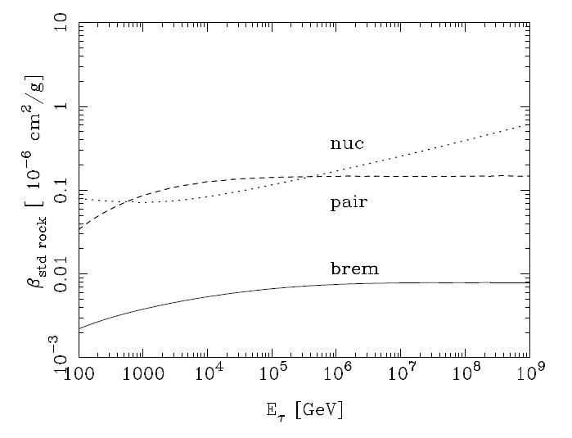
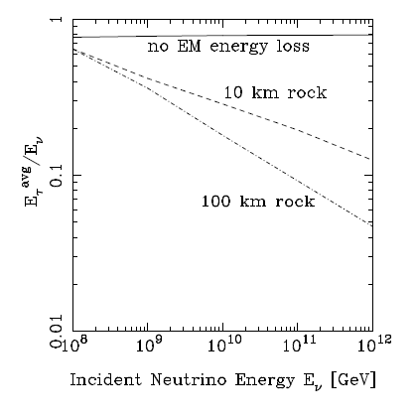
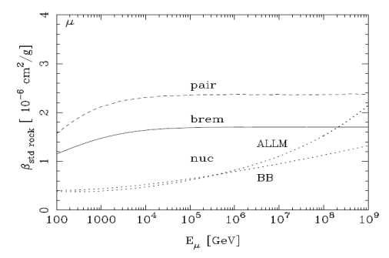

Tau energy losses
$$<\frac{dE}{dz}> ≅−βE with β=β_{brem}{+β}_{nuc}{+β}_{pair}$$
Tau emerges with sizeable energy only for d_{rock}<~100 kms
Photonuclear interaction dominate for E>10¹⁵eV
Taus
Dutta et al.
hep-ph/0012350
Dutta et al.
hep-ph/0504208v2
mus

Slide 26
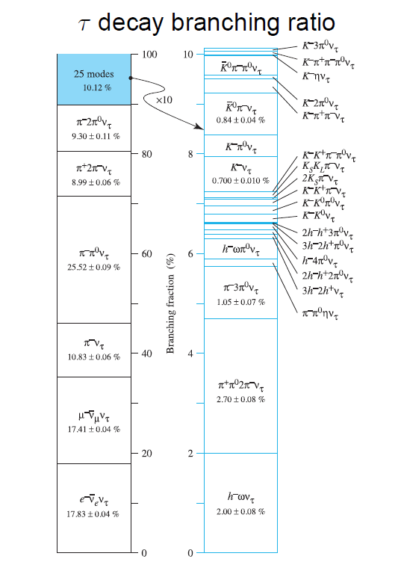
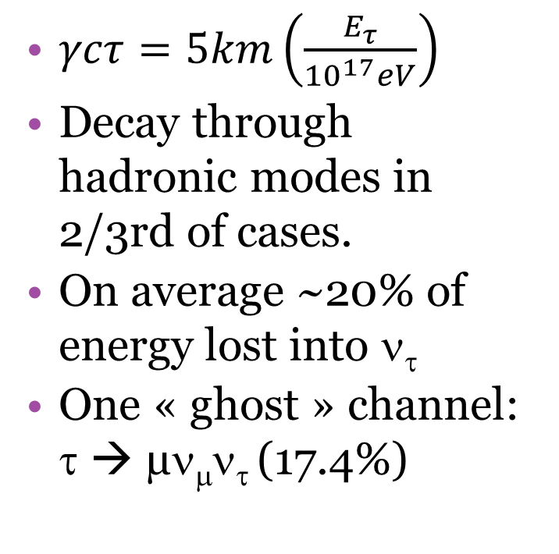
Tau decay
$γcτ=5km\left(\frac{E_{τ}}{{10}^{17}eV}\right)$
Decay through hadronic modes in 2/3rd of cases.
On average ~20% of energy lost into ν_{τ}
One « ghost » channel: τ → µν_{μ}ν_{τ} (17.4%)

Slide 27


