Slide 1
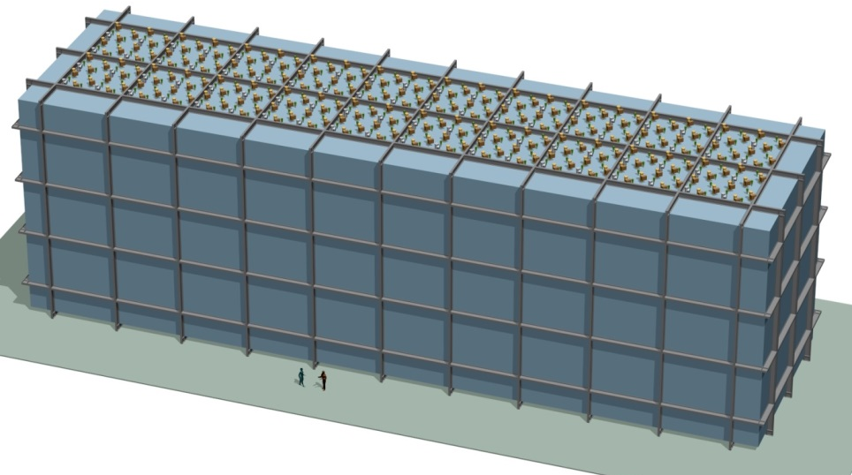
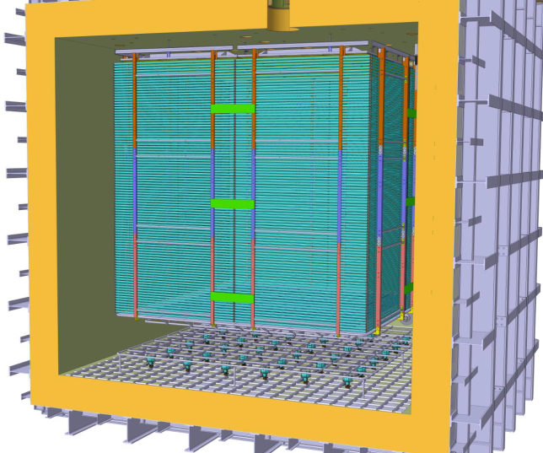
DUNE Overview
Dario Autiero, IPNL Lyon
GDR neutrino meeting, ESPP discussion
APC, 11/6/2018
DUNE
10 kton module
WA105
Dual-Phase ProtoDUNE

Slide 2
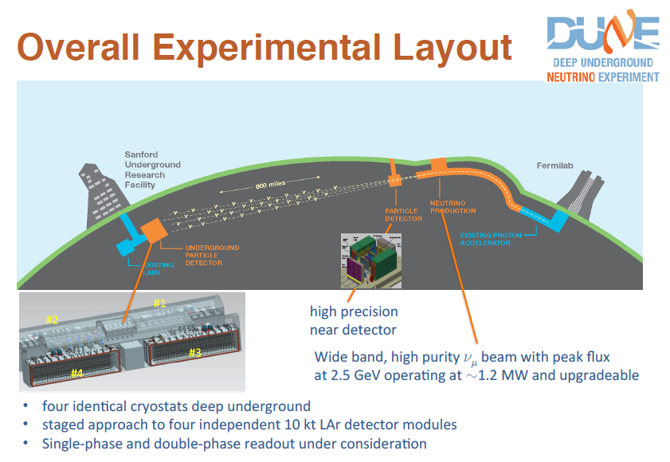
1.2 – 2.4 MW
40 kton FD mass
Operation since 2026

Slide 3
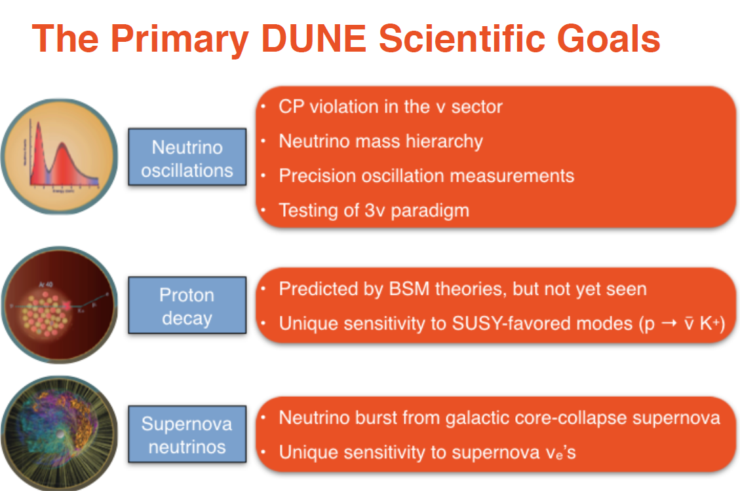

Slide 4
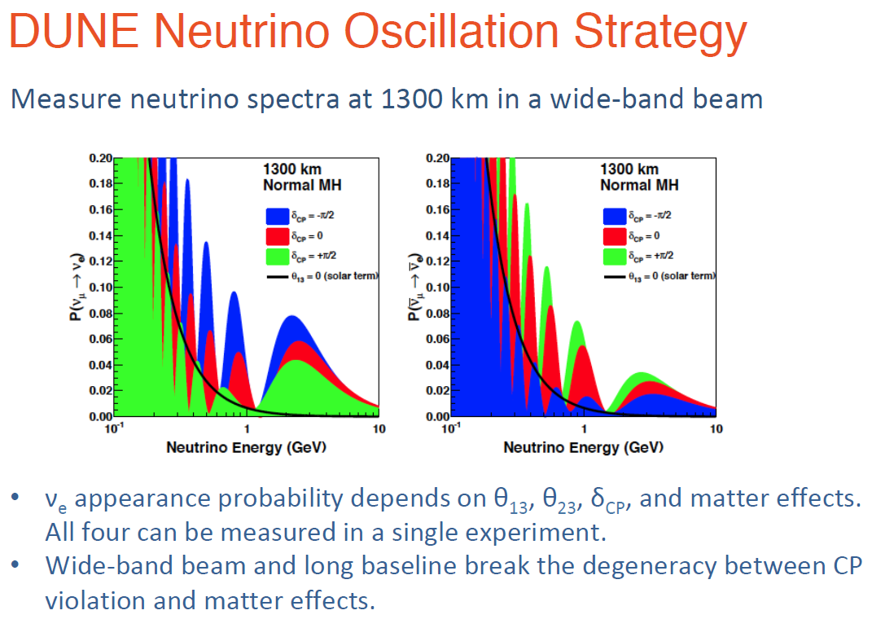

Slide 5
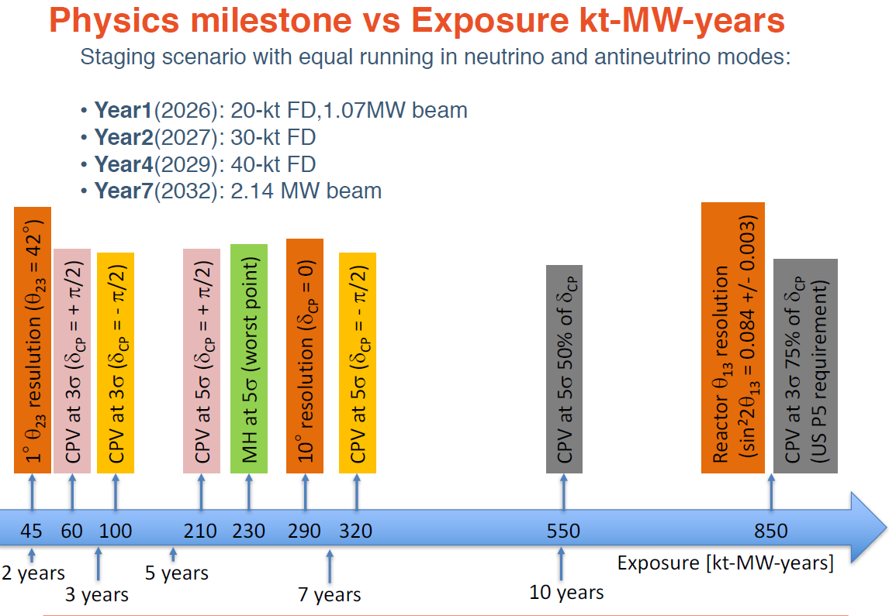

Slide 6
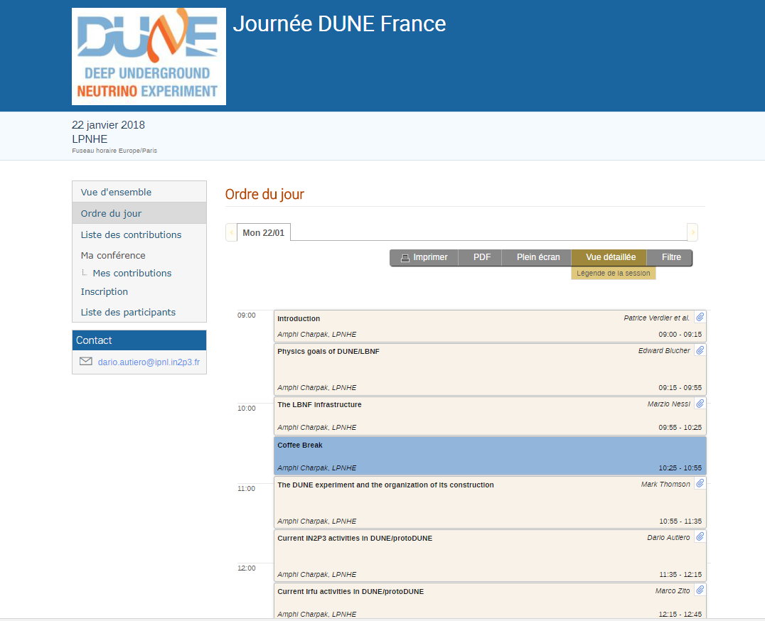
https://indico.in2p3.fr/event/16873/

Slide 7
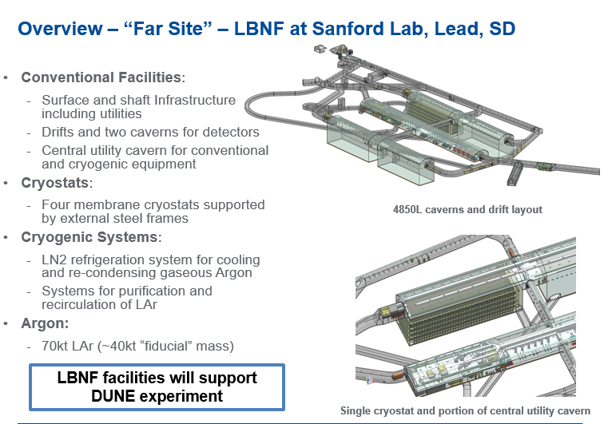

Slide 8
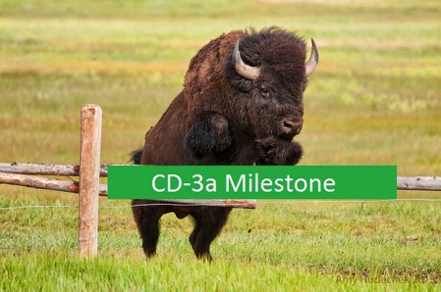
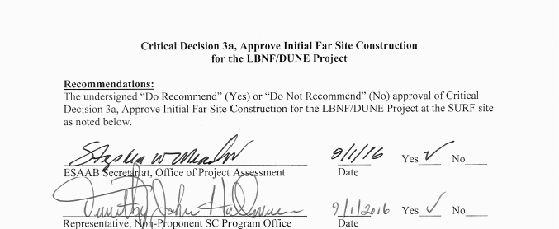
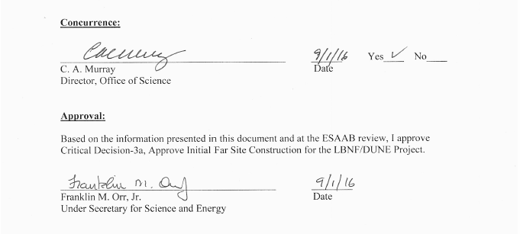
DUNE CD-1R 2015 (Conceptual Design Report)
LBNF CD-3a 2016 – Approval of Initial Far Site Construction
On September 1st 2016, DOE Under Sec’ty for Science and Energy approved the CD-3a milestone
Signifies DOE's strong commitment to move the project forward, solidify international partnerships, and position DUNE to rapidly pursue its science objectives.

Slide 9
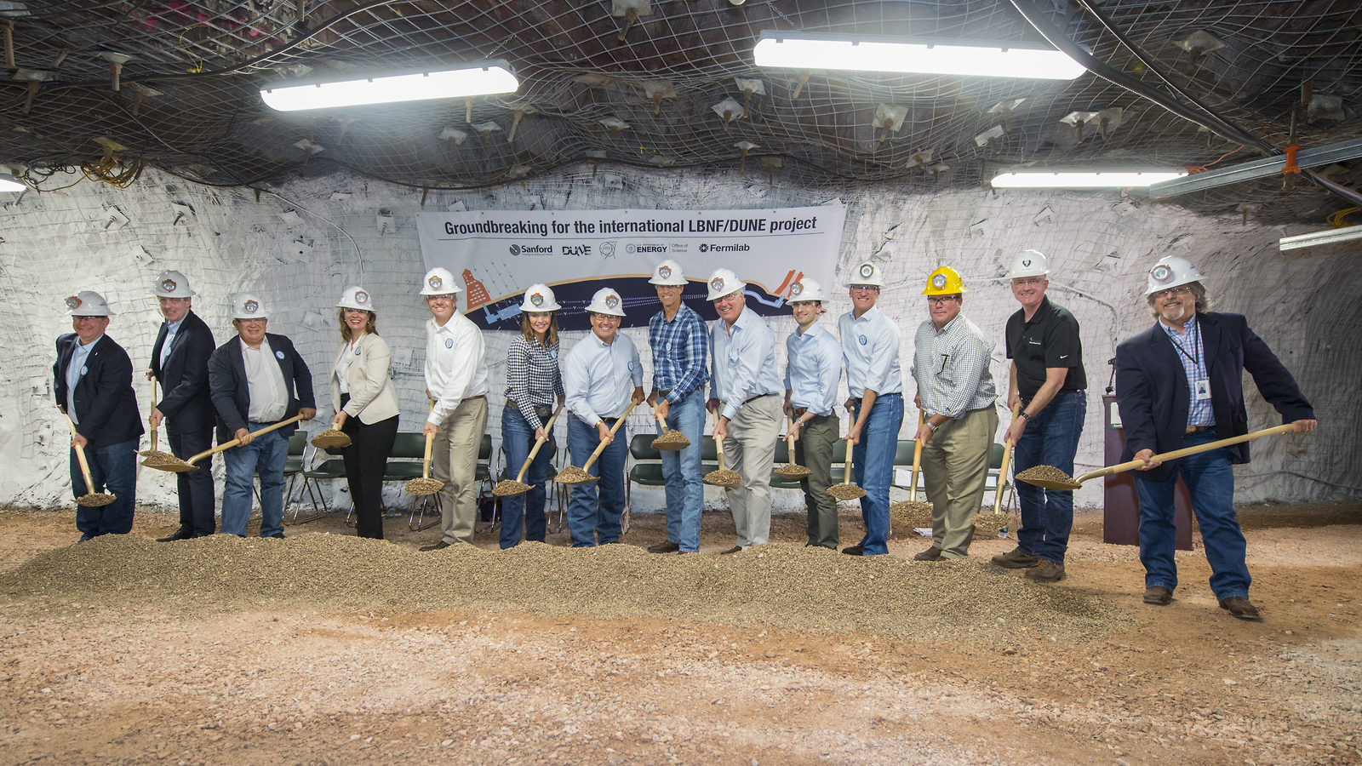
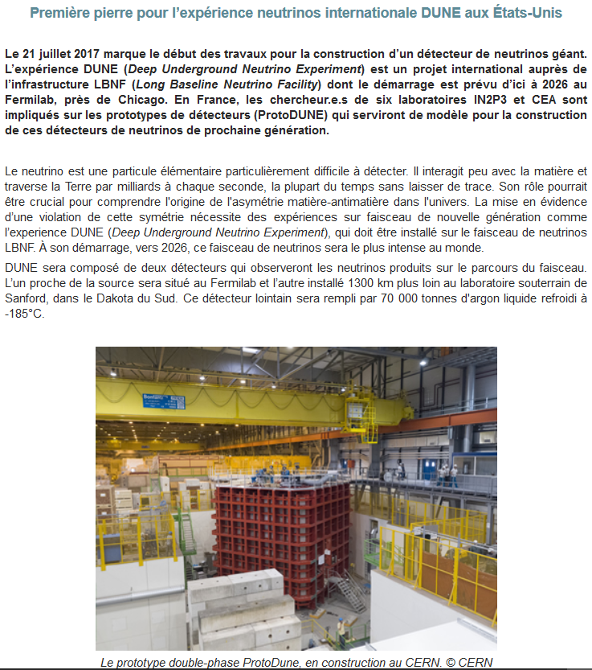
LBNF Groundbreaking 21/7/2017
→ Start of civil engineering works for LBNF
http://www.in2p3.fr/recherche/actualites/2017/nouvelle_experience_dune.html
http://news.fnal.gov/2017/07/construction-begins-international-mega-science-experiment-understand-neutrinos/
Strong committment reiterated: funding allocated for FY 2019 (95 M$) exceeded expectations and the budget recommended by the House of Representatives/Senate committees (80M$)

Slide 10
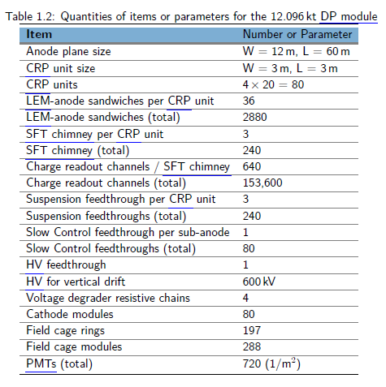
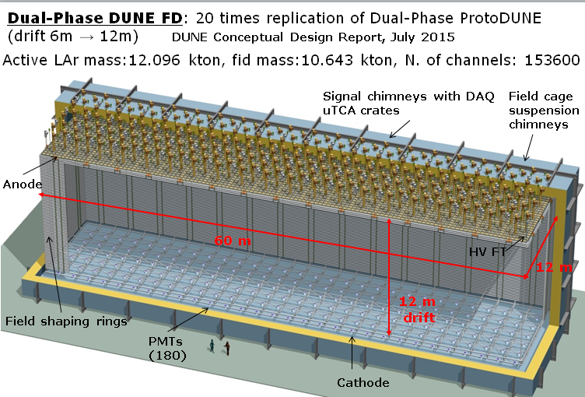
Advantages of dual-phase design:
Gain in the gas phase → robust and tunable S/N, lower detection threshold, compensation for charge attenuation due to long drift paths
Finer readout pitch (3.125 mm), implemented in two identical collection views (X,Y) on 3m long strips
Long drift projective geometry: reduced number of readout channels (153,600 for DP less than half of equivalent SP FD), absence of dead materials in the drift volume
Fewer construction modules
Full accessibility and replaceability of cryogenic front-end (FE) electronics during detector operation

Slide 11
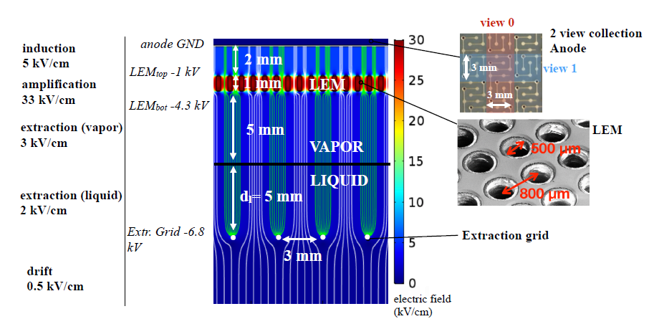
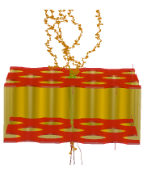
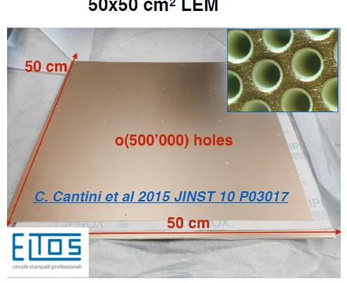
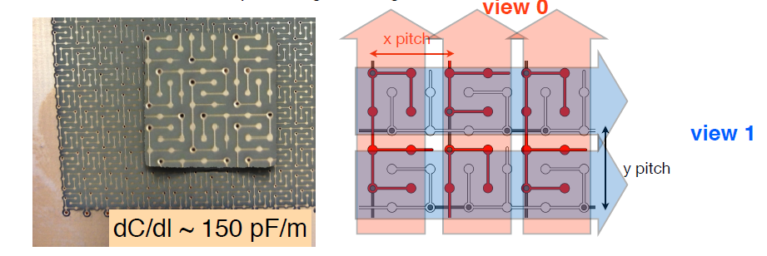
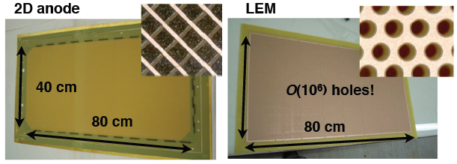
Charge Readout
Plane integrating
LEM-anode sandwiches
Electron avalanche in LEM hole
50x50 cm² LEM
50x50 cm² anodes with 2 collection views

Slide 12
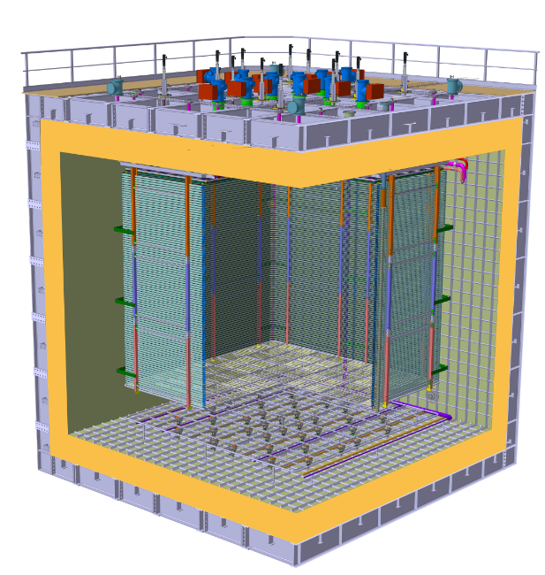
The DP-FD design described in the TP is based on ProtoDUNE-DP design
Digital electronics in uTCA crates
Cold FE electronics in SFT “chimneys”
Charge Readout Planes
Field Cage sub-modules (common structural elements with SP)
6 m
Cathode modules
36 cryogenic photomultipliers Hamamatsu R5912-02mod with TPB coating
6 m

Slide 13
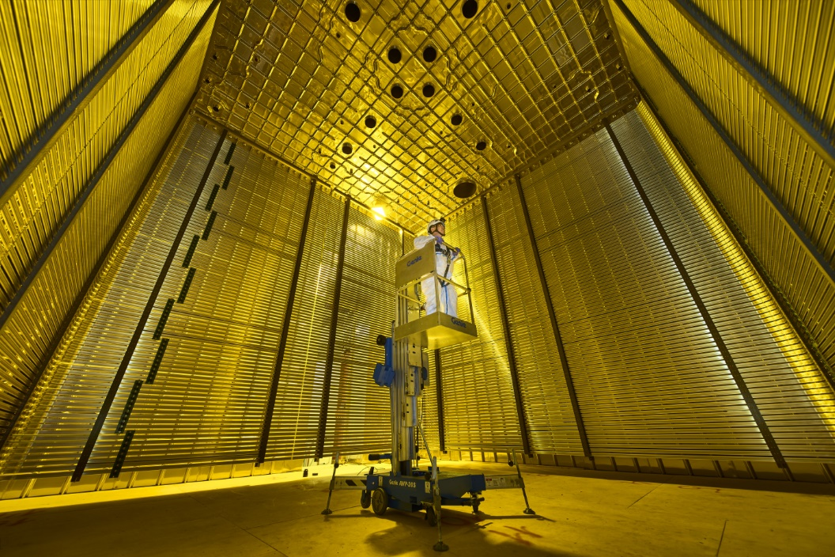
ProtoDUNEs detectors at
CERN EHN1
Dual-phase
Single-phase
ProtoDUNE dual-phase under construction
see also: http://news.fnal.gov/2018/06/dune-collaboration-grows-to-32-countries-prepares-for-operations-of-prototype-detectors/

Slide 14
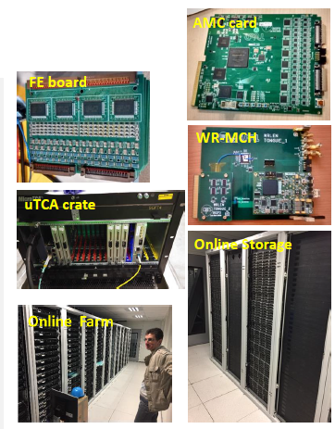
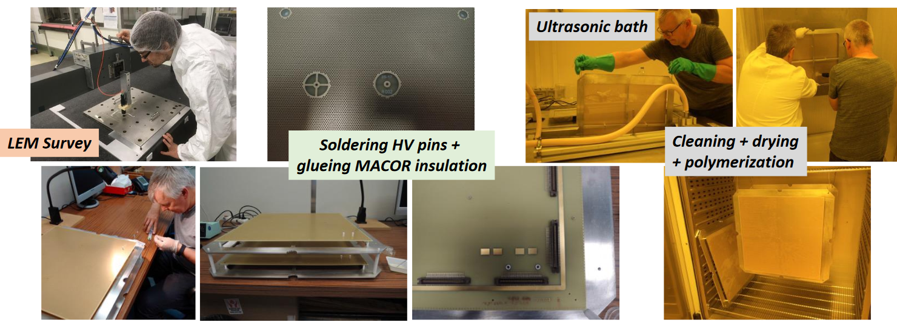
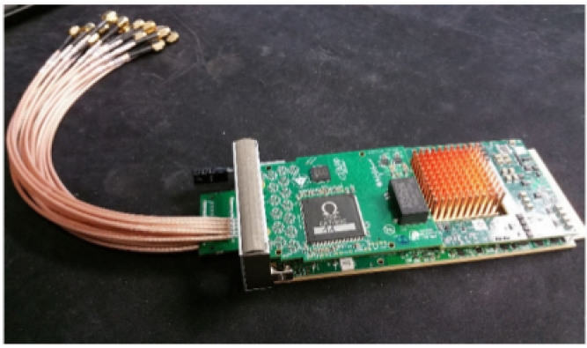
Current DUNE CEA/Irfu and IN2P3 groupshave been involved in ProtoDUNE-DP (formerly known as WA105) since 2013 and in DUNE since its creation (2014-2015)
IPNL: charge readout analog/digital electronics, DAQ
CEA/Irfu: LEM/anodes
APC/LAPP/OMEGA:
Light readout electronics
LAPP:
Charge Readout Planes mechanics

Slide 15
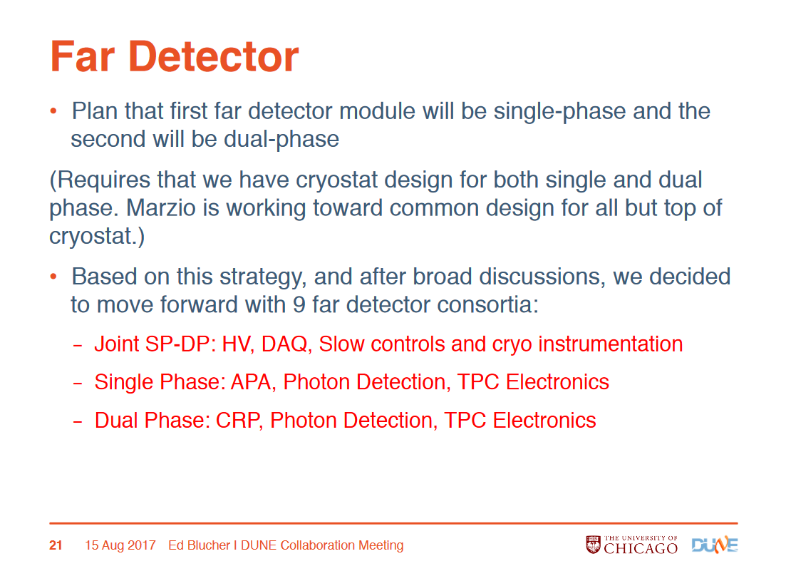
Creation of Far Detector consortia July-August 2018
Planning: First installed FD module single-phase, second module dual-phase

Slide 16
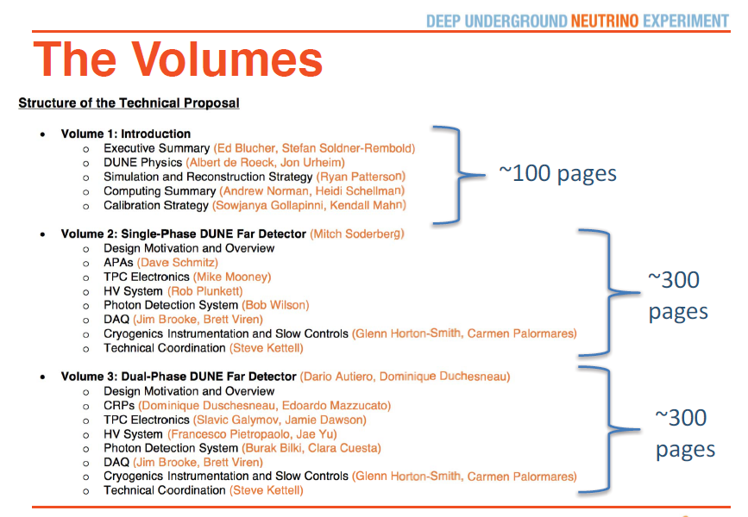
Schedule:
Technical Proposal (interim-TDR) submitted to LBNC in May 2018 (soon public)
Fall 2018-Spring 2019 ProtoDUNEs operation
Technical Design Report (under work) to be completed by May 2019
2019: Start of Far Site caverns excavation
2022: Start of installation of first FD module
2023: Start of installation of second FD module
2026: Start of neutrino beam
Snapshot of Technical Proposal (interim-TDR)

Slide 17
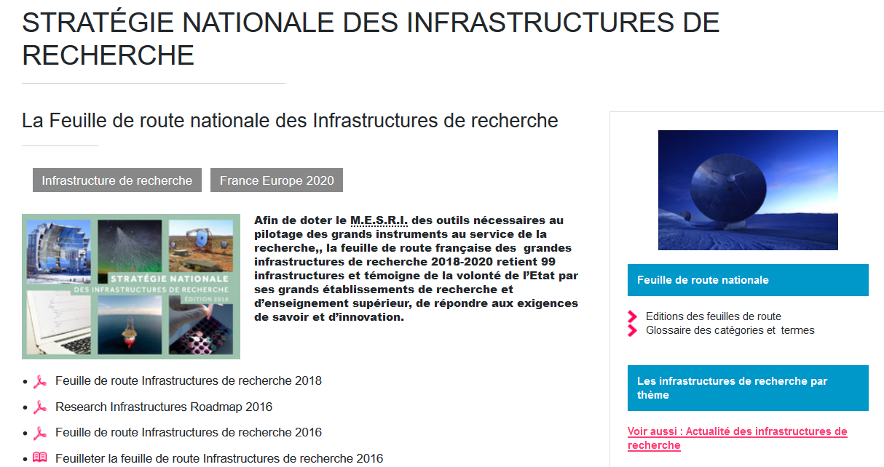
March 2018: Inscription of DUNE to the « Feuille de route nationale des Infrastructures de recherche »
http://www.enseignementsup-recherche.gouv.fr/cid70554/la-feuille-de-route-nationale-des-infrastructures-de-recherche.html
IR project for DUNE under definition:
Interest for additional contributions already expressed: LAL (detector), CEA/Irfu, IPNO, LAL (beam)
New groups are welcome !
2 pages input document to the IN2P3 for the ESPP from the DUNE IN2P3 groups will be provided by the end of July

Slide 18
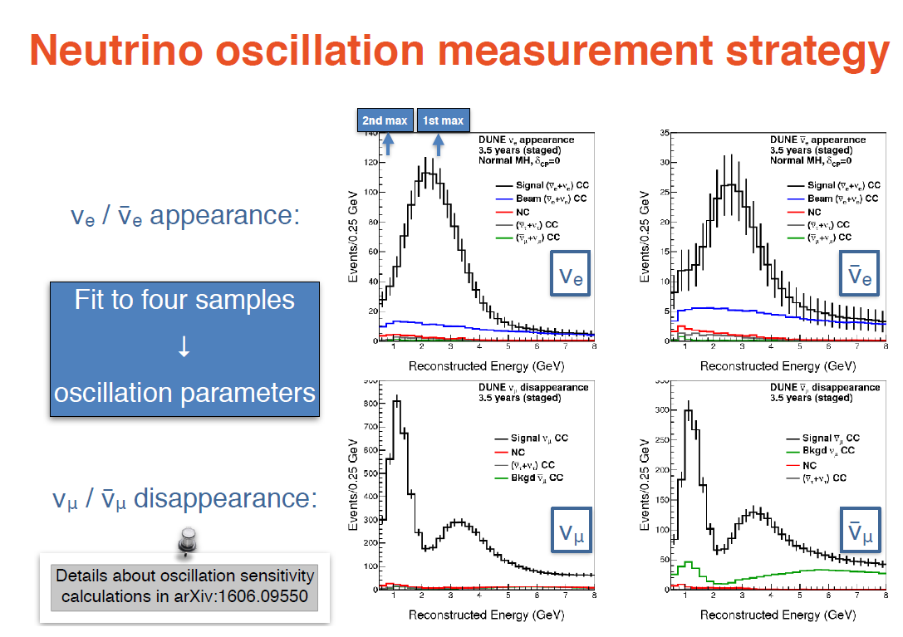

Slide 19
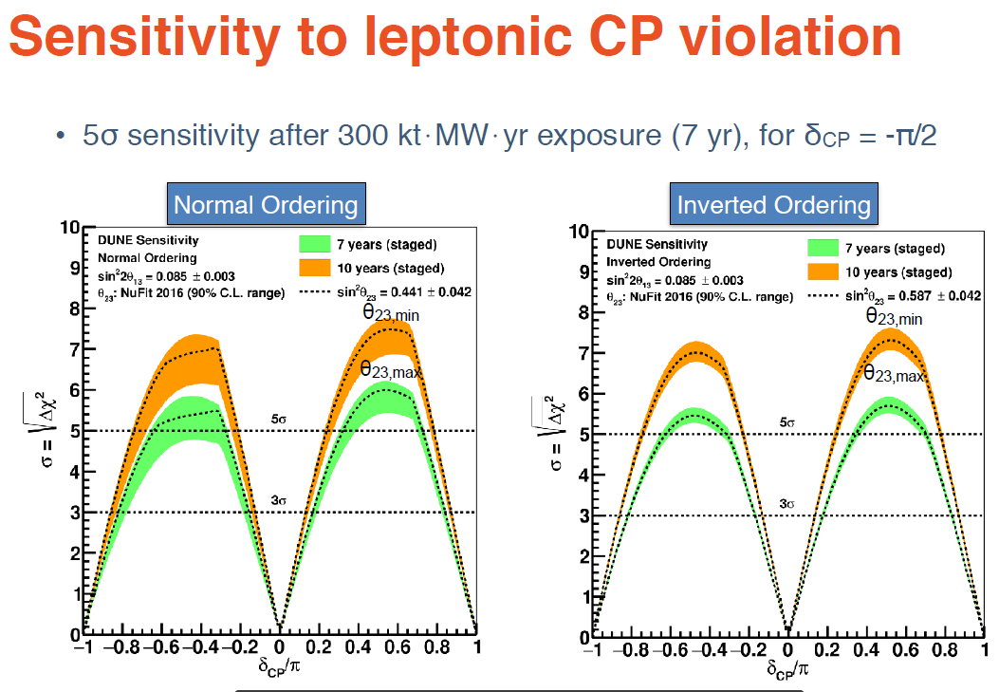

Slide 20
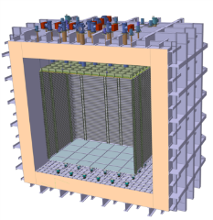
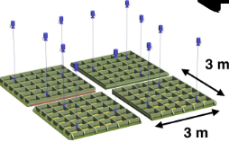
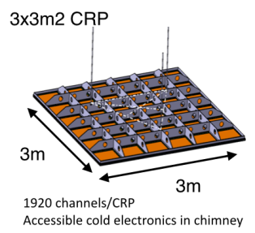
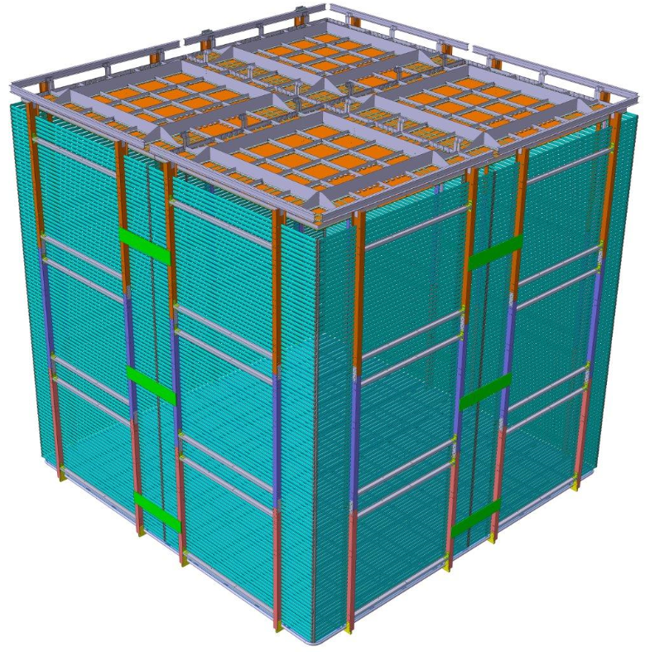
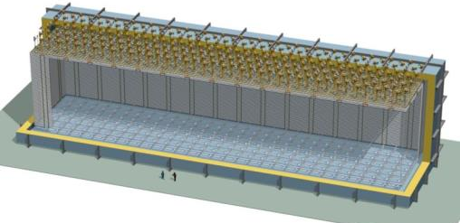
The Dual-Phase ProtoDUNE/WA105 6x6x6 m³ detector is built out of the same 3x3m² Charge Readout Plane units (CRP) foreseen for the 10 kton Dual-Phase DUNE Far Detector (same QA/QC and installation chains)
WA105: 4(2) CRP
10 kton: 80 CRP + 288 field cage sub-modules + 80 cathode/ground grid modules
6 m
12 m
6 m
6 m
60 m
20

Slide 21
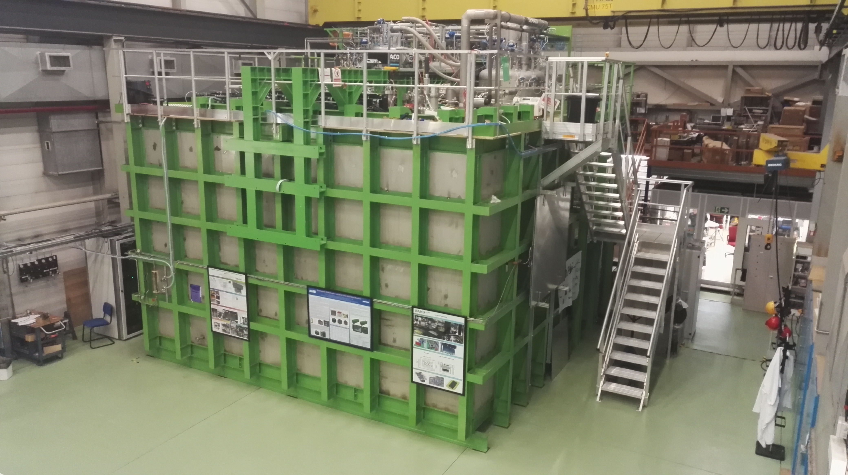
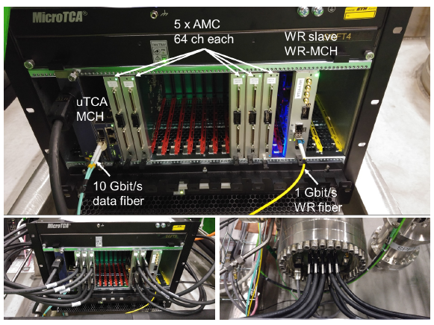
6x6x6: 12 uTCA crates (120 AMCs, 7680 readout channels)
3x1x1: 4 uTCA crates (20 AMCs, 1280 readout channels) Operational since fall 2016
Signal Chimneys and uTCA crates
Event builder, network, GPS/White Rabbit GM,
WR Trigger PC

Slide 22
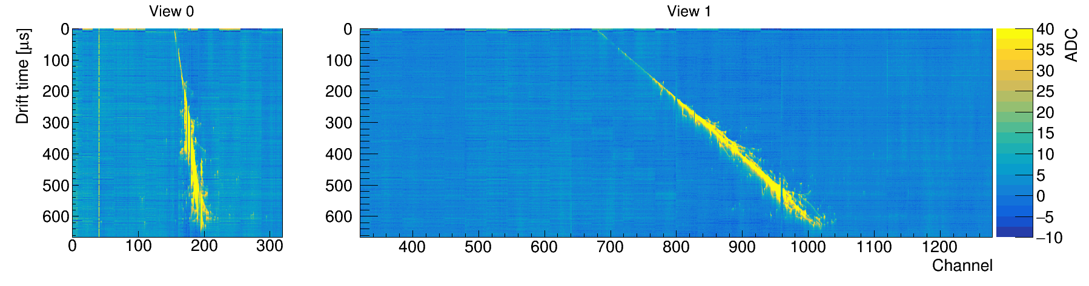
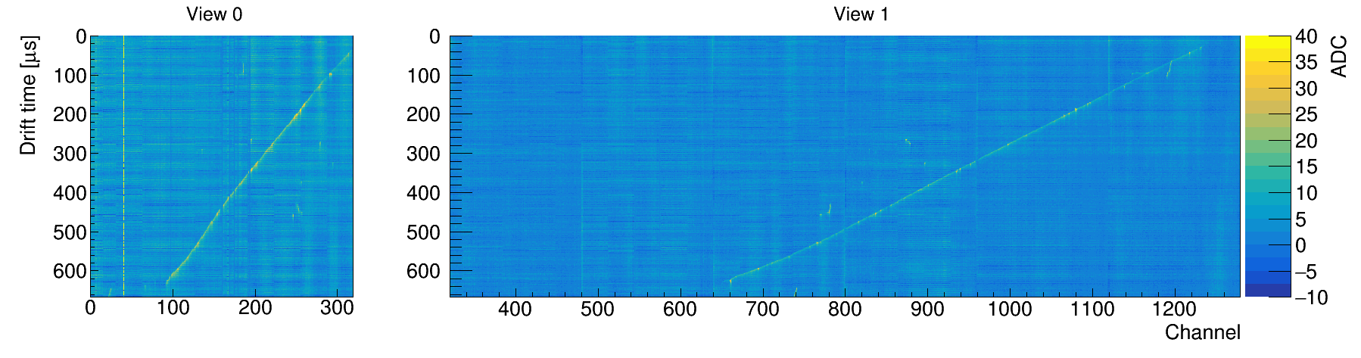
3x1x1 cosmic ray events:

