Slide 1
V. Breton Plan-e meeting
Notes:
Présentation générale de France Grilles (5’)
L’INRA dans France Grilles (5’)
Les services de France Grilles (3’)
Conclusion et perspectives (2’)

Slide 2
What is the Long Tail of Science?
The scientists in Europe who are not using data and computing infrastructures
In France: 156000 researchers, including 77000 PhD students
Estimated number of e-infrastructure users < 10% (15000)
The scientists outside Europe in developing countries
Notes:
regional HP Centers (6000), Tier-0 and Tier 1 HPC Centers (3000), France Grilles 1500), Grid5000(500)

Slide 3
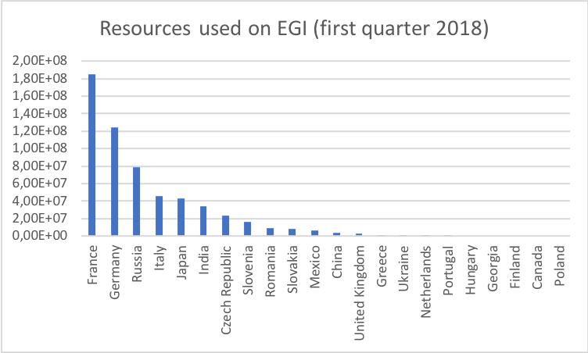
Specific efforts made to address long tail on EGI
Dedicated France Grilles VO for new users
80+ active users (4/18)
Hide grid complexity: FG-DIRAC
Training and support to users

Slide 4
Challenges to serving the LTOS on EGI
Year | CPU hours consumed by french certificate owners | CPU hours contributed by France and used by EGI | Share of France resources consumed by CERN
1-3/2018 | 185 M | 813 M | 84%
2017 | 676 M | 3,2 G | 83%
2016 | 760 M | 2,6 G | 77%
2015 | 850 M | 2,5 G | 76%
2014 | 700 M | 1,5 G | 72%
EGI competence centers are ESFRI centric
Most ESFRIs are under construction
Limited places to share experience
Technical silos
Lack of user forum

Slide 5
What are the scientific use cases driving EOSC?
EGI success owes a lot to LHC
LHC Computing Grid is EGI backbone
Science benefits from HPC technology progress
What is driving EOSC construction?
EOSC services will not be used if they do not respond to specific needs/ address scientific challenges
Need to involve users in EOSC gouvernance !!!

Slide 6
How to reach out to new users ?
Need for a distributed approach (salesman)
First at country level, then at regional level
Three keys:
Easy to use services
Training
User support
Challenges:
Cost
Limited interest from e-infrastructure stakeholders and funders ?

Slide 7
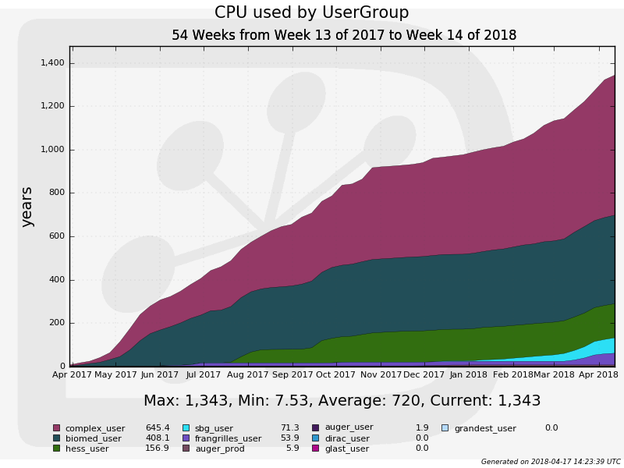
There is hope !!!
FG-DIRAC service is very active
Scientific portals on top of EGI resources experience constant growth
VIP for neuroscience community has 1200+ users

Slide 8
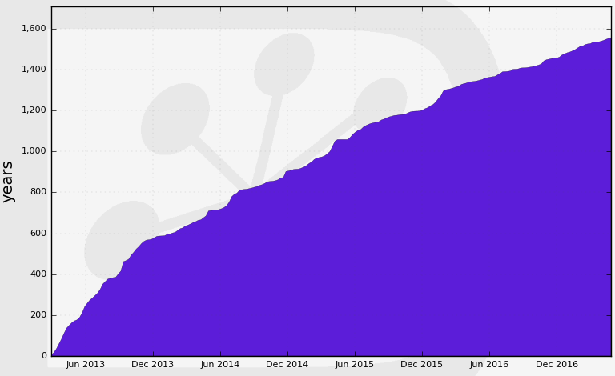
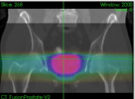
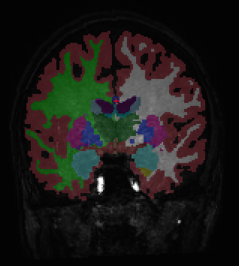
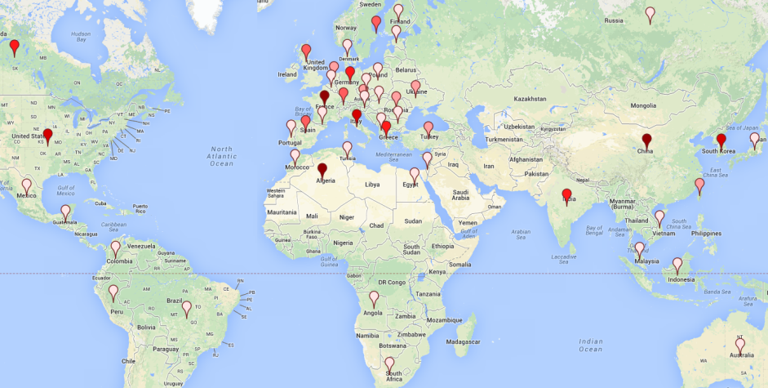
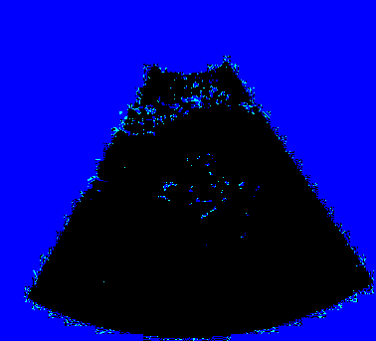
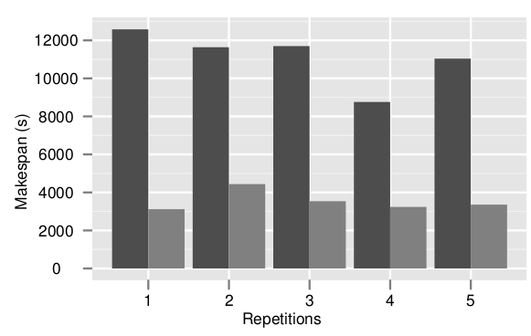
Virtual Imaging Platform (VIP)
https://vip.creatis.insa-lyon.fr
Web portal
Infrastructure
Application as a service
File transfer to/from grid
Supported by EGI Infrastructure
Uses biomed VO (~65 sites in Europe and beyond)
Available in N4U (Neugrid) portal
VIP consumes ~30 CPU years every month
France-Grilles
Scientific applications
Cancer therapy simulation
Neuro-image analysis
DIRAC
Users
1200+ registered users in April 2018
Most used robot certificate in EGI in 2012(http://go.egi.eu/wiki.robot.users)
>40 publications since 2011
Prostate radiotherapy plan simulated
with GATE(L. Grevillot and D. Sarrut)
Brain tissue segmentation
with Freesurfer
Image simulation
Modeling and optimization of
distributed computing systems
Echocardiography simulated with
FIELD-II (O. Bernard et al)
Acceleration yielded by non-clairvoyant
task replication (R. Ferreira da Silva et al)

Slide 9
Reaching out to the long tail of science in developing countries: our experience in Vietnam
Goal: enable scientists to access high level computing services locally
emerging disease surveillance
Method
Organization of grid schools (2007-2009)
Installation of grid nodes
Training of grid system administrators
Joint PhDs
The experience was a technical failure
But human contacts were very rich

Slide 10
Key lessons
Technology transfer of computing infrastructure services requires
Reliable electricity provision
Reliable academic network
Human factors are keys to success
Political support from local authorities
Engineers/scientists/PhD students willing to get trained and be pioneers
It is worth the effort!!!

Slide 11
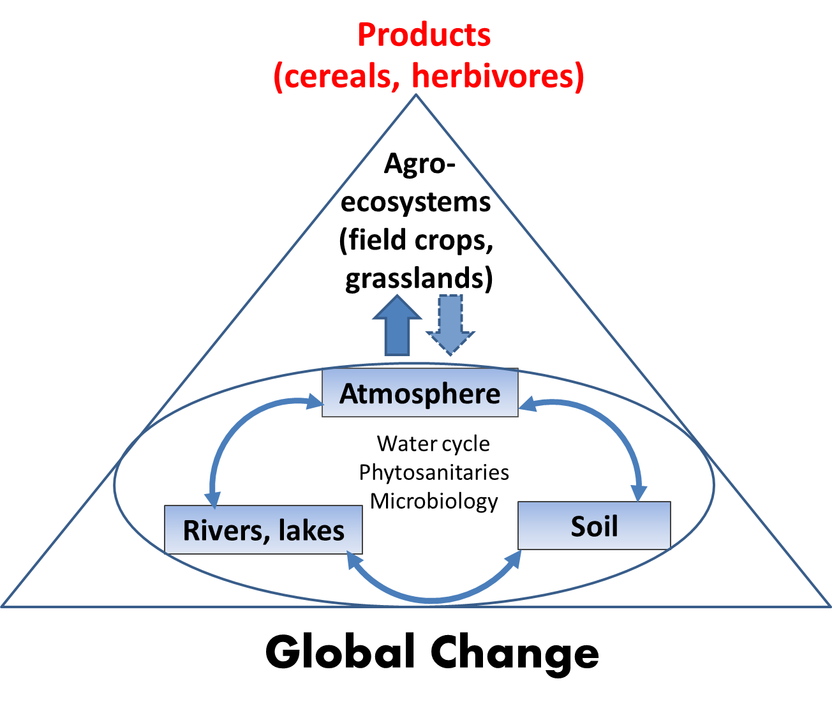
What about the long tail of data?
Considerations based on the experience of building an environmental cloud to the benefit of agriculture at a regional level

Slide 12
Key findings
Need for flexibility in data sharing policy
Need for flexibility in data structures
Need for friendly interfaces for data exploitation

Slide 13
Conclusions
Reaching out to the long tail of science in Europe is possible
Is it a priority?
Need for emblematic scientific use cases to drive EOSC
Need for a clear role for users in EOSC gouvernance
Opening our infrastructure to the LTOS outside Europe is a moral responsability and an asset for the future

