Slide 1
GDR QCD
Working group “Simple and multiple interactions between partons in nucleons”
1st meeting
Working group start https://indico.in2p3.fr/event/13459/
2nd meeting
Partons and Nuclei
https://indico.in2p3.fr/event/14438/
PWD WIFI
HScihc-!2018

Slide 2
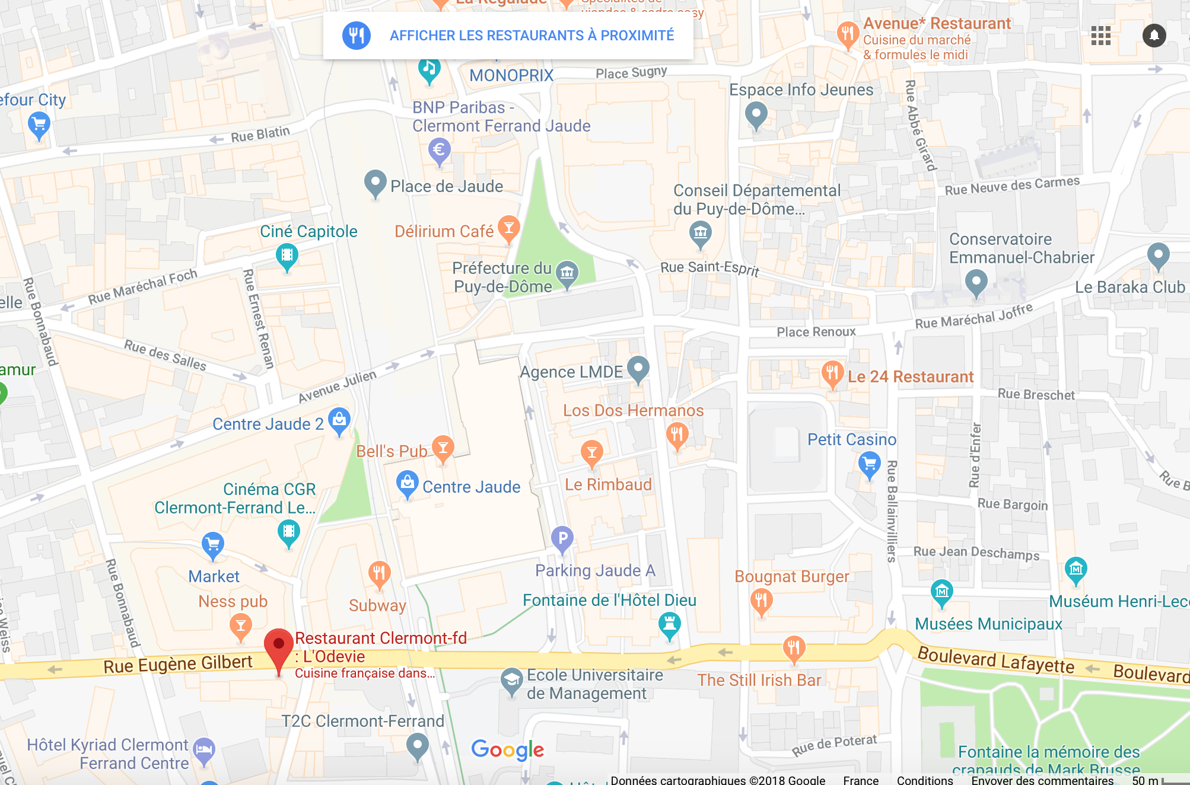
Social Dinner – ODEVIE
1 Rue Eugène Gilbert - 63000 Clermont-Ferrand

Slide 3
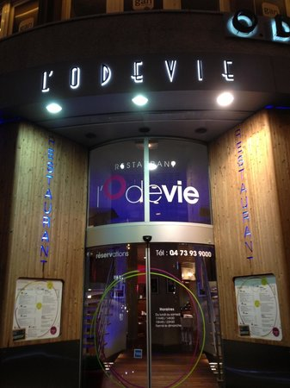
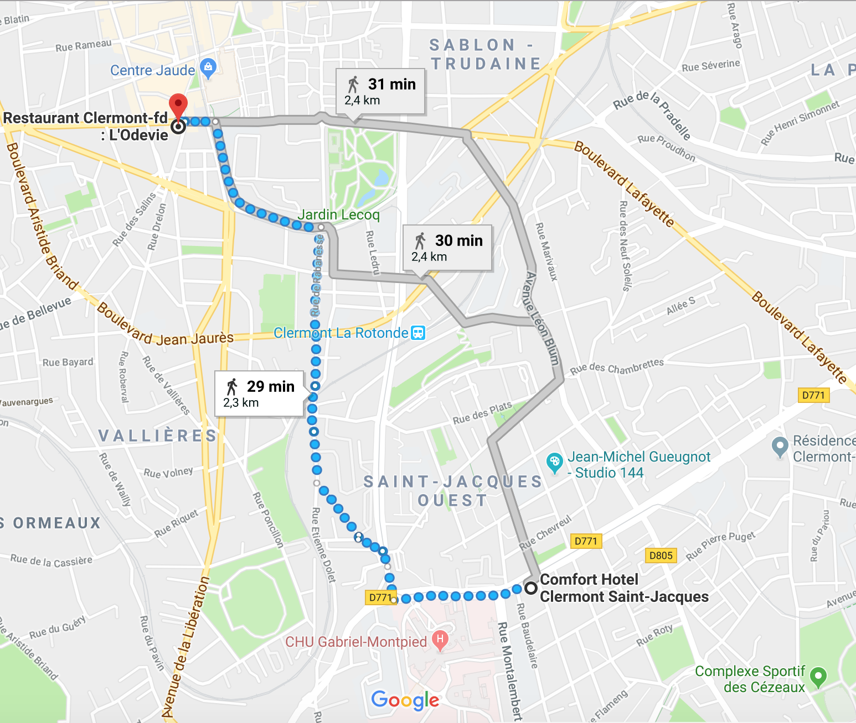
Social Dinner – ODEVIE
1 Rue Eugène Gilbert - 63000 Clermont-Ferrand

