Slide 1
MPGDs
Bordeaux 11/10/2018
CERN MPT workshop
Rui De Oliveira

Slide 2
Outline
Simplified TPC field-cage production
Existing MPGDs
Resistive detectors
  Micro Resistive well and resistive MicroMegas
  Advanced DLC coated material possibilities
How can we improve energy resolution
Dynamic range

Slide 3
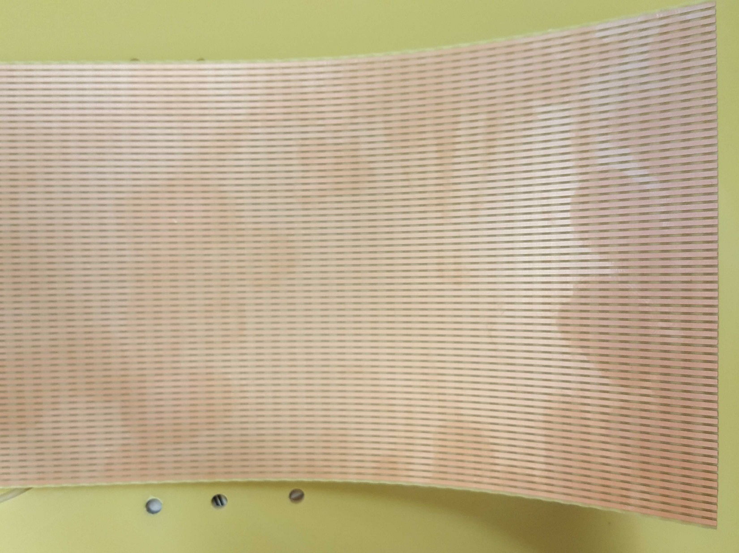
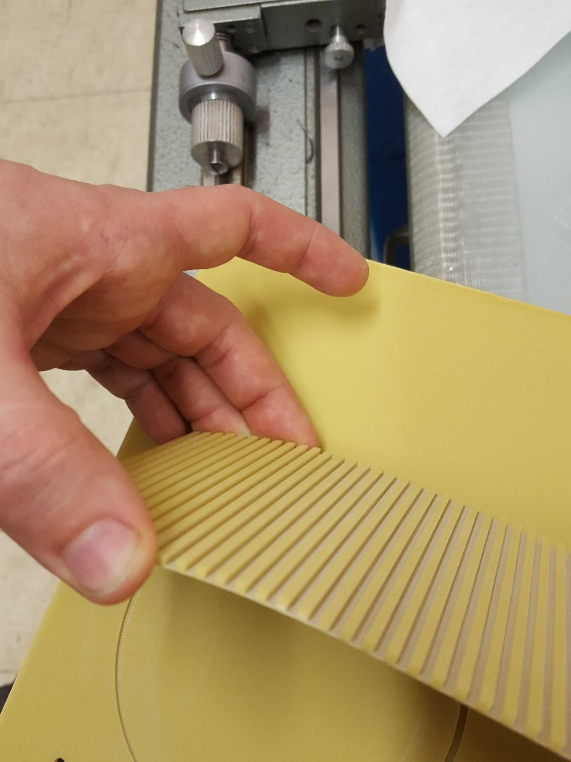
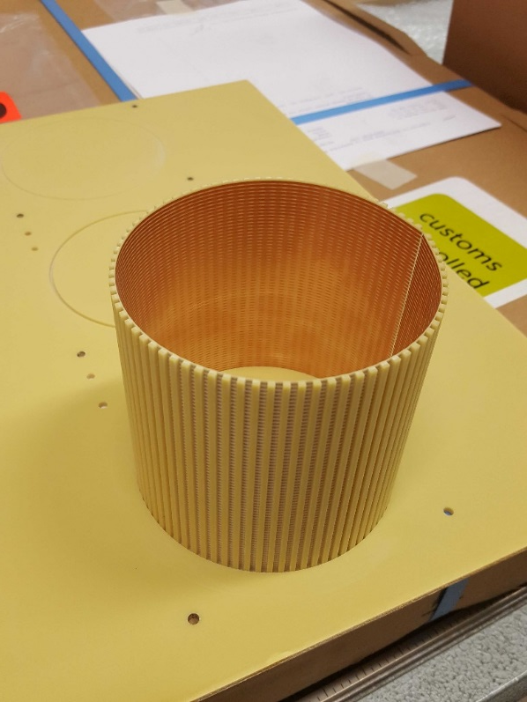
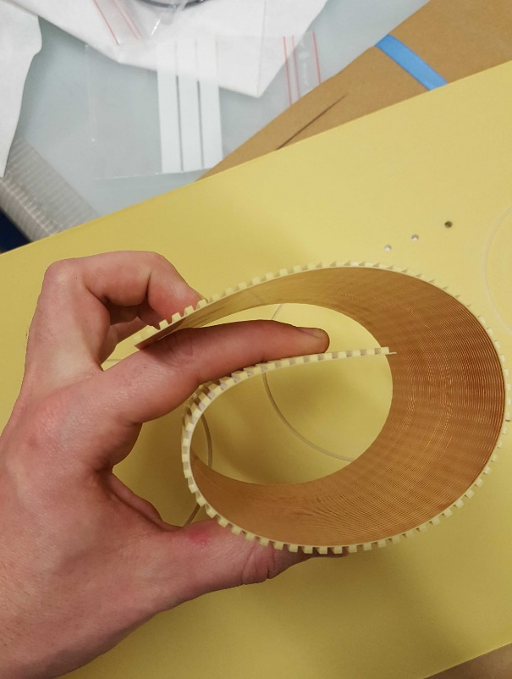
TPC fieldcage

Slide 4
Possibilities of this technique
PCB material self sustaining
Single wall
Double wall
Dismountable field-cage
Double wall with potting in between
Square TPCs with flexible angles.
Resistor assembly on rigid board.
Plated edges to simplify connections .
Resistive layer deposition to create uniform fields may be possible.

Slide 5
Existing MPGD structures
GEMs
  uWells
  uRwells
    Single resistive layer
    Double resistive layer
Micromegas
  BULK
  Micro BULK
  Floating mesh
  Resistive Micromegas
    Single resistive layer
    Double resistive layer
THGEM
  ML THGEM
  THwell
  R THwell
  MM THGEM

Slide 6
Resistive detectors
Why resistive layers
  Spark energy reduction ( 600 uJ in a GEM , 30uJ in a classical MM , 10 nJ in a protected device)
  Charge spreading for better spacial resolution
  Electronic front end protection not needed
Optimal resistive value for spark damage control
  The highest the better
  Below 10M there is some risks of microscopic damages (can always be cured but need new cleaning)
Optimal values for charge sharing
  For 10mm x 10mm pads → 500K/square typ
  For 0.4mm lines pitch → 80M/square typ
Optimal value for rate capability
  Depends a lot on the structure (single or double layers)
  Single layers up to 100Kevents/cm2 typ with one 10Mohms layer (be careful : detector size dependent).
  Double layers above 10Mevents/cm2 typ with two 10Mohms layers
Existing resistive layers
  Polymer paste 10Kohms to 100K/Square too low
  Thickfilm paste (high temp only on ceramic substrates) 10K to 100M/square limited detector size
  Resistive kapton 5M/square single value
  Disipative films 1G/square and above too high
  DLC 100K to 1G/square perfect in theory

Slide 7
Resistive detectors
Why resistive layers
  Spark energy reduction ( 600 uJ in a GEM , 30uJ in a classical MM , 10 nJ in a protected device)
  Charge spreading for better spacial resolution
  Electronic front end protection not needed
Optimal resistive value for spark damage control
  The highest the better
  Below 10M there is some risks of microscopic damages (can always be cured but need new cleaning)
Optimal values for charge sharing
  For 10mm x 10mm pads → 500K/square typ
  For 0.4mm lines pitch → 80M/square typ
Optimal value for rate capability
  Depends a lot on the structure (single or double layers)
  Single layers up to 100Kevents/cm2 typ with one 10Mohms layer (be careful : detector size dependent).
  Double layers above 10Mevents/cm2 typ with two 10Mohms layers
Existing resistive layers
  Polymer paste 10Kohms to 100K/Square too low
  Thickfilm paste (high temp only on ceramic substrates) 10K to 100M/square limited detector size
  Resistive kapton 5M/square single value
  Disipative films 1G/square and above too high
  DLC 100K to 1G/square perfect in theory

Slide 8
Resistive detectors
Why resistive layers
  Spark energy reduction ( 600 uJ in a GEM , 30uJ in a classical MM , 10 nJ in a protected device)
  Charge spreading for better spacial resolution
  Electronic front end protection not needed
Optimal resistive value for spark damage control
  The highest the better
  Below 10M there is some risks of microscopic damages (can always be cured but need new cleaning)
Optimal values for charge sharing
  For 10mm x 10mm pads → 500K/square typ
  For 0.4mm lines pitch → 80M/square typ
Optimal value for rate capability
  Depends a lot on the structure (single or double layers)
  Single layers up to 100Kevents/cm2 typ with one 10Mohms layer (be careful : detector size dependent).
  Double layers above 10Mevents/cm2 typ with two 10Mohms layers
Existing resistive layers
  Polymer paste 10Kohms to 100K/Square too low
  Thickfilm paste (high temp only on ceramic substrates) 10K to 100M/square limited detector size
  Resistive kapton 5M/square single value
  Disipative films 1G/square and above too high
  DLC 100K to 1G/square perfect in theory

Slide 9
Resistive detectors
Why resistive layers
  Spark energy reduction ( 600 uJ in a GEM , 30uJ in a classical MM , 10 nJ in a protected device)
  Charge spreading for better spacial resolution
  Electronic front end protection not needed
Optimal resistive value for spark damage control
  The highest the better
  Below 10M there is some risks of microscopic damages (can always be cured but need new cleaning)
Optimal values for charge sharing
  For 10mm x 10mm pads → 500K/square typ
  For 0.4mm lines pitch → 80M/square typ
Optimal value for rate capability
  Depends a lot on the structure (single or double layers)
  Single layers up to 100Kevents/cm2 typ with one 10Mohms layer (be careful : detector size dependent).
  Double layers above 10Mevents/cm2 typ with two 10Mohms layers
Existing resistive layers
  Polymer paste 10Kohms to 100K/Square too low
  Thickfilm paste (high temp only on ceramic substrates) 10K to 100M/square limited detector size
  Resistive kapton 5M/square single value
  Disipative films 1G/square and above too high
  DLC 100K to 1G/square perfect in theory

Slide 10
Resistive detectors
Why resistive layers
  Spark energy reduction ( 600 uJ in a GEM , 30uJ in a classical MM , 10 nJ in a protected device)
  Charge spreading for better spacial resolution
  Electronic front end protection not needed
Optimal resistive value for spark damage control
  The highest the better
  Below 10M there is some risks of microscopic damages (can always be cured but need new cleaning)
Optimal values for charge sharing
  For 10mm x 10mm pads → 500K/square typ
  For 0.4mm lines pitch → 80M/square typ
Optimal value for rate capability
  Depends a lot on the structure (single or double layers)
  Single layers up to 100Kevents/cm2 typ with one 10Mohms layer (be careful : detector size dependent).
  Double layers above 10Mevents/cm2 typ with two 10Mohms layers
Existing resistive layers
  Polymer paste 10Kohms to 100K/Square too low
  Thickfilm paste (high temp only on ceramic substrates) 10K to 100M/square limited detector size
  Resistive kapton 5M/square single value
  Disipative films 1G/square and above too high
  DLC 100K to 1G/square perfect in theory

Slide 11
Diamond Like Carbon base material vacuum deposition on 1m x 0.6m foils
DLC/Polyimide
DLC 0.1 to 1um
100K to 1G/square
Polyimide 50 um
APICAL NP
Kapton HN
DLC/Polyimide/Cu
Copper 5um
Polyimide 50 um
APICAL NP
DLC 0.1 to 1um

Slide 12
Single uRwell structure
Pick up pads/lines
PCB support

Slide 13
Single uRwell structure
Copper 5um
Polyimide 50um
DLC 0.1um typ
Pick up pads/lines
Glue 75um

Slide 14
Single uRwell structure
Patterned Copper
Etched Polyimide
DLC
Pick up pads/lines
+
Only 1 gluing + 1 patterning + 1 etching
Probably the simplest MPGD
Flexible detectors can be produced
Low mass detectors (rare event search)
mass production compatible
Top electrode fully supported
-
Lateral current evacuation
Rate limitation 10 to 100K depending on size
Only 50um amplification gap (today)

Slide 15
Single resistive MicroMegas structure
Pick up pads/lines
PCB support

Slide 16
Single resistive MicroMegas structure
DLC 0.1um
Polyimide 50um
Pick up pads/lines
Glue 25um

Slide 17
Single resistive MicroMegas structure
SS Mesh 400 to 700 LPI
DLC 0.1um
Polyimide 50um
Pick up pads/lines
+
Only 1 gluing + 1 Bulk
Single piece
different gaps possible
different meshes possible
-
Lateral current evacuation
Rate limitation 10 to 100K depending on size
Not Flexible
BULK steps are still manually performed

Slide 18
Advanced DLC materials
Cu/DLC/Polyimide
Copper 5um
DLC 0.1 to 1um
100K to 1G/square
Polyimide 50 um
APICAL NP
Kapton HN
Cu/Polyimide/DLC/Cu
Copper 5um
Polyimide 50 um
APICAL NP
DLC 0.1 to 1um
Copper 5um

Slide 19
High rate uRwell with 2DLC layers !
Base PCB

Slide 20
High rate uRwell with 2DLC layers !
Cu/PI/DLC/Cu → bot Cu patterning + gluing

Slide 21
High rate uRwell with 2DLC layers !
Microvia drilling + plating + top Cu patterning

Slide 22
High rate uRwell with 2DLC layers !
New CU/PI/DLC/Cu gluing
+ microvia drilling
+ Cu Plating

Slide 23
High rate uRwell with 2DLC layers !
Top Cu patterning + PI etching
-Rate above 10M events/cm2.s possible
-Spark protected
-full construction with std PCB processes

Slide 24
High rate MM with 2DLC layers
Base PCB

Slide 25
High rate MM with 2DLC layers
PI/DLC/Cu foil gluing

Slide 26
High rate MM with 2DLC layers
Micro via drilling + Cu plating + top Cu patterning

Slide 27
High rate MM with 2DLC layers
New PI/DLC/Cu gluing
+ microvia drilling
+ Cu Plating
+ Cu Patterning

Slide 28
High rate MM with 2DLC layers
Bulk creation on top of the structure
-Rate above 10M events/cm2.s possible
-Pillars should hide the Microvias
-Spark protected
-BULK step still manually performed

Slide 29
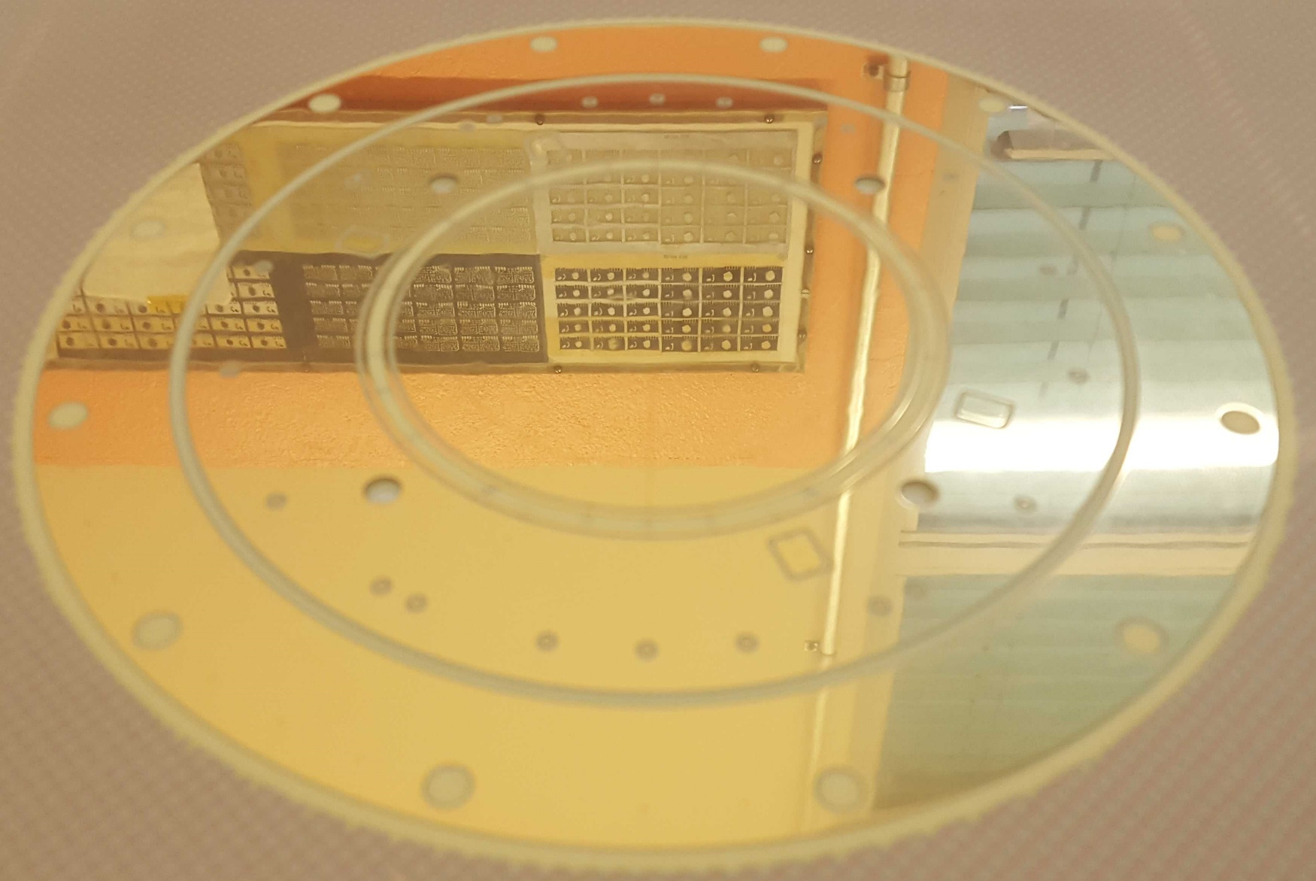
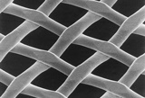
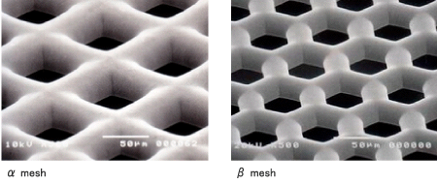
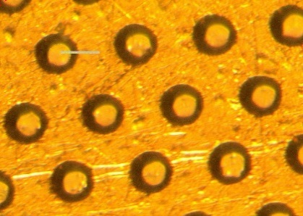
Can we get better energy resolution in MM detectors ?
Pad polishing
  Glass substrates give even better results
Improve amplification gap uniformity
  BULK : Hard to do better than what we have today
Mesh type
  Woven ( some field variations in the holes)
  Electro-formed
  Chemical etching (round shape seems to be the best)
Resistive layer
  Cancel the high fields at the edges of the pads
Remove Pillars
  Great contributor in field distortion

Slide 30
Interesting to know concerning energy resolution
Scan at mid height
What is the field variation if we do a scan following the blue arrow?
Constant?

Slide 31
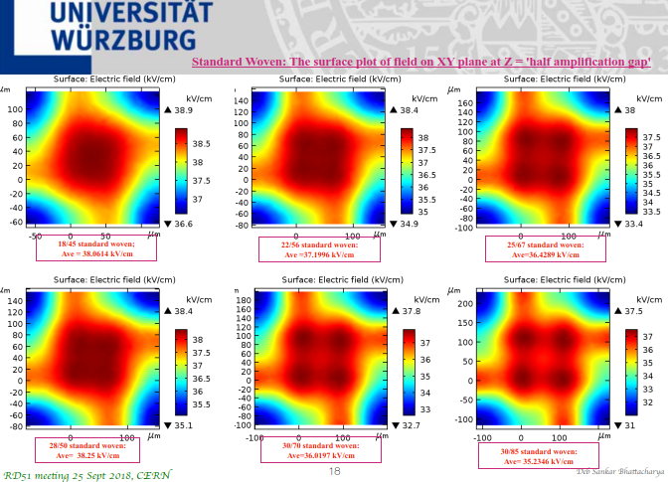

Extensive studies have
been done by ATLAS NSW on:
-Meshes
-HV stability
-Operational margins

Slide 32
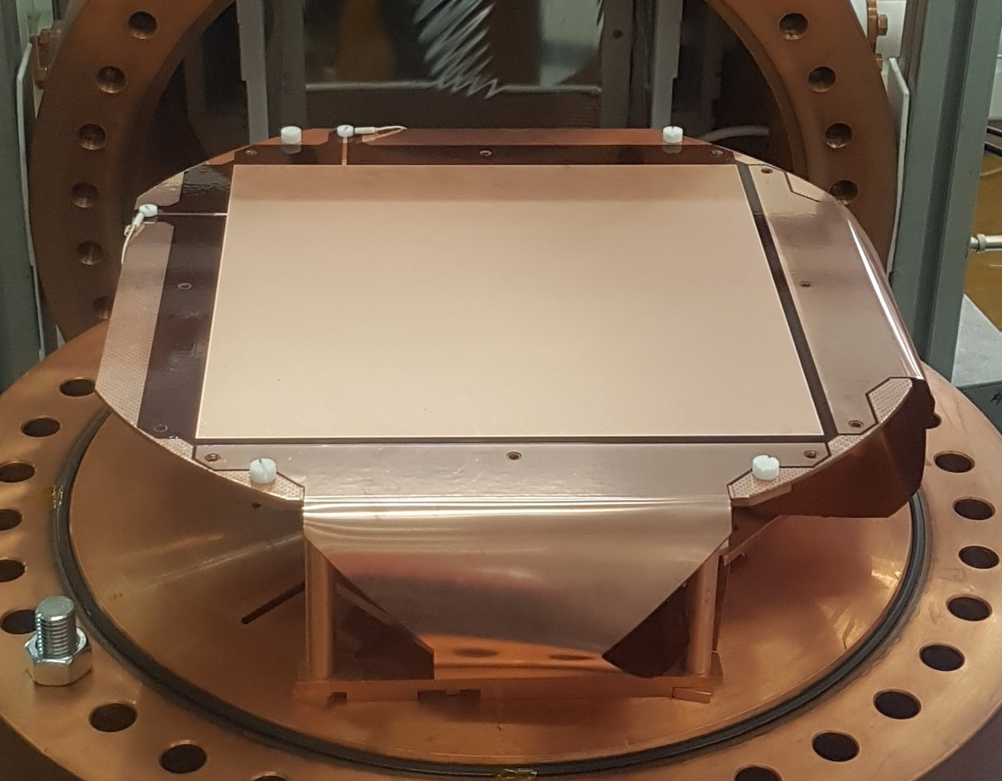
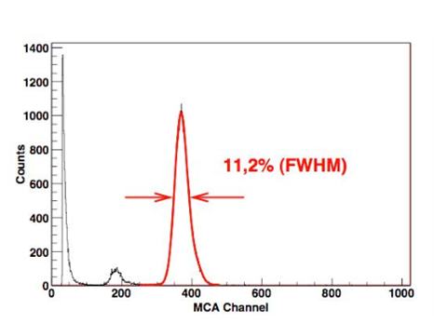

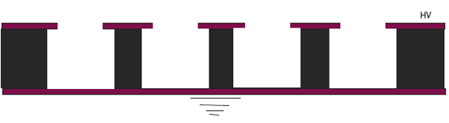
Best MPGD concerning Energy resolution: Micro BULK MM
  -11.2% FWHM measured (Fe55)
  -Round holes
  -No Pillars modifying fields
  -Electrodes have a mirror like finishing by process
  -Really precise gap define by base material less than 1% error
  -No pad edges in the amplification region (in the holes)

Slide 33
Dynamic range
Micromegas and micro-wells
  In Ar/Co2 mixtures with cosmic muons
  Average minimum gas gain for good efficiency : 3000 to 5000
  Sparks or instabilities at gas gain of 10 000 to 20 000
In similar conditions a triple GEM detector can reach gas gains above 100 000 before having instabilities.
It seems that only multi amplification gap devices can reach higher dynamic range.
  Triple or quadruple GEM detectors (THGEM also)
  Or may be multimesh structure

Slide 34
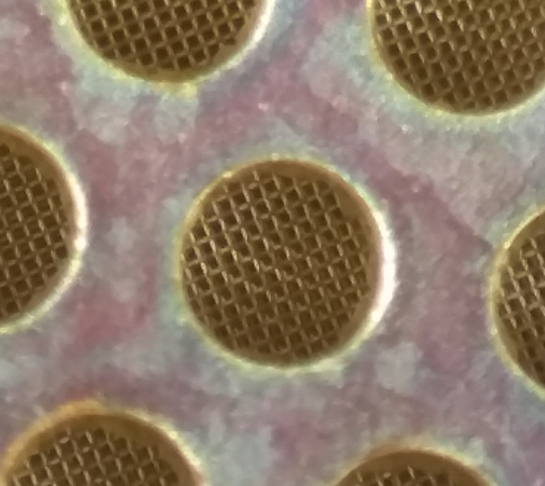
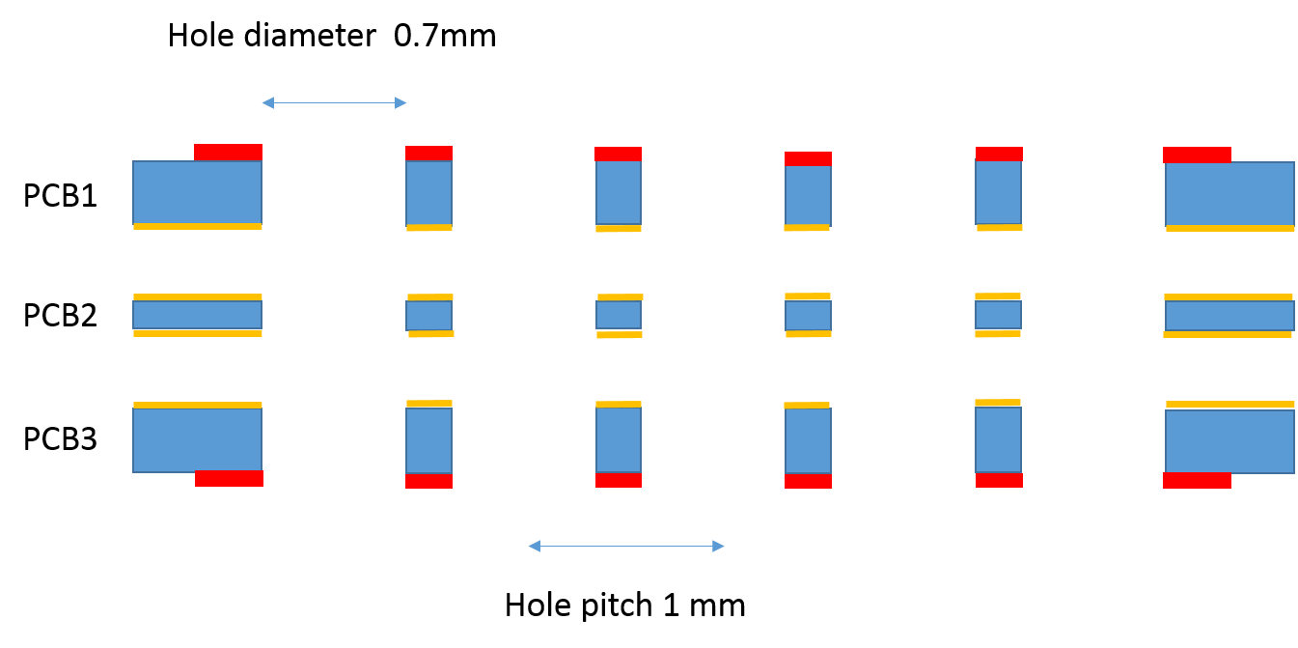
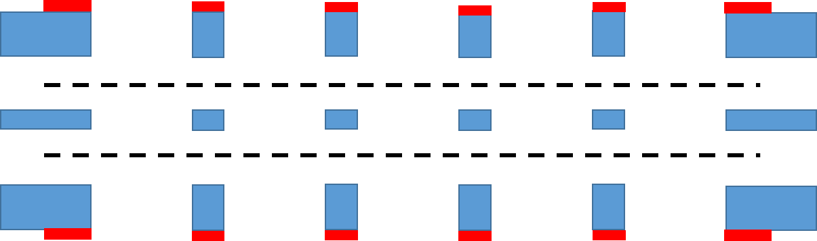
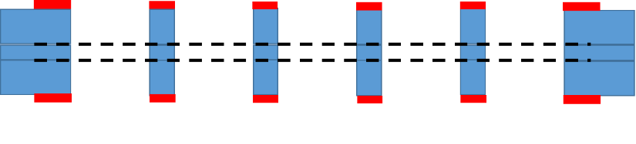
Multi Mesh device: MM THGEM
Marco Cortesi
Rui De OLiveira
-Self supporting panel no frames no pillars
-large size compatible
-Mass production compatible
-See Marco’s talk for performances

Slide 35
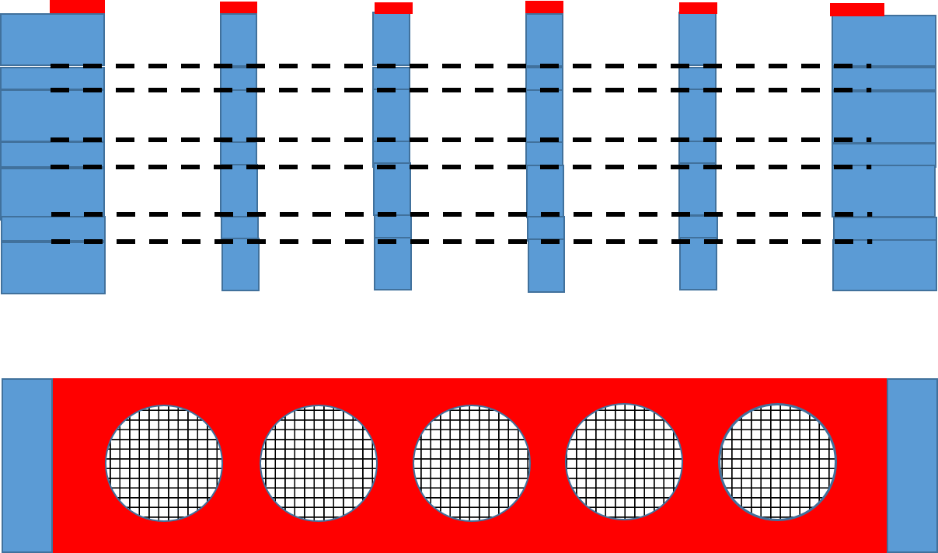
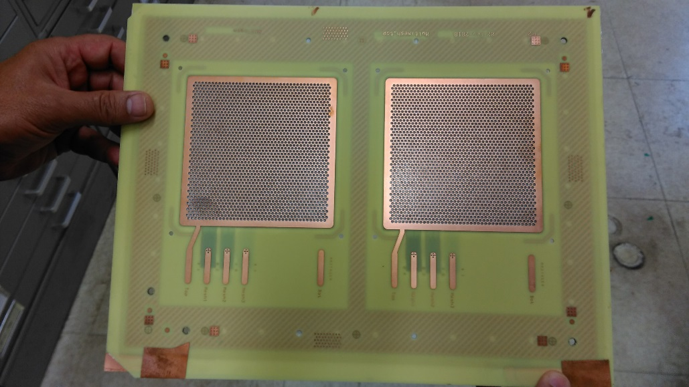

Future tests
- 2 and may be 3 stage MM-THGEM directly mounted on a simple PCB read-out
-triple GEM principle in a single object
-ultra Low IBF expected
-ultra High gain expected (high dynamic range)
-High rate by construction
-Efficiency/energy resolution needs to be studied?
-A multitude of possible configuration !
changing gaps, meshes, hole size, materials

Slide 36
Other possibility : special uRwell device
High ionising part
Can do both
low ionising part

Slide 37
Similar but with pad voltage control possible
High ionising part
Can do both
low ionising part

Slide 38
Thank you

Slide 39
Back slides

Slide 40
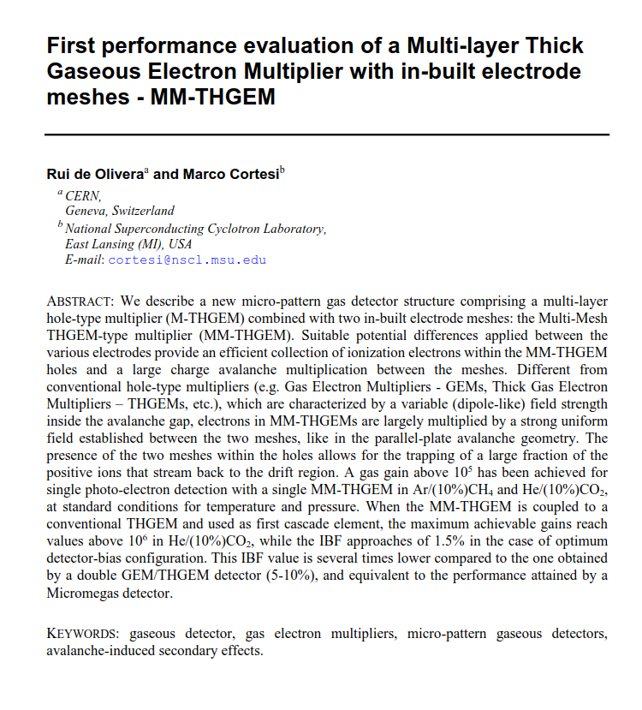
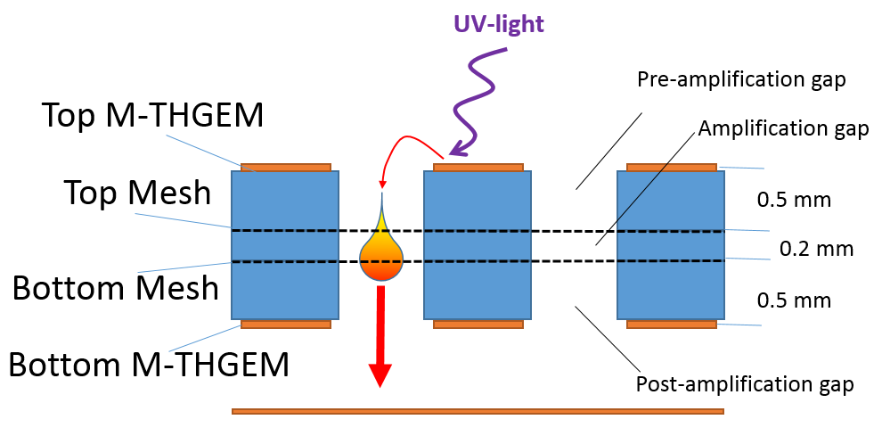
Multi-Mesh Thick GEM – MM-THGEM

Slide 41
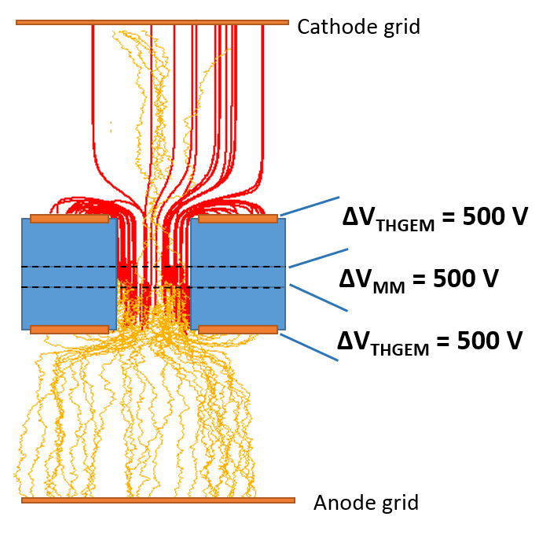
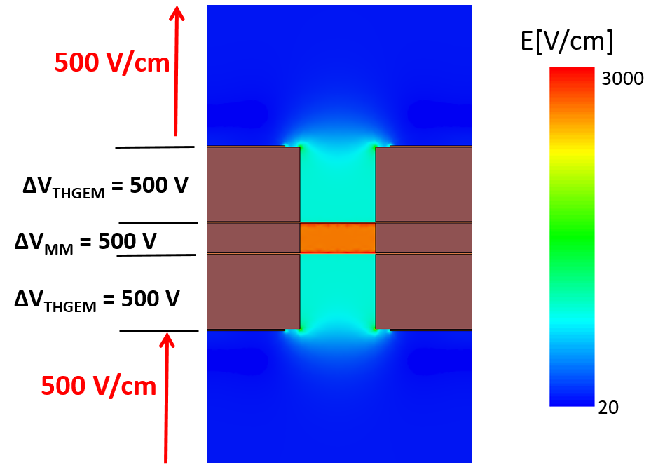
simulations results
Map of electric field strength
Garfield and Megaboltz qualitative Ion/Electron transport
and avalanche simulation

Slide 42
Gain MM-THGEM alone
-Maximum achievable gains (>10⁵ and >10⁴ for He/CO₂ and Ar/CH₄ respectively)
-Best configuration: High electric field strength in the avalanche gap and low dipole field at the extremities of the MM-THGEM holes.
-The avalanche processes are largely confined in the small volume between the two meshes, with small or no significant contribution from the pre- and post-amplification volumes.

Slide 43
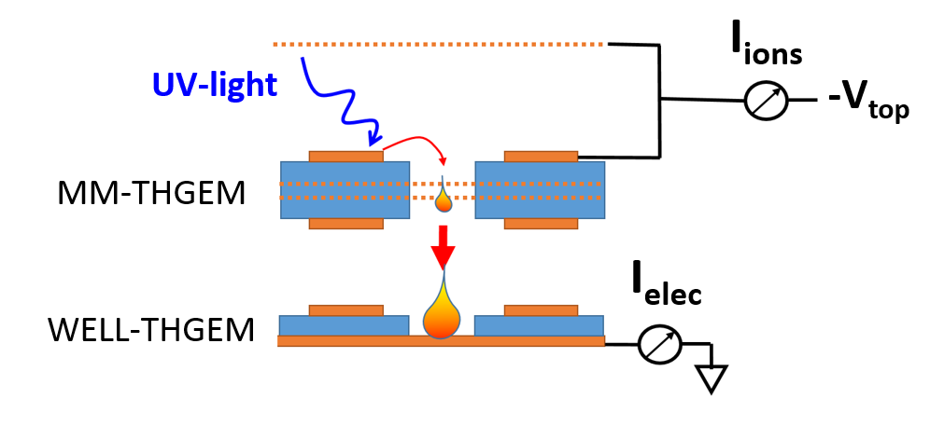
IBF study

Slide 44
IBF versus MM-THGEM gain
-Different MM-THGEM bias configurations tested (expressed in term of the parameter α).
-The WELL-THGEM electrode was kept at 900 Volt, corresponding to a gas gain of around 20.
-Most of the gas gain is delivered by MM-THGEM
-High capability of the MM-THGEM to trap ions generated by its own avalanches.

Slide 45
IBF versus Well THGEM gain
-MM-THGEM is efficient in trapping ions coming from the beneath transfer field also.
-lower IBF (ranging from 1.5-2%) is attained when the contribution of the WELL-THGEM to the total gain is the higher .
-ions drifting from the underneath multipliers are also trapped in the bottom mesh.

Slide 46
uRwell High rate with 2 DLC layers
Silver connection in yellow
DLC
+
-High rate
-Single piece
-Flexible
-
-Silver interconnects must be printed
-Accurate Screen printing difficult with large size
-Back build up process increasing seriously the complexity

Slide 47
High rate Micromegas with 2 DLC layers
DLC 0.1um
Silver connection
+
-High rate
-Single piece
-
-Silver interconnects must be printed
-Pillars should hide silver connections
-Accurate Screen printing difficult with large size

