Slide 1
GREENFIELD TECHNOLOGY
Dominique Monnier-Bourdin
Responsible product manager
www.greenfieldtechnology.com

Slide 2
SUMMARY
GFTY profil and information
Solution to generate picosecond delay
RPG ASIC Principe
RPG ASIC Specifications
Results: temporal results, jitter, INL
Conclusion
Annex (product line):
Data acquisition
Pulse and Delay generator
Signal generator
Time interval meter
Modules
www.greenfieldtechnology.com

Slide 3
COMPANY
GREENFIELD TECHNOLOGY
Greenfield Technology is a engineering company dedicated to the design and development of high precision electronic and optical instrumentation for test and measurement applications. Our expertise has been established over years of participation in numerous scientific project in the defense, energy, telecommunication and fundamental research sectors.
Business Model:
Specifications with the customer or GFTy R&D,
Design, scheme, layout with the same engineer
Manufacture by our partner
Final Test and metrology by GFT engineer
Export sell by our representative
Maintenance and calibration on-site
Quality process, ISO9001 in 2015
Locations:
Two laboratories located in France (Bordeaux / Paris) and one business unit in California (Greenfield Systems).
www.greenfieldtechnology.com

Slide 4
STANDARD PRODUCT LINES
Function (40 products):
  Data acquisition system,
  Pulse and Digital delay generator,
  Signal generator,
  Timing interval meter,
  Modules,
  Timing system,
Format:
  Rack 19’’, controlled via Ethernet, web page
  Local Board cPCI, PXI, VME,…
  Module,
Customer:
  France: CEA, CNRS, SOLEIL, IRSN, …
  Europe: AWE, STFC, ELI …
  USA: BNC, LLNL, LLE, National Instruments...
www.greenfieldtechnology.com

Slide 5
Solution to Generate Picosecond Delay
For many application, it’s necessary to generate a precise pulse (delay). It’s necessary to combine / mix:
FPGA : counter
Resolution: 5 ns (runs at 200 MHz)
AND
Numerical delay line (transit time of logic cell)
Resolution: between 10ps to 100ps,
OR
PLL : programmable skew
Resolution: 1ps to 100ps
OR
Analog delay line (analogic solution)
Resolution: < 1ps
Greenfield with a CEA collaboration design an RPG ASIC to generate a very precise pulse with a ps resolution and limited dynamic.
www.greenfieldtechnology.com

Slide 6
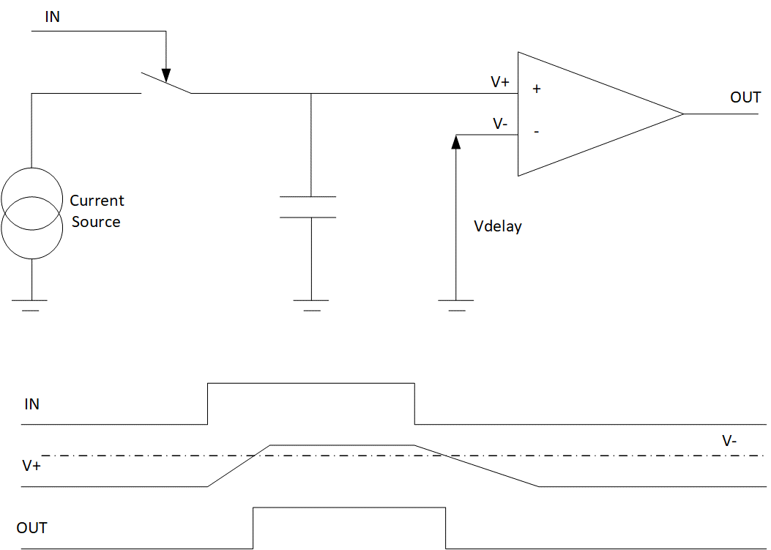
Programmable Delay Precise Generator
RPG ASIC Principe
www.greenfieldtechnology.com

Slide 7
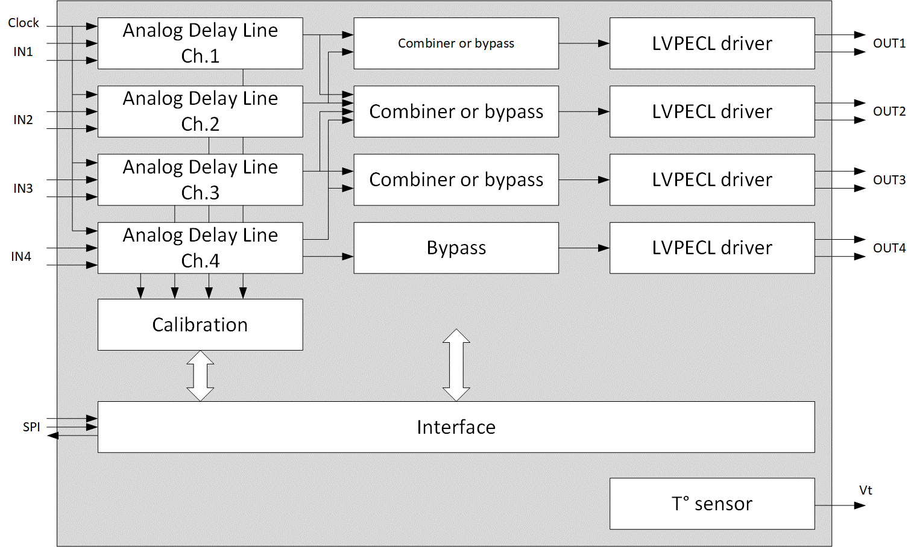
Programmable Delay Precise Generator
Principe
Calibration allow:
  Adjust delay between each channel
  Drift of ASIC (Temperature, Voltage, Frequency)
Duration of automatic calibration < 1 min
Automatic or manual calibration
www.greenfieldtechnology.com

Slide 8
Programmable Delay Precise Generator
RPG ASIC Specifications
ASIC
4 independent channels
Possible to mix 2 output channels to obtain a precise pulse (delay and width) or mix 4 output channels to obtain a precise pulse train
Dynamic: 0 to 5 / 7 ns
Automatic calibration
Trigger:
  Between DC to up to 20 MHz
  Trigger can be asynchronous or synchronous to clock input
Clock input: 150 to 200 MHz
1 ps resolution
< 3 ps rms jitter
Low propagation delay< 6 ns
Low drift
LVDS/LVPECL/CML input
LVPECL output
Width: 1ns (mix 2 channels) to up 1s
Packaging: QFN56
www.greenfieldtechnology.com

Slide 9
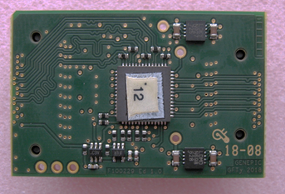
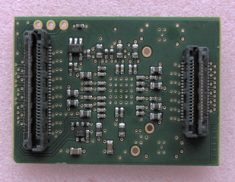
Programmable Delay Precise Generator (RPG)
Test environnement
Test of component:
Evaluation board with socket
Oscilloscope
Power supply
Arbitrary Wave Generator (clock and trigger)
Climatic chamber (test between -10 to 70°C)
Modules to test performances of RPG ASIC with Greenfield product:
www.greenfieldtechnology.com

Slide 10
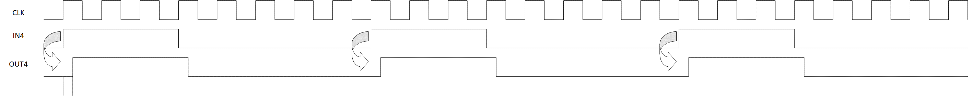
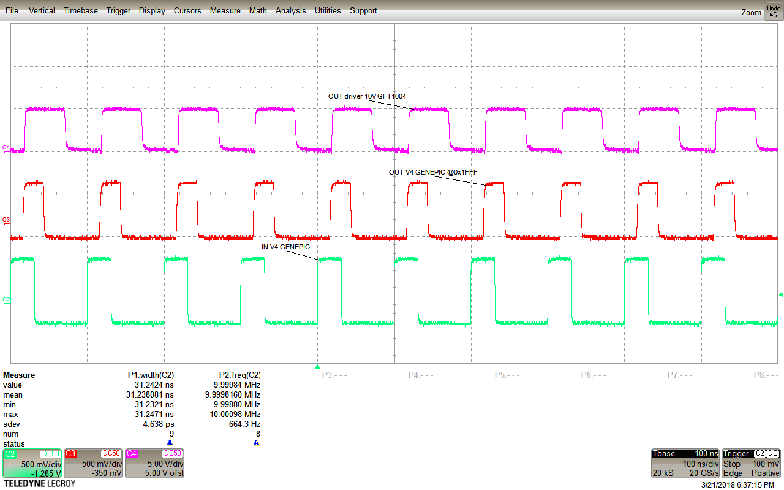
Temporal Results
Generate a pulse train with a precise delay for ch.4
Trigger rate: 10 MHz
Programmed delay: 6 ns
Output
LVPECL Output
LVPECL Input
www.greenfieldtechnology.com

Slide 11
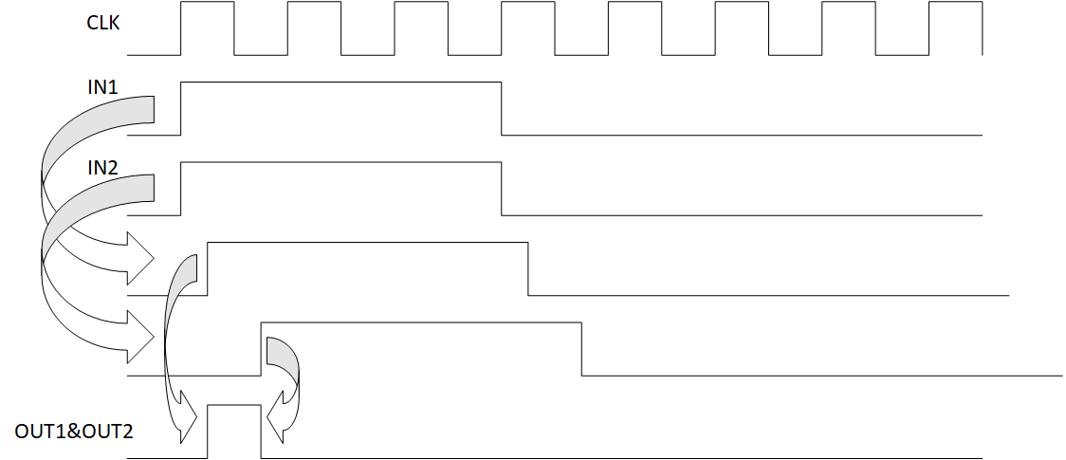
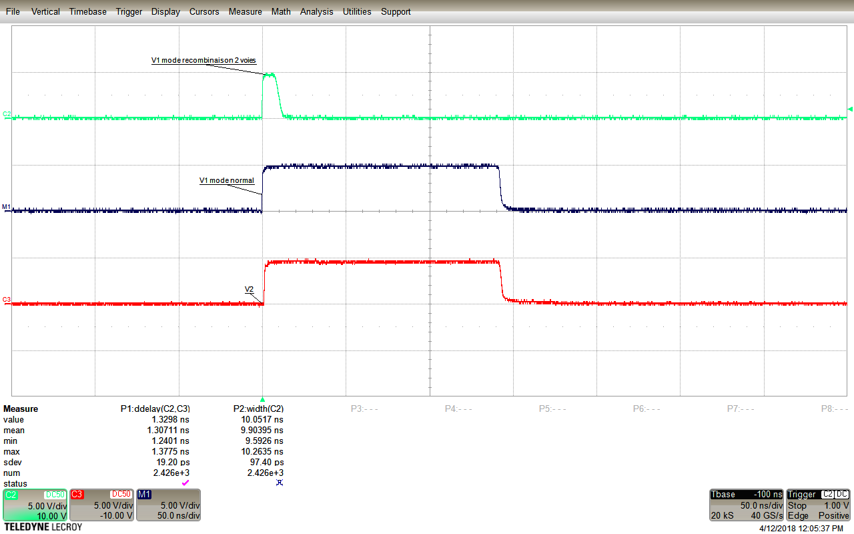
Temporal results
Generate a precise pulse (delay and width ) when you mix ch.1 and ch. 2
www.greenfieldtechnology.com

Slide 12
Results
Jitter function of Clock in (Ch1 and Ch2)
Jitter < 2,6 ps rms (Jitter of ASIC + Oscilloscope)
ASIC run between 125 to 250 MHz
2,6 ps rms
2,4 ps rms
www.greenfieldtechnology.com

Slide 13
Results
INL function of Clock input (Ch1 and Ch2)
INL < 120 LSB (1 LSB < 0,5 ps)
Clock input between 125 to 250 MHz
< 50 ps
www.greenfieldtechnology.com

Slide 14
Results
Jitter function of Trigger frequency (Ch1)
Jitter < 2,4 ps rms (Jitter of ASIC + Oscilloscope)
Trigger between 10 kHz to 30MHz
< 2,4 ps rms
www.greenfieldtechnology.com

Slide 15
Results
INL function of Trigger frequency (Ch1)
INL < 120 LSB
Trigger between 10 kHz to 30MHz
< 50 ps
www.greenfieldtechnology.com

Slide 16
Results
Jitter function of T° (Ch1 and Ch2)
Jitter < 2,6 ps rms (Jitter of ASIC + Oscilloscope)
ASIC run between -10 to 90°C
< 2,6 ps rms
www.greenfieldtechnology.com

Slide 17
Programmable Delay Precise Generator (RPG)
Conclusion
Tests results:
  Power: 410 mW
  Clock input > 250 MHz
  Trigger input > 40 MHz
  Resolution: 400 fs @ 150MHz
  INL < 120 LSB
  Jitter < 2,4 ps rms
  Insertion delay: < 5,6 ns
  Drift: 4ps/°C
Planning:
  Phase 1: Design an ASIC
  RPG ASIC prototype demonstrates all performances
  Next step
  Second RUN to improve performance and correct some minors mistakes (SPI, calibration error, …)
www.greenfieldtechnology.com

Slide 18
ANNEX : GREENFIELD PRODUCT
DIGITIZER
www.greenfieldtechnology.com

Slide 19
DIGITIZER
PRODUCTS
 | Bandwidth | Channel | Sampling rate | Size | Number of bit
FTD10000 | 7 GHz | 1 | 1 ps resolution | 4U | 13 bits
GFT6011 | 3 GHz | 1 | 10 GS/s | 1U | 10 bits
GFT6022 | 0.9 GHz | 4 | 4 GS/s | 1U | 12 bits
GFT6024 | 2 GHz | 2 | 4/8 GS/s | 1U | 12 bits
GFT6084 | 0.5 GHz | 4 | 2/4 GS/s | 2U | 8 bits
www.greenfieldtechnology.com

Slide 20
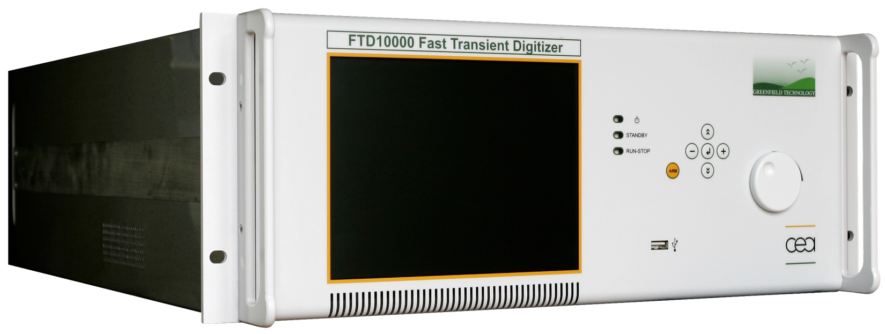
FTD10000
FAST TRANSIENT DIGITIZER
50 ps rise time,
1 ps time resolution,
1 ns to 1µs time base,
13 Bit vertical resolution,
2000 Volts max input Voltage,
External Trigger,
Interface : front panel, Ethernet network.
www.greenfieldtechnology.com

Slide 21
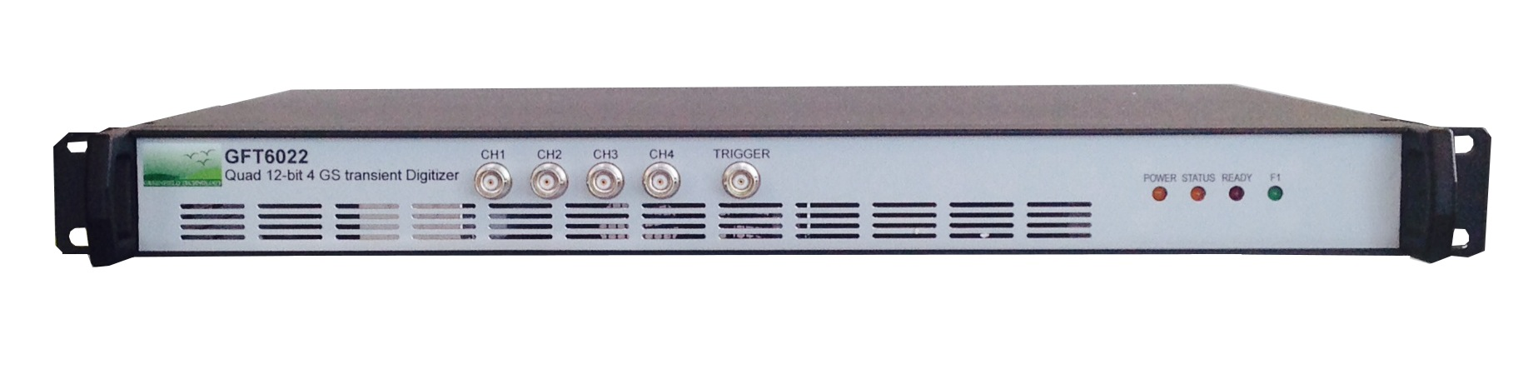
GFT6022
2 / 4 GS/s sampling rate
4 channels
12 bits vertical resolution
0.9 GHz Analog bandwidth
Controlled via USB, option Ethernet
www.greenfieldtechnology.com

Slide 22
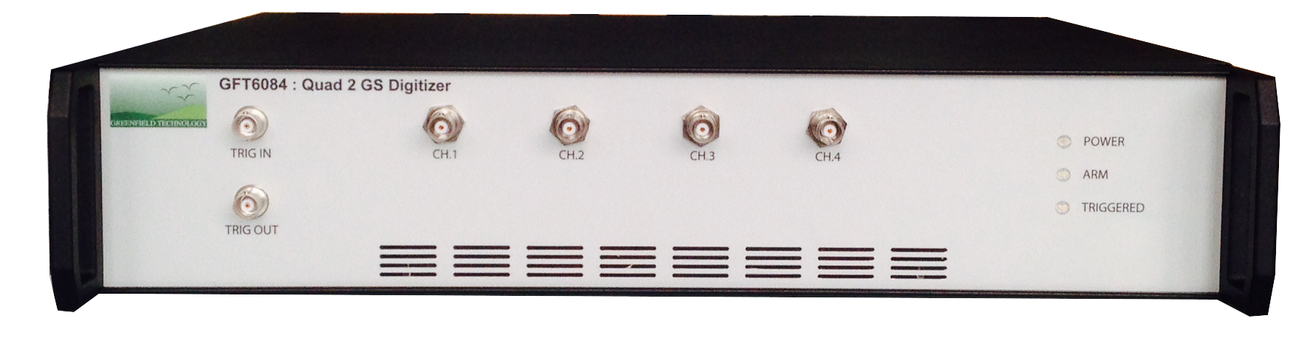
GFT6084
2 / 4 GS/s sampling rate
4 channels
8 bits vertical resolution
0.5 GHz Analog bandwidth
Controlled via Ethernet
Compatible with all Teledyne Lecroy software package
www.greenfieldtechnology.com

Slide 23
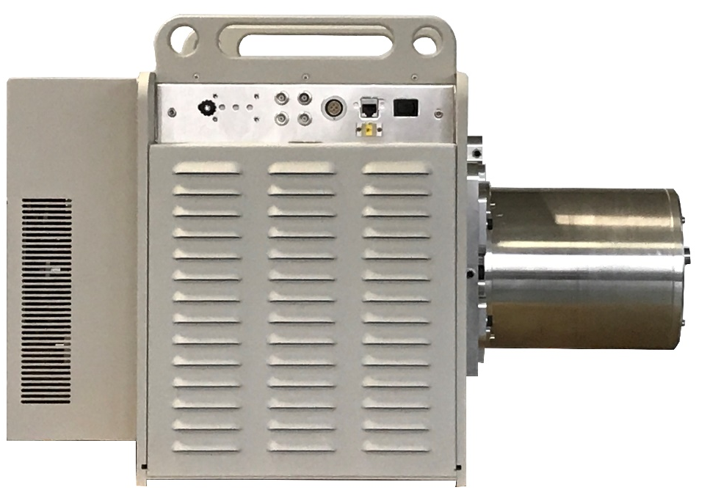

GFT500: STREAK CAMERA FOR LABORATORY
P5XX tube
300 – 900 nm spectral sensitivity
5ps time resolution
10 ps trigger jitter
150 dynamic range
5 to 50 ns analysis duration
11 bits analysis resolution
Controlled via Ethernet or Web page
www.greenfieldtechnology.com

Slide 24
PULSE AND DELAY GENERATOR
www.greenfieldtechnology.com

Slide 25
DIGITAL DELAY GENERATOR COMPARAISON
 | GFT1004 | GFT1504 | GFT1020 | MOD745 | GFT9404 | GFT1208
Form factor | 1U | Box | 2U | Box or OEM | PXI 3U | cPCI 6U
Channel | 4 / 8 / 10 | 4 / 8 | 20 | 4 + 4 | 4 + 4 | 8
Rise time (50 Ω) | < 2 ns | < 2 ns | < 2 ns | < 2 ns | < 2 ns | < 2 ns
Amplitude | 2.5 to 10V | 2.5 to 10V | 2.5 to 6V | 2.5 to 6V | 2 to 5 V | 3.3 or 10V
External ref. | 10 to 100 MHz (factory) | 10 to 100 MHz (factory) | 10 to 100 MHz (factory) | 10 to 100 MHz (factory) | 10 MHz PXI
Options | Timing system Driver | Timing system Driver |  |  | Timing system : GFT1404
Notes:
So, to summarize the performances, this graph compares 3 differents DDG : pxi board, cpci board and black box.
The GFTy board is the better compromise.

Slide 26
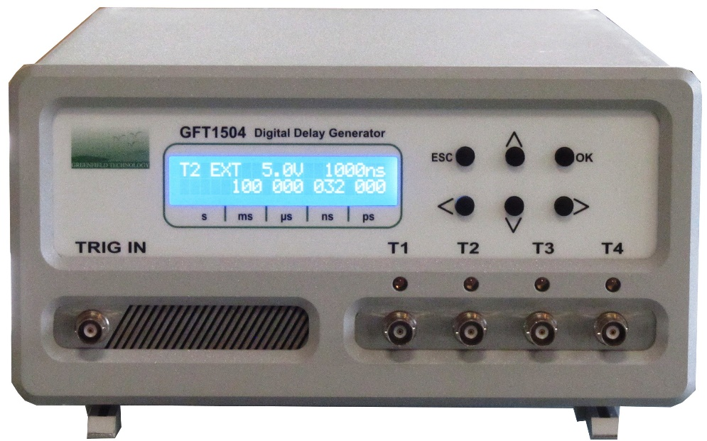
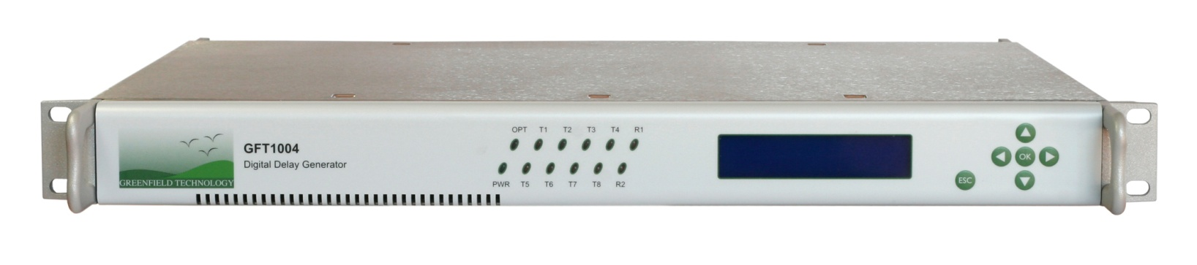
GFT1004 / GFT1504
DIGITAL DELAY GENERATOR
Rack 19", 1U, 300 mm or Box
Four / Eight / Ten independent Delay Channels
<1 ps delay resolution
<25 ps rms jitter external mode
<15 ps rms jitter internal mode
10 seconds delay range
Controlled via Ethernet and front panel
Trigger source:
  external,
  internal,
  optical network
www.greenfieldtechnology.com

Slide 27
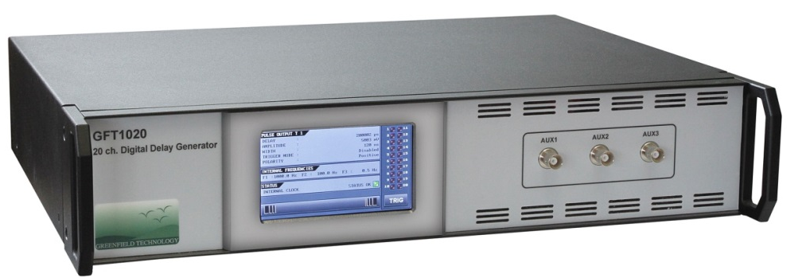
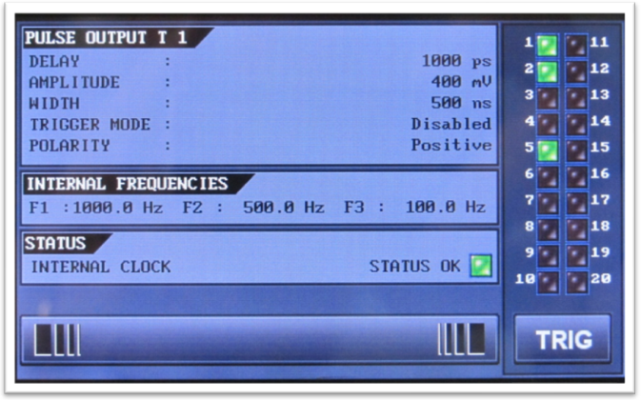
GFT1020
DELAY GENERATOR
20 independent Delay Channels
  1 ps / 100 ns delay resolution
  10 seconds delay range
Output pulse
  Amplitude: 2.5 to 6 V, 50 Ω
  Width: 100 ns to > 1 s,
  Rise time < 5 ns,
Controlled via Ethernet and front panel
www.greenfieldtechnology.com

Slide 28
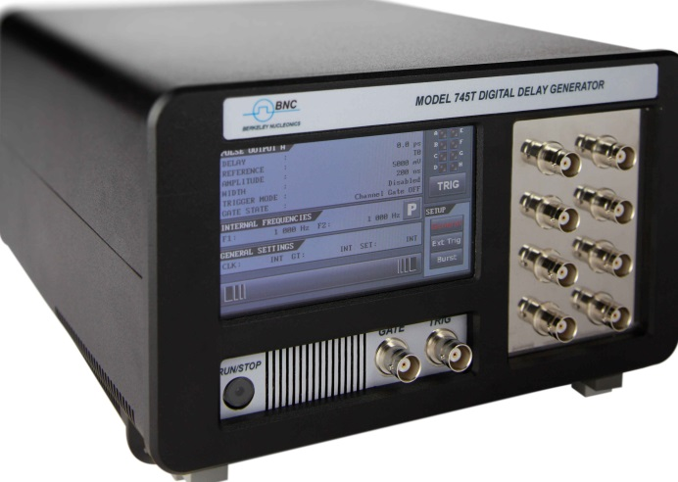
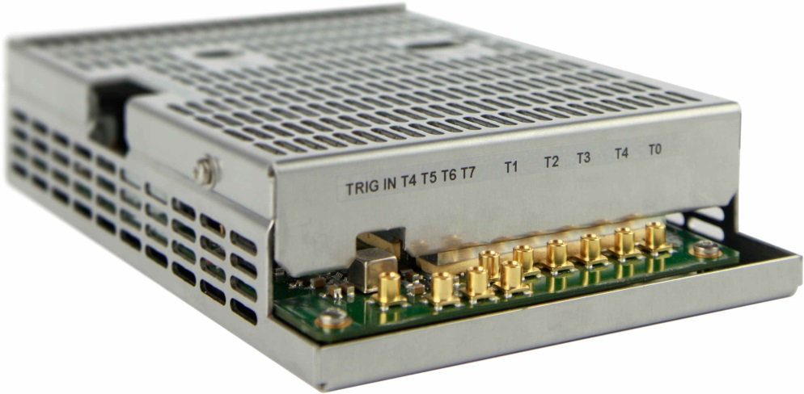
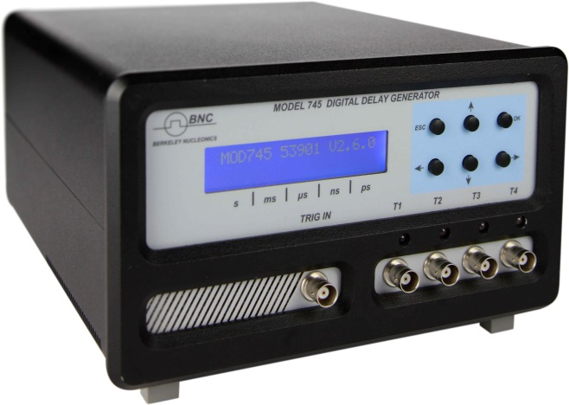
MOD745
DELAY GENERATOR (OEM)
Four / Eight independent Delay Channels
  15 ps channel to channel jitter
  0.3 ps / 1.25 ns delay resolution
  10 seconds delay range
Output pulse
  Amplitude: 2.5 to 6 V, 50 Ω
  Width: 100 ns to 10 µs /10 ms,
  Rise time < 1 ns,
Form factor: Box
Controlled via Ethernet and front panel
Trigger source: external, internal, burst, prescaler
www.greenfieldtechnology.com

Slide 29
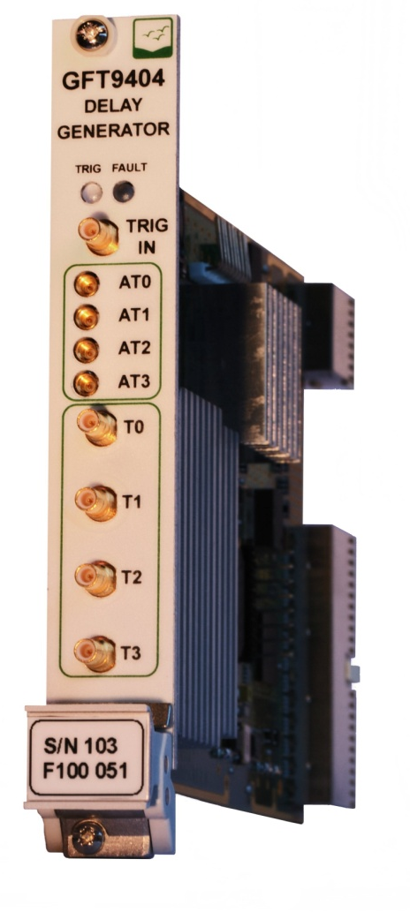
GFT9404
DIGITAL DELAY GENERATOR
PXI CARDS
Eight Independent Delay Channel
1 ps resolution
15 ps rms jitter
1 second delay range
PXI 3U, 1 slot,
Trigger source: external, internal,
Ouput:
  Level : 2.5 to 5 V,
  Positive pulse,
  width : 200 ns to 10 µs,
  Rise time < 2 ns,
www.greenfieldtechnology.com
Notes:
.

Slide 30
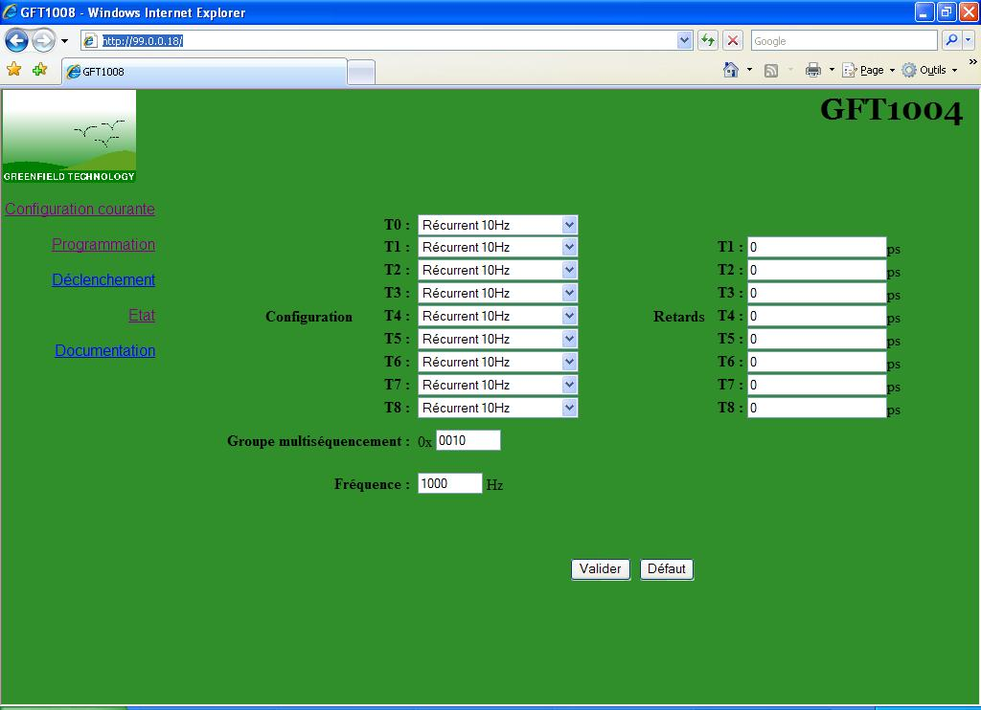
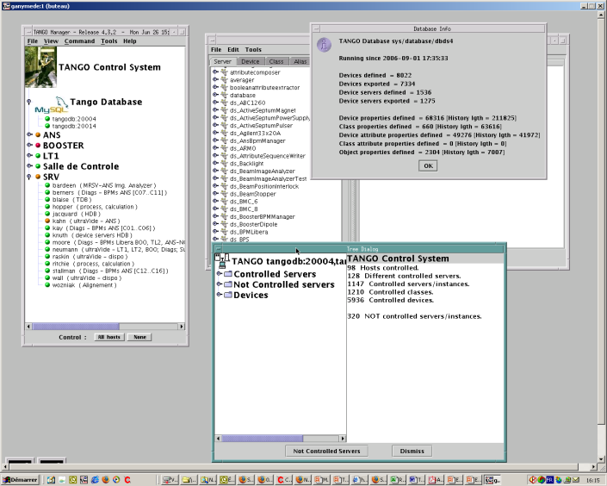
SOFTWARE
All parameters can be programmed:
  Web page,
  DLL, API,
Driver :
  Tango,
  Labview,
  EPICS
www.greenfieldtechnology.com

Slide 31
TIMING SYSTEM
www.greenfieldtechnology.com

Slide 32
TIMING SYSTEM
The Picosecond Timing System (PTS) provides several hundred triggers to equipments distributed over an area of thousands of square meters, within a resolution of 1 ps. The delay between triggers is programmable via Ethernet interface up to 1 s.
The high accuracy, wide range, low jitter, and up to 1 km separation between the triggers, designate the PTS as the ideal solution to many critical timing problems encountered in Big physics system like Synchrotron, accelerator and high energy laser.
Performances:
RMS jitter < 15 ps,
Delay > 1 s,
Up to 2048 triggers
Triggers : one shot or repetitive
www.greenfieldtechnology.com

Slide 33
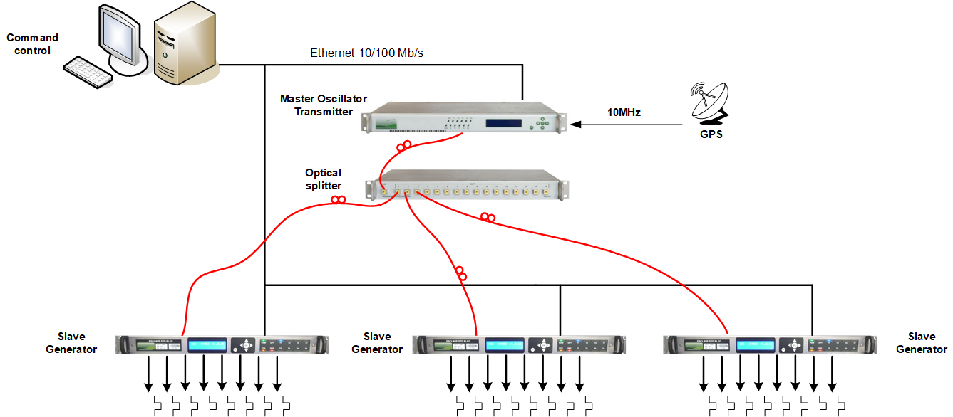
TIMING SYSTEM
PRINCIPE
Master Oscillator delivers a continuous data stream over optical network to manage the delay generator triggering and time base.
4095 channels,
Distance between equipments : 1 km,
< 15 ps rms channel to channel jitter,
www.greenfieldtechnology.com

Slide 34
Timing System
Application :
  High Energy Laser: NIF, LMJ, Polytechnique, ELI,
  Experimental laboratories
  Detonic : AIRIX, EPURE, French Z machine,
  Synchrotron: SOLEIL,
Performances :
  Jitter < 15 ps,
  Delay Dynamic > 1 s,
  Up to 4096 triggers
Delay generator Format :
  cPCI, PXI,
  Stand alone 1U, 19’’
  Box.
www.greenfieldtechnology.com

Slide 35
SIGNAL GENERATOR
www.greenfieldtechnology.com

Slide 36
SIGNAL GENERATOR COMPARAISON
Optical pulse Generator | Channel number | Peak Power | Pulse Width | Form Factor
GFT7016 | 4, 2(electrical) | 0.5 to 1.5mW | 0.1 to 10µs | 19”/1U
1.15GHz Phase Shifter Generator | Phase control | Amplitude | Frequency | Form Factor
GFT7012 | 25 ps step | 35dBm | 1.15GHz | 19”, 2U
300ps Step Generator | Rise time | Amplitude | Pulse duration | Form Factor
GFT 7002 | 300ps | 10V/50Ω | 100 ns | 19”/2U
8 Fast High Voltage Pulses generator | Rise Time | Output Level | Pulse Duration | Form Factor
GFT4218 | 6ns | +/- 100V/50Ω | 120ns | cPCI, 6U
1 to 8 Output Digital Splitter | Pulse Rise Time | Output Level | Pulse Duration | Form Factor
GFT4208 | <5ns | 3V / 50Ω | 150ns | cPCI, 6U
Notes:
So, to summarize the performances, this graph compares 3 differents DDG : pxi board, cpci board and black box.
The GFTy board is the better compromise.

Slide 37

Comb Generator
GFT7022
  @680nm
  35ps width
  Frequency up to 5 GHz
  >2mW optical power
  Burst mode, single shot mode
  Application: For optical calibration
  (ex: Streak Camera)
  Option: other wavelength
www.greenfieldtechnology.com

Slide 38
TIME INTERVAL METER
PRODUCT
www.greenfieldtechnology.com

Slide 39
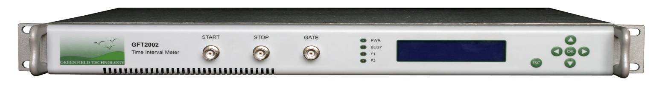
GFT2002
TIME INTERVAL METER
Two Channels (Start, Stop),
1ps one-shot time resolution,
< 10ps rms time interval jitter,
± 1 second time interval range,
> 1 s range,
19’’, 1U rack,
internal or external 10 MHz clock reference,
Controlled via Ethernet or front panel.
www.greenfieldtechnology.com

Slide 40
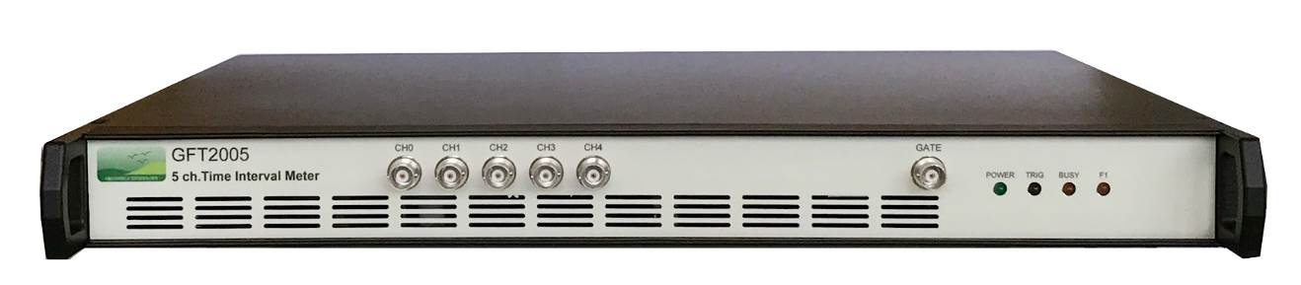
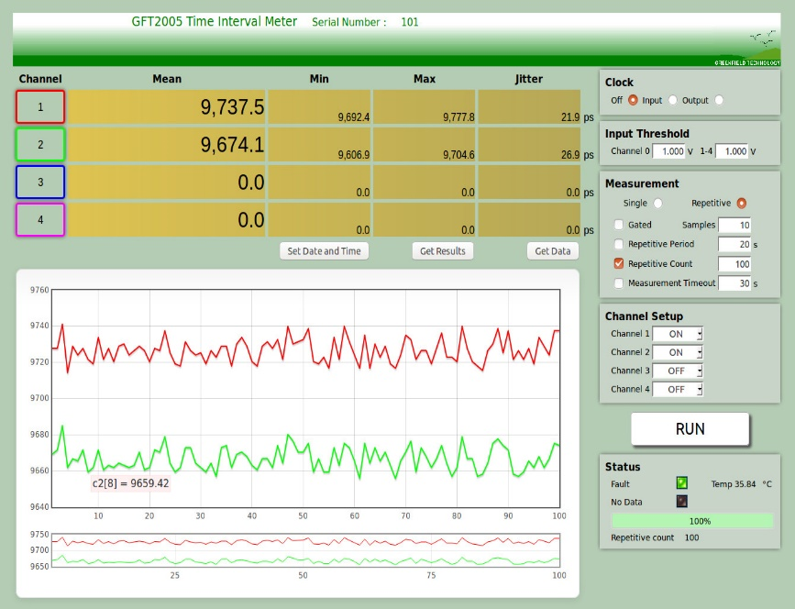
GFT2005
5 CHANNEL TIME INTERVAL METER
Five Channels (1 x Start,4 x Stop),
10MHz sample rate per channel,
13ps one-shot time resolution,
< 50ps rms time interval jitter,
> 100 seconds range,
19’’, 1U rack,
internal or external 10 MHz clock reference,
Controlled via Ethernet or web page.
www.greenfieldtechnology.com

Slide 41
MODULES
www.greenfieldtechnology.com

Slide 42
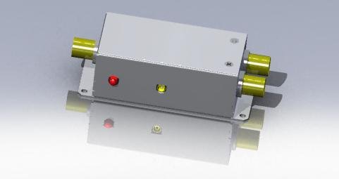
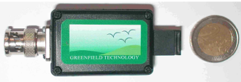
MODULE
COMPARAISON
E/O Converter | Input pulse | Wavelength | Output | Power
GFT101 | 2.5 to 10V | 1310nm | 0.3mW | none
O/E Converter | Input pulse | Wavelength | Output | Power
GFT 200 | >- 15dBm | 1310 to 1550nm | 10V/50Ω | + 12V
200ps Step generator | Rise time | Amplitude | Jitter | Power
GFT500 | 200ps | 4 to 9V | < 2ps | 12V
Pulse generator | Width | Amplitude | Jitter | Power
GFT400 | 500ps | 2V/50Ω | < 5ps | 12V
GFT632 | 1µs | 32V to 70V/50Ω | < 5ps | 12V
Notes:
The GFTy board is the better compromise.

