Slide 1
Extreme Light Infrastructure-Nuclear Physics
(ELI-NP) - Phase II
Status of the ELI-NP GBS instrumentation at ELI-NP
and possible future upgrades
Dimiter L. Balabanski for the ELI-NP team
GET Workshop, Bordeaux, France
October 10th – 12th, 2018
Project co-financed by the European Regional Development Fund through the Competitiveness Operational Programme
“Investing in Sustainable Development”

Slide 2

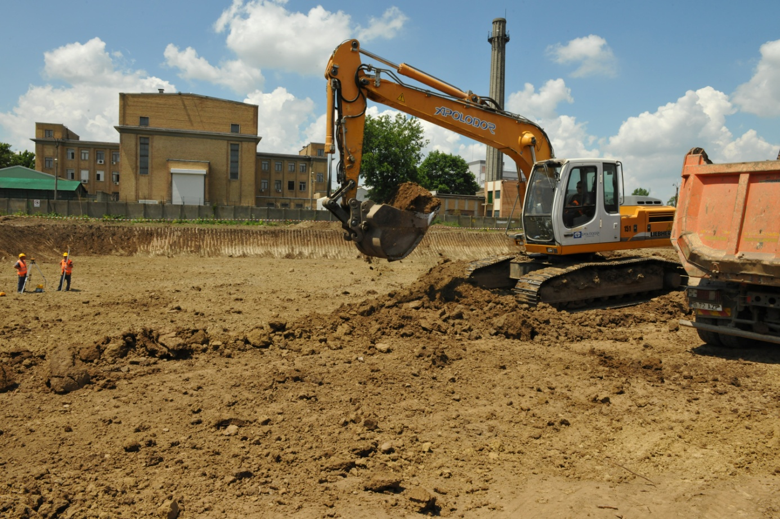
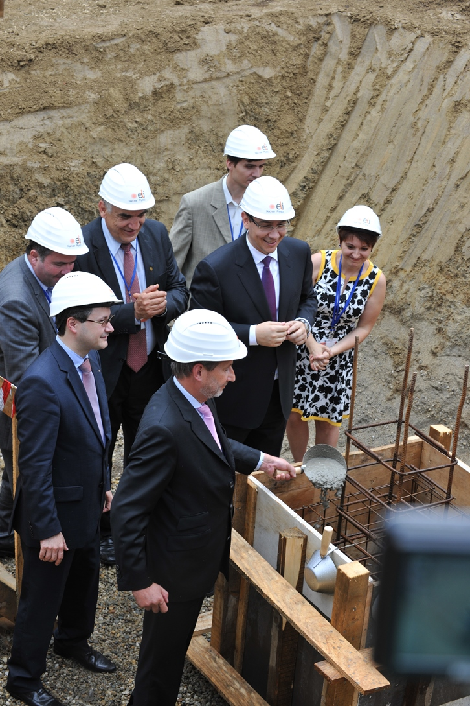
June 7th, 2013

Slide 3
Extreme Light Infrastructure – Nuclear Physics (ELI-NP)
ESFRI Landmark Laboratory 2017 (together with FAIR and SPIRAL2)
NUPECC 2017 Long Range Plan: Major Nuclear Physics Facility in Europe
Mission:
Nuclear Physics studies with high-intensity lasers and brilliant γ beams
      2 x 10 PW synchronizable lasers
      0.2 – 20 MeV 0.5% bw 95% polarized γ beams

Slide 4
The laboratory building is fully operational
17 000 m²

Slide 5

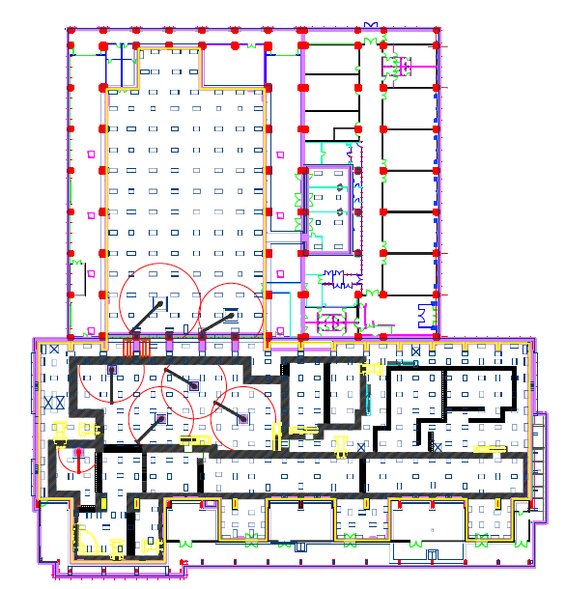
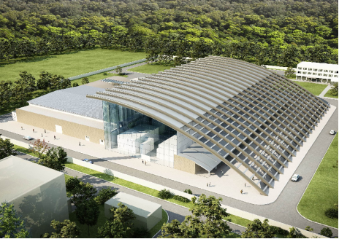
The ELI-NP laboratory building
120 m
A – A
HPLS
civil construction was commissioned in September 2016
Laboratories
accelerator
bays
140 m
A
laser rooms
basement
anti–vibration
mounts
Experiments
Platform supported on dampers
Anti–vibration platform
±1 μm @ < 10 Hz
Thermalized building
22⁰ ± 0.5⁰
Clean rooms: ISO-5, 7
GBS
A

Slide 6

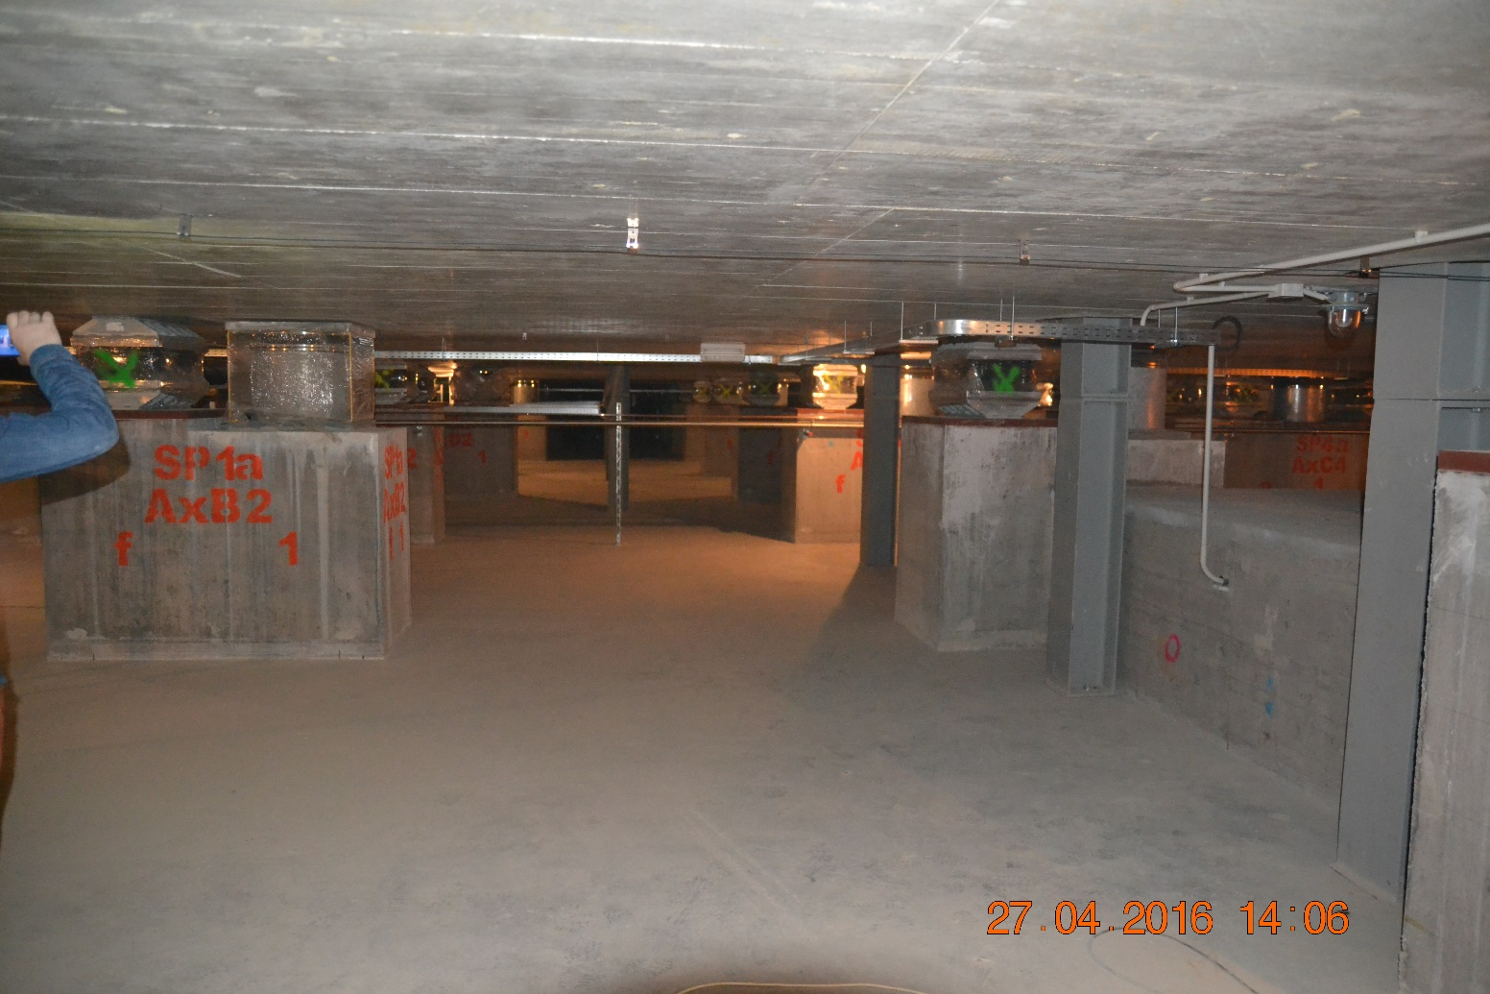
1.5m thick, 150,000 ton “optical table”
1000 springs + vibration dampers

Slide 7
Labs and workshops
GBS control room and utilities

Slide 8
Station E4
2 x 0.1 PW/10 Hz
70 m
Station E5
2 x 1 PW/1 Hz
Stations E1 and E6
2 x 10 PW/min
250 J in 25fs
1 pulse/min
Contrast
1:10⁷ @ 5ps
1:10⁹ @ 10ps
1:10¹⁴ @ 100ps

Slide 9

3 PW performance was confirmed ! (June 2018)

Slide 10
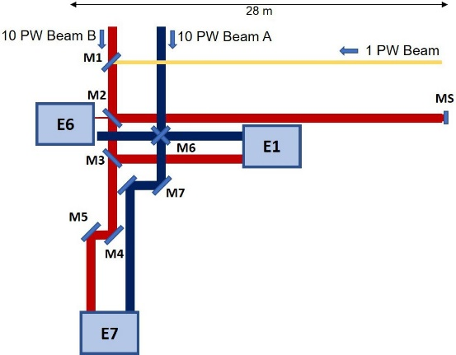
2x10 PW laser beam transport system in construction
10 PW
10 PW
1 PW/1 Hz
QED
(gas target)
Nuclear Physics
(solid target)
f=30m
AM
2x10 PW + 1 PW auxiliary beam to three experimental areas
f=30 m, F/50 mirror for electron LWFA at 10 PW
10 PW adaptive mirror upgrade
Commissioning fall 2019
Gamma
beam
Laser-Gamma

Slide 11
10 PW interaction chambers and mirrors under contracting

Slide 12
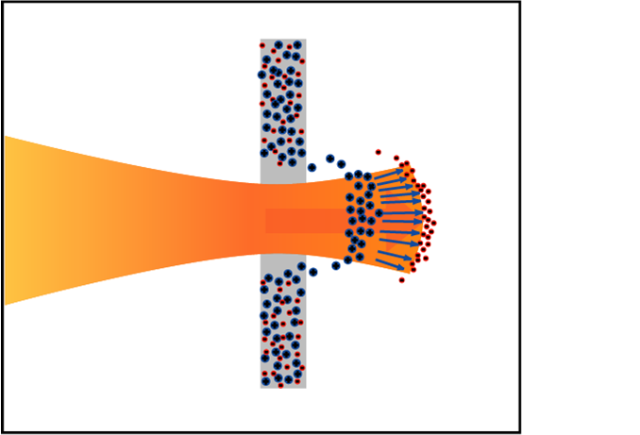
Nuclear Physics with High Power Lasers
Extreme light intensity (10²³ W/cm²)
Extreme light pressure (10 Tbar)
Radiation Pressure Acceleration
Radiation Pressure Acceleration of solid density GeV ion beams
electrons
Neutron-rich nuclei
Ultra-intense
ion, γ, neutron sources
Nuclear reactions in plasmas
ions
100 nm

Slide 13
Laser System Implementation Schedule
2017
2018
2019
100 TW
June
1 PW
Sept
10 PW
June
Thales Laser System Implementation
10PW Laser Beam Transport System Impl.
Commissioning Exp.

Slide 14
Nuclear processes in plasmas
Nuclear (de-)excitations in plasmas
observed in cold targets at 10⁻⁸ rates in ¹⁹⁷Au, ¹⁸⁹Os, and ¹⁹³Ir; never observed in plasmas
never observed
Nuclear lifetimes in plasmas
significant changes of nuclear lifetimes are predicted in hot and dense plasmas

Slide 15
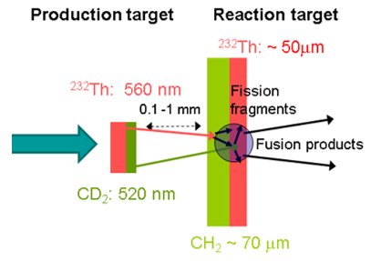
Neutron-rich nuclei production
Fission-fusion scheme (Thirolf et al 2011)
Requires accelerating solid density heavy ion bunches to ~10 MeV/A
Theory and experiments show promising direction

Slide 16
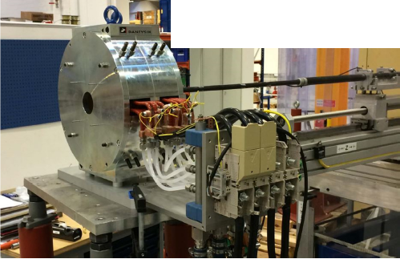
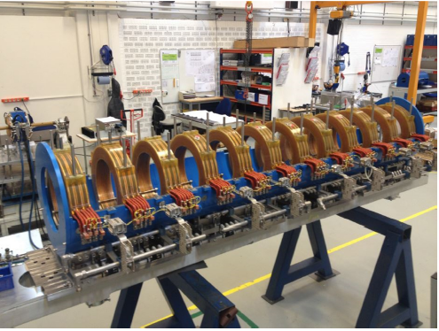
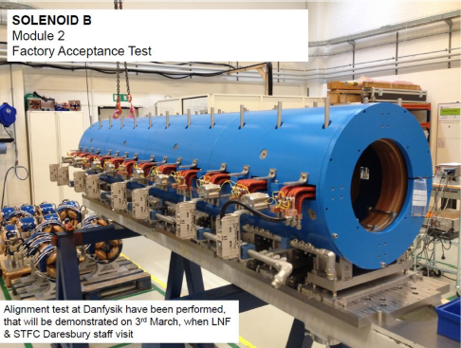
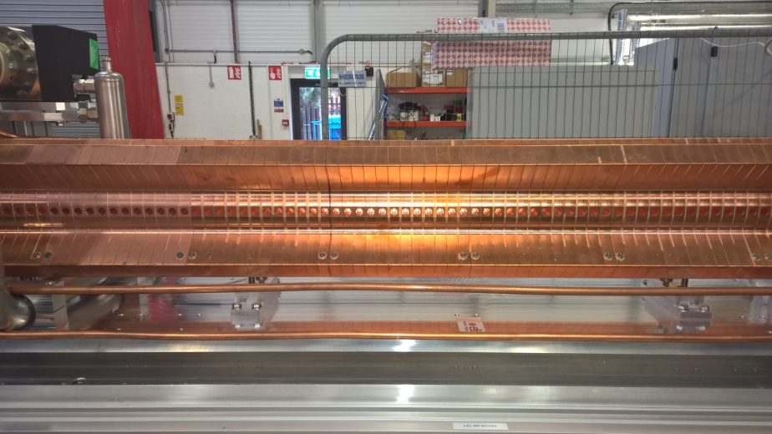
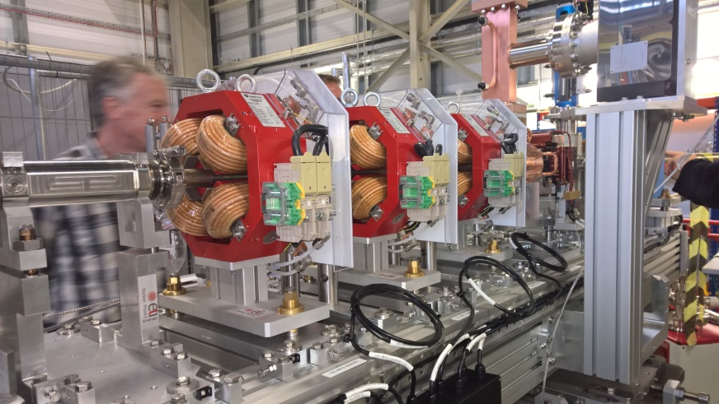
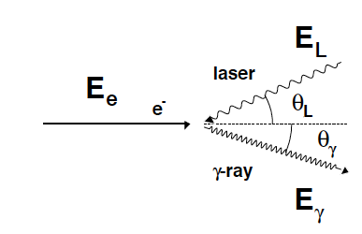
Gamma Beam System
low-energy accelerator section:
0.2-3.5 MeV
factory acceptance in Dec. 2015
high-energy accelerator section:
3.0-19.5 MeV
~ 4γ²·E_{L}

Slide 17

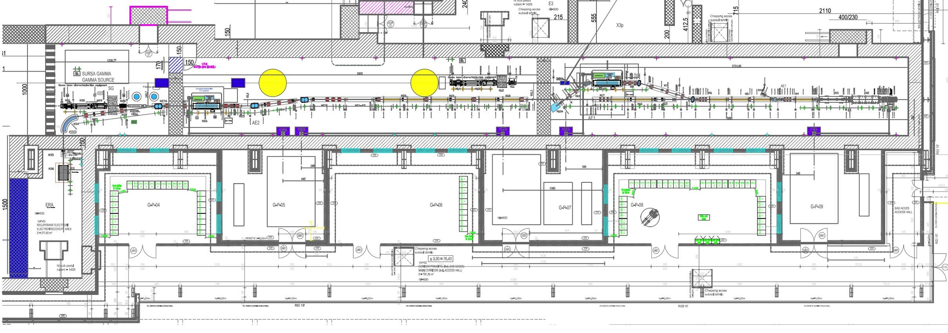
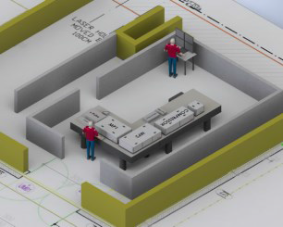
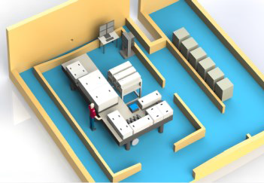
Gamma Beam System – Layout
e– beam
dump
Interaction Point
High Energy
e– beam
dump
Interaction Point
Low Energy
Photogun
multi-bunch
beam
coll&diag
beam
coll&diag
e– beam
dump
Control
Room
Racks
Room
Control
Room
Racks
Room
Interaction Laser
High Energy
e– RF LINAC
High Energy
720 MeV
Interaction Laser
Low Energy
e– RF LINAC
Low Energy
300 MeV
Photo–gun Laser
Master clock synchronization @ < 0.5 ps
High-Energy Stage: γ rays up to 19.5 MeV
Low-Energy Stage: γ rays up to 3.5 MeV

Slide 18
Gamma Beam System Implementation Schedule
2017
2018
2019
3 MeV
May
19.5 MeV
June
Gamma Beam System Implementation
Commissioning Exp.

Slide 19

what to remember
beam size: 1 mm at 10 m away from collimator
energy spread: 50 keV at E_{γ}=10 MeV
time structure: micropulses at 16 ns
photons/pulse: 10⁵
photons/macro-pulse: 32 x 10⁵=3 x 10⁶
photons/s: 3 x 10⁸

Slide 20
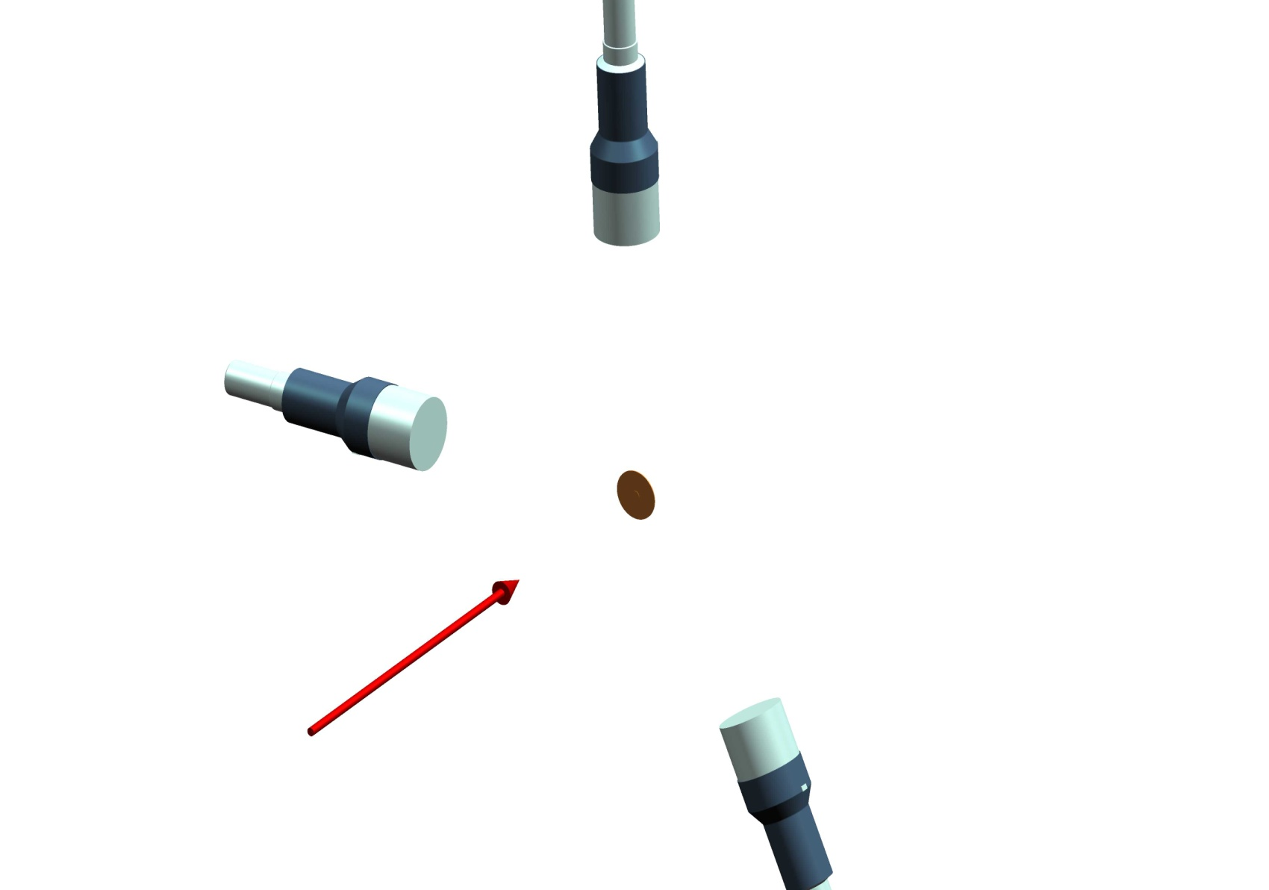
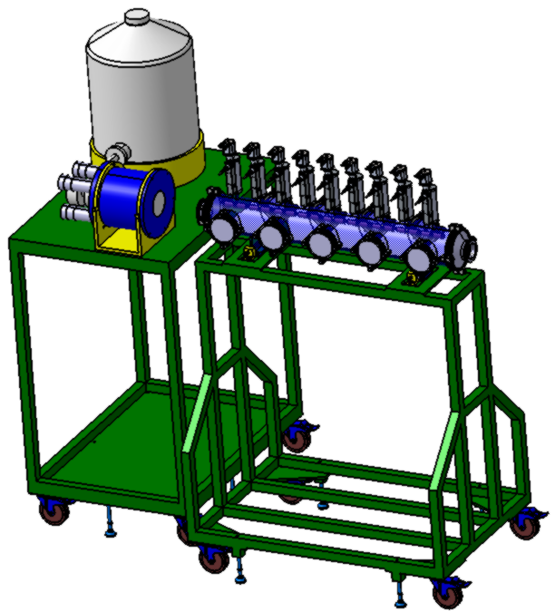
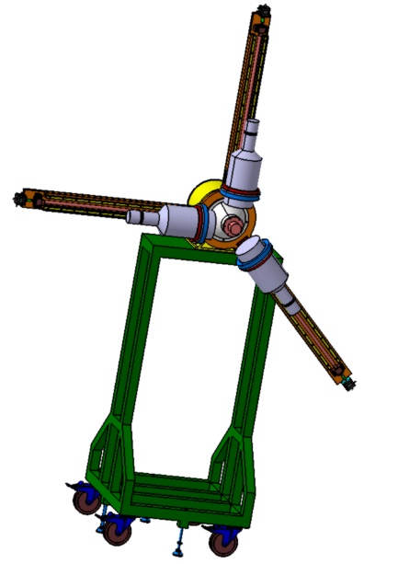
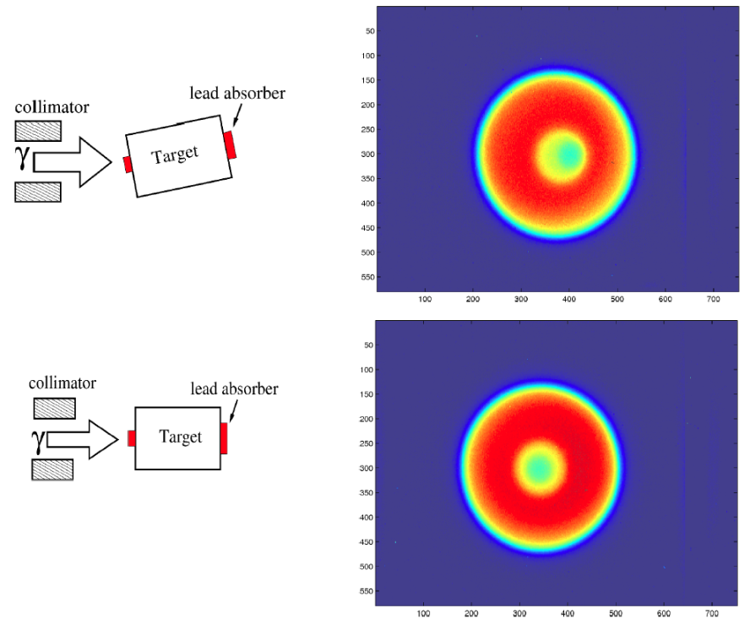

beam diagnostics
Spatial parameters: source diameter, beam width (at target), beam divergence, beam instability
Temporal parameters: micropulse duration and separation, number of pulses in train, macropulse separation
Spectral parameters: beam bandwidth and beam polarization
Power parameters: average brilliance at peak energy, peak brilliance at peak energy, time-average spectral
density at peak energy and off peak energy
10 ms (100 Hz)
16 ns
16 ns
90°
135°
>31 pulses for 512 ns @ 0.5J/pulse

Slide 21

Experiments with high-brilliance gamma beams at ELI-NP
TDRs: > 300 scientists involved
Rom. Rep. Phys. 68 (2016)
γ
separation threshold
n, p, α, ff
(Z´, N´)
g.s.
photoactivation
(Z, N)
(Z´±1, N´ 1)
±
Nuclear Resonance Fluorescence (NRF)
Giant/Pigmy Resonances (GANT)
Photodisintegration (γ,n), (γ,p), (γ,α)
Photofission (γ,ff)
Applications (positron beams)

Slide 22
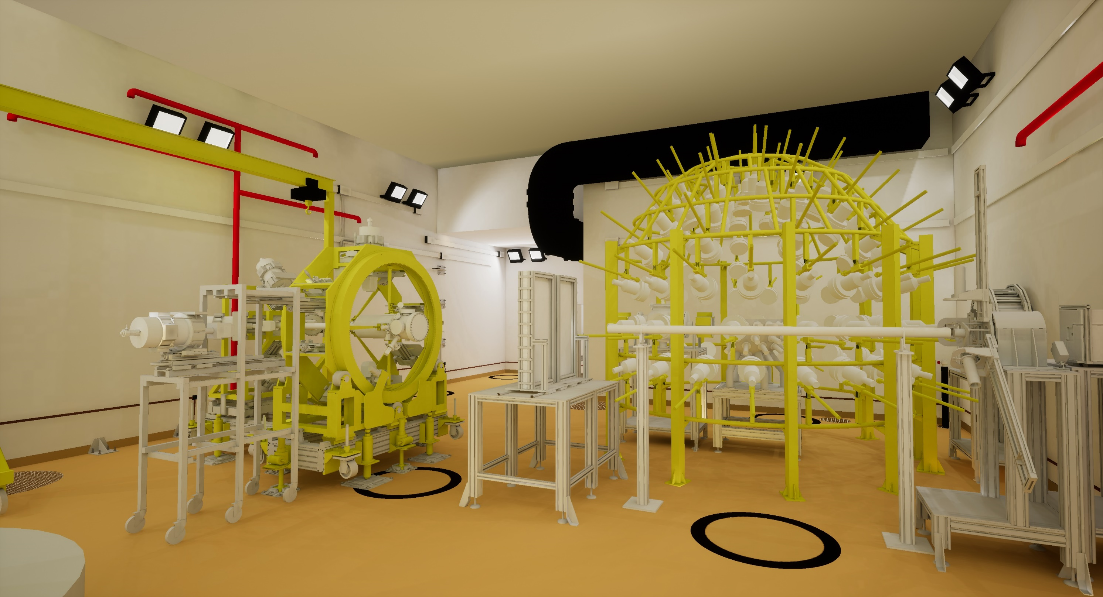
experimental hall E8
ELIGANT-GN
ELIADE
all mechanical structures are contracted

Slide 23
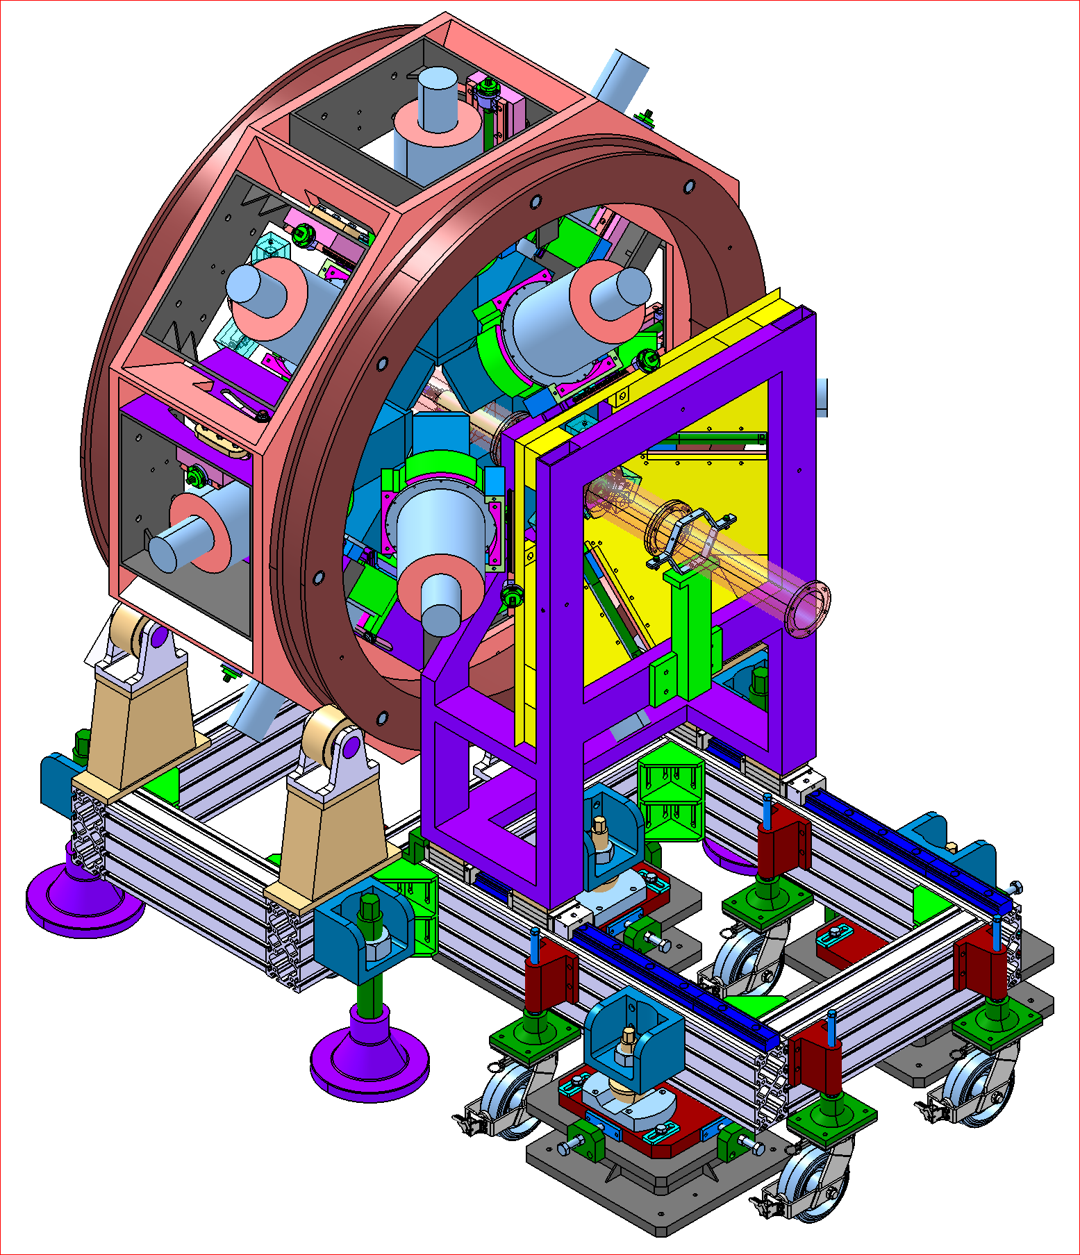
ELIADE array in collaboration with U. Koeln and TU Darmstadt
NRF experiment at ELI-NP
Rom. Rep. Phys. 68, S483 (2016)
detector tests are ongoing
array design is at a final stage
day-one experiments are under discussion
γγ coincidences
angular distributions
polarization measurements
γ beam
First in-beam test: Dec. 12-18, 2016

Slide 24
ELI-NP NRF physics cases
Rom. Rep. Phys. 68, S483 (2016)
Self-absorption measurements (Γ₀/Γ_{i})
Low-energy dipole response (e.g. Actinides)
Dipole response and parity measurements for weakly-bound nuclei
Investigation of the Pigmy Dipole Resonance
Rotational 2⁺ states of the scissor mode
Constraints on the 0νββ-decay matrix elements of the scissors mode decay channel: ¹⁵⁰Sm
Availability frontier
p-nuclei and actinides
Sensitivity frontier
week channels
Precision frontier
high statistics

Slide 25

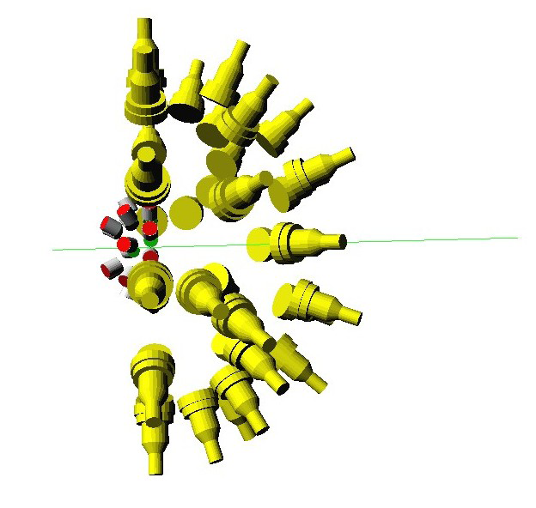
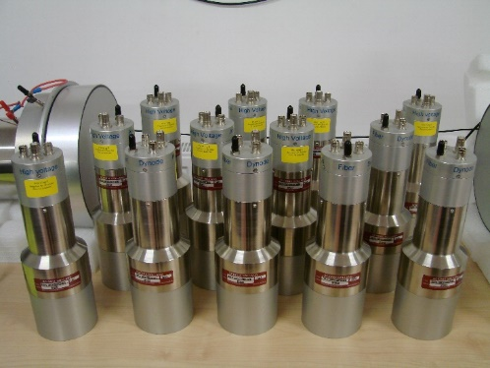
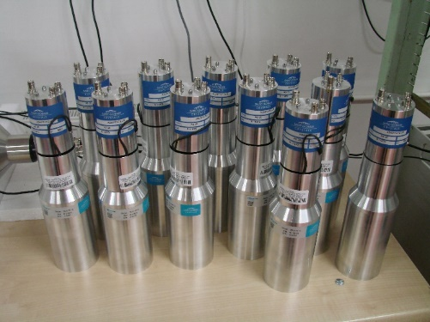
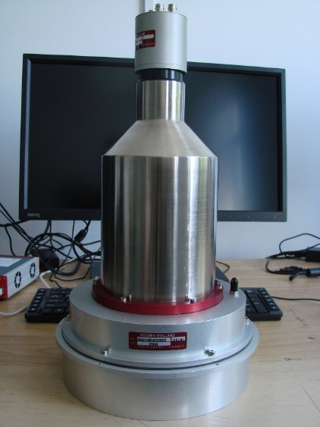
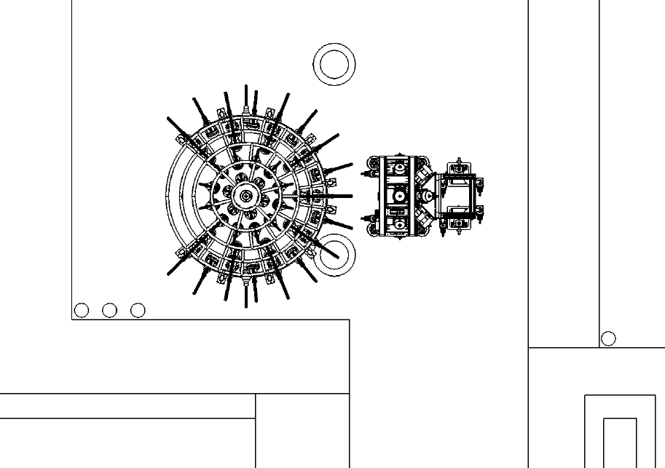
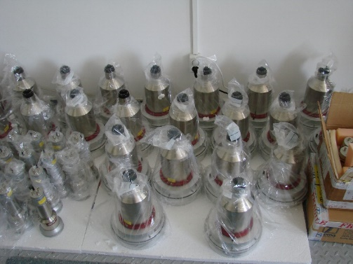
GANT experiment at ELI-NP
Rom. Rep. Phys. 68, S539 (2016)
key input U. Milano and Konan U.
Day ONE:
studies of GDR and PDR decay (⁹⁰Zr, ²⁰⁸Pb)
combine with information from (γ,n) experiments
combine with information from (γ,γ’) experiments (e.g. polarization)
γ-decay to gs and excited states as a function of excitation energy
ELIGANT-GN array
30 LaBr₃ or CeBr₃
20 ⁷Li glasses
30 Lq. Scint.
ELIGANT-GN
ELIADE
E8

Slide 26
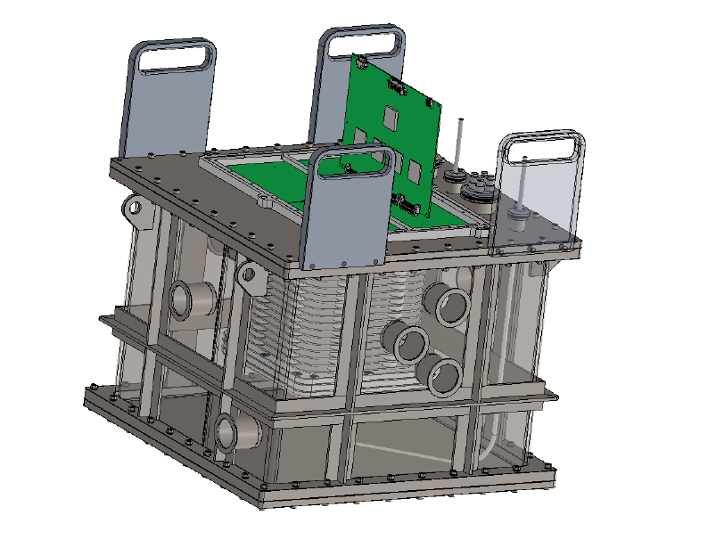
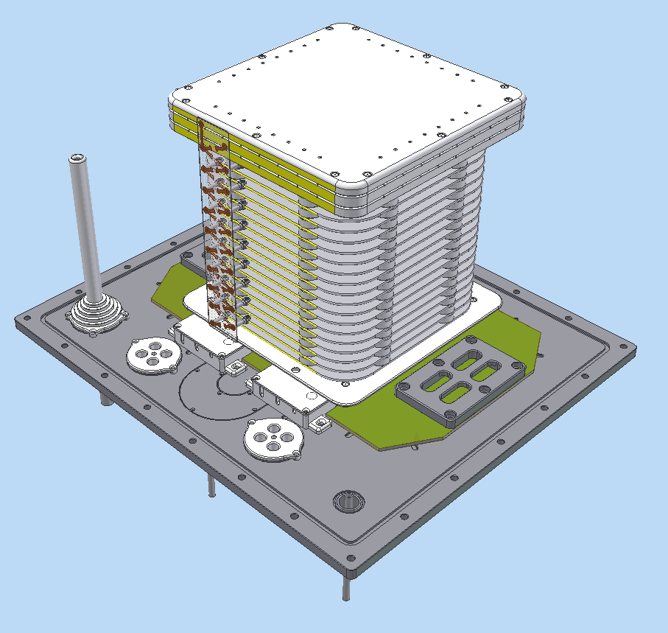
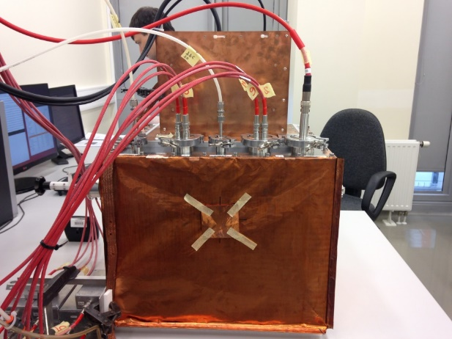
ELITPC
flagship experiment: ¹⁶O(γ,α)¹²C
Readout plane PCB
Front-end GET electronics
Gas port
HV BNC connectors
Detector upside-down view
Mountable handles for base-plate manipulation
Beam port
Source ports
Vacuum port
in collaboration with U. Warsaw
The mini-eTPC detector with 256-channel readout was built and successfully tested in-beam at the IFIN Tandem in 2016

Slide 27
in collaboration with INFN LNS Catania
C. Matei et al., exp. at HIγS in March 2017

Slide 28
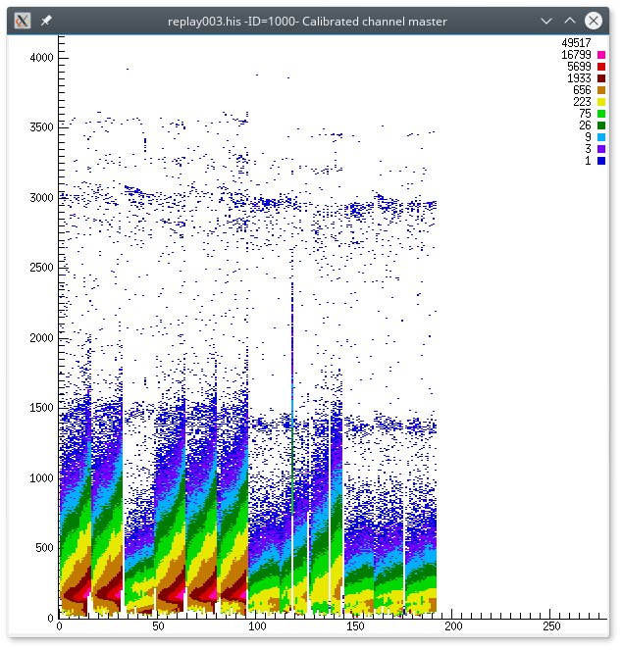
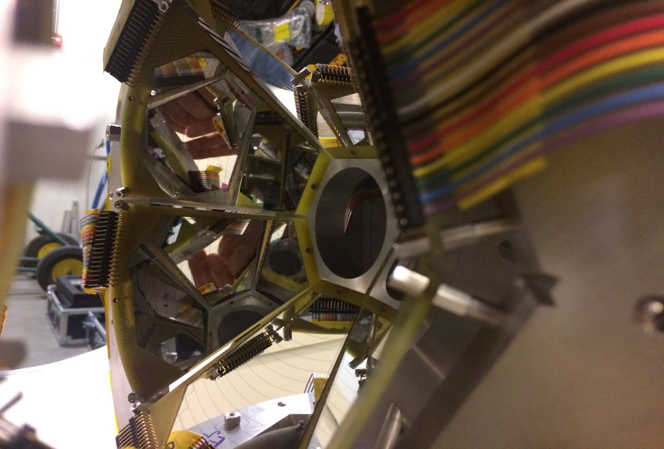
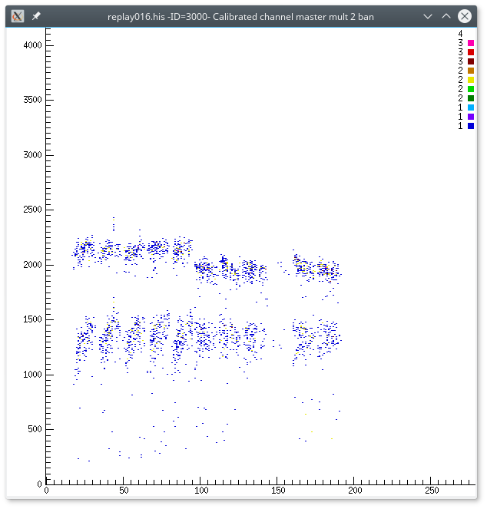
⁷Li(γ,t)α w/ SIDAR at HIγS, March-April 2017
addressing the Li-problem and theoretical aspects
using SIDAR array from ORNL
two lamp-shades of YY1: 300, 500, 1000 μm
clean alpha-triton coincidence
proposed by ELI-NP together w/: ORNL, Rutgers U, INFN-LNS, York U, Aarhus U, U Michigan
tritons
tritons
alphas

Slide 29
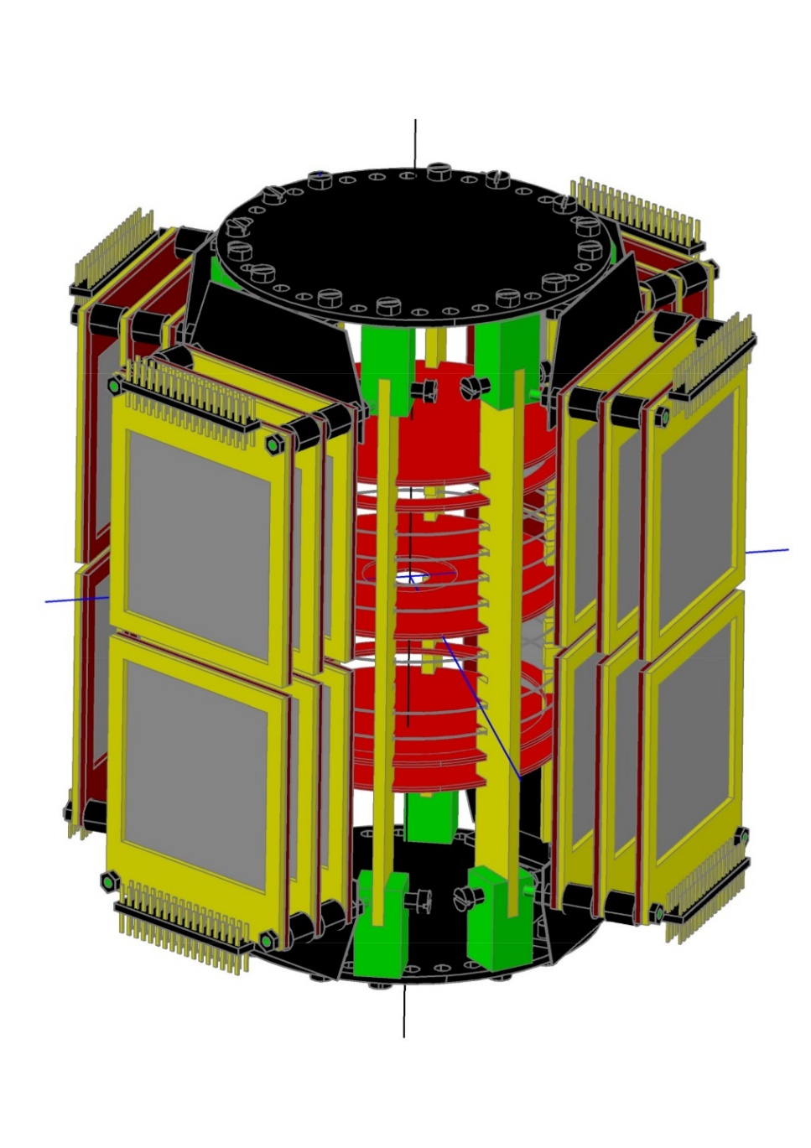
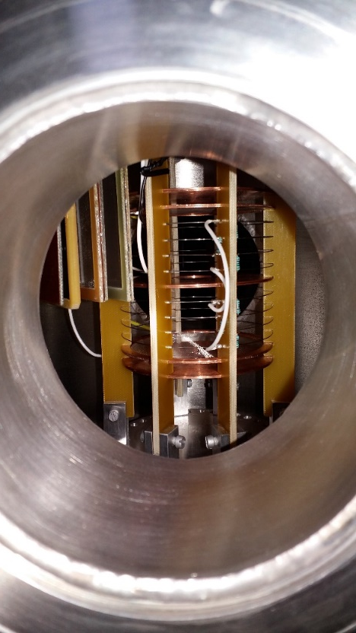
Photofission experiments at ELI-NP
Rom. Rep. Phys. 68, S621 (2016)
ELI-BIC
in collaboration with ATOMKI, Debrecen
BIC prototype tested with sources and in-beam
Array of Bragg ICs coupled to
Si DSSD based ∆E-E detectors

Slide 30
Photofission Instrumentation: ELI-BIC
in production

Slide 31
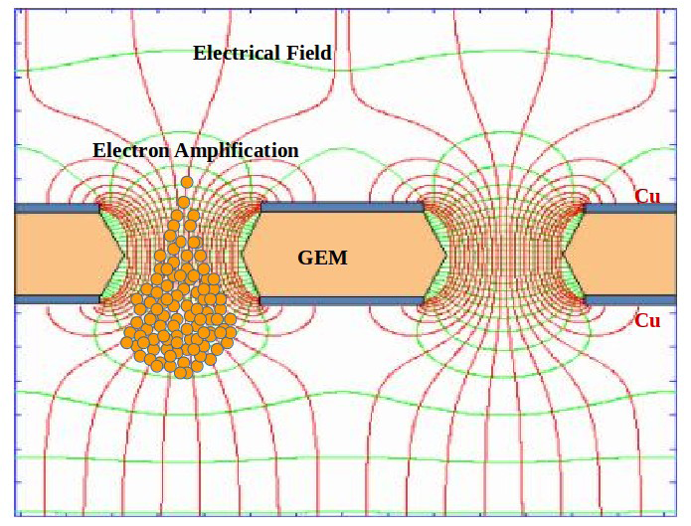
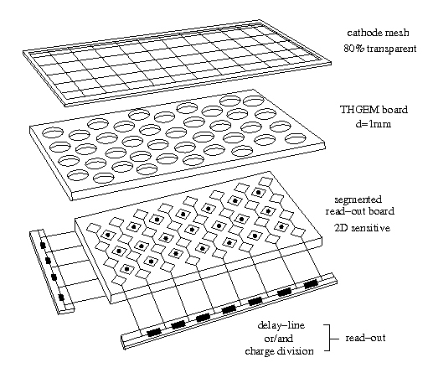
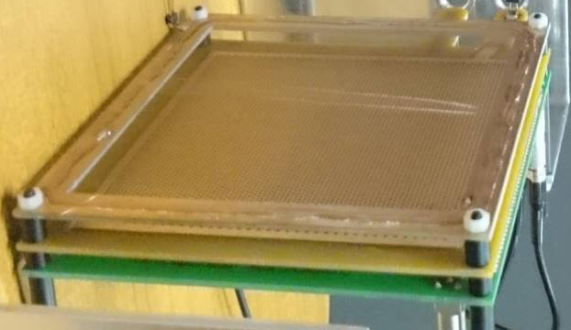
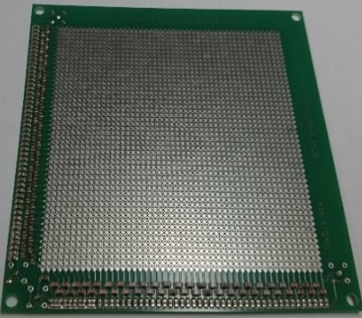
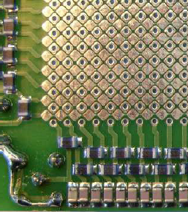
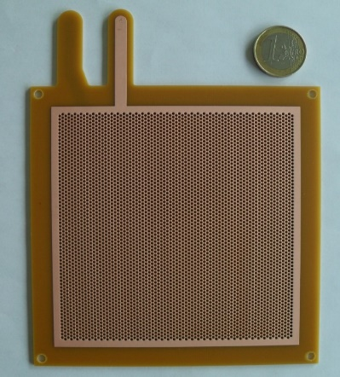
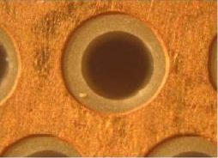
Instrumentation: ELITHGEM
Multi-target detector array consisting of position sensitive gas detector modules based on the state-of-art THGEM technology

Slide 32
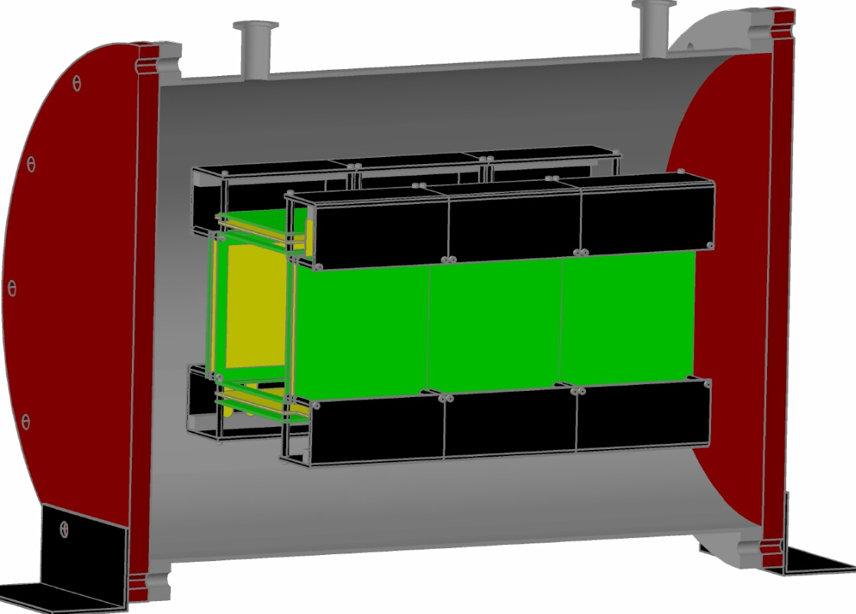
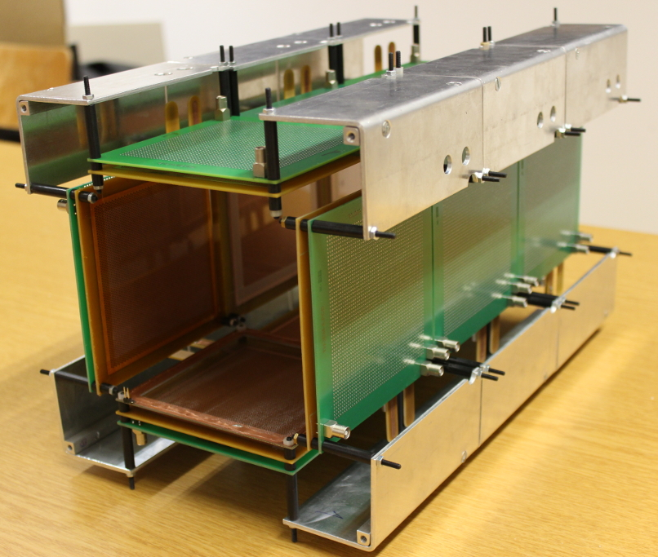
Instrumentation: ELITHGEM
Array of 12 THGEM detectors
CAD
Total target thickness: 20 mg/cm²
(10 x 2 mg/cm²)
For Eγ = 6 MeV,
~ 300 fissions / sec are expected for ²³⁸U
(from Geant4 simulations)
Beam
D. Choudhury et al., Acta Phys Pol. 48, 559 (2017)
Mechanical development
Isobutane at 5 mbar
Status
THGEM array has been assembled consisting of 12 THGEM and anode readout boards
After the development of a target holder, the full chamber will be ready for in-beam tests

Slide 33
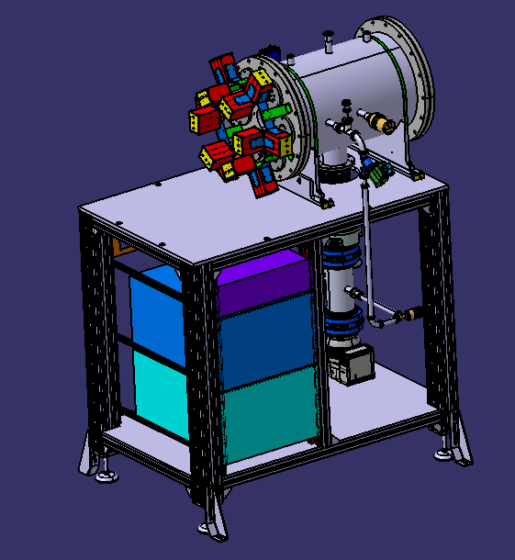
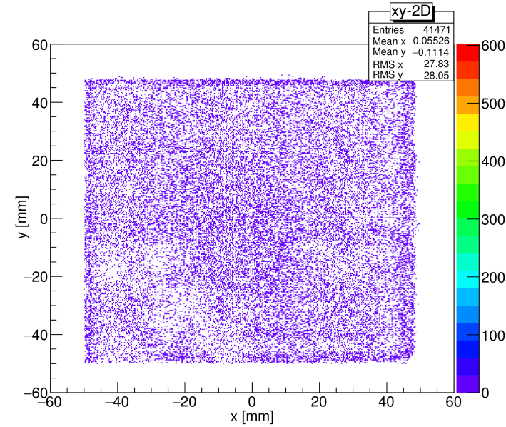
Instrumentation: ELITHGEM
Voltages
Transfer Zone : ~ -680 V
THEM front surface : ~ -650 V
THEM back surface : -150 V
Anode : Ground
tests ongoing
²⁵²Cf
good position sensitivity
stable with time
Gas
Isobutane (C₄H₁₀) at pressure of 5 mbar

Slide 34
Considered upgrades
Si detectors
ELISSA array: next generation DSSD detectors (higher granularity)
Gas-filled detectors
ELI-BIC array: improved A/Z resolution
ELITHGEM array: improved sensitivity

Slide 35


Thank you!
ELI-NP Team, March 5, 2013

