Slide 1

EUSO-SPB2 Cherenkov Camera, Built on SiPM With GET-based Readout
Evgeny Kuznetsov
University of Alabama in Huntsville
GET WORKSHOP : General Electronic for Physics
10-12 October 2018, Talence, France

Slide 2
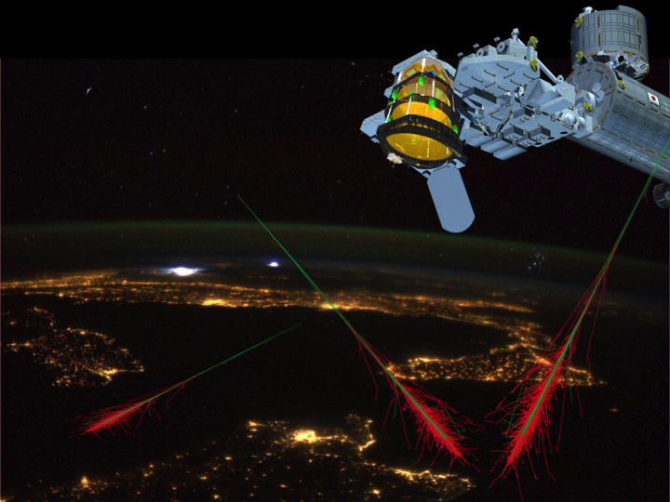

JEM-EUSO
Extreme Universe Space Observatory
(EUSO)
in the Japanese Experiment Module (JEM)
of the International Space Station (ISS)
Collaboration: 16 Countries, 95 Institutes, 358 Researchers
Refractor Fresnel Lenses large FOV and large MAPMT camera with 0.3M pixels
credit A. Olinto
16 Countries, 95 Institutes, 358 Researchers
Notes:
16 countries: Algeria, Bulgaria, France, Germany, Italy, Japan, South Korea, Mexico, Poland, Romania, Russia, Slovakia, Spain, Sweden, Switzerland, United States
EM-EUSO Collaboration: 16 Countries, 95 Institutes, 358 Researchers
Refractor with Fresnel Lenses and large FOV and large MAPMT camera with 0.3M pixels

Slide 3
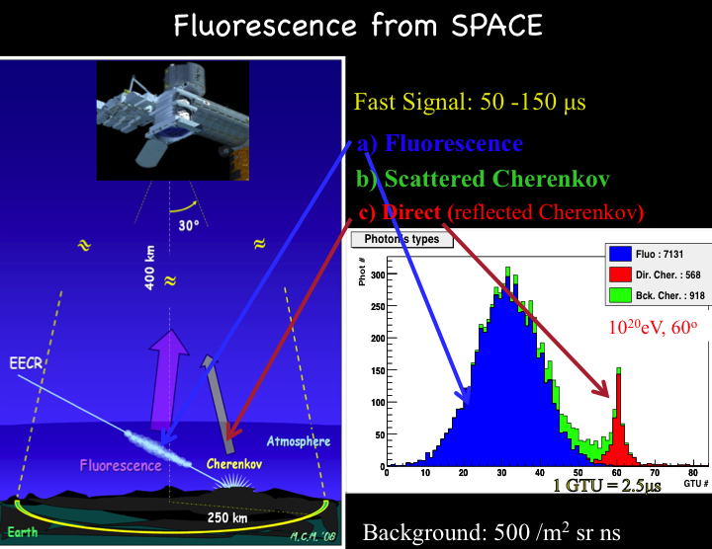

Slide 4
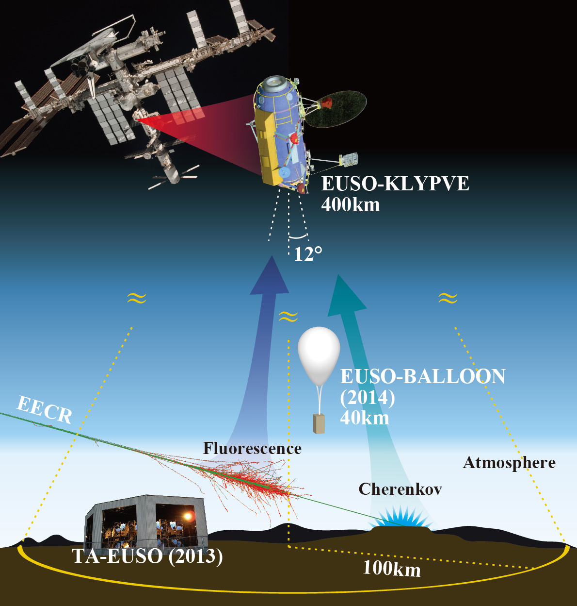

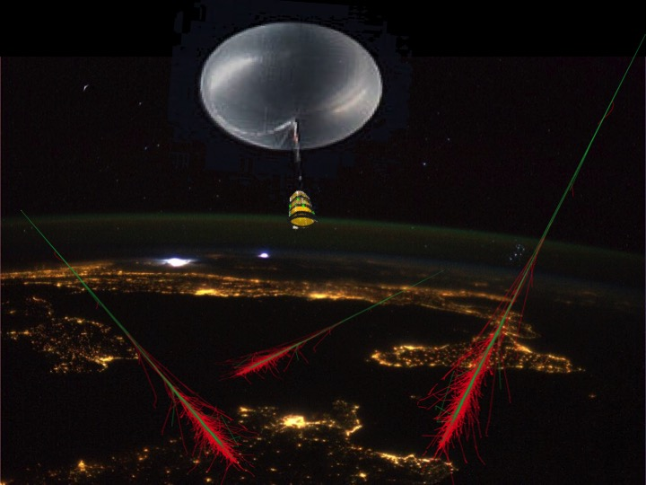
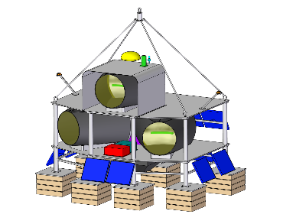
JEM-EUSO
program
EUSO-TA (2013- )
EUSO-Balloon (2014)
EUSO-SPB1 (2017)
Mini-EUSO (2019)
EUSO-SPB2 (2020-22)
K-EUSO (2023+)
POEMMA (2028+)
EUSO-SPB2
EUSO-SPB(2017)
Notes:
16 countries: Algeria, Bulgaria, France, Germany, Italy, Japan, South Korea, Mexico, Poland, Romania, Russia, Slovakia, Spain, Sweden, Switzerland, United States
EM-EUSO Collaboration: 16 Countries, 95 Institutes, 358 Researchers

Slide 5
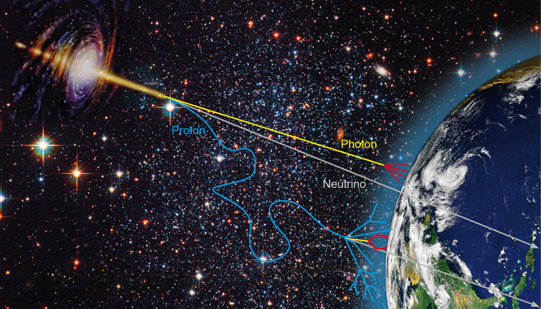
2020s
What Are the Sources of the
Extragalactic Cosmic Rays ?
What Are ALL the Sources of
IceCube Neutrinos?
What is the flux of Cosmogenic
Neutrinos?
What are Neutrino and Hadronic
Interactions at larger energies?
Notes:
Photons – absorbed
Hadrons – not straight – deviate
neutrinos

Slide 6
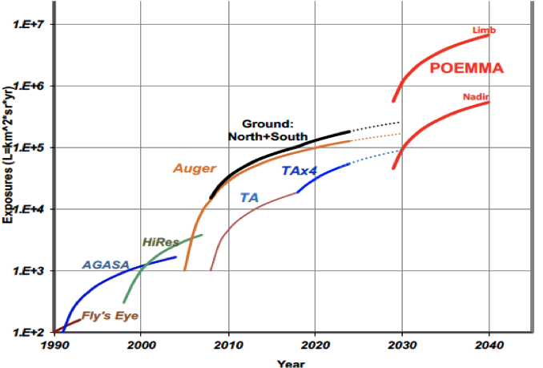

UHECR Exposure History
today

Slide 7




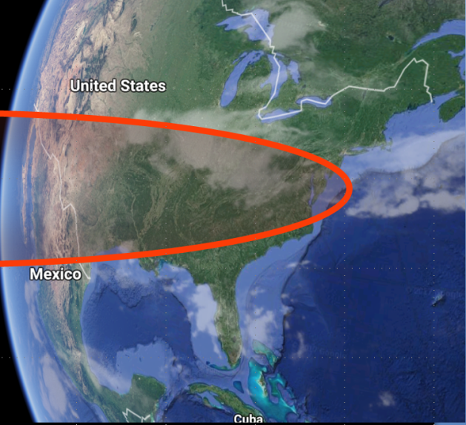
POEMMA
Probe of Extreme Multi-Messenger Astrophysi
ν_{tau}
Optical Cherenkov signal from tau neutrinos
PeV → highest energies

Slide 8
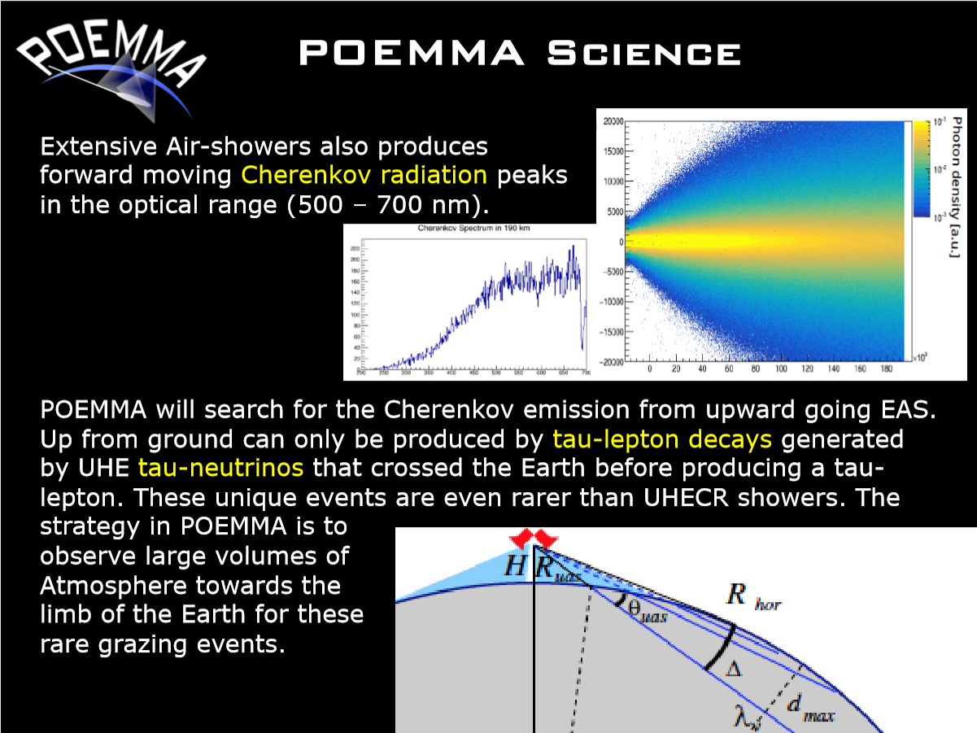

Slide 9

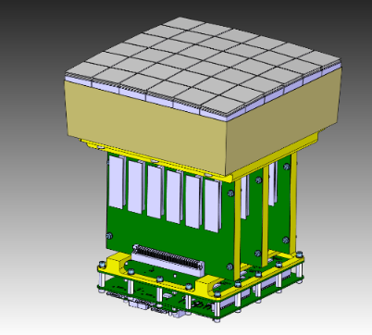
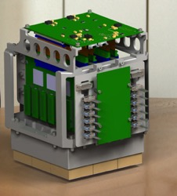
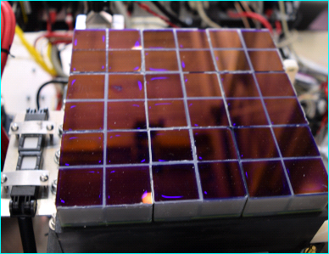
Hybrid Focal Surface
POEMMA
UV Fluorescence Detection with MAPMTs
Cherenkov Detection
with SiPMs
~ 150k pixels
1.6 m
  28 SiPM focal surface units
  Total 14,336 pixels
  pixels per FSU (6512 4x4x2)
  60 Photo Detector Modules (PDMs)= 138,240 pixels
  1 PDM = 36 MAPMTs = 2,304 pixels
9

Slide 10
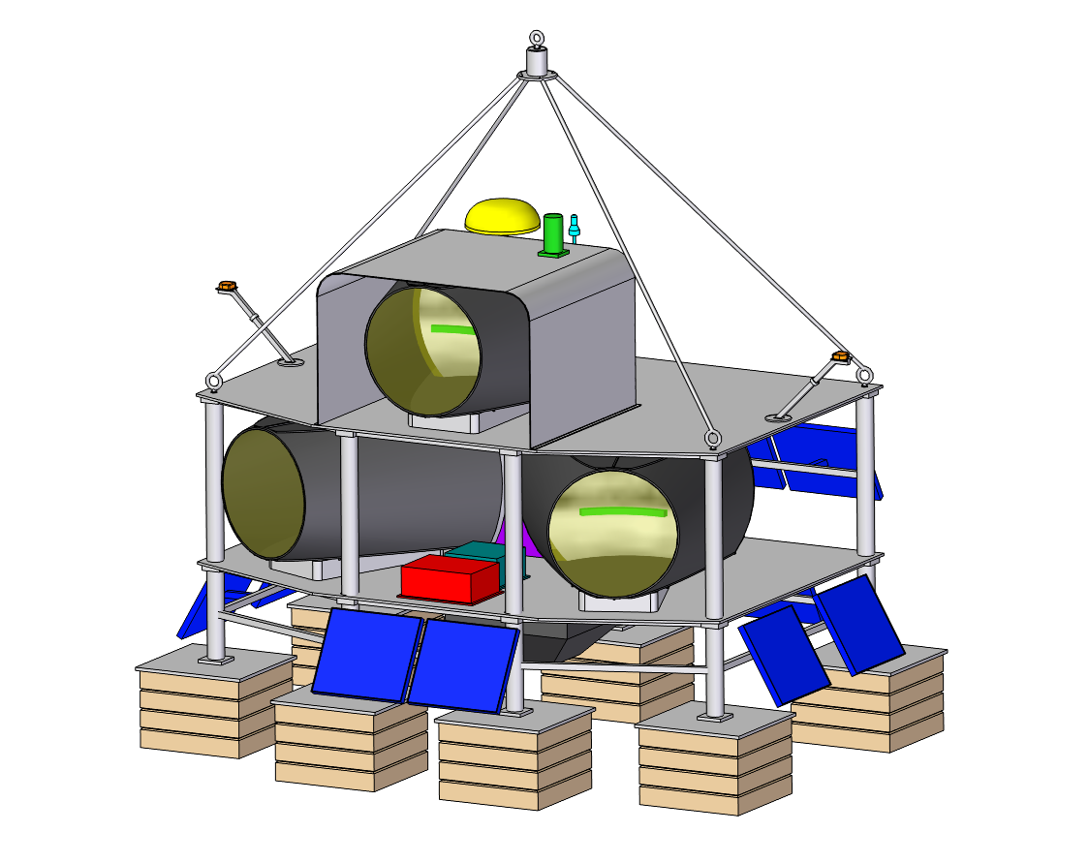

arXiv:1703.04513
EUSO-SPB2
Cherenkov Emission
from UHECRs
Tau Neutrino
Background
Fluorescence
from UHECRS
UHECRs
Cherenkov
UHECRs
Tau lepton
Fluorescence
Tau Neutrino

Slide 11
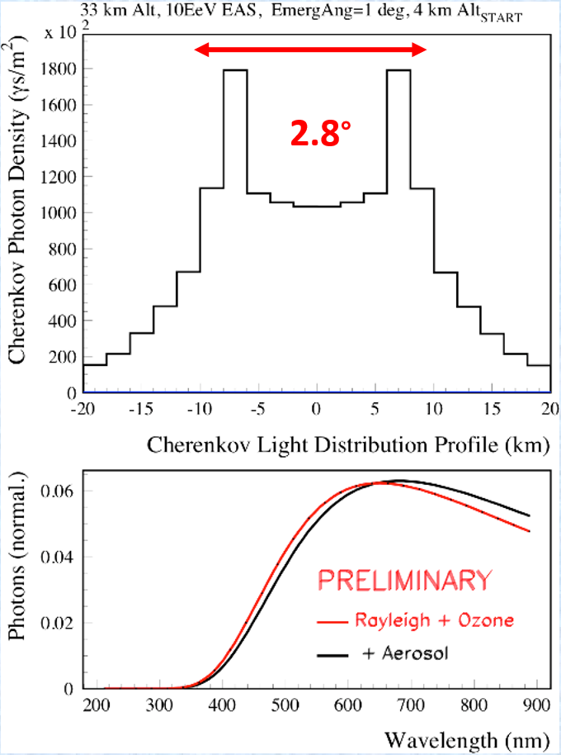
Parameters of the Cherenkov Light Pulse
  Wavelength of Cherenkov photons depends on starting altitude (shorter wavelength photons are absorbed by atmosphere).
  Dynamic range: 10 …>5000 photons per flash (in 3 x 3 mm pixel)
  Night sky background rate: up to 35 MHz ( photons per 3 x 3 mm pixel )
  Time width of the light pulse produced by UHE tau-neutrinos depends on angular position within Cherenkov cone, EAS energy ( from 10 to ~100ns).
  Sampling at 100 MHz allows to record pulse shape and perform discrimination from parasitic light sources (thunderstorms, airplanes…)
credit J. Krizmanic
Cherenkov light profile for 10EeV EAS, starting at 4km altitude. Observed at 33km

Slide 12
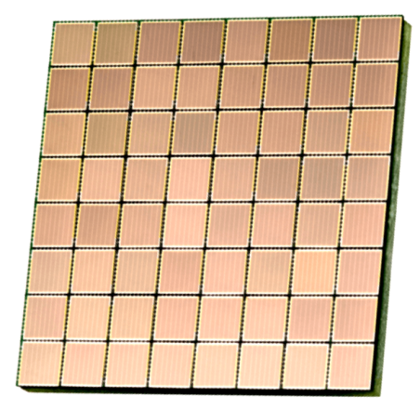
Cherenkov Detector. Focal Plane Layout.
SiPM: 3 x 3mm pixel size ( 8 x 8 ). Total : 84 sensors (3 x 28)
Option with custom FEE boards.
FEE
FEE
FEE
FEE
ADC
SiPM sensor
FPGA
Backplane
ADC
AGET
AGET
ADC
AGET
M1
M2
M3
M28
Focal Plane

Slide 13
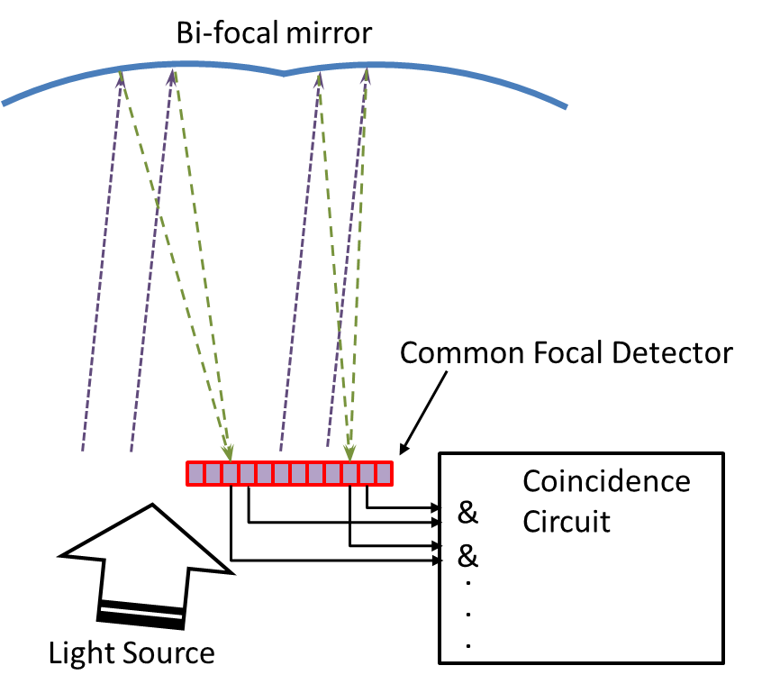


Bi-focal Mirror Concept
Std. mirror
Bi-focal mirror
TRIGGERING LOGIC:
- Trigger signals from 64 channels of SiPM sensor (8x8) build common multiplicity trigger which is continuously sampled (at 25MHz) and digitized on AsAd board and delivered to COBO then to MUTANT module;
- MUTANT module performs coincidence function between pairs of neighboring SiPM sensors issuing Trigger L1, which initiates readout of hit registers into COBO;
- MUTANT preforms analysis of pixel_hit_addresses: is address of 3x3 box with central hit_pixel of one sensor corresponds to similar address of hit-pixel box of the other sensor / from “bi-focal”-triggered pair /. The result: Trigger L2, which initiates readout of specified ASICs according to readout vector ( can be just 2 hit ASICs; the whole focal plane or specific sector ).

Slide 14
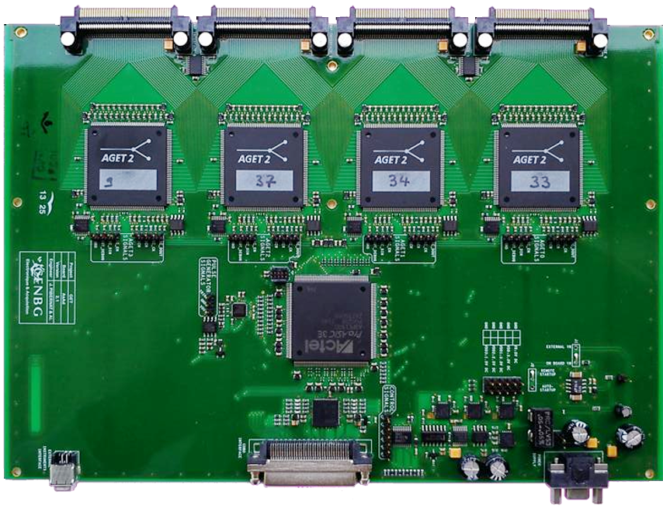
½ Focal Plane Layout (16 SiPM sensors)
4 x 4mm or 5 x 5mm pixel size. Connection to AsAd Boards
SiPM
Connector
Interconnect
Board
Connector on top of Interconnect
Board
Connector at the bottom of Interconnect
Board
Next AsAd board with Interconnect Board (in the stack of 4) is flipped over and connects to the other 4 SiPM connectors
Stack of 4 AsAd Boards

Slide 15
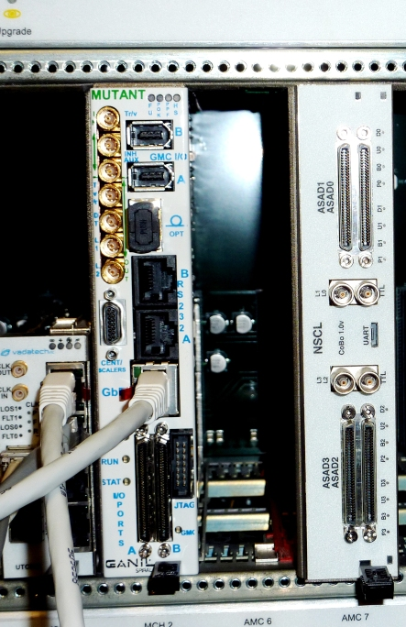
Focal Plane Layout (2 x 16 SiPM sensors)
Stack of 4 AsAd Boards
Stack of 4 AsAd Boards
Option1: All 8 AsAd boards are connected to μTCA crate
(2xCOBO ; 1 Mutant modules)
Option2: AsAd boards are read out by Zed boards (custom Zynq-based boards)
MUTANT
COBO

Slide 16
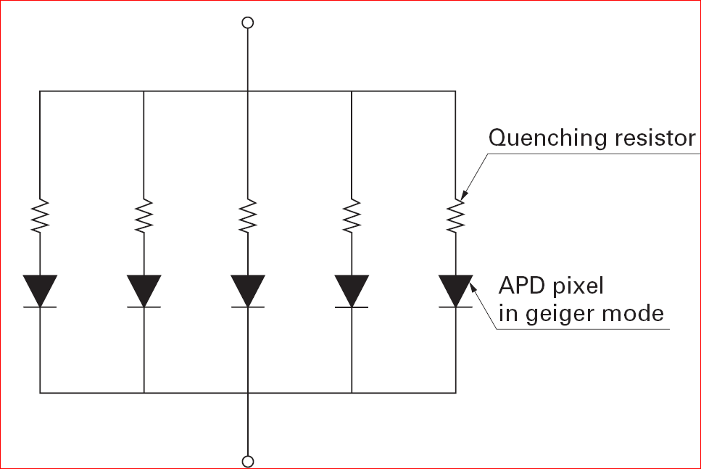
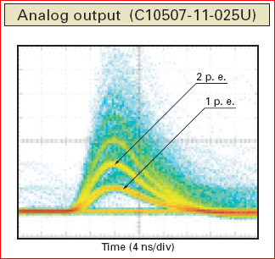
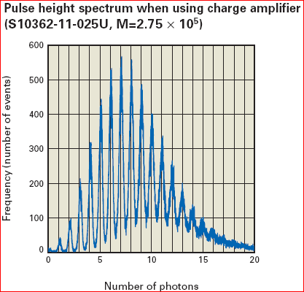
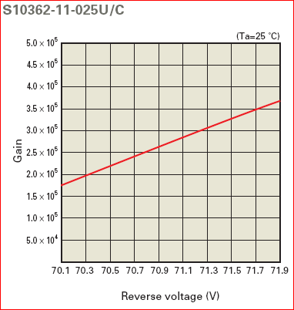
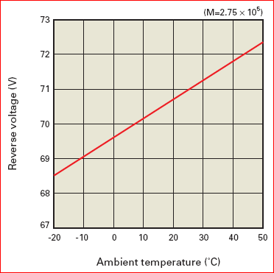
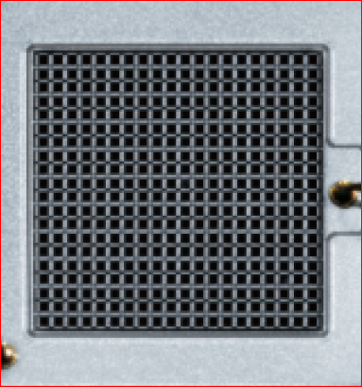
SiPM Functionality
SiPM equivalent circuit
Credit:
Hamamatsu

Slide 17
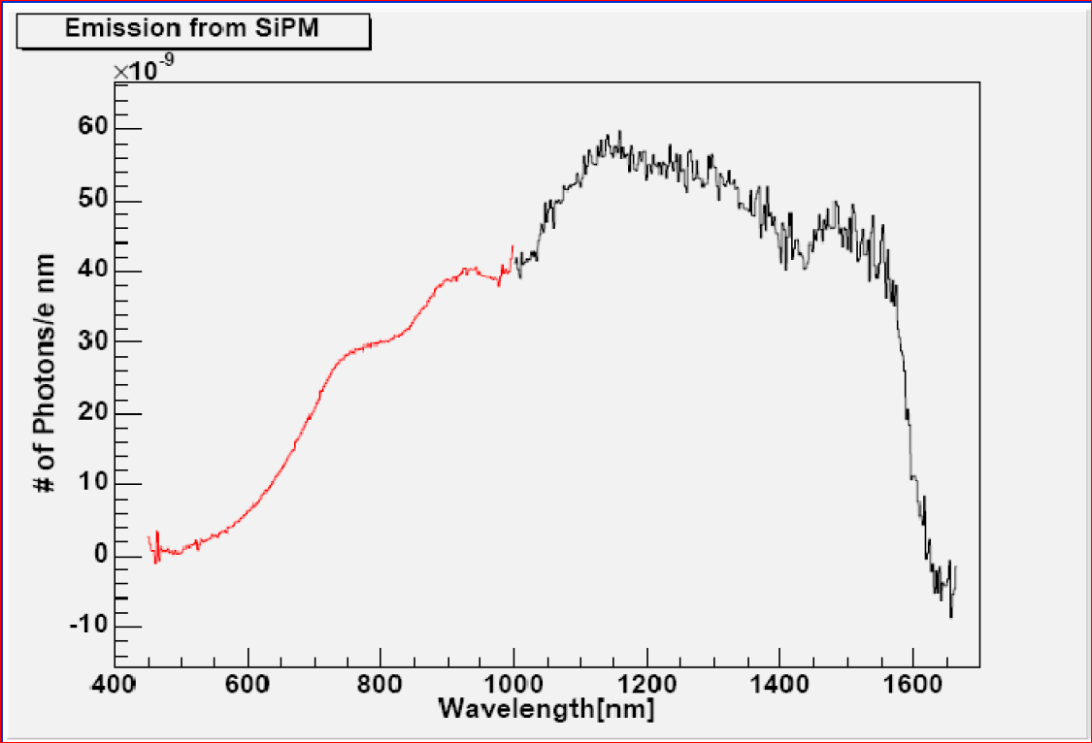
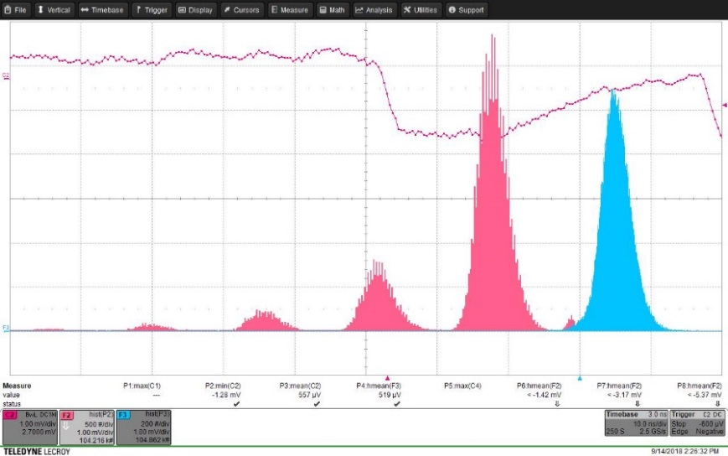
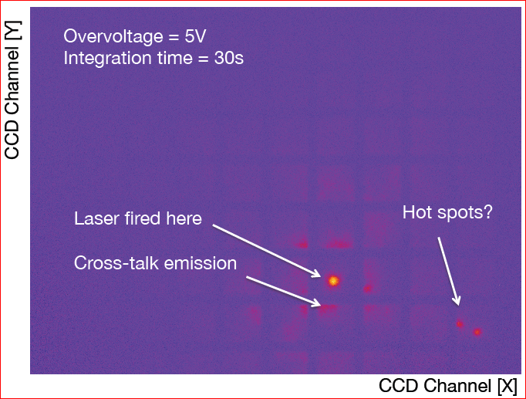
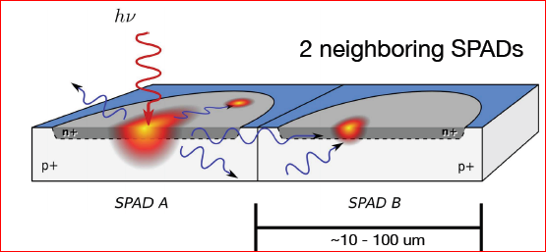
SiPM Optical Crosstalk
R.Mirzoyan
5pe
4pe
3pe
2pe
1pe
Dark counts amplitude spectra
Dark count rate = 50… 500kHz/mm² @RT
Secondary emitted photons (10⁻⁵ ph/electron) on each microcell breakdown
Credit: Derek Storm / ICASiPM2018

Slide 18
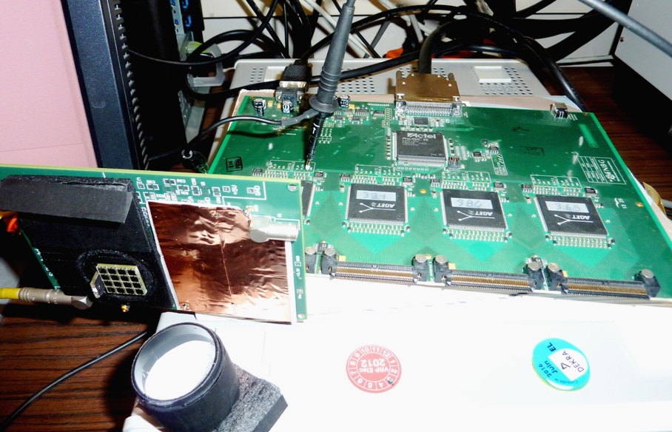
SiPM – AsAd Test Setup
AsAd Board
SensL SiPM matrix
( 3x3 mm pixels)
Light-tight Cup
SiPM chip ArrayC-30035-16P-PCB was connected to AsAd inputs using adapter card with connecting components. Pixel#2 was used for most of measurements. Pixells #2,5 and 6 were connected together for measurements with large area pixel. Load resistance = 51 Ohm; Connection to ASIC input: series of R,C ( 1k ; 220pF). Board and external LEDs were strobed by 20ns...160ns pulses of various amplitudes. Data were acquired at CEA Saclaly using full GET DAQ in standard and spy mode ( by probing of the SCA and shaper outputs of the AGET ASIC ).

Slide 19
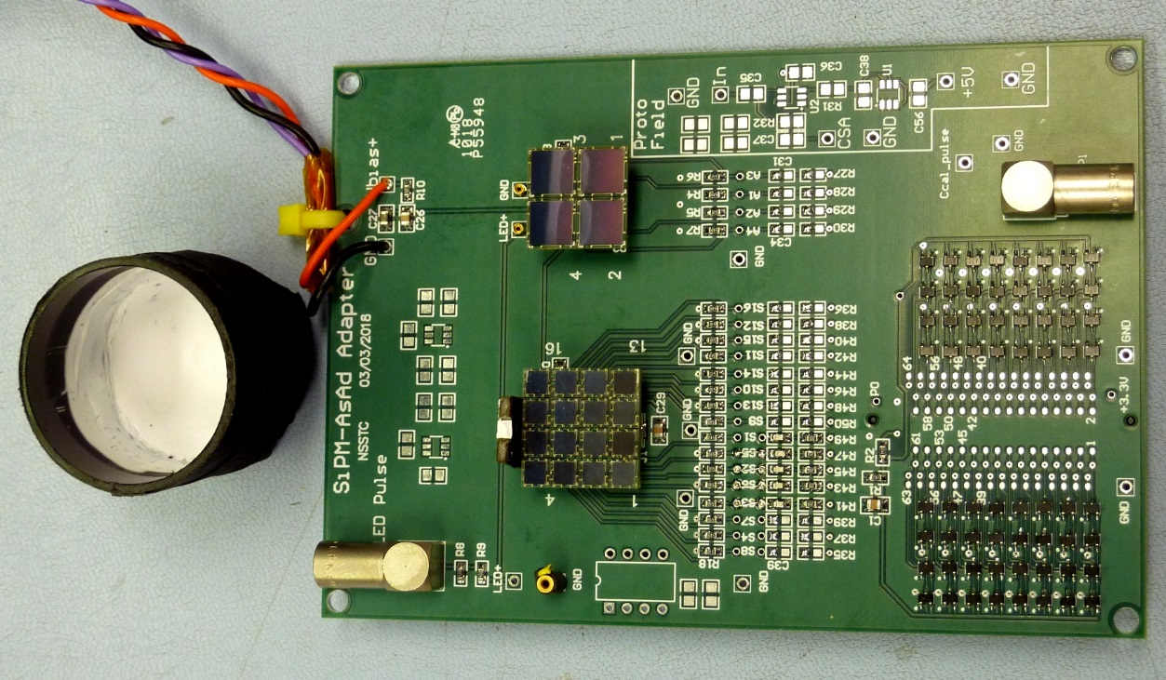
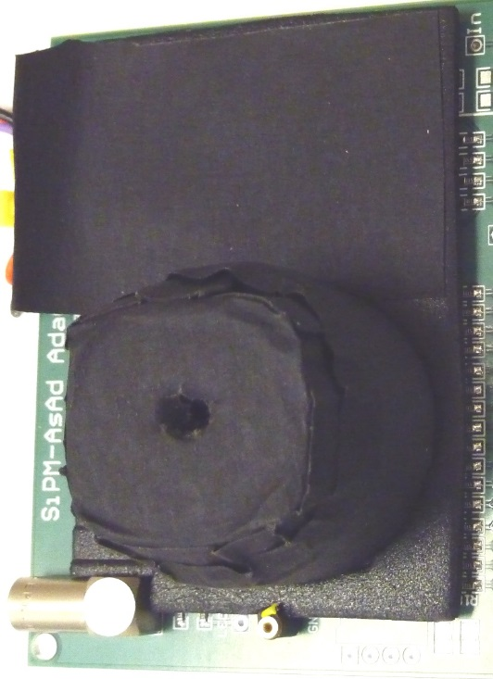
SiPM – AsAd Adapter Board
Light-tight
Cup
Board LED
SensL SiPM matrix ( 3x3 mm pixels)
Top port for external LED
- Adapter board accommodates and connects to GET front-end board SensL SiPM modules ArrayC-30035-16P-PCB (with 3x3 mm pixels) or ArrayC-60035-4P-EVB (6x6 mm pixels)
- Chip LED installed on the board illuminates internal surface of the light-tight cup covered by diffusing Teflon tape to provide test light pulse to SiPM chips.
- The hole on top of the light-tight cup allows to attach second external LED and also to conduct tests at elevated background levels

Slide 20
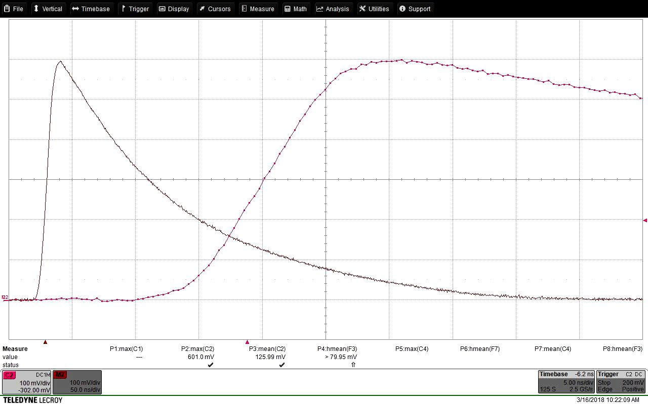
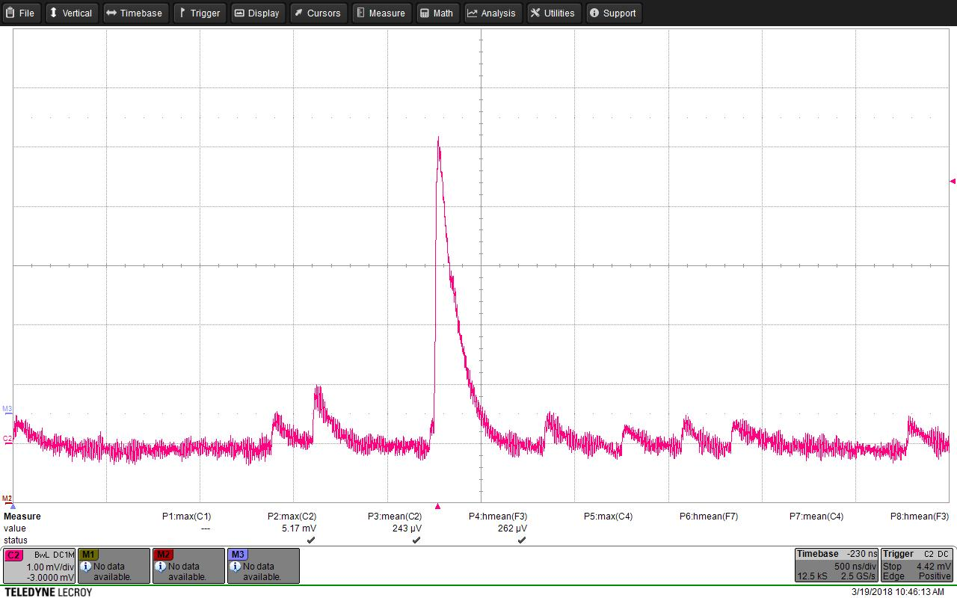
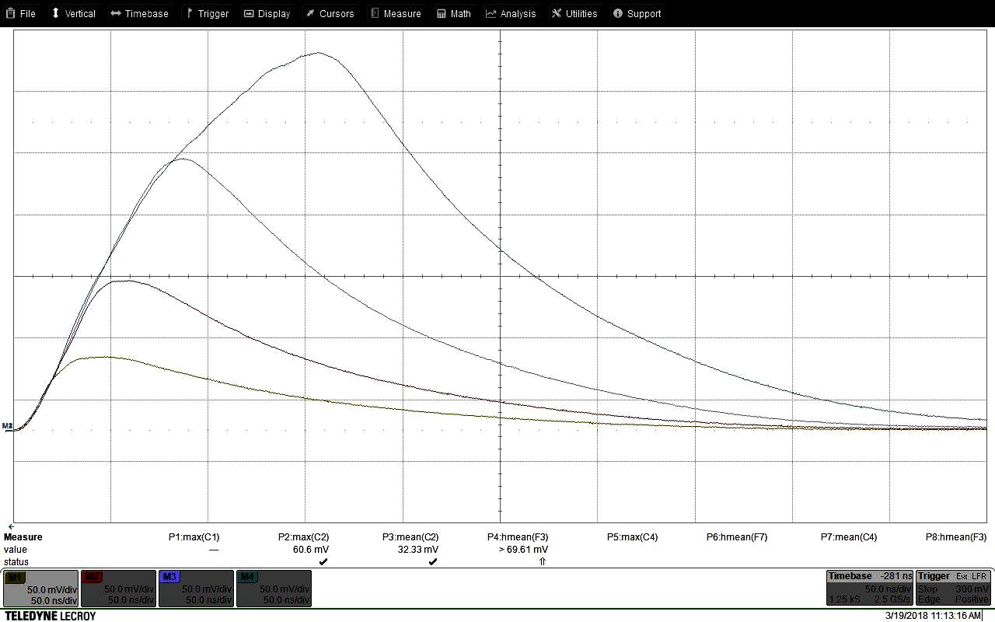
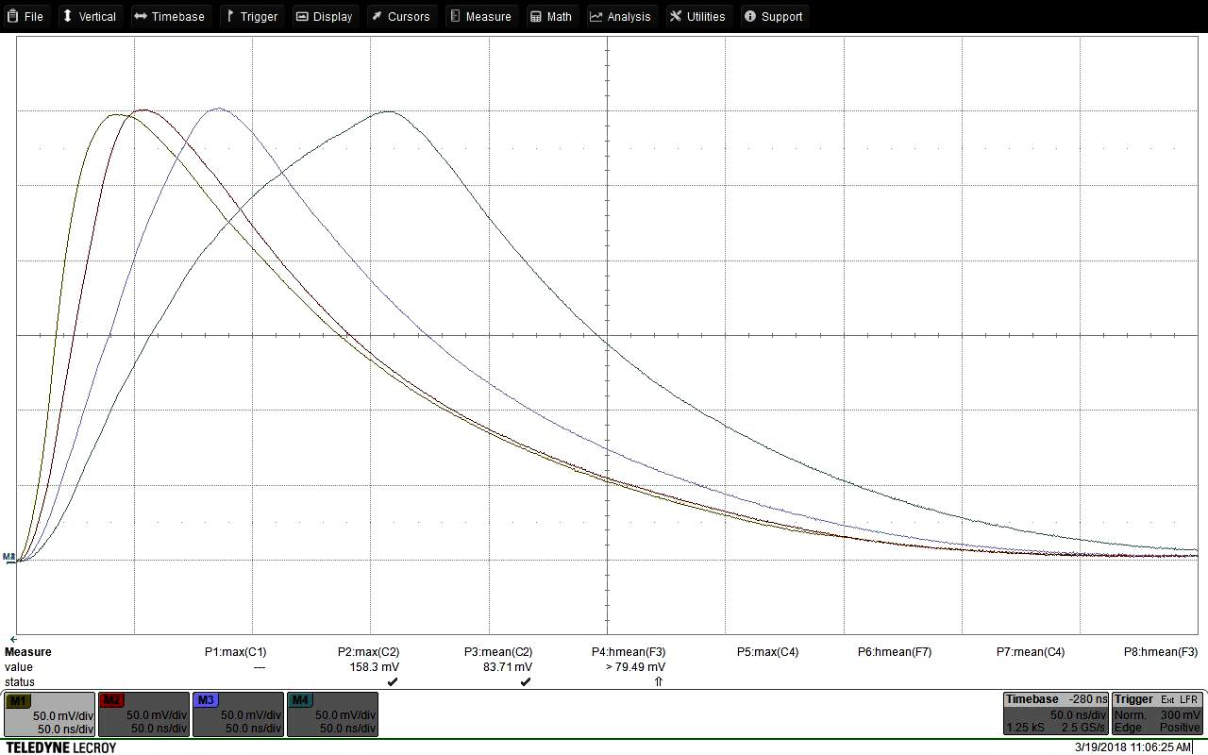
Characterizing of the LED sources with PMT
Zoomed
Front
20ns
3x3 mm SiPM response on 20-ns Board-LED flash
Dark counts/1p.e. level at 50 Ohm ( 1mV/div)
50ns
50ns
3x3 mm SiPM response on 20, 40, 80, 160ns-wide pulse from the external LED
SiPM response on 20, 40, 80, 160ns-wide pulse LED intensity is adjusted to obtain same amplitude

Slide 21
Ubias
Simplified AsAd Functional Diagram
SiPM
Rs
Cs
51
AGET ASIC #1 … #4
Trigger Logic Digital Interface
From SiPM
CLK1
CLK2
CLK2
Preamp
(CSA)
Shaper
SCA1
Analog Multiplexer
ADC
4 channels
ADS6422
Buffer
TP1
TP2
Preamp
(CSA)
Shaper
SCA64
Switched Capacitor Array continuously samples shaped SiPM output with CLK1 (100MHz)
Once event trigger is generated SCA stops
ADC sequentially digitizes N samples stored in connected SCA at slower CLK2 (25 MHz)
TP1 , TP2 of Ch#64 can be probed in “Spy” mode.

Slide 22
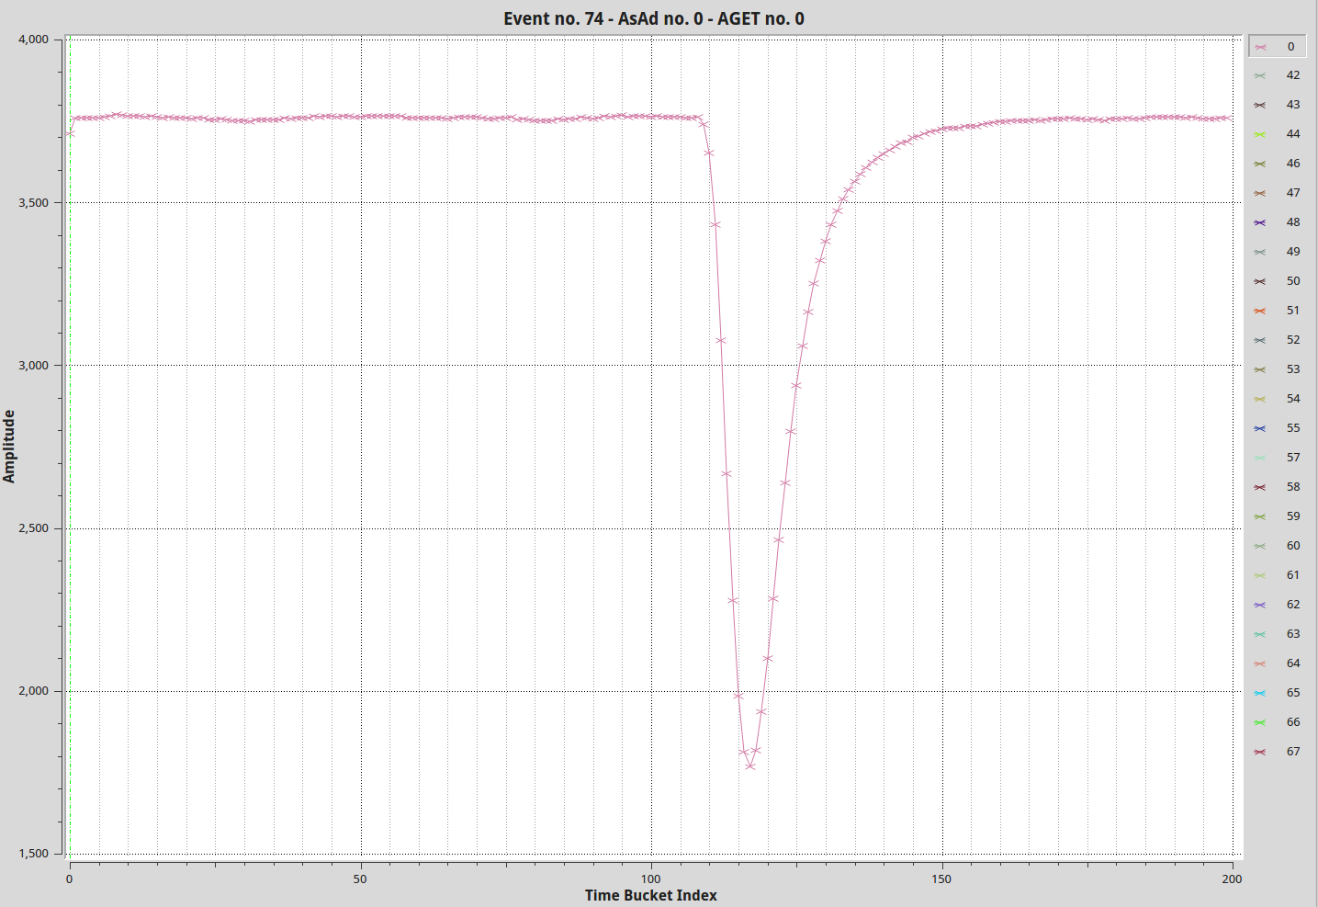
AGET Response on electrical test pulse (positive polarity) /Digitized out/
200ns
Fsmp=100MHz
External test pulse. Shaping time: 70ns

Slide 23
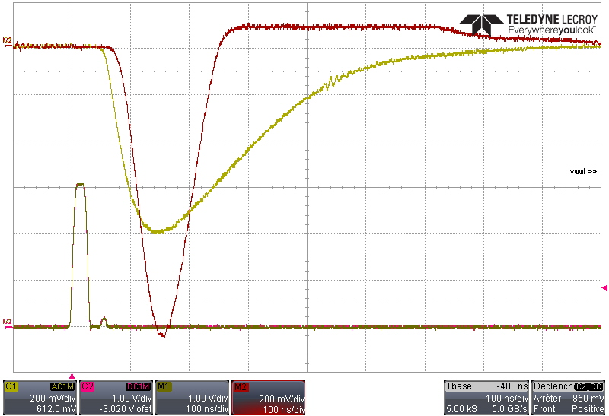
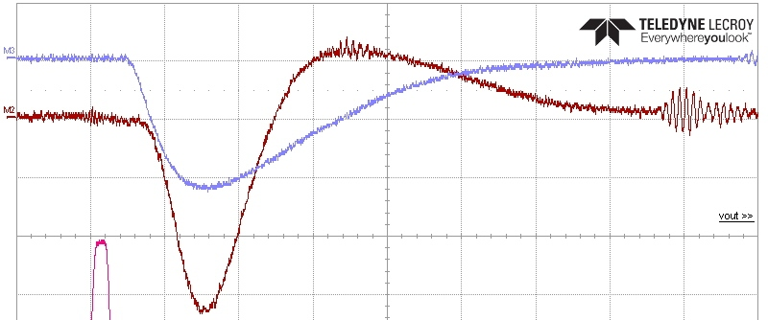
ASIC Response on 20ns LED pulse
CSA and shaper outputs in spy mode.
U_SiPM = 28 V SiPM pixel is connected via Rs = 220 Ohm; Cs = 220 pF
Ibias = x2;
CSA dyn. Range = 10pC;
Tsh = 70 ns
Board LED is strobed by 20ns pulse; U = 3.0V
Smaller amplitude with Non-saturated overshoot ( 50mV/div )
Preamp output (CSA)
Shaper output

Slide 24
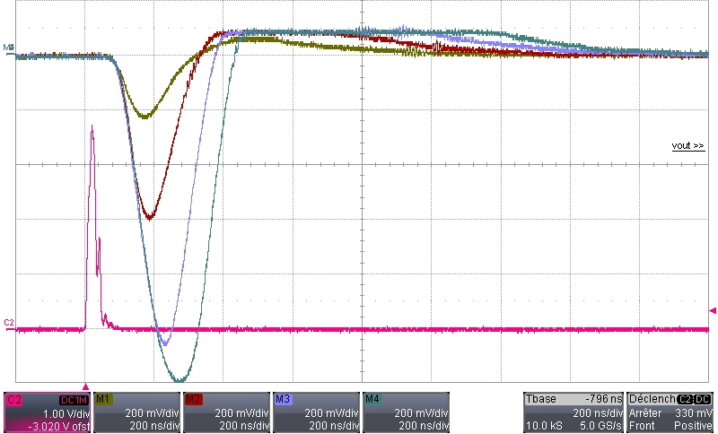
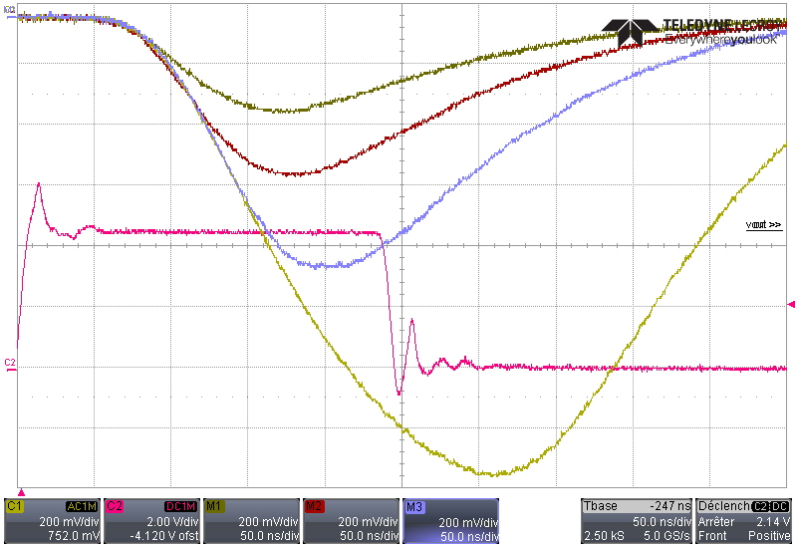
AGET Shaper output /various pulse width
Shaper output waveforms for 20; 40; 80 and 160ns LED strobes (200ns/div)
Zoomed view (50ns/div)
U_SiPM = 30 V
SiPM pixel is connected via
R = 1000 Ohm; C = 220 pF
CSA dyn. Range = 10pC
External LED ( top port ).

Slide 25
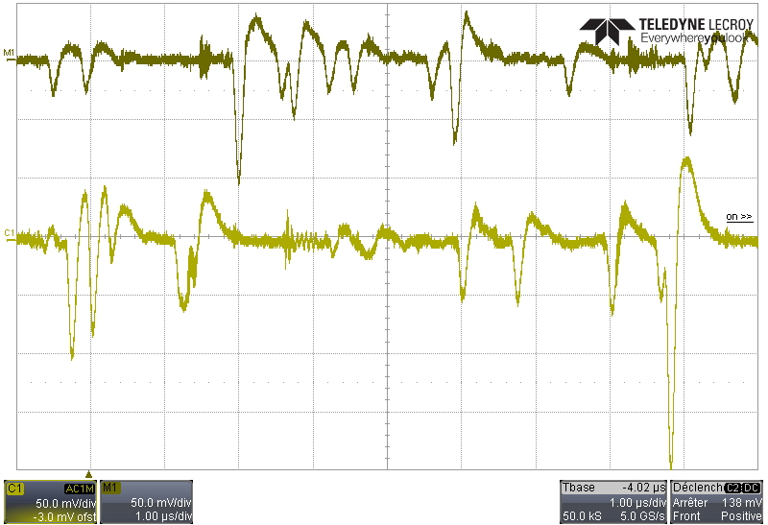
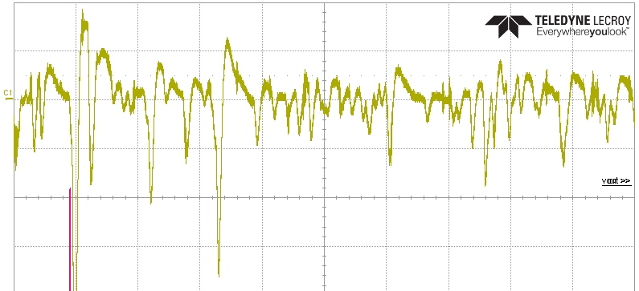
SiPM Dark counts at the AGET shaper output
U_SiPM = 28 V
U_SiPM = 30 V
SiPM noise counts at two bias voltages.
Pixel is loaded by 50 Ohm and connected at the ASIC input via C=220 pF; R = 220 Ohm
Ibias = x2;
CSA dyn. Range = 1pC;
Tsh = 70 ns
High background
( slight illumination via top port of the light-tight cup )
1pe~ 20mV
CSA dyn. Range = 1pC
1 p.e. level
50 mV
Base line is kept stable due to bi-polar pulse shape

Slide 26
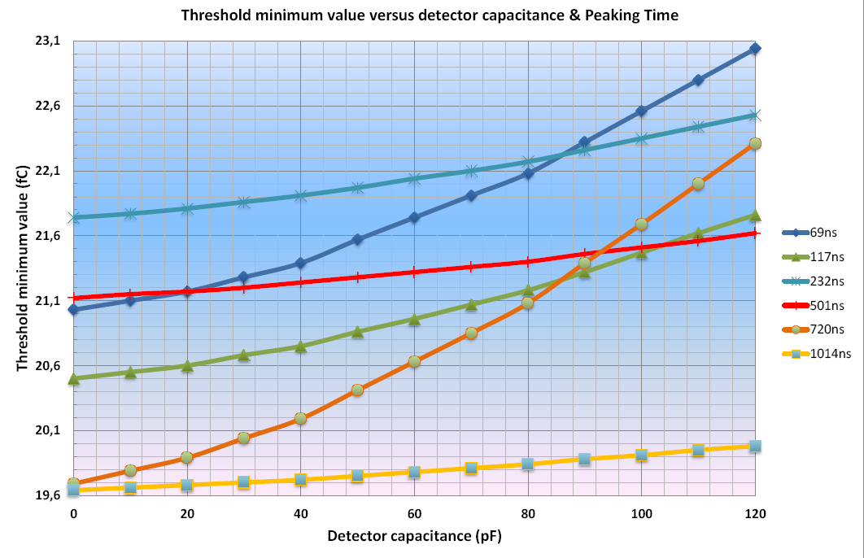
AGET Dynamic Range
Full Dynamic Range measured at the shaper output= 1.8V.
5% FDR = 90mV
The threshold value of the discriminator is controlled through 2 DACs. The first DAC (3bits plus 1 bit for polarity.) is global to all channels (MSB) The second DAC (3bits) – individual for each channel (LSB ).
Threshold LSB level at the Shaper output:
90mV/8/16 = 0.7mV
for threshold_FS = 5% of the
Dynamic Range
Min threshold vs detector capacitance CSA dyn.range = 10pC;
Full scale threshold: 5% of dynamic range.
ASIC dynamic range =430 (Full_Scale-to-min_Threshold) at Cdet = 120pF
U_SiPM = 30 V ; CSA dyn. Range = 10pC;
TRIG = 30 (14+ Global= 1) TRIG Rate = 13 Hz
U_SiPM = 29 V – no Triggers;
TRIG = 12 (12+ Global= 0) [~ 8.4mV]
U_SiPM = 28 V - TRIG Rate = 2 Hz
U_SiPM = 29 V - TRIG Rate = 56 Hz
U_SiPM = 30 V - TRIG Rate = 65 Hz

Slide 27
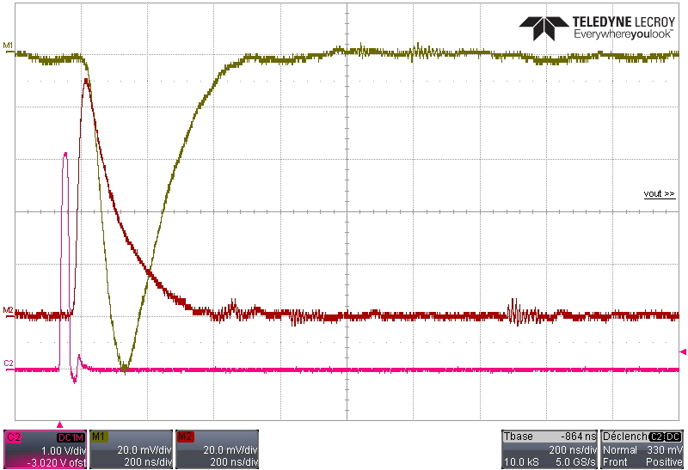
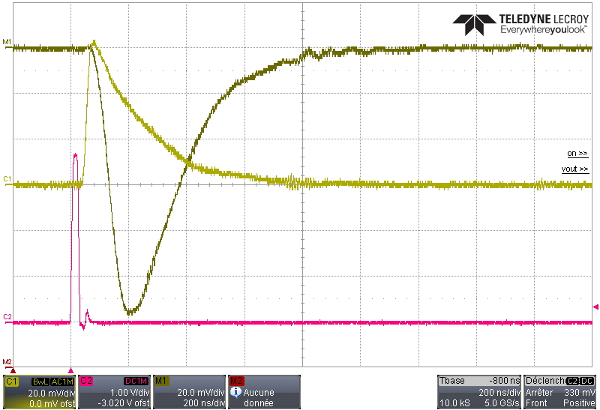
SiPM pixels connected directly to AGET shaper
U_SiPM = 30 V
Single 3x3 mm SiPM pixel is connected directly to AGET shaper via R = 1000 Ohm; C = 220 pF
CSA dyn. Range = 10pC
LED pulse : 20ns.
Shaper output
SiPM pulse ( at 50 Ohm)
3 SiPM pixels are connected together.
SiPM (C1) and Shaper (M1) output waveforms
200ns

Slide 28
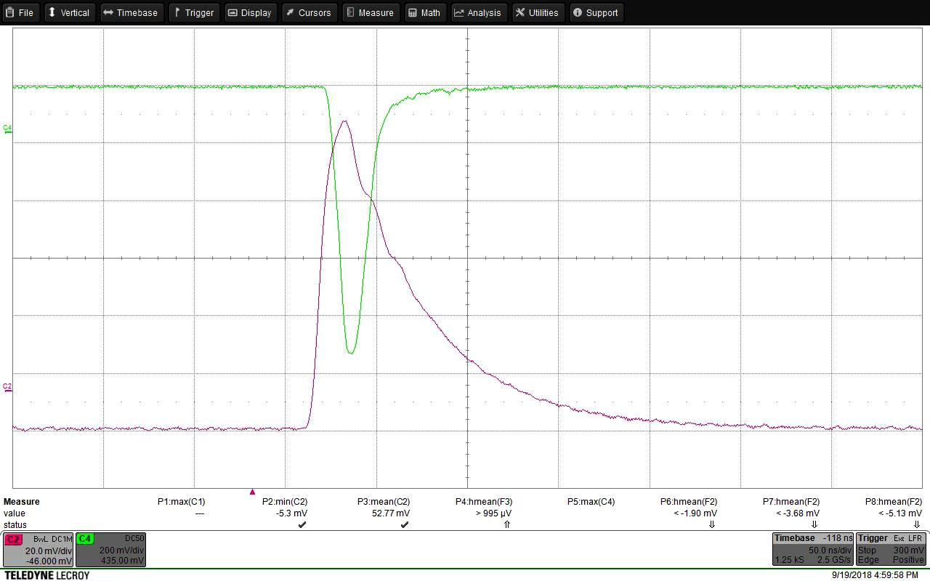
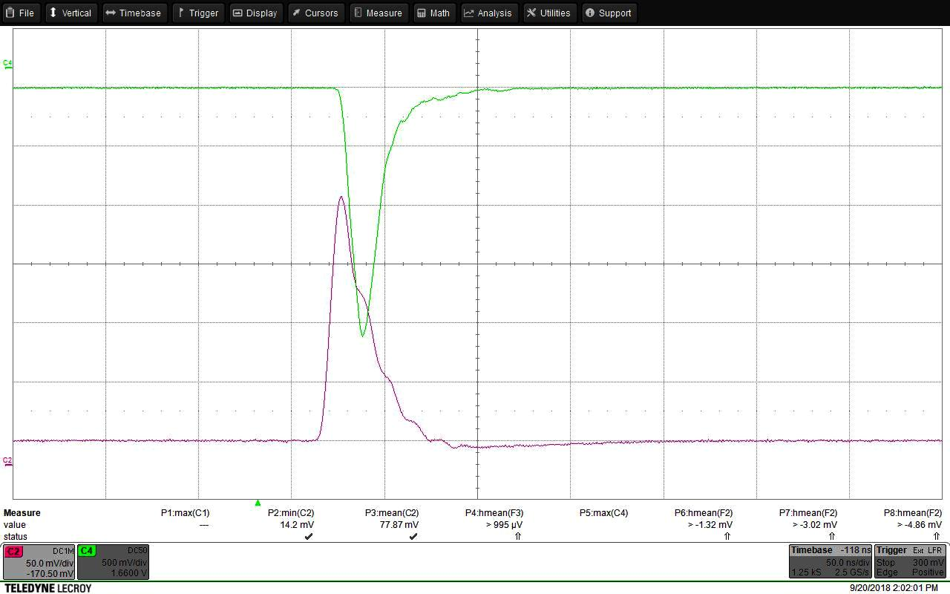
FBK RGB-UHD SiPM response on 20ns LED pulse
Monitor PMT response
FBK RGB-UHD SiPM sample
3 mm diameter aperture
15 x 15 µm cell size
50ns
SiPM output at 50 Ohm
Output of the FBK RGB-UHD SiPM terminated at 50 Ohm
Monitor PMT response
Output of the FBK RGB-UHD SiPM after passive HPF. Single photoelectron level = ~ 0.05…0.1mV
Filtered SiPM signal might be directly routed to SCA ( Gain x2 stage of the AGET chip) / when acquiring strong light pulses/
50ns
SiPM output after
passive filter

Slide 29
SiPM + AGET Tests Summary
Front-end board (AsAd) with connected adapter board, holding SiPM matrix performed stable operation even at highest preamp gain ( at dynamic range (DR) = 120fC );
Connection of the SiPM via simple R-C circuit results in bipolar pulse shape at the shaper output. Tor fastest shaper settings min. pulse width = 100ns ( at half maximum );
Bipolar pulse shape helps to maintain stable baseline, that can be important for large and fluctuating background;
With attached SiPM - AGET preamp can be operated at the lowest gain (DR = 10pC)
AGET Analog dynamic range ( pulse amplitude ) ~= 400 * U thres_min
Operation of the EUSO-SPB2 Cherenkov telescope might be possible using direct routing of signals from SiPM optical sensors to the switched capacitor array inputs. Additional tests required to identify minimal AGET triggering threshold and susceptibility to system noise.

Slide 30
Thank you for attention

Slide 31

½ Focal Plane Layout
( 4 AsAd FEE boards)
SiPM: 5 x 5mm pixel size ( 8 x 8 )
32 SiPM sensors
8 AsAd boards
2048 channels
Focal surface: 688 x 86mm
AsAd #1
AsAd #2
AsAd #3
AsAd #4
1 SiPM sensor (8x8): 5.36 x 5.36mm (pitch); overall dim: 43 x 43mm
4 AsAd boards in one crate read out 16 SiPM sensors
4 Interconnect boards route SiPM channels to AsAd input connectors

Slide 32
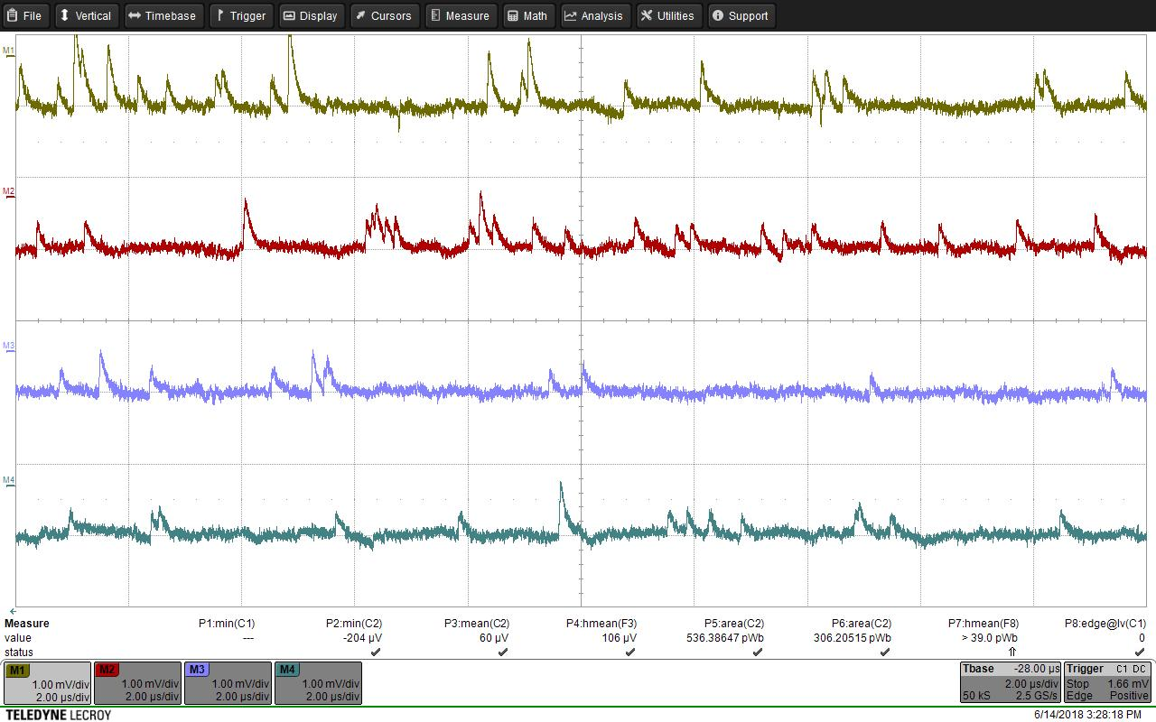
SensL (J-series) SiPM waveforms (3 x 3 mm pixel ).
Ubias = 30V
29V
28.5V
28V
Terminated at 50 Ohm / no amplification

Slide 33
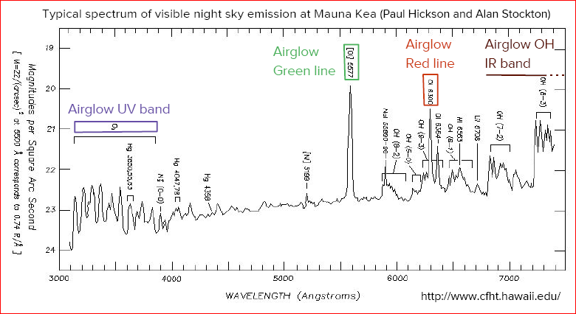

Slide 34
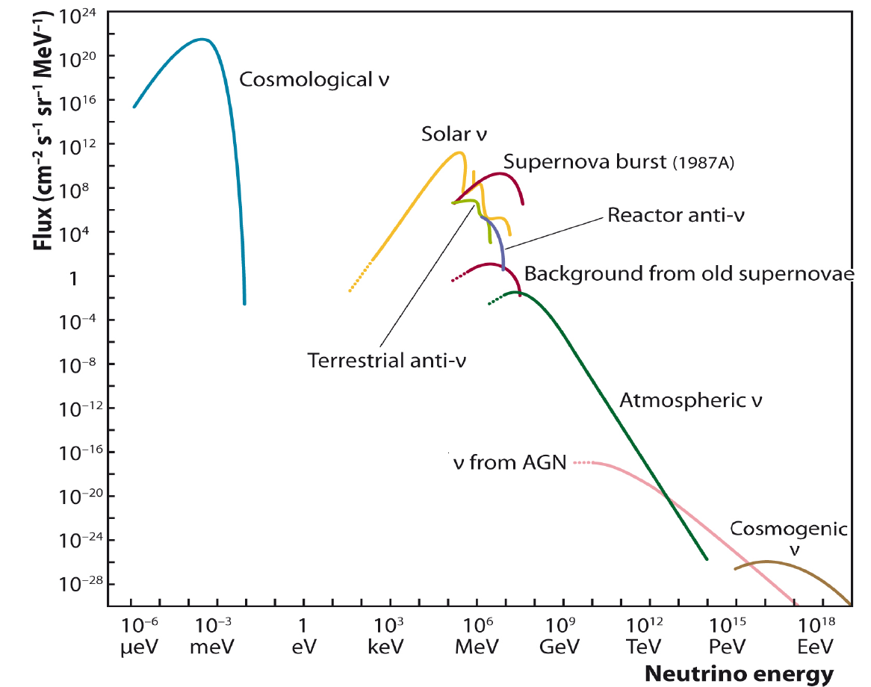

Cosmic Neutrino Spectrum
ICECUBE
Astrophysicall
K. Hanson

