Slide 1
LSST Scheduler
Status and Future Plans
Peter Yoachim
University of Washington

Slide 2
Old proposal based scheduler
Simulating the motion of the dome and telescope, using realistic weather logs, scheduled and unscheduled downtime, seeing model, sky brightness model, etc.
North Ecliptic Spur (NES)
Galactic Plane (GP)
Wide-Fast-Deep (WFD)
Deep Drilling Fields
South Celestial Pole (SCP)
Notes:
Updated figs in /Users/yoachim/gitRepos/18_scratch/dither_plots

Slide 3
Fixed fields mean overlap areas get over-observed

Slide 4
Old proposal based scheduler
WFD
WFD overlap
SCP, NES, GP
DDFs

Slide 5
Overlap region creates a spike in the power spectrum at ~1 degree

Slide 6
Before, we had a “Proposal Based” scheduler.
Write down all the observations we want (125 visits of Field 23 in r, 90 visits of field 36 in y, …)
Pick the “best” observation from remaining list at any given time
Mostly minimizing slew time
Alt,az distribution for the old scheduler. To minimize slew time, it tends to go to hit the airmass limit and raster in azimuth.

Slide 7
Now, with Markovian Feature Based framework
Track progress at high resolution (HEALpixels, nside=32, 1.8 degree resolution, 12,288 pixels)
Compute a reward function for which HEALpixel is most desirable at any given time
Lots of the work done my Elahe Naghib (Operations Research, Princeton) and Daniel Rothchild (CS, Berkeley)

Slide 8
How do we pick what to observe?
What has the least depth degradation (compared to dark time on the meridian)?
What area has fallen behind?
What’s the shortest slewtime?
What filter are we in?
Mask out bad regions in alt,az space
This let’s us pick which healpixel we would most like to observe. To decide where to actually point the telescope, we randomize the tessellation every night (so there is a changing nightly mapping of HEALpix to RA,dec telescope pointing).
Example r-band only survey

Slide 9
5-sigma limiting depth Compared to meridian dark time, using model sky brightness, airmass, and seeing

Slide 10
Target goal map, where regions are defined in terms of the ratios.
WFD = 1
NES = 0.46
SCP = 0.15
GP = 0.15
(No running out of observations, can make a map per filter)

Slide 11
Combine the target goal map with the map of completed observations to generate a map of how far behind HEALpixels are

Slide 12
Time to slew to any HEALpixels

Slide 13
Mask in alt,az space to prevent getting stuck near zenith or airmass limit

Slide 14
Final reward function is a linear combination of the basis functions.
Single filter survey only has 3* free parameters!

Slide 15
Full Survey
Requesting an observation, each “survey” returns target(s) and a reward value. Highest reward value gets selected.
(RA,Dec)
Reward
Pairs
(RA,Dec)
Reward
DD1
DD2
DD3…
(RA,Dec)
Reward
u
g
r
i
z
y

Slide 16
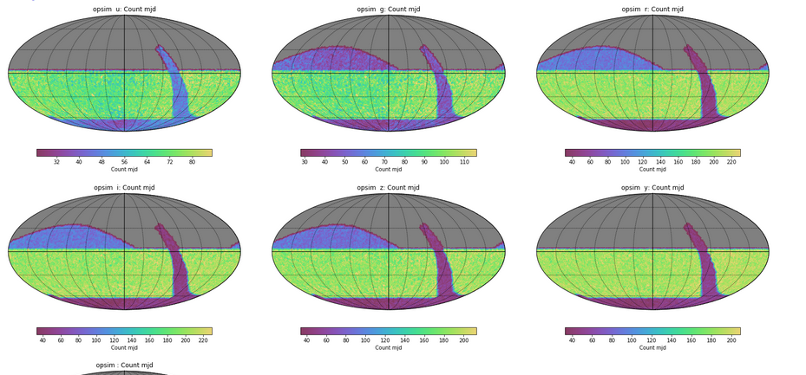
Number of observations in each filter

Slide 17
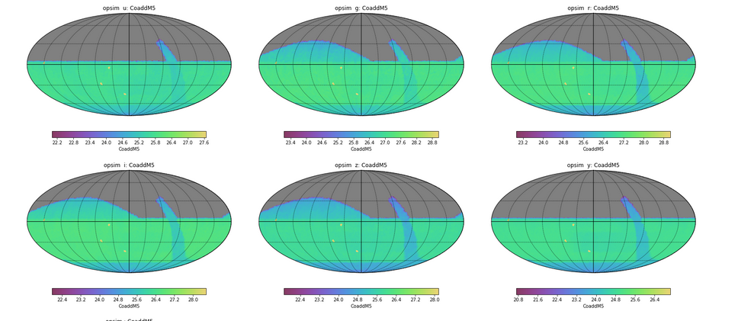
Coadded Depth

Slide 18
Fraction of observations that are in a pair that can be used for solar system object detection (peak around 90%)

Slide 19
Shutter open 76% of possible time. (82% would be the maximum with no filter changes and minimum slew times)
Observing mostly near meridian.

Slide 20
The reward function shows the best HEALpixel to observe.
Each night, we randomly rotate the tessellation and create a new mapping of HEALpix to pointings

Slide 21
No more over-exposed overlap regions

Slide 22
Feature based scheduler
WFD
SCP, NES, GP
No more overlaps!
DDFs

Slide 23
Feature based scheduler.
No more giant power spike at 1 degree (l=180)

Slide 24
Undithered
Sub field dithers
Feature Based scheduler
So far, we have only tried to keep the number of visits even. We could try to keep coadded depth even.

Slide 25
Another view at the WFD-SCP border

Slide 26
We are a little under-subscribed in winter, little over-subscribed in summer.
May want to adjust WFD area a bit to compensate. Make sure we don’t pile-up DD fields too much in RA.

Slide 27
Filter choice currently gets driven largely by lunar phase. So we get several days of red followed by days of blue.

Slide 28
Some initial experiments in rolling cadence
(proof of concept, I did these in a day)

Slide 29
WFD~90-100 observations/yr

Slide 32
Rolling Cadence:
Mask 1/3 of WFD region each year.
Now 120-130 observations/yr

Slide 36
Now Mask half the WFD region. Then unmask next year
140-160 obs/yr

Slide 39
Mask 2/3 of WFD
160-180/yr

Slide 41
Baseline:
Median inter-night gap of 3.95 days

Slide 42
1/3 rolling cadence
Median gap of 2.06 days

Slide 43
Half-sky rolling cadence:
Median gap 2.01 days

Slide 44
2/3 rolling cadence:
Median gap 1.97 days

Slide 45
Rolling cadence takeaway:
The baseline tends to have 4-day gaps (in all filters)
Overly aggressive rolling cadence can cut that down to 2
I often head 3 is the magic number for SNe, so we should be able to get close
We need to do the slightly more sophisticated experiment where we increase cadence but still observe the full sky each year (rather than masking the target map, just set it to a lower value)

Slide 47
Rather than have a greedy algorithm pick single observations, have a greedy algorithm select a large chunk of sky. Then solve the traveling salesperson to keep slewtime down. Go through the block twice to get pairs.

Slide 48
Future Plans:
Double check that all-sky re-tessellation is good for ubercal (it should be great)
Schedule large areas rather than single visits
More sophisticated DD cadence
We (still) need a dither strategy for the DD fields
We (still) need a strategy for dithering in camera rotator angle
More sophisticated rolling cadence
Adjust WFD area for summer/winter
Galactic plane as part of WFD
Try to enforce particular WFD cadence with a new basis function?
Depth uniformity basis function?
Special 1st year strategy to get templates
I’d like to try new sky tessellations
Red = I think DESC could help a lot with that

Slide 51
Full Survey
Requesting an observation, each “survey” returns target(s) and a reward value. Highest reward value gets selected.
(RA,Dec)
Reward
Pairs
(RA,Dec)
Reward
DD1
DD2
DD3
(RA,Dec)
Reward
u
g
r
i
z
y

Slide 52
Full Survey
Rather than pairs as a separate survey, have surveys that request blocks of observations that include pairs. Assume reward is slowly changing and solve traveling salesperson on sphere.
(RA,Dec)
Reward
DD1
DD2
DD3
(RA,Dec)
Reward
u
20m
g
20m+20m
r
20m+20m
i
20m+20m
z
20m+20m
y
20m
(RA,Dec)
Reward
u
g
r
i
z
y

Slide 53
Full Survey
Could include pairs in different filters.
(RA,Dec)
Reward
DD1
DD2
DD3
(RA,Dec)
Reward
u
20m
g
20m+20m
g+r
20m+20m
r
20m+20m
r+i
20m+20m
i
20m+20m
z
20m+20m
y
20m
(RA,Dec)
Reward
u
g
r
i
z
y

