Slide 1
Holographic Optical Element to measure the atmospheric transmission with AuxTel
Sylvie Dagoret, Jérémy Neveu, Olivier Perdereau and Marc Moniez (LAL-Orsay)
+ Marc Betoule and Laurent Le Guillou (LPNHE)
PCWG-Workshop 25/may/2018

Slide 2
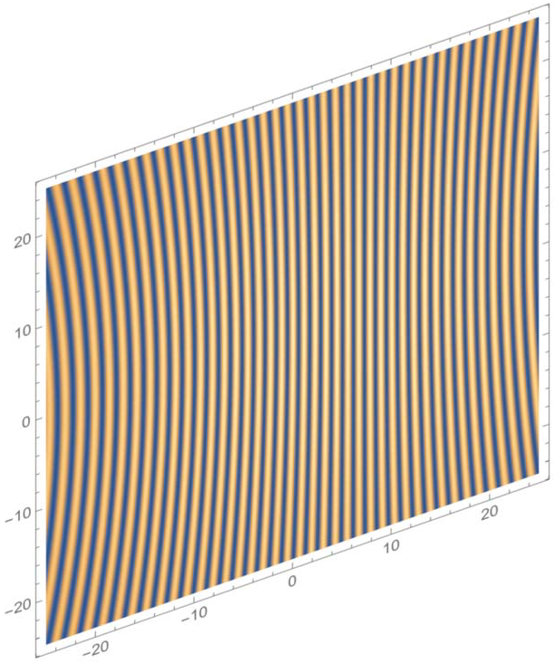
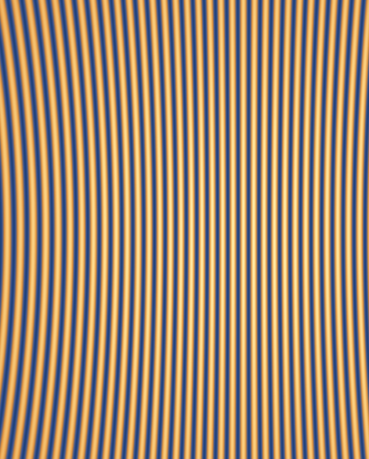
HOE for AuxTel
Usual gratings:
all wavelengths not focused simultaneously due to optical path variation with the diffraction angle
Distorsions (astigmatism) due to converging beam (not parallel)
Holograms:
Focusing forced on the focal plane at all wavelengths
No distorsions by design of the hologram
Theoretical hologram (linear phase encoding): only -1, 0, +1 orders

Slide 3
Realization of the HOE
(Holographic Optical Element)
Ultimate holography company: makes the best holograms in the world. Director (Mr Gentet) was the head of a Thales laboratory producing holographic windows for rafale planes until the end of cold war.
3 technologies:
  Amplitude holograms: transmission modulation
  Phase holograms: phase modulation (2 techniques)
Tested together with Ronchi and blazed gratings during may-june 2017 CTIO run (18 nights)

Slide 4
Holograms on a telescope

Slide 5
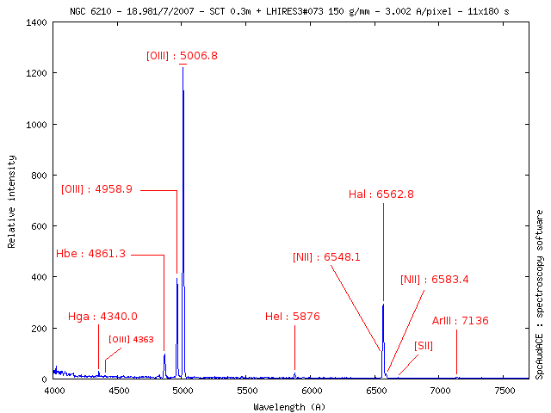
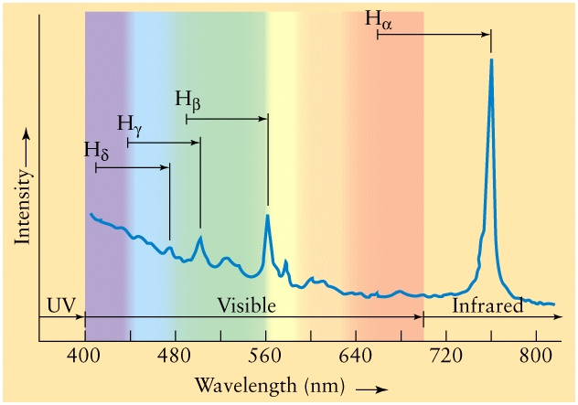
Tests on telescope : 27 may-13 june 2017
Objectives
Compare Ronchi, blazed gratings and holograms (phase & amplitude)
Obtain data with various atmospheric conditions
Observations made
16 clear nights with variable conditions
Measures and comparisons of spectra from:
  Standards HST spectro-photométriques (CALSPEC)
  Extended series of consecutive measurements with variable airmass
  Planetary nebulae
    Narrow and strong emission lines
    -> to study the dispersion law and estimate spectral resolution
  Quasars
    Strong redshifted Hα -> to test R et IR spectrscopy

Slide 6
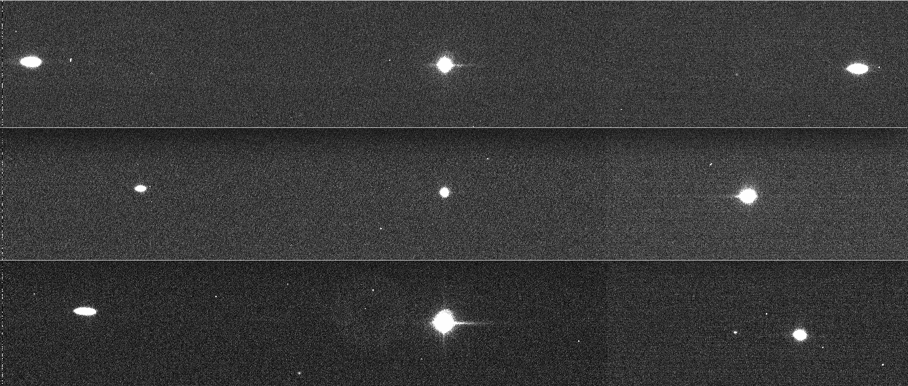
Disperser performances
HOE designed to compensate geometrical distortions for 1rst diffractive order, by design
  Tests with narrow H_{α} filter (FWHM = 6.4 nm)
  Best results with the +1 order of the hologram
Ronchi
400 lines/mm
Blazed grating
300 lines/mm
Phase hologram
~365 lines/mm
Order -1 Order 0 Order +1

Slide 7
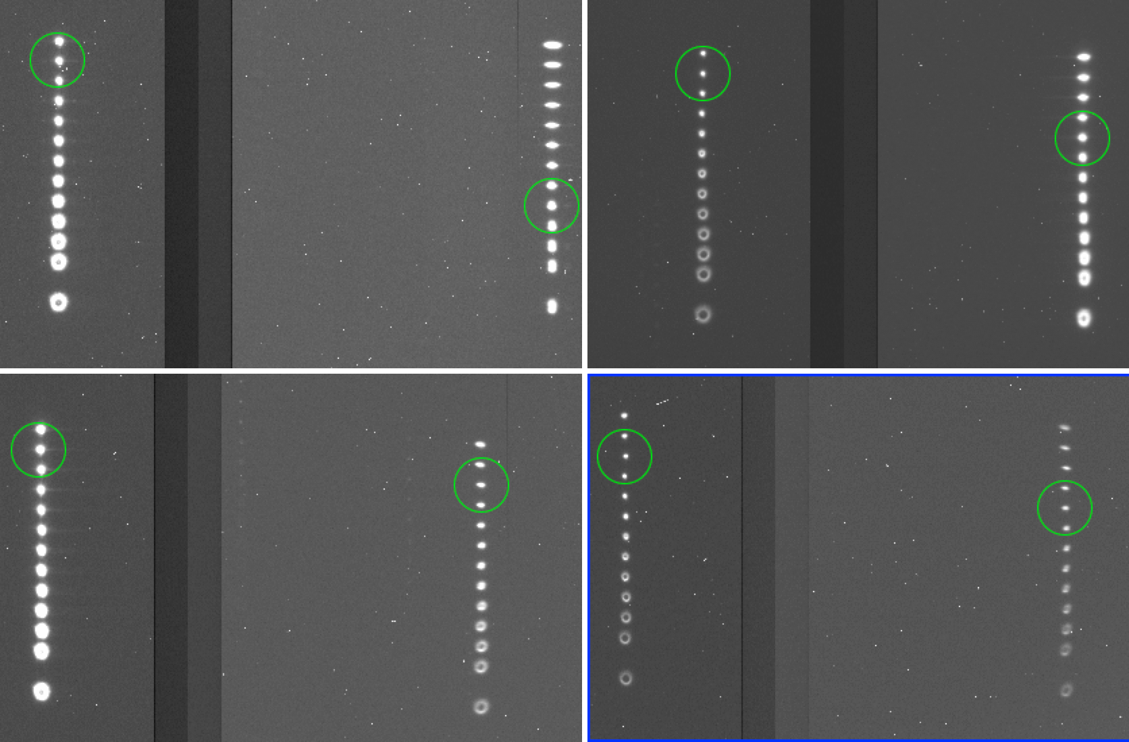
Let’s look in more details
SIMULTANEOUS focus procedures with the Hα narrow filter.
  0 order focus (left) vs +1 order focus (right)
Ronchi 400 l/mm
Blazed 300 l/mm
3.5 mm focus
difference
H_{α}
Order 0 Order 1
Phase hologram
Amplitude hologram

Slide 8
HOE performances: focus, resolution
Spectrum profile of CALSPEC standard star
O₂
Ronchi 400 l/mm
Phase hologram
Estimates of spectral finesse R=λ/Δλ @Hα
Gratings
- Ronchi 400 l/mm: R ~ 70
- Blazed 300 l/mm: R ~ 125
Holograms
- Photopolymer : R ~ 130
- Phase argentic : R ~ 280
- Amplitude Ag : R ~ 390
Profile width of the dispersed first order light, as a function of the wavelength (Gunn-z passband)
-> Commensurable with the expectations from simulations (ZEMAX)
-> Low performance of the photopolymer hologram due to protective layer (not anti-reflective)

Slide 9
Disperser performances: 2nd order
Blue filter allows to split 1^{rst}/2nd orders
2nd order
1^{rst} order

Slide 10
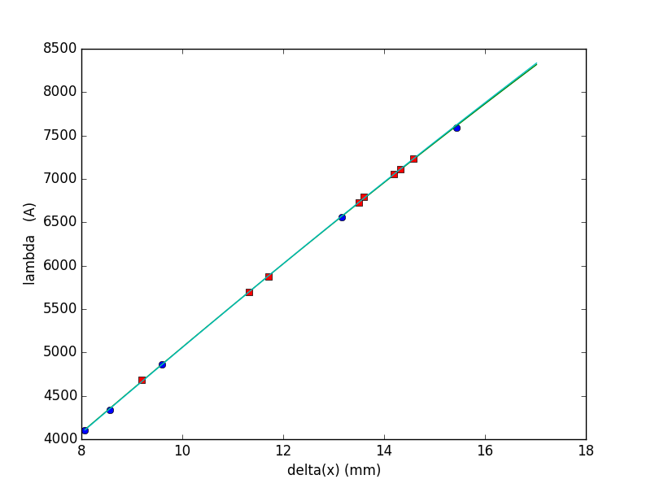
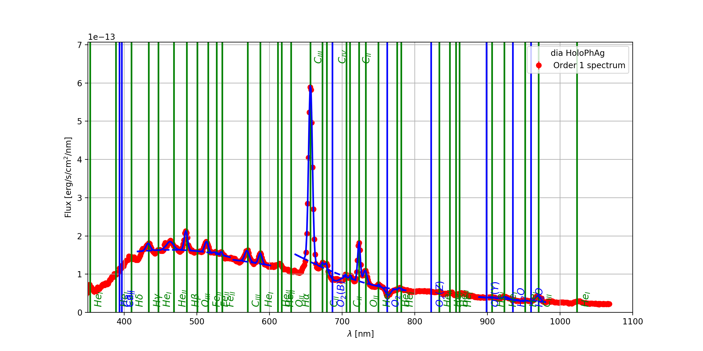
HOE performances: planetary nebula
Why? narrow emission spikes with measured intensities
-> λ calibration, resolution, and (ε_{CCD} x ε_{diffraction})(λ) estimates
Planetary nebula PNG032.9-02.8 emission spikes
Dispersion
relation
Argentic phase hologram

Slide 11
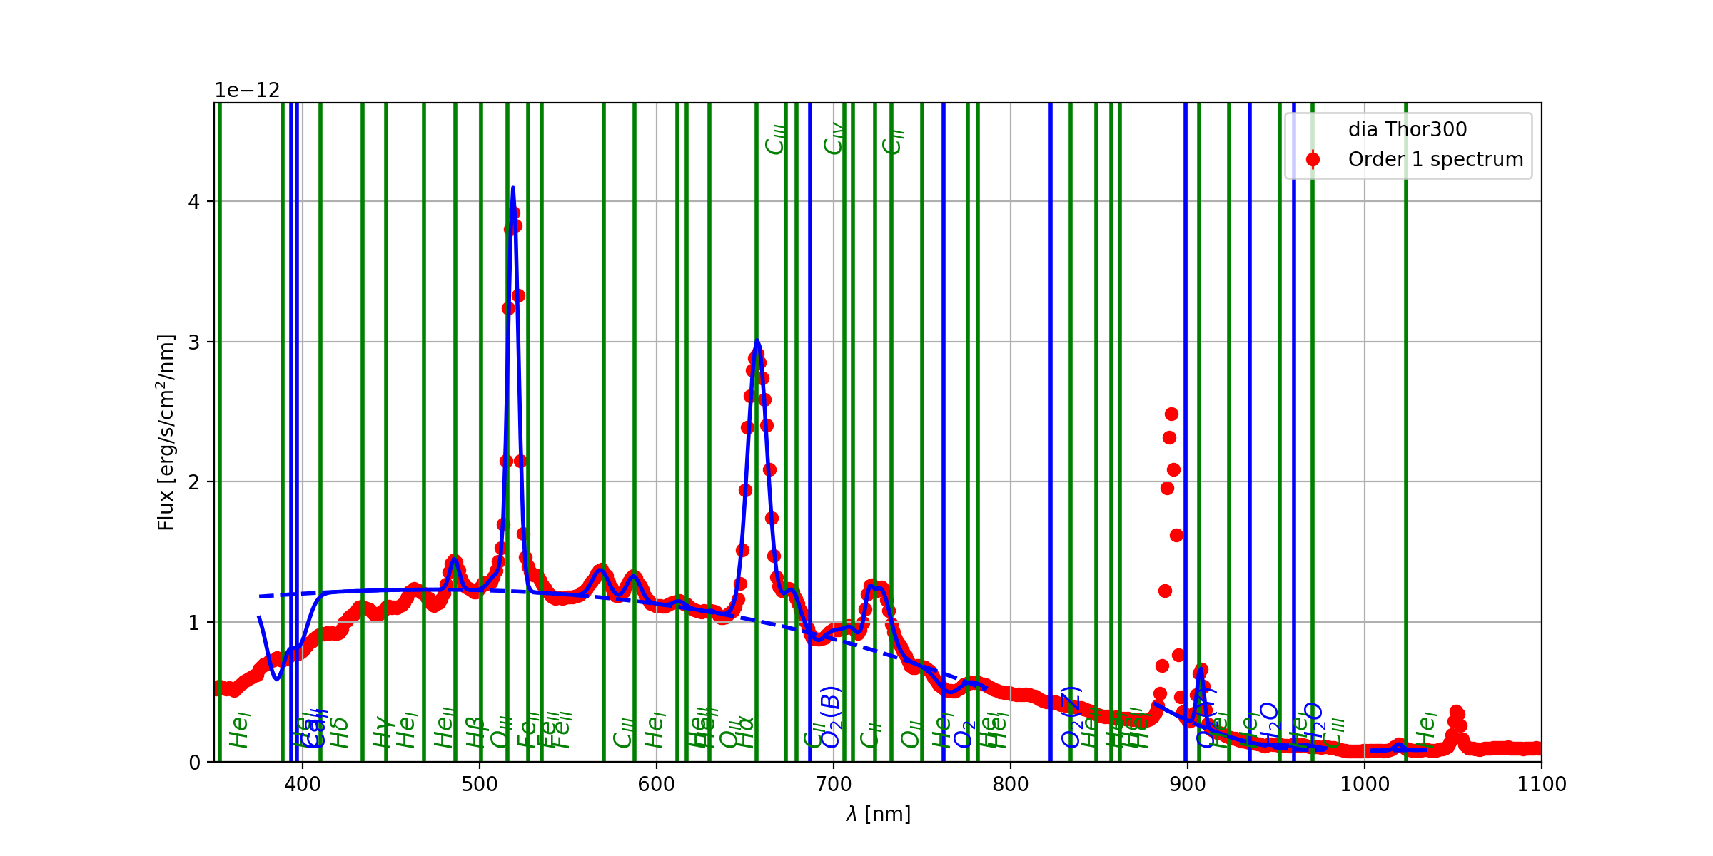
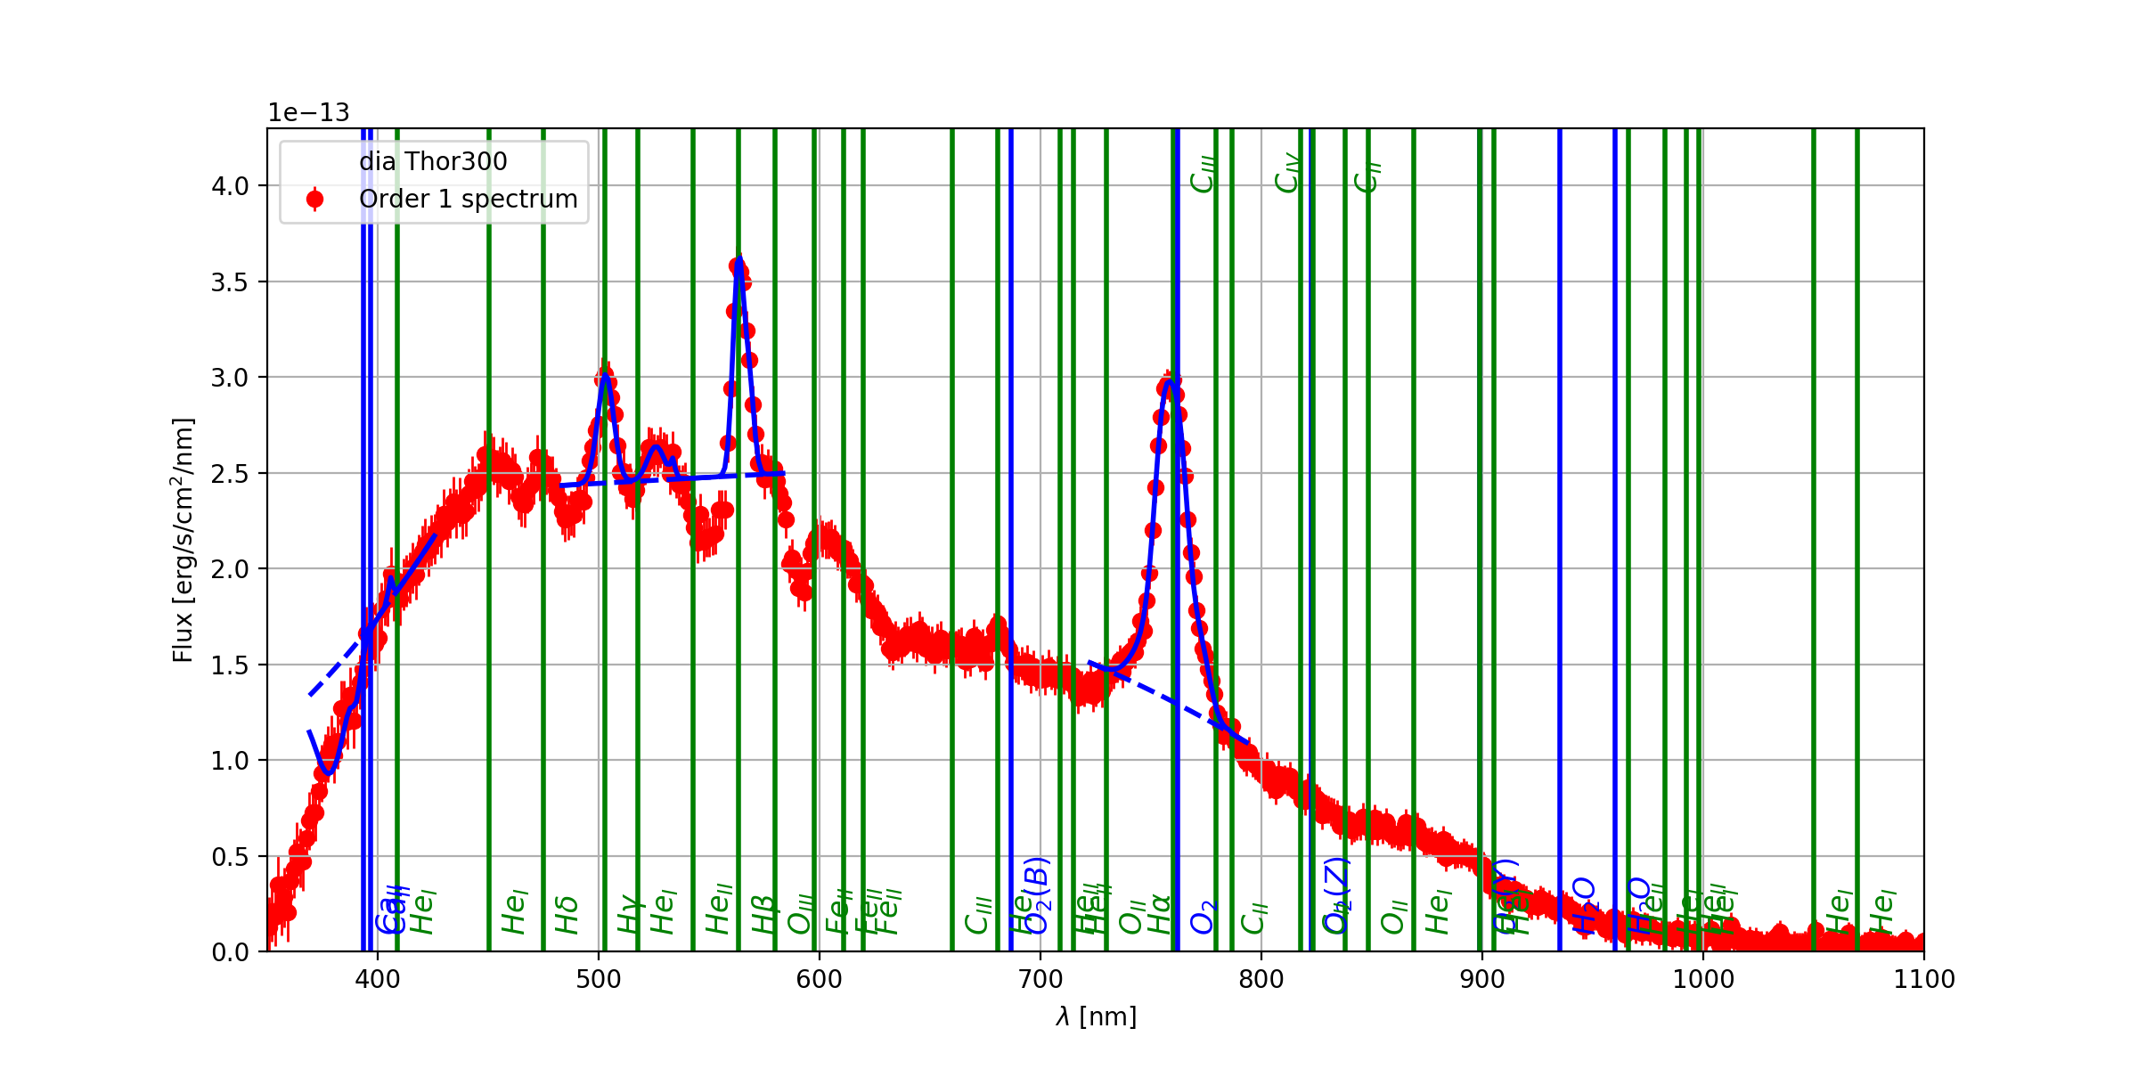
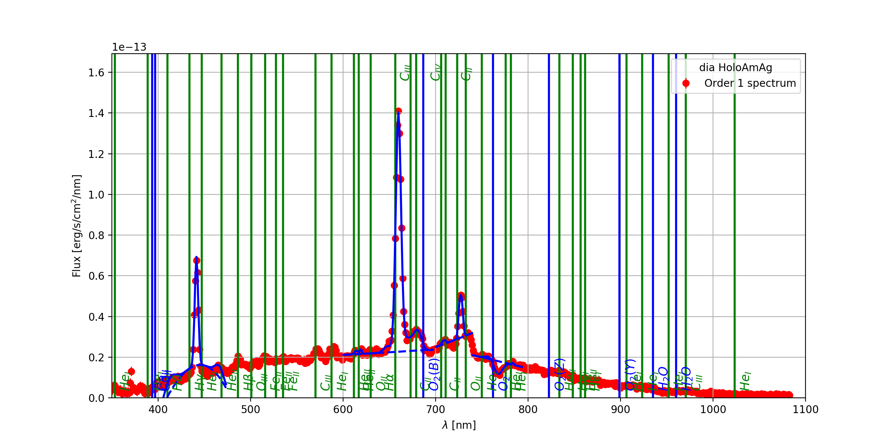
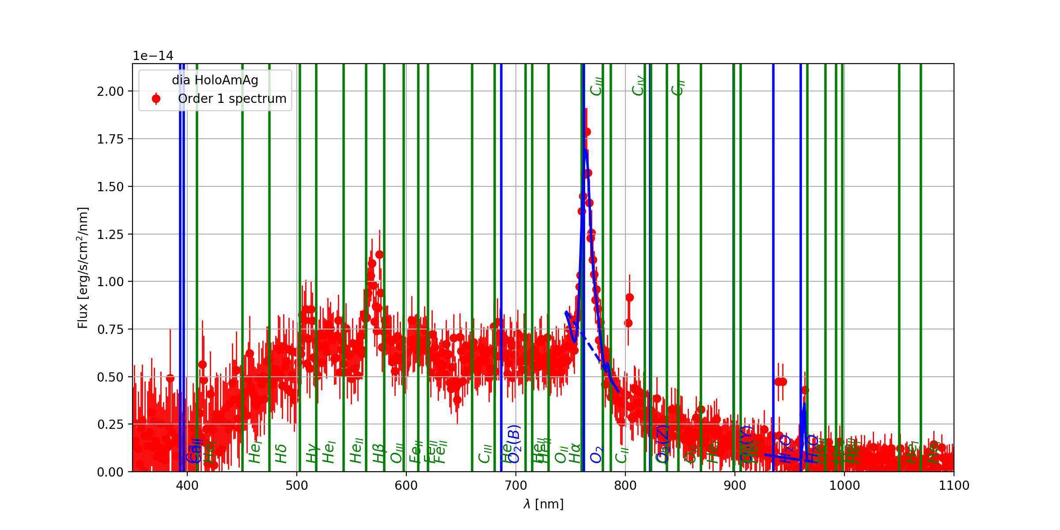
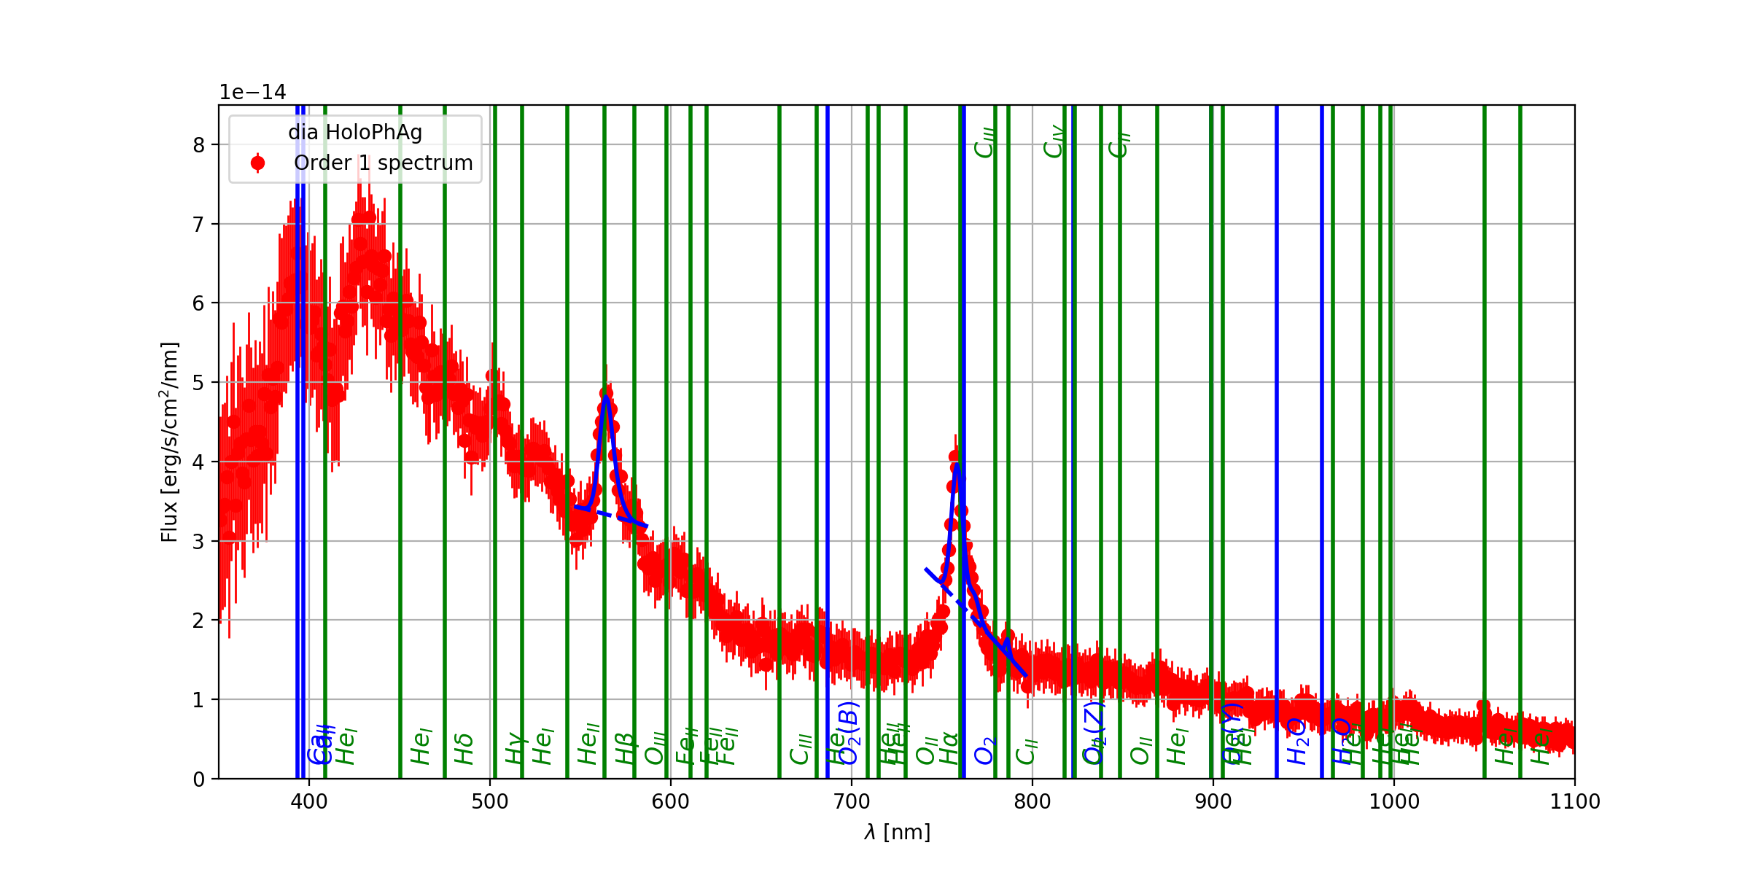
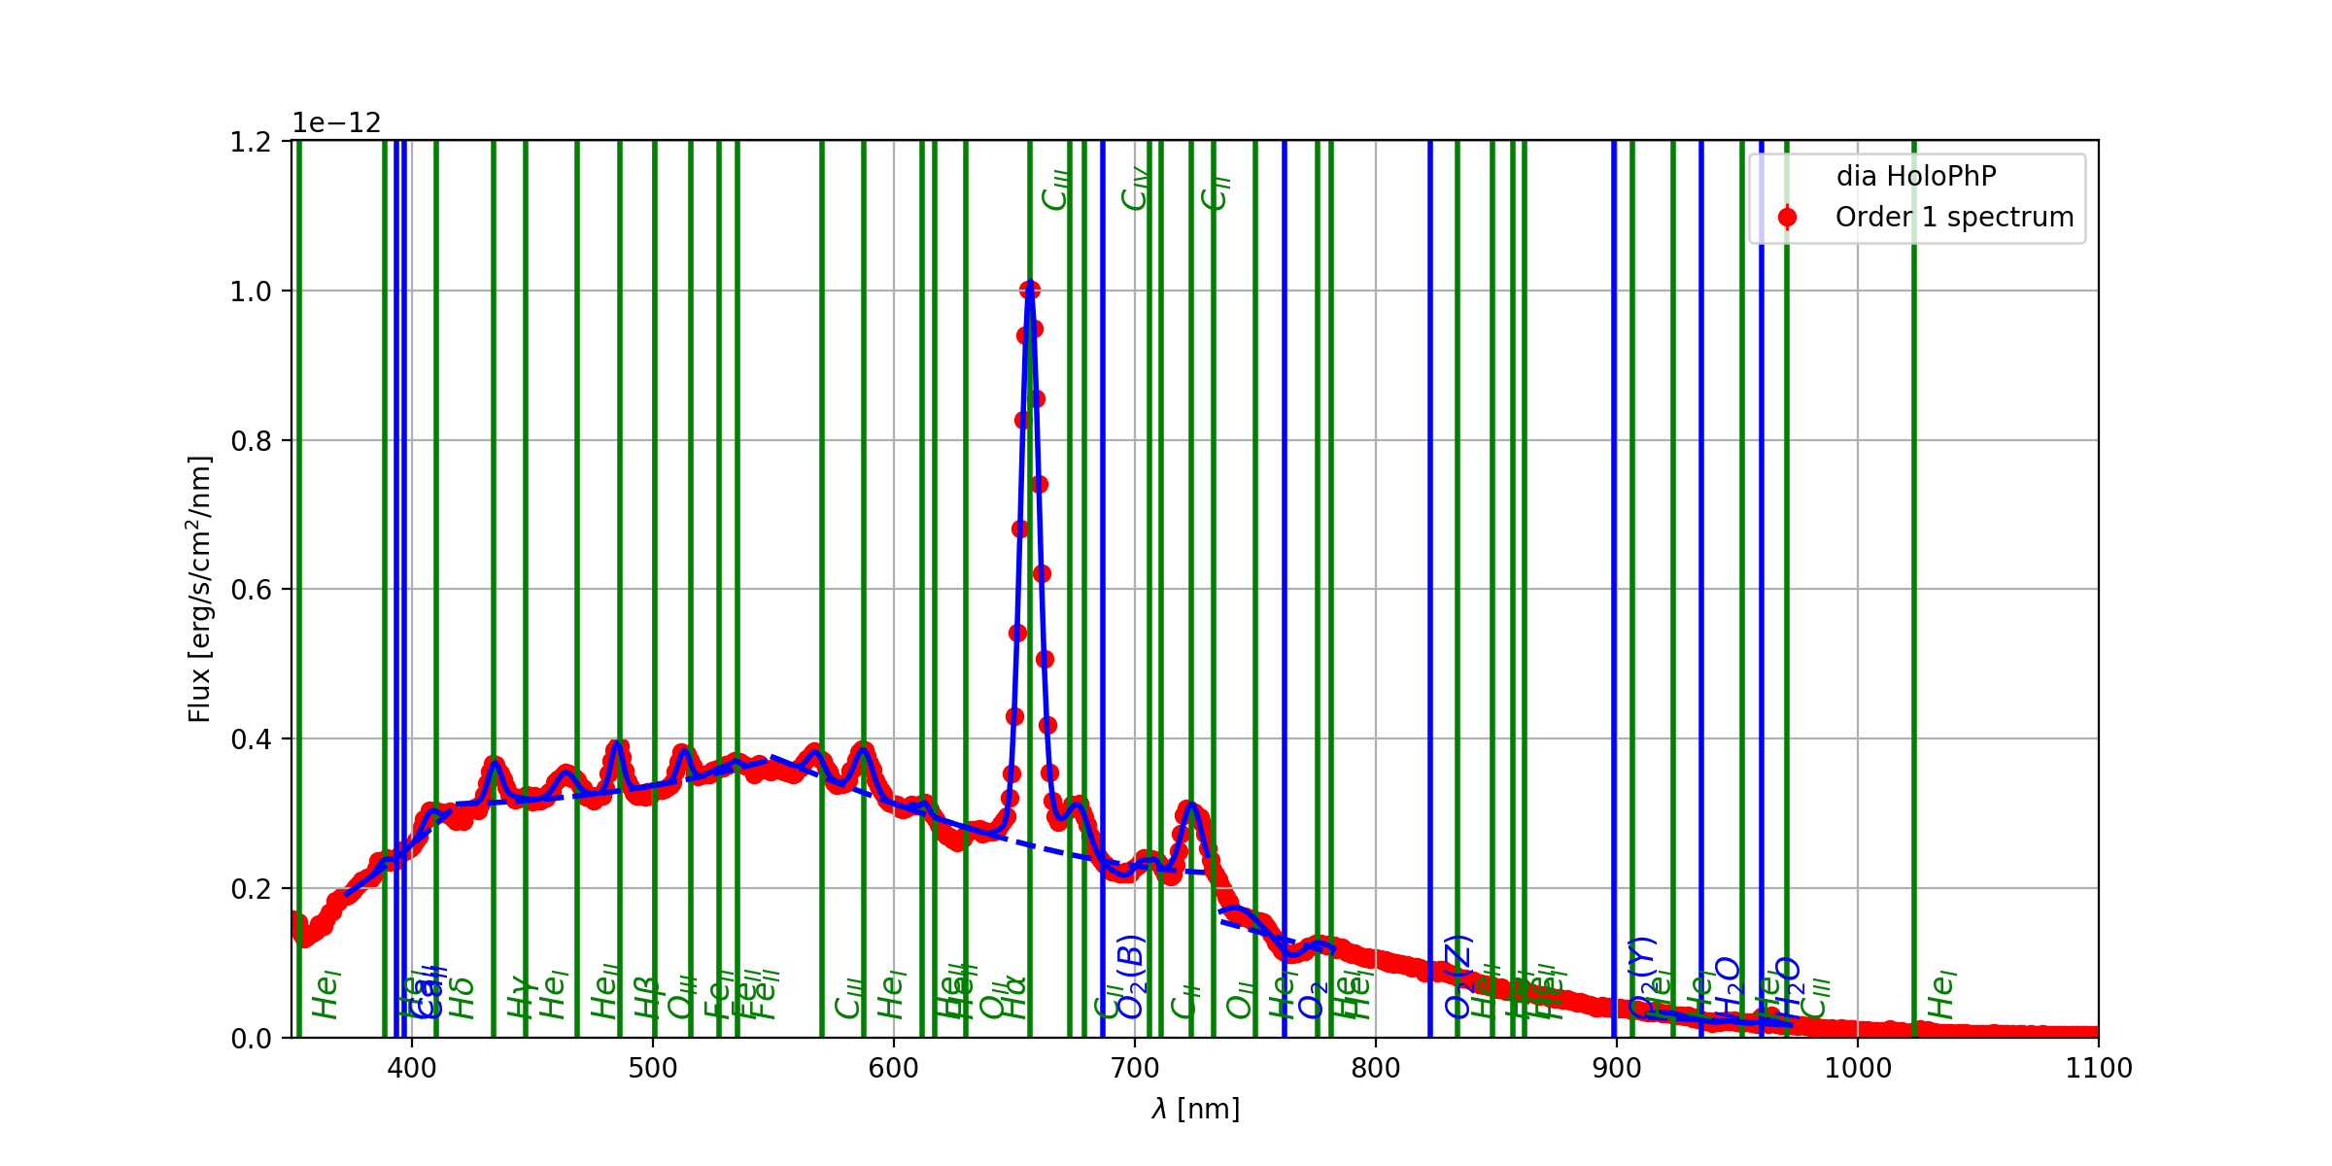
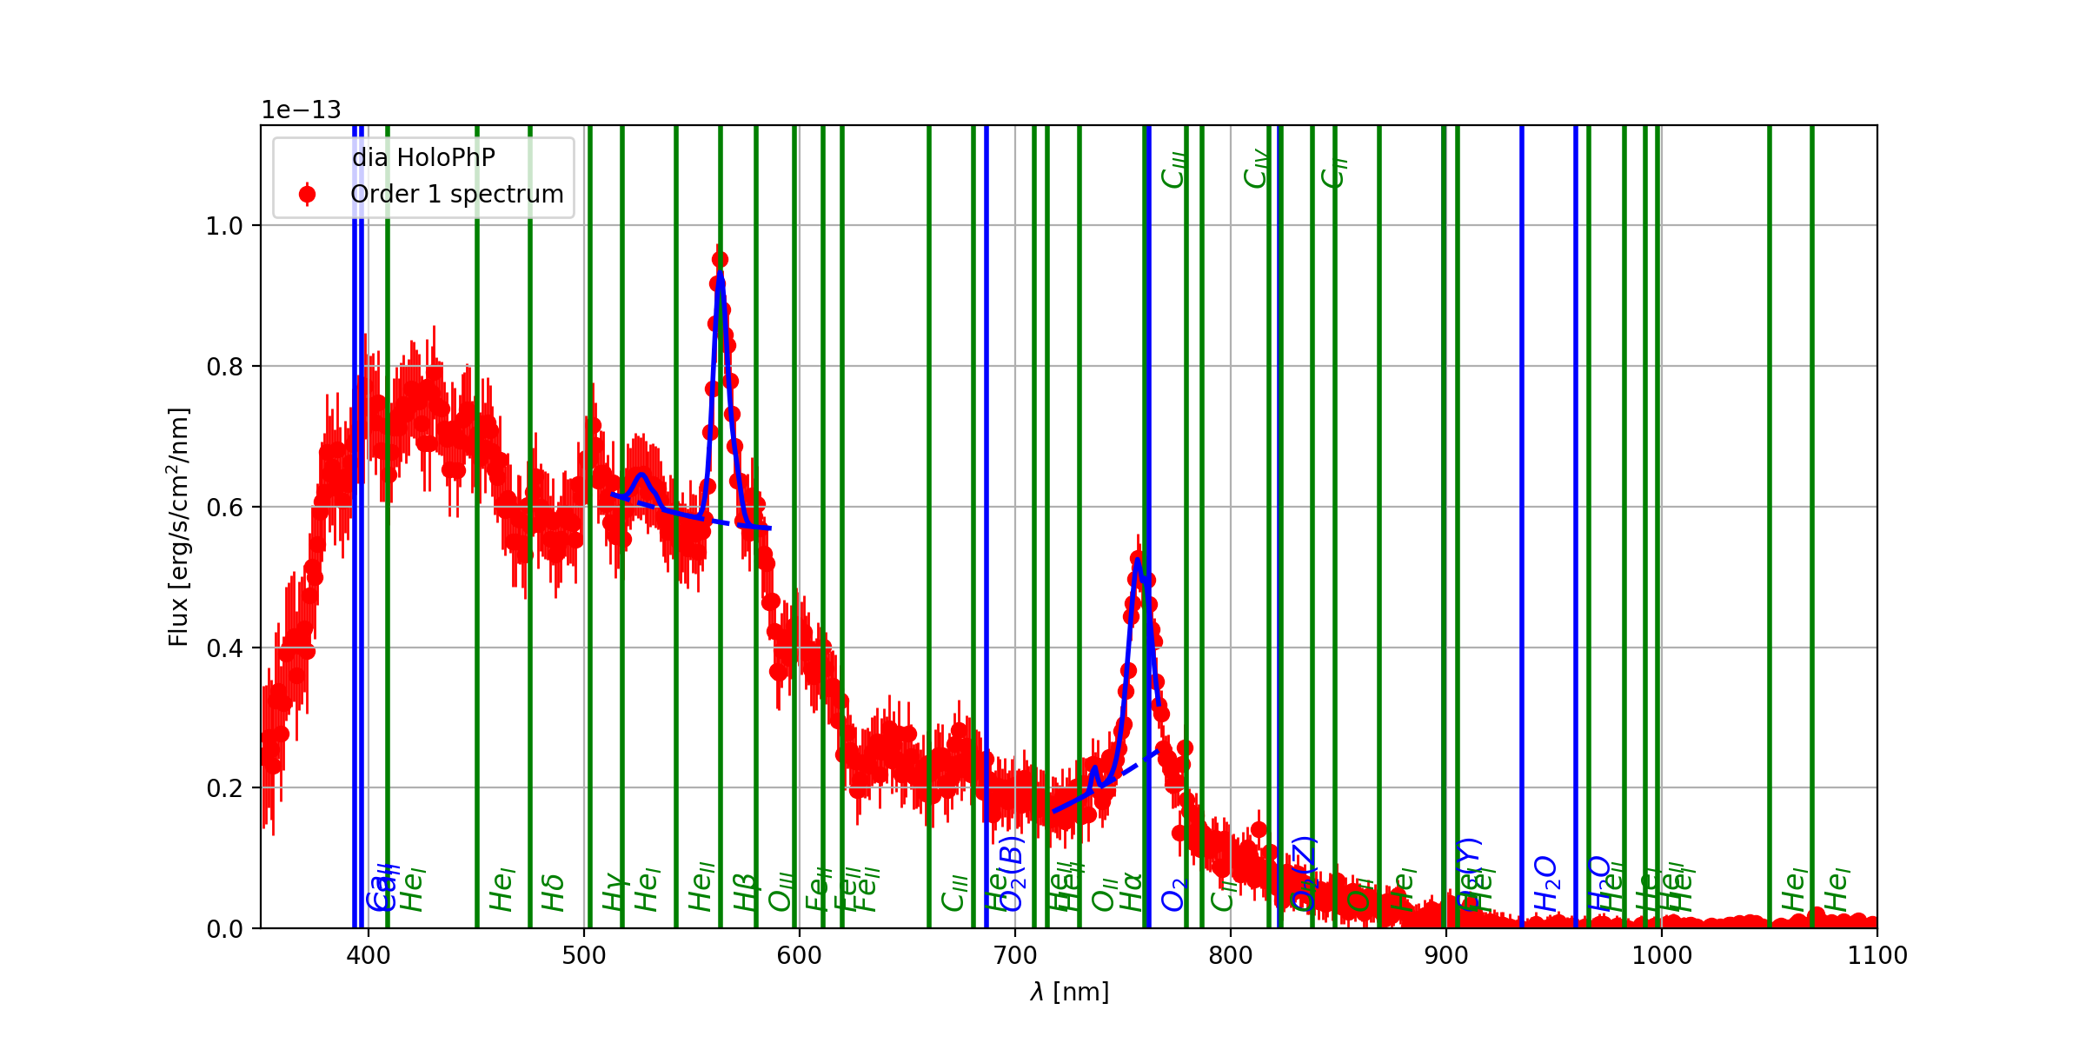
Blazed grating
300 lines/mm
Blazed grating
300 lines/mm
Amplitude hologram
Amplitude hologram
Argentic phase hologram
Argentic phase hologram
Quasar 3C273 SED (redshifted z=0.158)
Planetary Nebula SED
Polymer phase hologram
Polymer phase hologram

Slide 12
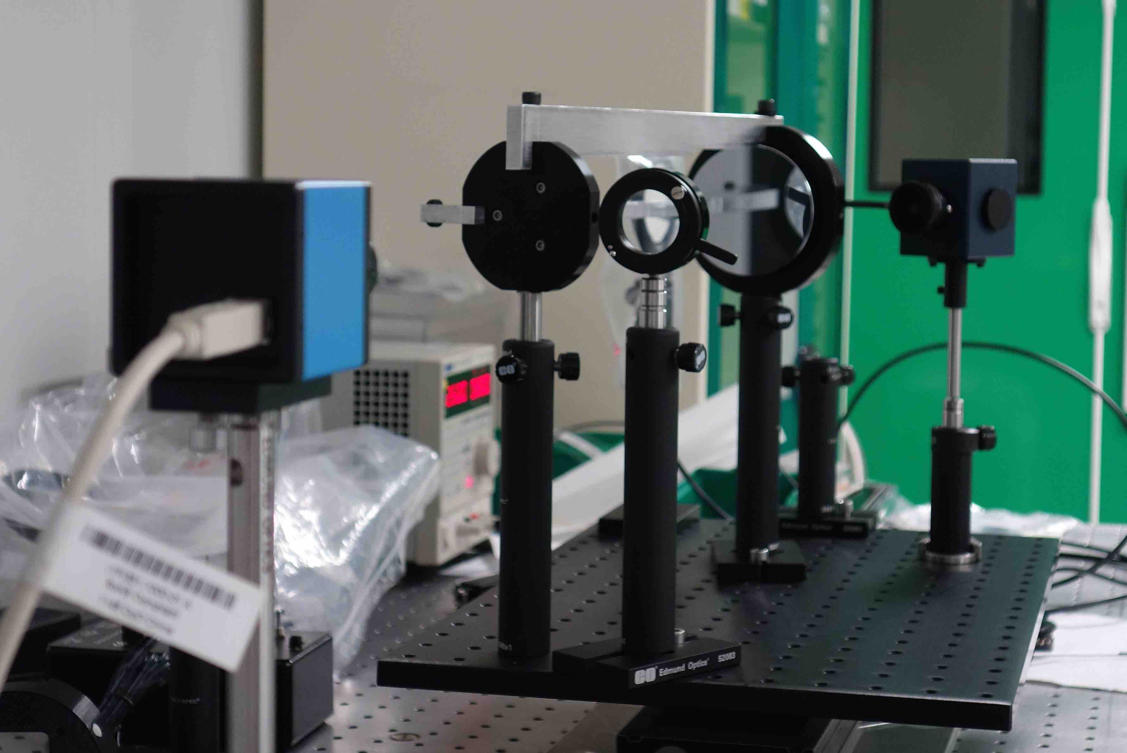
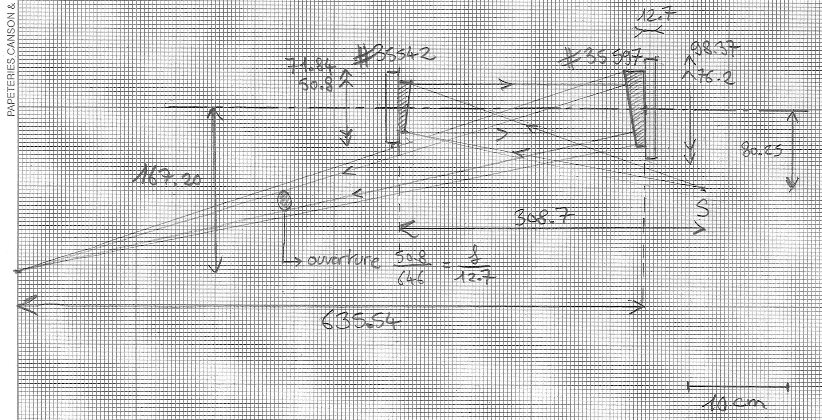
Optical Test-bench at LPNHE
Simulation of the AuxTel convergent beam
  Focus on a LSST-type CCD sub-arcsec equivalent PSF from converging beam
  Focus independent from the wavelength (mirrors)
  Uniform beam density obtained with integrating sphere + 20μ hole
  Hologram installed on a XYZ mounting
Measurements to do on every disperser
  Volume of validity ΔXΔYΔZ for acceptable use (>10mm10mm4mm)
  Spectral resolution λ/Δλ with emission line lamp and monochromator
  Transmission as a function of λ.

Slide 13
HOE: schedule
Janvier 2017: tests préparatoires au CTIO (Chili)
Mai 2017: premiers prototypes d'hologrammes
Juin 2017: tests de prototypes sur télescope au CTIO (Chili)
Eté 2017: analyse des tests
Automne-hiver 2017
  simulations optiques et atmosphériques
  Analyse: étude de la largeur équivalente de la bande d'absorption de l’eau (proche IR) et de l'absorption par les aérosols (bleu)
Spring-summer 2018
  production of finalized holograms (several technologies, 2/1 orders minimized; first order could take up to 80% of the light)
  measurements/characterization with the LPNHE test-bench
End 2018-beginning 2019
  Start operations on AuxTel
2019 – 2020
  Calibration of the system
  Extensive observations of the various atmospheric conditions on-site

Slide 14
Atmospheric attenuation estimation update on CTIO data (jun 2017)
Sylvie Dagoret-Campagne
Marc Moniez
Jérémy Neveu
Olivier Perdereau

Slide 15
Outline
CTIO may-jun 2015 ➔ 16 nights
  Focus only on « 4 photometric nights »
  CALSPEC/ 2 Filters Red/Blue / 2 grating, 3 Holograms
Reconstructed the star spectra and wl calibration
  Optimize reconstruction pipeline
  Still systematics under study (disperser dependent)
Extract atmospheric feature (knowing calspec SED)
  Set of time varying « atm. estimators» to be monitored
  To feed into simulation in order to reproduce spectra data
  External required info : overall throughput (telescope + CCD+ disperser)
Predict LSST atmospheric transmission for every exposure

Slide 16
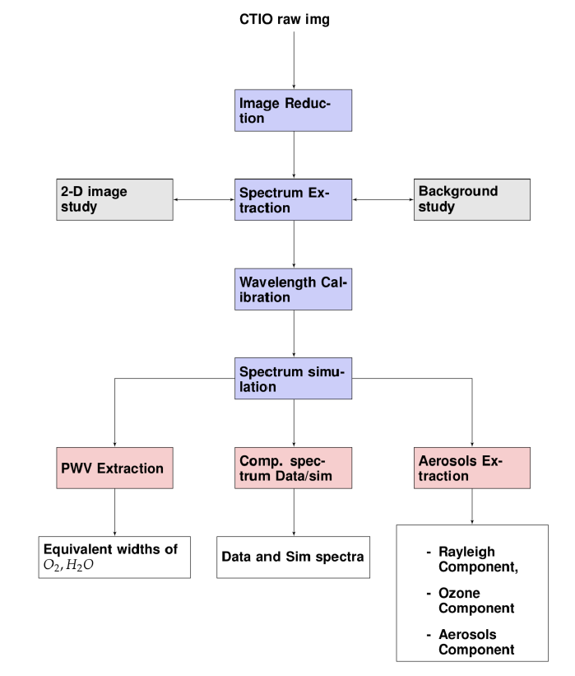
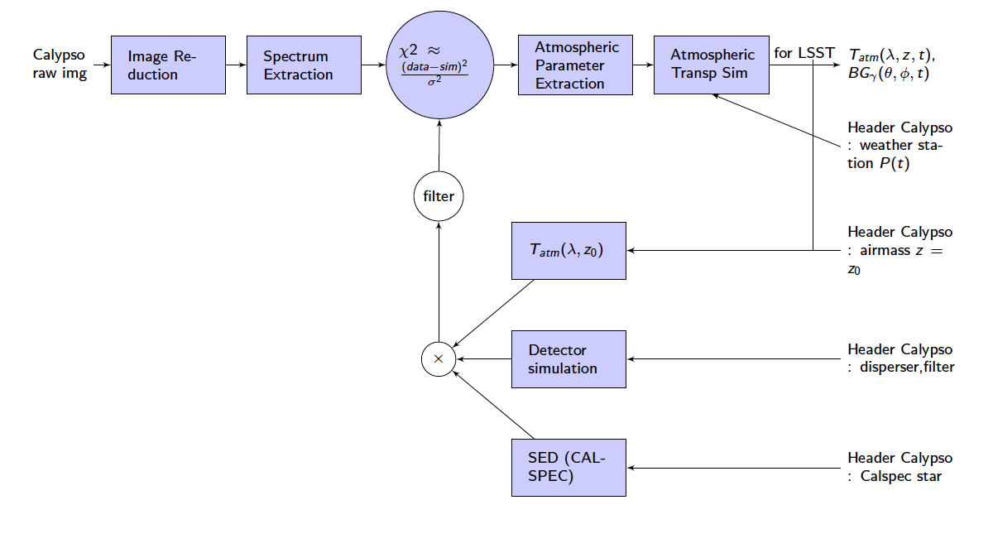
Software Design & Analysis Progress
Old fashion
Pipeline designed for mass production (>3000 images)
Done up april 18
Under progress since may 18,…
Parallel reconstruction of data & sim spectra (clear sky, aver. Sky, merra2 sky)
Spectrum Extraction (data) → spectra in erg/cm2/s/nm
Being done : the automated close loop with chi²/likelihood func
  Require the effective throughput

Slide 17
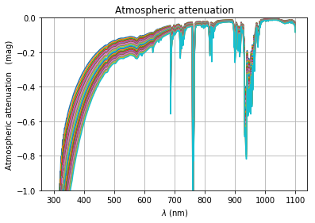
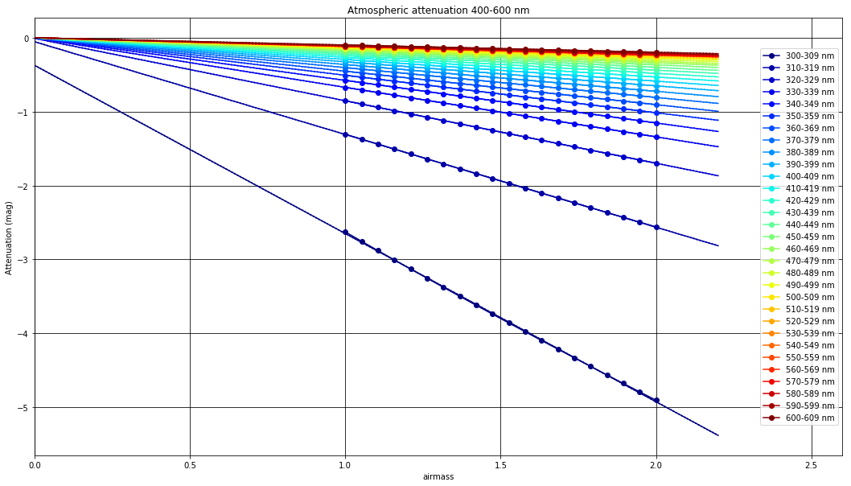
Principle of the Bouguer lines Methods
Proof on simulation
Generate atm transm.
Airmass : 1-2
Clear sky
Fit bouguer line in wavelength bins
Zero point
Ozone
Huggins cutoff
400-600 nm
UV Ozone
Huggins cutoff

Slide 18
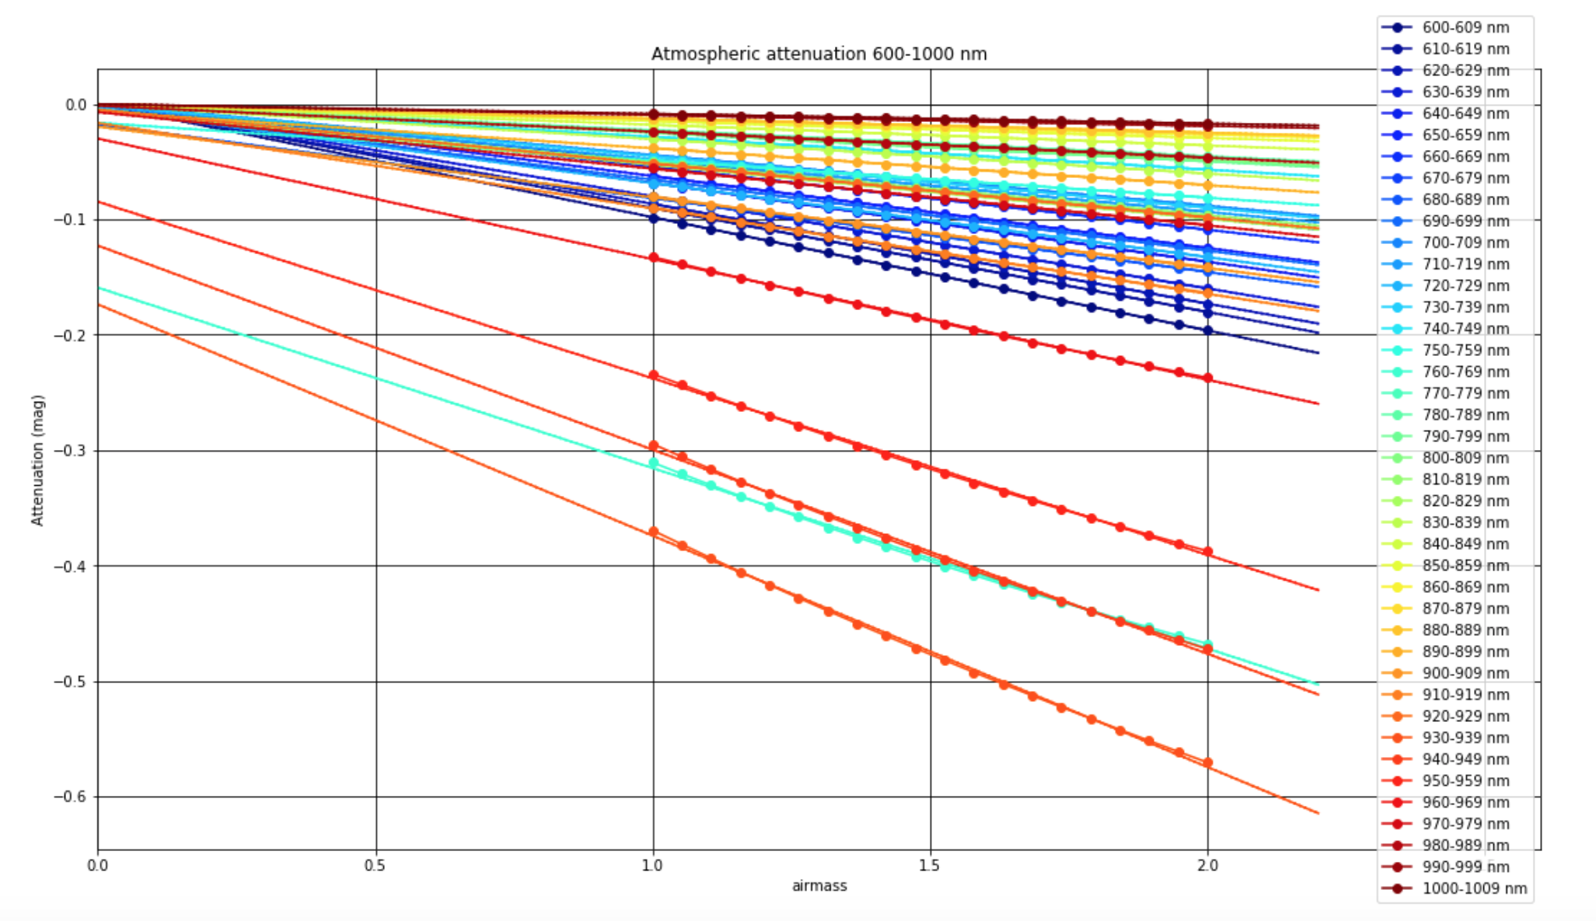
Saturation at molecular absorption
600-1000 nm
Zero point
Saturated lines (O₂, H₂O)

Slide 19
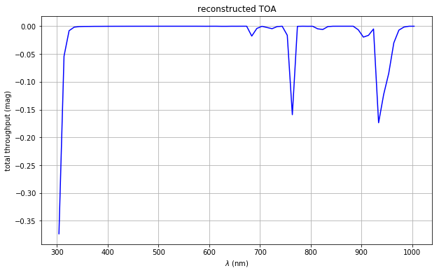
Reconstruction of light at TOA
(Top of Atmosphere)
Molecular absorption saturates :
Extinction α z → α √z
Intercept of Bouguer lines (airmass z=0)
O₂
O₂
H₂O

Slide 20
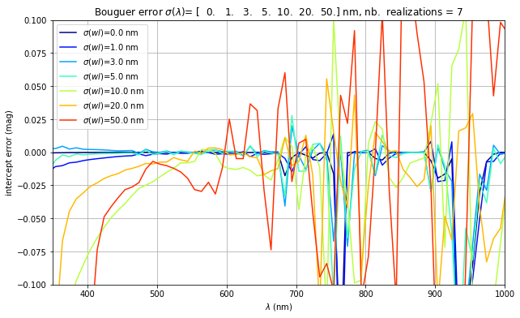
Bouguer line fit : effect of wavelength zero point accuracy : σ(λ)=2nm

Slide 21
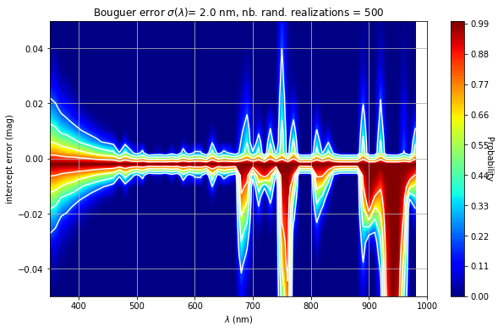
Bouguer line fit : effect of wavelength zero point accuracy : σ(λ)=2nm
80%
Requires a disperser with a very good wavelength accuracy σ(λ)=2nm

Slide 22
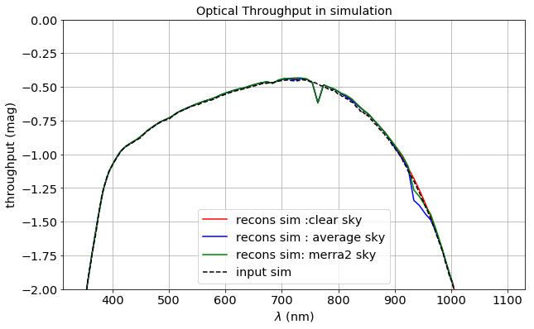
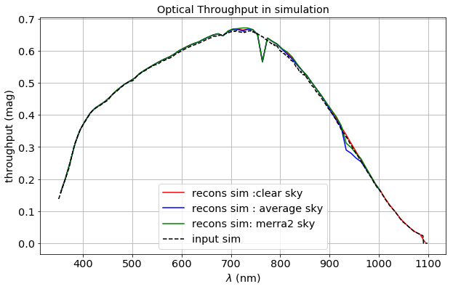
Simulation : Bouguer lines fit method to get back throughput
Magnitude Y scale
3 atm. simulations :
Clear sky, (no aerosol, no PWV)
Average sky
  (aer=0.05, PWV=4mm)
Merra sky (NASA/GMAO)
O₂
H₂O
Linear Y scale
O₂
Fit Method OK, except
At molecular absorption
Line and bands
H₂O

Slide 23
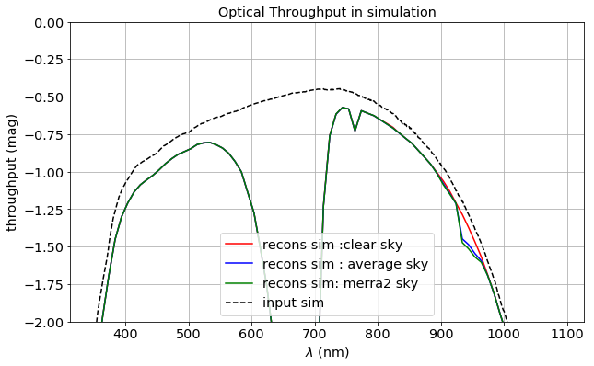
Simulation : Throughput :
Use of Blue/Red filters
Blue Filter
Red Filter

Slide 24
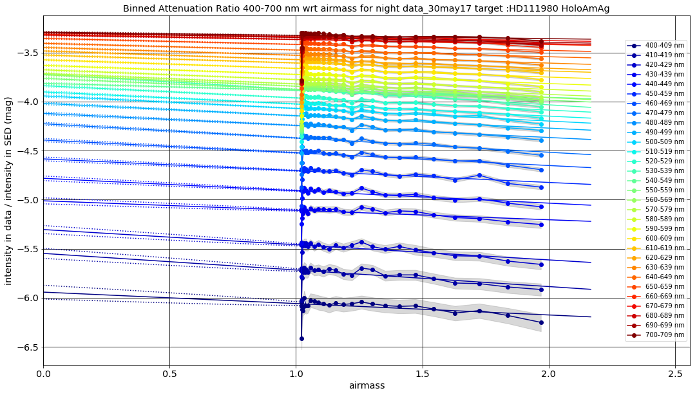
DATA : Fit of Bouguer lines on HoloAmAg
400-700 nm : ratio = Spectrum_{flam}(λ)/SED(λ)

Slide 25
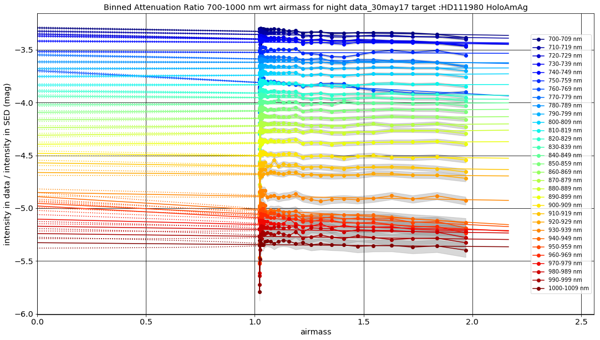
DATA :Fit of Bouguer lines on HoloAmAg
700-1000 nm : ratio = Spectrum(λ)/SED(λ)

Slide 26
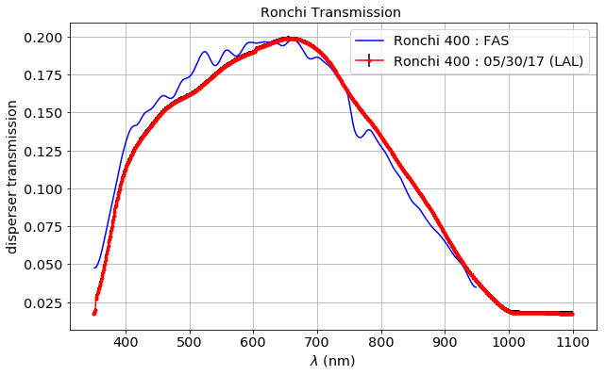
Absolute Throughput with Ronchi
(Qe x optics x 1st order disperser)
10/17

Slide 27
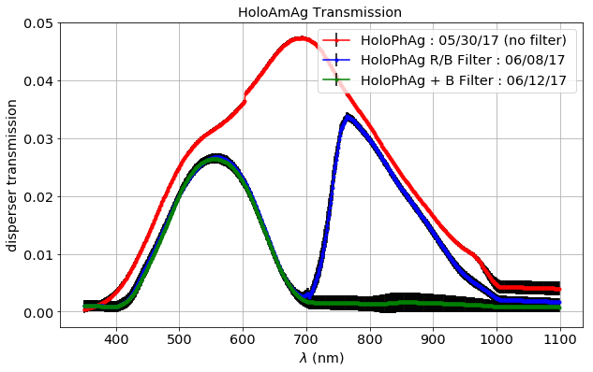
Throughput with HOE
(Qe x optics x Filter x 1st order disperser)
No filter

Slide 28
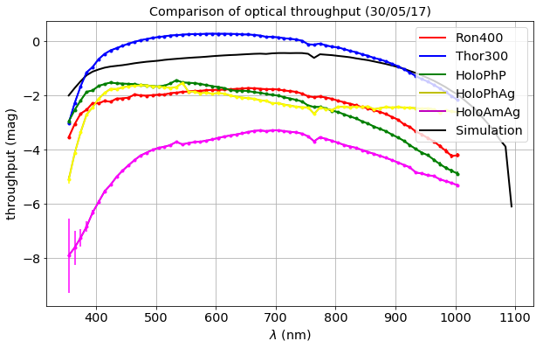
Throughput comparison night 30/05/17
No filter

Slide 29
Extraction of atmospheric parameters spectrum by spectrum
In progress
Jérémy N.
Estimate the best model parameters:
  PWV,
  aerosols,
  ozone,
  σ(pix) (seeing)
  δλ-shift
  Using LibRadTran as the atmospheric model
  Using the Throughput measured
Extraction performed by MCMC techniques
Model : Order 1+ Order 2
S(x) = [ A1 x ( Simu(x - shift) + A2 x Sim((x-shift) /2) ] * Gaussienne(reso) )

Slide 30
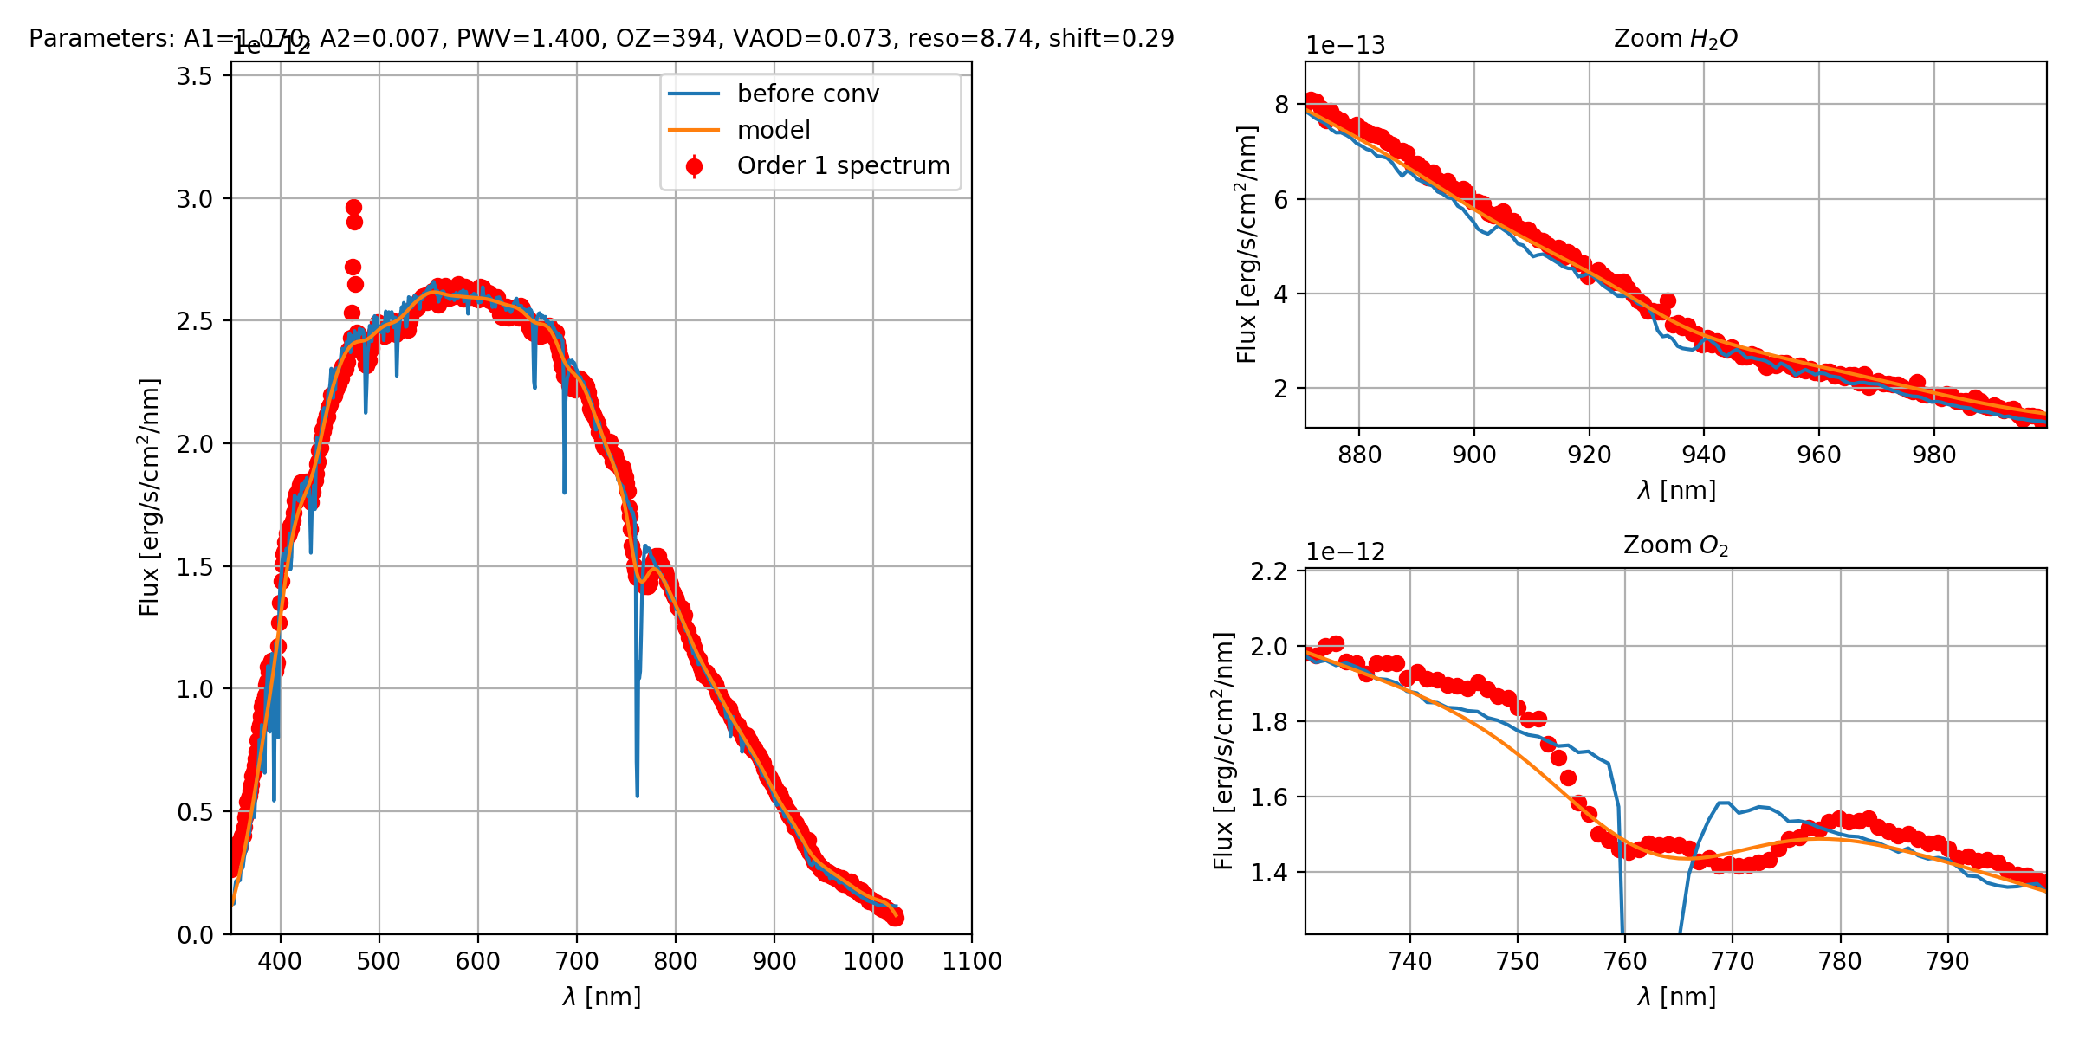
Ronchi 400 spectrum
Chi2/Ndf=8.7
In progress
model

Slide 31
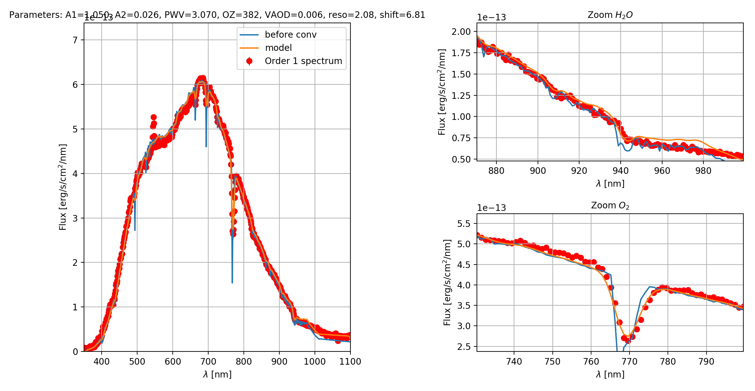
Hologram HoloAmAg
Chi2/Ndf=5.7
In progress

Slide 32
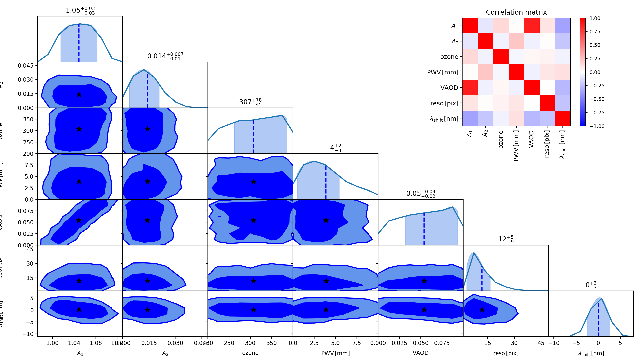
Covariance matrix for Ronchi400
ozone: 394.0
PWV: 1.4
VAOD: 0.0729
reso: 8.74 pix
Chi²/dof= 8.7
Ozone
PWV
VAOD
σ_{λ}(λ)
δλ

Slide 33
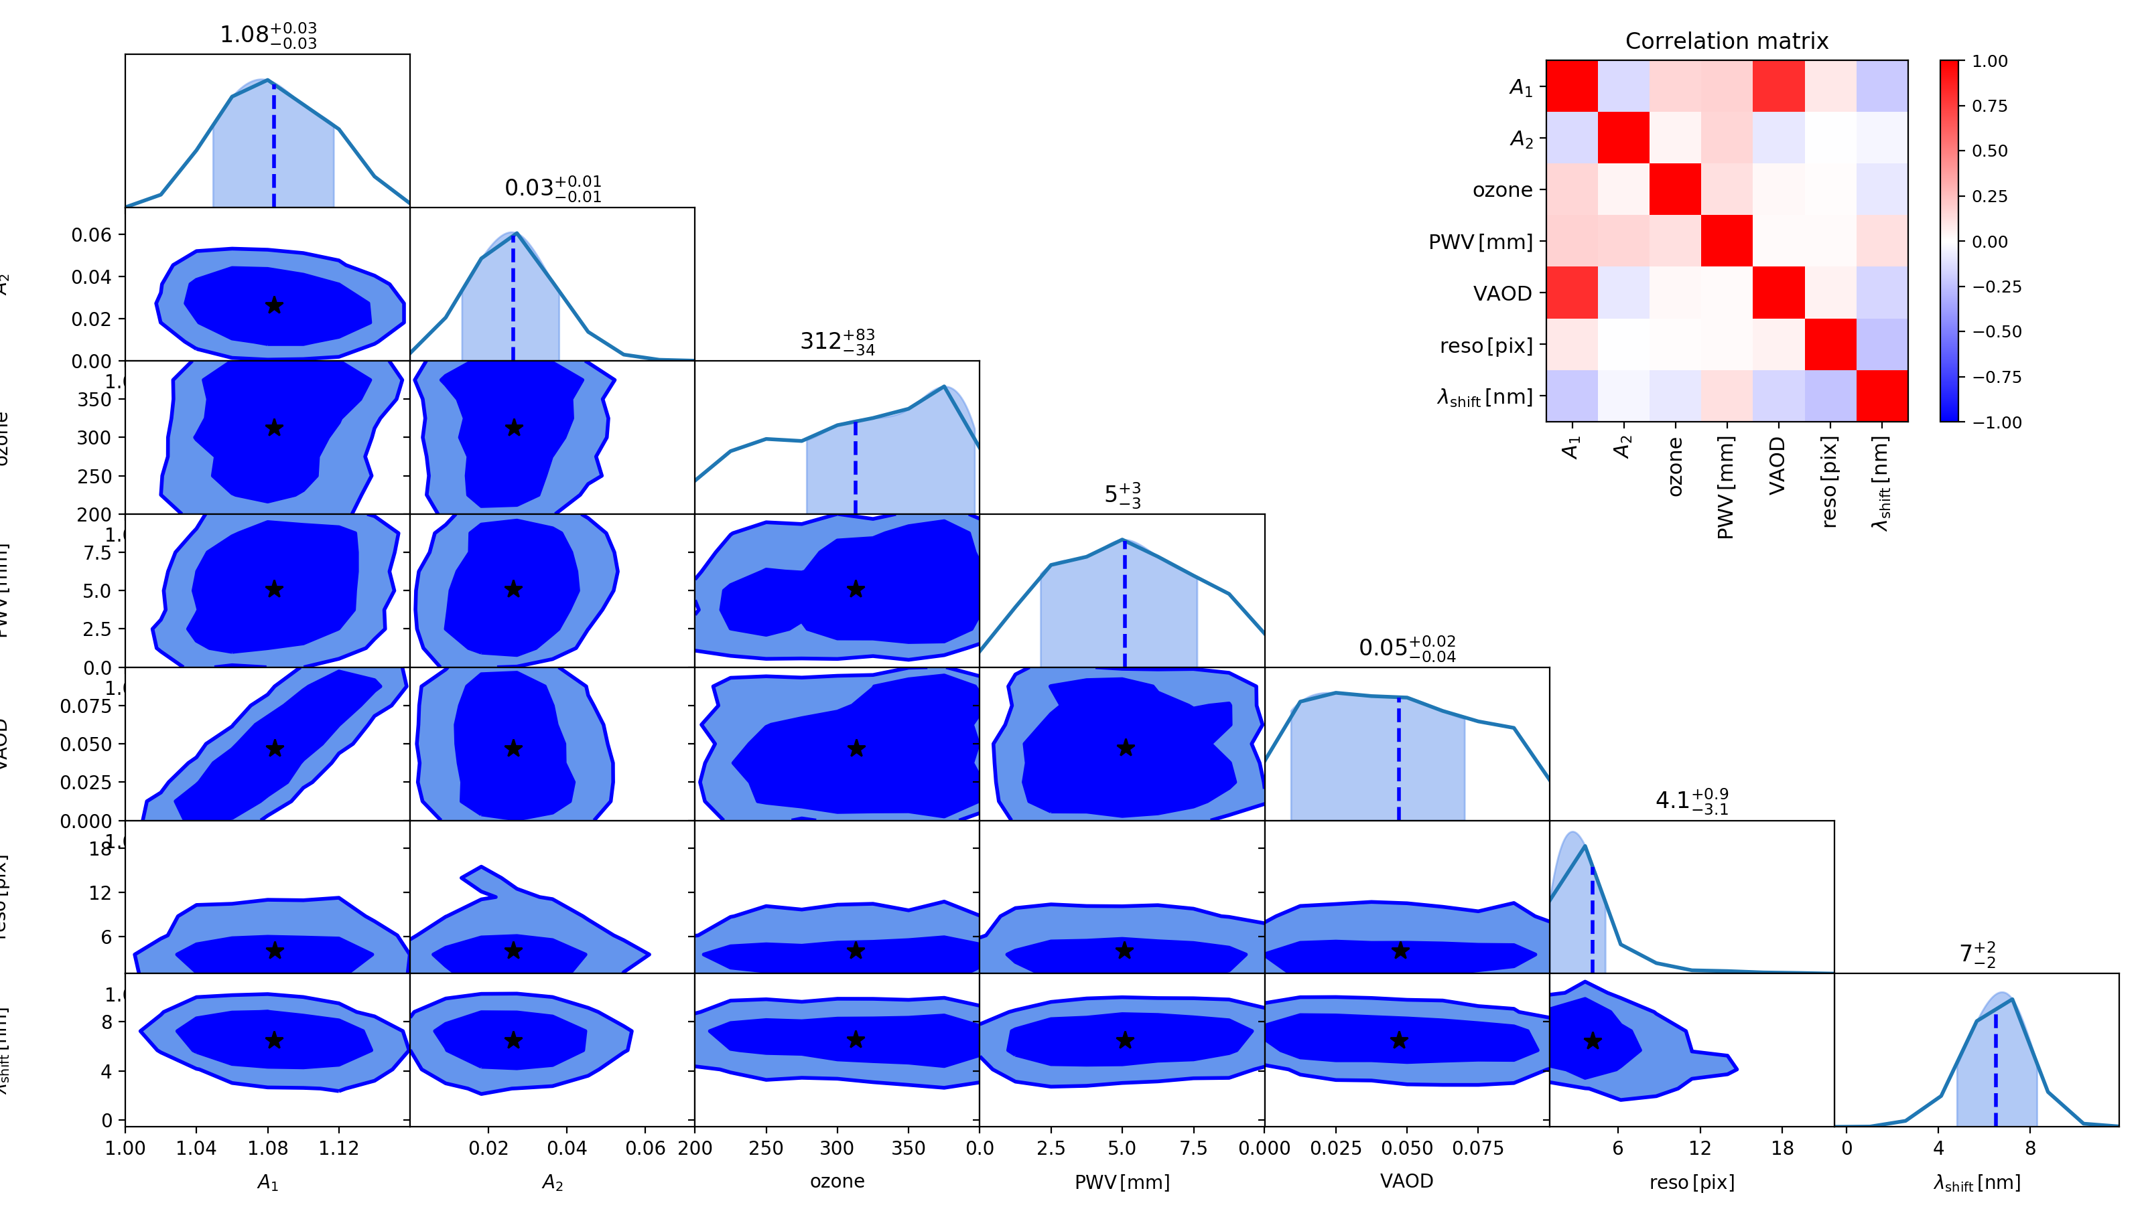
Covariance matrix for HoloAmAg
ozone: 382.0
PWV : 3.07
VAOD: 0.00634
reso: 2.08 pix
Chi²/dof= 5.7

Slide 34
Comments on the MCMC fit
First encouraging determinations of atmospheric parameters
Still room for progress
O₂ line and H₂O band are much better fitted for HoloAmAg than for Ron400

Slide 35
CONCLUSION
Progress in software chain including:
  Spectrum extraction/background subtraction
  Wavelength calibration, and λ=0 point
  Detector Throughput (Ronchi400, HoloAmAg)
  Extraction of parameters
Still poor in data (only 4 photometric nights)
  Not enough to accumulate variations over time
Need further transmission measurement at HOLOSPEC test-bench

Slide 36
Mini-Data Challenge for atmospheric calibration
Sylvie Dagoret-Campagne
LAL

Slide 37
Motivations
Setup methods to estimate atmospheric transmission
Different teams will Evaluate the performances of their methods
Evaluate the relative contribution of LSST alone config and (Auxiliary Telescope + LSST) config
  Set requirements on Auxiliary Telescope
On a fake but realistically simulated Dataset
Notes:
The goal would be to evaluate the differents methods differents temas may have in mind to achieve this work.
Performances may be evaluated on an accuracy bias and other criteria to be defined,…
According to
- Number of visits (1 year / 10 year)
- Series of visits with same atmospheric conditions (same night or photometric nights)
- Number of scanned patches of fields
Number of objects in the FOV of the field
This evaluation can be undertaken provided a mock dataset
Freeze the deadline to compare performances
Need to improve our mock dataset
Necessary to learn how to deal with our data

Slide 38
Data Product
N_{vis} visits ( i=1,…,N_{vis}) scheduled by minion16 cadence
N_{obj} objects sampled from a catalog of SED selected (j=1,…,N_{obj})
F_{i} is the filter used for visit i
  F_{i} = U, G, R I, Z, Y according a cadence (minion16)
Airmasses z_{i} of each visit i and the instrumental magnitude M_{ij} for each object j in the field :
the dataset : { z_{i} , F_{i} ,{M_{ij ,} δM_{ij}}_{j} }_{I}
One spectrum (undelivered SED) of a reference star in the field (to combine with auxiliary telescope data)

Slide 39
List of Tasks
Selection of star catalog : Phoenix → Done
SED Sampling according the magnitude distribution in SNLS → almost done
Atmospheric parameters distribution according MERRA2 → Done
Atmospheric transparency calculated by libradtran → Done
True effective LSST Filter → Done

Slide 40
Last Task : Calculation of Magnitudes and errors
How to go from
cadence (z_{am}, sky) + SED + atm transm. + F_{i}→ {M_{ij ,} δM_{ij}}
Two options can be used:
saunerie (Nicolas R expert), python2
LSST_SIM_MAF (python3) provides official LSST Filter Transmission
  (still need to learn how to use lsst.sims.photUtils)

Slide 41
Validation of SIMS_MAF use
Learn LSST_SIMS_MAF by comparing the results to saunerie
Check with Nicolas R, how we extract the parameters we want.

Slide 42
Diffused background light with librandtran comparison of clear sky and sky with aerosols
Sylvie Dagoret-Campagne and Arve Kylling
December 2015

Slide 43
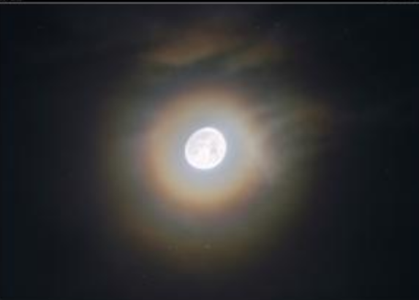
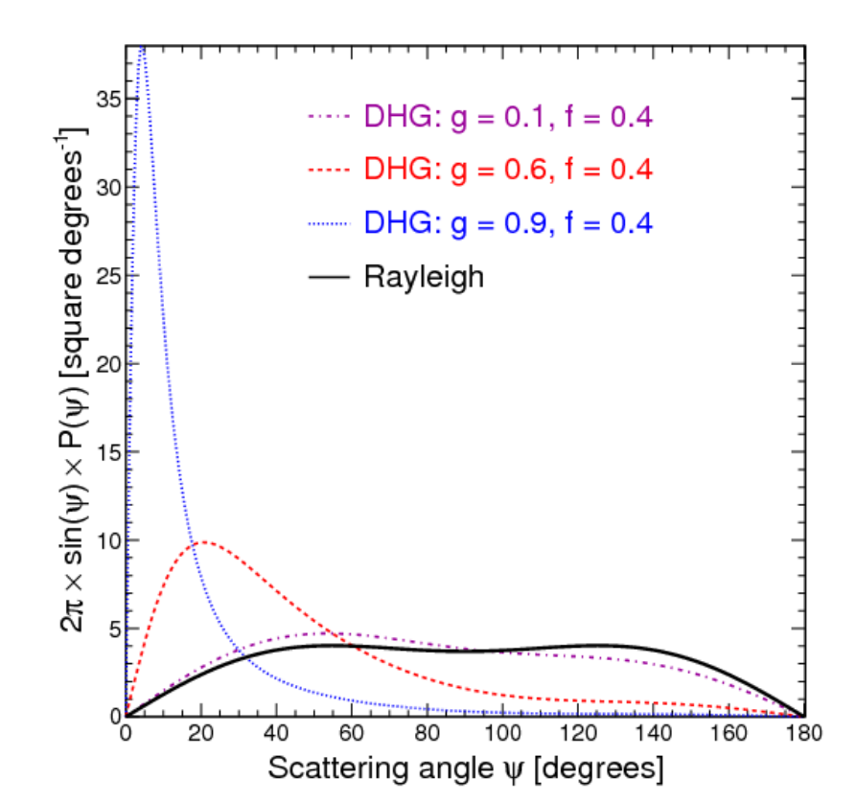
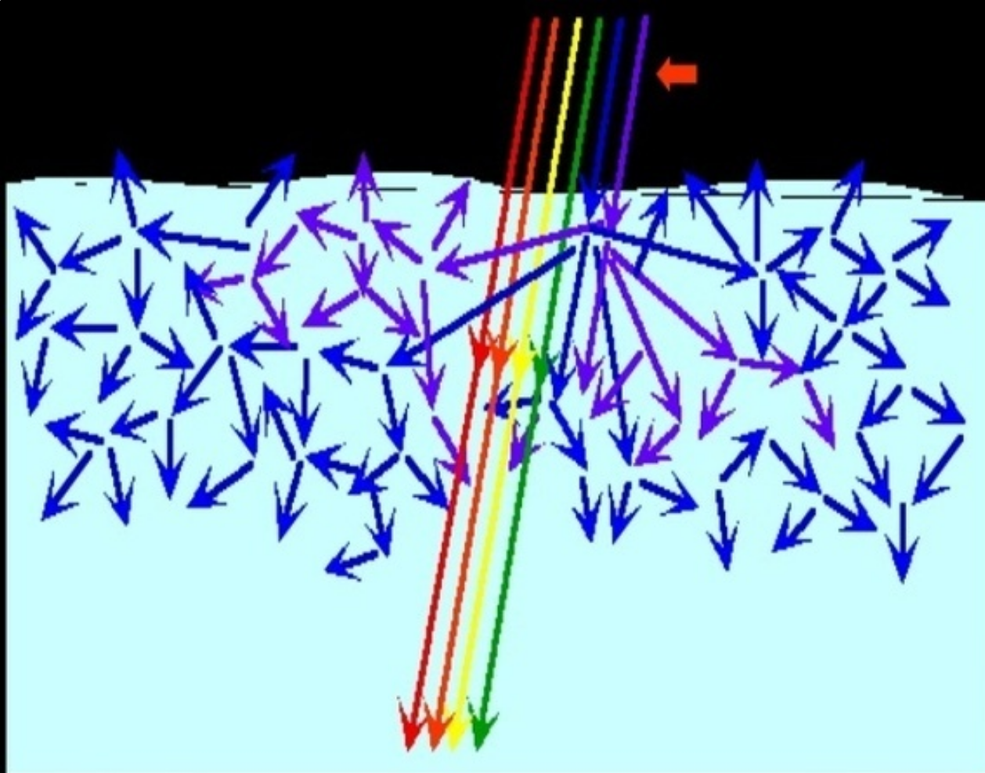
Scattering properties of atmosphere
Mie scattering peaked forward
Angular cross-section
Rayleigh scattering

Slide 44
Application to sky diffused background
Libradtran simulate not only direct light
But also diffused background
  Diffused background requires earth albedo
  (albedo for rocks also depend on weather conditions : wet/dry,snow,…)
    To be studied

Slide 45
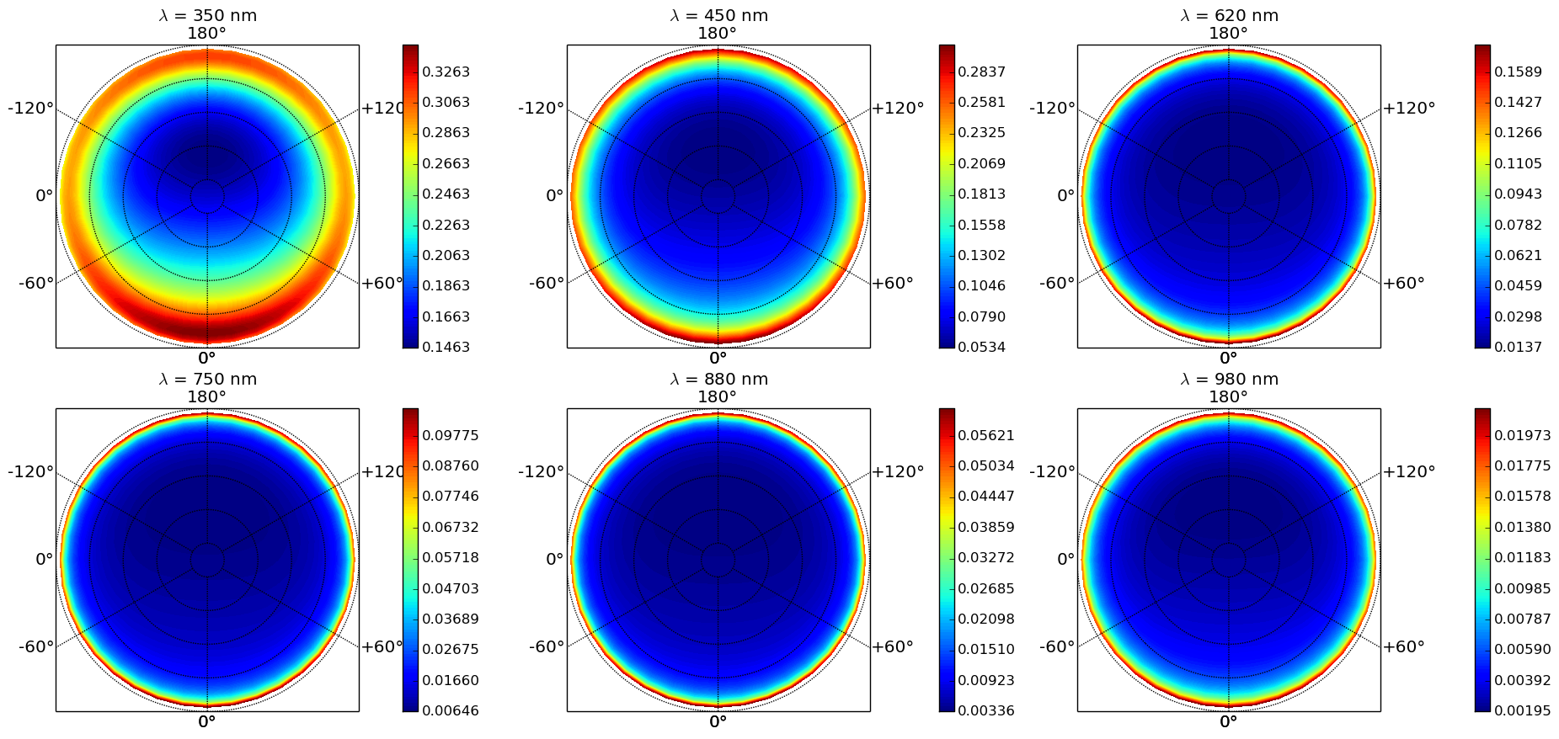
Map of Clear sky diffused light sun at 30° zenith angle

Slide 46
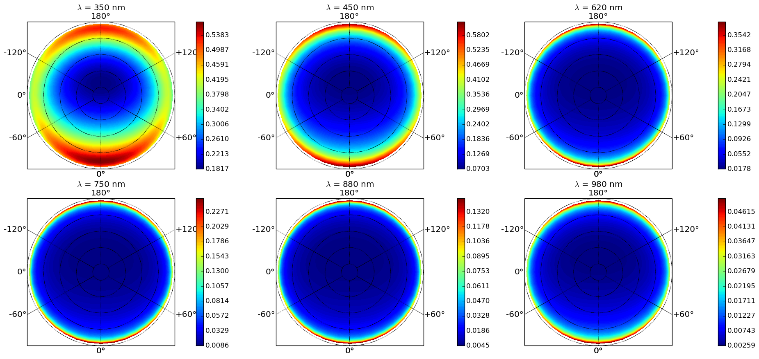
Map of Clear sky diffused light sun at 60° zenith angle

Slide 47
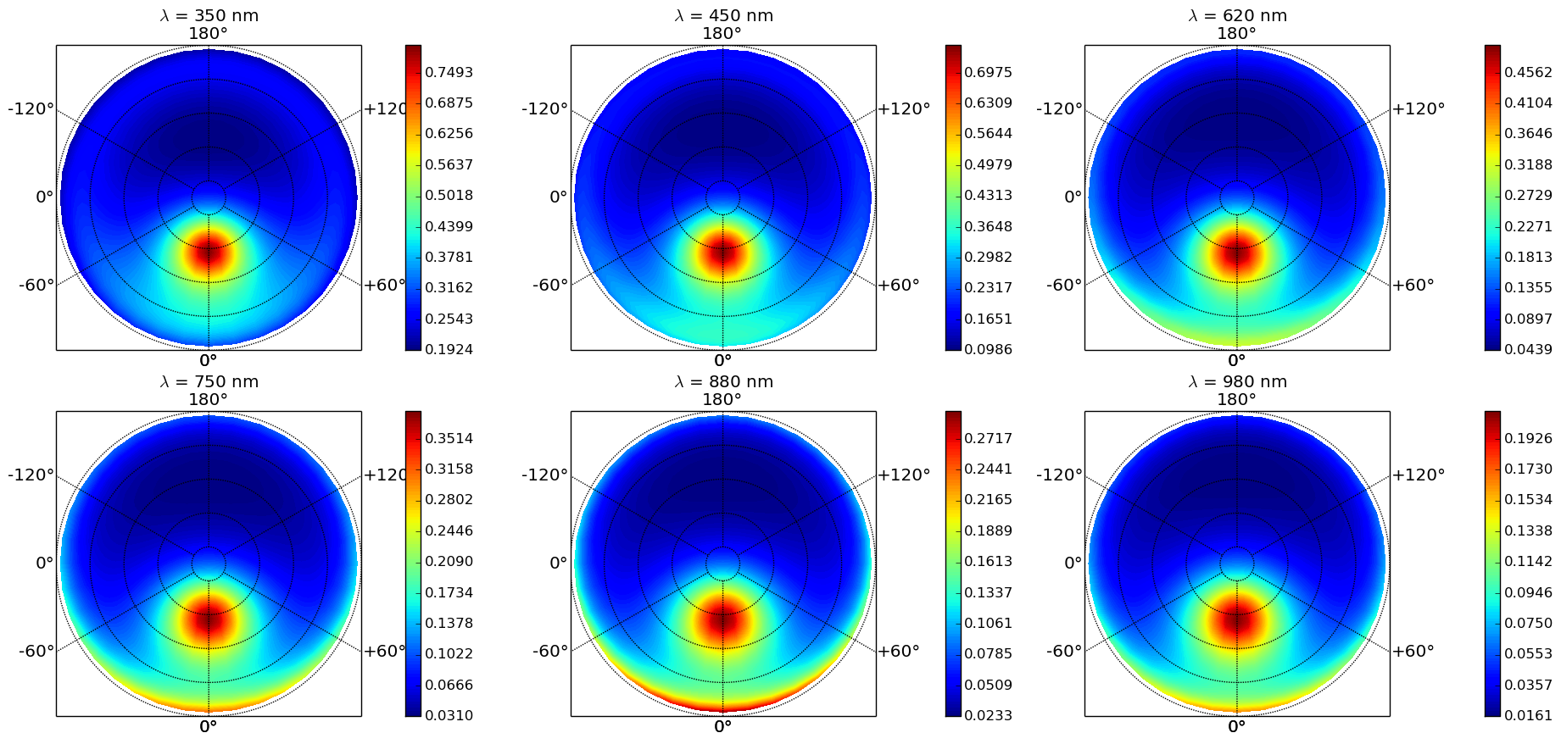
Map of diffused light with aerosols sun at 30° zenith angle

Slide 48
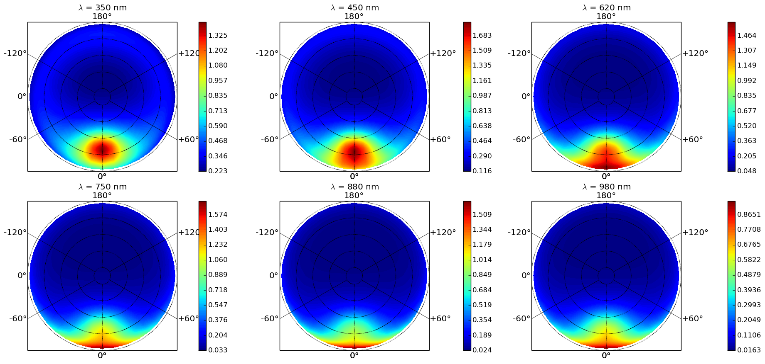
Map of diffused light with aerosols sun at 60° zenith angle

Slide 49
Normalized LIGHT

Slide 50
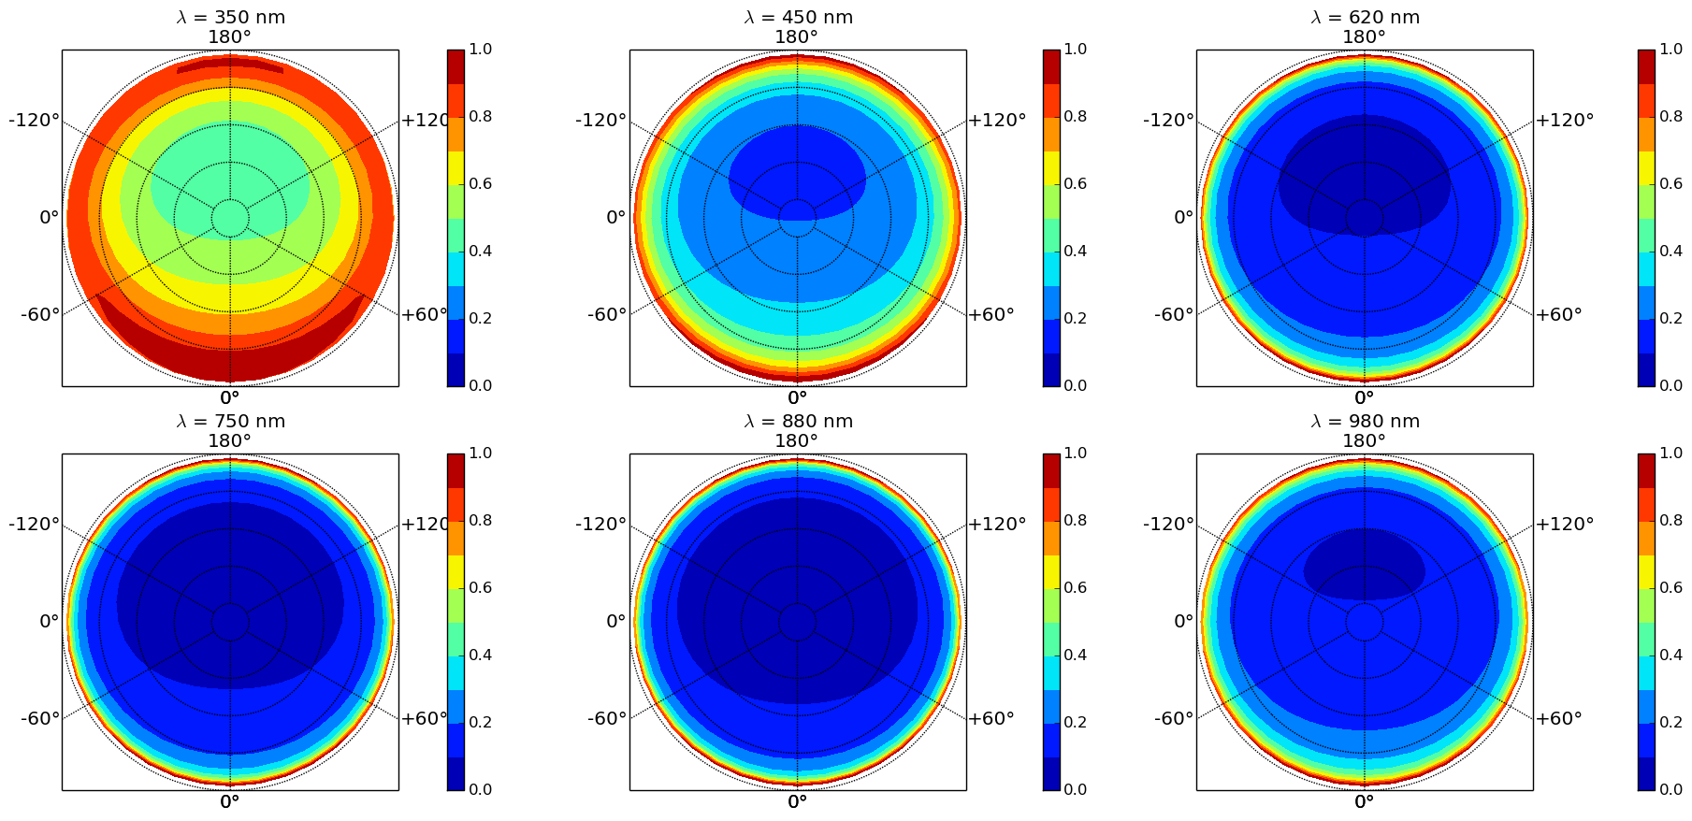
Map of Normalised clear sky diffused light sun at 30° zenith angle

Slide 51
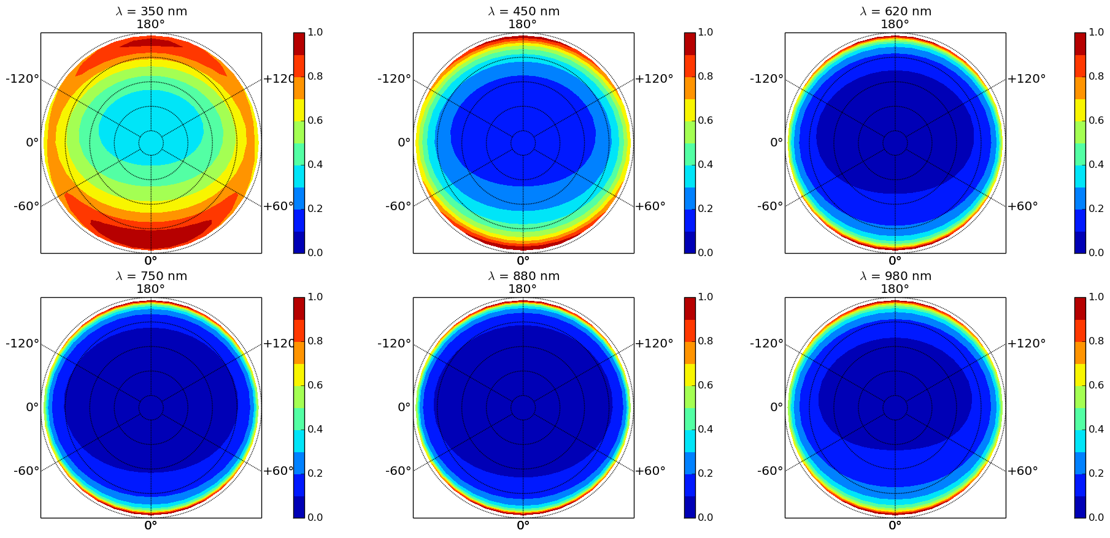
Map of Normalised clear sky diffused light sun at 60° zenith angle

Slide 52
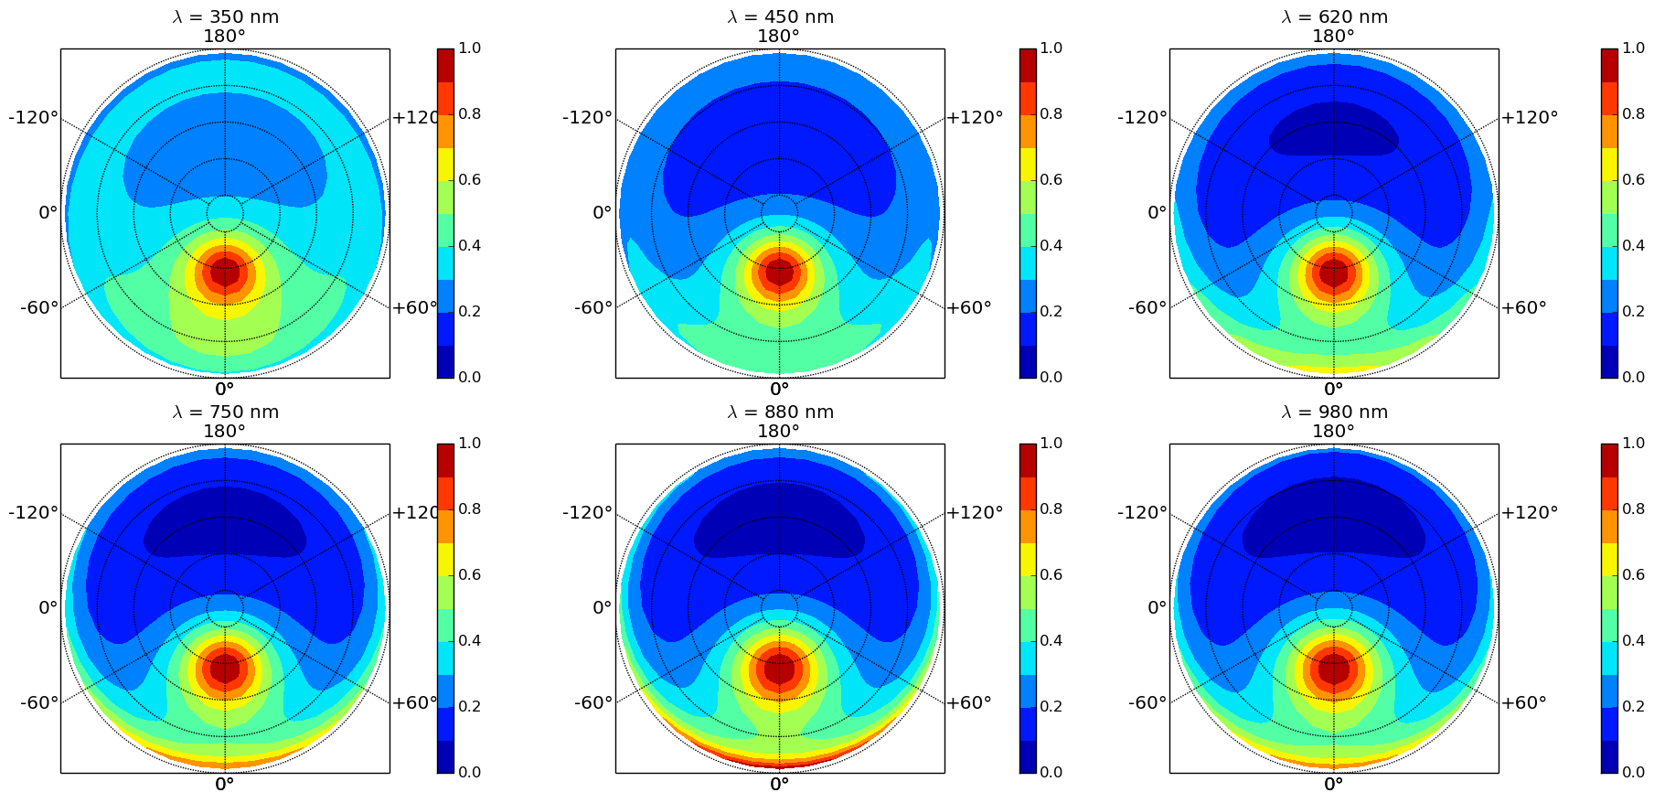
Map of normalised diffused light with aerosols sun at 30° zenith angle

Slide 53
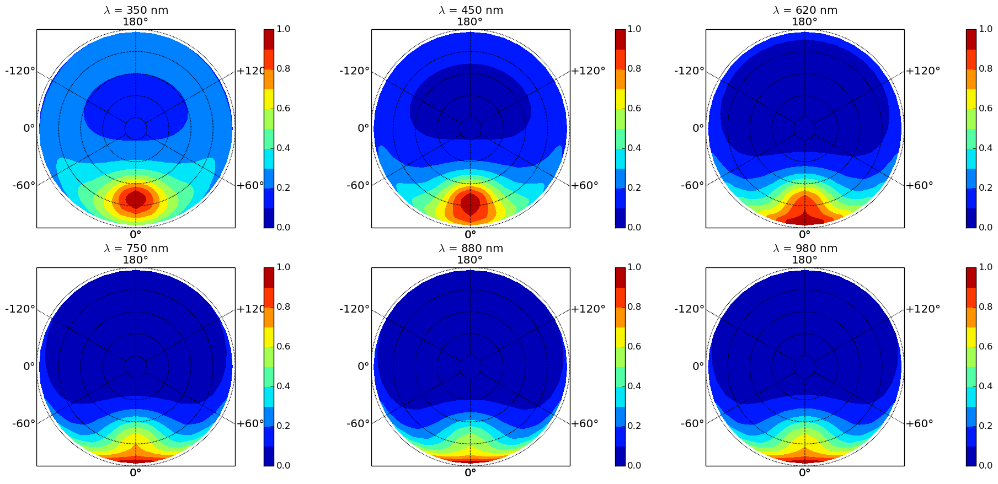
Map of normalised diffused light with aerosols sun at 60° zenith angle

Slide 54
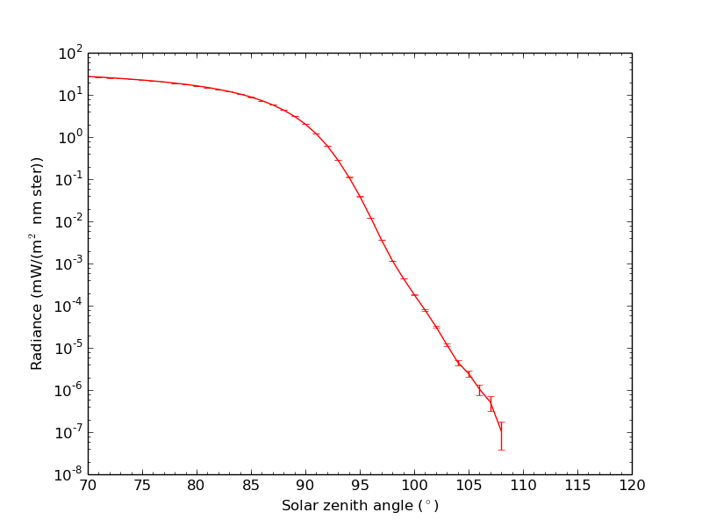
Radiance decrease with zenithal angle
Light diffused above
The horizon
Astronomical twillight : 10^8 radiance drop
-26.74 + 20 magnitudes
= - 6.74 magnitude

