Slide 1
The Collimated Beam Projector (CBP)
Nicholas Mondrik (Harvard)
Collaborators:
Michael Coughlin (Caltech)
Christopher Stubbs (Harvard)
John Woodward (NIST)
Paris LSST Calibration Meeting, May 23-25, 2018

Slide 2
Outline
Purpose of the CBP
CBP design and operation
Collecting data with the CBP
Results
Troubles, lessons, and the future

Slide 3
The flat field is not enough
Traditional broadband flat fields use a non-collimated light source to illuminate the focal plane
Can use monochromatic flat fields to estimate instrumental throughput as a function of wavelength
Primary issue:
Ghosted light paths are different than those produced by collimated beams
Wavelength dependent ghosting can masquerade as QE variation

Slide 4
Enter the Collimated Beam Projector (CBP)
Variable ND filter
Tunable laser
Integrating sphere
Monitor photodiode and spectrograph
To telescope
Collimating optic
Image mask

Slide 5
CBP mounted on platform attached to dome
Tunable laser

Slide 6
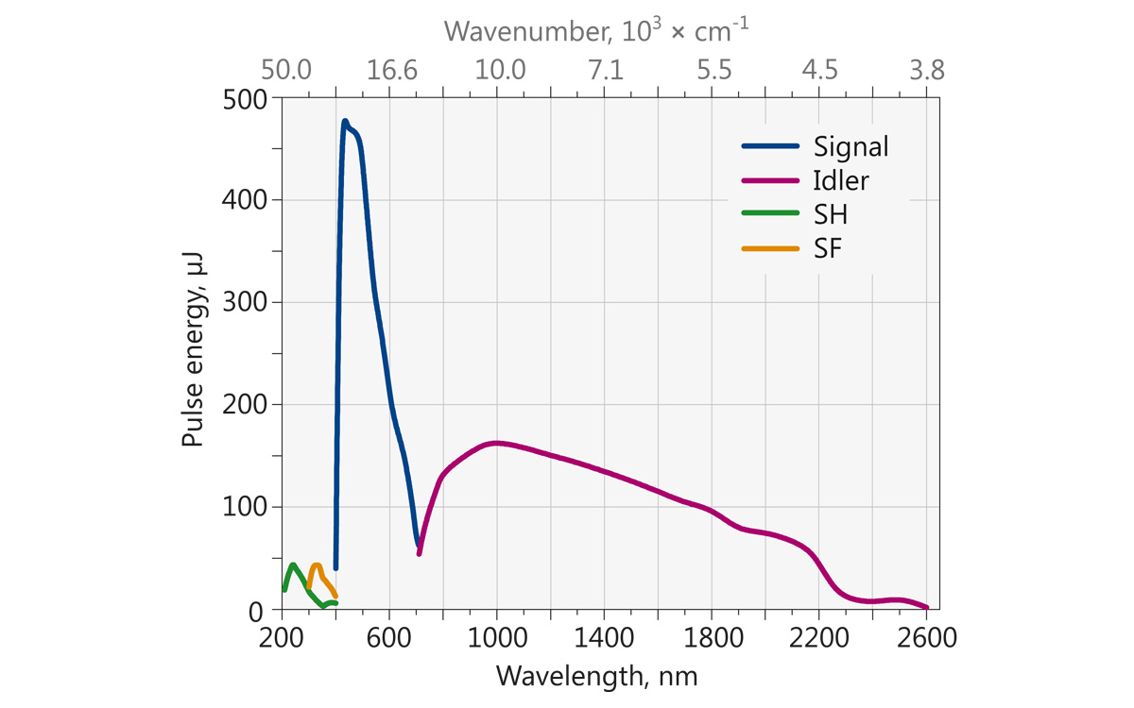
Tunable light source
Ekspla NT-242:
1 kHz rep rate
1064nm pump
Approx. 400nm
https://ekspla.com/product/nt242-series-tunable-wavelength-nanosecond-lasers/

Slide 7
LSST filters

Slide 8
Key point:
Use the NIST-traceable photodiode as metrology standard, NOT light source
$$\frac{\text{Charge} \text{collected} \text{on} \text{CCD}}{\text{Charge} \text{collected} \text{on} \text{photodiode}}$$
(X correction factor)
Challenge: measuring the transfer function of the CBP system

Slide 9
The Data

Slide 10
Taking data: SMARTS 0.9m, CTIO, Chile
Open telescope shutter
Open CBP shutter
Expose
Close CBP shutter
Close telescope shutter
Change wavelength

Slide 11
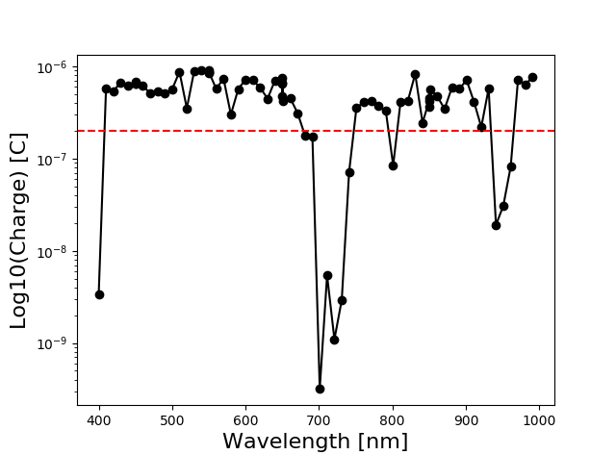
Charge homogeneity
$$\frac{\text{Charge} \text{collected} \text{on} \text{CCD}}{\text{Charge} \text{collected} \text{on} \text{photodiode}}$$
Goal: avoid divide-by-zero errors

Slide 12
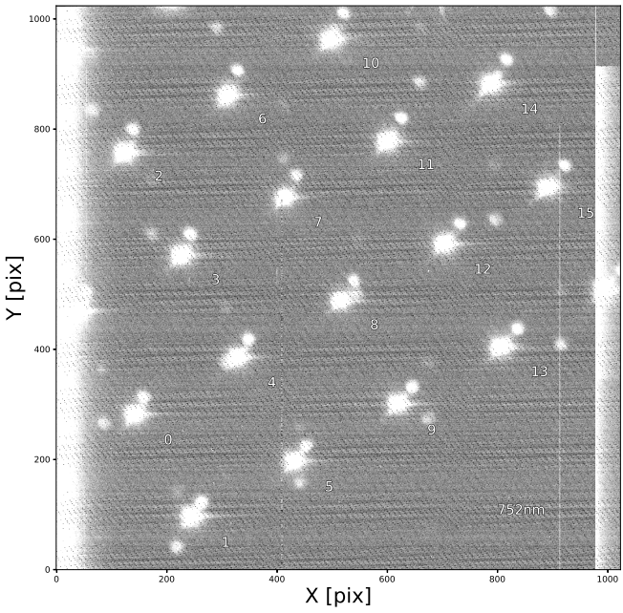
Primary spot (5x5)
Ghost spot
(due to filter)

Slide 13
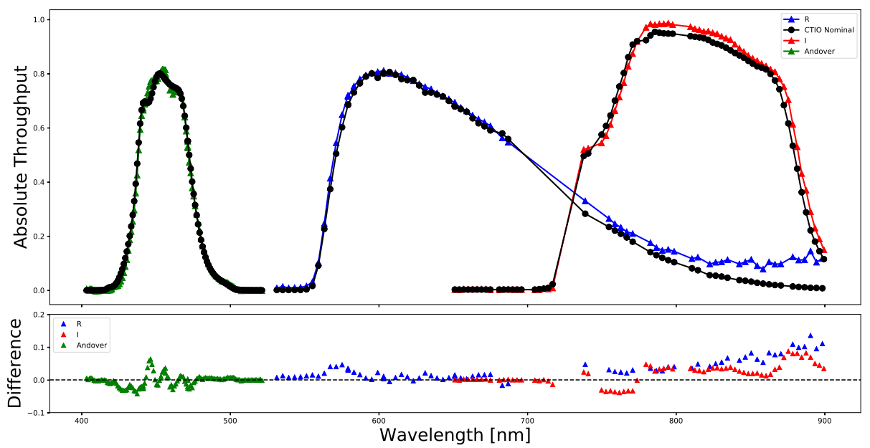
The results (so far)

Slide 14
Current Difficulties and Places for Improvement

Slide 15
Harvard CBP Specific

Slide 16
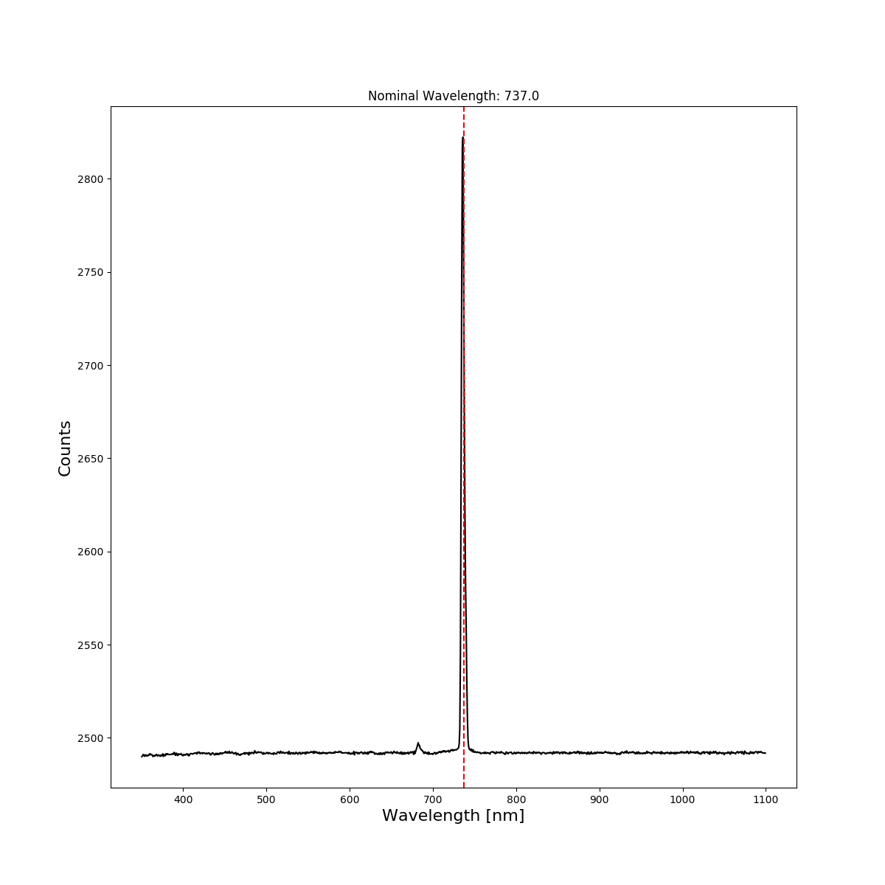
Challenges for the Harvard CBP
Alignment (equatorial vs AltAz + dome rotation)
Contamination from signal into idler beam
Temperature monitoring
Change from refracting to reflecting optics?
Fix tunable laser (or find new light source)

Slide 17
Questions and Challenges for the LSST CBP

Slide 18
General CBP challenges
Vignetting* corrections between days (more after this)
Output of tunable light source in blue (<400nm)
Spot-to-spot comparison map
Using a CBP to flat-field Ronchi data for atmospheric transmission
How broad can light source FWHM be, and still achieve effective bandpass measurements (alternatively, a method for including observed FWHM in bandpass extraction)
Impact of OPO degeneracy point on filter scans of r and i
Where should we take the CBP next?

Slide 19
“Vignetting” correction issue
In order to make accurate synthetic colors, we need to be able to put 2 different filters (w/ scans taken on different nights) onto same flux scale. That is, we need to know that the peak I-band throughput is 80% of the peak R-band throughput (don’t care about what the overall multiplicative offset is, though).

Slide 20
Spot Matching
Create a map that links same spots on CBP mask between different runs
No-filter scan image taken on 2017-10-11
No-filter scan image taken on 2017-10-04

Slide 21
Inconsistent raw throughput ratios
Nofilter/nofilter
Plot is ratio of raw throughputs of each spot
Note that not only are there large (>20%!) offsets between nights, but also not consistent spot-to-spot

Slide 22
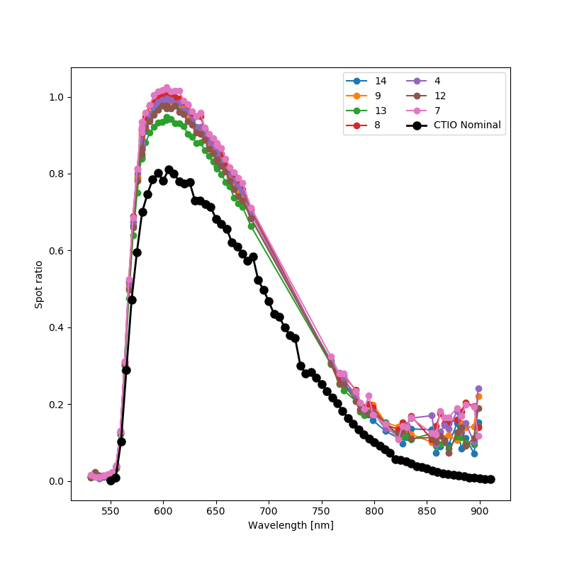
How does it affect throughput measurements
Same curve, but made by dividing an R-band scan by the 2017-10-11 no-filter scan
Our “flagship” R-band curve
Back-to-back scans taken without moving spots, CBP, or Dome
BAD

Slide 23
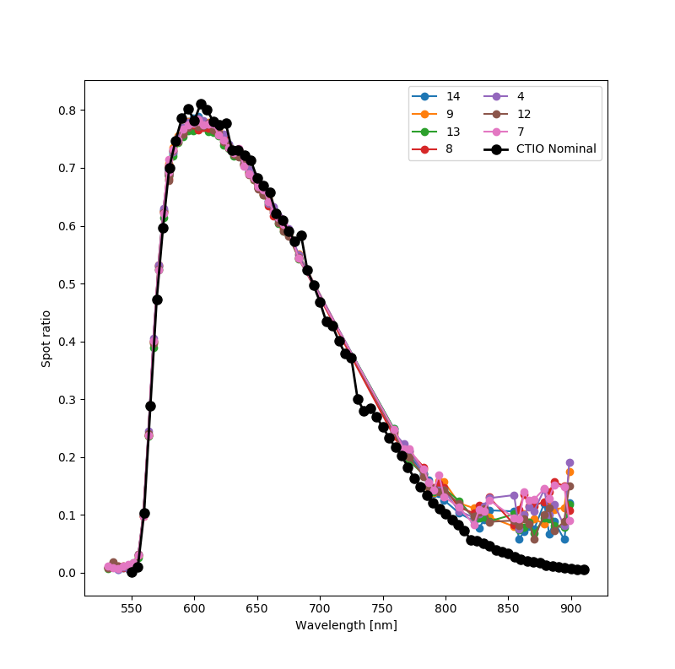
Can we correct for it?
In this case, the nofilter 2017-10-11 image is corrected by data from the nofilter 2017-10-04 run
Same pair as before, but this time, each spot has a “vignetting”(=overall multiplicative scaling) applied. Correction factor is found by MEDIAN(spot_A_Nofil_dayX[common wavelengths]/spot_A_Nofil_dayY[common wavelengths])

Slide 24
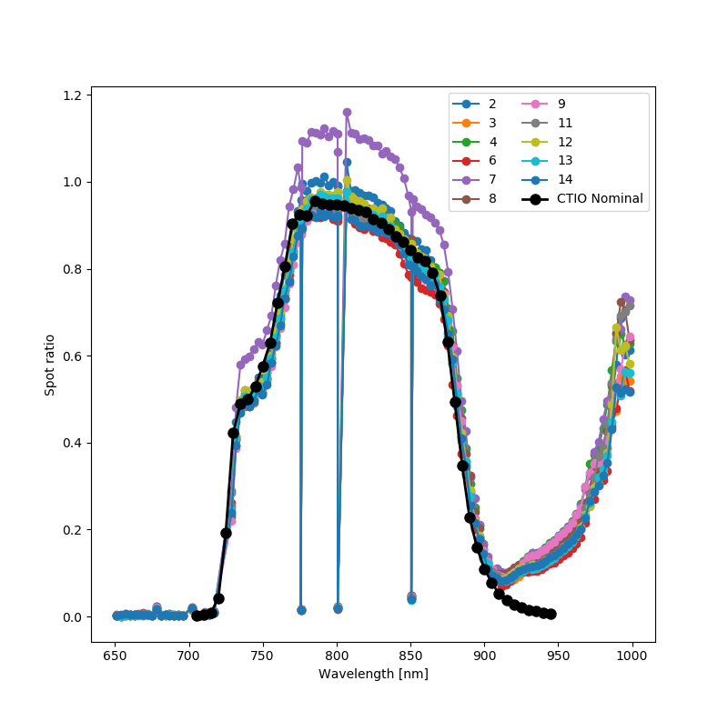
Application to I band
Spot-spot ratio of an I band scan from 2017-10-07 to the no filter scan on 2017-10-11
Same, but with a vignetting correction (based on a single wavelength no-filter image taken on 2017-10-07)

Slide 25
Conclusion
Large steps in the maturity of the CBP
There are a number of systematics in the existing CBP data that have been identified, and are in the process of being quashed
Unfortunately, the set of data taken at CTIO in 2017 is probably not going to provide us with final filter curves with uncertainties <1%
There also exist a number of broader challenges with regard to CBP data, which hopefully DESC can provide some input on

