Slide 1

Status report from WP3
Neutrino Week in Strasbourg, France - Co-organised by COST/EuroNuNet, GDR Neutrino and ESSnuSB
5-9 novembre 2018 Institut Pluridisciplinaire Hubert Curien
Elena Wildner

Slide 2
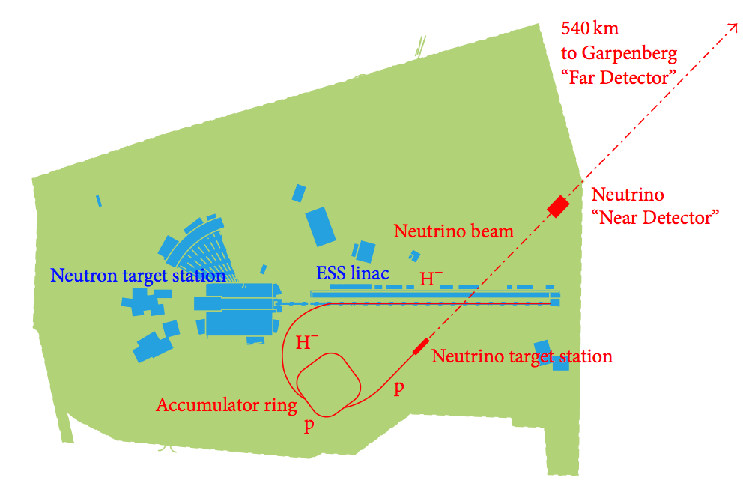
The Accumulator Ring, high intensity, 10 ¹⁵ p
2.5 GeV
Pupose:
Compress beam from 2.86 ms to a few μs
Extract from the ESS linac at well chosen energy
Transport H- beam to the accumulator
Inject into ring, multiturn, define beam properties
Accumulate beam, control beam properties
Keep beam in ring
Supervise and avoid uncontrolled beam loss
Collimate beam
Extract beam to target transfer channel

Slide 3
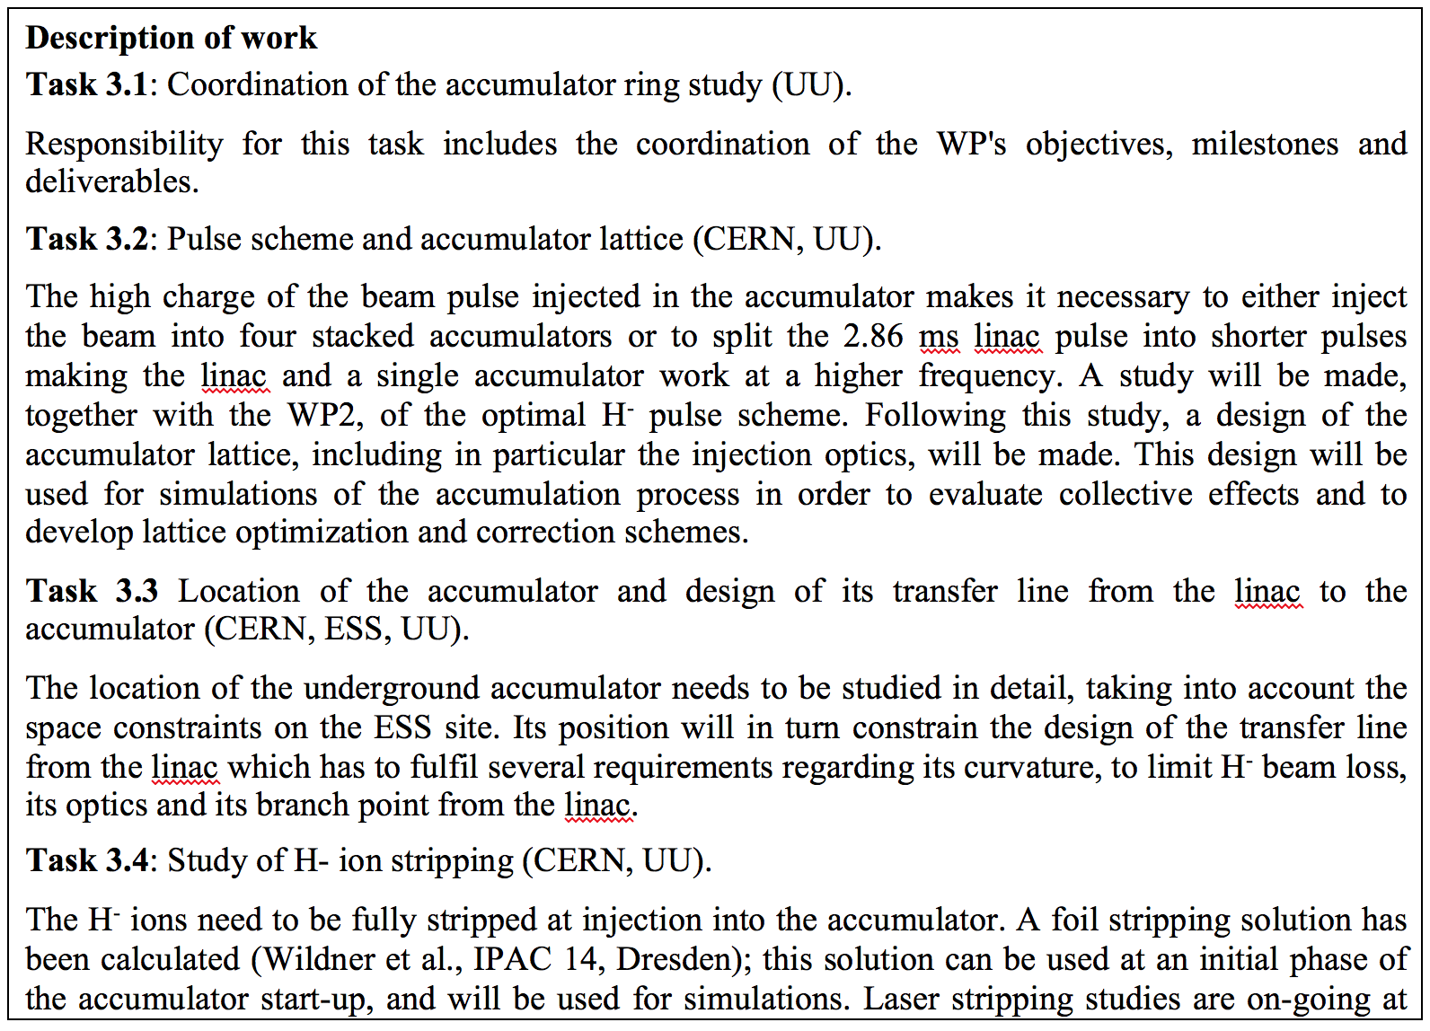
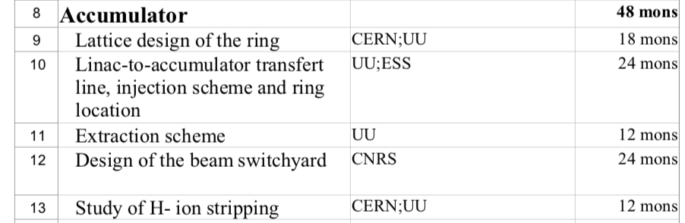
From Grant agreement
CERN, UU, RAL, viable lattice for first calculations with foil injection
CERN, estimation of linac/accu bending radius according to stripping rules (CERN)
ESS, civil engineering drawings
CERN, brief overview of extraction principles, presentation
CNRS, EUROnu design
CERN, only foil stripping and temperature calculations using a few lattice models

Slide 4
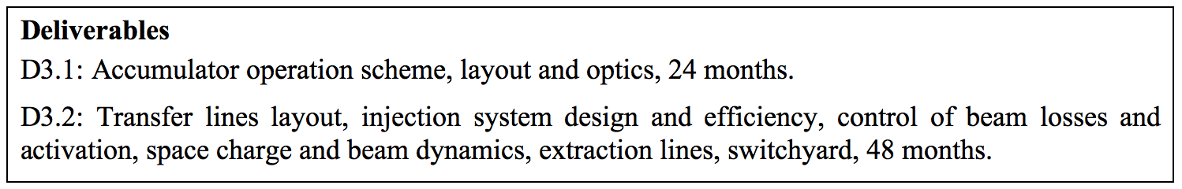
Deliverables
Deliverable D2.1 (linac operational schemes: 8 months), couples to D3.1
WP2&3 meeting early fall 2018 treating this subject in detail. ✔️
However: More work needed, ideas continue to emerge !

Slide 5
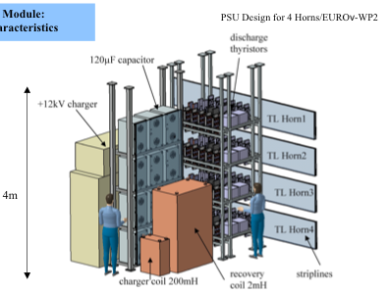
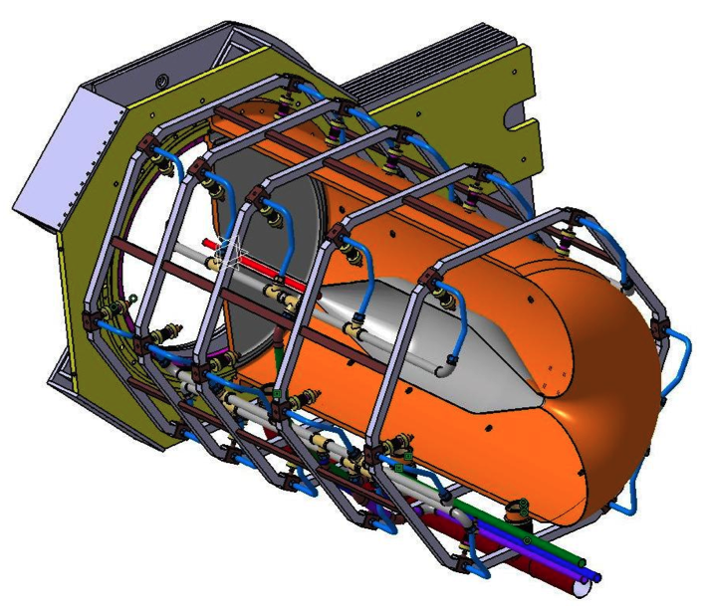
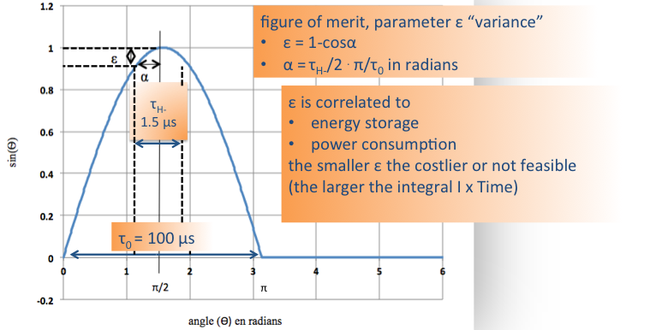
The present neutrino target/horn design
P. Poussot
PSU Design for 4 Horns/EUROnu, WP2
4 targets/horns (like the EUROnu design)
1 Power Supply
To get a good merit factor ε: τ _{Beam (H-)}~ 1.5 μs
The duration of the ESS Linac Beam (2.86 ms) must, with the present target system design, be reduced to a few μs to limit the ohmic heating of the focusing horn.
Challenge: Can the proposed pulsing sequence from accumulator be accepted?

Slide 6
High intensity and accumulator design
Laslett formula for tune shifts
x,y
Our handles are
Intensity (N):
  Divide the intensity by 4 (use four rings or four batches)
Emittances (E_{x,y}):
  Injection process, target requirements
Relativistic properties of beam:
  Energy (given by physics needs, the ESS linac and site layout)
The Bunching factor Bf :
  Ignored for the time being (coasting beam), by assuming
  linac longitudinal structure smeared (to be verified)

Slide 7
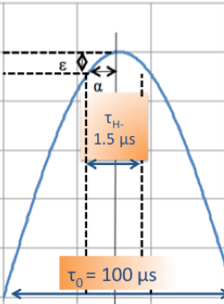
Intensity
The accumulator circumference should correspond to the requirements of the target/horn power supply design, < 1.5 μs or have a large gap in the beam.
1.1 10¹⁵ circulating p and a circumference corresponding to about 1.5 μs would result in tune shifts of 0.75 (target value < 0.2)
Remedy: stack 4 accumulators (Baussan et al.: Nuclear Physics B
Volume 885, August 2014, Pages 127-149), tune shifts would be reduced to acceptable values however expensive and operationally demanding.
OR
Pulsing of linac more often to fill accumulator sequentially
Demanding on linac equipment: cavities, couplers etc.
Demanding on target/horn powering
Gives higher temperatures on injection foil
Assessment of feasibilities ongoing

Slide 8
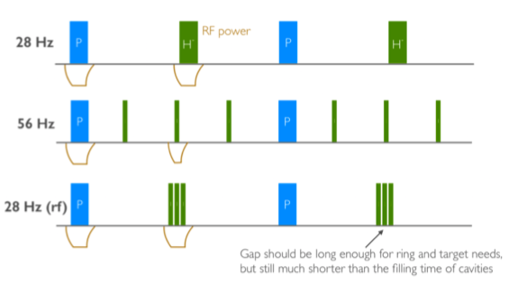
Basic Pulse schemes
Basic pulsing for 10 MW
Ok for foil stripping injection
Recent temperature calculations with foil show that this needs laser stripping.
Schema also valid for 4 rings
Can be more than 3 pulses…
New
Low current-longer pulses options are considered unfavorable for the linac however it may now be conceivable to add a separate modulator system for the H- beam, better adapted. Higher frequency options are also not ideal solutions.

Slide 9
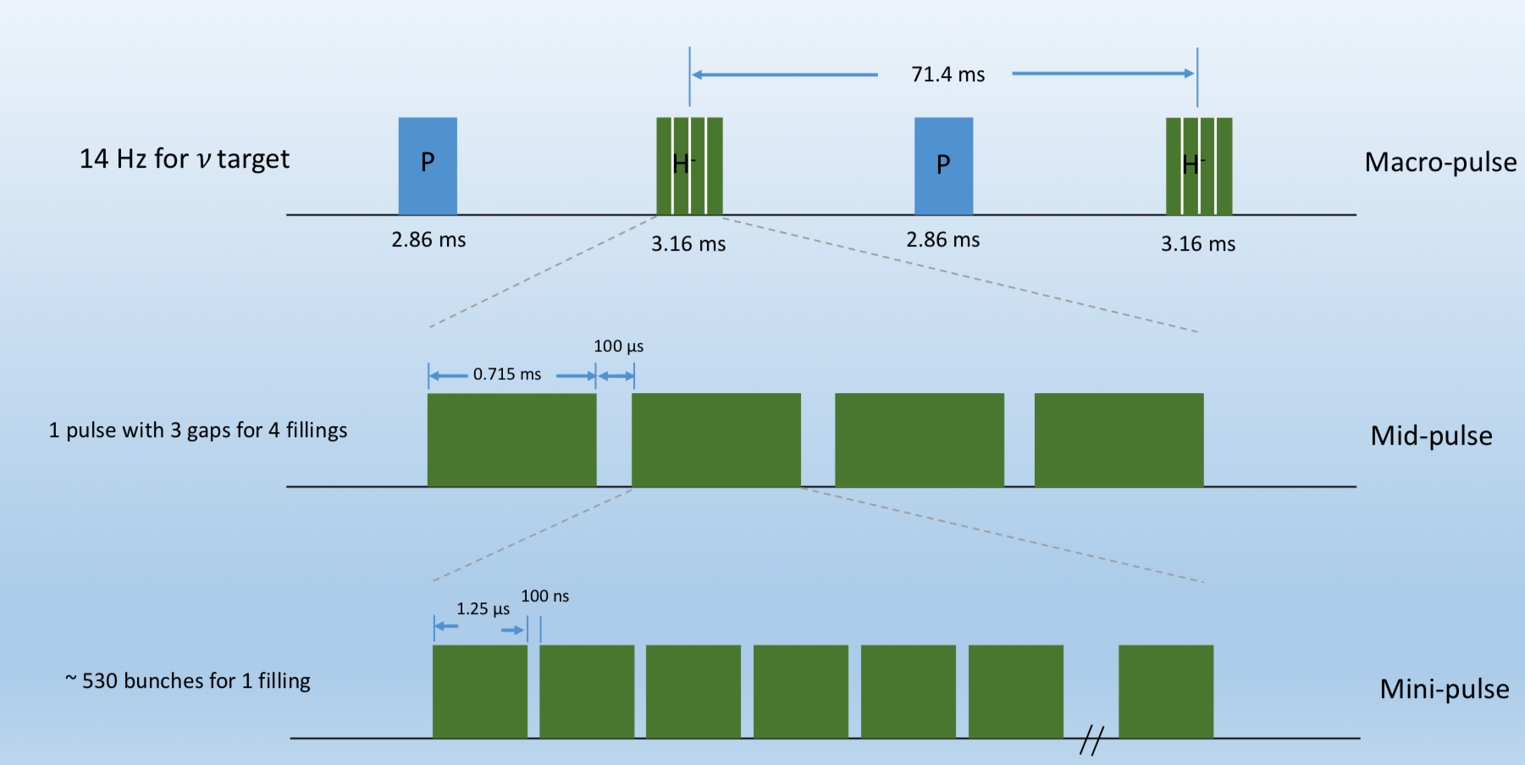
28 Hz linac pulsing schemes valid for 3 rings and one ring (laser stripping)
28 Hz for Linac
Recent information max 2.9 ms
We need to run physics longer?
3 Injection Gaps
530 Extraction Gaps

Slide 10
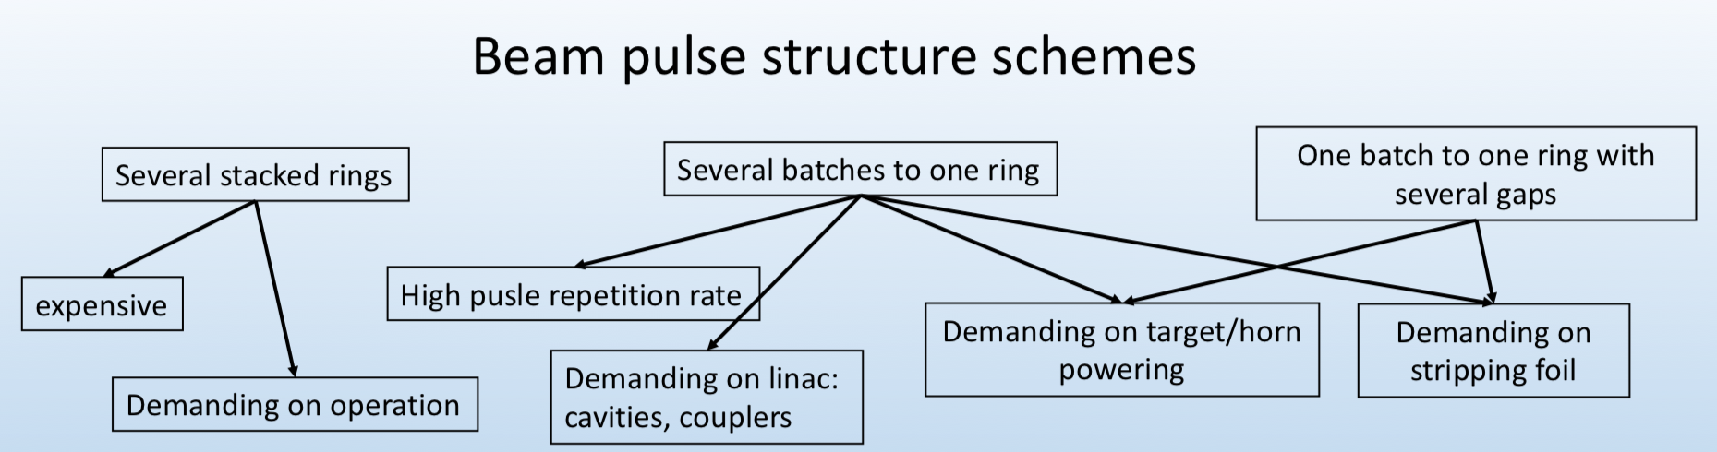
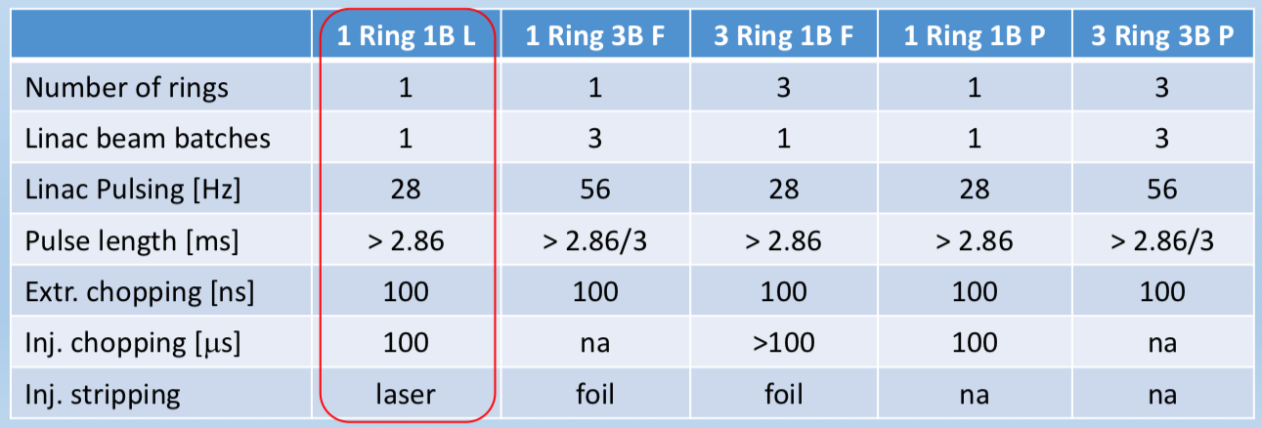
Seems possible!
Needs Laser stripping!
B: Batches
L: Laser stripping
F: Foil stripping
P: Proton injection

Slide 11
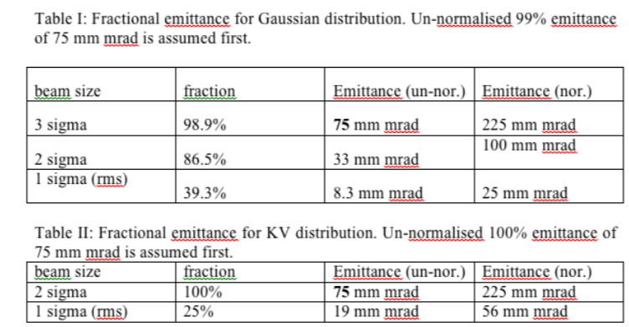

Emittance spec, meeting at RAL, Jan 2017
βγ = 2.967 for 2 GeV

Slide 12
Emittance spec, meeting 4/10 2018
Injection emittance (painting), halo formation and blow up are estimated by simulations
Conclusion of specification meeting October 4: we need at least 120 Pi ~ 100 % unnormalized (= acceptance of collimation system)
Extraction line specification 100 Pi, action needed !
Calculations show that 120 Pi is not possible to use for foil injection with linac pulsing 28 Hz -> Laser stripping
  one ring and linac 100 μsec chopping for injection bumpers.

Slide 13
Target beam requirements
The beam properties on/inside the target need to be specified as well
  ε and particle distribution in the beam result from injection painting, space charge and beam dynamics
  The divergence on the target should be zero (momentum and steering tolerances)
  SNS has specifications on the target of divergence and particle distribution
  Question to WP4 what are the requirements we have for the ESSnuSB target ?
The pulsing structure is a result of the injection pulsing structure and the accumulation
  The power supply from EUROnu studies cannot distribute with higher frequency than 56 Hz, does this rule out the scheme with 28 Hz linac pulsing and 100 μsec gaps for injection of the H- Bream?

Slide 14
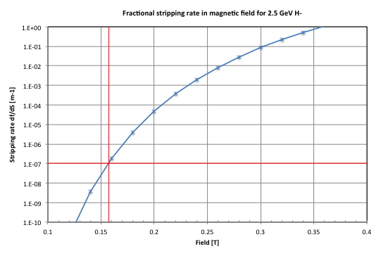
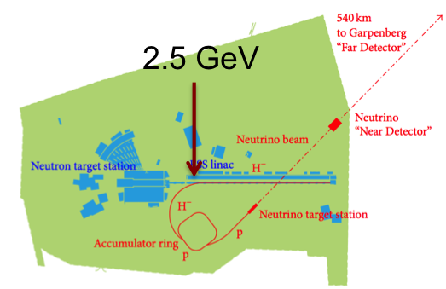
Injection beam line and choice of accumulator (injection) energy
1 MW 1E-7 frac. loss to get < 0.1 W/m
5 MW < 1/5 E-7 frac. loss -> ~ 0.15 T
0.15 T and 2.5 GeV: Brho 11.02 Tm, rho=73.5 m in dipoles
66% dipole filling factor, transfer line tunnel rho=111 m.

Slide 15
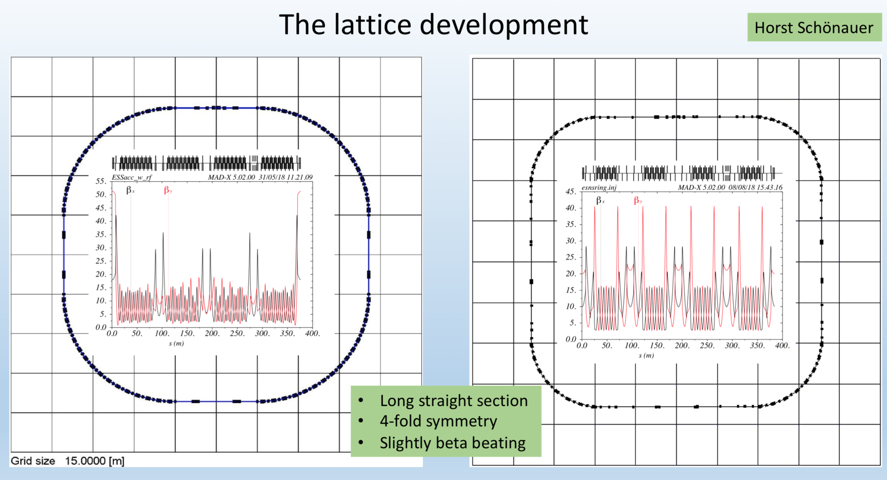

Slide 16
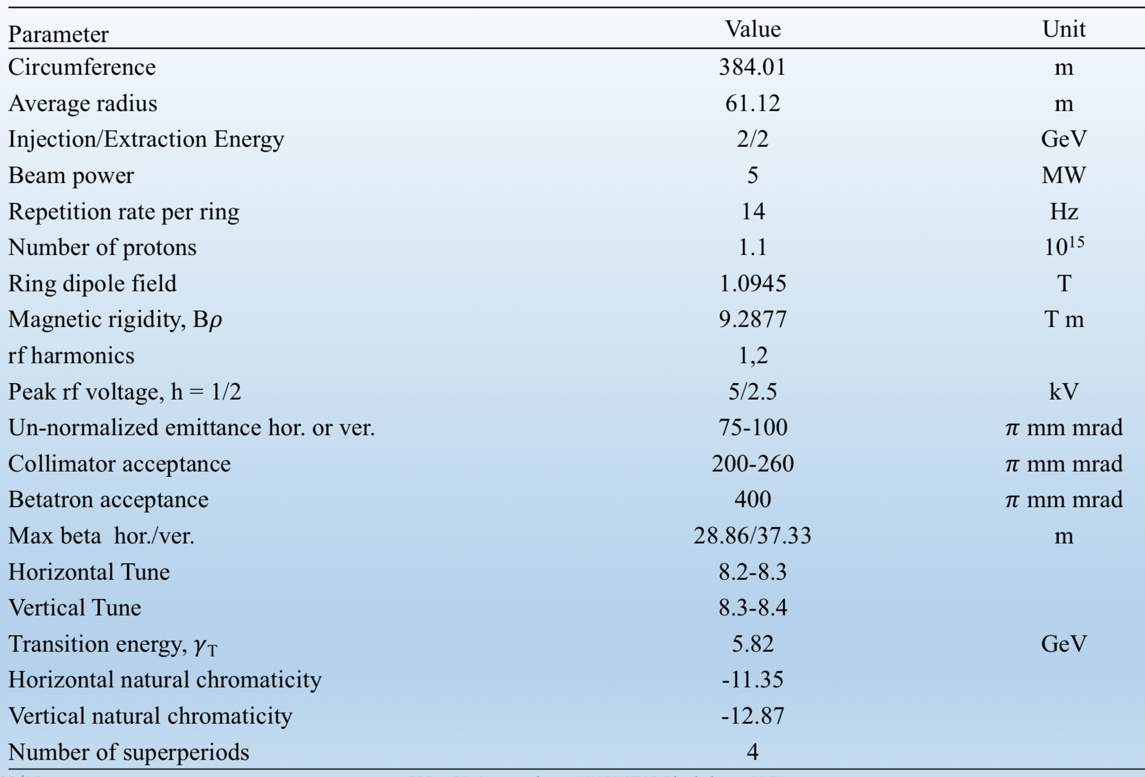
Accumulator Parameters

Slide 17
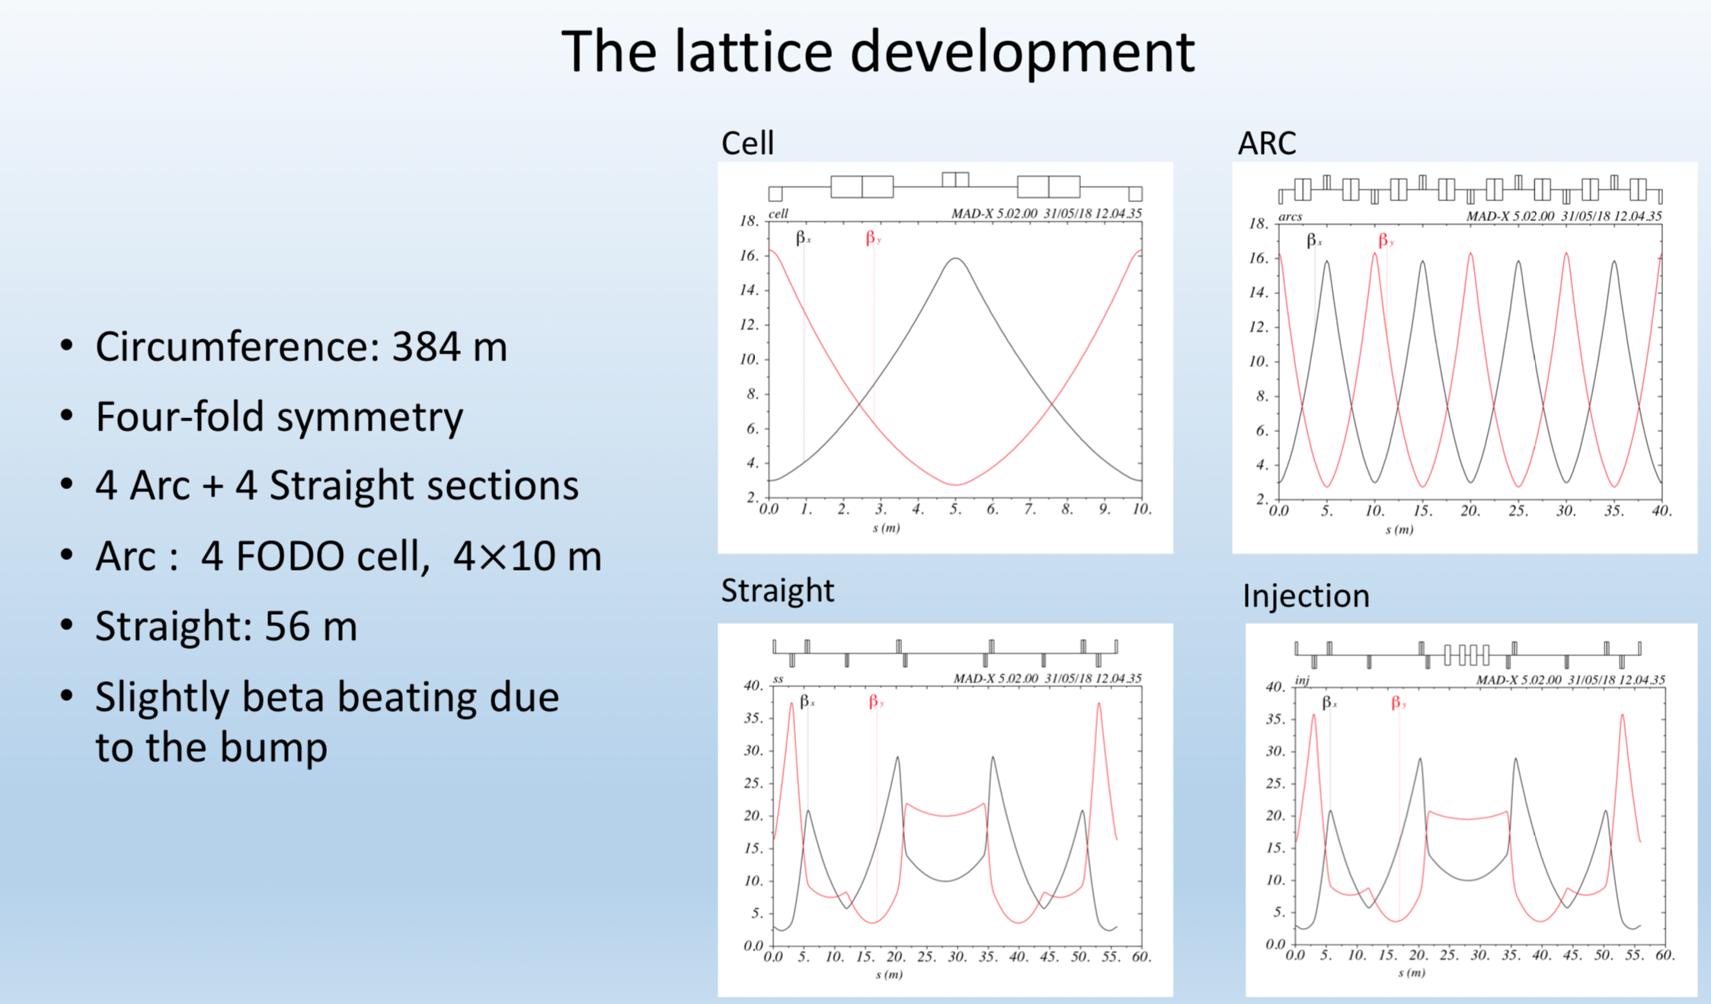

Slide 18
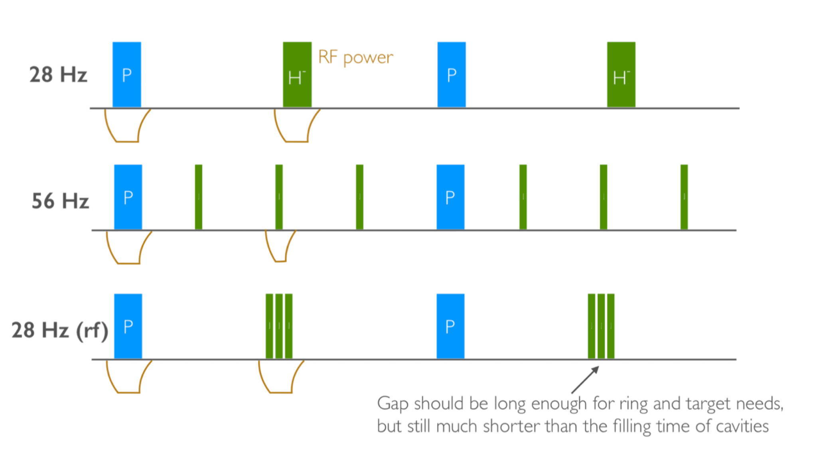
Injection I
The beam distribution is painted at injection
  Define the wanted distribution and the emittance critera (iterated simulations)
The baseline is now laser stripping, one ring 28 Hz
Lattice to be adapted to the laser stripping injection system
The fallback is to use foil, one ring 56 Hz or 4 rings 28 Hz
This case also needs gaps (100 μsec) for distribution into the different rings
Several stacked rings
One ring
One ring

Slide 19
Injection II
Linac beam, 100 μs chopping, 0.35 Pi mm mrad normalized 1 sigma
Brennan Goddard:
Should be possible to generate the new waveforms with one modified generator chassis. It may also be possible to use three generator chassis in parallel with an additional decoupling circuit. Simple series diodes would probably not be enough.
For pulse 2 and 3 there is already beam in the machine which means they have to be well synchronized: rise, flat top and fall. The existing design is not made for well synchronized current rise. Modification of design is required, but feasible. Flat top and current fall are not a problem.
Rack space would be increased by factor of 3 from 4 to 12 racks for the 3 magnets. Feasibility overall: OK. Complexity depends on precision and rise, fall time.
Check this for 4 batches!!! (comment E. Wildner)

Slide 20
Extraction
Evaluation of beam sizes and rise/fall times to estimate the extraction system technology and design ongoing. This need to be calculated from the evolution of the beam in the ring and/or collimation (also momentum ?).
Chopping of the linac beam is needed for the beam extraction gap
  Assume extraction gap 10 %
This gives part of the requirements on the extraction kicker and impedances (important contribution)
10 % of ~ 1.3 μs (one turn) ~ 130 ns to prepare extraction conditions.
To be able to optimize these timing conditions by for example make a larger ring, we need to check with HOM calculations in the linac.
The timing conditions may influence the kicker apertures (beam size, emittance) and consequently the kicker design and feasibility.

Slide 21
Summary I
CERN, UU, RAL, viable lattice for first calculations with foil injection
CERN, estimation of linac/accu bending radius according to stripping rules (CERN)
ESS, civil engineering drawings
CERN, brief overview of extraction principles, presentation
CNRS, EUROnu design
CERN, only foil stripping and temperature calculations using a few lattice models

Slide 22
Summary II
Deliverable D2.1 (linac operational schemes: 8 months), couples to D3.1
WP2&3 meeting early fall 2018 treating this subject.
However: More work needed, ideas continue to emerge !
To be discussed this meeting, WP2, WP3, WP4

