Slide 1
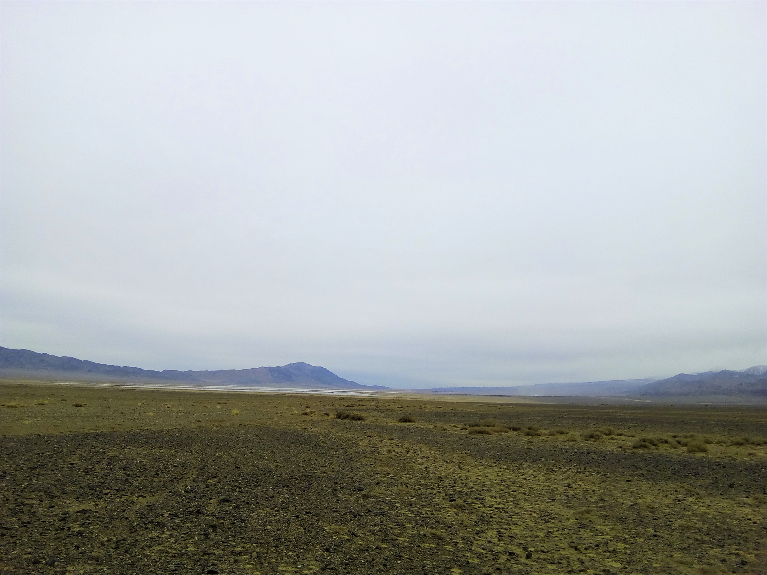

The Giant
Radio
Array for
Neutrino
Detection
growing up…
Olivier Martineau
FCPPL workshop, May 25, 2018
GRANDproto300 candidate site, April 2018

Slide 2
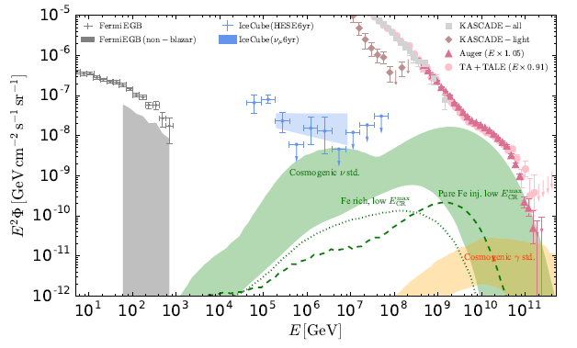
Why UHE neutrinos?
«Cleanest probe» of the Universe (no deflection, no attenuation, hadronic…).
Direct link to UHECRs (5% of primary energy)
5%

Slide 3
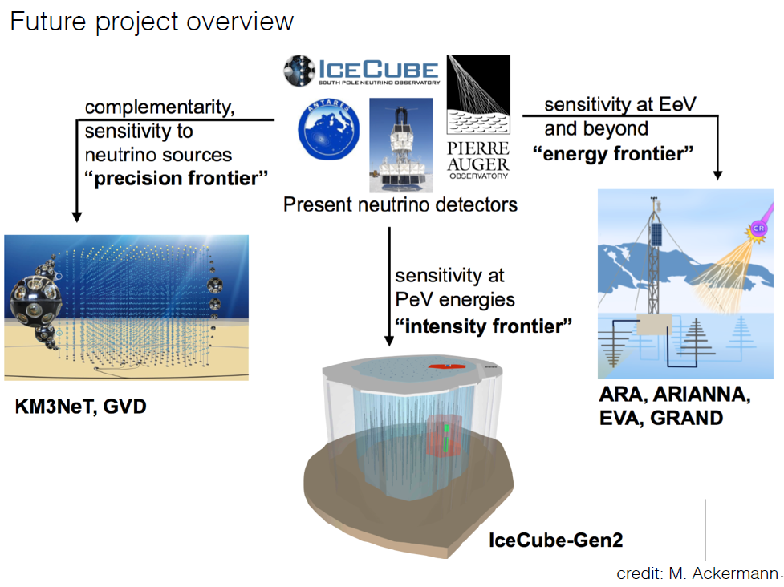
Kowalski@TeVPA2017

Slide 4
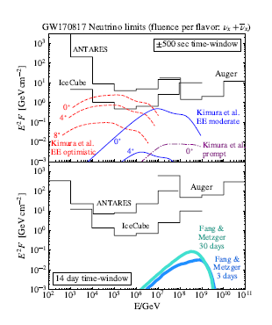
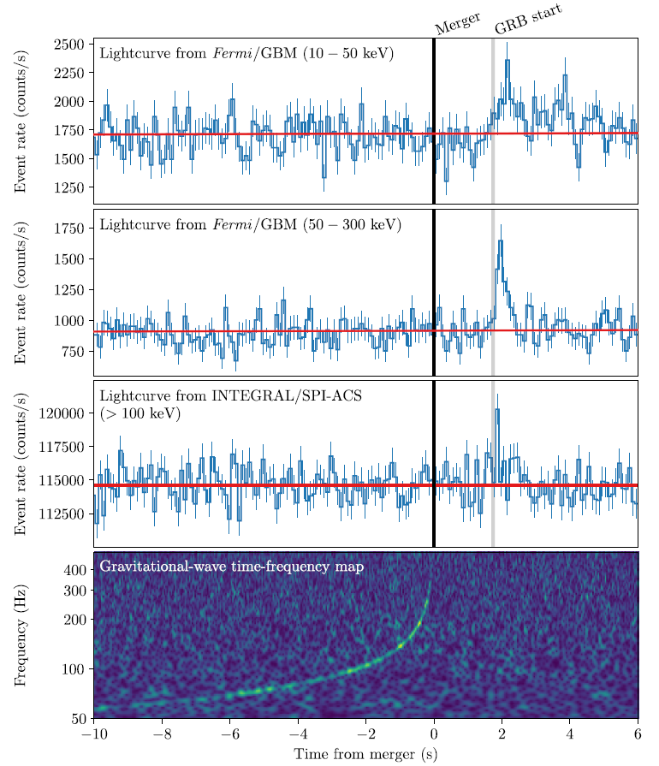
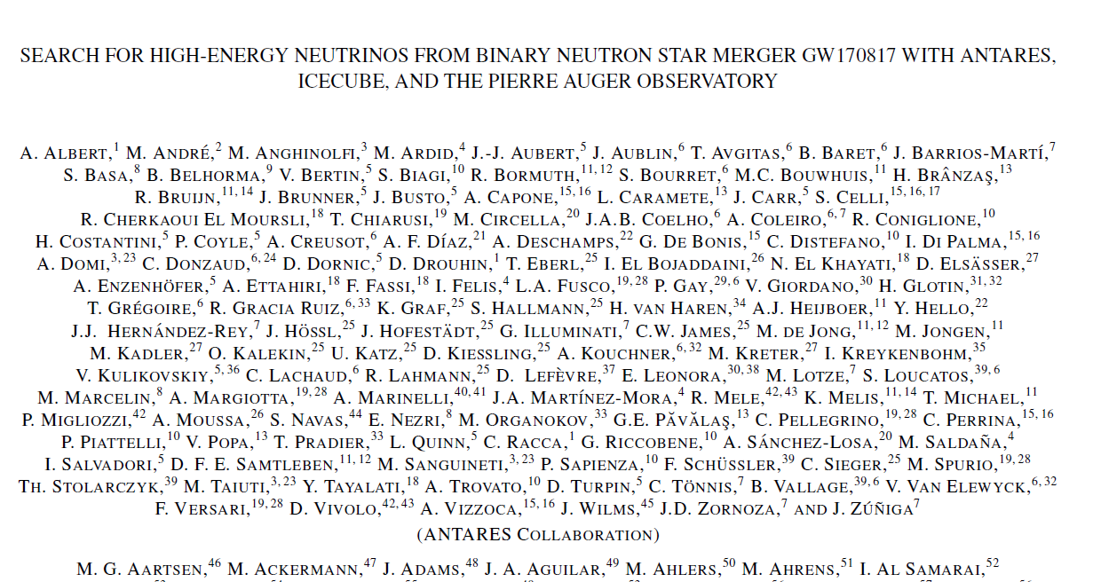
MultiMessenger Astronomy Era

Slide 5

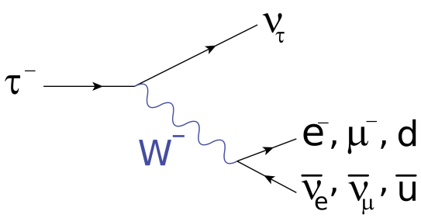
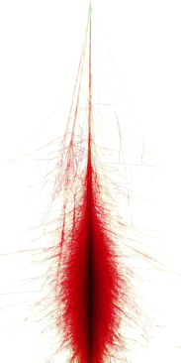
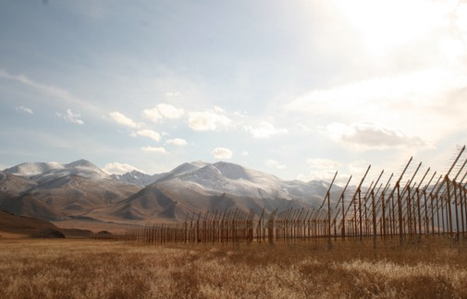
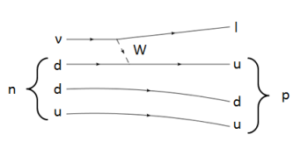
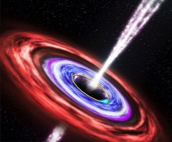
EeV neutrino radiodetection
τ
ν_{τ}
Rock target:
Principle:
  ν-induced tau decays in atmosphere generate ~horizontal extensive air showers.
  [Fargion astro-ph/99066450, Bertou astro-ph/0104452]
Issues:
  Earth-skimming trajectories
  VERY seldom events → requires HUGE detectors

Slide 6
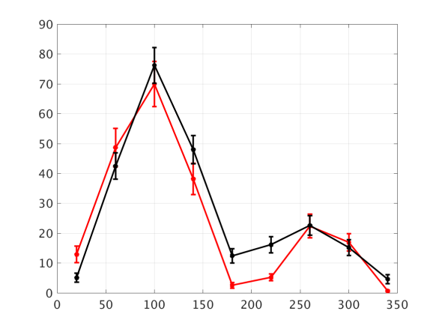
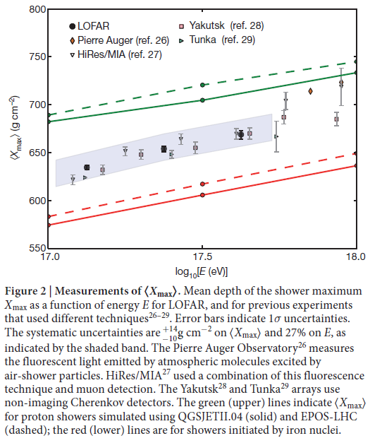
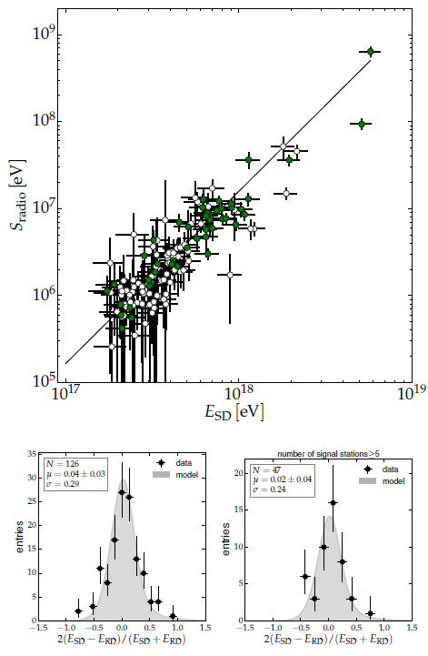
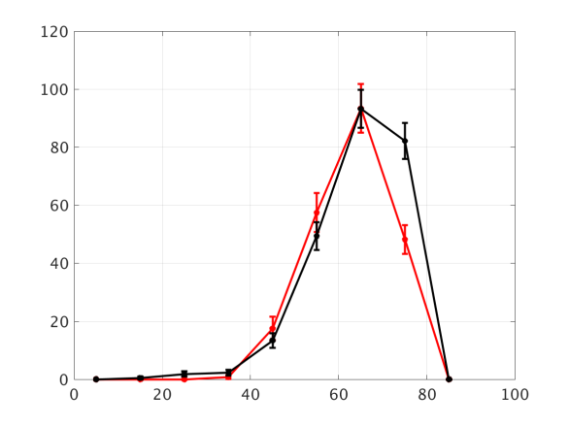
Why radio? Because it works!
MHz radio-detection of air showers becoming a mature technique
σ(Xmax) ~ 20g/cm²
ΔE/E<20%
Autonomous radio-detection & identification of air showers
-- Data
-- EAS simu
Aab et al., AUGER
astro-ph/1508.04267
Le Coz et al., TREND
ICRC2017
+ article in prep.
Azimuth (deg)
-- Data
-- EAS simu
Buitink et al., LOFAR, Nature
Zenith (deg)

Slide 7
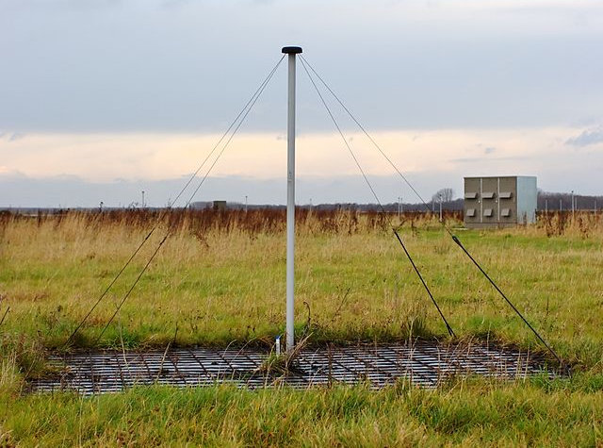
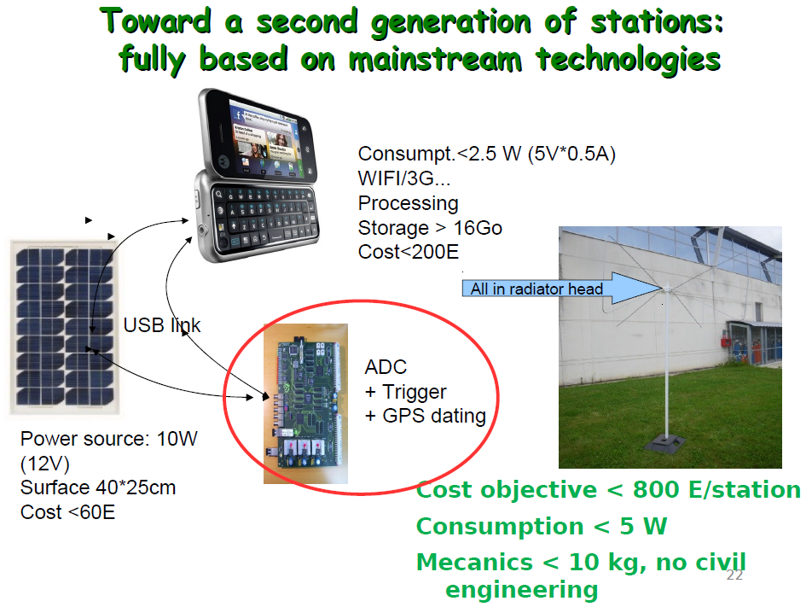
Why radio? Because it is cheap!
Basic ⬄ cheap
P. Lautridou (2011)

Slide 8
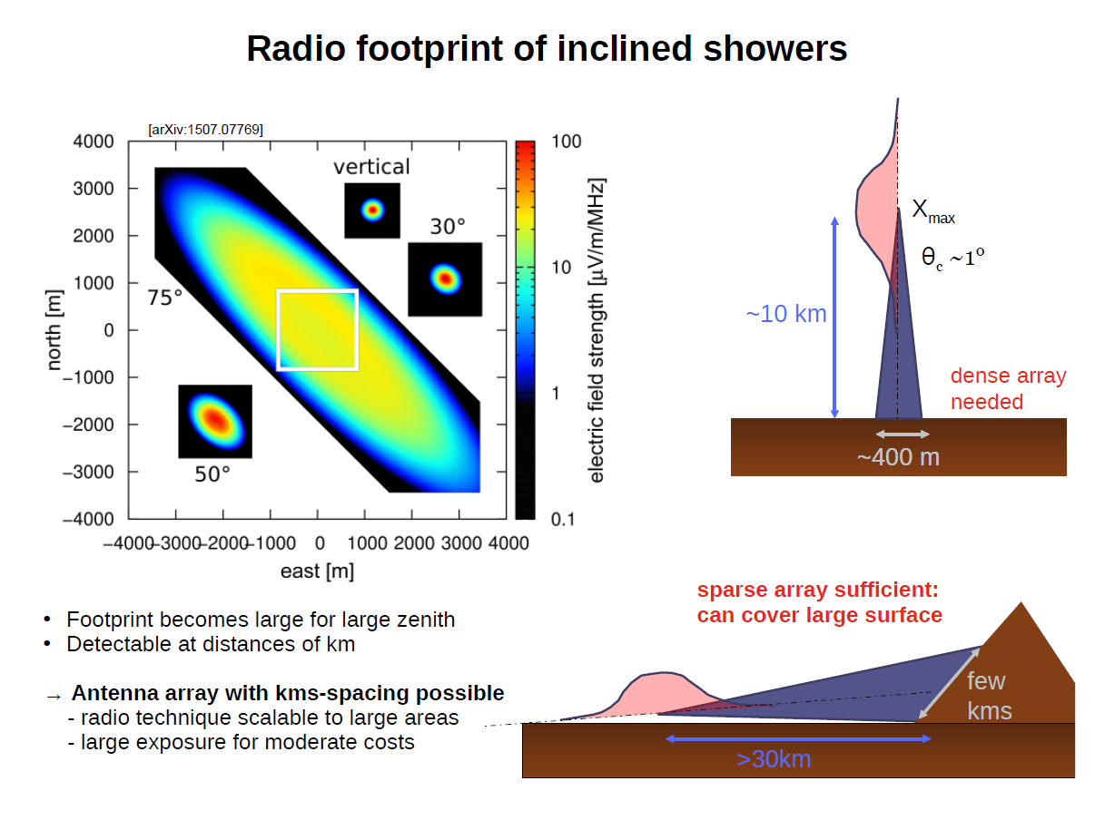
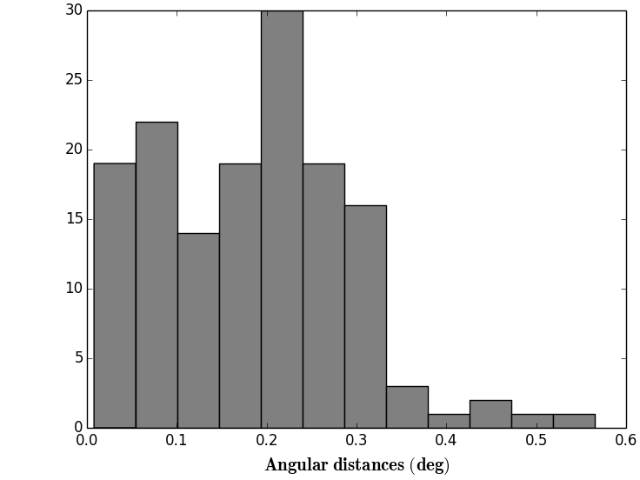
<ψ>= 0.2°
(Plane wave approx)
(V. Decoene)
PRELIMINARY
➔ Astronomy!!!
PRELIMINARY

Slide 9
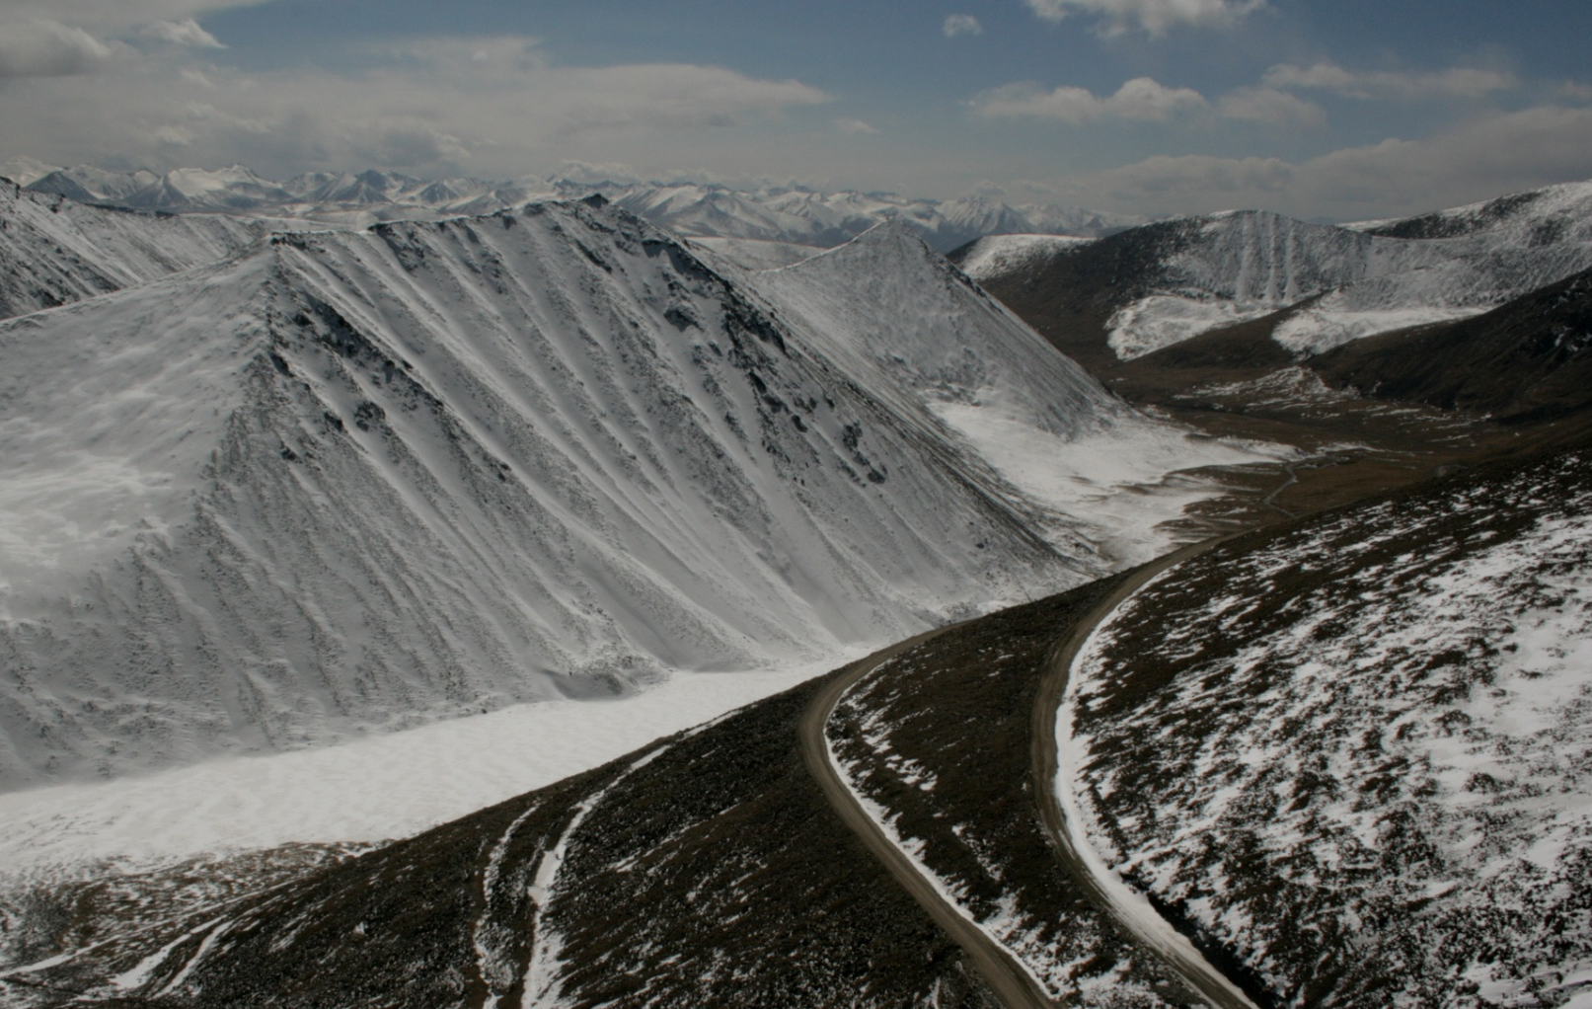
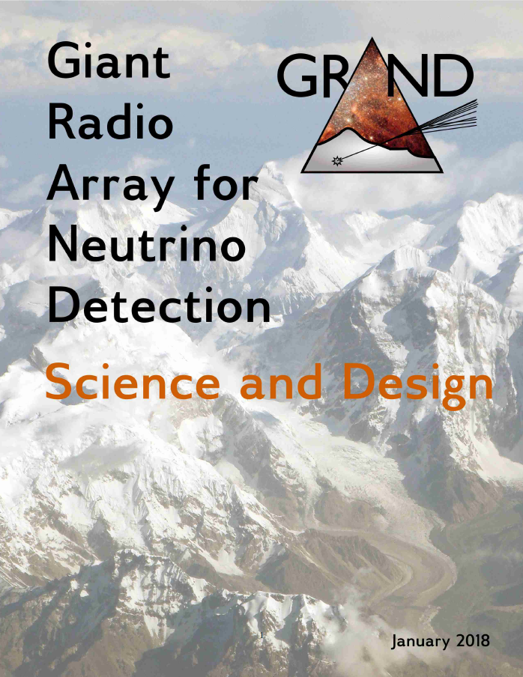
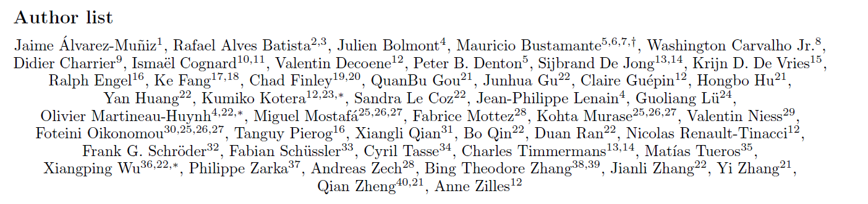
The GRAND project
A strong (& informal) group of world-class specialists including:
  Ralph Engel (spoke Auger)
  Sijbrand de Jong (CERN council president)
  Miguel Mosfata (spoke HAWC)
  Wu XiangPing (CAS academician, SKA-China lead)
  Zhang Yi & Hu HongBo (YBJ/LHAASO IHEP)
  FOURTEEN FCPPL members ☺, at the root of the project
Getting organised: MoU in preparation between Nijmegen, NAOC and INSU.
Size of the neutrino detector is a key parameter.
>10000 km²?
- technical capacity?
- topology?
Ulastai

Slide 10
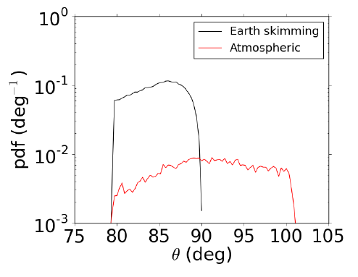
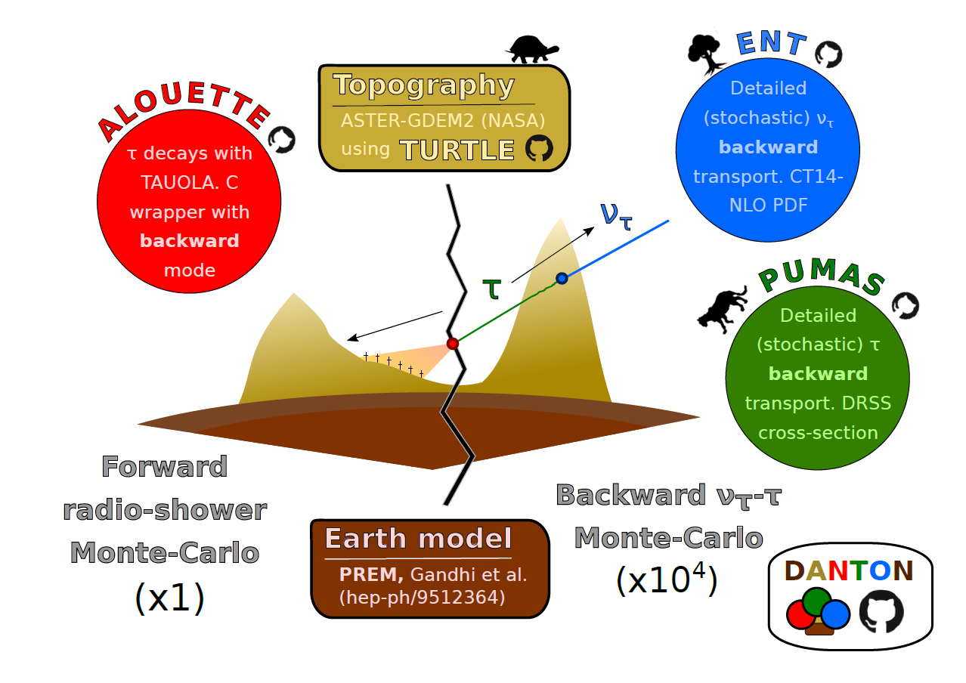
GRAND 2018 update
End-to-end neutrino simulation chain now complete:
ν traj ➔ τ decay through backward simulation.
V. Niess, LPC Clermont-Ferrand

Slide 11
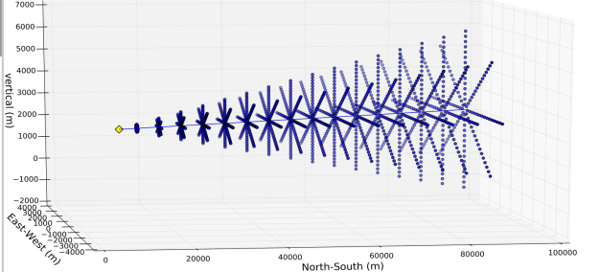
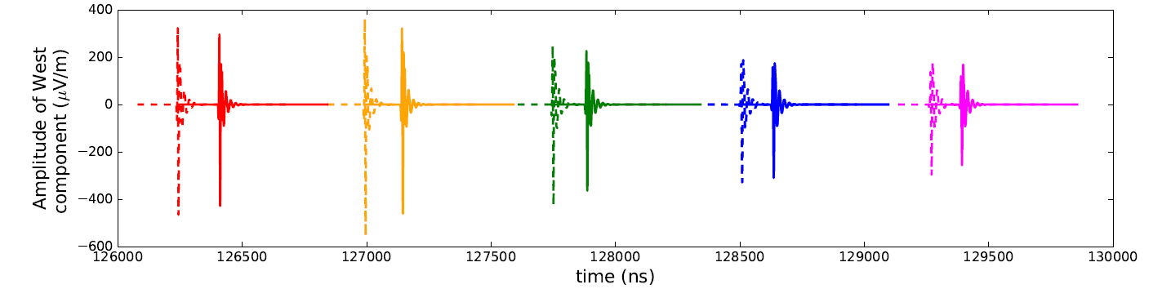
GRAND 2018 update
End-to-end neutrino simulation chain now complete
  Radio emission simulation: RadioMorphing [Zilles, Martineau-Huynh, Kotera et al., in prep] simulates radio signal from ANY shower at ANY location using ONE single reference shower ☺
Scaling signals of reference shower (E_{A},θ_{A},ϕ_{A}) to target shower (E_{B},θ_{B},ϕ_{B})
Interpolation of reference positions to target position
Very good match of resulting signals.
Huge gain on computation time (factor ~10³)

Slide 12
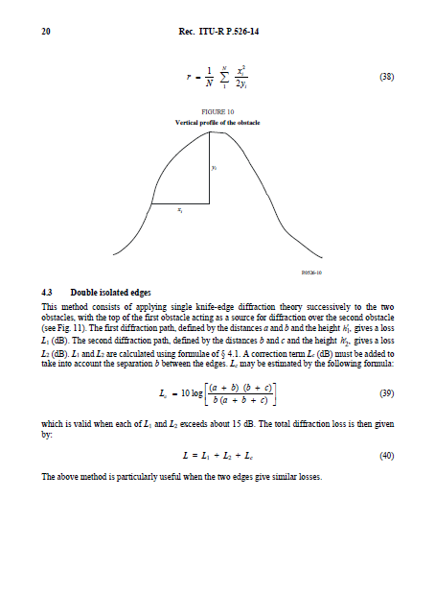
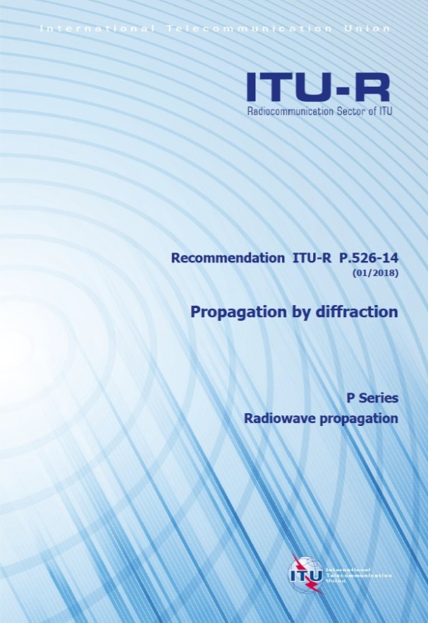
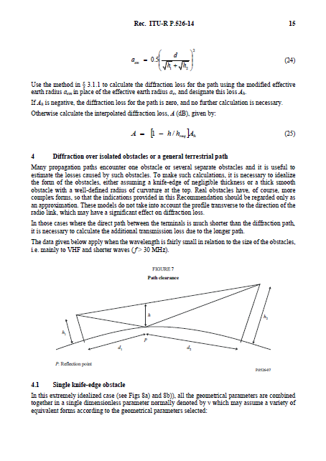
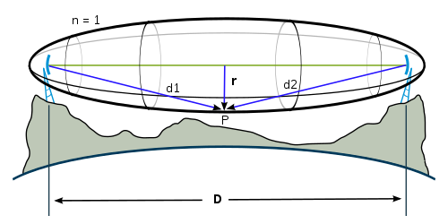
GRAND 2018 update
End-to-end neutrino simulation chain now complete
Radio response
  Difficult issue: complex effect of topography on radio signal & antenna response.
  Benefits from decades of engineering developments
  2 independant treatments:
    ground numeric simulation (NEC), assuming flat ground.
    analytical treatement of the attenuation during propagation
International Telecommunication Union

Slide 13
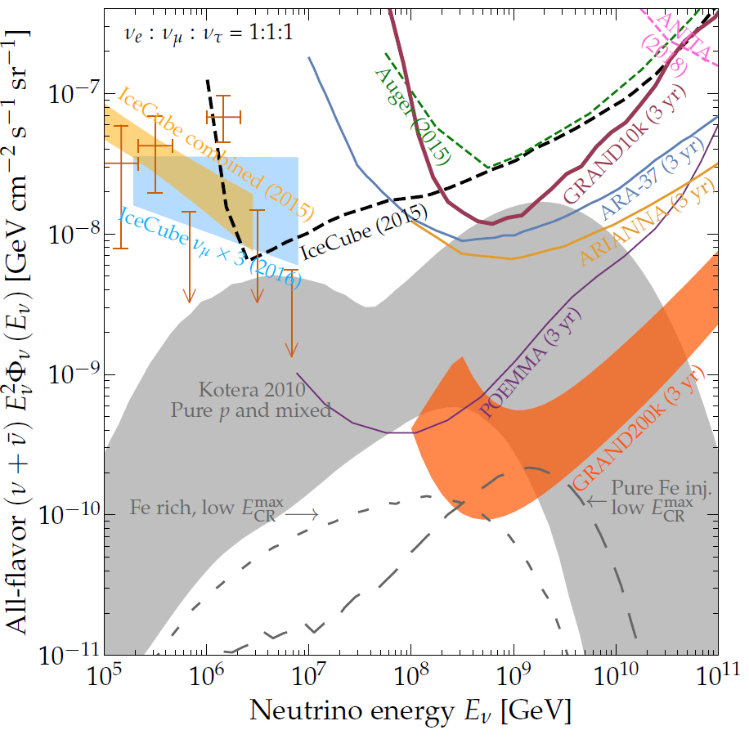
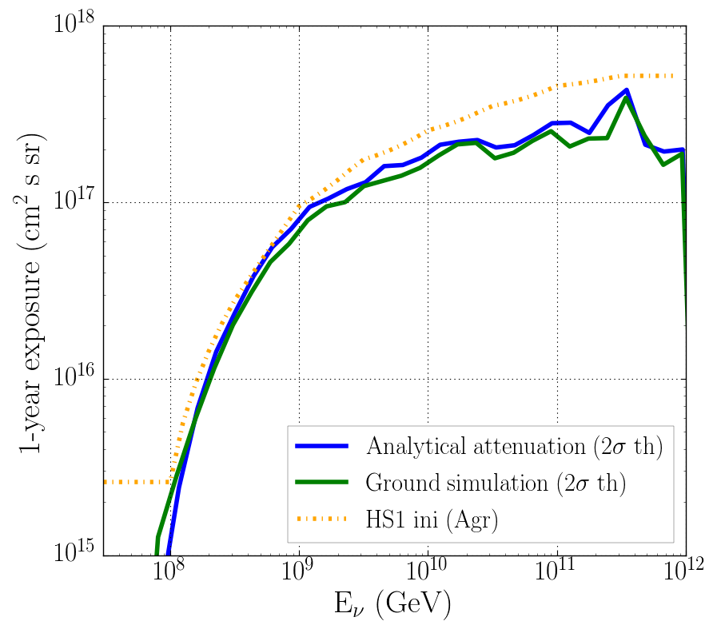
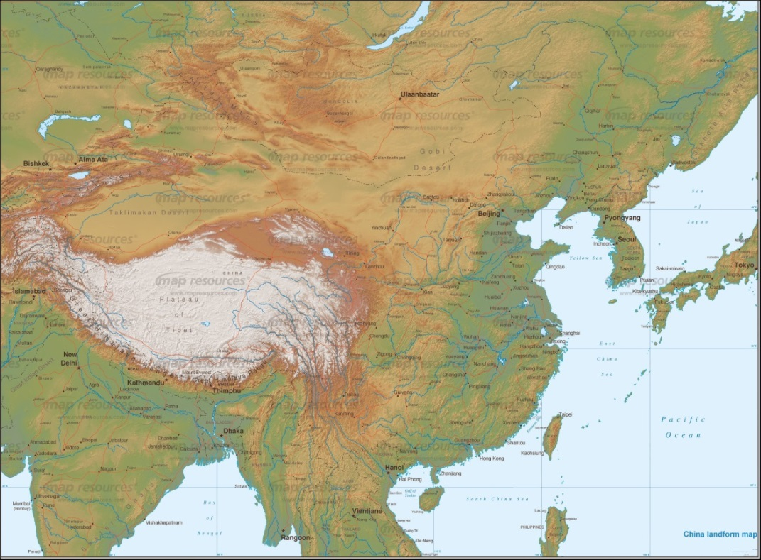
GRAND neutrino sensitivity for HS1
Both treatments give fully compatible results, also with initial study (except at HE, under investigation)
➔ initial sensitivity extrapolation to 200k array is robust, but more conservative limit now also ploted.
First firm GRAND200k sensitivity limit based on full-Earth simulation to be released by September 2018 (GRAND white paper v2).
o(10-20) hotspots of o(20-10) kAntennas
deployed over o(20-10’000) km² hotspots with favorable topographies in China & around the world ➔ total area: 200’000km²
Hot Spot 1
Hotspot 1

Slide 14
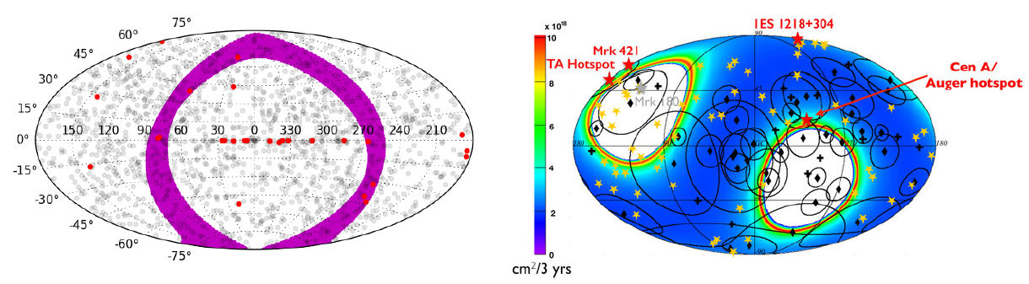
GRAND FoV
85<θ<95° but all azimuth ➔ large fraction of sky covered in 24h
- Here computed for one single 200’000km² array located at TREND site.
- Scattered hotspots would allow much better instantaneous FoV
➔ transient events astronomy at reach!!!

Slide 15
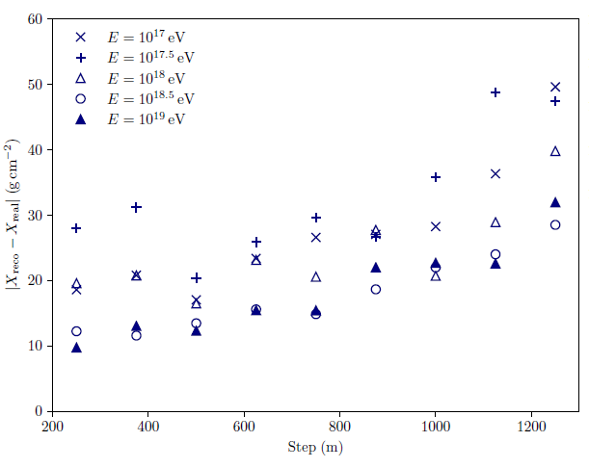
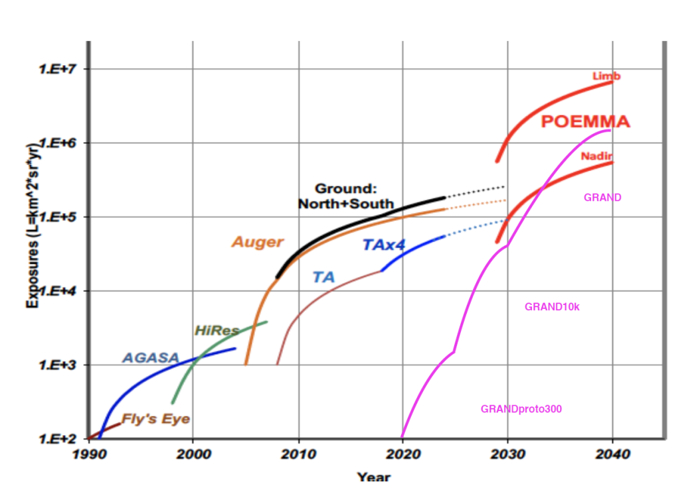
GRAND & CRs
Very large footprint for inclined air showers
➔ good detection efficiency & good X_{max} resolution (20g/cm²?)
Precision + stat (aperture ~ 15x AUGER)@highest energies
Great tool for UHECRs & UHE γ
PRELIMINARY
C. Guepin & A. Zilles

Slide 16
GRAND in practice
Huge technical challenge: Trigger? Data collection? Reconstruction of ~horizontal showers? Background rejection?
Need for:
  time (full array not before 2030) to develop a staged approach.
  Important step: an engeneering array with dedicated design ➔ GRANDproto300: 300 antennas over ~150km². See N. Renault-Tinacci’s talk.

Slide 17
Conclusion
UHE neutrino as a natural & powerfull tool for multimessenger study of violent phenomena in the Universe.
GRAND provides an extremely attractive science case for HE astrophysics (ν,γ,CRs).
Staged approach. Next phases: GRANDProto35 and GRANDProto300.
Radio prototype & YangBaJing
  5 antennas surrounding the AsGamma setup
  Pathfinder for tradio & LHAASO

