Slide 1
Report on BEAMS-LC-CEPC:
1. First luminosity monitoring at SuperKEKB
(2. Beam halo characterization at ATF/ATF2 → backup slides)
Philip Bambade
LAL-Orsay
On behalf of LAL SuperKEKB and ATF2 groups: *Chinese Scholarship Council
Philip Bambade, Salvatore di Carlo (postdoc), Angeles Faus-Golfe, Didier Jehanno (engineer), Viacheslav Kubytskyi, Yann Peinaud (engineer), Cécile Rimbault, Sandry Wallon (engineer), Chengguo Pang* (2nd year PhD student), Renjun Yang* (3rd year PhD Student)
Collaboration with Chinese Institutes:
IHEP: Sha Bai, Jie Gao, Dou Wang, Yiwei Wang
Nanjing Univ.: Edna Cheung, Taifan Zheng (1st year PhD Student)
11th FCPPL workshop Marseille - France 22-25 May 2018

Slide 2
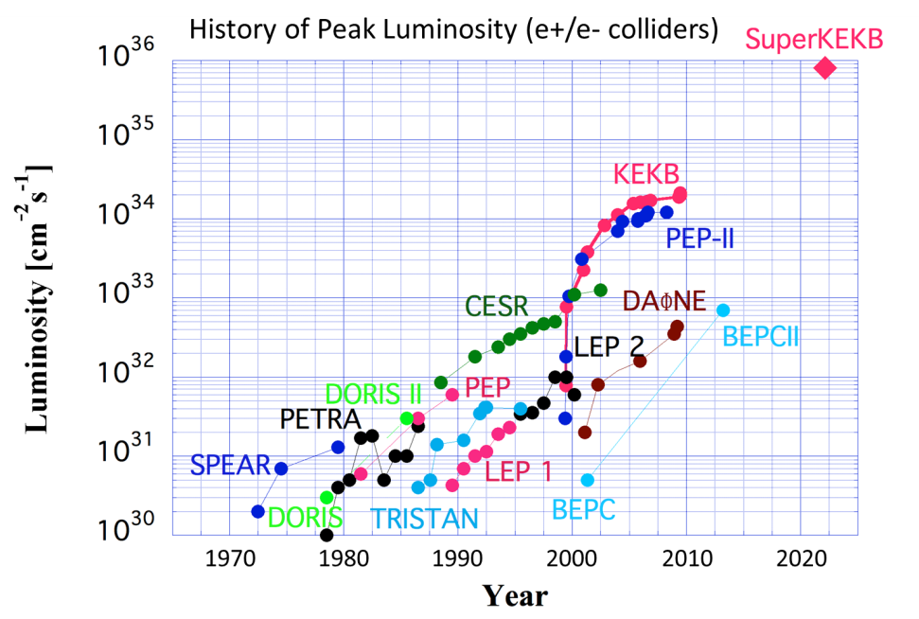
Exploring the luminosity frontier with SuperKEKB
1km diameter
KEKB
2×10³⁴/cm²/s
SuperKEKB
8×10³⁵/cm²/s
All future e+e− circular colliders use novel “nanobeam” collision scheme → being tried right now for 1st time at SuperKEKB in 2018
➔ essential validation + training for future CEPC / FCC-ee

Slide 3
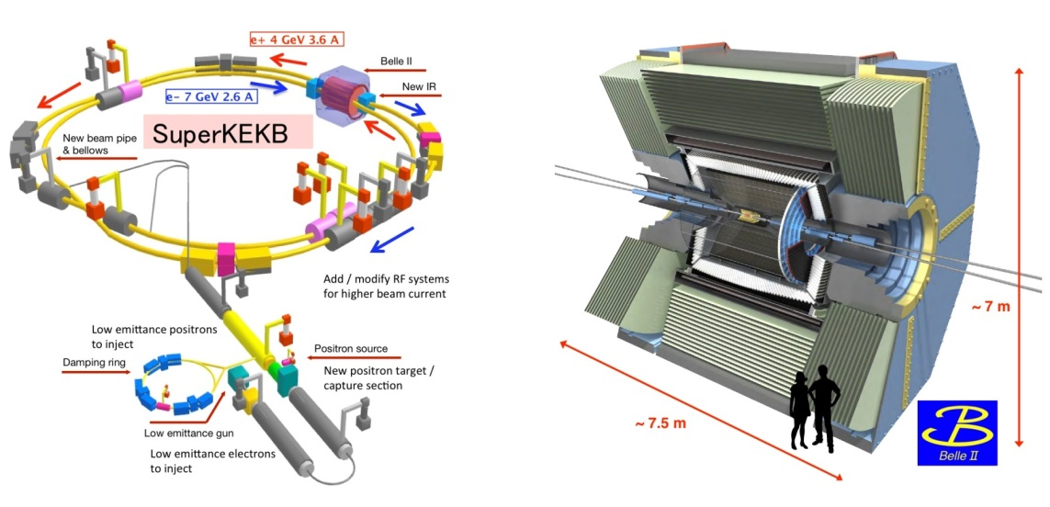
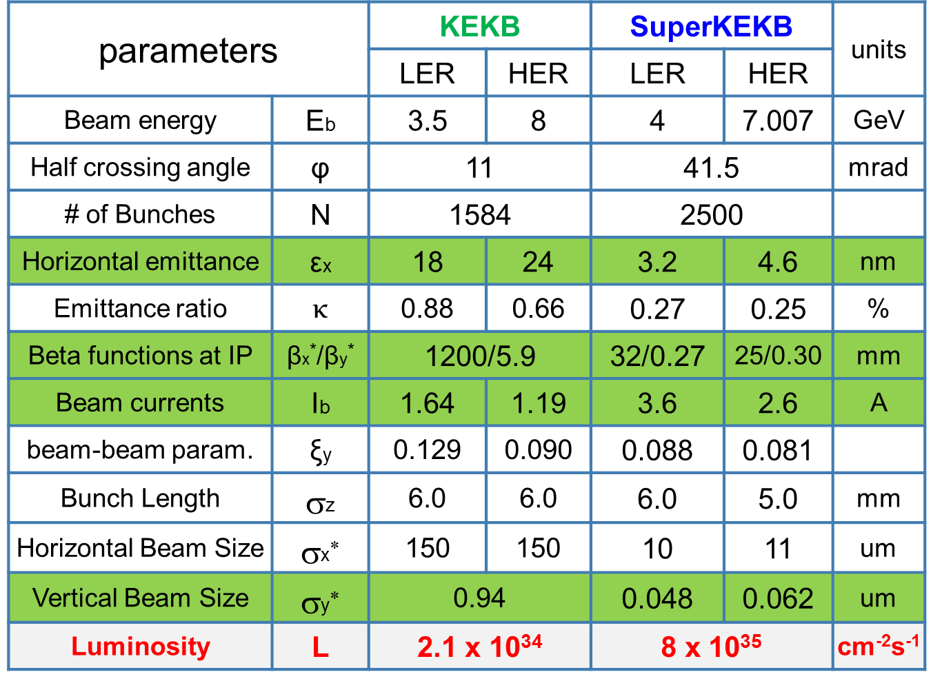
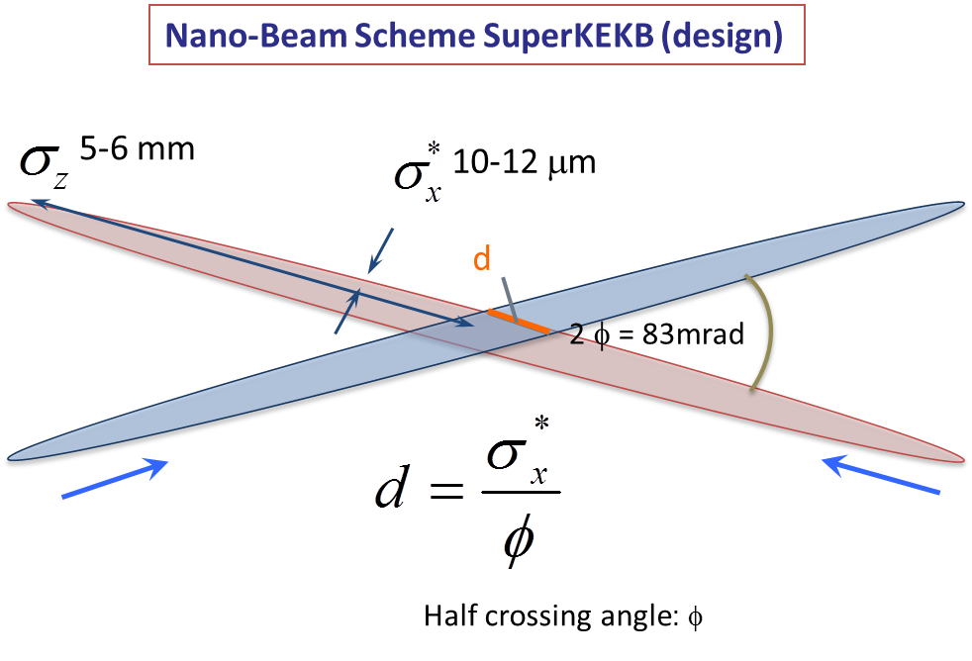
SuperKEKB / Belle-II & “Machine-Detector Interface”
Control beam induced backgrounds
Luminosity monitoring & tuning
1) Phase 1 : 2016/Feb. → Jun.
- single beam commissioning, vacuum scrubbing
- no luminosity (no final focus), no detector
2) Phase 2 : 2018/Feb. → 2018/Jul.
- colliding beam commissioning, no vertex detector
3) Phase 3 : ∼ February 2019…
- towards full luminosity for physics running
→
→
→
β_{y} = 300 μm
d ∼ 300 μm
→ mitigates beam-beam and hour-glass effects
→ Luminosity × 40

Slide 4
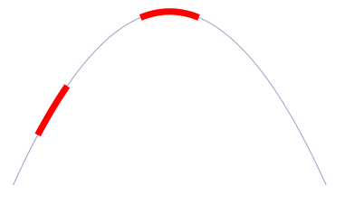
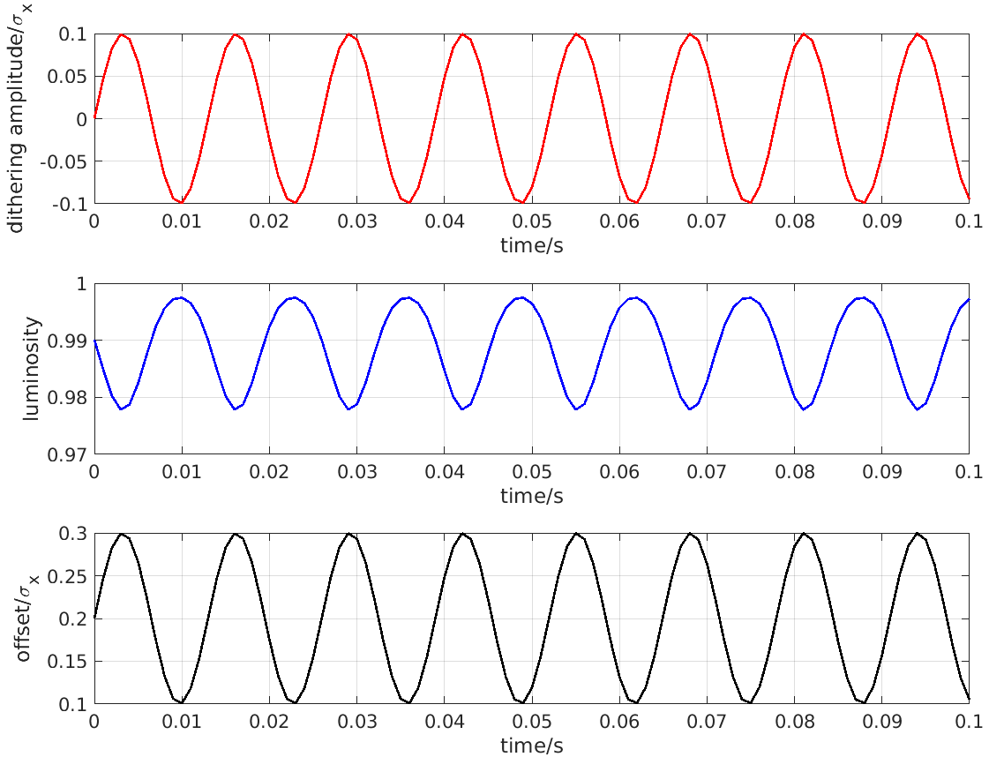
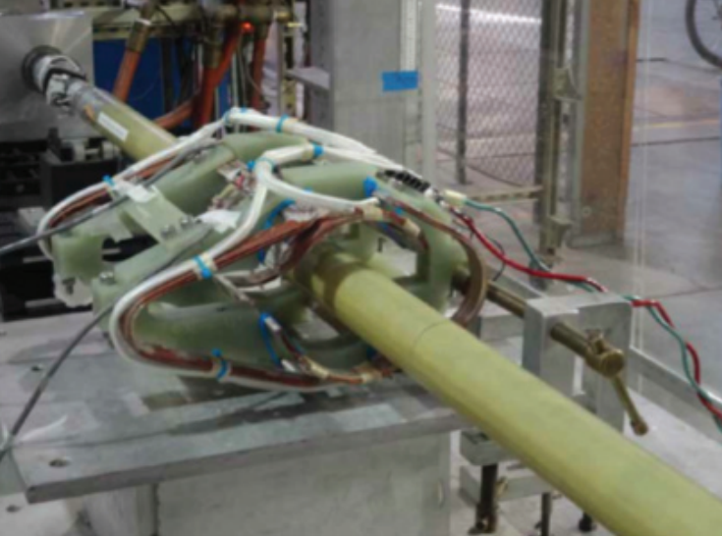
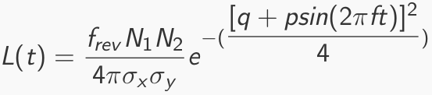
Luminosity
Fast & slow variations at IP require feedback corrections
Beam-beam deflection for fast vertical motion
Luminosity feedback by “dithering” for slower horizontal motion
Δy at IP=
∼ 5nm ∼ 1/10σ_{y}*
BPM
Δy at BPM= ∼ 1.3μm
Vertical vibration ∼ 25-100 Hz
Sampling (BPMs) ∼ 32 kHz
IP
BPM
↔
Horizontal motion ∼ few Hz
Modulation freq. f₀ ∼ 77 Hz
Sampling (lumi. meas.) ∼ 1 kHz
- minimize f₀ output component
- dithering × lumi. signal → phase
2×f₀
Luminosity
↔
f₀
x
Dithering coil x 12
DITHERING
LUMINOSITY

Slide 5
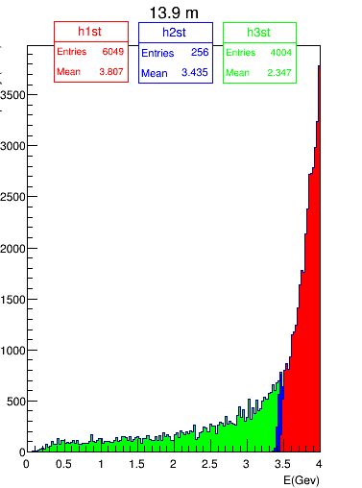
Radiative Bhabha at vanishing scattering angle
σ ∼ 250 mbarn (E_{γ} > 1% E_{beam} )
major background source from induced particle losses after IP
luminosity monitoring
Positron
energy
LAL & KEK
Luminosity monitoring specs
Relative measurements
10⁻² in 1 ms over all bunches (“dithering”)
10⁻² in ∼ 1 s for each 2500 bunch → 4ns
(for nominal luminosity)
Non luminosity scaling contamination < 1% (e.g. beam gas bremstrahlung and Touschek losses)
Should also work for initial luminosity
Macroscopic QED effect…
Y. Funakoshi (KEK), background workshop, Feb. 2012

Slide 6

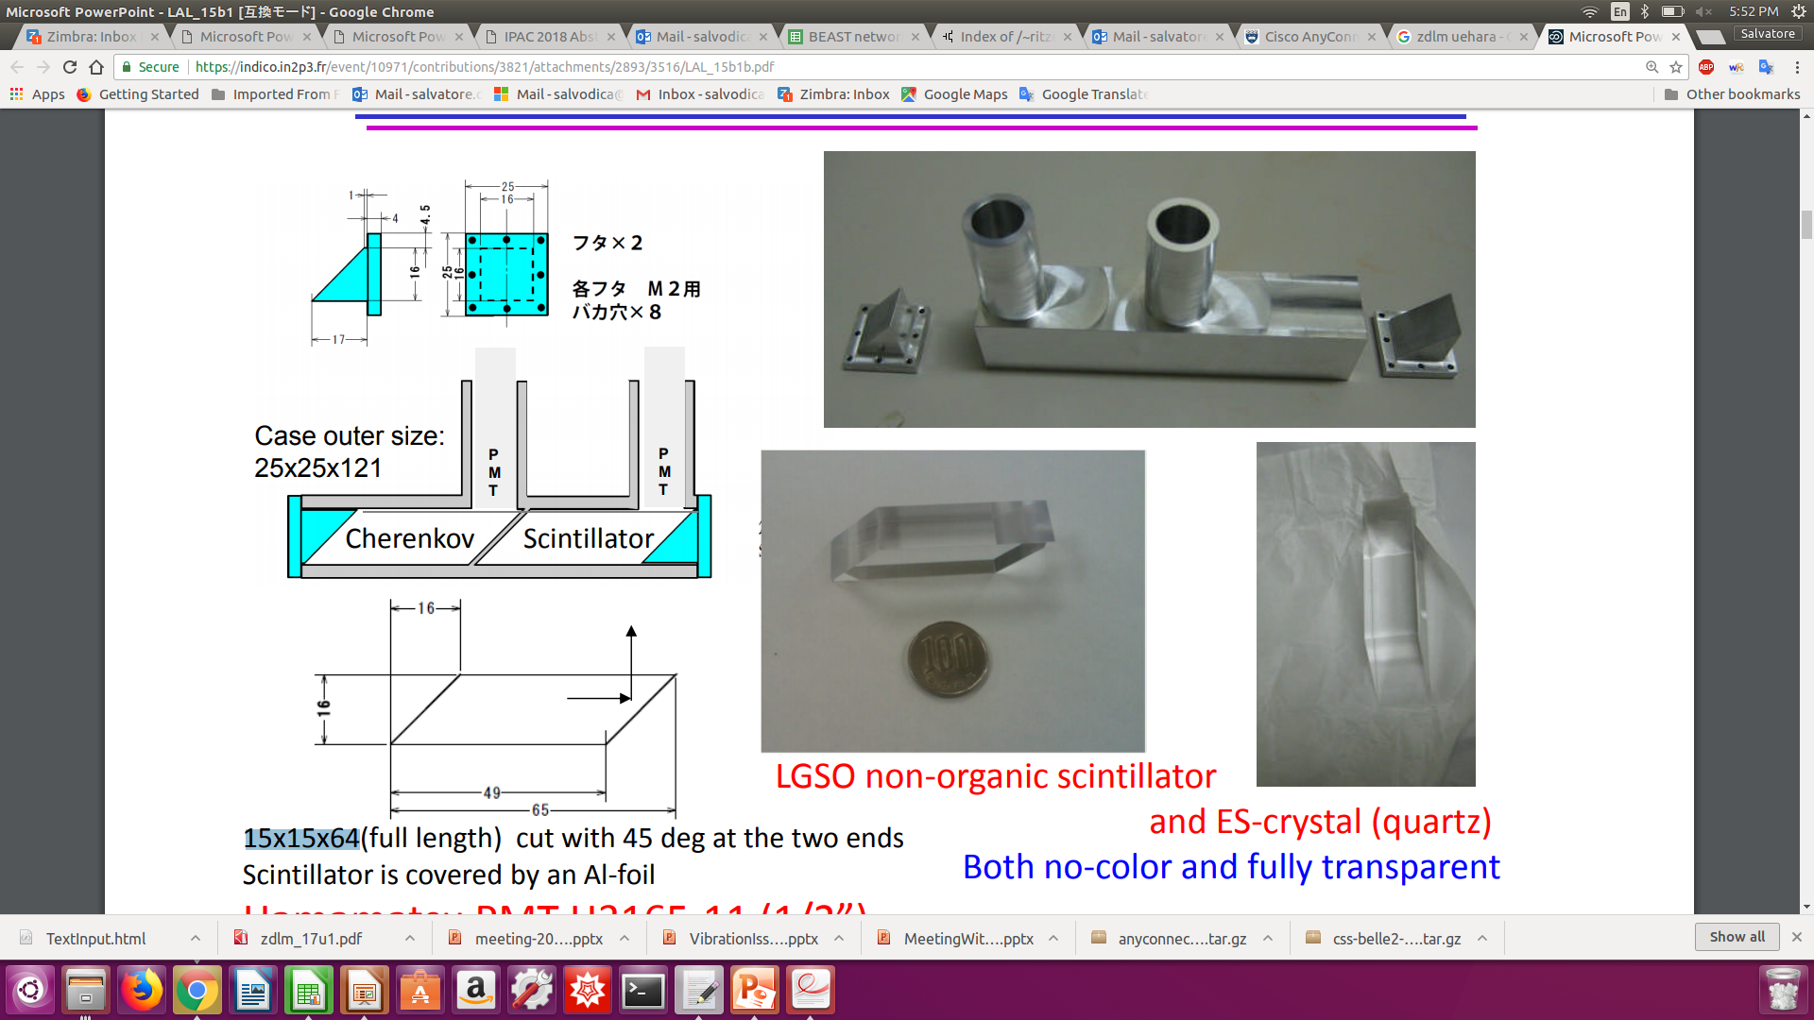

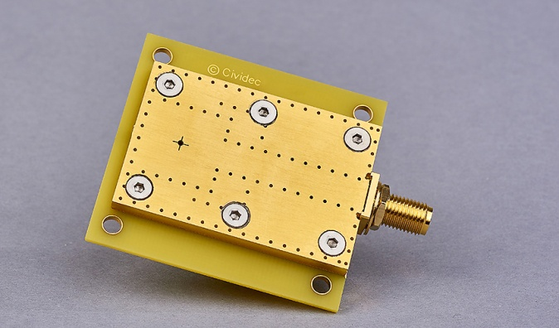
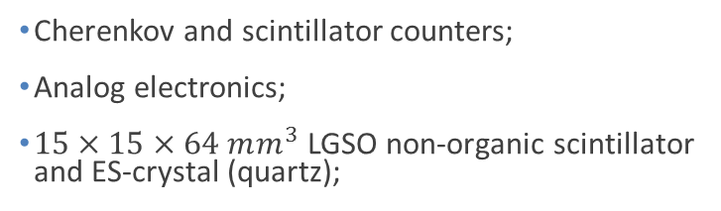
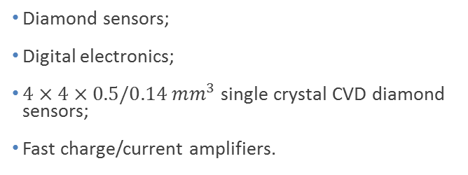
Two complementary techniques
LumiBelle2
ZDLM (Zero Degree Luminosity Monitor)
Both measure photons, recoiling electrons or positrons from the radiative Bhabha process at vanishing scattering angle → very large cross section.
Diamond sensors;
Digital electronics;
$4×4×0.5/0.14 mm^{3}$single crystal CVD diamond sensors;
Fast charge/current amplifiers.
Cherenkov and scintillator counters;
Analog electronics;
$15×15×64 mm^{3}$ LGSO non-organic scintillator and ES-crystal (quartz);
Notes:
LGSO (Lu2-xGdxSiO5)

Slide 7
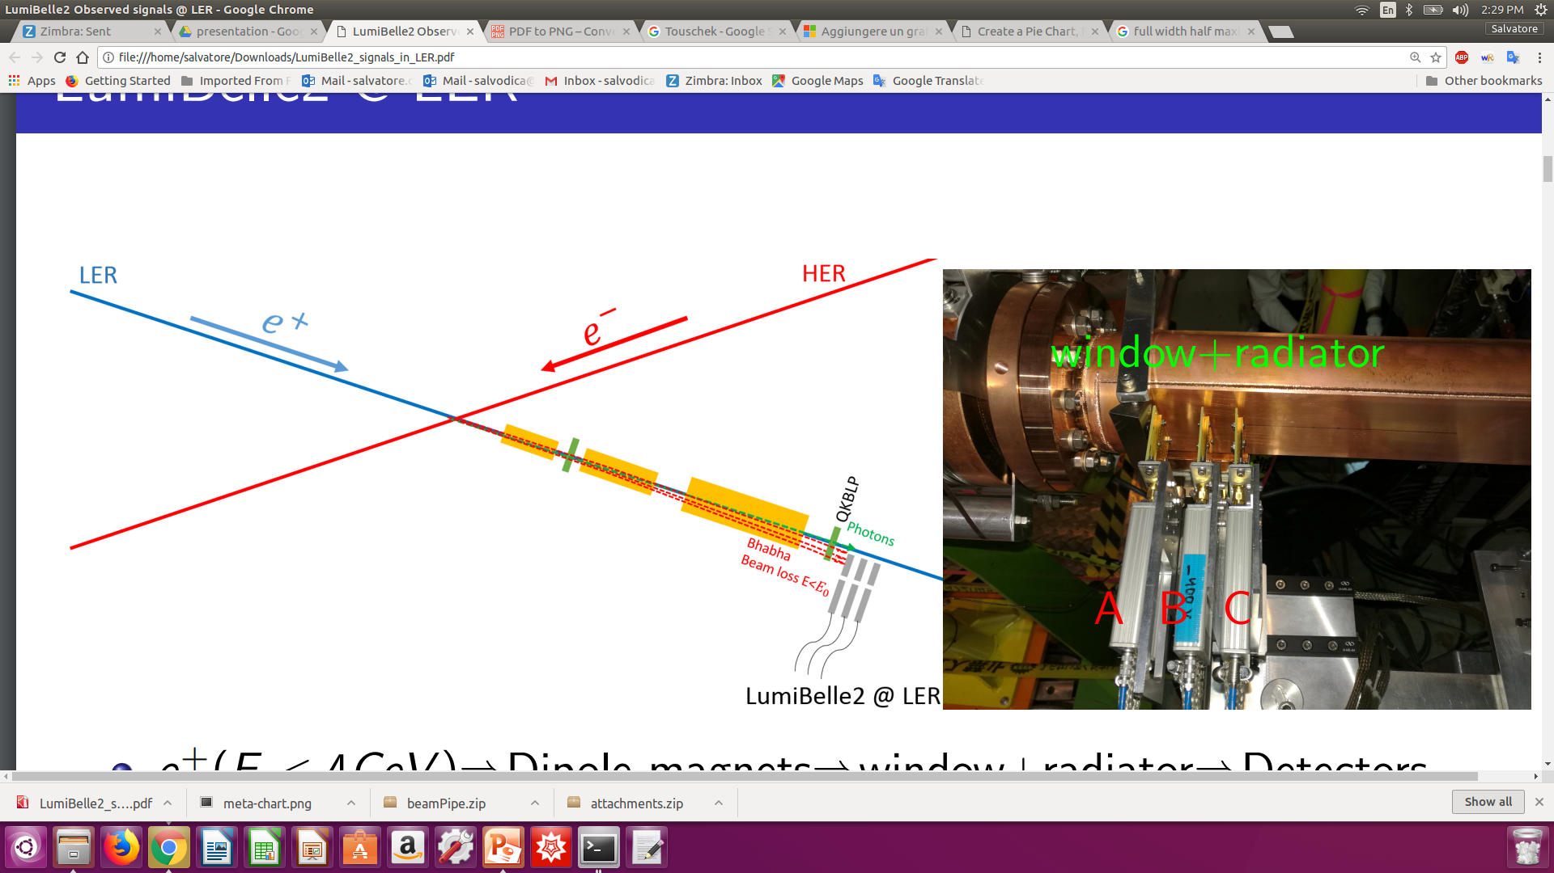
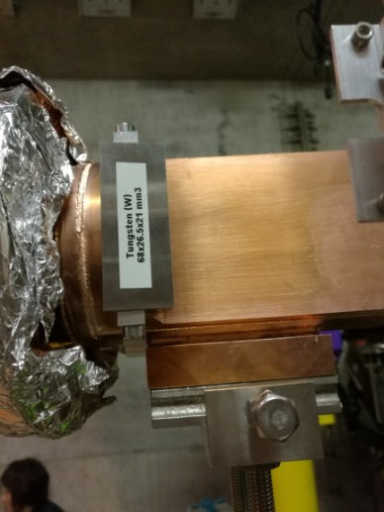
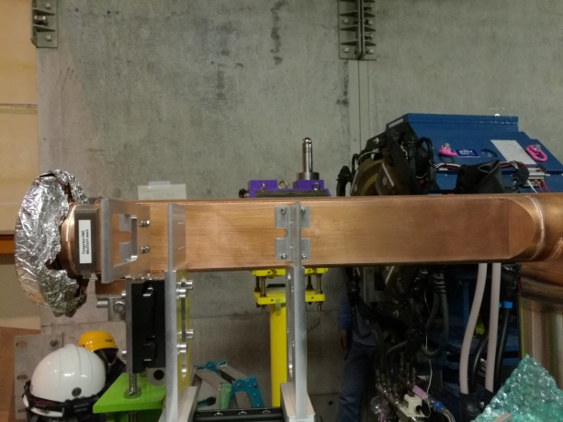
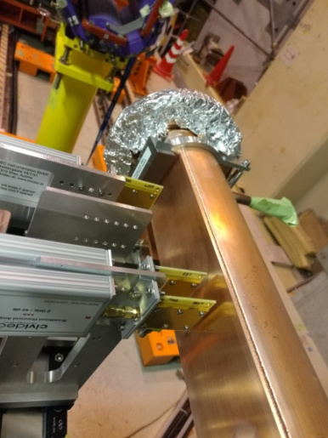
LER side
Signal: Bhabha positrons
Background: Bremsstrahlung and Touschek positrons
Platform: 11 m after IP
3 sensors aligned
Window + radiator

Slide 8
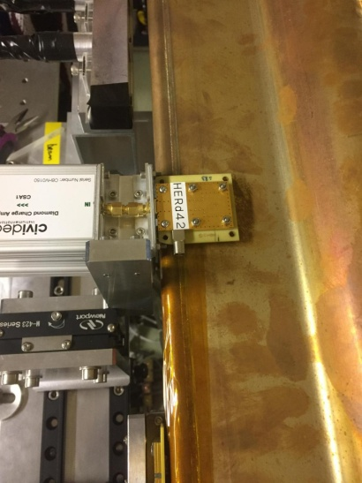
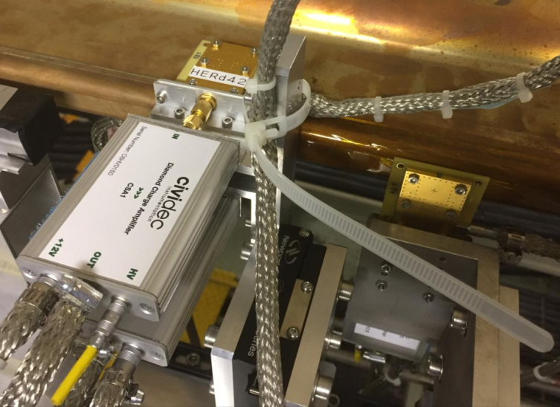
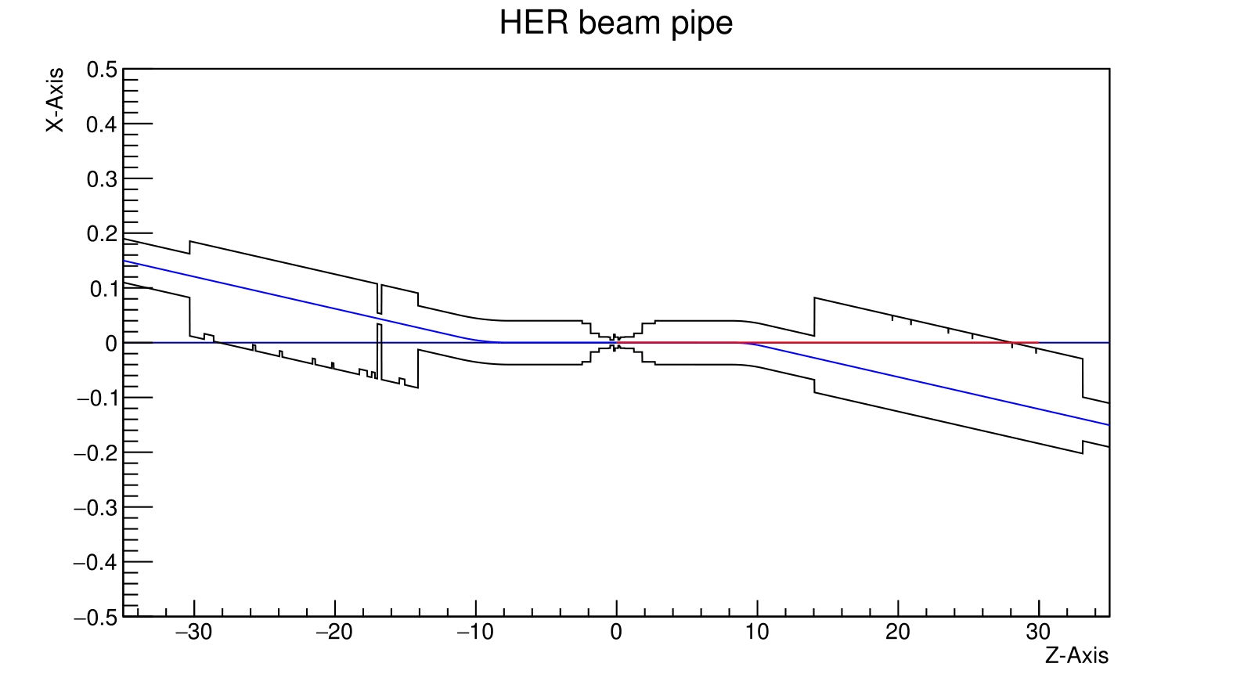
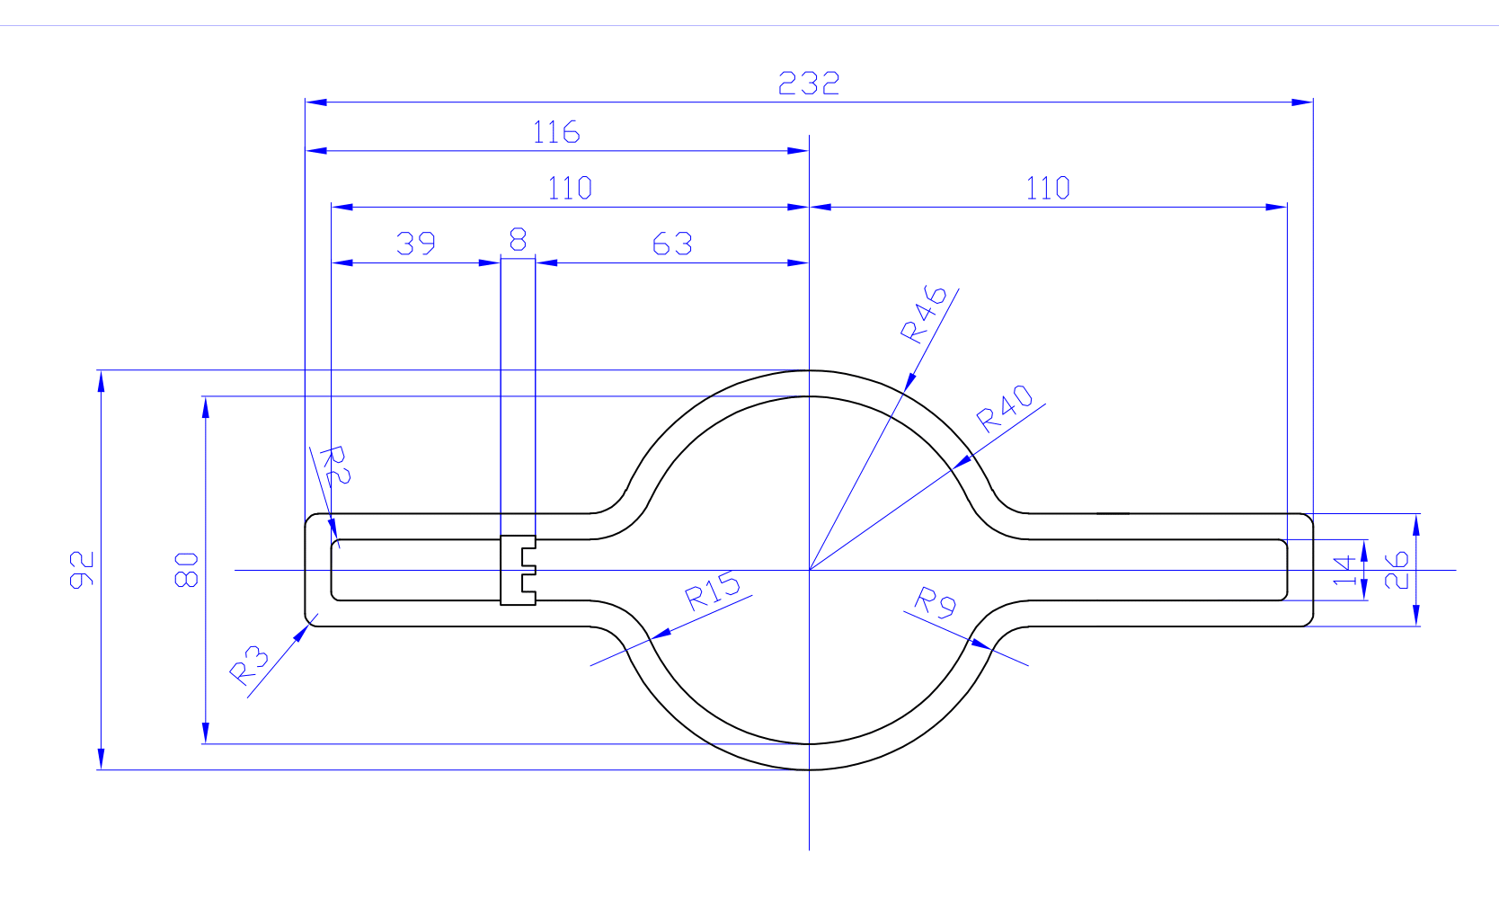
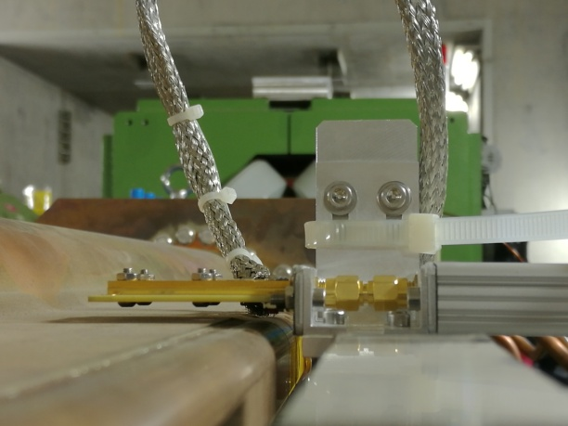
HER side
Signal: Bhabha photons
Background: Bremsstrahlung photons, Touschek electrons
Platform: 30.5-30.8 m after IP
3 sensors: up, down, side

Slide 9
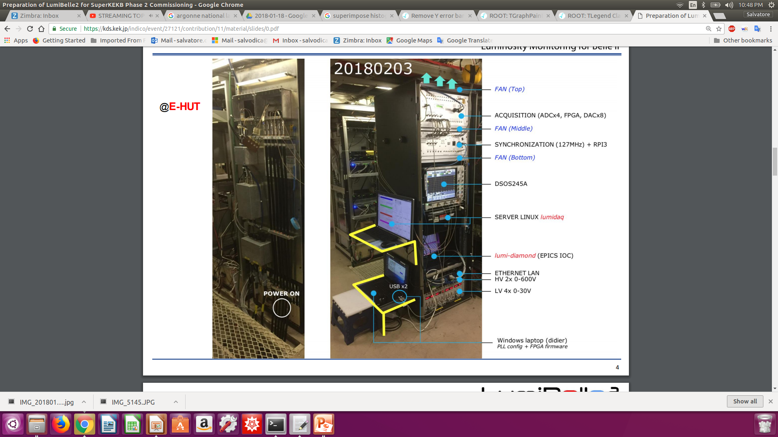
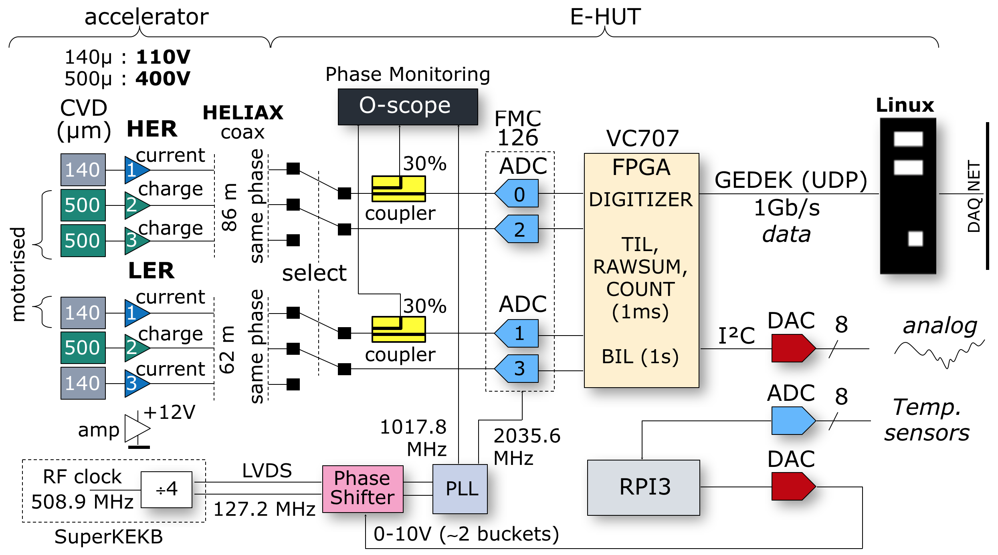
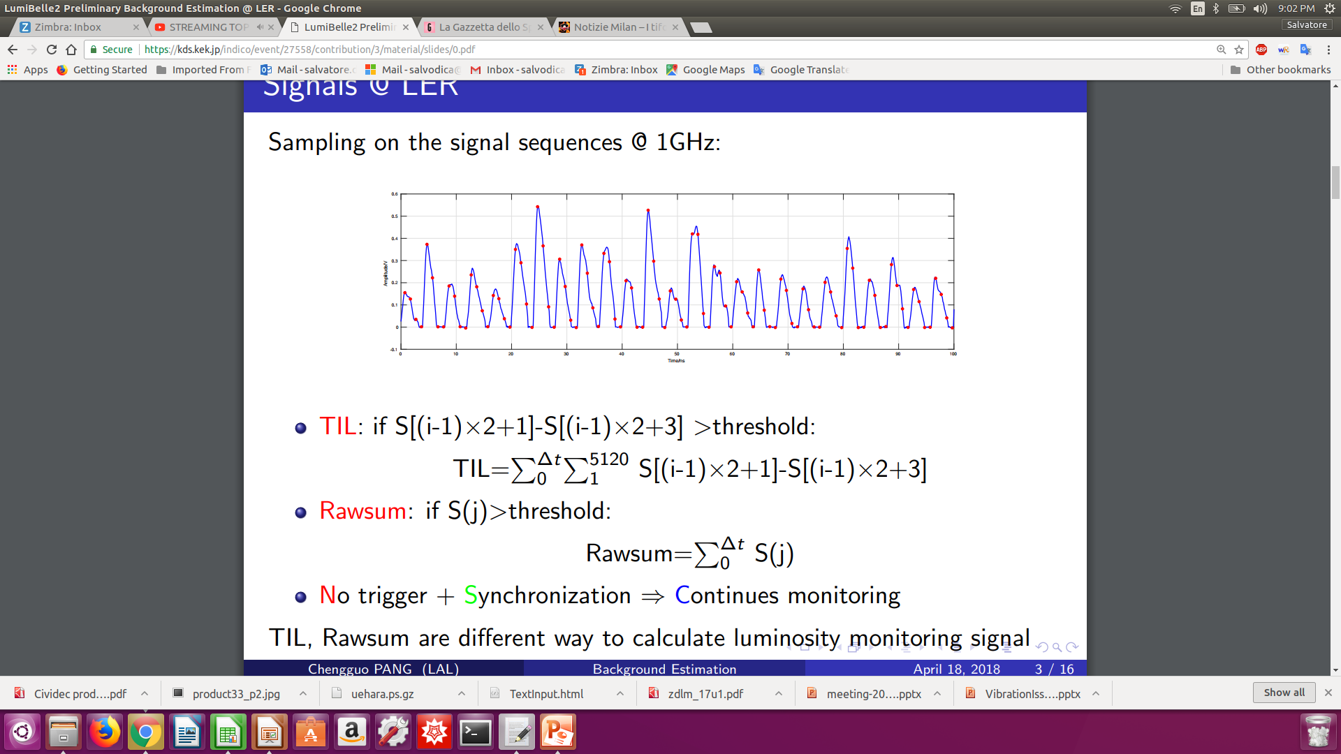
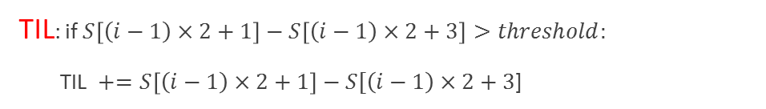
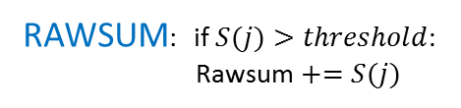
DAQ and online signal processing
Signal
Sampling signal
sequences at 1GHz
Time
TIL: if $S\left[\left(i−1\right)×2+1\right]−S\left[\left(i−1\right)×2+3\right]>threshold:$
TIL $+=S\left[\left(i−1\right)×2+1\right]−S[\left(i−1\right)×2+3$]
RAWSUM: if $S(j)>threshold:$
Rawsum $+=S(j)$
No trigger + Synchronization -----> Continuous monitoring, averaging at 1 kHz
TIL and RAWSUM are different ways of calculating the luminosity from the measured signal

Slide 10
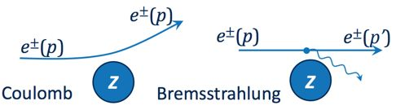
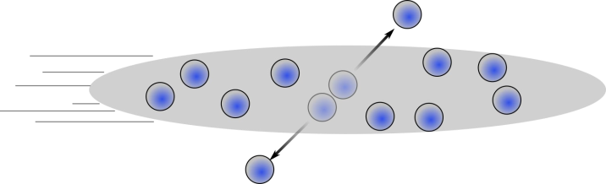
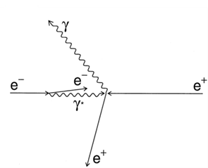
Signal beam background
Coulomb
  Proportional to vacuum pressure and beam current
  Important globally but negligible for luminosity monitoring
Bremsstrahlung → dominant
  Proportional to vacuum pressure and beam current
  Largest source of background in phase 2
  Photons measured at HER side
  Positrons measured at LER side
Touschek:
  Proportional to square of beam current
  Inversely proportional to beam size
Luminosity signal
Radiative Bhabha process:
Scattered @ IP
Proportional to luminosity
Large cross-section
Notes:
So, for our systems, Main signal sources and their features are listed here, the processes in the green box are background, and the Bremsstrahlung process is dominated for LumiBelle2 and ZDLM, and as explained before, Radiative Bhabha process is the basis of luminosity monitoring.

Slide 11
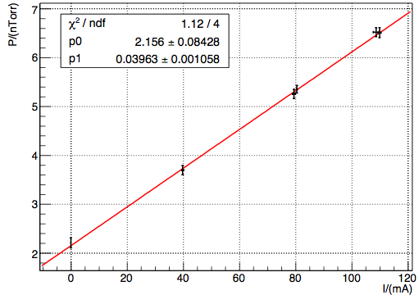
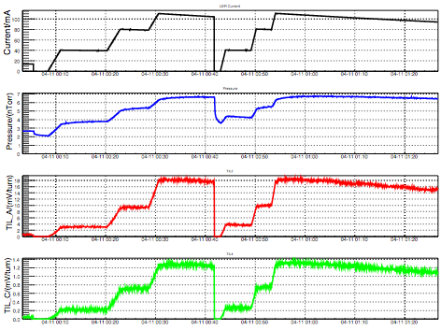
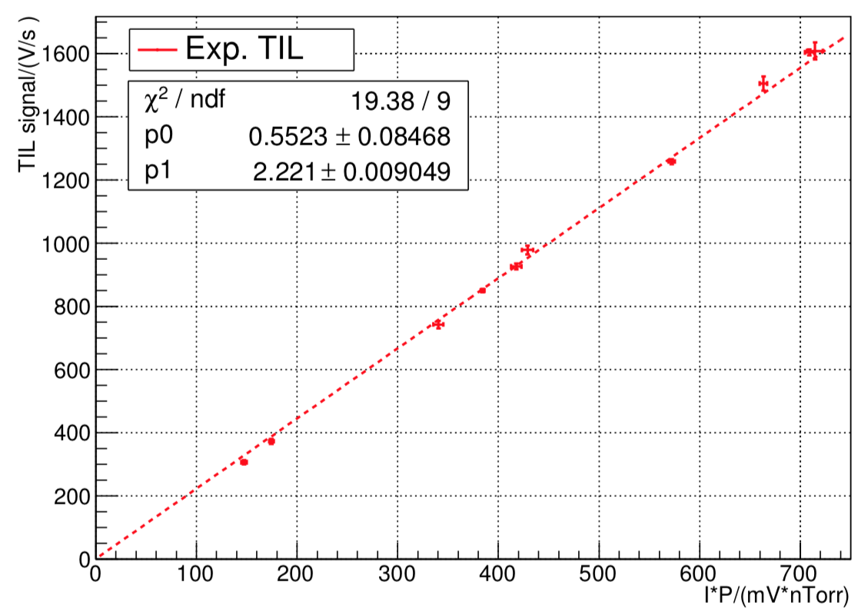
Background study (1)
Background measurement:
Bremstrahlung ∝ I*P Dominant
Touschek ∝ I²/(σ_{x}σ_{y}σ_{z}) ∝ I × P
Beam gas desorption
Beam current
Pressure is proportional to current
Pressure
TIL_A
TIL_C
Background signal is proportional to product of beam current and pressure
Notes:
During single beam commissioning of Phase-2, preliminary study of background was done, we increased the current several steps, and for each step we stay there several minutes for data taking, LER results are shown here. Due to the beam-gas desorption, the pressure is proportional to the beam current, so as you can see, background signal is proportional to the product of beam current and pressure, as expected.

Slide 12
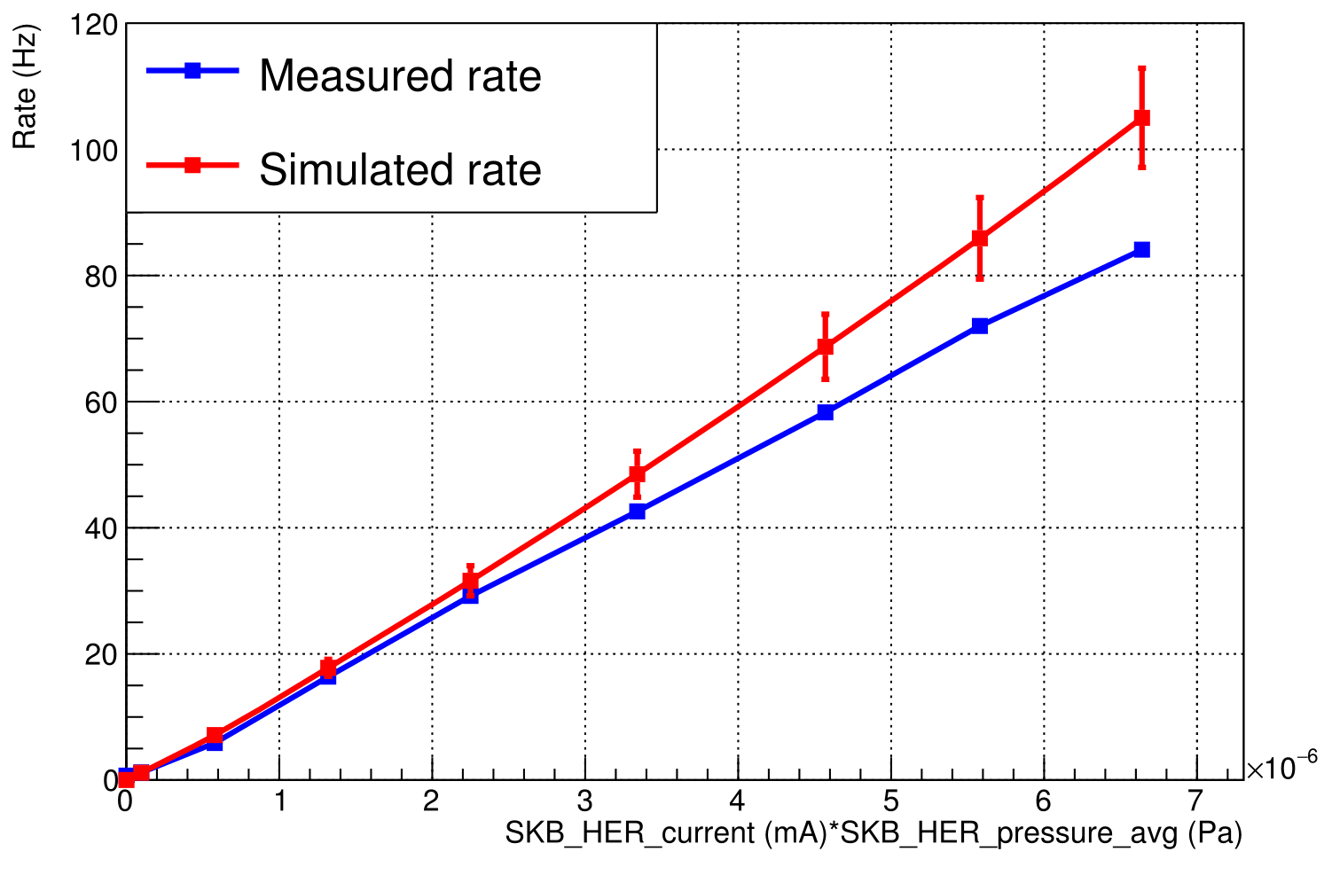
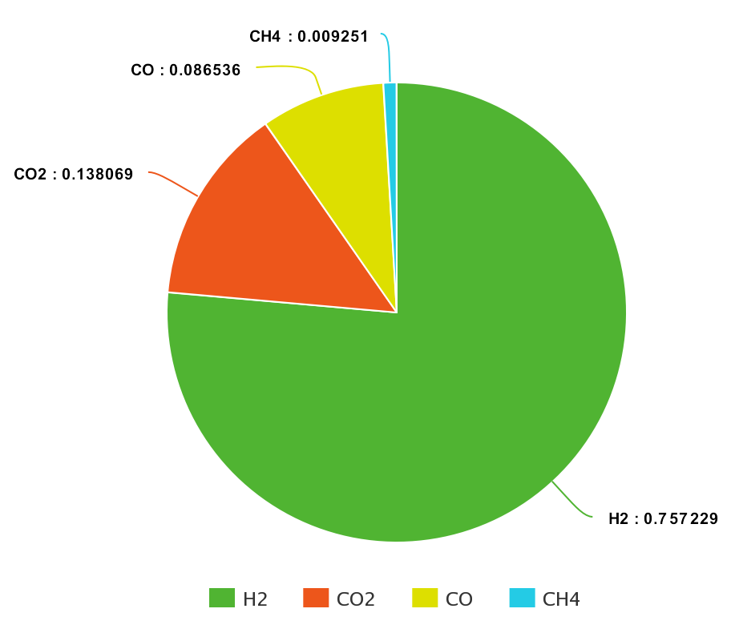
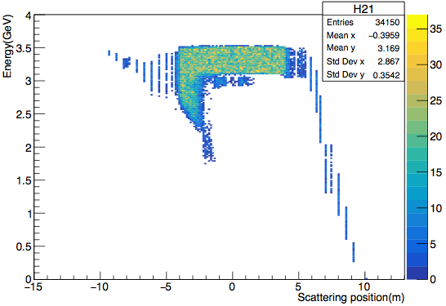
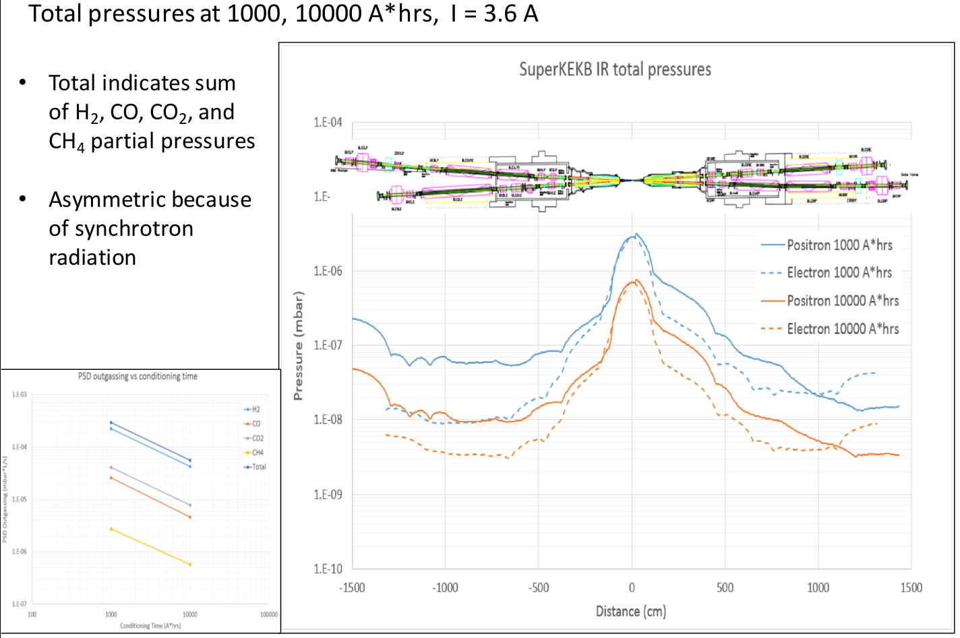
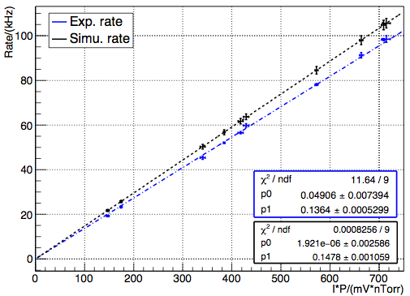
Background study (2)
Comparison with simulation
HER
Uniform pressure
IP
Simulated results is about 25% larger than measurement
Scattering position of lost particles
Zeff =4.5
Simulated results is about 10% larger than measurement
LER
Simulated vacuum profile @ IP
Notes:
Then those measured results was compared with our simulation, since bremsstrahlung process is dominated in our system, and the particles detected by our system are mainly scatted around IP, and the pressure at IP is higher than other place due to its tiny beam pipe and there is no vacuum bump in that region . After consider the vacuum level at IP and equivalent atomic number, we found that our simulation are just slightly higher than the measurement.as shown the two figures in the right.

Slide 13
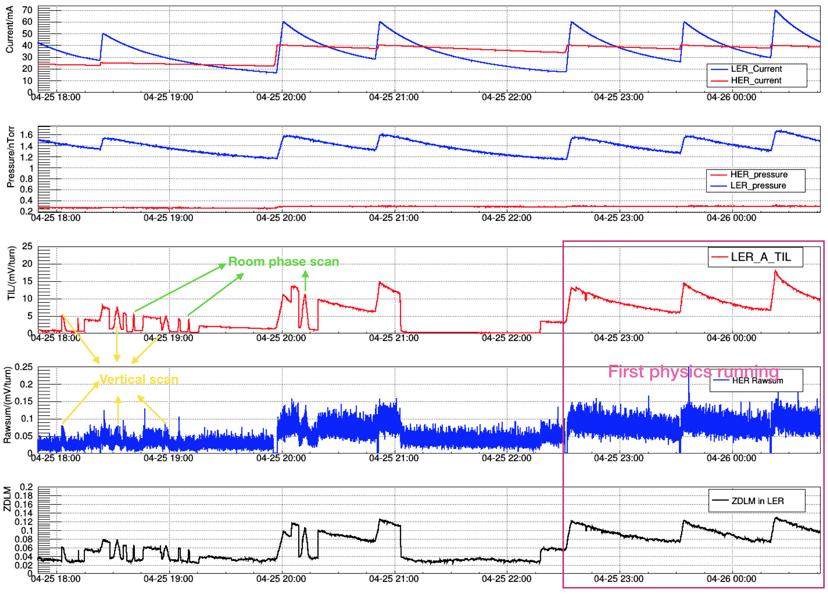
First collision – April 26, 2018
Current
Pressure
LumiBelle2 LER
LumiBelle2 HER
ZDLM LER
Notes:
As you already know, the first collision observed by Belle2 is around 1 am on 26th April, while for our system, we observed it several hours before, when the accelerator scientist try to find the collision by scanning the beam position vertically and longitudinally. As you can see, several peaks corresponding to those scans were observed in both ring and our both systems.
First belle-2 physics running from 10:30 pm, and then Belle 2 first collision was observed around 1 am 26th April.

Slide 14
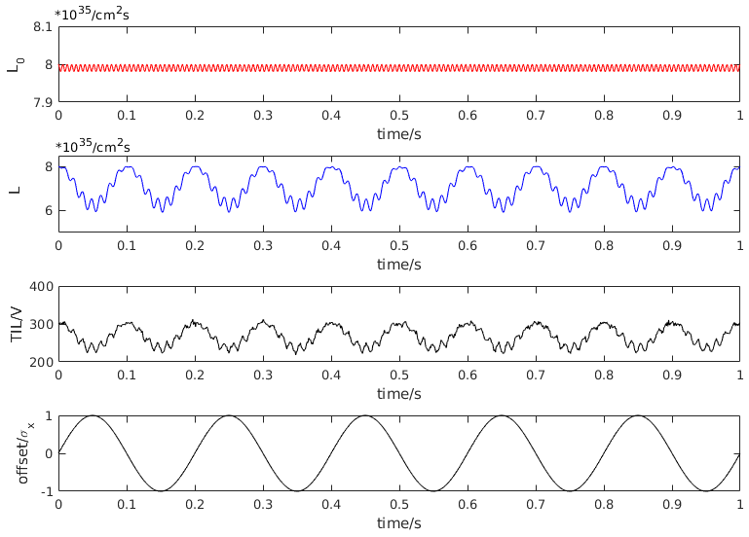
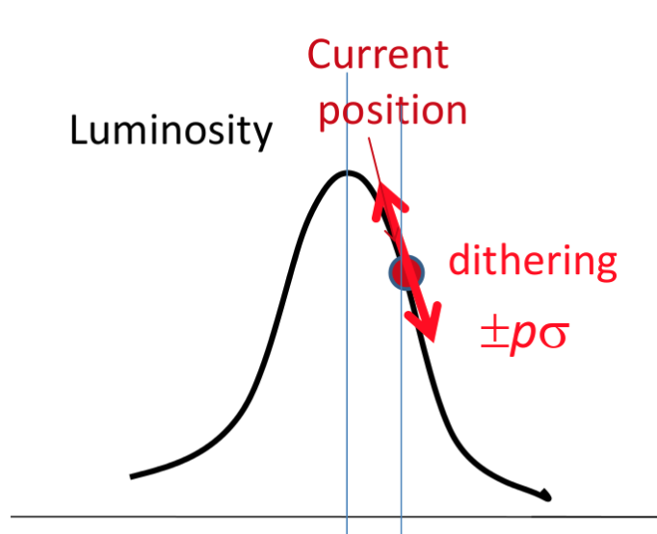
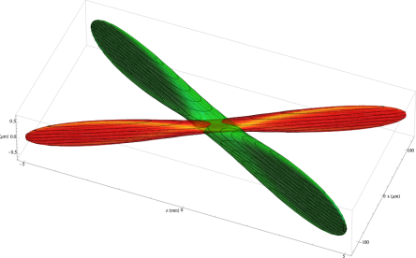
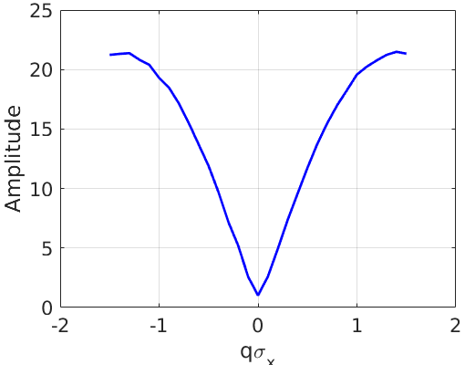
Dithering feedback algorithm
LER:
d=p*sin(2πft)
ZDLM LumiBelle2
Offset: q
HER
Luminosity monitoring signal
Luminosity
Lock-in amplifier
Offset
Closed orbit bumps
(correction @ 1 Hz)
Orbit offset @ IP calculation
(size and sign)
Notes:
Fist of all, I would like to introduce you about the dithering feedback briefly. For collision beams at SuperKEKB, LER beam is dithered at a fixed frequency, and then the luminosity changes as function of beam-beam offset like this, and then LumiBelle2 and ZDLM provide the luminosity signal, with the lock-in amplifier, we can extract the magnitude of luminosity signal at dithering frequency, and its output is something like this as function of offset, then based on this we can get the offset information and then kick the HER beam orbit to achieve the optimum collision and maintain it with a closed loop, so that’s done.

Slide 15
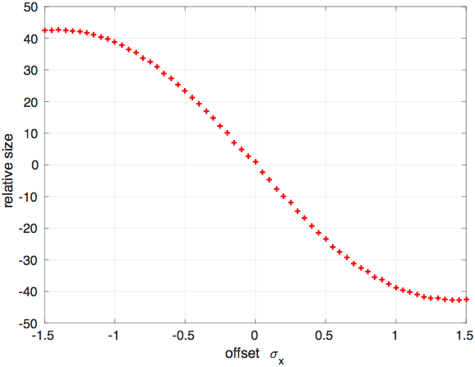
Dithering study with LumiBelle2 (1)
Measurement with Lock-in amplifier
Phase obtained by mixing dithering driven signal and luminosity monitoring signal
Slope information can be obtained by several successive corrective moves
Newton method is used to correct the beam orbit at 1 Hz
Simulated results
Notes:
By mixing the dithering driven signal and luminosity monitoring signal, you can get the Phase and then you get the final results, as shown here. then with several successful corrective moves, you can obtain the slope of this response function, and finally, with Newton method to find zero is used to correct the beam orbit at 1Hz.

Slide 16
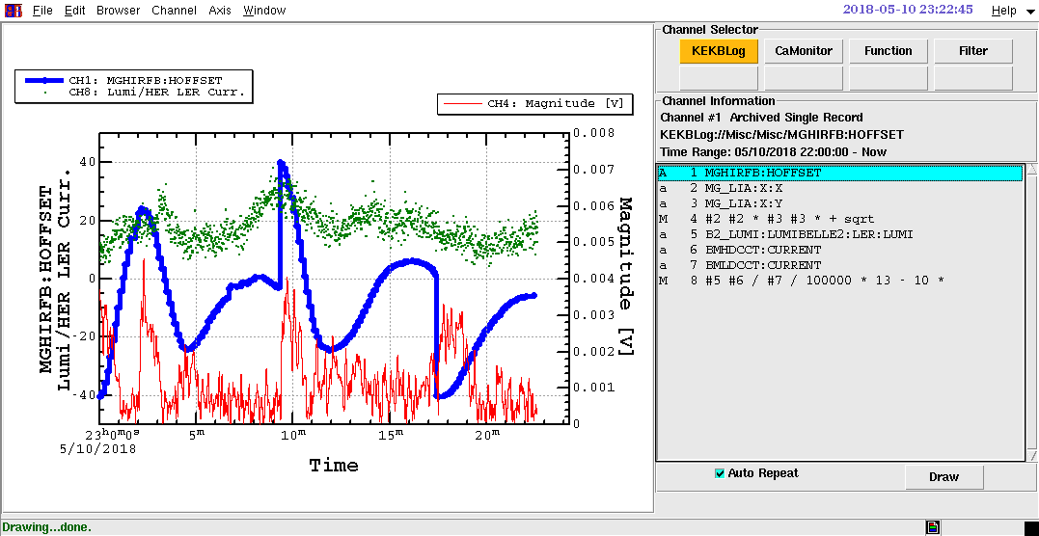
Dithering study with LumiBelle2 (2)
Feedback shown to correct a deliberately introduced horizontal offset
(after parameter tuning…)
Notes:
By mixing the dithering driven signal and luminosity monitoring signal, you can get the Phase and then you get the final results, as shown here. then with several successful corrective moves, you can obtain the slope of this response function, and finally, with Newton method to find zero is used to correct the beam orbit at 1Hz.

Slide 17
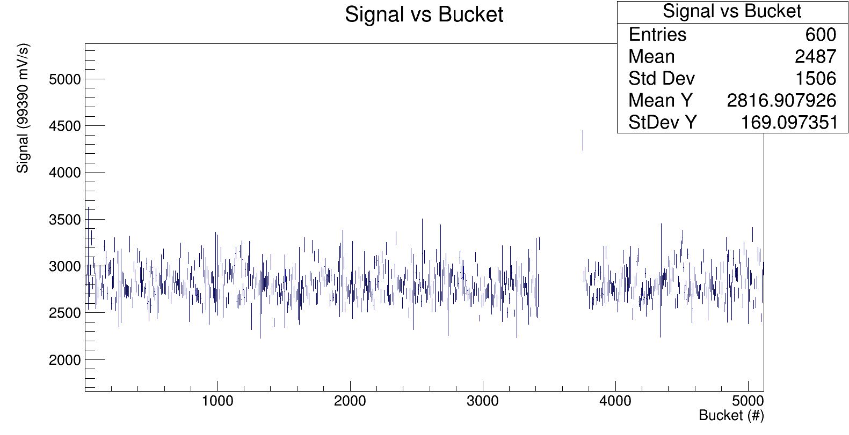
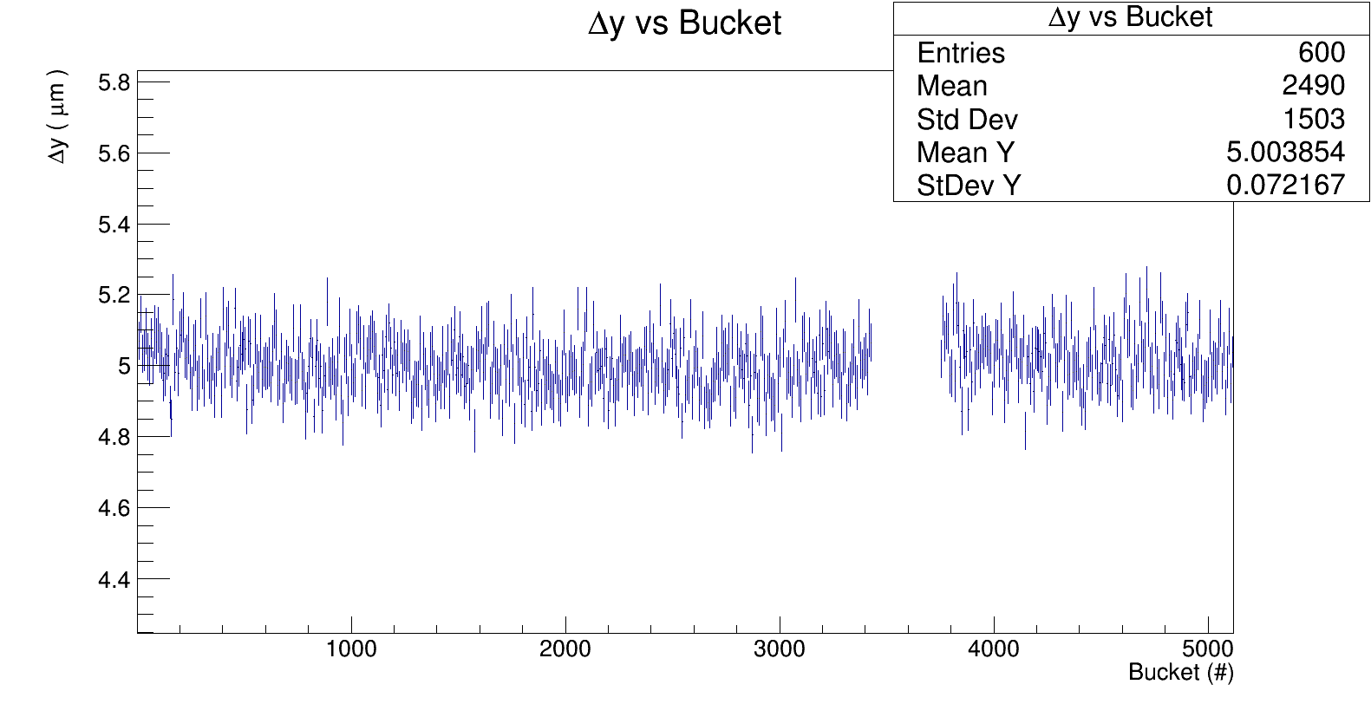
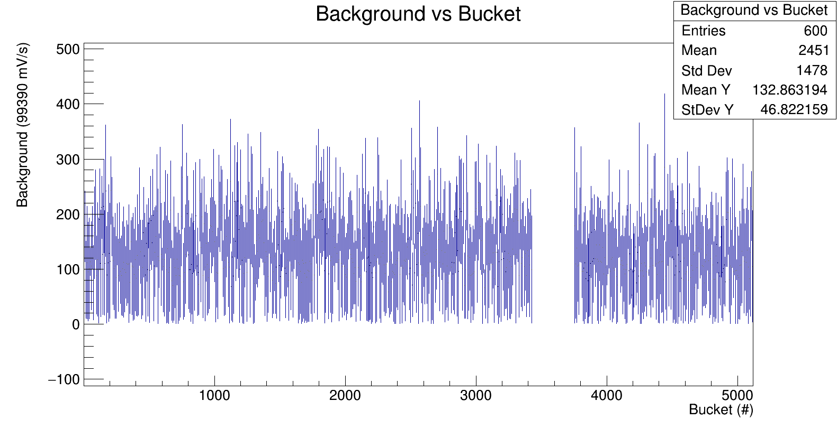
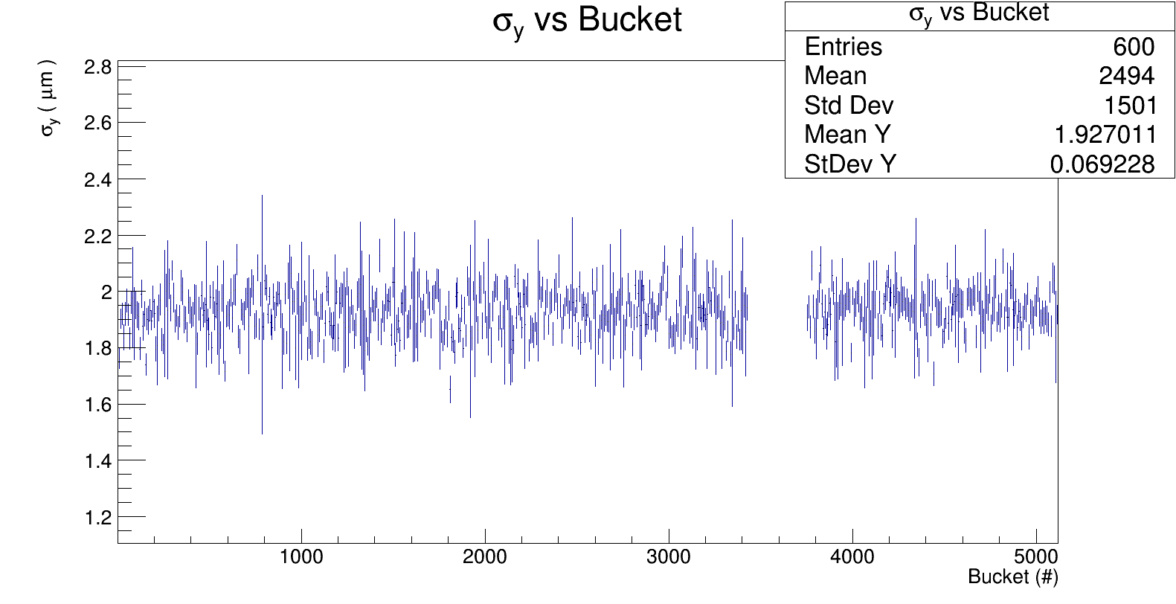
Bunch-by-bunch averaged LumiBelle2 measurements during vertical collision scanning
Fitting of vertical beam sizes and relative offsets bunch-by-bunch
Presently16 ns bunch separation, in Phase 3 → 4 ns (LHC has 25 ns)
Signals and backgrounds need normalization by bunch-by-bunch currents
Individual bunch vertical sizes and relative offsets are determined to a few percent
Notes:
By mixing the dithering driven signal and luminosity monitoring signal, you can get the Phase and then you get the final results, as shown here. then with several successful corrective moves, you can obtain the slope of this response function, and finally, with Newton method to find zero is used to correct the beam orbit at 1Hz.

Slide 19
Conclusions & future prospects
SuperKEKB: 1st trial in 2018 of new “nanobeam” collision scheme promises a breakthrough in luminosity (× 40 increase)
Latest instantaneous luminosity with 2.1.1 optics ∼ 10³³ cm⁻² s⁻¹
Challenge for beams controls and tuning, including backgrounds
Successful test of LumiBelle2 fast luminosity monitor during 2018 colliding beam commissioning at KEK:
- several channels for 1kHz % level luminosity precision over 3 orders of magnitude
- successful test of horizontal feedback based on LumiBelle2 by dithering technique
- bunch-by-bunch luminosities and vertical beam sizes / relative offsets
➔ Impact on future circular e+e− collider design work
➔ Rare, almost once in a life time, hands-on experience starting up
a major HEP accelerator project, especially for junior scientists
➔ IN2P3 (LAL & IPHC) has joined Belle II
- LumiBelle2 activity moving to Belle II as long-term technical service task
- prepare LumiBelle2 for sustainable long-term operation with more limited HR
➔ New perspectives for France-China collaboration

Slide 20
Backup slides
(ATF beam halo studies)

Slide 21
International Linear Collider
Accelerator Test Facility
Energy: 1.3 GeV, Repetition: 3.12 Hz
Intensity: 1x10¹⁰ e-/bunch (max. 2x10¹⁰),
1~20 bunches/pulse
Emittance: Design, 1 nm(H)/ 10 pm(V),
Achieved 4 pm(V)
Advanced Beam Instruments R&D
ATF2 beamline
Nano-meter beam R&D
Final focus system development
Technologies to maintain the luminosity at ILC
Goal 1: validate ILC-like final focus → σ_{y} ∼ 40 nm
Goal 2: nm-level IP beam stability via feedback
Damping Ring (∼140m)
Low emittance beam
Cs₂Te Photocathode RF Gun
1.3 GeV S-band Electron LINAC (~70m)

Slide 26
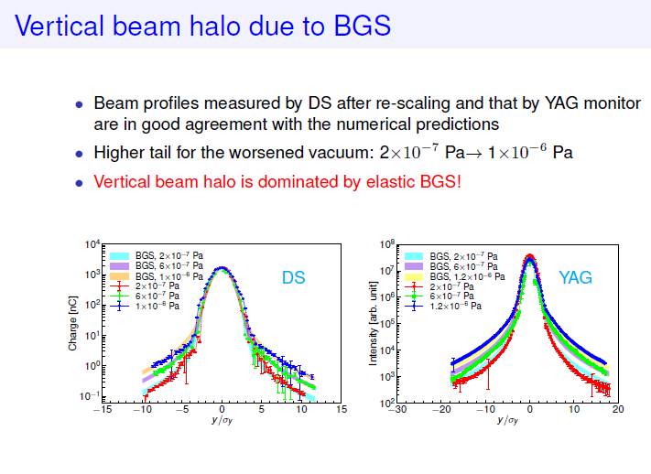

Slide 29


