Slide 1
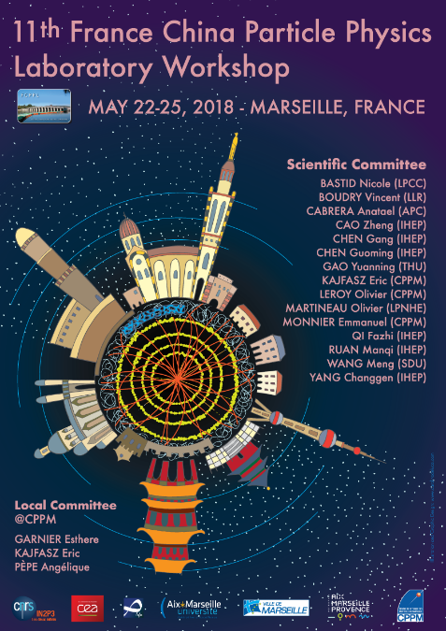
TECHNOLOGIES FOR DATA PROCESSING PLATFORMS FOR HEP EXPERIMENTS PROGRESS REPORT
11th France China Particle Physics Laboratory workshop (FCPPL2018)
Fazhi QI On Behalf of
IHEP CC: CHEN Gang, LI Weidong, QI Fazhi, WANG Lu, ZHANG Xiaomei, CHEN Yaodong, YAN Tian, SHI Jingyan, DU Ran, ZENG Shan, LI Haibo
CC-IN2P3:Fabio HERNANDEZ, Ghita RAHAL, Vanessa HAMAR,Fabien WERNLI, Mattieu PUEL
CPPM: Andreï TSAREGORODTSEV
22-25 May 2018, Marseille

Slide 2
Background
Guiding principle
to explore technologies of potential interest for the data processing needs of HEP experiments
Partners
CPPM, IN2P3 computing center, IHEP computing center
Funding
IHEP and IN2P3 through FCPPL 2017 call
CNRS-NSFC joint program for international collaboration

Slide 3
Topics
Topics of Interest
Exploring alternative ways for managing filesystem metadata
Automatic data migration based on machine learning
Experimentation with building blocks for inter-site bulk data transfer
DIRAC-based Computing platform for IHEP experiments
High-Performance computing platforms
Networking

Slide 4
Exploring alternative ways for managing filesystem metadata

Slide 5
Exploring alternative ways for managing filesystem metadata
Current existing storage systems issues
Metadata and file operations are tightly coupled, difficult to scale for a closed system
Local data and remote data are managed separately
Traditional RAID technology requires significant time for data recovery in case of host failure
EOS is an open disk storage system developed by CERN
All LHC and most non-LHC experiments data stored in EOS at CERN, more than 250 PB
EOS characteristics
multi-protocol access
secure access – strong authentication
multi-user management

Slide 6
Exploring alternative ways for managing filesystem metadata(EOS in IHEP)
EOS for batch computing
2 instances: LHAASO, HXMT
FUSE-based client access
~1.7 PB capacity
~60 million files
~1.3 million directories
+1 PB capacity in 2018 Q3
EOS for IHEPBox
A cloud disk system made up of OwnCloud and EOS
~160 TB capacity
~8.5 million files
~1 million directories
Computing
(AFS account)
Web service
(web account)
LHAASO EOS
HMXT
EOS
X
Public
EOS
Two separate clusters, based on different account system

Slide 7
Automatic Data Migration based on Machine Learning

Slide 8
Automatic Data Migration based on Machine Learning
Currently both Lustre and EOS filesystems support hierarchical storage management.
Data movement between the storage pools is triggered by manually-defined rules or according to a predefined list of files to transfer.
Input
historical access sequence of a certain file
Remote Sites
TAPE
SAS/SAS
SSD
Machine Learning Model trained on historical records
Output
Next access location and mode of the file

Slide 9
Automatic Data Migration based on Machine Learning (cont.)
Historical access pattern
EOS log, Lustre changelog, Instrumenting scripts
organized in counter vector sequence of file operation
Machine Learning model
Training samples come from billions of historical records
Based on DNN model
Currently collected 50 million EOS access records
For the task of prediction of future access location (login nodes/computing nodes), the precision is 98%

Slide 10
Automatic Data Migration based on Machine Learning (cont.)
Output of machine learning model
Access Mode: read-only or read-write mixed
Access Frequency: Hot or Cold
Location: Local or remote
Work in Progress !
Table 1: File Migration triggered by the predictions of ML model
 | Frequency | Future access mode | Migration Action | Migration Direction | Migration Mode
Big File | Hot → Cold | Read-Only | Disk → Tape | Down | Delete replica on disk
Big File | Hot → Cold | Mixed | Keep in Disk |  | Keep replica on disk
Small File | Hot → Cold | Mixed | SSD → Disk | Down | Delete replica on SSD
Small File | Hot → Cold | Read-Only | SSD → Disk | Down | Keep replica on SSD
Small File | Cold → Hot | Mixed | Disk → SSD | UP | Delete replica on disk
Small File | Cold → Hot | Read-Only | Disk → SSD | UP | Keep replica on disk
Small File | Has Remote access | Mixed | local → remote | out | Delete local replica
Small File | Has Remote access | Read | local → remote | Out | Keep local replica
Notes:
If the ML model can predict future access mode(Read only or Read Write mixed), access frequency(hot/cold), and access location(local or remote), data migration can be triggered automatically .

Slide 11
Experimentation with building blocks for inter-site bulk data transfer

Slide 12
Experimentation with building blocks for inter-site bulk data transfer
Goal: is HTTP suitable for bulk data transfer over high latency network links?
Why HTTP?
Standard, programmability of both client and servers in any relevant programming language, future-proof, ubiquitous, customisable semantics, ...
Confidentiality and data integrity ensured using standard TLS
Experience in LSST
CC-IN2P3 will be exchanging significant amounts of data with the archive center of the instrument located at NCSA near Chicago, USA, daily during the foreseen 10 years of operations starting in 2022.
Asynchronous reading of data stored in Swift for writing to GPFS showed a sustained throughput of 600 MB/sec.

Slide 13
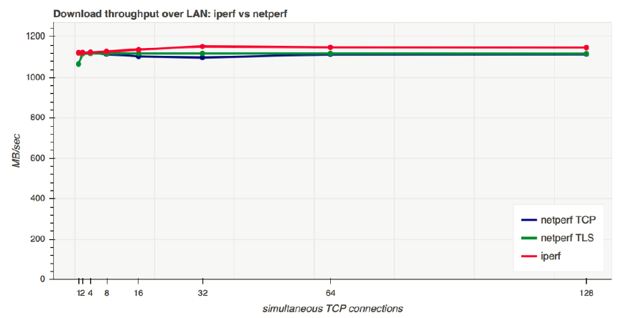
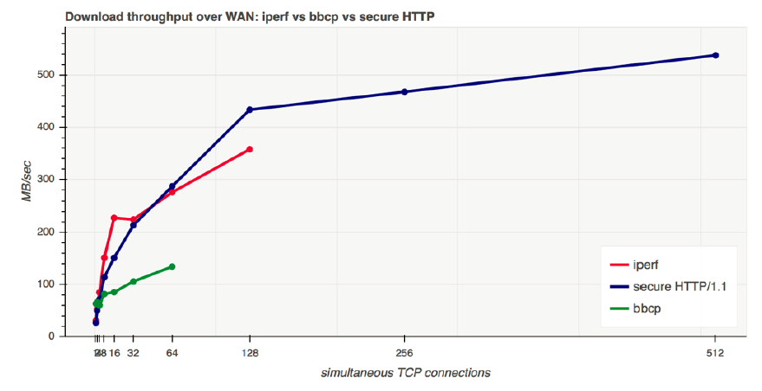
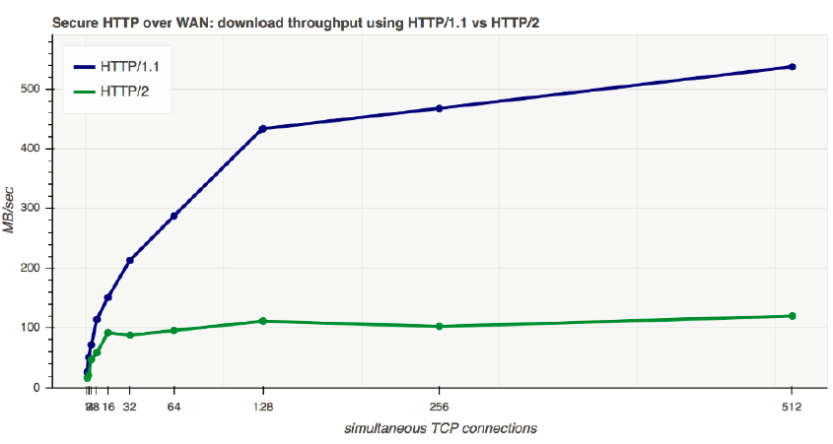
Experimentation with building blocks for inter-site bulk data transfer (cont.)
Results so far
it is indeed possible to use a modern implementation of the HTTP protocol for bulk data transfer over high latency links
with recent hardware, it is possible to use transport layer encryption (such as TLS) to guarantee data integrity and confidentiality without significant performance penalty
from the operational point of view, it is interesting to decouple the storage system used for import/export of data (OpenStack Swift in our case) from the one used for feeding data to the applications executing locally in the compute nodes (GPFS in our case).
Further details: PRACE white paper

Slide 14
DIRAC-based computing platform for IHEP experiments

Slide 15
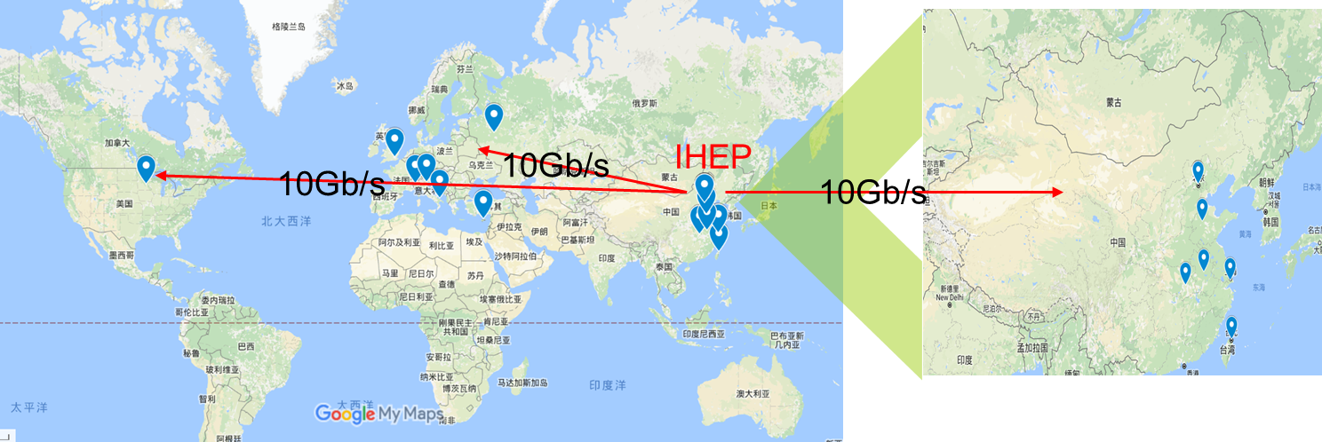
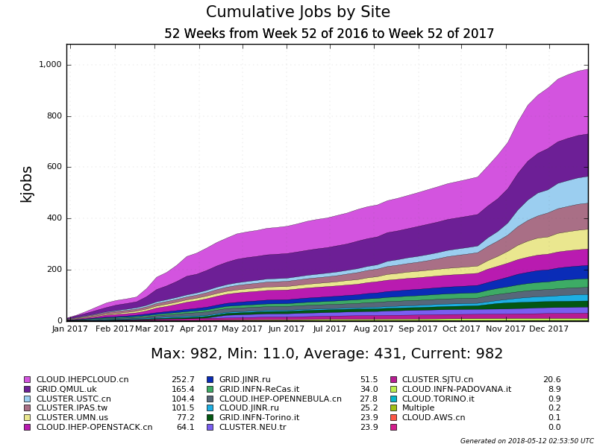
DIRAC-based computing platform for IHEP experiments
DIRAC instance at IHEP in production since several years
The BESIII distributed computing system was set up and put into production in 2014
Meet peek needs of BESIII
Extended to support multi-VO in 2015, e.g. JUNO, CEPC, etc.
In 2017, jobs reach ~ 1M
Several kind of resources, including cluster, grid, cloud
15 sites from USA, Italy, Russia, Turkey, Taiwan, China Universities(8)

Slide 16
DIRAC-based Computing platform for IHEP experiments (cont.)
Multi-process/thread applications became a trend in IHEP experiments
Work closely with CPPM on support of multi-core jobs in DIRAC
Two ways of multi-core job scheduling has been successfully tried and implemented in the prototype in IHEP
Independent pilots for single-core and multi-core jobs (A)
Shared partitionable pilots for all the jobs (B)
CPU utilization rate has been studied and measured
pilot
jobs
(A)
jobs
(B)

Slide 17
High-Performance computing platforms

Slide 18
High-Performance computing platforms
Both IHEP and CC-IN2P3 deployed pilot high-performance computing platforms
IHEP (2018): 2800 CPU cores(125 work nodes), 600TFlops(80 NVIDIA V100 GPUs in 10 hosts, Double Precision), InfiniBand EDR interconnection, Integrated to “HEP job tool” for job submission and query
CC-IN2P3: 160 CPU cores, 40 NVIDIA TESLA K80 GPUs in 10 hosts, InfiniBand interconnection
programming environment: CUDA, OpenCL, OpenMP, MPI
Early adopters getting familiar with those platforms
The platforms are integrated to the workload management systems of both sites
Sites understanding how to operate them and attracting users to these new facilities
Slurm + Docker
Experience to be shared among sites operators, platforms are integrated to the workload management systems of both sites

Slide 19
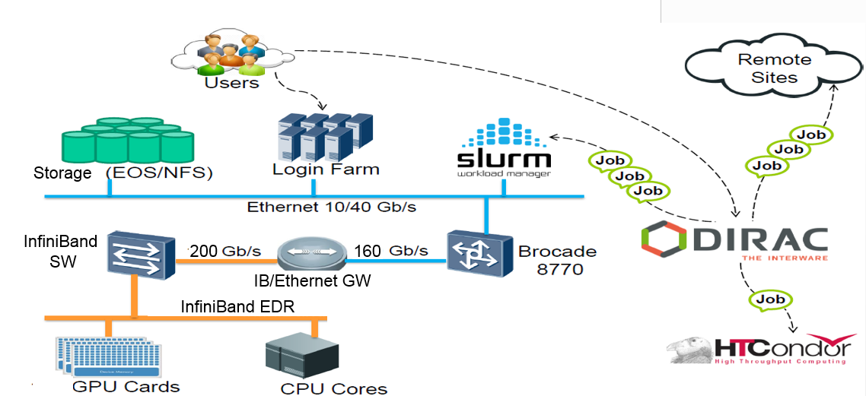
High-Performance computing platforms

Slide 20
Networking

Slide 21
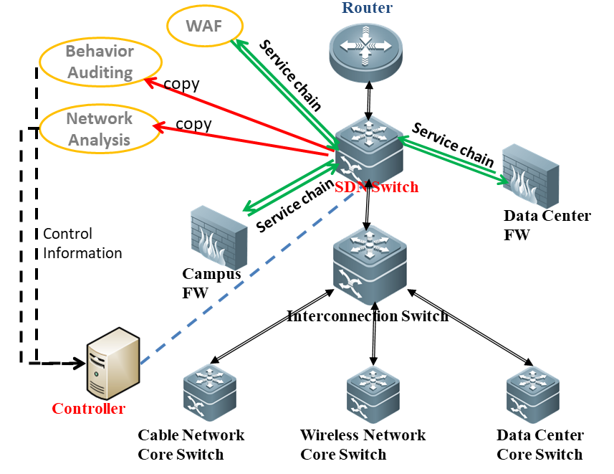
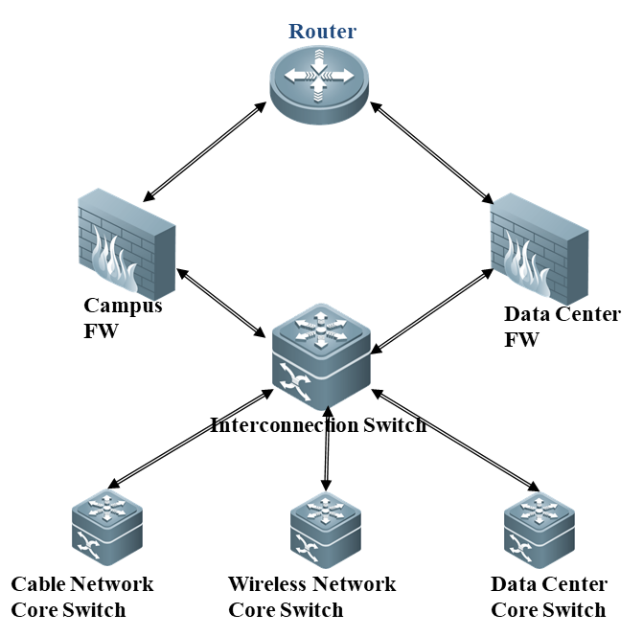
SDN @ Security
Thoughts
Minimize the impact on the existing network for network and information security using new architecture
Service Chain features and bypass security devices(firewall) for Science Data Traffic
Status
Capturing the network traffic with SDN features
Developing the security applications to analysis the network flows

Slide 22
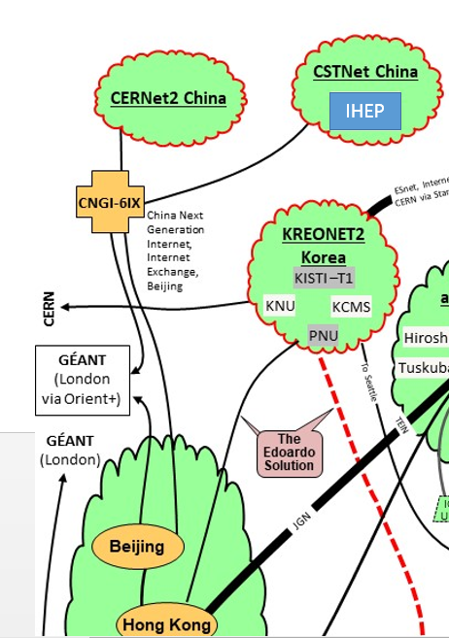
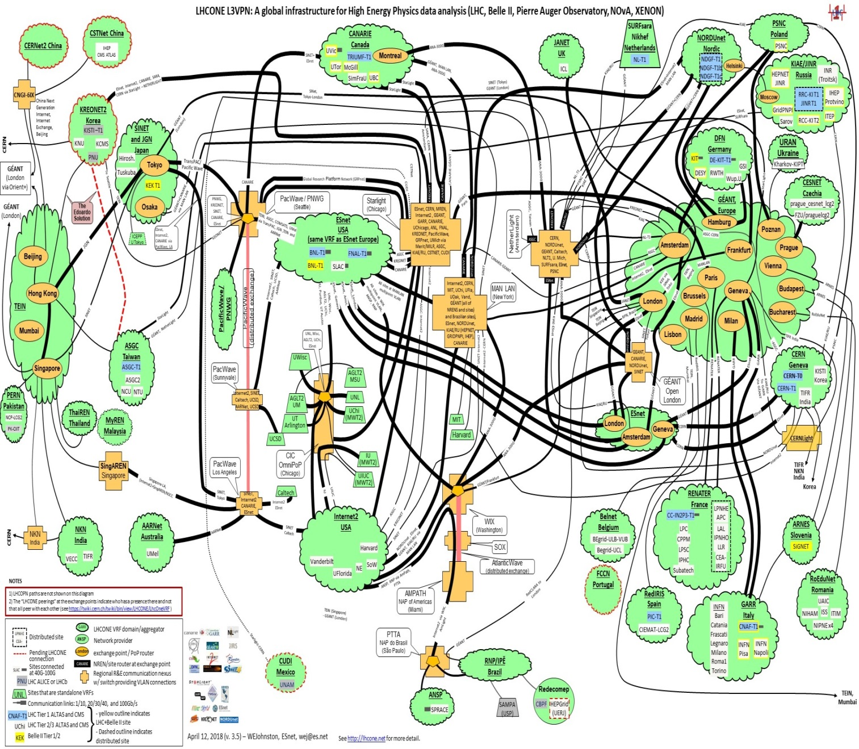
LHCONE in China

Slide 23
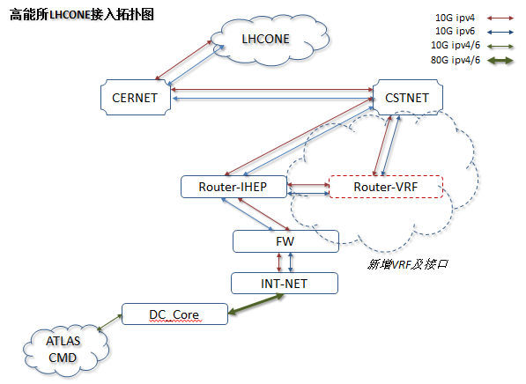
LHCONE in China (II)
Dedicated physical links for LHCONE from the existing CNGI links
Two dedicated links (10Gbps IPv4 + 10Gbps IPv6) have been set up for LHCONE between IHEP and CSTNet
The VRF peers to TEIN have been created by CERNET2
Deployed VRF+IBGP in IHEP
IBGP: Deploy Internal route forwarding policies in IHEP
Currently, the IPs of CMS and ATLAS servers in IHEP have been announced in LHCONE
Status
Scientific traffic from IHEP to Europe (CMS and ATLAS experiments) are all going on LHCONE
Plan
Will setup VRF peer to Internet2, ASGC in Hongkong (HKIX)
Will encourage the other universities in China to join in LHCONE

Slide 24
People

Slide 25
People
LI Jianhui, director of the Big Data division of the CAS’ Computer Network Information Center (CNIC) and CHEN Gang, QI Fazhi and WANG Lu visited CC-IN2P3 in March 2017. Dr LI made a presentation about the initiatives at CAS related to big data research infrastructures.
Andreï TSAREGORODTSEV and Fabio HERNANDEZ attended the 10th FCPPL workshop held in Beijing in March 2017.
ZHANG Xiaomei, who is responsible for IHEP’s DIRAC-based grid platform, attended the 7th DIRAC Users Workshop in Poland in May 2017 and presented a report about the usage of DIRAC for IHEP experiments
A delegation of 7 representatives of CAS visited CC-IN2P3 in September 2017, in the framework of a visit to several European research e-infrastructures. A one-day workshop was organized at CC-IN2P3 for discussing topics relevant to this subject, with a participation of more than 20 experts.
8th DIRAC users’ workshop being held at CC-IN2P3 this week

Slide 26
Perspectives

Slide 27
Perspectives
Project submitted to FCPPL 2018 call
Topics
DIRAC: improved integration of cloud and high performance computing resources
Machine Learning: understanding if and how machine learning technologies could help us extract information from the data we are collecting at the computer centers
Security: Using SDN technologies to collect and analysis the network traffic and to understand the network behaviors

