Slide 1


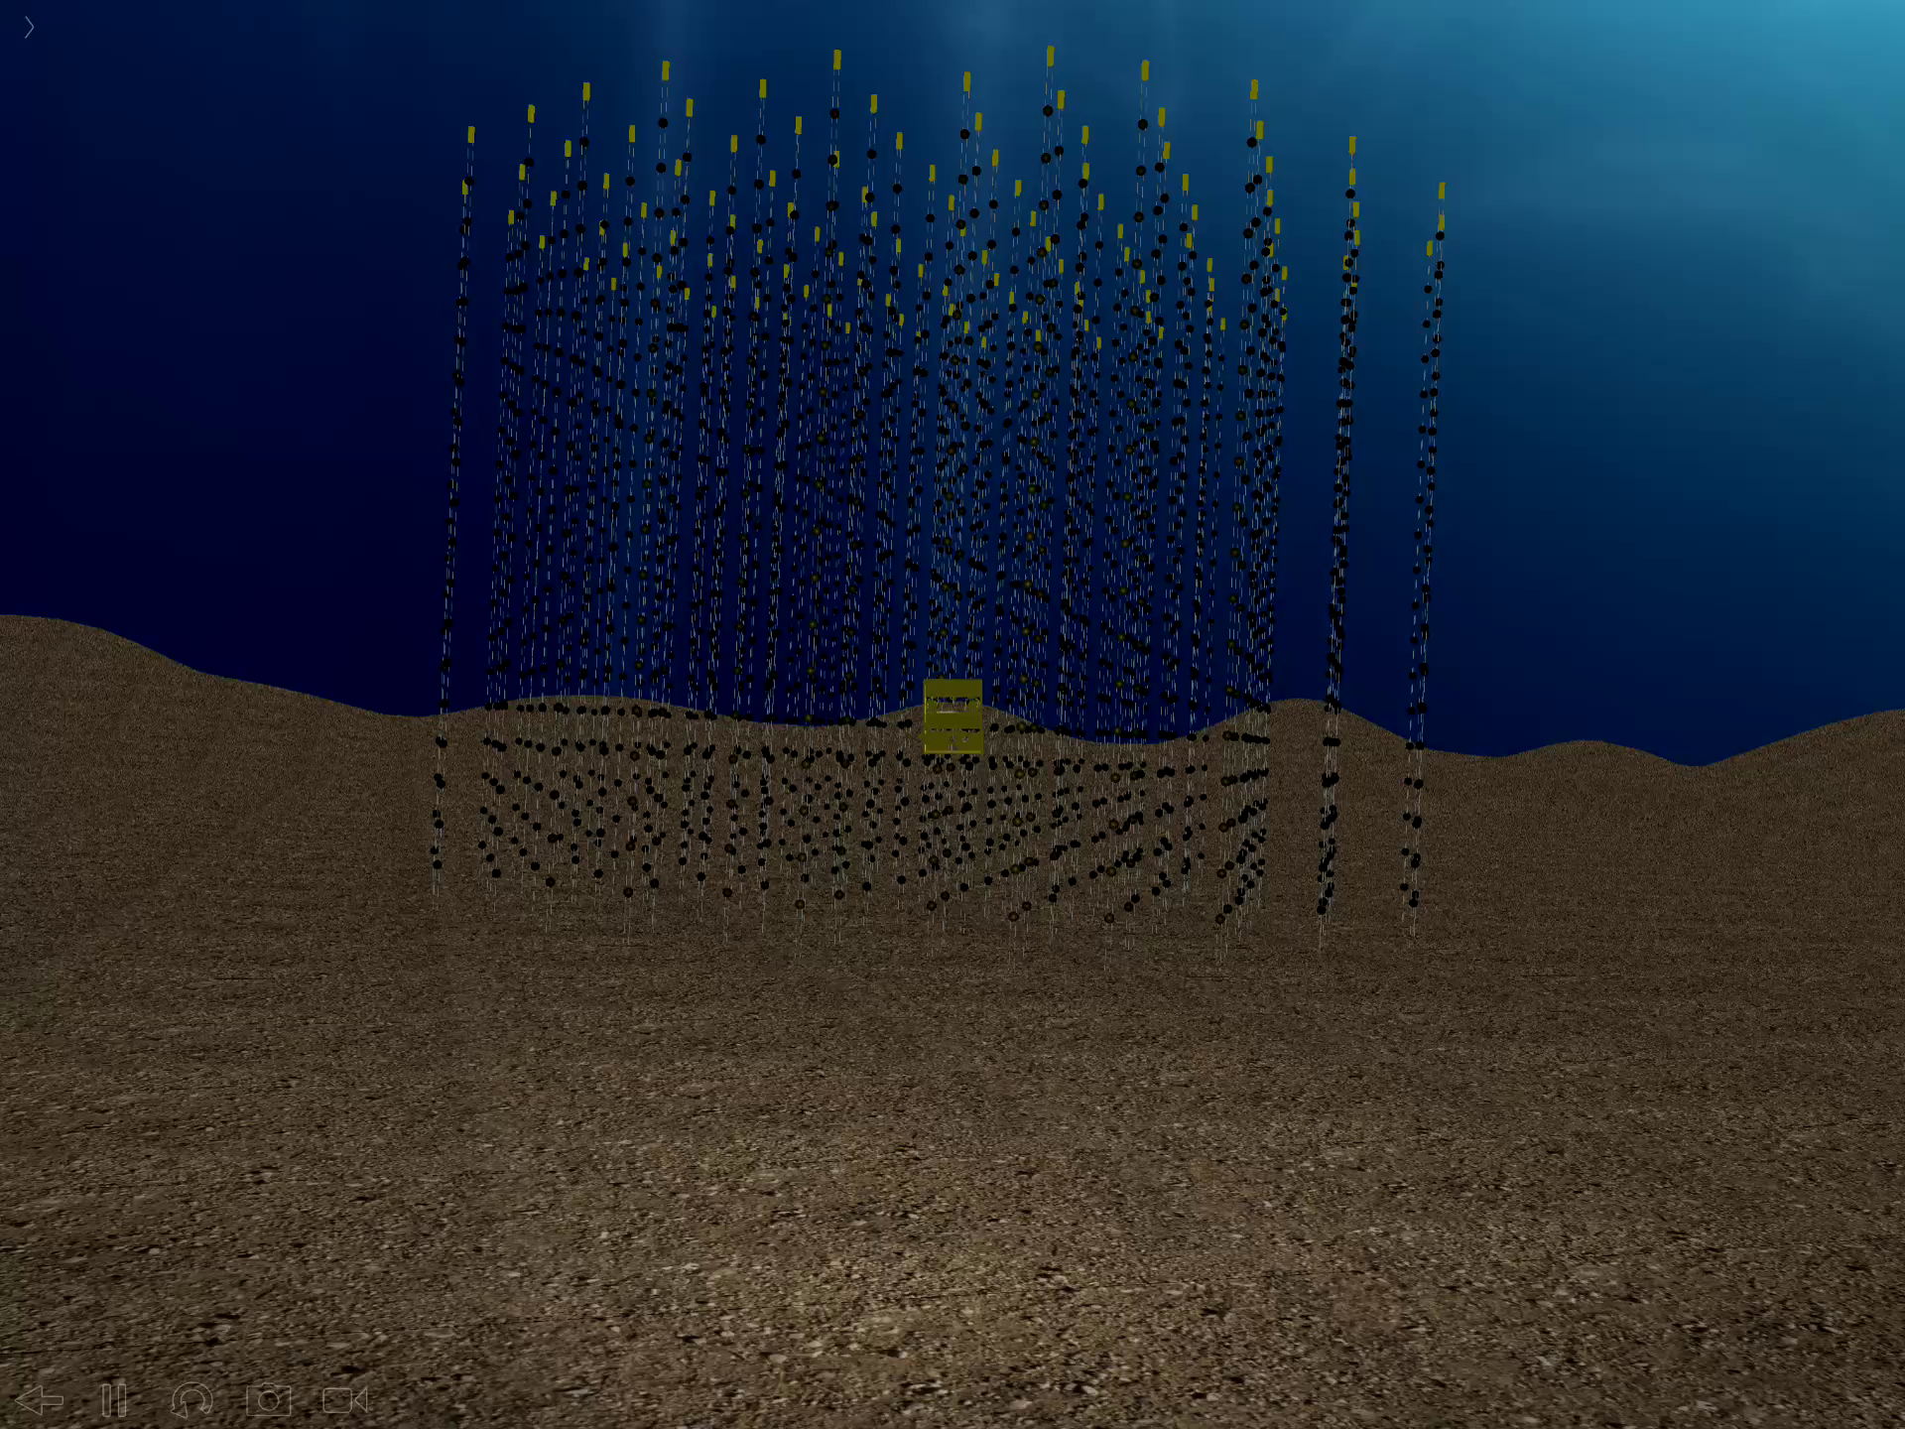
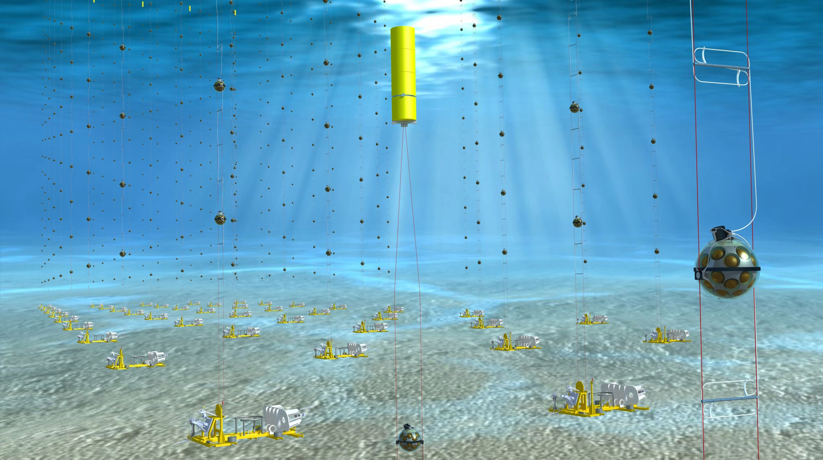
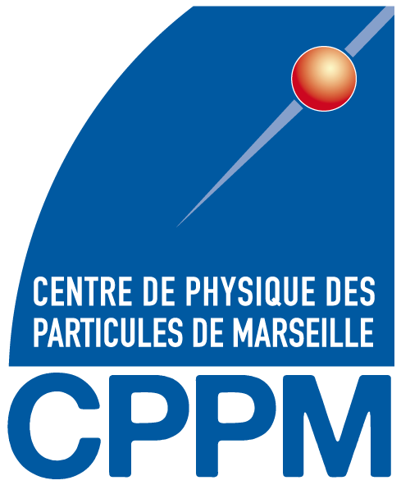

Status and Physics Prospects of
ORCA/KM3NeT
FCPPL/Marseille
23/05/18
Jürgen Brunner
Centre de Physique des
Particules de Marseille

Slide 2
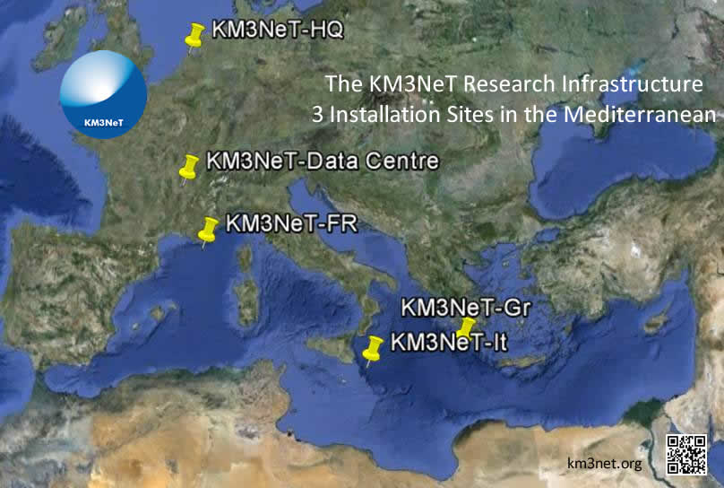
KM3NeT
KM3NeT is a research infrastructure with 2 main physics topics:
- The origin of cosmic neutrinos (high energy)
- Measurement of fundamental neutrino properties (low energy)
- Deep Sea Observatory (Oceanography, bioacoustics, bioluminescence, seismology)
Single Collaboration
Single Technology
Single Management
Low-Energy
(ORCA)
High-Energy
(ARCA)
ARCA- Astroparticle Research with Cosmics in the Abyss
ORCA- Oscillation Research with Cosmics in the Abyss

Slide 3
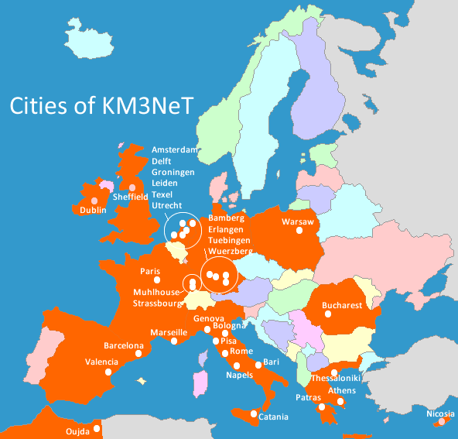
KM3NeT Collaboration
12 Countries
>40 Institutes
>220 Scientists
Mulhouse
Strasbourg
High-Energy
(ARCA)
Granada
Rabat
KM3NeT LoI , arXiv:1601.07459 [astro-ph.IM]
Journal of Physics G: Nuclear and Particle Physics, 43 (8), 084001, 2016

Slide 4
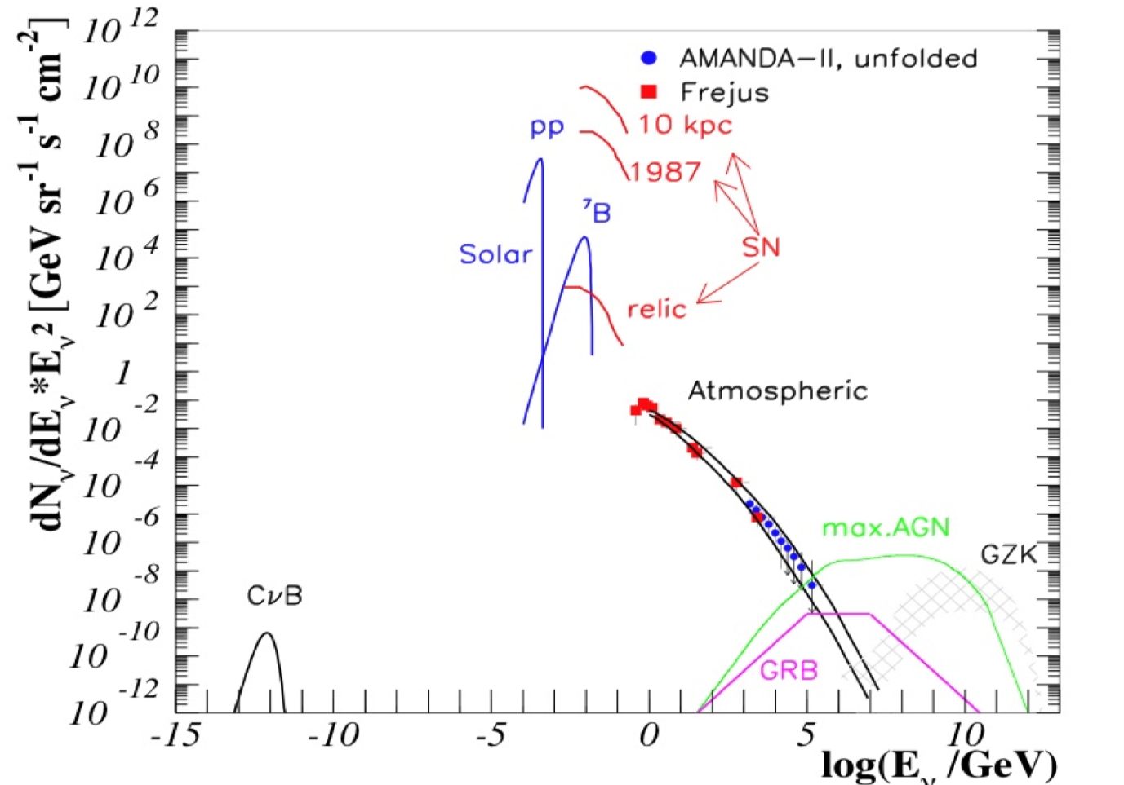
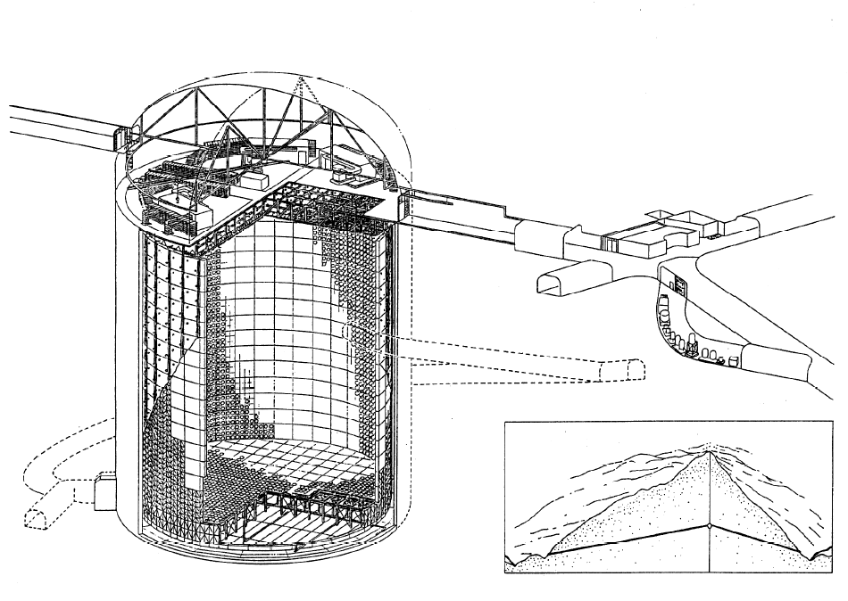
From MeV ν to PeV ν
High energy neutrino:
Small cross-sections
Need large detectors
for wide energy range
ARCA
41 m
ORCA
ANTARES
SuperK

Slide 5
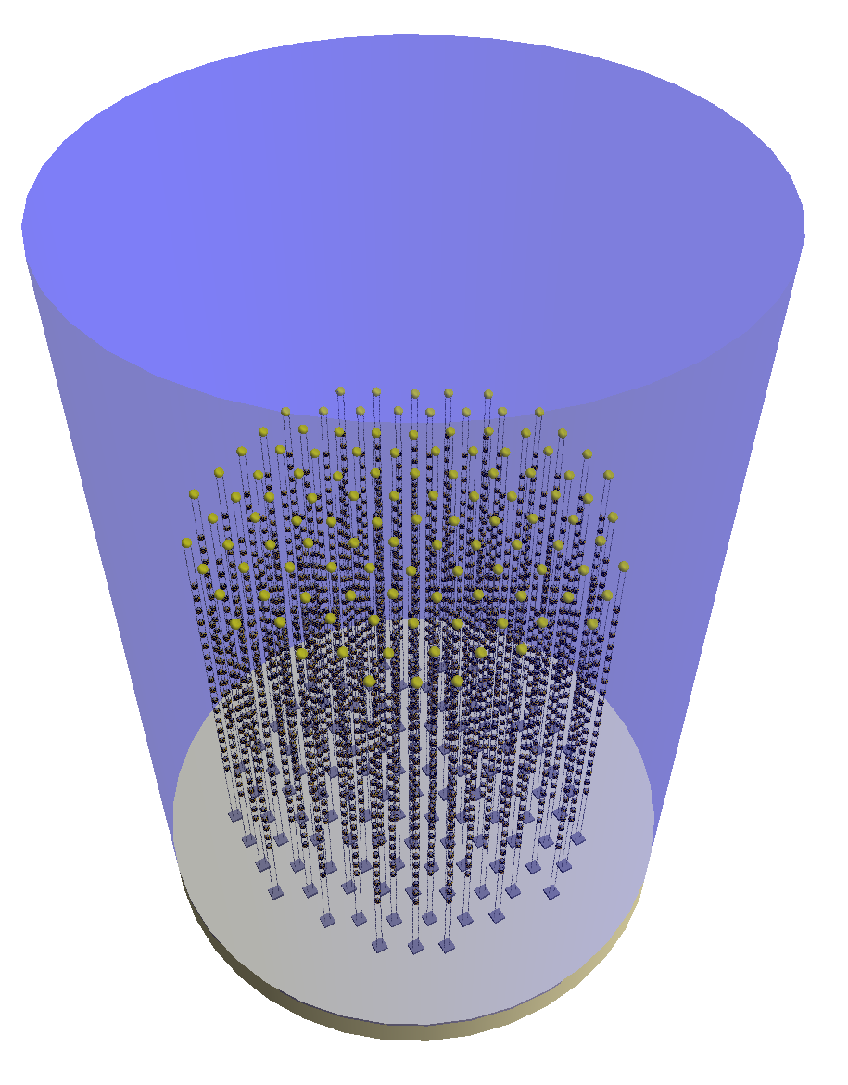
KM3NeT Building Block
ARCA/ORCA
115 strings
18 DOMs / string
31 PMTs / DOM
Total: 64k*3¨ PMTs
115 lines, 20m spaced,
18 DOMs/line 9m spaced
450 m
23/90 m
9/36 m
~200/800 m
 | ORCA | ARCA
String spacing | 23 m | 90 m
OM spacing | 9 m | 36 m
Depth | 2470 m | 3500 m
Instrumented mass | 8 Mton | 0.6*2 Gton
~210/1000 m

Slide 6
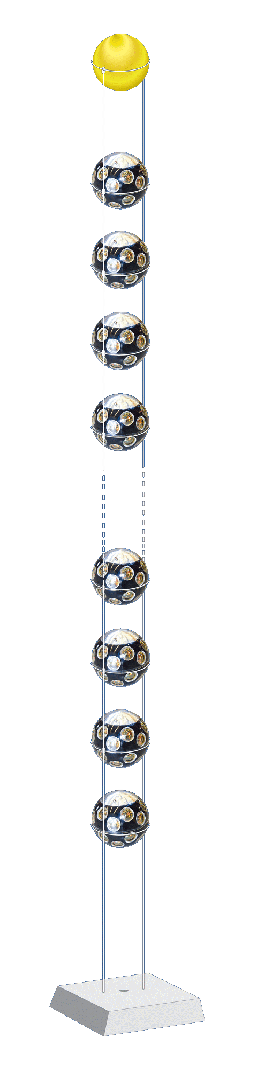
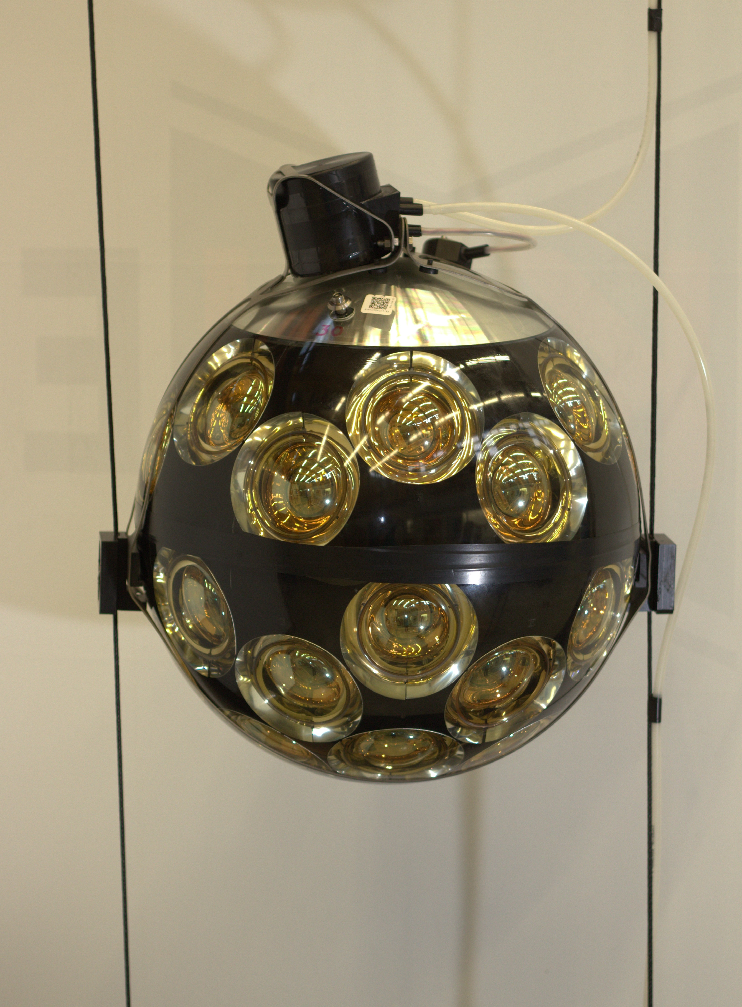
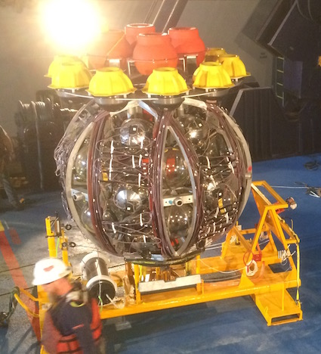

KM3NeT Technology
Optical module
Launcher vehicle
~ 600/150 m
17”
31 x 3” PMTs
PMT HV
LED & piezo inside
FPGA readout
Photon counting
Directional information
rapid deployment
autonomous unfurling
recoverable
6

Slide 7

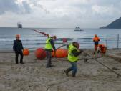
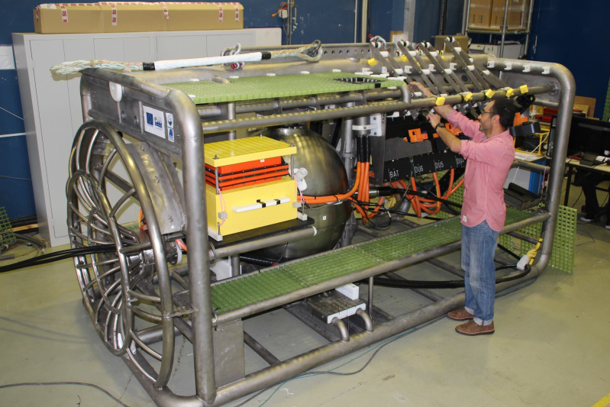
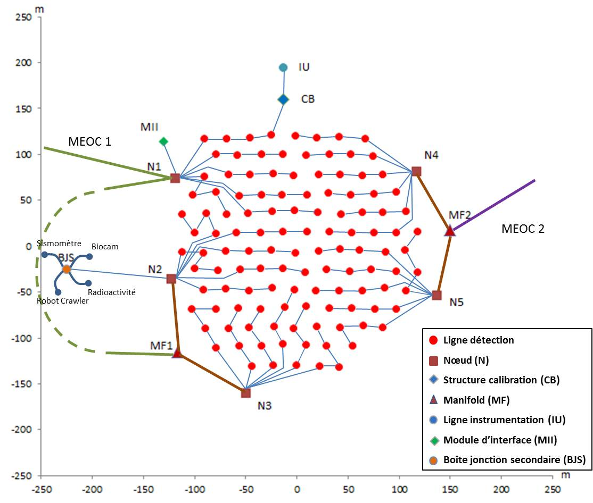
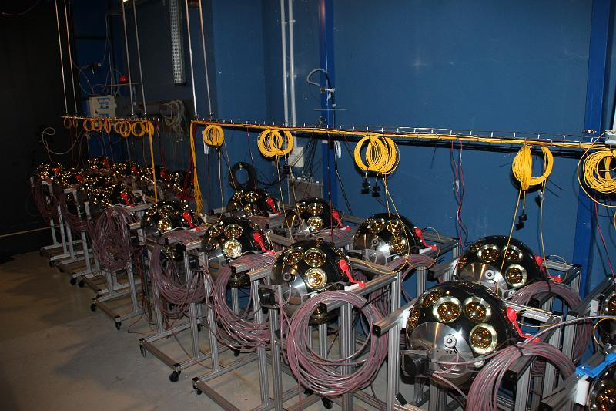
ORCA Status
Main Cable, 2015
Phase 1: 7 string array at KM3NeT-France site
to demonstrate technology/detection
methods in the GeV range
Phase 2: Deploy 1 building block (115 strings)
Junction Box, Sept 2016
Albatross
ANTARES
cable
First ORCA string: Sep 2017

Slide 8
Neutrino Signatures
atmospheric muon
μ±
μ±
neutrino or
charged lepton
⁽⁻⁻⁾
^{ν}_{x}
⁽⁻⁻⁾
^{νμ}
muon neutrino, CC only
(track reconstruction)
all neutrino flavours, CC & NC
(shower reconstruction)

Slide 9
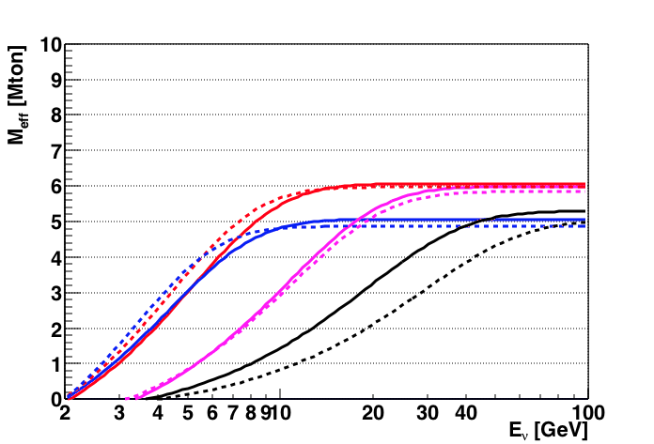
Effective Mass
After triggering, atmospheric muon rejection and containment cuts:
ν_{e}
ν_{μ}
ν_{τ}
NC
Events/yr (atm):
ν_{e}CC: 17,300
ν_{μ}CC: 24,800
ν_{τ}CC: 3,100
NC: 5,300
Energy threshold determined by DOM spacing
6 Mton@10 GeV
50% Efficiency at 5 GeV
Notes:
The above figure shows the precision with which theta23 can be measured by
ORCA. Note that a 2 degree prior has been included, so this does not include a
determination of the octant.

Slide 10
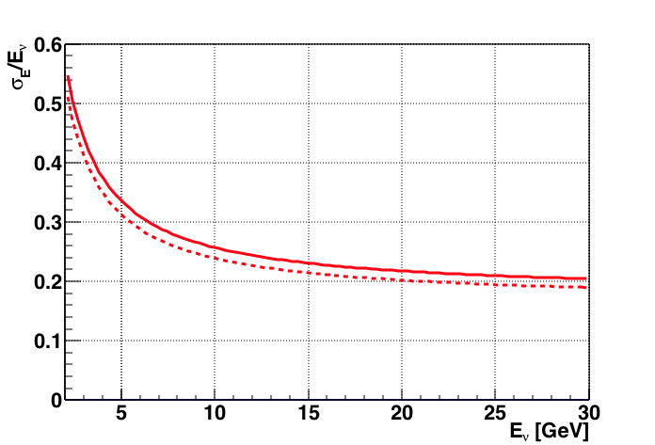
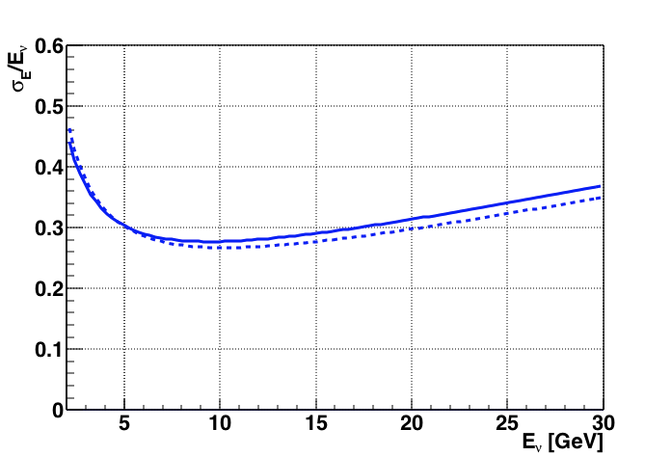
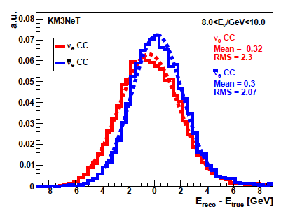
Energy Resolutions
Shower
Track
450 m
ν_{e}
ν_{μ}
Solid : nu
Dashed: anti-nu
KM3NeT
KM3NeT
Energy resolution better
than 30% in relevant range
Close to Gaussian
Notes:
PINGU donne ses performances pour 40 strings; donc un détecteur plus dense que 20 strings.
MONOPOD est une boite niore qui donne l’energie de la gerbe et ignore la trace. Mais on peut penser que la plupart de la lumère vue vient de la gerbe?
E_nu PINGU ORCA
3 0.7 1.0
5 1.2 1.1
7 1.6 1.9
9 2.0 3.2
11 2.7 4.2
13 3.4 5.7
15 3.9 7.5
17 4.7 8.7
19 5.2 9.0

Slide 11
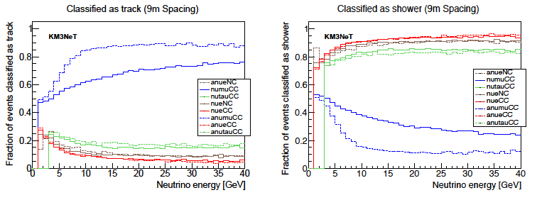
Shower/Track Identification
Discrimination of track-like and shower-like events
via Random Decision Forest
At 10 GeV:
  90% correct identification of ν_{e}^{CC}
  70% correct identification of ν_{μ}^{CC}
Notes:
The different curves show the energy resolved classification performance for different lower cuts on the fraction of
trees in the forest that agree that the event belongs to the class of track like events.
As one can see a stricter cut on the tree fraction increases the classification purity on the expense of the rate
at constant energy. Clearly, the classification rate is much more sensitive to the event energy than the purity. This
indicates that the classification benefits significantly from the increase in light output and track length at higher
energies.
Discrimination between 2 classes of events:
track-like ( ν_{μ}^{CC} ) and shower-like ( ν^{NC}, ν_{e}^{CC} )
Classification using „Random Decision Forest“ machine-learning algorithm.
Discrimination mainly due to event reconstruction observables.

Slide 12

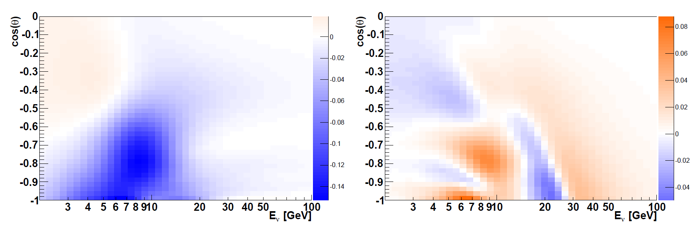
Measuring NeutrinoMassHierarchy
θ_{Z}
Measure neutrino direction and energy
Search for oscillation patterns from matter effects
Requires large statistics and good energy and direction res
ν_{e} + ν_{e} (NH - IH) / NH
ν_{μ} + ν_{μ} (NH - IH) / NH
Fractional Difference
E_{resol} = 25% θ_{resol} = (m_{p}/E)^{1/2}

Slide 13
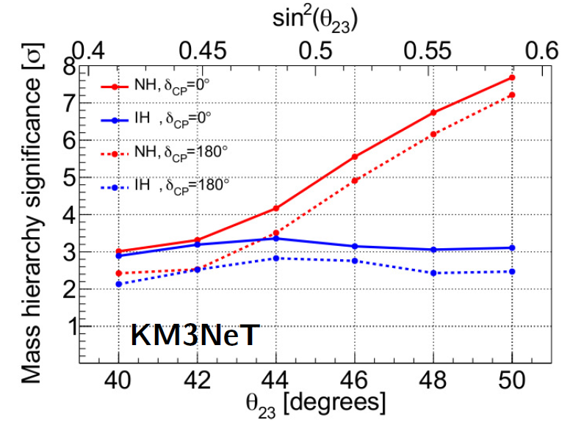
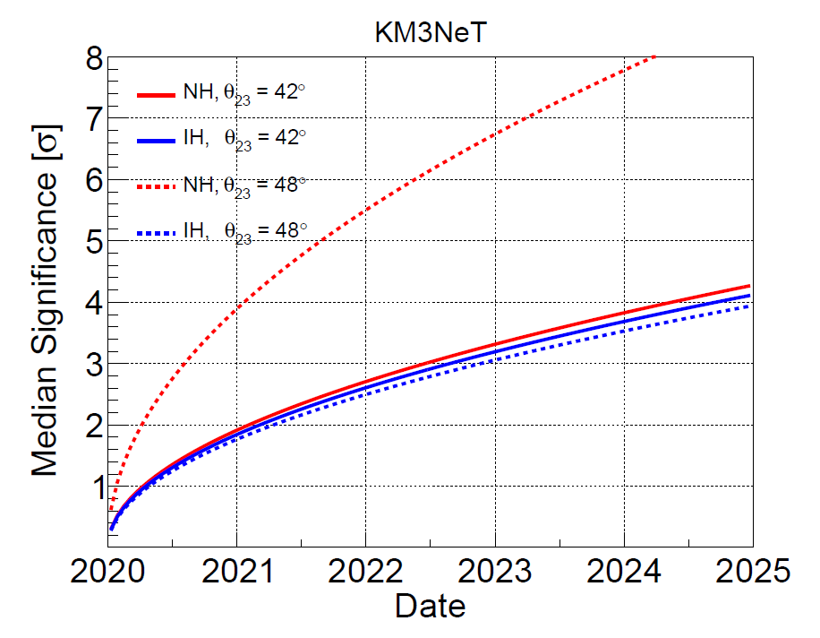
Neutrino Mass Hierarchy
Sensitivity to measure Neutrino Mass Hierarchy
3 yrs
Time evolution of this sensitivity

Slide 14
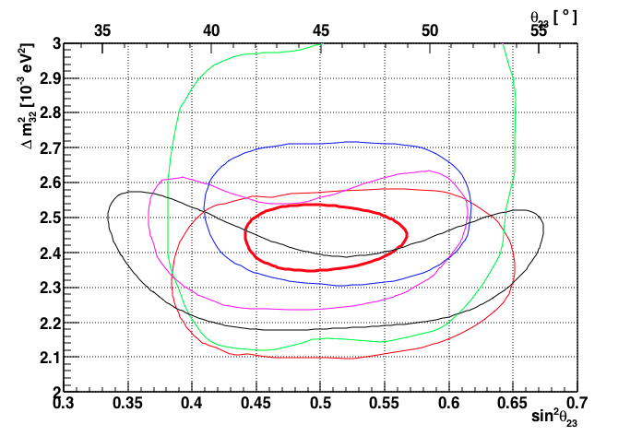
Measuring Oscillation Parameters
90% measurement contours for Δm²₃₂ and sin²θ₂₃
2% in Δm²₃₂ and 5% in θ₂₃
KM3NeT
SuperK
T2K
NOVA
IceCube
MINOS

Slide 15
SuperNovae
Count coincidence signals on individual Optical Modules
Excess of DOMs where 6-10 PMTs fire together
10 MeV anti-nu e from core-collapse SN
>80% of all Galactic SN with single building block

Slide 16
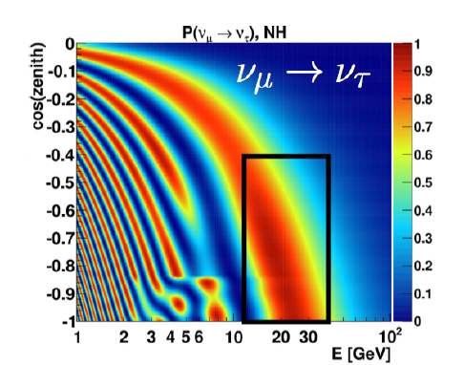
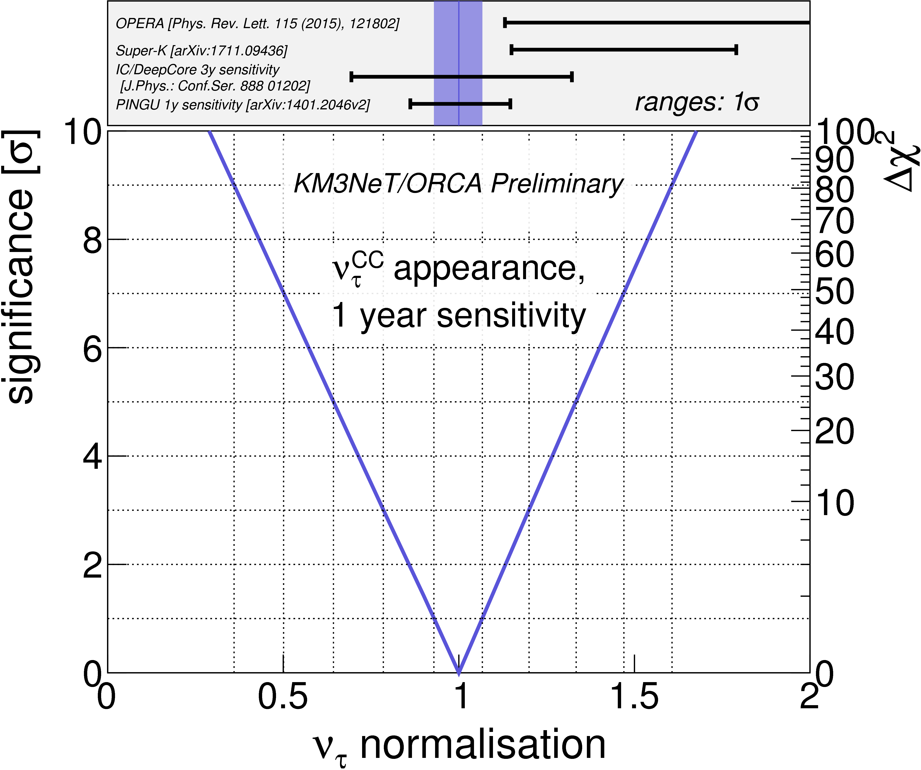
Tau Appearance
≈3k ν_{τ} CC events/year
Rate constrained within ≈10% in 1 year
Weak constraints from other exps

Slide 17
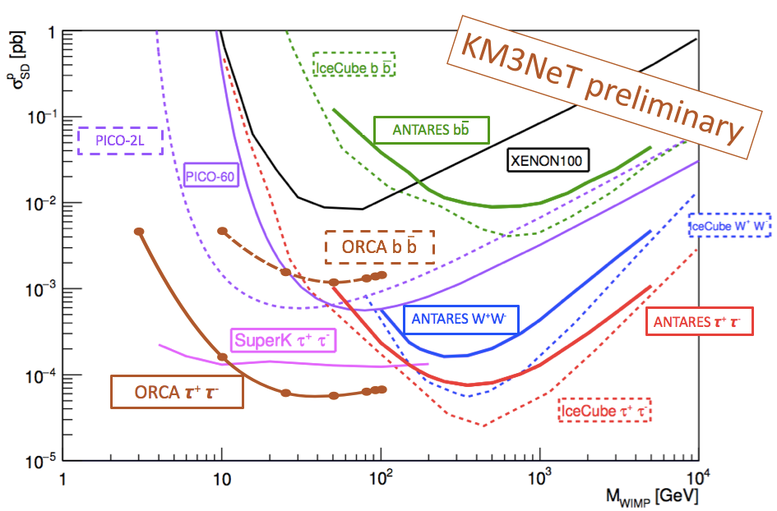
ORCA Post LoI – Dark Matter
ORCA 3 years, track+showers
Competitive for Spin Dependent coupling

Slide 18
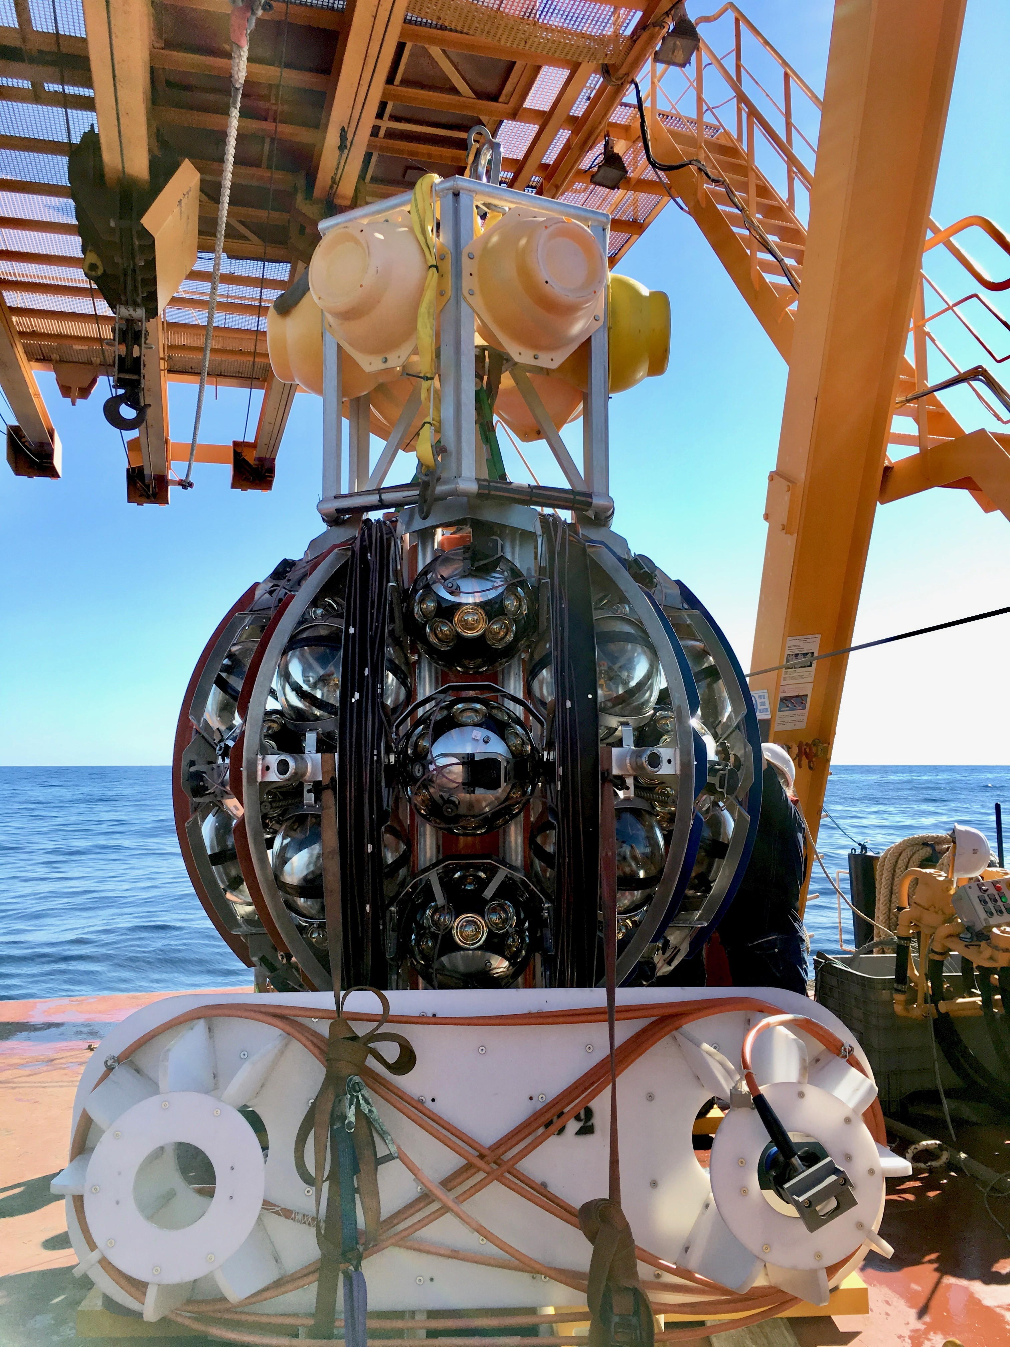
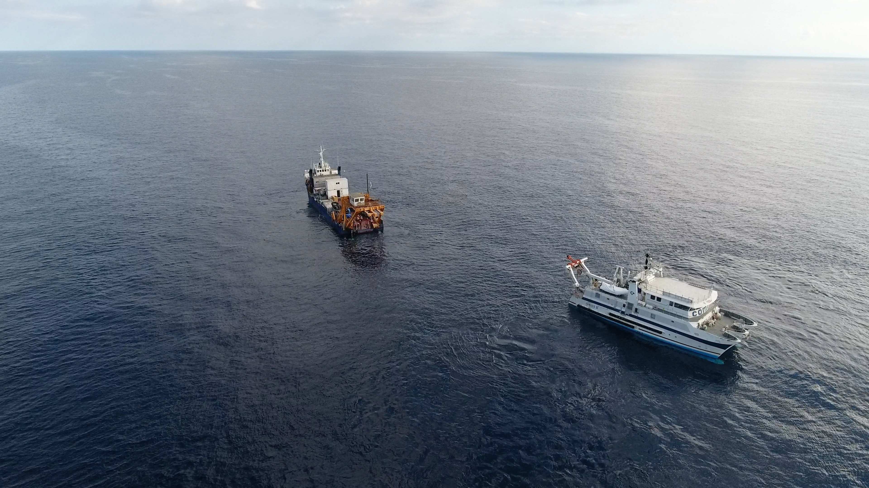
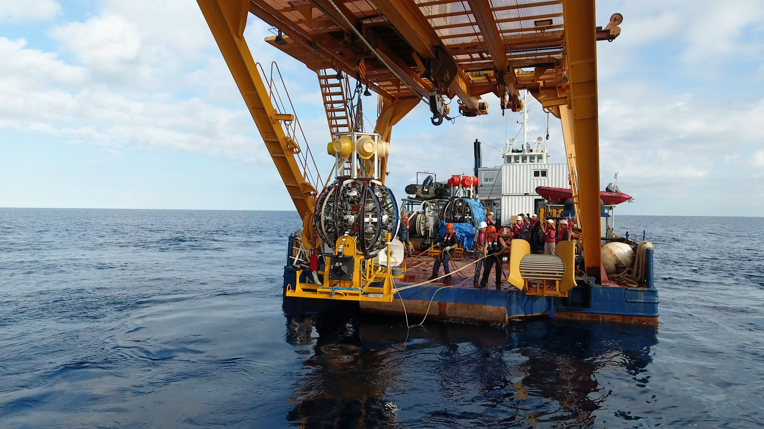
Deployment First Line 22/09/2017
https://www.youtube.com/watch?v=omlFkdCkbYk

Slide 19
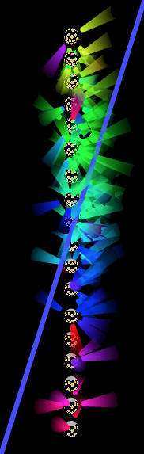
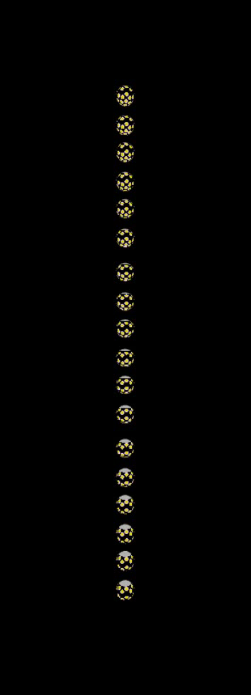
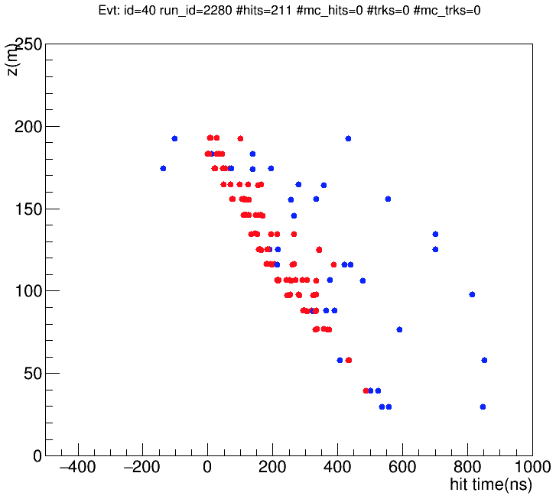
Early Muon bundle

Slide 20
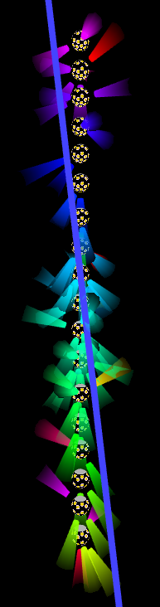
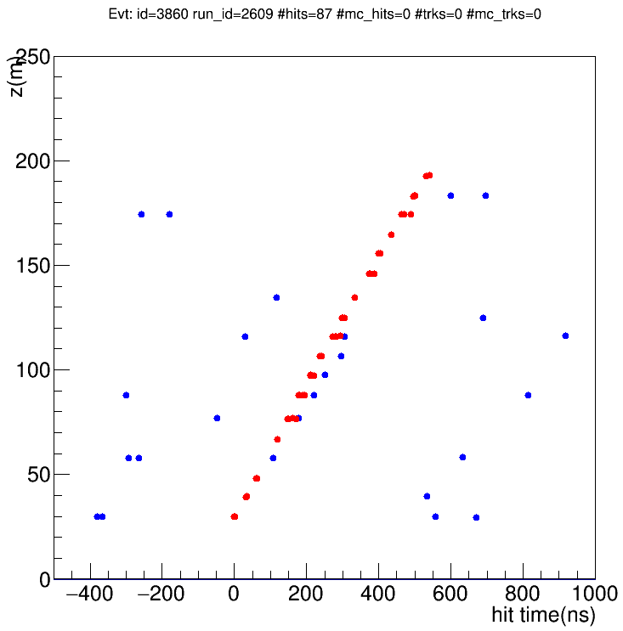
First Neutrino Analysis
1 month of data analysed
MC : (6 ν_{μ} + 1 atm. muon)
Data : 7

Slide 21
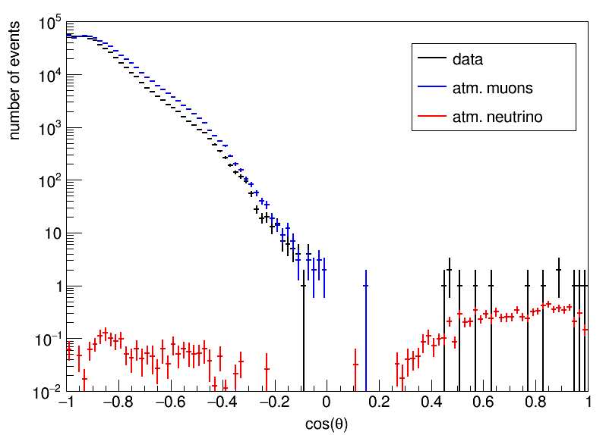
First Neutrino Analysis
82 days of data taking with first ORCA line
cos(theta) > 0 [0.5]
--------------
observed : 13 [10]
atm. muon: 1 [0]
neutrino : 8.33 [7.36]
nu_mu : 5.44 [4.89]
nu_e : 1.36 [1.17]
nu_tau : 0.96 [0.83]
nu_nc : 0.57 [0.47]

Slide 22
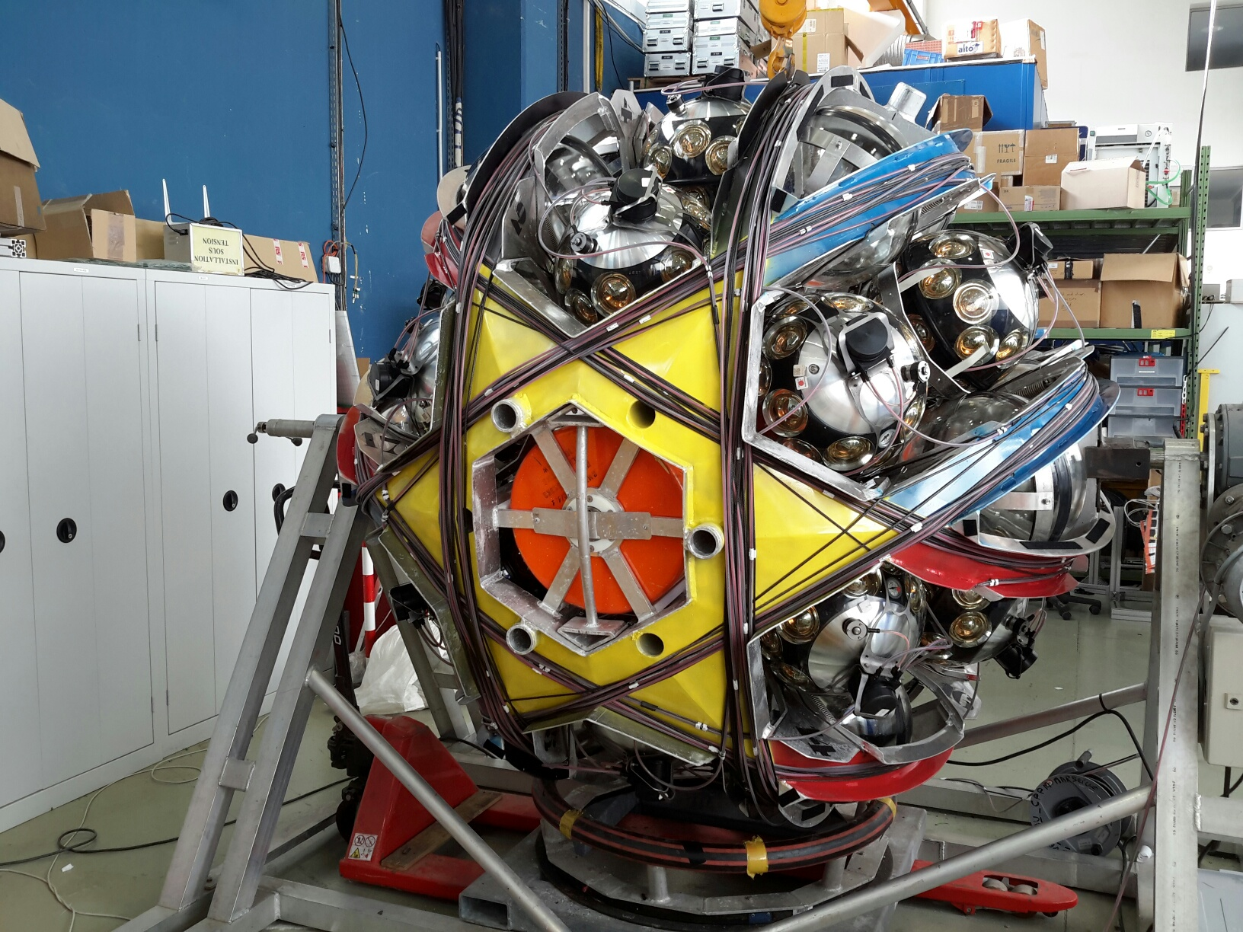
2nd Line ready for deployment
Deployment of 4 lines planned after summer 2018 in a single sea operation

Slide 23
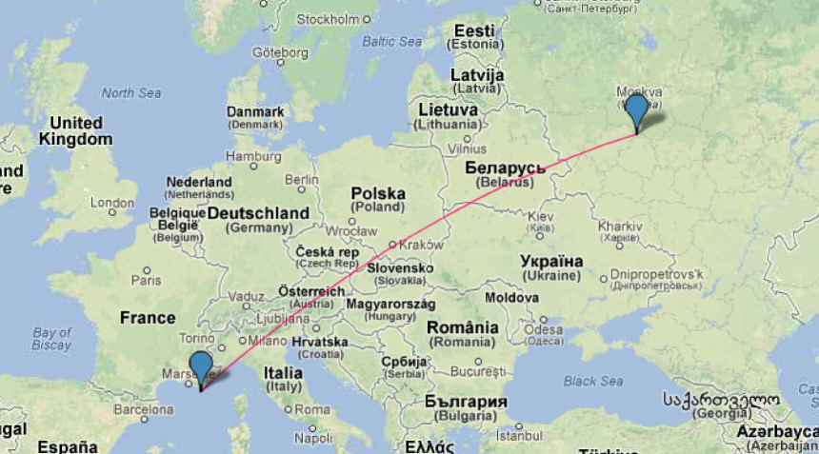
P2O : Protvino to ORCA
Baseline 2588km ; beam inclination : 11.7˚ (cosθ = 0.2)
First oscillation maximum 5.1 GeV
matter maximum 3.8 GeV

Slide 24
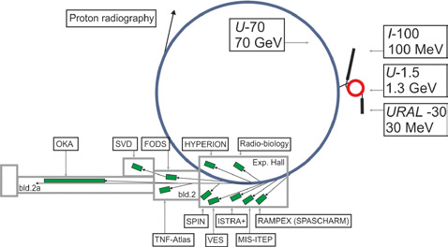
Protvino accelerator complex
(100 km South of Moscow)
1.5 km circumference
U-70 accelerator constructed in 1967
Now operates at 8 - 15 kW for ~ 60 days / yr
Upgrade to 450 kW feasible

Slide 25
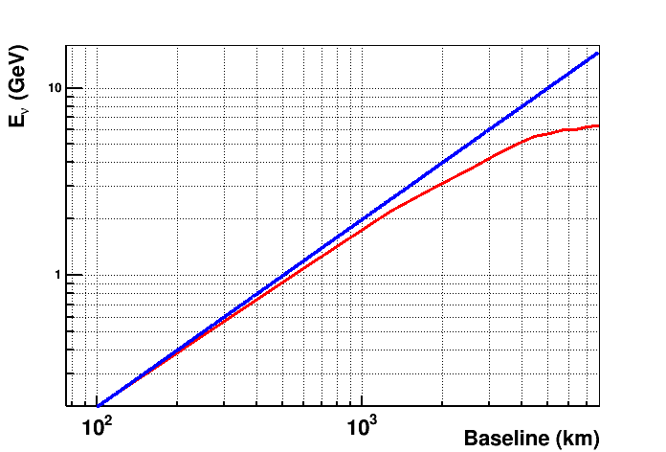
Comparison of LBL Projects
Energy versus baseline
1st Min P(ν_{μ}→ν_{μ})
1st Max P(ν_{μ}→ν_{e})
Matter resonance
P2O
4-5GeV
DUNE
2.4GeV
NOvA
1.6GeV
P2O
NOvA
T2K
HyperK
0.6GeV
DUNE
T2K
HyperK
Daya Bay (2km)
4.0 MeV

Slide 26
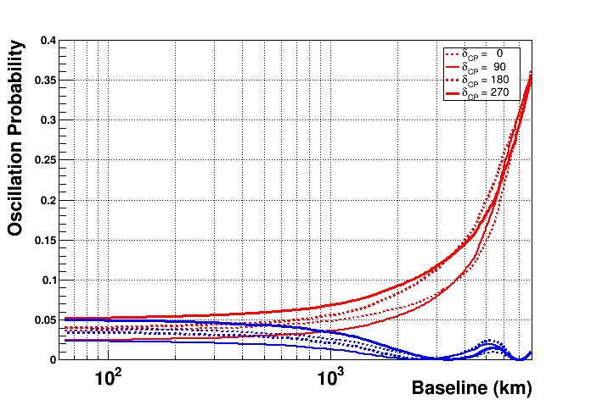
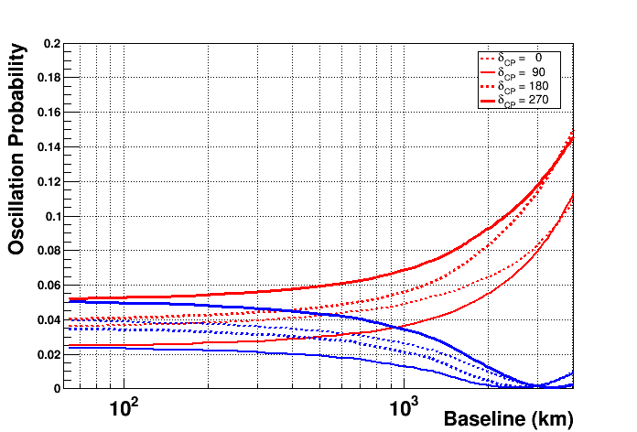
Comparison of LBL Projects
Main Signal : Appearance of ν_{e} : P(ν_{μ}→ν_{e})
CPV and mass hierarchy degenerate
DUNE
P2O
T2K
HyperK
NOvA
Normal
hierarchy
Inverted
hierarchy

Slide 27
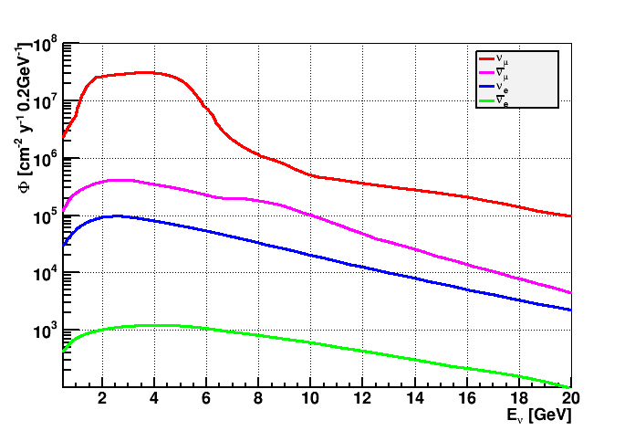
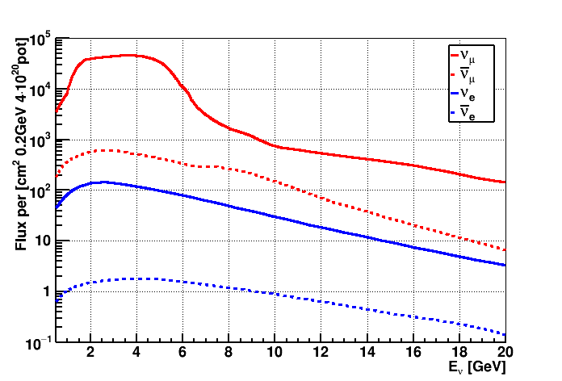
Neutrino Flux
Used for current study : IHEP Protvino internal note 2015-5
Designed for Beam to Gran Sasso (2200km)
Beam power 450kW → 4•10²⁰ p.o.t. per year
Fermilab-Nova : 700kW → 6•10²⁰ p.o.t. per year
Focus π⁺ (Neutrino beam)

Slide 28
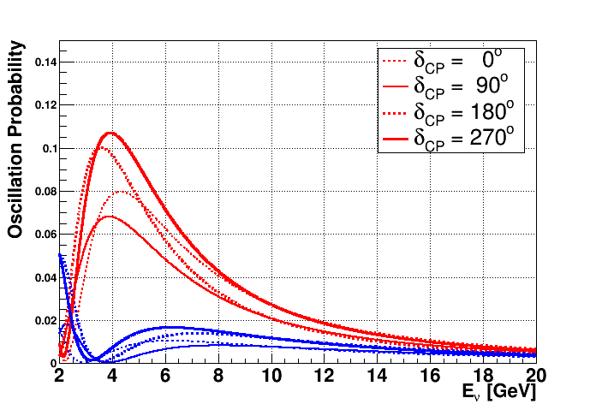
Oscillation Probabilities
P(ν_{μ}→ν_{e})
40% variation
L = 2590km
Normal hierarchy
Inverted hierarchy

Slide 29
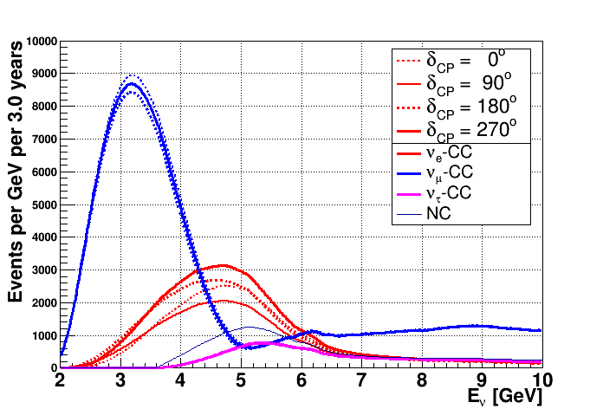
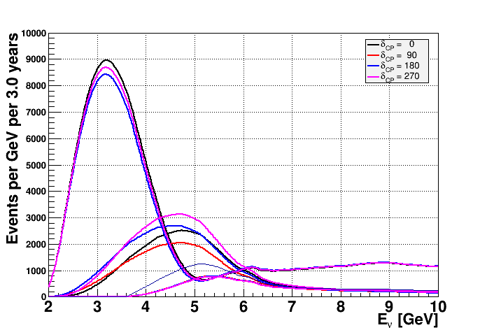
Event numbers – Neutrino Beam
3 year, θ₂₃=42°
Normal Hierarchy
ν_{μ}
3%
(total variation with δ_{CP})
Events
6600-9300
31000 ± 500
3520 ± 30
5900
ν_{e}
41%
NC
ν_{τ}

Slide 30
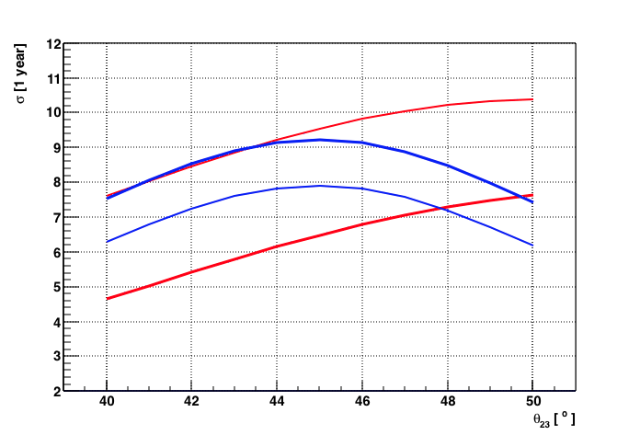
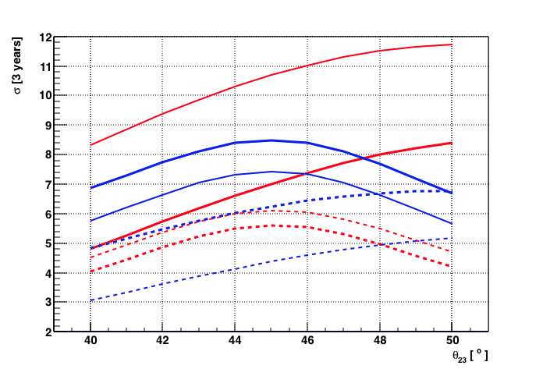
NMH determination
ORCA detector, 1 year neutrino beam
Better than 5σ for all combination of parameters
δ_{CP}
270°
90°
90°
270°
NH
IH

Slide 31
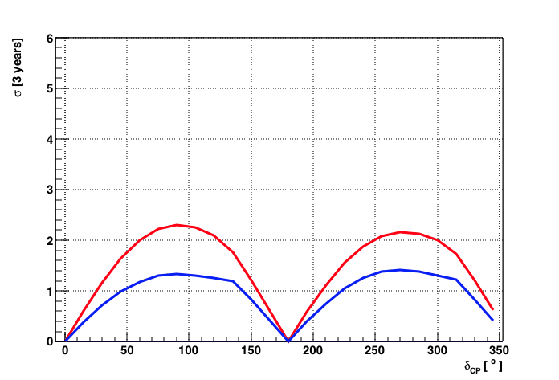




Sensitivity to δ_{CP}
Sensitivity of measuring non-zero CP-violation, i.e. δ_{CP} different from 0° AND 180°
After 6 years non CP-violation excluded for 35% of δ_{CP} values at about 3σ
3 years
NH neutrino beam
6 years
NH neutrino beam

Slide 32
Complementarity JUNO – ORCA
Different neutrino source, detection technique
Different energy range
Different systematics
 | JUNO | ORCA
Neutrino source | reactor | atmosphere
Neutrino energies | 1-10 MeV | 1-20 GeV
Detection technique | Scintillation | Cherenkov light
Leading systematics for NMH | Energy scale Scintillator light yield | Particle ID Neutrino flux

Slide 33
Complementarity JUNO – ORCA
Competing for Neutrino Mass Hierarchy, but
Different physics program beyond that :
 | JUNO | ORCA
Δm₂₁ | < 1% | ---
θ₁₂ | < 1% | ---
Δm₃₂ | < 1% | < 2%
θ₂₃ | --- | < 5%
δ_{CP} | --- | P2O, SuperORCA

Slide 34
Conclusion
KM3NeT / ORCA construction has started
Rich physics program, first results already with few detector lines
Complementary to other projects, notably Juno
Interesting options for “Phase 3” → CP violation

Slide 35
Backup

Slide 36

Antares Optical Module Efficiencies
After 7 years, 20% drop (blue : HV tuning)
Long-term operation in deep sea possible

Slide 37

ORCA: Oscillation Physics
Baselines and energies inaccessible to LBL or reactor neutrino experiments
Very different systematics
Above tau production threshold

Slide 38

Singles rates: ORCA1 vs ANTARES
Normalised
Singles rate
ORCA
ANTARES
For same sea current ➔ less bioluminescence in ORCA cf ANTARES
38

Slide 39


Compass Data
2 days
All 18 DOMs
100°
yaw
Line orientation
very stable over 2 months
40°
roll

Slide 40



Events after PID
δ_{CP} | 0° | 90° | 180° | 270°
tot | 20386 | 20065 | 20121 | 20432
ν_{e} | 1021 | 904 | 1178 | 1294
ν_{μ} | 17929 | 17717 | 17506 | 17709
ν_{τ} | 677 | 685 | 679 | 671
NC | 758 | 758 | 758 | 758
δ_{CP} | 0° | 90° | 180° | 270°
tot | 28084 | 27016 | 28188 | 29246
ν_{e} | 6570 | 5710 | 7142 | 8001
ν_{μ} | 13509 | 13270 | 13034 | 13263
ν_{τ} | 2842 | 2873 | 2848 | 2818
NC | 5164 | 5164 | 5164 | 5164
Tracks
NH
Cascades
NH
Total 8%
Total 2%
ν_{μ}
ν_{μ}
ν_{e}
ν_{e}
NC
ν_{τ}

Slide 41
Comparison of LBL Projects
Main Signal : Appearance of ν_{e} : P(ν_{μ}→ν_{e})
Normal
hierarchy
CPV and mass hierarchy degenerate
DUNE
P2O
T2K
HyperK
NOvA
Inverted
hierarchy

Slide 42

Cross section
At 5 GeV dominated by deep-inelastic reactions
Better known than quasi-elastic and resonant
Minerva arXiv:1701.04857

Slide 43

Cross section
Below 3 GeV uncertainty explodes
(Final State Interaction)
Minerva arXiv:1701.04857

Slide 44


Event numbers – Neutrino Beam
3 year, θ₂₃=42°
Inverted Hierarchy
ν_{μ}
Events
2200 ± 400
30800 ± 100
3730 ± 20
5900
NC

Slide 45

Proton Accelerator Complex Protvino
Presentation S. Ivanov (IHEP) on 22/11/2012 @ CERN

Slide 46
Modified Multi-Parameter fit
Combined fit of nuisance and oscillation parameters
Choice of nuisance parameters and priors inspired by LBNO study
Parameter | True value | Prior | Start value
θ₁₂ | 33.4° | fix | fix
Δm² [eV²] | 7.53 10⁻⁵ | fix | fix
θ₁₃ | 8.42° | 0.15° | 8.42°
θ₂₃ | 41.5° | 1.3° | 41.5°
ΔM² [eV²] | 2.44 10⁻³ | 0.06 | 2.44 10⁻³
δ_{CP} | many | no | many
Parameter | True value | Prior | Start value
Norm ν_{e} CC | from ν_{μ} CC | fix | fix
Norm ν_{μ} CC | 1 | 0.05 | 1
Norm ν_{τ} CC | 1 | 0.10 | 1
Norm NC | 1 | 0.05 | 1
PID | 1 | 0.10 | 1
Only used for CP fits, not for NMH

Slide 47


Comparison to DUNE CDR
https://arxiv.org/abs/1601.05471
CP violation after 3 years → ORCA comparable
3 years
NH neutrino beam
78% @ 1σ

Slide 48








Measurement of δ_{CP}
sdgfb
3 years
NH neutrino beam
δ_{CP}=0°
δ_{CP}=90°
δ_{CP}=180°
δ_{CP}=270°

Slide 49
Comparison of Future projects
Advantages / challenges are complementary
Experiment | Baseline Energy | Detector | Advantages | Challenges
Dune | 1300km 2.4 GeV | Liquid Ar 40 kton | Resolution Particle ID | Technology Scalability
HyperK | 295 km 0.6 GeV | Pure Water 0.3 Mton | Proven concept | Cavern, phototube production
P2O | 2600km 5 GeV | Sea Water 8 Mton | Low cost High statistics | Particle ID

Slide 50



ORCA Post LoI: Sterile, NSI, Tomography
Non-Standard Interactions
Sterile Neutrinos
Earth Tomography
10 year sensitivity (w systematics)
Mantle
NH
IH
Outer
core
Good sensitivity in U_{τ4} mixing
Factor of two better sensitivity
cf current limits from SK and IC
after only 1 year of data taking
ORCA sensitive to NSI effects
≈10% of the Fermi int.
Direct bounds are more than
10x larger in some cases
ORCA improves over current
atmospheric scale bounds
ORCA is sensitive to N_{e}
geophysics measure ρ_{m}
1σ stat.+ syst. Uncertainty:
5% in the whole mantle
6% in the whole outer core

Slide 51


ORCA Post LoI - Tau Appearance
ν_{τ} appearance tests PMNS unitarity and BSM theories
20% deviation of unitarity can be detected with 5σ in 3y

Slide 52




ORCA1: Data vs MC

Slide 53

Possible location of the near beam detector
Bend of proton beam in:
horizontal plane – 21.7⁰
vertical plane – 11.8⁰
~ 90 m of 1.6 T magn. field
Target hall
Beam dump
Max. depth (with respect
to the beam level in U70):
target hall – 8 m
beam dump – 32 m
near detector – 60 m
Near detector

