Slide 1
CMS upgrade
New electronics for the CMS RPC upgrade project
I.Laktineh

Slide 2
IPNL-Tsinghua collaboration
Collaboration between IPNL and Tsinghua started in 2008 on RPC detectors for the SDHCAL prototype
In 2012 a common proposal to upgrade the CMS high eta muon stations with a new generation of RPC with good timing.
The two groups have their collaboration that go beyond the two projects. It Is a scientific partnership
Tsinghua members:
Yi Wang, Dong Han, Xinjie Huang , Pengfei Lyu, Fuyue Wang, Yancheng Yu.
IPNL members:
Imad Laktineh, Laurent Mirabito, Gerald Grenier, Maxime Gouzouvitch, F.Lagarde, Konstantin Shchablo.

Slide 3
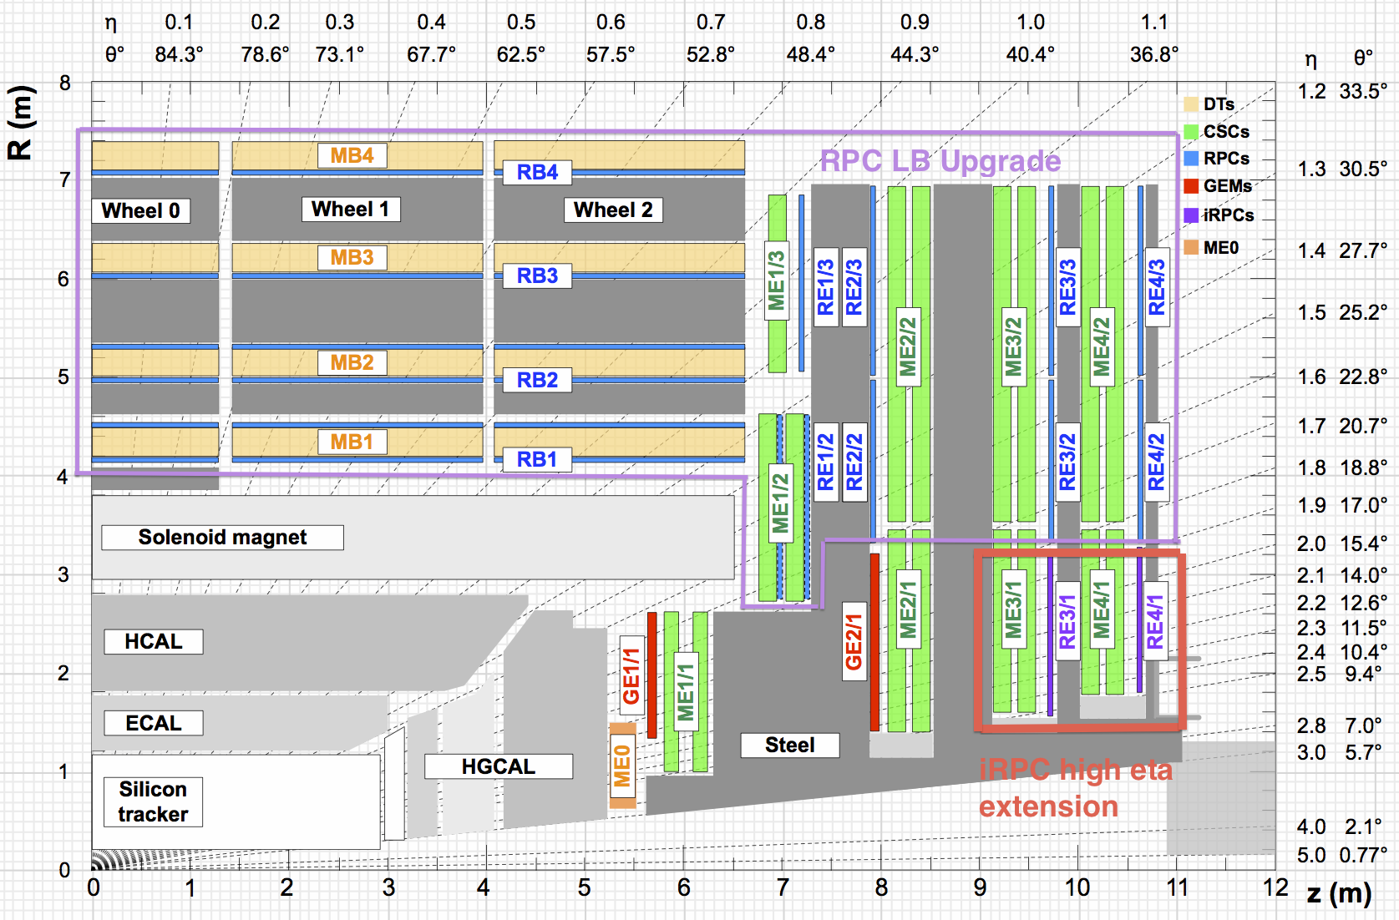
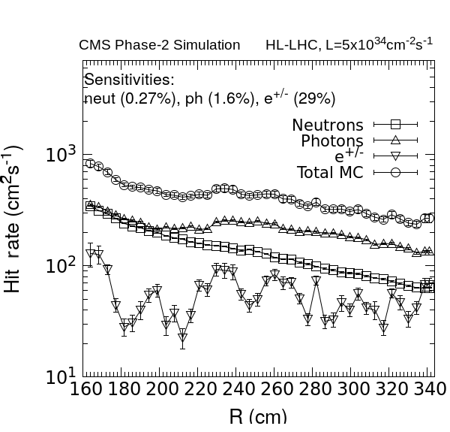
RPC upgrade project
Requirements and specifications
To improve on the muon trigger efficiency at high η
Background mitigation
HSCP search
iRPC location:
|η| = 1.8 – 2.5
RE3/1 and RE4/1 (36 chambers/station)
 | Present system | RE3/1-RE4/1
|η| coverage | 0 - 1.9 | 1.8 – 2.4
Max. expect. rate | 3 x 200 | 3 x 700
ϕ resolution | ~ 0.3 degrees | ~ 0.2 degrees
η resolution | O(20 cm) | O(2 cm)

Slide 4
RPC upgrade project
Requirements and specifications
Improving rate capability:
Smaller avalanche charge → thinner gas gaps + thinner electrodes
Thinner gap+electrodes allow:
lower Working Voltage-→ safer operations
Lower charge -> improve aging
Two RPC technologies were proposed: HPL-based (standard CMS) with reduced gas gap and electrode thickness (1.4mm) and glass-based thin RPC (1mm) proposed by Tsinghua-IPNL.
The proposed readout electronics is based on 2-D readout with timing information proposed by IPNL-Tsinghua.

Slide 5
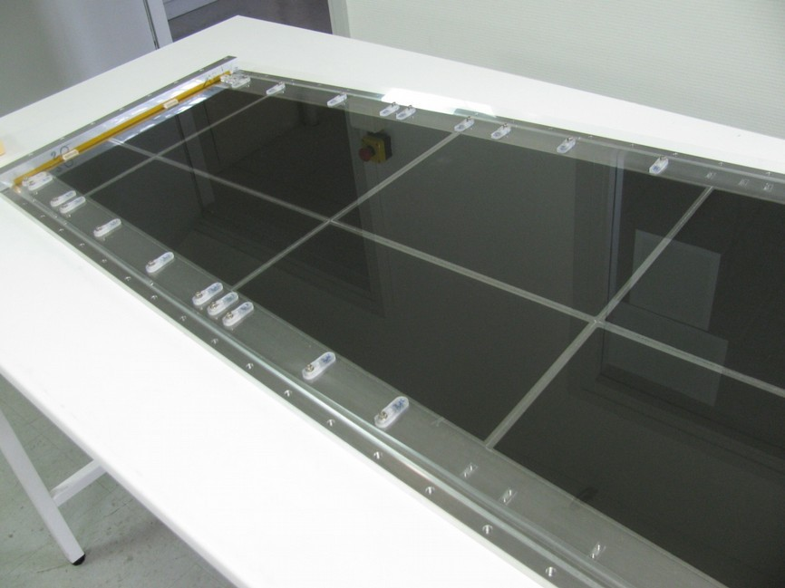
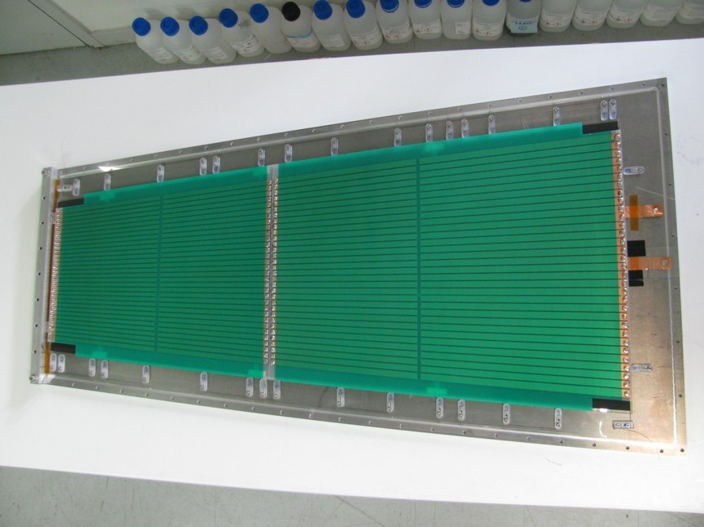
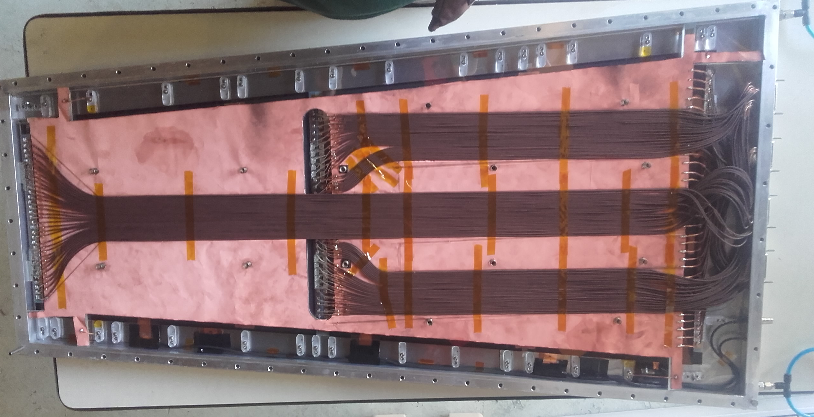
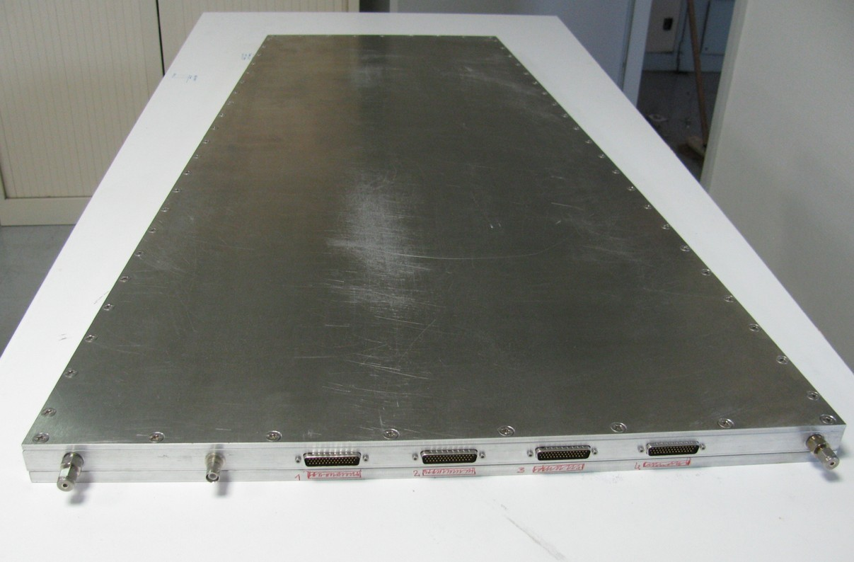
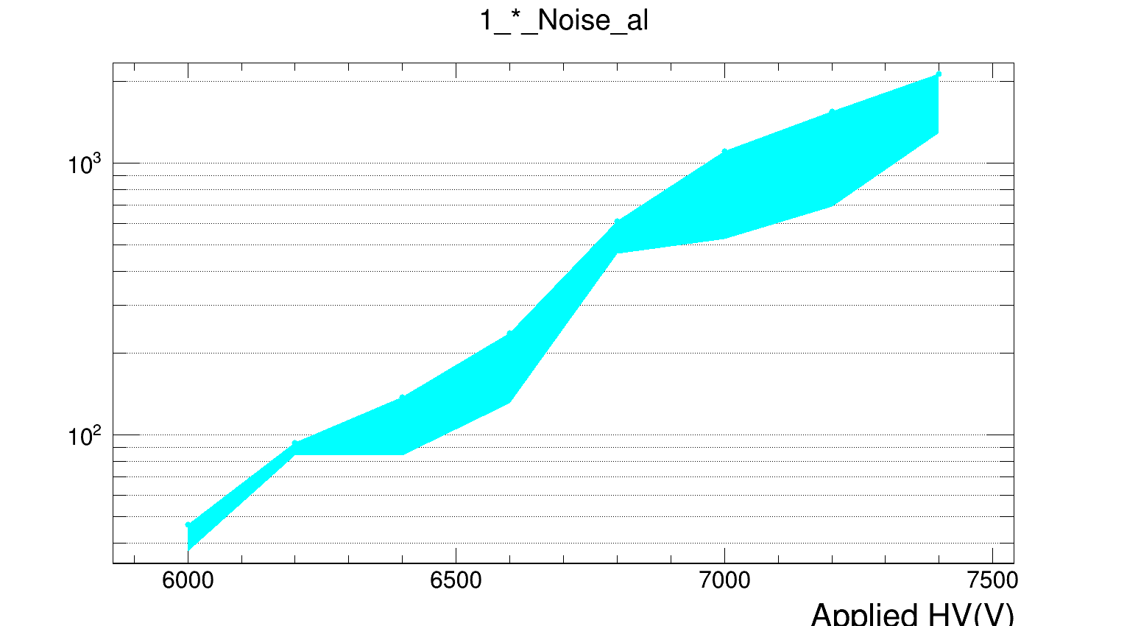
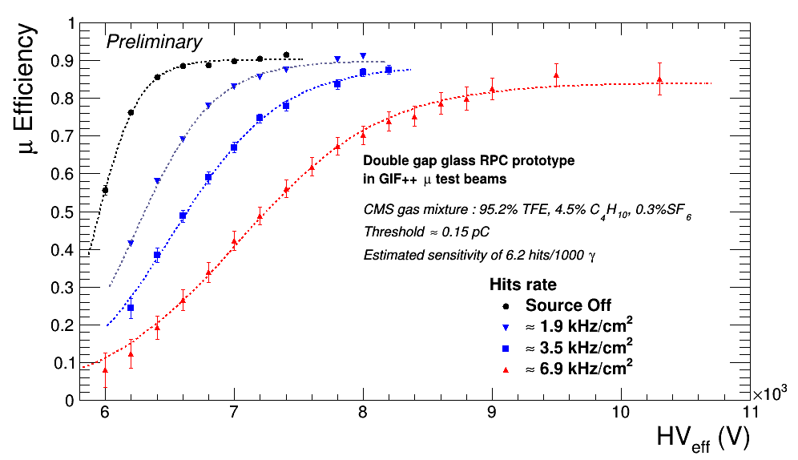
Large prototypes with the glass technology were produced and tested at GIF++
The tests were done using the standard CMS gas mixture (0.3% SF6) which was found not to be appropriate for the glass technology but CMS collaboration was reluctant to use a gas with higher SF6 rate

Slide 6
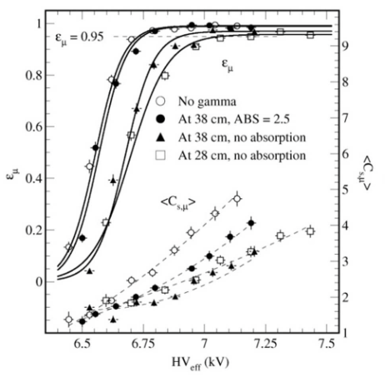
HPL based RPC were thus chosen. Indeed, the new design allows operating at higher particle rates at lower HV and with the same efficiency.
Working Point shift: ~ 300 V (ΔV/V ~ 4 %)
Efficiency drop: < 3 %
Max tested rate: 1.85 kHz
 | Present system | RE3/1-RE4/1
layout | Double gap | Double gap
Gas gap thickness | 2 mm | 1.4 mm
HPL thickness | 2 mm | 1.4 mm
HPL resistivity | 1-6 × 10¹⁰ Ω •cm | 0.9-3 × 10¹⁰ Ω •cm
Charge threshold | 150 fC | 50 fC
Eta segmentation | 3 eta partitions | 2D readout

Slide 7
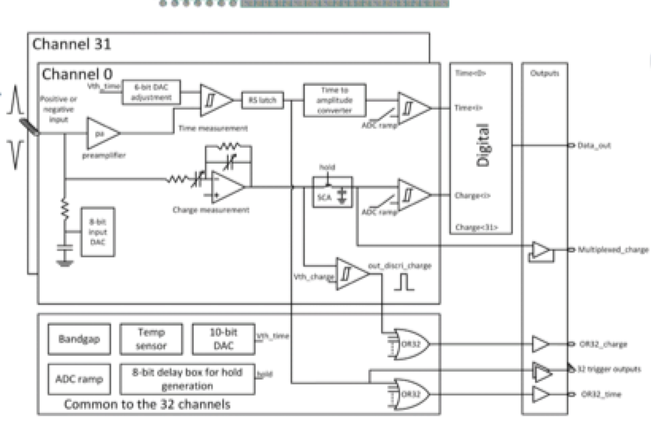
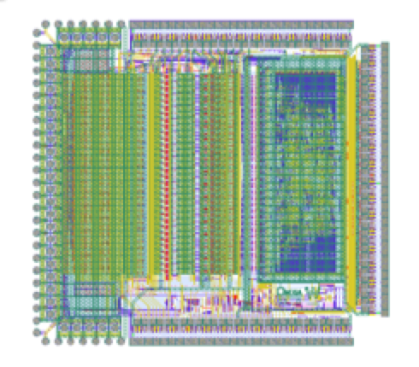
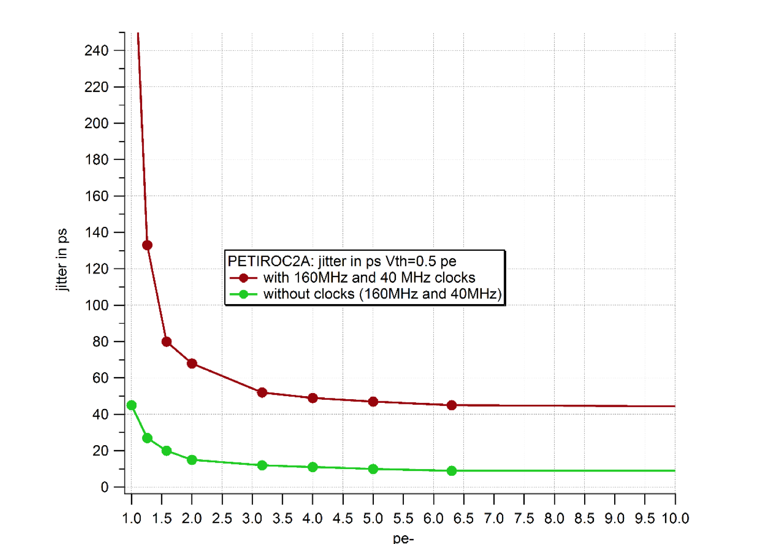
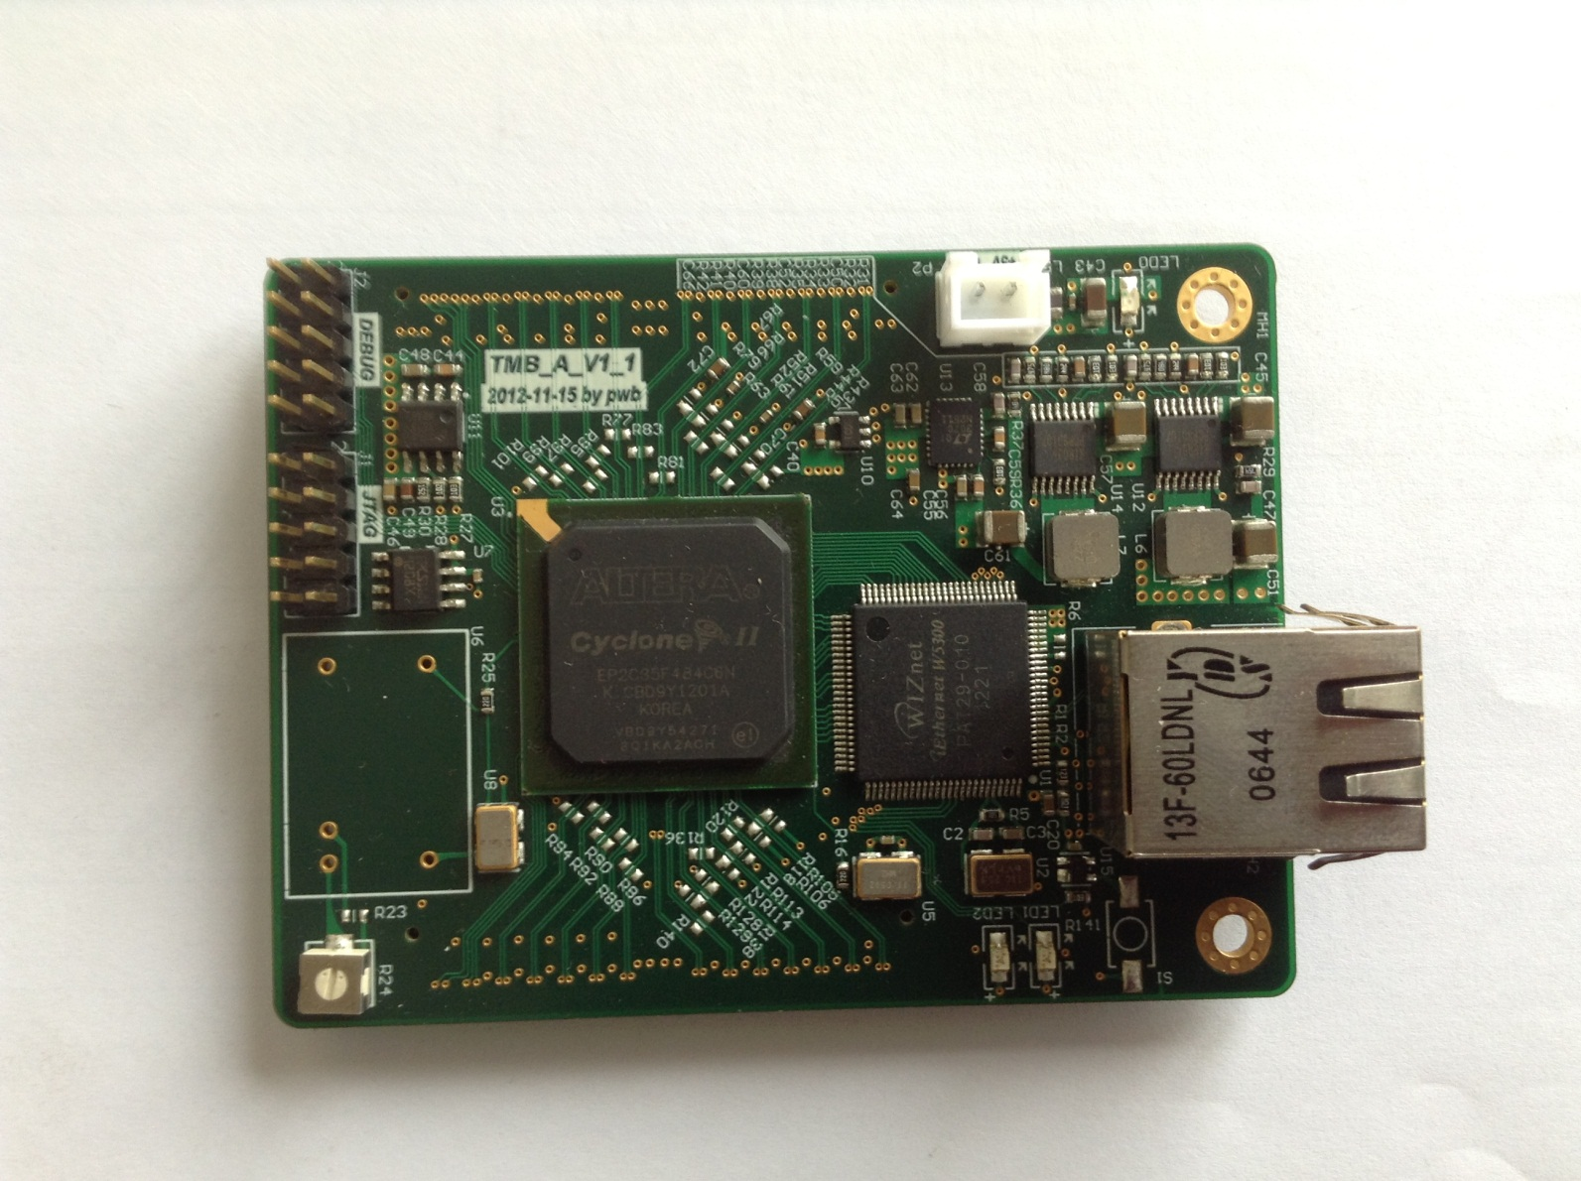
Electronic readout for the CMS RPC upgrade project
FE electronics
PETIROC
- 32-ch, SiGe, 0,5 -400 pC
-32 trigger output
-NOR32_charge
-NOR32_time
-global&individual threshold adjustment
20 ps resolution for Q_{inj} >.3 pC
TDC on FPGA
TDC
-Based on delay line technique. Developed by Tsinghua for medical
applications. Adopted by Lyon group for CMS upgrade project
-TDC on FPGA (25 ps time resolution)

Slide 8
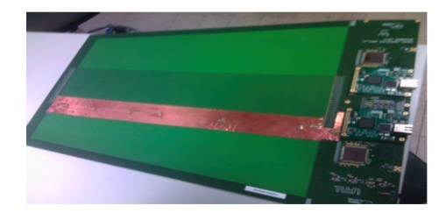
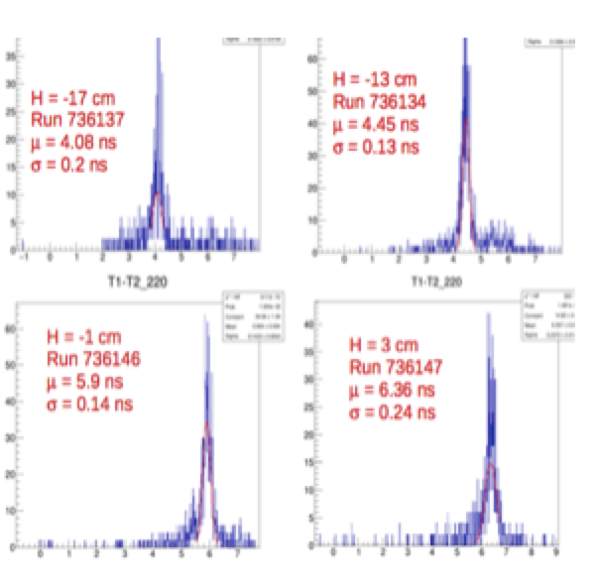
Electronic readout for the CMS RPC upgrade project
To use the 2D readout with good timing FEB (PETIROC)
Motivation
Better Y determination
Y= L/2-v*(t₂-t₁)/2 → σ(Y) = v* σ(T₂-T₁)/2
2) Less channels (2/eta rather than 5)
3) Good absolute timing: reduced jitter due to better electronics andreduced gas gap.
L
t₂
t₁
Y
32 on-detector strips with 3.5 mm pitch
and 32 off-detector return strips 1 mm pitch
→ 64 channels = 2 PETIROC + 2 TDC

Slide 9
Electronic readout for the CMS RPC upgrade project
The collaboration of the Lyon and Tsinghua led to the adoption of the 2D readout scheme as the baseline for the CMS RPC upgrade TDR.
However, to read out the future CMS RE3/1 and RE4/1 RPC, long PCBs (160 cm) are needed.
No possibility to have 6-layer PCB of large size as the small one was designed and produced before.
Two solutions are proposed :

Slide 10
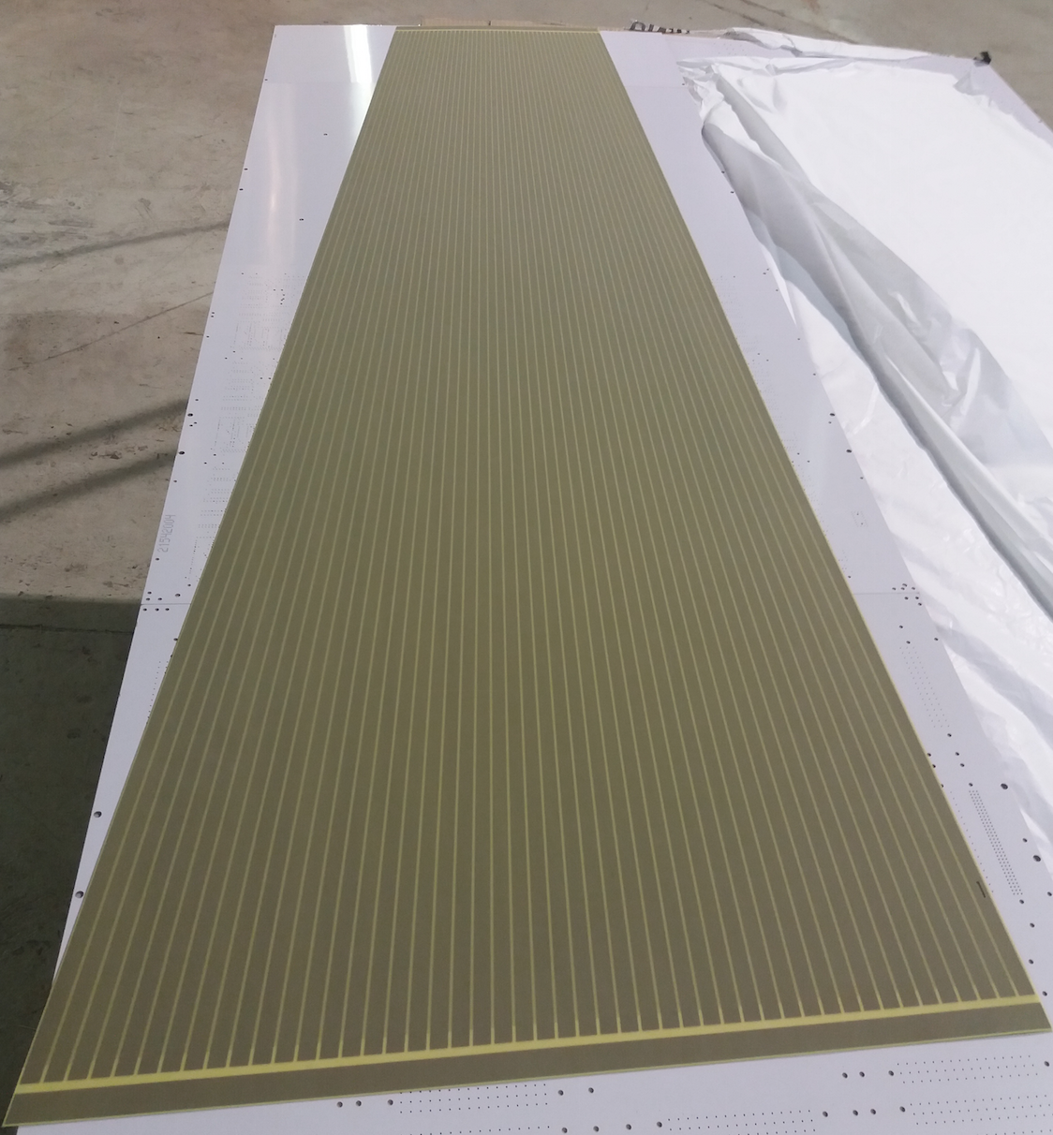
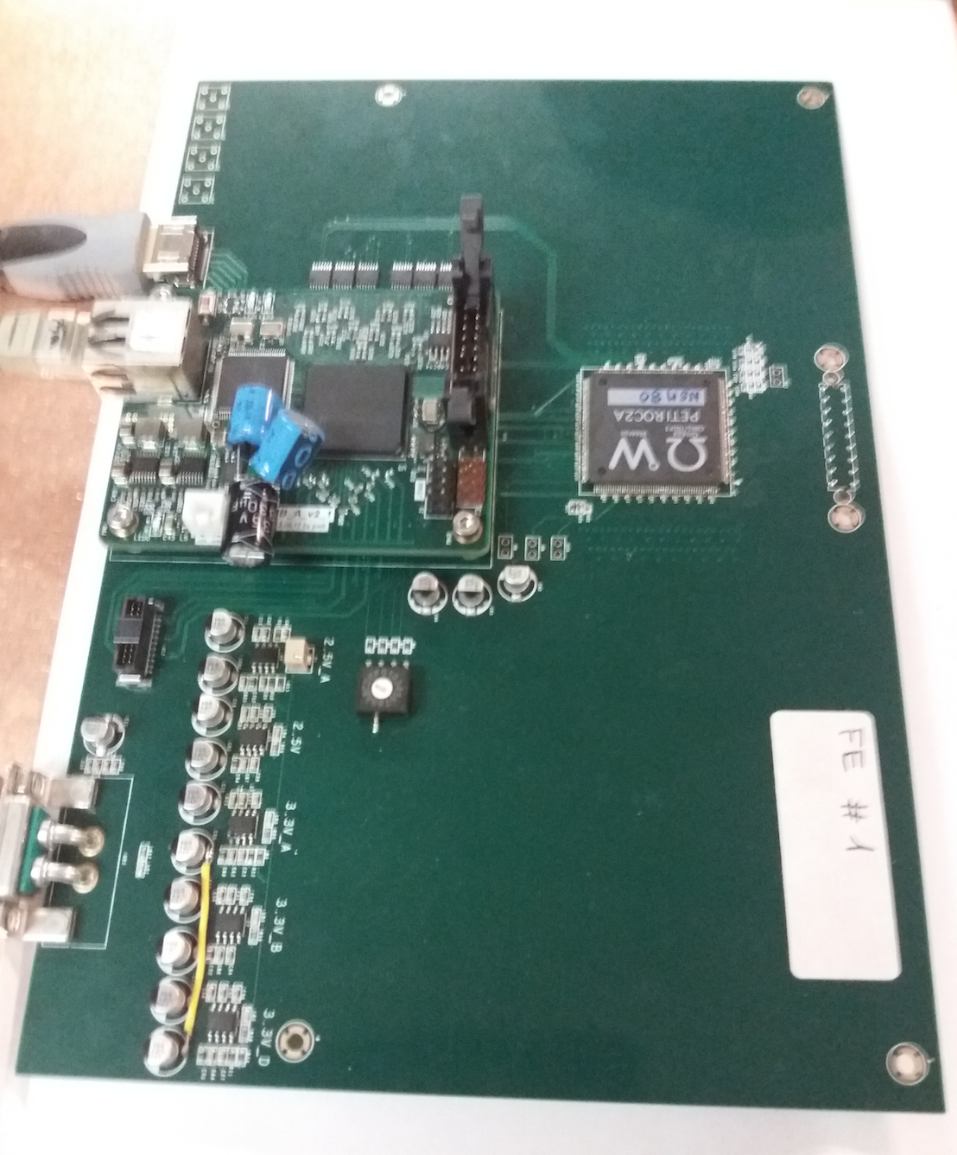
First solution (coax) : one layer PCB with strips. Return-strips are replaced with coaxial cables with the same impedance (company found : ELVIA).
ASICs and FPGAs on a separate board
GND
Two large PCB are needed
for the readout of one RPC
chamber
strips
GND
6 petiroc of 32 ch are needed
adapt. board
adapt. board
coax
FE
coax
GND
strip
This solution is equivalent to the one already tested but simpler and cheaper.

Slide 11
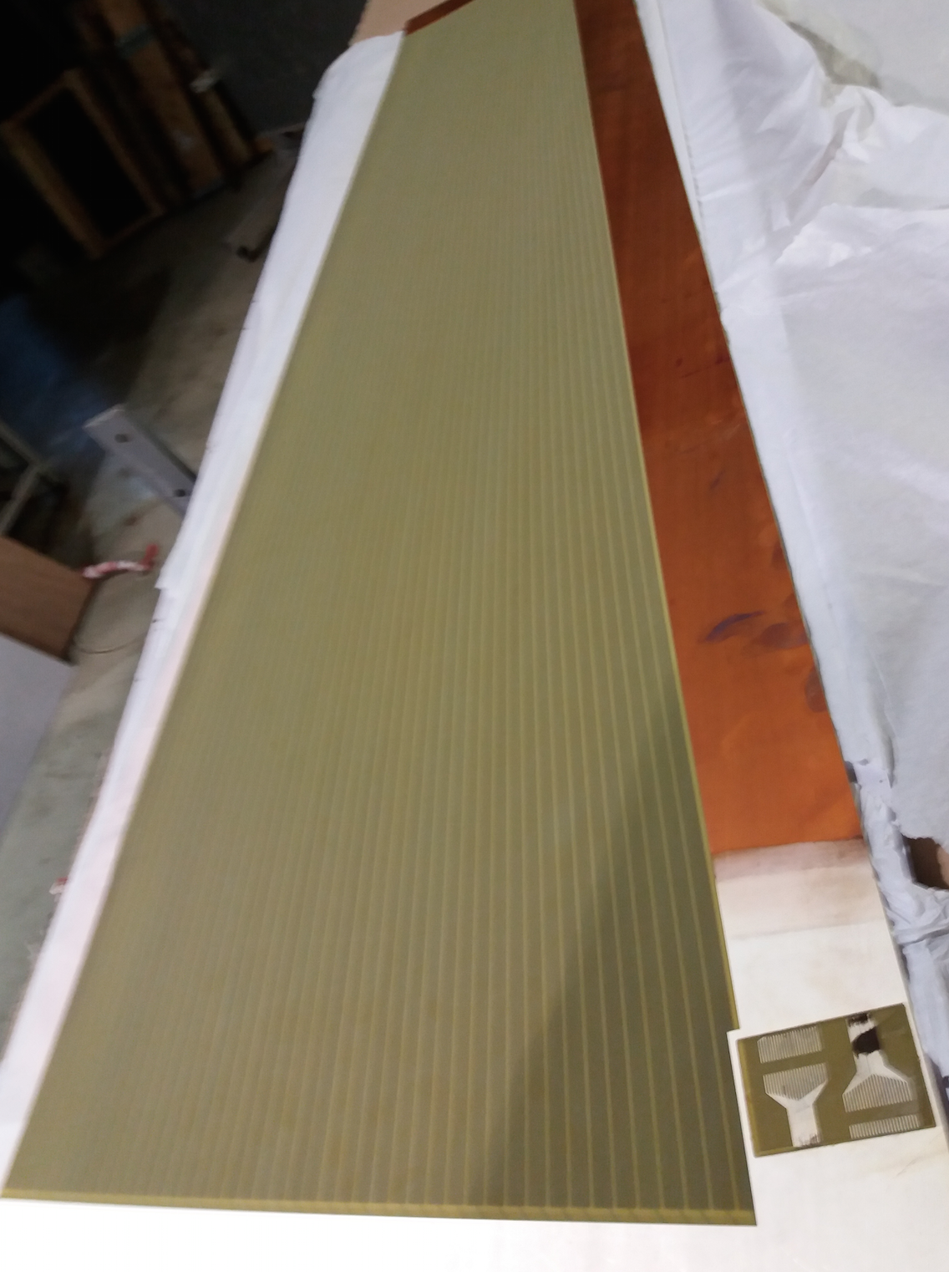
Second solution (return) : “3”-layer PCB with strips and return-strips are replaced with the same impedance. Same as for small PCB but with a separate readout electronics.
GND
Two large PCB are needed
for the readout of one RPC
chamber
Connectors
strips
GND
Flex will transmit the signal from the two ends of strips to the FEBs
This solution is as simple as the previous one and provides well controlled impedance

Slide 12
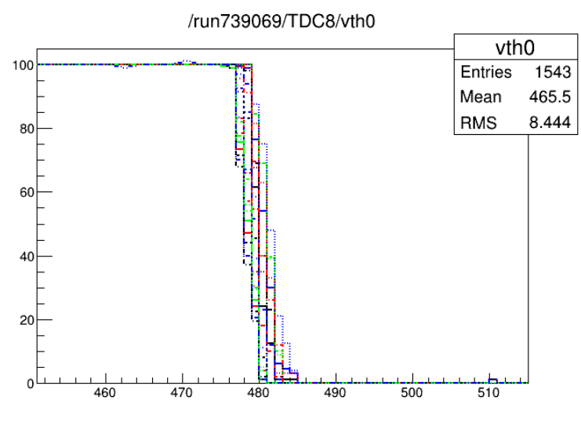
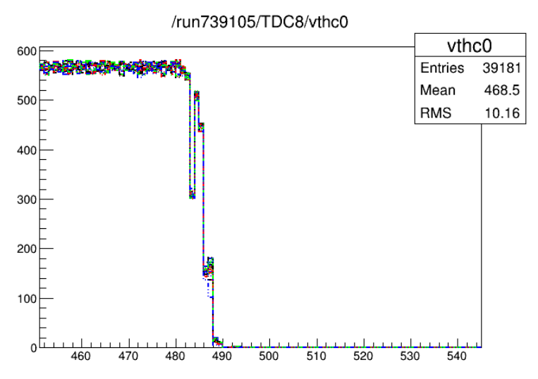
Configuration of the FEBs allow a uniform response
Pedestal channel per channel before alignment
THR
coax: PEDESTAL ~480 DACunits THR= 510 (30 DACu = 73.5fC / channel)
Real pedestal after alignment

Slide 13
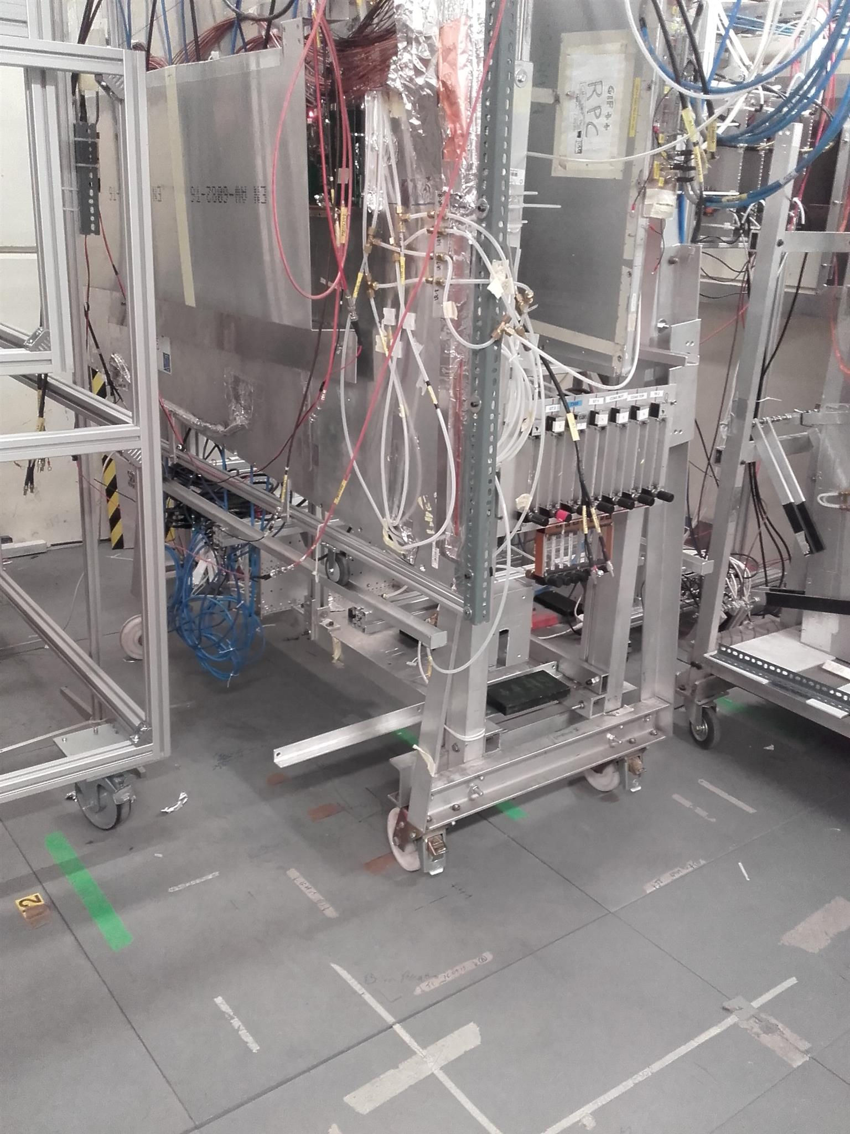
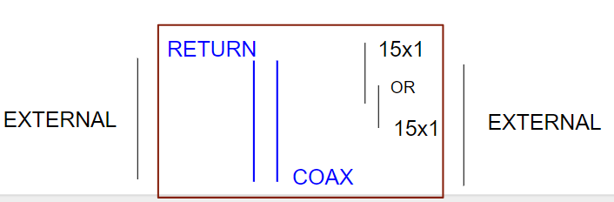
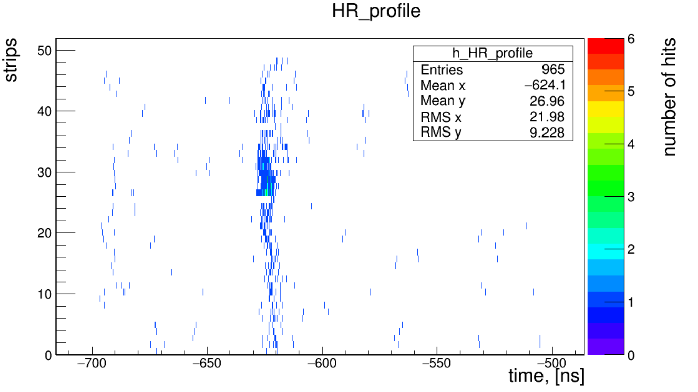
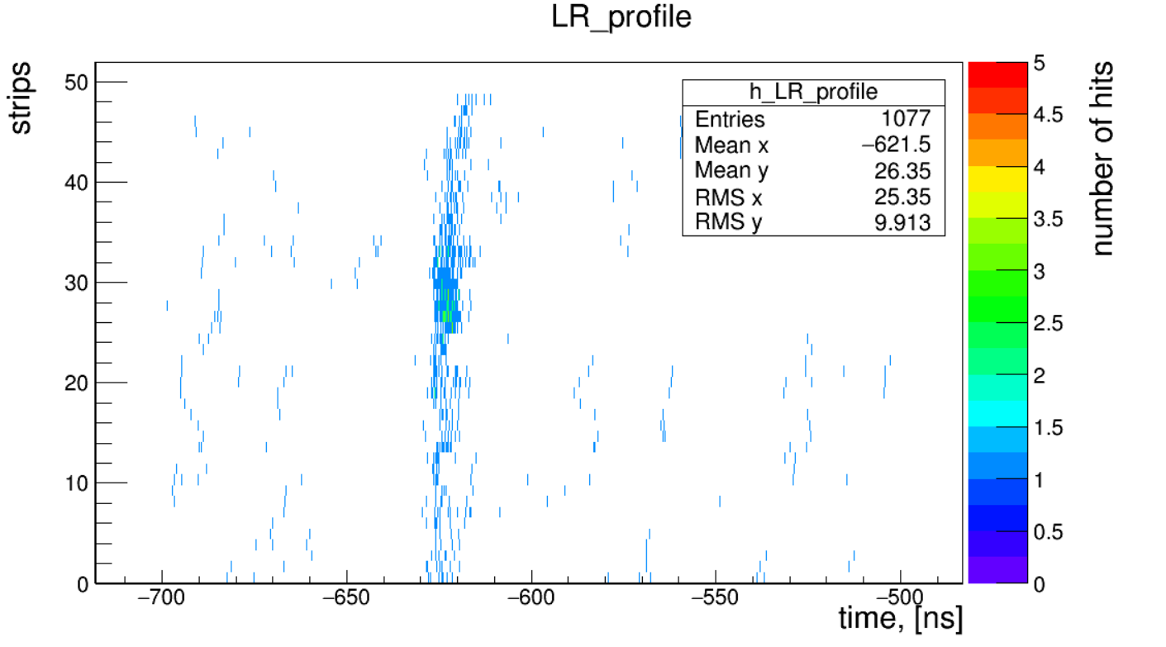
The two schemes were tested on 2-gap
RE3/1 CMS chambers recently at GIF++
With a muon beam.
COAX HVeff=7300 ATT46
noise
estimate
area
noise
estimate area
beam
area
beam
area

Slide 14
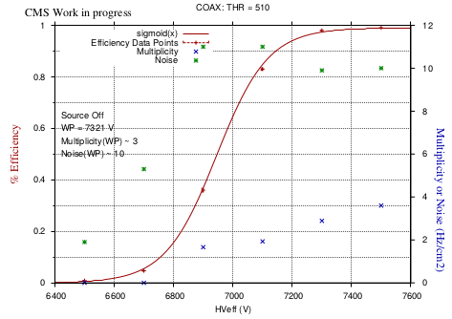
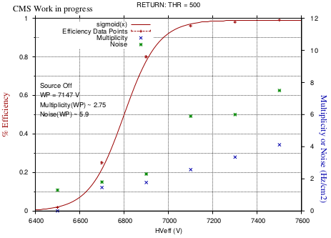
Efficiency, noise, multiplicity

Slide 15
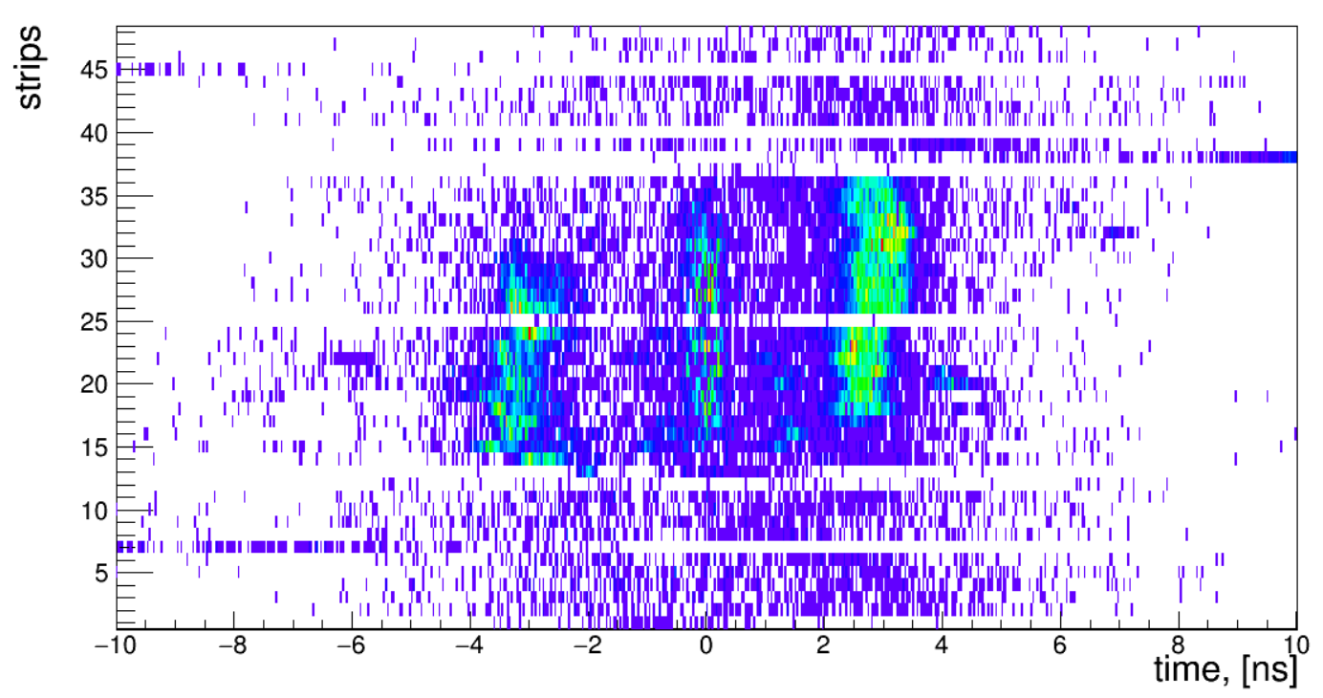
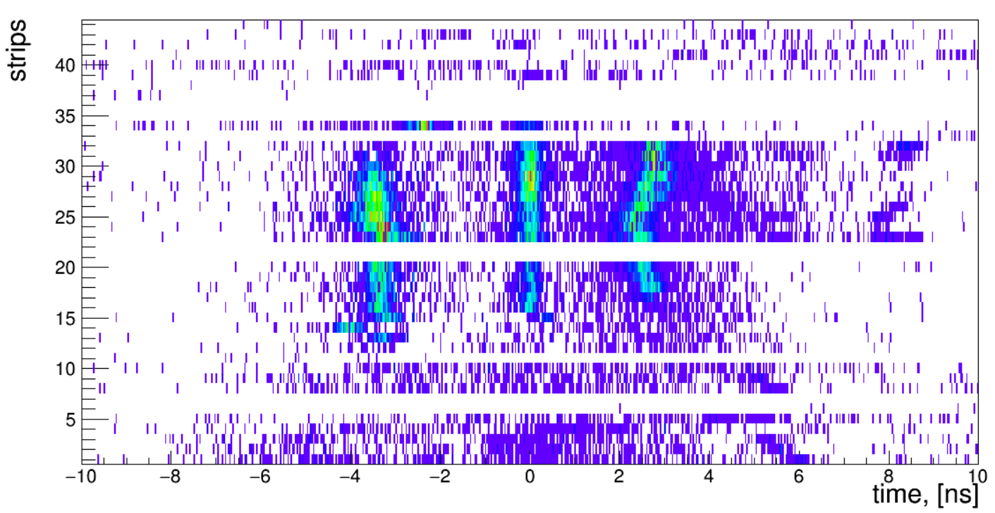
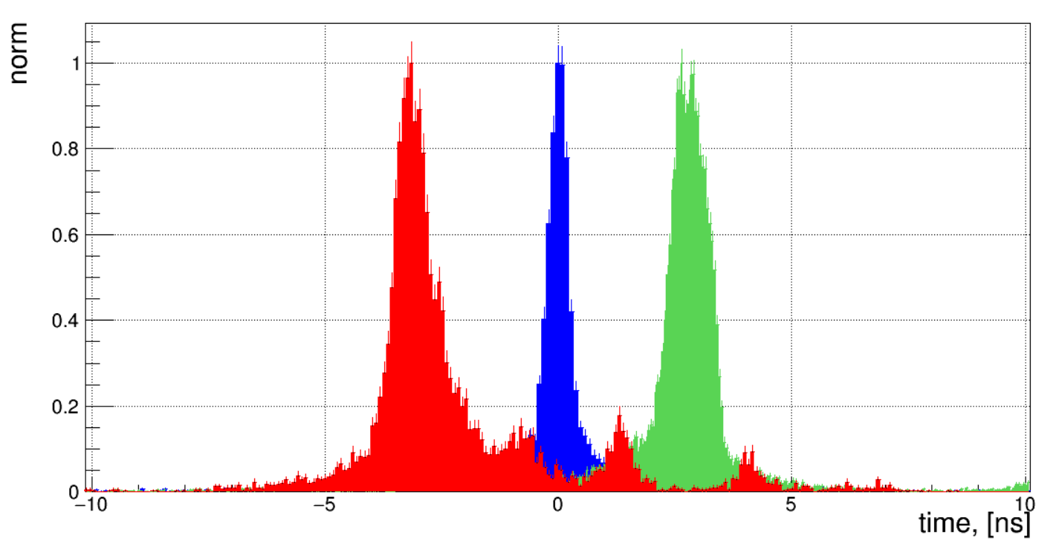
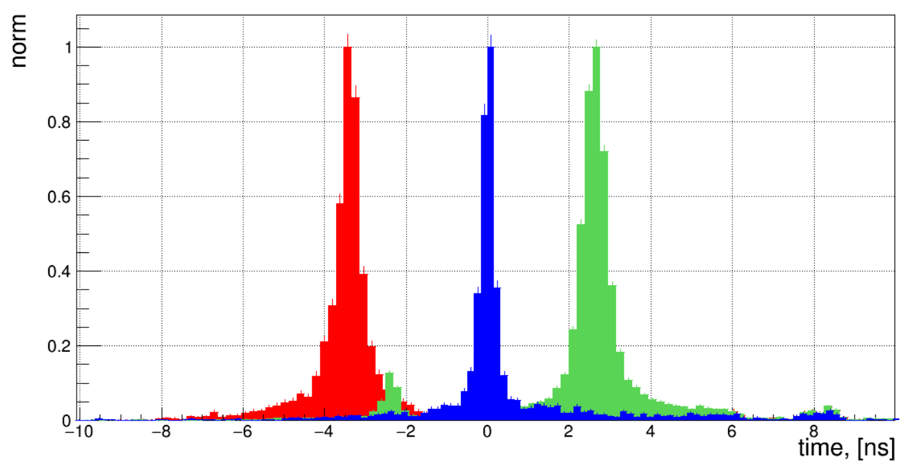
Using the time difference information one can find the Y position even without a very precise calibration (no TOT correction). Return scheme seems to perform better.
COAX
RETURN
Y0-32.5 cm
Y0
Y0+24.5 cm
Y0-32.5 cm
Y0
Y0+24.5 cm

Slide 16
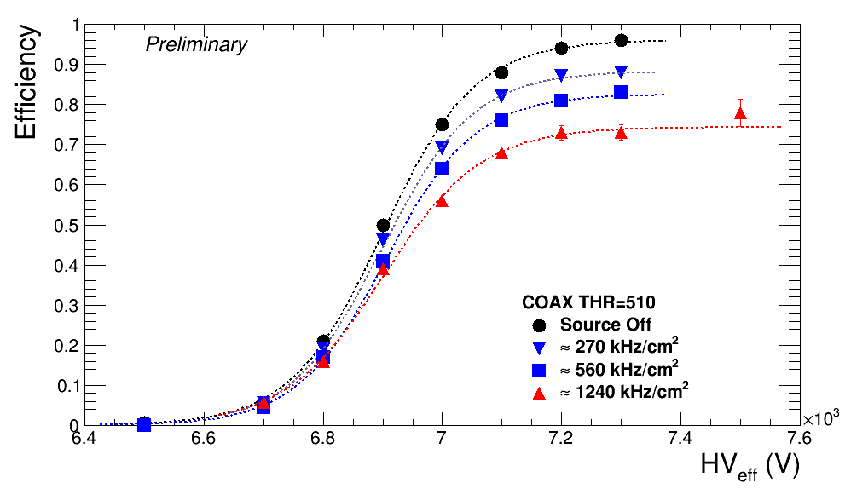
Coax chamber scans
Att: 0
Att : 46
Att: 22
Att: 10
Investigation to understand the efficiency reduction is ongoing. HPL resistivity maybe at the origin of this behaviour

Slide 17
Conclusion and perspectives
Collaboration between Tsinghua and IPNL have allowed them to play an important role in the CMS RPC upgrade proposal.
Based on the Tsinguha TDC, IPNL is developing a new version allowing to measure precisely the rising and the falling edge of the RPC signal and hence the TOT in the same TDC channel resolution for a signal width of more than 3 ns. Preliminary results show that 17 ps could be achieved.
Collaboration between the two groups will continue to exploit the new electronics on muon tomography projects.

