Slide 1
O3 comissioning and AdV+
Challenges and opportunities as seen by EGO
S. Katsanevas
31 May 2018

Slide 2
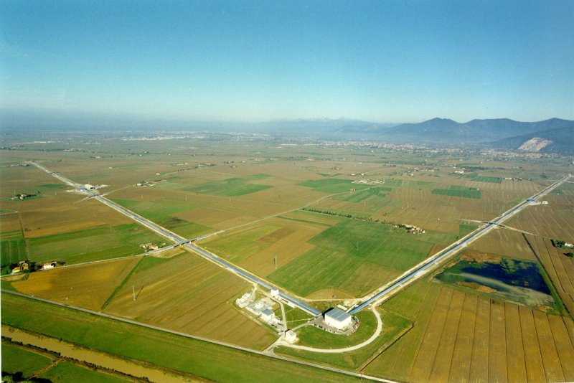






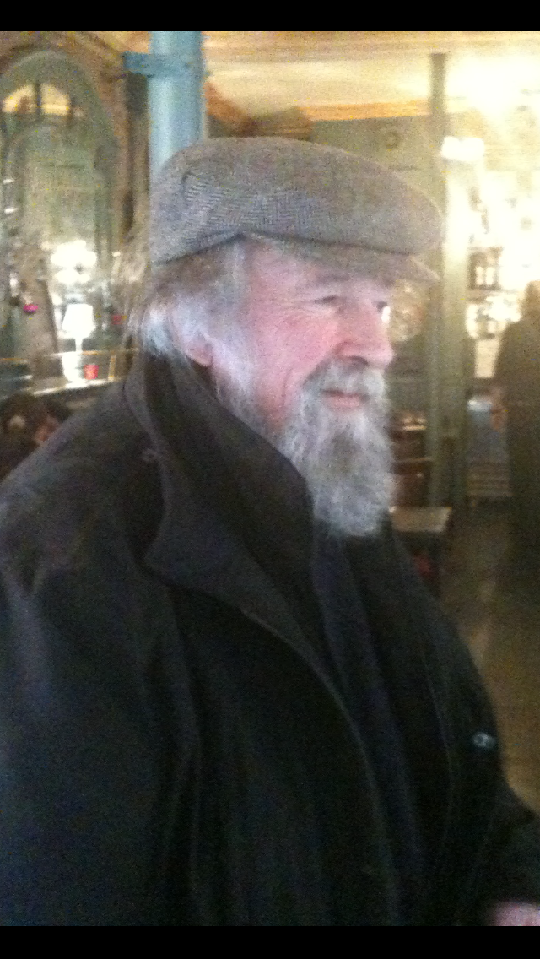
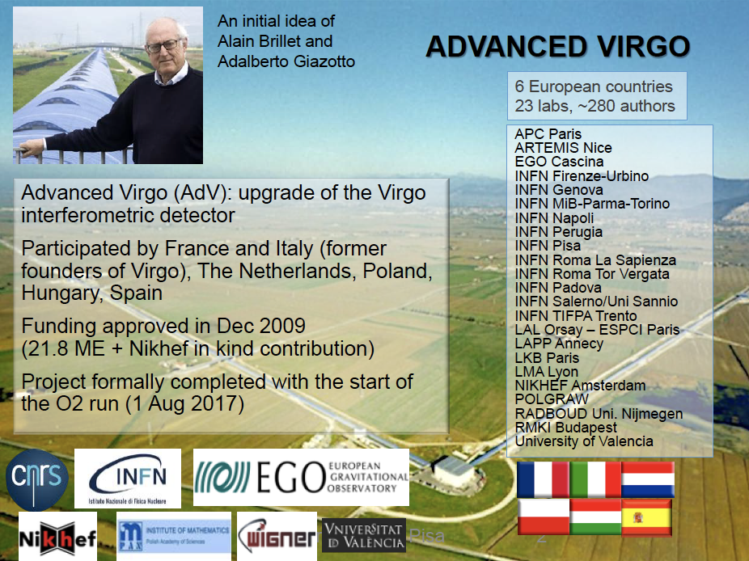
EGO/VIRGO
A short institutional and machine upgrade history
  1992 CNRS and INFN approve VIRGO
  1997 Construction starts near Pisa
  2000 Foundation of EGO (CNRS, INFN)
  2003 Inauguration of VIRGO
  2004-2006 Commissioning and Physics
  2006 Netherlands joins EGO as an Observer
  2007 LIGO-VIRGO “a single machine”
  2009 EGO Council approves AdVIRGO
  2010 Polish, Hungarian and Spanish groups join AdVirgo
  2017 First detection

Slide 3
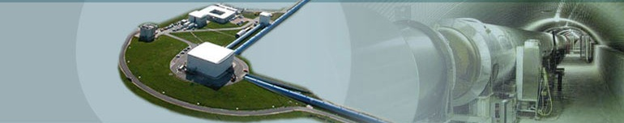

Aims
according to Statute
The Consortium shall have as its purpose the promotion of research in the field of gravitation in Europe.
EGO pursues the following objectives:
  ensures the construction of the antenna VIRGO, its operation, maintenance and the upgrade of the antenna as well as its exploitation.
  ensures the maintenance of the site infrastructures, including a computer centre and promotes an open co-operation in R&D;
  carries out any other research in the field of gravitation of common interest of the Members
  promotes contacts among scientists and engineers, the dissemination of information and the provision of advanced training for young researchers.
  promotes the co-operation in the field of the experimental and theoretical gravitational waves research in Europe

Slide 4
European Gravitational Observatory present structure
STAC
Scientific and Technical Advisory Committee
AFC
Advisory Finance Commitee
EGO Council
(INFN/CNRS/NIKHEF)
EGO Director
Stavros Katsanevas
Deputy Director Pasquale Popolizio (adm)
Virgo Collaboration
Jo Van der Brand
Directorate services
Europe, International,
Outreach, TT, SAfetya
Interferometer
Technology
General
Infrastructure
Information
Technology
Administration
Vaccum and
Mechanics
EGO budget: 10-11 M€
EGO staff 50-55 persons

Slide 5
AdV+ and Operation: 2 projects
PSB: Project Supervising Board.
OCO: Observatory Coordination Office.

Slide 6
Challenges from the point of view of EGO
(and not only)
  O2➔O3 AdV Operation
    Commissioning. Despite a large effort of organisation from the Virgo responsibles and obvious progress, it is very to streamline the commissioning activity. Some fragility from that from 4 experts in O2 we have come down to 2-3, we need to reinforce commissioning.
    Computing. Lack of manpower in Virgo/EGO. A clearer separation between the local computing infrastructure , the bulk data transfer and the relations with the CC, is under definition. The previous functions are clearly EGO responsibility In general a redefinition of the computing model in progress and under examination (ECC).
    Environmental noise. A very active program, in collaboration with Virgo labs, should be reinforced. Opportunities of technological transfer.
    Input optics, laser stabilisation and straight light control. EGO implication together with other Virgo labs.
  O3➔ O4 AdV+ Phase I
    Quality. It quality procedures need to be reinforced for the AdV+ deployment. Approach the space project paradigm.
    Influence of the infrastructure. AdV+ will reach sensitivities that the infrastructure (e.g. HVAC : Heating , Vacuum, Air Conditionning) has an impact on the sensitivities. An intelligent plan of upgrade of the infrastructure will have to be perfected (“smart infarastructure” ?)

Slide 7
STAC and Council recommendations
Commissioning: The STAC recommends that the commissioning team assesses with the EGO and Virgo leadership a series of measures to increase the size of the commissioning team.
Computing. The STAC recommends once again that additional computing positions be allocated to Virgo computing, probably at the Lyon and Bologna computing centers, by INFN and CNRS (and/or other funding agencies). The STAC also recommends to hire a professional computing coordinator at the international level.
Data analysis on site: The STAC recommends that EGO/VIRGO explore the possibilities of setting up a data analysis group on-site, e.g. via dedicated fellowships, attracting local researchers (university of Pisa) and/or long term secondments from outside groups.
Council : The Council strongly recommends that the Virgo Collaboration be as open as possible with external groups; their possible contribution could help in bringing more resources to the project. In addition, the Council suggests stimulating the mobility of the researchers within laboratories currently participating to Virgo since the increase of manpower is unlikely to come from new institutional hires.
See also Observation-Era Revision Committee (chair Barry Barrish) recommendations (for inspiration only):
  Concentrate actions around the production of h(t) at LIGO lab
  Define new bodies (Council, Management team, Program committee) , membership fees

Slide 8
HR Opportunities in EGO
    Recruit a commissioning expert and an operator (temporary with option of permanence) with funds included in current budget
    Recruit a high level Quality Responsible, associated with other high level functions (e.g. “smart” HVAC upgrade) within the EGO organisation.
    Propose to Virgo laboratories, cofounding of postdocs and engineers, ready to spend at least one year on site (commissioning, IT,…) .
      For this a budget from investment will be redirected.
      Positive reactions from CNRS and Italian labs (Projetto Premiale MUR/INFN ) open to other countries of course.
    MC fellowships

Slide 9
A list of possible Marie Curie Fellowships @EGO
  A call of MC Fellowships open, closing date: 11 September
  A collection of themes from the heads of Department, will be published at the EGO web site next week
    Optical simulations
    Stray light control
    Low loss Faraday isolators
    Active wavefront correction system development
    Cavity alignment system quantum noise reduction
    Alternative lock strategy of the Signal Recycling cavity without using Auxiliary Lasers
    Acoustic Newtonian Noise measurement and subtraction by means of low frequency microphonic array
    Residual amplitude modulation servo electronics design and implementation
    Noise subtraction with supervised learning
    Neural Network for feedback optimization
    Study, design and realization follow-up of a cryogenic pump for ultra-high-vacuum to be installed in the Virgo central vacuum area
    Study and test of Titanium evaporation and non-evaporable getter pumps application for Virgo chambers in UHV regime
    Study and test of outgassing from Virgo chambers in UHV regime [R&D – (physicist/engineer)
    Design, modelling and optimization of the reference system network for the Einstein Telescope interferometer
    EGO ready to serve as a hub to help, make publicity and direct fellowships to other labs

Slide 10
Education and Outreach
Clearly a huge opportunity given the social environment accompanying a scientific revolution as this of GW
But can also be a menace , for an undersized team and occupying a large percentage of researchers occupied with commissioning and operation
Must be programmed strictly since can be a source of
  “Visitorgenic noise”
Solutions:
  A contract with University of Pisa to make a trained pool of students to take part of the visits under remuneration.
  Organize the effort on local, regional and global grounds around the GW revolution ➔ ARGO (Swafs 1,5 ME for 3years)
  Try to obtain the funding from EU, if not, from regional funds and/or agencies for at least part of the program
  Organize anyway the existing through web based tools, etc, a forthcoming outreach meeting

Slide 11
Tasks at the institutional front
The Council deliberates that an extension of the current MoU will be prepared as soon as possible on the operations phase of VIRGO (2018-2025) in parallel of the renewal of the EGO Consortium (2020-2025), revising the distribution of contributions including Netherlands and the other countries participating to the VIRGO project. The MoU for the upgrades leading to Advanced Virgo + will be the basis for the renewal of the EGO Consortium and will be prepared for an appropriate duration, with the objective of enlarging the EGO membership beyond Italy and France.
Action list (to be proposed and approved by the Council)
  Enlargement to Netherlands, attracting new countries
  Preparation of a scheme of a 2 circle participation to EGO/VIRGO
    Consortium members and associates?
  Define the large domains and the relevant contributions of partners and assossiates to large subdomains
    e.g: Detector, Computing, Science ?
  Create a body where directors of participating laboratories are informed give their opinion on the projects and are accountable in fine (CIO of space projects, RRB for particle physics) ?
  Partnerhsip fees etc. ?

Slide 12
Coordination at European and Global level
Submission of an ERIC ?
Submission of an ESFRI proposal (AdV+/phase2 as GW 2.5G and ET (3G)
  ET Founding meeting 19-20 April 2018 at Cascina
  Not repeat errors of other infrastructures in the way to its realisation
Steamline global collaboration
  between KAGRA/LIGO/Virgo
  GWIC, GWAC

