Slide 1


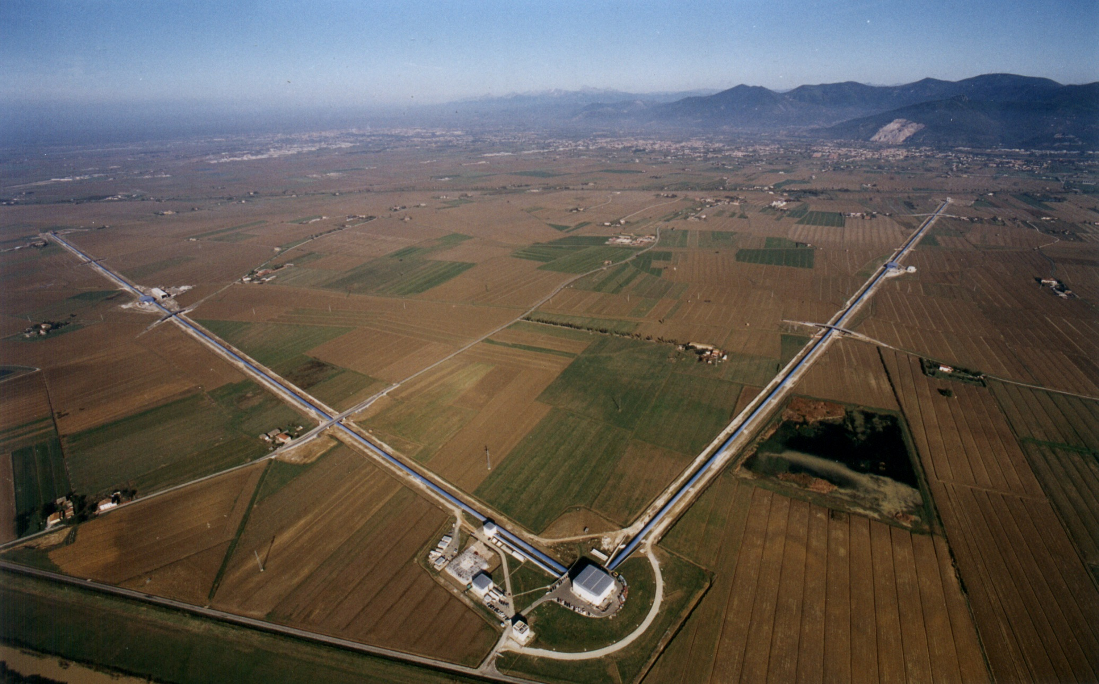


Advanced Virgo / Advanced Virgo+
Science
Patrice Hello
Laboratoire de l’Accélérateur Linéaire, Orsay.
CNRS/IN2P3 et Université de Paris-Sud
Paris
31/05/2018

Slide 2
Gravitational Waves
Propagation at speed of light
Transerve and traceless tensorial waves.
Two independant states of polarisation («plus » and « cross »).
Quadrupolar radiation at the lowest order. Luminosity:
Amplitude h: dimensionless !
Effect on matter ->

Slide 3
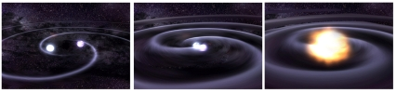
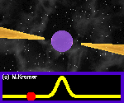
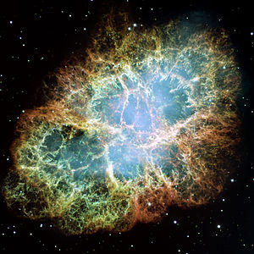
Astrophysical sources
High frequency sources (in bandwidth of detectors : > 1Hz)
Sources localised in time
Supernovae (gravitational collapses)
Compact Binary Coalescences (CBC)
(black hole (BH) and/or neutron stars (NS))
…
Permanant sources
Isolated NS, pulsars
Stochastic backgrounds (cosmologic or astrophysical origin)
…

Slide 4
Astrophysical sources
Transient sources provide 2 extreme examples
Signal well modelized
(PN expansion for the inspiral+
numerical relativity for the merger)
Compact Binary Coalescences
Gravitational collapses
Signal poorly modelized
Very rich physics not (yet) reproduced
by simulations
=> Consequences for Data Analysis : see MAB’s talk.
=> Consequences for science extraction

Slide 5
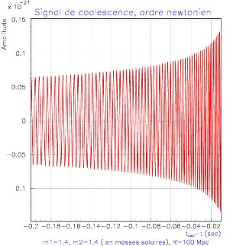
CBC signals
The signal at the lowest order:
Spiraling phase
where
Chirp mass:
frequency:
t_{c} : time of coalescence
Phase:
A “chirp”

Slide 6
CBC signals
The signal at the lowest order:
Absolute distance
CBC => Standard sirens
Spiraling phase
Phase includes
GR dynamics (PN expansion)
Matter effects (NS EOS)
Fundamental physics (GR extensions, graviton mass -> dispersion relation …)
Measure of phase => tests of GR, constraints on NS EOS etc…

Slide 7
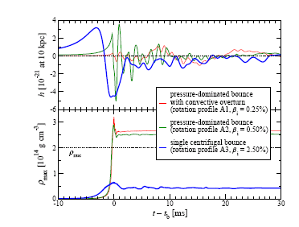
Supernova signals
Post collapse signals
(proto NS instabilities…)
Prompt signal (collapse)

Slide 8
Supernova signals
Jasmine Gill Supernova workshop2017

Slide 9
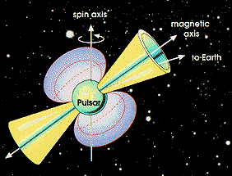
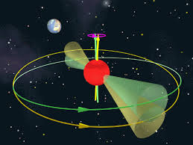
Don’t forget permanent sources
Not axisymmetric star (triaxial star)
ε = (I₁-I₂)/I₃ is the star ellipticity
I₃ = the moment of inertia along the rotation axis.
(signal at twice the orbital frequency)
Wobbling axisymmetric star
= precession angle, e= (I₃-I₁)/I₁ = star “eccentricity”,
I₁=I₂ and I₃ are the 3 principal moments of inertia.
(signal at twice the orbital frequency AND at the orbital frequency)
(Zimmermann and Szedenits, Phys.Rev.D 20, 351 (1979).

Slide 10
Don’t forget permanent sources
Not axisymmetric star (triaxial star)
ε = (I₁-I₂)/I₃ is the star ellipticity
I₃ = the moment of inertia along the rotation axis.
Measure of h₀ => measure of I₃ ε => constraint on NS EOS

Slide 11
Don’t forget permanent sources
Stochastic background(s)
=> Constraints on population evolution scenarios
Detectability of BBH+BNS background
LVC Phys. Rev. Lett. 120, 091101 (2018)

Slide 12
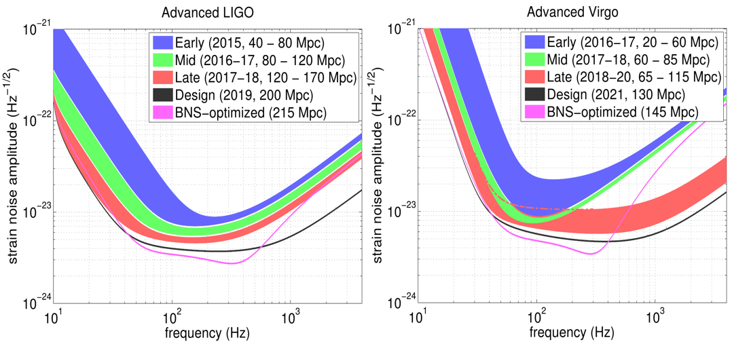
Science depends on instruments
Number of instruments (and duty cycle)
O1 : 2 detectors
O2 : 2 then 3 detectors
O3 (2019) : a full 3 detectors network
+ Kagra operational at some point => 4 detectors network
Sensitivity of instruments

Slide 13
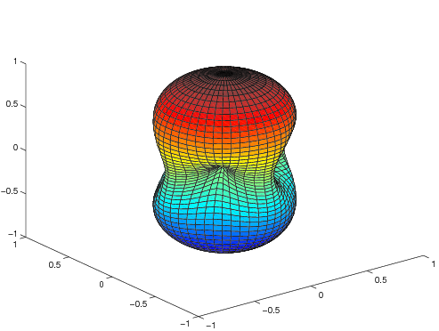
Three distant sites: what for?
Detector output is (non Gaussian non stationary) noise !
Detector not completely understood, noise artifacts …
=> impossible for a single detector to claim a detection.
Coincidence analysis (at least 2 detectors) allows to dramatically lower the false alarm rate and to estimate the background (time slides).
Interferometric detector is not directional.
(position in the sky determined by triangulation)
Coincidences with3 interferometers :
minimum for reconstructing the GW signal
(polarizations, sky position…)

Slide 14
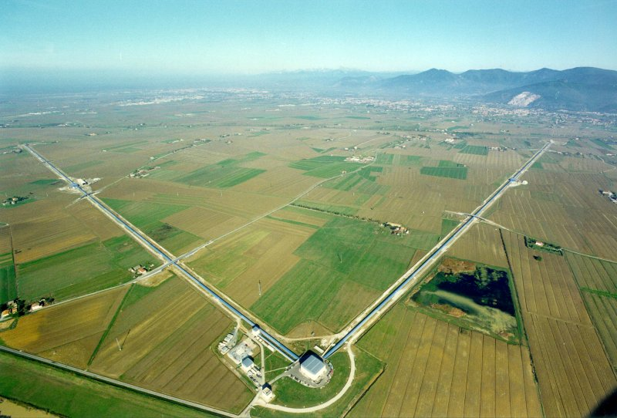
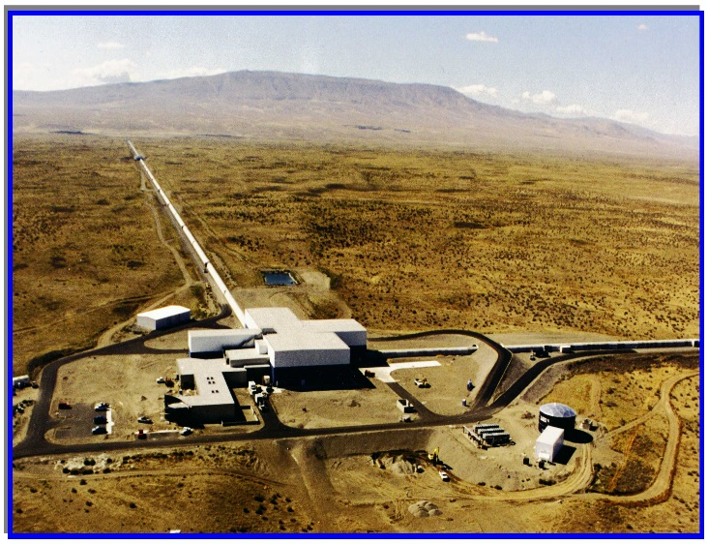
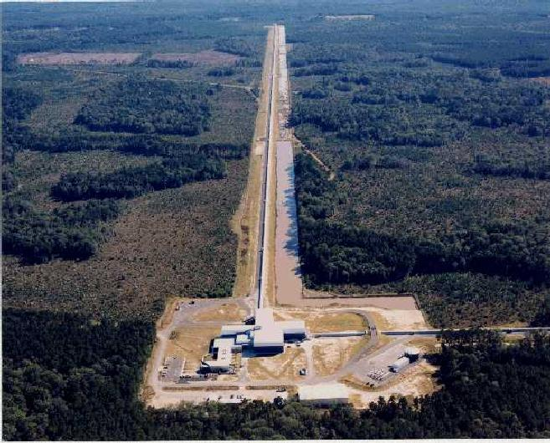
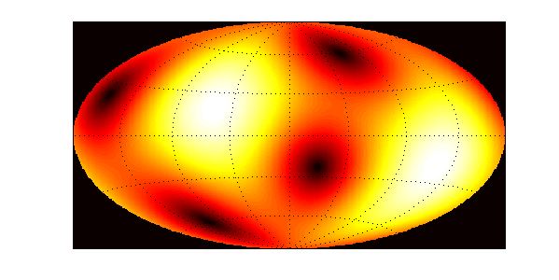
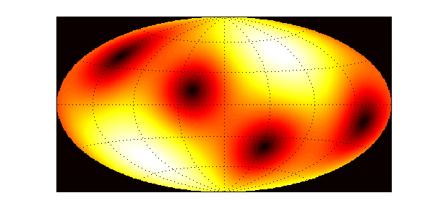
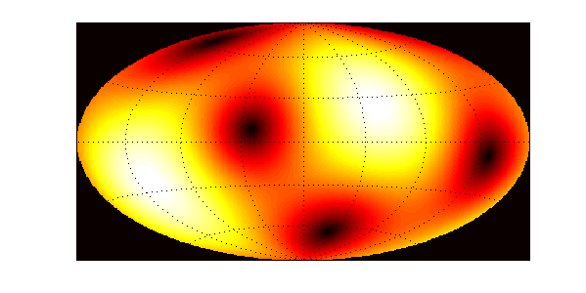
LIGO-Virgo network
Virgo
LIGO-Hanford
LIGO-Livingston
The LIGO-VIRGO Network :
Beam patterns
VIRGO
HANFORD
LIVINGSTON
Light time of flight : HL ~ 10 msec., VL ~ 26 msec. and VH ~ 27 msec.
Times delays set the Source Reconstruction Accuracy:
Minimal angular resolution ~ 1º
(much worse in practice =>10s of degrees)

Slide 15
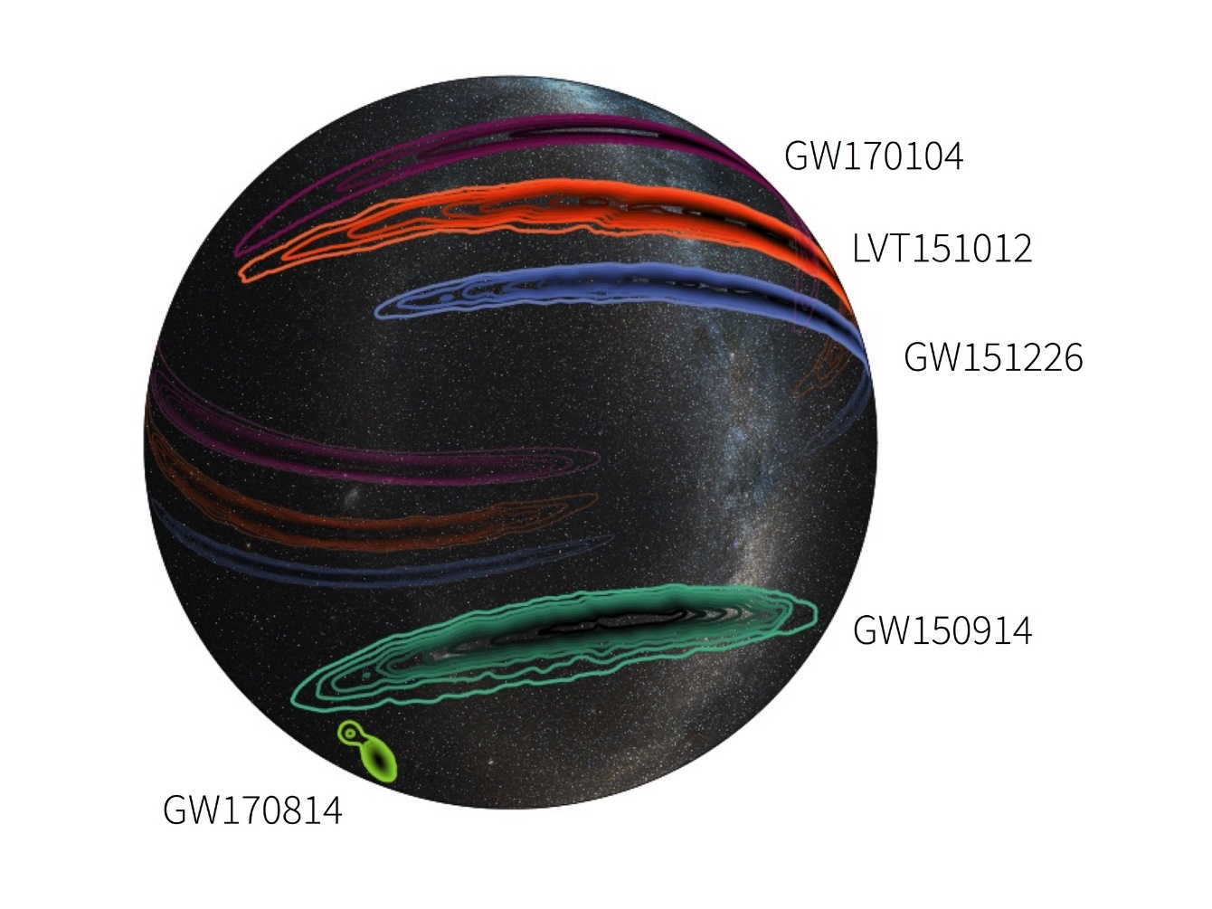
Examples of error boxes
2 detectors
3 detectors

Slide 16
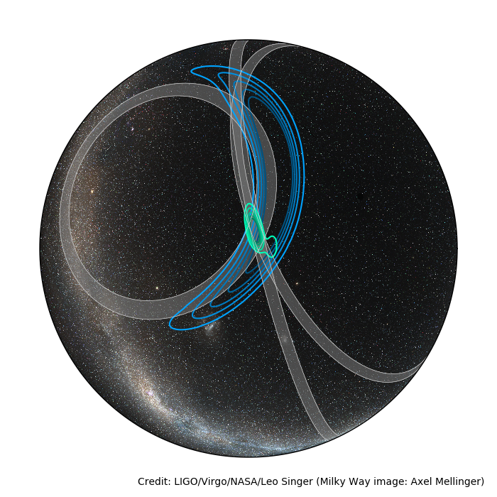
Examples of error boxes
GW170814
(BBH)
LIGO+Virgo = 3 instruments => better sky localisation
(crucial for optical follow-ups)
(1200 squared degrees)
(60 squared degrees)

Slide 17
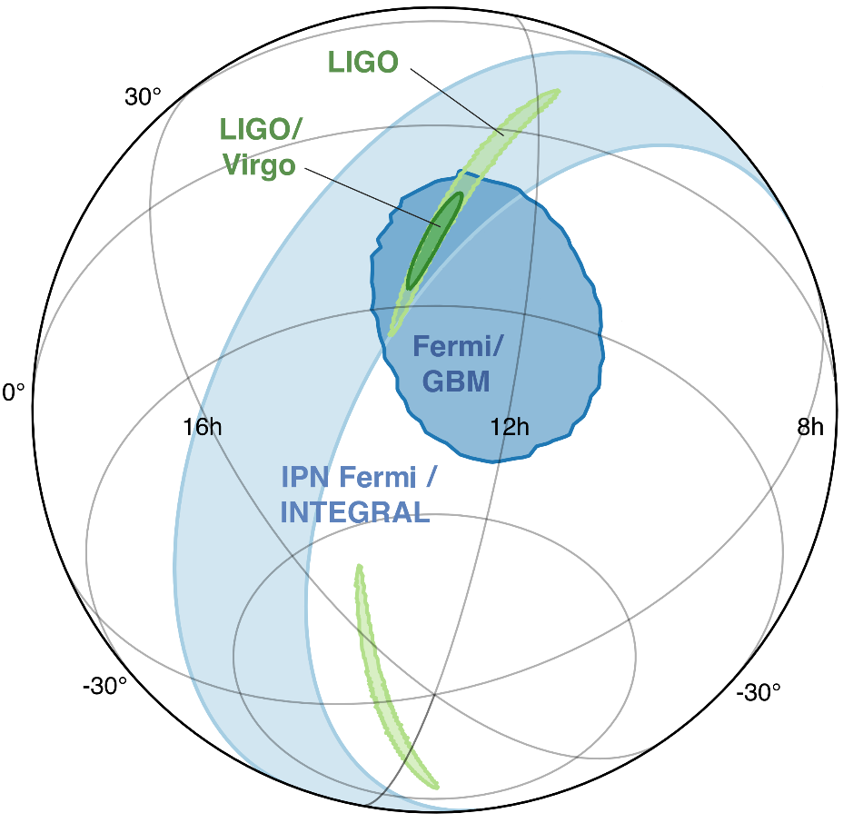
Examples of error boxes
GW170817
(BNS)
« Multi-messenger observations of a binary neutron star merger », Abbott et al., ApJ, 2017
GW170817 localization
2 interferometers (HL) | AddingVirgo (HLV)
190 deg², distance 40 Mpc | 28 deg², distance 40 Mpc Volume : 380 Mpc³
Less than 100 galaxies could be the host of the event !!

Slide 18
Error boxes with improved network
5 detectors network (>202X)
Consequences on measurements

Slide 19
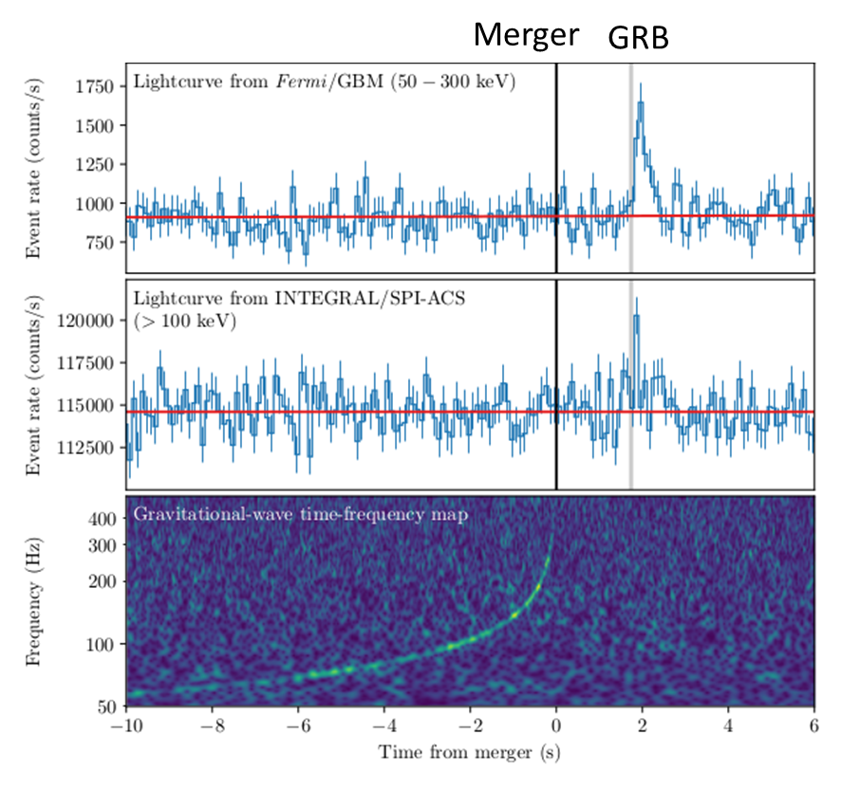
Other instruments
Most of GW science depends also on other instruments
Counterparts (photons, neutrinos …)
follow up of GW events
Access to the complete picture
Emblematic example : GW170817
GW+GRB+optical+IR+radio+X …
(GW astronomy => multi-messenger astronomy)
« Gravitational waves and Gamma-rays from binary neutron star merger: GW170817 and GRB170817A », Abbott et al., ApJ, 2017

Slide 20
Science? Which science?
Astrophysics
Cosmology
Fundamental Physics

Slide 21
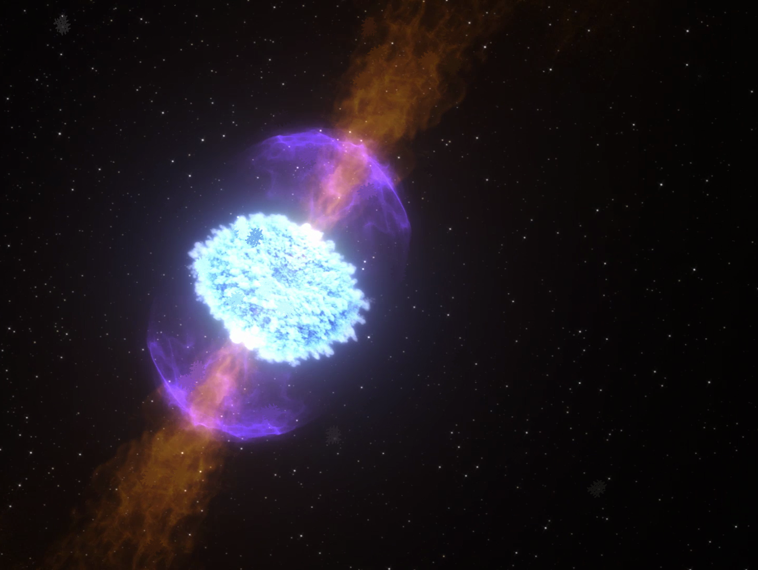
Astrophysics
Physics of compact objects BH and NS
Formation of BH and NS
Formation of BBH and BNS
(measure of masses and spins, measure of excentricities of binary systems)
EOS of NS
(measures of masses and radii, direct constraints on EOS, indirect via spin-down limits))
Measure of rates
- BBH, BNS, supernovae => stellar evolution.
Physics of GRB
Central engine ?
Late evolution (kilonova etc) => multimessenger astrononomy

Slide 22
Black hole physics

Slide 23
Neutron stars physics
Last cycles of CBC GW signal (> 600 Hz) => information on tidal deformability
(tidal field induces a quadrupole moment => effect on h(t))
Where k₂ is the 2nd Love number
(depends on EOS : ~ 0.05-0,15)
Observation favor EOS that implied more compact NS

Slide 24
Neutron stars physics
Constraints from pulsar searches
Excluded by e.m. observations
Excluded by GW searches
LIGO coll., Astrophys.J.683:L45-L50 (2011)

Slide 25
Fundamental Physics
Mainly Tests of SR and GR
Speed of GWs
Polarizations of GWs (tensor vs. Scalar-tensor, or vector-tensor …)
=> any kind of source
PN expansion
Test of EP (via the Shapiro effect)
Test of Lorentz Invariance
Mass of graviton
Mass of neutrinos

Slide 26
GW170814 and GW polarization
With a third detector (non aligned) : tests of polarization
Only ones expected with GR
Allowed by other gravitation theories
Vector modes
Tensor modes
Antenna pattern
GW170814: Favor pure tensor vs pure vector or scalar
Cannot conclude on mixed version
Scalar modes
GW170814: A Three-Detector Observation of Gravitational Waves from a Binary Black Hole Coalescence, Abbott et al. , PRL 119, 141101

Slide 27
GW170817+GRB170817A : tests of fundamental physics
« simultaneous signals » (+ known distance of the source)
Speed of GW
(best constraint by orders of magnitude !)
Consequences on modified gravity theories : some are totally ruled out (galileon)
Test of Equivalence principle (Shapiro effect)
Improves by > 1 order previous limits (radio tracking of Cassini)
Limits on Lorentz Invariance Violation (relative group velocities of GW and EM)
Again best limits
+ implications on the physics of GRB, rates of coincident events…
(Milky Way
gravitational potentiel)

Slide 28
GW150914 : tests de la Relativité Générale
Masse du graviton
Graviton massif => relation de dispersion => vitesse de propagation velocity dépendante de l’énergie :
Terme supplémentaire dans la phase du signal :
où D = distance, z = redshift et
est la longueur d’onde de Compton du graviton.
GW150914 =>
soit encore
Meilleure limite !
Meilleure limite précédente : tests dans le système solaire (Mars) :
(correction de Yukawa au potentiel de Newton ).
Pulsars binaires: non compétitifs
(effet de seuil, émission si )

Slide 29
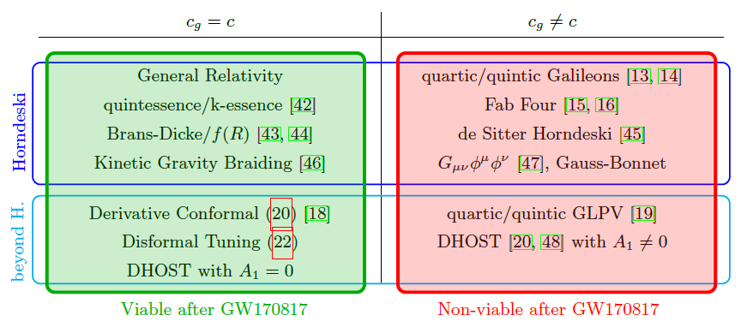
Contraintes sur les théories de gravité modifiée
Energie noire P = w ρ
soit tenseur-scalaire |w+1| < 1.2 10⁻¹⁴
soit f(R) |w+1| < 510⁻⁸ (Nojiri & Odintsov 2017)
Plus contraignant que les mesures de Planck (1% sur |w+1| )

Slide 30
Cosmology
CBC => standard sirens measure of R
Host galaxy => measure of redshift ie V
Independant Measure of Hubble constant
Primordial Universe (phase transitions)
=> prediction of GW stochastic backgrounds
(eg cosmic strings)

Slide 31
Constraints on cosmic strings parameter space via Burst and Stochastich searches
LVC, Phys. Rev. D 97, 102002 (2018)

Slide 32
Hubble constant measurement
For closed-by source : v=H₀D
Distance (GW) and orientation are correlated
"A standard siren measurement of the Hubble constant with GW170817",
Nature 551, 85 (2017)

Slide 33
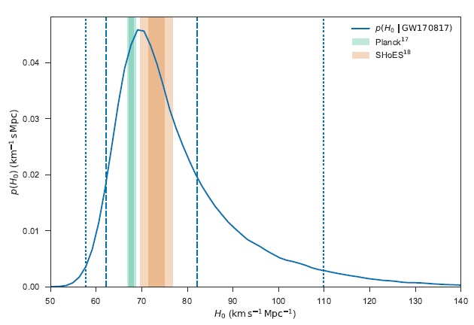
Hubble constant measurement
Planck data 67.74 ± 0.46 km/s/Mpc
Supernovae 73.24 ± 1.74 km/s/Mpc
3σ « discrepancy ».
More GW events may allow to see clearer!
A few tens of evens => < 1% accuracy

Slide 34
New questions
Origin of massive black holes ?(> 20-30 M )
Gap in the mass spectrum ?
GW170817 : nature of the final object? (several possible scenarios)
No hint from GW searches for post-merger signal(s)
GRB170817A : mechanism of the short GRB ?
(atypical GRB : sub-luminous by 3-4 orders of magnitude but hard gammas)

Slide 35
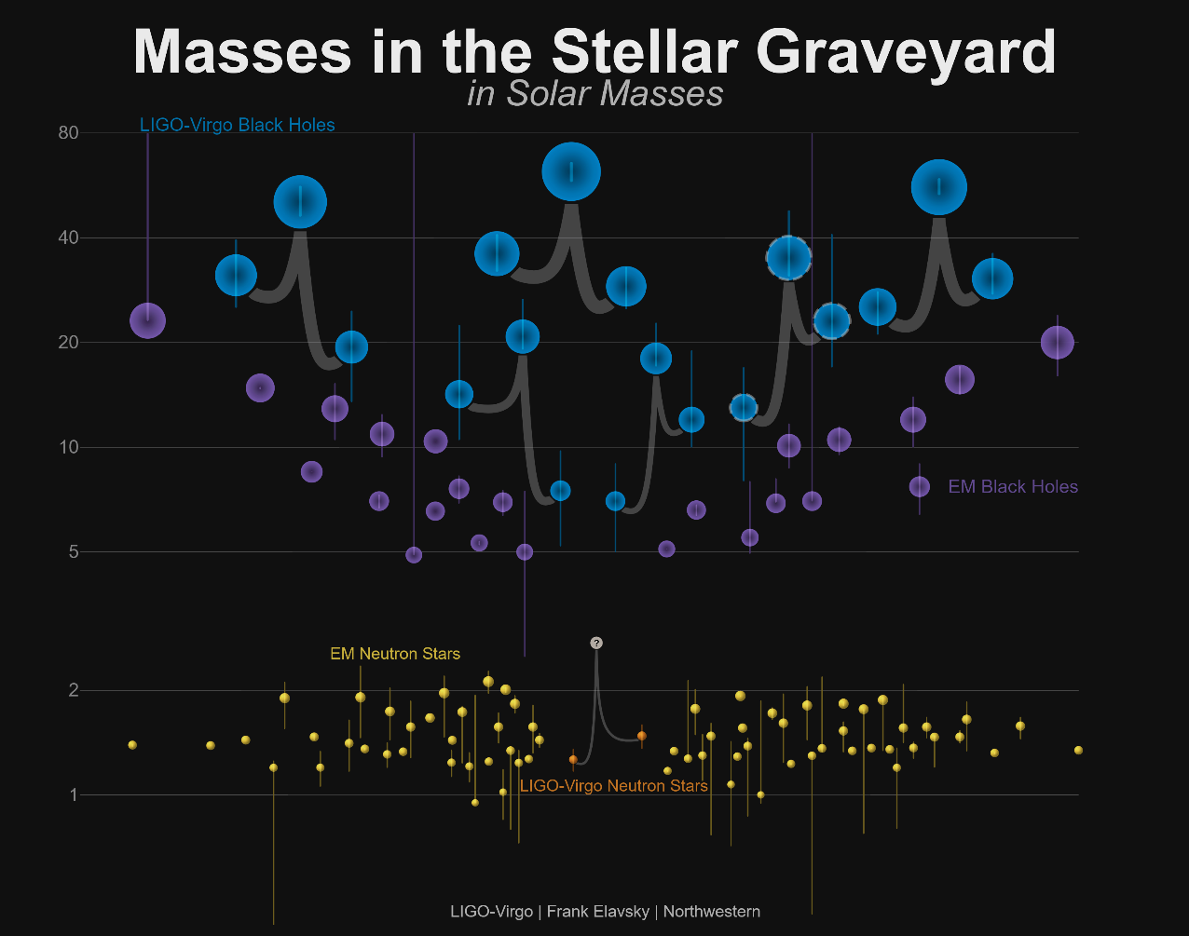
MASS GAP

Slide 36
Conclusions
GW astronomy is only 2 years old
Already a number of results (and papers)
But it is only a beginning
A number of sources/phenomena to be discovered
Constraints to be improved
Measurements to be more accurate
New questions have been raised (and need answers)
GW Science is already rich, we can expect al lot from the future!
Instrument point of view: any improvement in sensitivity does
have impact on Science

Slide 37
backup

Slide 38
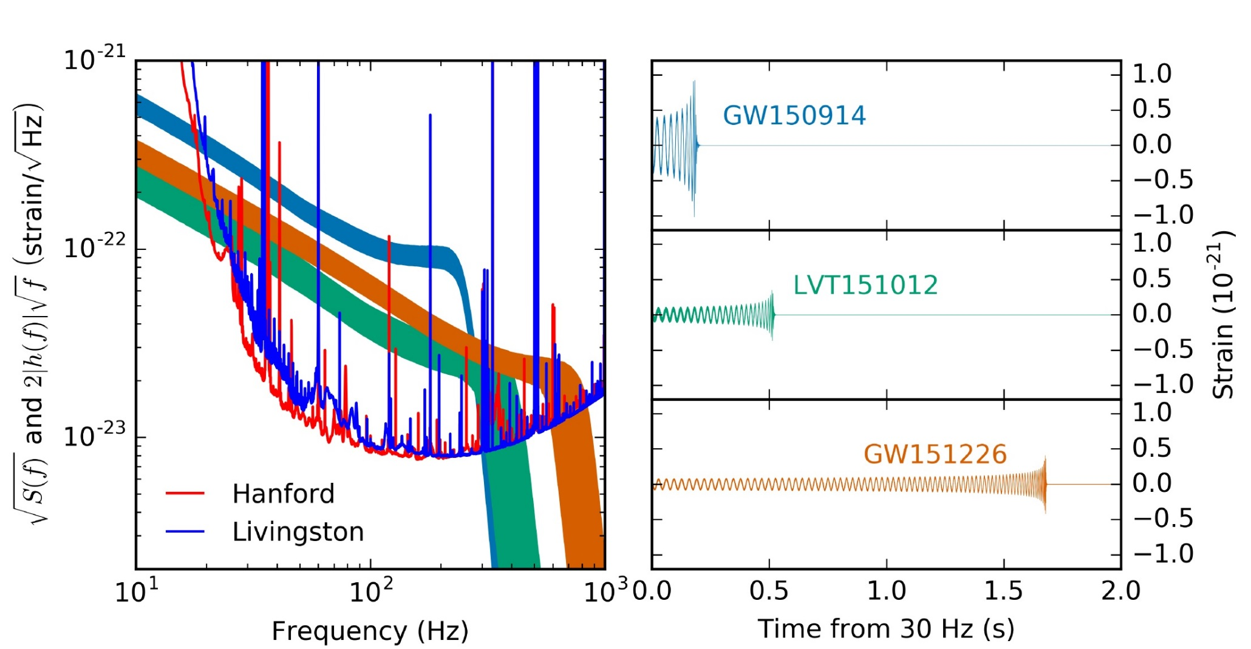
O1 scientific results
O1 : 2 (+1) BBH detected : GW150914 et GW151226.
GW150914 : 36.2M+29.1M -> 62.3M @ 420 Mpc
GW151226 : 14.2M+7.5M -> 20.8M @ 440 Mpc
LVT151012 : 23M+13M -> 35M @ 1000 Mpc

Slide 39
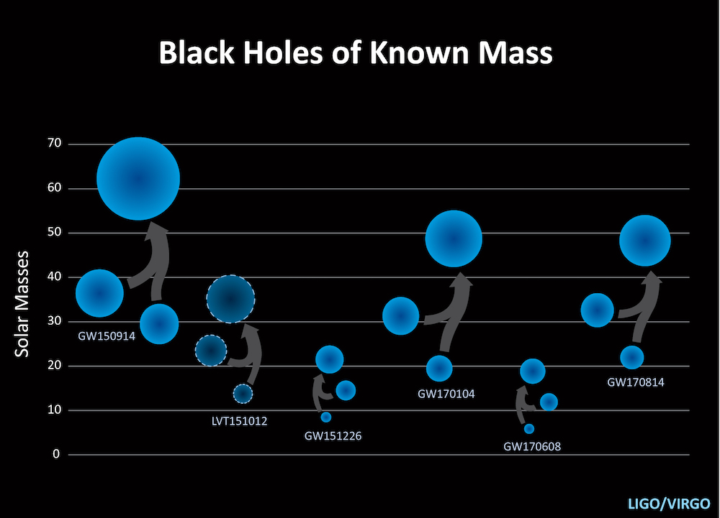
O2 and the role of Virgo
3 new BBH:
GW170104 : 31.2M+19.4M -> 48.7M @ 880 Mpc
GW170608 : 12M+7M -> 18M @ 340 Mpc
GW170814 : 30.5M+25.3M -> 53.2M @ 540 Mpc (triple coincidence)
The first BNS:
GW170817 : 1.4-1.6M+1.2-1.4M -> [?] @ 40 Mpc (triple coincidence)
The bestiary is enriched!
BBH catalogue is growing:
5(+1) BBH
First BNS

Slide 40
GW170817
17/08/2017
12:41:04
Signal from BNS : GW170817
Detection from Fermi/GBM of a short gamma-ray burst (GRB170817A)
+2 s
+16 s
GRB alert sent
+40 min
Sent alert on GW side
Beginning of the multi-messenger campaign
+1h20min
First reports from temporal coincidences with GW170817
« Gravitational waves and Gamma-rays from binary neutron star merger: GW170817 and GRB170817A », Abbott et al., ApJ, 2017
Report from Integral/SPI-ACS
Detected GRB170817A
P(GW-GRB only by chance) < 5 10⁻⁸

Slide 41
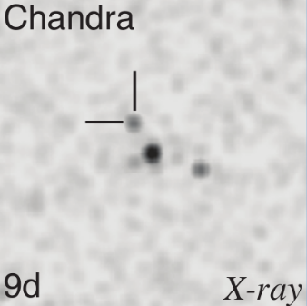

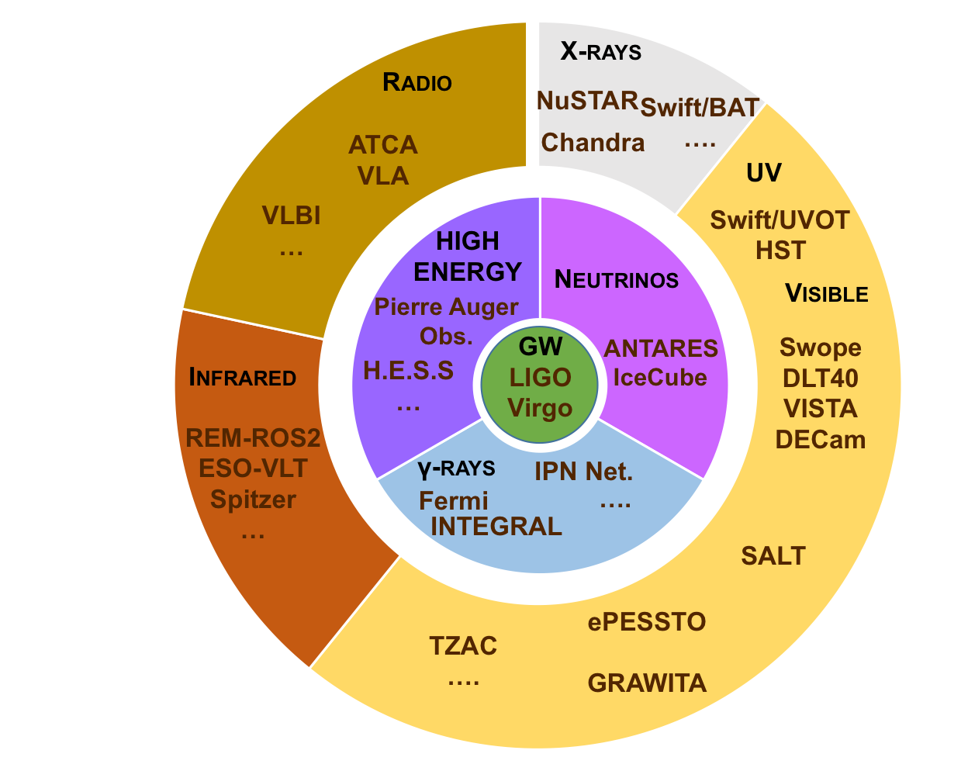
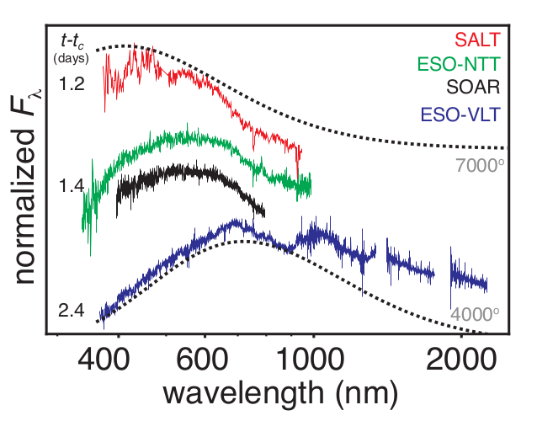
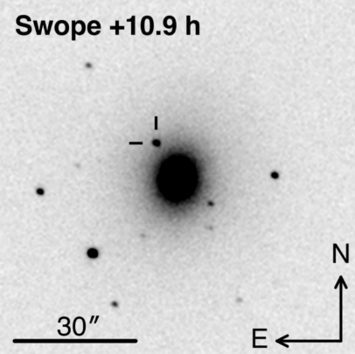
GW170817
17/08/2017
12:41:04
GW170817
+2 s
GRB170817A
+5h
Localisation with GW
Distance 40 Mpc
« Multi-messenger observations of a binary neutron star merger », Abbott et al., ApJ, 2017
+11h
Discovery of kilonova
AT2017gfo by Swope
Find host galaxy : NGC4993
Start Campaign on AT2017gfo
+1.2j
First spectra of the kilonova
+9j
Discovery of an X-ray counterpart
+16j
First radio signal found with VLA

Slide 42
GW170817 parameters

Slide 43
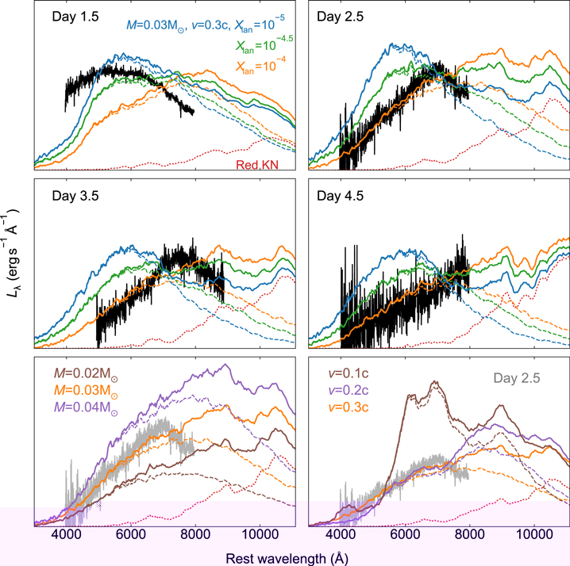
Kilonova
Predictions Vs observations
Spectrum : blue->red as time
Favors ejecta v ~ 0.3 c .
Eject mass ~ 0.03 M
(LIGO-Virgo estimate ~10⁻³-10⁻² M
from GW observations only)
Initially poor in lanthanids
Nicholl et al. 2017

Slide 44
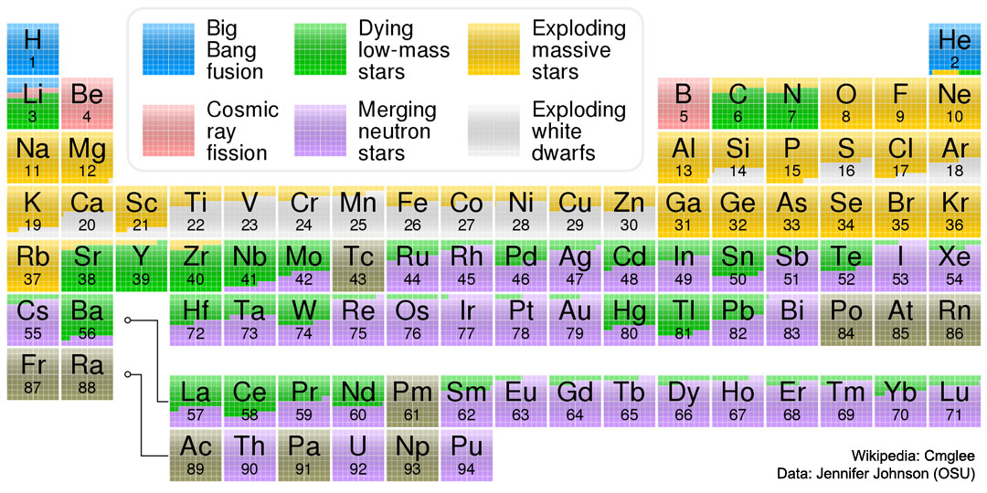

Slide 45
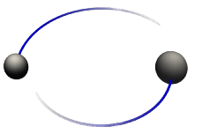

GW150914 : estimation des paramètres
15 paramètres !
Masses initiales, spins initiaux, masse finale, spin final, distance, angle d’inclinaison du plan orbital +angle de précession.
Estimation des densités de probabilités (méthodes MCMC)
avec 2 modèles (estimation des erreurs systématiques)
S₁
m₁
θ_{JN}
S₂
m₂
d_{L}

Slide 46
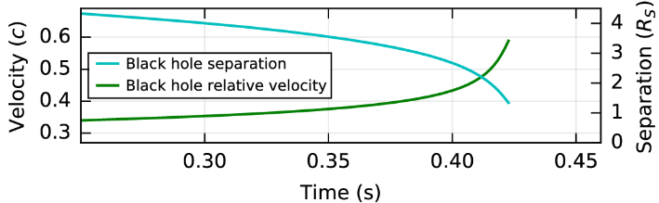
GW150914 : tests de la Relativité Générale
Tests précédents : système solaire, pulsars binaires (Hulse-Taylor et autres), cosmologie...
=> Champs faibles, régime linéaire …
Avec GW150914 : champ fort, régime non-linéaire, vitesses relativistes => tests inédits !
Test basique: on soustrait des données la forme d’onde reconstruite (IMR) et on
étudie les résidus.
=> Ces résidus sont compatibles avec du bruit gaussien à la limite de la précision de mesure
=> Écarts à la RG contraints à moins de 4%.

Slide 47
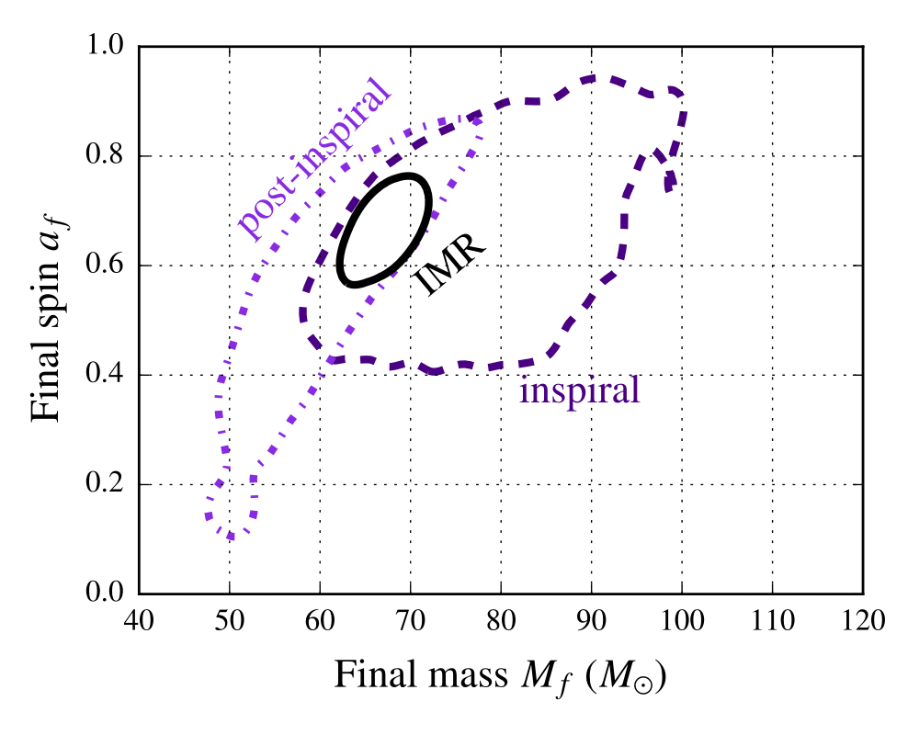
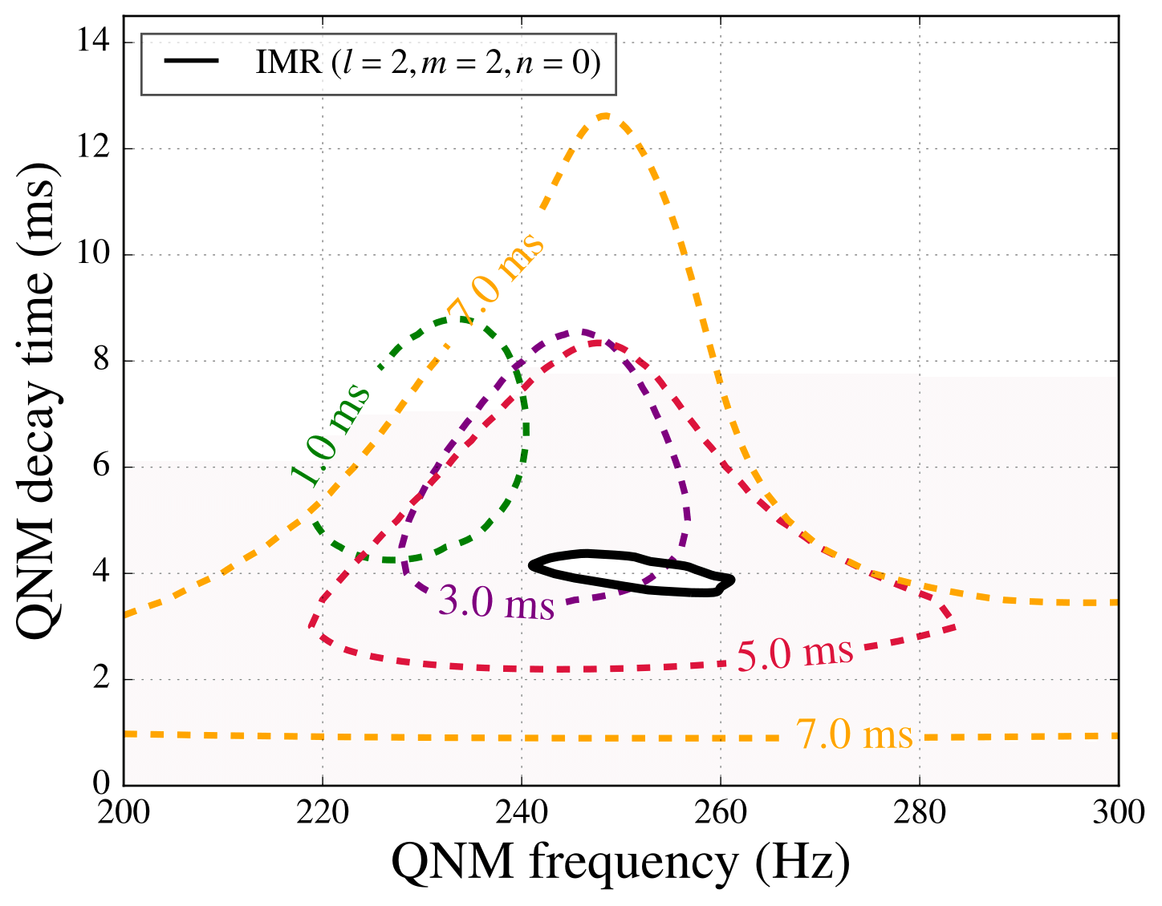
GW150914 : tests de la Relativité Générale
Test de coherence interne
La forme d’onde (IMR) possède 3 régimes distincts : inspiral+merger+ringdown.
Cohérence des paramètres obtenus
à partir de régimes différents
Meilleurs paramètres pour le «ringdown »(f~250Hz, τ~4ms)

Slide 48
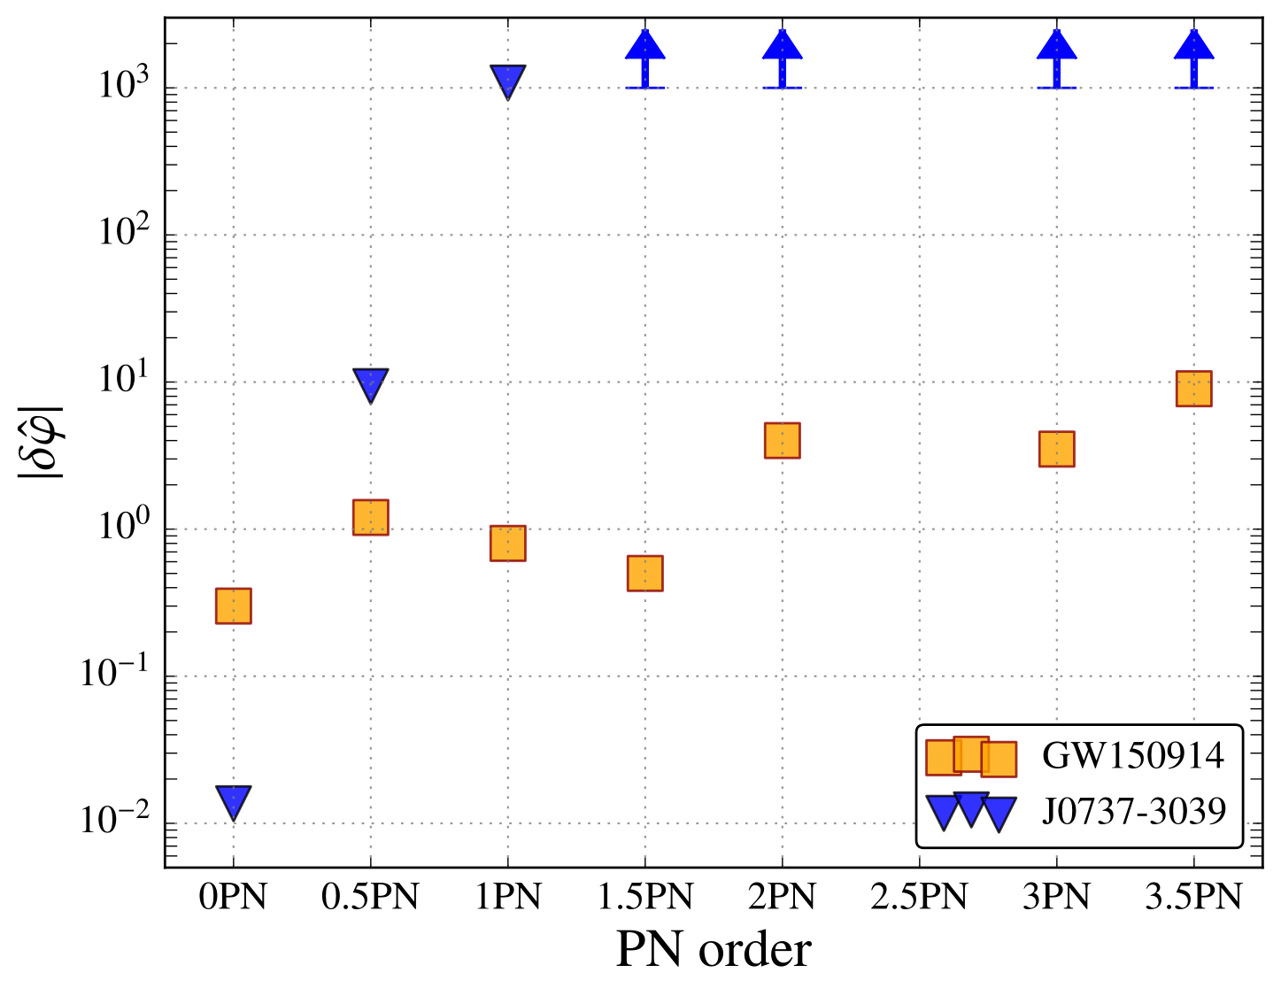
GW150914 : tests de la Relativité Générale
Recherche de déviations aux termes du développement PN prédits par la RG
pour la phase du signal ( xPN ⬄ (v/c)^{2x} )
Contraintes faibles mais les meilleures existantes sauf pour l’ordre le plus bas.

Slide 49
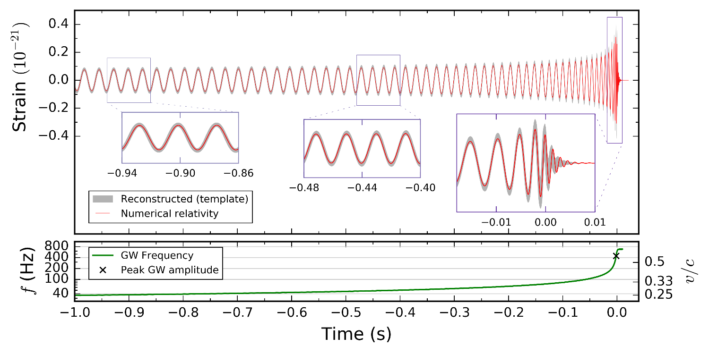
GW151226 : tests de la Relativité Générale
Amélioration des contraintes sur les coefficients PN de la phase du signal.
Pas de gain significatif sur les contraintes sur la masse du graviton.

