Slide 1


Neutrino
mass hierarchy and the JUNO experiment
Marcos Dracos
Institut Pluridisciplinaire Hubert Curien
Strasbourg
(marcos.dracos@in2p3.fr)
n

Slide 2
Outlook
n
Brief introduction
Neutrino Oscillations
Mass hierarchy problem
Experimental situation
The JUNO experiment
  nuclear reactor neutrinos and mass hierarchy
  The JUNO detector
  JUNO physics program
  Activities at IPHC

Slide 3
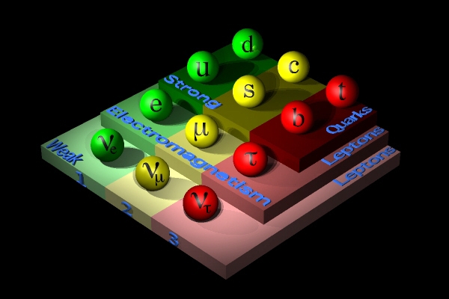

But, what a neutrino is?
fermions (spin 1/2)
elementary particles,
neutral (electrical charge=0)
interacting only through weak interaction,
they have massive and charged partners,
massless up to 90’s (this is what was assumed by the Standard Model of elementary particles)?
+bosons currying the interactions (spin integer)
strong
weak
electromagnetic
the fermions’ anti-particles
the Higgs boson

Slide 4
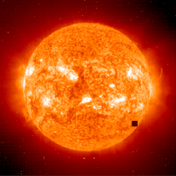
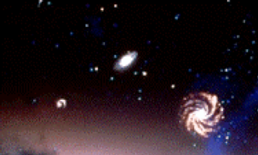


Where can we find neutrinos?
Solar Neutrinos : 2 10³⁸ ν/s → 40 billions ν/s/cm² on the earth → 400000 billion ν/s/human (<20 MeV).
Universe :
Big-Bang : 330 ν/cm³ (0.0004 eV → 2000 km/s if m_{ν}=10 eV/c²).
Stars : 0.000006 ν/cm³.
Supernovae : 0.0002 ν/cm³.
Earth radioactivity : 50 billion ν/s human.
Nuclear Plants:10-100 billion ν/s/human (1-10 MeV).
Human body: 340 million ν/day (20 mg of ⁴⁰K, β decay).

Slide 5
Neutrino Energy Spectrum

Slide 6
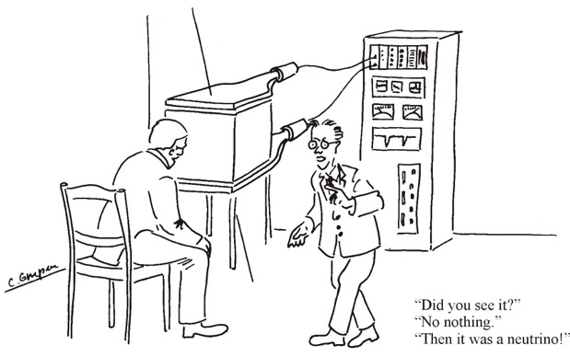
Neutrino interactions
1933 : First estimation of the neutrino interaction cross-section (interaction probability) by Hans Bethe and Rudolf Peierls
(N for nucleon), very very weak cross-section!!!
mean free path
mean free path in lead for 3 MeV neutrino
to stop a neutrino a lot of lead is needed or many neutrinos...
The beginning of a long neutrino hunting which lasted 26 years...
(Pauli: “I bet a case of champagne that nobody would ever detect the neutrino”)

Slide 7
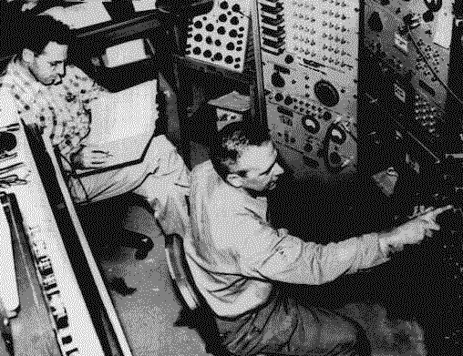
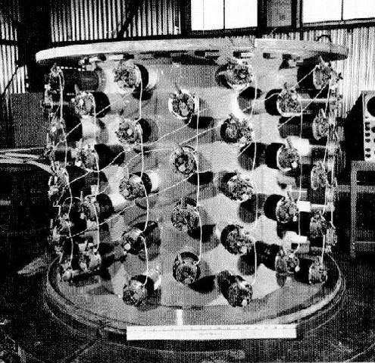
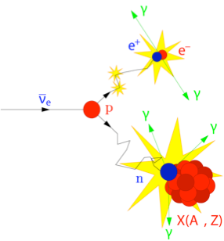
First (anti) neutrino observation
1956: Fred Reines and Clyde Cowan detect the first neutrino interactions near the nuclear reactor of Savannah River at the USA (11 m from the reactor and 12 m underground).
Nobel prize in 1995
about three neutrinos per hour
prompt
produced by the nuclear reactor
water, scintillator, CdCl_{2 (cadmium chloride)}
inverse β decay
∼200 μs
they also envisaged the use of an atomic explosion...
delayed

Slide 8
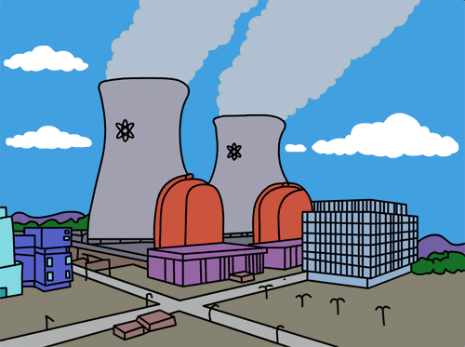
Nuclear Reactors as neutrino source

Slide 9
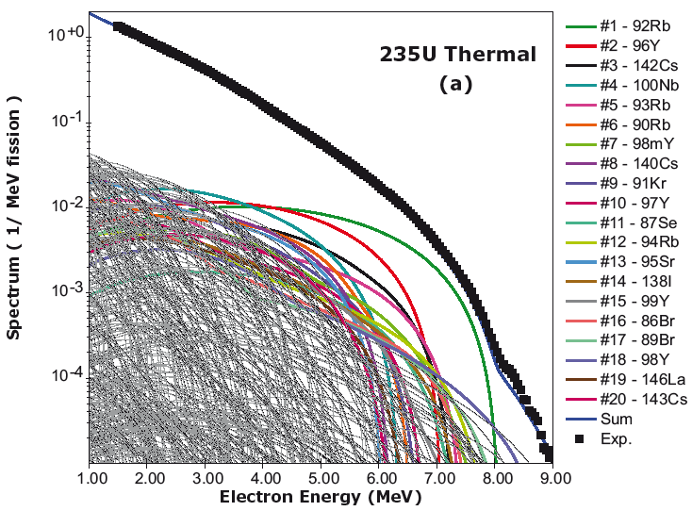
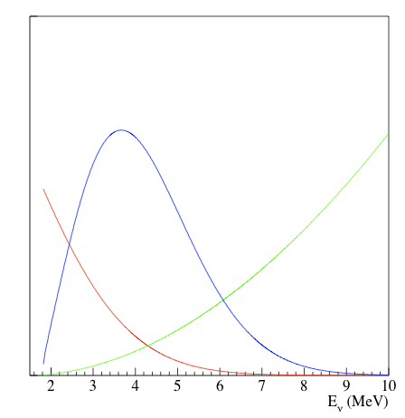
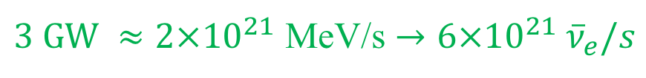
Nuclear Reactors as neutrino source
Nuclear reactors are a very intense electron anti-neutrino source (β decay of neutron rich fission fragments).
Each fission releases an energy of ~200 MeV and generates ~6 electron anti-neutrinos. For a typical commercial reactor (3 GW thermal energy):
(Bemporad, Gratta, Vogel)
arbitrary units
Observable ν spectrum
$3 GW ≈2×{10}^{21}$ MeV/s $→6×{10}^{21} {\overline{ν}}_{e}/s$
Observable neutrino energy spectrum= neutrino flux * cross section.
The spectrum has a maximum at ~3.7 MeV.
Cross section
Flux

Slide 10
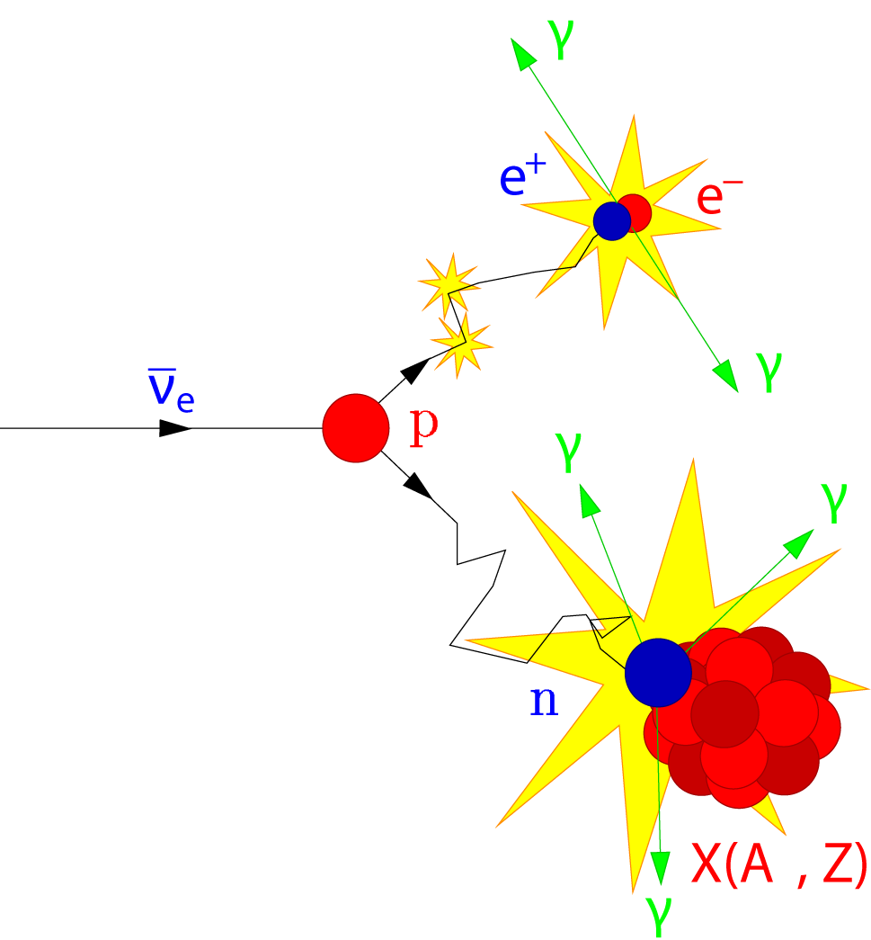
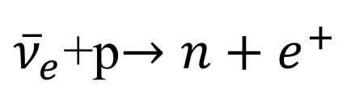
Inverse β decay and detection mode
${\overline{ν}}_{e}$+p$→n+e^{+}$
IBD
511 keV
Prompt
In a pure scintillator the neutron will be captured by hydrogen (~200 μs):
n H → D γ (2.2 MeV)
Very often the scintillator is doped with gadolinium that increase the capture probability and liberates more γ's (~30 μs):
n ^{m}Gd → ^{m+1}Gd γ’s (8 MeV)
511 keV
delayed

Slide 11
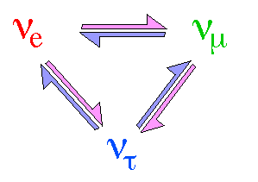
Neutrino Oscillations
According to Quantum Mechanics, if neutrinos have a non-zero mass they can "oscillate" (change family during travelling).
Why? Because their mass eigen states could not coincide with their flavour eigen states (or interaction eigen states).

Slide 12
Quantum Mechanics and lepton mixing
The "known" neutrinos are combinations of neutrino mass eigen states, e.g., for the electron neutrino:
Propagation in time:
For all neutrinos, we can write:
ν₂
ν₃
ν₁
ν_{e}
ν_{μ}
Pontecorvo-Maki-Nakagawa-Sakata Matrix
Weak interaction
ν_{τ}
Unitarity: UU⁺=I
(U⁺=(U*)^{t})

Slide 13
Matrix Properties
Unitarity UU⁺=I:
(U⁺=(U*)^{t})
n² free parameters
If each matrix element is replaced by (with arbitrary φα and φj modulo 2π):
the unitarity condition is always respected
n²-(2n-1)=(n-1)²=4 free parameters

Slide 14
Neutrino Oscillations
Pontecorvo-Maki-Nakagawa-Sakata matrix
ν₃
well established now
θ₁₃
ν_{μ}
ν_{τ}
θ₂₃
θ₂₃
θ₁₂
ν₂
Usual parametrization
ν_{e}
ν₁
θ₁₂
θ₁₃
atmospheric,
accelerators
reactors,
accelerators
CP violation
solar,
reactors
δCP for neutrinos
-δCP for anti-neutrinos

Slide 15
CP Violation
1964 : Discovery of the CP violation by J. Cronin and V. Fitch
“small” difference of 0.3% between the two ratios...
P
C
CP
CP conservation
Escher’s drawing

Slide 16
CP violation
P
C
X
CP
CP violation
Escher’s drawing

Slide 17
How neutrinos propagate through the time (and in vacuum)?
According to Quantum Mechanics:
(H: Hamiltonian)
Solutions of Schrödinger equation
For 3 neutrinos with a well defined mass and energy:
Schrödinger equation:
for the mass eigen states
for the flavour eigen states
with:

Slide 18
Neutrino propagation through the time
at time t=0:
α=e, μ, τ
temporal evolution of flavour eigen states:
with energy:
with: p>>m_{k}
can be expressed as function of the neutrino flavour eigen states
the amplitude of the transition ν_{α} →ν_{β} at time t (or at distance L)
with:

Slide 19
Transition Probability
(the time has been replaced by the distance)
with:
the transition probabilities do not depend on the particle masses but on the squared mass differences
Finally, the transition probabilities depend on the mixing matrix elements, the 2 squared mass differences and on the parameter L/E.
No transitions if:

Slide 20
Probability as a function of mixing angles
To obtain:
CP transformation
if this term ≠0
replace:
or:
if:
CP violation

Slide 21
Oscillation Parameters
mixing angles:
mass differences:
(only 2 are free)
what can be varied by humans to study neutrino oscillations:
Often used: Oscillation Length
(length at which neutrinos reappear):

Slide 22
Oscillation Probabilities in vacuum
1st order development in α and sinθ13
~3%
Not affected by δ_{CP}

Slide 23
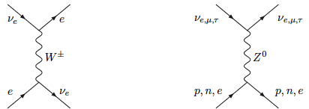
How neutrinos propagate through matter?
(Mikheyev-Smirnov-Wolfenstein effect)
only for electron neutrinos
in "ordinary" matter
CC
NC
with:
(ρ~3 g/cm³ for earth crust)

Slide 24
Present measurements
up to 2011
~δ_{CP} (almost) unknown
We can then write:
?
?
"large" mass splitting
"small" mass splitting
normal hierarchy
inverted hierarchy

Slide 25
Oscillation probability
(neutrino beams)
"atmospheric"
"interference"
"solar"
matter effect
for antimatter: δ_{CP} →-δ_{CP} and a→-a
fake matter/antimatter asymetry due to matter effect
for NH: Δm₃₁²→|Δm₃₁²|
for IH: Δm₃₁²→-|Δm₃₁²|
δ_{CP} dependence,
sizable matter effect for long baselines
if θ₁₃~0 → oscillation probability not sensitive to δ_{CP} → impossible to observe CP violation in the leptonic sector.

Slide 26
Why to measure MH?
The oscillation parameter values (slightly or strongly) depend on the mass hierarchy and this avoids precision measurements and checks of the unitarity of the mixing matrix.
This also significantly reduces the CPV discovery performance of future projects.
Reject many theoretical models.
NH
NH

Slide 27
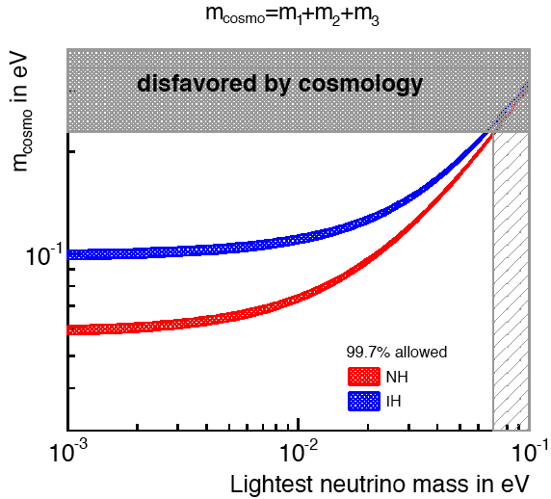
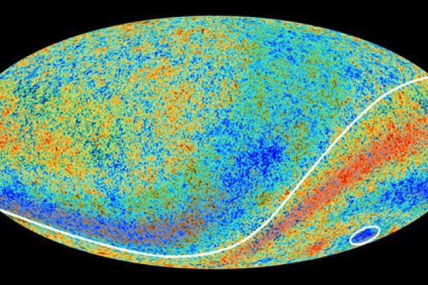
MH and cosmology
from cosmology
if m_{cosmo} < 0.1 eV ⇒ NH
arXiv:1505.01891
(3 σ uncertainty on all mixing parameters)

Slide 28
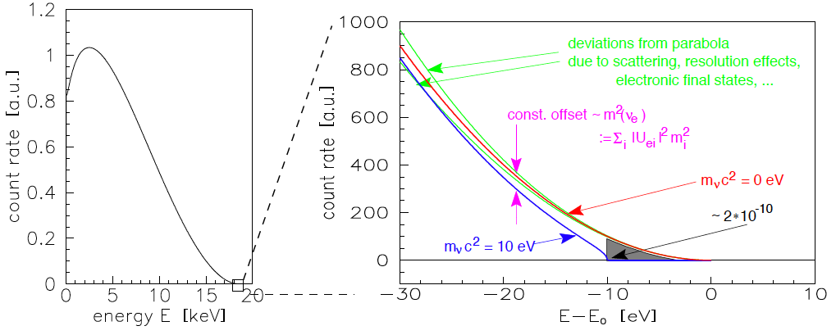
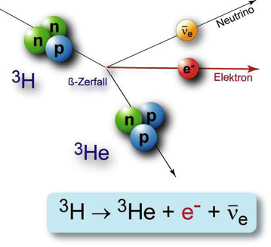
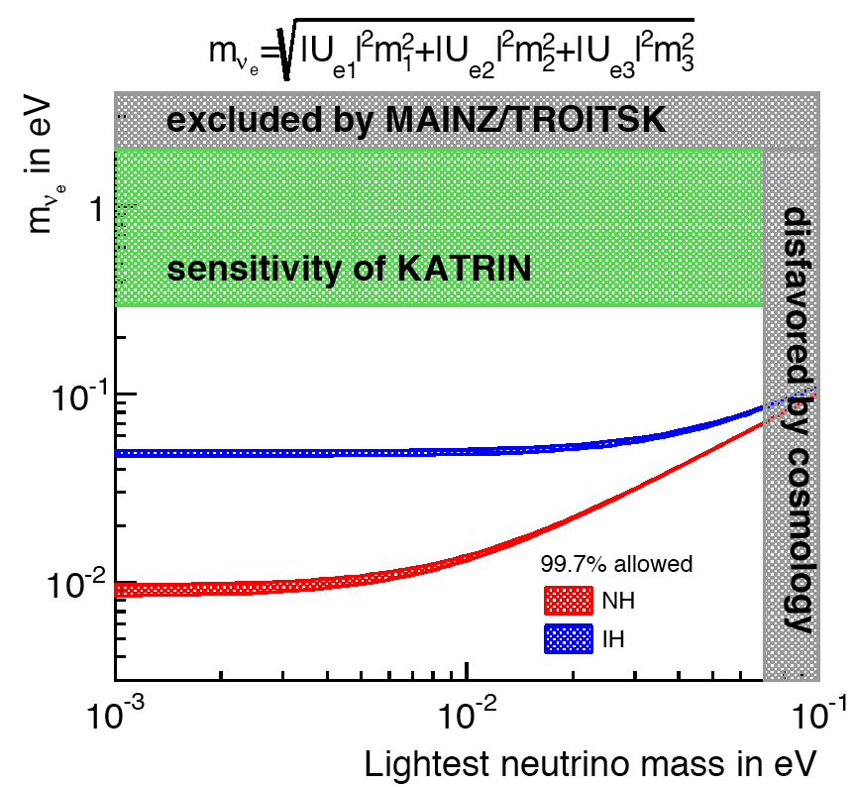
MH and direct neutrino mass measurements
from direct mass measurements
if m_{νe} < 0.05 eV ⇒ NH
arXiv:1505.01891

Slide 29
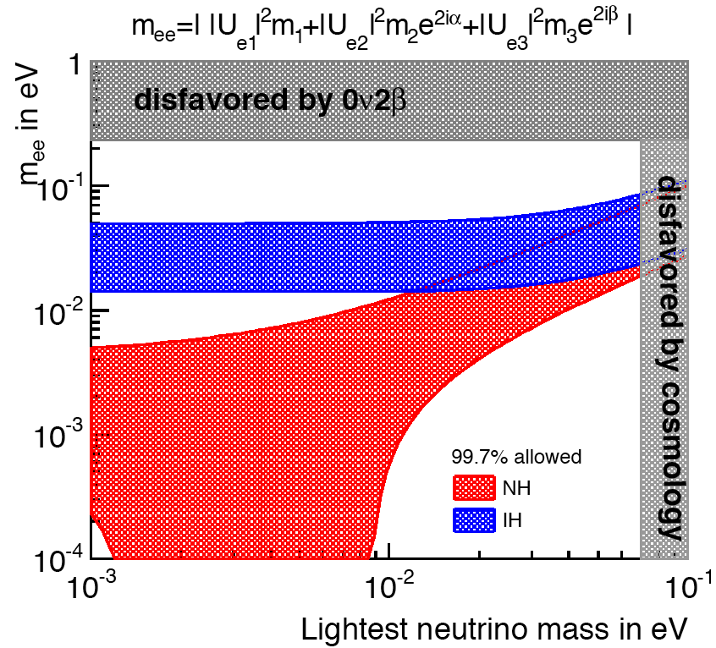
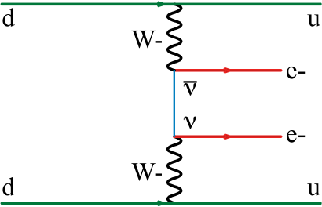
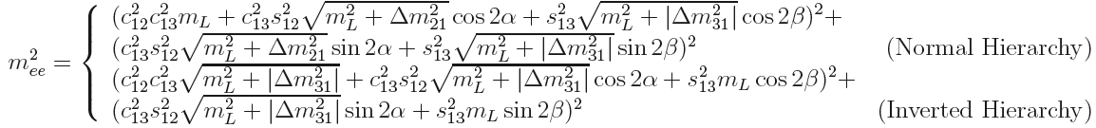
MH and neutrinoless Double Beta Decay
arXiv:1505.01891
from double beta decay (Dirac or Majorana particles)
if m_{ee} > 0.015 eV ⇒ IH ⇒ future Double Beta Decay experiments could observe neutrinoless DBD (Majorana neutrinos)
else, if NH, hard time for DBD experiments.

Slide 30
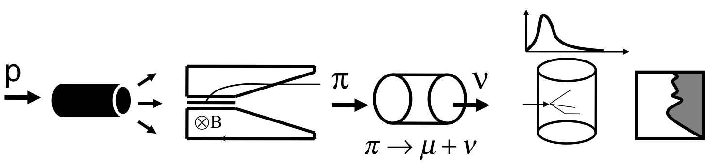
θ₁₃ hunting…
(up to ~2012)
New proposals for neutrino beams to measure:
θ₁₃ (as low as possible)
neutrino mass hierarchy (sign of Δm²₁₃)
CP violation
(Super Beams, Beta Beams, Neutrino Factory…)

Slide 31
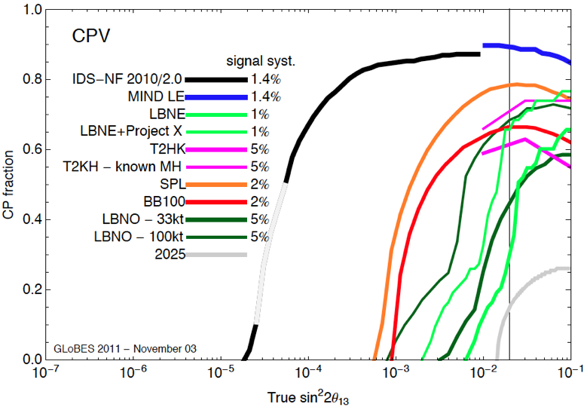
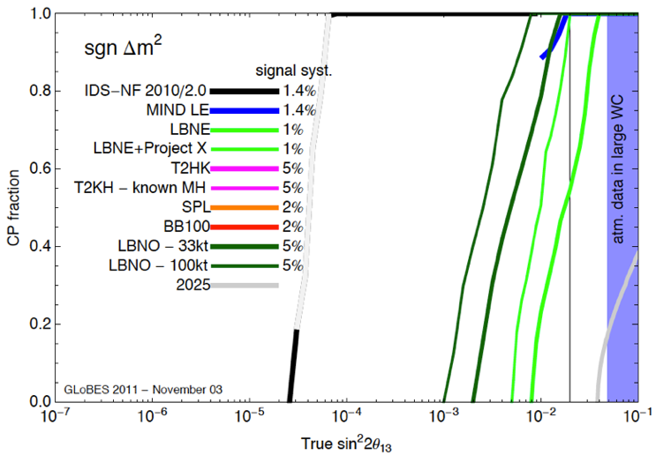
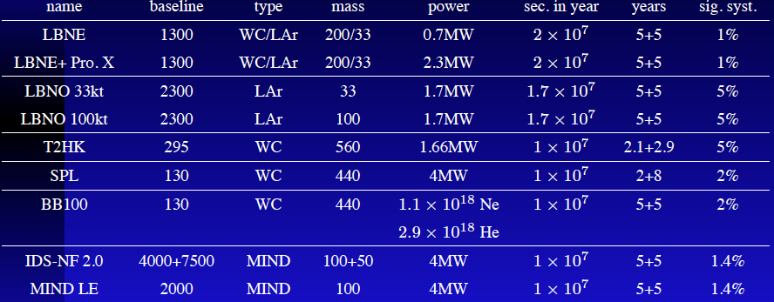
Project Comparison (unknown θ₁₃)
landscape up to 2011
the game:
go as low as possible on θ₁₃

Slide 32
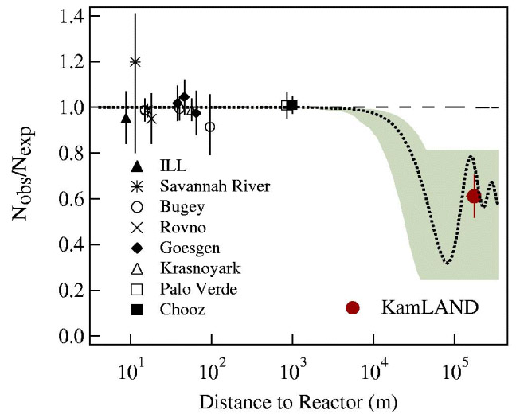
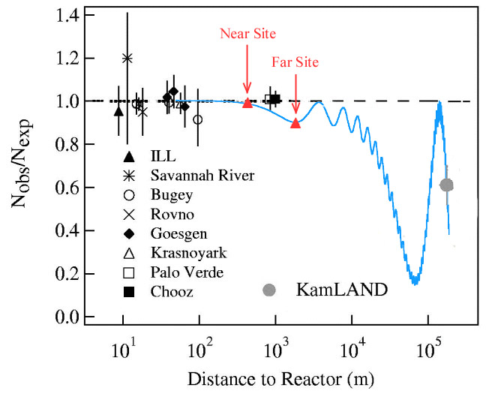
The θ13 hunting
(meanwhile, reactor neutrinos)
disappearance of electron anti-neutrinos
Actually, we have almost neglected θ13 on this figure
For θ13 ~ 10°

Slide 33

Inverse β decay and reactor neutrino detection mode
511 keV
Prompt
511 keV
no δ_{CP} dependence
matter effect negligible
~28 μs
delayed

Slide 34
Sin²2θ₁₃ and the "new" reactor experiments
isotropic electron anti-neutrino “well known” source
ν_{e}
ν_{e}
E_{ν} ≤ 8 MeV
Oscillations observed as an anti-neutrino deficit
ν_{e}
ν_{e}
ν_{e}
ν_{e}
1.0
sin²2θ₁₃
unoscillated neutrino flux observed here (normalisation)
Probability ν_{e}
Distance
1000 to 1800 meters
=1! =1!

Slide 35
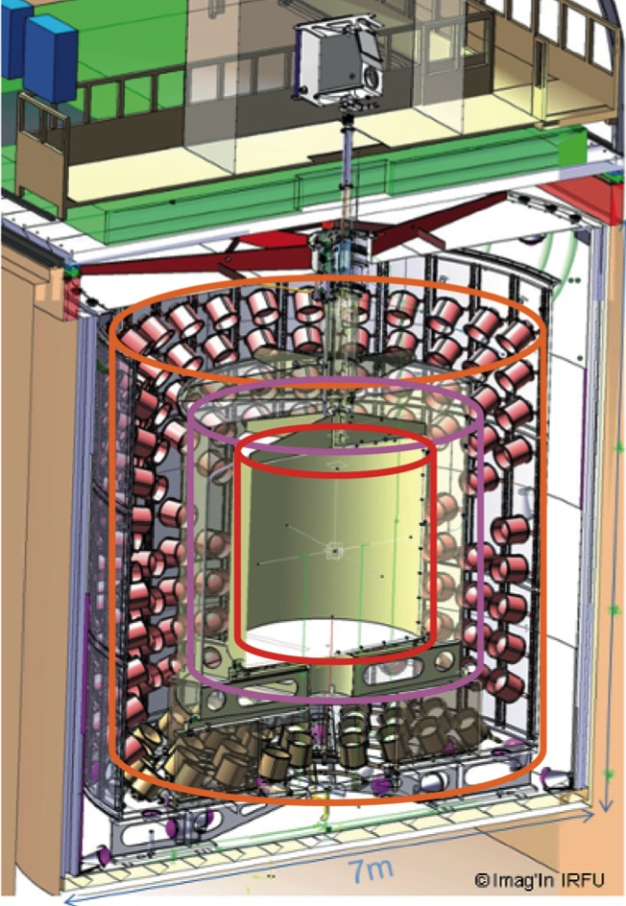

Reactor neutrino detectors
Outer Veto
(plastic scintillator)
Target (r=1.2 m)
acrylic vessel (8 mm)
8.3 tons Gd-scintillator
Shielding
(15 cm steel)
7 m
Gamma Catcher (e=0.55 m)
scintillator
Buffer (e=1.05 m)
steel (3 mm)
80 tons "oil"
390 PMTs (10")
Inner Veto
(liquid scintillator)
78 (8") PMTs

Slide 36
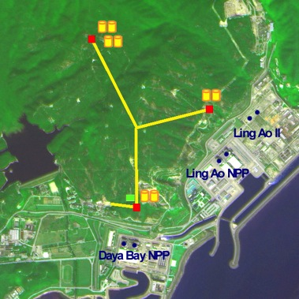
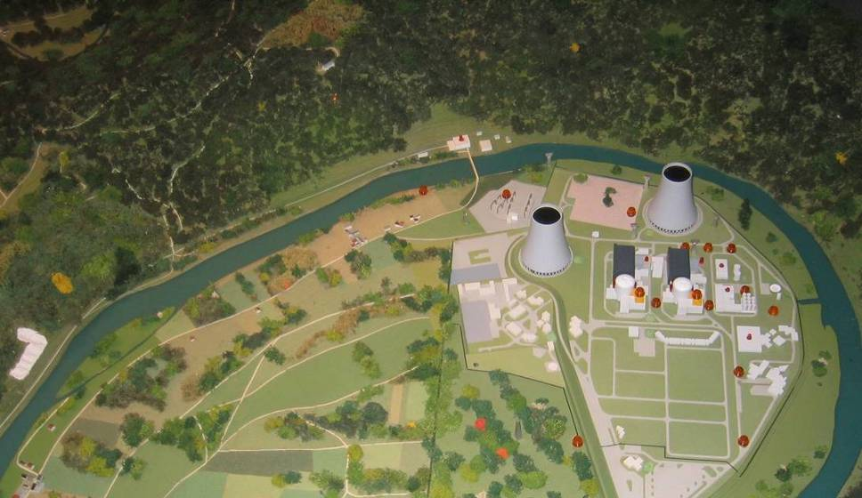
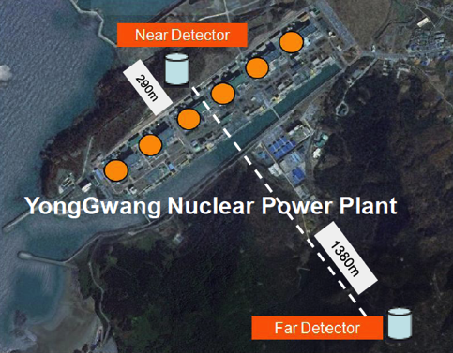
New Reactor Projects ready (2011)
Daya Bay
(China)
Double Chooz
(France)
RENO
(South Korea)
 | Luminosity in 3 years (ton·GW·y) | Overburden near/far (mwe) | Expected sensitivity | Start of data taking
Daya Bay | 4200 | 270/950 | <0.01 | August 2011
Double Chooz | 210 | 80/300 | 0.02~0.03 | April 2011
RENO | 740 | 90/440 | ~0.02 | August 2011

Slide 37
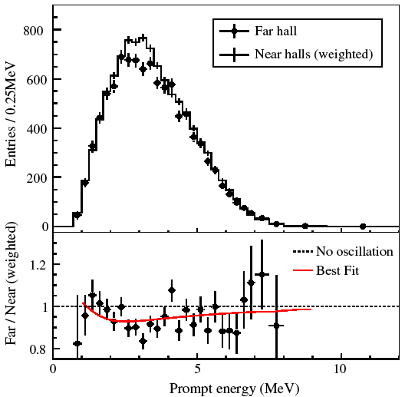
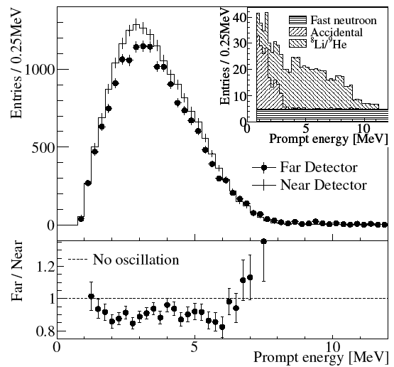
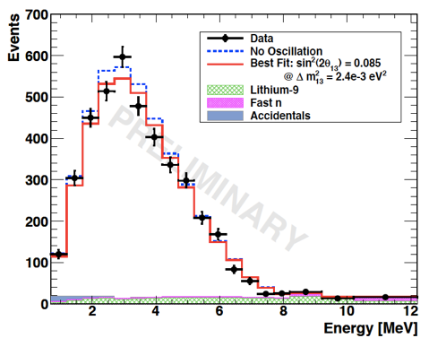
θ13 is large!!!
reactor experiments discovery of the 1→3 oscillation
Daya Bay
(March 2012)
RENO
(April 2012)
Double Chooz
with only a far detector
(Nov. 2011)
proposed LBL beam facilities had to be readjusted…
now, the name of the game is MH and CPV
θ₁₃>0 (C.L. > 5 σ)

Slide 38

Next steps…
The door is now open for Mass Hierarchy measurement
and CP Violation discovery
but, how steep is the slope?

Slide 39
Oscillation probability
(Long Baseline Experiments)
E_{ν}=3.0 GeV
enhanced phenomenon for neutrinos with MSW effect
P(ν_{μ}→ν_{e})
NH
IH
neutrinos+MSW
vacuum (neutrinos+anti)
anti-neutrinos+MSW
δ_{CP}=0
distance [km]
opposite phenomenon for anti-neutrinos
compare neutrino and anti-neutrino oscillations
MSW effect helps to find the right MH

Slide 40
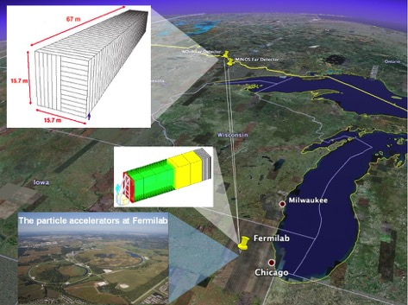
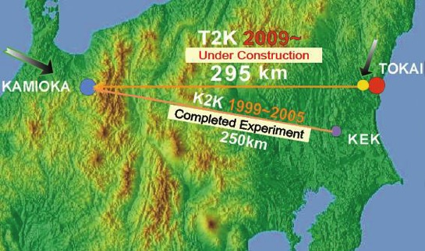
Present accelerator neutrino oscillation facilities in the world
JPARC beam and T2K experiment
(appearance/disappearance, off-axis, E_{ν}~0.6 GeV, L=295 km)
NOνA, same beam than MINOS, off-axis, E_{ν}~2 GeV, L=810 km.
E_{ν}=0.6 GeV
position of T2K
position of NOνA
E_{ν}=2.0 GeV
P(ν_{μ}→ν_{e})
NH
P(ν_{μ}→ν_{e})
IH
NH
δ_{CP}=0
IH
δ_{CP}=45
δ_{CP}=0
δ_{CP}=90
δ_{CP}=45
δ_{CP}=90
distance [km]
distance [km]

Slide 41
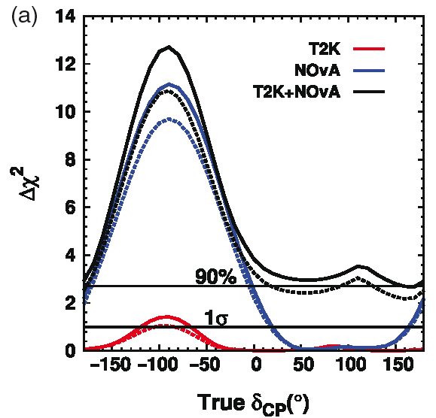
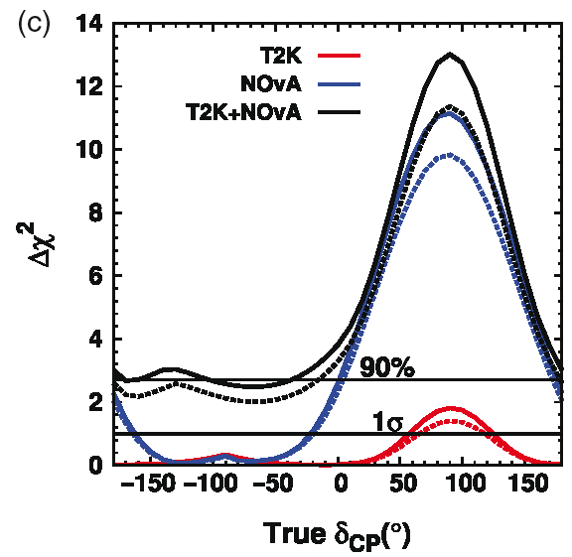
Present accelerator neutrino oscillation facilities in the world
JPARC beam and T2K experiment
(appearance/disappearance, off-axis, E_{ν}~0.6 GeV, L=295 km)
NOνA, off-axis, E_{ν}~2 GeV, L=810 km.
Mass hierarchy determination
+normalization systematics
NH
IH
if lucky, NOνA can reach more than 3σ significance (little contribution from T2K)
Strong dependence on mass hierarchy !!!

Slide 42
Future neutrino non-acceleration projects for MH determination

Slide 43

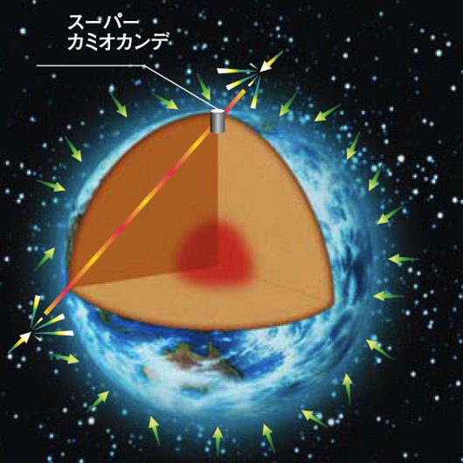
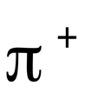
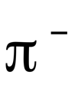







Using atmospheric neutrinos
primary flux
N₂,O₂
decay cascades
neutrinos arrive from all directions
~2x more ν_{μ} than ν_{e}

Slide 44
Atmospheric neutrinos
integrate all neutrinos between 3 and 15 GeV
P(ν_{μ}→ν_{μ})
3 GeV
15 GeV
NH
IH
distance [km]

Slide 45
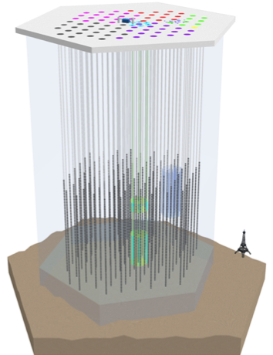
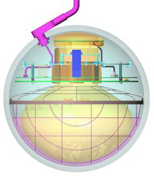
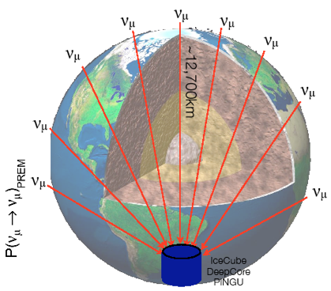
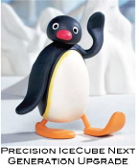
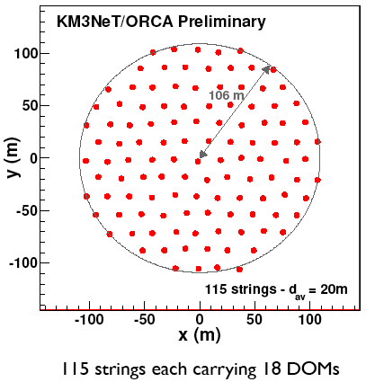
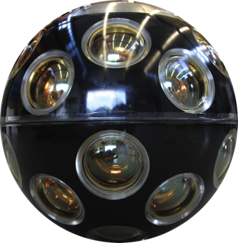

Large Water Cherenkov detectors
(neutrino mass hierarchy)
ICE Cube
(south pole)
PINGU
2-12 GeV neutrinos
good angular resolution
good energy resolution
Mediterranean see

Slide 46
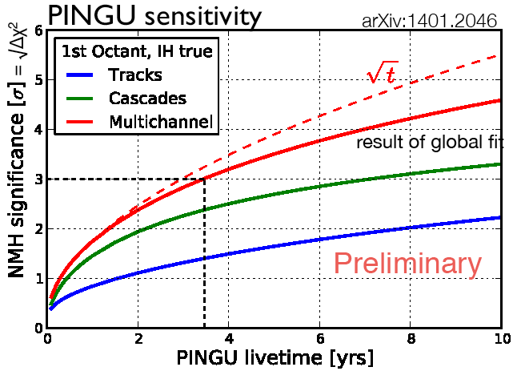


Future neutrino non-acceleration projects
large dependence on θ₂₃
ORCA

Slide 47

Reactors are back…
(mass hierarchy)
no δ_{CP} dependence
matter effect negligible
with:
=(2n-1)π/2⇒ max. sens.
=nπ ⇒ non sensitivity

Slide 48


Neutrino spectrum
511 keV
Prompt
Daya Bay
DC
RENO
JUNO
511 keV
KamLAND
~200 μs
delayed
S.T. Petcov et al., PLB533(2002)94,
S.Choubey et al., PRD68(2003)113006,
J. Learned et al., PRD78 (2008) 071302,
L. Zhan, Y. Wang, J. Cao, L. Wen,
PRD78:111103, 2008, PRD79:073007, 2009
can we observe the difference?

Slide 49
Neutrino spectrum
θ₁₃
Δm²₃₁

Slide 50

Energy resolution
The sensitivity will strongly depend on the energy resolution (E_{m}: mesured energy)
stat.
(N_{pe})
syst.
(non-uniformities, energy leaks…)
noise
Measured spectrum (without background):
JHEP 1305 (2013) 131
Shift in energy spectrum of ~Δm₂₁²/Δm₃₁²~3%
An energy resolution of ~3% (for E~1 MeV) is needed

Slide 51
With 3% energy resolution

Slide 52

Spectral analysis
Fourrier transform of the energy spectrum F(t):
(t=L/E)
PHYS. REV. D 78, 111103(R) (2008)
Discriminant variables:
(for FCT)
(for FST)
RL>0 and PV>0 →NH
RL<0 and PV<0 →IH
Statistical test of RL+PV

Slide 53


Reactor performance
Conditions:
Go to the right distance
Accumulate 100 kIBD (~6 years)
  ~20 kt detector
High energy resolution ~3% (at 1 MeV)
  high PMT coverage (~80%)
  high PMT Quantum Eff. (~35%)
  high liquid transparency (>20 m)
PHYS. REV. D 88, 013008 (2013)
~52 km
significance: 3 – 4 σ
Baseline
acceptable uncertainty on the distance: ±500 m

Slide 54



Initially two proposals on the market
JUNO/RENO-50
JUNO
Guang Zhou
Rich physics program:
  Reactor neutrinos
    Mass Hierarchy
    precision measurements of oscillation parameters
  Supernovae neutrinos
  Geoneutrinos
  Solar neutrinos
  Atmospheric neutrinos
  Exotic searches
2.5 h drive
Shen Zhen
Zhu Hai
Daya Bay NPP
Hong Kong
53 km
Macau
53 km
Taishan
NPP
Yangjiang NPP
RENO-50

Slide 55

JUNO Experiment
Jiangmen Underground Neutrino Observatory
a multiple-purpose neutrino experiment,
approved in Feb. 2013,
~ 300 M$,
data taking: ~2021.
72 Institutions, 600 collaborators

Slide 56




JUNO
NPP | Daya Bay | Huizhou | Lufeng | Yangjiang | Taishan
Status | Operational | Planned | Planned | Under construction | Under construction
Power | 17.4 GW | 17.4 GW | 17.4 GW | 17.4 GW | 18.4 GW
Overburden ~ 700 m
Kaiping,
Jiang Men city,
Guangdong Province
Previous site candidate
Guang Zhou
Shen Zhen
Huizhou
NPP
Lufeng
NPP
Daya Bay NPP
Zhu Hai
Hong Kong
by 2020: 26.6 GW
53 km
Macau
53 km
Taishan
NPP
Yangjiang NPP

Slide 57



JUNO (72 institutes)
(under construction)
Overburden ~ 700 m
apartments
offices
dormitories
tunnel
assembling
+
storage
assembling

Slide 58



Experimental site
apartments
offices
dormitories
tunnel
assembling
+
storage
assembling
already constructed
Surface Campus
Vertical shaft: 564 meters
already constructed
竖井入口
Slope Tunnel：1266 meters @ slope of 42%
Experimental hall
Overburden: 680 m meters
Width: 49 meters
Length:55 meters

Slide 59
JUNO detector

Slide 60


Detector Construction
Chimney
Acrylic sphere
Latticed shell
node prototype
Acrylic sphere:
  ø35.4 m,
  thickness: 120 mm
  >200 pieces of panels bonded on site (600 t)
• Stainless steel: ø40.1-41.1m
Truss-supported structure
Acrylic bonding tests

Slide 61


High energy resolution
How to reach the required energy resolution?
Photocathode coverage: 77% with 20" PMTs
High PMT QE: ~35%
Liquid scintillator attenuation length: >20 m
High light yield with optimised fluors
DYB
KamLAND
JUNO
 | KamLAND | BOREXINO | JUNO
LS mass | 1 kt | 0.5 kt | 20 kt
Energy Resolution | 6%/√E | 5%/√E | 3%/√E
Light yield | 250 p.e./MeV | 511 p.e./MeV | 1200 p.e./MeV

Slide 62

Liquid Scintillator pilot plant
Purified 20 ton LAB to test the overall design of the purification system at Daya Bay by replacing the target LS in one detector
  Optimization of recipe, study of radioactivity background
Target properties:
  Optical: >20 m attenuation length @430nm
  Radio-purity: 10⁻¹⁵g/g (U, Th)
pilot plant

Slide 63


20" Photodetectors
5000 PMTs
15000 PMTs

Slide 64

JUNO Photodetectors
Contracts were signed in 2015
15k MCP-PMT (75%) from NNVT
5k Dynode (25%) from Hamamatsu
container
20" PMT mass testing started

Slide 65
3" PMT
25000 3-inch PMTs, contracted to HZC (China)
Together with the 20-in PMT as a double calorimetry
  Increase photon statistics by 3%
  Energy measurement via “photon counting”, better control of systematics
  muon tracking, supernova detection …

Slide 66


Veto
WC veto
Water Cherenkov detector
  ~2000 20” PMT
  35 kton ultrapure water
Top Tracker
  Re-using the OPERA’s Target Tracker
  Already in China
Top Tracker
(3 x-y layers)
Earth Magnetic Field shielding

Slide 67





Calibration System
Automatic Calibration Unit (ACU)
Cable Loop System (CLS)
Remotely Operated under-liquid-scintillator Vehicles (ROV)
Guide Tube Calibration System(GTCS)
Complimentary for covering entire energy range of reactor neutrinos
Full-volume position coverage inside JUNO central detector

Slide 68

JUNO background
Δm²_{atm.}
Δm²_{solar}
(JUNO Yellow Book:, J. of Phys. G: Nucl. Part. Phys. 43 (2016) 030401)

Slide 69



Performance
PRD 88 013008 (2013)
Inputs
  100 kevents (6 years)
  3% @ 1 MeV energy resolution
  1% energy scale uncertainty
  realistic backgrounds
Sensitivity
  JUNO only
    50% chance to have 3 σ or higher
    2.3% chance to have 5 σ or higher
  JUNO + 1% Δm_{μμ}²
    84% chance to have 3 σ or higher
    16% chance to have 5 σ or higher
arXiv:1303.6733
by NOvA, MINOS, T2K

Slide 70





Oscillation parameters
(precision measurements)
First experiment to observe:
  simultaneously “solar” and “atmospheric” oscillations
  more than two cycles of neutrino oscillations
Complementary to long baseline accelerator program
Probing the unitarity of U_{PMNS} to the sub-percent level!
 | Current | JUNO
Δm²₂₁ | ~3% | ~0.6%
Δm²₃₂ | ~4% | ~0.5%
sin²θ₁₂ | ~7% | ~0.7%
better precision than for CKM matrix elements

Slide 71




Supernovae explosions
5000 ν will be detected by JUNO if explosion at 10 kpc (centre of our galaxy)
  energy spectrum
  time distribution
better understanding of the explosion mechanisms
detection of relic neutrinos produced by previous explosions
SN1987A
in 10 years

Slide 72


Geo-neutrinos in JUNO
JUNO ~700/year
Kamland 116/10 years
Borexino 14.3/5 years
KamLAND: 30±7 TNU
Borexino: 38.8±12.0 TNU
JUNO:
  reach an uncertainty of 3 TNU
  large background from reactors
  Aim: 37 ±10% (stat.) ±10% (syst.)
Events/10keV(10³² p y) ⁻¹
Neutrino Energy（MeV）
1.8-3.4MeV
  Reactor Neutrinos: 14±0.14/day
  Geo-neutrinos 2±0.5/day
(TNU ~ number of detected ν/year/kt LS (IBD, 10³² p)

Slide 73

Signal Rate in JUNO detector

Slide 74








Milestones & Schedule
2021:
Detector ready Data taking!
2019-2020:
Electronics production starts
Civil work and lab preparation
completed; Detector constructing
2018:
PMT potting
starts Delivery of surface buildings
Start production of acrylic sphere
2017:
Start PMT testing
TT arrived
2016:
Start PMT production
Start CD parts production
2015:
PMT production line setup
CD parts R&D
2014:
International collaboration established
Start civil construction

Slide 75
The JUNO Top Tracker
(Strong contribution of IPHC/IN2P3)

Slide 76


JUNO Top Tracker
Top Tracker
(3 layers)
Veto for the covered surface (impossible to cover all surface around the central detector).
Study the production of ⁹Li/⁸He produced by muons crossing the detector and mimicking IBDs (~80 ⁹Li/⁸He against ~60 IBD/day).
Study the production of fast neutrons produced by muons crossing the surrounding rock.
Precise measurement of the energy spectrum of cosmogenic isotopes.
Define the cuts to be applied in the CD to reduce these backgrounds.
Introduce all measured parameters in the simulation.
Better estimation of systematic uncertainties induced by this noise.
Tuning of track reconstruction using the CD PMTs.
muon

Slide 77
Cosmogenic background

Slide 78




JUNO Top Tracker
62 walls (496 modules)
6.8x6.8 m² sensitive area
y
x
Hamamatsu MA-PMT (3x3 cm²)
(64 channels, 64 kch. in total)

Slide 79






OPERA Target Tracker
500 modules
During the extraction of one TT wall (over 62) from OPERA detector.
6.8 m
6.8 m
OPERA Target Tracker
(entirely constructed in IPHC)
~2900 m² sensitive plastic scintillator surface
The TT has been packed into 7 containers and shipped from the underground lab of Gran Sasso to China in 2017.

Slide 80







Top Tracker
11/05/2017
15/07/2017
TT storage (and LPMT testing)
Final destination
Pan-Asia Warehouse
JUNO site

Slide 81





TT onsite aging monitoring using cosmic rays
Conditions during storage are very different wrt Gran Sasso (temperature, humidity, radiation etc.) and hence the ageing of the plastic scintillator could be faster if the proper treatment is not done promptly.
Few TT modules remained with their "old" electronics and DAQ to monitor their behavior inside the containers using cosmic rays.
TT modules with electronics inside the containers
reconstructed muon track
No significant aging observed up to now
number of p.e.

Slide 82



Estimation of the TT DAQ Rate
(mainly due to rock radioactivity)
The sample with label 2702 is extracted from underground between -633 m and -638 m, few meters above the bottom of the water pool.
Measurement realised by CENBG -Bordeaux using a Ge detector.
JUNO site
GS (just for comparison):
  ⁴⁰K 26 ± 2 Bq/kg
  ²³⁸U 1.8 ± 1 Bq/kg
  ²³²Th 1.5 ± 1 Bq/kg
much higher radioactivity than in GS!
New electronics needed

Slide 83

Top Tracker Strategy
Main TT features:
62 walls in 3 layers
992 PMT’s => 63488 electronic channels
Expected rate:
The event rate per channel is 32x higher in JUNO site compared to Gran Sasso Laboratory due to rock radioactivity.
muon
Trigger Strategy:
Level 1:
  Wall level (Square of 6.7x6.7m²⁾
  64*16 Channels
  Counting rate: 50 kHz/PMT
  L1 trigger selection needed
  (~10 kHz/wall)
Level 2:
  Global level for track alignment
Coincidences based on 3 aligned points can drastically reduced the rate and can be done offline

Slide 84




TT new Electronics
PM1
PM2
PM3
PM4
M1
M2
M3
M4
OPERA ROC (OMEGA)
PM16
M16
RO1
RO2
RO3
RO4
M5
PM5
RO16
RO5
CONCENTRATOR BOARD
PM15
M15
RO15
RO6
M6
PM6
PM14
M14
RO14
RO7
M7
PM7
PM13
M13
RO13
RO8
M8
PM8
OPERA
RO12
RO11
RO10
RO9
M12
M11
M10
M9
new electronics
PM12
PM11
PM10
PM9
local x-y trigger (LV1)
global trigger (LV2, if needed)
concentrators,
one per TT wall (16 PMTs)
(63)
front end cards with MAROC3 chip (996)
DAQ cards
(996)
LV2 feedback to the sensors in less than 1 μs

Slide 85
MAROC3 Chip (Omega)
Out_Q :
Multiplex charge output for analog reading on ROB
64 triggers continuously active
Fast OR trigger propagated to the concentrators for time-stamping and LV1 trigger selection
Out_ADC :
Wilkinson internal ADC output

Slide 86


Front End Board
Successful running the chip two times faster than recommended (80 MHz) to decrease the dead time!
Ready for production (mounting in IPHC during 2019): 1200 boards
Maroc 3A BGA encapsulation → ongoing (1500 chips)
 | AVDD = DVDD = 3.5V | FPGA = 5V | Power
Consumption | 150 mA | 170 mA | 2W

Slide 87

Concentrator Prototype
(1st version)
To White Rabbit switch
~ 200 x 340 mm²
8 layers
Min space/trace 125 μm
~ 1000 components
+12V DC
SOM 3x100 pins
  ZYNQ 7030
  Using 99% of available IOs
16x MDR for ROBs
TTIM
@ FMC conn
Signal conversion, buffering
DC/DC regulators
SFP ~1Gb/s
Zynq SOM
μSD
JTAG
Ethernet 1Gb/s
2 boards have been assembled
tests ongoing

Slide 88

Complete electronic chain
10 m cable
(real conditions)
Concentrator card
(IPHC)
MAROC3
(OMEGA)
MA-PMT
Front End Board
(IPHC)
Timing
(Tsinghua)
Read-Out Board
(INFN/CAEN)
To equip soon the TT prototype in Strasbourg and start preparing the online software

Slide 89

TT prototype
Test of electronics in almost real conditions
IPHC
4 x-y layers (1.7x1.7 m²)
electronics tests
triggering
online software
calibration system
muon telescope

Slide 90




Top Tracker drawings
bridge (40x21 m², ~200 tons)
IHEP
overlap of sensitive areas by ~15 cm
TT mechanical support by JINR, drawings by IPHC
3 TT layers
~3 m
electronics accessible from the bottom or top
access to bottom electronics

Slide 91





Top Tracker mounting
(during CD filling)
used for positioning of TT end caps
supporting frame used during mounting and remaining after for final mounting
auxiliary frame used during mounting and transportation
(same for all walls)
walk paths to access the TT electronics
Dubna
Supporting frames
~6 months in total for mounting the TT
area to mount the TT walls

Slide 92



TT mechanical structure
3 more compact TT layers on top of the chimney
TT wall transportation tool to be used during mounting
From the drawings to the realisation

Slide 93
Conclusions
neutrino oscillations
Reactor experiments allowed the θ₁₃ measurement and opened now the door to:
  neutrino Mass Hierarchy determination
  observation of a possible CP violation in the lepton sector using conventional neutrino beams.
Present projects (mainly NOνA and T2K) will give some indications on MH.
Atmospheric neutrinos are very useful for MH (projects still to be approved)
New Medium baseline large volume reactor experiments will very probably solve the Mass Hierarchy problem during the next 10 years:
  High energy resolution is needed.
  JUNO:
    Under construction in China (data by 2021)
    Accurate measurement of neutrino oscillation parameters
    Solar and atmospheric neutrinos
    Super nova neutrinos
    Geo-neutrinos.

Slide 94
Open Questions
Mass hierarchy: normal or inverted?
CP Violation in the leptonic sector?
Are neutrinos their own anti-particle (Dirac or Majorana)?
How many neutrino families? Are there sterile neutrinos?
What is the absolue neutrino mass scale?
What is the neutrino rôle in the Universe evolution?

Slide 95
Backup

Slide 96

Double beta decay

Slide 97



Present results
(NuTel2015)
arXiv:1505.03456

Slide 98




T2K (θ13 on accelerators)
Very intense proton beam (0.75 MW nominal power, 30 GeV)
Off-axis (2.5 deg.)
< E > 0.7 GeV
Oscillation
Maximum

Slide 99

Neutrino Interactions
ν
ν
ν
l
ν
ν
ν
l
π⁰
e
e
n
n
n
n
n
hadrons
Elastic
Quasi-Elastic (QE)
Resonant (RES)
Deep inelastic (DIS)
neutrinos
antineutrinos
According to neutrinos to be detected their interaction cross-section has to be taken into account.

Slide 100

Can we use the other “free” neutrinos to measure other oscillation parameters?

Slide 101

Matter/antimatter asymmetry in the Universe
At the very beginning of the Universe:
10,000,000,001
10,000,000,000
matter
antimatter

Slide 102

Matter/antimatter asymmetry in the Universe
After annihilation:
+ radiation
matter
what we see around us today…
Baryon Asymmetry in the Universe (BAU)

Slide 103


CP Violating Observables
atmospheric
Non-CPV terms
solar
interference
CP violating
matter effect
⇒ accessibility to mass hierarchy
⇒ long baseline
≠0 ⇒ CP Violation
be careful, matter effects also create asymmetry

Slide 104


δ_{CP} and Matter-antimatter asymmetry magnitude
(Jarlskog invariant)
Theoretical models predict that if |sinδ_{CP}|≳0.7 (45°<δ_{CP}<135° or 225°<δ_{CP}<315°), it could be enough to explain the observed asymmetry.

Slide 105
Present and Future Projects
T2K increases its statistics.
Increase of the beam power.
A slight preference for δ_{CP}~-90º and NH.

Slide 106




Present and Future Projects
CPV
MH
Goal:
Determination of mass hierarchy.
Observation of CP violation.
Improve the sin²2θ₂₃ measurement.
Determination of θ₂₃ octant.
they must be very lucky…

Slide 107



Future acceleration projects
295 km
1300 km
LAr (~40 kt)
DUNE
conditionally approved
HyperK
(JPARC-Japon)
not yet approved
CPV
MH and CPV
On top of the neutrino beam program:
Proton decay
Astroparticles
  understand the gravitational collapsing: ν from galactic SN
    SN relic ν
  Solar Neutrinos
Atmospheric neutrinos
ESS (Lund, Suède)
CPV
540 km
long term project

Slide 108

“cosmological” neutrino mass measurement
(Planck satellite)

Slide 109



Double Beta Decay
and Majorana Neutrinos
double beta decay without neutrino emission
allowed double beta decay
ΔL=2

Slide 110






Detection in Super-Kamiokande
solar neutrinos
interaction with atomic electrons (low energy, very sensitive to detection threshold)
diffused rings
more clear rings
atmospheric neutrinos
interaction with nucleons (high energy)
Cerenkov rings

Slide 111
Latest results
PRD 95, 072006 (2017)
DYB
clear L/E dependence
direct fit of Δm²_{ee}

Slide 112
How these precise results have been obtained?
DYB
PRD 95, 072006 (2017)
many radioactive sources used to calibrate the detectors,
better understanding of systematic errors,
better background reduction.
grey band: remaining uncertainty
8.7% @ 1 MeV

Slide 113




Oups… a problem!
DC
excess for 4<E<6 MeV
DB
RENO
~2.2% overall excess
⇒ excludes an "external" origin

Slide 114


Possible explanations
A single β-branch or mono-energetic line cannot simulate this excess.
A possible explanation:
Decays of prominent fission daughter isotopes (~ 42% rate from ⁹⁶Y, ⁹²Rb, ¹⁴²Cs, ⁹⁷Y, ⁹³Rb, ¹⁰⁰Nb, ¹⁴⁰Cs, ⁹⁵Sr).
PRC 91, 011301(R) (2015)
PRL 114, 012502 (2015)
Summation (or ab initio ) method: makes use of all available information on the β decays of each fission fragment, summing each nuclide’s individual β spectrum weighted by its yield in fission.
"illustrative comparison…
the overall agreement between the measurements and ab initio calculation is surprising…"

Slide 115
Reactor Anomaly
(DYB+RENO)
PRL, 116, 061801 (2016)
Chinese Phys. C41, 13002 (2017)
R_{DYB}= 0.946 ±0.020
DYB
R_{RENO}= 0.946 ±0.021
RENO
Daya Bay’s result is consistent with previous world measurement
World average including Daya Bay is 0.9430 ± 008 (exp.)+-0.023 (model)
RENO 1500 days at near detector (411 m)
Data/Prediction (Huber+Mueller)= 0.946 ± 021 (exp.)
  The deficit of observed reactor neutrino fluxes relative to the prediction (Huber+Mueller model) indicates an overestimated flux or possible oscillation to sterile neutrinos.

Slide 116
Sterile neutrinos
Δm²₁₄~1 eV2
sin²2θ₁₄~0.1
Δm²₁₄~0.03 eV²

Slide 117
Sterile neutrinos (DYB)
[1607.01174]
Δm²₁₄~0.03 eV2
sin²2θ₁₄~0.1
(Preliminary,
500 days)
[1607.01177]

Slide 118
Reactor/detector configuration
Double Chooz
(France)
RENO
(South Korea)
Daya Bay
(China)
started only in 2015
8 t
16 t
16 t
8 t
arXiv:1003.5800[hep-ph]

Slide 119
Use also of H for neutron capture to increase statistics
DYB
RENO
H with higher background
Gd
significant reduction of the background after signal treatment
DC
prompt DC signal
(gain of ~x2.5 in statistics)

Slide 120

Comparisons and complementarities
(big unknown: t₀)
arXiv:1311.1822
complementarities:
  reactors (low energy)
    LS, antineutrinos
  LBL (high energy)
    accelerator and atm. neutrinos
    LAr, WC, …
width of bands due to:
  δ_{CP} (for NOνA and LBNE)
  40º<θ₂₃<50º (for INO and PINGU)
  3.0%√(1 MeV/E)<σ_{E}<3.5%√(1 MeV/E)

