Slide 1
Test-beam facility at IPHC
Ulrich Goerlach¹), Vladimir Cherepanov¹), Patrick Asenov²), Jeremy Andrea¹)
¹) IPHC-Strasbourg
²) INPP-NCSR Demokritos

Slide 2
After-meeting conclusions
Obviously our project is still far from being accepted
High rate issue and pile up, but is problem for all beams. Needs clarification from CMS
HIPs (really high ionization,) could be generated by nuclear interaction in a thin foil just in front of the DUT
Reference counters (position sensitive) are a problem, start without?
We probably have to duplicate / set-up a new DAQ
Work without vacuum:
  This would simplify the set-up substantially,
  reduce the costs of the project by quite a bit!
  test set-up will be independent from beam line. →
  If PERCy is delayed we could also go to /collaborate with Louvain!
Geant4 simulation Natalya/(Vladimir ?)

Slide 3
Introduction
Can the cyclotron of IPHC (CYRCé) be used for test beam ?
  Estimate the usefulness for CMS,
  Would require construction of a dedicated beam line (not existing yet).
Cyclotron Characteristics :
  25 MeV protons,
  High intensities (up to 100nA => 10¹² protons/second),
  85 MHz time structure.
Possible interests for CMS
  Highly ionizing particles (~10 MIP),
  At high rate,
  Beam structure : synch. trigger and beam,
  Single Event Upset in FE electronics,
  Available from summer 19.

Slide 4
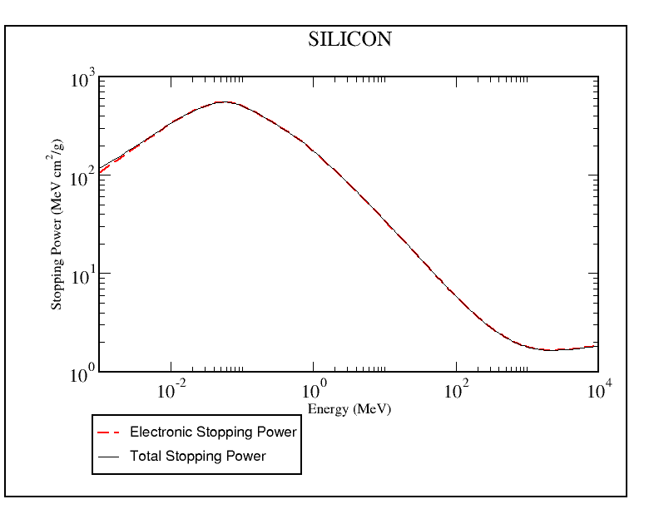
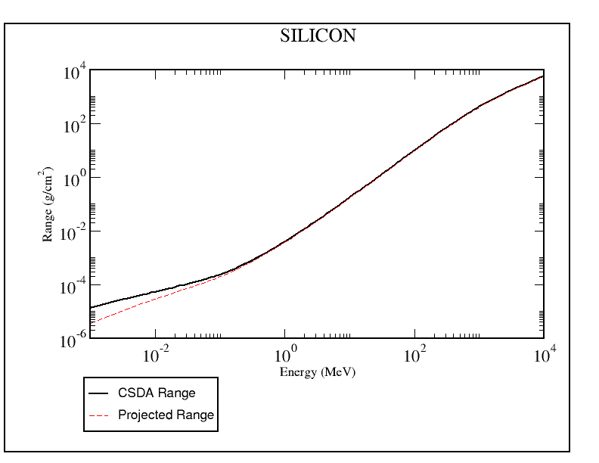
25 MEV PROTONS ON SILICON:
Density = 2,33 g/cm³
X₀=21,8 g/cm2 = 9,36 cm
Stopping power
= 18 MeV.cm²/g
= 42 MeV/cm. (differential)
= 1,26 MeV in 300 micron
Mip in Si = 1,666 MeV/g/cm²= 3,87 MeV/cm
Mip in 300 micron = 0,116 MeV
= > 25 MeV protons 11 Mips. =HIP.
Range : 0,7 g/cm2
= 0,7/2,33 = 3 mm !
Conclusion: HIPs, large MS but high rate

Slide 5
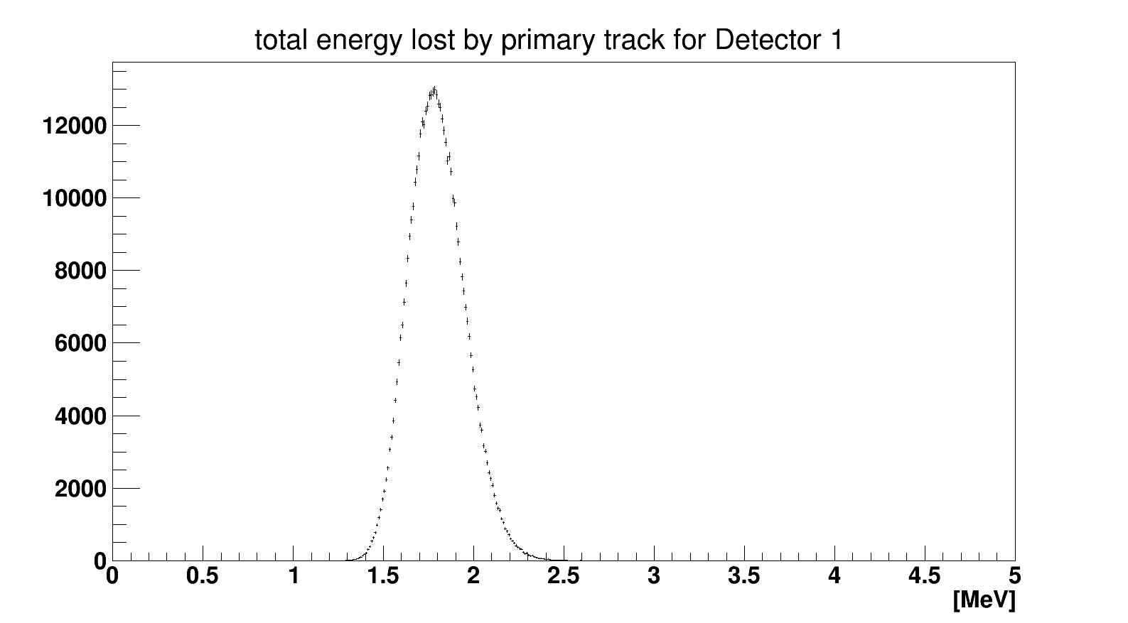
Start Geant4 simulation
A basic set-up is implemented in Geant4
(thanks to Patrick Asenov )
25 protons hitting a 2S (320µ) sensor at 0 angle
Plan:
Evaluate spatial resolution of track position on DUT obtained from reference planes, depending on position
Influence and optimization of trigger scintillator and reference plane thickness
P_{T} resolution of stab trigger for HIP?
Stab-Coincidences from secondaries in HIP environment?
Charge deposition by HIPs in preamplifier and FE electronics
V. Cherepanov
MIP

Slide 6
The CYRCé cyclotron and the (planned) beam line.

Slide 7
CYRCé: installed at IPHC in 2014

Slide 8
PERCy project will provide the transport beam line and the focussing and switching magnets needed for adding external beam lines.

Slide 9
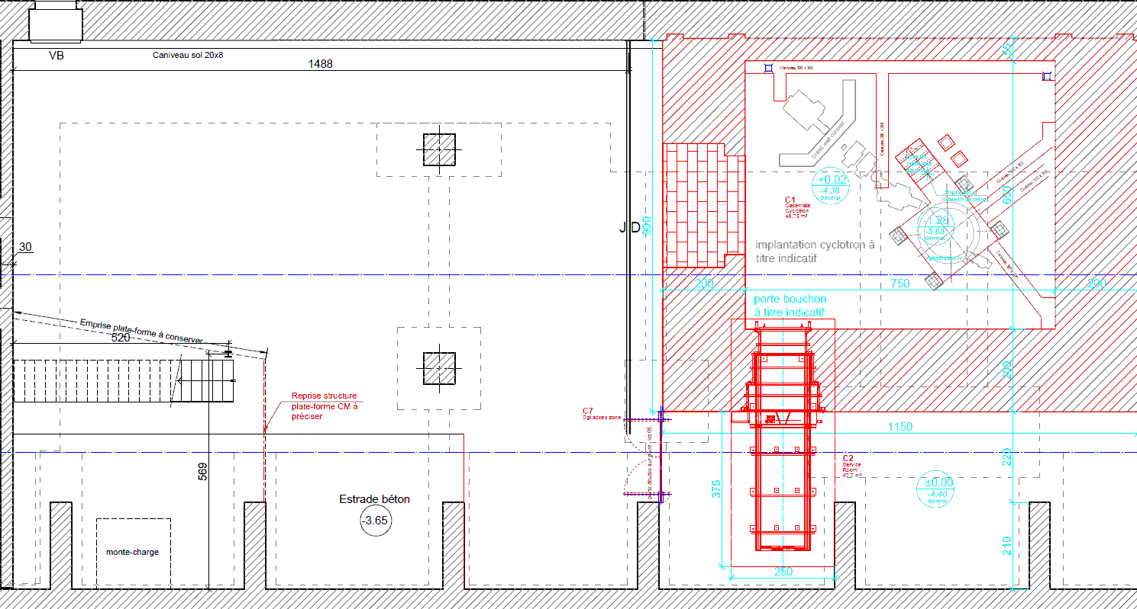

5-exit switching magnet, option 1 (0, ±22°, ±44°)
Scale 1 : 100
1 m
1 m
1 m
1 m
1 m
Existing
+44°, 5 m
Possible beam line
+22°, 9.2 m
1 m
Experimental casemate
Planned
0°, 14 m
-22°, 15 m
2.55 m
1 m
-44°, 10 m
CYRCé cyclotron

Slide 10
Planned (!) beam line in front of switching magnet
Vanne « chercheur »
Beam direction
Cup
profileur
Diffuseur + collimateur
Vanne « ligne »
steerer
switching magnet
Vanne « Vide »

Slide 11
Beam of 25 MeV protons delivered by Cyclotron
Some more details on the beam characteristics.
Energy (fixed): 16-25 MeV; dispersion: ΔE = 100keV,
Particle: Protons,
Intensities max 10¹² p/s, min 10² p/s.
Time structure: micro-structure: 85.085 MHz. = 11,75 ns, just about twice the 40MHz of LHC
Emittance at input of switching magnet: (VERY preliminary measurement , σ_{x} < 1.4 π mm mrad, σ_{y} < 5.4 π mm mrad, not well understood )
Re-Measurements of emittance in vertical and horizontal direction will only be possible in spring

Slide 12
Beam time structure and triggering
Frequency is 85.085 MHz corresponding to 11,75 ns
Have to run electronics at 42,5 MHz, use signal from cyclotron
interaction
11.75ns
Latency = 4
time
Beam
Beam 85 MHz
LHC clock
23,5ns
Scint trigger ready
LHC clock 42,5 MHz
Scint trigger ready
Trigger synchronized @ 42,5 MHz and sent to FE, latency is 4
Scint trigger ready
In time signals will have correct latency
Odd bunches will see info in pipeline, which has been written 11,75 ns after particle has passed detector
Trigger synchronized w 42,5MHz and sent to FE with latency = 4
Scint trigger ready
Trigger synchronized w 42,5MHz and sent to FE with latency = 4

Slide 13
Tentative beam line layout without quadrupoles for a wide beam of about
10-100mm diameter
Scintillator Y, X
and trigger
Scintillators
PMT
Lightguide
Switching magnet
valve
X-Y Steering
X-Y Steering
valve
Collimator 2
DUT
valve
Manual X-Y table
Faraday cup
Beam dump
profiler
Collimator 1
Faraday cup
support
Mechanical pump
Beam direction
Mylar window
CMS Set-Up
Test-bench
Fixed PERCy beamline

Slide 14
Cautious(!) planning for 2019
Existing: CYRCé
Planned and financed : PRECy
  Q-poles will arrive in February-March ➔ it will be possible to measure the beam emittance.
  Switching magnet will arrive in spring but can only be installed in fall when
  Civil engineering of experimental hall is finished
Start in 2018
  Order Mechanical supports, beam pipes, collimators, vacuum pumps in spring 2018 (at best),
  Build test table/set-up with detectors, telescope etc.. in spring, summer and fall 2018,
  Design, buy and construct reference pixel planes and DAQ, ??????
Start with installation of beam line (in parallel with PRECy) end 2018 beginning of 2019, if everything is well prepared. A challenge!
If beam-line ok, we could program beam forv spring 2019 onwards…
If beam-line not yet available we could envisage to go to Louvain !???

Slide 15
Questions to you, in case this project is interesting for CMS
Beam intensities ok ? Total rate (trigger to electronics) and density
Beam spot size: is (10mm)² up to (100mm)² ok ?
Are extensive HIP studies interesting?
We need 2 reference (Pixel, thin) planes before and after DUT including read-out, which can be easily correlated to DUT-DAQ
What is by experience the ratio between the time for setting up, for calibrating and data-taking
How much beam time do we need (we should ask for) and for what durations (few days, a week, longer ?), considering the working hours of the cyclotron (only day time, no nights or WE!)
Who else would be interested to participate in setting up and running test-beam
Jeremy, What did you find out in the mean time ???

Slide 16
CONCLUSIONS
A 25 MeV proton beam could be available during 2019 for testing modules :
  High rate possible,
  Time structure at 85 MHz allowing clock of 42,5 MHz for electronic,
  HIP studies, if needed, Study of SEU ??
  It seems to me that a major justification of the project will be to train students
Allows testing of detectors in extreme environments with simplified tracking
A simplified set-up (no vacuum, wide beam, only scintillator trigger) could be operational by spring summer 2019.
We need feedbacks from CMS :
  Main question to answer : is CYRCé interesting for the tests of CMS tracker upgrade PII modules ?
  What information on the beam, results from simulation, estimations (etc…) is needed to take a decision ?
  The sooner we decide, the sooner we can contact our funding agency and start the construction. We will need a clear expression of interest from CMS.

Slide 17
Backups

Slide 18
Beam line
Beam elements (details):
  Vacuum: 10⁻⁵ in scattering chamber.
  Mechanical and turbo pump for beam line
  Valve (automatic ?) after switching magnet
  1 or 2 Collimators. For beam spots between 10 and 100 mm diameter
  Focussing quadrupole with PC control (for small beam spot between 2 and 100 mm diameter)
  Steering magnets X and Y with PC control
  Profiler (before and) after Q-poles
  Scattering chamber (has been found! We need to know size of detectors and FE electronics
  Mechanical pump for chamber
  Pressure measurement in beamline and vacuum chamber
  Valve to separate scattering chamber from beamline
  Retractable Faraday cup before and fixed after chamber
  PC to control beam line
  Slit-scintillator in X and Y, rate-read-out by PC for beam profile
  Thinn (3mm?) and fast(!) trigger scintillator
Availability of beam:
  between 8h00 and 18h00, no night shift or WE
  Quite as few other users claim interest, not clear who else would be ready

Slide 19
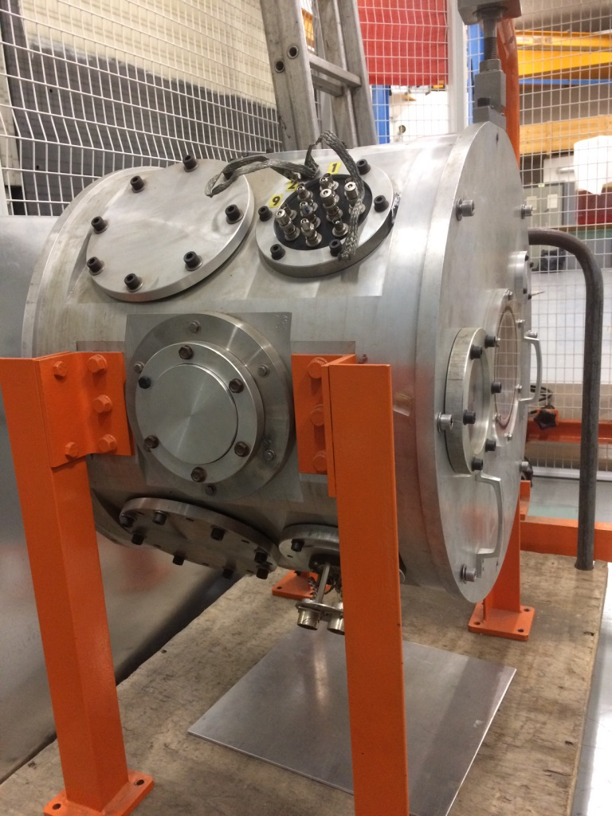
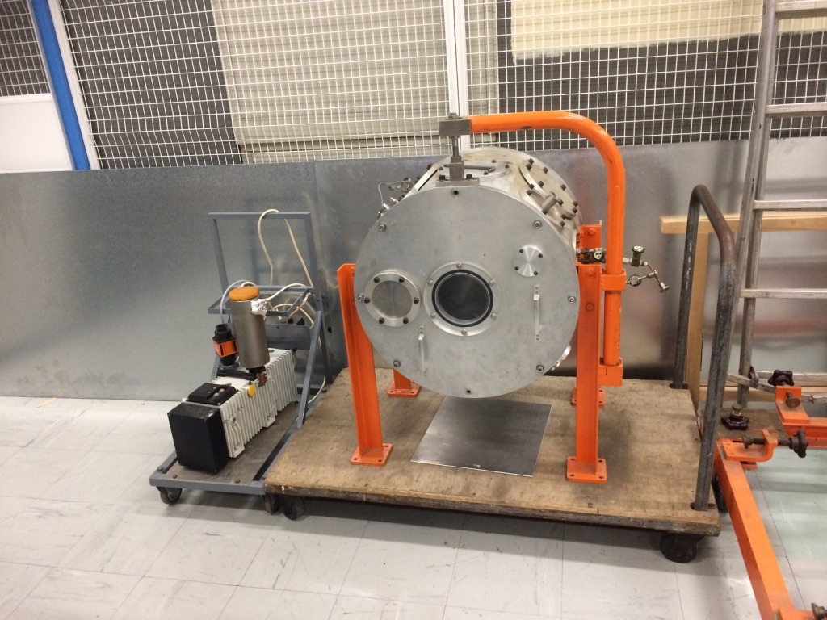
Vacuum chamber for DUT and reference (pixel) planes
25 MeV protons interact with the air => need for a vacuum chamber for DUT and (simplified) telescope. (10⁻⁵ bar)
A possible vacuum chamber is already existing!

Slide 20
Beam line layout with quadrupoles for a narrow beam of. 2-10 mm
(more expensive and longer delays)
Scintillator Y, X
and trigger
Scintillators
PMT
Lightguide
Switching magnet
valve
Scattering Chamber
X-Y Steering
Quadrupol X Y
X-Y Steering
valve
profiler
Collimator
DUT
profiler
valve
Faraday cup
Beam dump
Collimator
Faraday cup
valve
valve
Beam direction
Mechanical pump
Turbo pump
Quadrupoles can reduce the beam size from 10-100 mm down to 2-10 mm.
But, significant delays in the installation (several months).
Is a 10-100 mm beam size good enough for CMS ?
Mechanical pump

