Slide 1
An Experimental Survey on Big Data Frameworks
W. Inoubli, S. Aridhi, H. Mezni, M. Maddouri, E. Mephu Nguifo

Slide 2
Categorization of popular Big Data frameworks
 | Hadoop | Spark | Storm | Flink | Samza
Data Format | Key-value | RDD,DataFrame,DStream | Key-value | Key-value, DataStream | Events
Programming mode | Batch | Batch and Stream | Stream | Batch and Stream | Stream
Data sources | HDFS | HDFS, DBMS and Kafka | HDFS, HBase and Kafka | Kafka, Kinesis, message queus, socket streams | Kafka
Programming model | Map and Reduce | Transformation and Action | Topology | Transformation | MapReduce
Pogramming languages | Java | Java, scala and python | Java | Java | Java
Cluster manager | YARN, Mesos | YARN, Mesos, Standalone | Zookeeper | YARN ,Standalone, Mesos | YARN
Comments | Stores large data in HDFS | Gives several APIs to develop interactive applications | Suitable for real-time applications | An extension of MapReduce with graph methods | Based on Hadoop and Kafka
A comparative study of popular Big Data frameworks

Slide 3
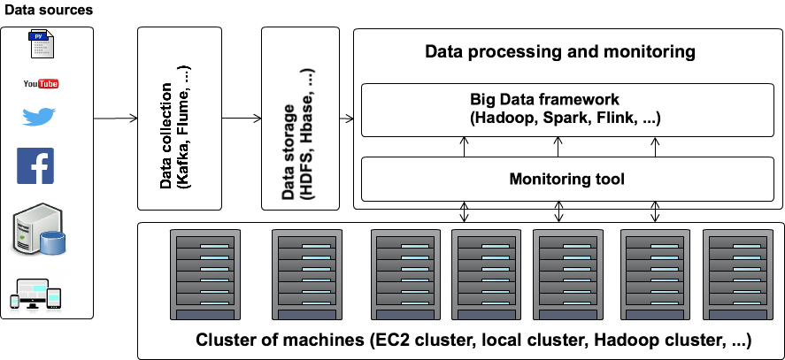
Experimental protocol (1)
Batch Mode evaluation
Experimental environment : Galactica
Workload: kmeans, WordCount and PageRank.
Frameworks: Hadoop (Mapreduce), Spark and Flink.
Features: Scalabilty, Configuration parameters.

Slide 4
Experimental protocol (2)
StreamMode evaluation
Workload: ETL Workload
Frameworks: Storm, Spark, Samza and Flink
Features: Number of processed events

Slide 5
Experimental Study
Scalability
Data partitioning
Impact of the cluster manager
Impact of some configuration parameters
Resources consumption

Slide 6
Conclusion
An overview of Big Data frameworks (Hadoop, Spark, Storm, Samza and Flink)
Published in the Future Generation Computer Systems
We have identified the features of each framework
An experimental study of the studied frameworks
Best practices

Slide 7
Thank you for your attention
Any questions or recommendations?

