Slide 1
Mesosphere DC/OS

Slide 2
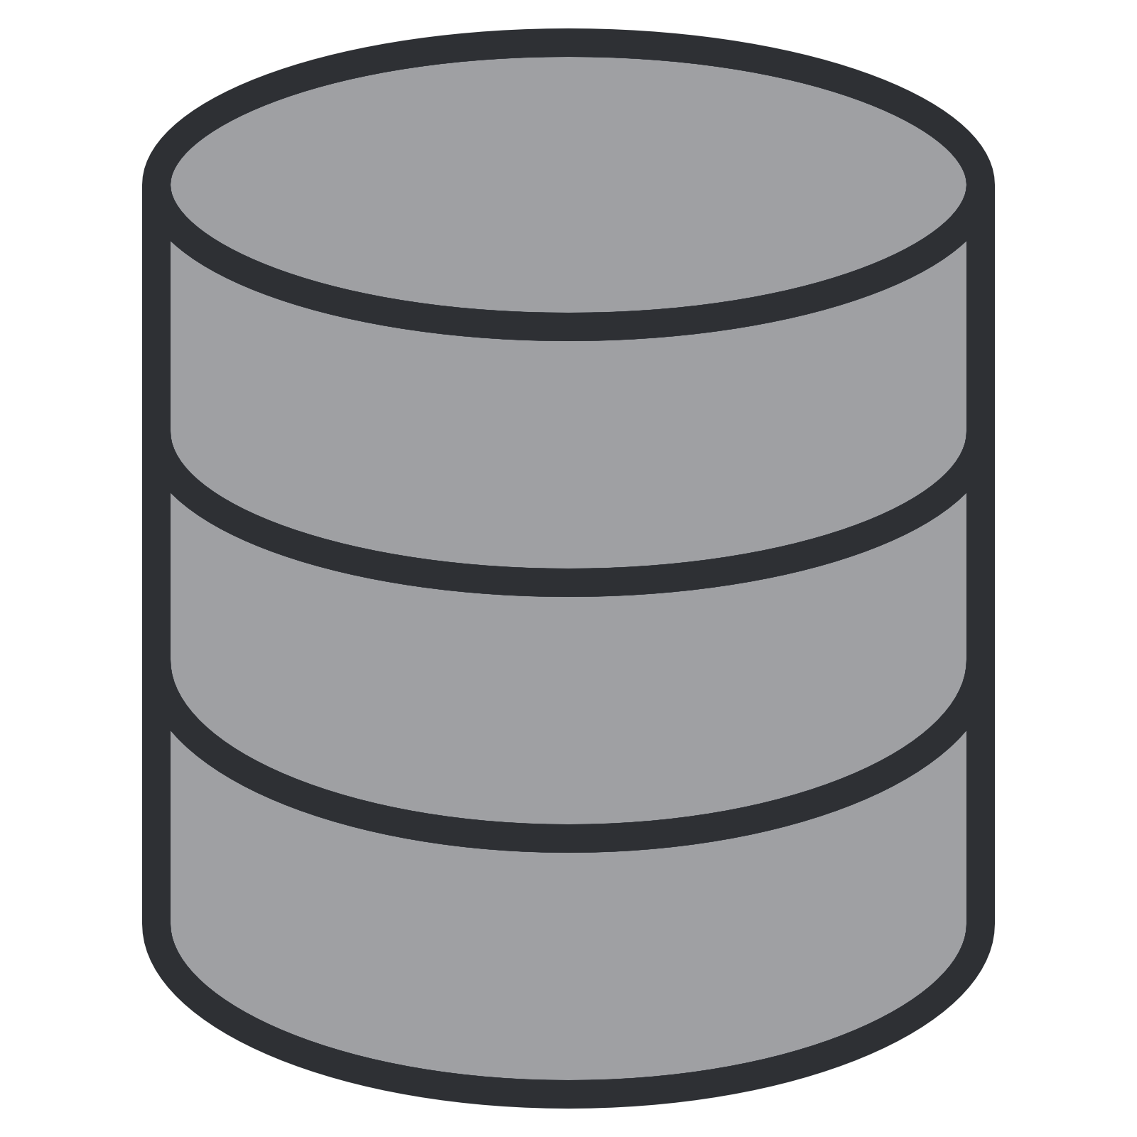
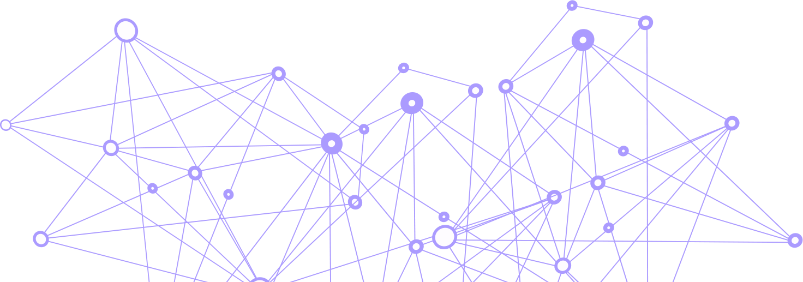
Modern Data-driven Applications Power Customer-centric Services
18 Billion connected users & devices
Users
Always-connected users & devices
TRADITIONAL APPLICATION
MODERN DATA-DRIVEN APPLICATION
Monolith
Containerized microservices (your code)
Serve
Relational DB
Data services & AI/ML tools
(their code)
DC or Cloud
Hybrid Cloud & Edge
Transport
Store
Analyze / Streaming
Analyze
Analyze / ML
Source: 2017 IHS Markit estimates
2
Notes:
Enterprise applications are now shifting from traditional apps with monolithic code backed by traditional database, to modern data-driven applications.
Users of the modern enterprise application are not just employees, but customers, and their connected devices. (top) This has two main implications:
1) scale of the application itself to engage the large number of users and endpoints (middle)
2) variability & scale of the data (bottom) that needs to be managed and analyzed
These modern data-driven apps require you manage four key concepts as a business: (listed in purple)
--
Data and user growth:
Users
http://www.kpcb.com/internet-trends
2+ Billion smartphone users in 2014
3+ Billion internet users in 2016
Data
http://www.edgelens.com/mobile-data-growth-to-hit-enterprise/#sthash.IMRP9gtP.EVQGv8YX.dpbs
Cisco’s VNI predicts 10EB monthly in 2016.
Global Mobile data traffic at 10 Exabytes/month in 2016 with 78% CAGR
http://www.emc.com/leadership/digital-universe/2014iview/executive-summary.htm
Enterprise data growth at 40% CAGR

Slide 3
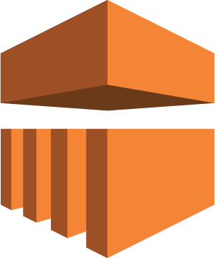
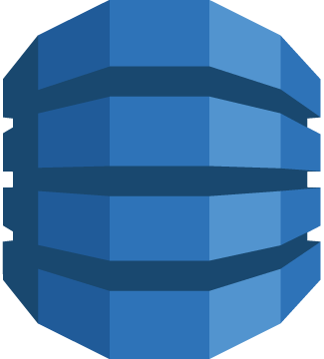
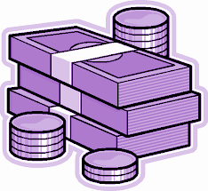
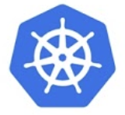
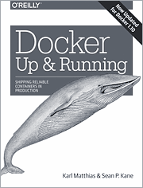
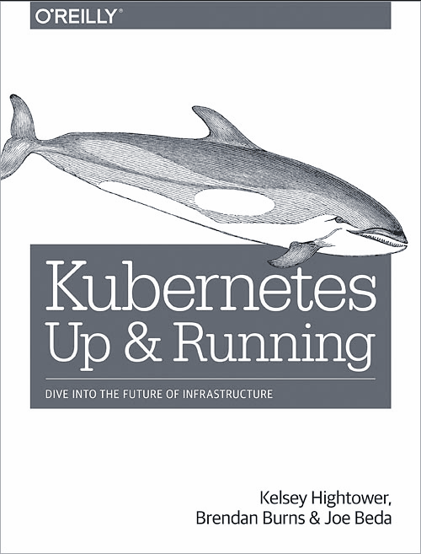
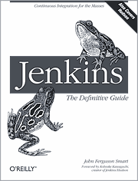
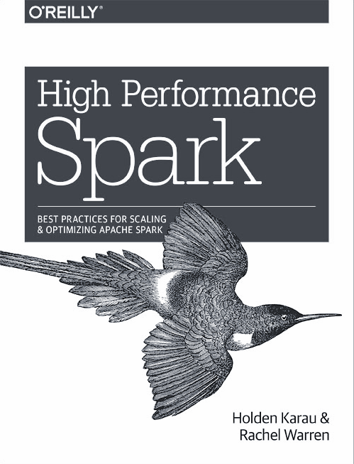
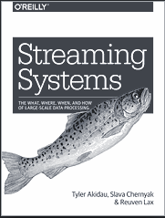
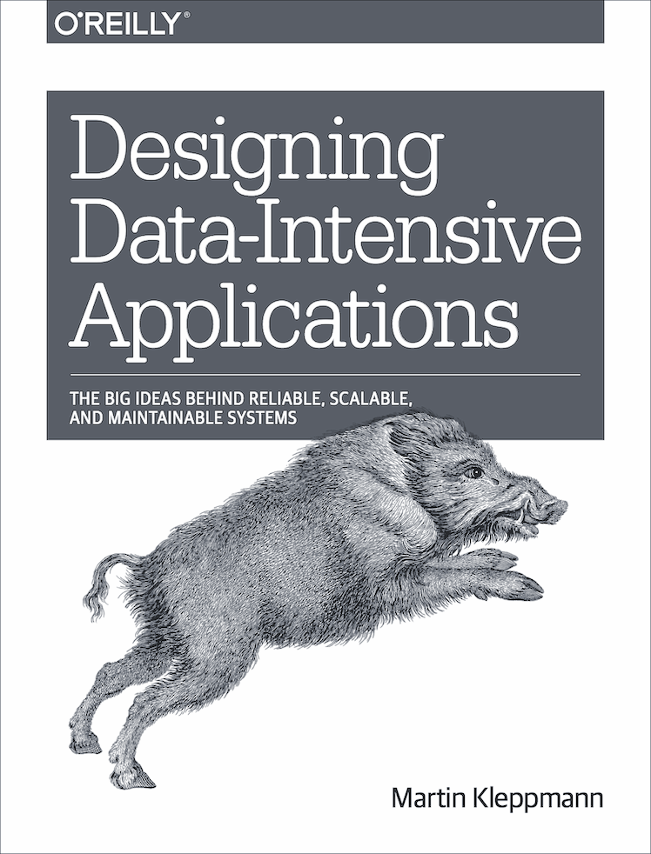
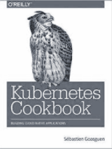
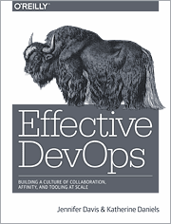
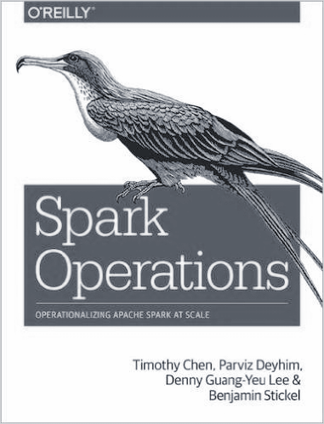
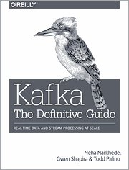
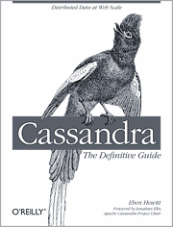
Digital Transformation Challenges
Locked to a cloud provider
ECS
CodePipeline
EMR
Kinesis
DynamoDB
Expensive services
Container Orchestration
Data Services
Applications need the latest technology
Container orchestration, data services, machine learning/AI tools, & CI/CD toolchains
Container Orchestration Cluster
CI/CD Cluster
Data Analytics Cluster
Message Queue Cluster
Data Persistence Cluster
High cost, low utilization
Cloud-native technologies are distributed systems that require dedicated clusters
Significant training & skills development
Complex IT projects to run containers and data services; developed talent poached by competitors
Notes:
Digital transformation today means delivering data-driven customer-centric applications. But this is challenging in several ways.
[click]
These applications require new container orchestration and data services technologies, which evolve quickly, and can take a long time to adopt. By the time you have made progress with one technology, the technology itself may have evolved.
[click]
Once these new technologies are adopted it can be extremely costly from an infrastructure perspective - whether it’s on prem or in the cloud. This is because new cloud native technologies often evolved on their own and were never designed to share infrastrastructure, leading to separate clusters that are very rarely utilized.
[click]
From a skills perspective, each of these technologies require a tremendous amount of effort to learn. This means having technical resources on critical path, and putting your project at risk if they leave or get poached by a competitor.
[click]
Each of these issues raises questions on how to be successful with digital transformation.

Slide 4
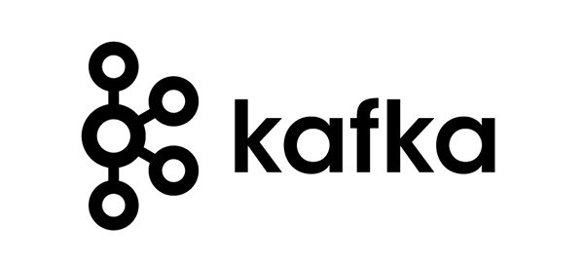
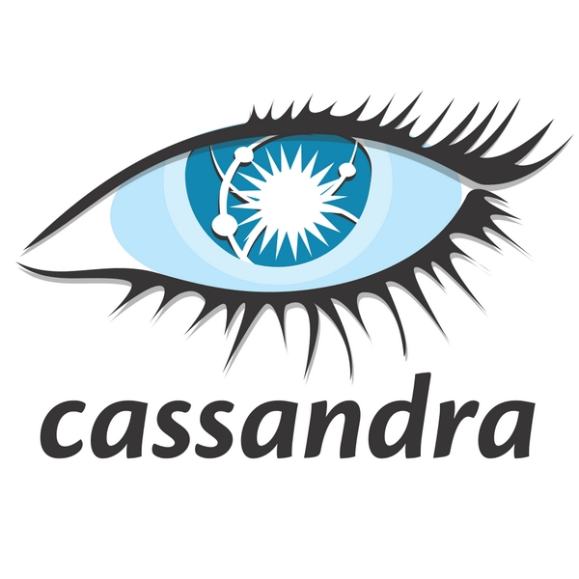
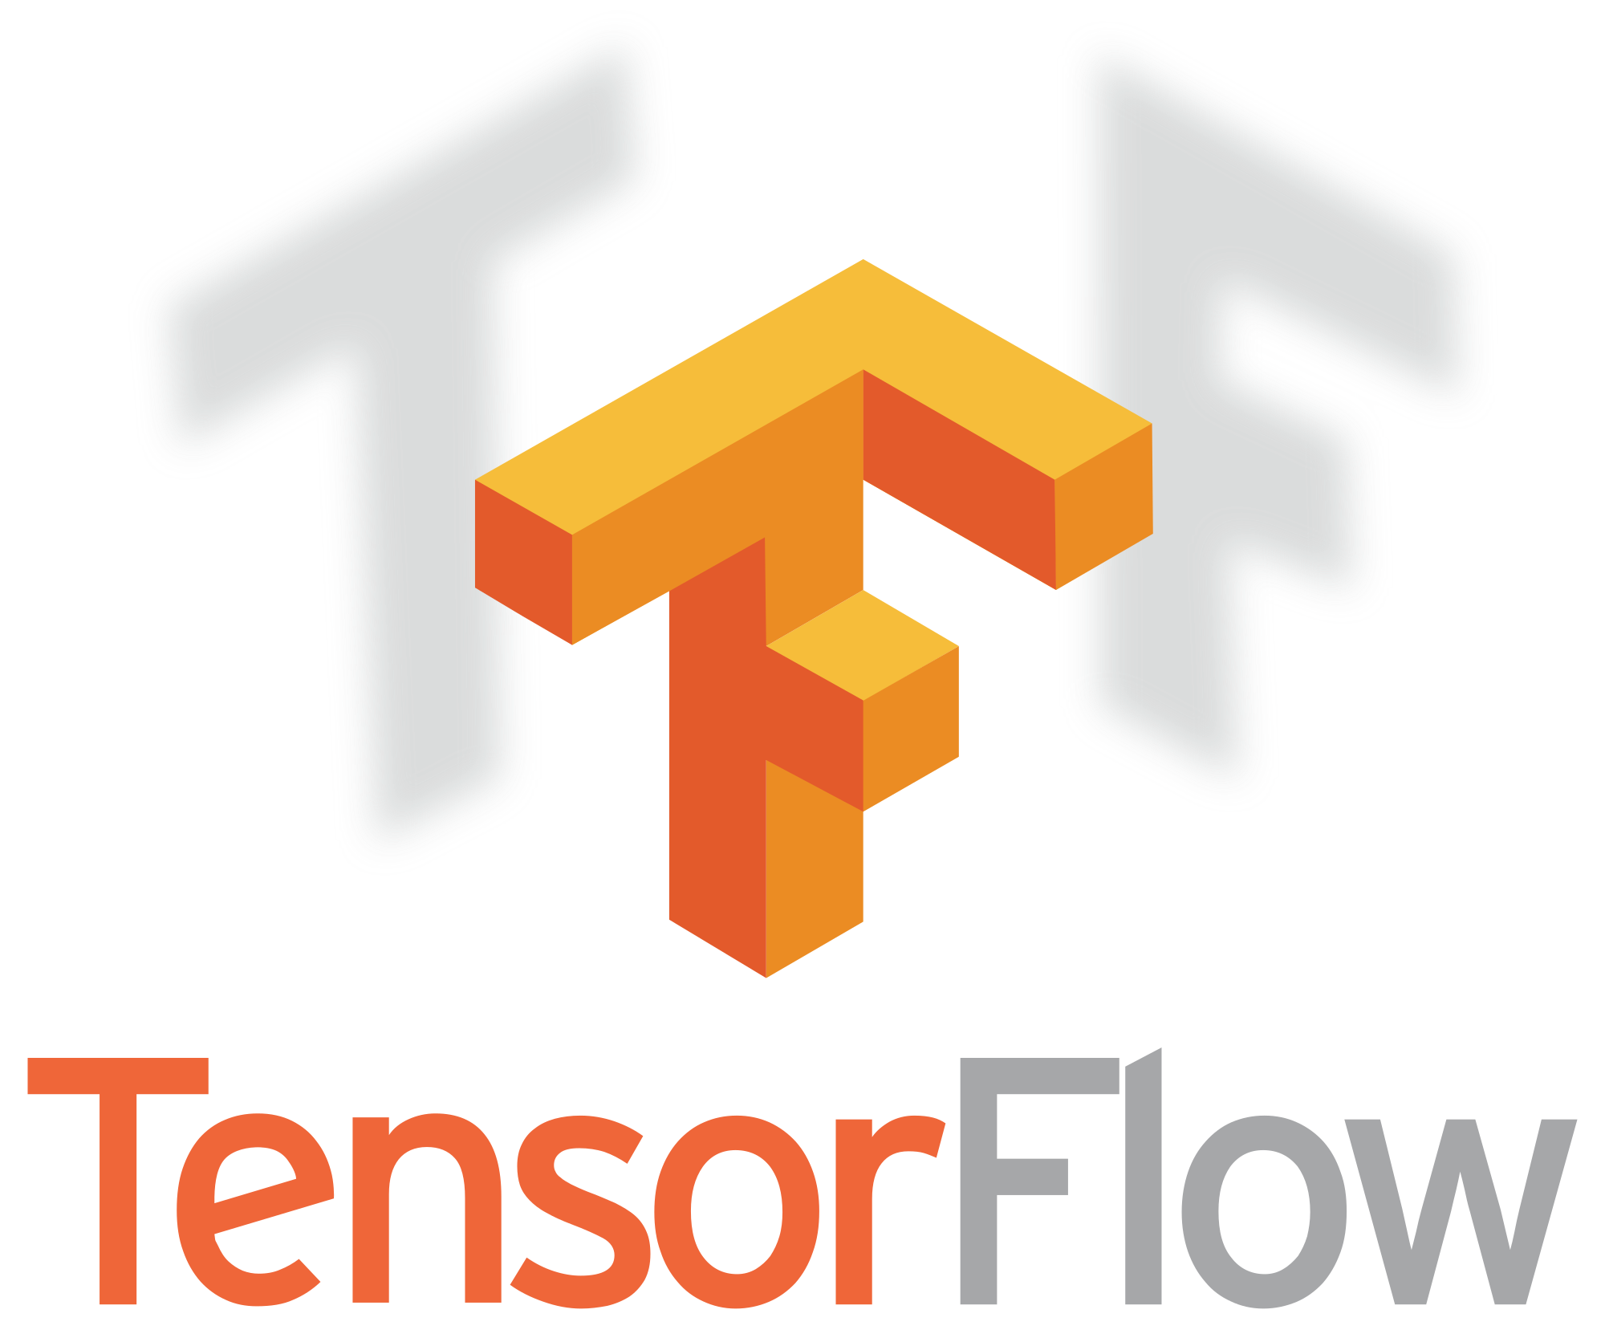
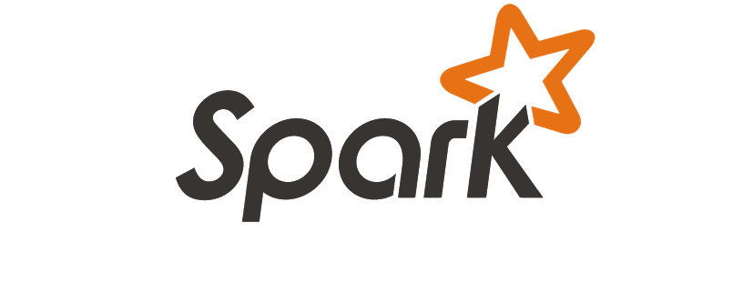
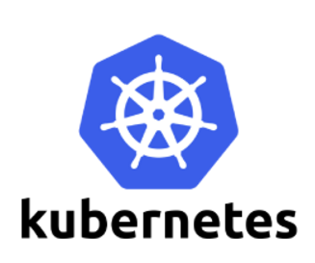
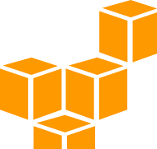
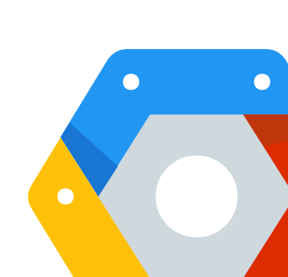
Mesosphere Accelerates Innovation for New Digital Services On Hybrid Cloud Infrastructures
Application-Aware Automation empowers IT to introduce any application technology “as-a-Service” quickly & efficiently
Unified Hybrid Cloud Operations for consistent, secure, & resilient services across cloud, datacenter, and edge infrastructures
Transport
Message Queue
Store
Distributed Database
Analyze
AI / ML + Real-time
Serve
Container Orchestration
Infrastructure
Datacenter & Edge Clouds
AWS EC2
Microsoft Azure
Google Cloud
4

Slide 5
Apache Mesos manages all the resources
Notes:
You have just seen how Mesosphere DC/OS gives you the ability to run any platform service from an open partner ecosystem, on any infrastructure. Additionally, the automation enabled by DC/OS means faster time to value, cost savings, and resilient services that are always available.
The heart of Mesosphere DC/OS is Apache Mesos, which aggregates datacenter and cloud resources and enables a broad set of workloads to share compute resources. Apache Mesos is production proven for over seven years and runs in mission critical high scale datacenters.

Slide 6
Mesosphere DC/OS automates everything securely
Notes:
You have just seen how Mesosphere DC/OS gives you the ability to run any platform service from an open partner ecosystem, on any infrastructure. Additionally, the automation enabled by DC/OS means faster time to value, cost savings, and resilient services that are always available.
The heart of Mesosphere DC/OS is Apache Mesos, which aggregates datacenter and cloud resources and enables a broad set of workloads to share compute resources. Apache Mesos is production proven for over seven years and runs in mission critical high scale datacenters.

Slide 7
Kubernetes or/and Marathon let you deploy your applications easily
Notes:
You have just seen how Mesosphere DC/OS gives you the ability to run any platform service from an open partner ecosystem, on any infrastructure. Additionally, the automation enabled by DC/OS means faster time to value, cost savings, and resilient services that are always available.
The heart of Mesosphere DC/OS is Apache Mesos, which aggregates datacenter and cloud resources and enables a broad set of workloads to share compute resources. Apache Mesos is production proven for over seven years and runs in mission critical high scale datacenters.

Slide 8
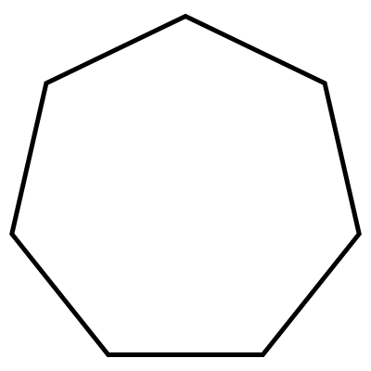
Kubernetes with DC/OS 1.11 Features
Simple HA Cluster Provisioning
Scalable Kubernetes
Transport Layer Security
Robust API
Server Auth
Non-disruptive Upgrades
Choice of Ingress and CNI*
Disaster Recovery
* Container Network Interface

Slide 9
DC/OS deploys and manages the CI/CD tools you need
Notes:
You have just seen how Mesosphere DC/OS gives you the ability to run any platform service from an open partner ecosystem, on any infrastructure. Additionally, the automation enabled by DC/OS means faster time to value, cost savings, and resilient services that are always available.
The heart of Mesosphere DC/OS is Apache Mesos, which aggregates datacenter and cloud resources and enables a broad set of workloads to share compute resources. Apache Mesos is production proven for over seven years and runs in mission critical high scale datacenters.

Slide 10
DC/OS deploys and manages the services your applications need
Notes:
You have just seen how Mesosphere DC/OS gives you the ability to run any platform service from an open partner ecosystem, on any infrastructure. Additionally, the automation enabled by DC/OS means faster time to value, cost savings, and resilient services that are always available.
The heart of Mesosphere DC/OS is Apache Mesos, which aggregates datacenter and cloud resources and enables a broad set of workloads to share compute resources. Apache Mesos is production proven for over seven years and runs in mission critical high scale datacenters.

Slide 11
DC/OS can be deployed anywhere
Faster time to market
Providing the latest technology in few clicks
Reduce management cost
Automating the deployment, upgrade, recovery, …
Reduce infrastructure cost
No lock-in
Moving working between clouds or even back on premise
Deploying all the services on the same hardware
Notes:
You have just seen how Mesosphere DC/OS gives you the ability to run any platform service from an open partner ecosystem, on any infrastructure. Additionally, the automation enabled by DC/OS means faster time to value, cost savings, and resilient services that are always available.
The heart of Mesosphere DC/OS is Apache Mesos, which aggregates datacenter and cloud resources and enables a broad set of workloads to share compute resources. Apache Mesos is production proven for over seven years and runs in mission critical high scale datacenters.

Slide 12
Mesosphere DC/OS: Seamless Hybrid Cloud Operations
Edge and Multi-Cloud Federation
Business Continuity & Disaster Recovery
Cloud Bursting
Minimize footprint at edge or remote infrastructures
Consistent operations across clouds
Deploy applications to multiple clouds simultaneously
Workloads automatically deployed across fault domains (Racks or Cloud Availability Zones)
Easily add and remove cloud capacity to on-premise clusters
Notes:
Hybrid:
Unified multi-cloud clusters
Workload bursting
Regions so you know where to burst to
Add and remove nodes
High Availability
Multi-cloud DC/OS clusters to facilitate failover scenarios
Federated multi-cloud management
Consistent operations across clouds
Linked clusters
Minimize foodpoint at edge or remote infrastructures with centralized management
Stretch clusters
High Availability
Intelligent and automatic workload placement across multiple fault domains at the rack or cloud availability zone
HA for failues within a cloud
onsistent Deploy applDefine zones t
Intelligent workload placements across zones for high availability
Edge
Cloud federation

Slide 13
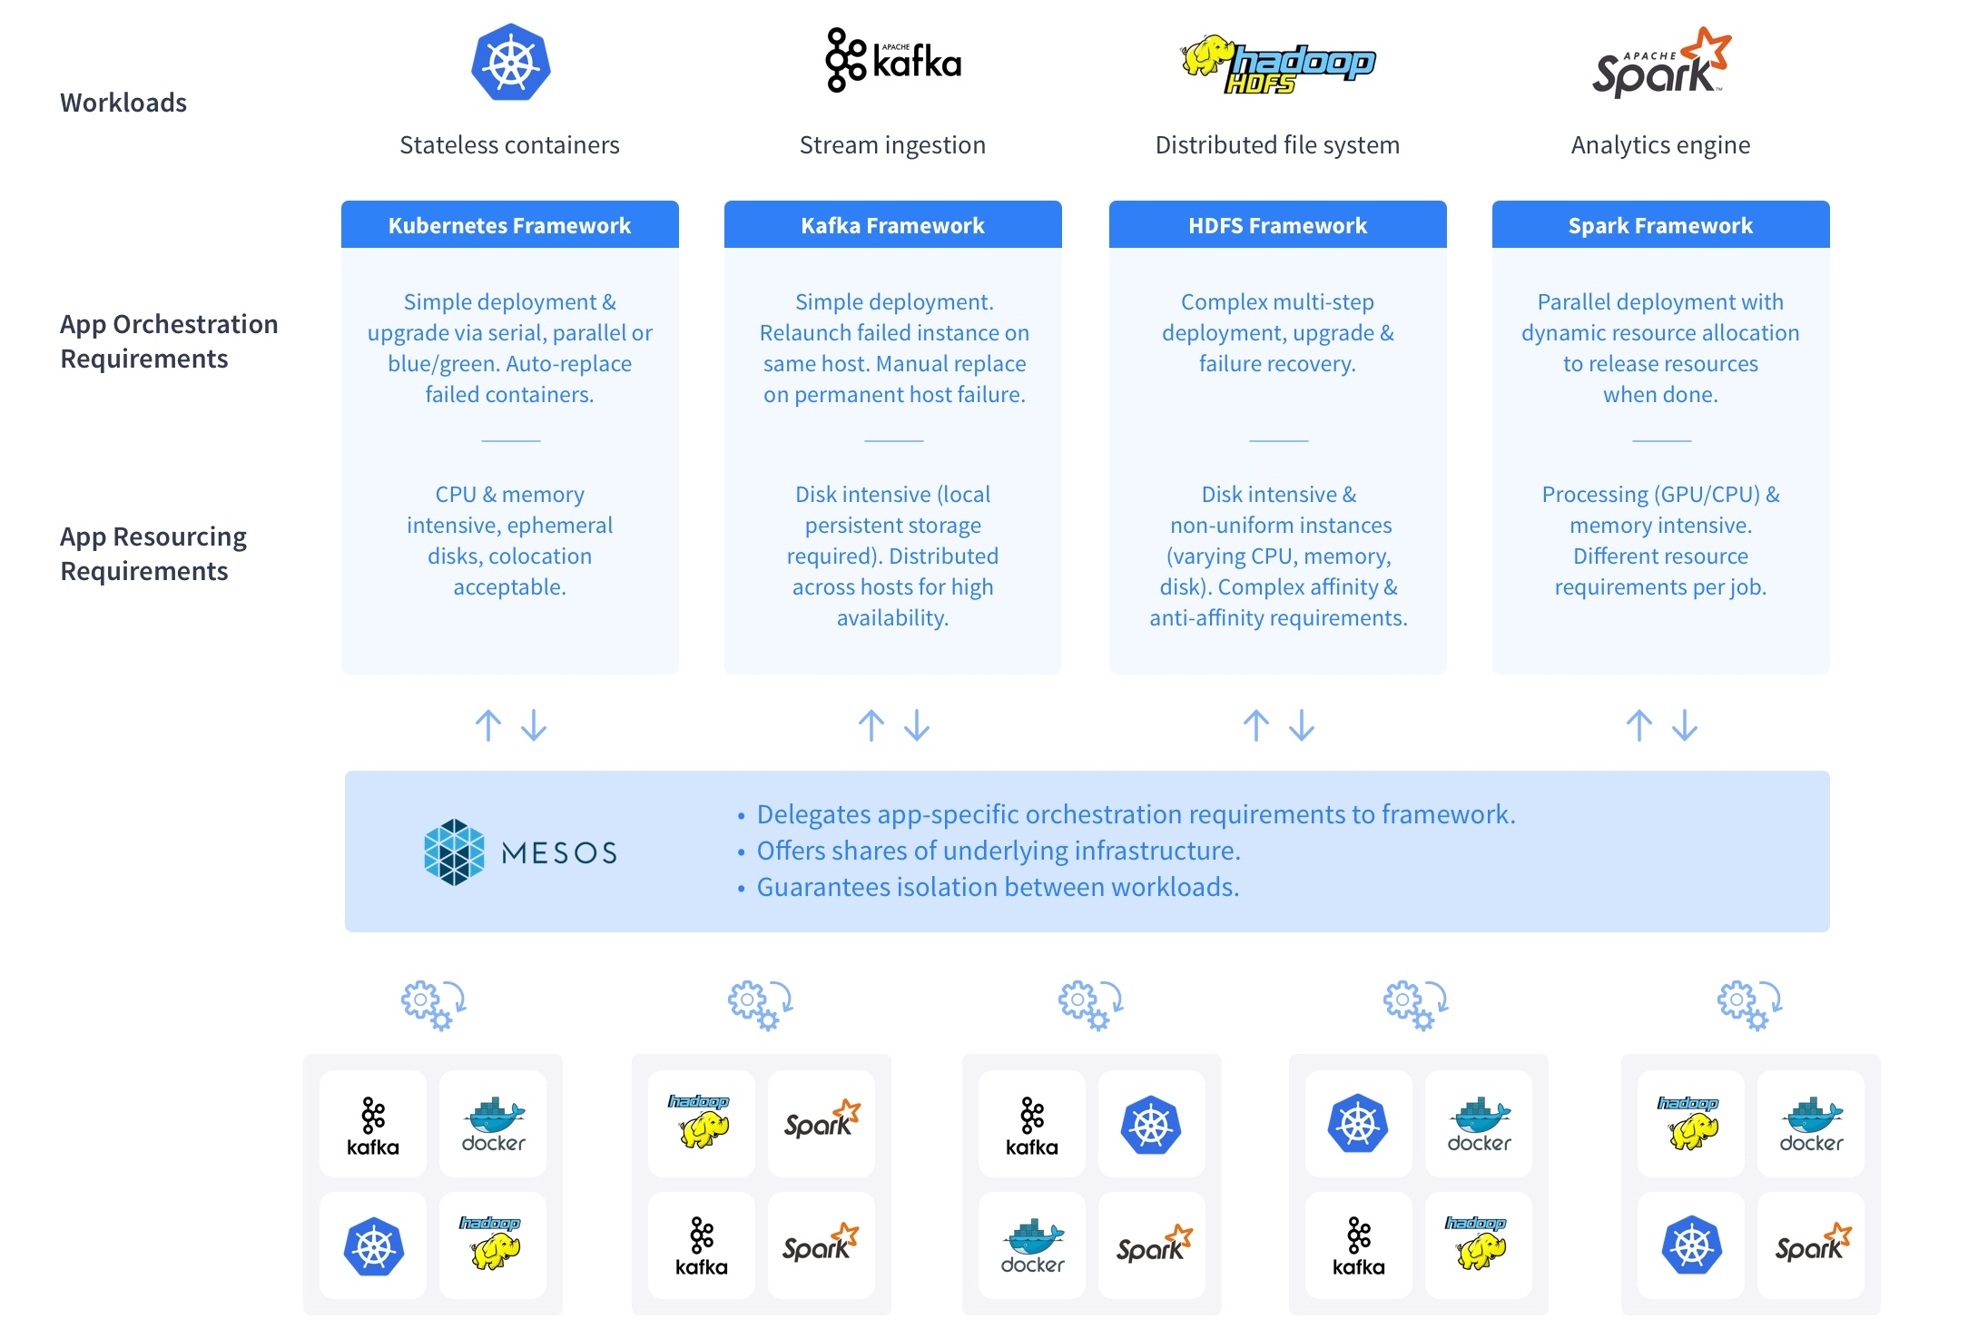
Mesosphere’s Unique Approach: Application-Aware Scheduling

Slide 14
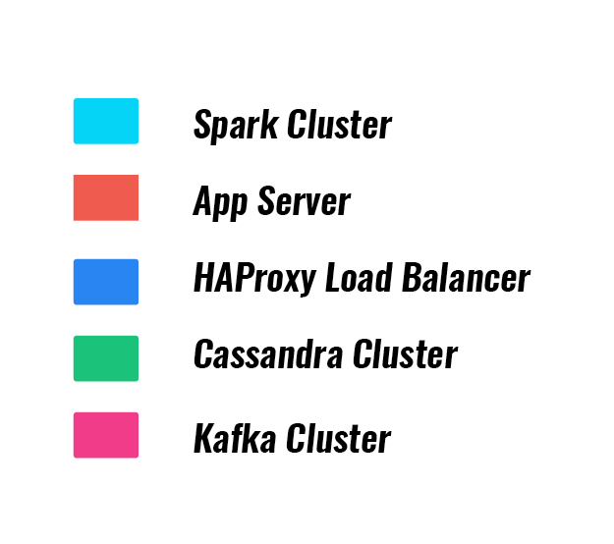
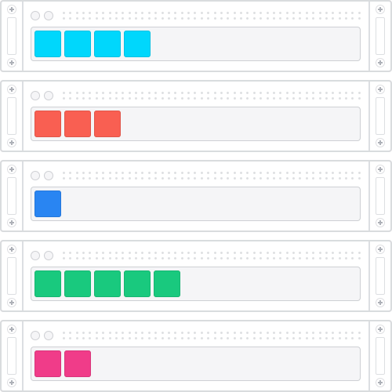
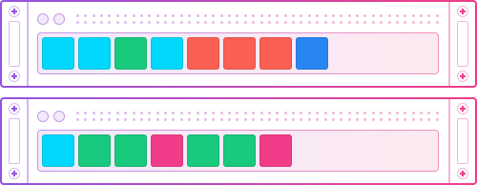
Run everything on the same cluster
DC/OS Multiplexing 30-40% utilization, up to 96% at some customers
Industry Average 12-15% utilization
4X
Typical Datacenter siloed, over-provisioned servers, low utilization
DC/OS Datacenter automated schedulers, workload multiplexing onto the same machines

Slide 15
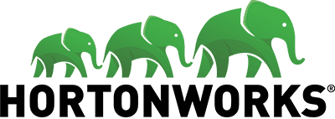
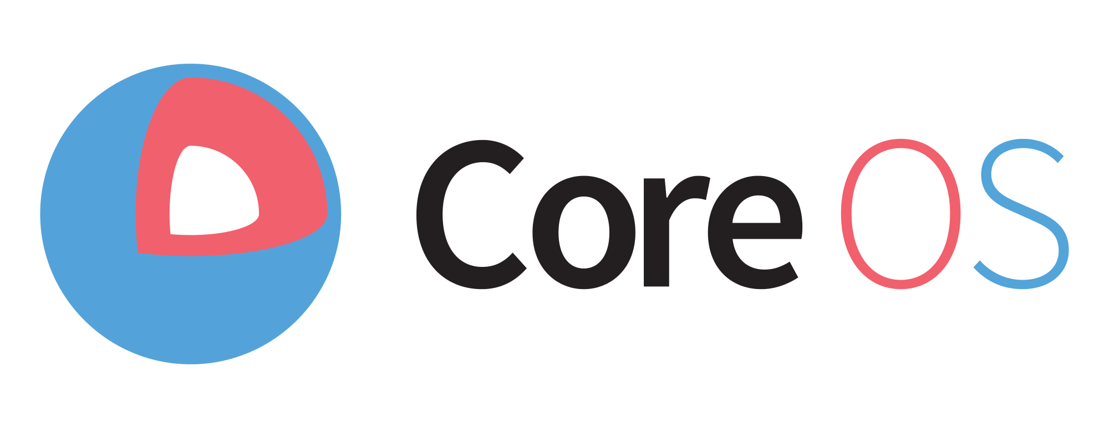
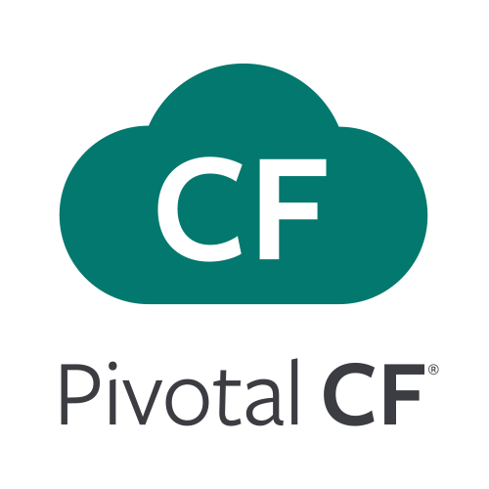
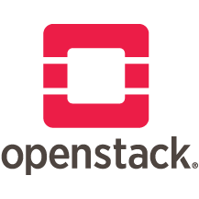
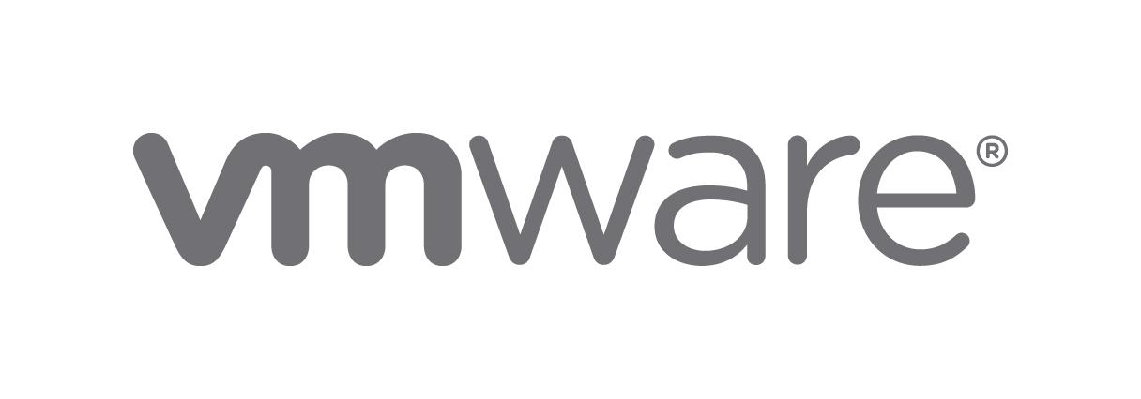
Mesosphere DC/OS defines a new category
Fast Data
Public Cloud
Microservices
Big Data
ML / AI
Streaming
Containers
Orchestration
Tooling
Data-Intensive Applications
Hybrid Cloud
15

Slide 16
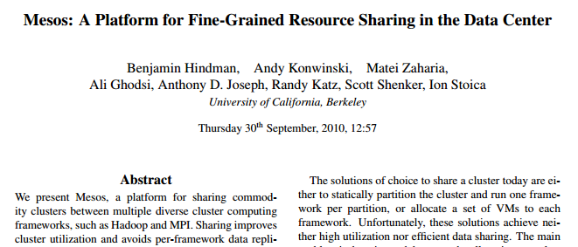
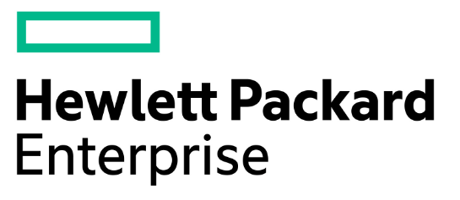
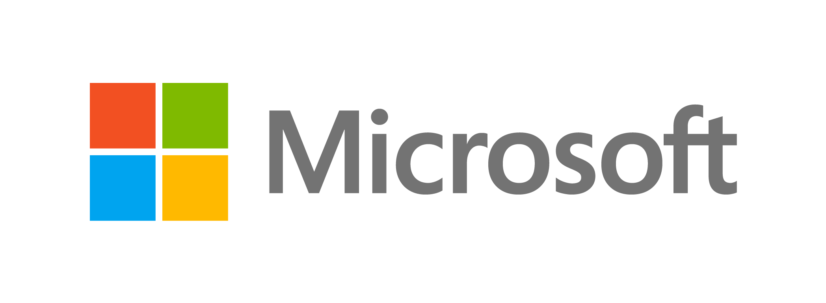
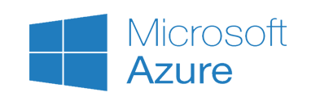
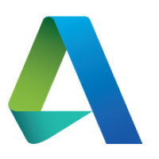
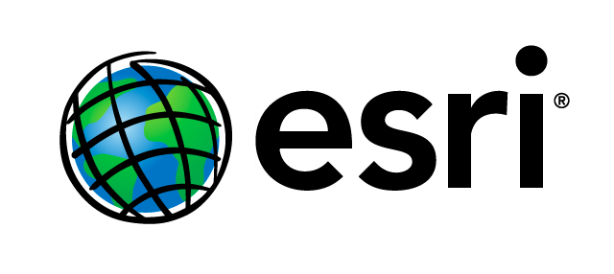
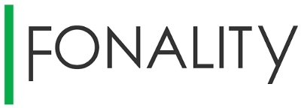
Mesosphere Technology is Production-proven at Scale
2000
2010
2014
2015
2016
2017
Reseller Program
DCOS Launched
DC/OS OSS Project
Mesosphere
Proprietary
Apache Mesos Project
Borg & Omega
Tupperware & Bistro
Notes:
Mesosphere was founded after our co-founders experienced real-world infrastructure challenges at Twitter and AirBnB. Since then the technology they developed has become used at the most recognized brands across industries.

Slide 17
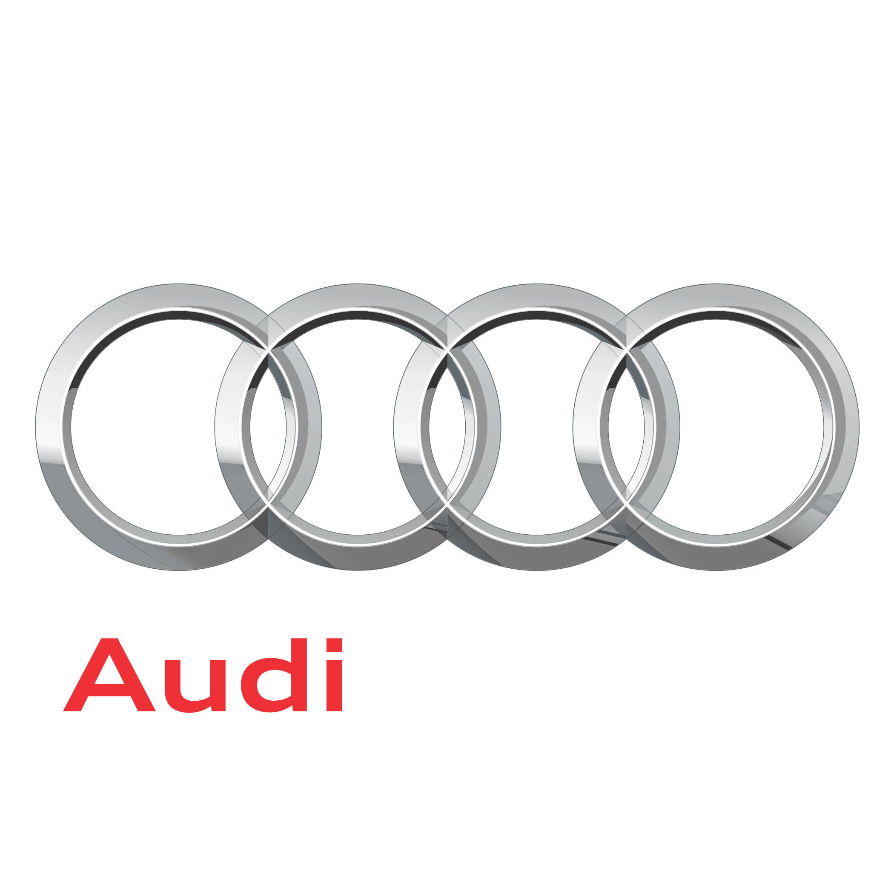
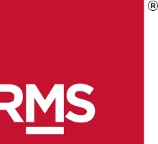
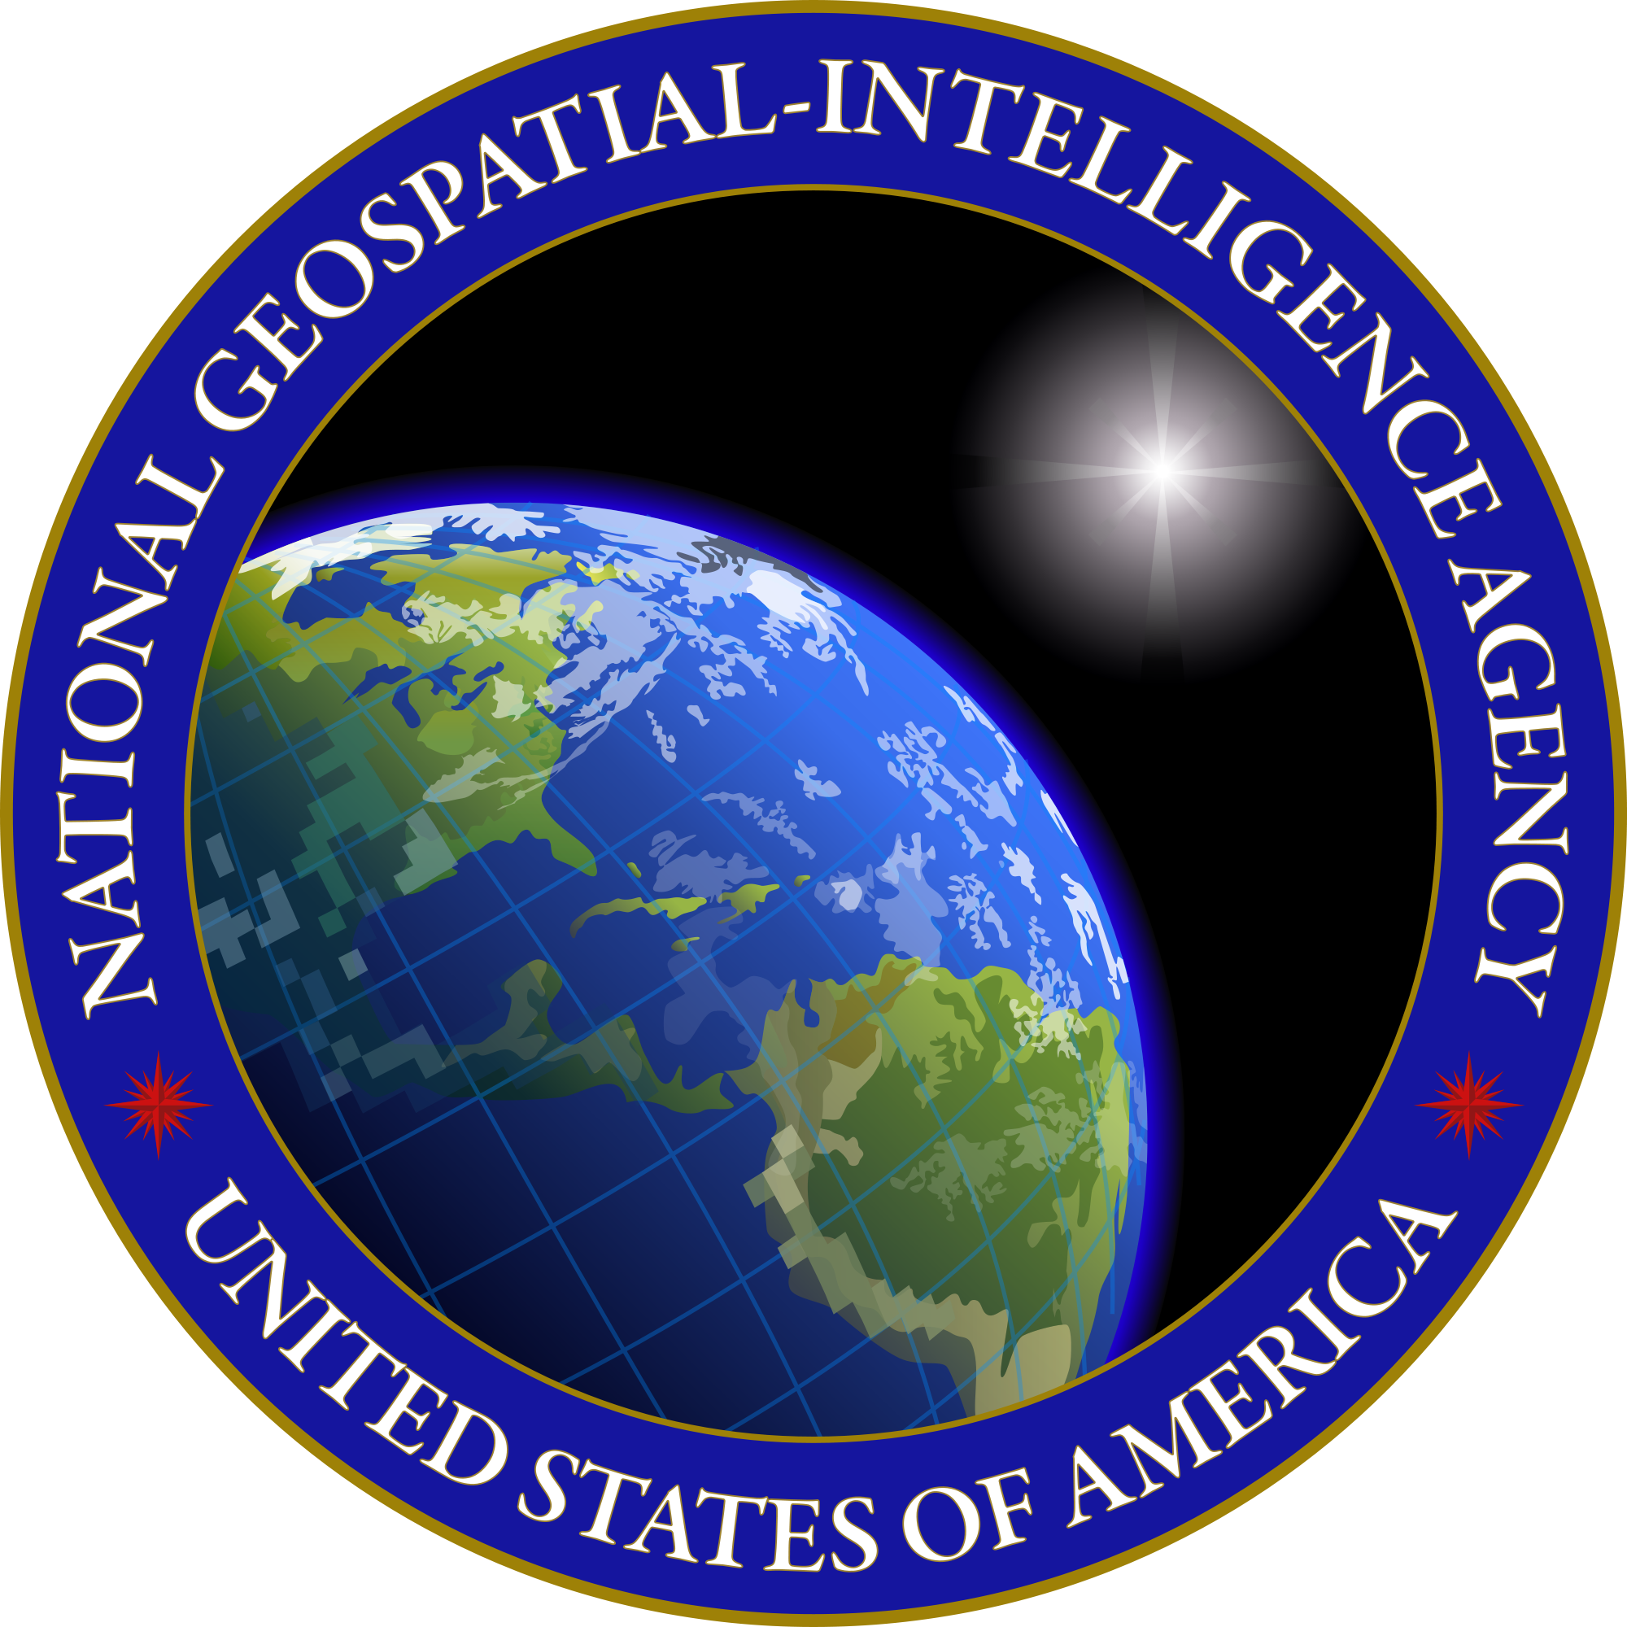
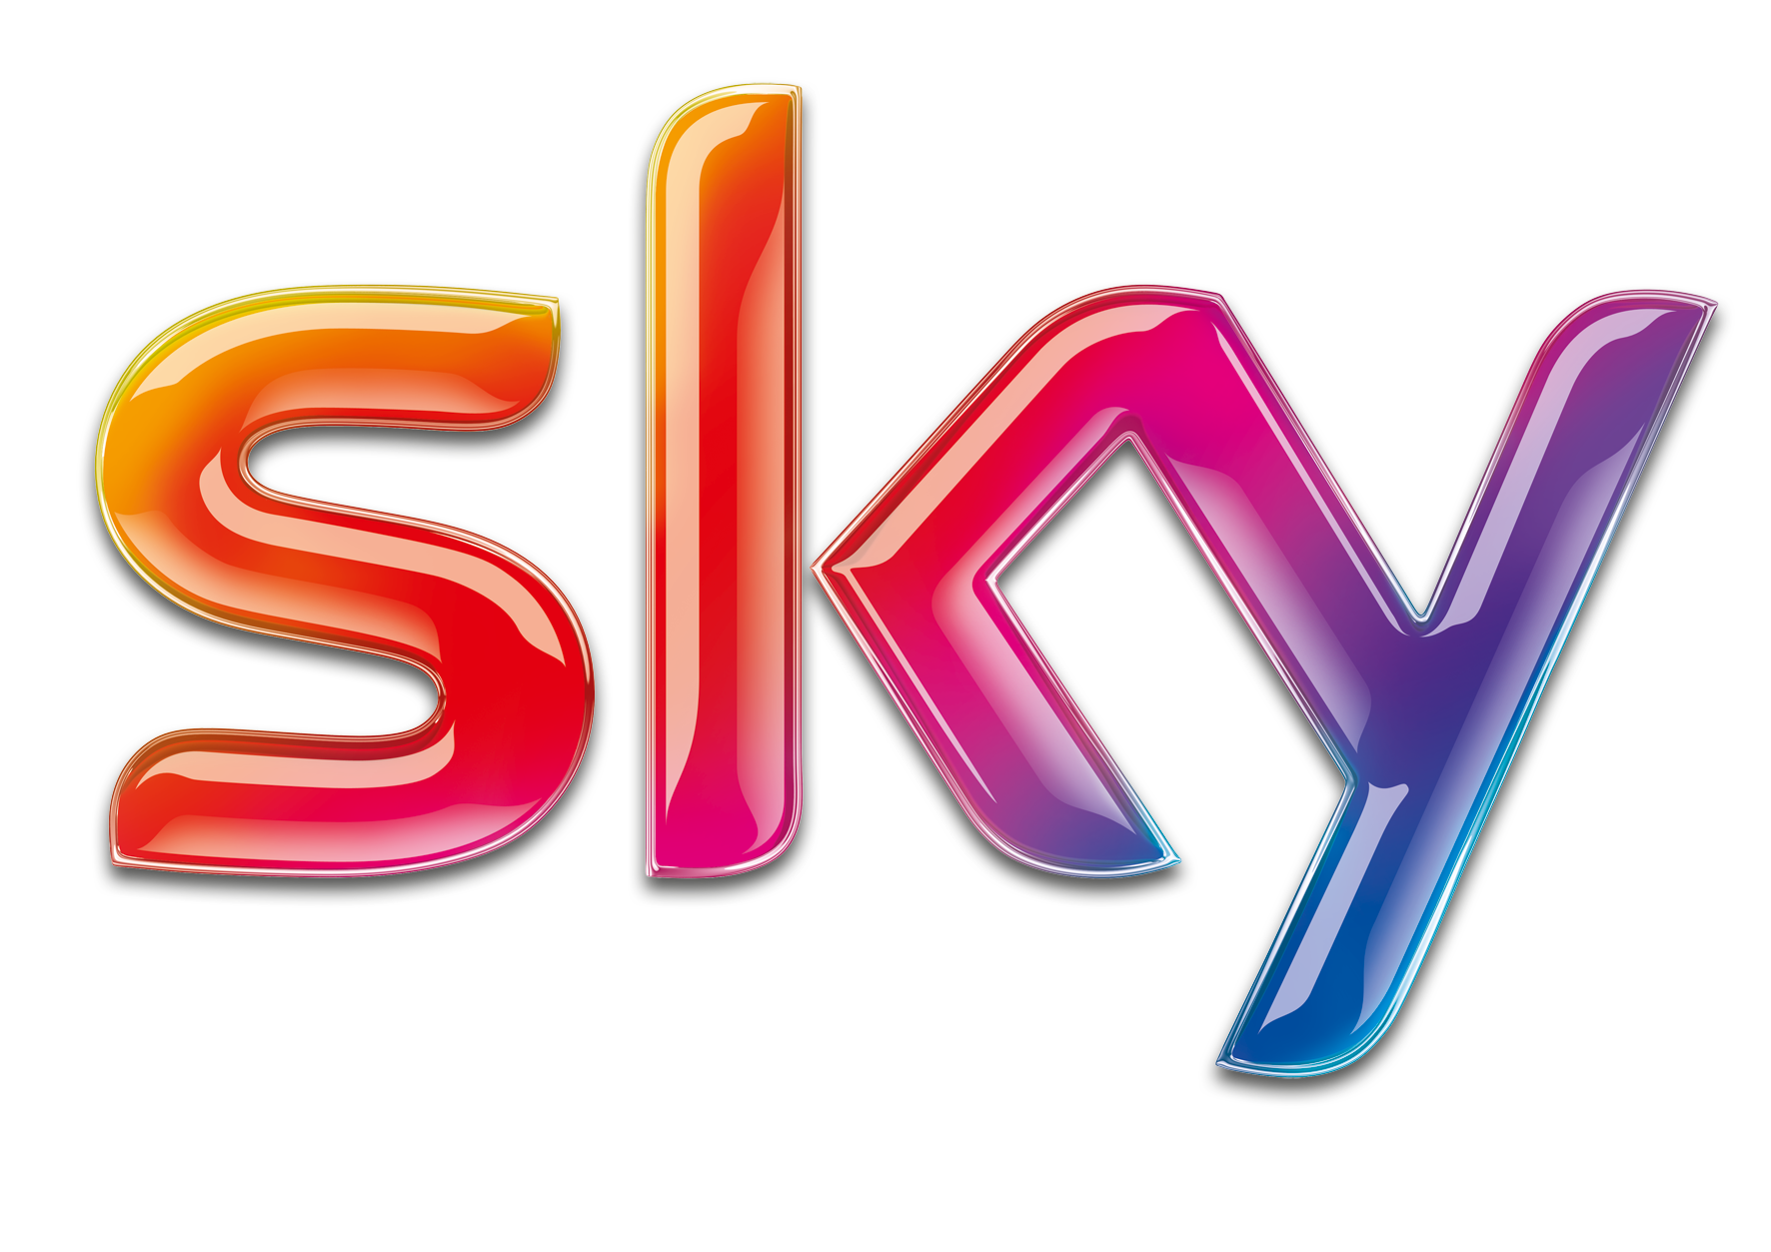
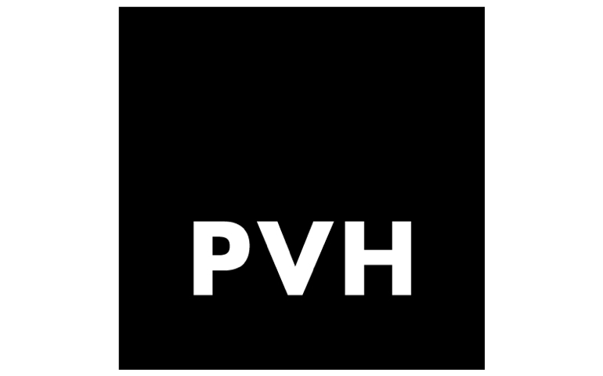
Mesosphere is Powering Industry Leaders
Over 125 Enterprise Customers
Connected Car
Customer Insights
Industrial IoT
Machine Learning and Simulations
Geospatial Analytics + Mapping
Personalized Experiences

Slide 18
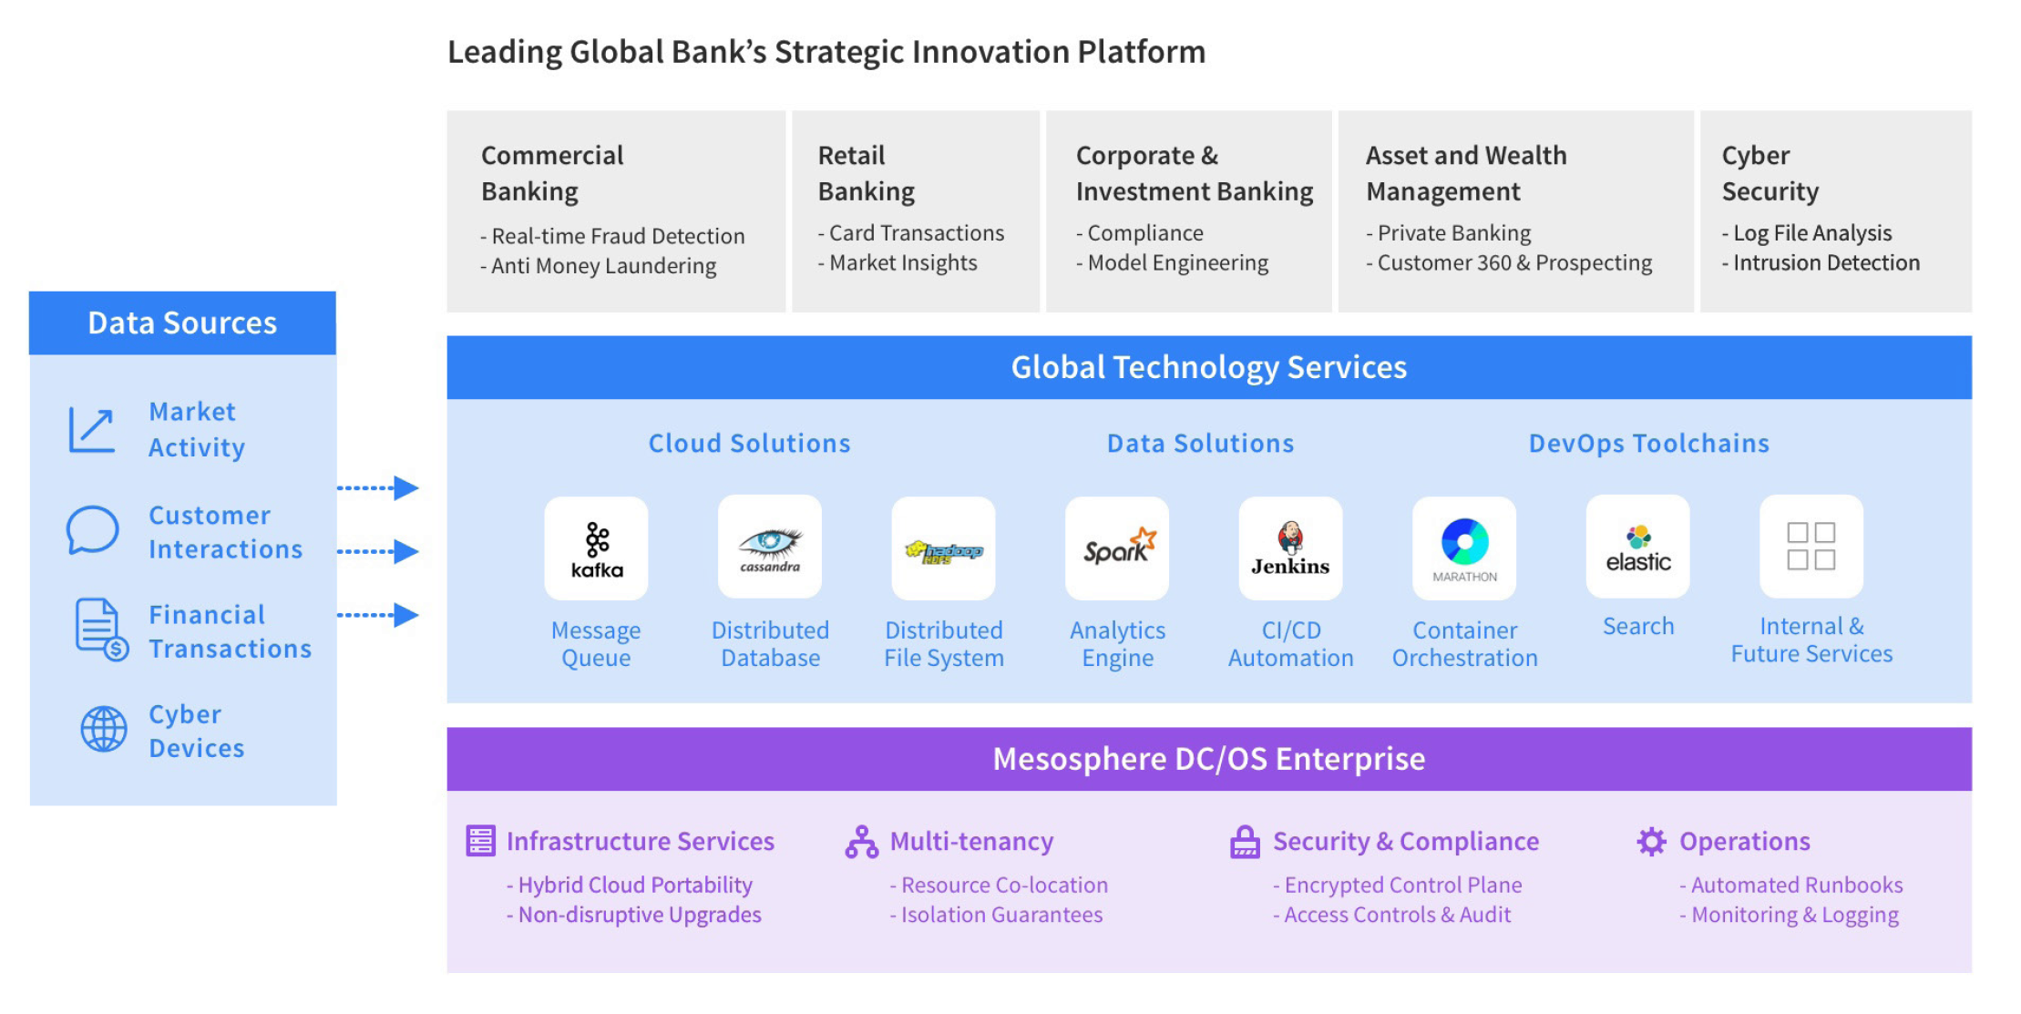

Slide 19
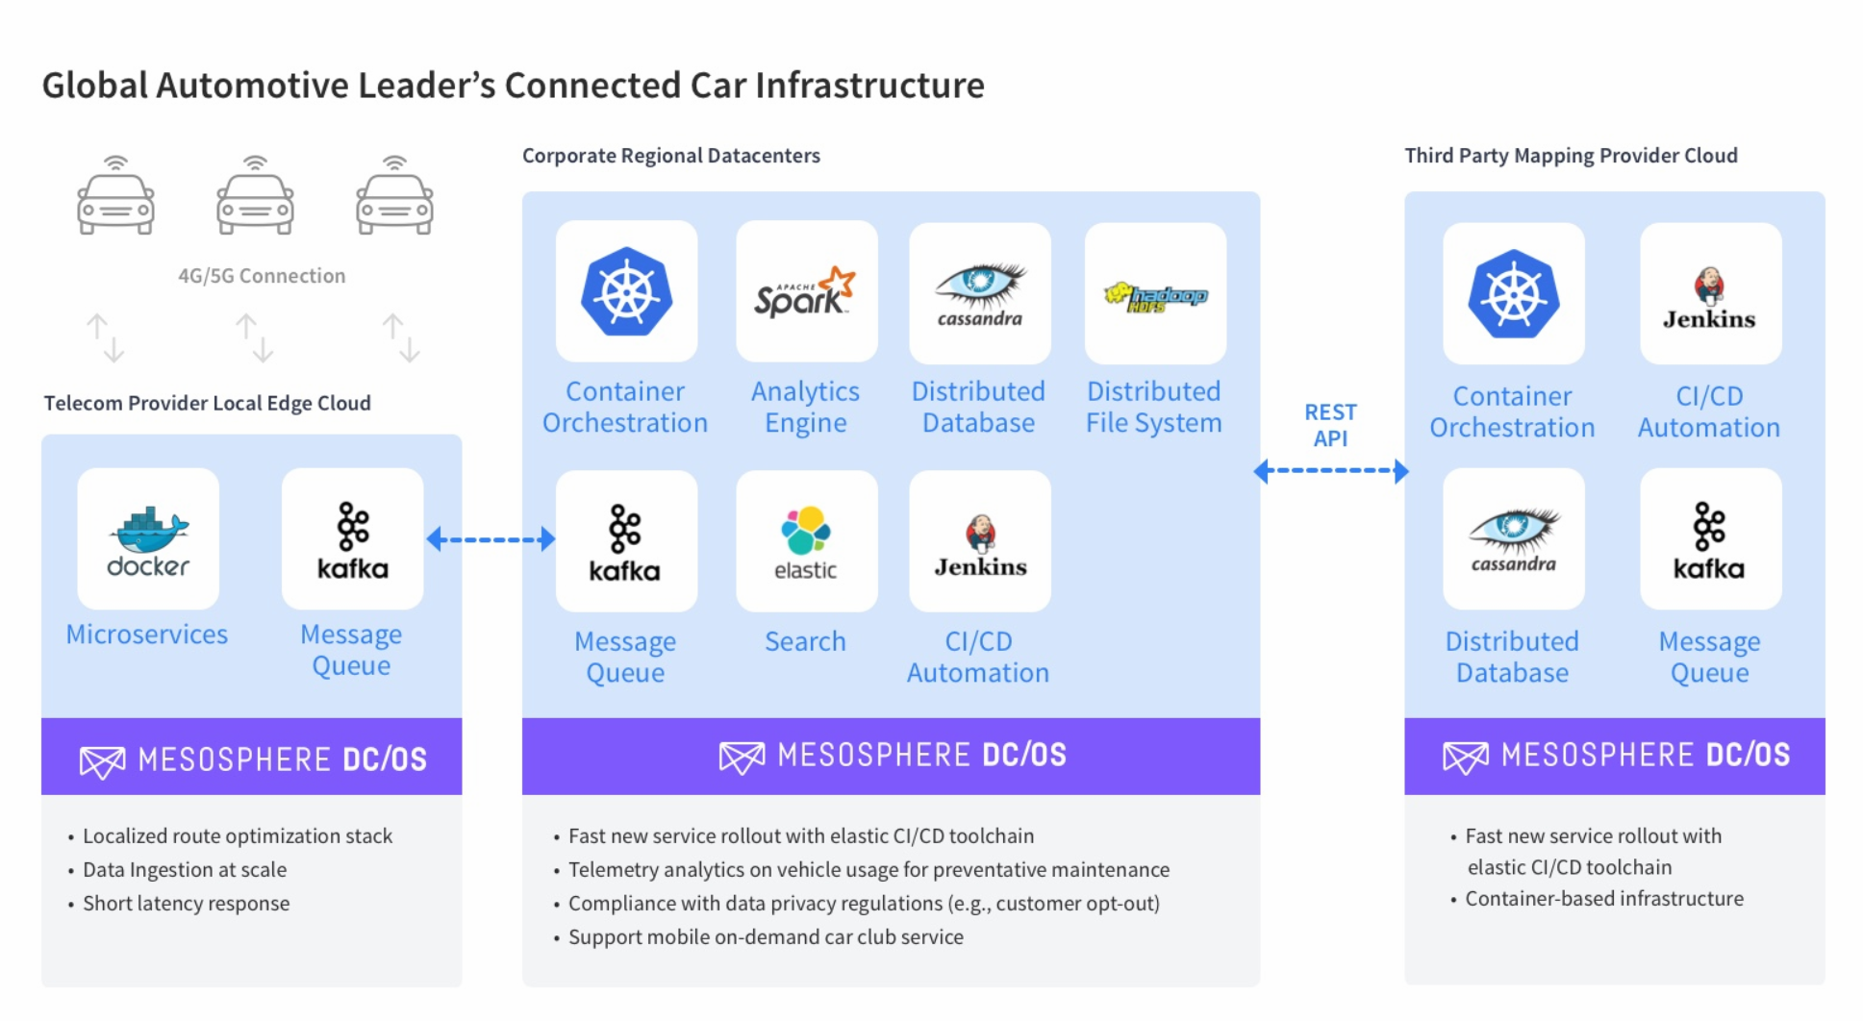

Slide 20
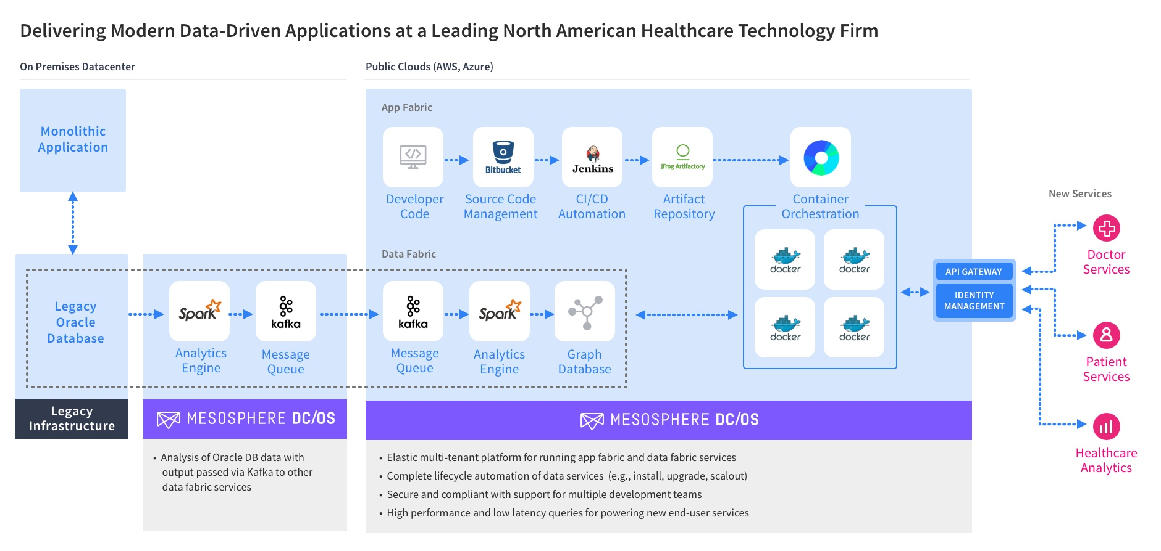

Slide 21
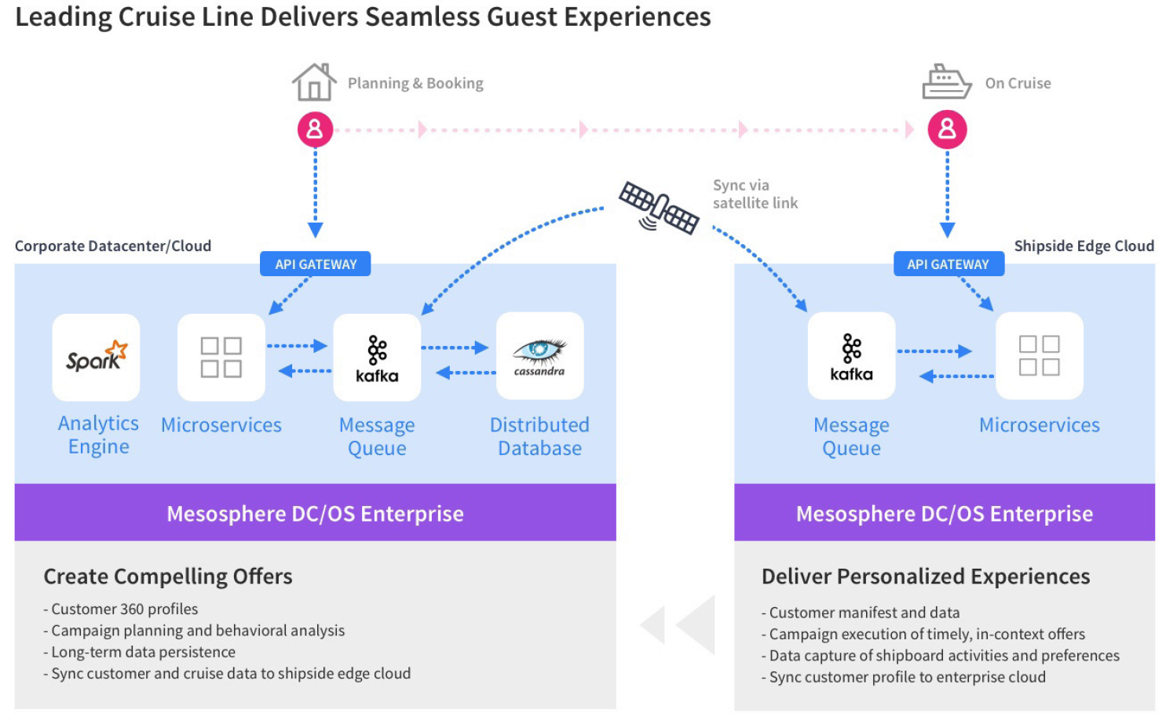

Slide 22
“We are building for the coming IoT market…if I build everything in a silo, I have no chance.
With Mesosphere DC/OS, I have one single contiguous cluster…to ingest data, store it and run all my apps as well, and that's a huge advantage.”
Larry Rau
Director Architecture & Infrastructure, Verizon Labs

Slide 23
“We’re running real time analytics and visualization of data from connected sensors. Before DC/OS we had no where near the scale we had today, from thousands of to millions of events per second.
Next, we’re doing predictive GIS.”
Adam Mollenkopf
Real Time Geospatial Information Systems Capability Lead

Slide 24
Why Mesosphere?
Unmatched DC/OS Platform
Experts in Distributed Systems
“Datacenter or cloud as a computer” operating model
Rich ecosystem of platform services, with hybrid cloud portability
Automation to elastically run containers and data services together
Production experience on datacenter and cloud infrastructures
Training and professional services to get you to desired outcomes
Ongoing mission-critical support of your applications

Slide 25
Learn more at mesosphere.com

