Slide 1

Are you ready to speak English?
No! Mercy! Mercy!

Slide 2
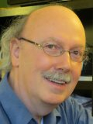
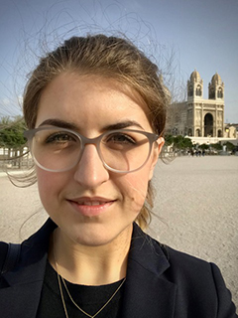
Participants of the video conference
Students from:
Colmar (France)
Innsbruck (Austria)
Presov (Slovakia)
Braga (Portugal)
Moderators at CERN:
Alice Morris
Michael Hauschild

Slide 3
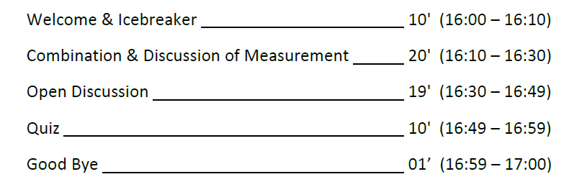
Outlines of the video conference

Slide 4
How is your pronunciation?
Oh my God!!

Slide 5
What does LHC mean?
L
H
C

Slide 6
What does LHC mean?
Large
Hadron
Collider

Slide 7

What is the name of this detector?

Slide 8
What is the name of this detector?
ATLAS

Slide 9
Can you pronounce the name of these particles?
Electron
Muon
Photon
Z

Slide 10
Can you pronounce the name of these particles?
Higgs boson
Upsilon
J/Psi
Z’
Graviton

Slide 11
Do you like multiple choice questions?
Damned!!

Slide 12
The proton beams …….. in the center of the ATLAS detector.
Crash
Collide
Merge
Kiss

Slide 13
The proton beams …….. in the center of the ATLAS detector.
Crash
Collide
Merge
Kiss

Slide 14
The Z boson …….. into 2 leptons.
Merges
Splits
Breaks
Decays

Slide 15
The Z boson …….. into 2 leptons.
Merges
Splits
Breaks
Decays

Slide 16
What is the mass of the Higgs boson?
125 GeV
91 GeV
14 TeV
511 keV

Slide 17
What is the mass of the Higgs boson?
125 GeV
91 GeV
14 TeV
511 keV

Slide 18
There is a …….. at 1000 GeV in the plot.
bump
cliff
peak
Smurf
Jul
M
1000 GeV

Slide 19
There is a …….. at 1000 GeV in the plot.
bump
cliff
peak
Smurf
Jul
M
1000 GeV

Slide 20
For getting an accurate measure, I need a lot of …………
luck
Smurfs
events
steroids
statistics

Slide 21
For getting an accurate measure, I need a lot of …………
luck
Smurfs
events
steroids
statistics

Slide 22
More questions?
ZZZZZZZZZZ

Slide 23
What is the favourite moment of your day?

Slide 24
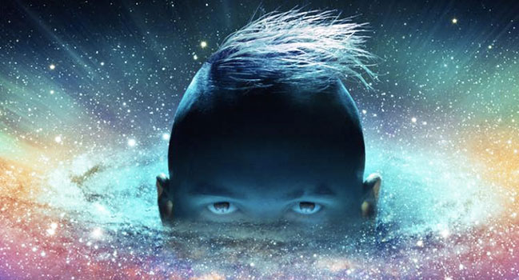
Do you like listening Jul?

Slide 25
Are you sure to like listening Jul?

