Slide 1


Slide 2
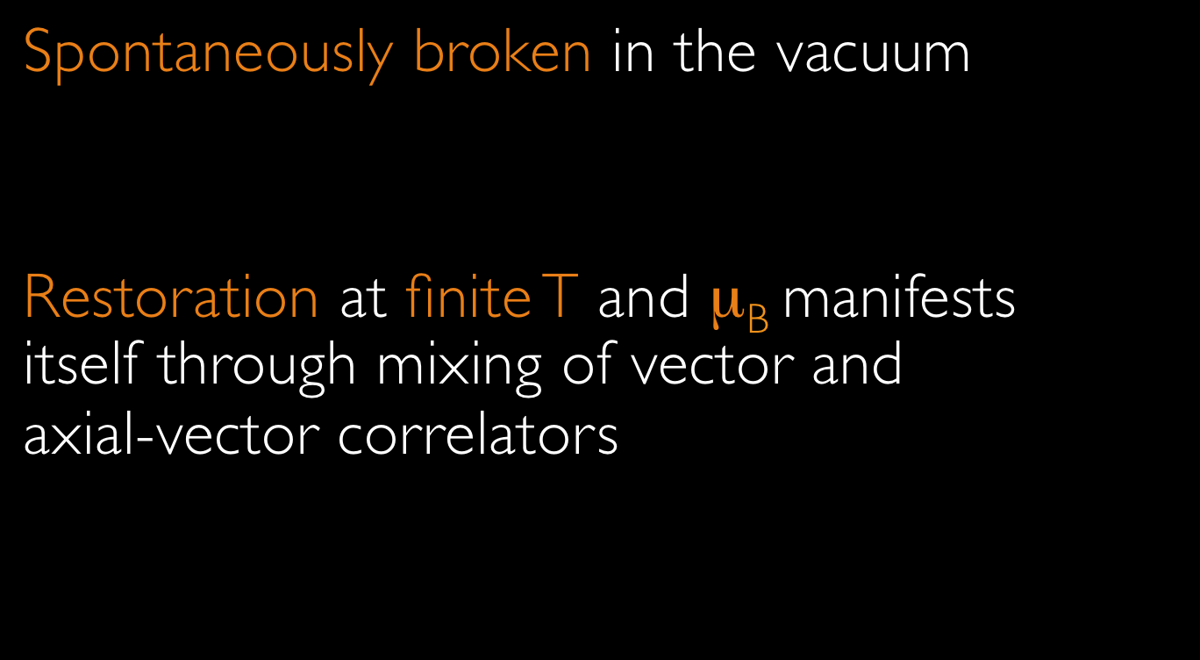


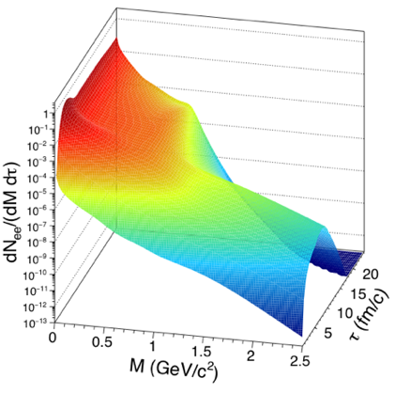
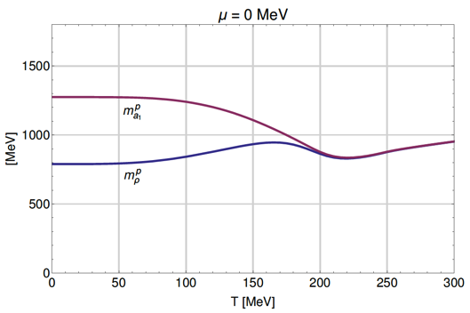



Slide 3








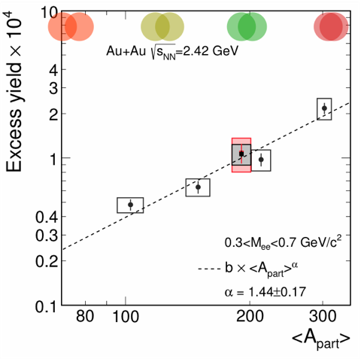
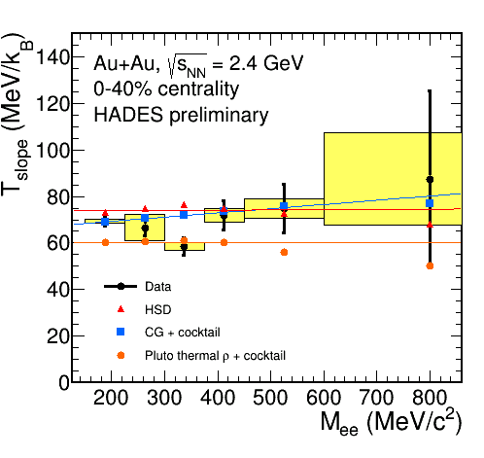
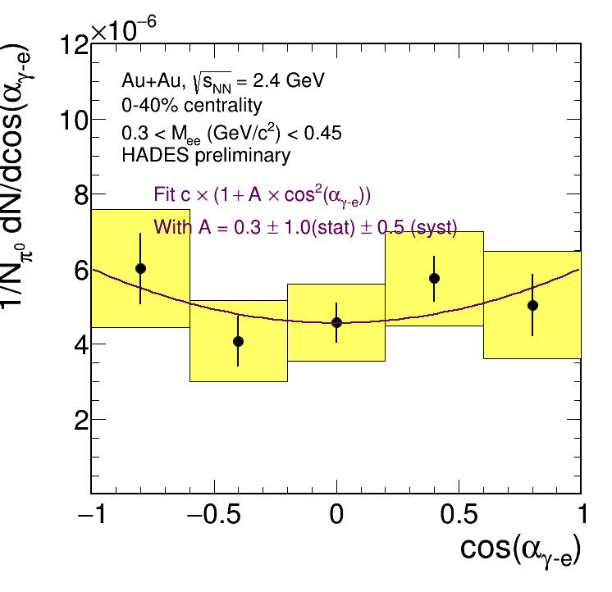

Spectrometer
Thermometer
Chronometer
Barometer
Polarimeter
  M_{ll} of excess pairs
  T_{eff} vs. M_{ll}
  v₂ vs. M_{ll}
  γ* polarization
  via lepton angular
  distribution

Slide 4
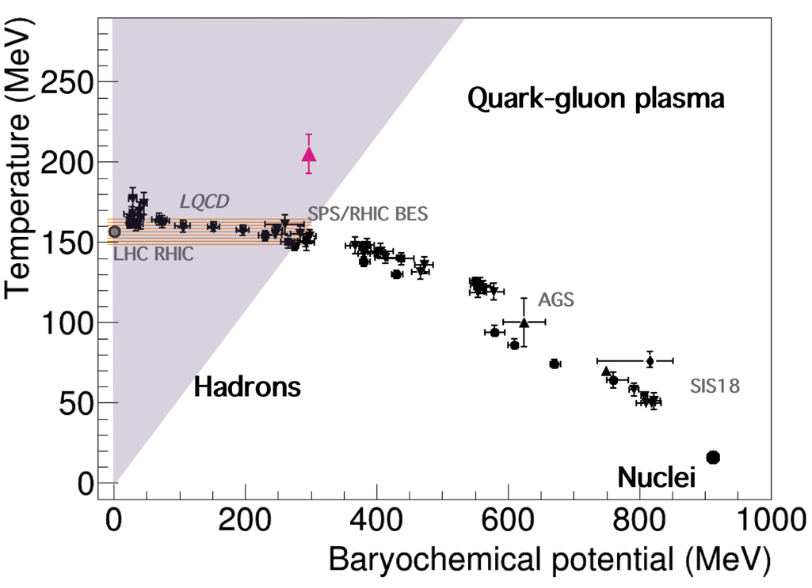

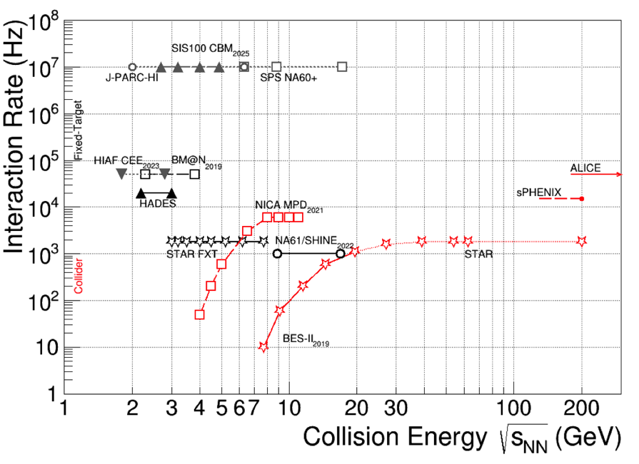
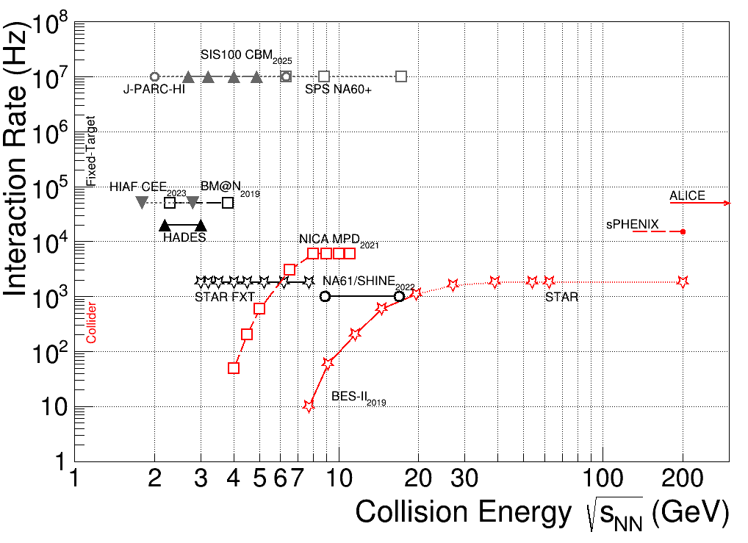
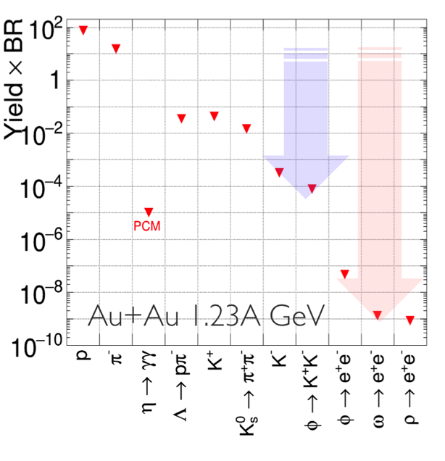
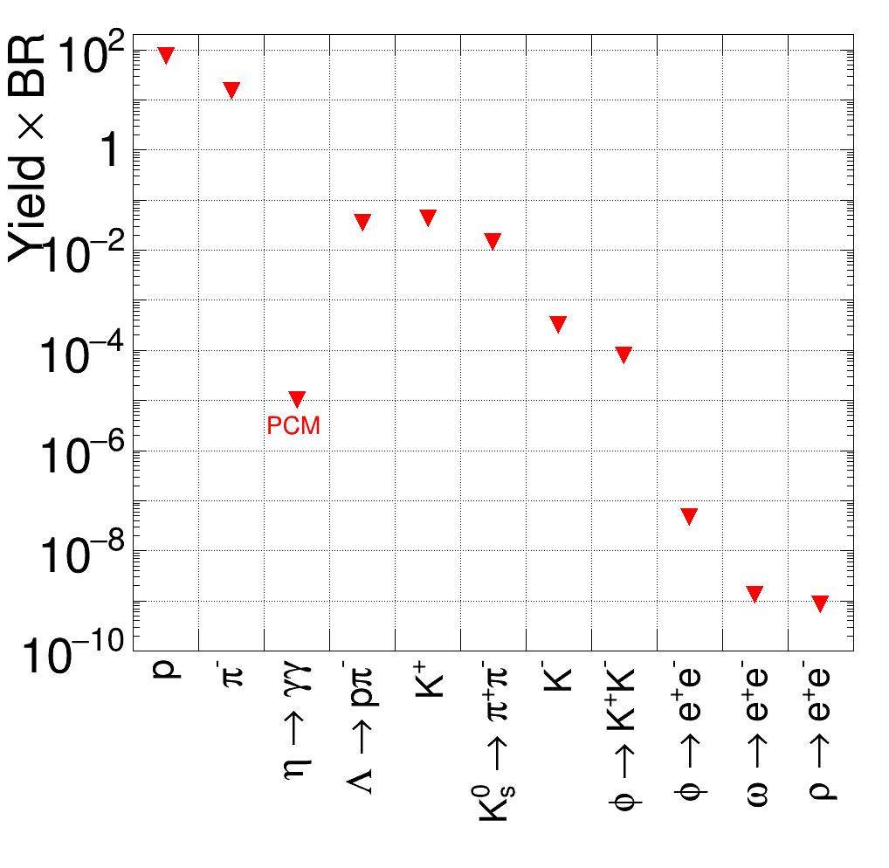



HADES explores the high-μ_{B} region
Focus on rare and penetrating probes
Au+Au 1.23A GeV
Very competitive w.r.t. interaction rate capability

Slide 5
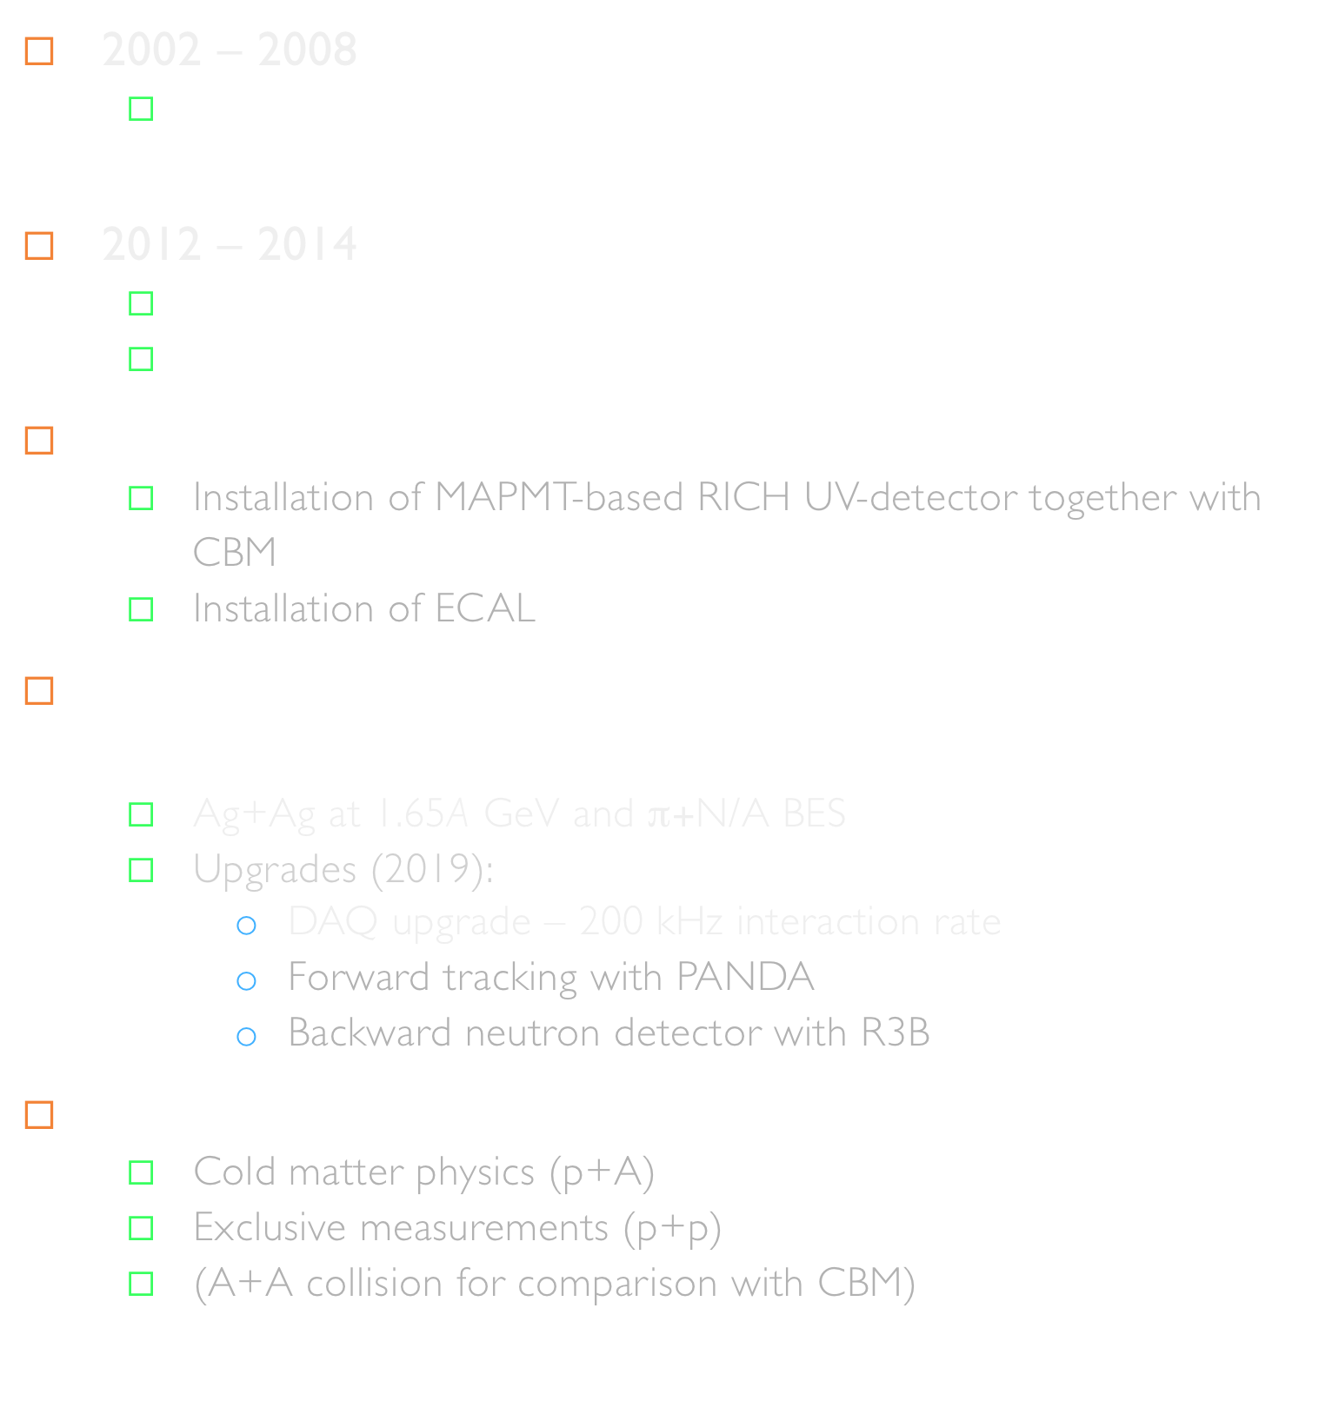
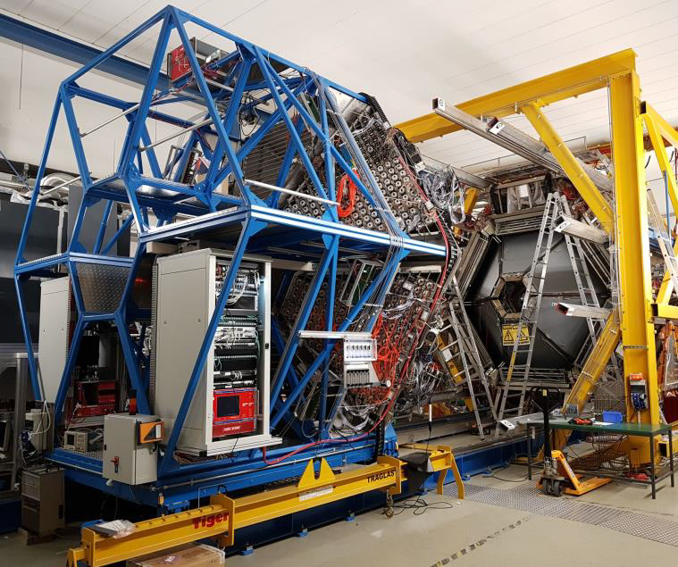
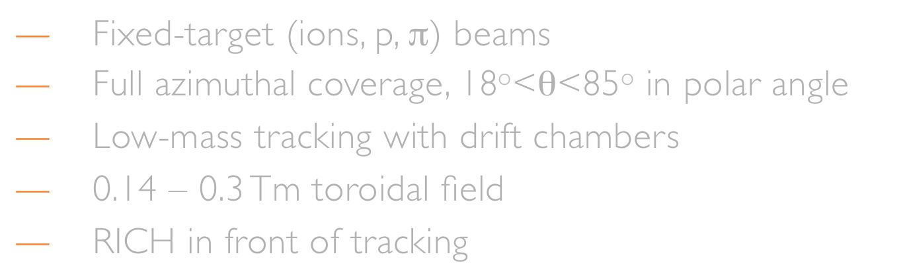


Slide 6
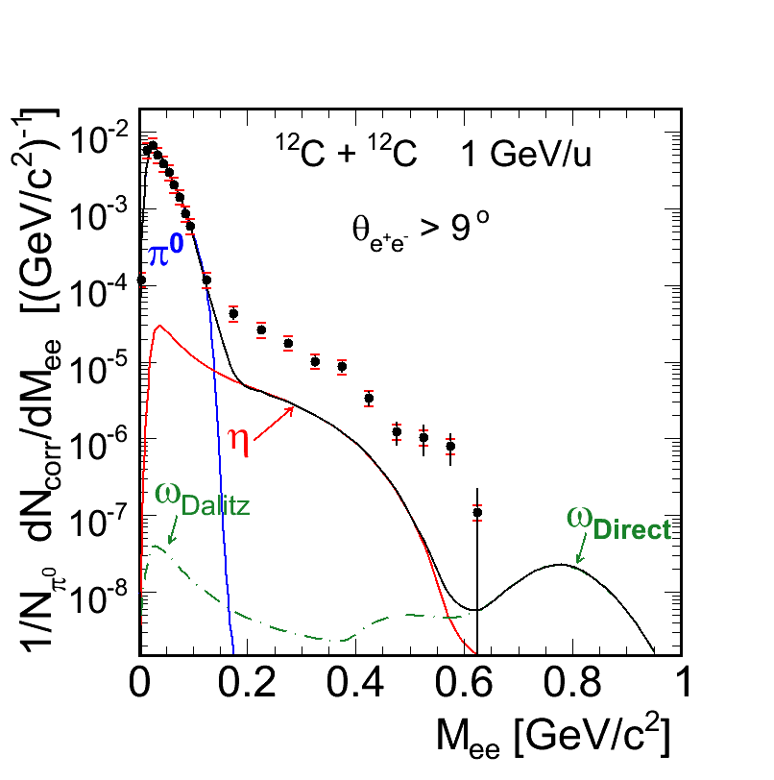
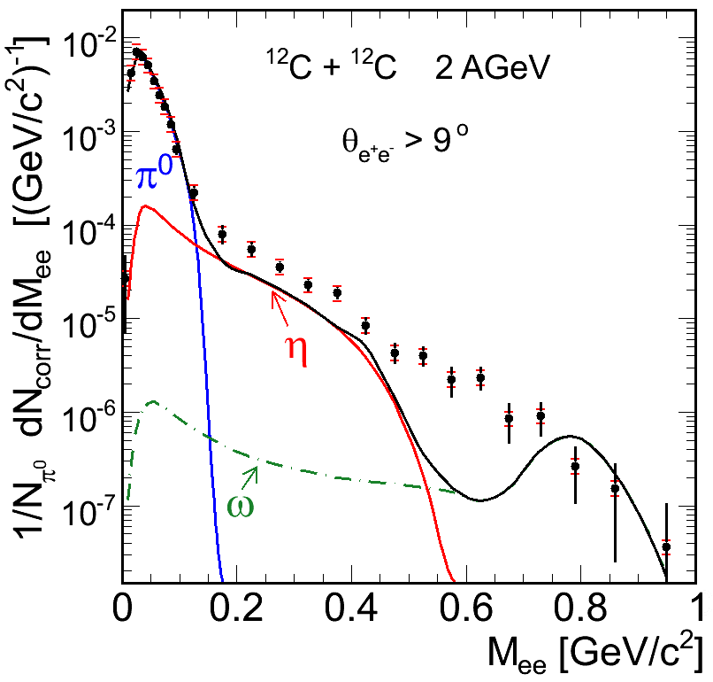
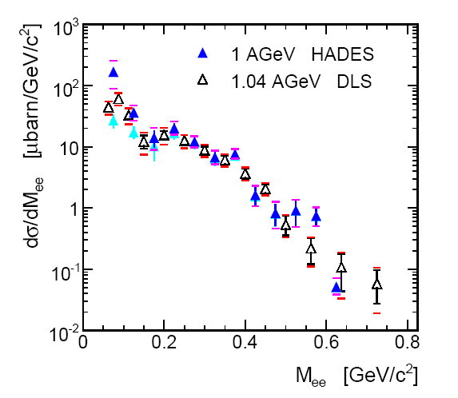




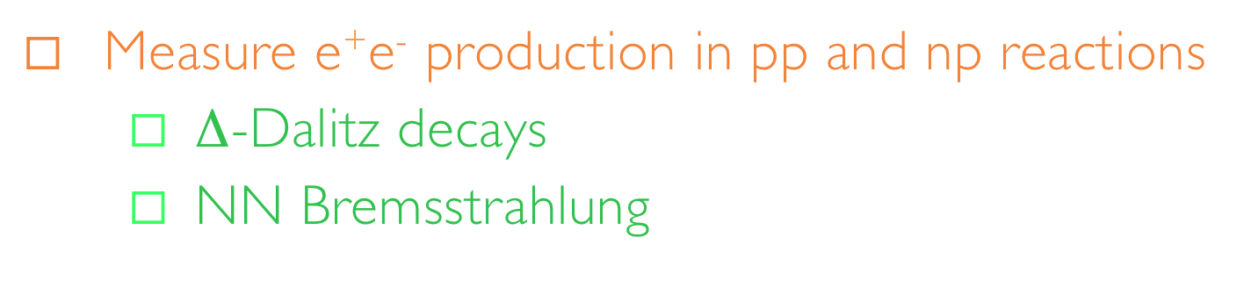


Slide 7




Slide 8
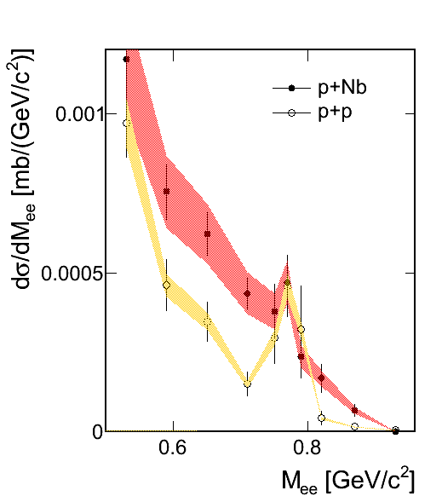
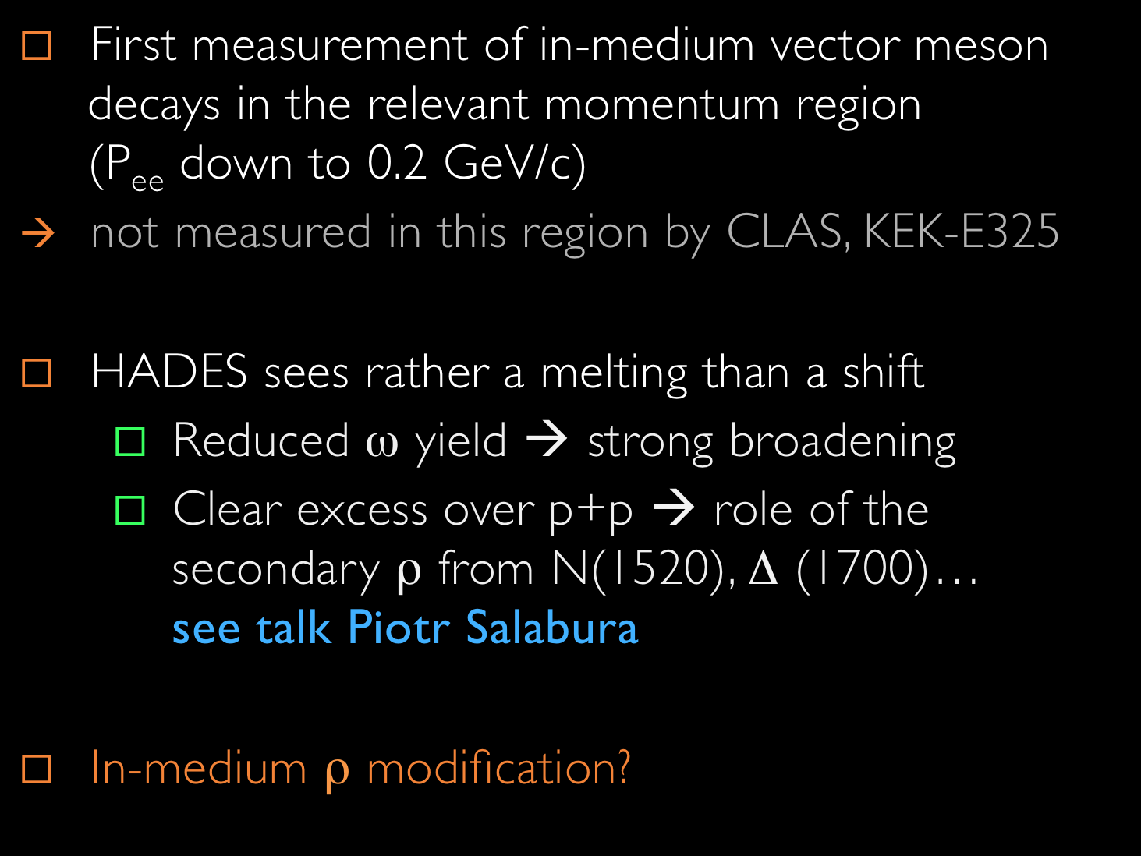
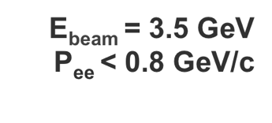




Slide 9
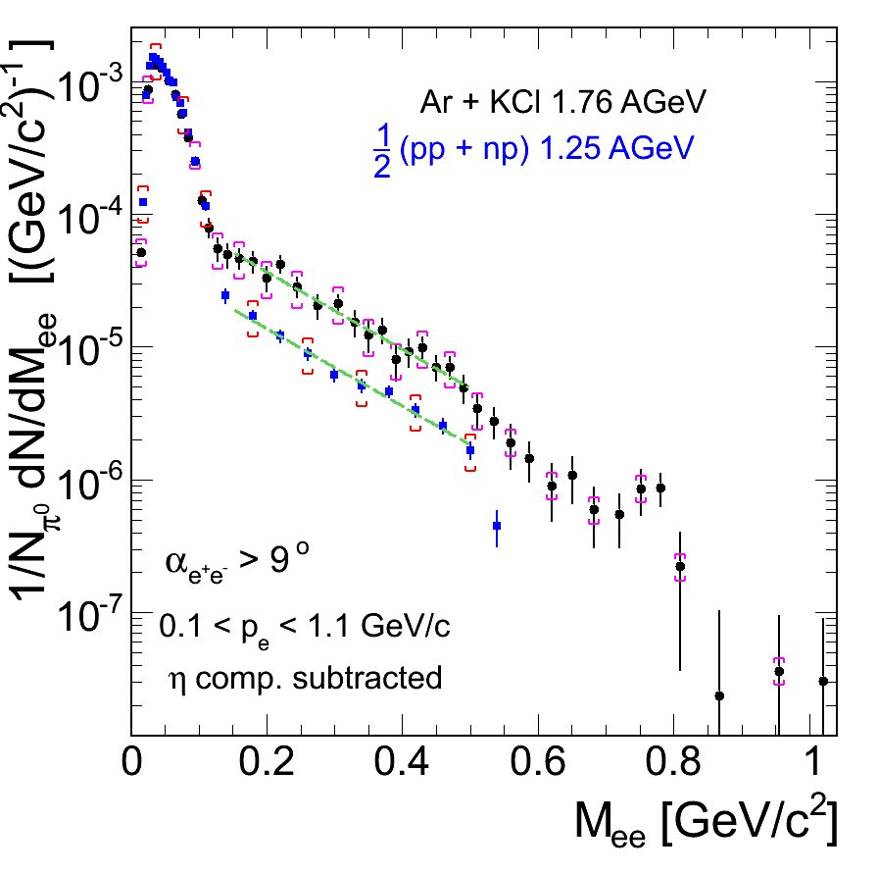
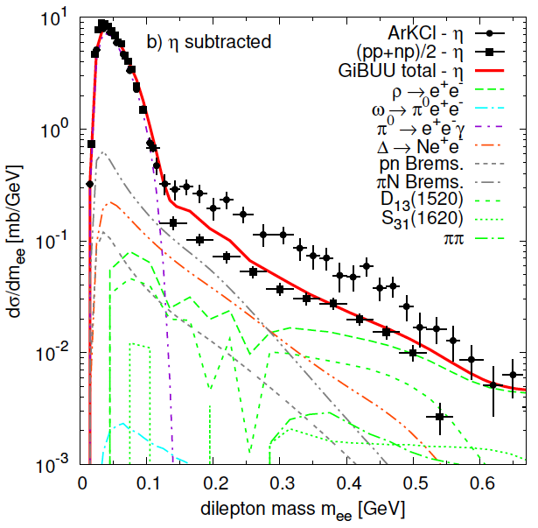
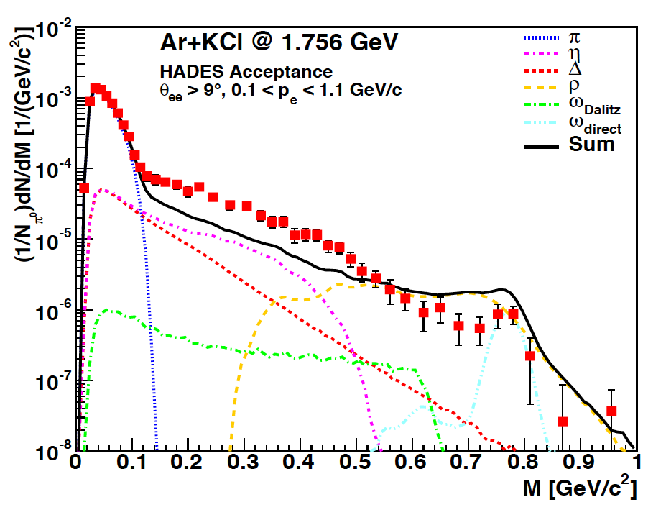






Slide 10

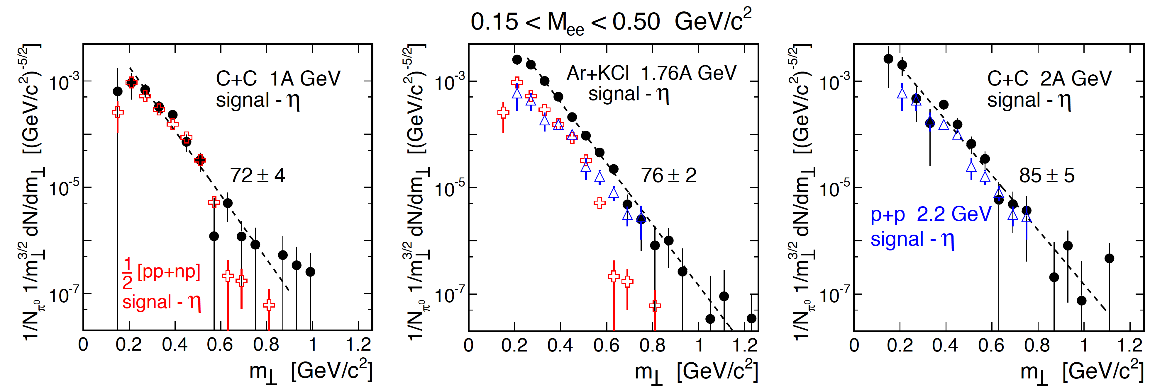



Slide 11
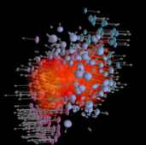
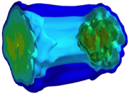

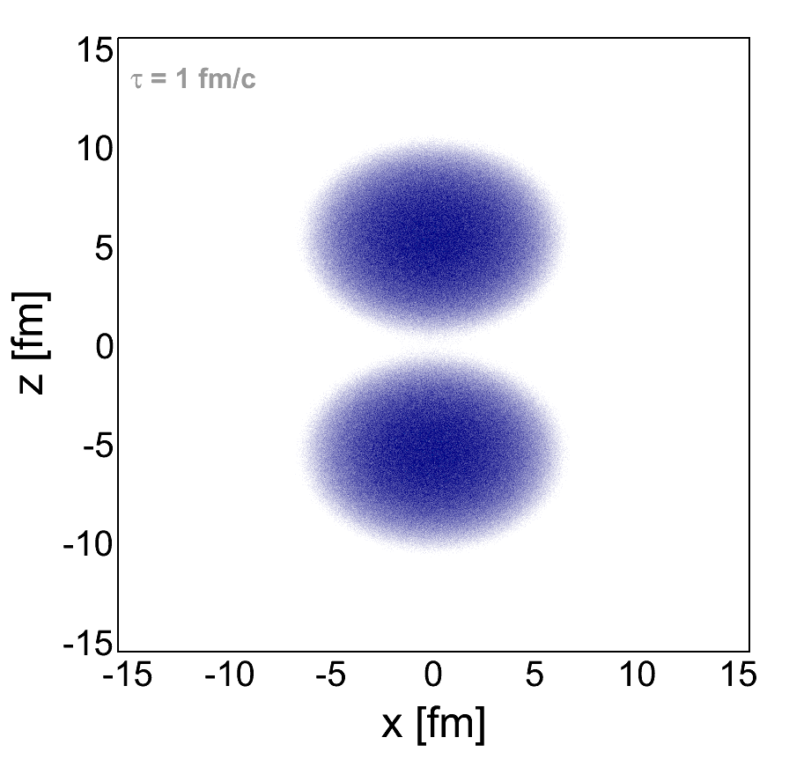
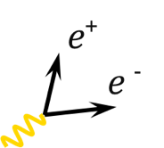







e⁺
e ⁻
Divide space-time evolution into 4-dimensional cells
21 x 21 x 21 space cells (1fm³), 30 time steps → ~ 280 k cells
Determine for each cell the bulk properties like T, μ_{B} , μ_{π}, collective velocity
Apply in-medium ρ & ω spectral functions to compute EM emission rates
  parameterization of RW in-medium spectral function
Sum up contributions of all cells

Slide 12
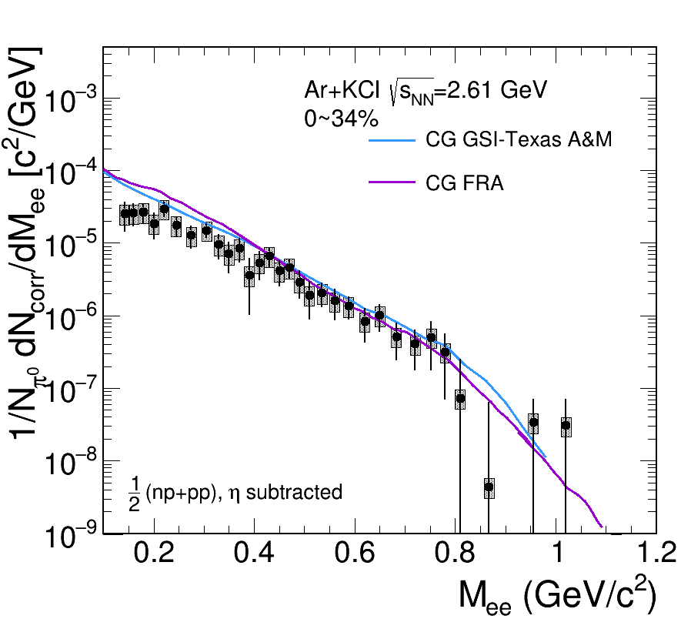
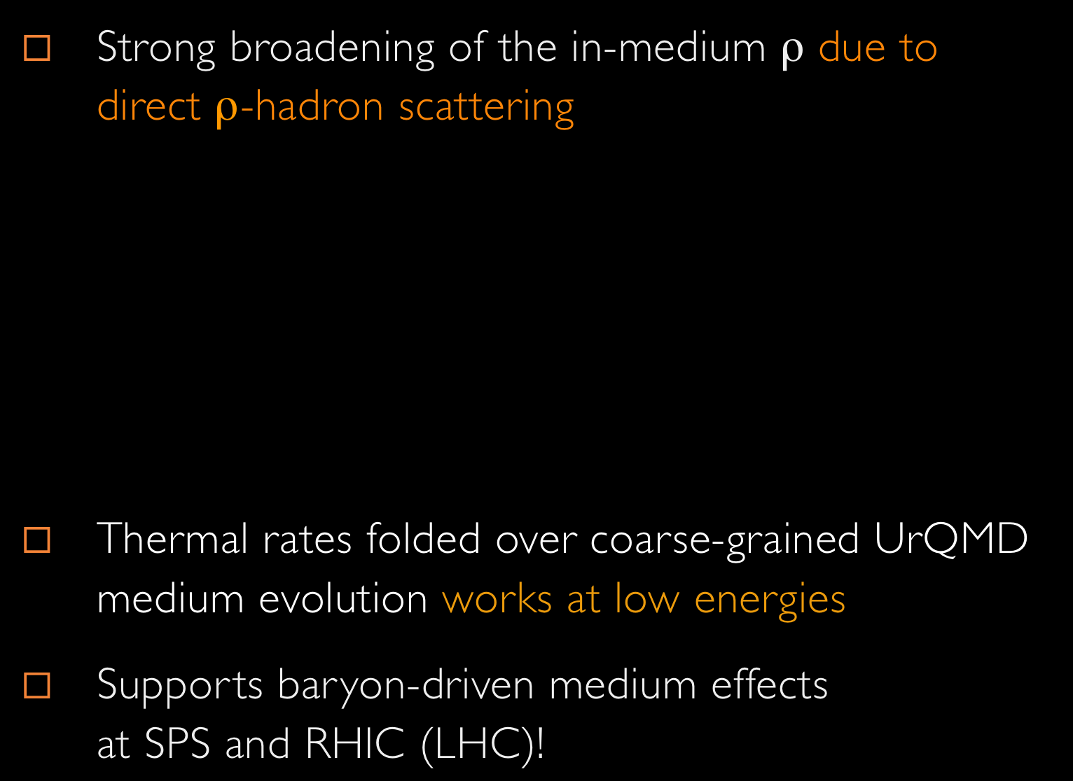
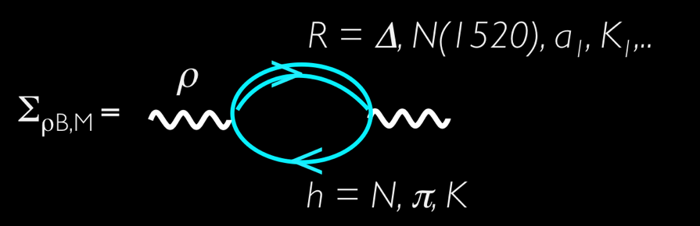



Robust understanding across QCD phase diagram

Slide 13
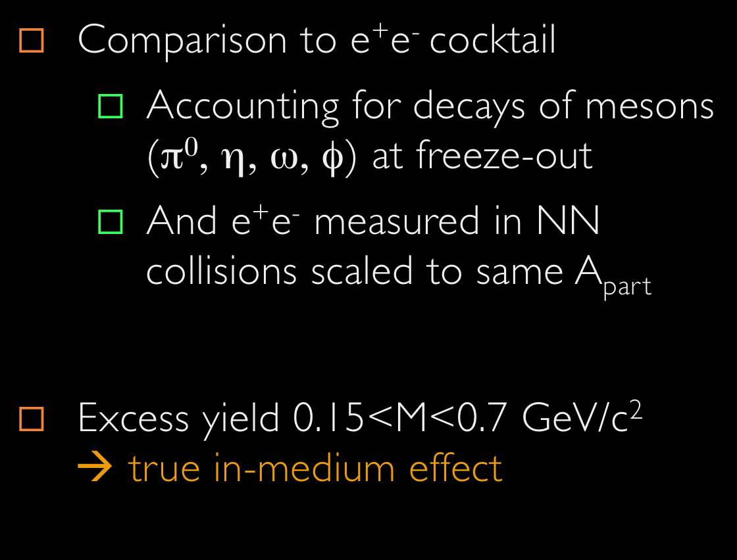


Slide 14
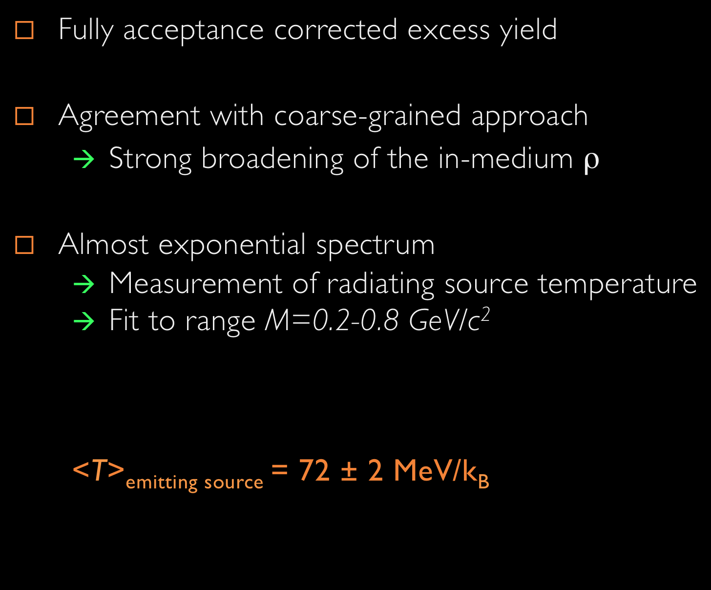



Slide 15

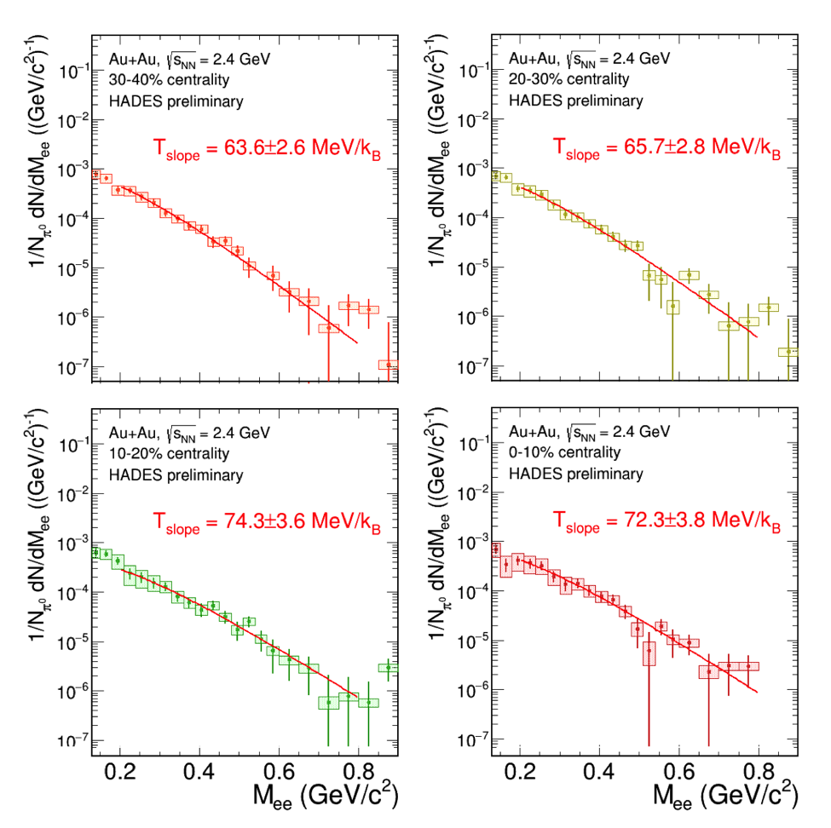

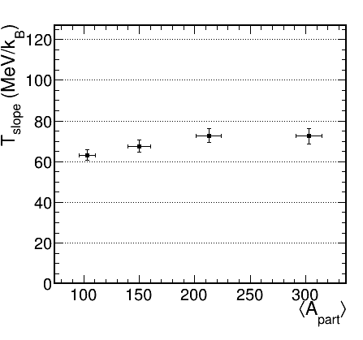
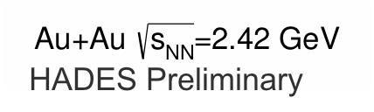











Slide 16
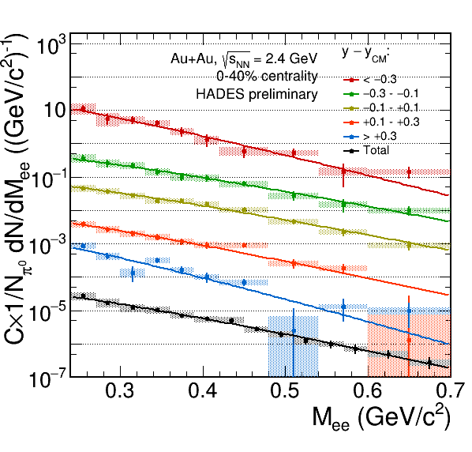
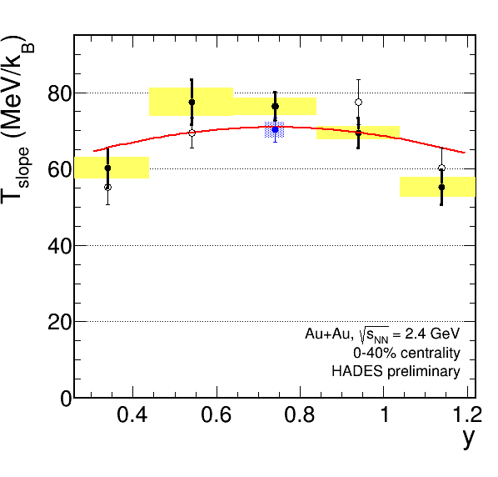






Slide 17
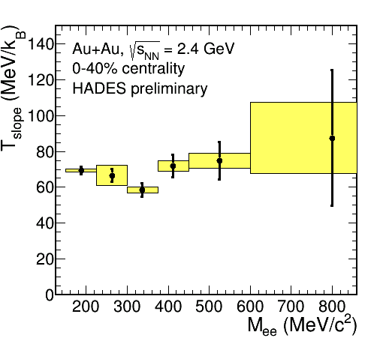
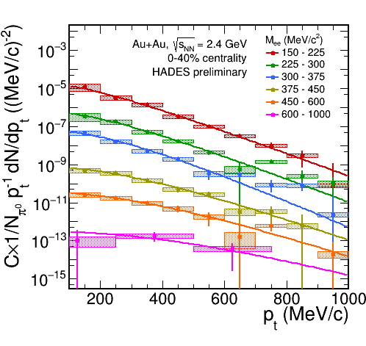



Fit to the models:
CG: T_{kin}= 65 MeV/k_{B}, <β>=0.19
HSD: T_{kin}= 74 MeV/k_{B}, <β>=0.05

Slide 18






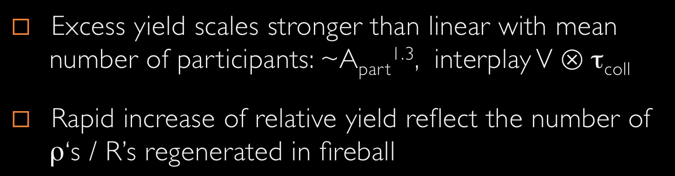




Slide 19



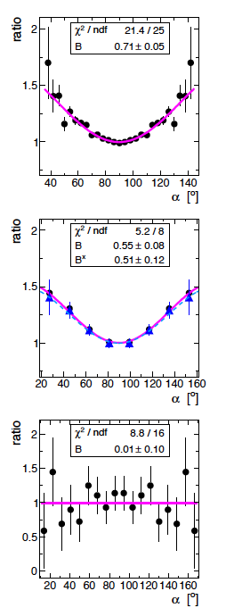



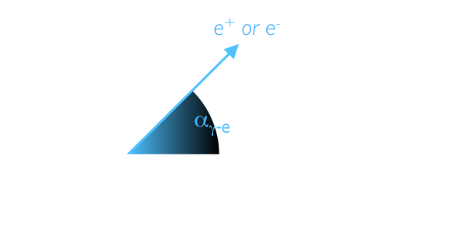


M_{ee} (GeV/c²) < 0.15
0.15 < M_{ee} (GeV/c²) < 0. 5
M_{ee} (GeV/c²) > 0.5
Pseudoscalar Dalitz decays are self-polarizing
Excess has polarization consistent with Δ
Not clear → need more statistic
(B=0 at SPS)

Slide 20




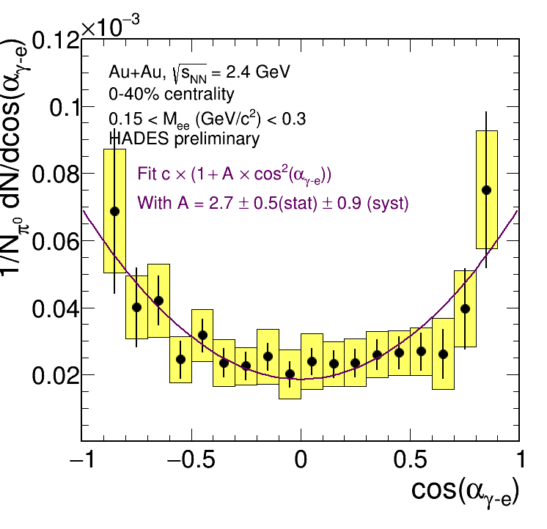
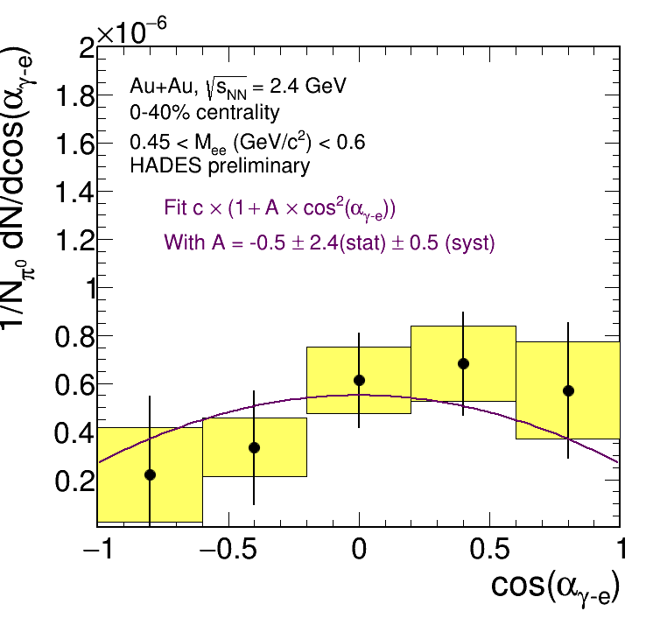
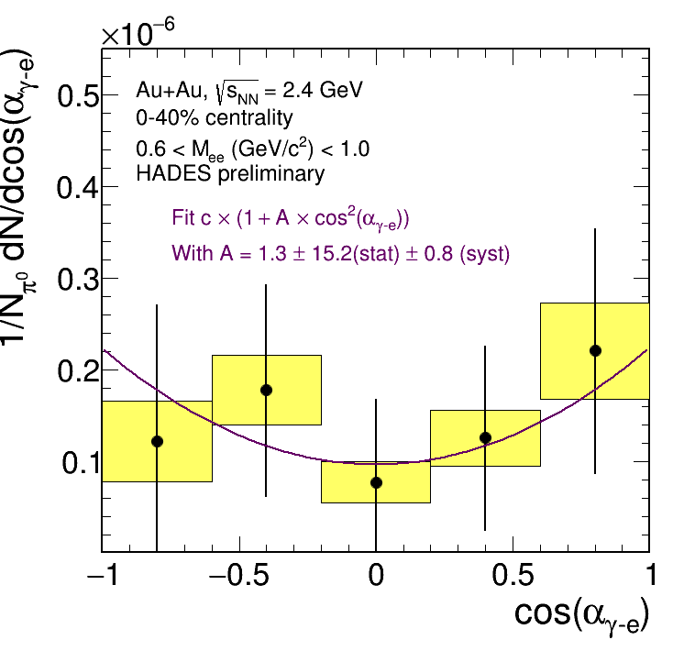


Slide 21



Slide 22

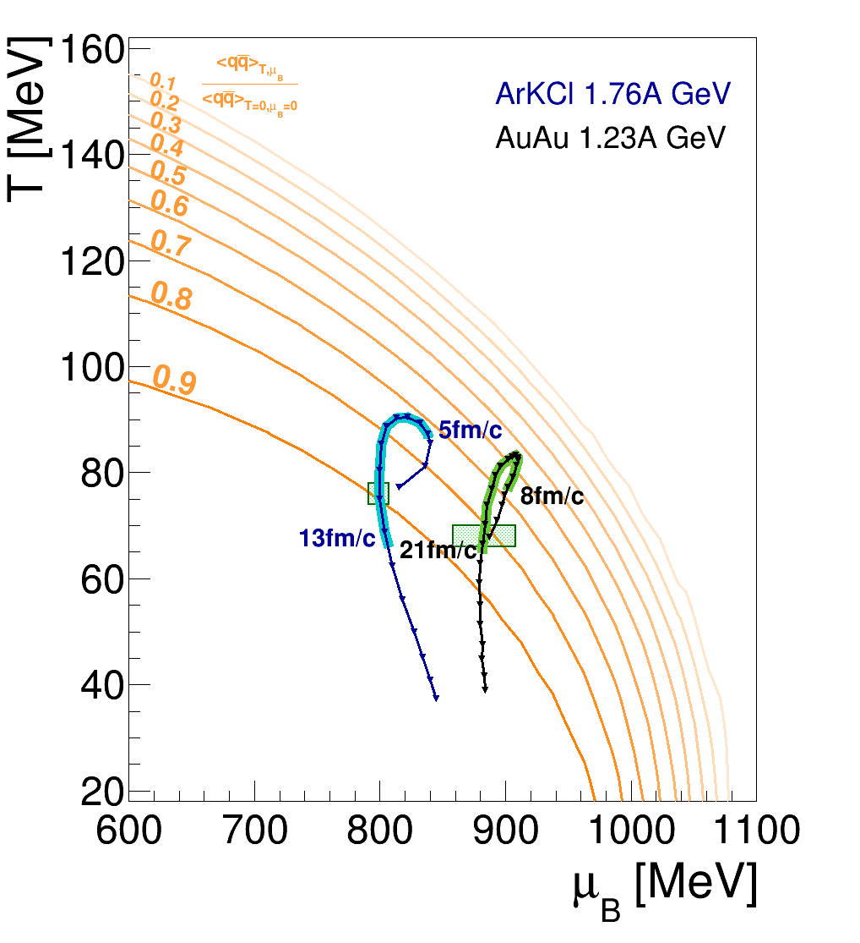
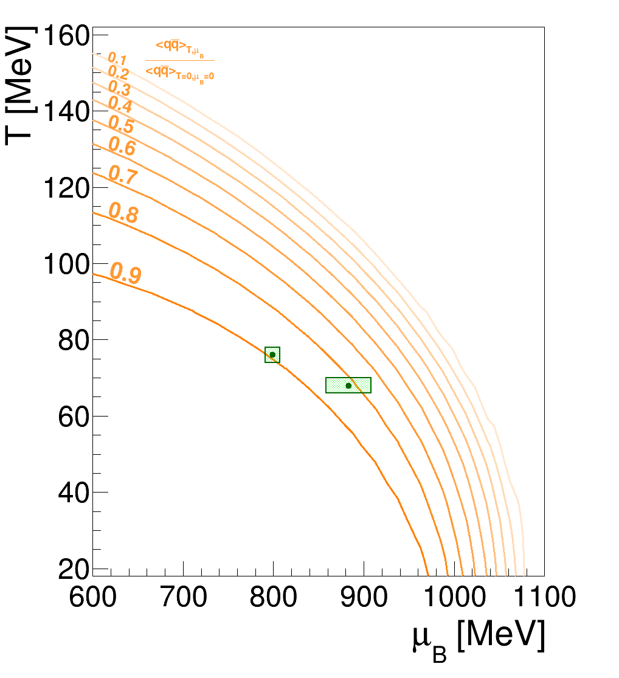



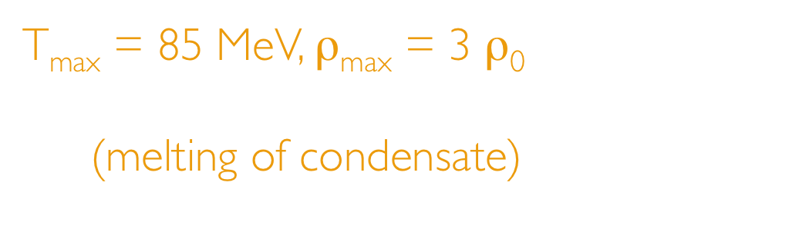




Chemical freeze-out from measured particle yields analyzed with SHM
  Trajectories extracted from inner cube of cells with coarse-grained UrQMD
Time-window of dilepton emission → access to hot and dense stage of the heavy-ion collision
T_{max} = 85 MeV, ρ_{max} = 3 ρ₀
Excitation of the vacuum
(melting of condensate)
matches spectral medium effects!

Slide 23





What are the possible signatures in dilepton radiation?

Slide 24







M_{ll}<1 GeV/c²
  ρ dominates, ‘melts’ close to T_{c}
  Yield in low-mass window tracks fireball lifetime
Search for ”extra radiation” around phase transition
(& critical point?)
M_{ll}>1 GeV/c²
  Measures true T (no blue shift) of emitting source from fit of acceptance corrected thermal spectra with M^{3/2}exp(-M/T_{s})
Plateau around onset of deconfinement?
see e.g. liquid-hadron gas phase transition in nuclear matter
M. D’Agostino et al. NPA 749 (2005) 5533

Slide 25




202x : p+p, p+Ag at 4.5 GeV
  Establish reference for SIS100
2018 : Ag+Ag √s_{NN}=2.6 GeV
  First measurement of the IMR shape and slope at SIS18 energy regime

Slide 26



Résumé and prospects
Thank you
for your attention!

Slide 27



