Slide 1

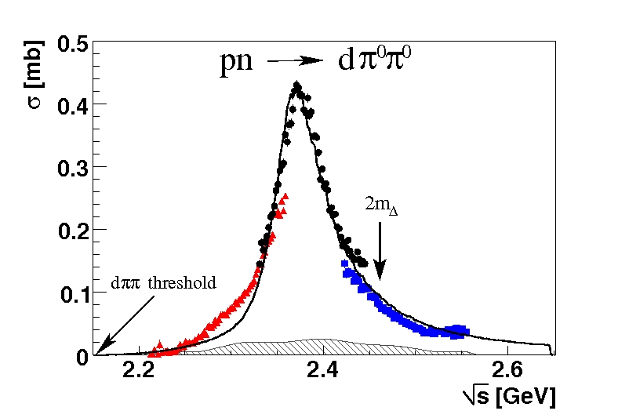
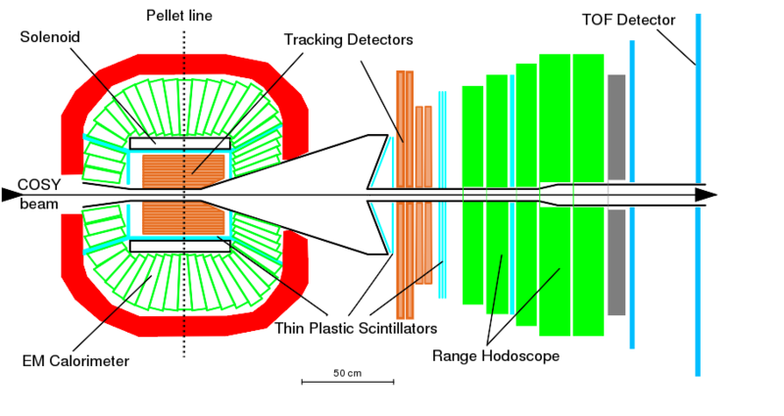
Two pion production in pp → ppπ⁺π⁻
− evidence for a D₂₁ dibaryon
Orsay 2018
Tatiana Skorodko
for WASA-at-COSY Collaboration

Slide 2
Dyson & Xuong‘s Prediction
Family of non strange dibaryons
State I J Asymptotic Configuration m_{theor} [MeV] m_{exp} [MeV] G_{exp} [MeV]
---------------------------------------------------------------------------------------------------------------------------------
D₀₁ 0 1 Deuteron 1876 1876
D₁₀ 1 0 virtual ¹S₀ 1876 1878
D₁₂ 1 2 NN(¹D₂) ↔ ΔN ↔ NNπ 2160 DN threshold
D₂₁ 2 1 2160
D₀₃ 0 3 2350
D₃₀ 3 0 2350
---------------------------------------------------------------------------------------------------------------------------------

Slide 3
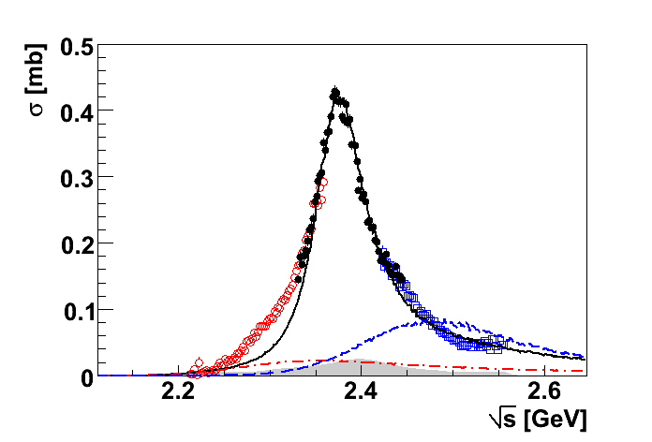
pn → d* → dπ⁰π⁰
Argand diagram:
M ≈ 2.37 GeV
G ≈ 70 MeV
Pole in ³D₃ at
2380±10 - i 40±5 MeV
PRL 106 (2011) 242302
PRC 90 (2014) 035204

Slide 4
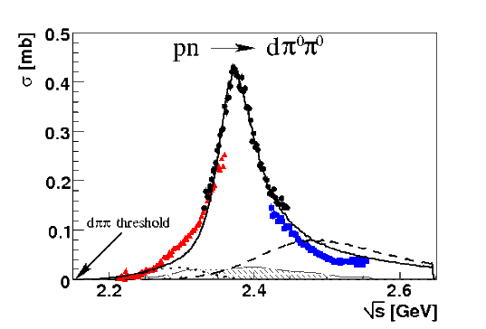
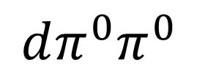
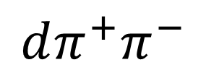
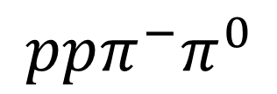
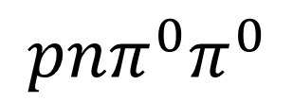
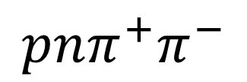
hadronic decays
PLB 721 (2013) 229
PRL 106 (2011) 242302
I = 0+1
I = 1
I = 0
dπ⁺π⁻
½ dπ⁺π⁰
2 dπ⁰π⁰
WASA data
pn → d*(2380)
PRC 88 (2013) 055208
PLB 743 (2015) 325
Phys. Scr. T 166 (2015) 014016
d*
d*
d*
→ √s [GeV]

Slide 5
Established dibaryon states
⁰S₁ – deuteron ground state I(J^{P})=0(1⁺)
¹S₀ – virtual state (NN FSI) I(J^{P})=1(0⁺)
¹D₂ – resonance structure at ΔN threshold I(J^{P})=1(2⁺)
⁰D₃ – d*(2380) ΔΔ resonance I(J^{P})=0(3⁺)
Are there more states?
²D₁ I(J^{P})=2(1⁺), ³D₀ I(J^{P})=3(0⁺) ?

Slide 6
Where D₂₁ can be seen?
I=2 ⇒ only associated production
pp → ppπ⁺ π⁻
D₂₁

Slide 7
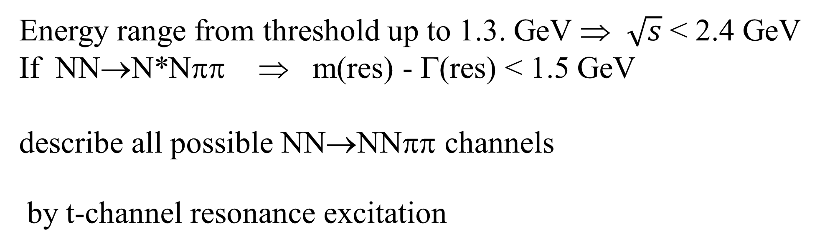
Model description – Valencia model
Energy range from threshold up to 1.3. GeV ⇒ $\sqrt{s}$ < 2.4 GeV
If NN→N*Nππ ⇒ m(res) - Γ(res) < 1.5 GeV
describe all possible NN→NNππ channels
by t-channel resonance excitation
Reasonable total cross sections from absolute calculations

Slide 8
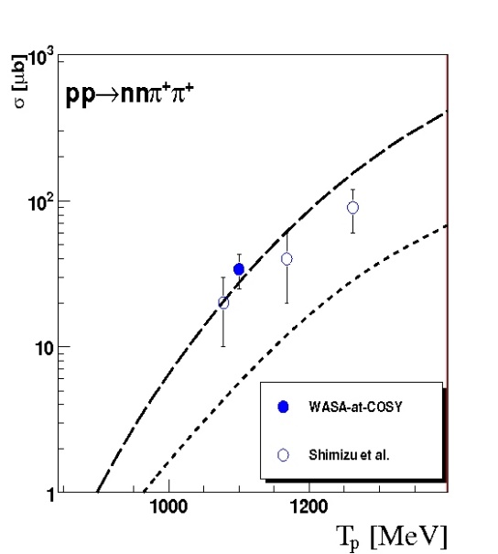
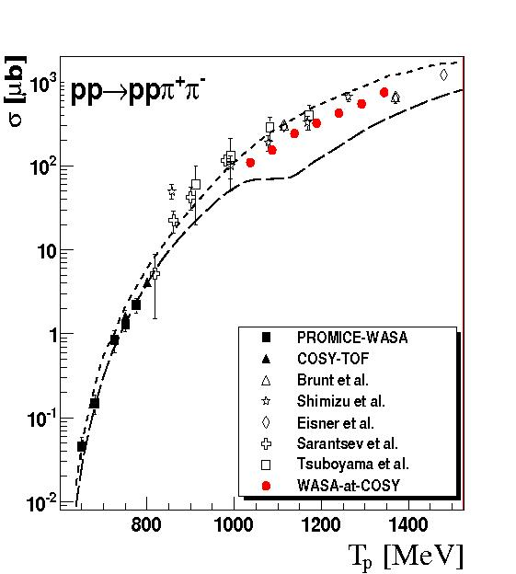
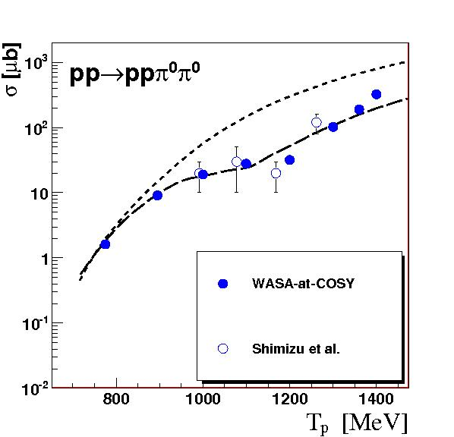
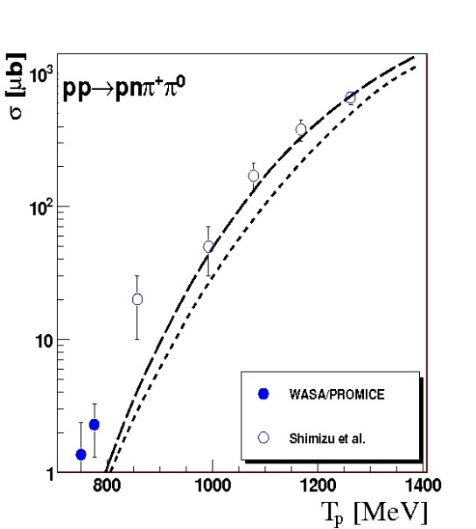
Model description
PLB 695 (2011) 115
ΔΔ + Δ(1600)
ΔΔ + Δ(1600)
Roper + ΔΔ
Roper + ΔΔ
original Valencia model (Roper + ΔΔ)
modified Valencia model (reduced Roper + ΔΔ + Δ1600)

Slide 9
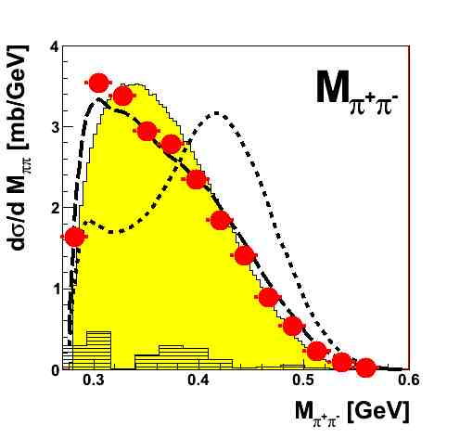
Model description
original Valencia model
modified Valencia model

Slide 10
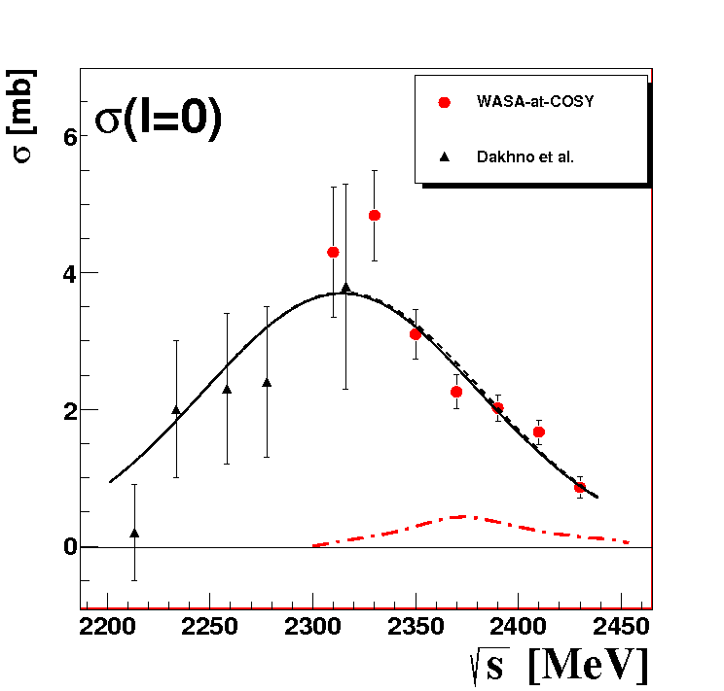
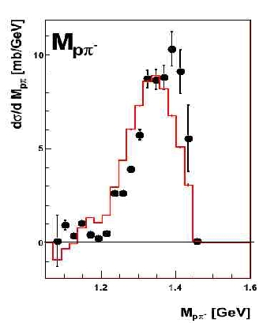
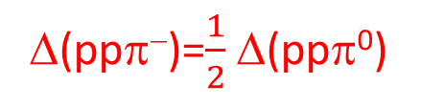
Isoscalar Single-Pion Production
PLB 774 (2017) 599
σ₀(ΝNπ)=3[2σ(pn→ppπ⁻) - σ(pp→ppπ⁰)]
Δ(ppπ⁻)=$\frac{1}{2}$ Δ(ppπ⁰)

Slide 11
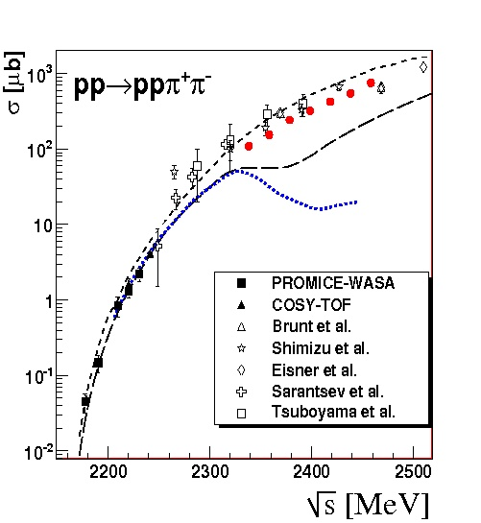
∼2320 MeV
∼2320 MeV
Roper
d*

Slide 12
Model description
PLB 695 (2011) 115
ΔΔ + Δ(1600)
ΔΔ + Δ(1600)
Roper + ΔΔ
Roper + ΔΔ
original Valencia model (Roper + ΔΔ)
modified Valencia model (reduced Roper + ΔΔ + Δ1600)

Slide 13
pn → NNππ
PRC 88 (2013) 055208
PLB 743 (2015) 325
Phys. Scr. T 166 (2015) 014016
modified Valencia model
modified Valencia model + d*
d*
d*
d*

Slide 14
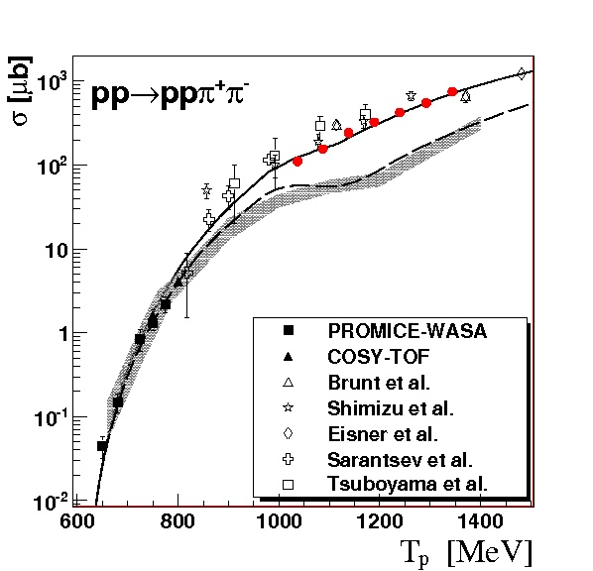
Model description
PLB 695 (2011) 115
ΔΔ + Δ(1600)
ΔΔ + Δ(1600)
Roper + ΔΔ
Roper + ΔΔ
original Valencia model (Roper + ΔΔ)
modified Valencia model (reduced Roper + ΔΔ + Δ1600)

Slide 15
Isospin decomposition
T. Skorodko et al., Phys. Lett. B 679(2009), 30

Slide 16
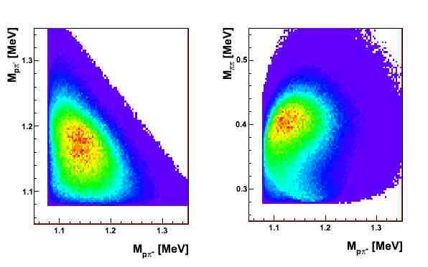
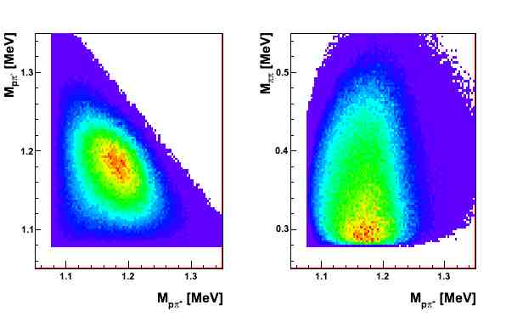
pp → Roper → ppπ⁺π⁻
pp → ΔΔ → ppπ⁺π⁻

Slide 17
Isospin decomposition
T. Skorodko et al., Phys. Lett. B 679(2009), 30

Slide 18
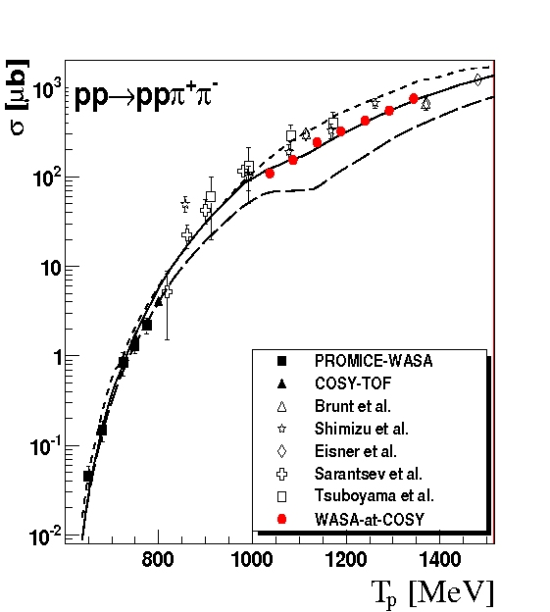
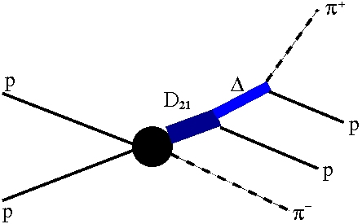
Results
original Valencia model
modified Valencia model
modified Valencia model +
D₁₂
M = 2140 MeV
Γ = 110 MeV

Slide 19
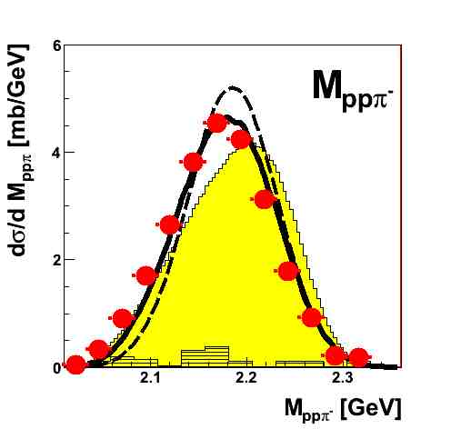
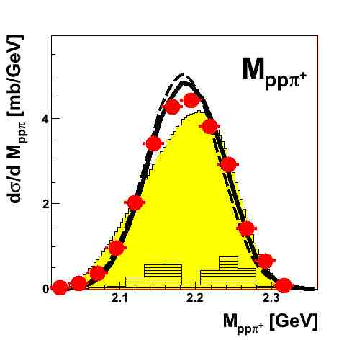
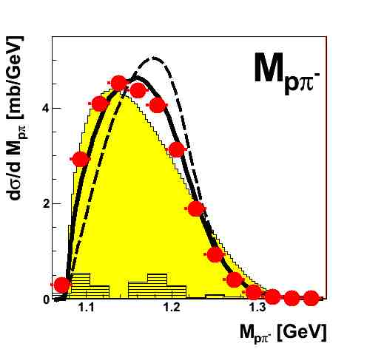
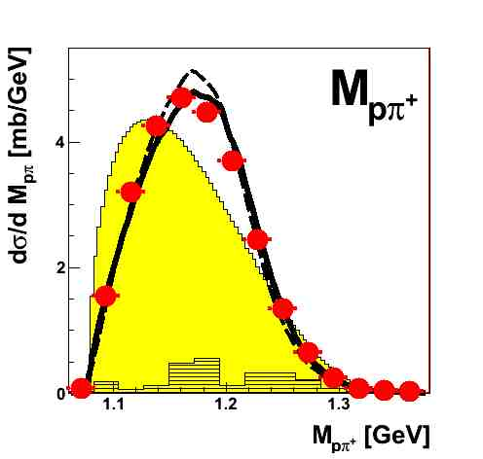
Results
modified Valencia model
modified Valencia model + D₁₂
If ΔΔ is dominate at
T_{p}≈1.2 GeV (Valencia model)
M_{pπ+} = M_{pπ−}
⇒

Slide 20
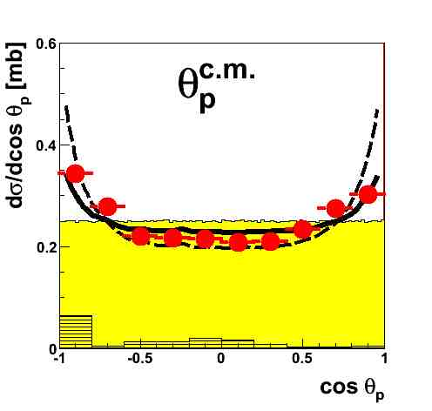
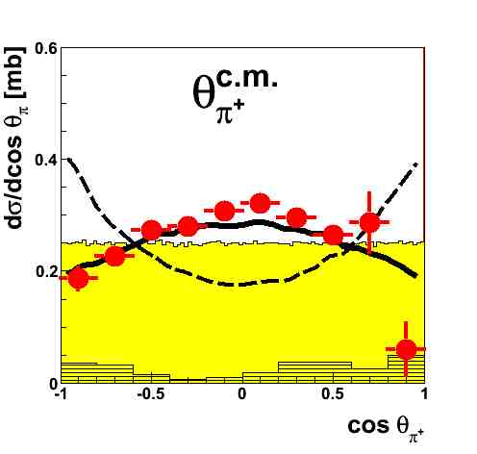
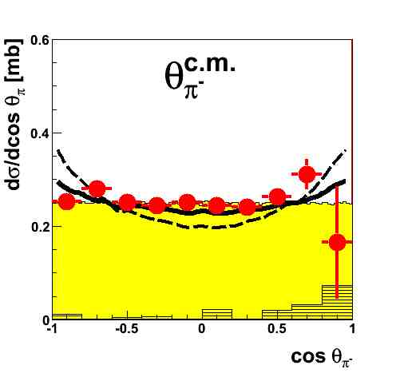
Results
modified Valencia model
modified Valencia model + D₁₂
If ΔΔ is dominate at
T_{p}≈1.2 GeV (Valencia model)
θ_{π+} = θ_{π−}
⇒

Slide 21
Conclusions
isospin relations for total cross sections demand the opening a new contribution in pp→ppπ⁺π⁻
differential M_{pπ−} and θ_{π+} distributions show a clear deviation from the modified Valencia model calculations
total and differential cross sections agree well with assumption that in case of pp→ppπ⁺π⁻ channel there is an additional production mechanism – the associated production of the isotensor ΔN state D₂₁
• the strength of D₂₁ excitation in measured energy range is compatible with the strength of ΔΔ excitation

