Slide 1



$d^{∗}(2380)$ properties
Mikhail Bashkanov

Slide 2
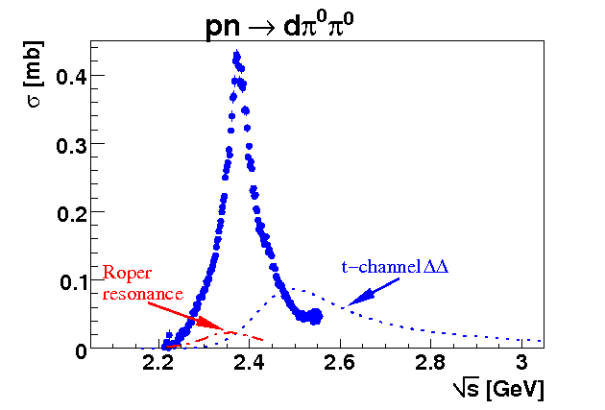
Total cross section pn → dπ⁰π⁰
d*(2380) dibaryon
Γ∼70 MeV
P. Adlarson et. al Phys. Rev. Lett. 106:242302, 2011

Slide 3

$d^{∗}(2380)$ dibaryon
$$Γ_{d^{∗}}=70 MeV≪Γ_{ΔΔ}=240 MeV$$
u
u
u
d
d
d
Threshold
I(J^{p}) = 0(3⁺)
80 MeV
d*
Δ
Δ
$$M_{d^{∗}}=2.38 GeV≈2M_{Δ}−80 MeV$$

Slide 4
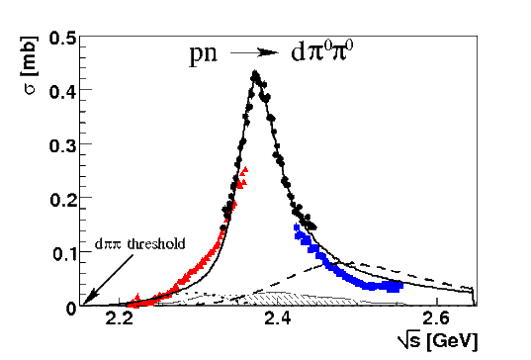






Dibaryon: hadronic decays
PRL 106 (2011) 242302
PLB 721 (2013) 229
WASA data
$$dπ^{0}π^{0}$$
$$dπ^{+}π^{−}$$
pn → d*(2380)
$$pn$$
$$ppπ^{−}π^{0}$$
$$pnπ^{0}π^{0}$$
$$pnπ^{+}π^{−}$$
PRL 112 (2014) 202301
PRC 90, (2014) 035204
d*
d*
PRC 88 (2013) 055208
PLB 743 (2015) 325
d*

Slide 5

$d^{∗}$ Internal Structure

Slide 6
d* internal structure
Hexaquark
Molecule
Diquark dominated
Meson assisted
σ-dressed
σ

Slide 7
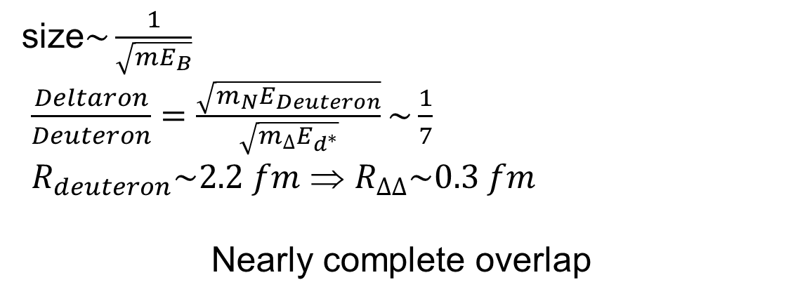
Deuteron vs Deltaron
size$\sim \frac{1}{\sqrt{mE_{B}}}$
$\frac{Deltaron}{Deuteron}=\frac{\sqrt{m_{N}E_{Deuteron}}}{\sqrt{m_{Δ}E_{d^{∗}}}}\sim \frac{1}{7}$
$R_{deuteron}\sim 2.2 fm$ ⇒ $R_{ΔΔ}\sim 0.3 fm$
Nearly complete overlap

Slide 8

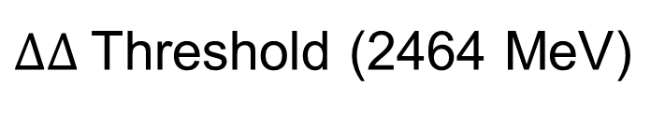


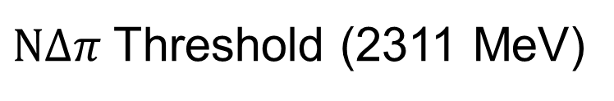


Possible $d^{∗}$internal structure
$ΔΔ$Threshold (2464 MeV)
$$ΔΔ_{D−wave}$$
fluffy
compact
$$ΔΔ_{S−wave}$$
80 MeV
80 MeV
$$6q+ΔΔ_{S−wave}$$
d*(2380)
compact
$$NΔπ$$
fluffy
$NΔπ$Threshold (2311 MeV)

Slide 9

$d^{∗}$ in-medium
$ΔΔ$Threshold (2464 MeV)
$$ΔΔ_{D−wave}$$
fluffy
compact
$$ΔΔ_{S−wave}$$
80 MeV
80 MeV
$$6q+ΔΔ_{S−wave}$$
d*(2380)
compact
$$NΔπ$$
fluffy
$NΔπ$Threshold (2311 MeV)

Slide 10
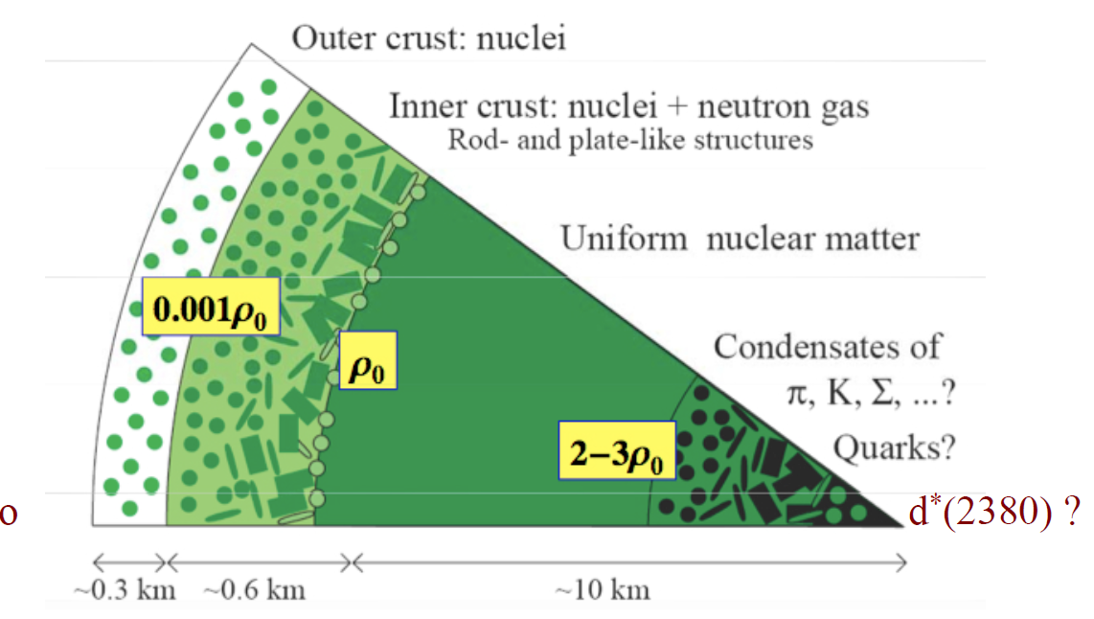
Nuclear matter at high density

Slide 11
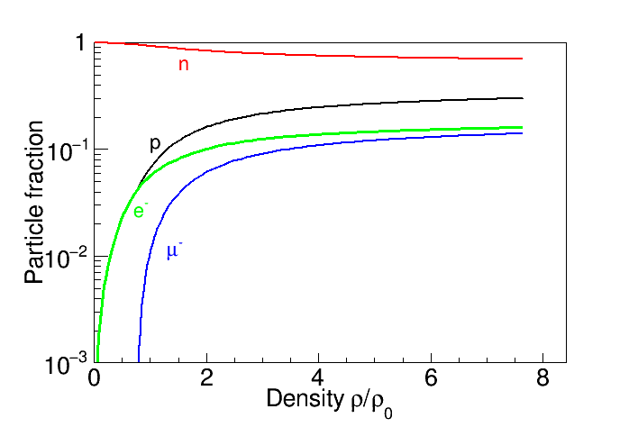
Neutron stars EoS
I. Vidaña, M. Bashkanov, D.P. Watts, A. Pastore
Phys.Lett. B781 (2018) 112

Slide 12
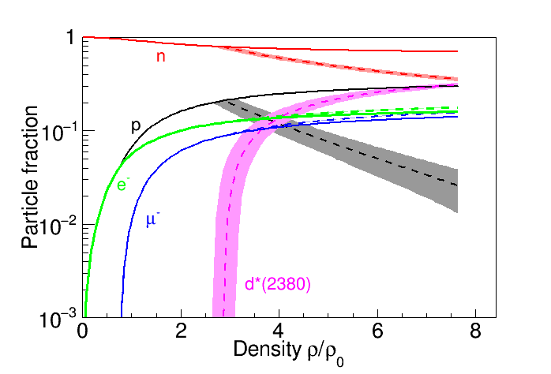

The d*(2380) in neutron stars a new degree of freedom?
$d^{∗}$ gets stable at $ρ\sim 2.8⋅ρ_{0}$
All decays are Pauli blocked
Dibaryon matter?
$d^{∗}$in nuclei?
I. Vidaña, M. Bashkanov, D.P. Watts, A. Pastore
Phys.Lett. B781 (2018) 112

Slide 13
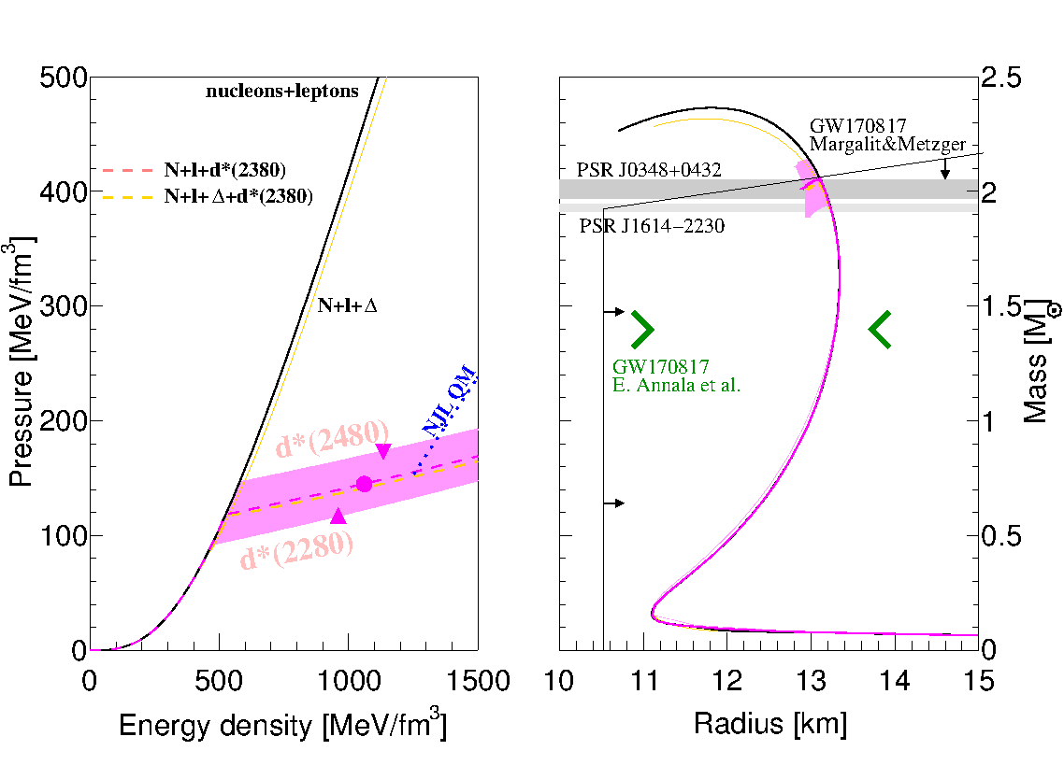
The d ∗ (2380) in neutron stars
I. Vidaña, M. Bashkanov, D.P. Watts, A. Pastore
Phys.Lett. B781 (2018) 112
GW170817 from arXiv:1710.05938v1

Slide 14
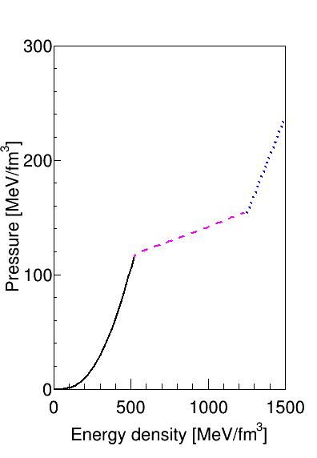
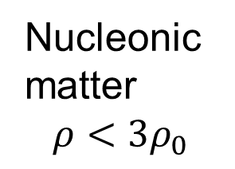
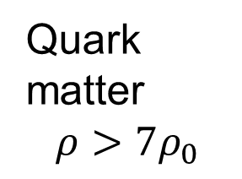
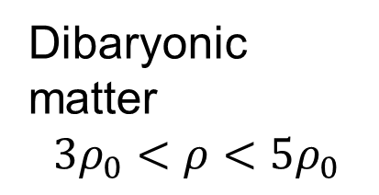
From Nucleons to Quarks
Dibaryonic matter
$$3ρ_{0}<ρ<5ρ_{0}$$
Quark matter
$$ρ>7ρ_{0}$$
Nucleonic matter
$$ρ<3ρ_{0}$$

Slide 15
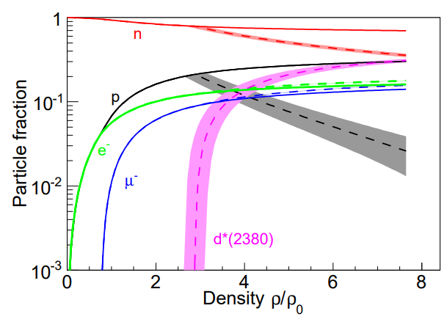
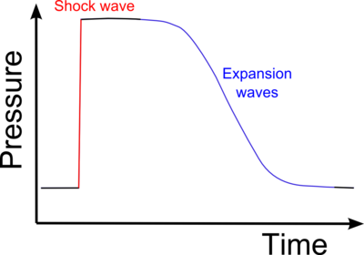






$d^{∗}$ in neutron stars
Urca cooling
$$d^{∗}→nn+e^{+}+ν_{e}$$
$$ρ\sim 2.8ρ_{0}$$
Neutron stars mergers
$$ρ>2.8ρ_{0}$$
$$d^{∗}→pn$$
$$nn→d^{∗}+e^{−}+\overline{ν_{e}}$$
Ejecta
HMNS->black hole
nucleosynthesis

Slide 16

$d^{∗}$ size

Slide 17
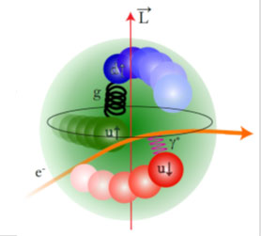

$d^{∗}$size
e⁻
e⁻
γ*
d*(2380)
d
Transition form factor
Charge distribution
Internal structure

Slide 18
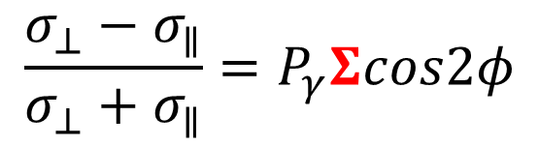
$d^{∗}(2380)$ electroproduction
d*(2380) electroproduction?
γ
$$Γ(d^{∗}→γd)\sim 1keV$$
d
γ
Δ
d
$$Γ(d^{∗}→γγd)\sim 1keV$$
Δ
γ

Slide 19
$d^{∗}(2380)$ electroproduction
d*(2380) electroproduction?
e⁻
e⁻
γ*
e⁻
γ*
d*(2380)
e⁻
d*(2380)
γ*

Slide 20
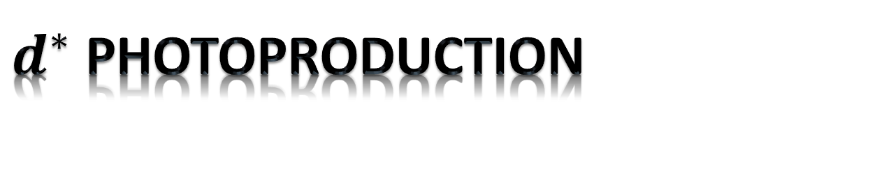
$d^{∗}$ photoproduction

Slide 21
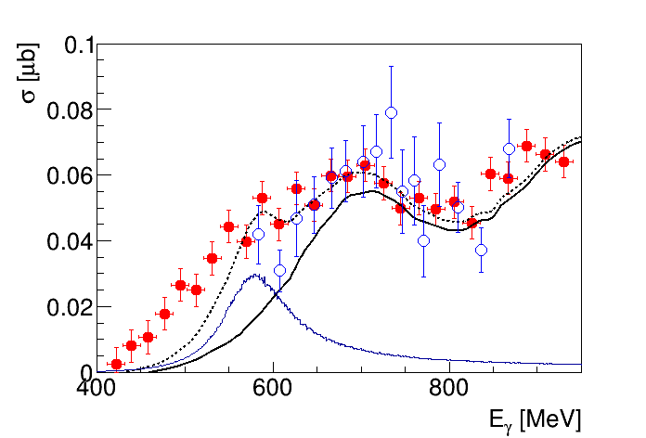




d*(2380) in photoproduction?
$$π^{0}$$
γ
p
$$π^{0}$$
d*
γ
d*
d
d
d
n
$γd→dπ^{0}π^{0}$
$γd→dπ^{0}π^{0}$
Conventional Background
M. Egorov, A. Fix,
Nucl.Phys. A933 (2015) 104-113
$$d^{∗}$$
M. Guenther, Hadron 2017
T. Ishikawa et al. Phys.Lett. B772 (2017) 398

Slide 22
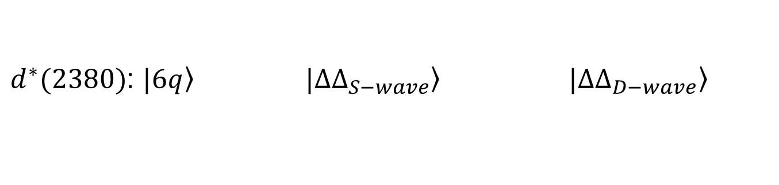
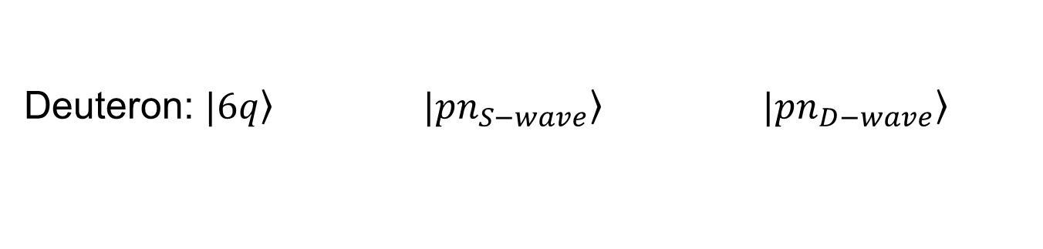


deuteron to d*(2380) transitions
0.15%
5%
Deuteron: $\left.|6q\right\rangle$ $\left.|pn_{S−wave}\right\rangle$ $\left.|pn_{D−wave}\right\rangle$
$$γ$$
$$γ$$
$d^{∗}(2380)$: $\left.|6q\right\rangle$ $\left.|ΔΔ_{S−wave}\right\rangle$ $\left.|ΔΔ_{D−wave}\right\rangle$
66%
30%
2%

Slide 23
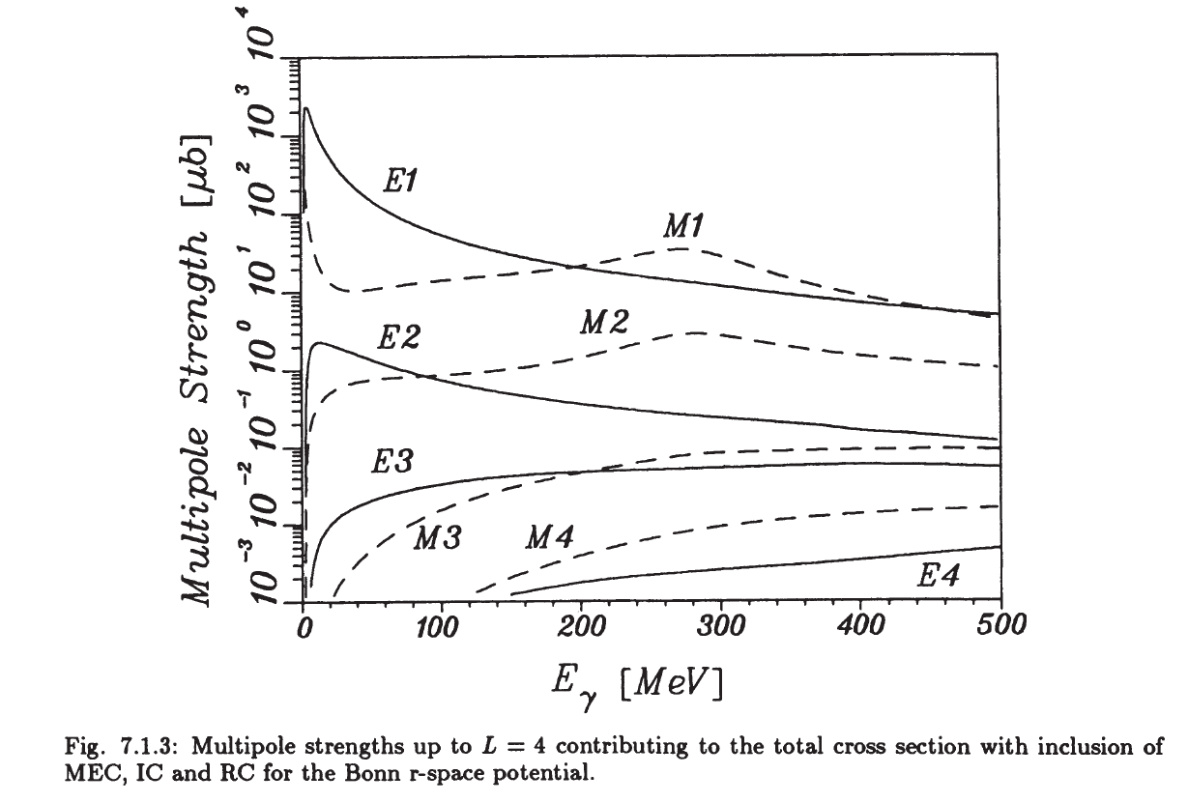
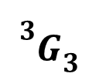

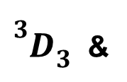

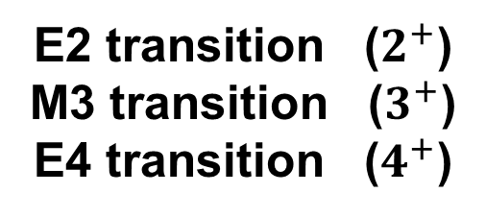
$d^{∗}$ and beam asymmetry $Σ$
E2 transition ($2^{+}$)
M3 transition ($3^{+}$)
E4 transition ($4^{+}$)
$$d^{∗}$$
p
γ
${}_{}^{3}{D_{3}}$ &
$${}_{}^{3}{G_{3}}$$
d
n
90% 10%
$$\frac{σ_{⊥}−σ_{∥}}{σ_{⊥}+σ_{∥}}=P_{γ}Σcos2φ$$
H. Arenhoevel, M. Sanzone “Photodisintegration of the deuteron”

Slide 24
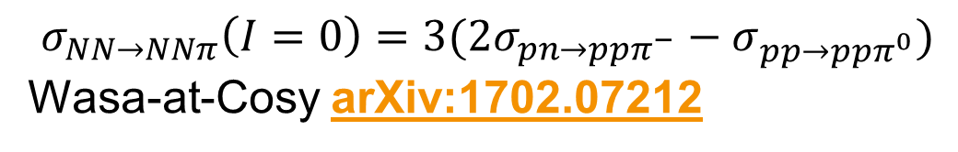

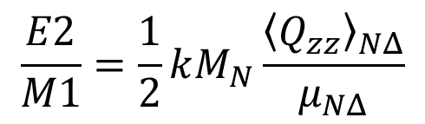

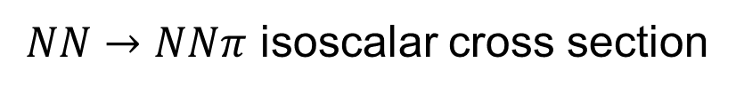
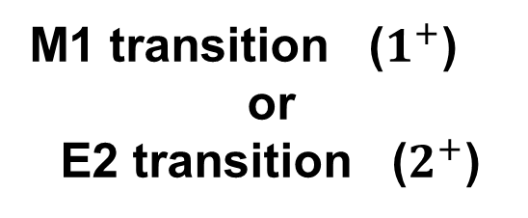

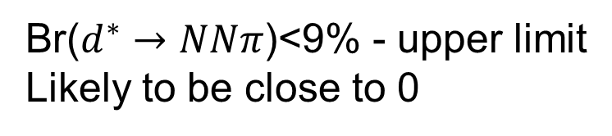
Beam asymmetry $Σ$
γ
$$Δ$$
$$π$$
M1 transition ($1^{+}$)
or
E2 transition ($2^{+}$)
p
N
$$\frac{σ_{⊥}−σ_{∥}}{σ_{⊥}+σ_{∥}}=P_{γ}Σcos2φ$$
E2/M1 ratio for the $γN→Δ$
$$\frac{E2}{M1}=\frac{1}{2}kM_{N}\frac{{\left\langle Q_{zz}\right\rangle }_{NΔ}}{μ_{NΔ}}$$
T. Watabe et al.
hep-ph 9502244
$$\frac{E2}{M1}=2.5\%$$
R. Beck et al. (MAMI-A2)
Phys.Rev. C61 (2000) 035204
Analysis of beam asymmetry

Slide 25
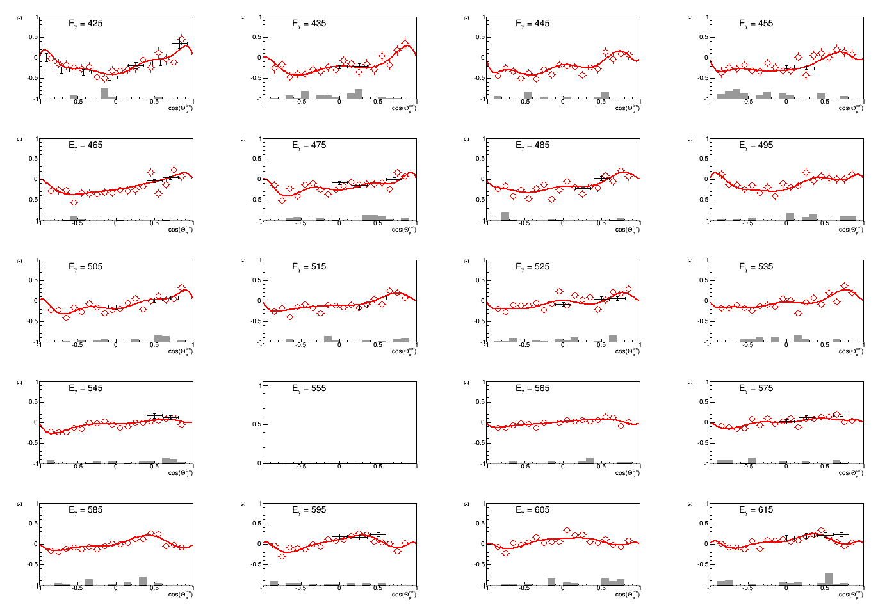


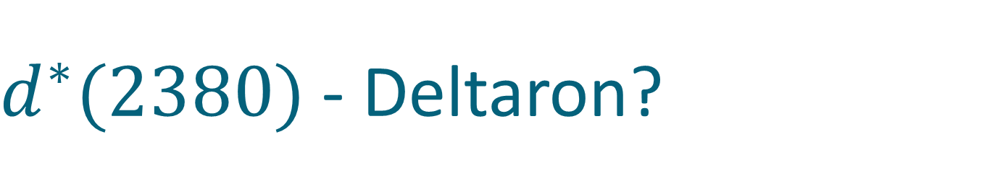

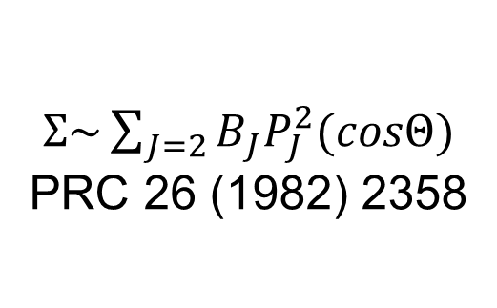
Deuteron photodisintegration, $Σ$
γ
p
$Σ\sim \sum_{J=2}{B_{J}P_{J}^{2}(cosΘ)}$
PRC 26 (1982) 2358
d
n
$$Σ$$
$E_{γ}\sim 420−620MeV$
$$cosΘ_{n}^{∗}$$

Slide 26
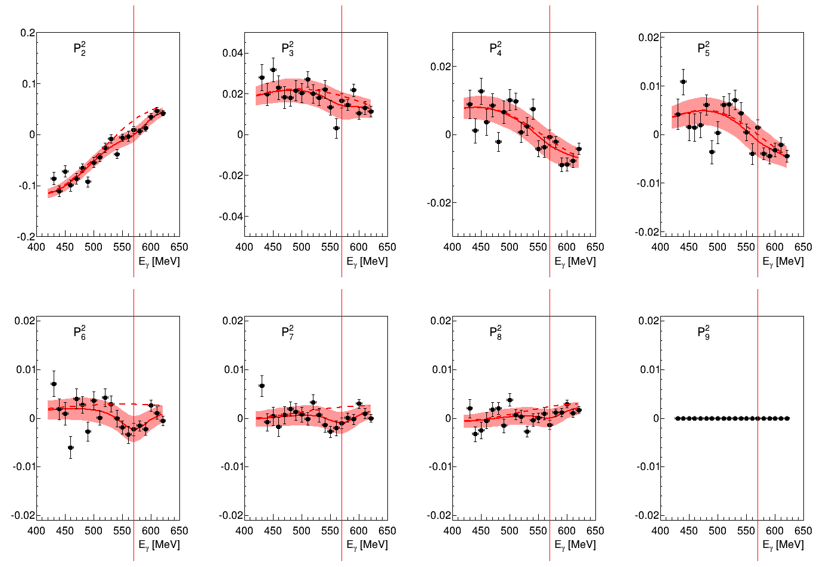


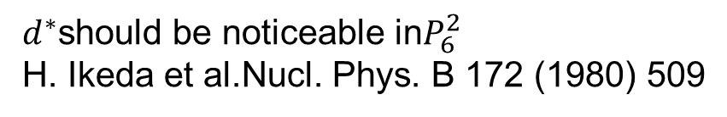
Deuteron photodisintegration: beam asymmetry $Σ$
$d^{∗}$should be noticeable in$P_{6}^{2}$
H. Ikeda et al.Nucl. Phys. B 172 (1980) 509
$\frac{Σ\left(Θ\right)σ\left(Θ\right)}{σ_{0}}$ $\sim \sum_{J=2}{B_{J}P_{J}^{2}(cosΘ)}$
Magnetic M3 transition
might be sizable

Slide 27
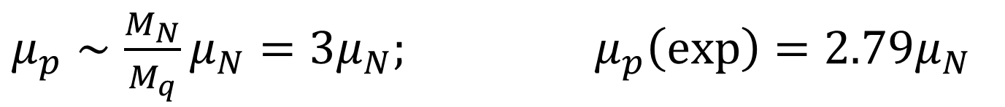

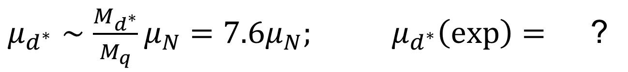
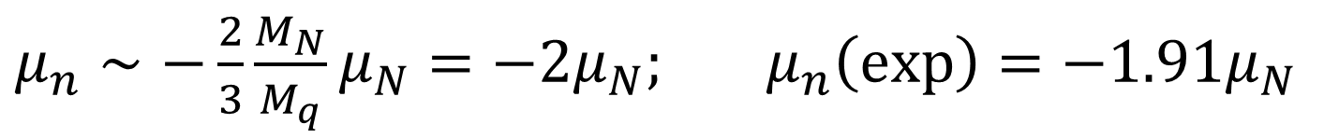
$d^{∗}(2380)$ magnetic moment
$μ_{p}∼\frac{M_{N}}{M_{q}}μ_{N}=3μ_{N};$ $μ_{p}\left(exp\right)=2.79μ_{N}$
$μ_{n}∼−\frac{2}{3}\frac{M_{N}}{M_{q}}μ_{N}=−2μ_{N};$ $μ_{n}\left(exp\right)=−1.91μ_{N}$
$μ_{d^{∗}}∼\frac{M_{d^{∗}}}{M_{q}}μ_{N}=7.6μ_{N};$ $μ_{d^{∗}}\left(exp\right)=$ ?

Slide 28
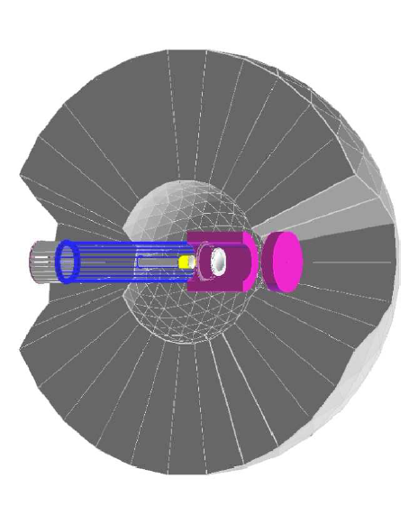

The benchmark measurement
Edinburgh polarimeter
$$\vec{γ}$$
d*
p
d
n
Measure polarization of both
proton and neutron !

Slide 29


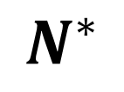


Experiment
$$\vec{γ}d→p\vec{n}$$
$$γ$$
p
$$n$$
$$Θ,φ,E$$
p
Target
$$Θ^{′},φ′$$
Polarimeter

Slide 30
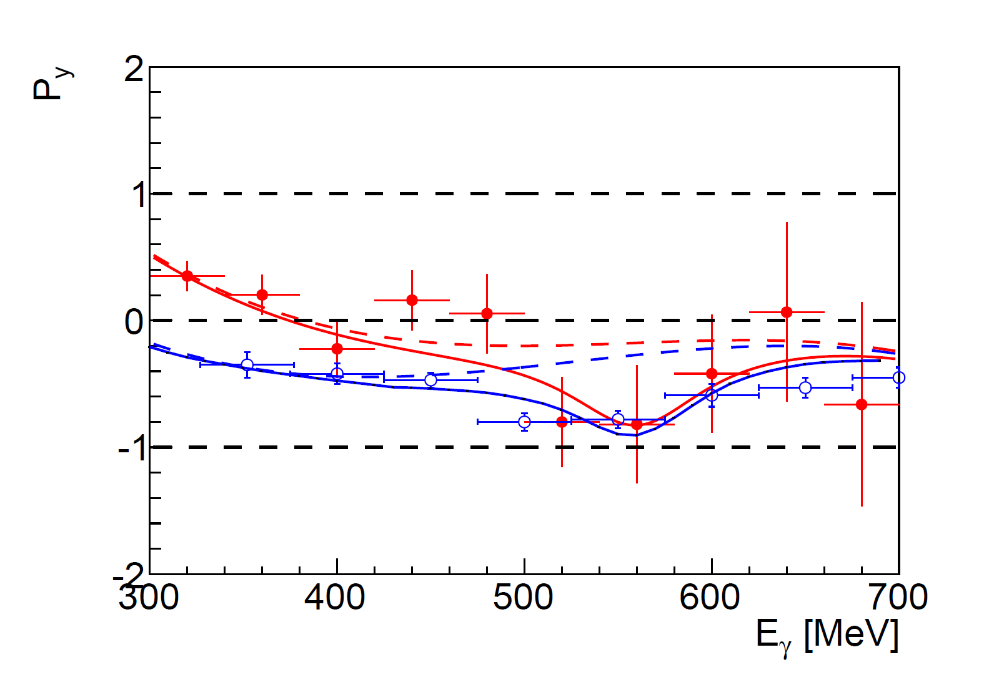
Recoil polarization at 90 degree
neutron
proton
background+ d*
Conventional background, Kang et al
H. Ikeda et al., Phys. Rev. Lett. 42, May 1979, 1321

Slide 31

$d^{∗}$ photoproduction in medium

Slide 32
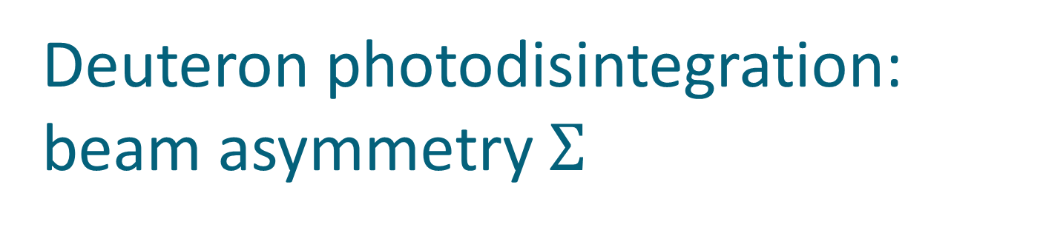
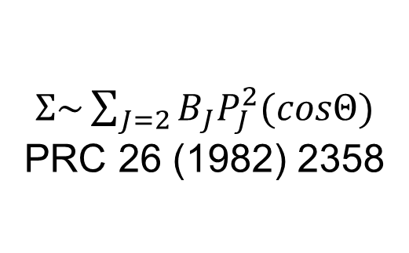
$d^{∗}(2380)$ medium modifications?
d*(2380) medium modifications?
N
N
Trivial modifications:
Fermi smearing
Collision damping
N
Δ
N
$$d^{∗}$$
Δ
Δ
BUT!
Pauly blocked in
infinite nuclear matter
$d^{∗}$ is stable!
N

Slide 33


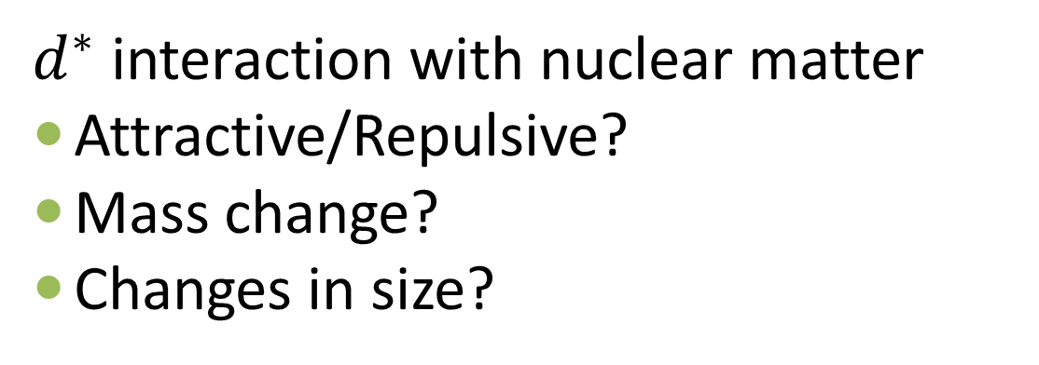








$d^{∗}(2380)$ medium modifications?
d*(2380) medium modifications?
$d^{∗}$ interaction with nuclear matter
Attractive/Repulsive?
Mass change?
Changes in size?
N
$$π$$
$$π$$
Δ
$$d^{∗}$$
Δ
$$d^{∗}$$
N
$$σ,η,ω$$
$$π,ρ$$
N
N
$$d^{∗}$$
$$d^{∗}$$
$$d^{∗}$$
$$d^{∗}$$

Slide 34




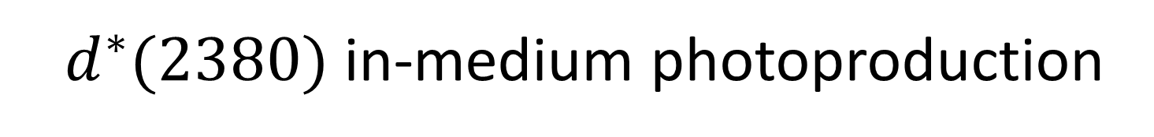





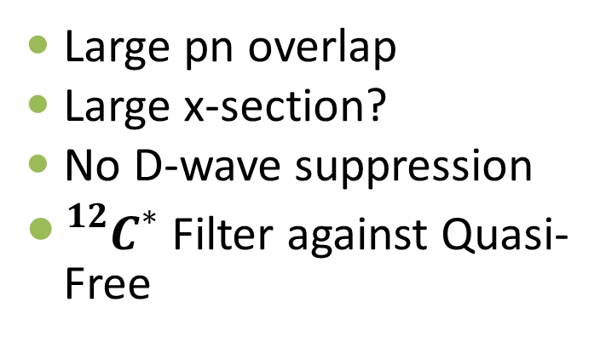
$d^{∗}(2380)$ in-medium photoproduction
d*(2380) in-medium photoproduction
$$L=0$$
$$π^{0}$$
$$π^{0}$$
Small pn overlap
Small x-section
D-wave suppression
γ
d*
d
$$L=2$$
d
$$L=0$$
$$π^{0}$$
$$π^{0}$$
Large pn overlap
Large x-section?
No D-wave suppression
${}_{}^{12}{C^{∗}}$Filter against Quasi-Free
γ
d*+10N
γ
$${}_{}^{12}C$$
$$L=0$$
$${}_{}^{12}{C^{∗}}$$
$${}_{}^{12}C$$

Slide 35
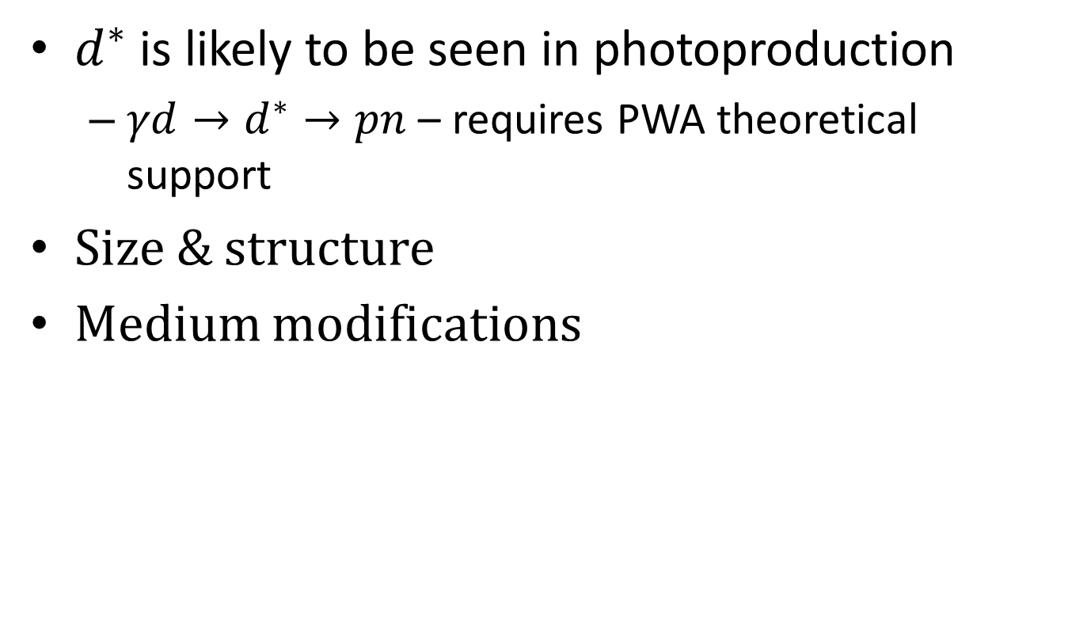
Conclusion
$d^{∗}$ is likely to be seen in photoproduction
  $γd→d^{∗}→pn$ – requires PWA theoretical support
Size & structure
Medium modifications

Slide 36

ΔΔ
$$d^{∗}(2380)$$
Thank you
ΔΣ*
ΔΞ*
ΔΩ

Slide 37
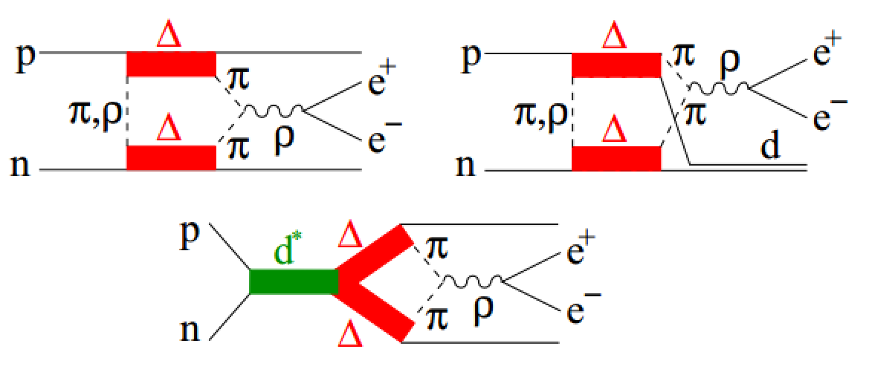
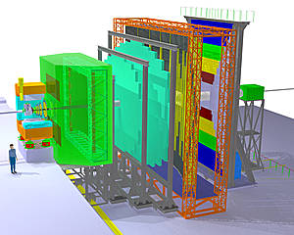

Cold Baryonic Matter
DLS puzzle
Dibaryons as a probes of
“cold hadronic soup”
M. Bashkanov, H. Clement, Eur. Phys. J. A50, 107, (2014)

Slide 38





Beam asymmetry $Σ$ fit
$σ_{1}=σ_{⊥}−σ_{∥}=Σσ$ $\sim \sum_{J=2}{B_{J}P_{J}^{2}(cosΘ)}$
$$σ(γd→pn)\sim 8μb$$
$$\frac{σ_{⊥}−σ_{∥}}{σ_{⊥}+σ_{∥}}=P_{γ}Σcos2φ$$
$\frac{Σ\left(Θ\right)σ\left(Θ\right)}{σ_{0}}$ $\sim \sum_{J=2}{B_{J}P_{J}^{2}(cosΘ)}$
$B_{J}=f(E)$ – smooth function
+BW for the d*
Federico Ronchetti arXiv 1301.5886

Slide 39

Deuteron photodisintegration: beam asymmetry $Σ$
$\frac{Σ\left(Θ\right)σ\left(Θ\right)}{σ_{0}}$ $\sim \sum_{J=2}{B_{J}P_{J}^{2}(cosΘ)}$
$B_{2}∼c_{1}{\left|{}_{}^{3}{D_{3}\left(E2\right)}\right|}^{2}+c_{2}{\left|{}_{}^{3}{D_{3}\left(M3\right)}\right|}^{2}$
+$c_{3}{\left|{}_{}^{3}{G_{3}\left(E2\right)}\right|}^{2}$+ $c_{4}{\left|{}_{}^{3}{G_{3}\left(M3\right)}\right|}^{2}+…$
γ
$$d^{∗}$$
p
d
n
Magnetic M3 transition
might be sizable
$B_{6}∼$ $d_{1}{\left|{}_{}^{3}{G_{3}\left(M3\right)}\right|}^{2}+…$
$$+d_{i}\left|{}_{}^{3}{D_{3}\left(M3\right)}\right|\left|{}_{}^{3}{G_{3}\left(M3\right)}\right|cosδ_{i}+… \\ +d_{j}\left|{}_{}^{3}{D_{3}\left(E2\right)}\right|\left|{}_{}^{2S+1}{{L≥4}_{J}\left(E4\right)}\right|cosδ_{j}+…$$

Slide 40


d*(2380) in photoproduction?
R. Gilman and F. Gross nucl-th/0111015 (2001)
d*
γ
p
T. Kamae, T. Fujita Phys. Rev. Lett. 38, Feb 1977, 471
d
n
H. Ikeda et al., Phys. Rev. Lett. 42, May 1979, 1321
I(J^{p}) = 0(3⁺)
$$M=2.38 GeV$$

Slide 41


$d^{∗}(2380)$ decay branches
$d^{∗}$ decay channel | Branching ratio, %
$$pn$$ | 12(3)
$$dπ^{0}π^{0}$$ | 14(1)
$$dπ^{+}π^{−}$$ | 23(2)
$$pnπ^{+}π^{−}$$ | 30(5)
$$pnπ^{0}π^{0}$$ | 12(2)
$$ppπ^{0}π^{−}$$ | 6(1)
$$nnπ^{0}π^{+}$$ | 6(1)
$$NNπ$$ | 0(<9)
Eur.Phys.J. A51 (2015) 7, 87

Slide 42

$d^{∗}(2380)$ - Deltaron?
L=0
Δ
Δ

Slide 43


Deltaron: the width quest
$Δ(1232)$ width

Slide 44


Deltaron: the width quest
$2∗Δ(1232)$ width

Slide 45
Deltaron: the width quest
$2∗Δ(1232)$ width

Slide 46



Deltaron: the width quest
$$M_{Δ}=\sqrt{{\left(\frac{M_{d^{∗}}}{2}\right)}^{2}−q_{Δ}^{2} }$$
The mass of the bound $Δ$
in the Deltaron
$Δ$ momentum in the Deltaron
$$M_{Δ}=\frac{M_{d^{∗}}}{2}$$
only if $q_{Δ}=0$
$q_{Δ}=0$ only if the size of the Deltaron is$∞$
For $R_{d^{∗}}=0.9fm$, $Γ_{d^{∗}}=2Γ_{Δ}=70 MeV$
see A. Gal, Phys.Lett. B769 (2017) 436 for details

Slide 47


$d^{∗}$size and width
A. Gal, Phys.Lett. B769 (2017) 436
F. Huang et al,
Chin.Phys. C39 (2015) 7, 071001

Slide 48


Effective degrees of freedom
Fan Wang et al. 1711.01445
When the two clusters are well separated (s → ∞),
the two physical bases, colorless $ΔΔ$ and hidden color CC, are orthogonal.
When the two clusters are merged into one cluster (s → 0),
the two physical bases are the same.
Possible 6q configuration

Slide 49






Possible $NΔπ$ configuration in $d^{∗}$
82%
$$NNπ$$
$$NΔ$$
18%
$$NN$$
82%
$$NNππ$$
$$NΔπ$$
18%
$$NNπ$$
$${\left|Ψ_{NΔπ}\right|}^{2}\sim 5⋅Br(d^{∗}→NNπ)$$

Slide 50



$d^{∗}→NNπ$ decay in experiment
$$pp→pnπ^{+}$$
$$pp→ppπ^{0}$$
Pure isovector (I=1)
$$pn→ppπ^{−}$$
$$pn→pnπ^{0}$$
Mixed (I=1& I=0)
Predominantly isovector
Interested in isoscalar part only
$σ_{NN→NNπ}\left(I=0\right)=3(2σ_{pn→ppπ^{−}}−σ_{pp→ppπ^{0}})$
Proton beam
Deuteron target
$$pd→ppπ^{−}+p_{spectator}$$
$$pd→ppπ^{0}+n_{spectator}$$

Slide 51


$d^{∗}→NNπ$ decay in experiment
$NN→NNπ$ isoscalar cross section
$σ_{NN→NNπ}\left(I=0\right)=3(2σ_{pn→ppπ^{−}}−σ_{pp→ppπ^{0}})$
PLB 774 (2017) 599-607
Systematical errors!!!!
Same beam
Same detector
Same deuteron target
Two protons in final state measured in the same kinematics
Br($d^{∗}→NNπ$)<9% - upper limit
Likely to be close to 0

Slide 52




$d^{∗}→dππ$ decay and D-wave $ΔΔ$ component
pn → d* → ΔΔ → dππ
π
p
Δ
$$N_{1}$$
d
n
$$N_{2}$$
Δ
π
$$\overset{⃑}{{p_{Δ}}_{2}}−\overset{⃑}{{p_{Δ}}_{2}}=\left(\overset{⃑}{p_{N_{1}}}+\overset{⃑}{p_{π_{1}}}\right)−\left(\overset{⃑}{p_{N_{2}}}+\overset{⃑}{p_{π_{2}}}\right)=\left(\overset{⃑}{p_{N_{1}}}−\overset{⃑}{p_{N_{2}}}\right)+\left(\overset{⃑}{p_{π_{1}}}−\overset{⃑}{p_{π_{2}}}\right)≈\left(\overset{⃑}{p_{π_{1}}}−\overset{⃑}{p_{π_{2}}}\right)$$
$$\overset{⃑}{p_{N_{1}}}≈\overset{⃑}{p_{N_{1}}}$$
$$\overset{⃑}{{p_{Δ}}_{2}}−\overset{⃑}{{p_{Δ}}_{2}}≈\left(\overset{⃑}{p_{π_{1}}}−\overset{⃑}{p_{π_{2}}}\right)↔M_{ππ}$$

Slide 53
d*(2380) internal structure and the ABC effect
L=0
Δ
Δ
Δ
Δ
L=2
M. Bashkanov et al, Nucl.Phys. A958 (2017) 129

Slide 54


$Λ−Δ$ competition in neutron star
Phys.Rev. C90 (2014) no.6, 065809

Slide 55



$d^{∗}−Δ$ competition in neutron star

Slide 56


Hyperon puzzle?
$ΛN$
$ΣN$
$ΛN→ΣN$
$ΞN$
$ΛΛ$
$ΞN→ΛΛ$
$ΛNN$, $ΣNN$, $ΛΛN$, $ΛΣN$…

Slide 57


